Slide 1


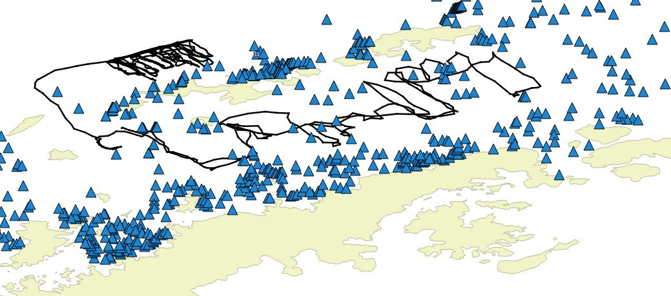
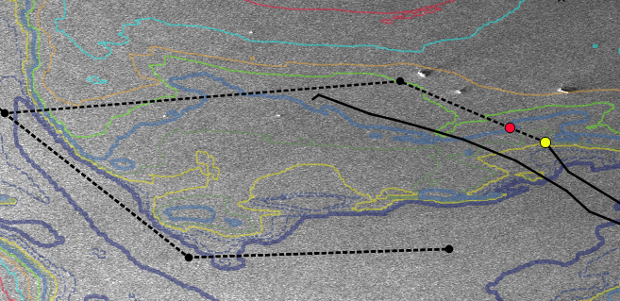
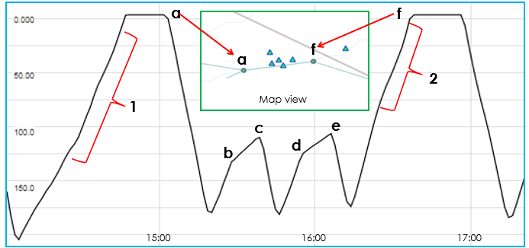
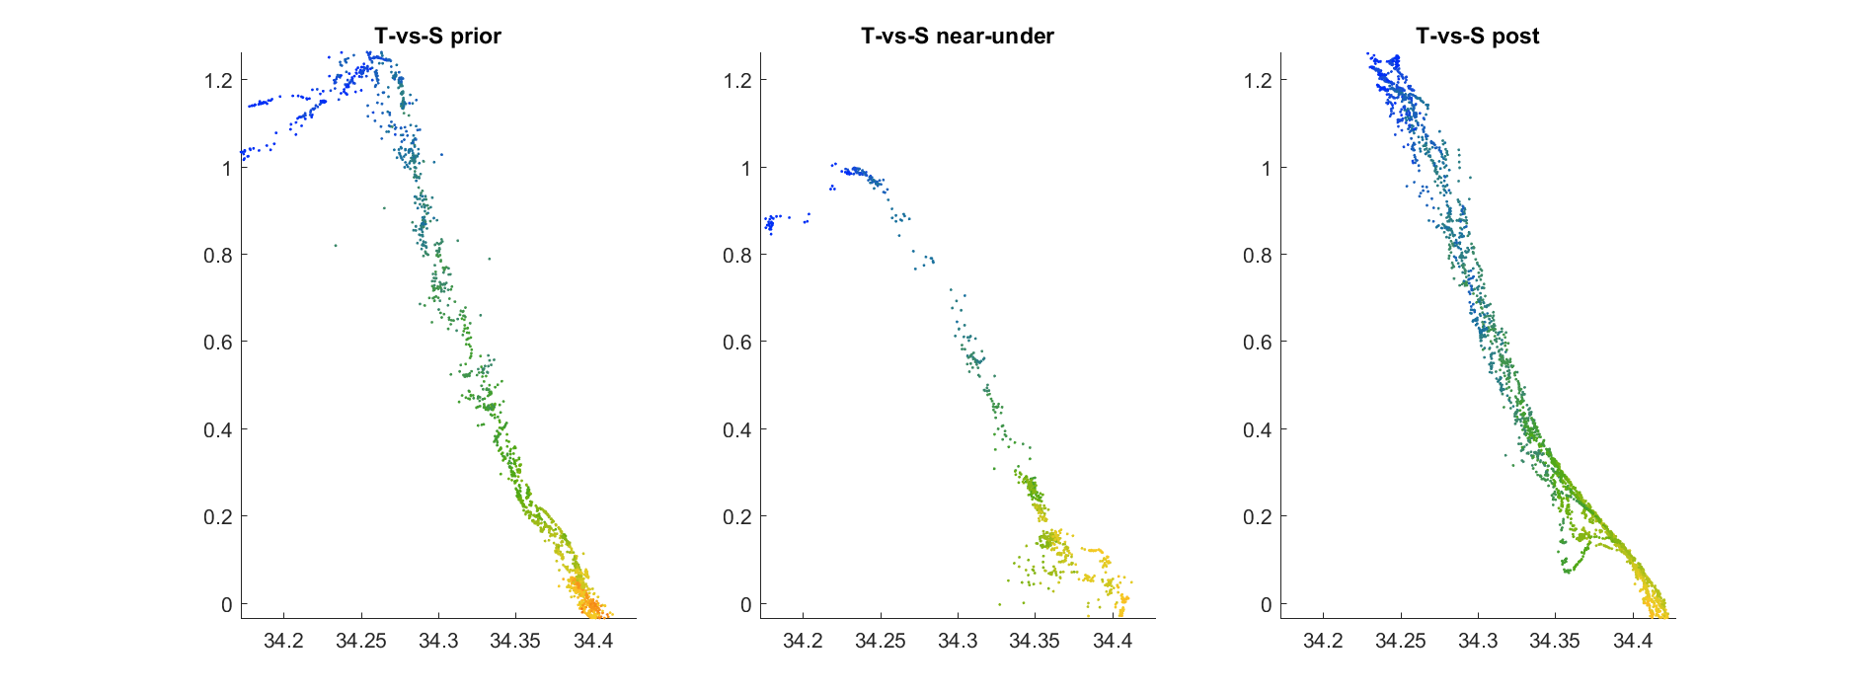
Oops. We sampled under a few icebergs
A. Cossio, G. Cutter, C. Reiss, J. Walsh, and G. Watters
Antarctic Ecosystem Research Division,
Southwest Fisheries Science Center, NOAA Fisheries
Mission objective: estimate Antarctic krill biomass
Two Slocum G3 gliders deployed around the South Shetland Islands from December 2018 – March 2019
Combined transit distance of more than 2,750 km
Completed more than 2,250 yos
Black lines = glider tracks
Blue triangles = icebergs
Icebergs from one day (2019-03-06)
Antarctic Peninsula
Mission obstacle: icebergs
RADARSAT imagery provided most current iceberg locations every 2 – 3 days
Goal was to leave a 5 km buffer around all icebergs
Newest imagery already a day old when it became available
Ice moves FAST (sometimes up to several km per day)
Accidents happen….
Solid black lines: completed glider tracks. Dotted black lines: future glider tracks. Yellow dot: last surfacing. Red dot: next waypoint. White circles: icebergs.
Close encounters of the icy kind
Rates of ascent slowed as gliders entered lenses of less-dense water beneath ice (b c and d e)
Ascents were terminated when glider exceeded stall or hover thresholds and resumed diving
Less-dense plumes extended past icebergs, resulting in wobbly ascents immediately before and after icebergs (1 and 2)
Inset shows marked icebergs as the glider transited from “a” to “f”
Example of one ice encounter. Ice was encountered twice on 18 Jan and once on 22 Jan north of the South Shetland Islands, and once on 29 Dec in the Bransfield Strait. X = depth (m), Y = time on 18 Jan.
Red boxes = change in temperature and salinity as glider passed under the iceberg
Blue red = change in depth
Change in temperature most evident after glider emerges from ice
No evidence of change in chlorophyll (glider at depth)
Before ice
Under ice
After ice
Temperature (°C)
Salinity (‰)

