Slide 1


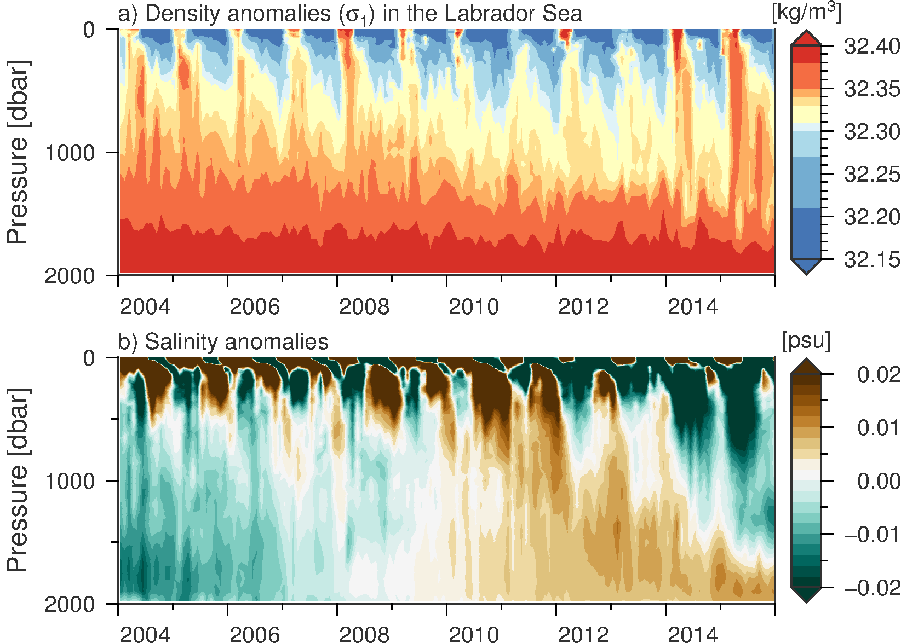
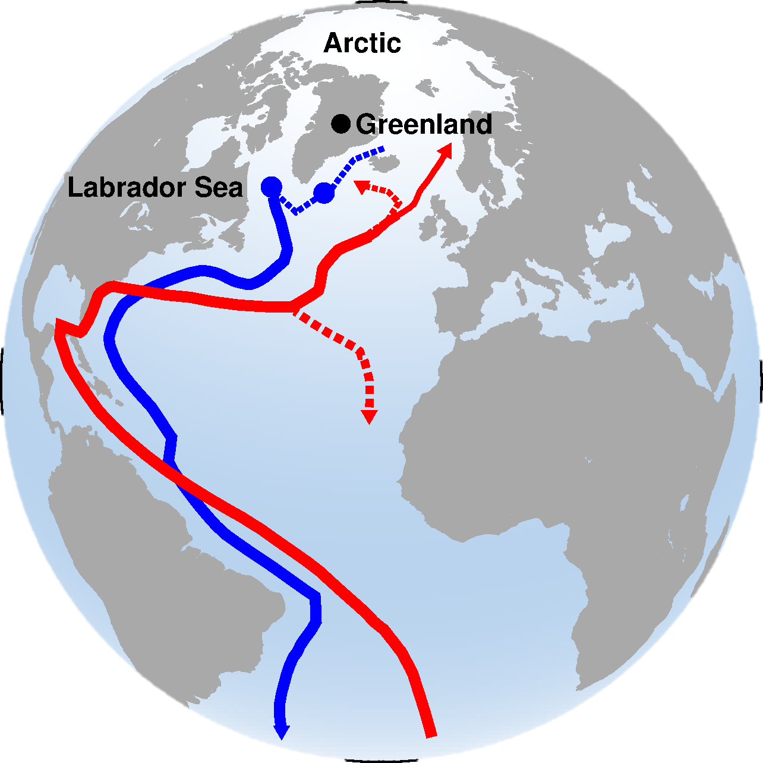
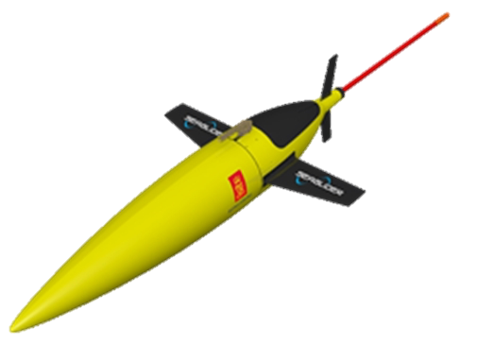
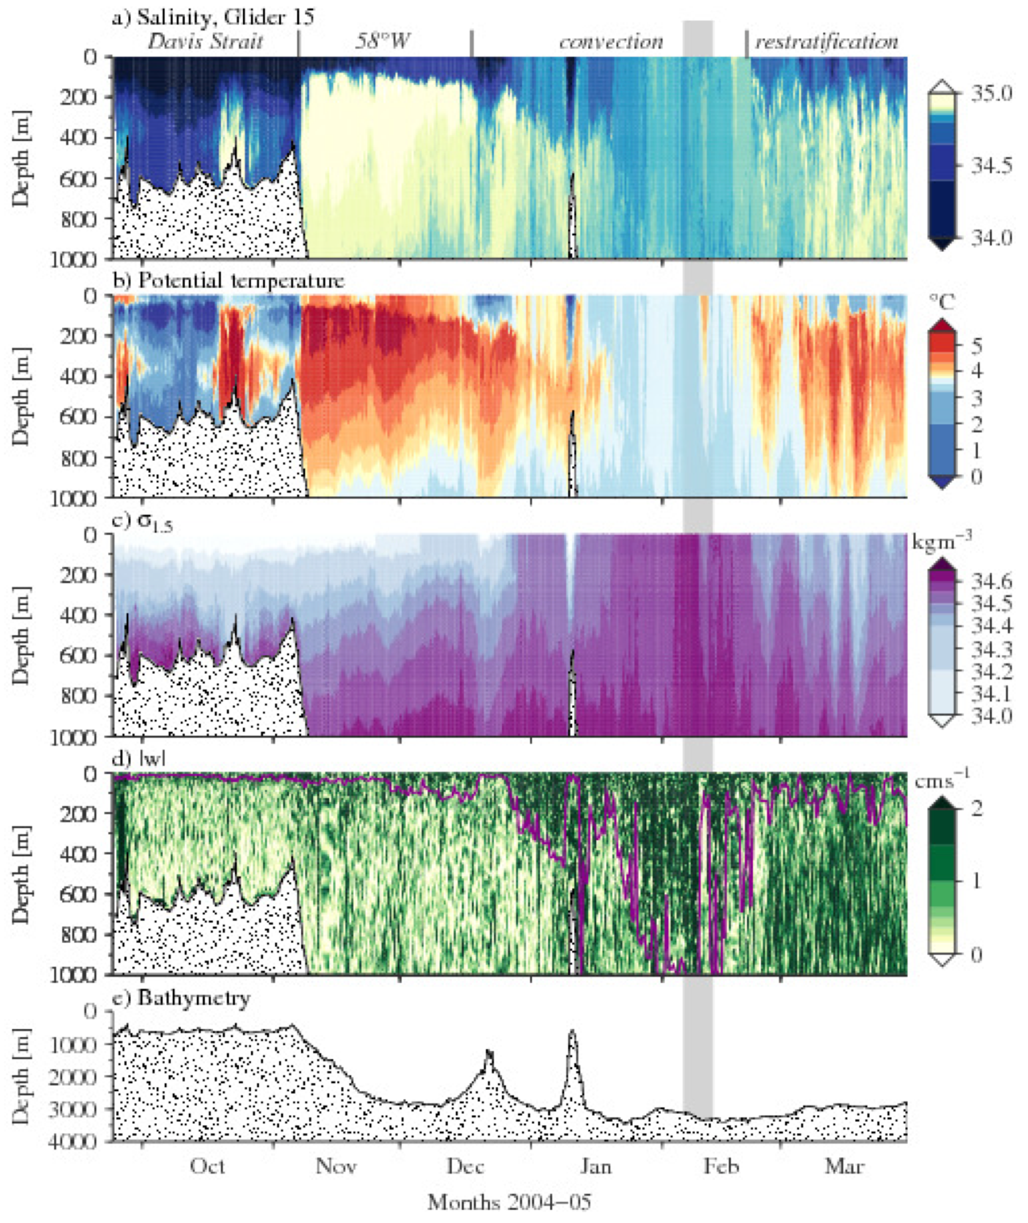
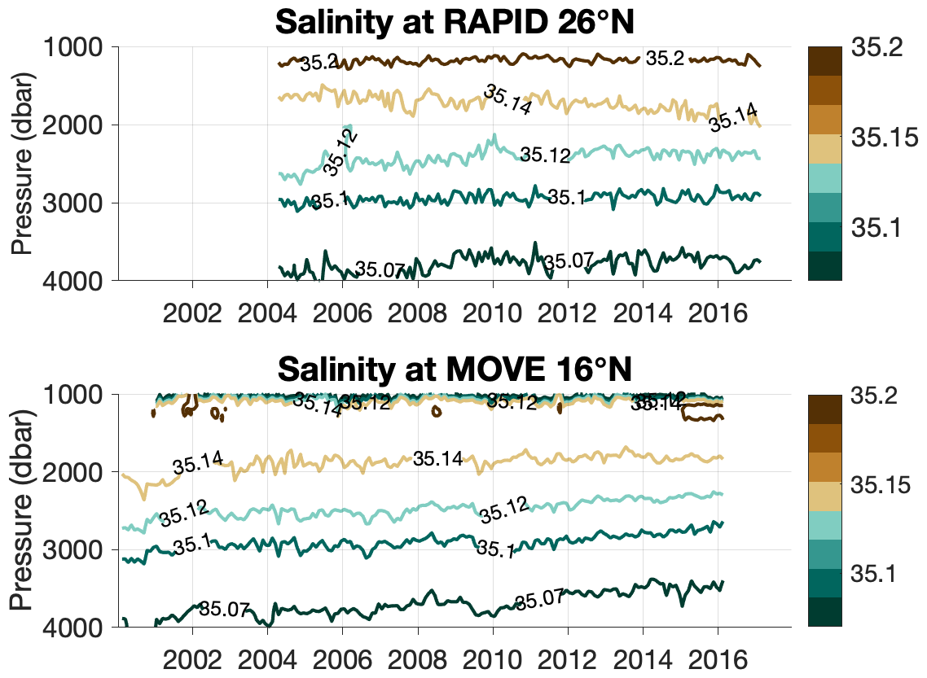


INTRO
AMOC is sensitive to freshwater fluxes at high latitudes.
Freshwater sources are increasing - from Greenland and the Arctic.
Small-scale processes are key mediators of the response of the large-scale ocean circulation. E.g.,
Shelf-edge exchange,
Deep convection,
Restratification & lateral mixing.
TERIFIC aims to elucidate the dynamics of these processes.
FIELDWORK PLANS (2019 – 2020)
Drifter deployments at the shelf edge of Greenland: 212 drifters from December 2019 – July 2020 (divided into 4 deployments spanning the seasonal cycle)
Autonomous surface vehicle (Sailbuoy) and two Seagliders will be deployed from Qatortoq, Greenland in December 2019 – to be recovered 6 months later.
DATA
Seaglider with CTD (2 units)
Sailbuoy surface vehicle with met station and CTD (1 unit)
Drifter positions (CARTHE, 200 units)
Drifter with CTD (SVP, 12 units)
OBJECTIVES
Map convective processes and evolution: vertical water velocity, associated heat fluxes, and plume geometry.
Directly measure surface meteorological conditions to compute air-sea turbulent heat fluxes over the convective winter.
Identify characteristics of cross-shelf transport: timescales & hotspots, response to winds & eddy stirring or shedding.
Evaluate mixed layer deepening and its relationship to air-sea and wind-driven buoyancy fluxes.
Quantify the potential for instabilities to restratify the region and the expected buoyancy fluxes associated with instabilities.
Argo observations in the Labrador Sea
Density and salinity anomalies in the Labrador Sea. In 2013 and 2014, convection was deep and the Labrador Sea Water produced was relatively fresh.
Previous Seaglider missions
Seagliders in deep convection (2004/5) observed large horizontal density gradients during active convection, indicative of the potential for lateral mixing to act to restratify even as intense heat loss drives convection.
COMPLEMENTARY FIELD PROGRAMMES
Brad de Young (Memorial Univ.) Autonomous vehicles in the Labrador Sea
Femke de Jong (NIOZ) Drifter deployments in east Greenland
Eleanor Frajka-Williams, Ilona Goszczko
National Oceanography Centre Southampton
Saltier LSW
TERIFIC project: Autonomous vehicles in the Labrador Sea
More AABW?
www.terific.org
Notes:
Notes:
In Powerpoint, click View > Guides
Keep text within gutter guides.
Author list: Don’t split names onto two lines (e.g., “Jimmy [break] Smith”). If that happens, use a new line, unless you need the space. Bold the first names of anybody who’s presenting in person.
Intro/methods/result: Do not drop below font size 28, but if you have extra space, jack up the font size until the space is full.
Do not use color in the sidebars except in graphs/figures. It’ll pull attention from the center and slow interpretation for passersby.

