Slide 1
SOCIB Glider Data Toolbox
Glider Data Processing
- for science and operational users -
Emma Heslop
JP. Beltran, C. Troupin, M. Torner, J. Tintoré
www.socib.es
7th EGO Meeting, NOCS, UK – September 2016

Slide 2

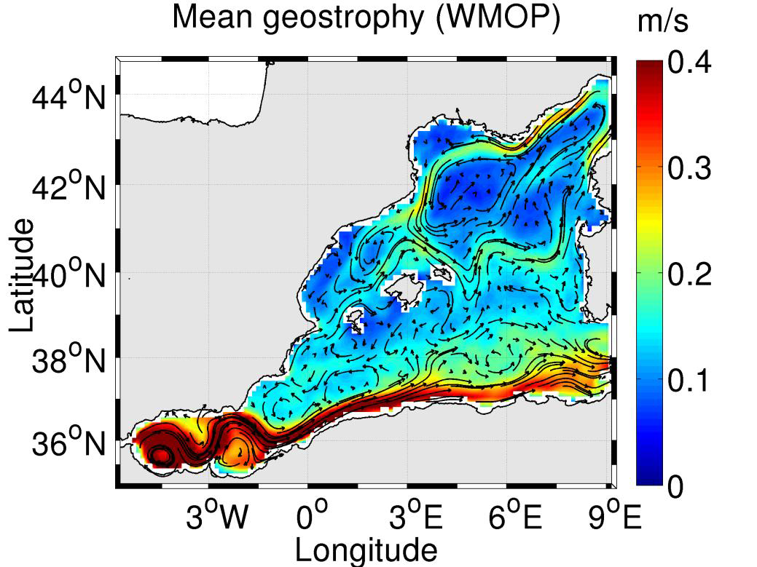
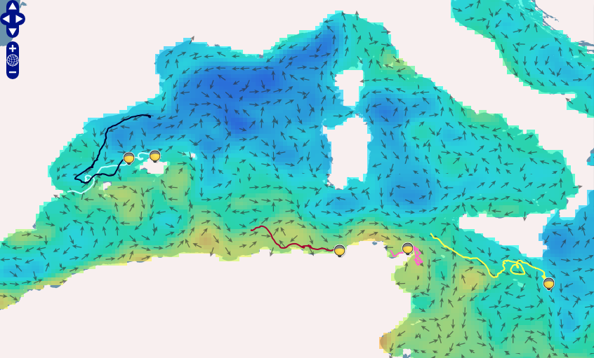

Agenda
Why a glider data processing Toolbox?
SOCIB Glider Toolbox overview
Processing levels and steps
Installation and set-up
Figure outputs
How SOCIB uses

Slide 3
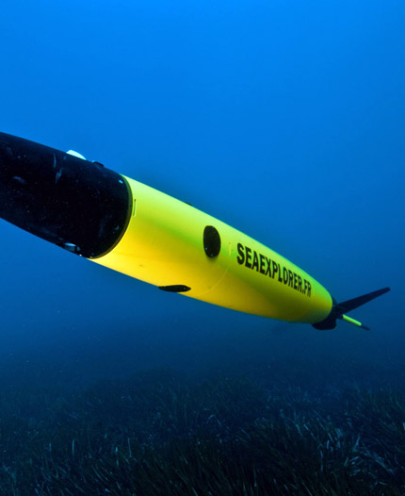
Context - why a glider data processing toolbox
Gliders are now an important tool in oceanography – access to unique time and space scales, year round operation, at a different cost level
But not yet ‘plug in plug out’ – quickly generate a lot of data
Specifics of the platforms, ‘V’ shaped flight path, un-pumped CTDs, separate time base for navigation and scientific data, different variables different platforms
Manufacturers supply conversion tools for raw binary/text format data - need to develop standard methods to process data beyond conversion

Slide 4
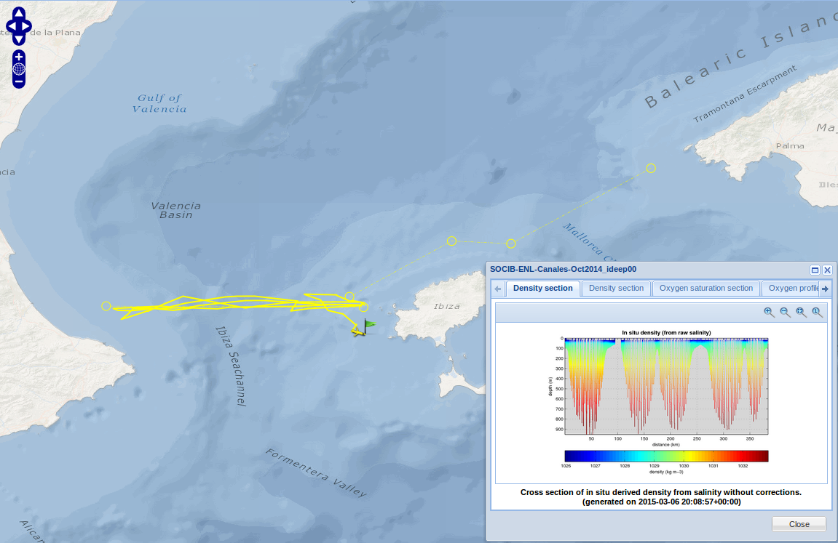
SOCIB context – why developed
SOCIB is a multi-platform Ocean Observing System based in the W Mediterranean
Operating glider ‘endurance’ lines since 2011
Slocum and Seaglider platforms
70+ missions, Ibiza Channel endurance line and others
Quasi-continuous operations
Data freely available science and society – real time and delayed mode
>> Glider Toolbox developed to process and visualise SOCIB data
Notes:
The SOCIB monitoring of the Ibiza Channel Choke point has now reached 5 years, with 31 successful deep glider missions, it is quasi continuous with the aim of not more than 1 month gap between missions, this is one of the keys of success – if anyone is interested in understanding more about the operational please ask or catch up later

Slide 5
SOCIB Glider Toolbox Overview
A set of MATLAB/Octave scripts and functions – the toolbox
Supports Slocum, Seaglider and recently added SeaExplorer platforms
Provides:
  Tools to generate standard netCDF files and figures from raw glider data
  Advanced processing features, e.g. thermal lag correction
  Standard quality control tests (range, spikes)
  Covers main initial steps of the glider data management process
Modular structure and user configurable output, for addition of new sensors, etc.
Built for an operational facility, also useful for scientist users as standalone
  User-friendly, real-time/delayed mode, processing toolkit for glider data
  Delivers data ready for science and operations
  - available at https://github.com/socib/glider_toolbox -
Notes:
The SOCIB monitoring of the Ibiza Channel Choke point has now reached 5 years, with 31 successful deep glider missions, it is quasi continuous with the aim of not more than 1 month gap between missions, this is one of the keys of success – if anyone is interested in understanding more about the operational please ask or catch up later

Slide 6
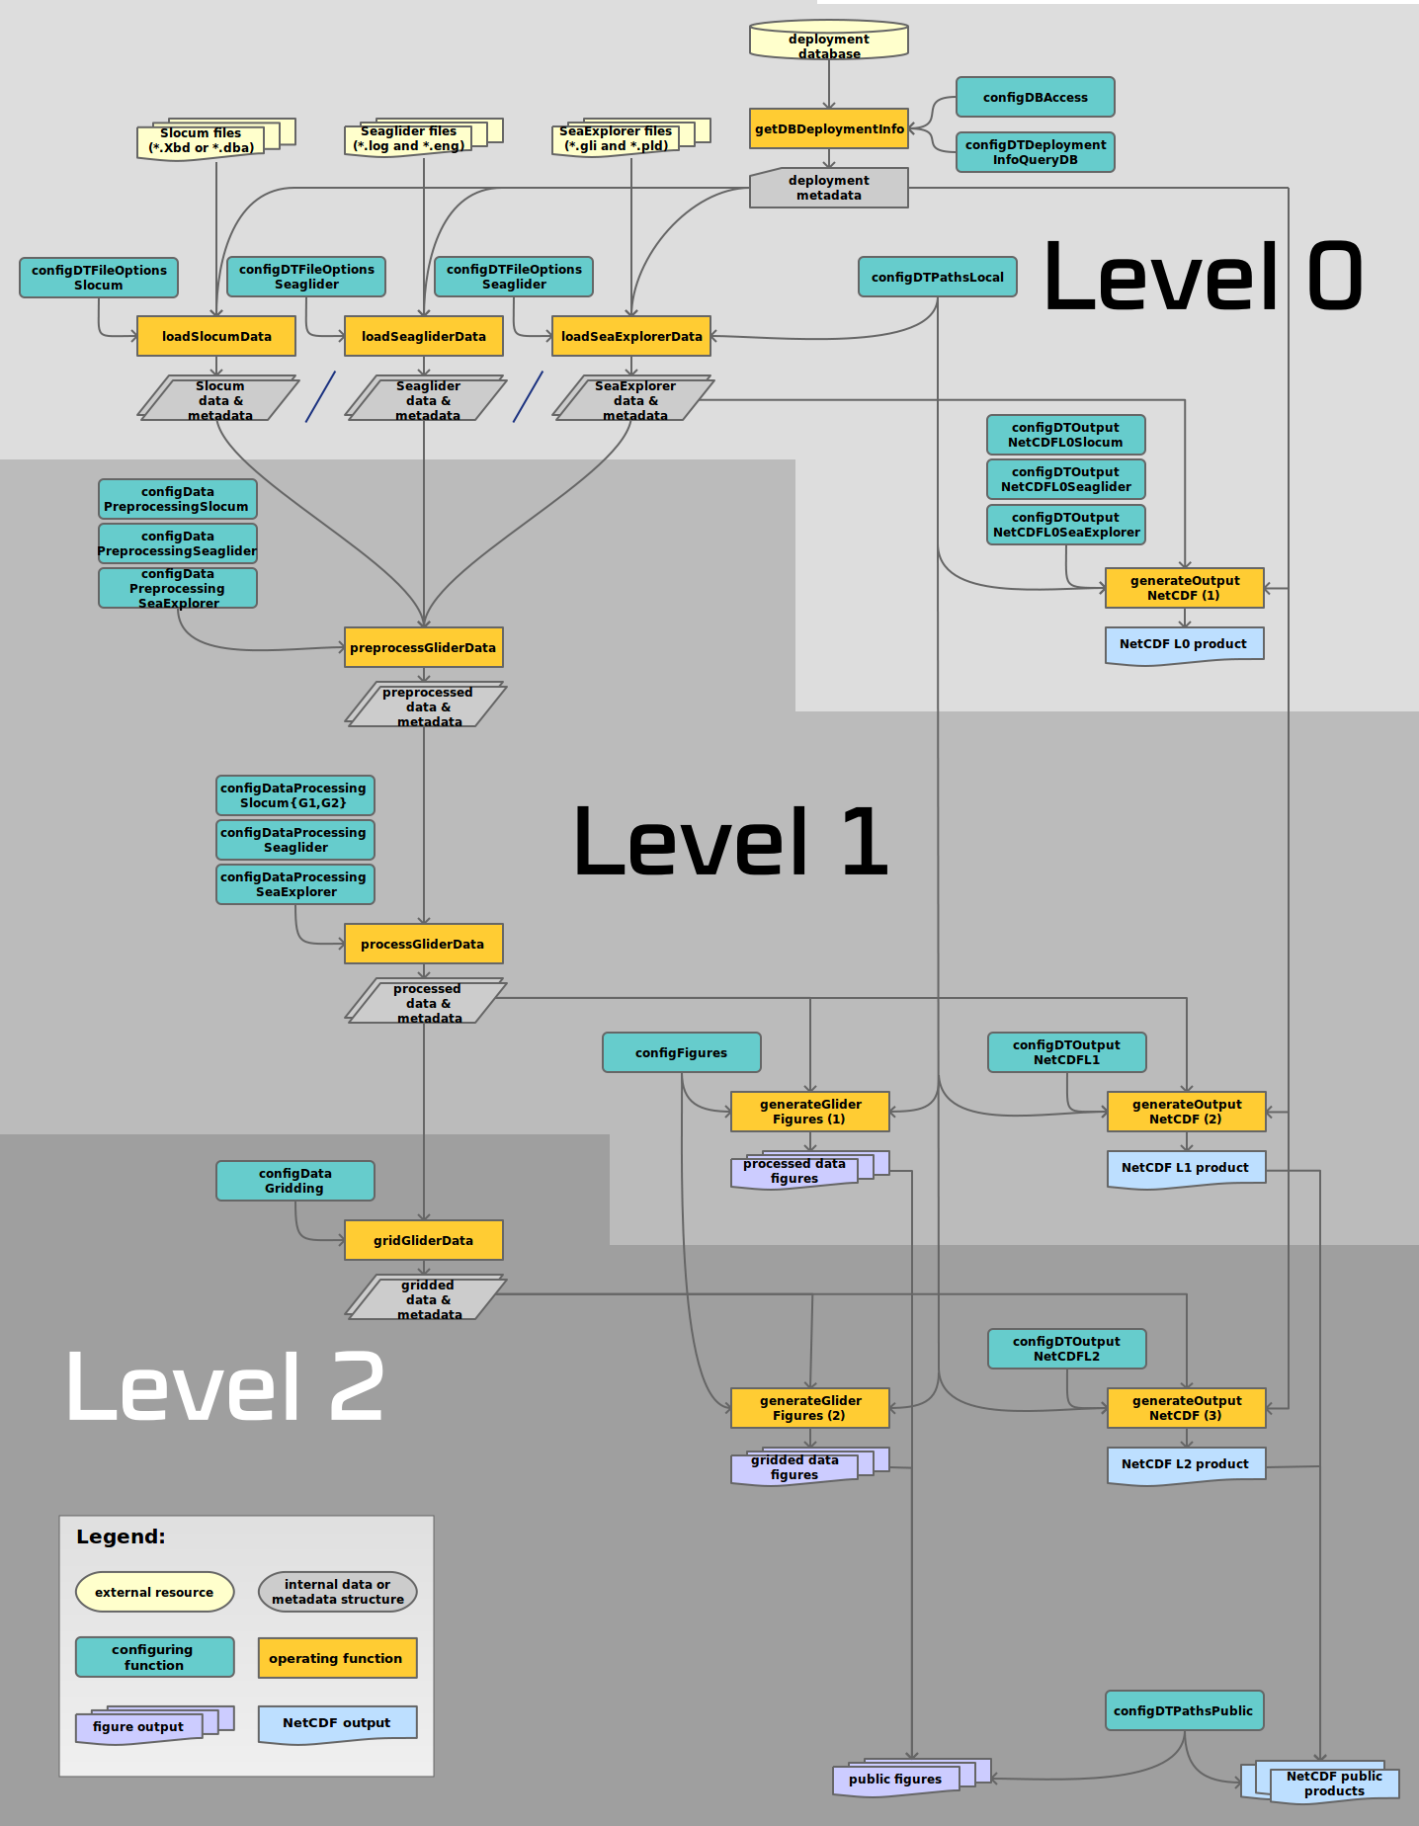

Flow diagram the best guide - information processing levels, scripts, inputs and outputs, user configurable components
Essentially 4 processing steps and 3 levels of output: L0, L1 and L2

Slide 7
SOCIB Glider Toolbox - Levels
Three levels of data outputs:
Level 0 (L0): contains selected raw data files (without modification)
Level 1 (L1): contains processed glider data, on a common time base, with conversions, corrections and the addition of derived variables
Level 2 (L2): the Level 1 data in a gridded format, i.e. as vertical profiles interpolated onto a user configured vertical grid
Note:
Data files are standard netCDF with standard CF convention metadata formats
There are figure outputs for Level 1 and Level 2
Notes:
The SOCIB monitoring of the Ibiza Channel Choke point has now reached 5 years, with 31 successful deep glider missions, it is quasi continuous with the aim of not more than 1 month gap between missions, this is one of the keys of success – if anyone is interested in understanding more about the operational please ask or catch up later

Slide 8
SOCIB Glider Toolbox – Processing – Step 1
STEP 1
Data retrieval: download of raw binary files from remote dock servers or base stations (real-time) or reading in of mission files from specified folder (delayed mode), and conversion from binary into text format (Slocum).
OUTPUT
Level 0 netCDF file
USER CAN CONFIGURE
Source of deployment information
Address of dockservers/base stations (real-time)
Paths to raw data input and netCDF output
Variables to read, default + any others of interest
Notes:
A SOCIB Web Tool Box – a web page with access to relevant data, SOCIB derived variables (scientific value add) and related tools. Created to give target end users access to SOCIB expertise and value added information to assist in analysis and decision making. Communication of availability of this facility to target end users in the Balearics.

Slide 9
SOCIB Glider Toolbox – Processing – Step 2 & 3
STEP 2
Pre-processing: turn different glider data platform variables to a common format, e.g. unit conversions and factory calibrations.
STEP 3
Processing: interpolation of reference coordinates (spatial and temporal) onto common time base, optional pressure filtering, profiles identified, sensor processing (including sensor lag correction, thermal lag correction), and derivation of new variables (salinity, salinity_corrected)
OUTPUT
L1 netCDF file
L1 figures
USER CAN CONFIGURE
Which variables to use as reference variables (t, z, lat, lon)
Interpolation ref. variables (yes/no/method)
Pressure filtering (yes/no/parameter)
Profile identification
CTD processing, sensor processing variable selection
Thermal Lag (yes/no/find params/supply params)
Notes:
A SOCIB Web Tool Box – a web page with access to relevant data, SOCIB derived variables (scientific value add) and related tools. Created to give target end users access to SOCIB expertise and value added information to assist in analysis and decision making. Communication of availability of this facility to target end users in the Balearics.

Slide 10
SOCIB Glider Toolbox – Processing – Step 4
STEP 4
Gridding: binning of the level 1 data to the selected depth levels, allocation of mean time and profile position to profiles, so as to have the data as instantaneous vertical profiles
OUTPUT
L2 netCDF file
L2 gridded data figures
USER CAN CONFIGURE
Variables to use for reference (t, z, lat, lon)
Specify profile index
Specify depth resolution
Which variables want to grid
http://www.socib.es/users/glider/glider_toolbox/doc/index.html?page=m/processing_tools/gridGliderData.html
Notes:
A SOCIB Web Tool Box – a web page with access to relevant data, SOCIB derived variables (scientific value add) and related tools. Created to give target end users access to SOCIB expertise and value added information to assist in analysis and decision making. Communication of availability of this facility to target end users in the Balearics.

Slide 11
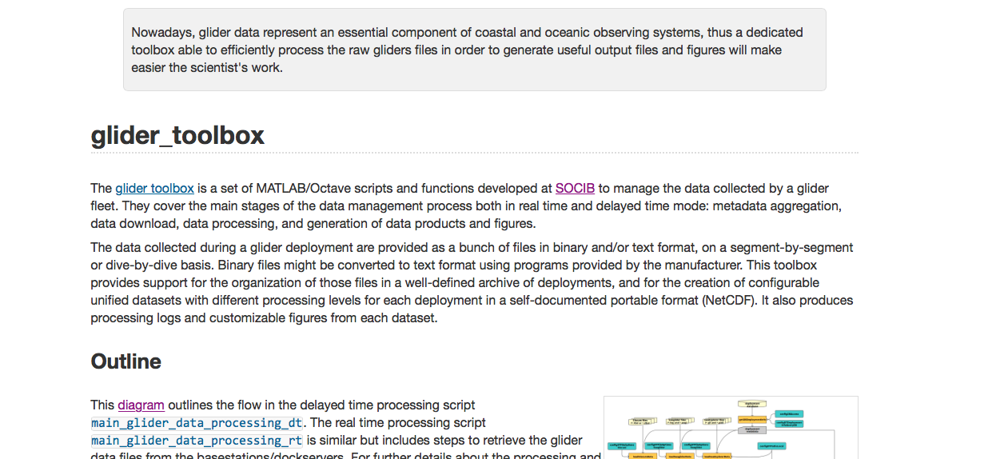
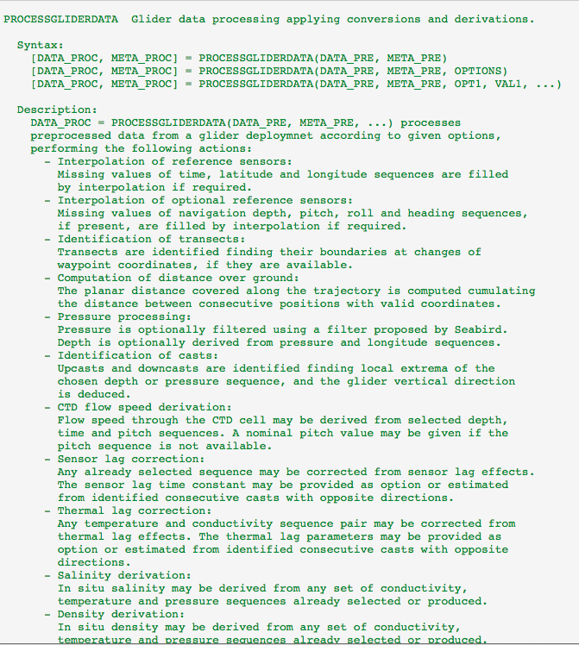
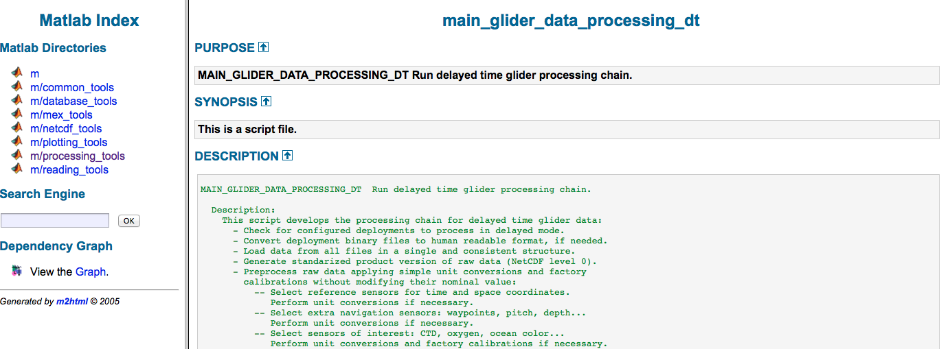
Installation and Notes
http://www.socib.es/users/glider/glider_toolbox/
Notes:
The SOCIB monitoring of the Ibiza Channel Choke point has now reached 5 years, with 31 successful deep glider missions, it is quasi continuous with the aim of not more than 1 month gap between missions, this is one of the keys of success – if anyone is interested in understanding more about the operational please ask or catch up later

Slide 12
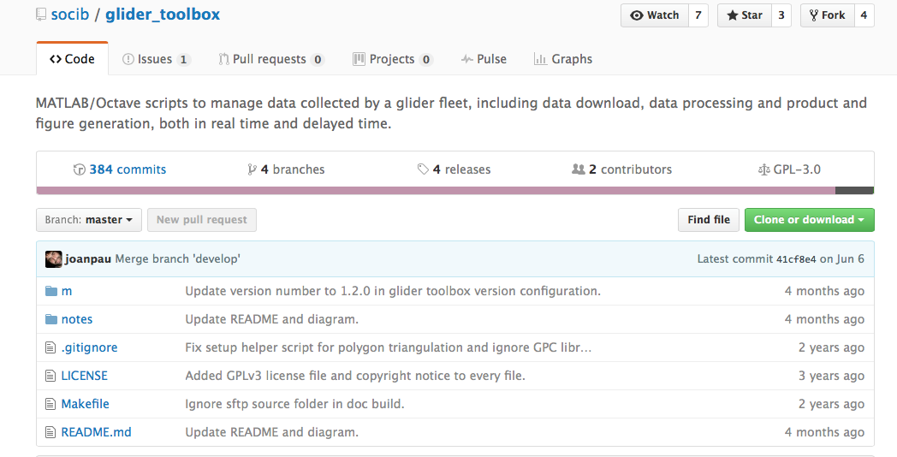
Installation and Set Up (1)
1.1 Download toolbox & set up folders:
Copy glider toolbox master (m) to a project folder (e.g Glider Project/glider_toolbox-master/m)
Notes:
Fredric Cyl

Slide 13
Installation and Set Up (2)
1.2 Install dependencies:
Get m_map libraries and place under master program directory e.g. Glider Project/glider_toolbox-master/m/m_map
Get seawater libraries and place under master program folder (e.g. Glider Project/m/seawater)
Get snc tools for Matlab/octcdf for Octave and place under master program directory (e.g. Glider Project/m/mexcdf/snctools)
Install Mex compliler and run setupMexPosixtime.m (follow instructions in Mex setup), Matlab only
Download the GPC library from Alan Murta, place under mex_tools, rename folder gpcl e.g. Glider project/glider_toolbox-master/m/mex_tools/gpcl and run setupMexPoly2Tri.m
For thermal lag correction in Matlab need to have the Matlab Optimization Toolbox
For Slocum data find Slocum programs provided by Teledyne Webb Research, place the program dbd2asc under a folder in the master program directory (e.g. Glider Project/slocum_programs/src). To build you run file from the same directory (you need to have a c++ compiler installed)
Finally run configGliderToolboxPath.m to add all the new folders

Slide 14
Installation and Set Up (3)
1.3 Configure missions to process:
Copy glider data files (binary or ascii) to a folder of choice, e.g. Glider Project/ Deployments/GliderName/StartDate/binary
Configure to get deployments list from database or the lookup script, e.g. deployment_list = configDeploymentsFMI(); If no database available for missions (scientist user) create a lookup script to list one or a series of missions – example available on request or read comment - https://github.com/socib/glider_toolbox/issues/2#issuecomment-187798277
Configure local paths for binary files, ascii files and output files, log L0, l1 and L2 etc. e.g. in configDTPathsLocal.m, local_paths.binary_path = '/Glider Project/deployments/${GLIDER_NAME}/${DEPLOYMENT_START,Tyyyymmdd}/binary';

Slide 15
Installation and Set Up (4)
1.4 Configure idata input/output:
Public outputs are configured in the corresponding public script, configDTPathsPublic.m, if not doing can make empty e.g. public_paths.netcdf_l0 = ' ';
configDTFileOptionsSlocum.m – two things to check/modify in this configuration file.
  1) Binary or ascii source files; normally binary files, but if you are reprocessing a mission it is worth remembering that you can skip the binary to ascii step (it takes a while) and just use the ascii already stored, e.g. slocum_options.format_conversion = false;
  2) Sensor list, check that you have all the variables listed that you want for the processing steps, here is where you add variables that you need that are not standard.
Check configWRCPrograms – this is where you state where the dbd2asc etc. files are
Run main processing script e.g. main_glider_data_processing_dt.m!

Slide 16
Installation and Set Up (4...)
Notes:
1) Conversion is slow the first time, depending on how many dbd’s etc., but once done can skip this step and process from ascii. However ascii files are big, so you can easily run out of space, so when finished and have L1, L2 and L3, can delete ascii and re-process from binary if required.
2) Thermal lag, for G2 it is switched off by default, but if you want to switch it on change settings in configDataProcessingSlocum.m
3) Use seawater libraries rather than TEOS. TEOS could be imbedded but would need to edit several parts of the code and still create seawater equation EOS80 files for archive.

Slide 17
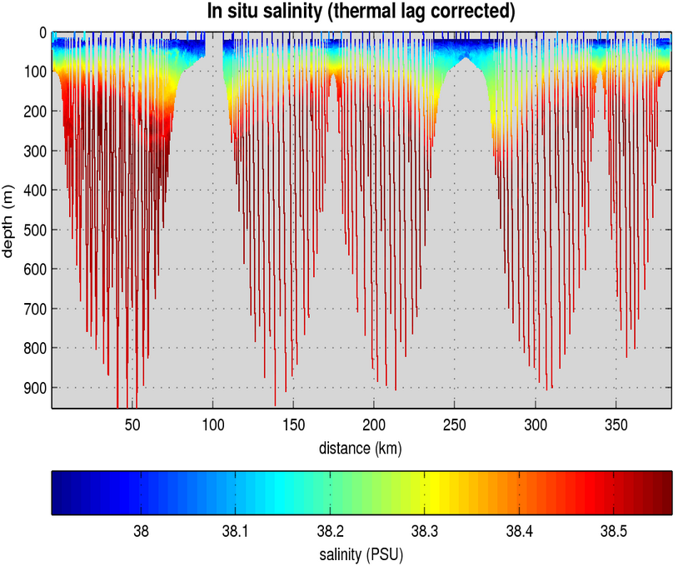
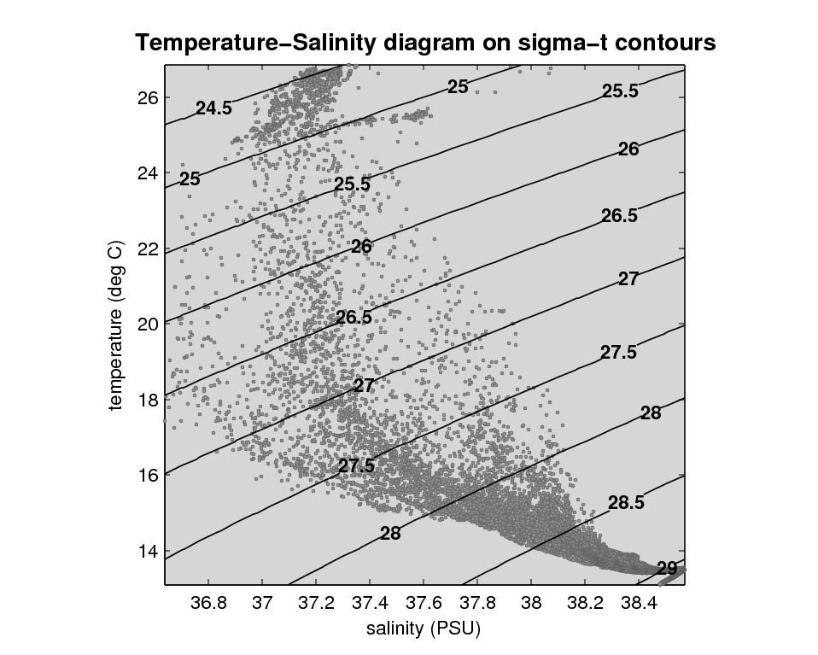
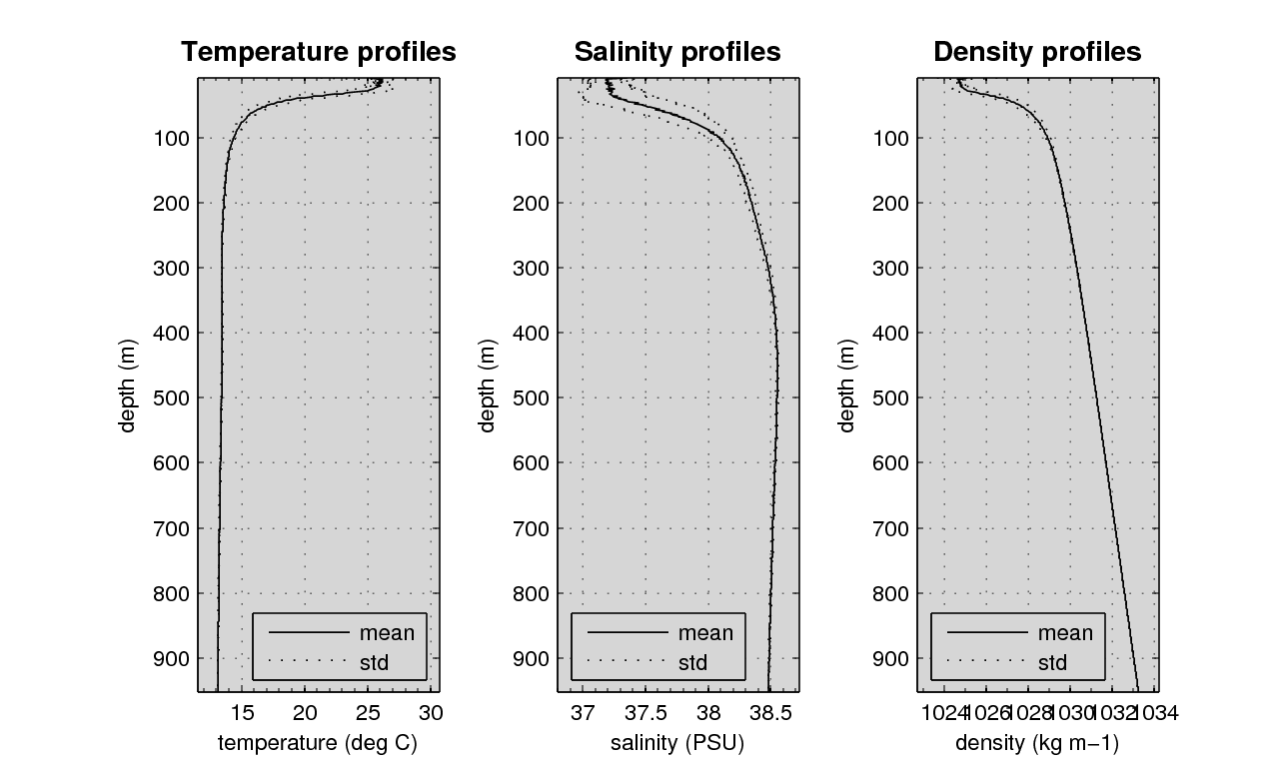
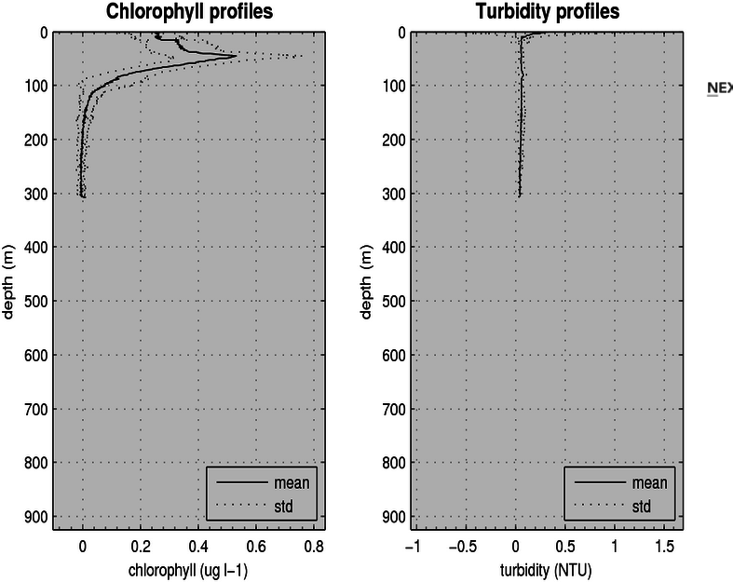
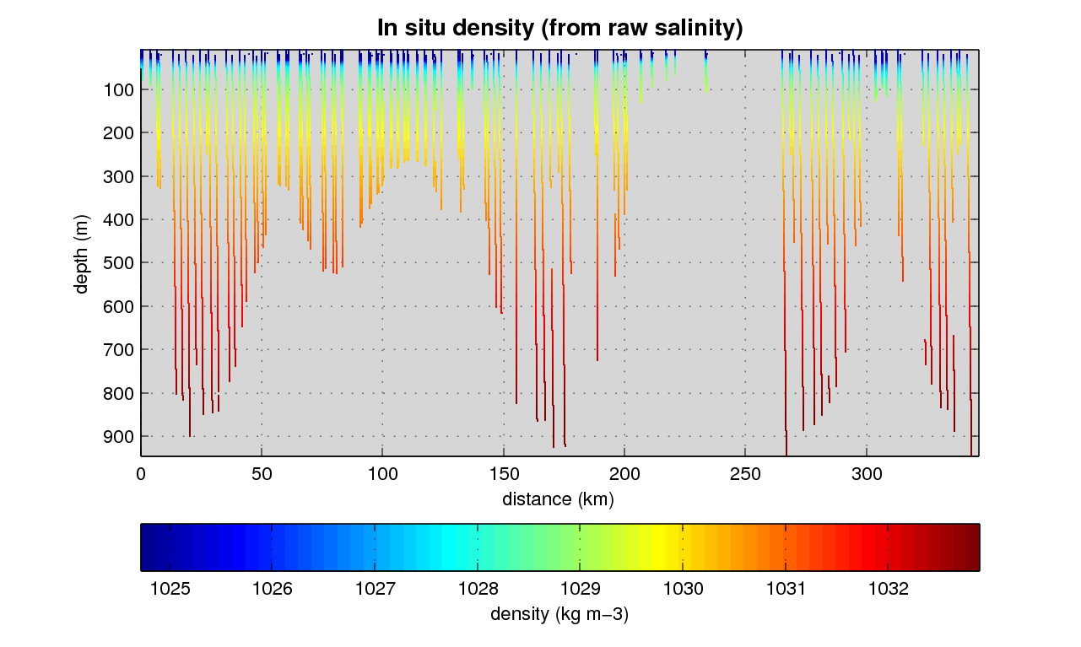
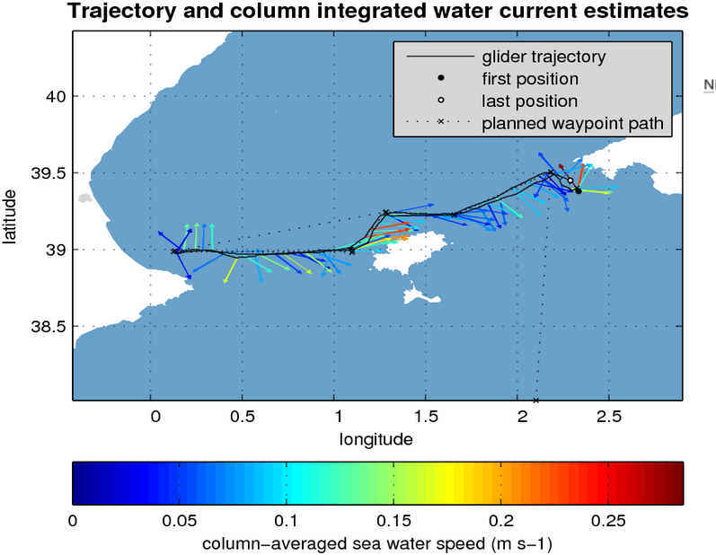
Sample figure outputs
Notes:
The SOCIB monitoring of the Ibiza Channel Choke point has now reached 5 years, with 31 successful deep glider missions, it is quasi continuous with the aim of not more than 1 month gap between missions, this is one of the keys of success – if anyone is interested in understanding more about the operational please ask or catch up later

Slide 18
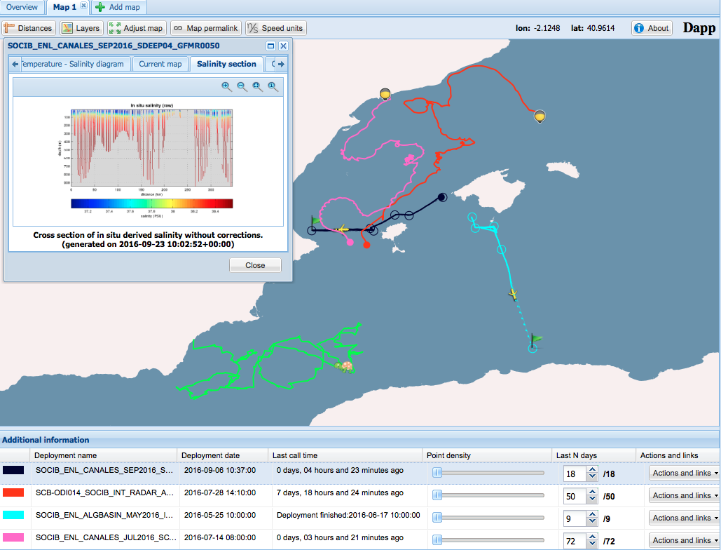
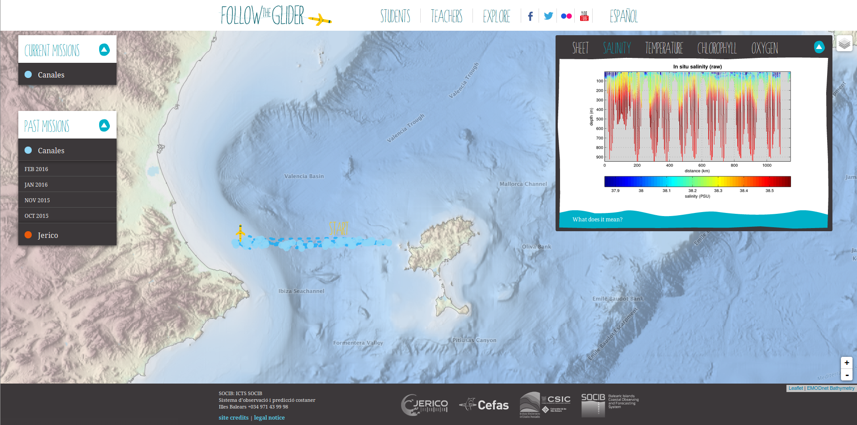
How SOCIB uses the Glider Toolbox
1. DAPP
A deployment application used to visualise all the SOCIB mobile platforms. Links to download the NetCDF files are provided, as well as figures showing the variables. http://apps.socib.es/dapp/
2. FOLLOW THE GLIDER
An application for the discovery of glider data specifically designed for kids and teachers. Contains information on gliders and all the past and current missions are available for visualisation.
http://followtheglider.socib.es/
Notes:
A SOCIB Web Tool Box – a web page with access to relevant data, SOCIB derived variables (scientific value add) and related tools. Created to give target end users access to SOCIB expertise and value added information to assist in analysis and decision making. Communication of availability of this facility to target end users in the Balearics.

Slide 19
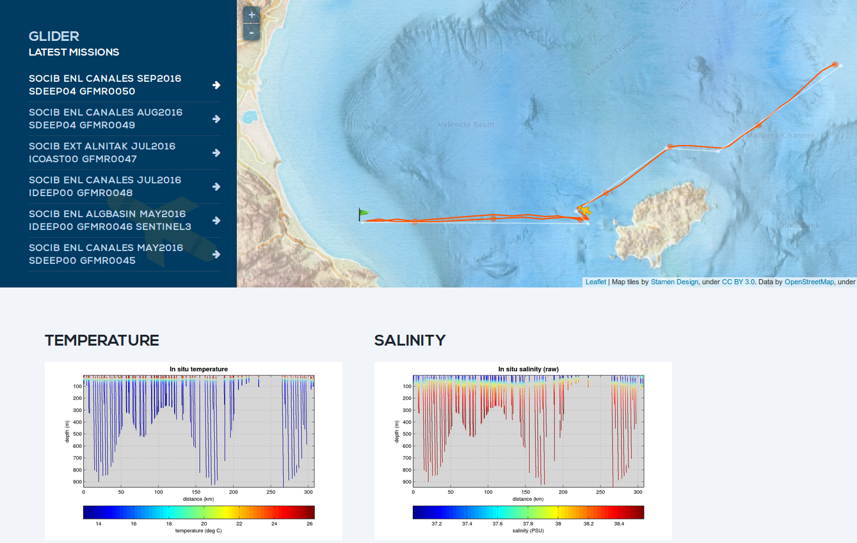
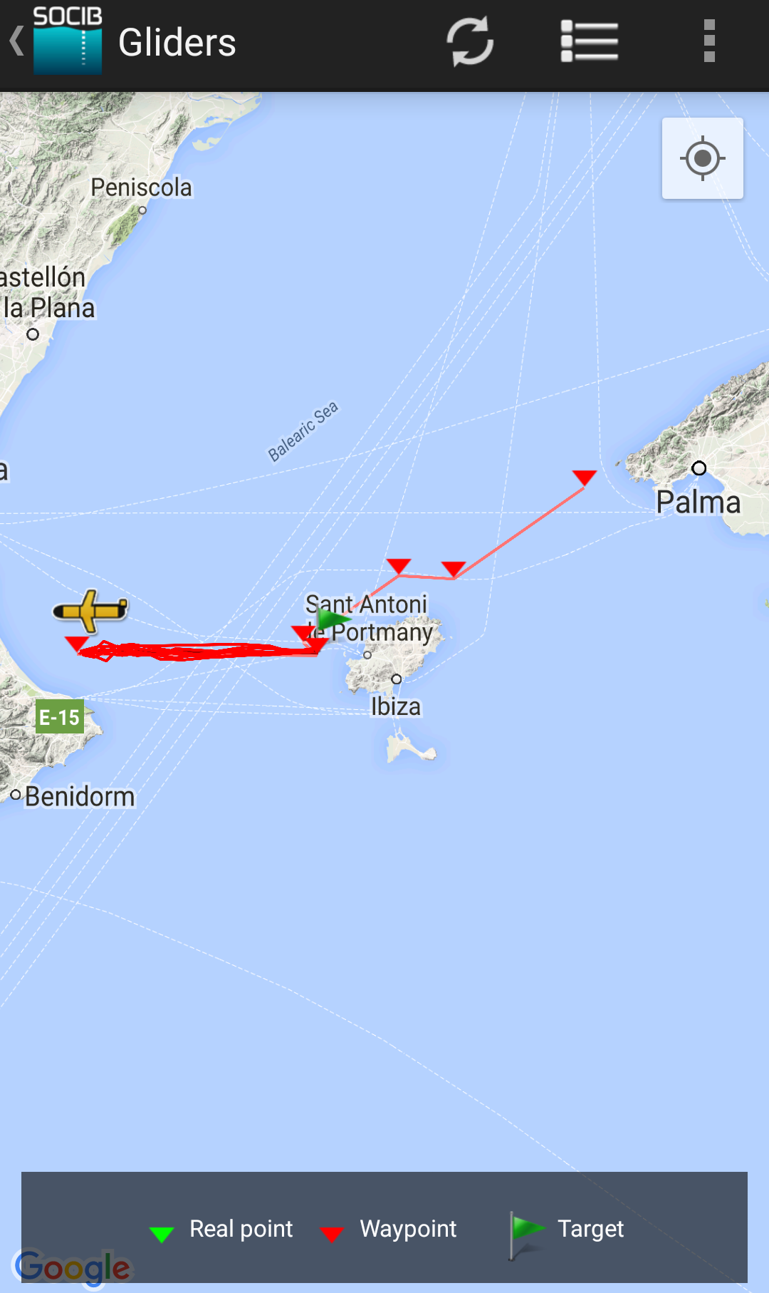
How SOCIB uses the Glider Toolbox (2)
3. MEDCLIC
‘The Mediterranean in one click’ is a research and dissemination project focused on the scientific, technological and societal approaches of SOCIB, in collaboration with la Caixa Foundation. The web displays all glider deployments and provides information on how a glider works and how we sample the ocean with material (animations, diagrams, texts) specifically designed for the general public. http://www.medclic.es
4. SOCIB APP
The App (iPhonr/Android) offers access to all the data managed by our facilities; fixed stations, drifters, profilers, gliders, turtles, and models forecast waves and ocean state. As soon as a deployment starts, the positions appear on the map.
Notes:
A SOCIB Web Tool Box – a web page with access to relevant data, SOCIB derived variables (scientific value add) and related tools. Created to give target end users access to SOCIB expertise and value added information to assist in analysis and decision making. Communication of availability of this facility to target end users in the Balearics.

Slide 20
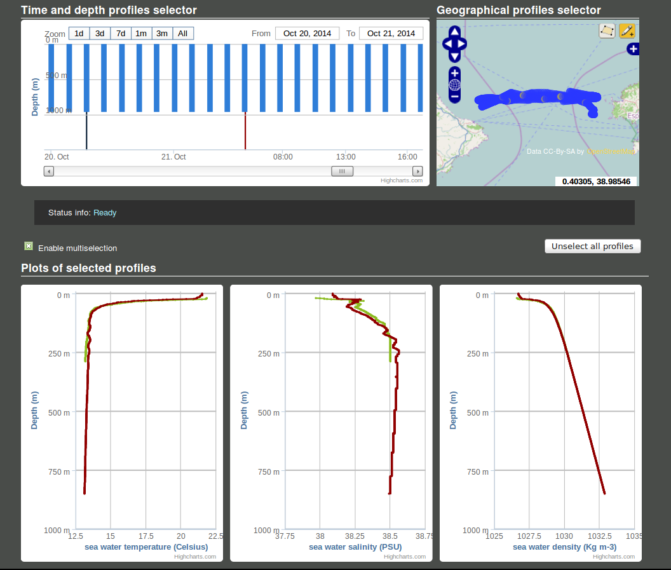
How SOCIB uses the Glider Toolbox (2)
5. INTERACTIVE PROFILE VIEWER
An tool for selecting, from any mission, the data that you want to visualise on the web and interactively (location or time). The selected data variables can then be displayed as profiles.
http://www.socib.es/?seccion=observingFacilities&facility=profile&id=676
Notes:
A SOCIB Web Tool Box – a web page with access to relevant data, SOCIB derived variables (scientific value add) and related tools. Created to give target end users access to SOCIB expertise and value added information to assist in analysis and decision making. Communication of availability of this facility to target end users in the Balearics.

Slide 21
Round-up
Acknowledgements:
Tomeu Garau
Joan-Pau Beltran
  SOCIB Glider Toolbox
  Delivers data ready for science or operational use
  Download toolbox from https://github.com/socib/glider_toolbox
For examples of figures & data formats visit www.socib.es
Read Troupin et al. (2015)
& use the flow diagram!

