Slide 1
Getting the Most Science
Out of your Seaglider
Jim Bennett
bennett@ocean.washington.edu
7th EGO Conference
September, 2016
Notes:
Tell them who you are, what you do.
Slide deck will be available.
A talk meant for pilots and oceanographers that have gotten through their first deployment.
New best practices for both
Initial training was likely overwhelming with first steps.
More nuanced topics in this talk.

Slide 2
Acknowledgements
Seaglider and Deepglider lab
Charlie Eriksen, Kirk O’Donnell
Integrative Observational Platforms lab (APL)
Craig Lee, Jason Gobat and Geoff Shilling
Seaglider Fabrication Center
Fritz Stahr
Kongsberg Underwater Technology
Liz Creed

Slide 3
Pilot/Scientist Collaboration
The vehicle will fly using a wide range of parameters
But the vehicle will supply good science for a smaller range
Achieving best deployment data requires planning and teamwork from all
Important steps and techniques during launch and early dives are key to good data quality
Basestation code performs many quality control checks
Encapsulates many things learned from deployments
Oceanographers direct to prepare best quality data
Regressions are critical for mission longevity and best data
Notes:
In the ‘rental’ model the oceanographer might never have been a pilot or gotten trained on flight or data details.
Yet they need to be involved with getting ‘good data’ with the pilot and then understand where all the data and what processing has occurred.
The vehicle will *fly* in a wide range of parameters but will *not* always deliver good data there.
There are a few ways to drive the glider that yield the best data.
There are many more ways to drive the glider to get it back.
The oceanographer wants the former over all but sometimes the later is the better part of valor.
Talk is about best practices to narrow to the good range.

Slide 4
Talk Structure
Practices on land and bench:
Mission planning: science and energy
Instrument preparation and test
Practices during launch and operation:
Overview of main 66.12
Selftest analysis
Trimming, compass calibration, and flight model tuning
Navigation
Analysis during and after deployment:
Overview of Base-2.09 (and Base-2.08)
Data files, variables, and QC practices
Reprocessing and deposit to archives
Analysis scripts

Slide 5
Mission Planning
Energy/science tradeoffs
Best science sensor rates versus …
Powering through ocean stratification and currents
Depends on whether 15V or 10V/24V battery system
Handling CT thermal inertia requires planning
High data rates in high thermal gradients, e.g., during flare
Tradeoff with low data rates at depth
Tradeoff with vertical velocity vs sample rate
Tune science file to different vertical ocean regimes

Slide 6
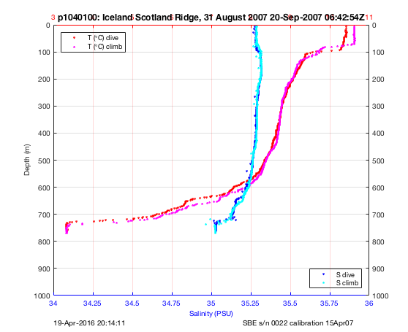
Example CT sampling regimes
// Alt Faroe science: CT, Optode, WL
/depth time sample gcint
150 20 111 200
600 20 112 200
800 5 118 200
1500 20 112 200
Notes:
Trade offs for sensors.
Forget WL in the lower part of the water column generally.
Trade resolution in high CT stratification for lower freq sampling elsewhere.
Scicon available in case you need higher resolution.
Depends on expected vertical velocity (and its changes) and desired vertical resolution; higher in VM situations (high thrust)
Sometimes you must slow down to get even the fast sample (w/o scicon) to work!

Slide 7
Sampling on dive or climb
science file supports whether to sample on dive or climb
0 – neither dive nor climb
1 – dive only
2 – climb only
3 – both dive and climb (default)
// Science: CT, SBE43, Optode & WL
/depth time sample gcint profile
40 10 1121 300 3222
80 10 1121 300 3222
150 20 1120 300 3220
300 30 1140 300 3220
1500 60 1180 300 3220
Notes:
Note highlighted column.
The profile must permit the sample and the sample count must permit a sample or it isn’t taken.

Slide 8
On the bench
Weigh the dry vehicle ‘all up’ to the nearest gram!!
Record as $MASS onboard (in grams) and
Record as mass= in sg_calib_constants.m (as kilograms!)
Take the sensor caps off!
Critical to know the vehicle density, hence thrust, etc.
Ensure all $SEABIRD CT calibration constants are onboard
Some precision is lost (single-precision floating point)
sg_calib_constants.m overrides for basestation processing
Add all sensor calibration values to sg_calib_constants.m
Verify sensors using hardware menu and modes/sample menu
Ensure values are plausible and respond to input!
Notes:
Splurge on a good 100kg scale.
It is the only way you’ll be able to estimate vehicle density, hence thrust, for other accurate calculations.
Make sure it is dry and all components are attached.

Slide 9
Instrument Best Practices
Various lore and ‘gotchas’ for getting the most out of your instruments
Tests to do on the bench before they go to sea…
SBE conductivity sensor
Aanderaa optodes
WET Labs ECO pucks
GPS units
Additional issues and practices for ‘in-situ’ operation

Slide 10
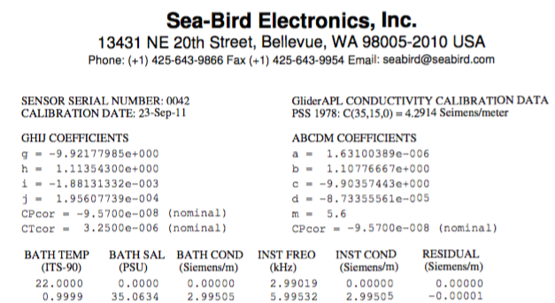
Conductivity Zero Frequency
Measure conductivity frequency in air (hw menu)
If different by .2Hz, conductivity tube is bad! Scrub launch!!
Seabird reports in kHz!
Acceptable frequencies here are between 2990.0Hz and 2990.4Hz
Rinse with TritonX after measurement and before putting in water!
Notes:
Note kHz vs. Hz. Bound.
Tube is likely cracked.
TritonX keeps surface oil from sticking inside the tube. Clears in under a minute. Don’t let it dry in tube.
Beware: TritonX appears ‘salty’ if you measure it on land before it clears in the ocean.
Will be added to selftests in later release.

Slide 11
Aanderaa Optode constants
Aanderaa records calibration constants on sensor
Use ‘direct addlf=1’ in hw/sensors/AA4330 menu and capture ‘get_all’
Use get_optode_constants.m to convert to proper format for putting into sg_calib_constants.m
Use Stern-Volmer Uchida formula if available
SVU_Enabled(Yes) onboard
See more info in docs/Optode-4831-setup.txt
Verify correct data parsing using modes/sample!
Notes:
Two different calibration schemes with latest FW: Foil and SVU.
SVU is preferred (simpler, fewer coefficients) but may not be enabled.
Little difference between foil and SVU at least to 2km.
See optode document about proper settings and how to talk with it.
Generally you want the basestation to process the raw data the way the instrument did for [o2] except we apply pressure and salinity corrections.

Slide 12
Aanderaa Optode drift
Optodes drift in air; no one knows why.
Multi-point calibrations seem to make no difference.
Basestation implements Johnson et al. drift compensation
[O₂] within 1%
Record mean Optode calphase and temperature in air
Foil should be dry and dark…keep cap on loosely
Get values from selftest eng file
Record sea-level pressure at selftest location in dbar
optode_st_calphase = 33.168; % pt0350016.eng
optode_st_temp = 13.16; % pt0350016.eng (vs. 16.1 CT)
optode_st_slp = 1019.3; % www.weather.bm 1/30/2015 (NCEP monthly mean 1017.4)
Notes:
Ken Johnson, Plant, Riser paper in press J Atmos Ocean.
Basic scheme is you can predict [O2] in air given temp and pressure and given the optode measurement of calphase you compute a drift factor so the instrument will report air [O2].
No salinity or deep pressure problems.
Drift rates vary by instrument. Drift slows or stops in seawater.
Get SLP from ship or weather station, else NECP, which might be too coarse if changing weather during launch.
Bastien mentioned measurements at forced anoxic conditions on bench as well.
He suggests that drift continues somewhat even in water…

Slide 13
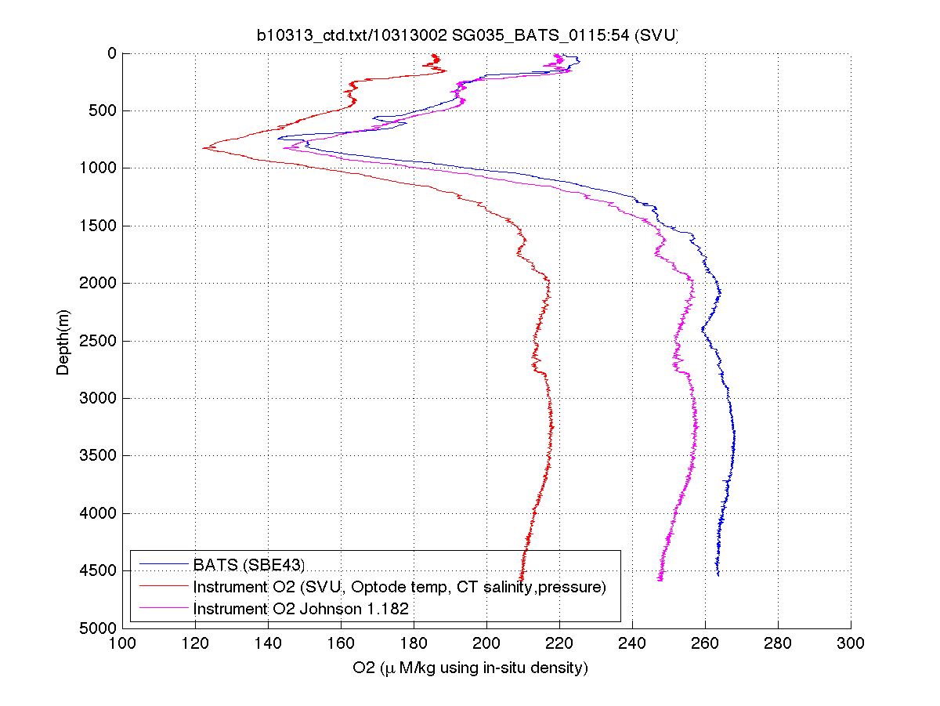
Aanderaa Optode drift
Drift correction is good unless anoxic (< 40 μm/kg)
Notes:
See shift from low to high because of drift correction.
Note that things are ok above 1km but the pressure correction is not correct for DG (yet).
Doesn’t matter if you use foil or SVU correction scheme since code corrects from TCPhase raw data.

Slide 14
WET Labs Firmware
New-style: 7 columns with fixed ‘wavenumber’ labels
Old-style: 6 columns with variable ‘reference’ signals
‘Constant columns’ suggest bad sensor parsing
You are recording the wavenumber label!
Check using ‘modes/sample’
If you recalibrate, they may upgrade firmware
Depends on if HW permits reflashing…
Notes:
Make sure you know this lore. Easy to get burned.
Ensure the numbers change using the test sticks and holding in your hand to change temperature.

Slide 15
WET Labs Sensor Processing
New canonical instrument and column names
sig470nm rather than ‘redCount’ (which was wrong!)
All known WET Labs frequencies supported
Reprocessing files converts old supported to new canonical names
Modify your cnf files to use new canonical names!
Glider code now emits new names for stock hardware choices
Calibration constants supported, e.g.,
calibcomm_wetlabs ='WET Labs BB2FL-VMT SN 855, cal 19-Sep-2011';
wlbb2fl_sig470nm_dark_counts = 53
wlbb2fl_sig470nm_scale_factor = 1.126e-5
wlbb2fl_sig470nm_resolution_counts = 1.0
Basestation computes derived values, e.g.,
wlbbfl2_sig470nm_adjusted backscattering in meter⁻¹steradian⁻¹
Notes:
The new nc file will no longer have use the old names, but all the data is preserved of course.
We don’t handle old iRobot column names that encoded serial numbers!!

Slide 16
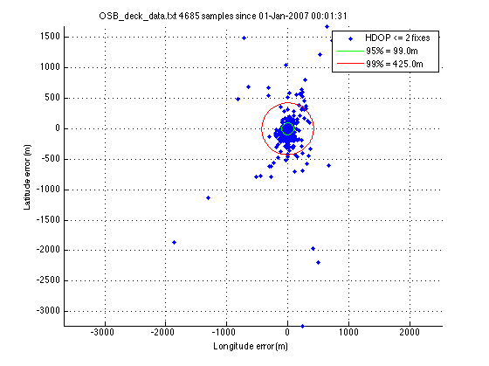
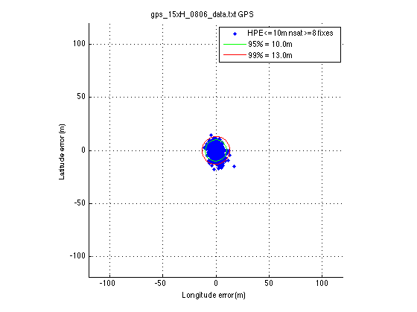
GPS Position Error
Note change of scale
Notes:
First panel: Position scatter around a fixed point for 4.6k GPS acquisitions.
Note scale and how outliers are sometimes km off!
Second panel: Current corrections with revised code in 66.12.

Slide 17
$N_GPS,100840
66.11 used potential HDOP to terminate acquisition
Premature: Actual position error ~100m, sometimes worse
Bad DAC estimates for short dives
Poor recovery locations
66.12 tracks Garmin GPS engine estimate of HPE
$N_GPS gives finer control over accuracy demands
10 meter accuracy using HPE
08 minimum satellites
40 maximum position estimates before accepting fix
DAC on longer dives generally not impacted…
15xH requires ~15 fixes vs. ~35 fixes for 15H (after first ‘A’)
Backward compatibility: Old $N_GPS values use HDOP…
Saves energy but at risk of higher error
Notes:
HDOP: Horizontal Dilution of Precision.
HPE: Horizontal Position Error.
Consider decreasing accuracy (99) reducing sats (4) to reduce time to fix during recovery until ship is nearby…

Slide 18
More GPS Lore
$T_GPS_ALMANAC is gone
No almanac question during launch/selftest
Run the engine for 30-40s in direct comms
Before running first selftest in new location
If not getting ‘A’ fixes, something is wrong with GPS engine

Slide 19
Deck dives and Selftest
Run deck dives to test comms and basestation
Review nc history for sensor issues
ncdump –h pgggdddd.nc | grep ‘.py’
Run selftest before deck dives
Use /usr/local/basestation/selftest.sh to find problems
Failures and warnings, timed out sensors, etc.
NOT a substitute for detailed review!
Notes:
Deck dives AKA simulated dives.
>> Add QC_temp_min/max and QC_salin_min/max

Slide 20
selftest.sh Example
$ /usr/local/basestation/selftest.sh
Scanning pt0380004.cap in /home/sg038/ps/2015.01.06
Roll 1.87deg (2235) to -2.04deg (2097)
0.2s 119 mA (273 mA peak) 27.0 V 920.00 AD/sec
Pitch -6.59cm (769) to -8.52cm (152)
1.6s 99 mA (325 mA peak) 26.8 V 385.62 AD/sec
…
Pump 741.62cc (889) to 842.13cc (543 [528, 558])
79.7s 323 mA (4152 mA peak) 25.5 V 4.34 AD/sec; 1 retries
…
There are no targets specified!
---- Self test PASSED! ----
WARNING! $T_ABORT,120.0000: Value must be between 720.0000 and 4320.0000!
WARNING! $SM_CC,930.0000: Value must be between 150.0000 and 800.0000!
Unable to determine $parameter,value in '$P_OBSHOOT_WITHG
--> VBD retries
internal humidity 1880 counts (48.223286% RH)
internal pressure 8.987156 psia
Loaded bathymap.001 [101 100] 100m (LL) 47.8833
…
Loaded bathymap.007 [ 56 75] 100m (LL) 47.6500
Current location (4741.24,-12224.20) is covered by at least one bathymetry file
Data lines with timed out or missing values in pt0380004.eng : 0
Notes:
An example from a deck dive motor move lines reformatted.
Looks for failures, warnings, errors, ‘nots’
Note last line. You want that to be zero else you have a sensor problem.
High number of bathymaps takes a while to process.
Large bathymaps (> 100x100 points) will blow out memory 300kb.

Slide 21
Processing History
$ ncdump -h p1440119.nc | grep '.py'
"INFO: QC.py(392): Changed (2/711) 2 332 to QC_PROBABLY_BAD because raw temperature spikes\n",
"INFO: QC.py(404): Changed (1/711) 711 to QC_BAD because raw salinity below bound\n",
"INFO: QC.py(415): Changed (1/711) 711 to QC_BAD because
bad raw salinity indicates raw conductivity issues\n",
"INFO: MDP.py(3226): Changed (41/711) 509:549 to QC_BAD because
uncorrectable 89.8m raw conductivity anomaly\n",
"INFO: QC.py(207): Changed (2/711) 2 332 to QC_PROBABLY_BAD because
changed raw temp implies changed raw salinity\n",
"INFO: MDP.py(3398): Changed (3/711) 331:333 to QC_BAD because slow apogee CT flow\n",
"INFO: MDP.py(3513): Changed (3/711) 1:3 to QC_BAD because prior to dive start\n",
"INFO: MDP.py(3592): Changed (1/711) 710 to QC_BAD because end of climb\n",
"INFO: MDP.py(3619): Changed (49/711) 1:3 331:333 509:549 710 711 to QC_BAD because
bad corrected temperature and conductivity suggests bad salinity\n",
"INFO: QC.py(207): Changed (49/711) 1:3 331:333 509:549 710 711 to QC_BAD because
changed corrected salin implies changed speed\n",
"INFO: TSV.py(1233): TSV exiting after 2 iterations\n",
"INFO: TSV.py(1237): Changed (27/711) 422:425 687:709 to QC_PROBABLY_BAD because
stalls avoid thermal-inertia salinity correction\n",
"INFO: MDP.py(3777): 49 (6.89%) HDM speeds are QC_BAD; 27 (3.80%) are stalled (711)\n",
"INFO: MDP.py(3799): Average estimated final speed: 22.86 cm/s\n",
"INFO: MDP.py(3802): RMS observed vs. computed w: 1.84 cm/s\n",
"INFO: MDP.py(3854): Starting sensor extensions data processing\n",
"INFO: QC.py(207): Changed (28/711) 422:425 686:709 to QC_PROBABLY_BAD because
changed salinity implies changed optode oxygen\n",
"INFO: QC.py(207): Changed (49/711) 1:3 331:333 509:549 710 711 to QC_BAD because
changed salinity implies changed optode oxygen\n",
"INFO: MDP.py(3856): Finished sensor extensions data processing\n",
"INFO: MDP.py(3886): Estimated total flight and drift time: 28459.0s (SM: 210.0s)\n",

Slide 22
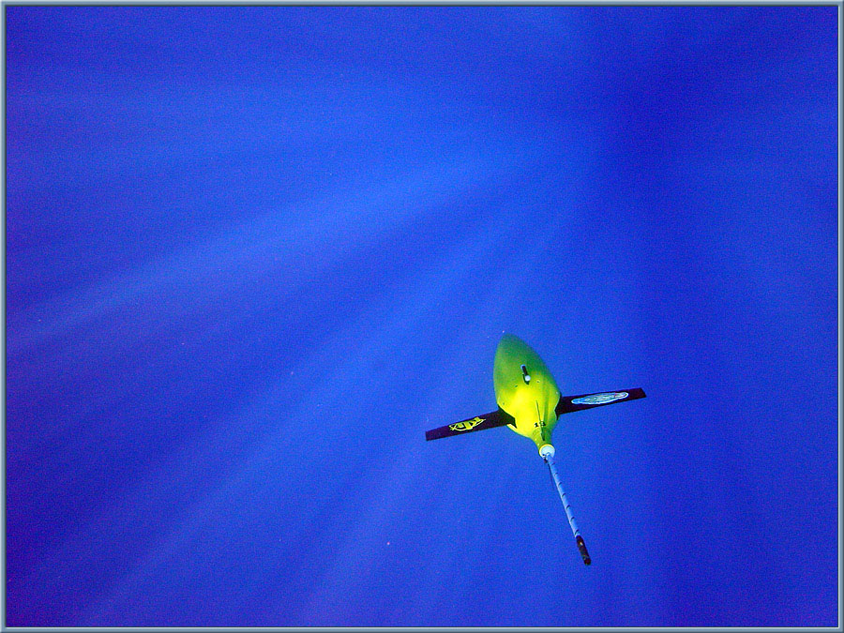
Into the deep blue - KvT photo of SG019
Let’s go gliding …
Notes:
Let’s go diving.

Slide 23
Main 66.12
New $NOCOMM_ACTIONs:
Send SMS
Try both phone numbers
$STOP_T,mmddyyhh – go into recovery after this time
$VBD_LP_IGNORE – use with caution!
“grep” pdos command; handles compressed files
/i case insensitive; no regexp or wildcards….
Beware autologout declarations in .cshrc
“x!” pdos command: execute command on basestation
x! touch .delete_pdoscmds_bat
$GPS log entries report surface drift speed and direction
Improved rudicsd handling of dropped calls
Notes:
Summary of the major changes. In addition to $N_GPS.
Parameters doc’d in the usual place.
LP ignore: Use if a lin pot goes bad and you still want to dive on the remaining linpot toward recovery; if you lose the last one she’s dead in the water
Rudicsd handles some missed dropped calls so no logout processing occurs.

Slide 24
Those first 10 dives…
Critical for pilot and oceanographer!
4 dives to trim: pitch, VBD, roll
Easier if you can statically ballast before hand…
Consider using trim.m
2 200m dives to calibrate compass in-situ
Use pdoscmds.bat to update tcm2mat file
4 200+m dives to gather flight performance data
Doing last ensures trapped bubbles are gone
Deeper is better...more performance data
Notes:
Do these things first so you have a trimmed vehicle that is capable of best science.

Slide 25
trim.m
Simple trim estimator for vbd/pitch/roll
Employs the 50% change heuristic
Uses w at apogee
NOT a substitute for detailed review!
>> trim
Dive cycle number: 2
Measured pitch response implies changing $C_PITCH by -371 AD counts
Recommend changing $C_PITCH from 2706 to 2520
Recommend changing $PITCH_GAIN from 22.0 to 18.6 degrees
Recommend doing that first before attending to VBD and roll changes!
Measured w at 53.1m implies adjusting $C_VBD by -53.4 cc (183 AD counts)
Recommend changing $C_VBD from 2076 to 2167
Measured roll on dive implies adjusting $C_ROLL_DIVE from 2332 to 2316
Recommend changing $C_ROLL_DIVE from 2332 to 2324
Measured roll on climb implies adjusting $C_ROLL_CLIMB from 2332 to 2335
Recommend changing $C_ROLL_CLIMB from 2332 to 2333
>>
Notes:
W == vertical velocity
Based on looking at pitch and roll regressions and the 1:1 plot for VBD at apogee

Slide 26
Roll Trim
Trim $C_ROLL_DIVE, $C_ROLL_CLIMB to be ‘flat’
According to compass: Roll vs. Roll control
If still turning, likely some source of asymmetric drag:
Bent antenna bulb; sensor or rudder askew
Biofouling on a wing or even a shark bite!
Adjust both centers in 50-100 AD count increments
Dealing with turn overshoot:
Open $HEAD_ERRBAND (reduces need to roll)
Limit $ROLL_DEG and/or increase $T_TURN_SAMPINT
Finally, try auto roll adjust; not bang-bang control

Slide 27
Compass Calibration
Vehicle components generate soft- and hard-iron fields
Soft: Electronics
Hard: Battery cladding
Distort the compass’ measurement of earth’s field
Invariant fields compensated by calibration procedure
Calibration defeated by subsequent hard-iron changes
Wanding the vehicle on/off
Sitting on ships or on large magnetic rocks (Greenland)
Accurate heading critical to navigation and DAC
Always fly with $COMPASS_USE,4
Can correct DAC headings on basestation later
Notes:
The SI and HI components are invariant as the vehicle is rotated so these can be estimated and eliminated.
The residual is Earth’s local field.
Given rotated X/Y field using pitch and roll and then atan2(y,x) give heading.

Slide 28
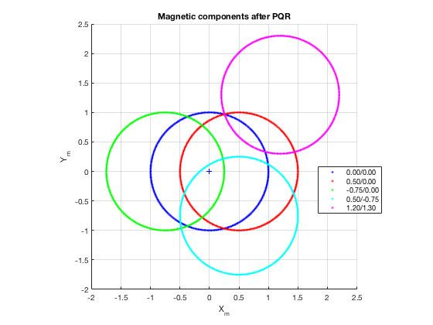
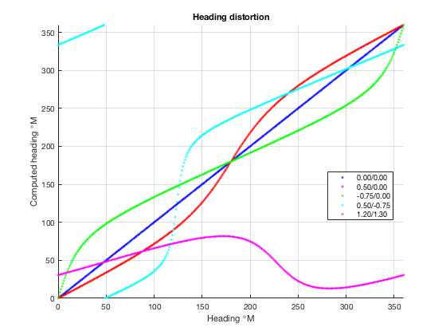
Hard-iron Distortion
Notes:
First panel: If HI is corrected properly residual (earth) field after transforming by pitch/roll will fall on the blue circle and using atan2(y,x) will yield heading
If HI is distorted in different ways it ‘offsets’ the circle.
Second panel: If you swing a vehicle through 360deg (actual) what do different distortions report as headings?
Blue line: 1:1, as you’d expect and like.
Note magenta cicle which doesn’t overlap the center of panel 1.
The reported headings vary from 25 to 70 degrees!!

Slide 29
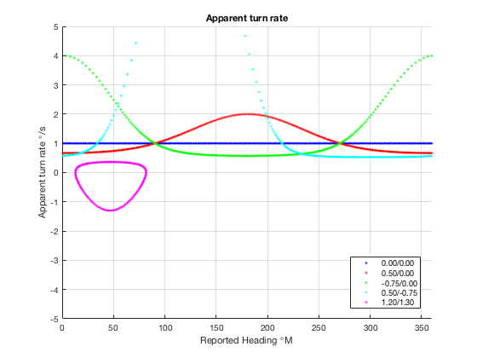
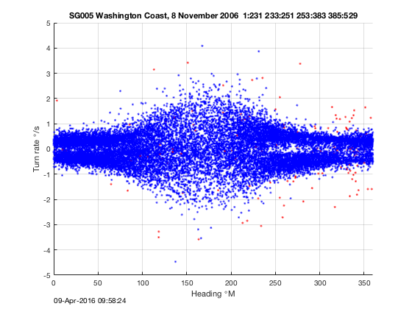
Distortion Observed
Notes:
And if you turn the vehicle at a rate of 1 degree/s you’ll see a reported spin rate that differs according to the distortion.
Blue has no distortion (1 degree/s)
Note magenta again!
Second panel: Measured (mild) distortion shown by tracking turn rates across many dives.

Slide 30
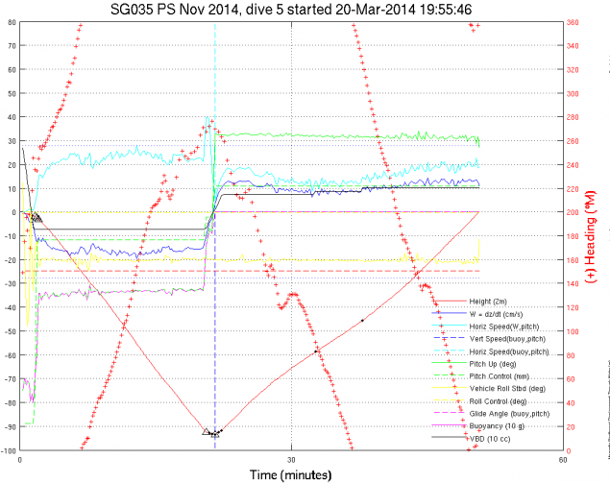
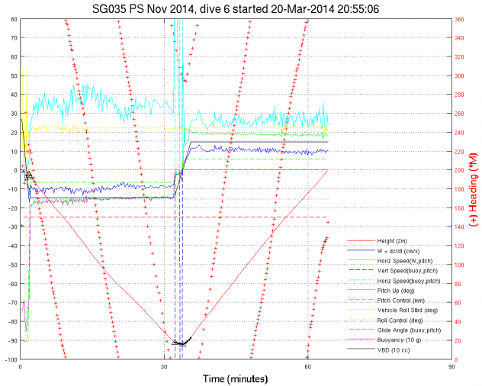
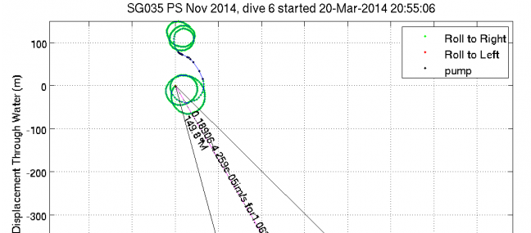
“Spinny-spinny”
$COMPASS_USE,4
Notes:
So what to do? In-situ compass calibration
Two dives, low pitch and high pitch, pegged in a roll to port and then to starboard with $COMPASS_USE,4
Procedure is in matlab/README.compass

Slide 31
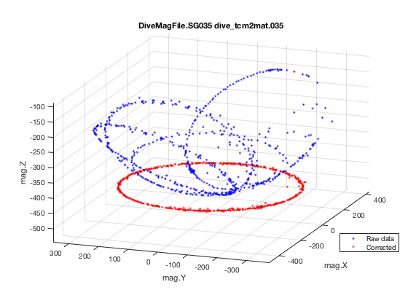
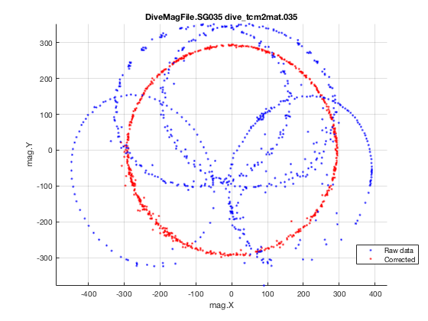
In-situ Calibration
Notes:
Once you get the dive data back, use divemagcal and yields a new tcm2mat file.
You can use visualize_magfile to look at the collected data against different tcm2mat files,
including the old one to compare how bad it was…
Note how filled in the red circle is (that indicates you got full 360 turns)
And note how it is centered on 0,0.
If the distortion is bad you can run the collected data using the old tcm2mat and it will show an offset from 0.0.

Slide 32
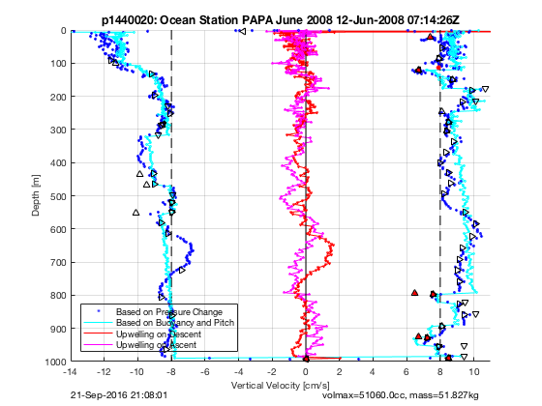
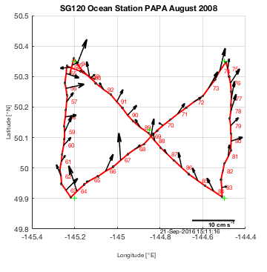
Accurate DAC and w_{w}

Slide 33
Accurate Flight Model
L
B = g(-M+ ρV(p,T))
D
V(p,T) = [V₀ + v_{c}]e^{-κp+ε(T-T*)}
L = ql²aα
B
D = ql²(bq^{-1/4} + cα²)
q = ρ₀(U² + W²)/2
M | mass
V₀ | volmax & vbdbias
l | glider_length
ρ₀ | rho0
κ | abs_compress
ε | therm_expan
T* | temp_ref
a,b,c | hd_a,hd_b,hd_c
w_{stdy} = (U² + W²)^{1/2} sin(ϕ – α)
w = dp/dt
Solve: min <w – w_{stdy}> varying a,b,c, etc.
Notes:
The fllight model is for STEADY flight.
Accelerations (flare), decelerations (apogee and surface) and rolls are removed.
Must know the vehicle and seawater density to compute buoyancy.
Buoyancy forcing is order 100-200g so mass should be to nearest gram.
Glider_length is a scaling parameter, NOT a measurement. We use 1.8 uniformly, regardless of hull type!
Rho0 is also a scaling parameter, a nominal density (1023). No need to change it.
NOTE: abc will scale appropriately but it is actually l²a and l²b and l²c that are the true parameters.
The aluminum isopyncal hull of Seaglider has fixed measured values for compression and thermal expansion.
Compression is the same as seawater. Thermal expansion is the same as aluminum.
T* is a reference temperature (15C).
Adjust abs_compress only if you add a lot of syntactic foam. Kgs worth.
Hd_c (implied drag) adjusts the stall speed and is typically very small.
Vbdbias?

Slide 34
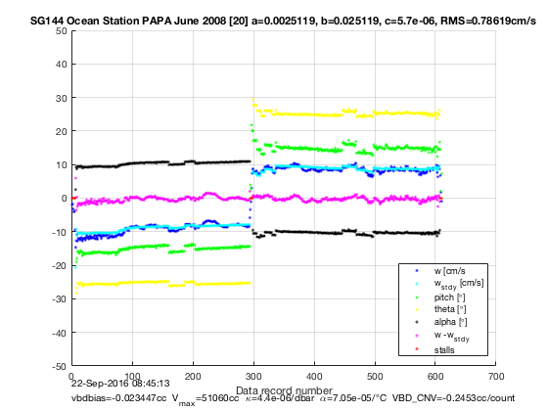
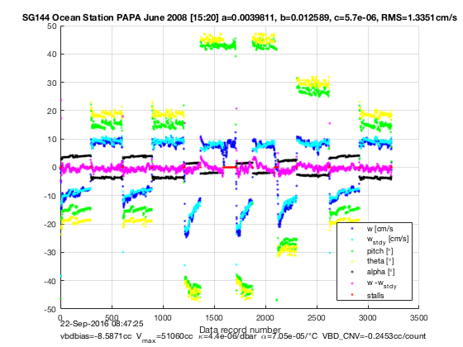
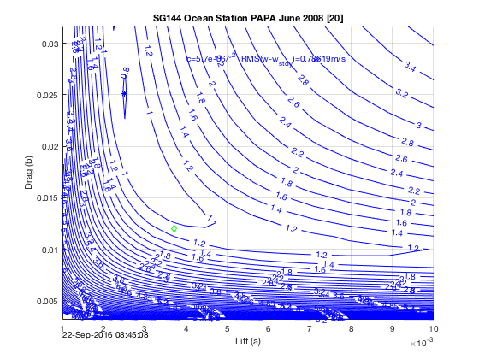
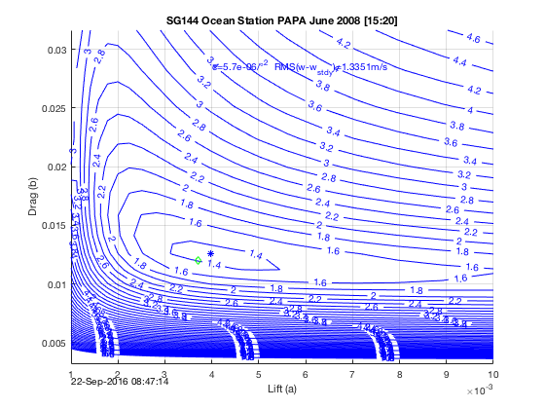
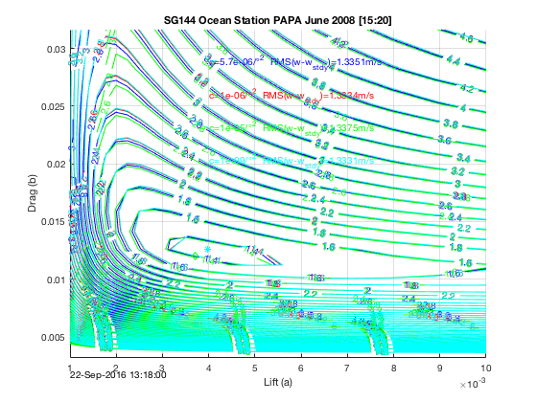
Fitting hydrodynamic a b c

Slide 35
Flight Model Heuristics
Measure glider mass to nearest gram on bench
Measure volmax at apogee when well trimmed
4 200+m dives: 2 at nominal and 2 at steep pitches
‘Quiet’ water
Use $GLIDE_SLOPE to limit shallow pitch (< 10°)
Open $GLIDE_SLOPE to larger pitches (>30°)
Focus on hd_b, less concern about hd_a
Don’t change glider_length, abs_compress, therm_expand, hd_c
Update the parameters on board ($NAV_MODE,2)
Update sg_calib_constants and reprocess previous dives!
Notes:
Don’t change rho0 either….like glider_length it is just a parameterized scale
Tell of the attempt to verify DAC model with a week of several gliders in tidal environment with bottom mounted ADCPs
Data set was great BUT that’s when we discovered the GPS issue and they hadn’t varied buoyancy and pitch sufficiently to constrain the vehicle’s regressions

Slide 36
“Rattle Trap” Mass Shifters
Rolls cause pitch mass to ‘walk’ in the direction of gravity
This is generally in your favor…
Dynamic pitch control can be problematic
Pitch moves with gravity overshoot more
$P_OVSHOOT_WITHG
Estimate on the bench
Notes:
Move to TTI mass shifter has an unfortunate side effect… Crosstalk between roll and pitch since they share the screw and tube
Pitch down on dive means you speed up, good in increasing stratification
Pitch up on climb, good in decreasing stratification.
But it depends on the amount of rattling and assemblies vary.
And pitch moves overshoot even more with gravity. P_OVSHOOT_WITHG makes dynamic pitch adjust useable for really sensitive shifters.

Slide 37
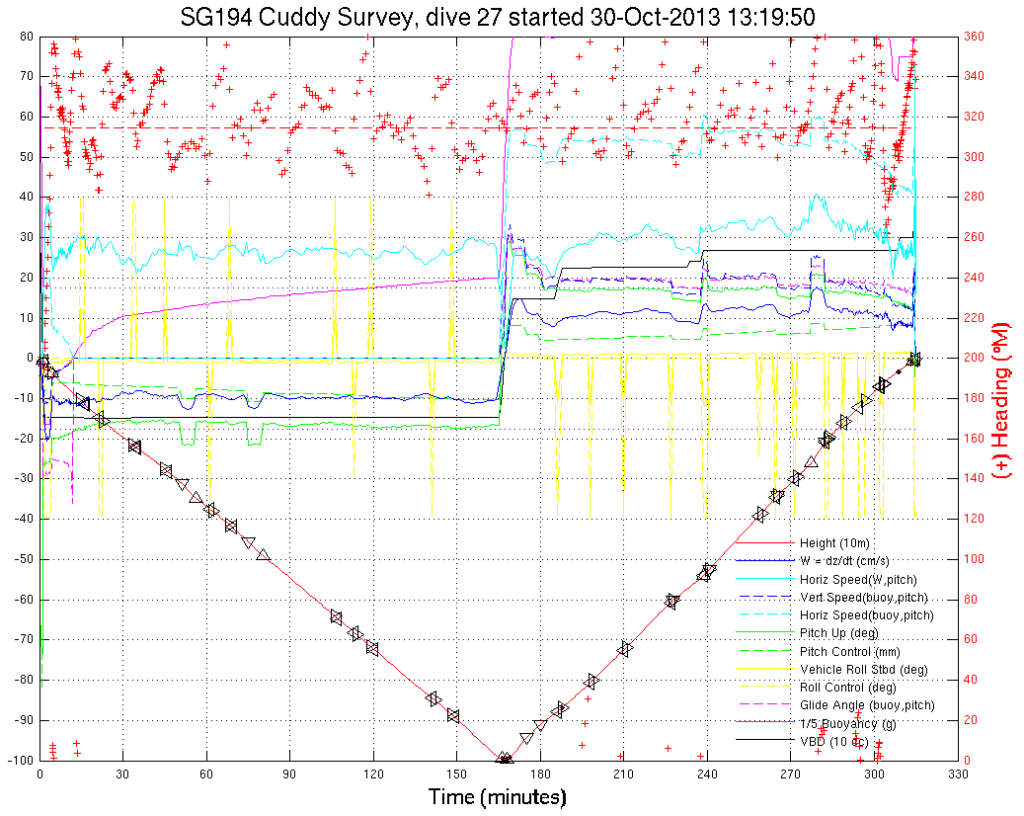
“Rattle Trap”
Notes:
Example of overshoot issue.
Pitch adjust was on and a very small move was commanded..just on the edge of controller.
Wanted 1deg change but overshoot provided 5deg with concomitant speed increase.
Had to wait to correct back. Happened several times.

Slide 38
TT8 Sensor Timing
warmup
WETlabs
warmup
Optode
warmup
CT
warmup
Compass
Pressure
-0.5
0.0
0.5
1.0
1.5
2.0
2.5
3.0
Time (secs past time stamp)

Slide 39
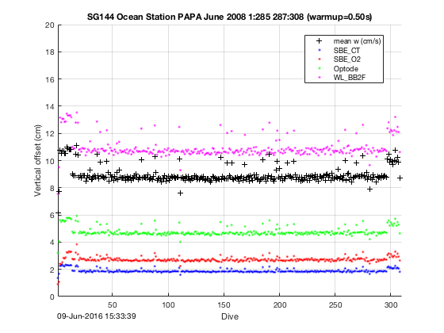
TT8 Vertical Drift Example
Vertical drift is negligible (<10cm); SciCon timestamps each sensor!

Slide 40
Navigation Modes
4 ways to navigate Seagliders
Various combinations of
Real or synthetic targets
Glider estimated currents to stem on next dive
Several coupled parameters
$HEADING, $NAV_MODE, $FERRY_MAX
$HD_A, $HD_B, $HD_C, $KALMAN_USE
First step: Compute bearing (θ) and range (Δ)
If $HEADING,-1 compute θ and Δ to current target from $GPS2
Else θ = $HEADING and Δ= 20km
Second step: Apply $NAV_MODE using θ and Δ
Notes:
This topic is a common source of confusion.

Slide 41
$NAV_MODE,0
Steers θ direction. Ignores currents.
θ
Δ
Notes:
‘Default’ or normal mode
Be careful if you switch to $NAV_MODE,3…it will use $HEADING.

Slide 42
$NAV_MODE,1
Steers θ direction given KALMAN predicted variable tidal currents.
Δ
θ
$KALMAN_USE,1
Notes:
Kalman filter predicts currents.
Learns local mean, diurnal, and semi-diurnal components. ONBOARD calculation.
If KALMAN_USE is off, acts like NAV_MODE,0
>> Be careful about dive cadence aliasing tidal modes. Shallow is better.
Diurnal and semi-diurnal components can be disabled (and see $NAV_MODE,2 if mean current is steady or you are doing deep dives).
Kalman filter sometimes needs to be reset.

Slide 43
$NAV_MODE,2
Steers θ direction given previous dive’s depth-averaged current.
θ
Δ
$HD_A, $HD_B, $HD_C,$FERRY_MAX
Notes:
Uses glide_slope() model (pitch,w) and GPS to estimate DAC from the previous dive ONBOARD!
Good in high constant current environments not tidally dominated.
If no DAC then acts like $NAV_MODE,0 (no current)
Iteratively solve for best speed and angle to reach current target given distance and bearing.
You gotta have the thrust to make it though!! Depends on the type of section calculation you want to do later.
Surface current not taken into account. Avoid $NO_SURFACE especially if you want DAC.
$FERRY_MAX limits the final correction angle

Slide 44
$NAV_MODE,3
Steers $HEADING direction with respect to previous dive’s
depth-averaged current. Ignores targets.
30°
Θ = DAC + $HEADING
Δ = 20km
$HEADING,30
Notes:
Measure DAC like $NAV_MODE,2 but steer ferry angle wrt to it.
Ala Spray.
Useful for staying in eddies.

Slide 45
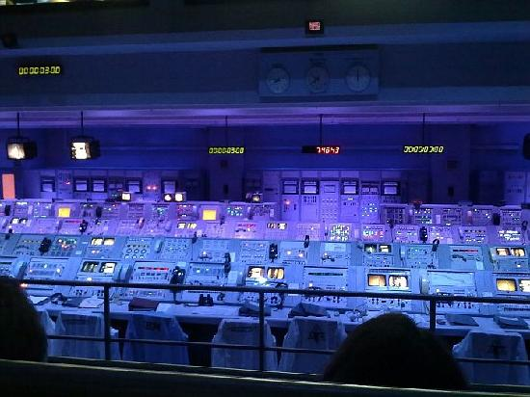
Meanwhile, back on shore…

Slide 46
Operational Data Flow
Basestation
Iridium
Piloting Tools
Base.py, etc.
ssh/sftp
http and/or ssh/scp
http
Visualization server/program
(e.g., web site, diveplot.m)
Notes:
Review of data and comms flow.
Boxes are code bits we deliver.
Files are not named here. That’s a good thing.
The basestation is written in python for portability and ease of handling files etc.
The basestation exports netCDF (more on this below).
This is now the lingua franca of oceanographic analysis. Do NOT write code against eng/log files.

Slide 47
Oceanographer Data Flow
Workstation
Reprocess.py,
MakeDiveProfiles.py, etc.
local
Analysis programs
(e.g., regress_vbd, diveplot.m)
Notes:
Now we’ll focus largely on oceanographer’s use of basestation code (Reprocess, MakeDiveProfiles, etc.).

Slide 48
Base-2.09 (and Base-2.08)
Review of basic processing and QC operations
Applies to both releases of the basestation
Production of netCDF files is central
Basestation converts log/eng/dat files to common format
Archival quality following various metadata conventions
Types of QC controls and overrides
Notes:
rudicsd handles proper logout when call is dropped. Still some residual issues.

Slide 49
NetCDF (nc) Files
Master file format for all oceanographic and piloting work
Basestation and matlab code employs it exclusively
All raw data included and processing history
No need for log/eng files
Archival format for deposit at NOAA’s NCEI (aka NODC)
Many QC checks for raw and processed results
GPS and DAC quality
Individual data point quality for T, C, S, O_{2,} etc.
Various conductivity anomalies, ‘wafting water’, etc.
Principled conductivity thermal-inertia correction
Individual sensors use cal constants to derive results
Use ncdump (-h) to see structure and data sizes
See get_dive_data() and ncload() for matlab uses
Notes:
Learn to find and read the processing history!

Slide 50
Types of nc files
‘per-dive’ pGGGDDDD.nc
All raw eng and log data, sg_calib_constants.m
Derived quantities and associated qc tags (scalar and vector)
‘profile’ sgGGG_mission_5.0m_up_down_profile.nc
2-D binned projects (profile,depth)
Missing data filled with NaNs
Can specify bin size and dives, climbs, or both
Default is 5m bins for both up/down profiles
‘timeseries’ sgGGG_mission_timeseries.nc
Concatenated all dive vectors for vector and qc values
Various per-dive scalars concatenated into vectors
Dive number vector assigns dive to data point
ctd_data_point_dive_number
profile and timeseries files derived from per-dive files
Notes:
There are three types of nc files that can be produced.
To get the profile and timeseries you can
(1) add MakeMissionProfile and/or MakeMissionTimeseries to .extensions in glider directory, or, better,
(2) Run the reprocess script whenever you want in the glider directory.

Slide 51
Remove these from sg_calib_constants
% knobs that never did anything
pump_power_intercept pump_power_slope
pump_rate_intercept pump_rate_slope
% knobs we get from the glider instead
vbd_min_cnts vbd_max_cnts vbd_cnts_per_cc
pitch_min_cnts pitch_max_cnts
roll_min_cnts roll_max_cnts
% knobs that don’t change and you shouldn’t either
% constants or vehicle defaults supplied
cpcor % nominal bulk compressibility of glass CT tube
ctcor % thermal coefficient of expansion for glass CT tube
therm_expan % thermal expansion coefficient for hull
temp_ref % reference temperature for hull thermal expansion calculation
abs_compress % vehicle compressibility (seawater for Seaglider)
% knobs that don’t work anymore
% Use QC temperature, conductivity, and salinity bounds instead
sbe_temp_freq_min, sbe_temp_freq_max
sbe_cond_freq_min, sbe_cond_freq_max
Notes:
NOTE: If you remove them from sg_calib_constants but already have nc files then the previous values are cached.
We only pick up on changed values from defaults, not ‘dropped’ values.
So you should delete all nc files and reprocess from log and eng files.

Slide 52
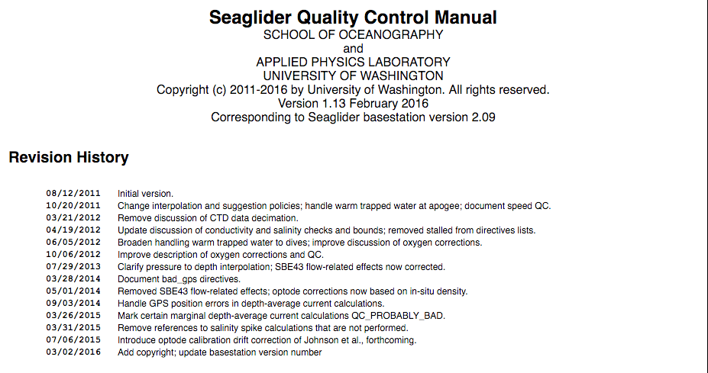
Quality Control
Notes:
Read it for many details on tests and controls! Some discussed below.

Slide 53
Quality Control
QC tags, format, and checks based on ARGO program
Basic T,C,S spike and bound detection
Additional QC checks performed (see below)
Original log, eng, and sg_calib_constant.m data preserved
Derived results and QC state are separate variables
Parallel QC vectors determine quality of individual points
E.g., temperature_raw and temperature_raw_qc etc.
QC checks controllable by directives and variables

Slide 54
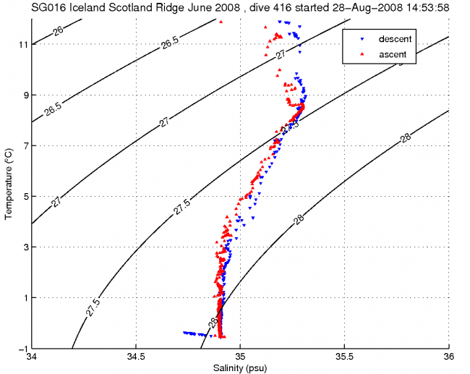
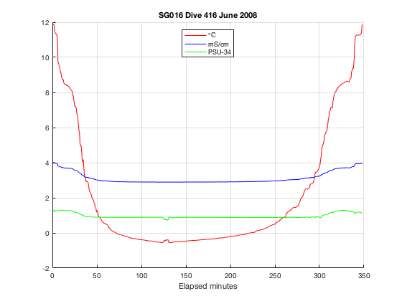
Wafting Warm Water
Notes:
Trapped interstitial warm water and heavy glider at apogee spills water from hull past the thermistor.
Seagliders only (with interstitial water volume).

Slide 55
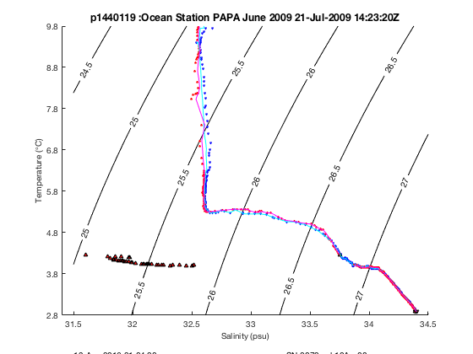
Conductivity Anomalies
INFO: Changed (41/711) 509:549 to QC_BAD because uncorrectable 89.8m raw conductivity anomaly
Notes:
CA works by bounding the expected conductivity change given a change of temperature at pressure:
We expect a ~.1PSU change for a change of ~1C. Anything much in excess means it ain’t seawater.
Detects ‘snot’ and surface ‘bubbles’.
Note the black points. Several sets.
The one to the lower left is ‘snot’, an anomaly at depth that cleared. Lasted for 90m.
Removed 41 of 711 total CT points.
Notice ‘chunk’ out of the climb.
The one at the bottom are apogee points (not anomalies).

Slide 56
Conductivity Thermal Inertia
Adjusts timing of C and T according to vehicle orientation and sensor geometry
First-principles heat flow analysis following Lueck 1990
Predicts modified temperature of water, not conductivity
Models heat-flow through glass
Handles boundary layer effects due to variable flow rates
Employs measured Poiseuille flow transition in cell
Can be turned off via sg_directives.txt file

Slide 57
Conductivity Thermal Inertia
New ‘thermal decay modes’ scheme available
Will be described in Eriksen and become the default
Models radial heat-flow through glass and jacket
Majority of heat is stored in the jacket
Employs several (odd-numbered) thermal decay modes
Enable in sg_calib_constants.m:
SBECT_modes = [1,3,5];
Time to compute increases with increasing modes
SBECT_modes = 1; is comparable to the current scheme
SBECT_modes = 0; (default) forces previous scheme

Slide 58
Thermal Inertia Correction
Notes:
Correction using the old mode. The new 5mode code is better but doesn’t deal with the upper part of the water column as well in this dive because of poor sampling and de/accelerations.

Slide 59
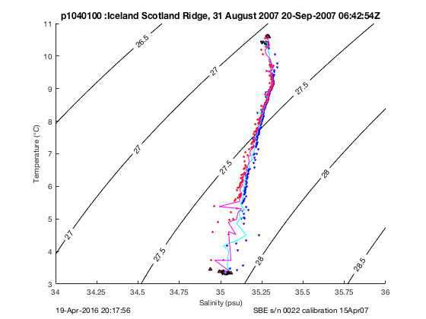
Thermal Inertia Correction
Notes:
This is the dive shown earlier regarding the science file planning.
But here, the sampling interval was a uniform 20s and you can see in the thermocline how ‘ratty’ the correction can be without higher sampling rates.

Slide 60
TEOS-10 and Gibbs Seawater
Under evaluation
For Deepglider the basestation reports
Conservative temperature
Absolute salinity
Based on corrected temperature, salinity, latitude, longitude, and pressure
Uses gsw python library; optional install
Notes:
We could change it to compute for all deployments.

Slide 61
Reviewing Data
diveplot.m
Reports processing history
Use a negative dive number to just load data w/o graphs
ts_diagram.m
Detailed TS plot to see corrections and issues
Data cursor function for identifying outlier points
nc_bin_edit.m
Uses profile nc file to show bulk results
Data cursor function for identifying outlier dives
Notes:
You can also use ncload to just get (any) file into a structure with GLOBALS and ATTRIBUTES sub-structures.
Use get_dive_data() to fetch loginfo,eng,results for old code.

Slide 62
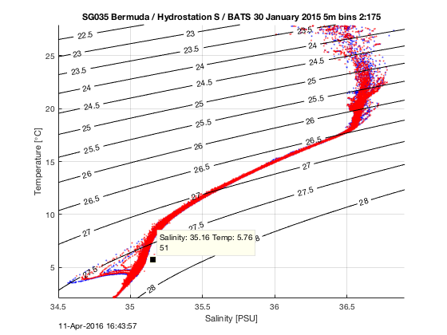
nc_bin_data
Notes:
Makes use of the ‘profile’ nc file. Red and blue mark climb and dive bin values.
Data tip reports dives that contain nearby points.
There are points from 173 dives here.
Note ‘eddy’ in TS space. When did it happen (dives)?
Note saltier point? When did it happen?

Slide 63
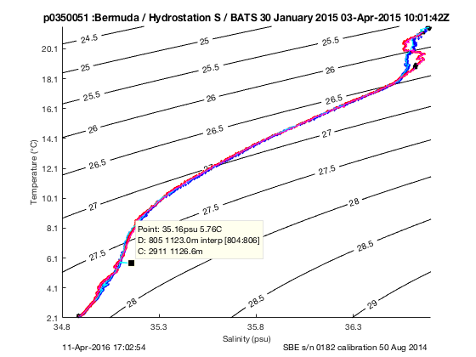
ts_diagram
Put into sg_directives.txt: 51 bad_conductivity 805 % bad point
Notes:
Run after diveplot (use a –dive number)
Red and blue points are ‘raw’ climb and dive points
Magenta and cyan are ‘processed’ (TI) corrected points
Black are QC_BAD points
Data tip shows location of data point selected.
Directive shows how to declare something is bad.

Slide 64
Adjusting QC and processing
Temperature, conductivity, salinity:
Min and max bounds
Deep and shallow spike threshholds
Specified in sg_calib_constants.m
Manual QC directives and overrides
For example,
30:50 bad_temperature depth below 500 % transient malfunction
Specified in sg_directives.txt
See QC manual for format
Add comments!! They are saved in the nc file.
Notes:
The names of the variables and directives are in the SQCM.

Slide 65
Reprocessing dives
After updating sg_calib_constants.m
After updating sg_directives.txt
/usr/local/basestation/reprocess.sh [dive numbers]
reprocess.m in MATLAB; asks for dive numbers
Check Reprocess.log and per-dive history global for issues
Notes:
Don’t forget to share updated files or move to archive location.

Slide 66
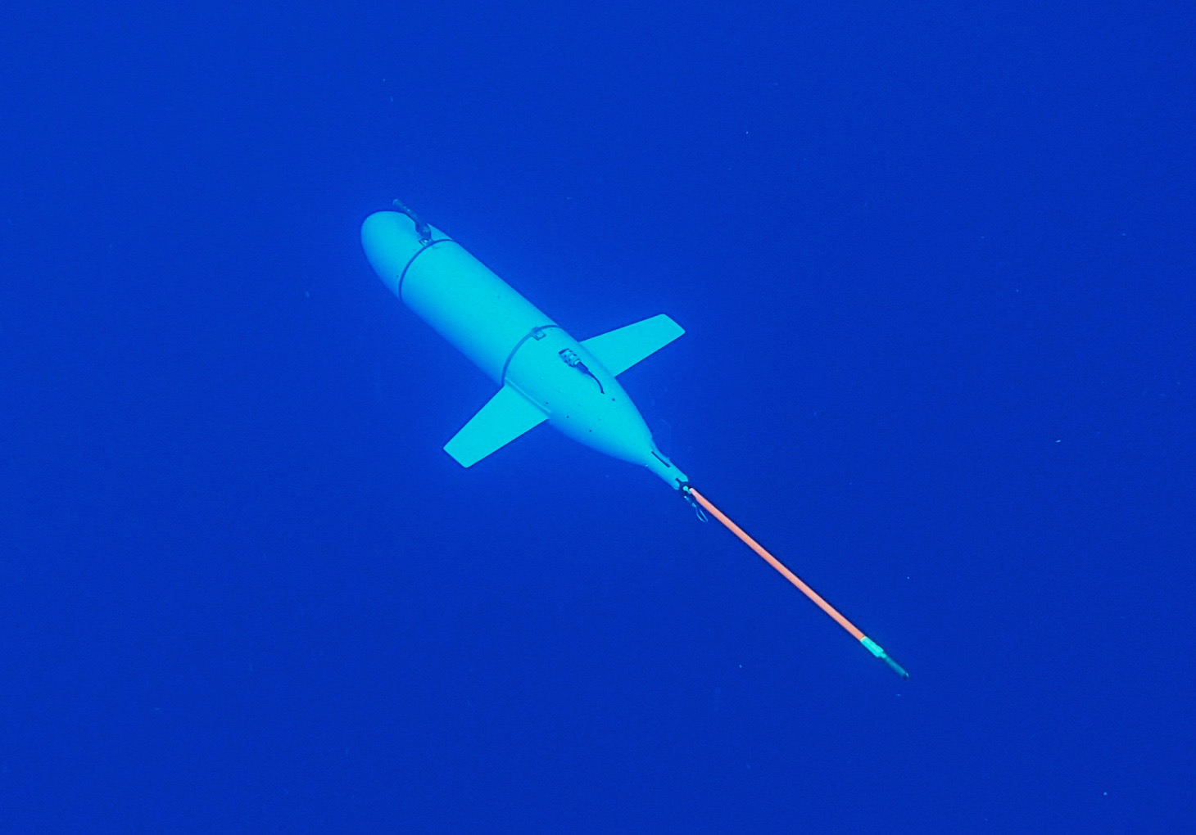
Thanks, and happy gliding …
bennett@ocean.washington.edu

