Slide 1


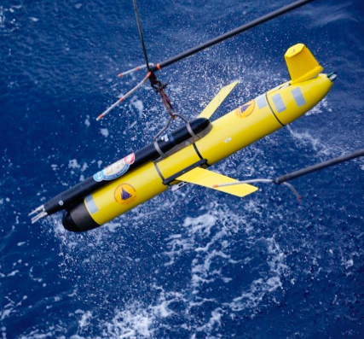
Workshop:
Turbulence Measurements with the MicroRider
Southampton, England
Date: September 29, 2016
Chair: Fabian Wolk
fabian@rocklandscientific.com

Slide 2










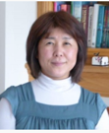

Who We Are
Focus
Turbulence measurements and instrumentation
Location
  Victoria, B.C. Canada
Cumulative Experience
  50 years in oceanographic turbulence research
  22 years in oceanographic instrumentation
  > 50 publications on turbulence measurements
Team
  16 full-time staff / + students
  Oceanographers
  Mechanical / Electronics Engineers
  Software Developers
  Technologists
  Administration

Slide 3
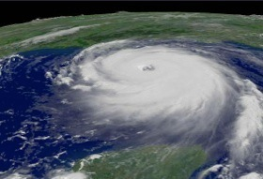
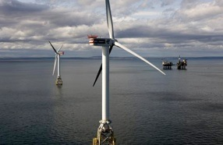
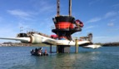
Why Ocean Turbulence is Important
Climate Change: Understand ocean circulation.
  Mixing Processes affect the exchange of heat, salt and momentum.
Global Heat Transport
  50 per cent of the pole-ward transport of heat is in the ocean.
  Turbulence affects ocean-atmosphere exchange processes
  Affects rates of ice melt
Anthropogenic impact
  Local changes to water stratification affect wildlife and fisheries
  Resource extraction (minerals, energy, etc.) requires environmental impact assessment
Notes:
Why should we care about Ocean Turbulence?

Slide 4
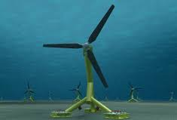
Emerging Applications
Tidal Energy Conversion
  Site characterization
  Device-resource interaction
  Array layout optimization
Offshore Mining
  Manganese nodule mining
  Tailings disposal
Oil & Gas
  Pollution propagation measurement & modelling

Slide 5
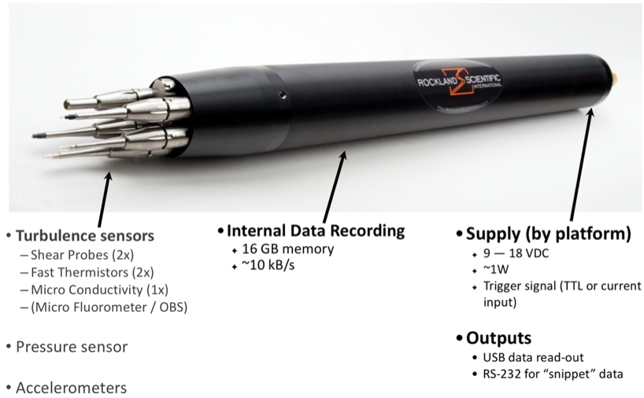
The MicroRider
Notes:
What is the platform for the shear probe?

Slide 6
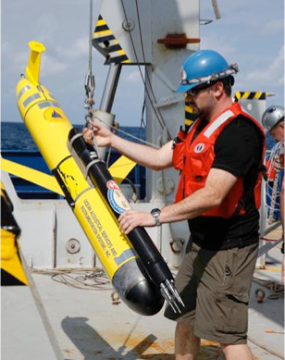
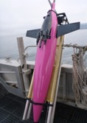
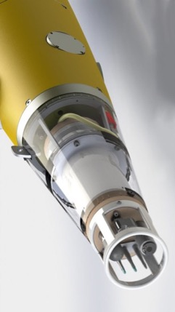
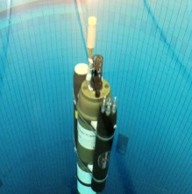
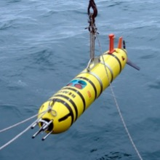
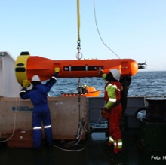
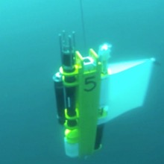
MicroRider integrations
2008 Slocum
2014 Seaglider
2016 SeaExplorer
Notes:
What is the platform for the shear probe?

Slide 7
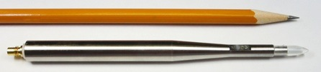

The Velocity Shear Probe
Notes:
How can we measure ocean turbulence?

Slide 8
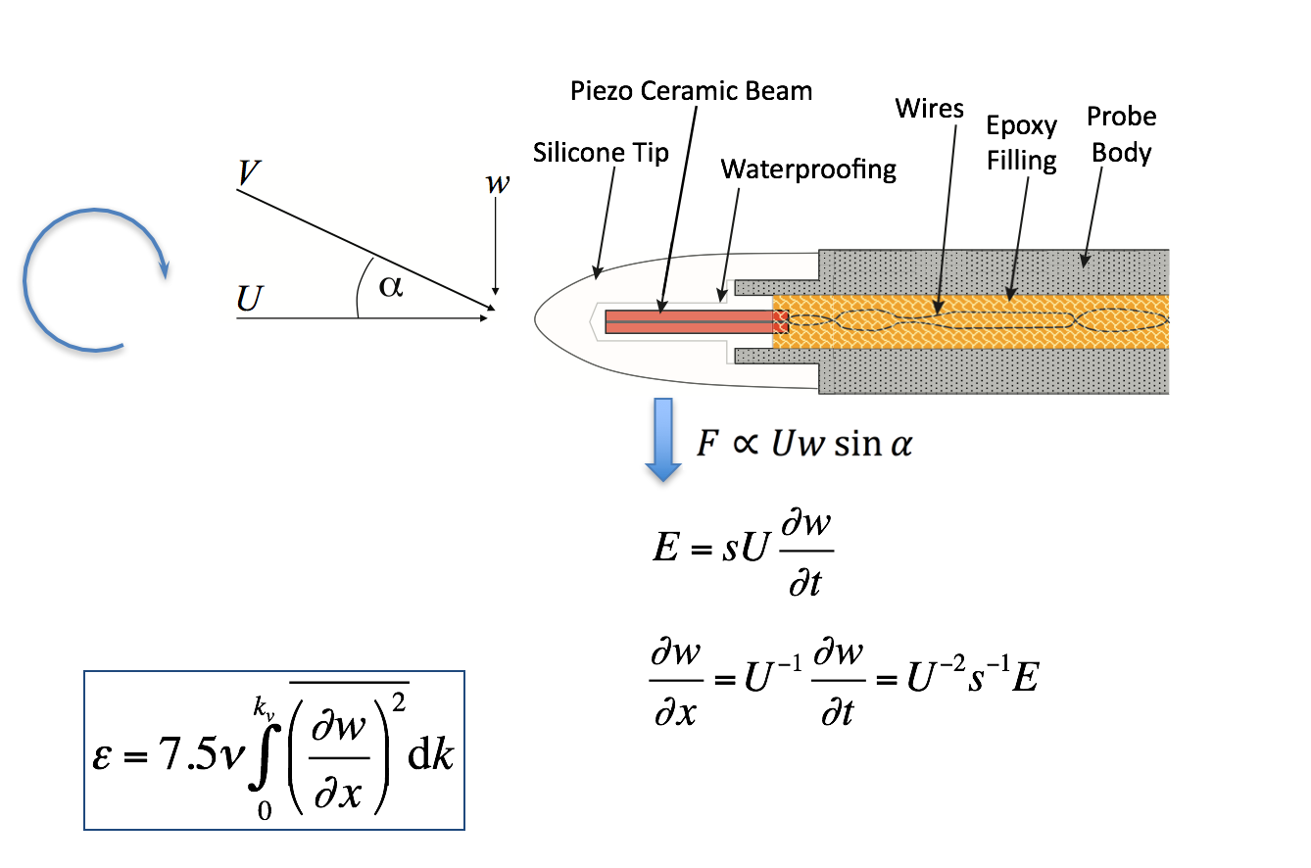
The Velocity Shear Probe
+ Extremely sensitive, high signal-to-noise ratio
+ Low power
Must move through the water
Resolves only cross-stream velocity fluctuations
Notes:
How can we measure ocean turbulence?

Slide 9
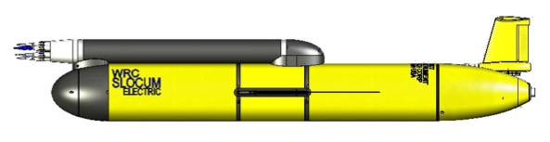



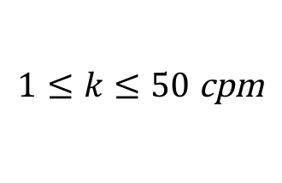
Scale Resolution
L ~ 0.01 m
$$k_{max}={\left(2L\right)}^{−1}$$
L ~ 2 m
$$k_{min}={\left(0.5L\right)}^{−1}$$
Wavenumber resolution:
$$1≤k≤50 \text{cpm}$$

Slide 10
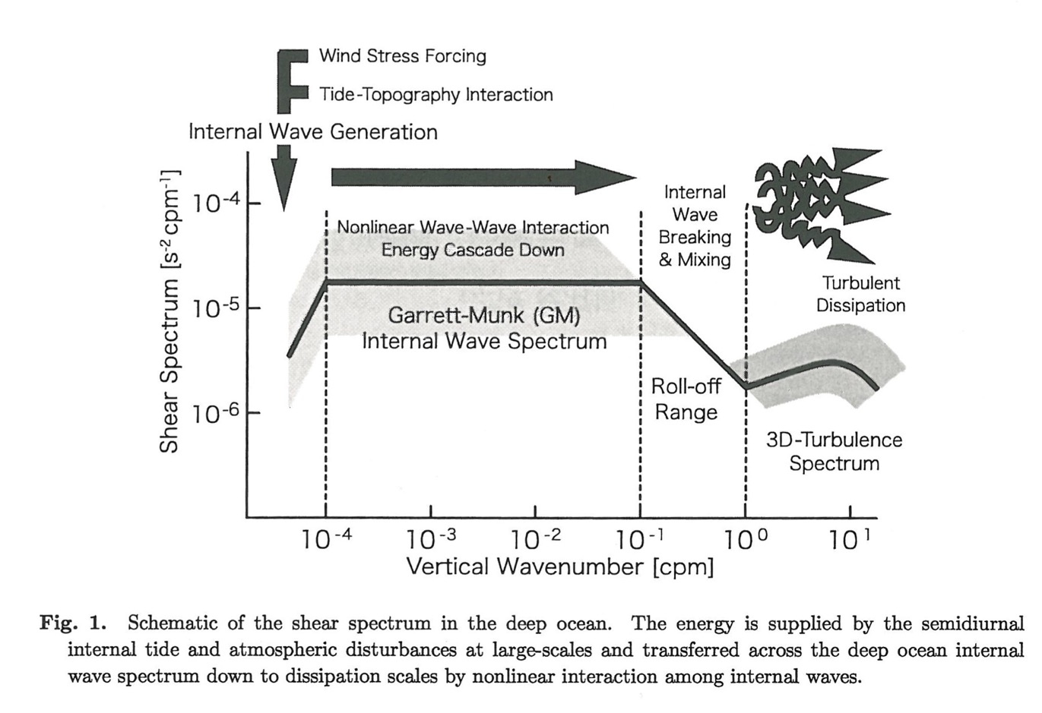
Figure by T. Hibiya (2008)

Slide 11
Data Recording
Environmental Signal
e.g.: velocity, temperature, micro-conductivity
Sensor (transducer)
e.g., shear probe
Analog to Digital conversion
Binary data file recorded
Signal conditioning (pre-emphasis)
Analog signal out
DAT_013.p file
16 bit

Slide 12
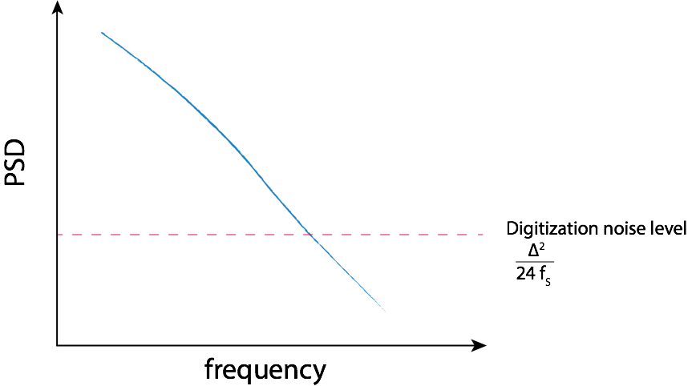
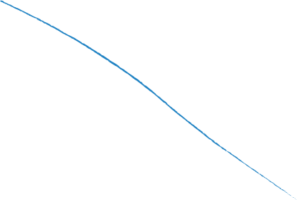
Signal Conditioning (Temperature)
Signal pre-emphasis
  Combine signal with it’s own time derivate, e.g. T+ G dT/dt
  Must be done before digitization
T + G dT/dt
T

Slide 13
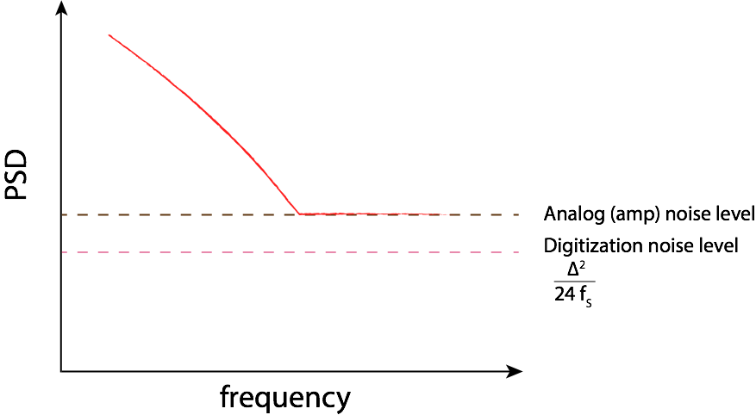
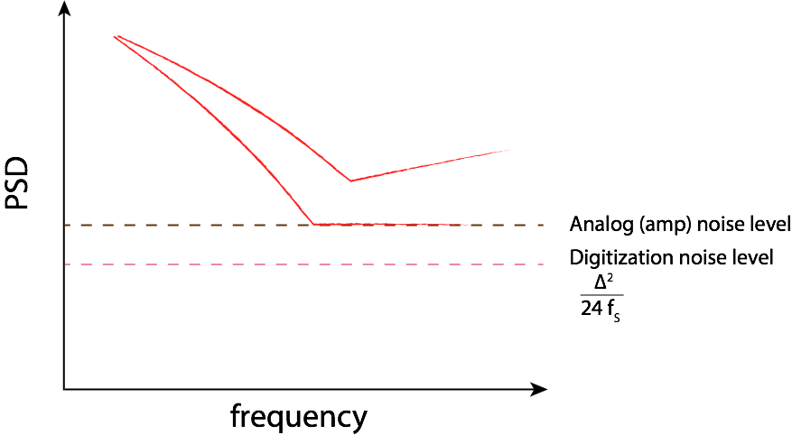
Signal Conditioning
Signal pre-emphasis, with high analog noise level

Slide 14
Data Processing
Binary Data File
DAT_013.p
De-emphasize and convert to physical units
i.e., temperature in deC
Signal Cleanup
High-pass filter
Calculate dissipation rate
Epsilon
Removal of vibration
Removal of spikes

Slide 15
Signal Cleanup: De-spiking
Spikes occur in the data from impact with plankton or debris
Spikes need to be removed to avoid bias of spectrum (spectral “whitening”)

Slide 16
Signal Cleanup: Vibration removal

Slide 17
Vibration signatures

Slide 18
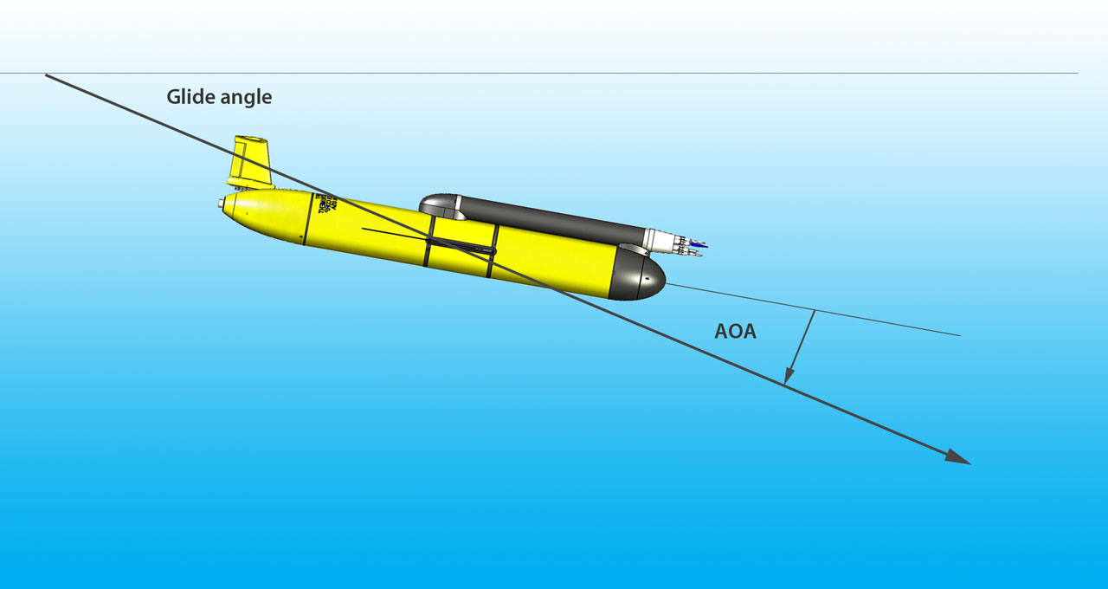





Data processing
$$γ=θ+α$$
pitch
$$θ$$
$$α$$
$$w=\frac{dp}{dt}$$
$$U=w\sin{γ}$$

Slide 19
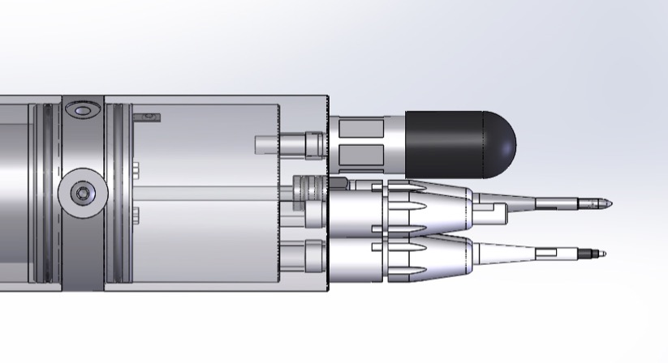
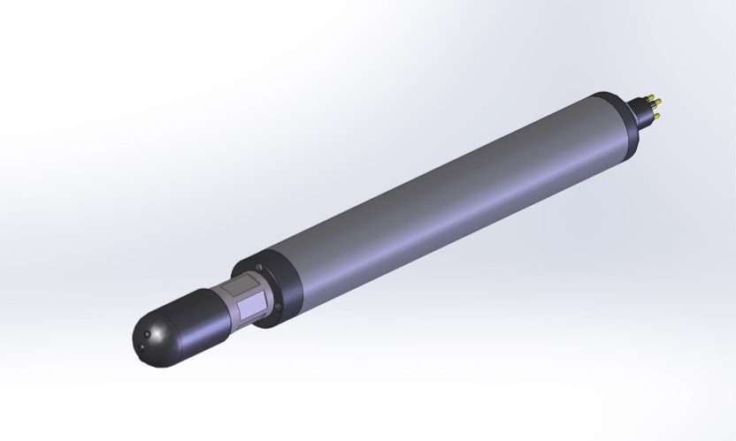
EM Flow sensor for MicroRiders
Nemo Turbulence Float
TWR Slocum Glider

Slide 20

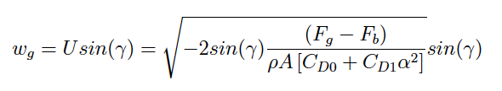


OMG: Flight model
(Merckelbach et al, 2010)
Accounting for the angle of attack, α
θ
Total glide angle,
α
γ
θ
We employ the hydrodynamic flight model of Merckelbach et al, 2010;
α
U
w
Where V_{g} = 56.075 ×10⁻³m³
m_{g} = 57.56 kg
A = 0.1m²
and ΔV_{bp} & θ from sensors
C_{D0} and C_{D1} are drag coefficients (due to parasitic and induced drag) dependent on α
Balancing buoyancy and gravitational forces
Γ = mixing efficiency

Slide 21

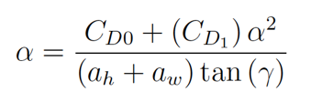
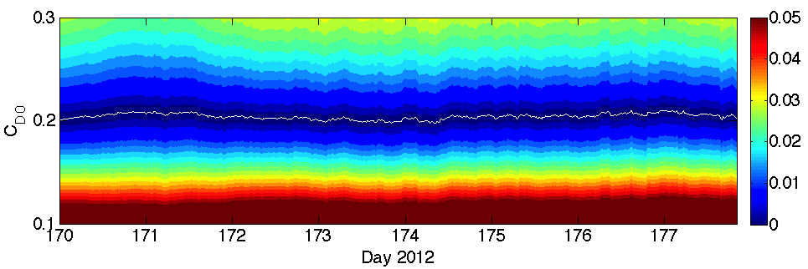
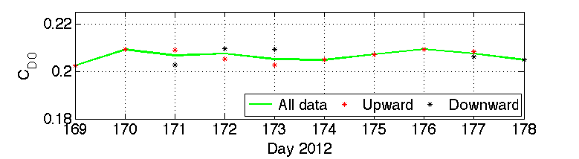
Using a flight model to constrain C_{D0} and α
Minimising difference between measured and modeled vertical velocity;
-
0
Estimate α iteratively using prescribed values for the lift-slope coefficients (a_{h} and a_{w}) and the induced drag C_{D1}
C_{D0,down} = 0.2070 (±2%)
C_{D0,up} = 0.2065 (±2%)
C_{D0} ~0.2066
Γ = mixing efficiency

Slide 22
Data Products

Slide 25
Case Study 1: Celtic Sea, Matthew Palmer
9 days (near) continuous microstructure time-series.
766 profiles of ε and CTD.
Resolving finescale temperature, density and turbulent structure.

Slide 26
Case Study: Faroe Straight (Ilker Fer)

Slide 27

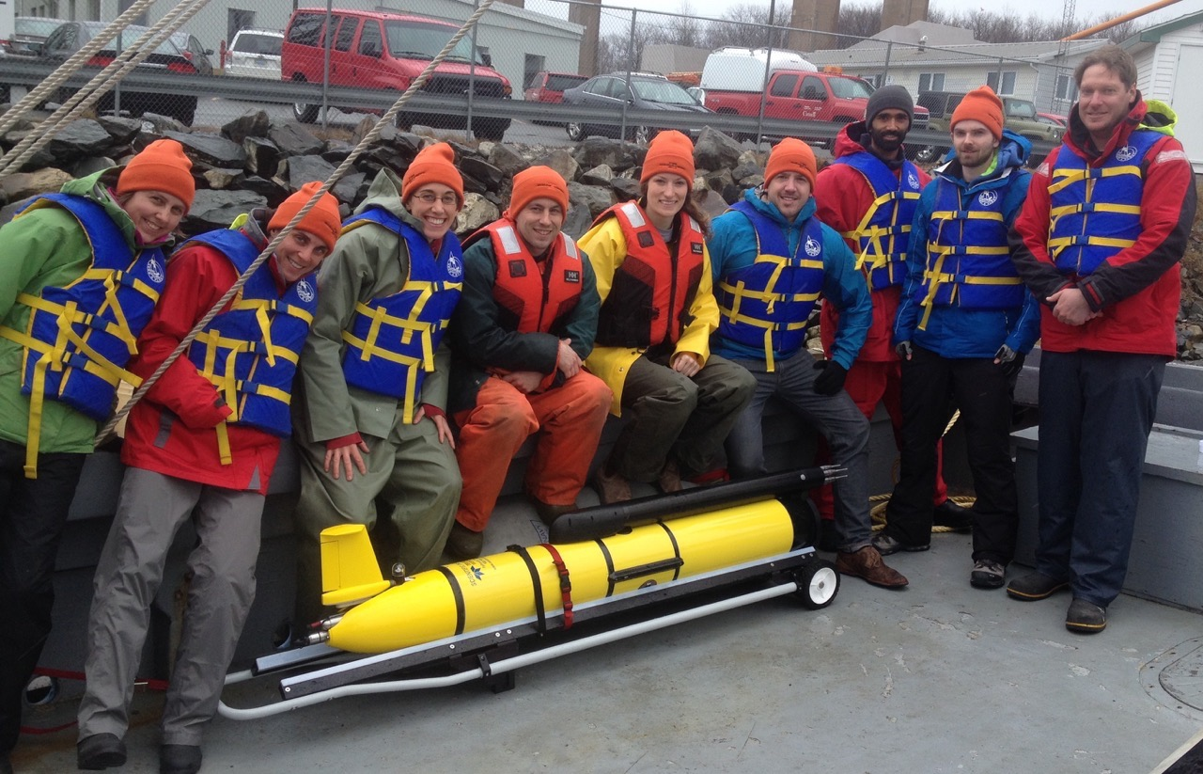
Ocean Microstructure Glider Workshop
Day 1 – technical overview and setup
Introduction to the MicroRider
Data Acquisition Software (ODAS5IR)
Pre-deployment Checks
Day 2 – field test
Glider field deployment
MicroRider Maintenance (optional)
Day 3 – data acquisition and processing
Data Conversion and Processing
Signal Conditioning
Day 4 – special topics

Slide 28
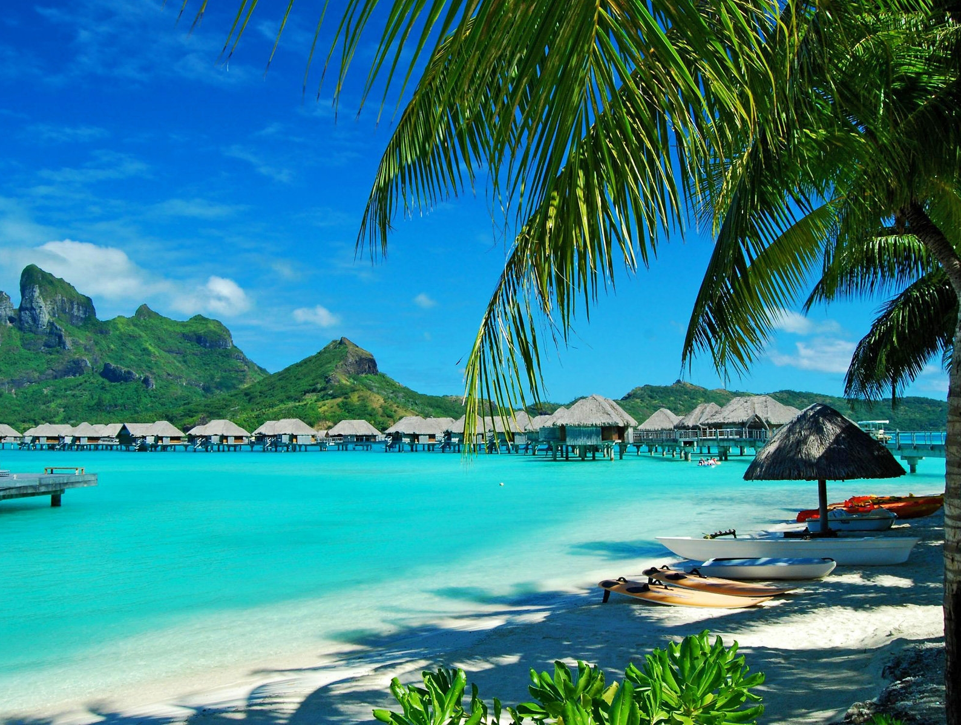

March 5-8, 2017
Honolulu, Hawaii
following the ASLO Aquatic Sciences Meeting (Feb 27-Mar 3, 2017)

Slide 29
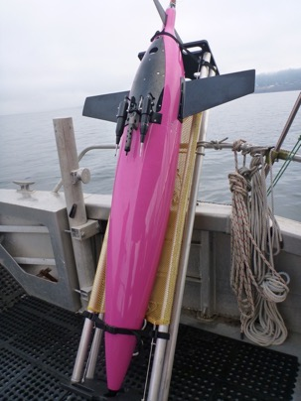
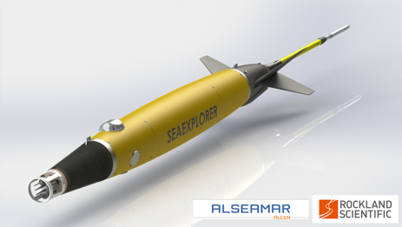
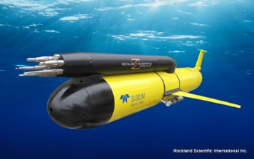
Summary
Gliders are an excellent platform for ocean turbulence measurements., because their are driven by buoyancy.
Dissipation rates resolved ε ~10⁻⁸ to ε ~ 5 x 10⁻¹¹ W/kg, meets open-ocean requirements.
Glider measurements reveal new physical processes that cannot be observed from ship borne measurements.
Next: on-board data processing
Thank you.

