Slide 1
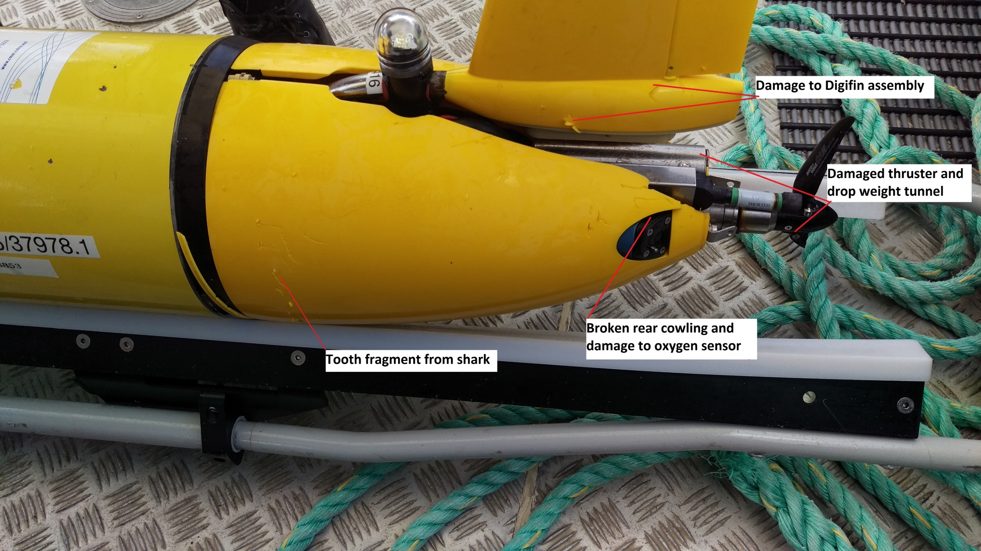
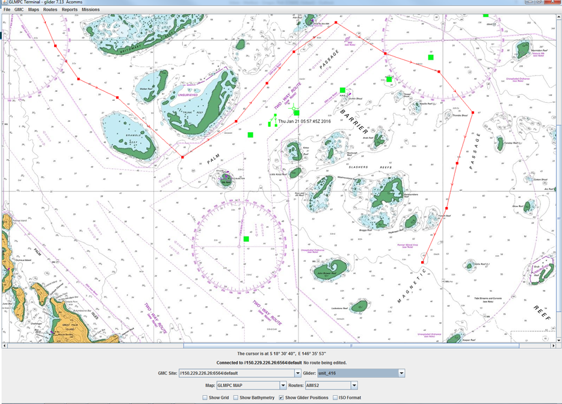
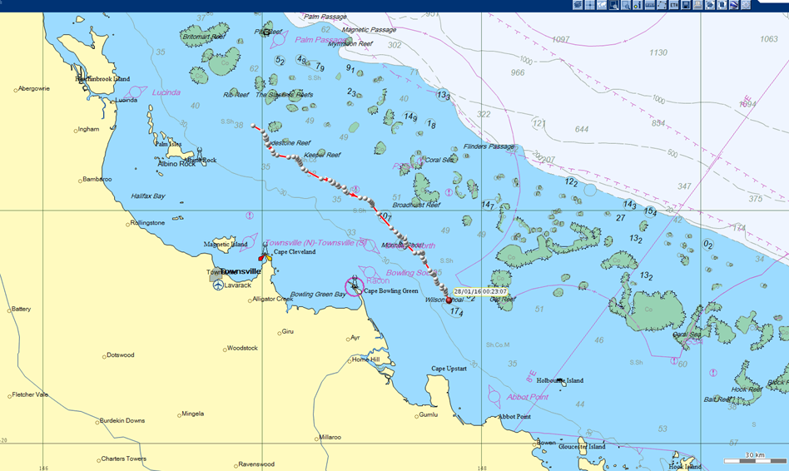
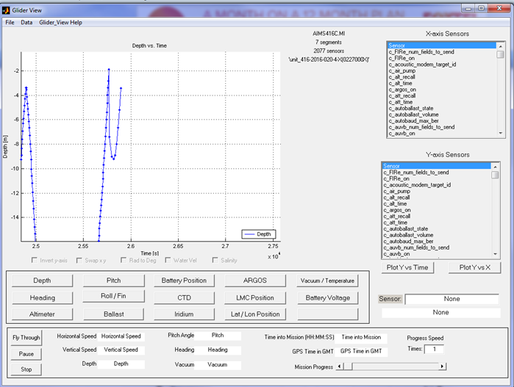
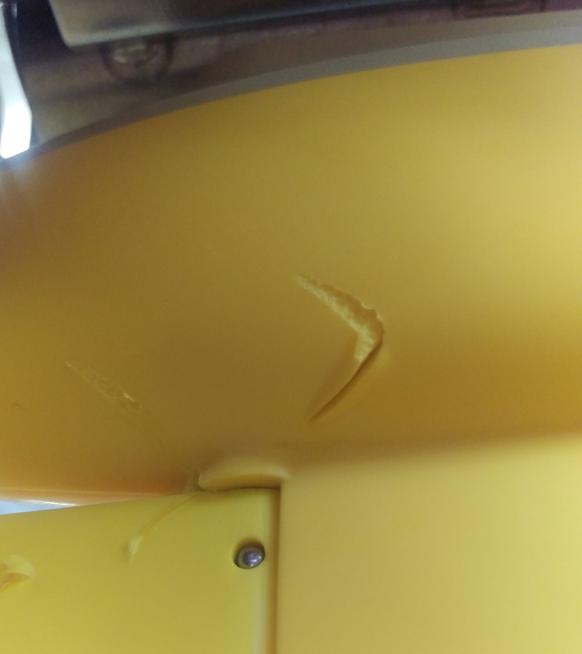
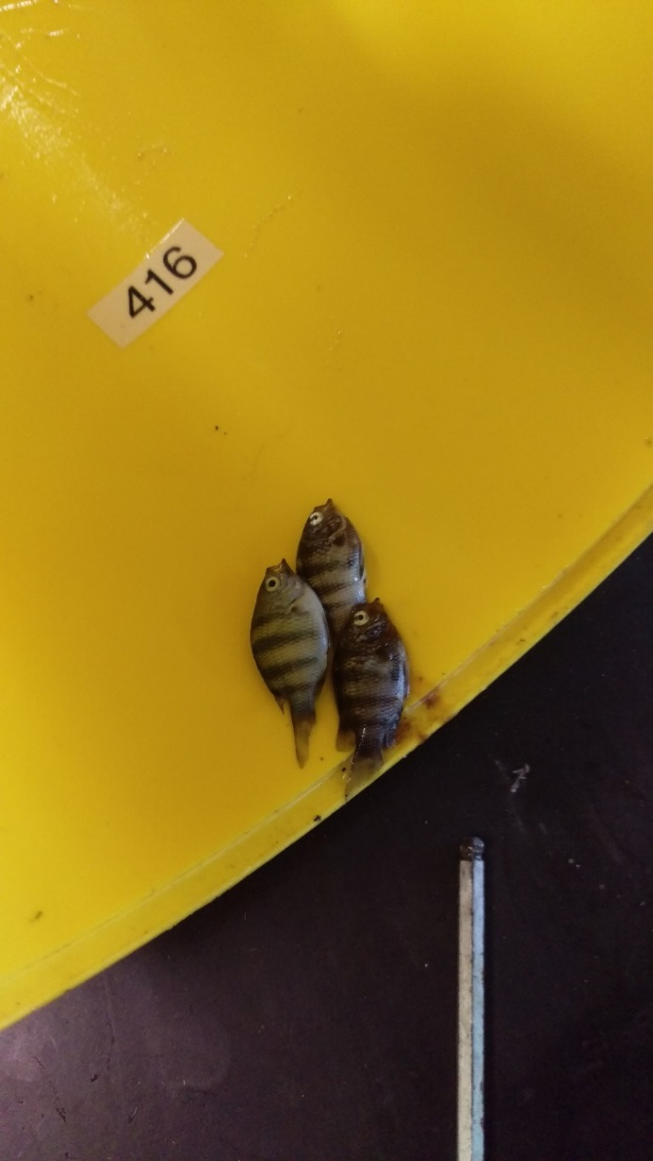
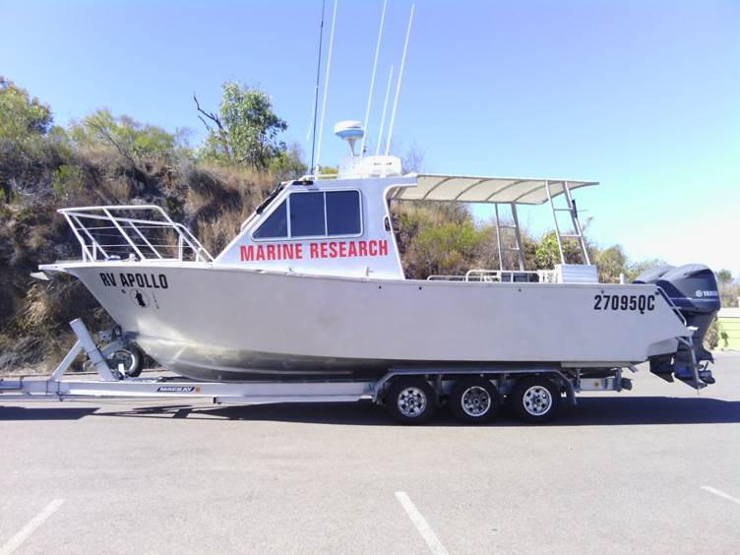
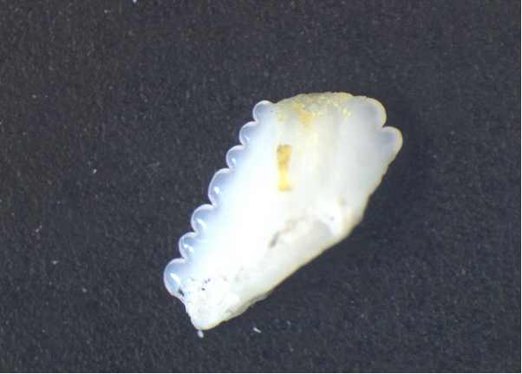
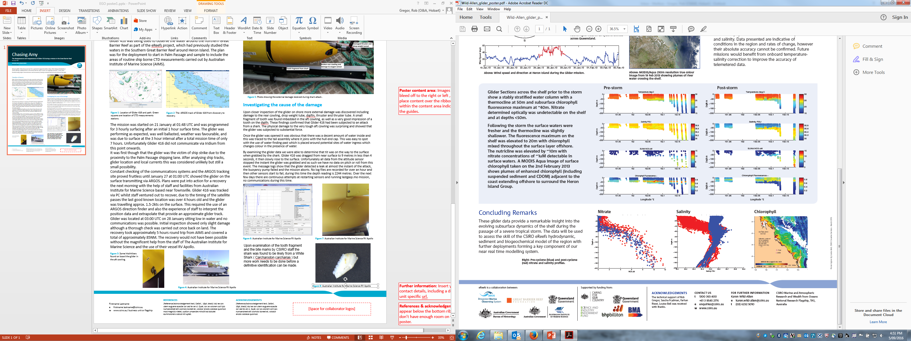
Chasing Amy
The mystery disappearance of Glider 416 (Amy) during a mission in the Great Barrier Reef
Rob Gregor CSIRO
Oceans and Atmosphere
Slocum glider 416 (Amy) was lost for a period of approximately 6 days after being attacked by a shark during a deployment in the Great Barrier Reef as part an ongoing research project. It was then located using Argos transmissions and recovered, having received internal and external damage.
Timeline of Events
Glider 416 was being used to observe the water around the northern Great Barrier Reef as part of the eReefs project, which had previously studied the waters in the Southern Great Barrier Reef around Heron Island. The plan was for the deployment to start in Palm Passage and sample to include the areas of routine ship borne CTD measurements carried out by Australian Institute of Marine Science (AIMS).
Figure 5: Photo showing the external damage received during shark attack..
Figure 1: Location of Glider 416 and path. Green squares are location of CTD measurements stations.
Figure 2: The ARGOS track of Glider 416 from discovery to recovery.
Investigating the cause of the damage
Upon closer inspection of the glider on shore more external damage was discovered including damage to the rear cowling, drop weight tube, digifin, thruster and thruster tube. A small fragment of tooth was found imbedded in the aft cowling, as well as a very good impression of a tooth on the digifin. These findings confirmed that Glider 416 had been subjected to an attack from a shark. The physical damage to the very tough aft cowling was surprising and showed that the glider was subjected to substantial force.
Once the glider was opened it was obvious that there was a significant water damage inside and this ingress was traced to the tail assembly where it joins with the hull end cap. Using water finding paste around potential sites of water ingress which changes colour in the presence of water enables us to pinpoint the site of ingress.
By examining the glider data we were able to determine that it was on the way to the surface when grabbed by the shark. Glider 416 was dragged from near surface to 9 metres in less than 4 seconds, it then slowly rose to the surface. Unfortunately all data from the attitude sensor stopped the instant the glider was grabbed and as such we have no data on pitch or roll from this event. The message logs show that the glider detected a leak at almost the instant of the attack, the buoyancy pump failed and the mission aborts. No log files are recorded for over an hour and then other sensors start to fail, during this time the depth reading is 2244 metres. Over the next few days there are continuous attempts at restarting sensors and running lastgasp.mi mission, there are no communications during this time.
The mission began on 21 January at 01:48 UTC and was programmed for 3 hourly surfacing after an initial 1 hour surface time. The glider was performing as expected, was well ballasted, weather was favourable, and was due to surface at the 3 hour interval after a total mission time of only 7 hours. Unfortunately Glider 416 did not communicate via Iridium from this point onwards.
It was first though that the glider was the victim of ship strike due to the proximity to the Palm Passage shipping lane. After analysing ship tracks, glider location and local currents this was considered unlikely but still a small possibility.
Constant checking of the communications systems and the ARGOS tracking site proved fruitless until January 27 at 01:00 UTC showed the glider on the surface transmitting via ARGOS. Plans were put into action for a recovery the next morning with the help of staff and facilities from Australian Institute for Marine Science based near Townsville. Glider 416 was tracked via PC whilst staff ventured out to recover, due to the timing of the satellite passes the last good known location was over 4 hours old and the glider was travelling approx. 1.5-2kts on the surface. This required the use of an ARGOS direction finder and also the experience of staff to interpret the position data and provide an approximate glider track.
Glider was located at 03:00 UTC on 28 January sitting low in water and no communications was possible. Initial inspection showed only slight damage although a thorough check was carried out once back on land. The recovery took approximately 5 hours round trip from AIMS and covered a total of approximately 85NM. The recovery would not have been possible without the magnificent help from the staff of The Australian Institute for Marine Science and the use of their vessel RV Apollo.
Figure 6: Graph showing glider depth profile at time of shark attack
Figure 7: Excellent impression of shark tooth on glider digifin
Upon examination of the tooth fragment and the bite marks by CSIRO staff the shark was found to be likely from a White Shark ( Carcharodon carcharias ) but more work needs to be done before a definitive identification can be made.
Figure 3: Some hitchhikers found on board the glider in the aft cowling.
Figure 4: Australian Institute for Marine Science RV Apollo
Figure 8: Section of tooth approx. 3.5mm in length
Robert Gregor
e rob.gregor@csiro.au
w www.csiro.au/ Oceans & Atmosphere
t +61 3 6232 5425
ACKNOWLEDGEMENTS
Lindsay MacDonald and Sascha Frydman from CSIRO, with piloting, tracking and all glider work.
Joe Gioffre, Chris Bartlett, Shaun Byrnes and staff from AIMS for help with boating and glider prep.
Barry Bruce from CSIRO for work on shark identification.

