Slide 1





GOOS Biogeochemistry
Framework for Ocean Observing
– Glider component
Maciej Telszewski – IOCCP Director
Institute of Oceanology of Polish Academy of Sciences, ul. Powstańców Warszawy 55, 81-712 Sopot, Poland
Phone: +48 58 731 16 10 / Fax: +48 58 551 21 30, www.ioccp.org
Biogeochemistry
Panel

Slide 2
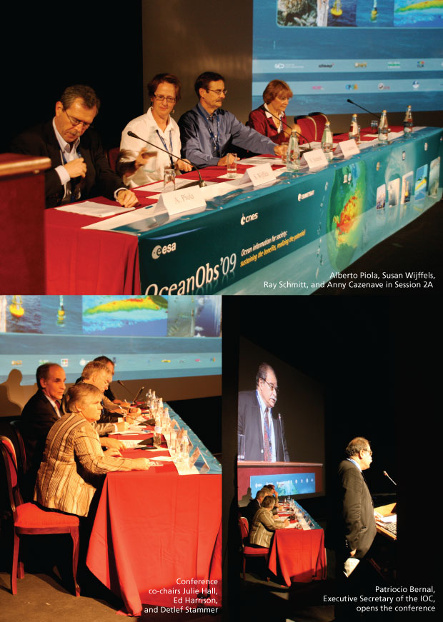
Framework for Ocean Observing Why a Framework?
OceanObs’09 identified tremendous opportunities and significant challenges for the global ocean observing system
Called for a framework for planning and moving forward with an enhanced global sustained ocean observing system over the next decade, integrating new physical, biogeochemical, biological observations while sustaining present observations
Notes:
What is this Framework for Ocean Observing?
Its genesis comes from the OceanObs’09 conference, which took place 21-25 September 2009 in Venice, Italy. It brought together more than 600 participants from 36 countries, focused on defining a collective vision for the coming decade of ocean observations for societal benefit. The papers from this conference, which form an excellent resource reviewing progress and identifying opportunities and community plans, are all available at its website www.oceanobs09.net
The conference identified tremendous opportunities to expand ocean observing capabilities, and noted significant challenges. There are many players in a potential integrated sustained ocean observing system.
The conference, amongst other things, called for the development of a Framework for planning and moving forward with an enhanced global sustained ocean observing system over the next decade, integrating new physical, biogeochemical, and biological observations while sustaining present observations.
It is this Framework that I’ll describe in the next portion of the talk.

Slide 3

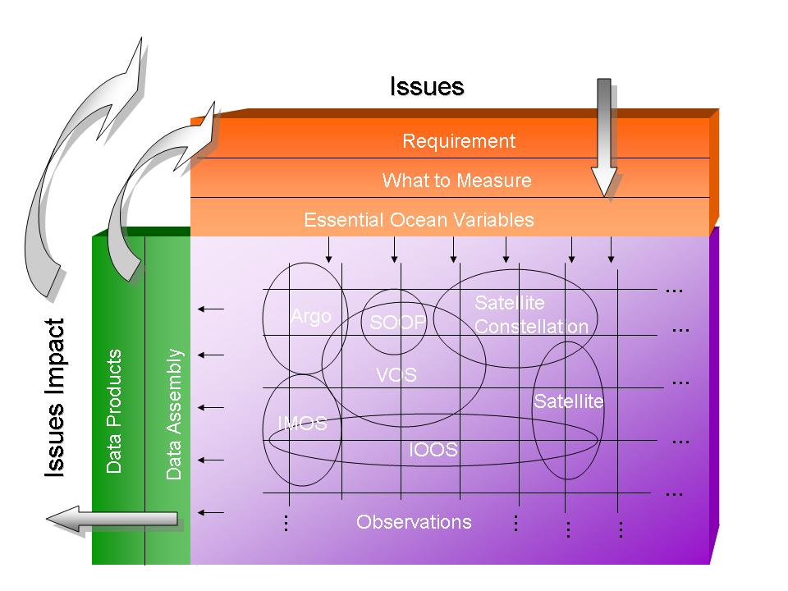
Framework for Ocean Observing Societal drivers prior to OceanObs’09
Climate and
Weather
Notes:
This is a cartoon then of the global ocean observing system that we have now.
The reality is that there are many more societal drivers than climate and weather for ocean observations. And we should try to engage them to build additional advocates for the observing system, and to help drive an integration across disciplines and especially the data products that will help build a system that is more than a sum of its individual parts.

Slide 4
Framework for Ocean Observing Societal and scientific drivers expanded
Climate and
Weather
Fisheries
Assessments and
management of
ecosystem services
Regional
priorities
Real-time
services
Requirements
Expanded EOVs
Expanded observing systems and networks
Data Products
Notes:
We should try to engage these different scientific questions and societal benefits that require sustained ocean observations, including biodiversity, regional seas and regional fisheries management organizations, global fisheries agreements, global marine assessments, and the development of ecosystem-based approaches to management of the ocean environment. We could follow the model that has successfully been implemented by climate – developing implementation plans from an expert group of scientists like the OOPC, which would be put forward to different international conventions and agreements, to get wider buy-in for sustained ocean observations from the international community and nations. That would expand the number of Essential Ocean Variables into the chemical, biological and ecosystems realm (gray box to right) and expand the number of data products. We will then have impact on more issues (for both science and for society).
A central concept of the Framework is that the nations of the world cannot afford multiple ocean observing systems each responding to different expressed requirements – that one integrated system that responds to many different requirements will be far more fruitful.
This is the 60,000 foot view of the Framework, a high-level picture that looks at driving the observing system with societal issues, developing requirements on what to measure, organizing and coordinating autonomous observing networks, and delivering data that has impacts on these societal issues – helping to drive understanding and good decisions.
In some cases the science is ahead of the conventions in its needs for sustained ocean data, but having these conventions there at the top level is an important reminder that we should be developing sustained observations to feed societal benefit. Some of these conventions are regional, and we expressly did not make a distinction between coastal and open ocean observations.

Slide 5

Potential role of gliders in GOOS
Expanded societal and scientific drivers require enhancing the observational effort in the transition zone between open ocean and coastal regions allowing us to monitor boundary currents, upwelling/downwelling regions, physical-, biogeochemical- and biological fronts, natural hazards, anthropogenic pollution and more.
7th EGO Conference on autonomous gliders and their applications
26-29 September 2016, NOC, Southampton, UK
Biogeochemistry
Panel

Slide 6

Societal drivers and scientific applications for the global ocean observing system
The role of ocean biogeochemistry in climate
Q1.1 How is the ocean carbon content changing?
Q1.2 How does the ocean influence cycles of non-CO₂ greenhouse gases?
Human impacts on ocean biogeochemistry
Q2.1. How large are the ocean’s “dead zones” and how fast are they changing?
Q2.2 What are rates and impacts of ocean acidification?
Ocean ecosystem health
Q3.1 Is the biomass of the ocean changing?
Q3.2 How does eutrophication and pollution impact ocean productivity and water quality?
7th EGO Conference on autonomous gliders and their applications
26-29 September 2016, NOC, Southampton, UK
Biogeochemistry
Panel
Notes:
…

Slide 7
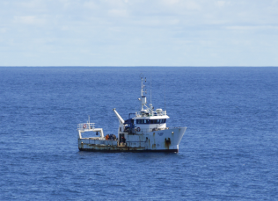
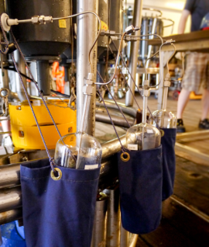
1: The role of ocean biogeochemistry in climate
Q 1.1: How is the ocean carbon content changing?
Carbonate system
DOC
Transient Tracers
O₂
Macronutrients (NO₃, PO₄, Si, NH₄, NO₂)
¹³DIC, ¹⁴DIC
Q 1.2: How does the ocean influence cycles of
non-CO₂ greenhouse gases?
N₂O
CH₄ (regional)
DMS
Halocarbons/O₃-depleting substances
O₂
7th EGO Conference on autonomous gliders and their applications
26-29 September 2016, NOC, Southampton, UK
Biogeochemistry
Panel

Slide 8
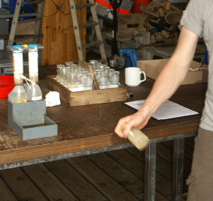
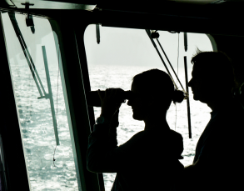
2: Human impacts on ocean biogeochemistry
Q 2.1.: How large are the ocean’s dead zones and how fast are they growing?
O₂
Macronutrients (NO₃, PO₄, Si, NH₄, NO₂)
Transient Tracers
Export rates and/or Ar/O₂
Carbonate system
Q 2.2: What are rates and impacts of ocean acidification?
Detection
Carbonate system (saturation state as derived variable)
O₂
Macronutrients (NO₃, PO₄, Si, NH₄, NO₂)
Atmospheric deposition of anthropogenic sulfates
Transient Tracers
¹³DIC
PON, POP, DON, DOP
Ra isotopes (coastal)
Impact
Carbonate System (saturation state as derived variable)
Dissolution Rates
PIC, POC
Phytoplankton Functional Groups
Benthic and Pelagic Species
²³¹Pa, ²³⁰Th
7th EGO Conference on autonomous gliders and their applications
26-29 September 2016, NOC, Southampton, UK
Biogeochemistry
Panel

Slide 9
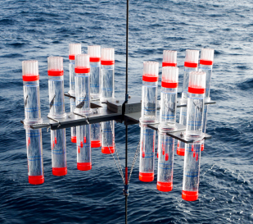
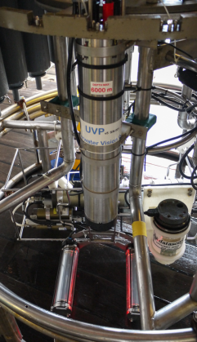
3: Ocean ecosystem health
Q 3.1: Is the biomass of the ocean changing?
Q 3.1a: Is production changing
Macronutrients (NO₃, PO₄, Si, NH₄, NO₂)
Micronutrients (eg. Fe)
O₂
Carbonate System
O₂/Ar
O₂ isotopes
Opal, POC, CaCO₃
Q 3.1b: Is biomass changing
POM (POC, PON, POP)
Chlorophyll
Macronutrients (NO₃, PO₄, Si, NH₄, NO₂)
Particle size spectra
7th EGO Conference on autonomous gliders and their applications
26-29 September 2016, NOC, Southampton, UK

Slide 10
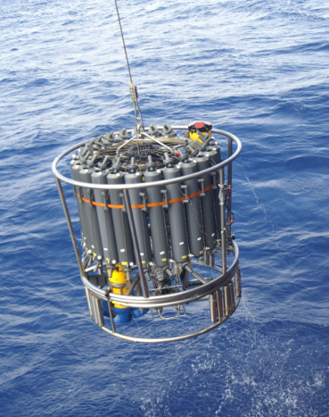
3: Ocean ecosystem health
Q 3.2: How does eutrophication and pollution impact ocean productivity and water quality?
Q3.2a: Eutrophication
Macronutrients (NO₃, PO₄, Si, NH₄, NO₂)
O₂
POC, DOC
¹⁸O/¹⁶O
Ra isotopes (coastal)
Q3.2b: Pollution
Dioxin
POPs (particulate organic pollutants)
Plastics
Heavy Metals
7th EGO Conference on autonomous gliders and their applications
26-29 September 2016, NOC, Southampton, UK
Biogeochemistry
Panel

Slide 11
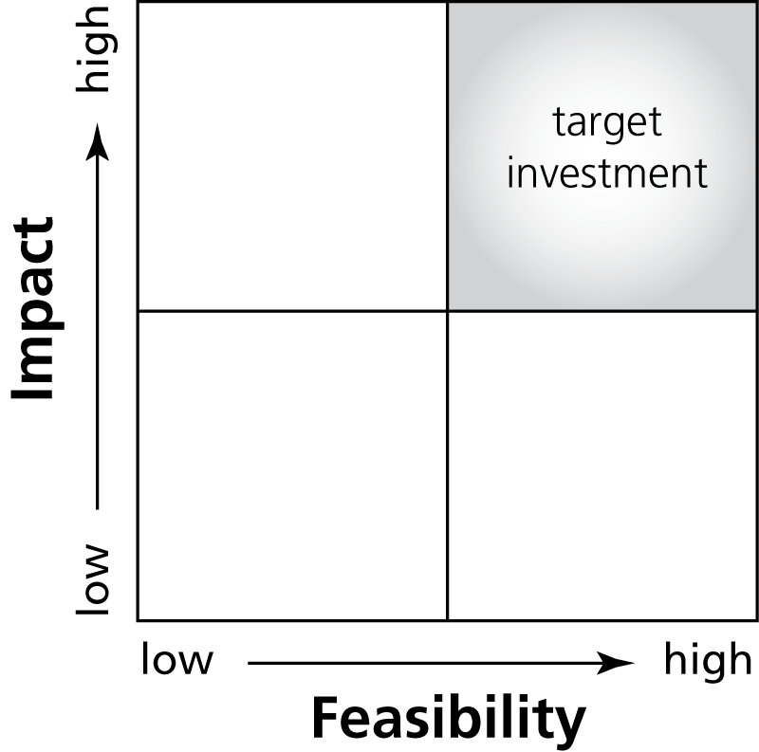
Essential Ocean Variables
for Biogeochemistry
Oxygen
Macro Nutrients
Carbonate System
Transient tracers
Suspended Particulates
Nitrous Oxide
¹³Carbon
Dissolved Organic Carbon
Light and Colour in the Ocean
We cannot measure everything, nor do we need to…
7th EGO Conference on autonomous gliders and their applications
26-29 September 2016, NOC, Southampton, UK
Biogeochemistry
Panel

Slide 12
Potential role of gliders in GOOS
The enhanced design of GOOS calls for multidisciplinary observing system and hence multi-parameter observing platforms. The ability of gliders to carry a variety of sensors and provide data at a very high spatial and temporal resolution makes them productive and versatile observing platforms.
7th EGO Conference on autonomous gliders and their applications
26-29 September 2016, NOC, Southampton, UK
Biogeochemistry
Panel

Slide 13
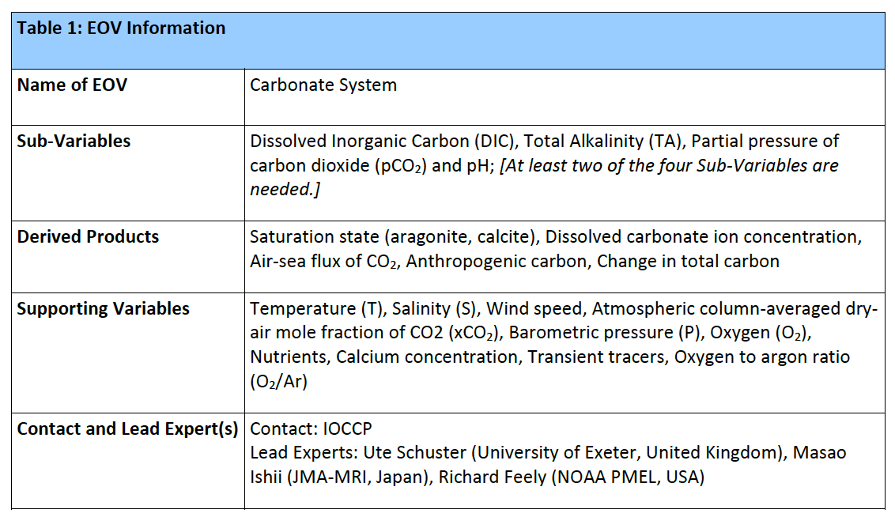
The Essential Ocean Variables Specification Sheets
7th EGO Conference on autonomous gliders and their applications
26-29 September 2016, NOC, Southampton, UK
Biogeochemistry
Panel

Slide 14
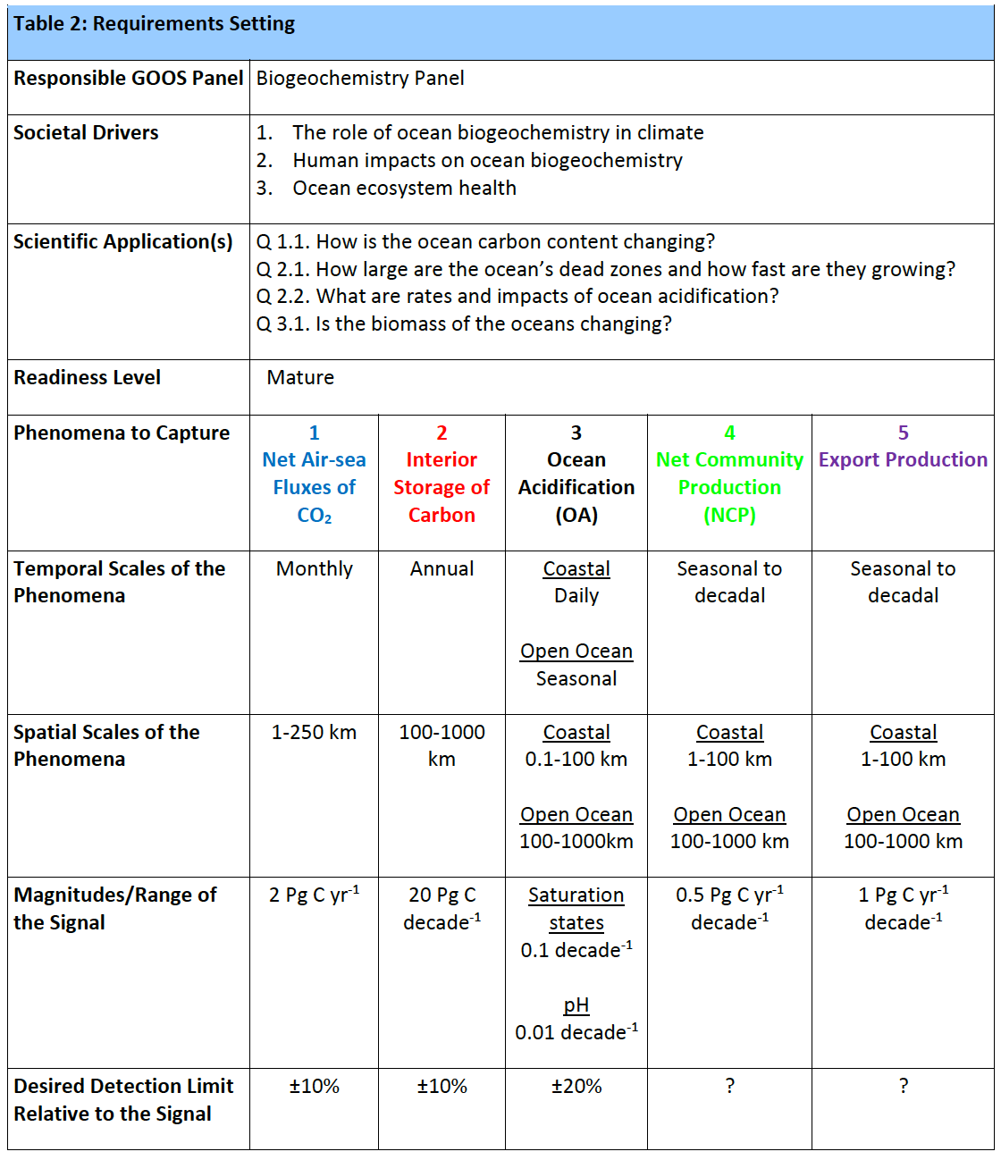
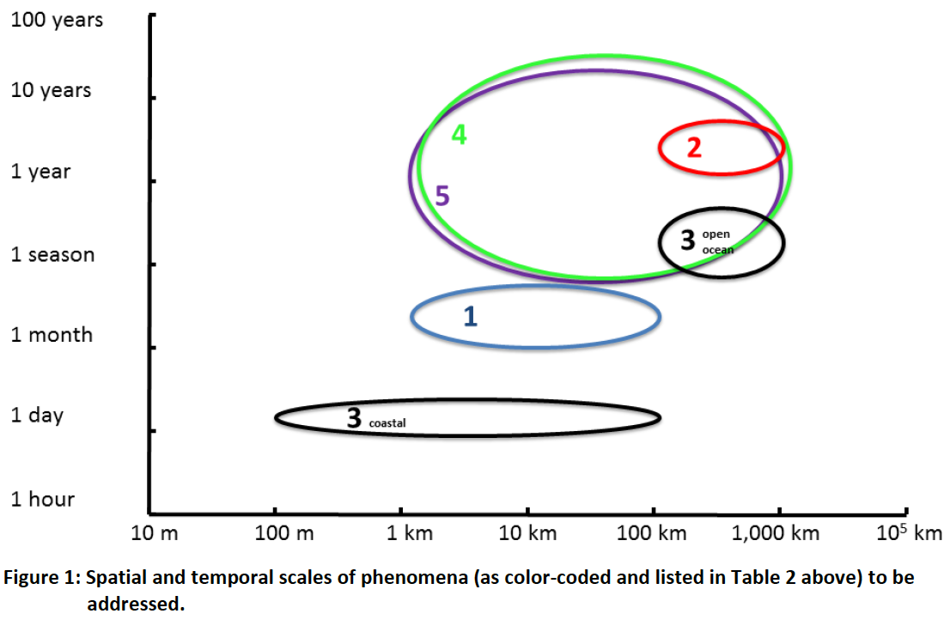
Specifications of the
observational requirements
(Carbonate System)
7th EGO Conference on autonomous gliders and their applications
26-29 September 2016, NOC, Southampton, UK
Biogeochemistry
Panel

Slide 15
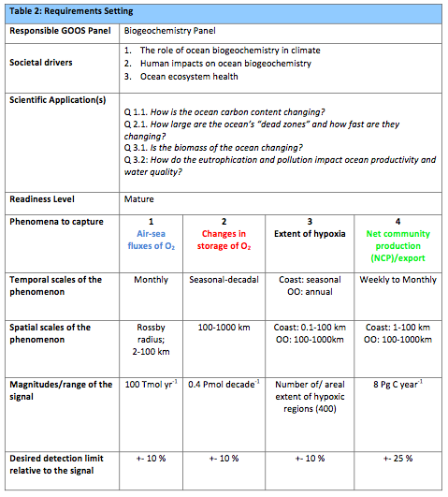
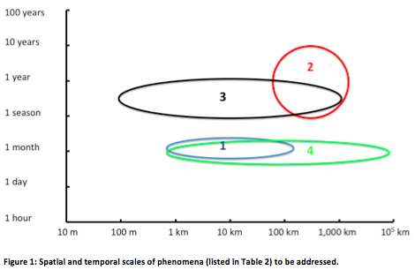
Specifications of the
observational requirements
(Oxygen)
7th EGO Conference on autonomous gliders and their applications
26-29 September 2016, NOC, Southampton, UK
Biogeochemistry
Panel

Slide 16
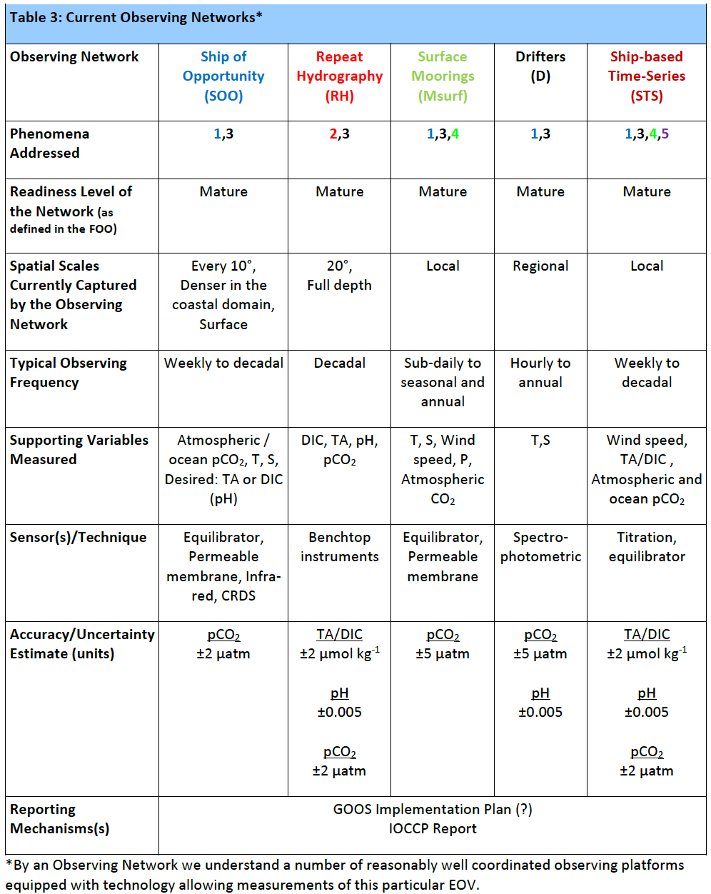
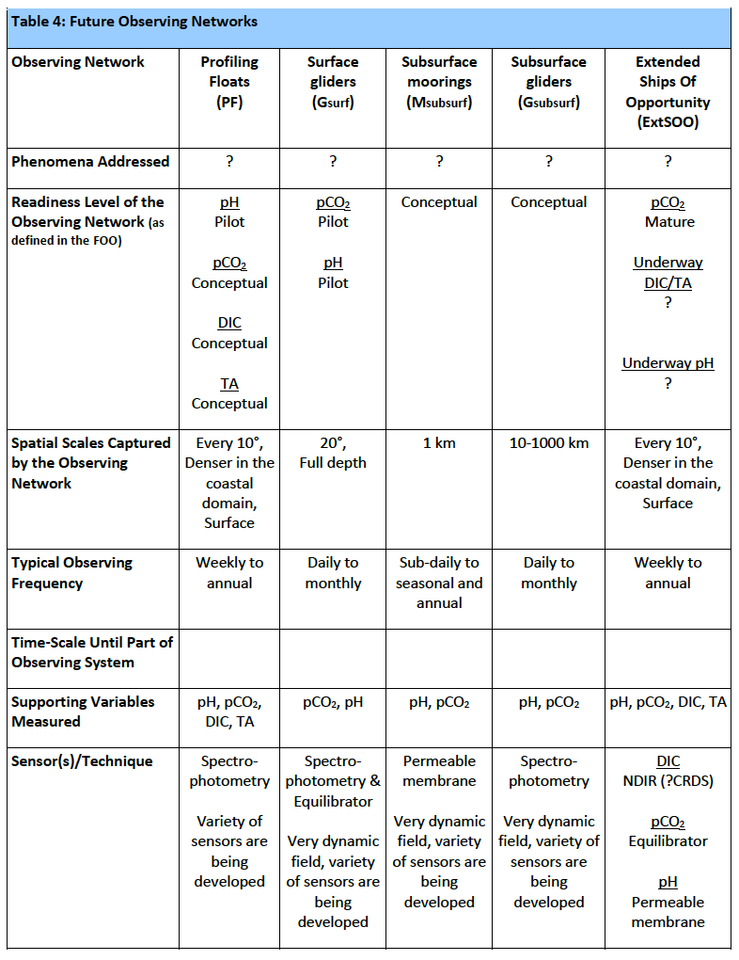
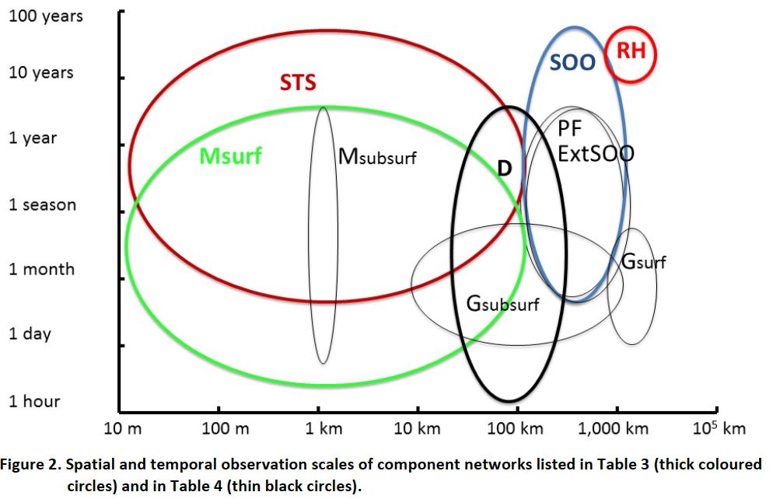
Combined performance
of current and future networks
(Carbonate system)
Notes:
We should try to engage these different scientific questions and societal benefits that require sustained ocean observations, including biodiversity, regional seas and regional fisheries management organizations, global fisheries agreements, global marine assessments, and the development of ecosystem-based approaches to management of the ocean environment. We could follow the model that has successfully been implemented by climate – developing implementation plans from an expert group of scientists like the OOPC, which would be put forward to different international conventions and agreements, to get wider buy-in for sustained ocean observations from the international community and nations. That would expand the number of Essential Ocean Variables into the chemical, biological and ecosystems realm (gray box to right) and expand the number of data products. We will then have impact on more issues (for both science and for society).
A central concept of the Framework is that the nations of the world cannot afford multiple ocean observing systems each responding to different expressed requirements – that one integrated system that responds to many different requirements will be far more fruitful.
This is the 60,000 foot view of the Framework, a high-level picture that looks at driving the observing system with societal issues, developing requirements on what to measure, organizing and coordinating autonomous observing networks, and delivering data that has impacts on these societal issues – helping to drive understanding and good decisions.
In some cases the science is ahead of the conventions in its needs for sustained ocean data, but having these conventions there at the top level is an important reminder that we should be developing sustained observations to feed societal benefit. Some of these conventions are regional, and we expressly did not make a distinction between coastal and open ocean observations.

Slide 17
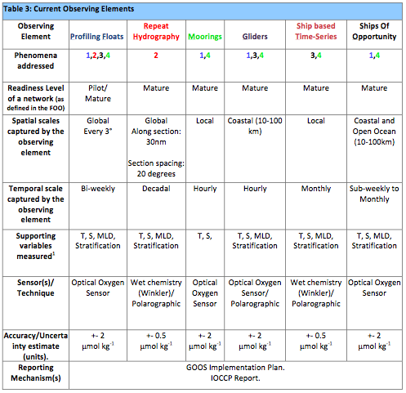
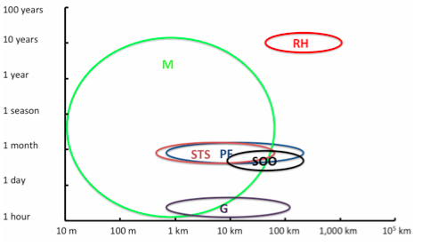
Combined performance
of current and future networks (Oxygen)
7th EGO Conference on autonomous gliders and their applications
26-29 September 2016, NOC, Southampton, UK
Biogeochemistry
Panel

Slide 18
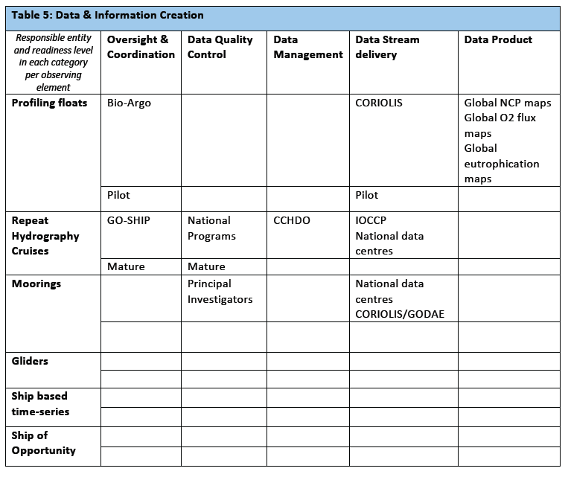
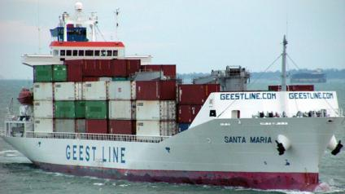
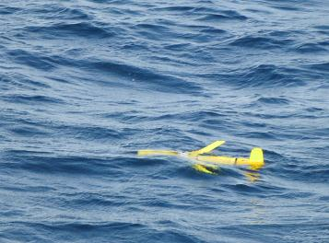
Data and Information Creation
(Example: Oxygen)
Links
7th EGO Conference on autonomous gliders and their applications
26-29 September 2016, NOC, Southampton, UK
Biogeochemistry
Panel

Slide 19
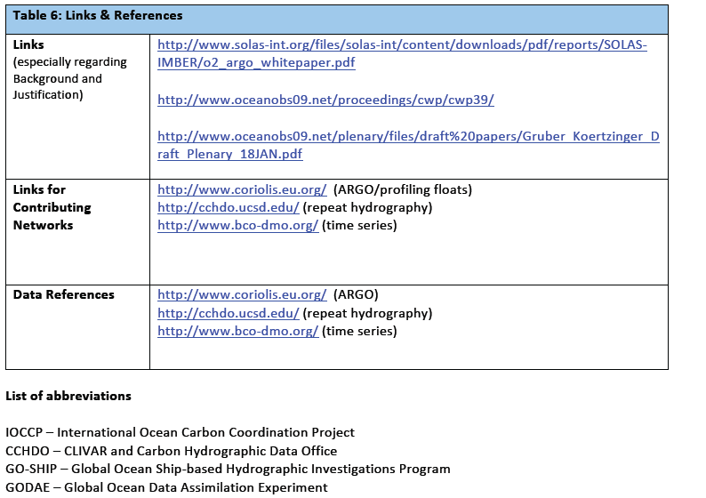
Links and References
Oxygen
7th EGO Conference on autonomous gliders and their applications
26-29 September 2016, NOC, Southampton, UK
Biogeochemistry
Panel

Slide 20
Potential role of gliders in GOOS
In order for gliders as tools and glider operators as a community to become a fully integrated element of the global ocean observing system there is a need to strengthen coordination efforts at the global level to develop a community-approved structure which will provide technical coordination with regards to: standardization of operating procedures, software and hardware interoperability standards, data quality standards, data management, training and outreach.
7th EGO Conference on autonomous gliders and their applications
26-29 September 2016, NOC, Southampton, UK
Biogeochemistry
Panel

Slide 21
7th EGO Conference on autonomous gliders and their applications
26-29 September 2016, NOC, Southampton, UK
Biogeochemistry
Panel

Slide 22
A communication and coordination service for marine biogeochemistry
Institute of Oceanology of Polish Academy of Sciences, ul. Powstańców Warszawy 55, 81-712 Sopot, Poland
Phone: +48 58 731 16 10 / Fax: +48 58 551 21 30, www.ioccp.org
Biogeochemistry
Panel

Slide 23


For questions and input please contact us at:
Maciej: m.telszewski@ioccp.org
Visit our website: www.ioccp.org
Institute of Oceanology of Polish Academy of Sciences, ul. Powstańców Warszawy 55, 81-712 Sopot, Poland
Phone: +48 58 731 16 10 / Fax: +48 58 551 21 30, www.ioccp.org
Biogeochemistry
Panel

