Slide 1



Tidewater Glacier Measurements from Gliders: Results from the
Fjord Ecosystem Experiment on the West Antarctica Peninsula
Hank Statscewich¹, Peter Winsor¹, Martin Treuffer¹, Douglas
Brinkerhoff¹, Craig Smith² and Maria Vernet³
¹University of Alaska Fairbanks,²University of Hawaii at Manoa, ³Scripps Institute of Oceanography
EGO 2016: Southampton, UK

Slide 2
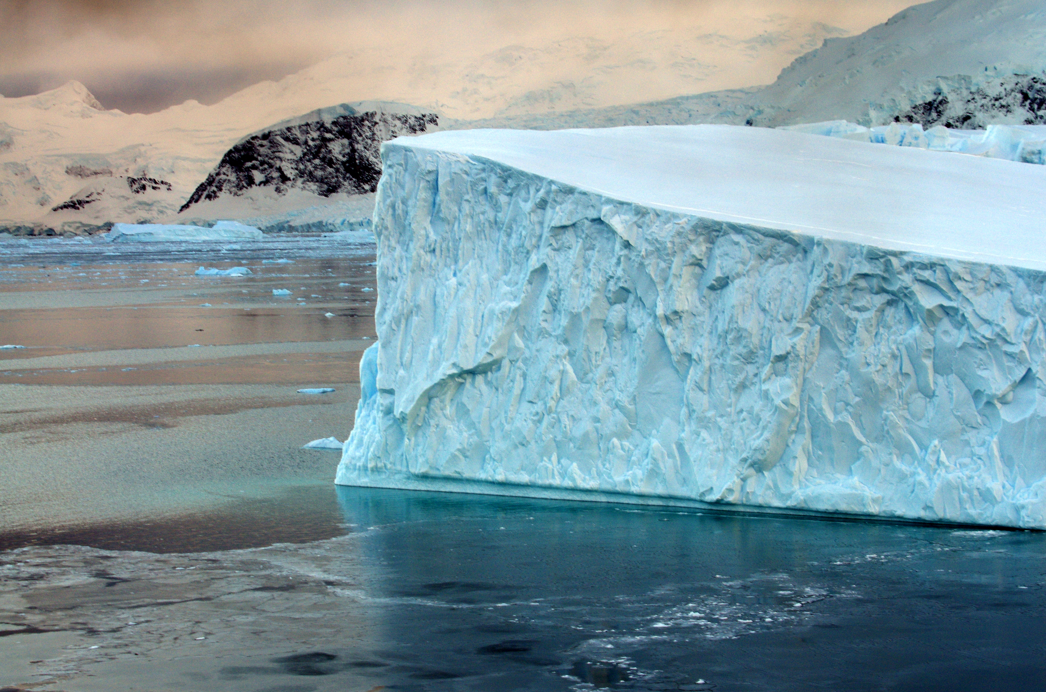
Outline
Introduction
Background
Objectives for use of a glider in a WAP Fjord
  Gather observations of tidal induced mixing over fjord sill
  Measurement of meltwater plume structure at the tidewater glacier front
Conclusion:
  Lessons learned
  Moving Forward

Slide 3
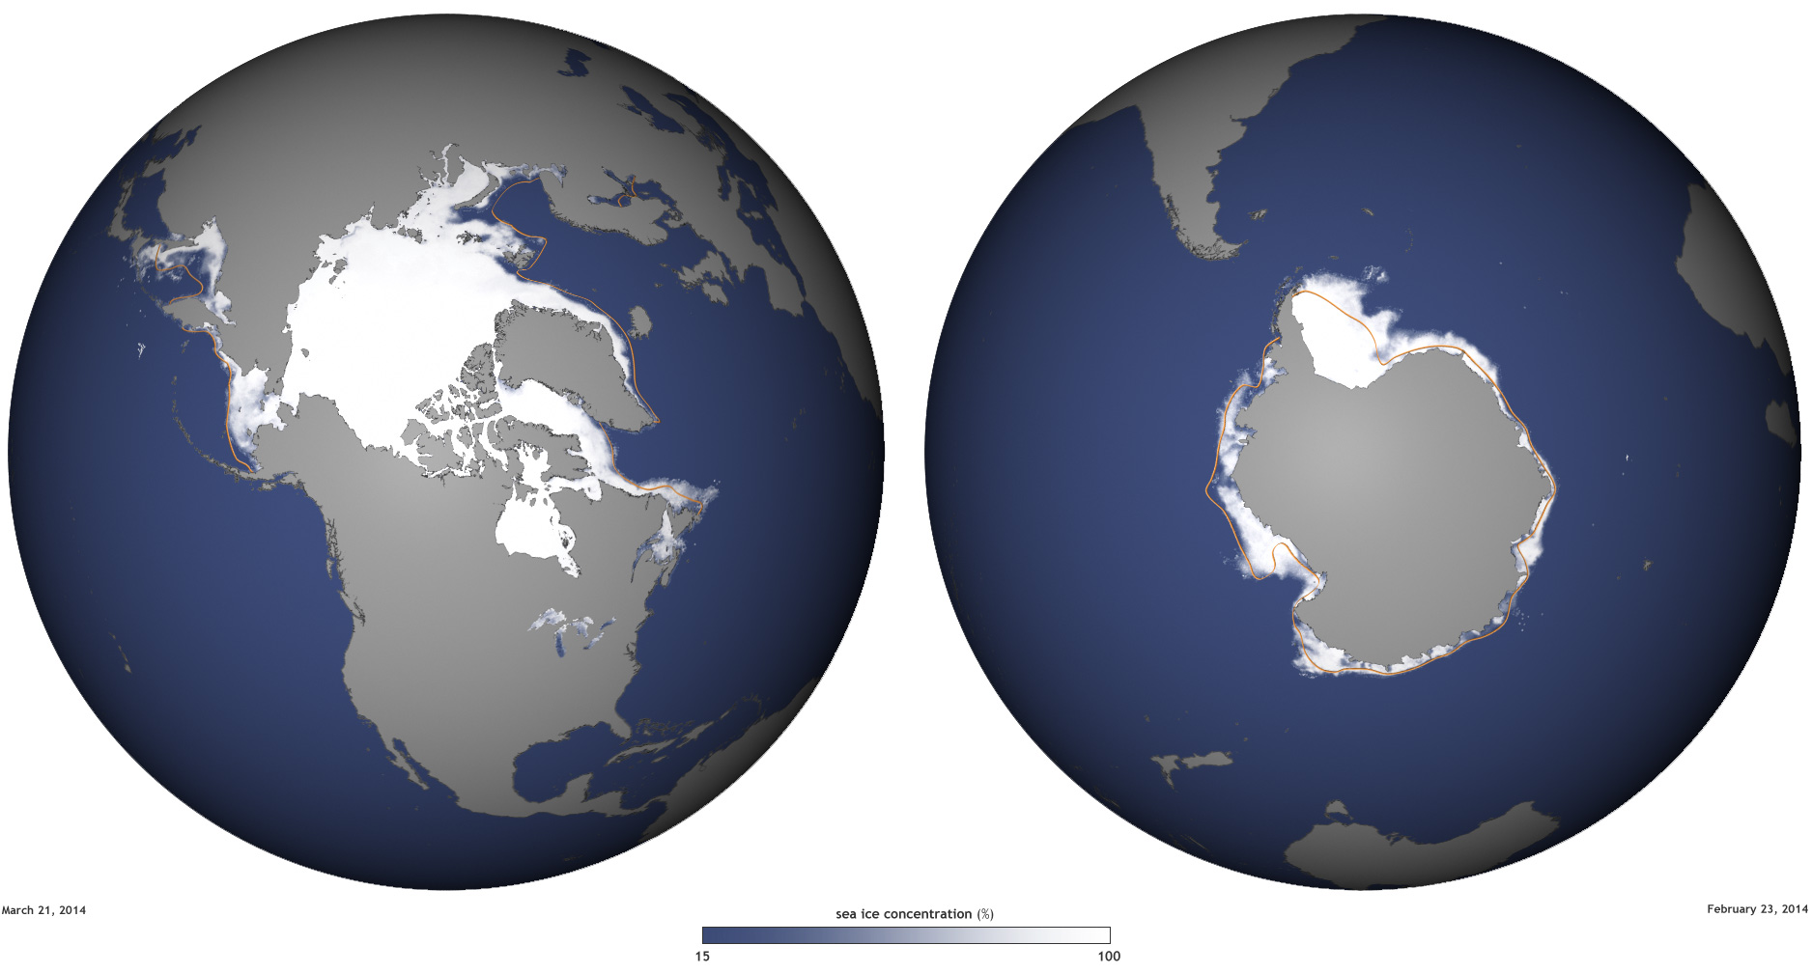
Introduction: A Polar View
Chukchi Sea
Western
Antarctic Peninsula
Notes:
Working in Polar areas with seasonal ice cover, lab has 6 TWR slocum gliders, 4 shallow and two deep.

Slide 4
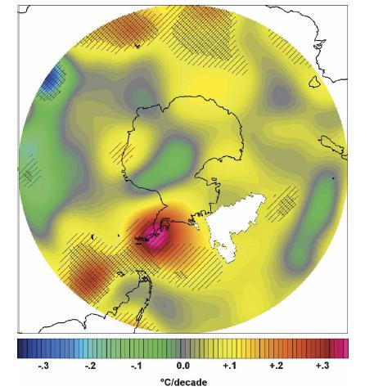
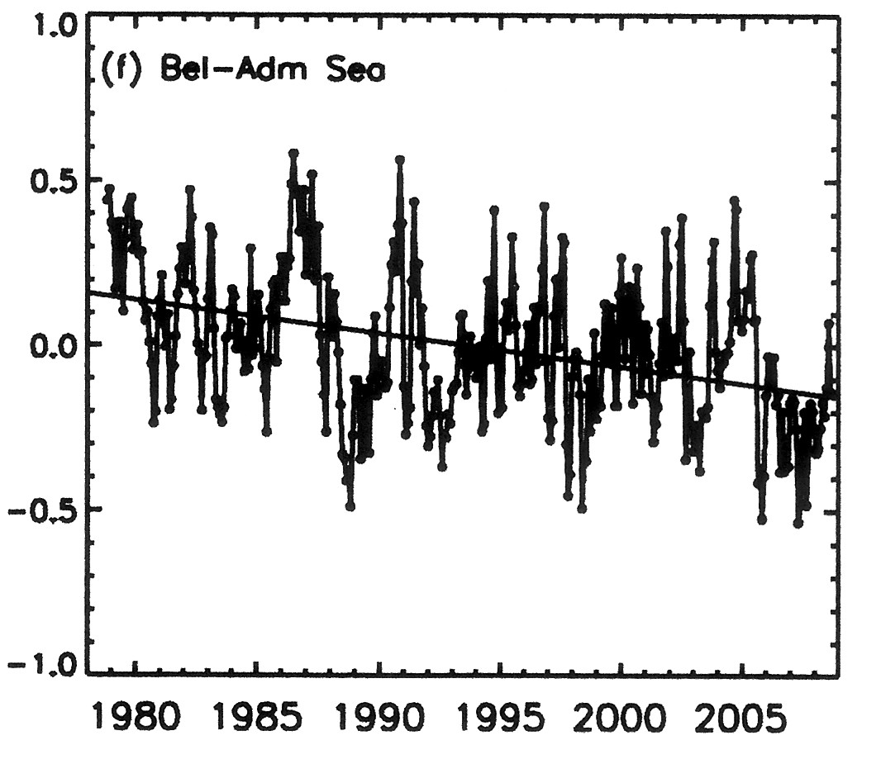
Climate is warming very rapidly along the West Antarctic Peninsula –
Rising Annual Mean Air Temperatures +1.6 º C from 1958–2002
(+5 º C for winter mean)
(Chapman and Walsh, 2007)
And is correlated with:
(i) Decline in extent/duration of sea-ice -
Monthly Ice Extent Anomalies
( X 10⁶ km)
Declining Sea-Ice Extent in the Bellingshausen-Amundsen Seas
- 7% per decade
(Comiso, 2010)

Slide 5
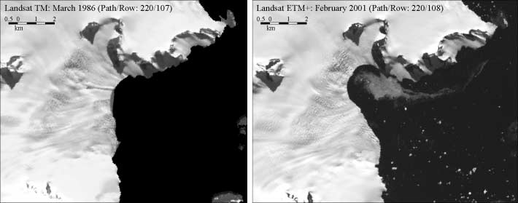
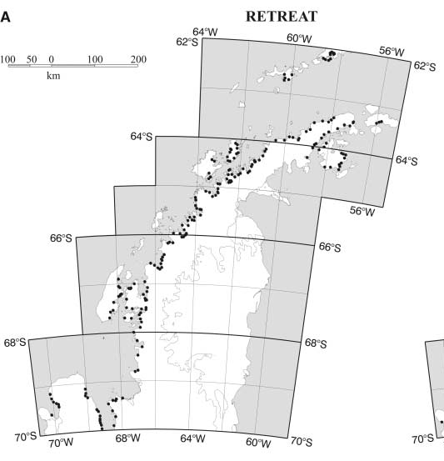
ii) Warming is also correlated with Glacial Retreat -
87% of 244 glaciers along the West Antarctic Peninsula have retreated in last 61 years.
1986
2001
Sheldon Glacier
Adelaide Island
(Cook et al., 2005)

Slide 6
Some interesting questions
How much ice are the glaciers delivering to the ocean and what happens to this ice?
How much freshwater are the glaciers delivering to the ocean?
How do ice and freshwater fluxes affect fjord circulation and marine ecosystems, and should we expect this to change with further warming?
How do changes in the ocean affect the rate of ice flow and the extent of glaciers?
Can we utilize gliders to help answer these questions?

Slide 7
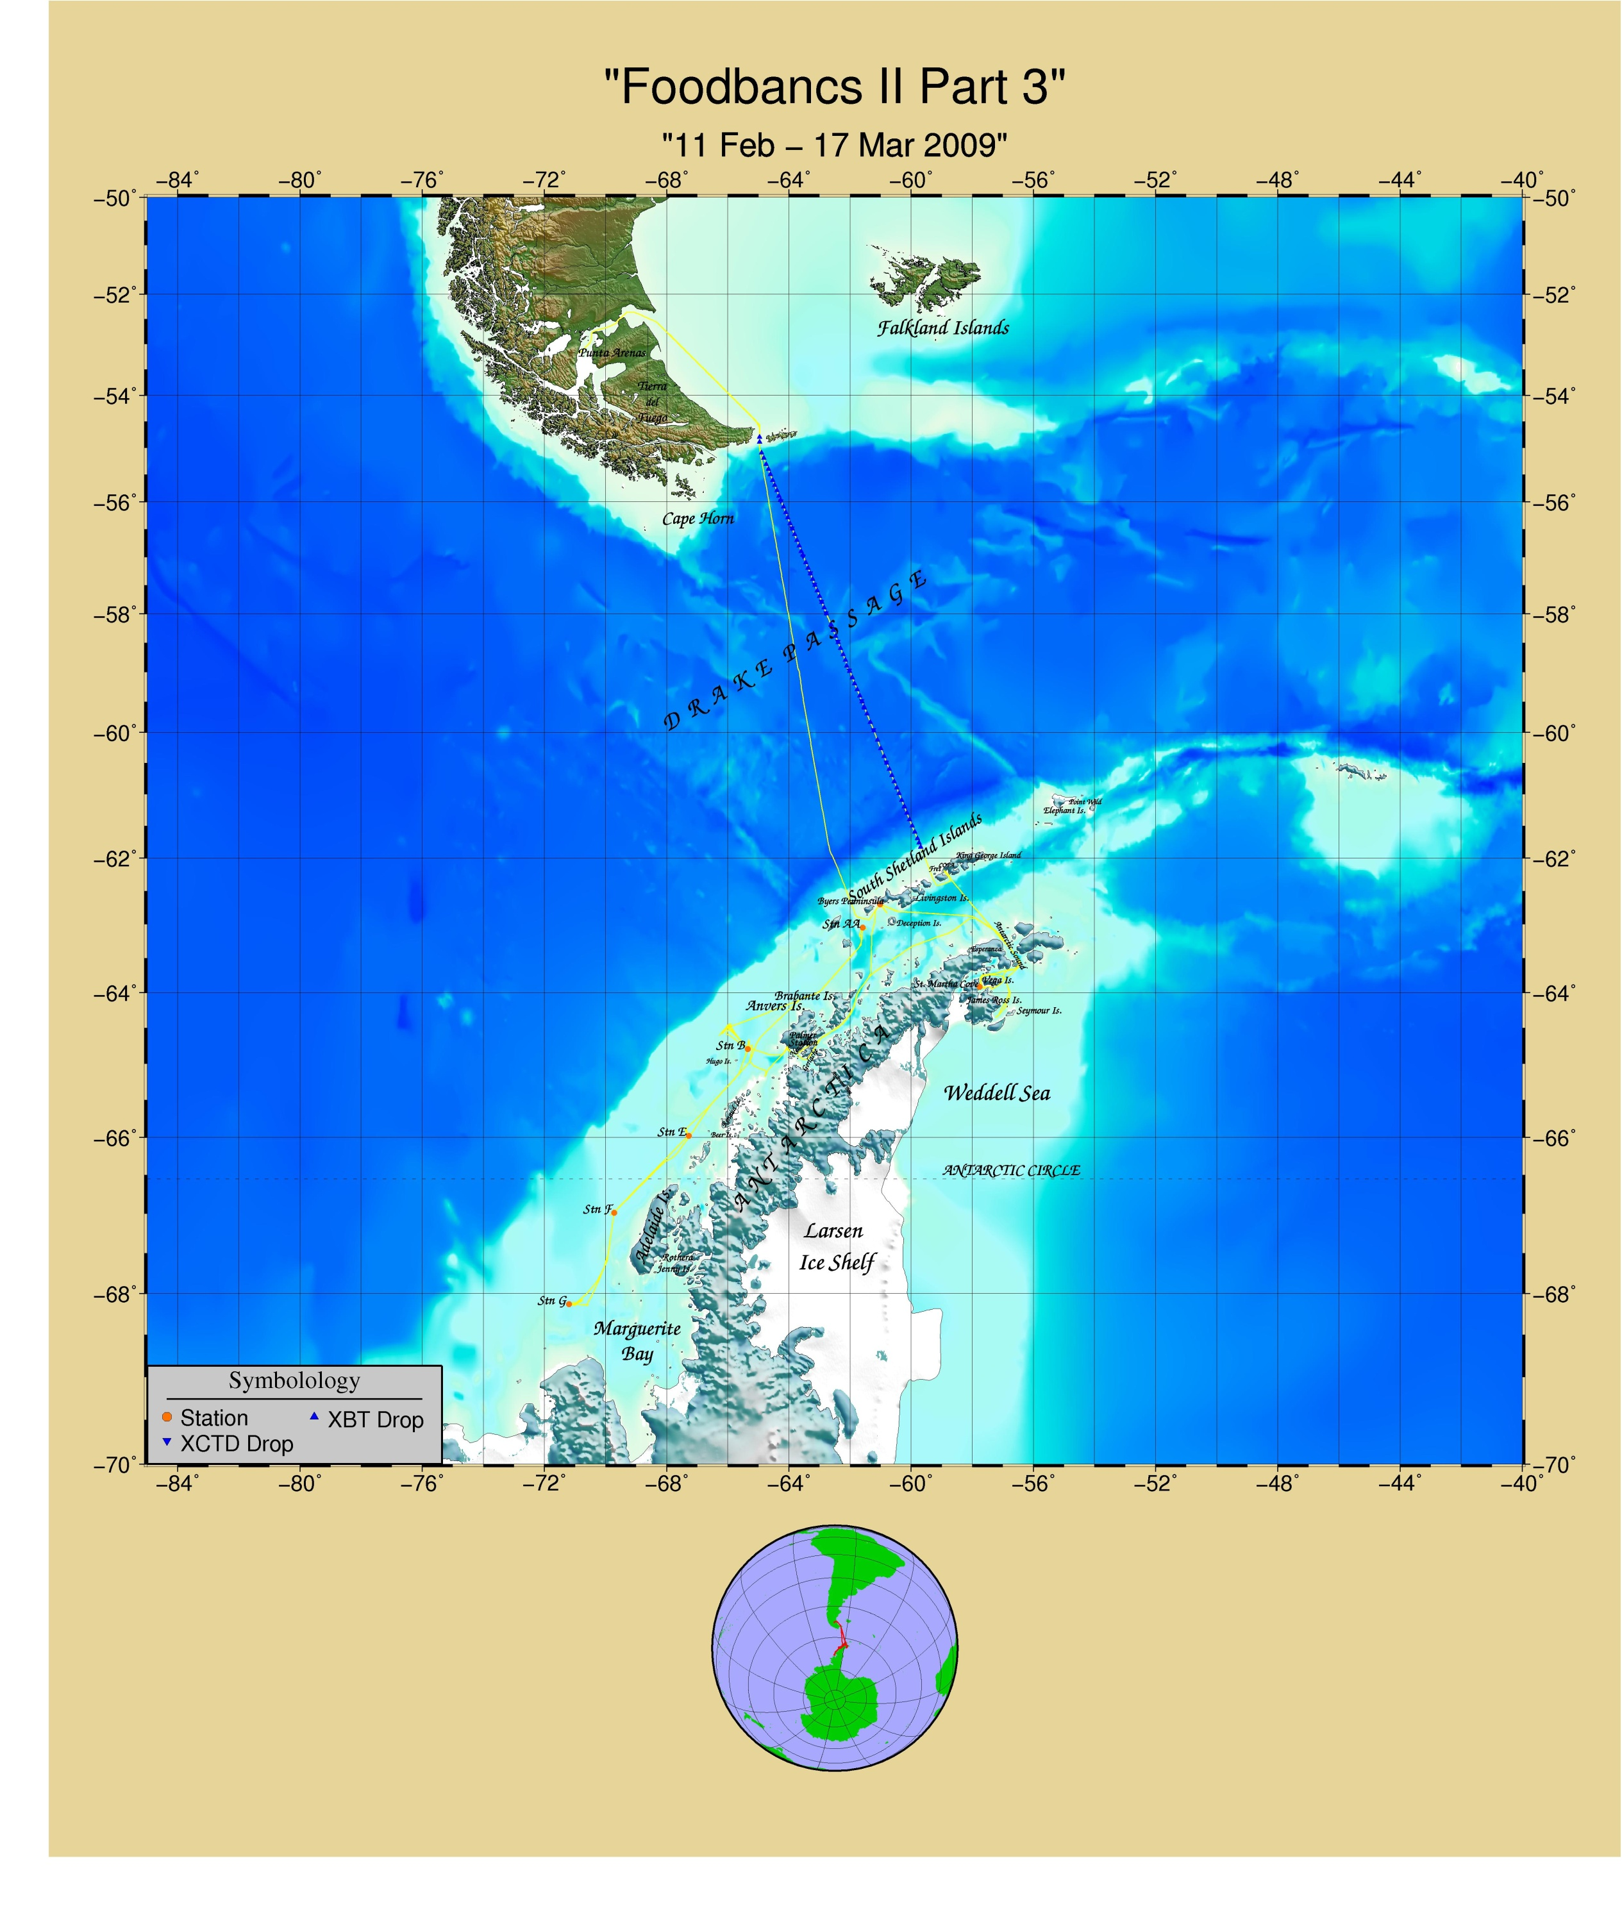
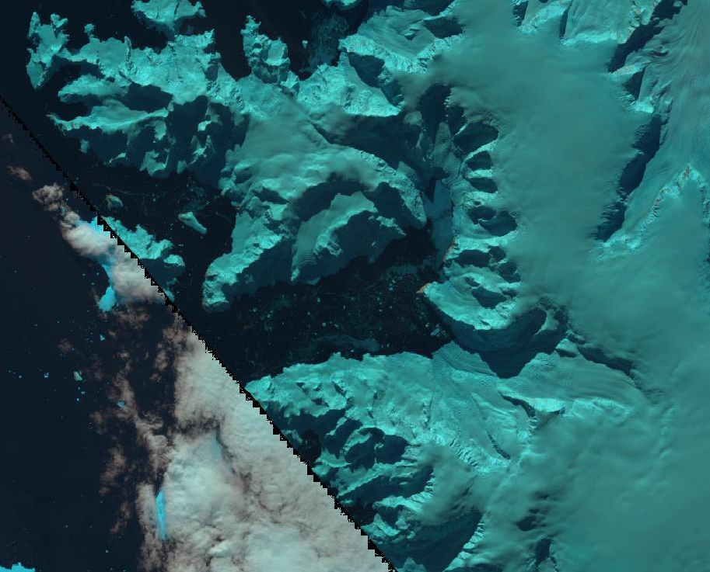
Background: Andvord Bay
Worldview March 2016
35 km long
5 km wide
Mean depth = 400 m
Sills = 270 m
Basin = 500 m
Notes:
Worldview imagers from March 2016 – italy boot

Slide 8
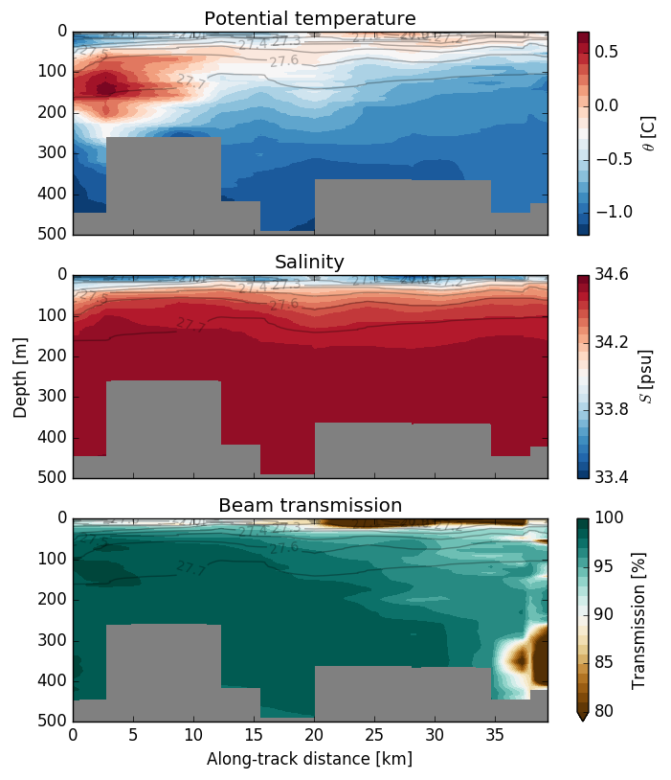
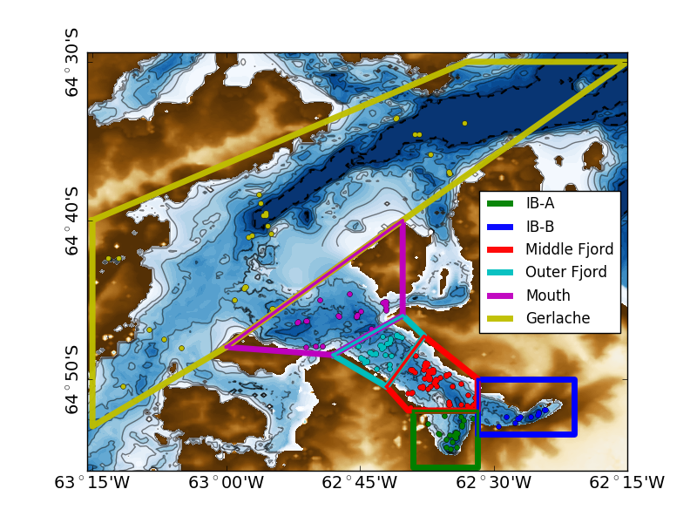
Along Fjord CTD Transects:
Initial Results: Along Fjord CTD Cross Section Dec 2015
Sill 3
Gerlache
Inner Basin A
Notes:
Sediment Plume Structure and some evidence of Mixing over the sill

Slide 9
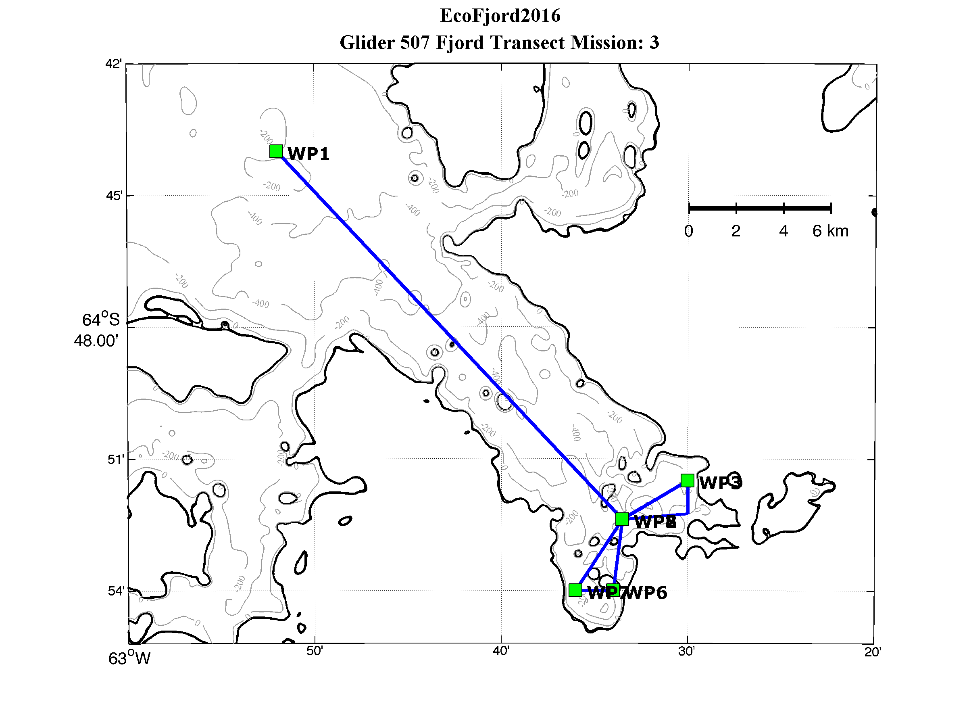
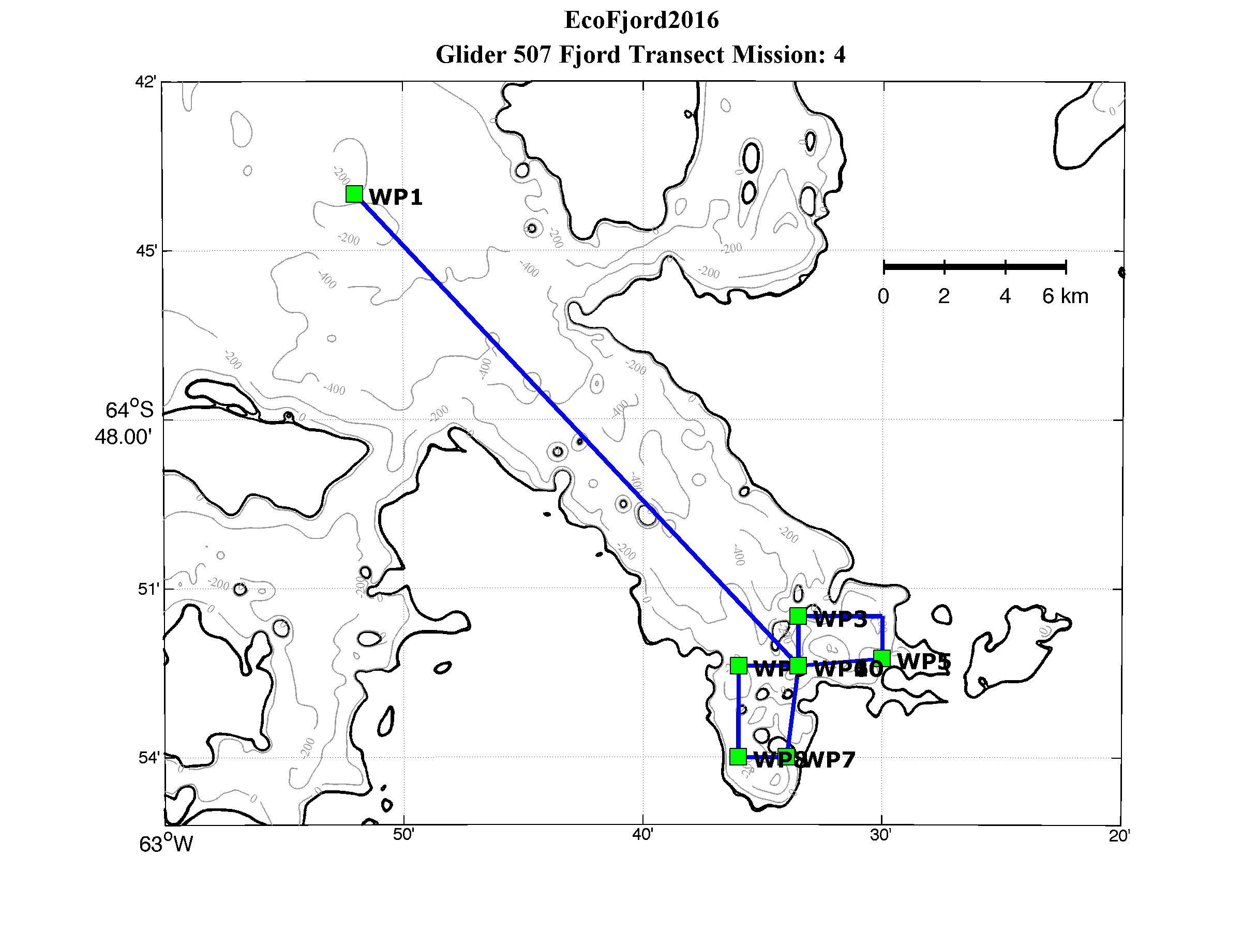
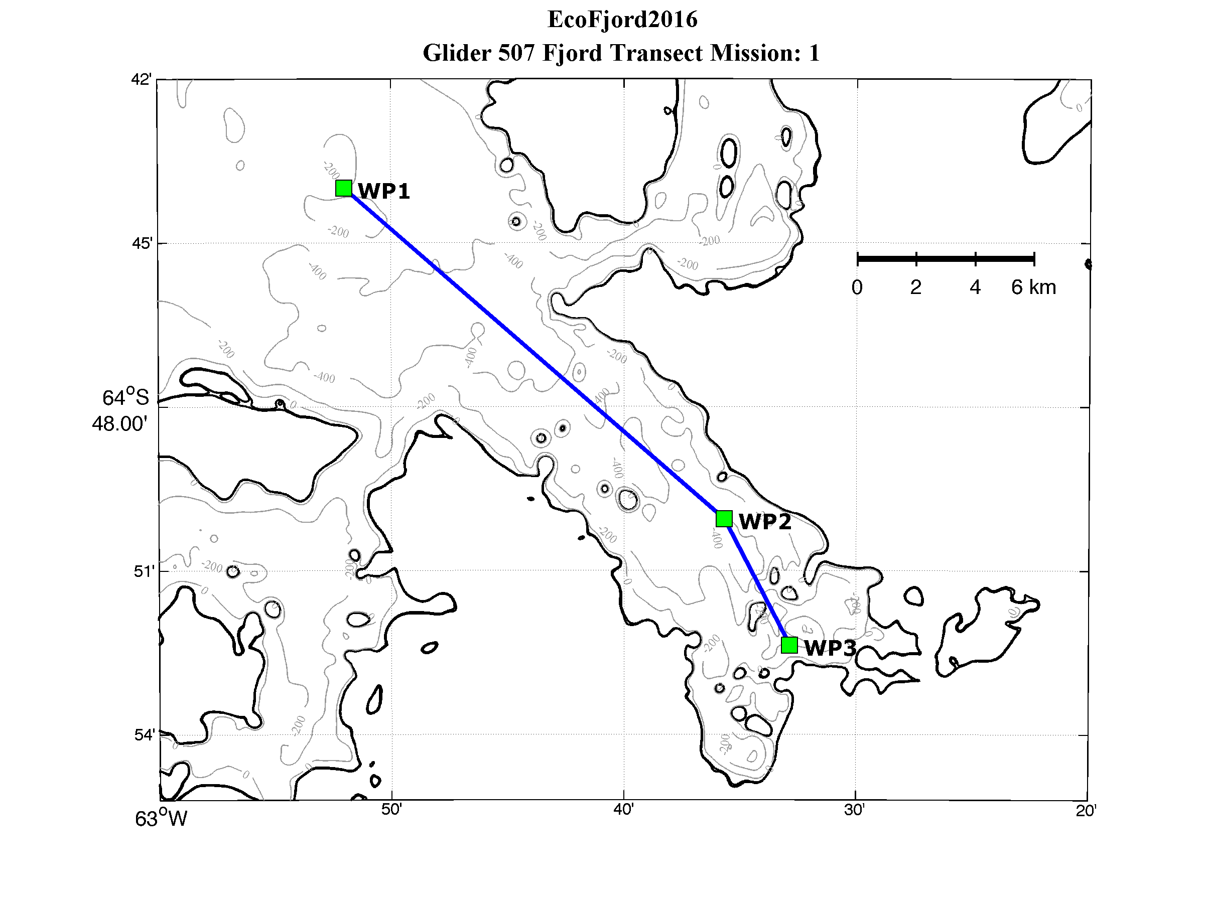
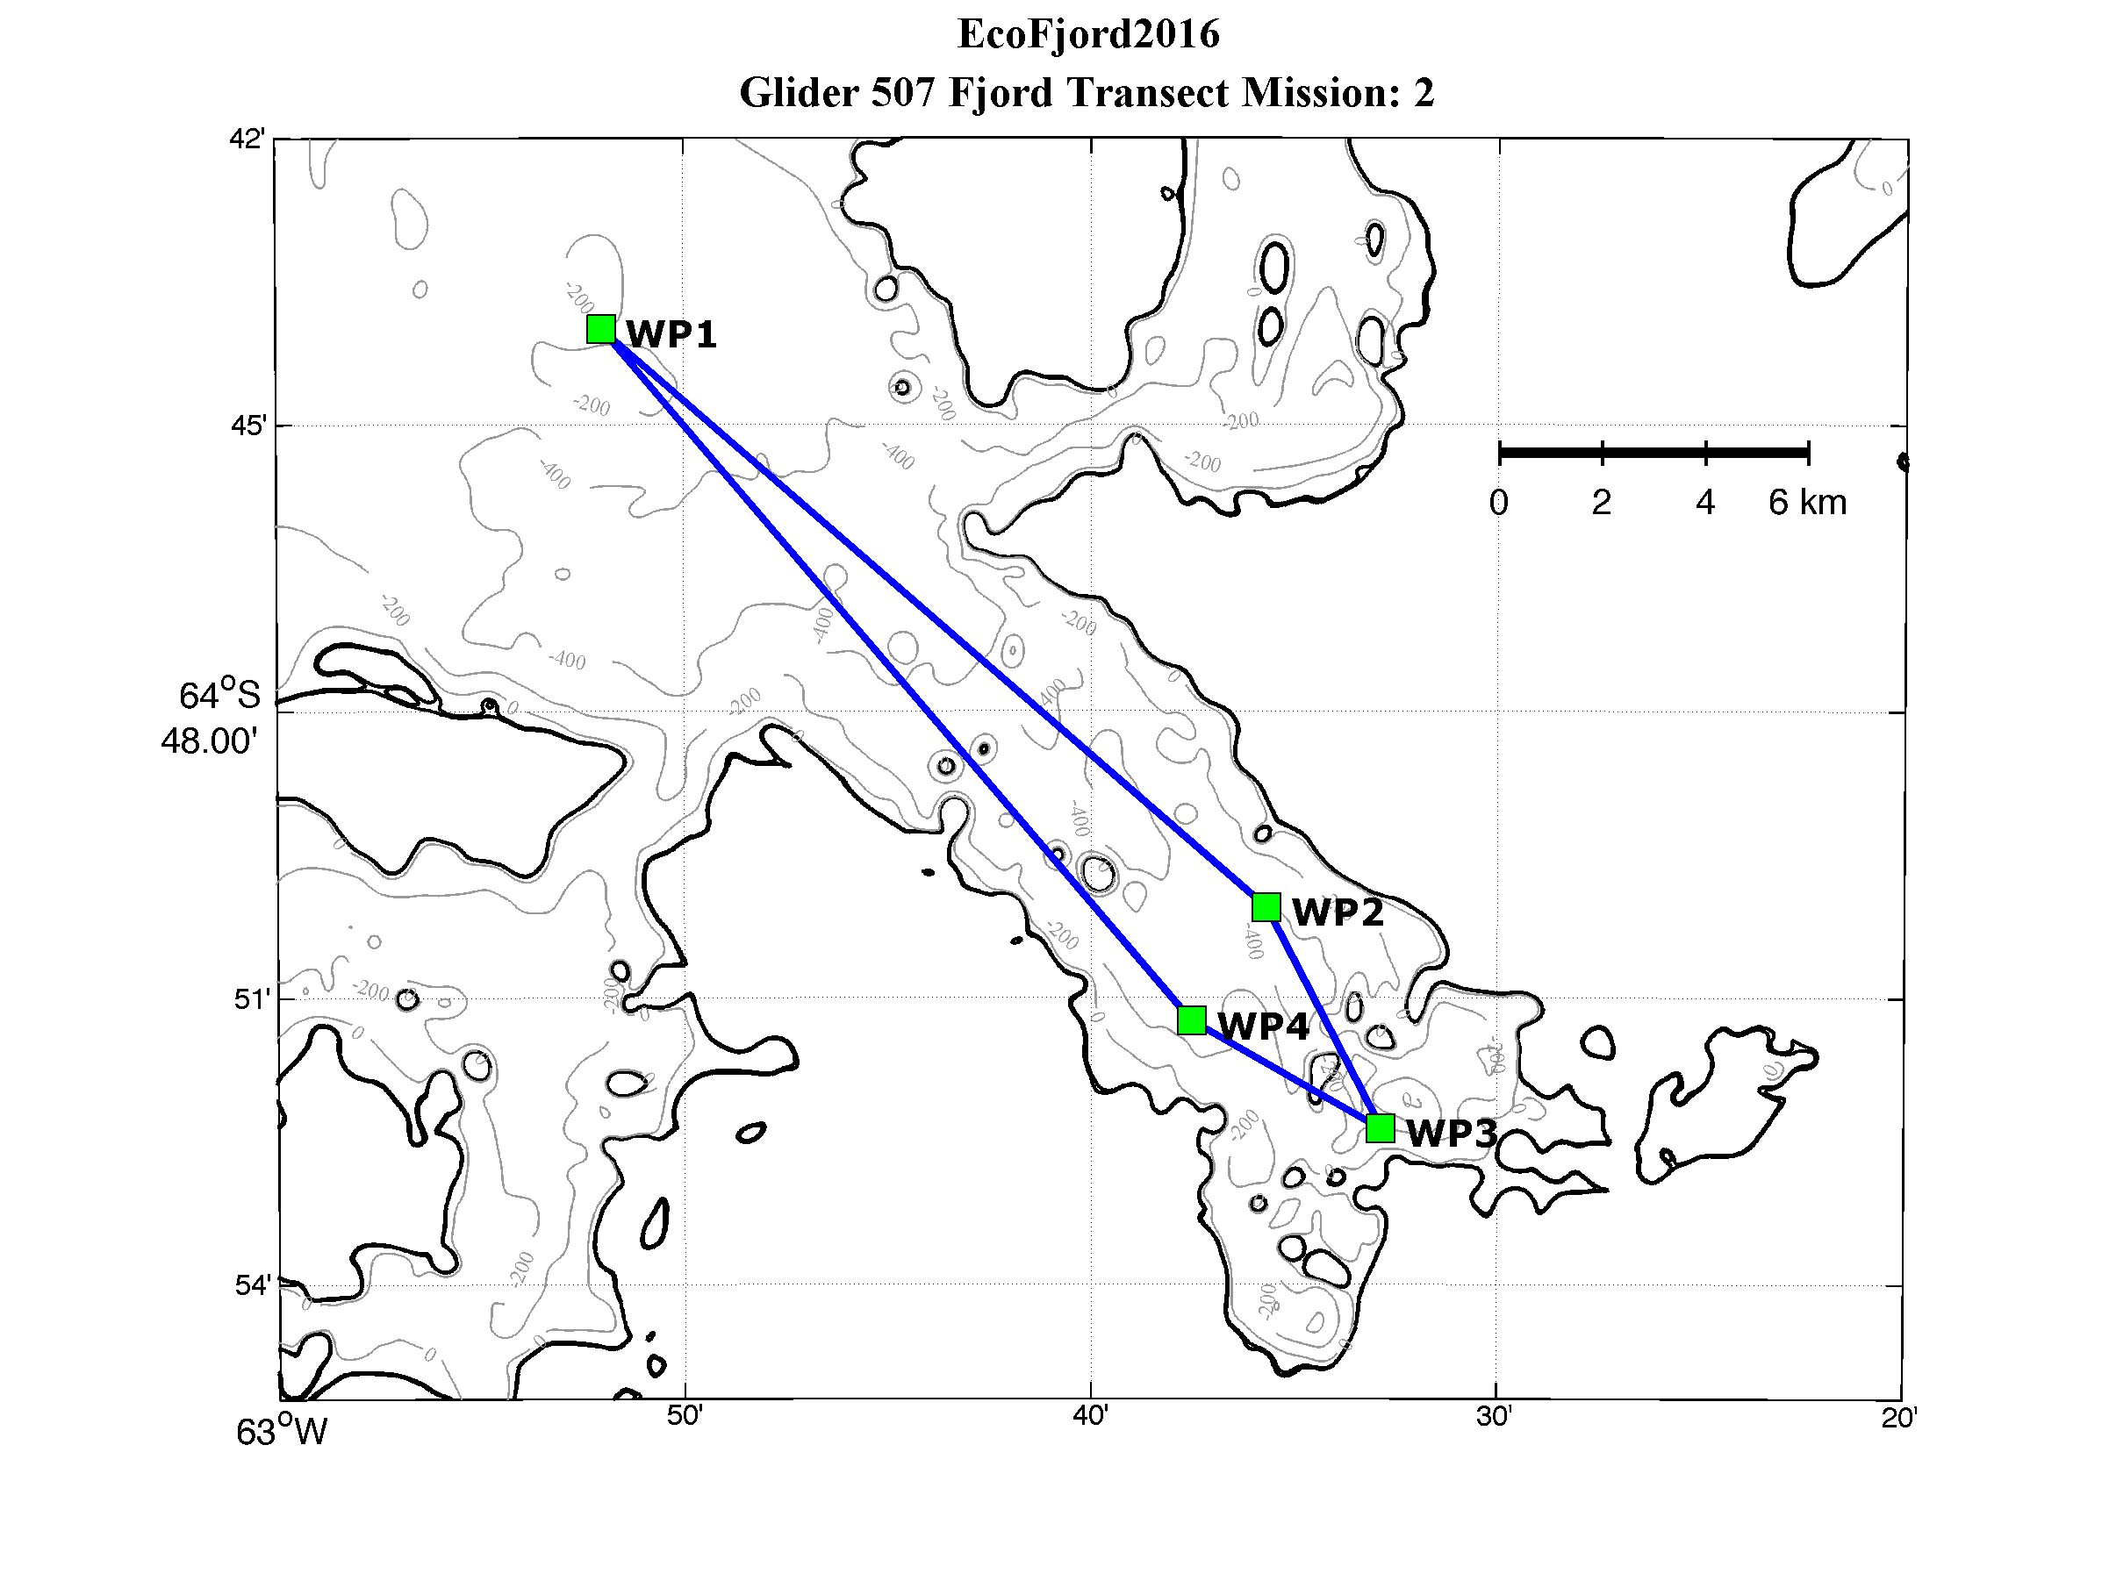
Pre-Cruise Mission Planning
Notes:
15 realizations of the along fjord hydrographic structure

Slide 10
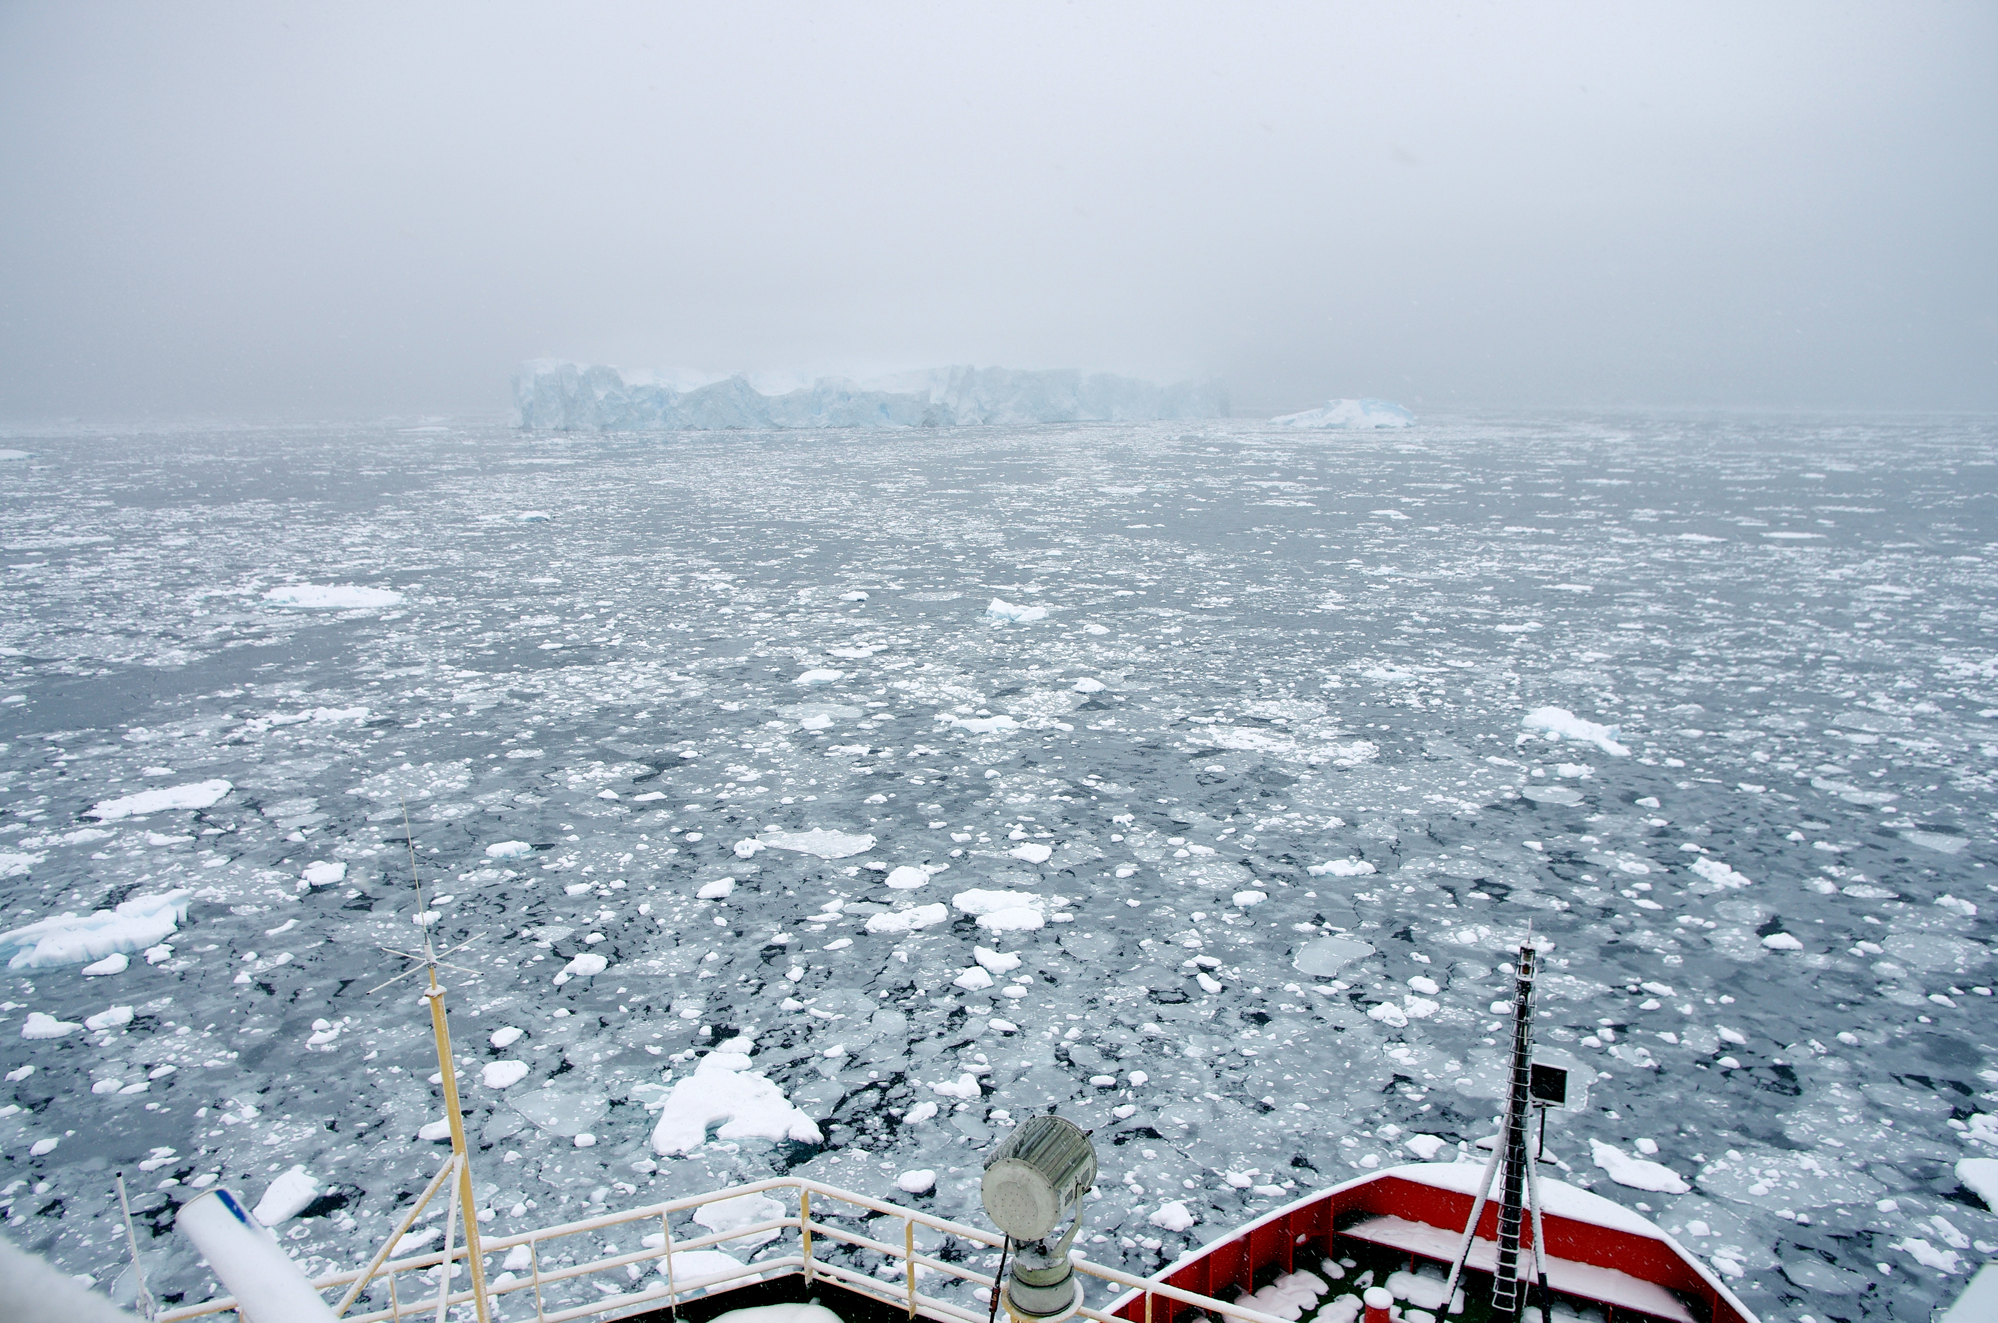

Slide 11
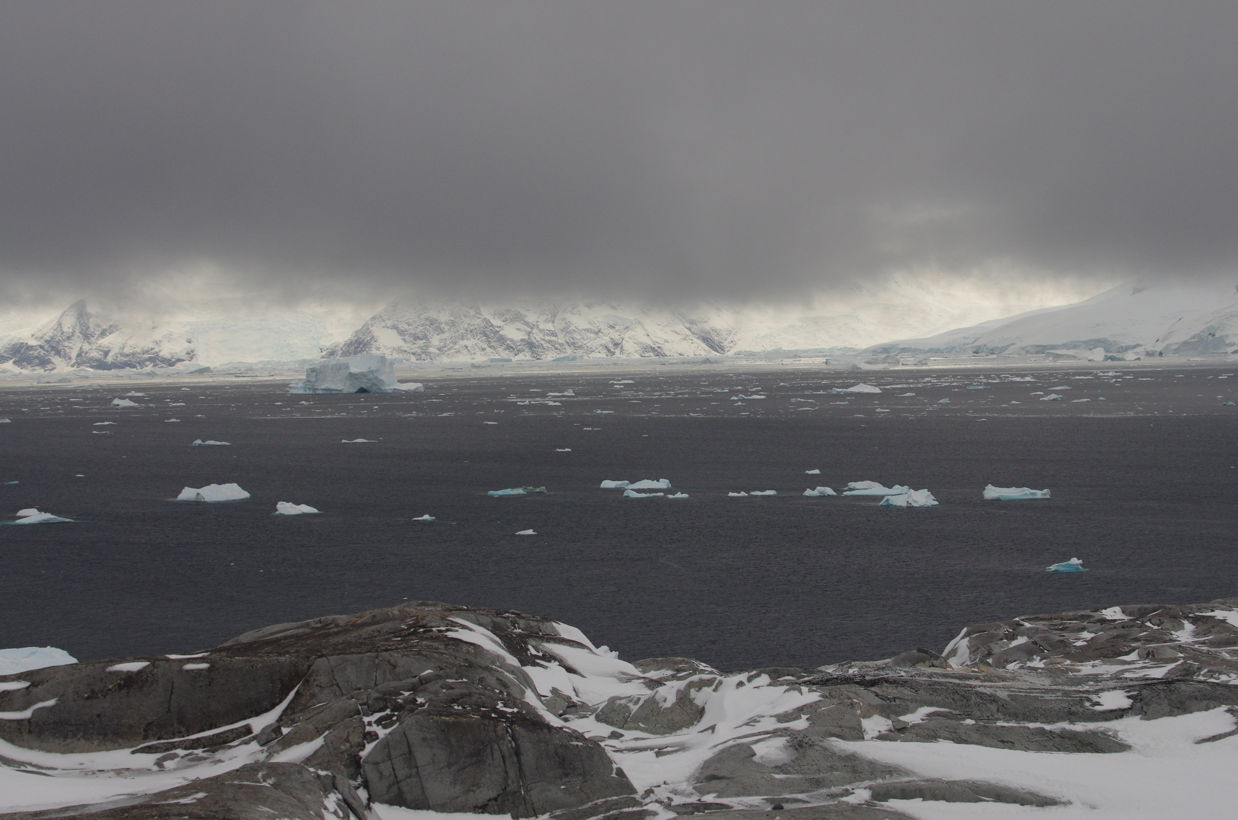

Slide 12
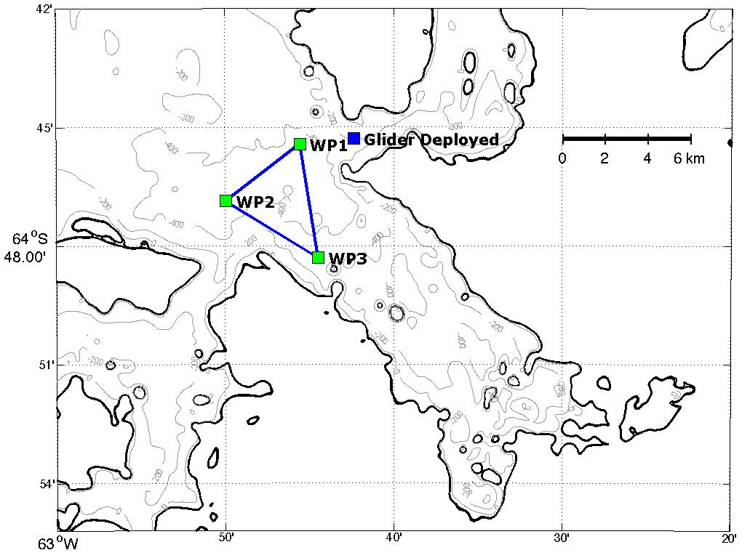
Objective #1:
Measurement of tidal induced mixing over fjord sill
Notes:
Not explicitly measuring mixing with the glider, we just wanted to characterize the evolution of the hydrography over multiple tidal cycles

Slide 13
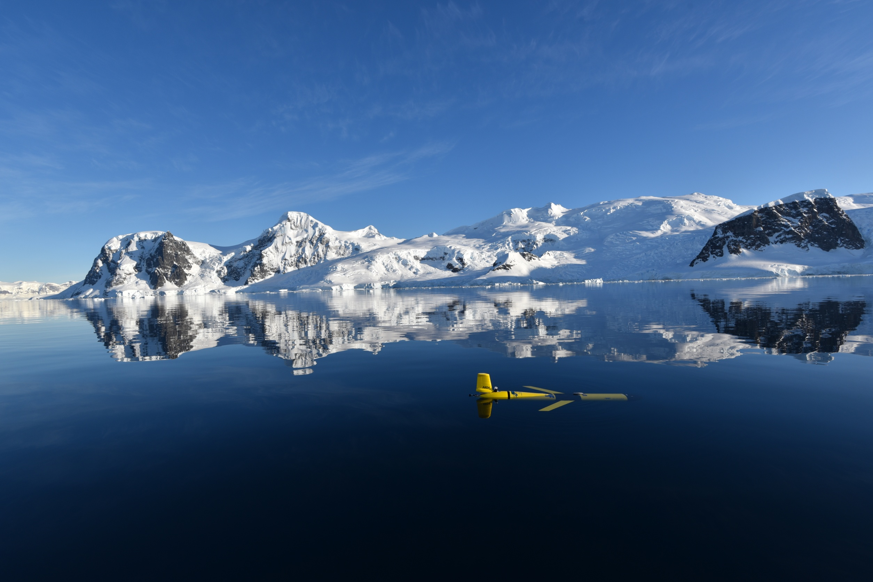

Slide 14
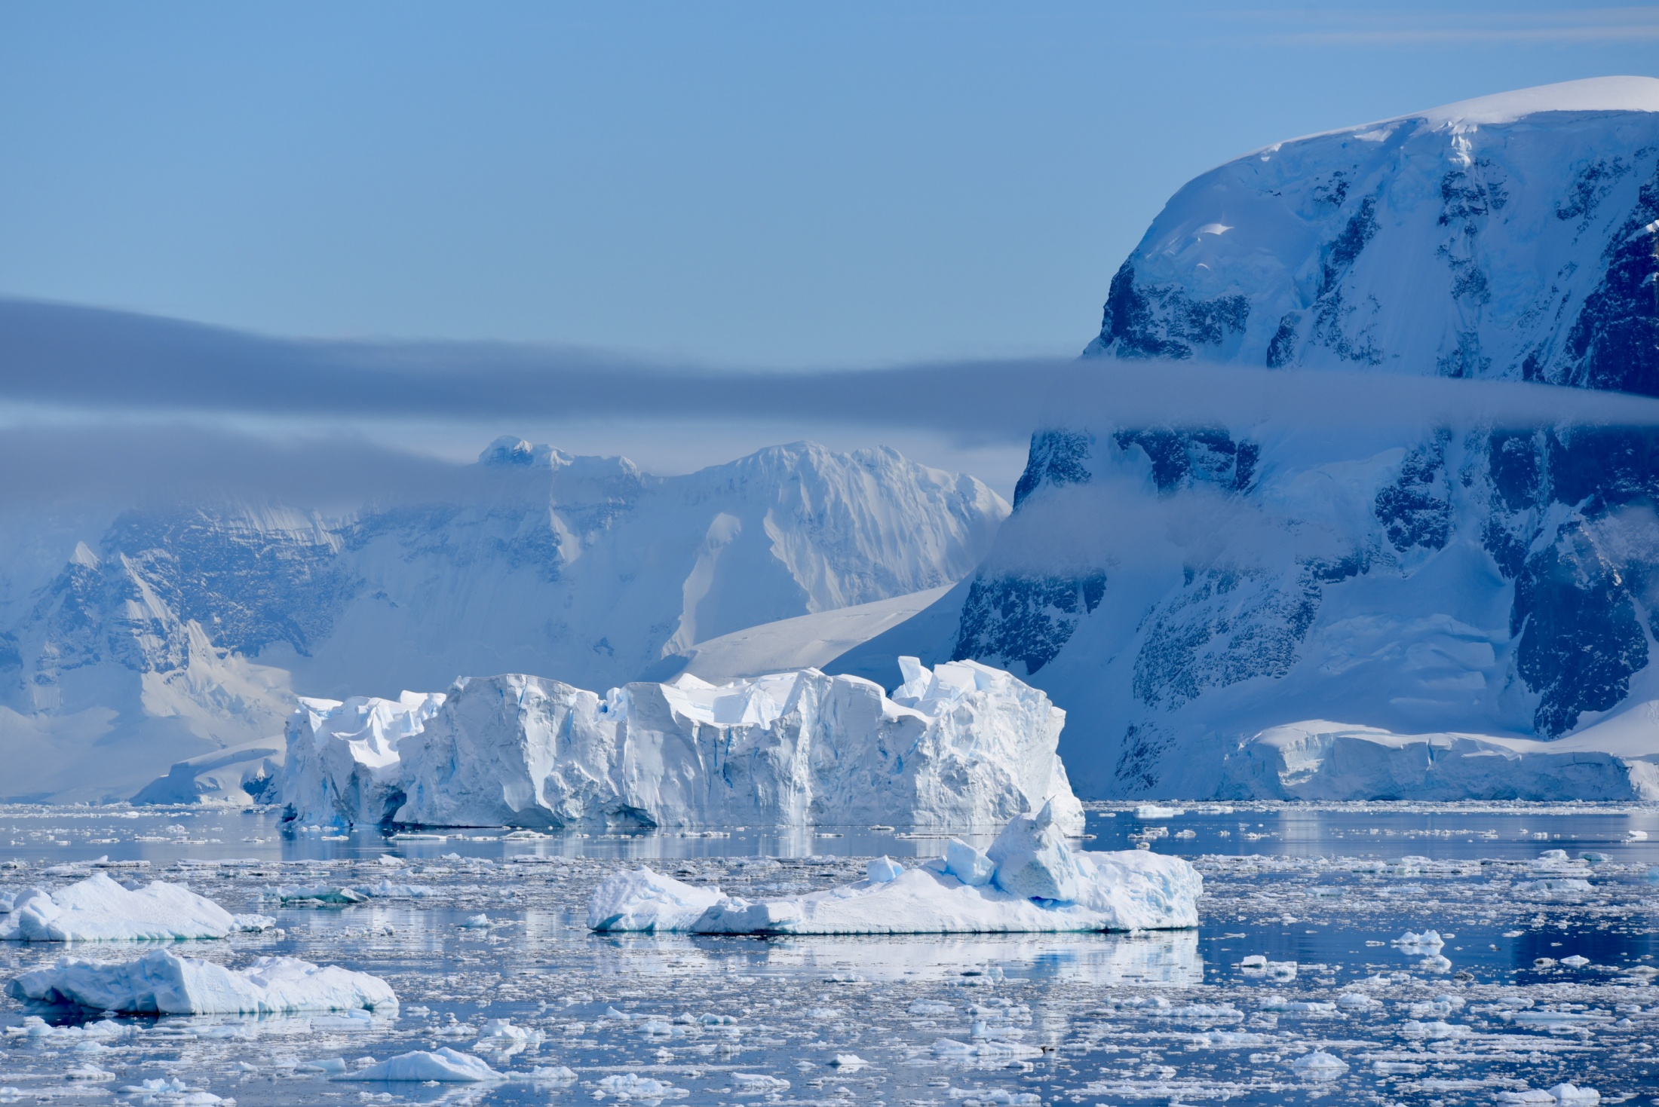
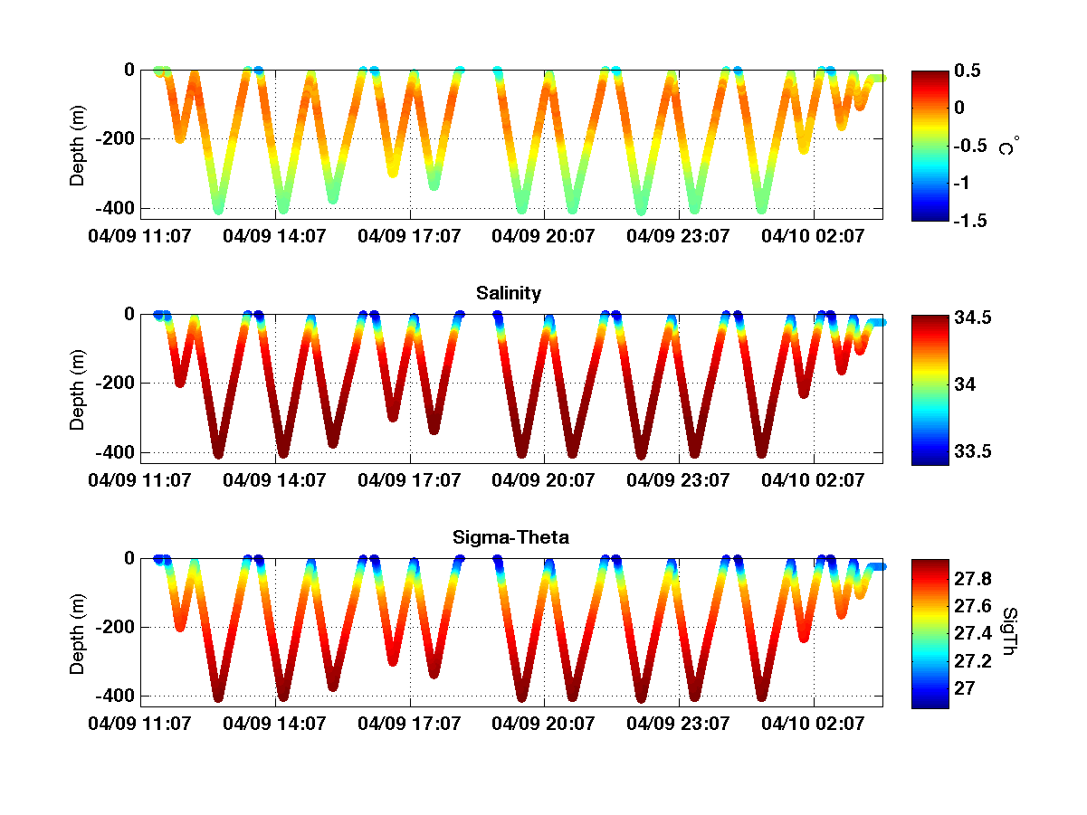
Glider Data from Sill 3

Slide 15
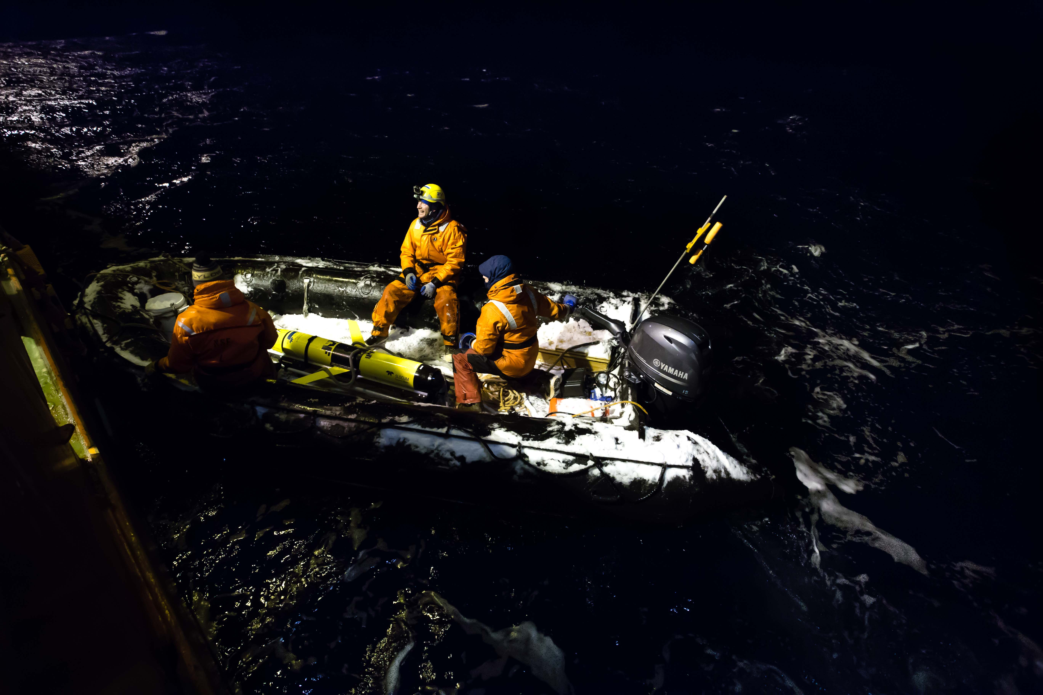
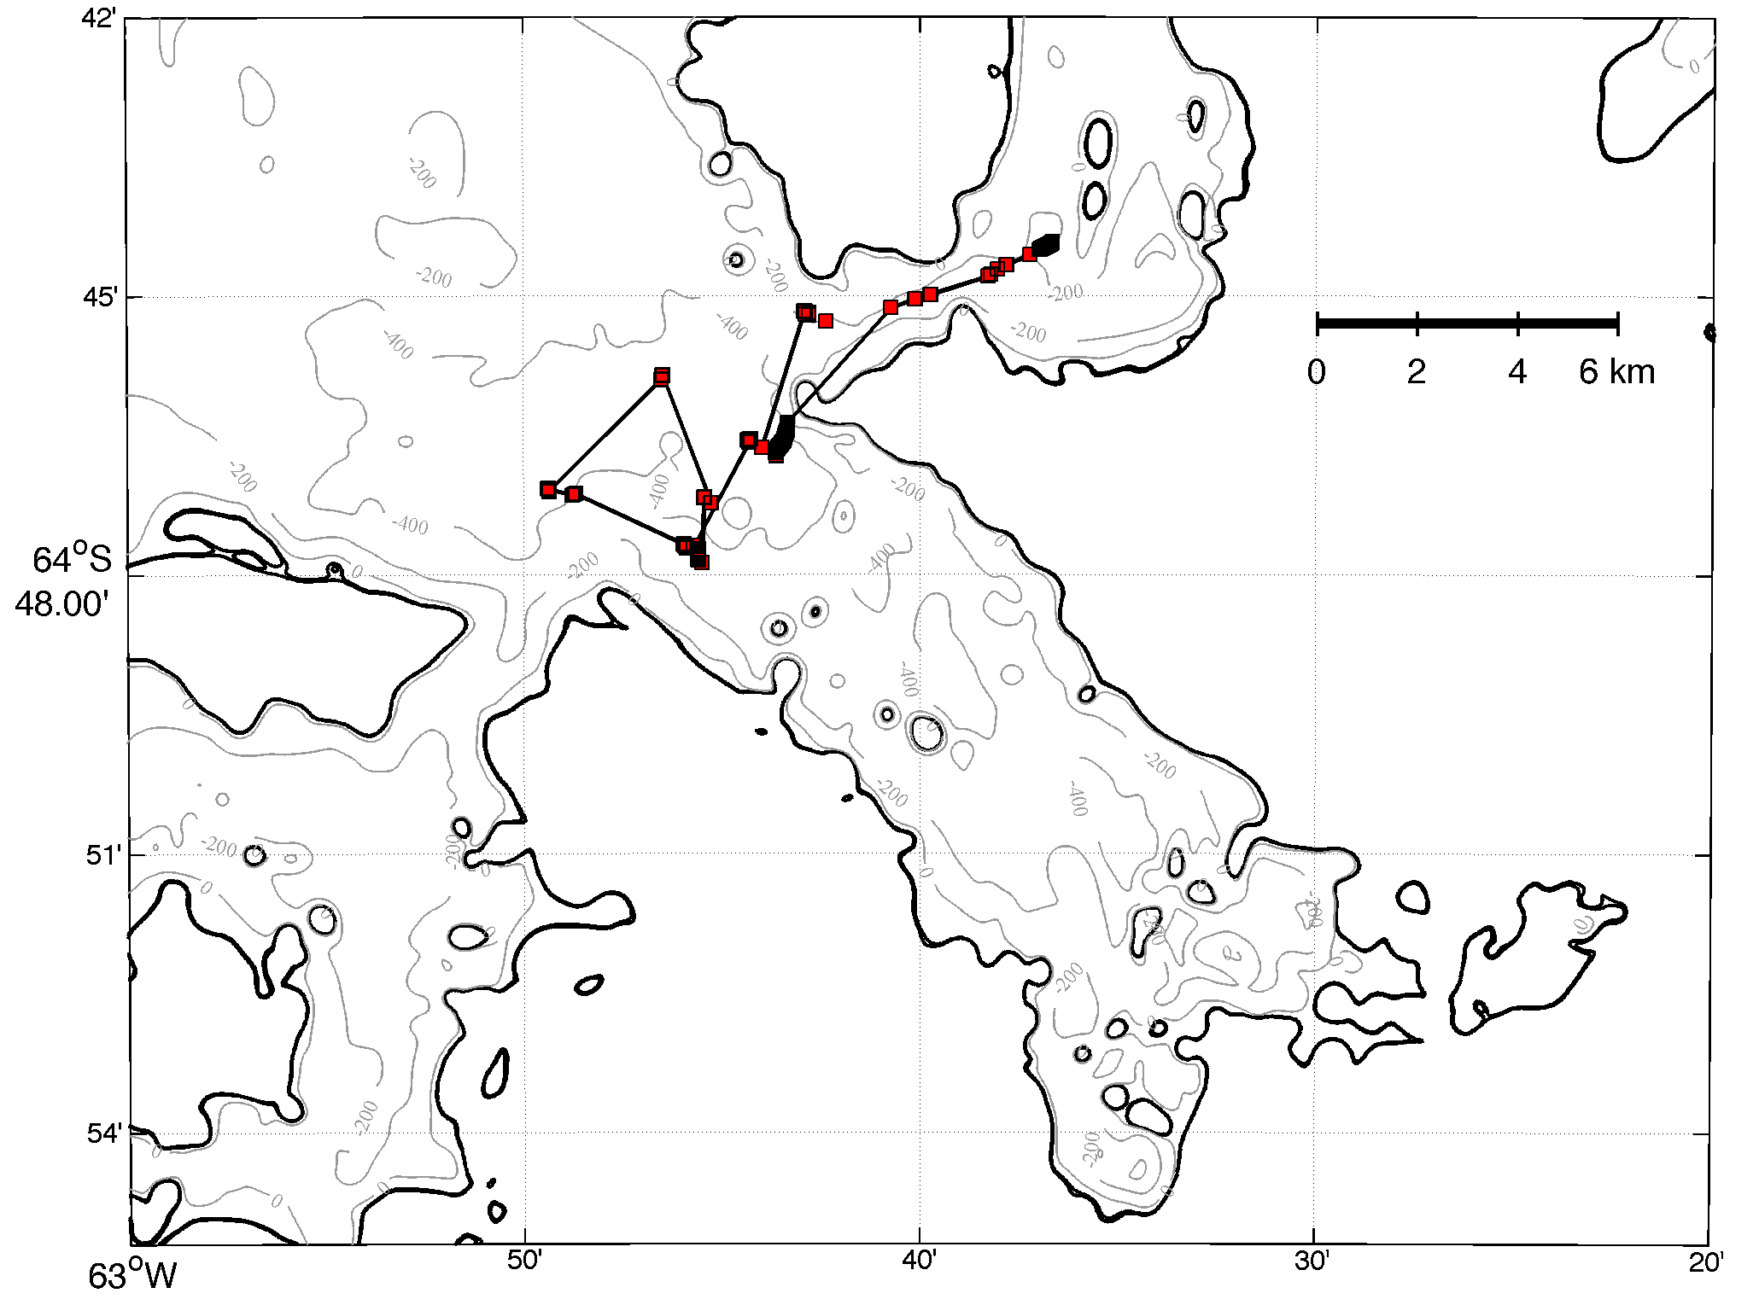

Start of Mission
Glider Recovered
Glider Back on Surface
Glider Stuck at 26m

Slide 16
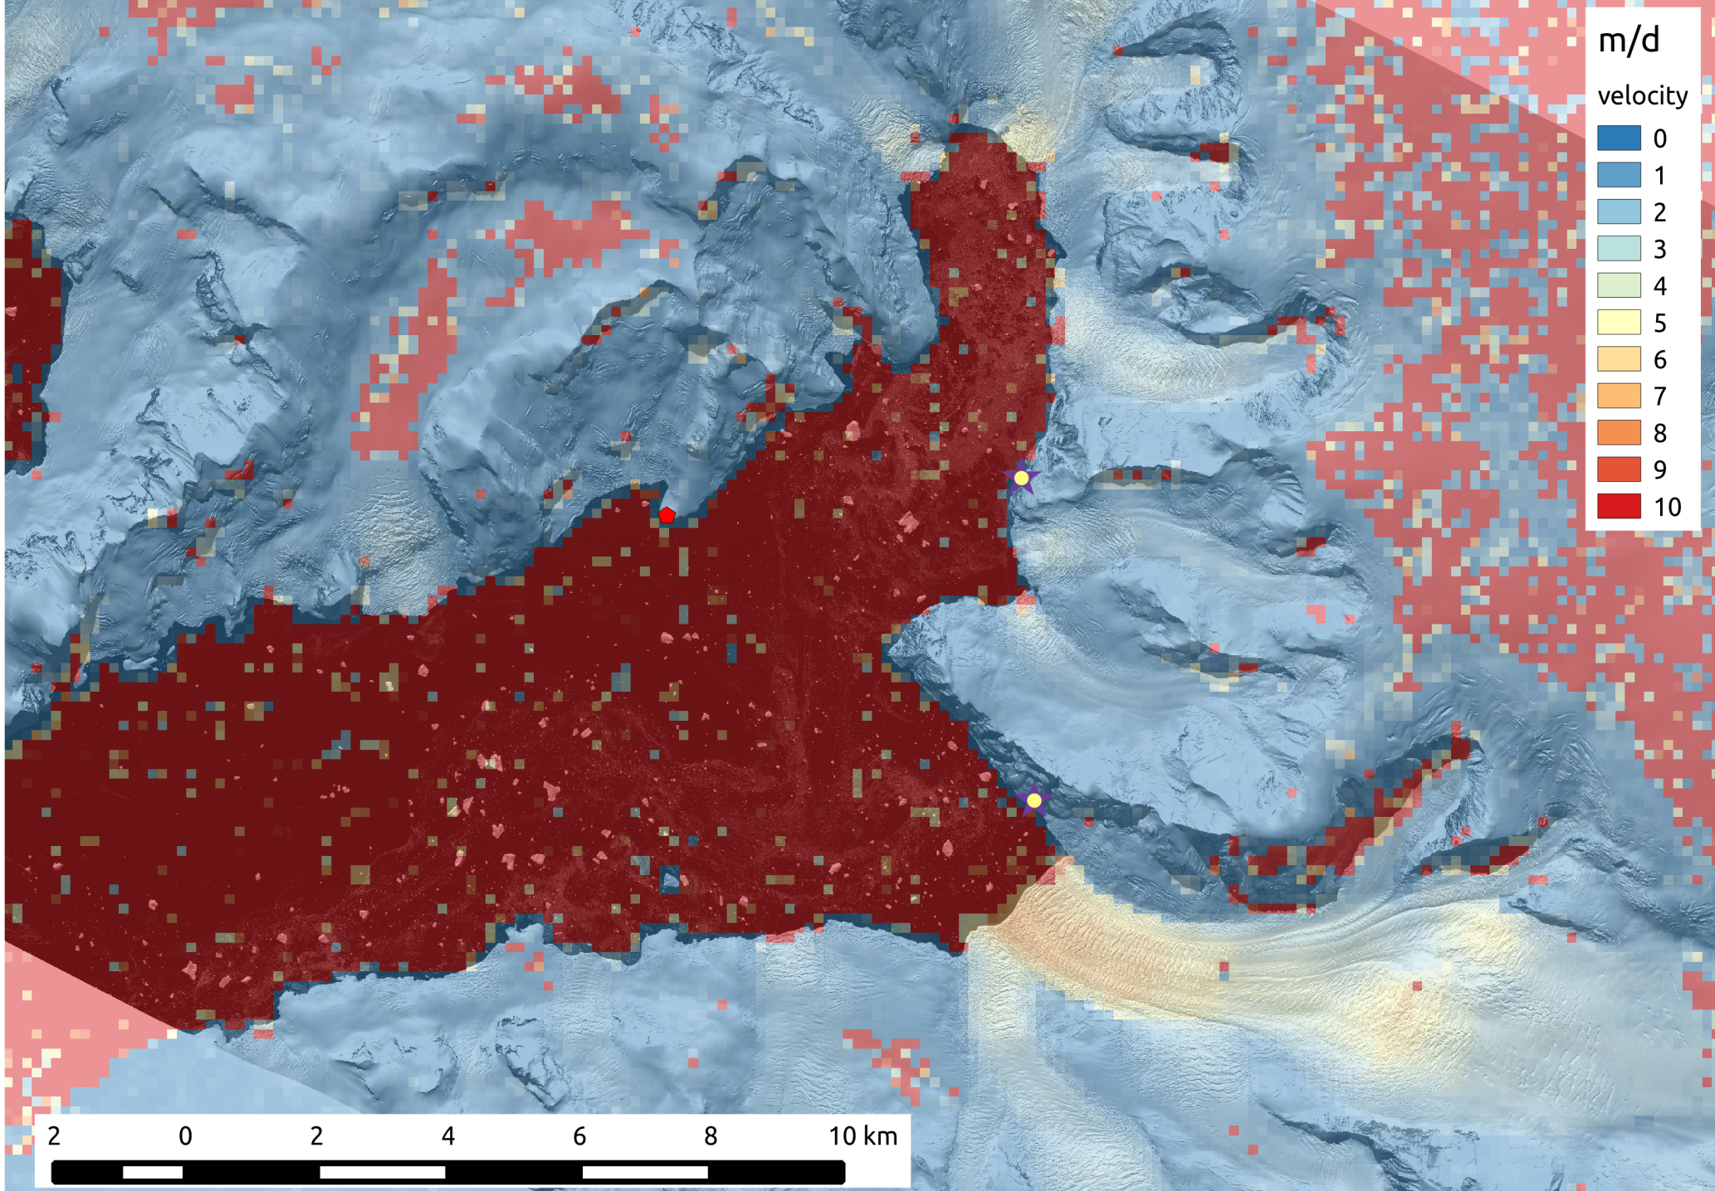
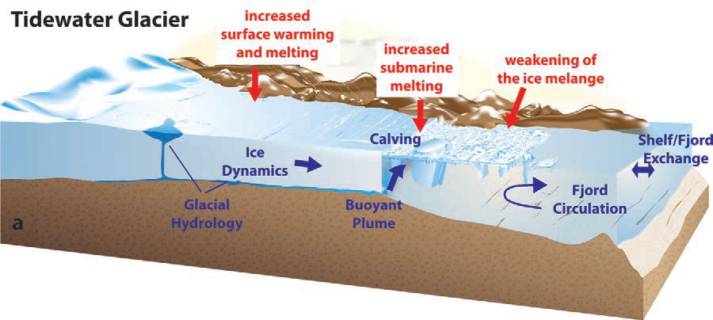
  Objective #2:
  Measurement of meltwater plume structure at the tidewater glacier front
Bagshawe Glacier
5 m/day or ~3 x 10⁶ m³/day
Notes:
Glider deployed 500 m from glacier face, 5 m per day, Ice flux =

Slide 17
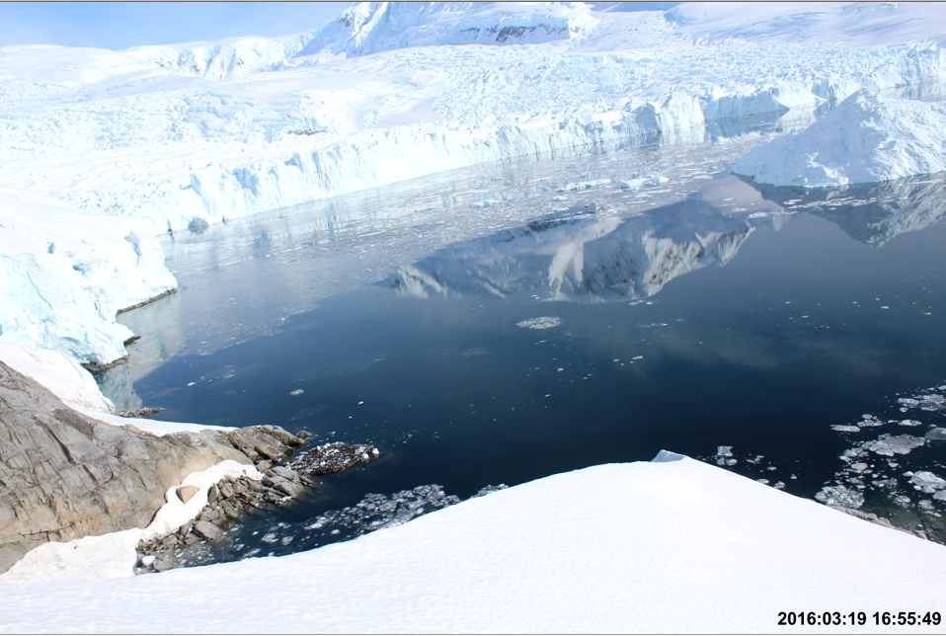
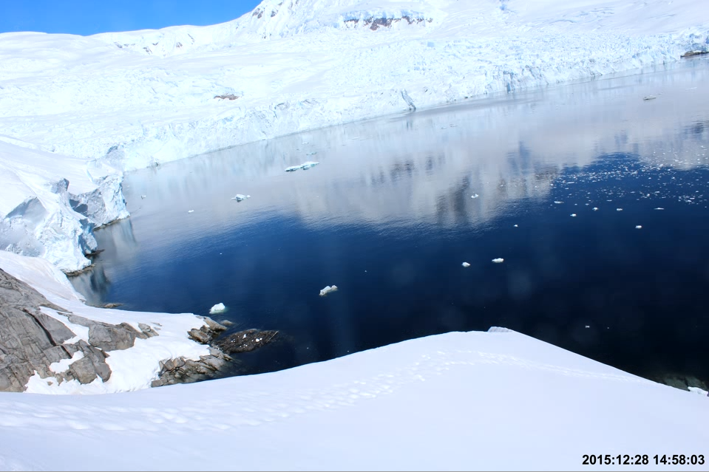
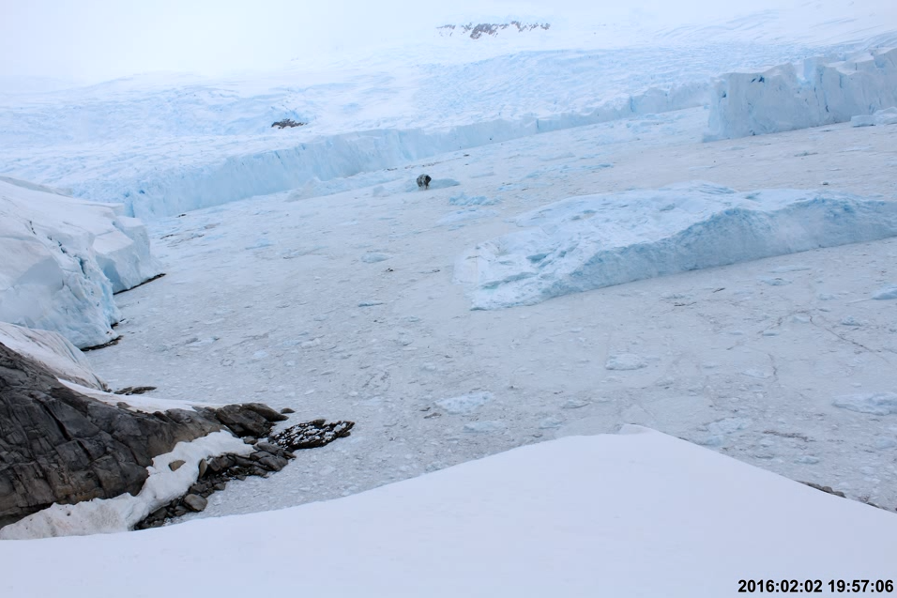
Bagshawe Glacier Timelapse

Slide 18
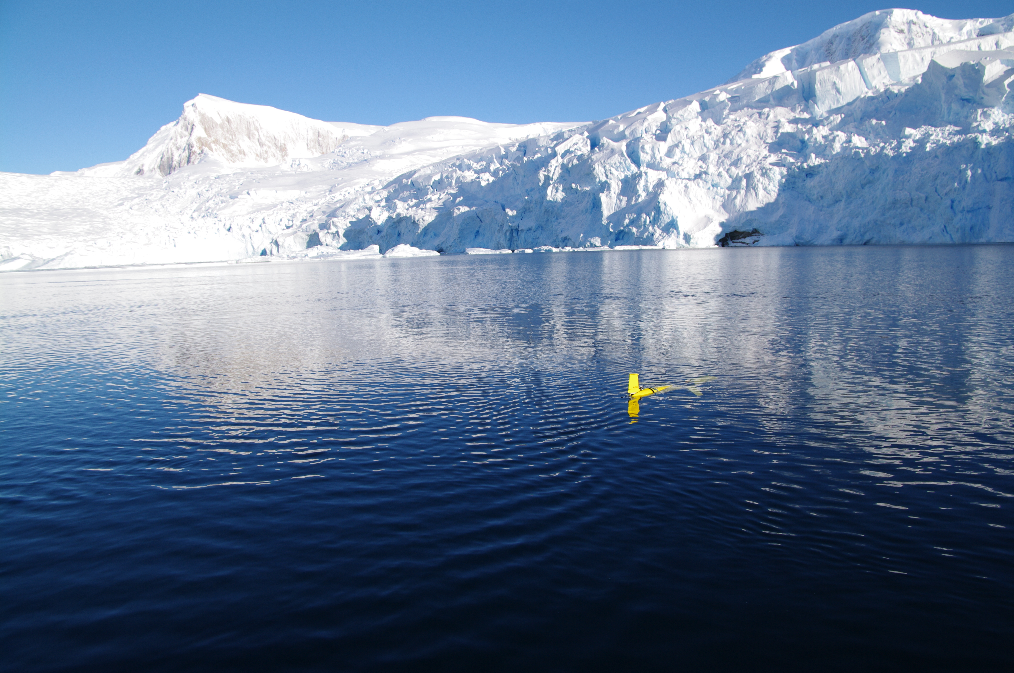

Slide 19
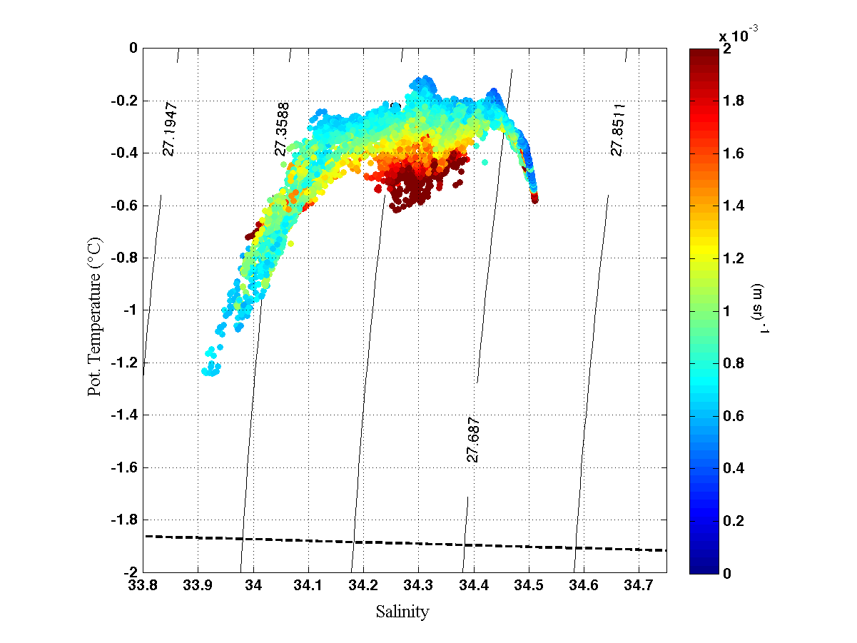
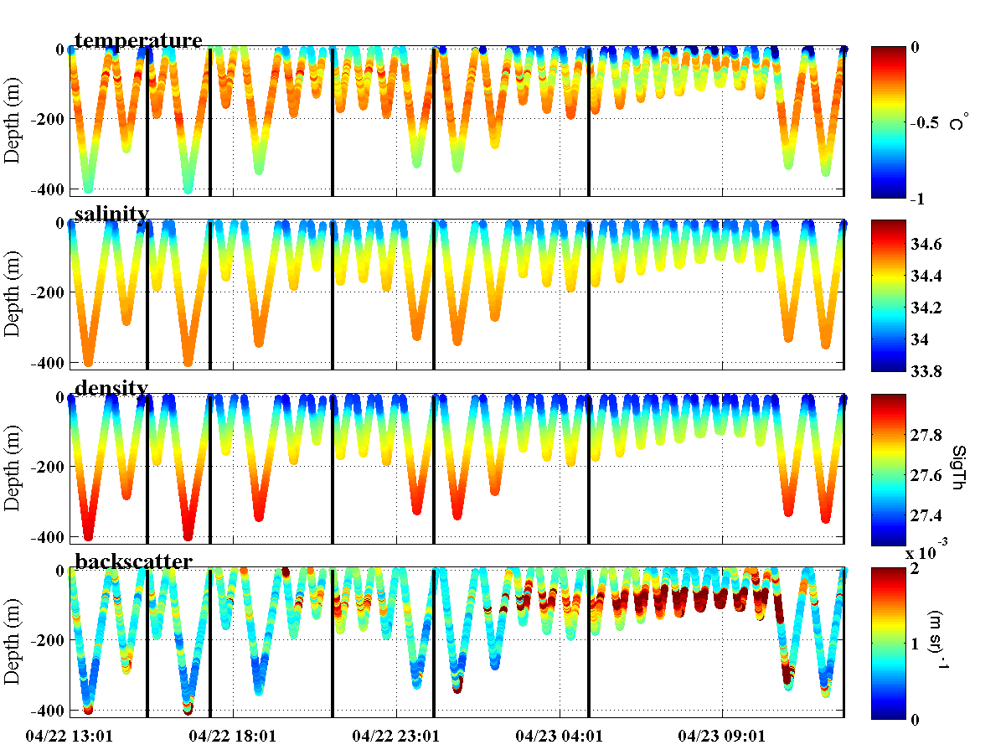
Glacier transect data from glider
Notes:
Backscatter in volume scattering units of per meter per steradian

Slide 20
Conclusion and Lessons Learned
Gliders are capable of operating in seasonally ice covered waters
Fjord-glacier interactions are complicated and can change rapidly.
  Watch out for icebergs, they are dangerous!
  Highly buoyant plume waters from glacier terminus may exit at high velocity
To truly act as force multipliers, there needs improvement in hardware and software specific to under-ice applications
  Upward looking sonar for ice avoidance
  Underwater navigation (inertial, sonobuoy)
  Underwater communication (acoustic modems)
  Locator beacons
  Backtrack capability in case of interrupted climb (Hansel and Gretel follow the breadcrumb strategy)

Slide 21
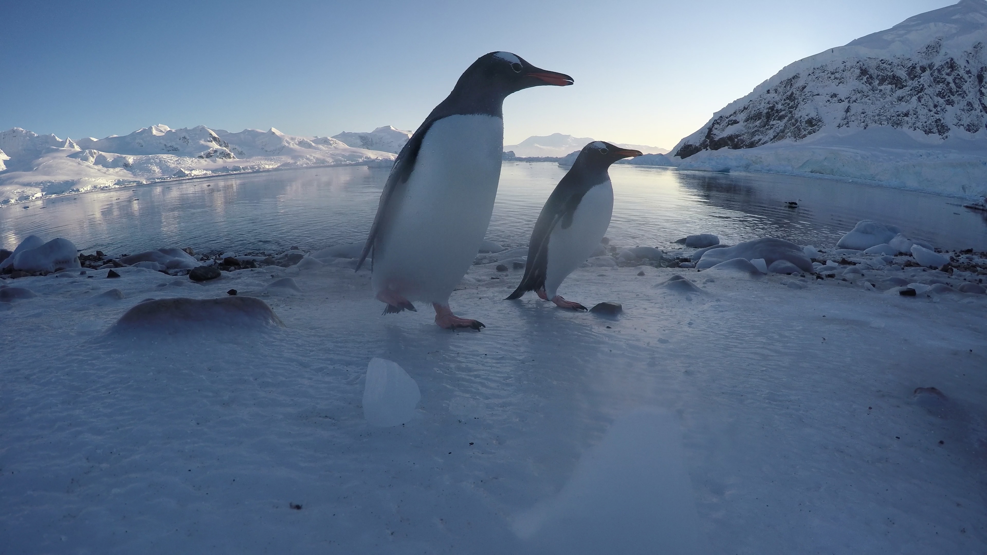
Thank You – Questions?
Hank Statscewich
hank.stats@alaska.edu

Slide 22
Why do the WAP fjords, e.g. Andvord Bay, have such high biomass and biodiversity?
How sensitive are these remarkable fjord ecosystems to climate warming?
These question are the focus of our National Science Foundation project:
Fjord Ecosystem Structure and Function on the West Antarctic Peninsula - Hotspots of Productivity and Biodiversity? (FjordEco)
Key Project Goals:
1) Evaluate oceanographic, glaciological, and ecological processes in Andvord Bay to determine what enhances WAP fjord productivity and biodiversity compared to the open shelf.
2) Create an ecosystem model of Andvord Bay (from glaciers to seafloor) to explore fjord sensitivity to climate warming (e.g., increased meltwater and sediment inputs).

Slide 23
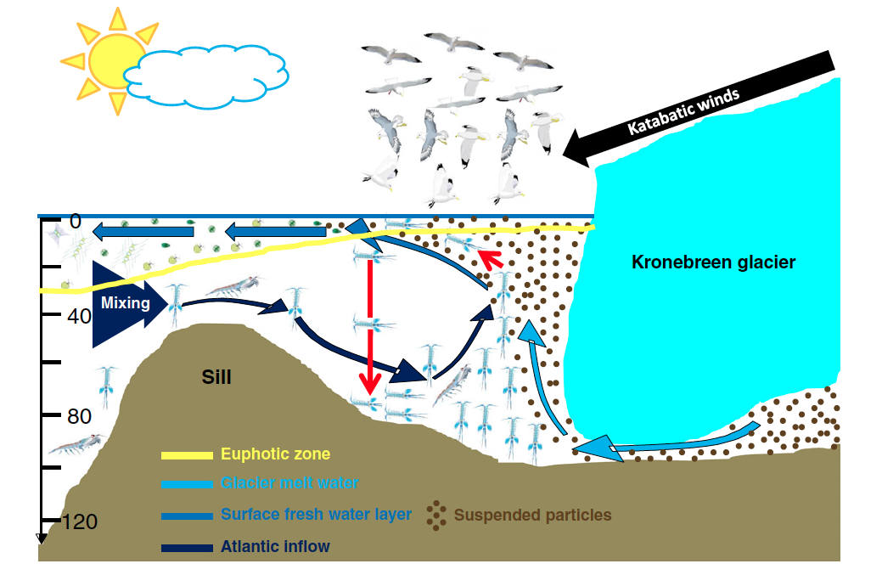
The Arctic Model:
Physical forcing of biological processes in arctic tidewater glacier ecosystems
From: . C. Lydersen et al. / Journal of Marine Systems (2014)
Notes:
Physical forcing of biological processes in the inner part of Kongsfjorden during summer. Kongsfjorden is lined by tidewater glaciers (e.g. Kronebreen) that discharge large amounts
of freshwater (light blue arrows) and sediments (brown dots) into its inner part. The inner part is separated from the deeper, outer part by a shallow sill. The prevailing down-fjord katabatic
winds (black arrow) favour an outflow of surface freshwater (“medium” blue arrows) along the northern shore which is compensated by the inflow of deeper, saline shelf waters
(dark blue arrows) along the southern shore of Kongsfjorden. This estuarine circulation is the characterising hydrographical feature during summer. Primary productivity (depicted by
different phytoplankton taxa) and depth of the euphotic zone (yellow line) are strongly reduced in the inner part due to turbidity resulting from glacier derived sediment discharge
and increase with distance from the glaciers. Advected zooplankton is either stunned or killed by osmotic shock (red arrows) upon entrainment into glacier meltwater and serve as an
important food source for benthic communities and sea birds foraging near the glacier front. C. Lydersen et al. / Journal of Marine Systems 129 (2014) 452–471

Slide 24
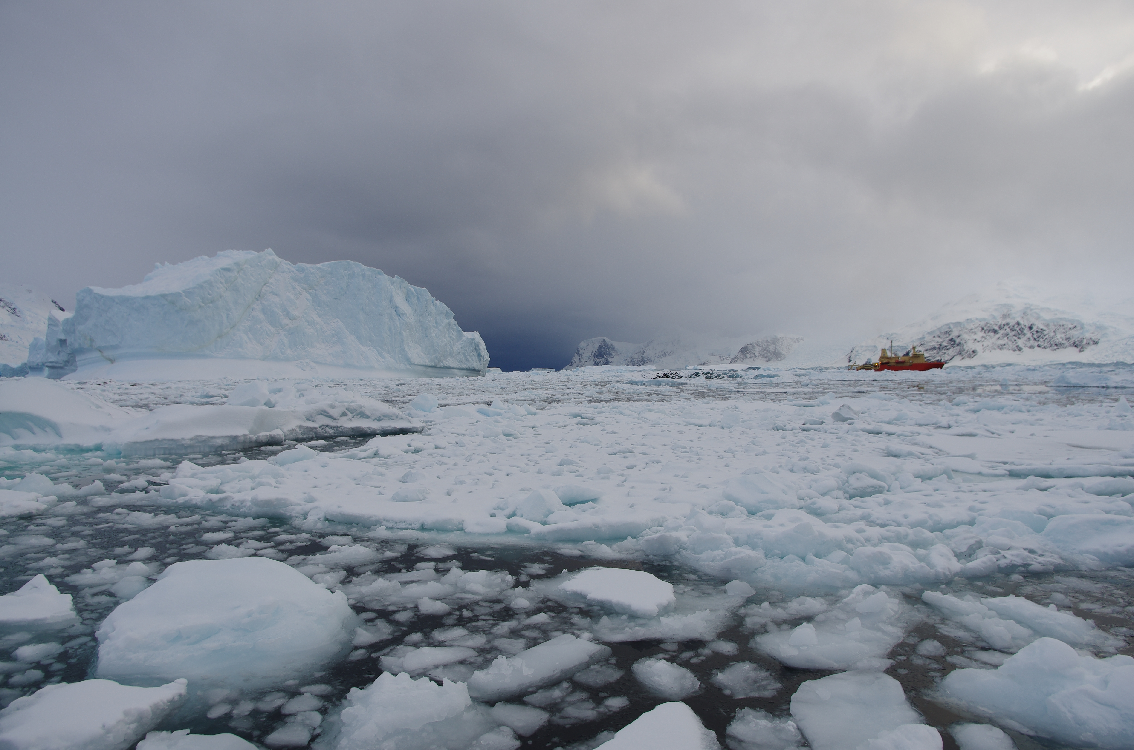

Slide 25
Background:
Andvord Bay CTD Stations Dec. 2015
Notes:
least some degree of geostrophically balanced pressure gradients inside the fjord
Point out Anvers Island

