Slide 1
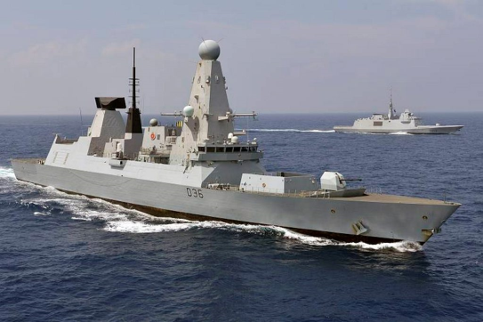
Information from Data: Research into the use of submarine gliders by the UK Ministry of Defence
Dr A.C.Baker
Dstl Fellow
acbaker@dstl.gov.uk
27th September 2016
© Crown Copyright Dstl
Notes:
Good afternnon, My name is Adrian Baker. This afternoon I am going to talk to you about the research programme that is ongoing to look at how the MOD can use submarine gliders and what information can be gained from them.

Slide 2
Overview
Why is the Royal Navy (RN) interested in using submarine gliders?
MASSMO – Marine Autonomous Systems Supporting Maritime Operations
How we have used these to investigate information products
Where next?
27th September 2016
© Crown Copyright Dstl

Slide 3
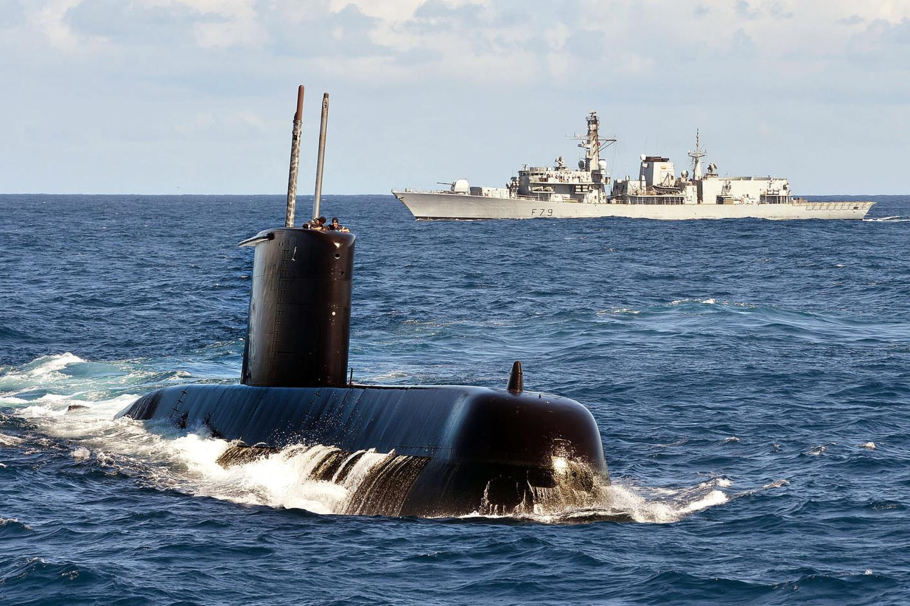
Why may the RN wish to use gliders?
Improve effectiveness of military operations
But ….
What is the really important information?
How much information is needed?
What concepts of operation should be employed?
How do we present information to aid understanding?
How do we overcome bandwidth issues and other constraints?
Notes:
Real time information
Not just modelled or historic
Improved and current geospatial understanding
Improved decision making
Better operational effectiveness

Slide 4
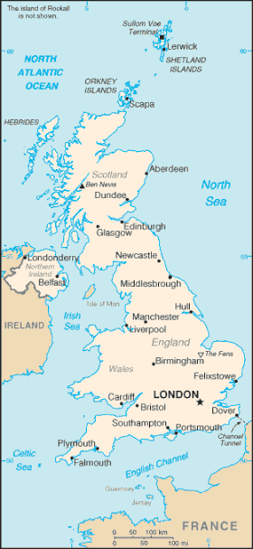
MASSMO programme
Interested in collaborating – contact:
Tim Clarke - tclarke@dstl.gov.uk
or
Adrian Baker – acbaker@dstl.gov.uk
Robustness trials (getting them wet)
Understanding and post-processing data
Concepts of operation, real time data processing and developing information products
Exploitation of acoustics for environmental understanding and marine life mitigation
Unmanned vehicles in Arctic regions (including under ice)
2018?
2017
❸ 2016
❶ 2014
❷ 2015

Slide 5
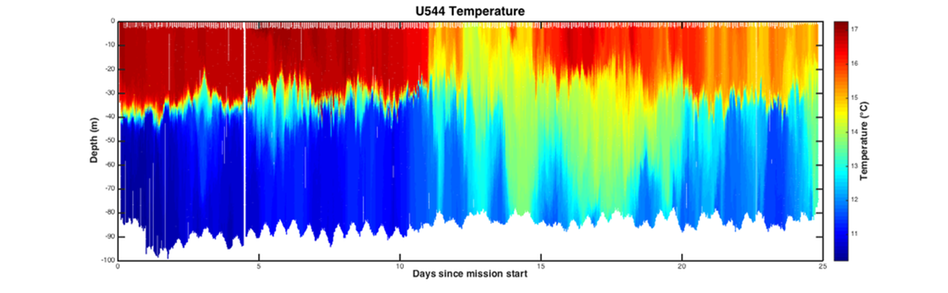
MASSMO2 – common output
Position in space cannot be determined

Slide 6
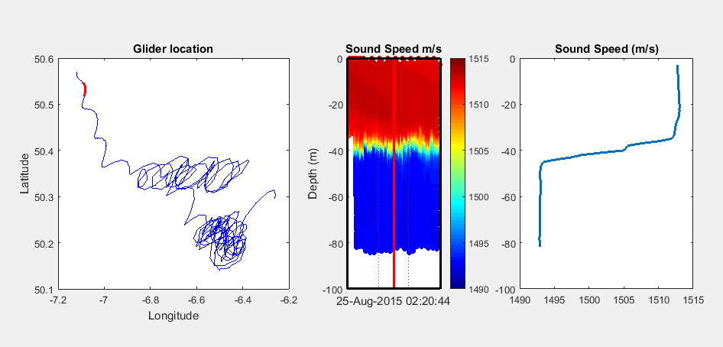
MASSMO2 - Representing 4-D data

Slide 7
Create new spatial parameters to simplify dimensions
Top of thermocline
ΔH
Base of thermocline
Depth
ΔT
ΔT²/ΔH = strength of thermocline?
Temperature

Slide 8
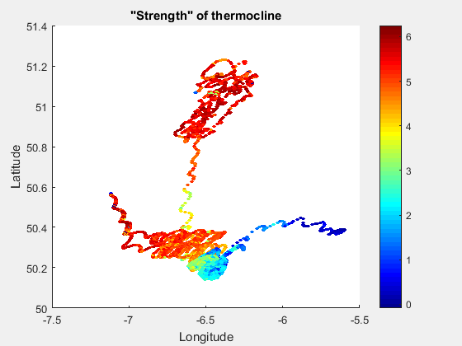
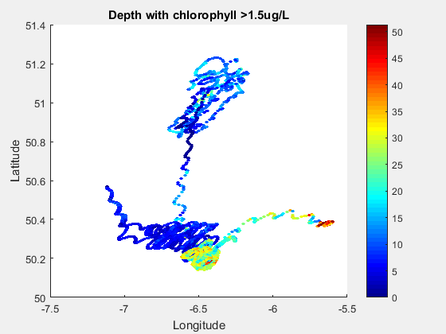
MASSMO2 - Spatial plots

Slide 9
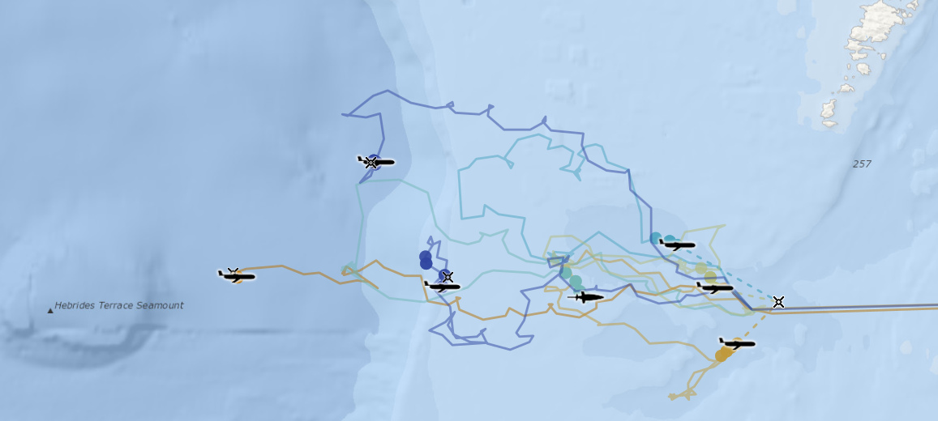
MASSMO3 - trialling possible concepts of operation for the RN
Virtual mooring
Single glider transit
Dense coverage
Reproduced with permission from National Oceanography Centre. Tiles © Esri

Slide 10
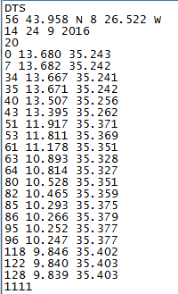
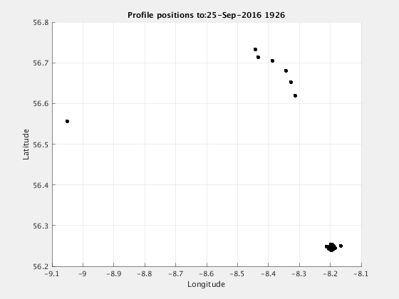
MASSMO3 - real-time processing
Current systems - low bandwidth

Slide 11
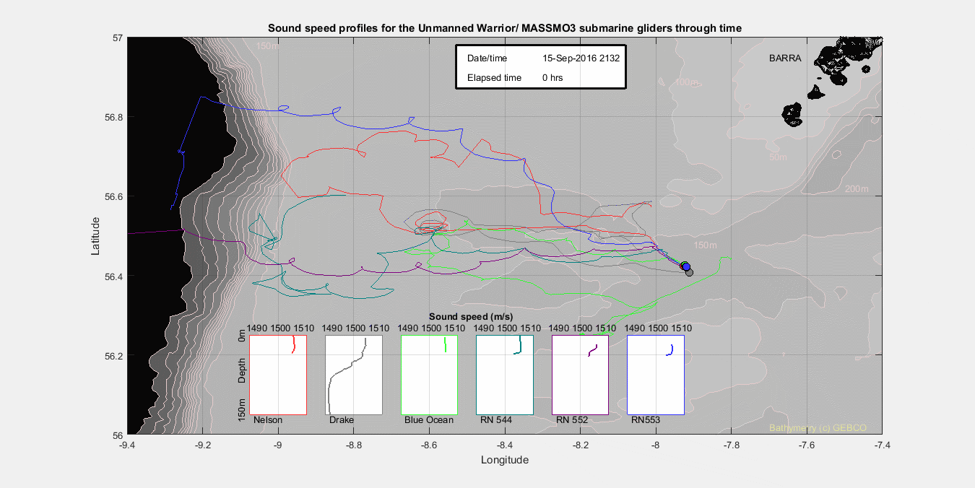

Slide 12
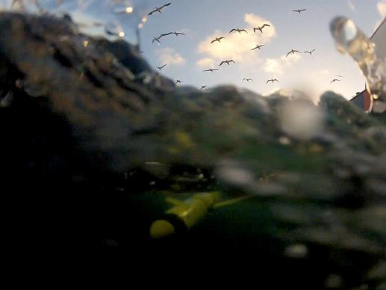
Where next?
Near term
A better understanding of where gliders can really help
A focus on concepts of operation
Better data products and methods of communicating data
Further ahead
Real time model assimilation
Increased bandwidth
Far ahead
New Royal Navy systems
27th September 2016
© Copyright Dstl

Slide 13
Summary
Benefits to Royal Navy from submarine gliders
MASSMO programme
Data processing and information products
Any Ideas?
Tim Clarke - tclarke@dstl.gov.uk
Adrian Baker – acbaker@dstl.gov.uk
27th September 2016
© Copyright Dstl

Slide 14
Notes:
This slide may be shown at the end of the presentation.

