Slide 1
How much use can you get from your glider?
David White
Manager, MARS glider group
National Marine Facilities
NOC

Slide 2
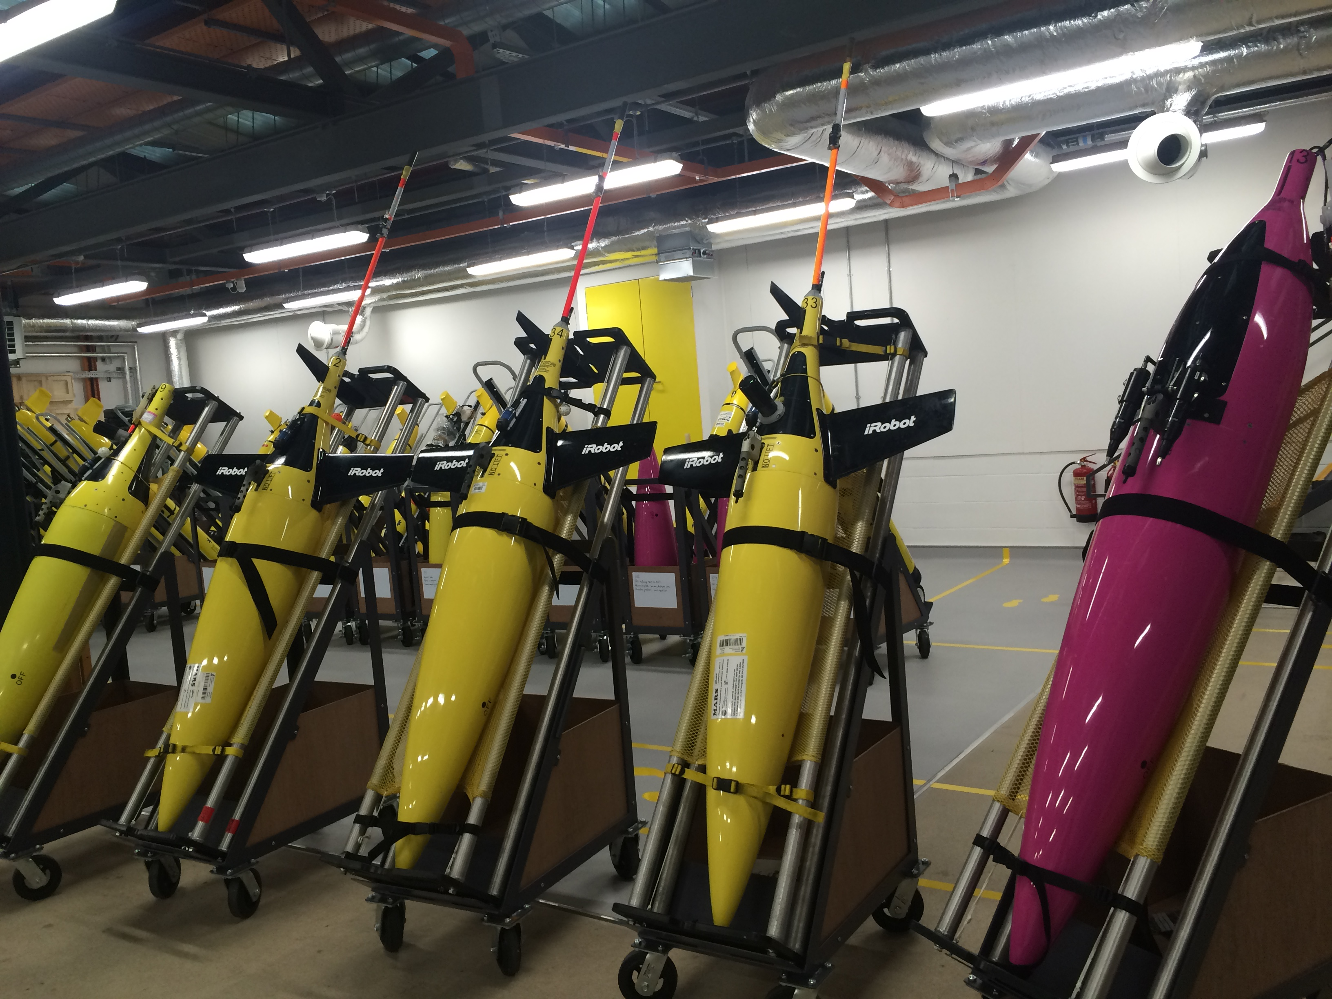

Slide 3
Defining the problem
Management and Finance want a measure of how well we are using the glider(s).
What are the phases of a complete glider deployment.
What is the relationship between this and the standard metric, “Glider days in the water”?
What does this relationship mean when planning?
What does it cost?
How can we improve it?

Slide 4
The problem - 1
To deploy and recover a glider you have to do some or all of:
      Prepare and ballast the glider
      Ship or freight it to a port or launch site
      Sit on the ship until you reach the work site
      Wait for good weather to go out and deploy
      Pilot during the actual deployment
      Sit on the ship between work site and port
      Ship or freight from the port
      Decommission the glider
      Calibrate the sensors

Slide 5
The problem - 2
For days-in-the-water, only one segment counts:
      Prepare and ballast
      Ship or freight to a port
      Sit on the ship until you reach the work site
      Pilot during the actual deployment
      Sit on the ship between work site and port
      Ship or freight from the port
      Decommission the glider
      Calibrate the sensors

Slide 6
Simplifying assumptions
Dividing the total deployment into 5 segments:
Preparation – Ballasting, functional checkout and pre-mission modifications
Freight outbound –time between leaving the workshop and entering the water
Deployment – Actually in the water
Freight inbound – the reverse of (2)
Decommissioning – bring back to ready-to-go status, instruments calibrated where required

Slide 7
Transporting your glider
Local transport: Lab to ship or site: 1 day or 1 week
Long distance transport: 1 week to 6 months
Time before actual deployment: Weather, ship transit time: 1 day to 6 months
2015 results:
Local deployments (SSB) mean time = 8 days (return = 8 days)
Other UK deployments mean time (OSNAP and EEL) = 35 days (return = 15 days)
Long distance deployments (Antarctic) mean time = 104 days (return = 124 days)

Slide 8
Refurbishment and recalibration
The other big consumer of time:
2015 Mean time for recalibration of sensors:
      Slocum Science bay = 160 days
      Seaglider CT sail = 65 days
      Aanderaa Optode = 108 days
      WetLabs puck = 36 days
    (Time between placing the order and receiving the sensor back)
    Excluding zero days – sensors not calibrated or glider lost.

Slide 9
What were the 2015 means?
Segment: | Days in the water | Transport there and back | calibration | % of deployment in the water
SSB | 44 days | 16 days | 90 days | 29.3%
OSNAP/EEL | 153 days | 50 days | 108 days | 49.2%
Antarctic | 27 days | 228 days | 99 days | 7.6%

Slide 10
How much does it cost? (theoretically)
Length of time out of the water can be costed in terms of depreciation at circa £20k p.a. depending on financial models. (5 years to depreciate in this case)
This is £55 per day, so 190 days of research ship transport “costs” £10,450, or ten times the cost of airfreighting.
Having a glider out of commission for 108 days while a sensor is recalibrated “costs” £5.9k. Spending money on a spare sensor reduces that to zero.
Providing a back-up glider increases the overhead costs: roughly £55/day of freighting - £825, £2.7k and £12.5k for the 3 examples.

Slide 11
A few comparisons.
A 3-month calibration delay is 17% of the cost of a science bay, which is about 30% the cost of a glider.
Seaglider CT and WetLabs puck = 18% of a glider
Optode (common to both) = 7% of a glider

Slide 12
How to improve the statistics?
Increase deployment time.
Reduce shipping time.
Purchase spare sensors.
Use a better indicator than days in the water.
Reduce delays around calibration.

Slide 13
Conclusions
Purchasing extra sensors is a one-off cost that allows faster turn-around of gliders.
Purchasing expensive spare sensors does not always make financial sense.
Fewer, longer missions make the most efficient use of your glider fleet.
Reduce shipping time wherever possible: the least expensive is not always the cheapest.
Glider days in the water is not a usable metric if you are transporting gliders around the world, especially if you use the cheapest means.
A reasonable figure for “full usage” of a glider fleet in home waters is 30%-50%.

Slide 14
Thank you
Any questions?

