Slide 1

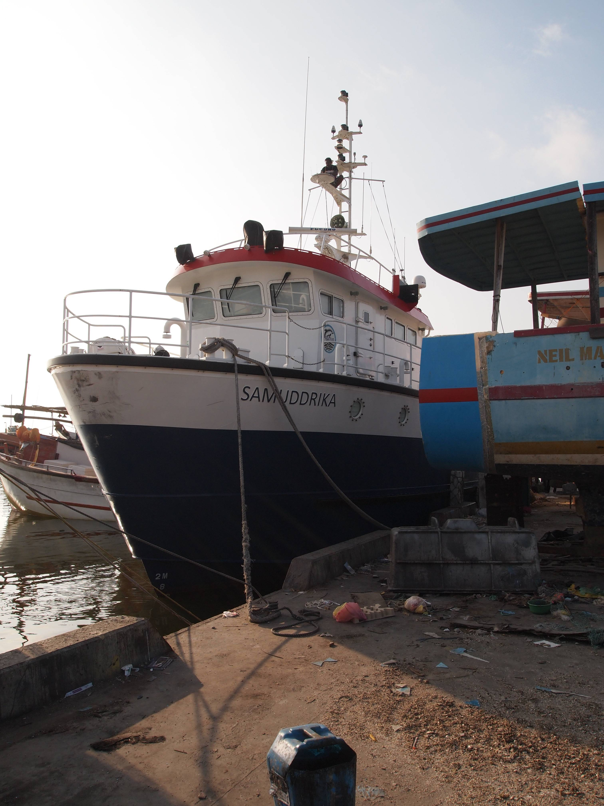
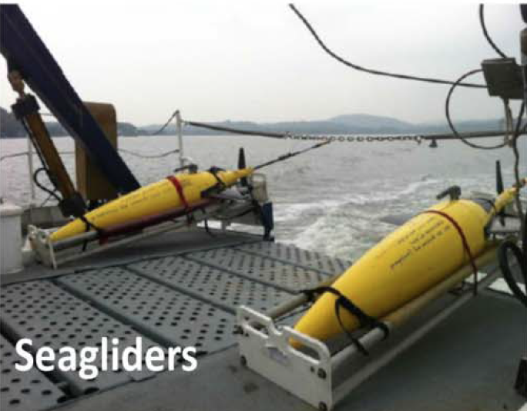
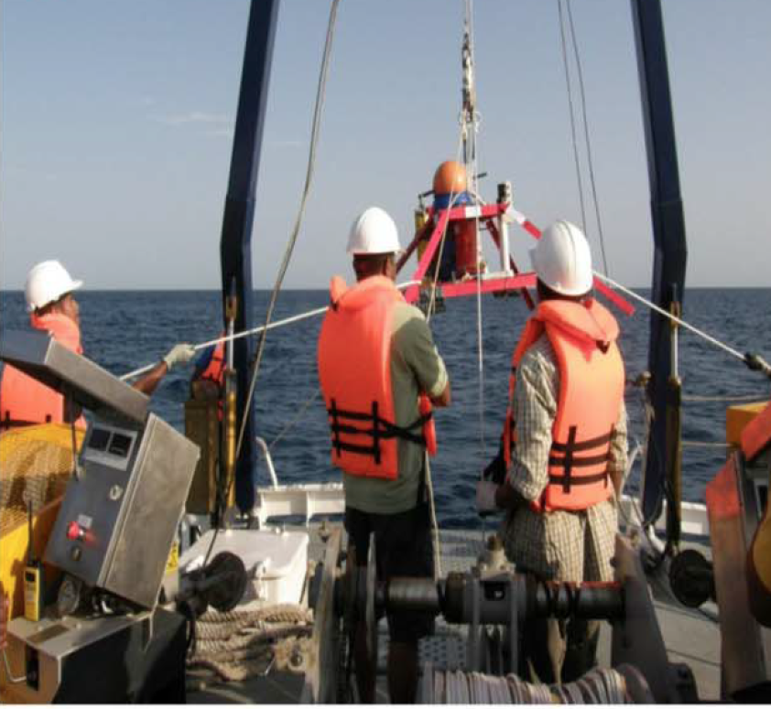
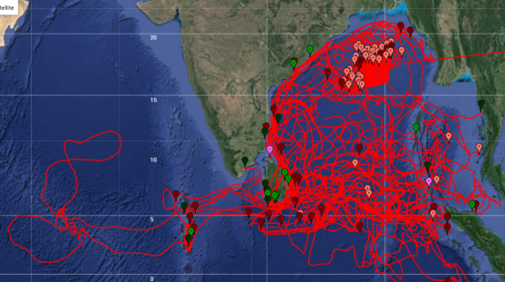
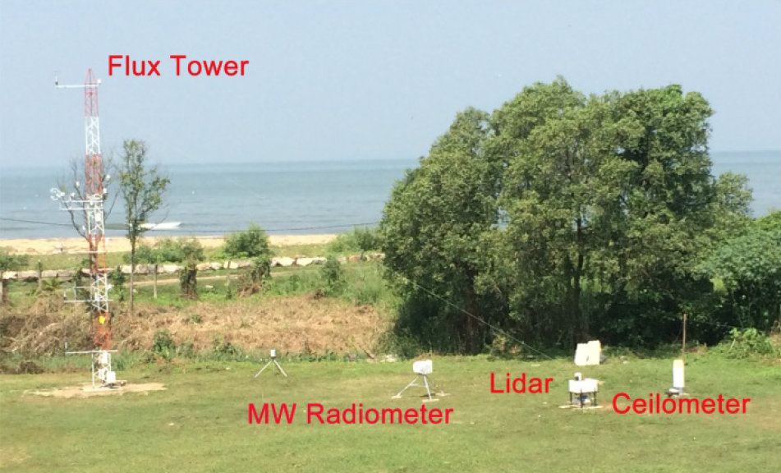
Collaborative Observations of Boundary Currents, Water Mass Variability and Monsoon Response in the Southern Bay of Bengal
ASIRI
EBOB
Luc Rainville^{1,} Craig M. Lee¹, Priyantha Jinadasa², Luca Centurioni³, Harindra J. Fernando⁴, Varena Horrmann³, Uwe Send³ and Hemantha Wijesekera⁵
¹Applied Physics Laboratory, Univ. of Washington, ²National Aquatic Research Agency, Sri Lanka, ³Scripps Institution of Oceanography, ⁴Univ. of Notre Dame, ⁵Naval Research Laboratory
PIES
Drifters

Slide 2
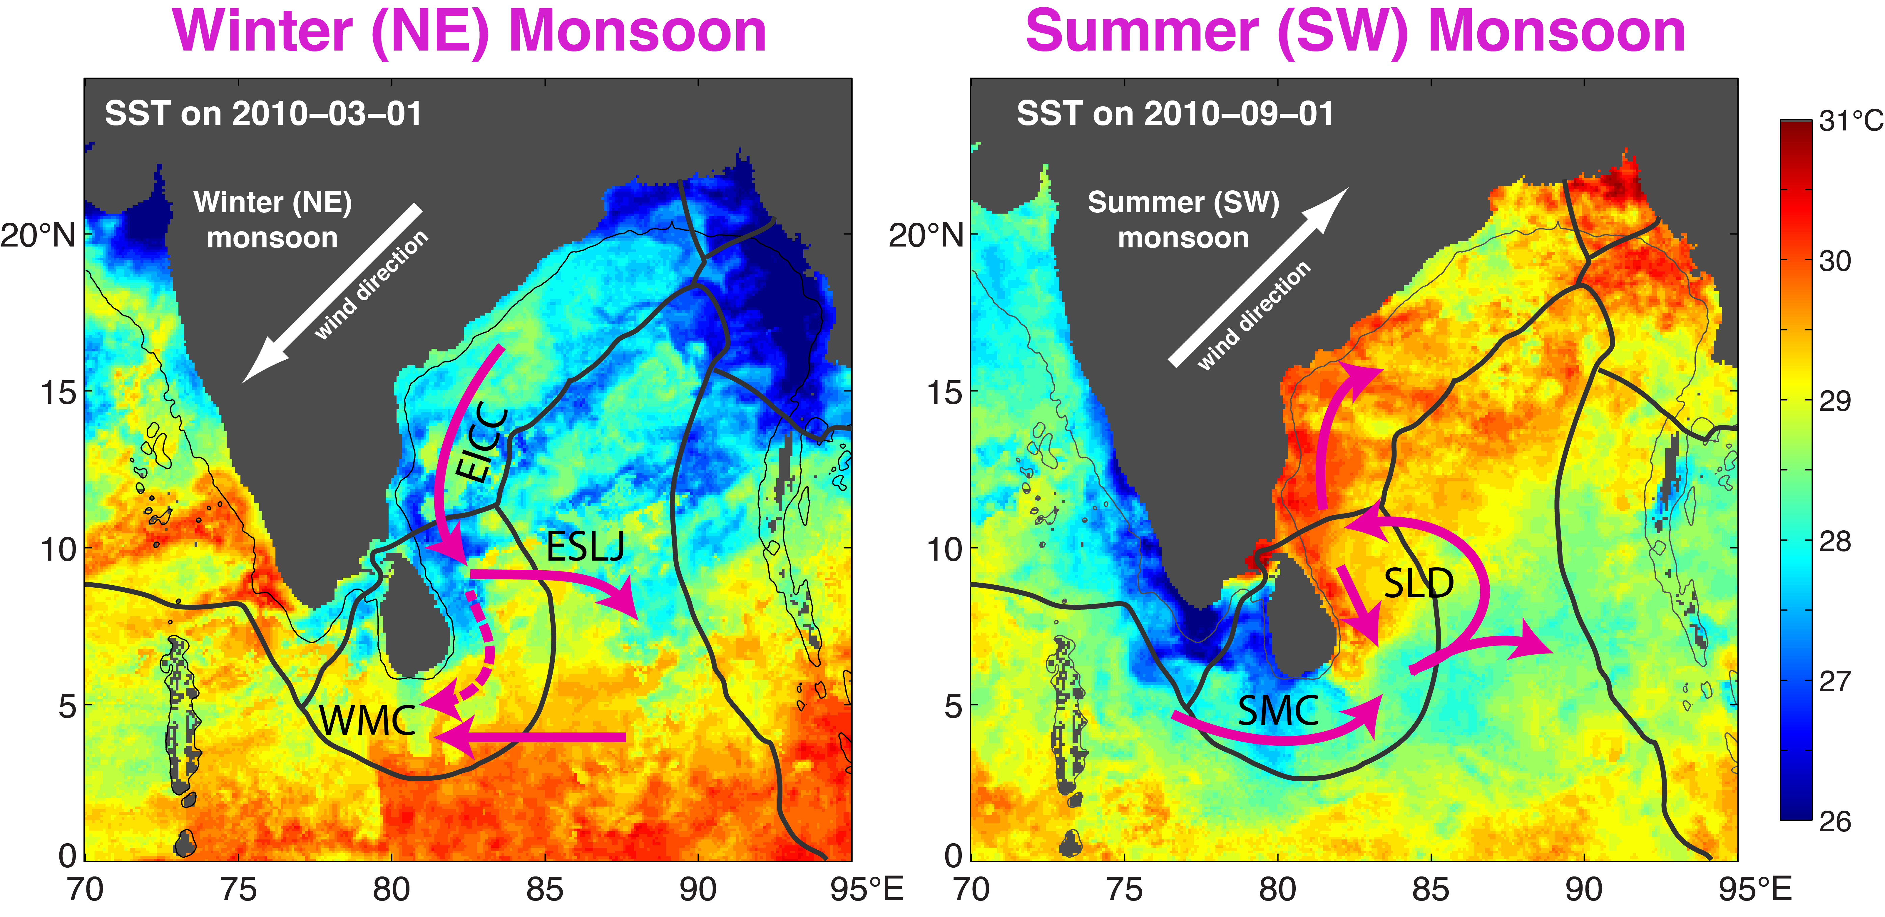
ASIRI-EBOB Science Objectives
ASIRI
EBOB
Characterize variability in circulation and mixing around Sri Lanka in the context of inter-basin exchange.
Examine the impact of freshwater distribution on SST, barrier layer evolution, stratification and circulation.
Characterize atmospheric boundary layer and ocean mixed layer variability and feedbacks to longer timescale patterns.

Slide 3
Seasonal Cycle of Surface Currents
ASIRI
EBOB
Maps of monthly mean, smooth, geostrophic currents from satellite altimetry
Northeast
Monsoon
Important questions:
Vertical structure?
Water mass variability?
Modulations of cross-basin exchanges?
Southwest
Monsoon

Slide 4
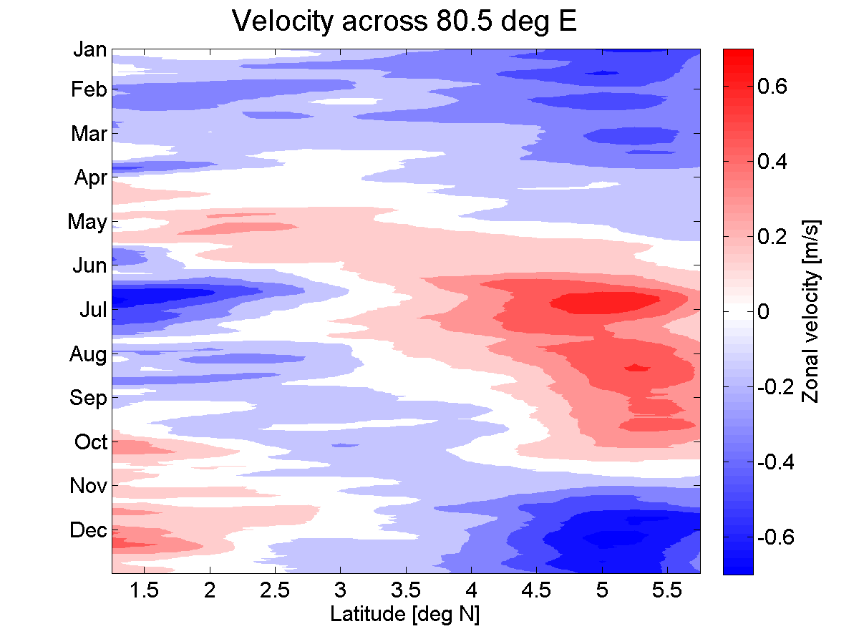
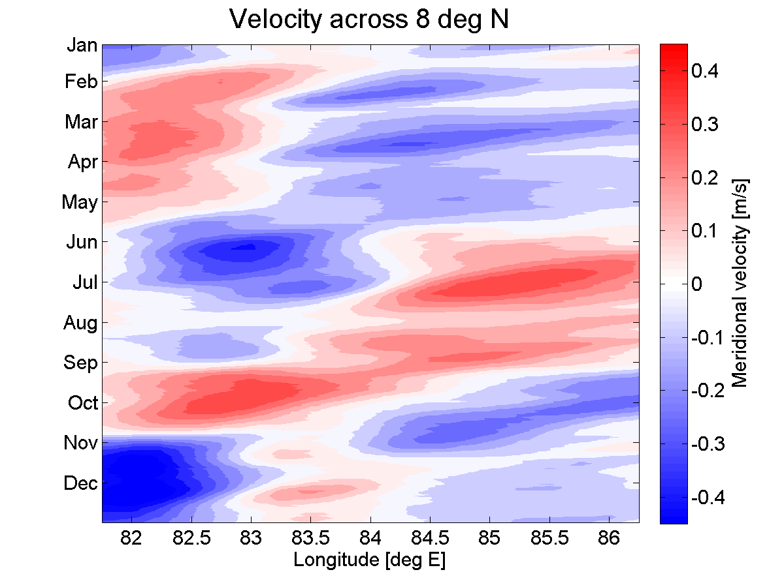
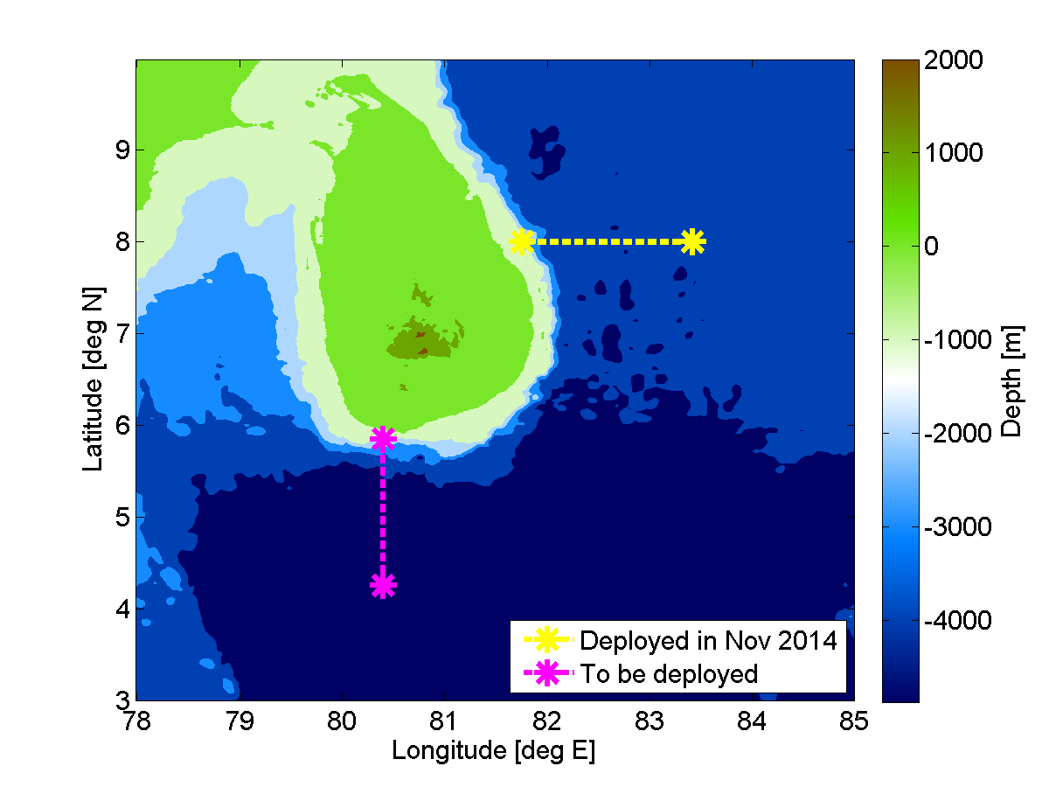
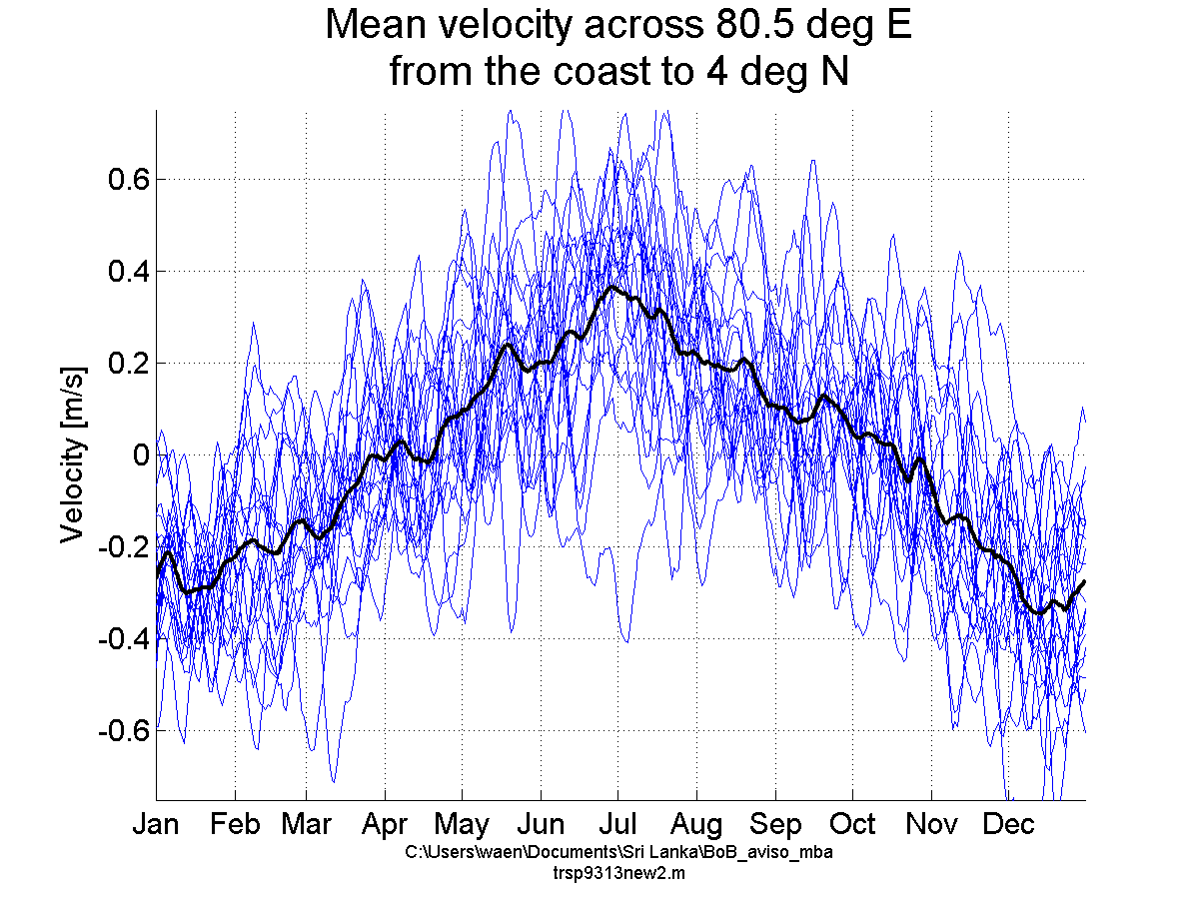
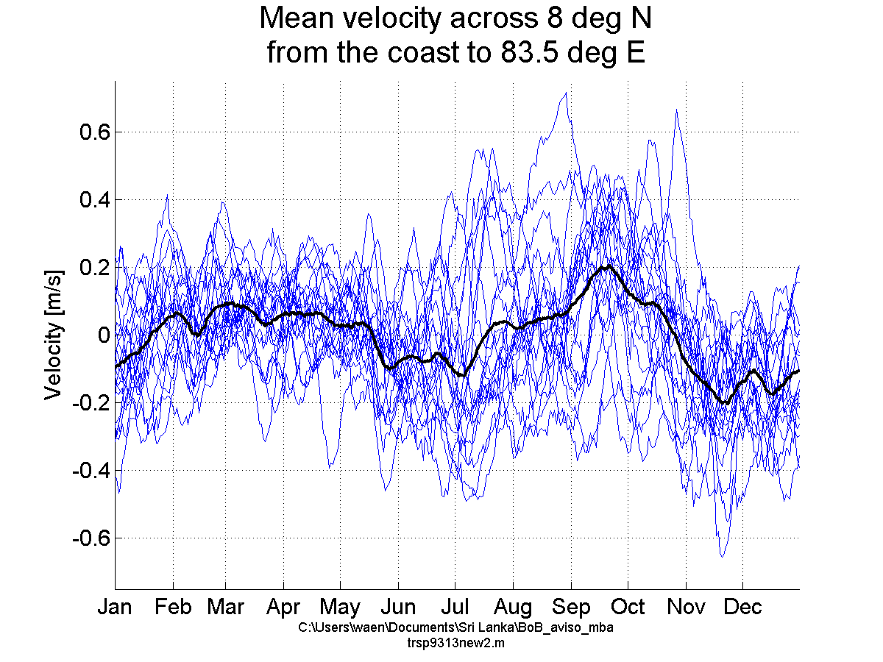
ASIRI
EBOB
Seasonal Cycle & Interannual Variability
Mean surface currents from satellite altimetry (1993-2013).
Annual cycle at 80.5° E
Large interannual variability.

Slide 5
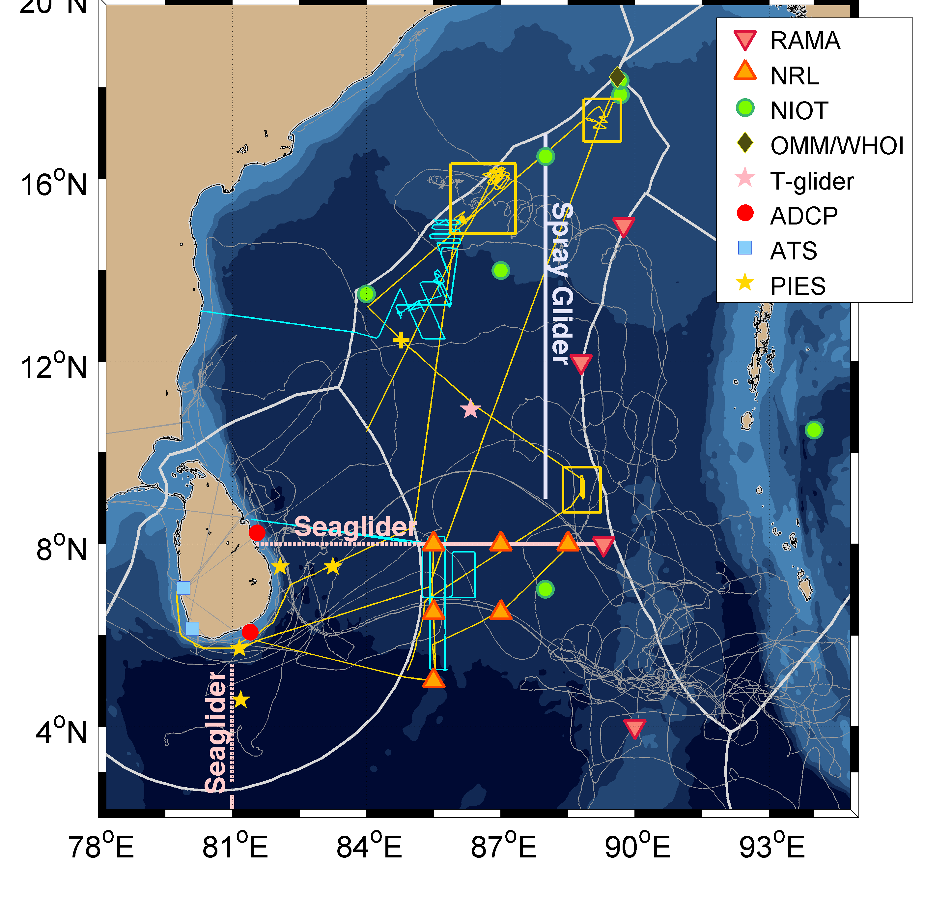
ASIRI
EBOB
Observations in the Southern Bay of Bengal
Sustained observations around Sri Lanka include:
Shelf ADCP moorings 2013-present (NARA)
Repeat hydrographic surveys 2013-present (NARA)
Central basin moored array 2013-2015 (NRL)
Boundary Current PIES arrays 2015-2016 (SIO)
Boundary Current glider sections 2014-2016 (APL-UW)
Drifter deployments 2013-2015 (SIO)
Atmospheric boundary layer sites 2015 (UND)
(Wijesekera et al. 2015)

Slide 6
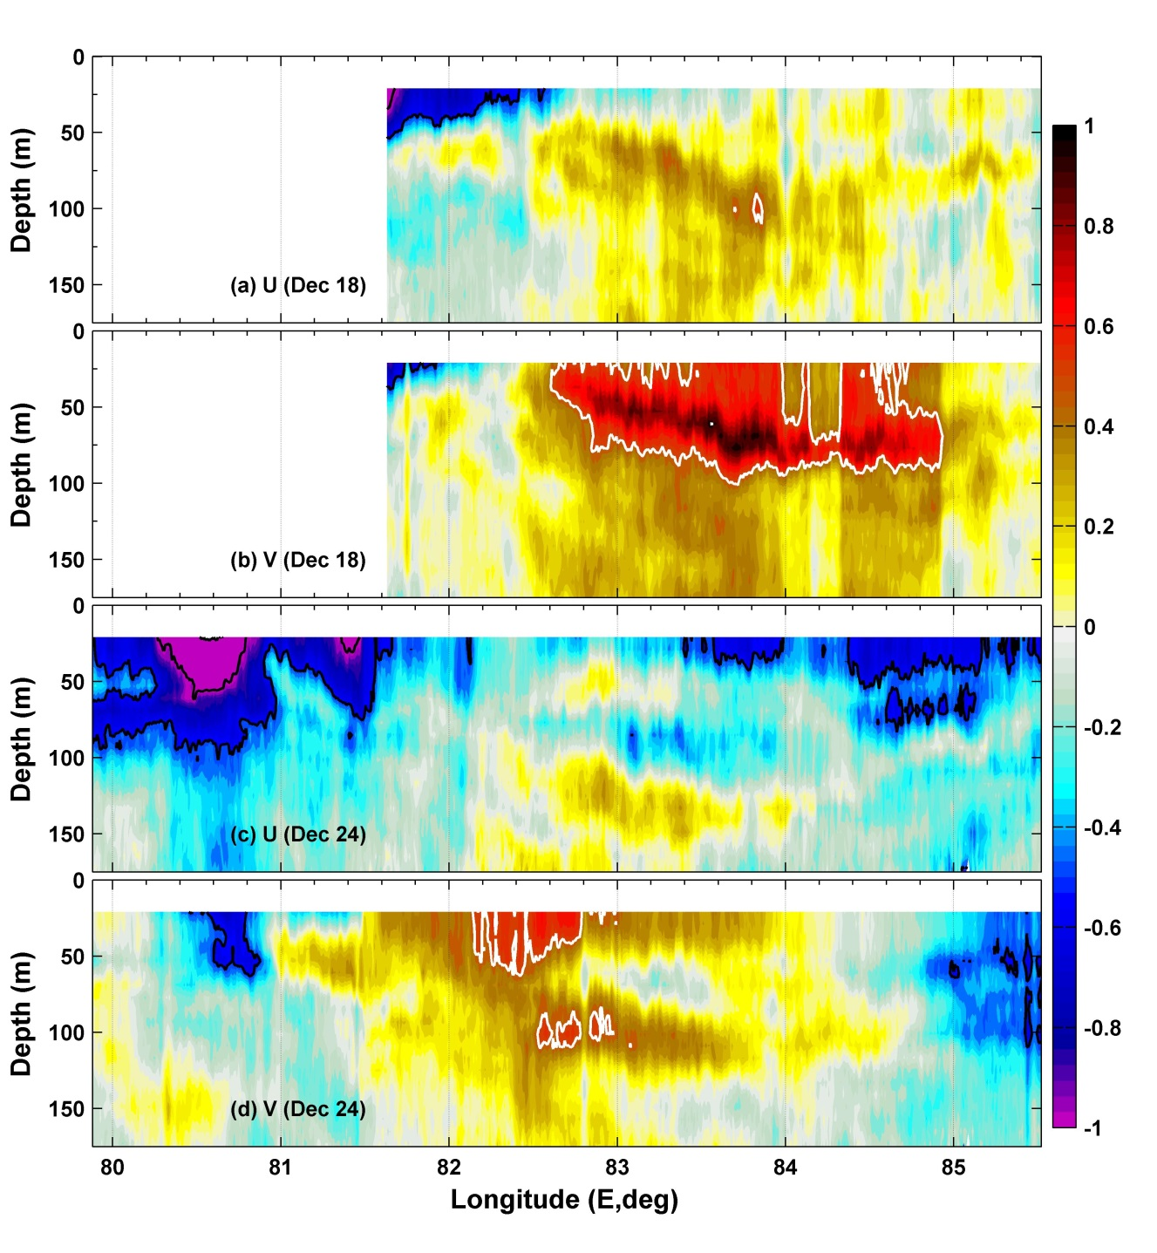
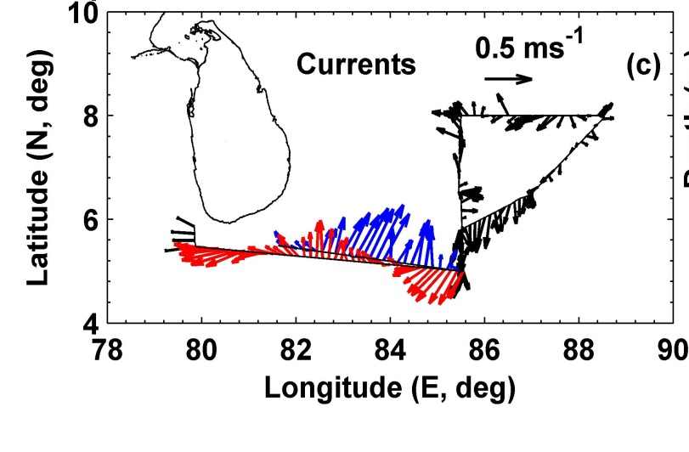
Northeast Monsoon- December 2014
ASIRI
EBOB
Depth-average velocity (22-175 m)
EICC
Arabian Sea Inflow
EICC
Freshwater exported from Bay of Bengal into Arabian Sea within EICC.
Saline import into Bay of Bengal further offshore.
(Wijesekera et al. 2015)

Slide 7
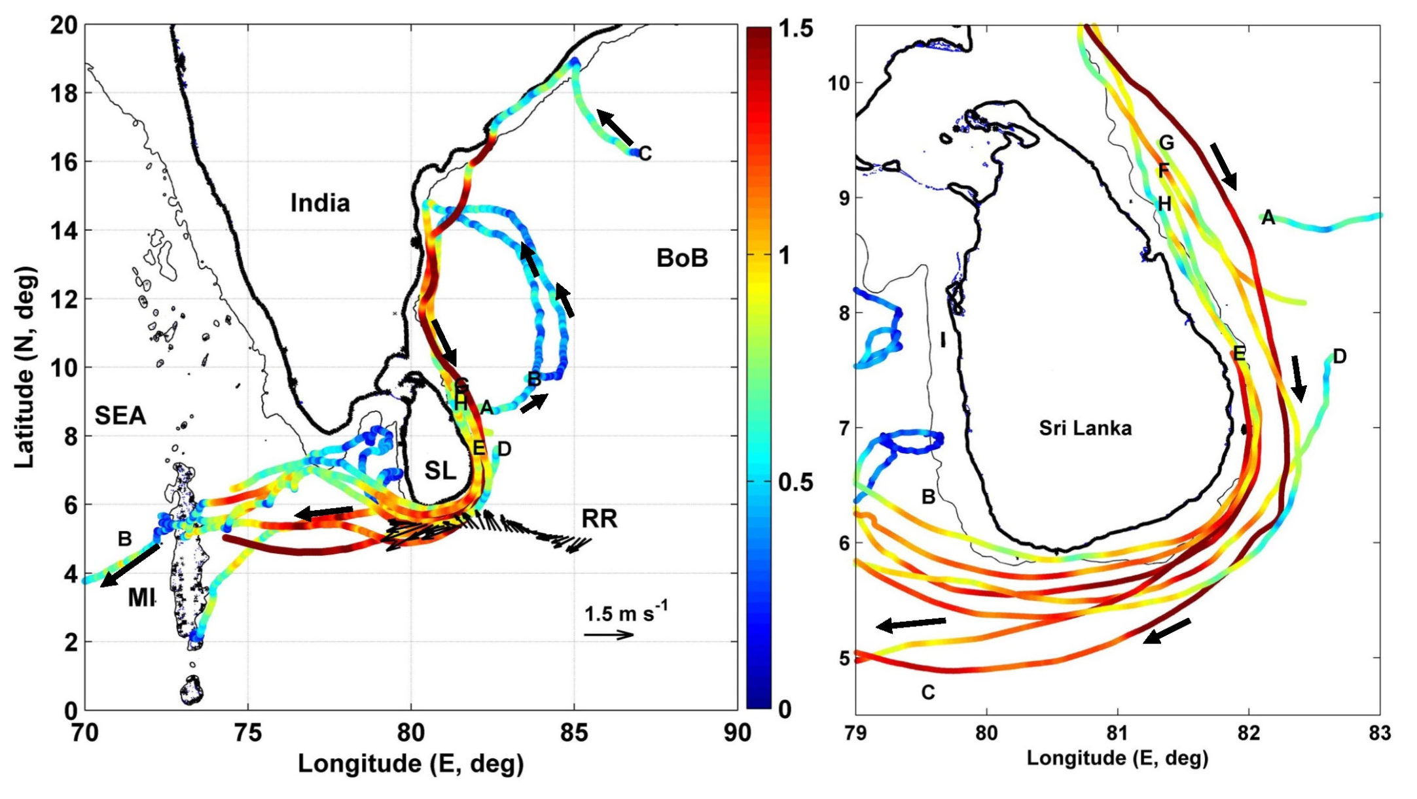
Northeast Monsoon Nov-Dec. 2013 Surface currents from drifters (Wijesekera et al. 2015)
Surface Drifter Tracks & Surface Velocity (Nov-Dec 2013)
ASIRI
EBOB
speed (m/s)
EICC broadens as it turns westward.
(Wijesekera et al. 2015)

Slide 8
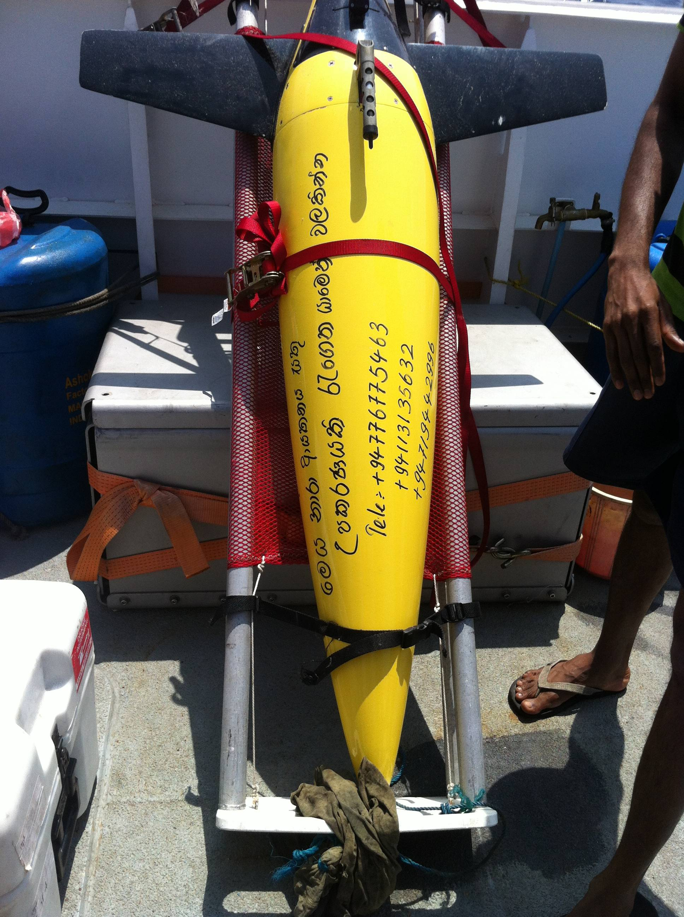
ASIRI
EBOB
Collaborative Operations in Sri Lanka

Slide 9
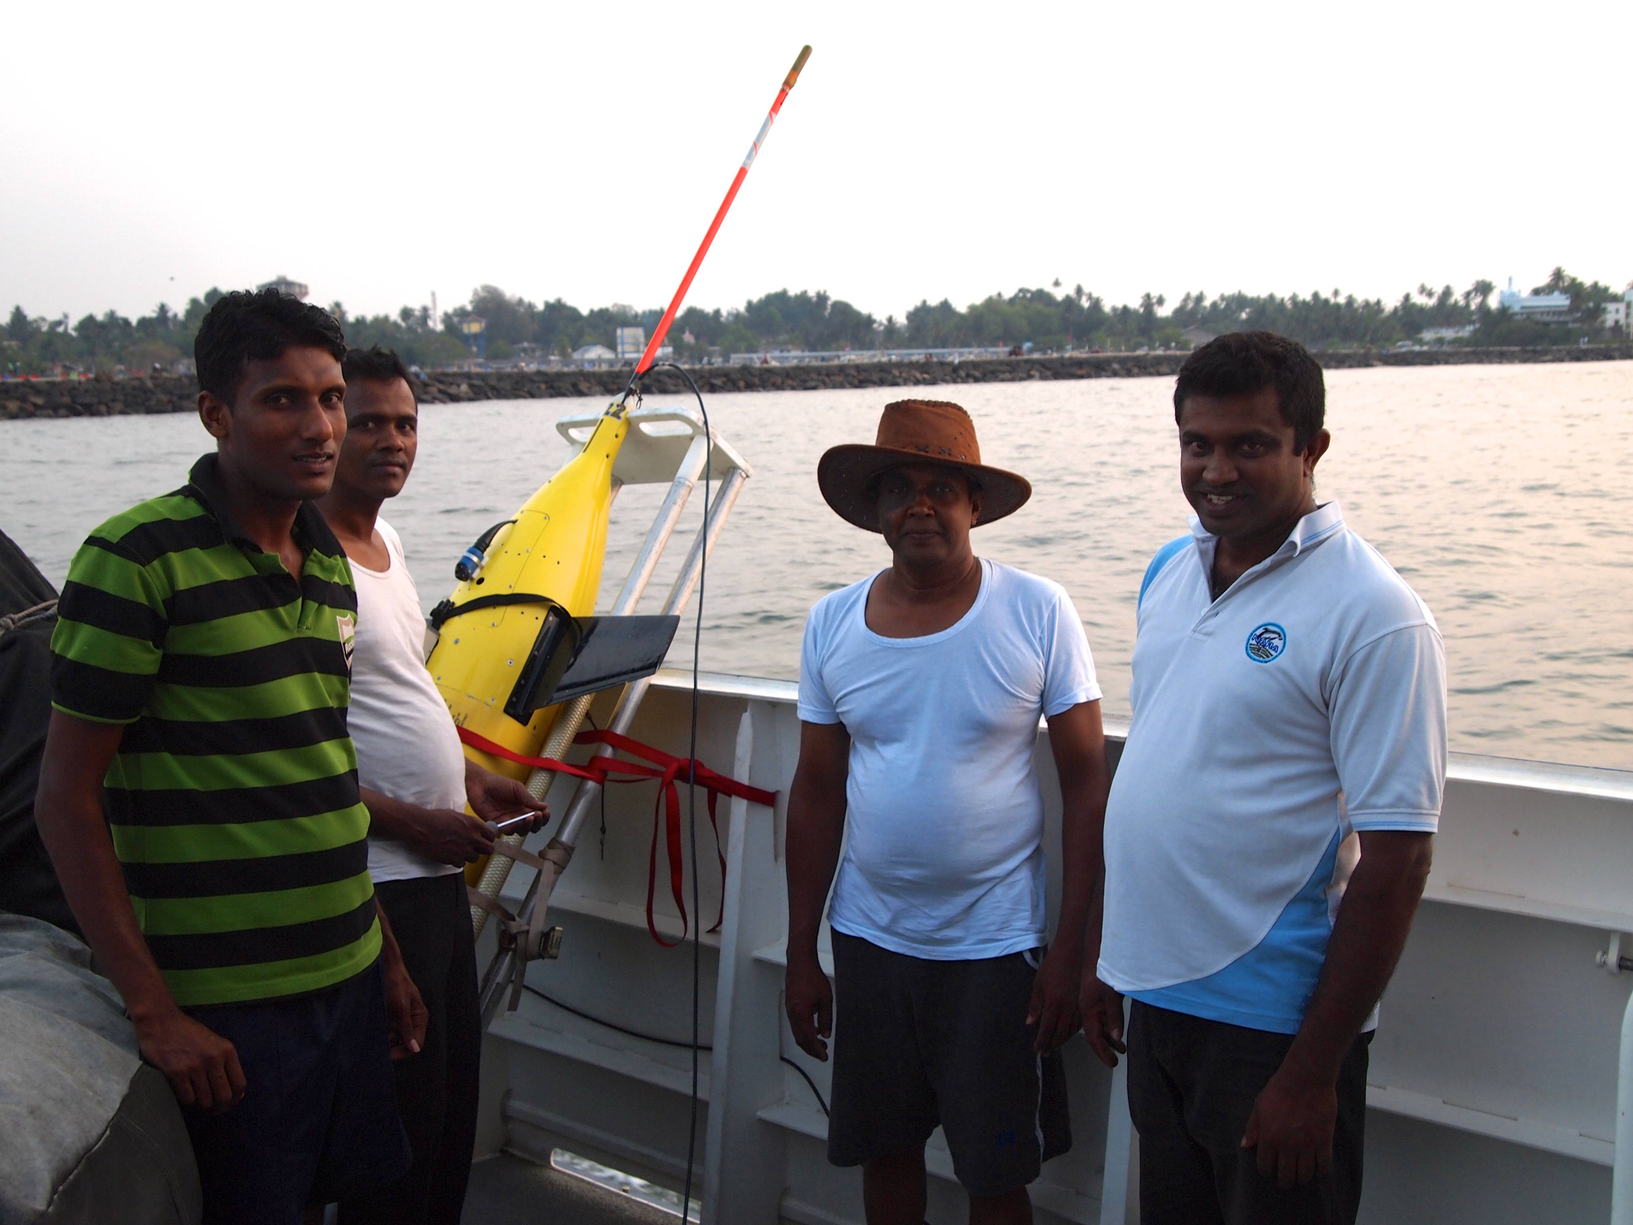
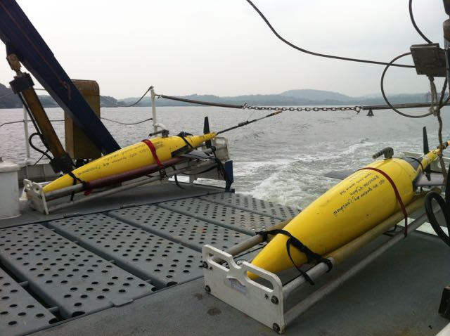
ASIRI
EBOB
Collaborative Operations
Collaboration with Sri Lanka
Joint deployment of 8 Seagliders from R/V Samuddrika & chartered vessels (Jokinen, Rainville)
Week-long training course for Samuddrika marine technicians conducted by (Ben Jokinen , former tech for R/V Pt. Sur).
Collaboration with India
Lectures on technologies and approaches (Lee & D’Asaro).
uCTD set-up and training for R/V Sagar Nihdi (Adam Huxtable).
Seaglider training and support (INCOIS)

Slide 10
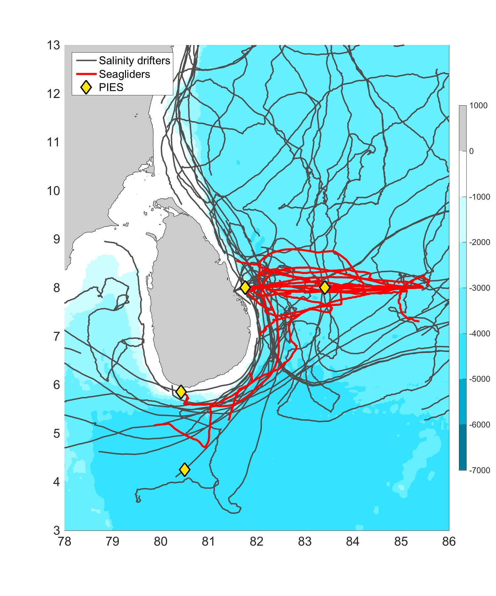
ASIRI
EBOB
Collaborative Operations
1600 profiles of temperature, salinity, dissolved oxygen, and optical backscatter from the surface to 1000m
About 18 sections along 8°N, from the shelf break on the west coast of Sri Lanka into international waters, 400 km to the east

Slide 11
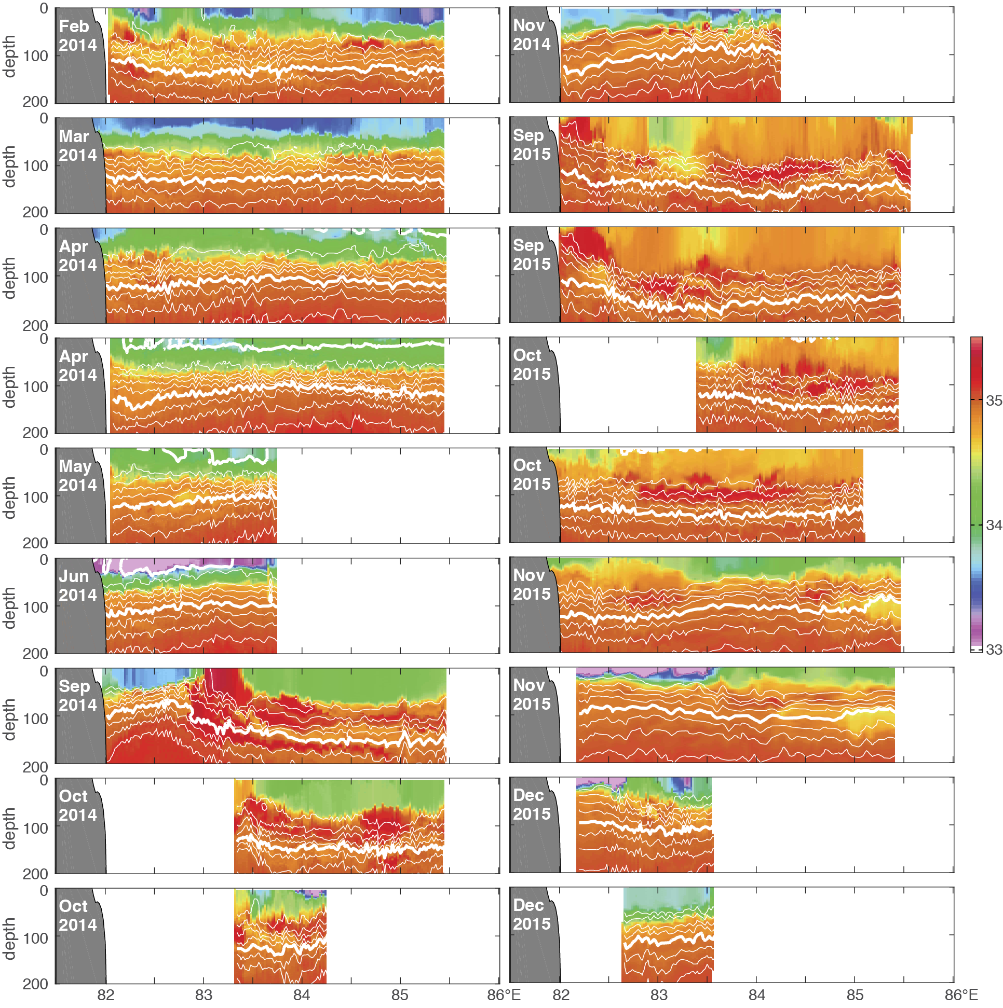
Seaglider Sections of Salinity along 8°N (2014-2015)
ASIRI
EBOB

Slide 12
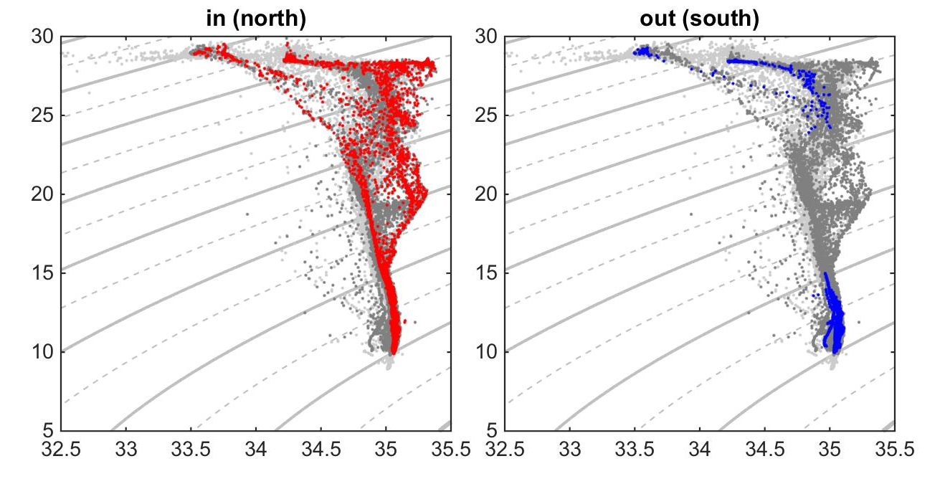
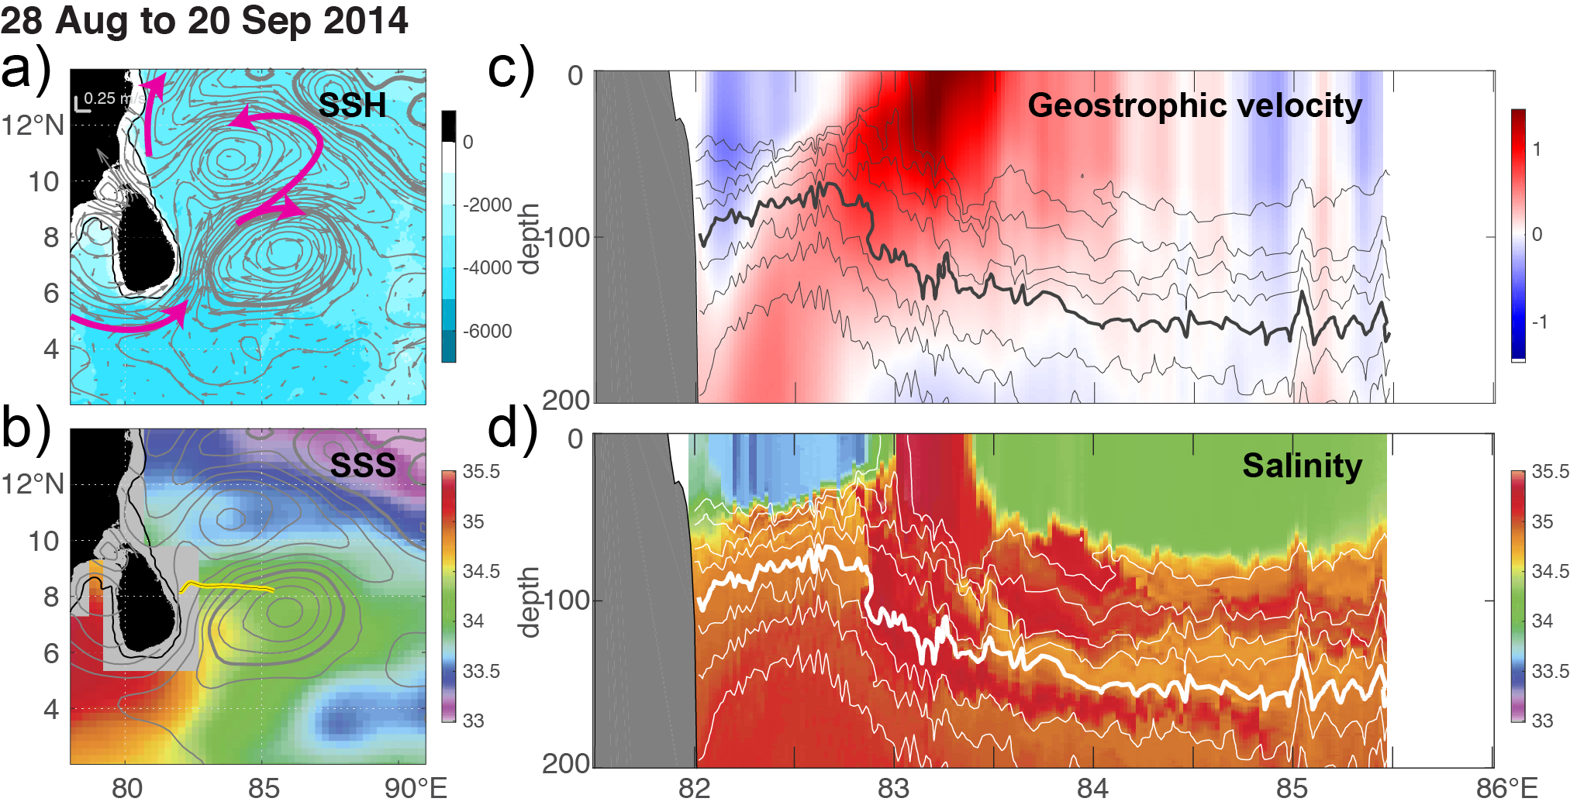
ASIRI
EBOB
September (post-Southwest Monsoon)
Boundary Flow Across 8° N
Saline Arabian Sea water circulates around the Sri Lanka Dome.
Bay of Bengal freshwater flows southward along the coast in a near-surface layer.
?
into BoB
out of BoB
EICC
Arabian Sea Water
Sri Lanka Dome

Slide 13
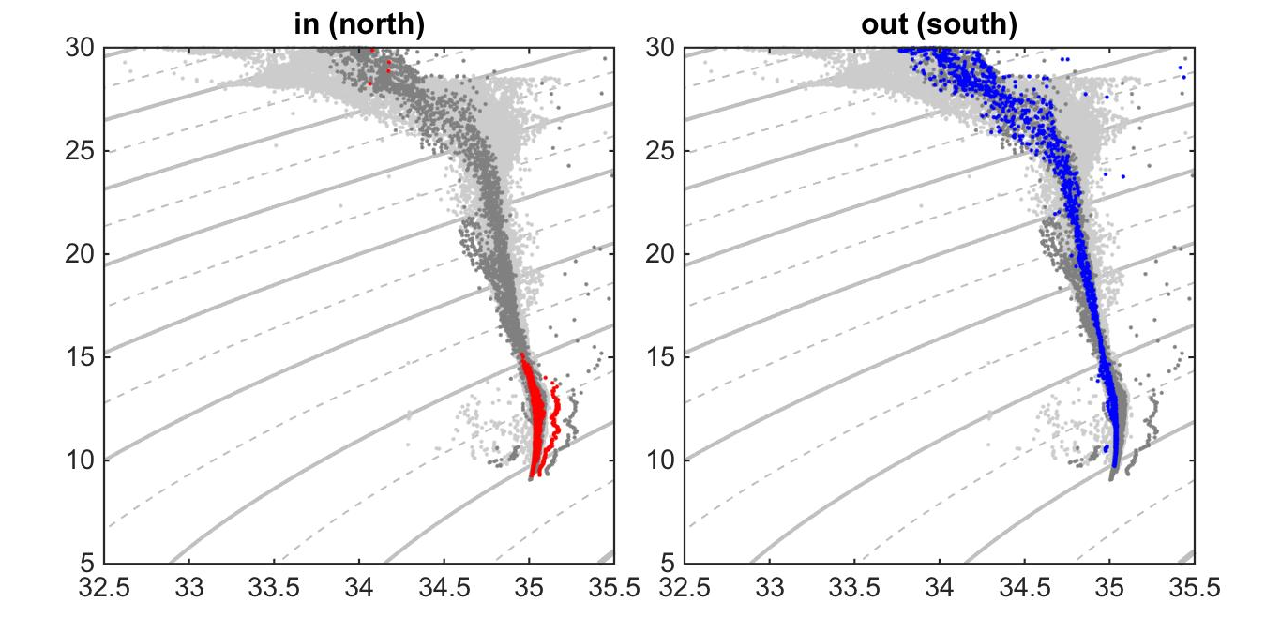
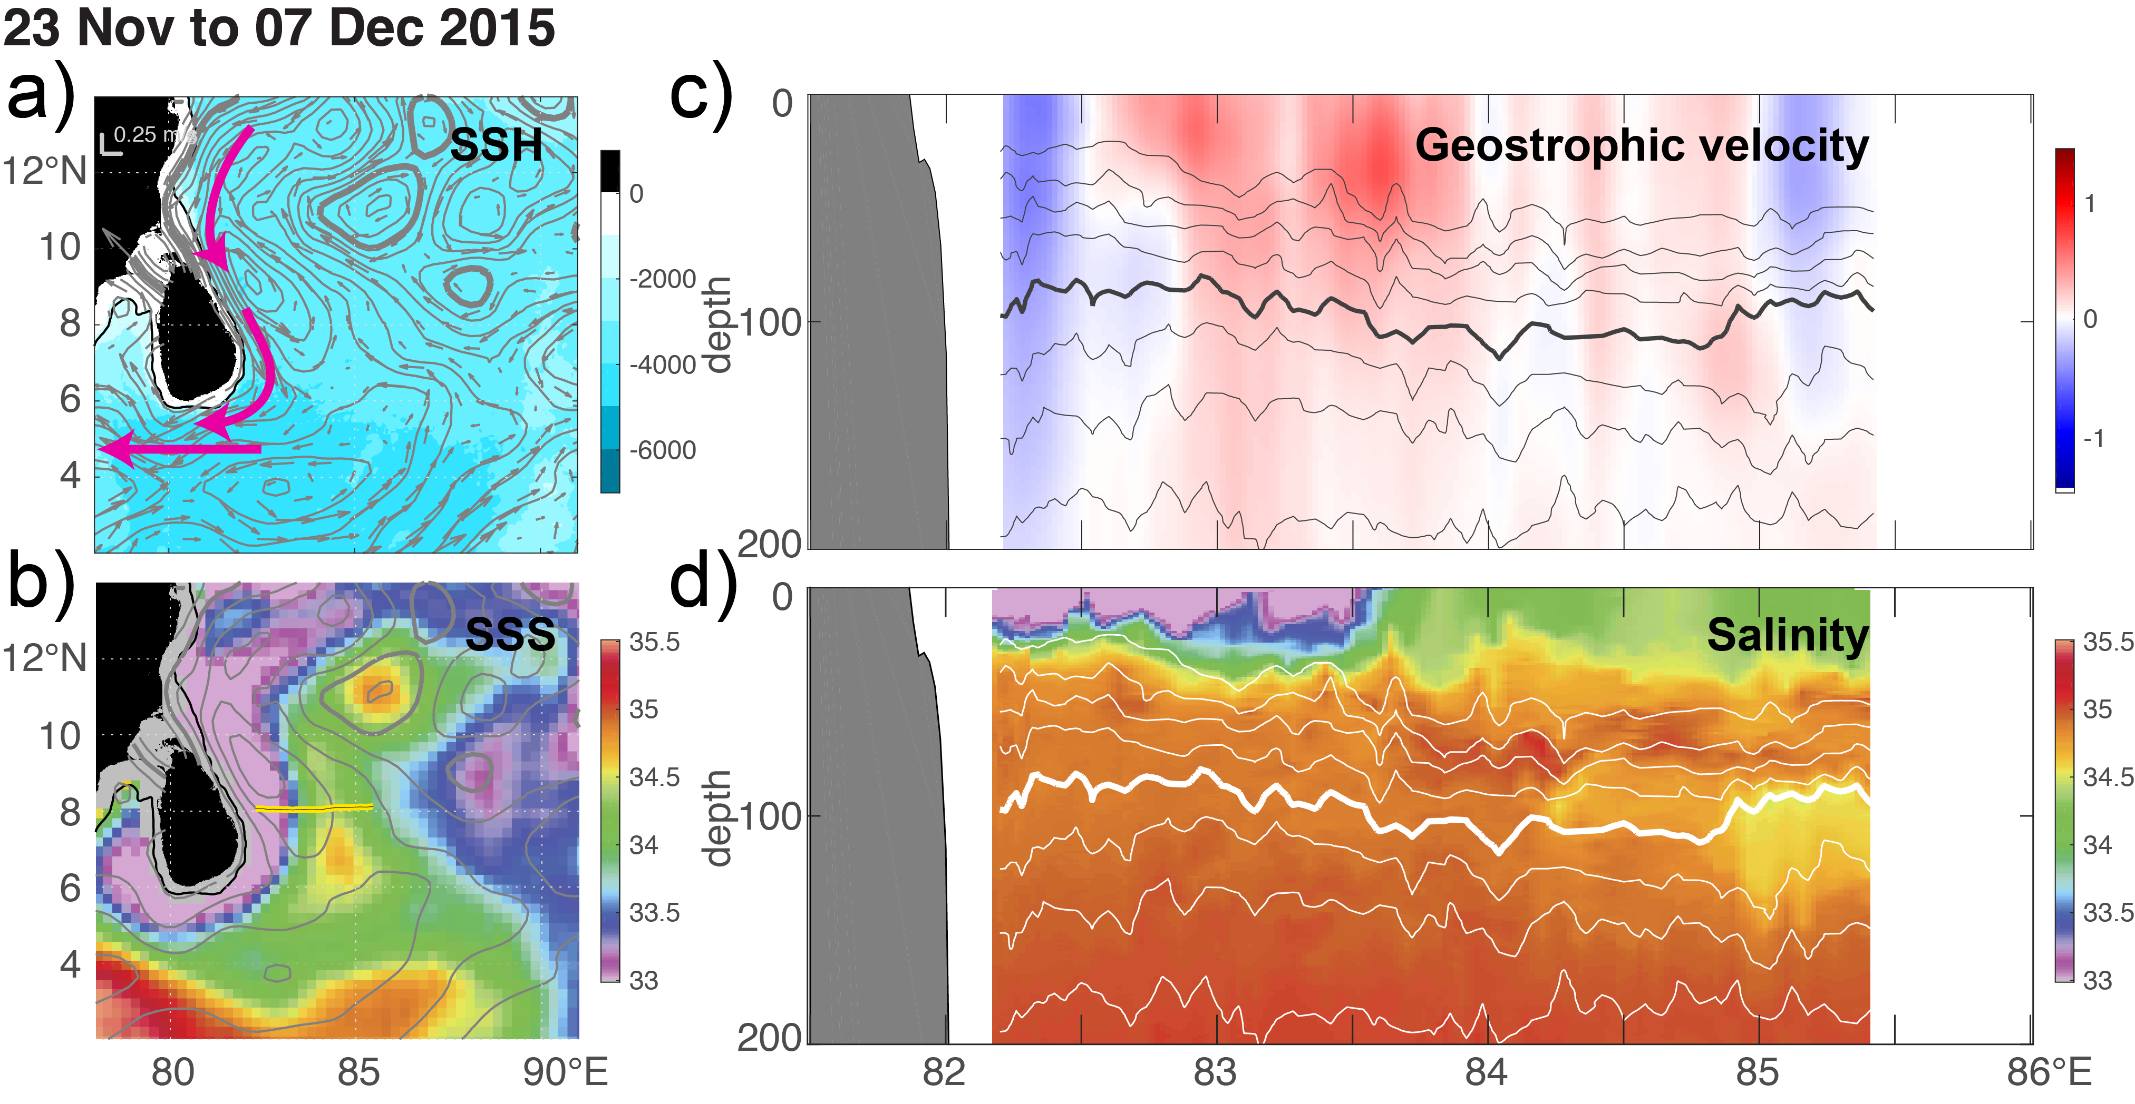
ASIRI
EBOB
April (spring inter-monsoon)
Boundary Flow Across 8° N
Bay of Bengal freshwater flows southward in a broad, near-surface layer.
into BoB
out of BoB
into BoB
out of BoB
EICC

Slide 14
ASIRI
EBOB
Summary
Extensive measurement program focused on:
Circulation around Sri Lanka.
Monsoon-mediated exchange between the Bay of Bengal and Arabian Sea.
Complementary platforms provide 2+ years of observations of the boundary currents and surroundings.
Salty Arabian Sea inflow during much of the year (perhaps even during the winter monsoon).
Sustained observations require strong local involvement for logistics, and science objectives.

