Slide 1
KUGON
Korea Underwater Glider Operation Network
JongJin Park and DongYoung Kim
Center for Autonomous Best-Integrated Surveillance System
Kyungpook National University

Slide 2
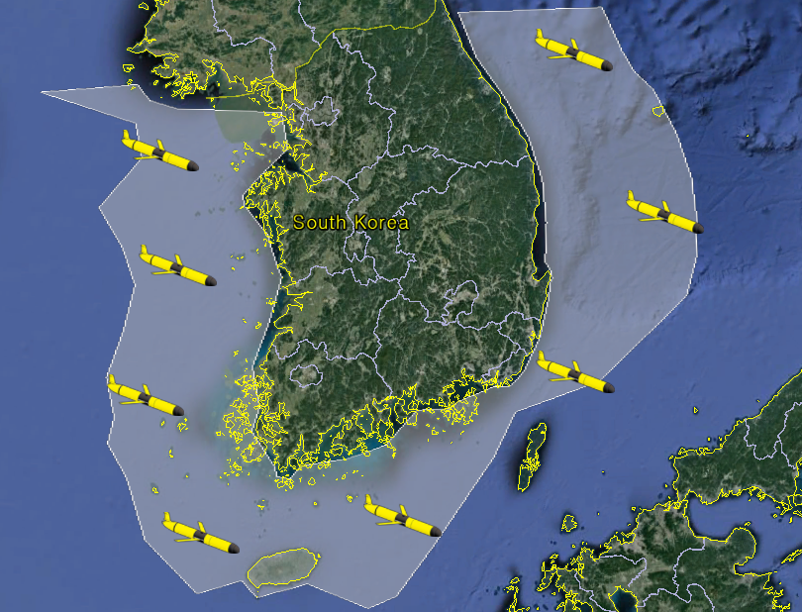
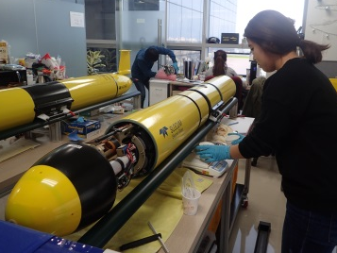
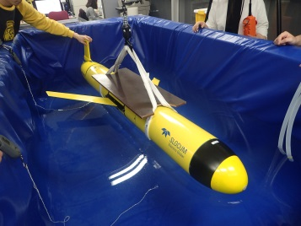
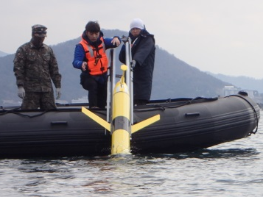
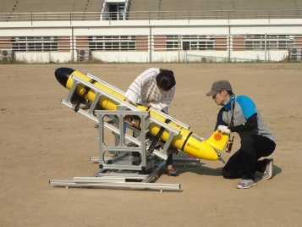
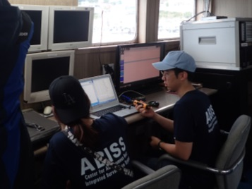
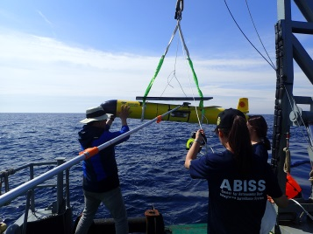
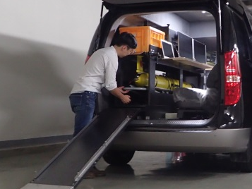
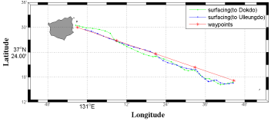
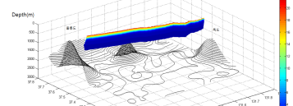
KUGON
Korea Underwater Glider Operation Network
Purpose :
Building infrastructure for
glider operation
Any necessary work for operational
use of glider
(Optimizing glider missions to
reduce operation risk)
Goal:
Replacing and improving regular
ship-based measurements
Initiating integrated autonomous
marine observation and surveillence
system

Slide 3
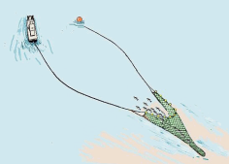
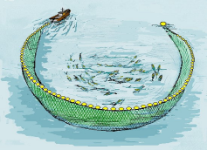
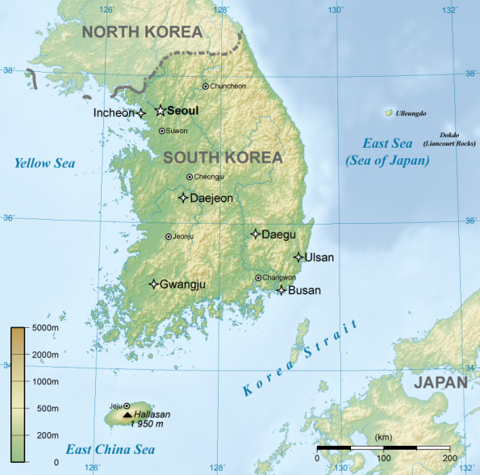
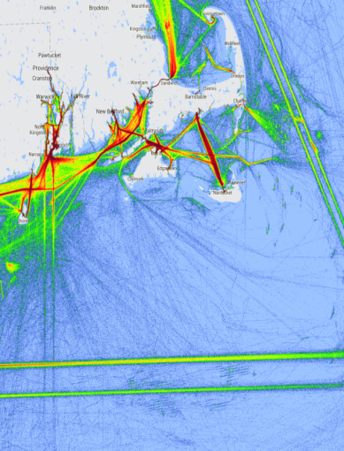
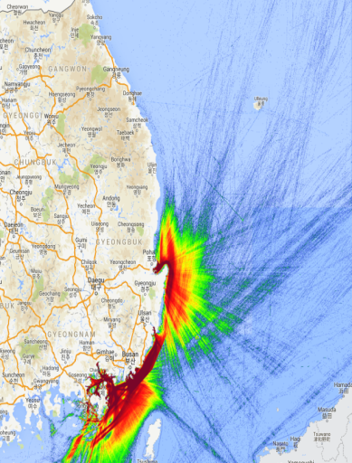

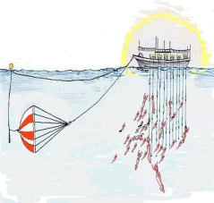
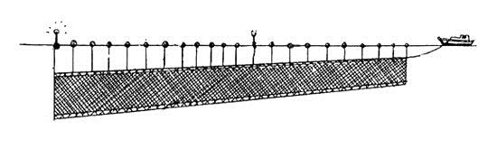
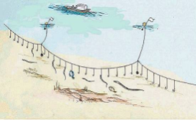
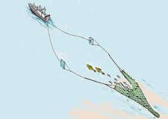

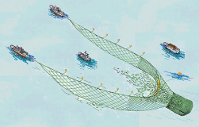
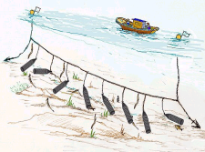
Needs of KUGON Project
Tough marine environment for Autonomous Glider Operation
Complex ship traffic
Various types of
fishing activity
Various and energetic current system
Woods Hole (US)
South Korea
> 2000m
< 80m
~150m
< Comparison of ship traffic between
US and Korea >
< Geometry around
the Korean Peninsula >
< Fishing gears in Korea >
Operation Risk Management is necessary!
Notes:
크레인으로 내리는 사진..

Slide 4
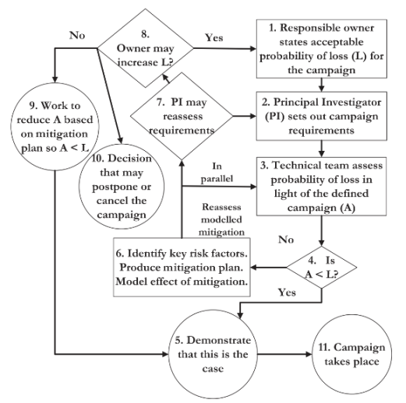
Operation Risk Management
Concept of Operation Risk Management
Goal Setting
Operation Environment
Analysis
Don’t
GO
Ship Traffic
Environment
Operation
Risk
Evaluation
Griffiths and Trembranis (2006)
Fishery Environment
GO-
Don’t GO
Decision
Optimized
Mission Design
GO
Current Environment
Feedback
Optimizing Data Transfer Cycle,
Route & Diving Depth Setting,
Contents of Data Transfer,
Observation Cycle and etc.
Optimized Mission Design using Operational Risk Analysis

Slide 5
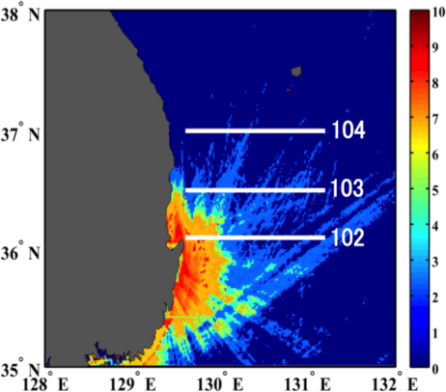
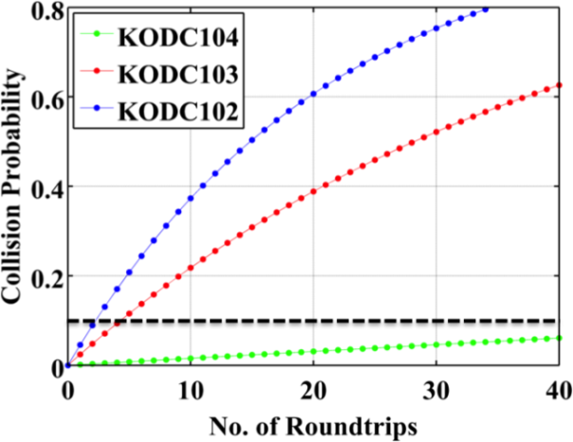
Glider-Ship Collision Probability Model
Glider-Ship Collision Probability Model
Based in Kaplan-Meier Survival Model
Glider-Ship Collision Probability in the specific area(1km×1km) cell
[Ship Traffic Density Distribution (unit: ships per day per km²)
and Virtual Glider Trajectory]

Slide 6
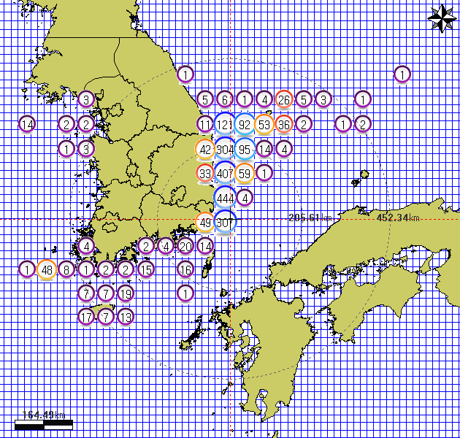
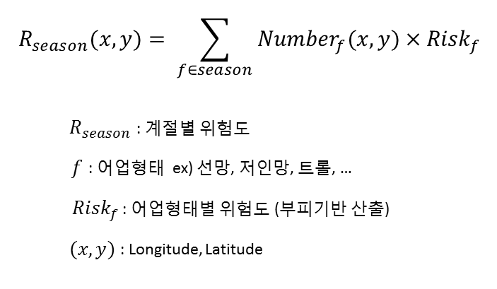

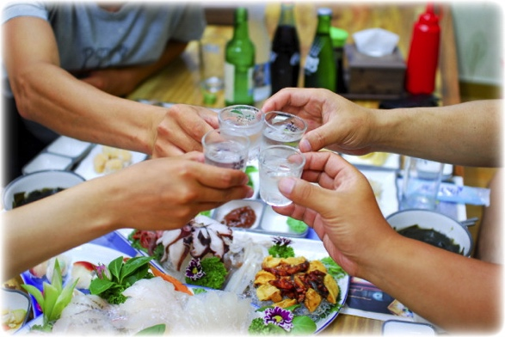
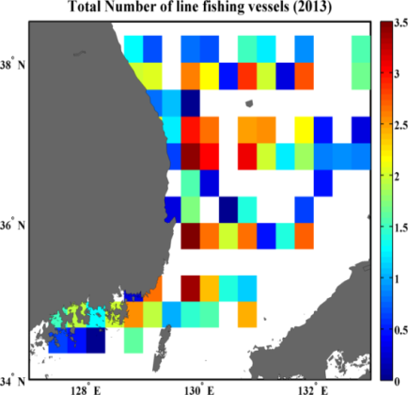
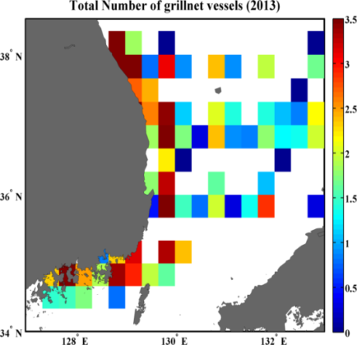

Fisheries of the Korea Ocean
Risk by Fisheries
Seasonal Risk
Investigating the Number of Fishing vessels
Total Number of Fishing Vessels
by Fishery Type and Fishing Location
Seasonal Risk Calculation
The information of fishing activities is not
enough. Difficult to predict the risk by fishing.
The most important risk management work is to drink with local fishermen!
[Total Number of Line fishing Vessels]
[Total Number of Grillnet Vessels]

Slide 7
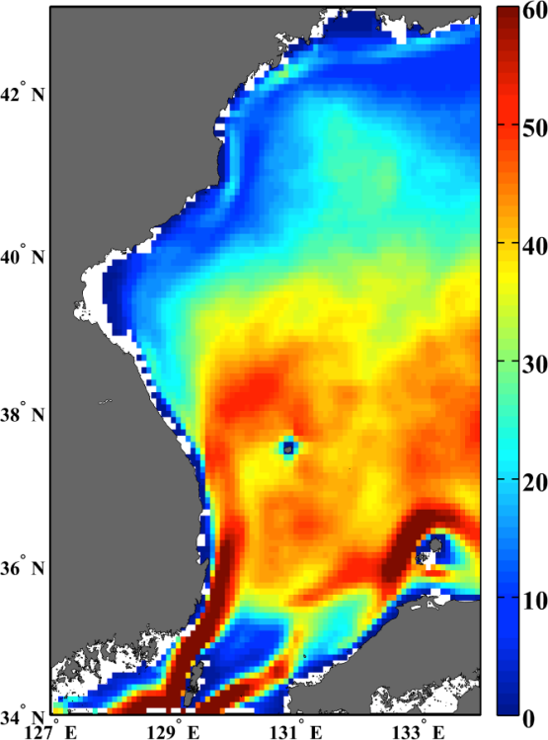
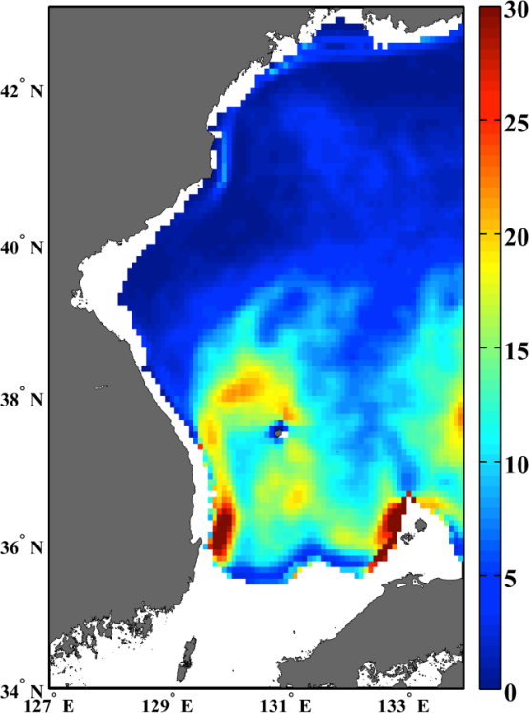
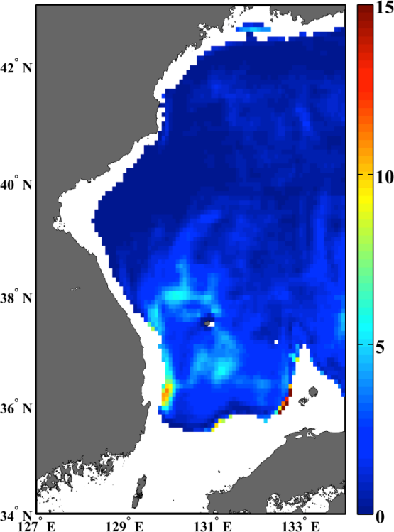
Current of the East Sea
Current prevalence estimates from 13 year-long HYCOM Reanalysis Data
Occurrence Probability of currents stonger than 0.25m/s
(a)U030m
(b)U200m
(c)U400m
Prevalence (%)
Prevalence (%)
Prevalence (%)
Gliders in the southern part of the East/Japan Sea should dive deeper than 400m at least!

Slide 8
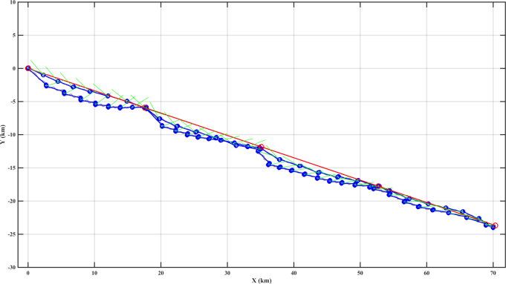

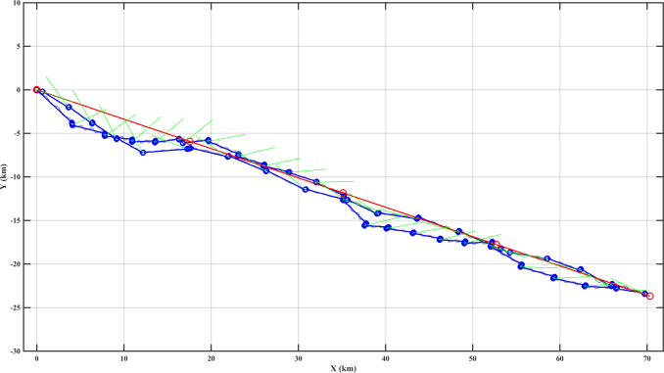


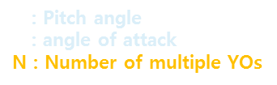
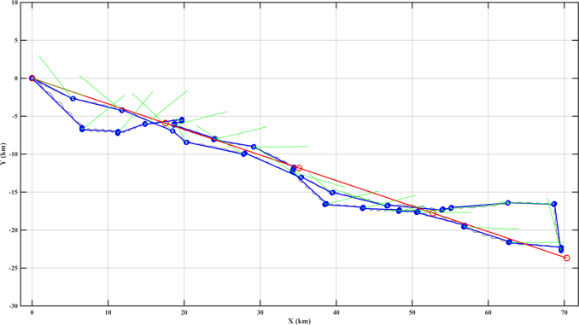
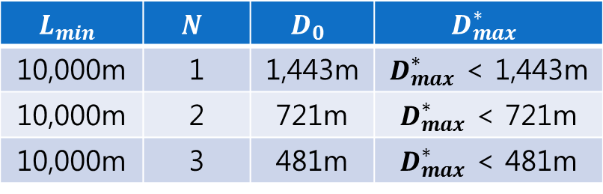
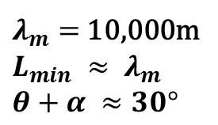
Selecting glider YO pattern
Vertical Route – Ocean Scale
<Glider trajectory simulation
using HYCOM Reanalysis Data>
Maximum Diving Depth + Number of Multiple YOs
Needs of optimizing Vertical Route
- To Increase spatial resolution of data as well as
to reduce the number of surfacings
Maximum Diving Depth using Ocean Scale
Surrounding the Ulleungdo in the East Sea
10
0
-10
-20
Ulleungdo
2 multi-YOs
Y (km)
Dokdo
10
0
-10
-20
3 multi-YOs
Ulleungdo
Y (km)
Dokdo
10
0
-10
-20
-30
5 multi-YOs
Ulleungdo
Y (km)
Dokdo
0 20 40 60
X (km)

Slide 9
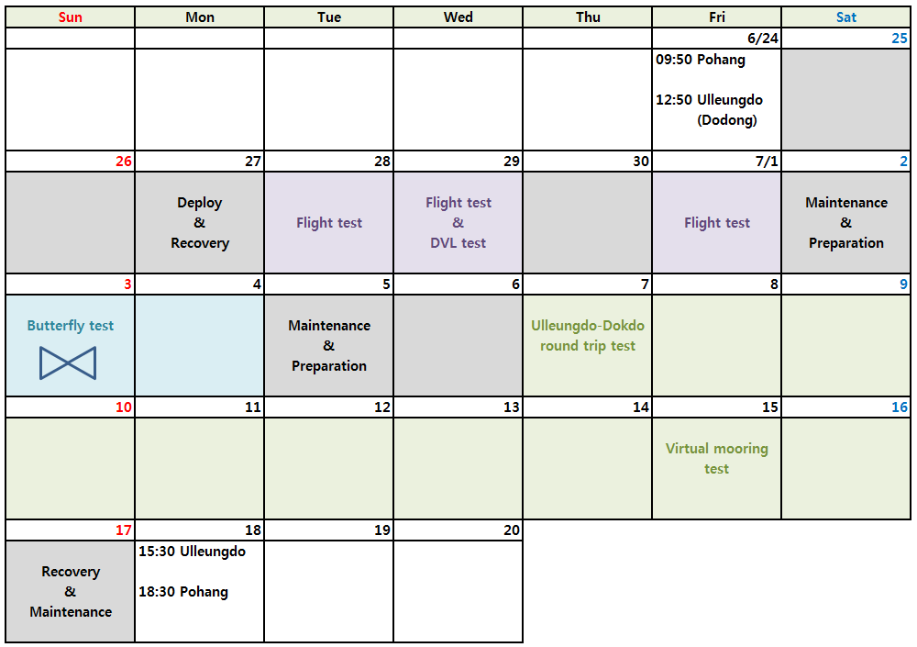
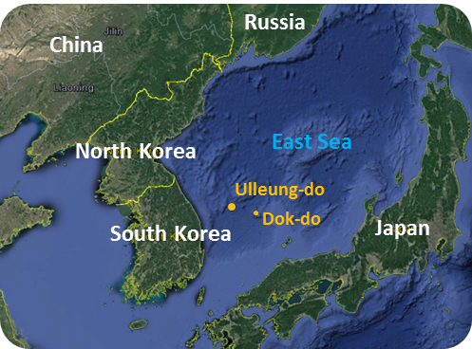
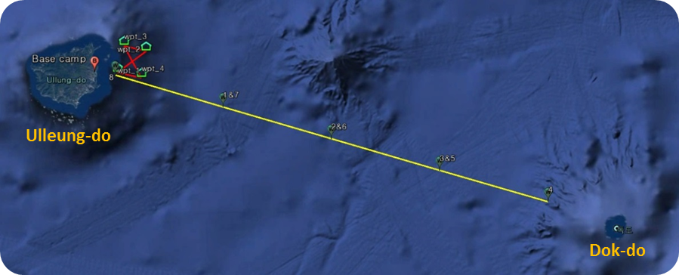
Ulleungdo – Dokdo Field Test
First Sea Trial of KUGON
June 24th - July 18th (25 days)
Test List
  Basic Flight Test
  Butterfly Route Flight Test
  Ulleungdo-Dokdo Round Trip
  (Virtual Mooring Test)

Slide 10
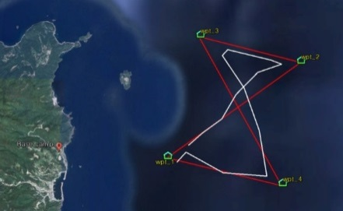

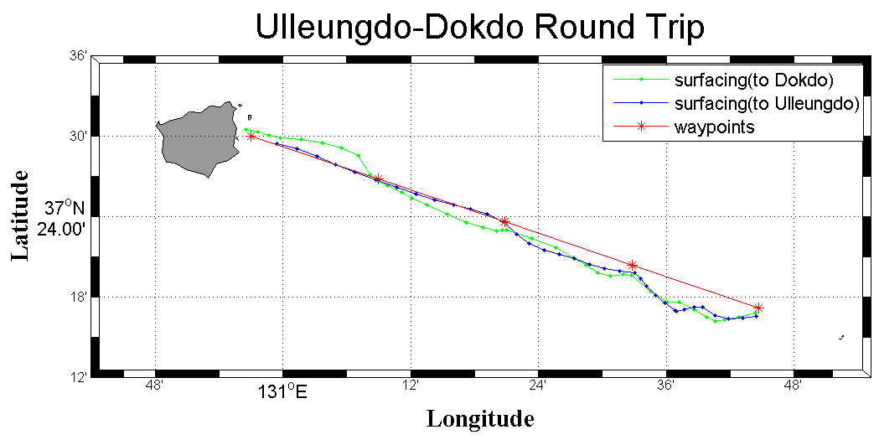
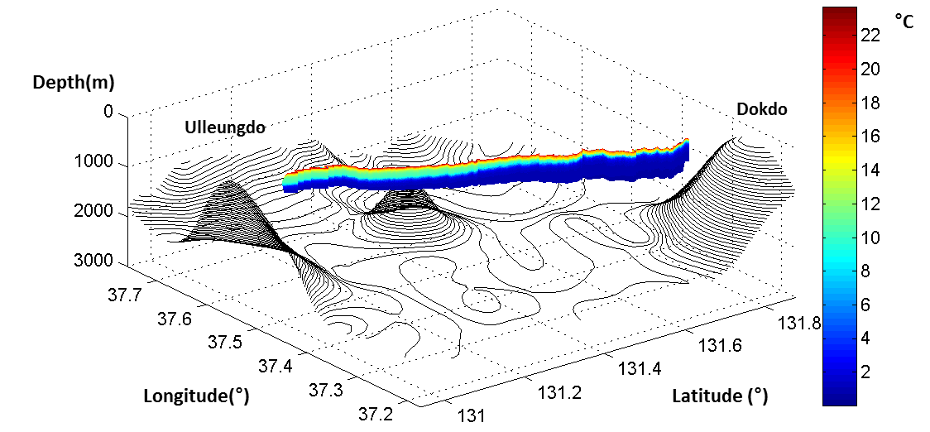
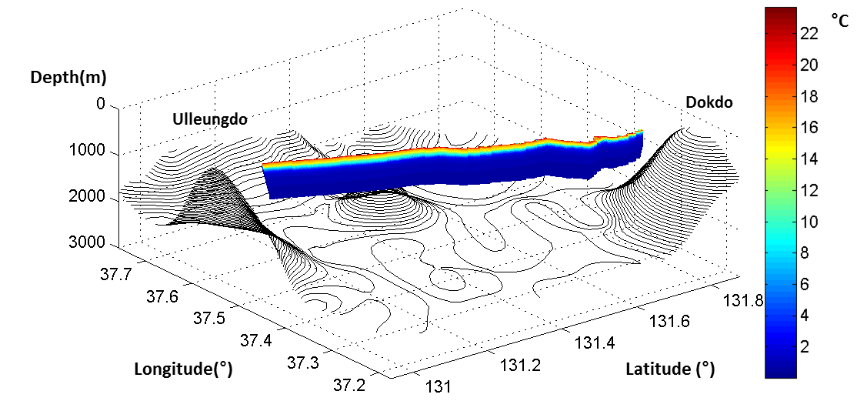
Ulleungdo – Dokdo Field Test
Butterfly Test & Ulleungdo-Dokdo Round Trip Test
Total Travel Distance : 17 km
Total Travel Time : 25 hours
Diving Depth : 400 m
Total Travel Distance : 150 km
Total Travel Time : 191 hours (8 days)
Diving Depth : 400 m ~ 800 m

Slide 11
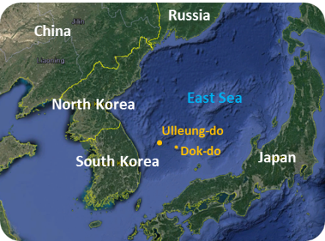
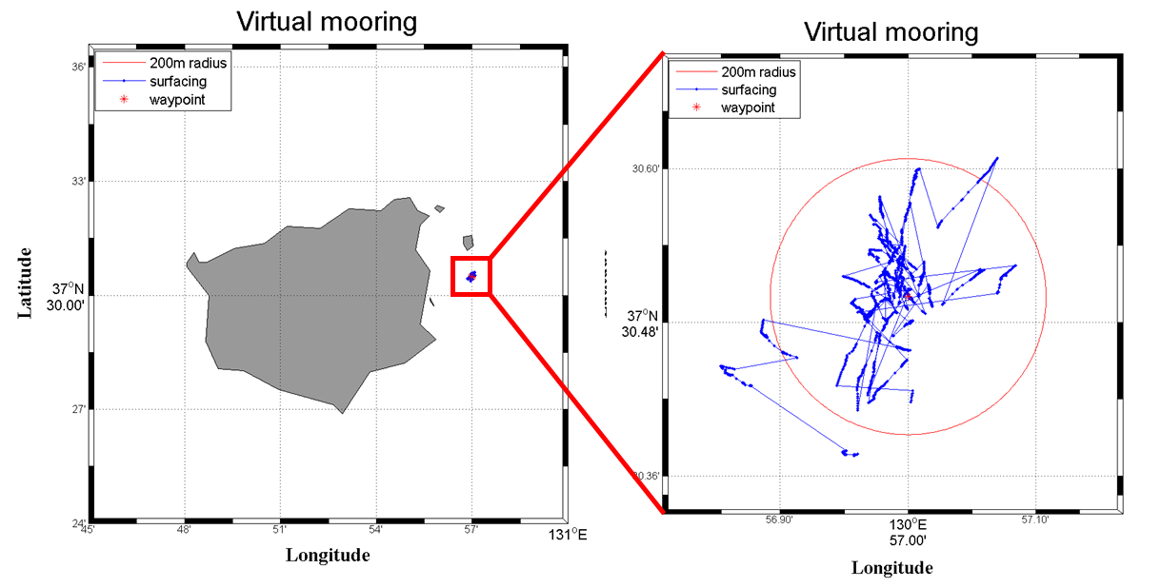
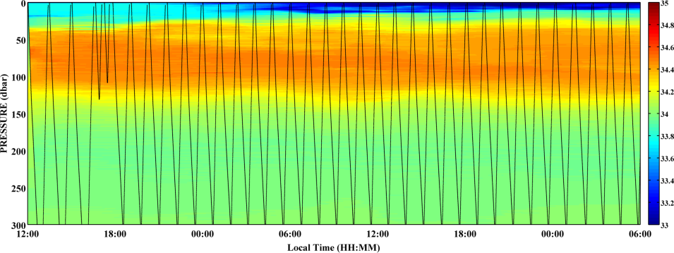
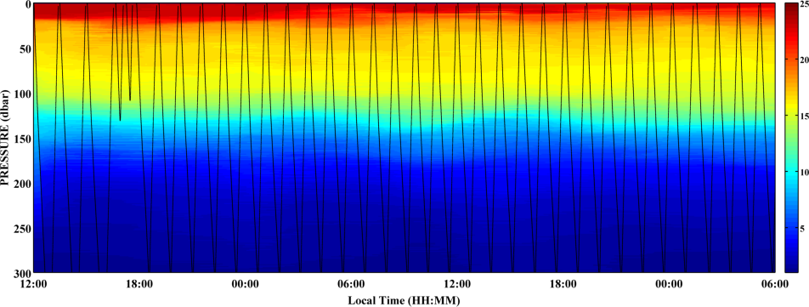
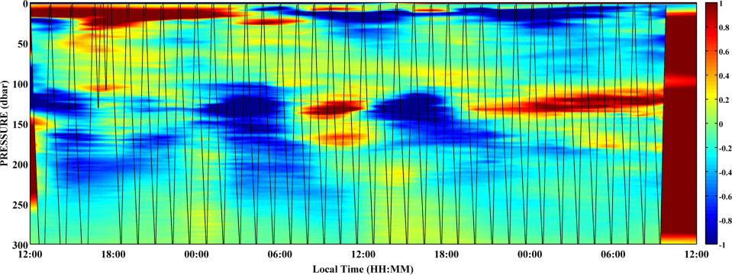
Ulleungdo – Dokdo Field Test
Virtual Mooring Test
Total Travel Time : 45 hours
Diving Depth : 300 m
Salinity
Temperature
(Anomaly)

Slide 12


Benefits to other major programs
Korea Underwater Glider Operation Network
KODC(Korea Oceanographic Data Center)
Regular Ship-based Measurement Program
Program for Wide-Integrated Surveillance System of Marine Territory
Geosynchronous Satellite
SAR and Optical Satellite
Medium Altitude UAV
HF Ocean Radar
Low Altitude UAV
Airship
AUV
Increasing demand for Higher Spatio-temporal Resolution of Oceanographic data
Building 3-Dimensional Autonomous
Marine Surveilance System (~$100M)

Slide 14



Possible Integration with Argo Floats
Best testbed for integration with Argo floats and underwater glider fleet
Argo float location
(21 floats active in Jan. 2016)
Argo float in East Sea
Argo float data
(1999~2015)
The East/Japan Sea
Deploying about
5-10 floats every year
Similar thermo-haline
circulation to open ocean
(including its own MOC)
-> Best testbed to develop ways to integrate with Argo floats and Glider fleets
High Argo Data Density!
Yet, still sparse within 10 days!

Slide 15

Simulator
Underwater Glider Simulator Model
Current
Database
Glider
Flight Model
Navigation Model
(Current Correction)
Simulator
Mission Setting
Value
Traffic volume
of vessels,
Fisheries Data
Bathymetric
Data
Development Procedure

Slide 16


Simulator
Horizontal Movement Simulator
Horizontal Speed
Diving Depth
Single or Multi Dive
Time to Stay
on the Surface
Waypoints
Prototype Simulator
HYCOM
Current Data
Dead-reckoning
Algorithm
Simple
Flight Model
Error Rate

Slide 17





Compass Calibration
Compass Calibrator
±30°
360°
Dimensions | 1360mm(L)×1280mm(W)×780mm(D)
Mass | About 40kg
Material | Aluminium, Brass, MC Nylon
Detail | Heading 360°, Pitch ±30°, Separable

Slide 18






Compass Calibration
Compass Calibration
Calibration start
Adjust Horizontality
Set calibrator
Preparations
Mount glider
Compass accuracy
check
Measure compass error
Compass calibration
Compass calibration
Error 1% ↑
Confirm error
Error 1% ↓
× 3 (normal heading,
pitch, pitch-roll)
Calibrated!
Random error variance
Apply result
(Bias correction)
Calibration finish

