Slide 1
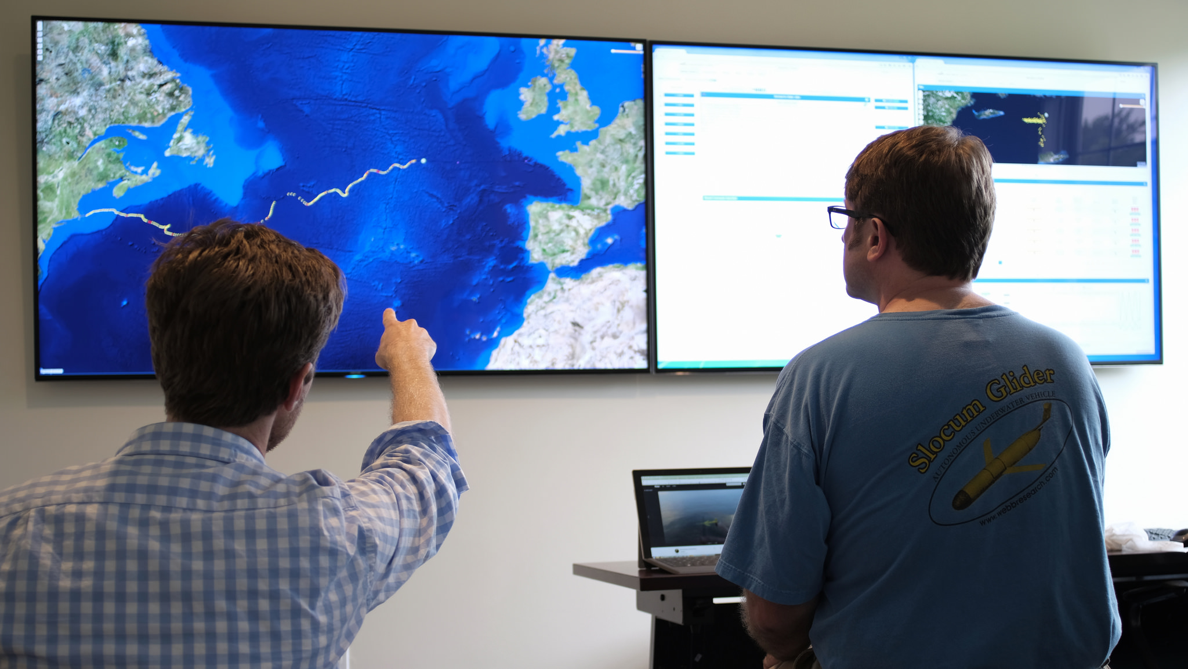
Slocum Fleet Mission Control Advanced Glider Piloting Tools
Ben Allsup, Clayton Jones & Chris DeCollibus

Slide 2

There are the updated global pictures from the remote sensors on satellites, there the evolving maps of subsurface variables, there the charts that show the position and status of all our Slocum scientific platforms, and I am satisfied that we are looking at the ocean more intensely and more deeply than anyone anywhere else.
- Dr. Henry Stommel The Slocum Mission, 1989

Slide 3
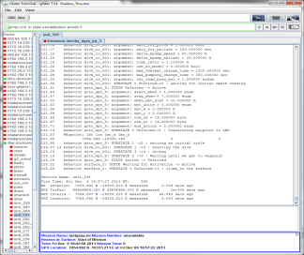
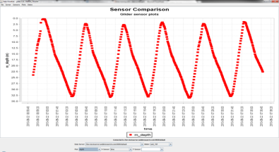
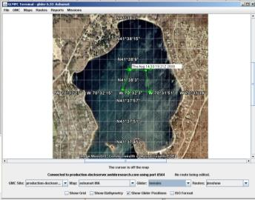
History
Gliders communicate to a server on shore through a satellite connection routed to either a static IP address or a landline. A “Dockserver” application was created to allow pilots to interact with gliders when connected and in mission so the gliders can be monitored and controlled.
Traditional Java Dockserver tools:
Glider Terminal
Text-based glider communication
Data Visualizer
MySQL database
GLMPC Terminal
Mapping and Waypoint tool
FTP client
Used to send files to/from glider

Slide 4
Limitations of Existing Tools
All 4 tools require Java and are only compatible with Windows or Linux.
Single level of security
Outdated
Lack rapid visibility to glider/fleet status
No pilot note keeping system
GLMPC Tool
Allowed for a location plotting of a single vehicle only.
Cut and paste map of .jpg images are hard to use and do not allow the user to zoom.

Slide 5
Objectives of New Tools
Ability to easily Pilot and Monitor Multiple Vehicles
Access the tools from any platform (PC, MAC, tablet, smartphone)
Increase security
Allow for collaboration between multiple pilots.
Allow for roles: Admin, pilot and viewer only accounts
Combine the functionality of the old tools into a single application.
Leverage and optimize existing tools and visualizations.

Slide 6
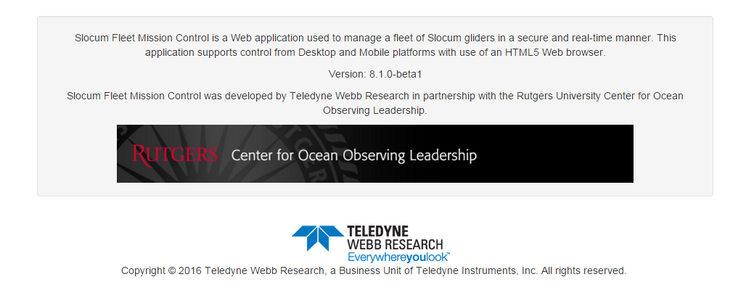
Continuing to Partner with colleagues in Education and Industry

Slide 7
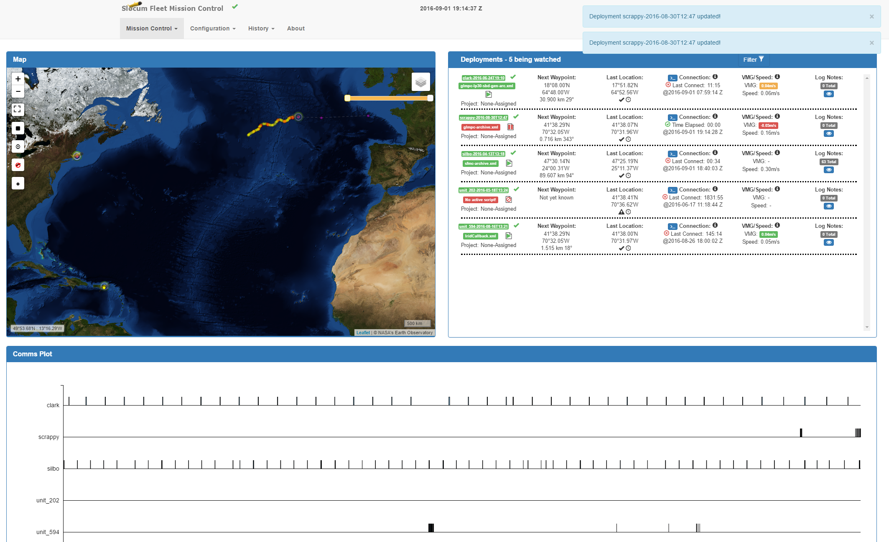
Slocum Fleet Mission Control (SFMC)

Slide 8
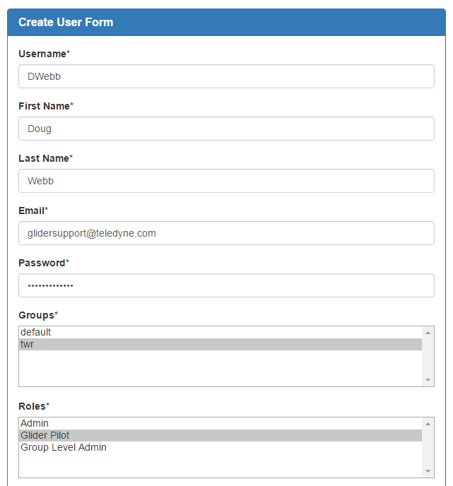
Features: User Accounts
Increased Access Control
Individual user accounts with different roles:
Admin
Group Admin
Pilot
Viewer
Customizable Group Assignments
Gliders and User are linked to groups.

Slide 9
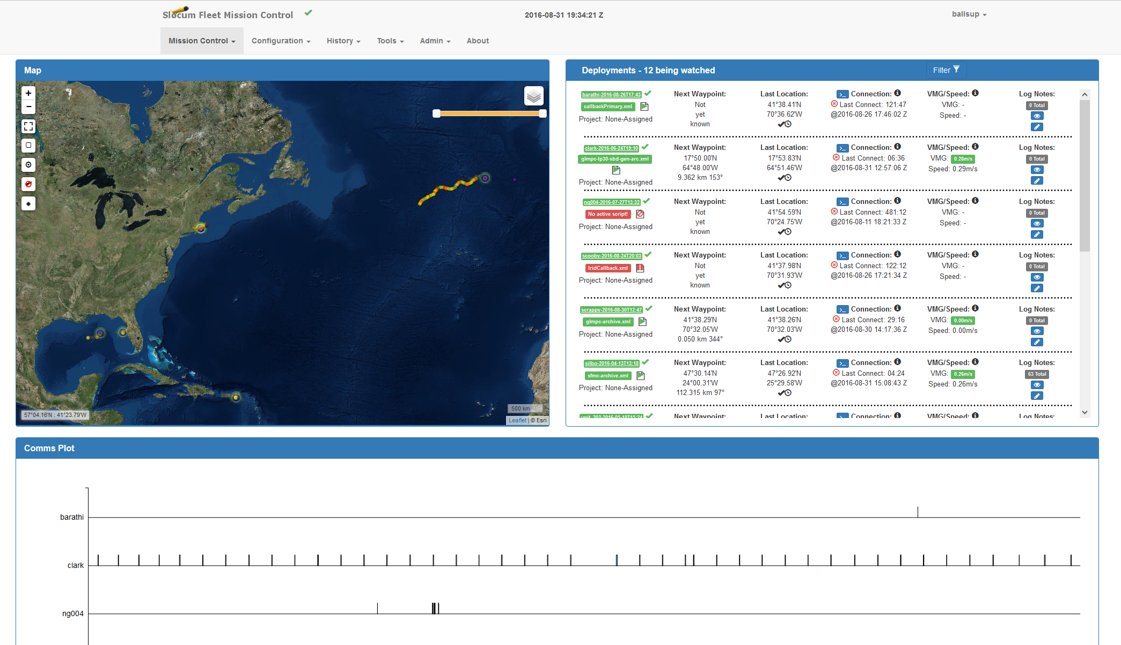
Glider Monitoring :Dashboard

Slide 10
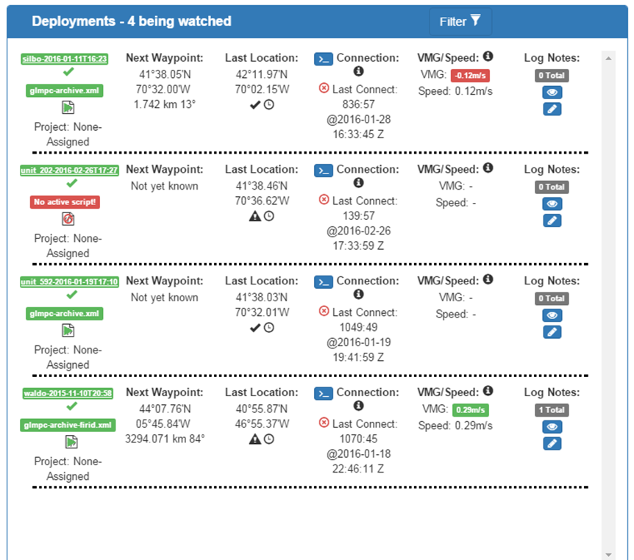
Dashboard : Deployment Status
Connection status
Time Connected
Last connection time and date
Speed over ground
Next waypoint, and distance to waypoint.
Dockserver script status
Near real time updates
Direct link to terminal session with the glider

Slide 11
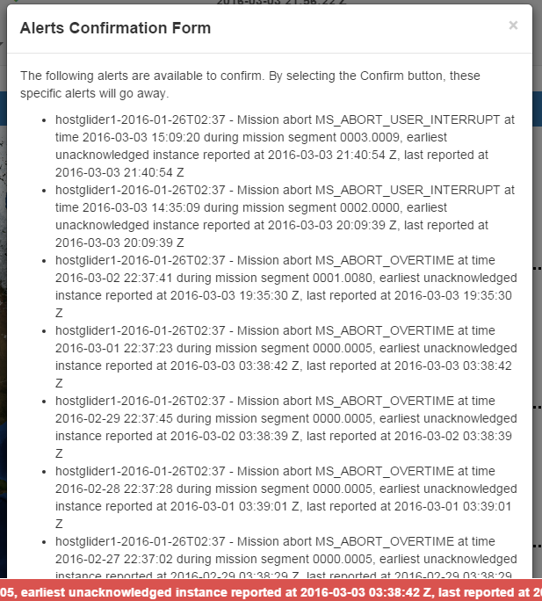
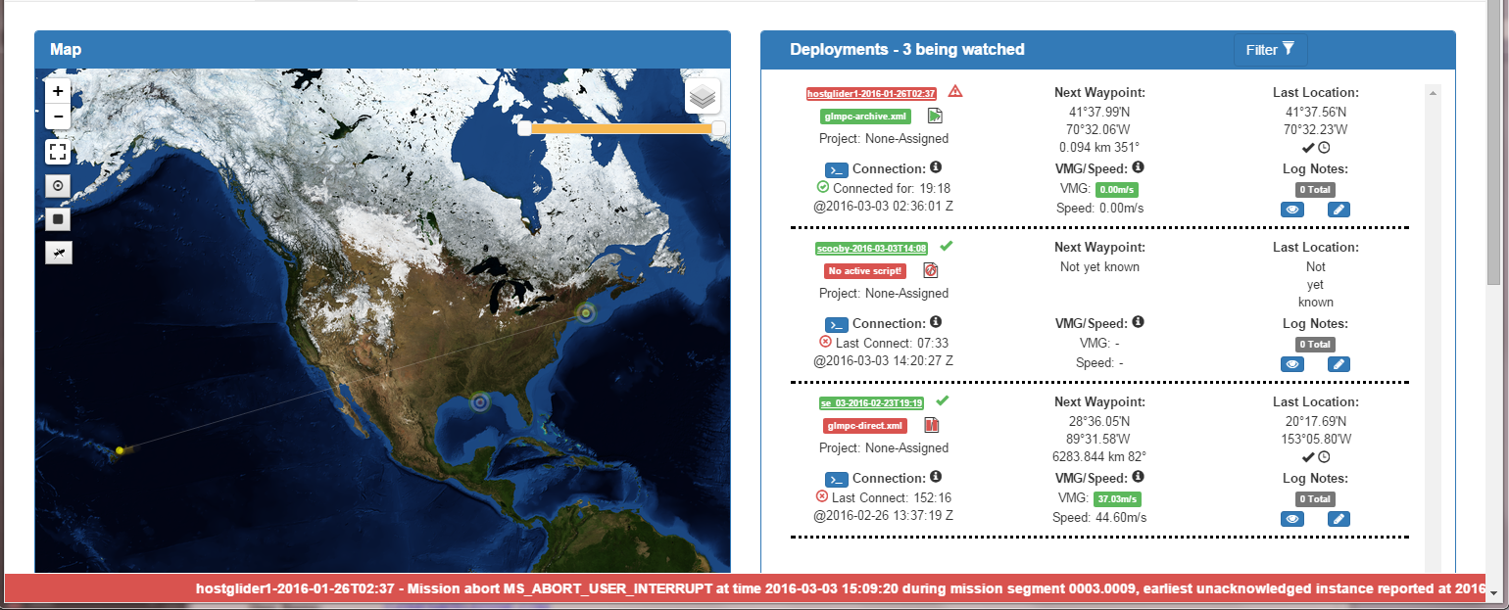
Dashboard: Alerts: New email notification capability on alerts

Slide 12
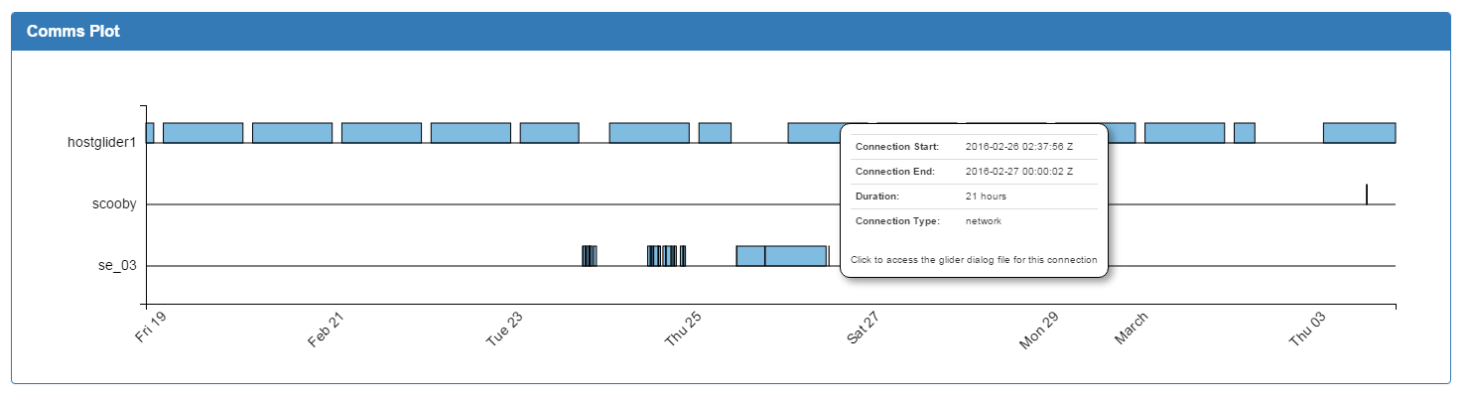
Dashboard: Comms Plot
Shows the connection times of individual gliders
Allows user to click on a particular surface event and download the corresponding surface log file.

Slide 13
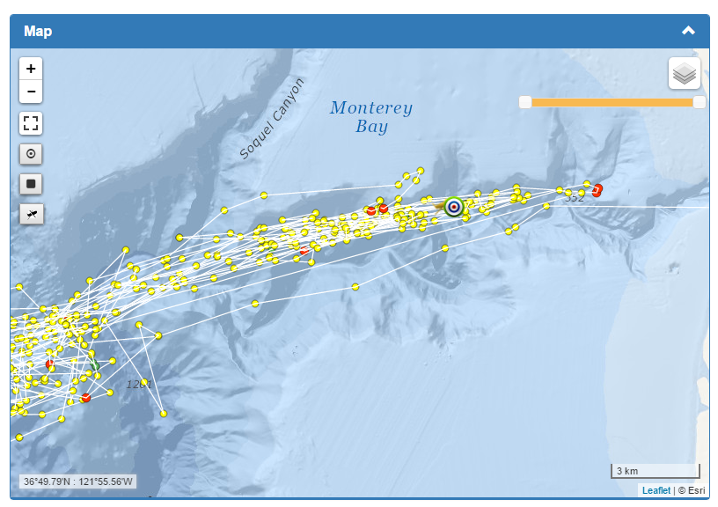
Dashboard: Maps
Shows Multiple glider deployment
Features:
Zoom to selected deployment
Full Screen
Change track color
Hide Glider icon overlay
Time Slider
Overlays
Base Map cutomization
User overlays (WMS)

Slide 14
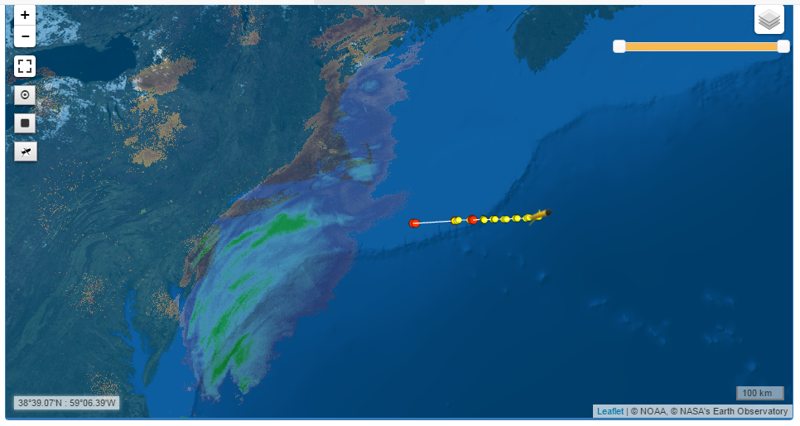
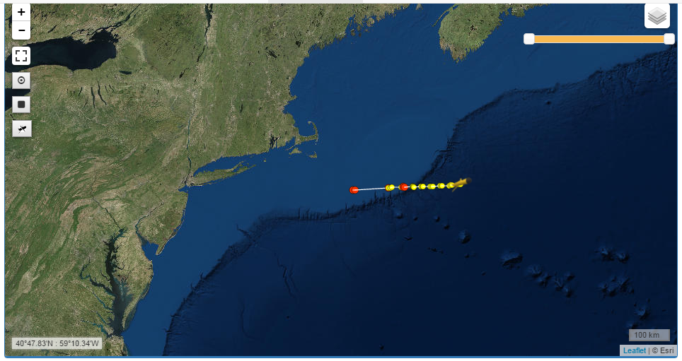
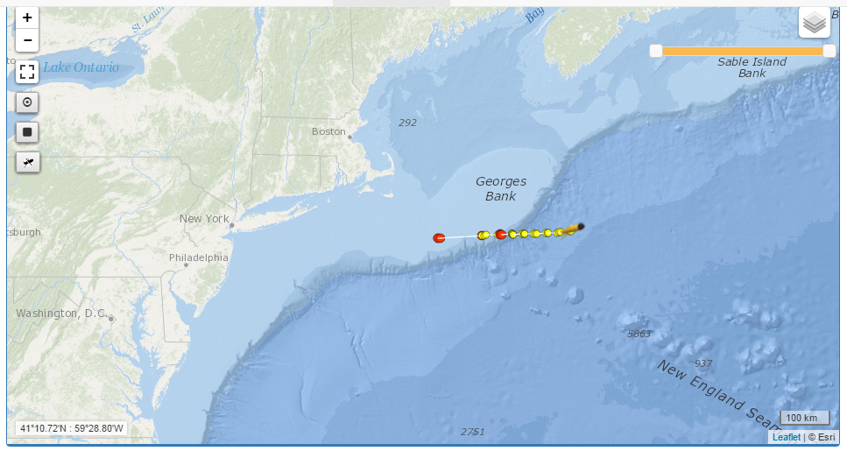
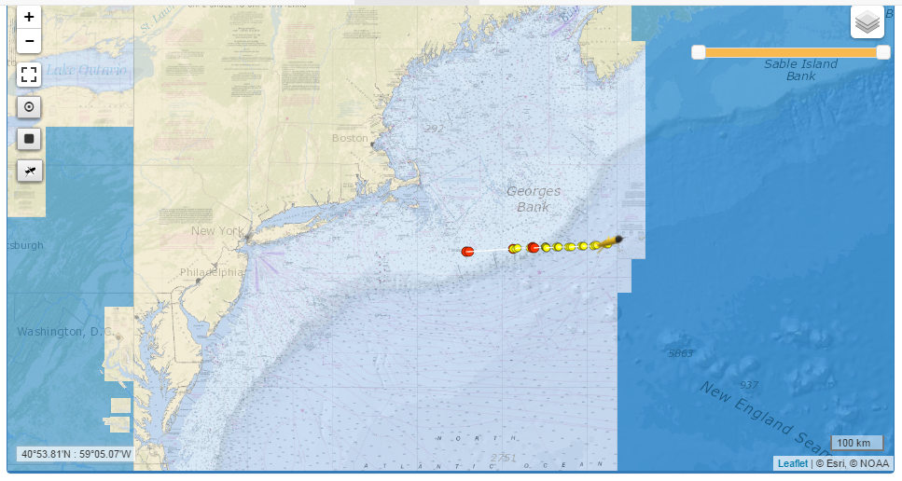
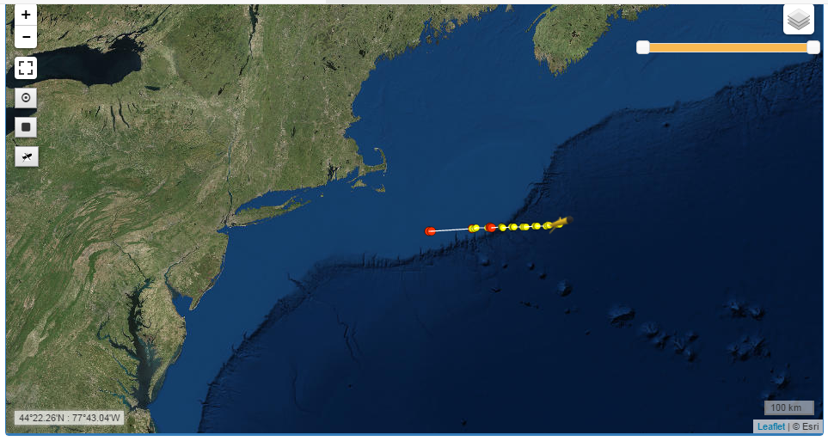
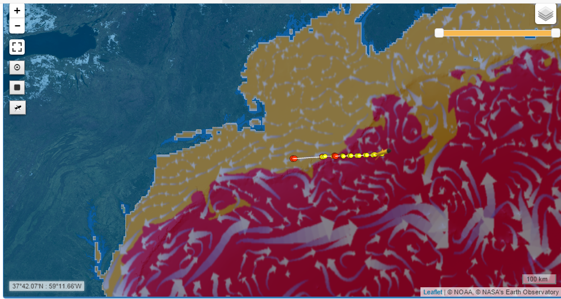
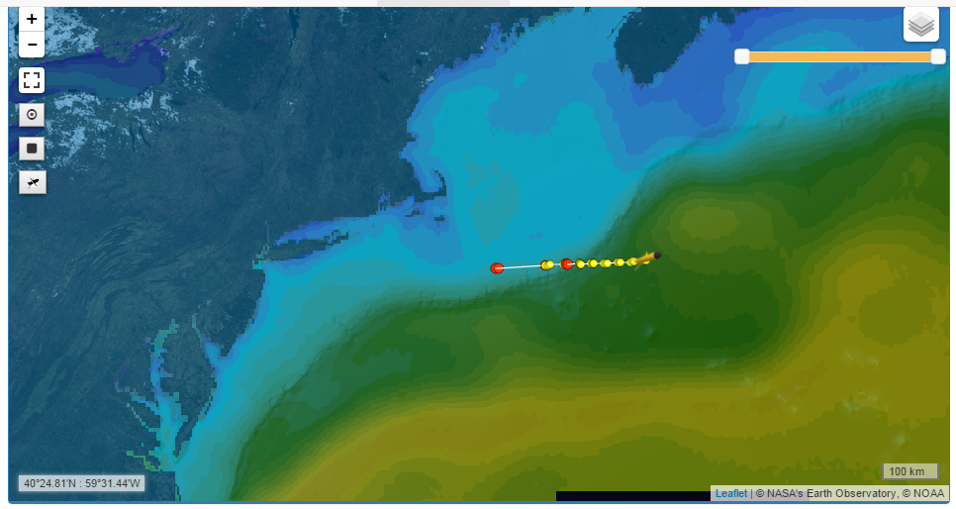
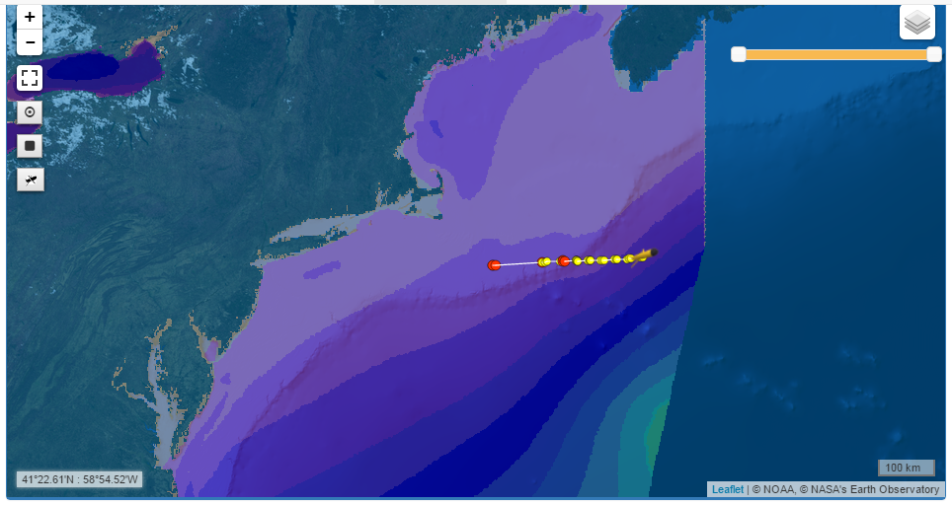
Dashboard: Maps

Slide 15
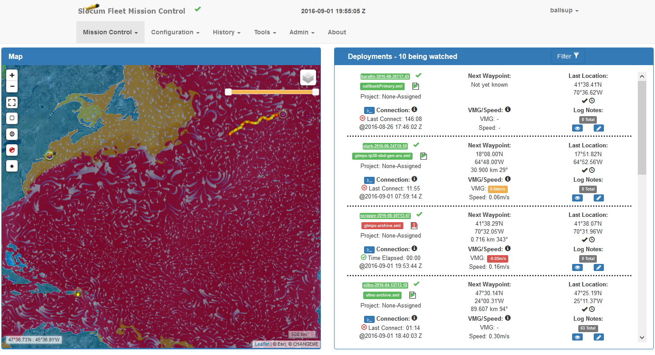
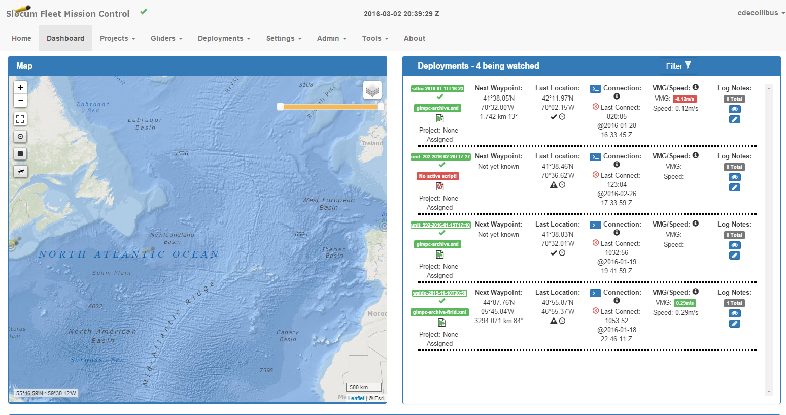
Deployment View
Summary: a status bar
Map: single glider
Surfacings
Surface Sensor Values

Slide 16
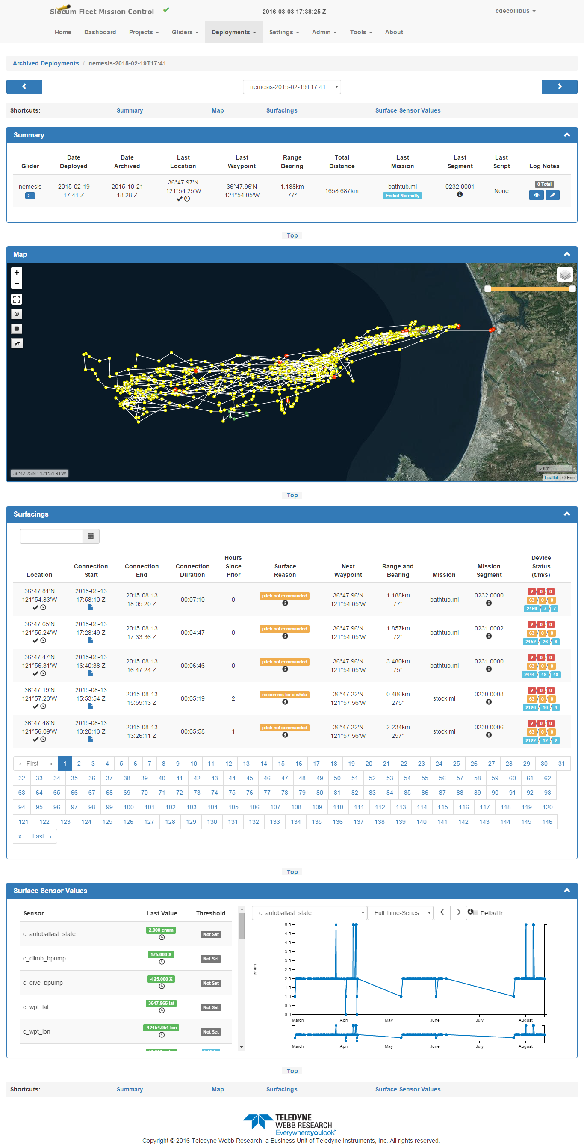

Slide 17
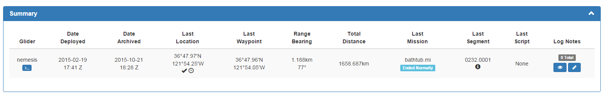
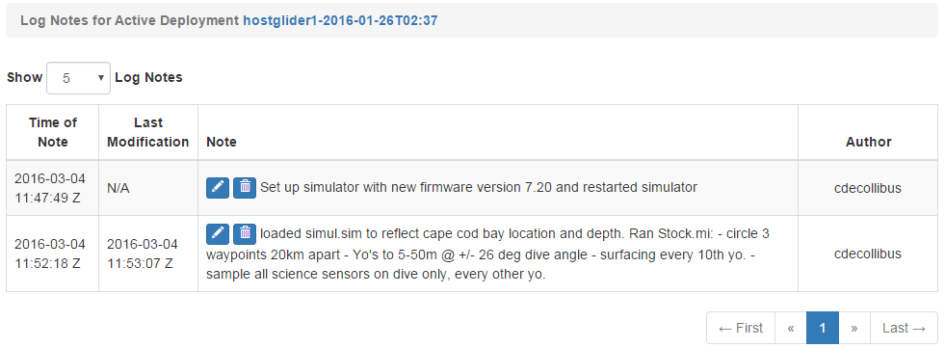
Deployment View: Summary and Notes
Summary:

Slide 18
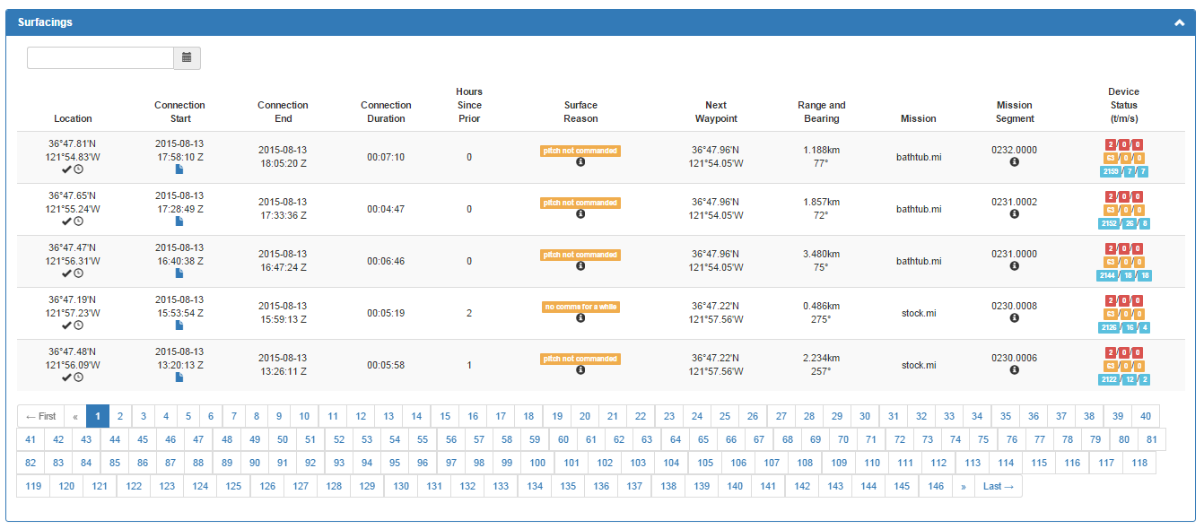
Deployment View: Surfacings
- Similar to the Summary Bar, but includes information on all glider surfacing's
- Easily search surfacing's by date
- Includes link to download the log files from the indivual surfacing.

Slide 19
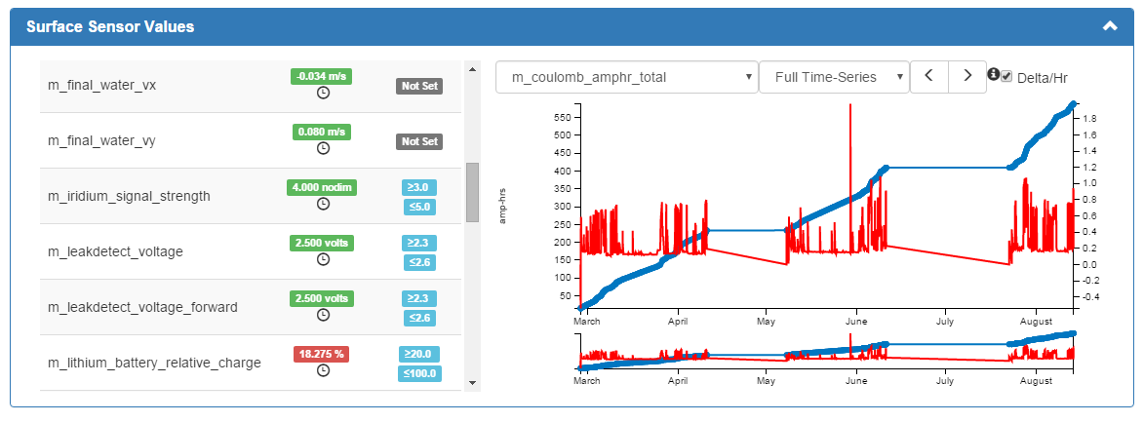
Deployment View: Surface Sensors
Allows user to easily track and monitor sensors that are included in their surface dialog
Individual users can set upper and lower limits for each sensor which can trigger alerts if they are exceeded.
Sensor Plotting:
Surface sensors can quickly be plotted over time.
A delta/hr can be applied to allow the user to see what their normal run rate is.

Slide 20
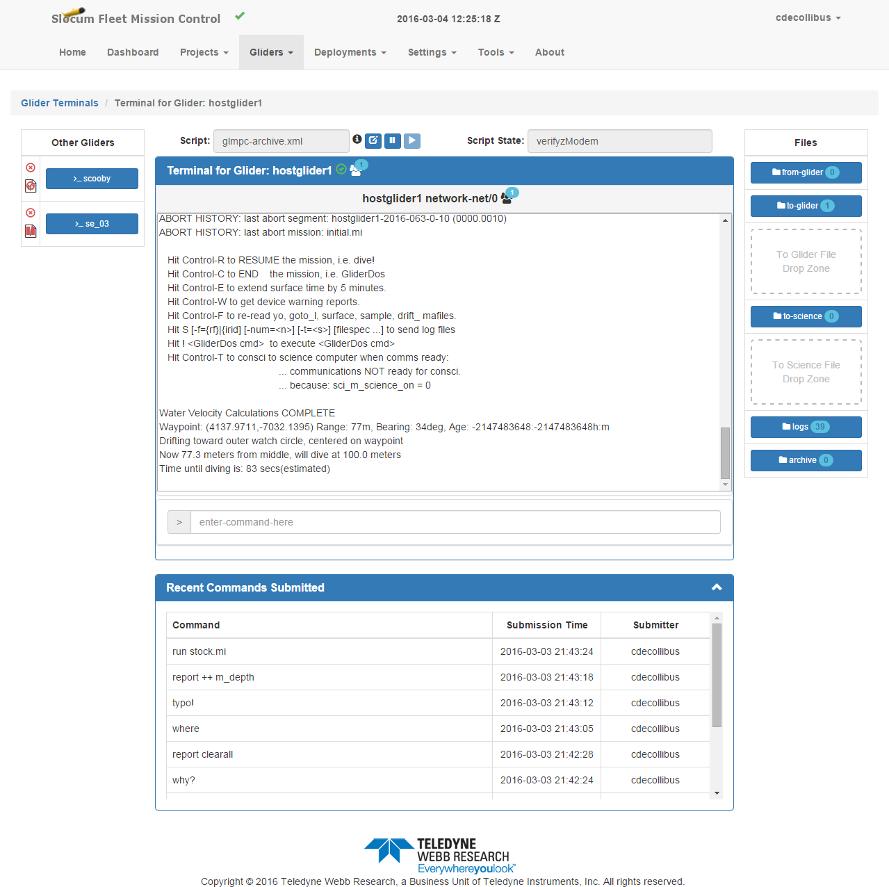
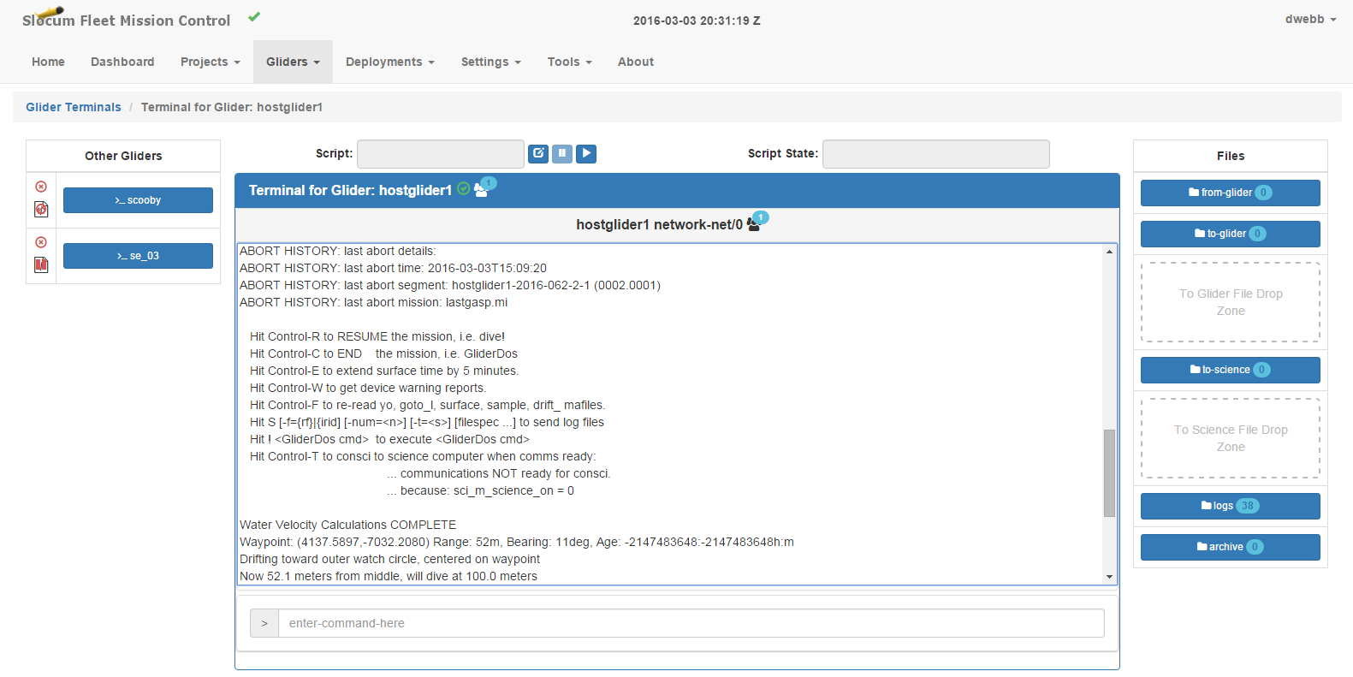
Terminal

Slide 21
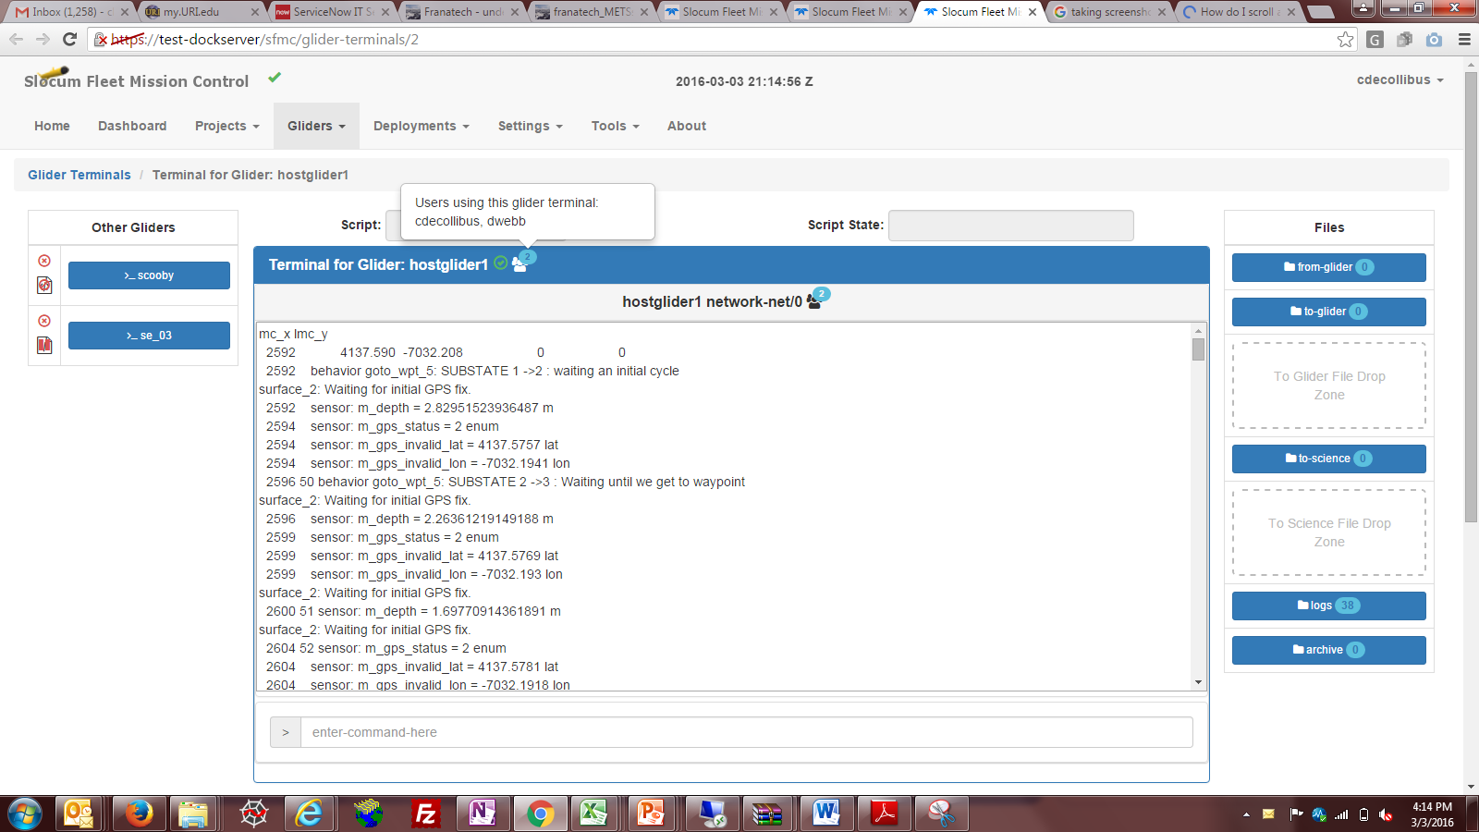
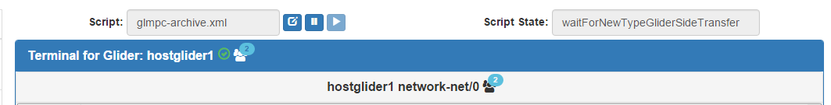
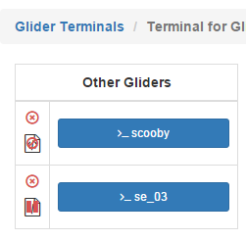
Terminal
Terminal Status Bar
Includes:
Glider name
The script name, status and state
Script controls
Connection type and port information
Other users who are viewing this terminal
Glider Connection Area:
Shows status of other gliders that are currently connected to this Dockserver
Shows status of other gliders that have connected to this Dockserver in the past

Slide 22
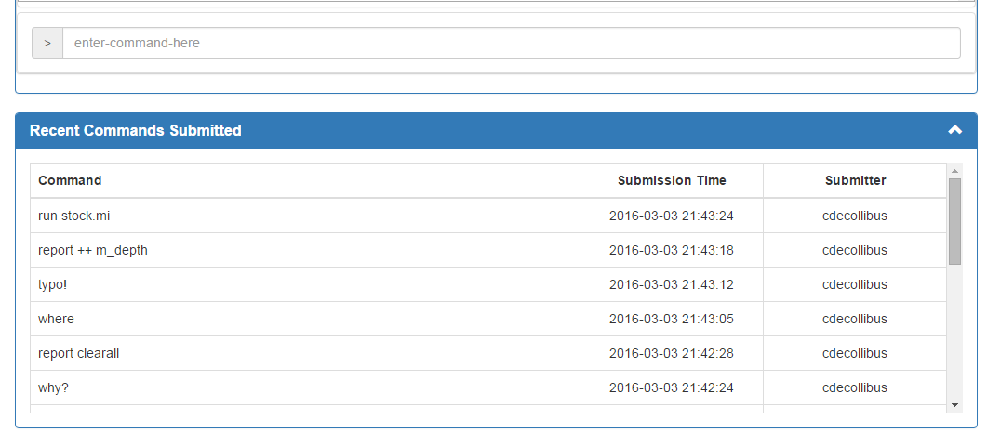
Terminal: Command Entry
Shows Recent Commands. Includes Date and User Name
Uses browser command recall

Slide 23
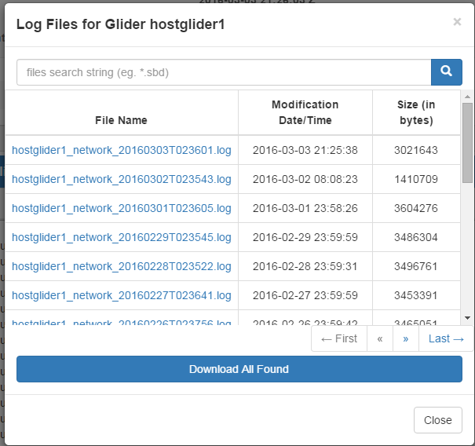
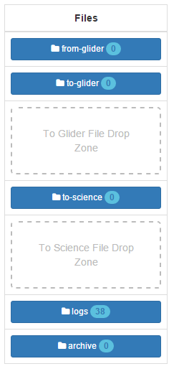
File Transfer
File transfers can now be done straight from the Terminal Page (drag and drop)
Easy access to the To-Glider, From-Glider, Logs, and Archive directories.
Click on the title to open a search box which easily sorts through data.
Files can be individually downloaded right from this search or entire sets can be downloaded as a zip file.
FTP no longer needed

Slide 24
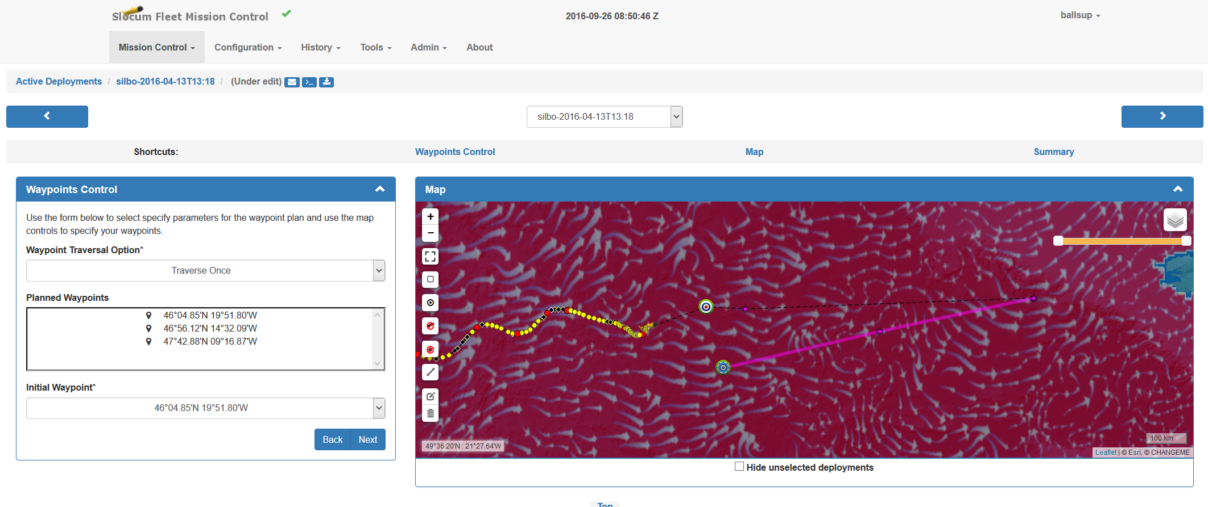
Waypoint planning

Slide 25
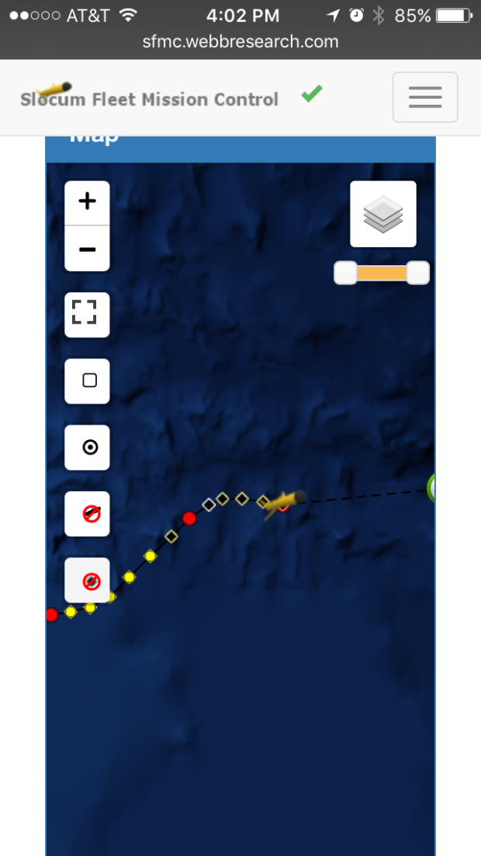
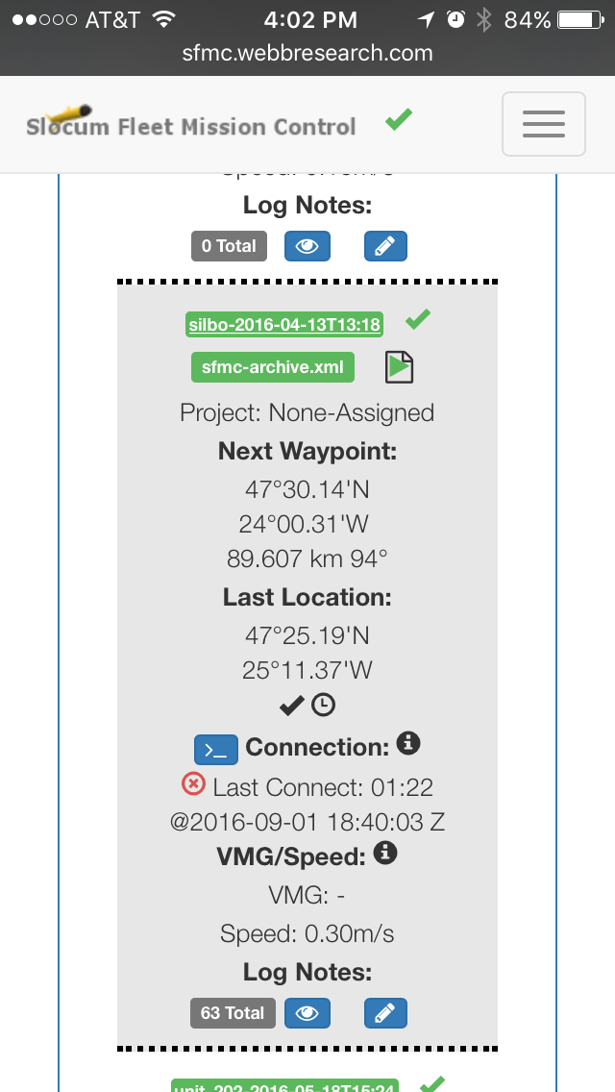
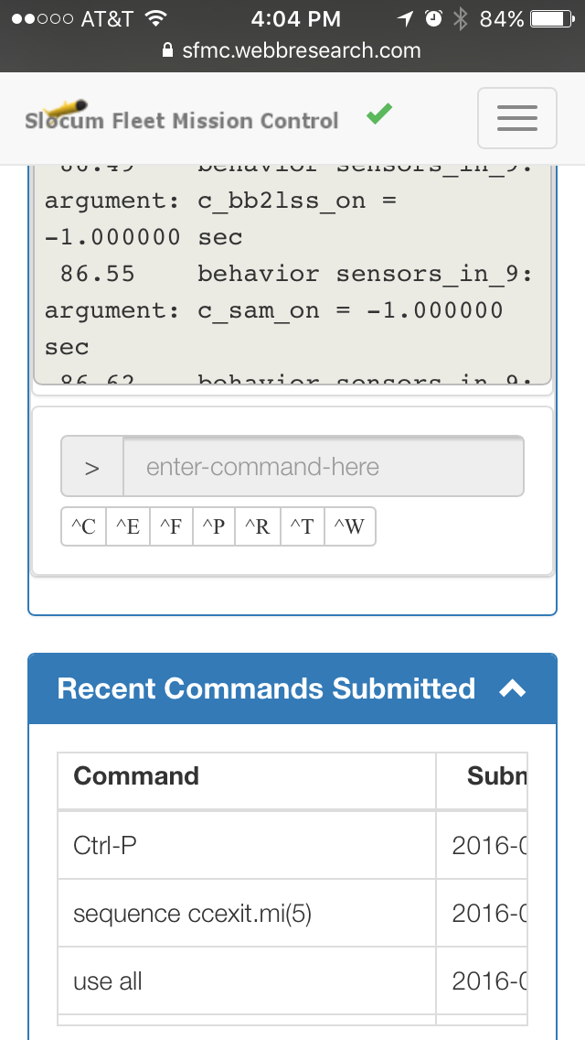
Iphone and Tablet
shot here

Slide 26
System Specifications
Web based tool
Backend: developed with Java
Frond-end: Developed using HTML5 and Javascript.
There is no Java dependency for client usage.
Data base switched over from MySQL to PostgresQL.
Compatible with existing Dockserver hardware

Slide 27
Services - Hosting
TWR Hosted SFMC Server (Primary or Backup)
SSAE 16 Type II compliant facility located in Rockland, MA
RUDICS capability
Redundant internet
Redundant power
- Multiple redundant phone lines and modems - reliable (99.9% uptime) - secure - fault-tolerant
Server has easy access from North Falmouth Facility however not on Cape Cod
- rsync capability upon request

Slide 28
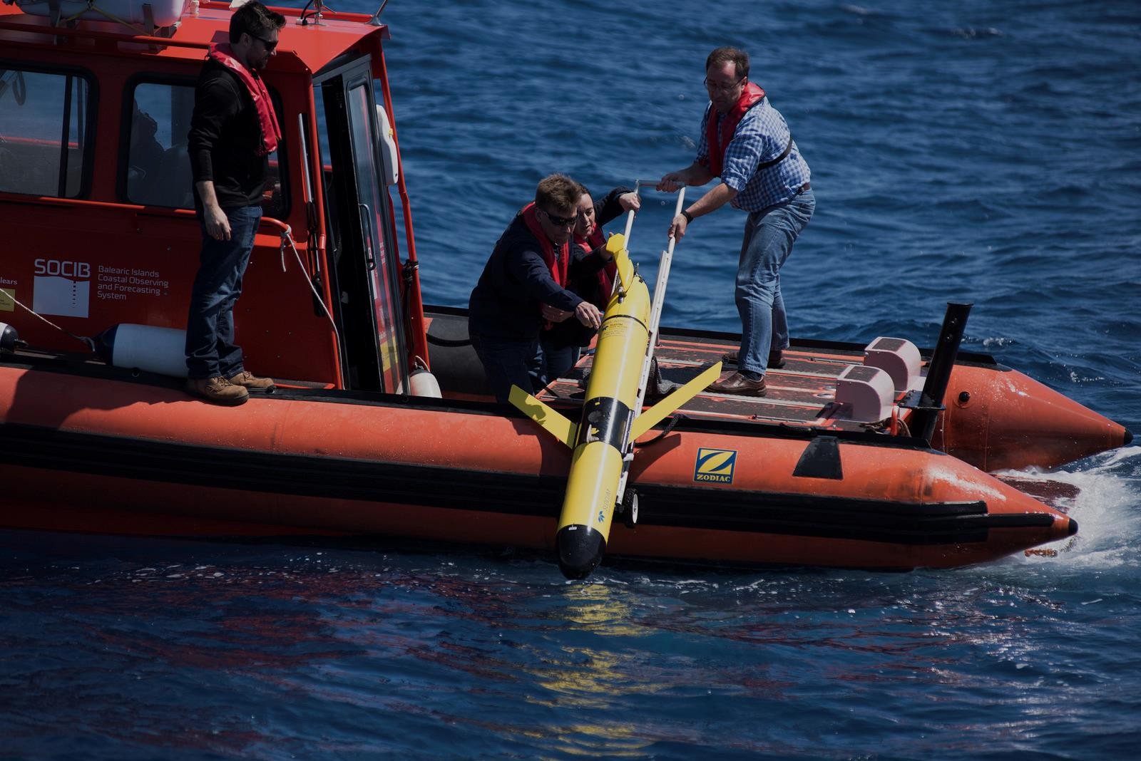
Services Piloting Training
Primary, Emergency support and back up
Dedicated piloting room
Training Center
Dedicated server(s)
TWR has over 5 decades of Glider piloting experience on staff
Over a year of “glider days” in 2016 to date

Slide 29

Future
Web based data visualizer replacement.
Mission Planning.
And More!
Available for quote and shipping with new orders now.
Looking for user feedback.

