Slide 1
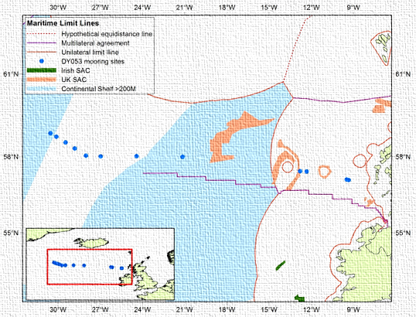
EGO2016
Gliders and Marine Law Surgery
R J Rogers
rxr@noc.ac.uk

Slide 2
EGO 2016 – Gliders and Marine Law Surgery – Types and Sources
The scope of applicable marine law cover three sources:
State e.g. Italian
Regional e.g. EU
International e.g. UNCLOS or LDC
and also the three types of regulation:
Legislation
Case Law
Customary Practice
Notes:
2
2

Slide 3

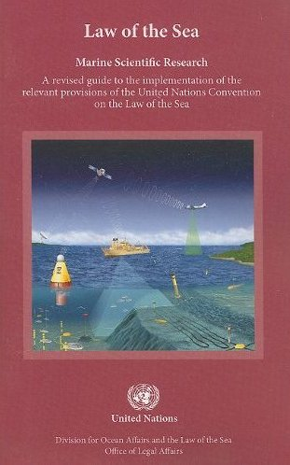
EGO 2016 – Gliders and Marine Law Surgery – UNCLOS Part XIII
The new Sub Section 4.3 – Particulars of AUV asks for the following information from the Researching State:
Name:
Manufacturer and make/model:
Nationality (Flag State):
Website for diagram and specifications:
Owner:
Operator:
Overall Length (meters):
Displacement/Gross Tonnage:
Cruising and Maximum Speed:
Range/Endurance:
Method and Capability of Communication (Including Emergency Frequencies):
Details of Sensor Packages:
Other Relevant Information:
(source DOALOS)

Slide 4
EGO 2016 – Gliders and Marine Law Surgery MSR v OO
Marine Scientific Research
OR
Operational Oceanography

Slide 5
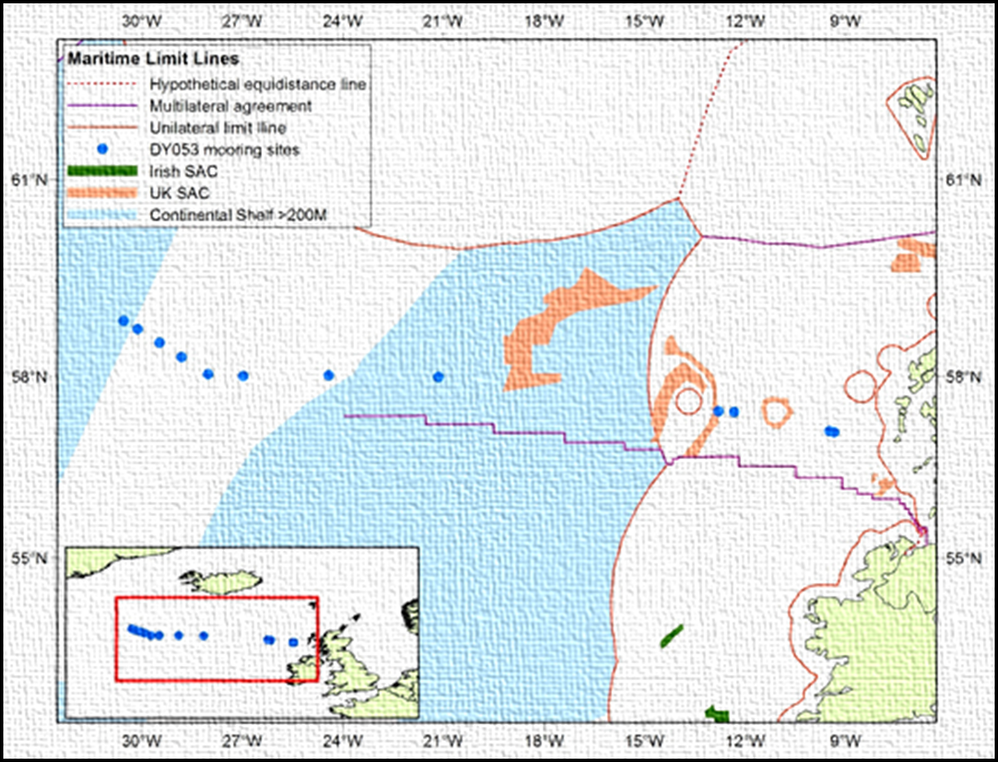
EGO 2016 – Gliders and Marine Law Surgery – Novel Ops

Slide 6
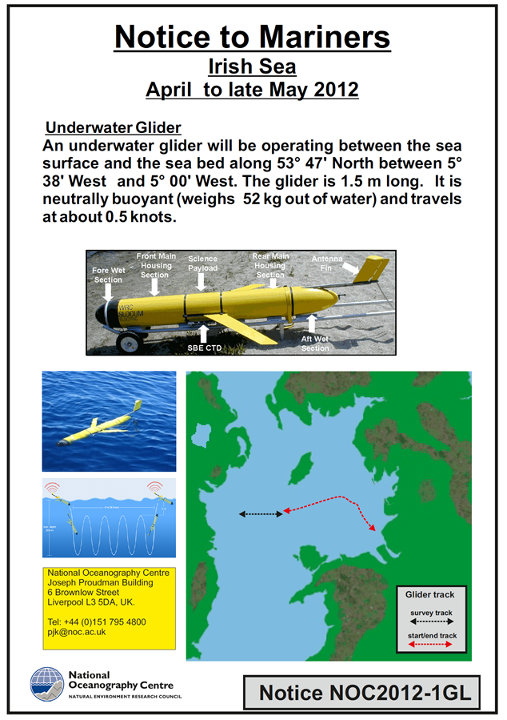
EGO 2016 – Gliders and Marine Law Surgery – Legal Process

Slide 7


EGO 2016 – Gliders and Marine Law Surgery Guidelines and COC/COP

Slide 8
EGO 2016 – Gliders and Marine Law Surgery
What can the EGO community do to ensure Glider Deployments do not get constrained by unnecessary legislation at State, Regional and International levels ?

Slide 9
EGO 2016 – Gliders and Marine Law Surgery Guidelines and COC/COP

Slide 10
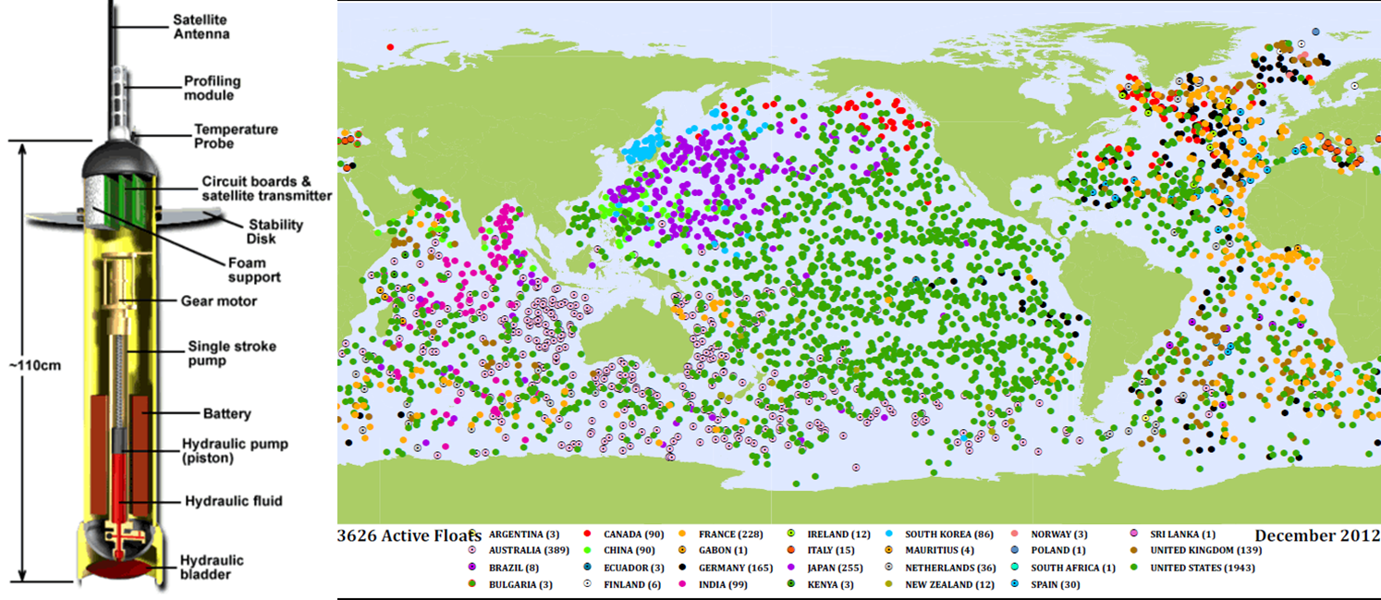
EGO 2016 – Gliders and Marine Law Surgery - TMT
Potential legal benefits in building an international glider community

Slide 11
EGO 2016 – Gliders and Marine Law Surgery
What else can the EGO community do to ensure Glider Deployments do not get constrained by unnecessary legislation at State, Regional and International levels ?
[1] Use the EGO Website as a repository/library of applicable legislation
[2] Create a user group on the website base around Gliders and Marine Law.
[3] Use the network to collect lessons learnt from glider deployments that encounter legal problems.
[4] Use these collective lessons learnt to influence the law and also set legal precedence.
[5] Develop common operational procedures for the deployment of gliders.
The EGO community can shape, help evolve and lead on the development pf applicable marine legislation. Lead do not be Led

