Slide 1




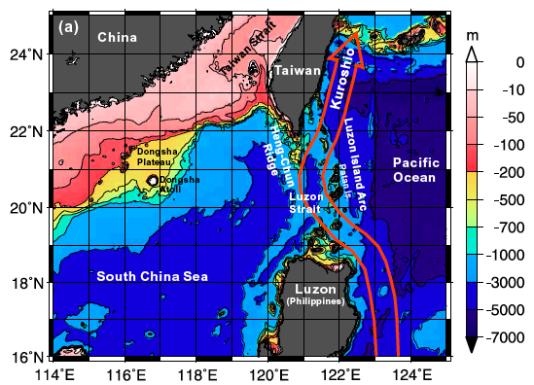
Kuroshio Transport and Water Mass Modification in the Vicinity of Luzon Strait
Craig M. Lee, Barry Ma, Ren-Chieh Lien, Luc Rainville
Applied Physics Laboratory, University of Washington
Kai-Chieh Yang, Sen Jan, David Tang
National Taiwan University
  Western boundary current- heat, freshwater transport.
  Impact of eddies on Kuroshio transport & intrusion into South China Sea (Lien et al., 2014).
  Kuroshio modification by pathway mixing and stirring.
  Kuroshio impact on internal wave generation, propagation (Rainville et al, 2014).
(Jan et al., 2008)
With thanks to Jason Gobat, Adam Huxtable, Geoff Shilling, Ben Jokinen, Ming-Huei Chang, Ying Jang Yang and the Captains and crews of OR1, OR2, OR3 and OR5.

Slide 2
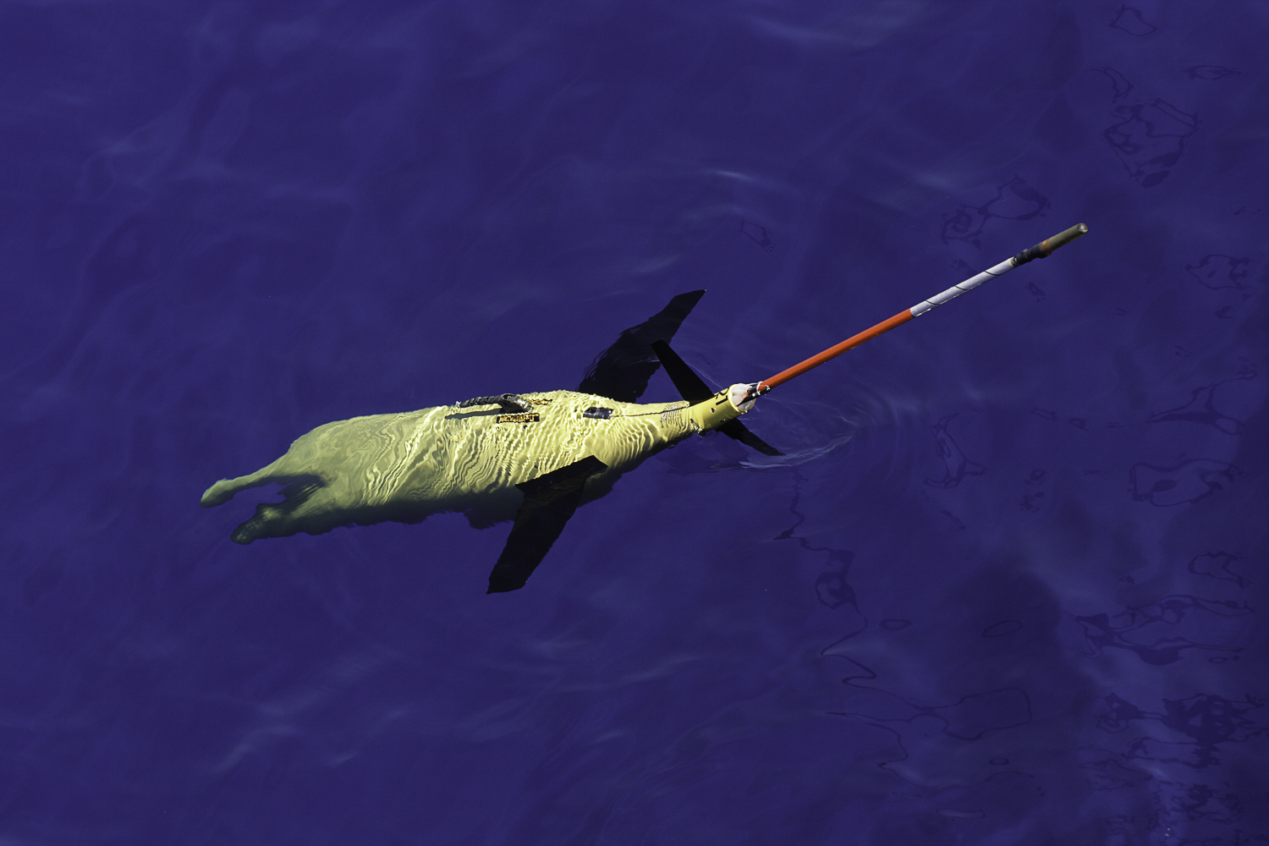
OKMC Kuroshio Objectives
Technical
Refine approaches for persistent,
autonomous characterization of
strong boundary currents.
Develop methodologies for using
gliders to characterize internal
waves (Rainville et al.).
Scientific
Characterize Kuroshio transport- mean, variability, seasonality, watermass structure.
Investigate the processes governing Kuroshio evolution during transit off Luzon and Taiwan- pathway modification, role of eddies.
Investigate impact of Luzon Strait/South China Sea on Kuroshio structure.

Slide 3
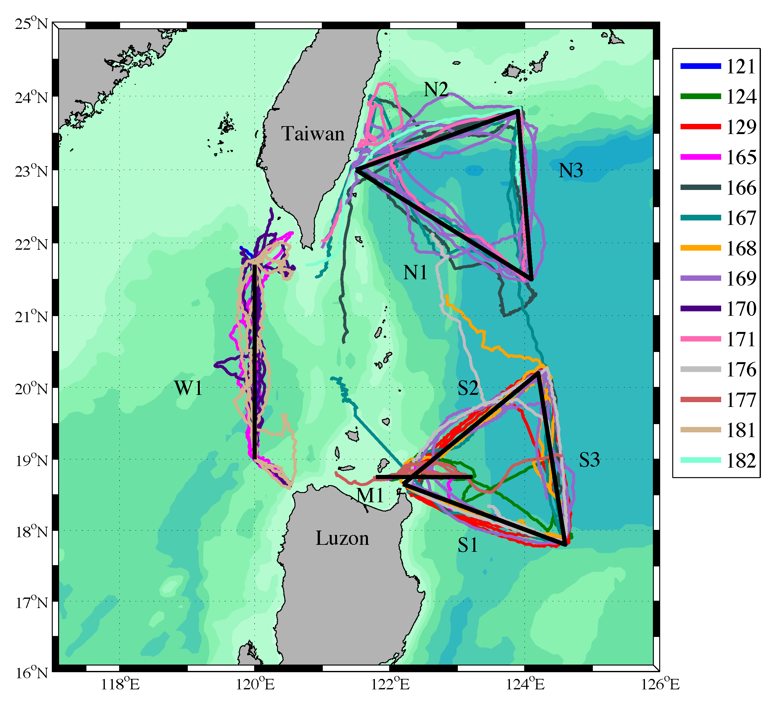
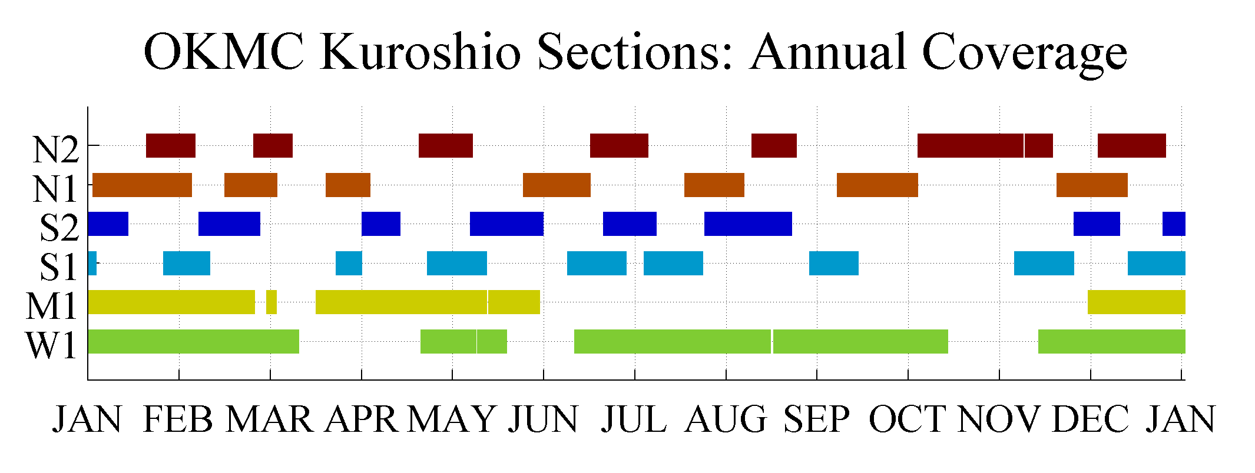
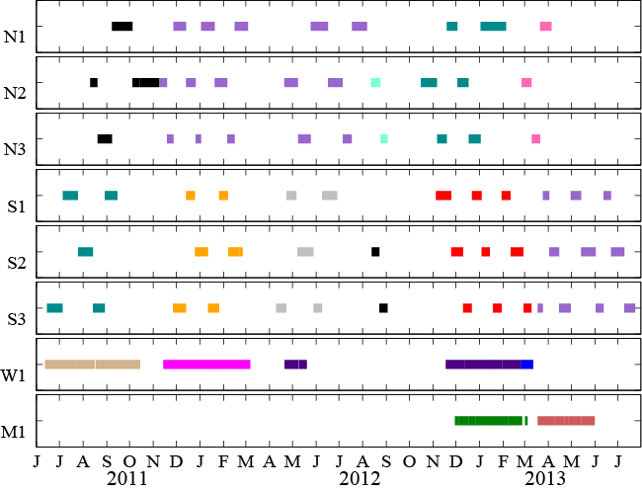
OKMC Kuroshio Glider Operations
9
10
10
12
  2 Years (2011 – 2013)
  14 Seagliders
  20 missions
  1,774 Days
  8,705 Dives
  Local logistics critical.
12
14
15
Moorings & HPIES
16

Slide 4
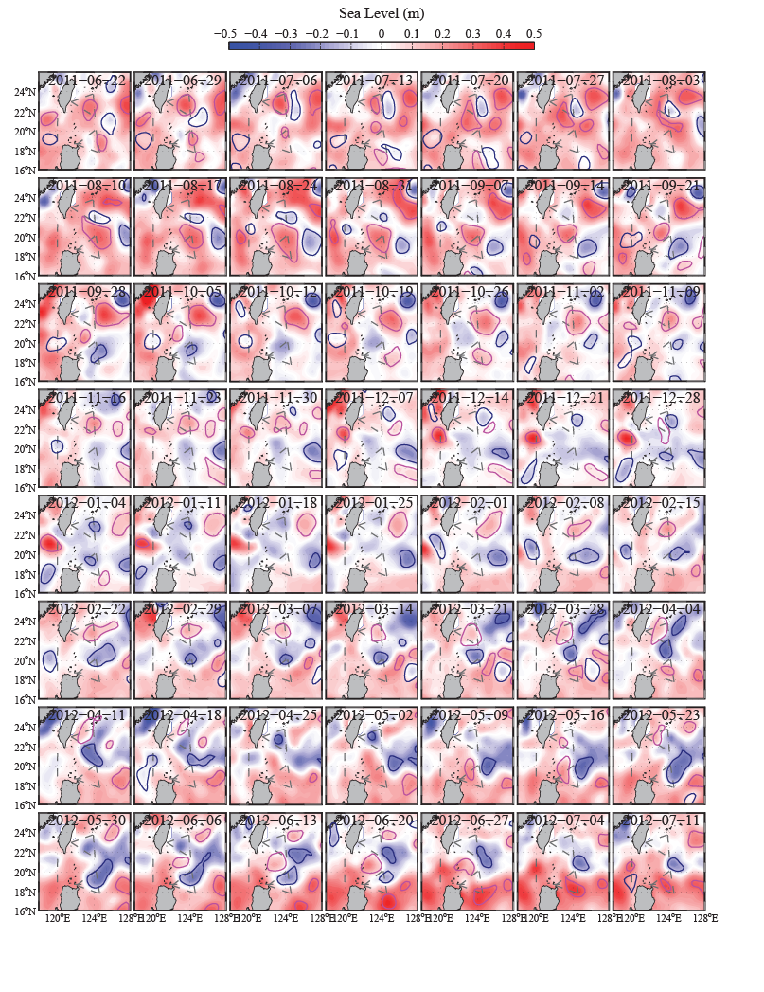
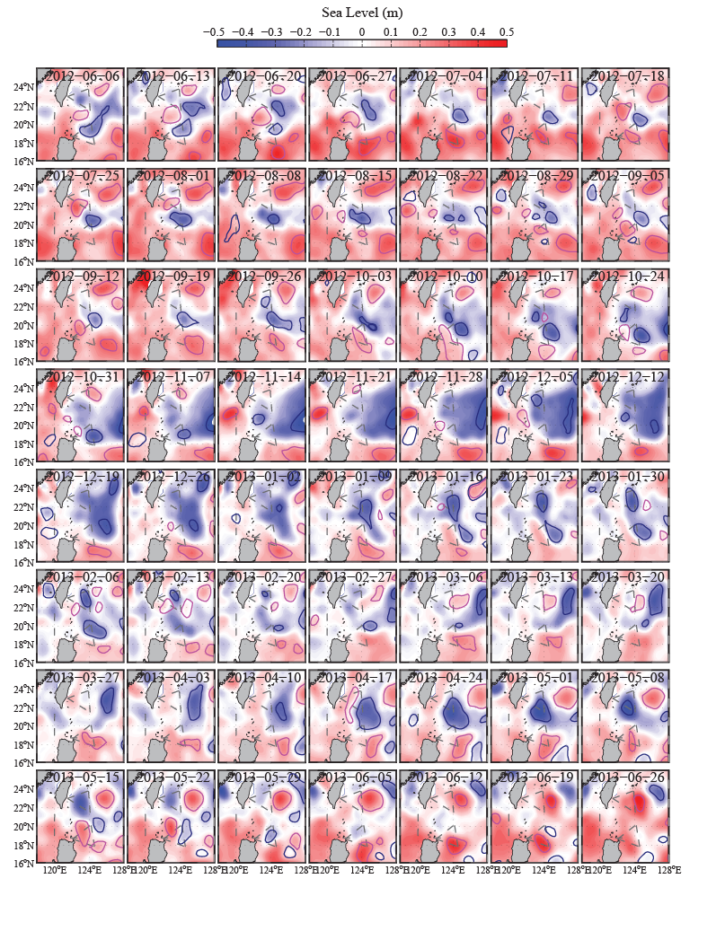
AVISO Satellite SSH and Eddy Tracking
22/06/2011 – 11/07/2012
06/06/2012 – 26/06/2012
Notes:
Is this colormap looks better?

Slide 5
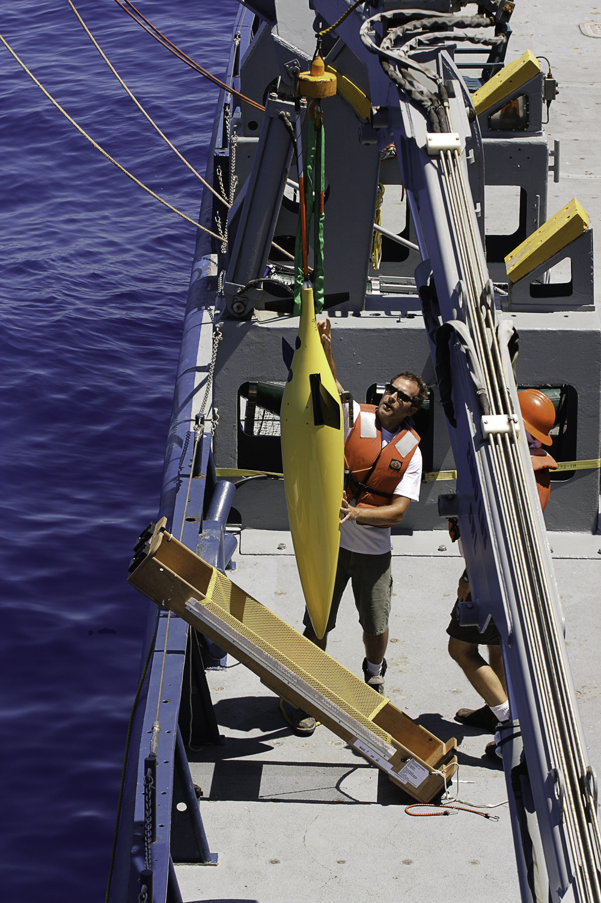
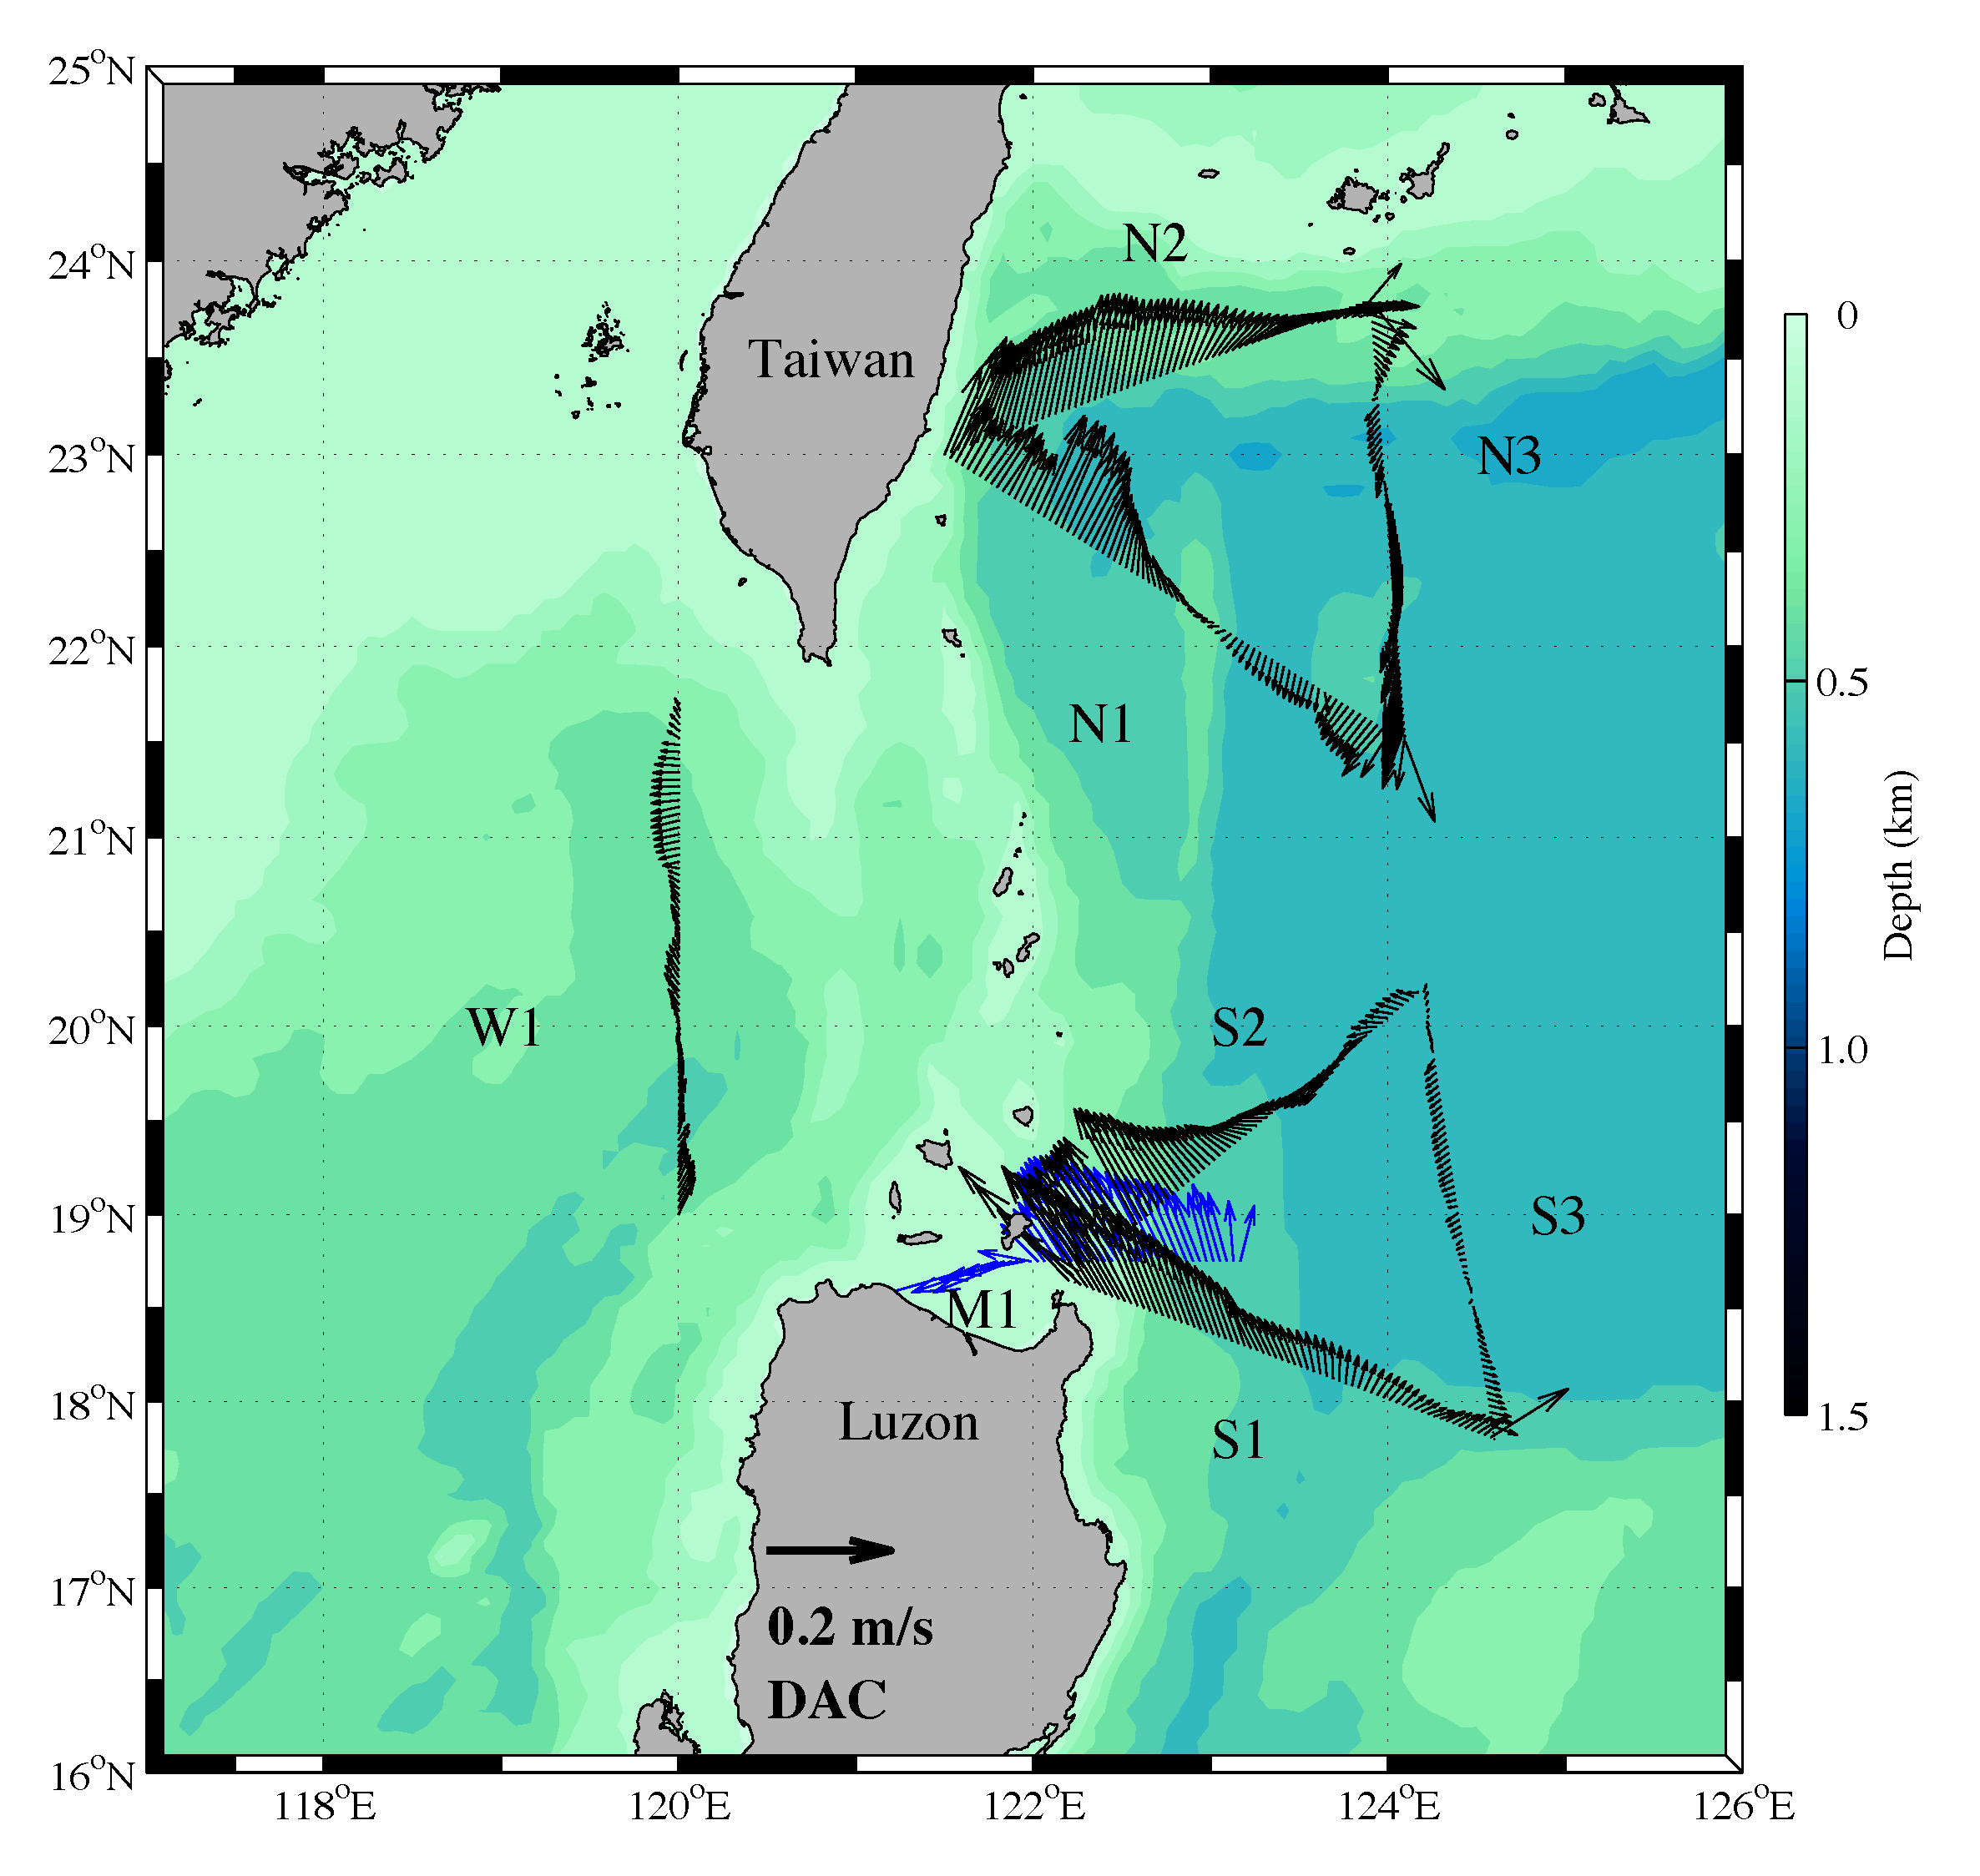
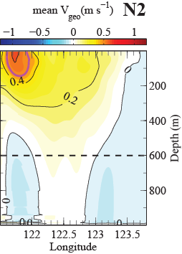
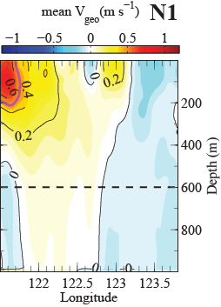
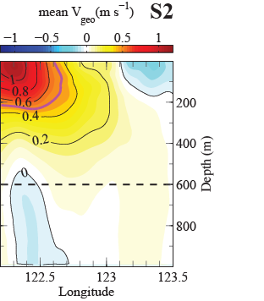
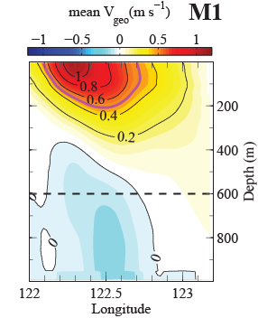
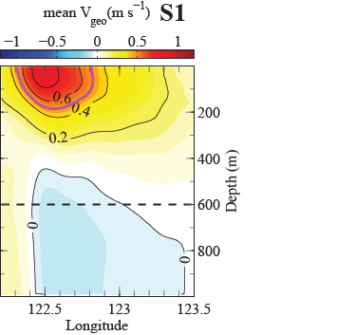
Mean Circulation
Mean Depth-averaged Velocity
Velocities remain strong into the coast.
Dual velocity maxima at N1 (Yang et al., 2015).
Consistent southward flow east of ridge at N1 (recirculation gyre?).
Kuroshio broadest at N2.
S2 and N1 align best with Kuroshio axis.
Individual sections show strong variability associated with eddies.
N2
N1
N1
S2
S1
M1
S1

Slide 6
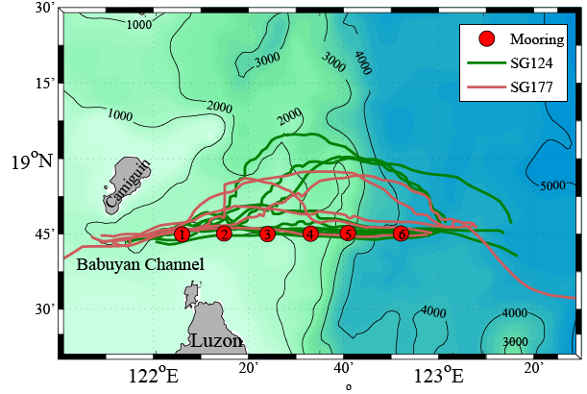
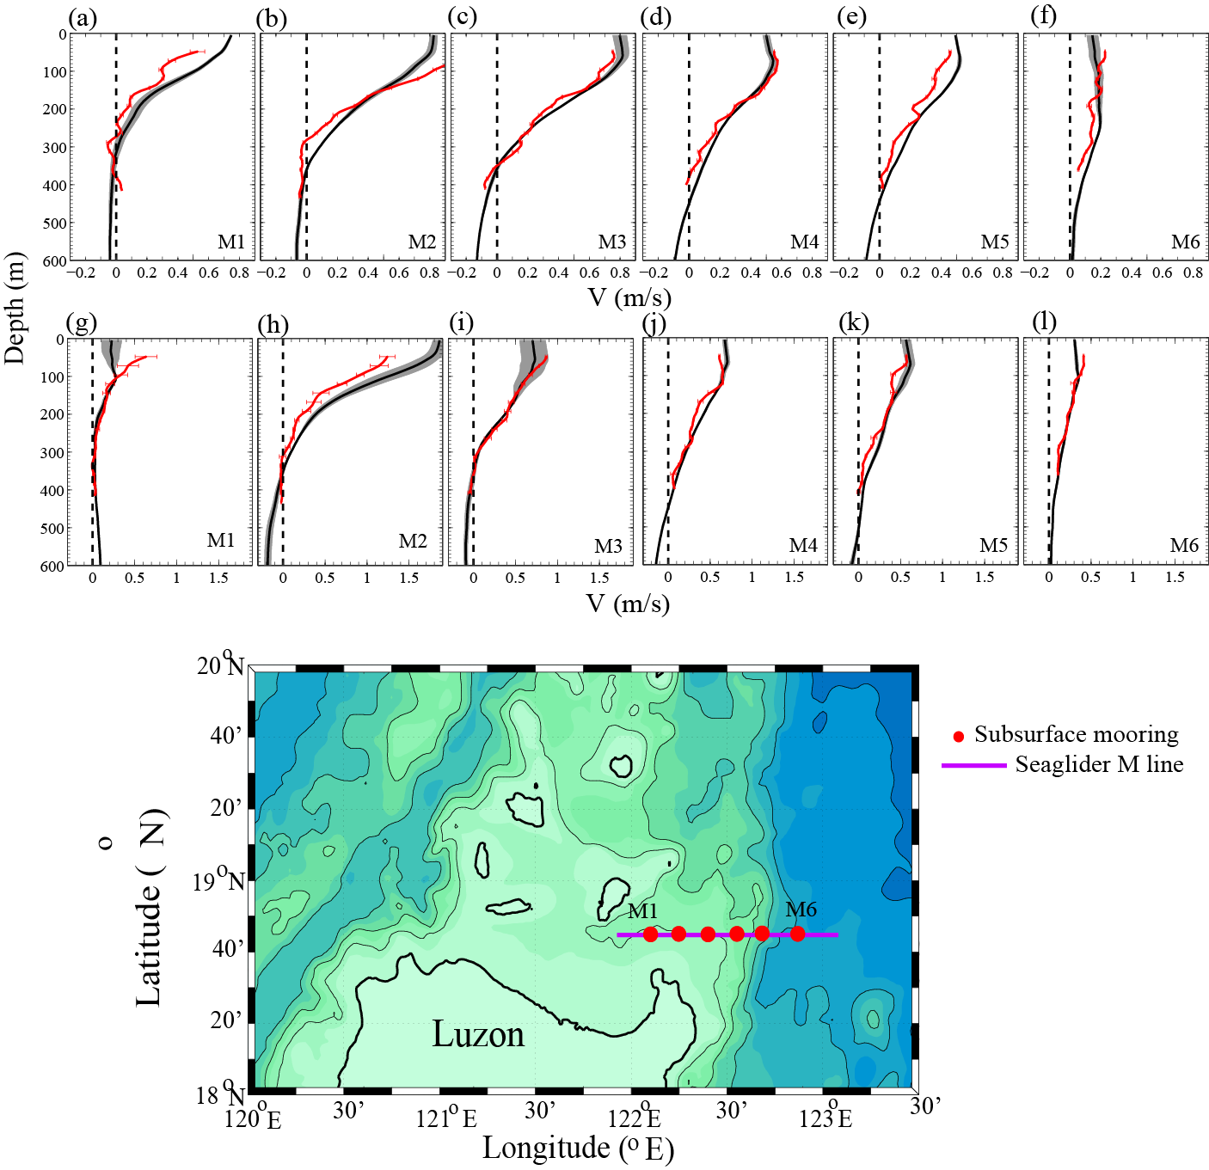
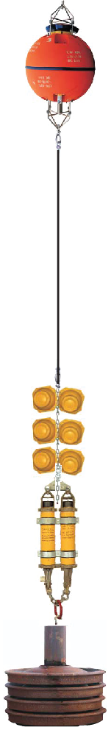
Glider-based Absolute Geostrophic Velocity vs. Mooring Velocities
Absolute
Geostrophic
Velocity
Relative Geos.
Velocity
(thermal wind)
Depth
Average
Velocity from
GPS fixes
Depth
Average
Relative
Velocity
~450 m
Westward
2012/11/29
~2012/12/04
Mooring
Glider V_{abs}
Eastward
2012/12/04
~2012/12/14

Slide 7
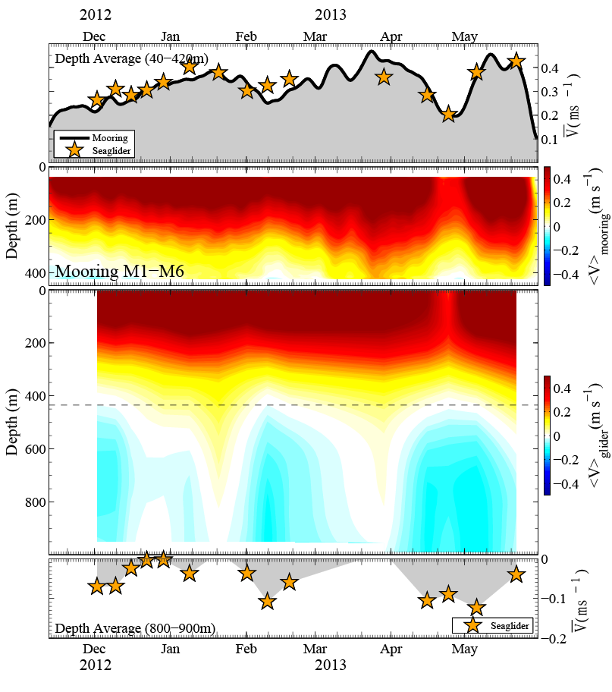
Glider-based Absolute Geostrophic Velocity vs. Mooring Velocities
Northward Current
(40-420 m)
Mooring Current
(M1-M6, 0-400 m)
Seaglider Geostrophic Current
(0-1000 m)
Southward Current
(800-900 m)

Slide 8
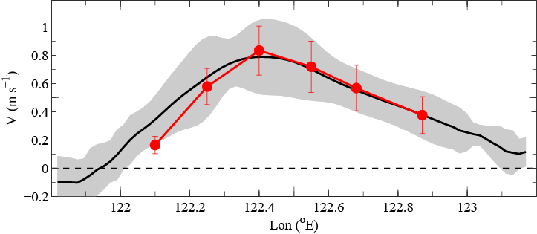
Glider-based Absolute Geostrophic Velocity vs. Mooring Velocities
Mooring
Average top 200m
Notes:
Average meridional current at top 200-m for 16 Seaglider along ‘M’ section (black line) and RC’s mooring (red line). The gray shade and red vertical bar indicated the 1 standard deviation.

Slide 9
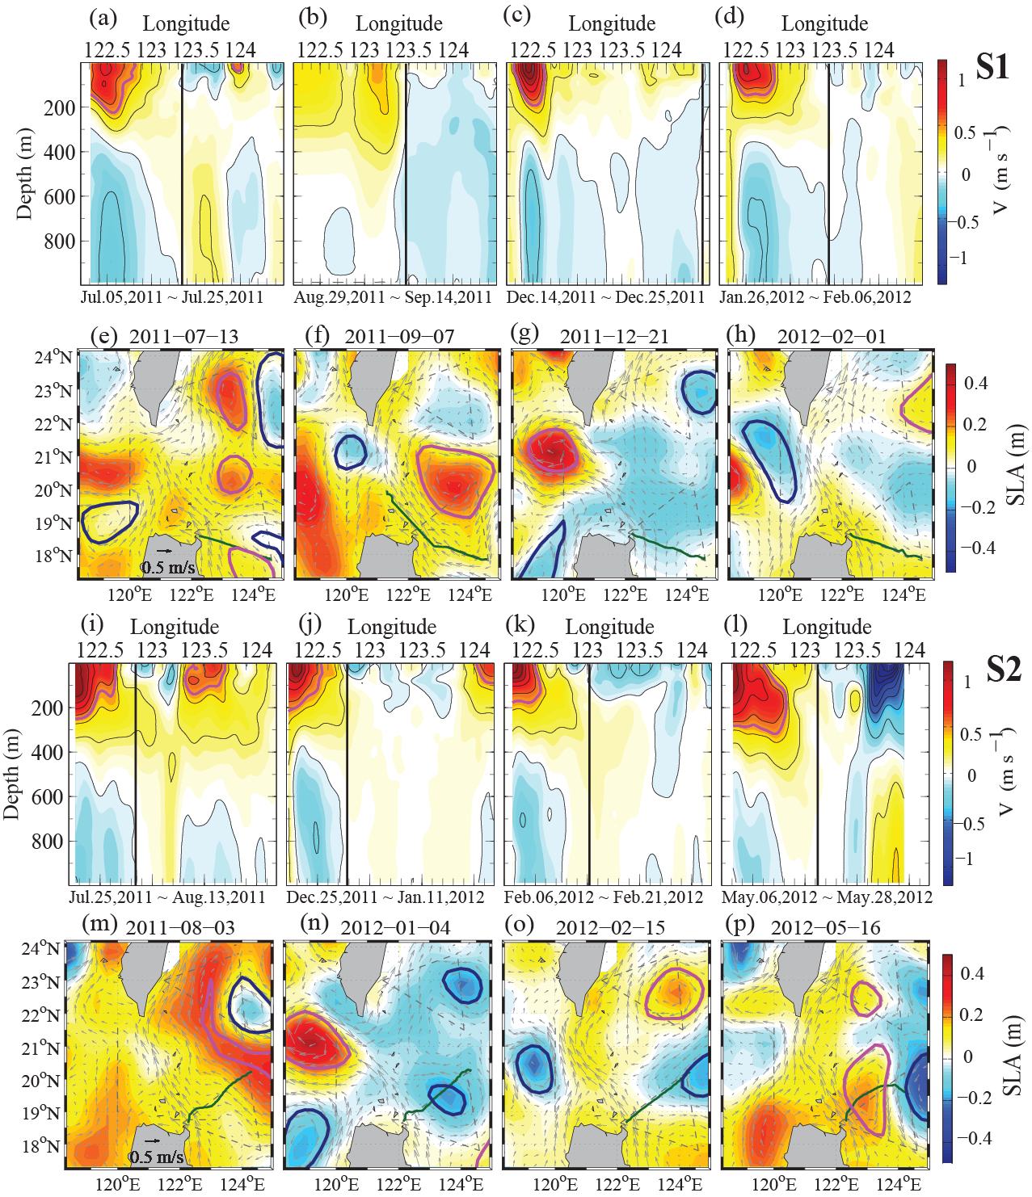
Example S (Luzon) Sections
S1
Dual velocity maxima
Cyclonic eddy reduces transport
S2
Notes:
Figure 5. The Seaglider transect on S1 and S2 line and corresponding satellite altimeter data. (a)–(d) and (i)–(l) show the V_{abs} for S1 and S2 line respectively. The interval of black contour line is 0.2 m s⁻¹. The magenta contour is 0.5 m s⁻¹. The vertical black line marks the eastern boundary for KC transport calculation. The start and end time are shown on the bottom of each panel. (e)–(h) and (m)–(p) show the corresponding AVISO sea level anomalies and absolute geostrophic velocities. The green line marks the Seaglider track.

Slide 10
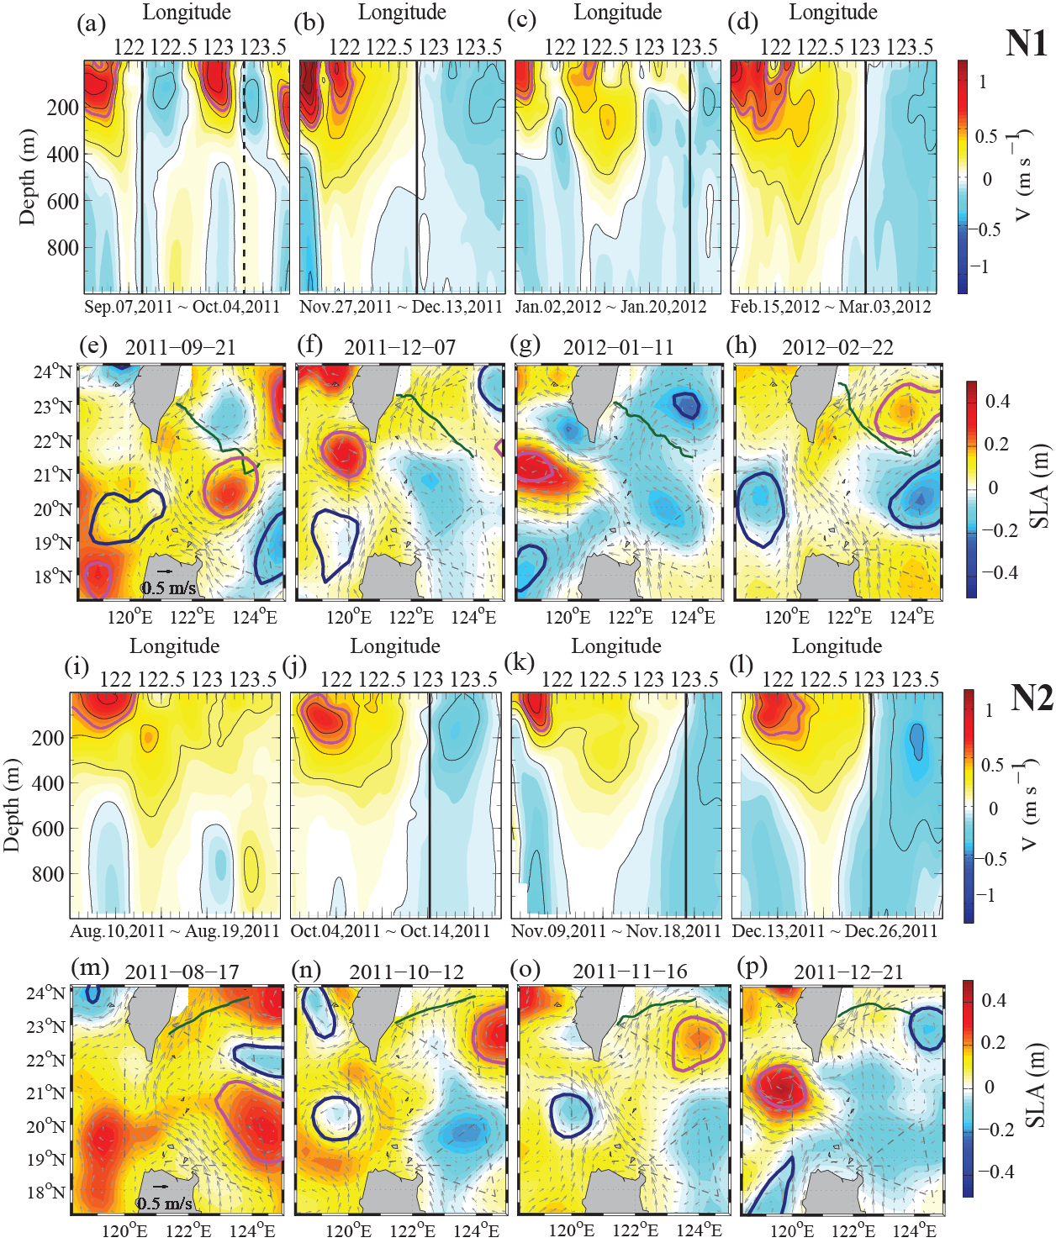
Example N (Taiwan) Sections
Dual velocity maxima
N1
Kuroshio broadens,
branches recombine?
N2
Notes:
Figure 6. The Seaglider transect on N1 and N2 line and corresponding satellite altimeter data. (a)–(d) and (i)–(l) show the absolution geostrophic current for N1 and N2 line respectively. The interval of black contour line is 0.2 m s⁻¹. The magenta contour is 0.5 m s⁻¹. The vertical black line marks the eastern boundary for KC transport calculation. The start and end time are shown on the bottom of each panel. (e)–(h) and (m)–(p) show the corresponding AVISO sea level anomalies and absolute geostrophic velocities. The green line marks the Seaglider track.

Slide 11
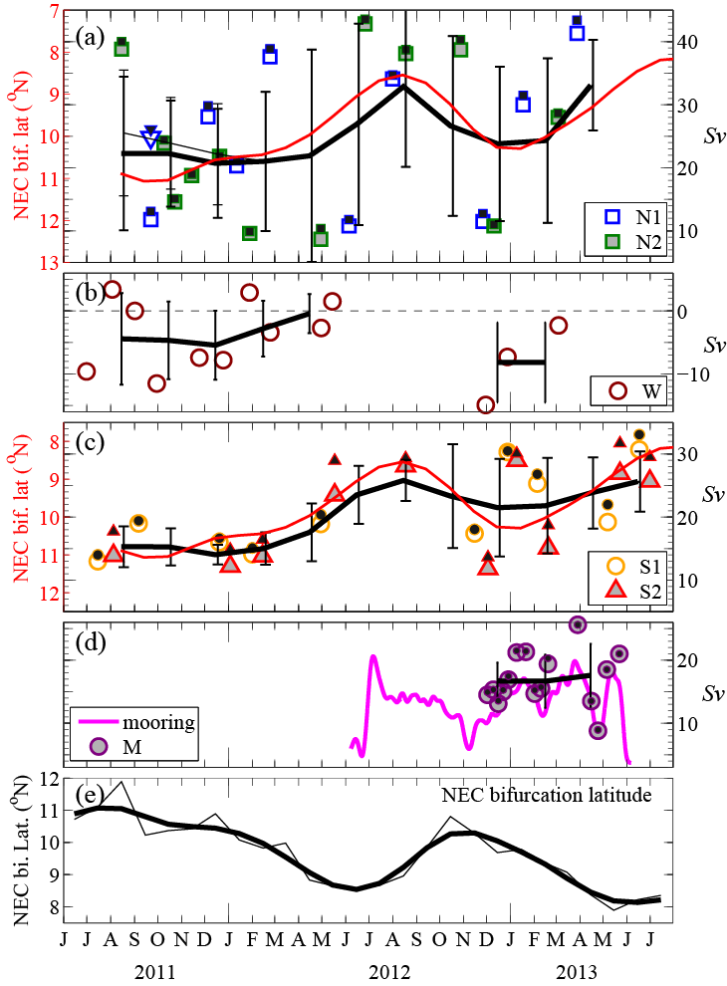
Seasonal Variation in Kuroshio Transport
Extrapolation to western (inshore) boundary by fitting QG model (solid symbols, 1-14% correction).
Mean transports: N 25 ± 12 Sv
    S 20 ± 7 Sv
    M 17 ± 4 Sv
Large variation in N transports driven by greater eddy influence.
M/S difference due to restricted eastern extent of M sections.
r = -0.34 (-0.60/0.00) between NECBL and N (Taiwan) transport.
r = -0.61 (-0.83/-0.23) between NECBL and S (Luzon) transport.
2-month lag
Bifurcation Latitude (Qiu and Chen, 2010)
Y_{p}(t) = 11.9 - 0.13 h’(t) (ºN)
h’(t) SSH anomaly (in cm)
12-14 °N and 127-130 °E average
Notes:
Figure 7. The combined transport and NECBL. (a) the N1 and N2 section represent the KC transport at 23°N. The red line is the NECBL with 2-month lag. The blue triangle is the transport calculated using the eastern boundary defined in Figure 6a (dash line). The thick black line is 2-month interval with 6-month running mean. The thin vertical bar is one standard deviation. The thin black line is the same 2-month interval with 6-month running mean using the blue triangle. The black-filled squares are the transports including western boundary fitting with QG solution. (b) the W line section is the net transport at upper 600m from 20°N – 21.7°N. (c) the S1 and S2 section represent the KC transport at 18.7°N. (d) The Seaglider M line (purple circle) and mooring array (magenta line). (e) The bifurcation latitude is calculated using SSH anomaly value in the 12°–14°N and 127°–130° box (Qiu and Chen 2010, equation 2). The thin black is monthly data. The thick black line is 6-month low-pass data.

Slide 12
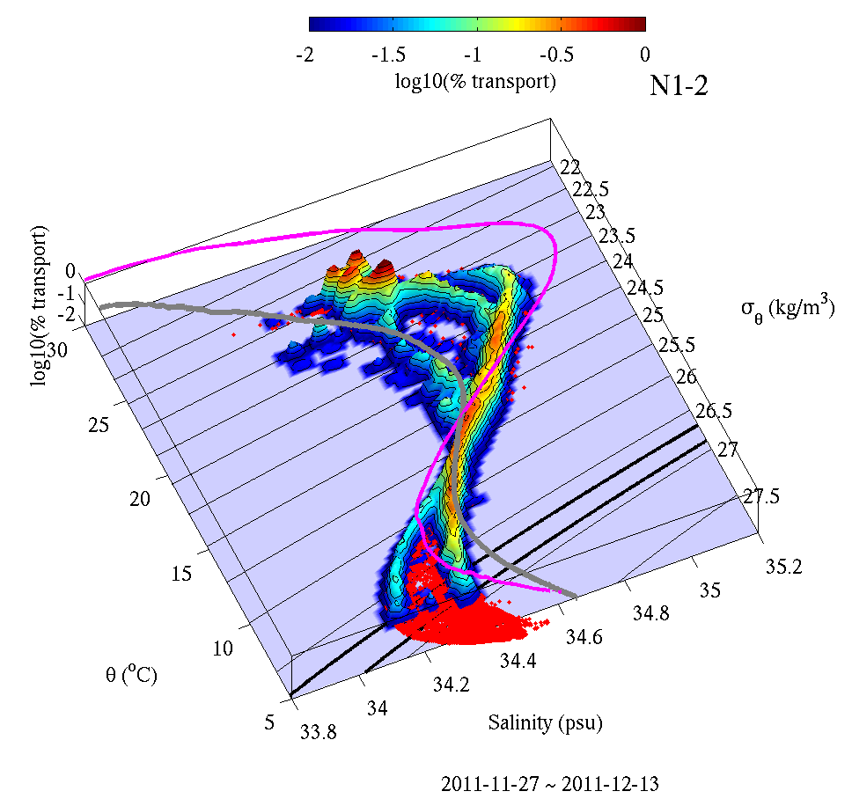
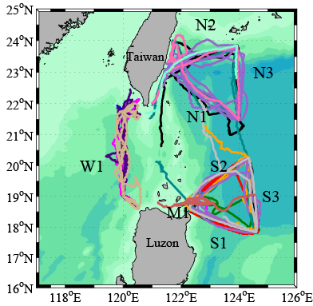
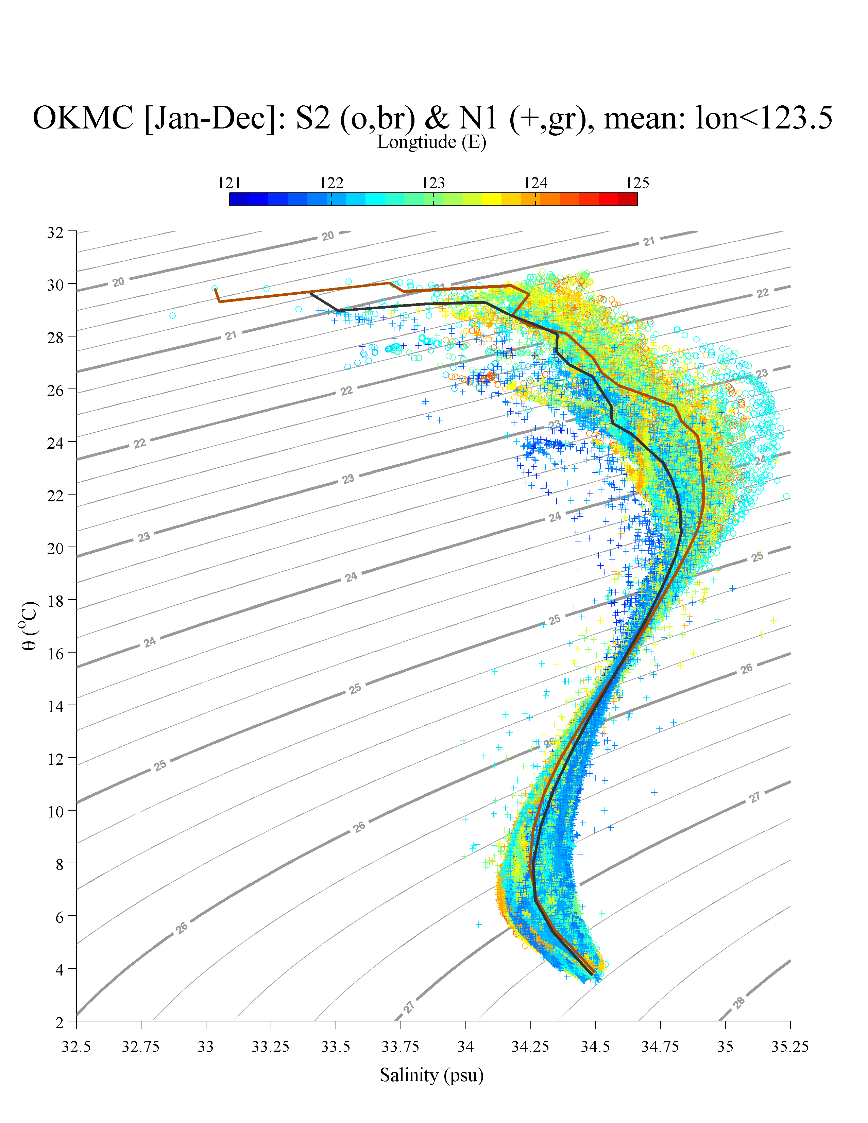
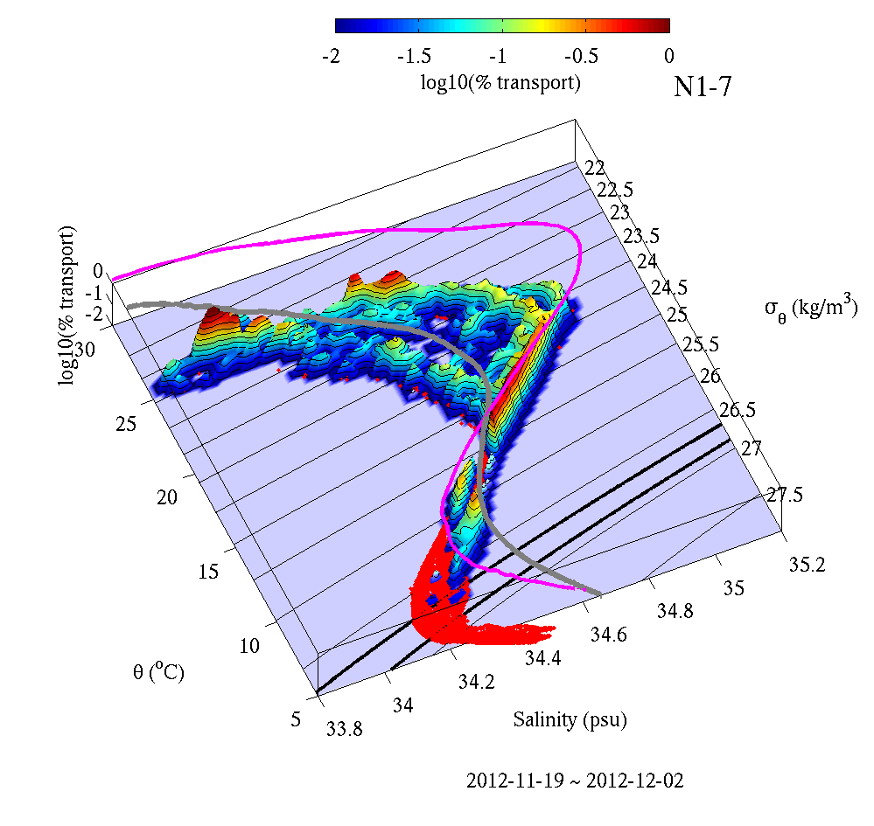
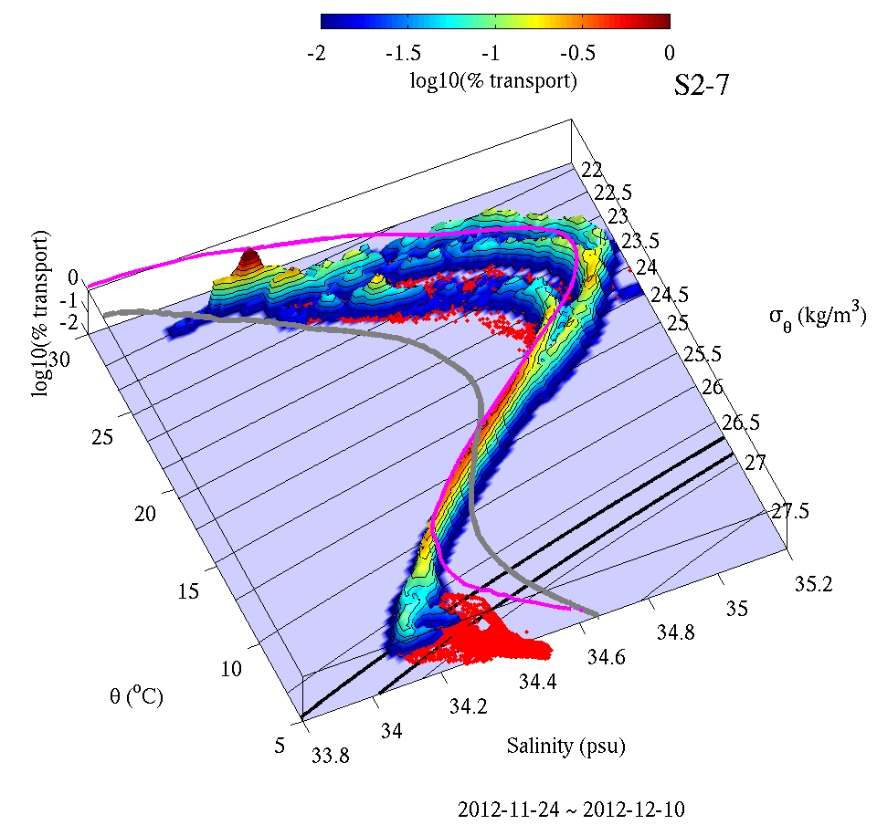
Mixing during Transit Through the South China Sea
N1-2
north (N1)
south
north
NPTW Kuroshio
south (S2)
South China Sea
N1-7
South China Sea
NPIW
Kuroshio
Shifts in θ-S suggest mixing and entrainment during transit though SCS.
Clear shifts in NPTW.
NPIW shows small, but consistent, shift above 26.6, within Kuroshio.
Consistent with observed elevated 'spiciness' on these isopycnals.
S2-7

Slide 13
Summary
Gliders maintained a persistent presence to repeatedly survey strong boundary current.
    Local logistics critical to maintaining continuous operations.
    Densely inhabited regions offer unique hazards.
    Improve repeat cycle (more gliders).
Transport estimates consistent with expectations.
Eddy interactions contribute to Kuroshio transport variability.
Transports east of Luzon inversely correlated with NEC bifurcation latitude (2 month lag).
Finestructure suggests lateral stirring at salinity extrema.
Shifts in θ-S suggest mixing and entrainment during the Kuroshio's passage through the South China Sea.
Real-time data to NAVO throughout experiment. Processed data ready for OKMC modeling & state estimation efforts. Collaborate to investigate sources and mixing pathways.

Slide 15
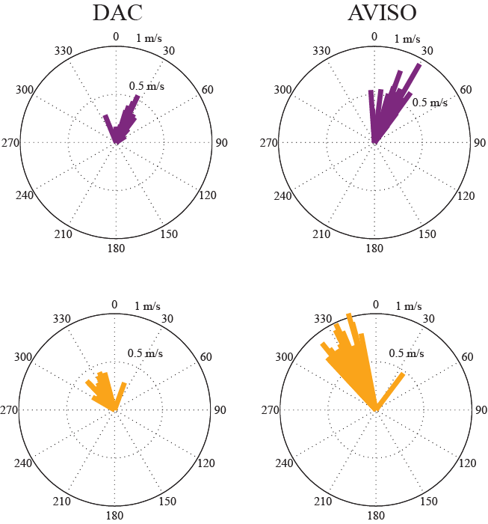
Kuroshio Axis & Section Orientation
N1, N2
DAC
DAC
AVISO
S1, S2, M
DAC
AVISO
Kuroshio Horizontal Axis
 | M | S1 | S2 | N1 | N2
V_{geo} (section) | 0°T | 20°T | 321°T | 032°T | 340°T
V_{MADT} | 332 ± 9 °T | 340 ± 7 °T | 328 ± 4 °T | 025 ± 8 °T | 017 ± 10 °T
V_{dac} | 317 ± 26°T | 328 ± 13 °T | 328 ± 8 °T | 032 ± 27 °T | 023 ± 22 °T

Slide 16
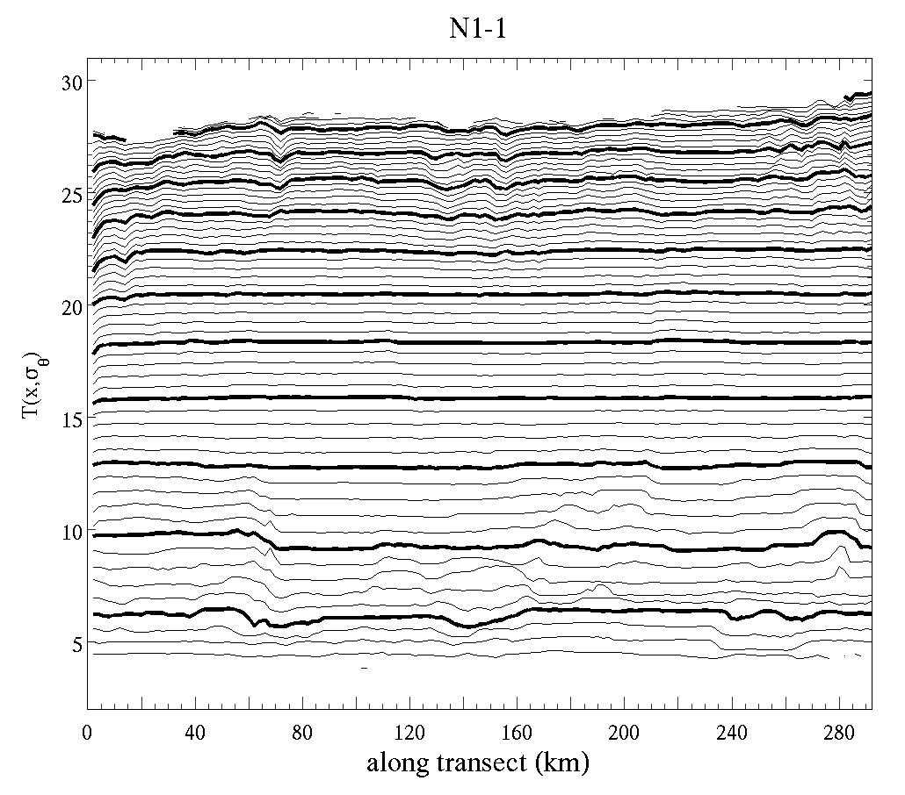
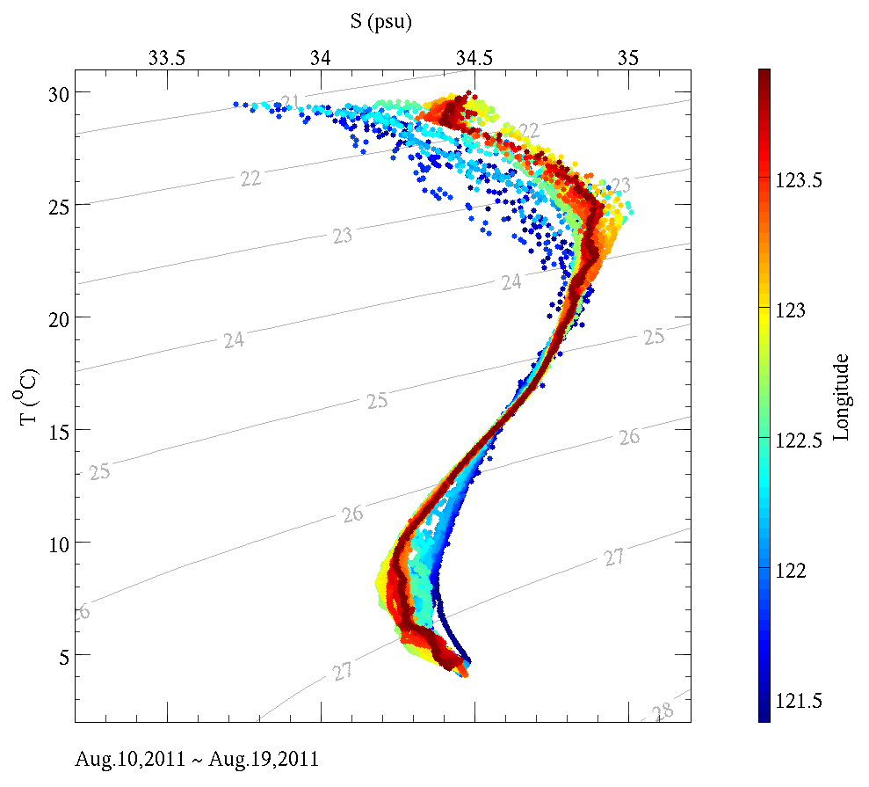
Watermass Properties & Finestructure
NPTW and NPIW signature strongest to the east (outside the Kuroshio)
Elevated finestructure ('spiciness') associated with salinity extremes (NPTW & NPIW)- indicative of isopycnal stirring.

Slide 17
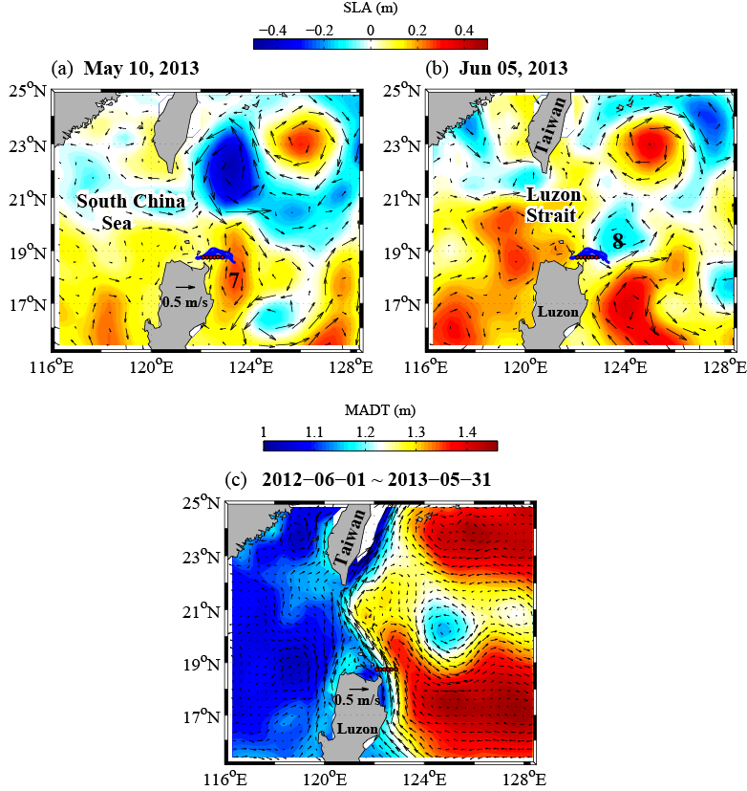
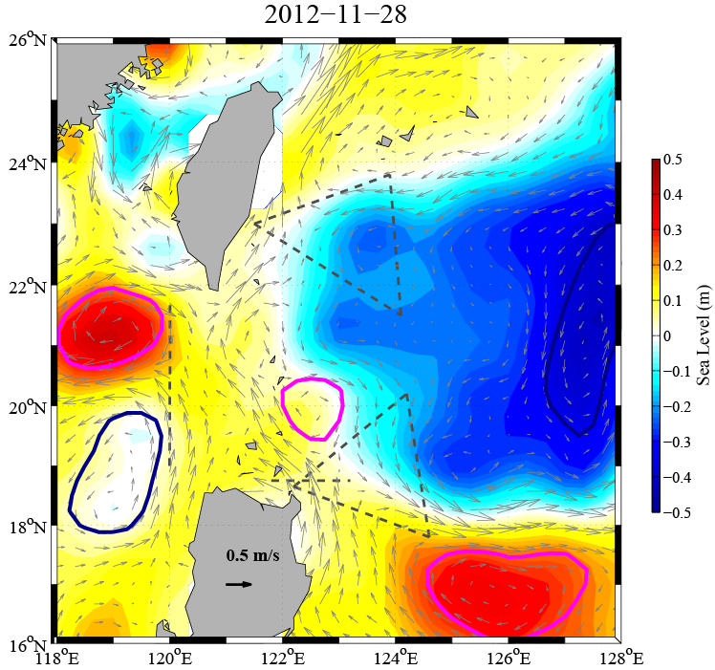
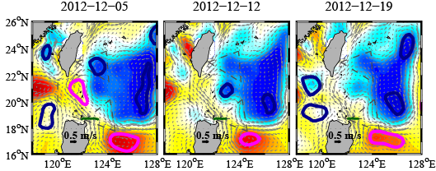
AVISO Satellite SSH and Eddy Tracking
MSLA:
Maps of Sea Level Anomalies & geostrophic velocity anomalies
cyclonic
anticyclonic
Detection and Tracking Algorithm
Nencioli et al. 2010 & Cheng et al. 2014
Notes:
Positions of six moorings at the entrance to the Luzon Strait (red dots), Aviso sea level anomaly (SLA) (color shading), and Aviso surface current anomaly (vectors) on 10 May 2013 (a) and 5 June 2013 (b). Velocity reference scale of 0.5 m s^{–1} is labeled in panel (a). Two eddies leading to Kuroshio transport anomaly events 7 and 8 are labeled in panel (b). Blue curves northeast of Luzon represent seaglider tracks. Panel (c) shows the map of absolute dynamic topography (MADT) and Aviso surface current.

Slide 18
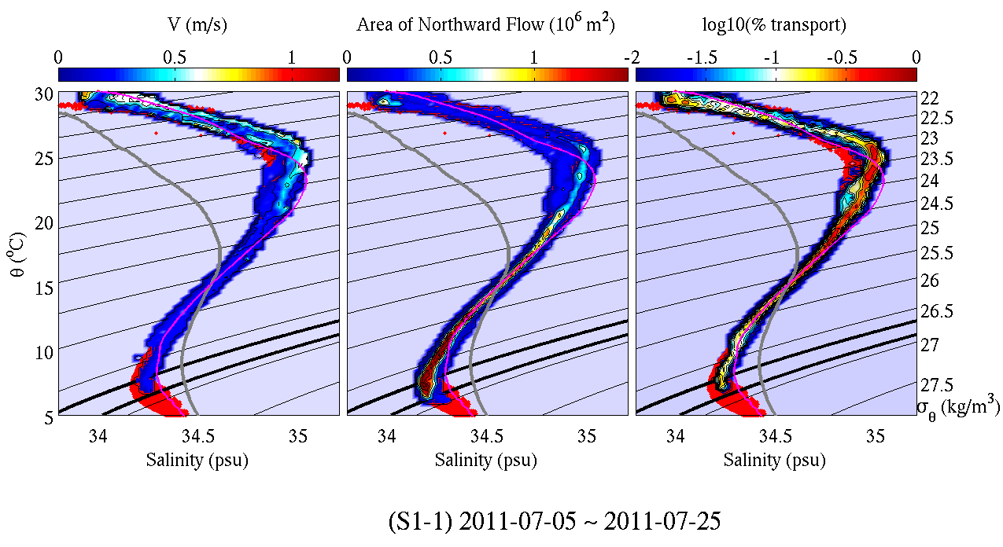
Watermass Properties and Pathway Mixing
South China
Sea
Kuroshio
Section S1 (5-25 July 2011)
Reference Curves (Mensah et al. 2014)
Kuroshio
South China Sea

Slide 19
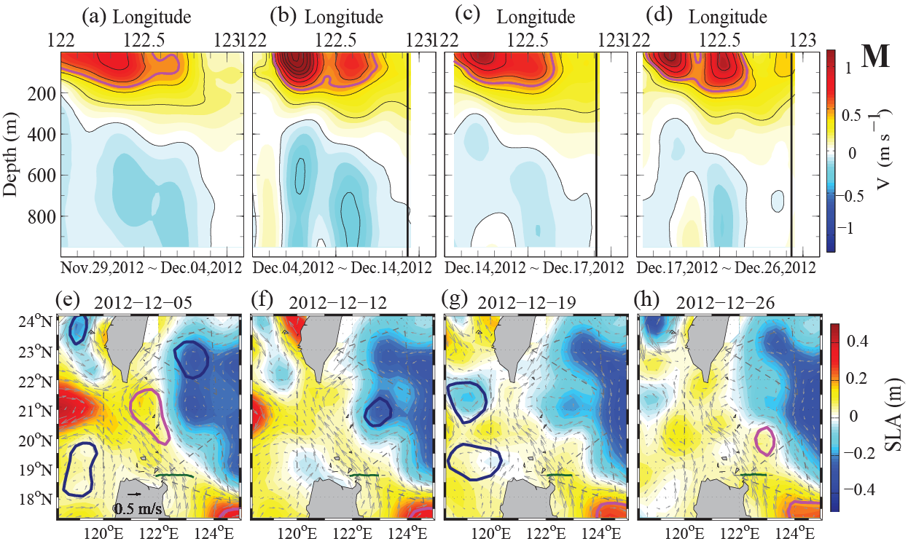
Example Mooring Line Sections
Notes:
Figure 4. The Seaglider transect on M line and corresponding satellite altimeter data. (a)–(d) show the absolution geostrophic current (V_{abs}) of M line. The interval for black contour line is 0.2 m s⁻¹. The magenta contour is 0.5 m s⁻¹. The vertical black line marks the eastern boundary for KC transport calculation. The start and end time are shown on the bottom of each panel. (e)–(h) show the corresponding AVISO SLAs (color contours) and MADT_{u,v} (grey velocity vectors) with 7-day interval delay-time product. The closest time within each Seaglider transect is selected to represent the spatial condition of the eddy field. Eddy detection and tracking algorithm were used to identify the eddy (see section 4.1). Blue contours show the cyclonic (cold) eddies and magenta contours show the anti-cyclonic (warm) eddies detected by the detection and tracking algorithm. The green line marks the Seaglider track. Only 4 out of 15 M line transects are shown in here.

Slide 20
Mixing during Transit Through
the South China Sea
north
south
south
NPTW Kuroshio
north
Shifts in θ-S suggest mixing and entrainment during transit though SCS.
Clear shifts in NPTW.
NPIW shows small, but consistent, shift above 26.6, within Kuroshio.
Consistent with observed elevated 'spiciness' on these isopycnals.
South China Sea
South China Sea
NPIW
Kuroshio

Slide 21
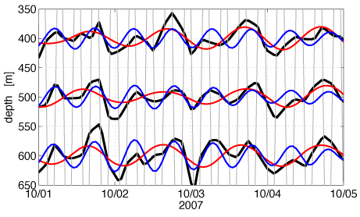
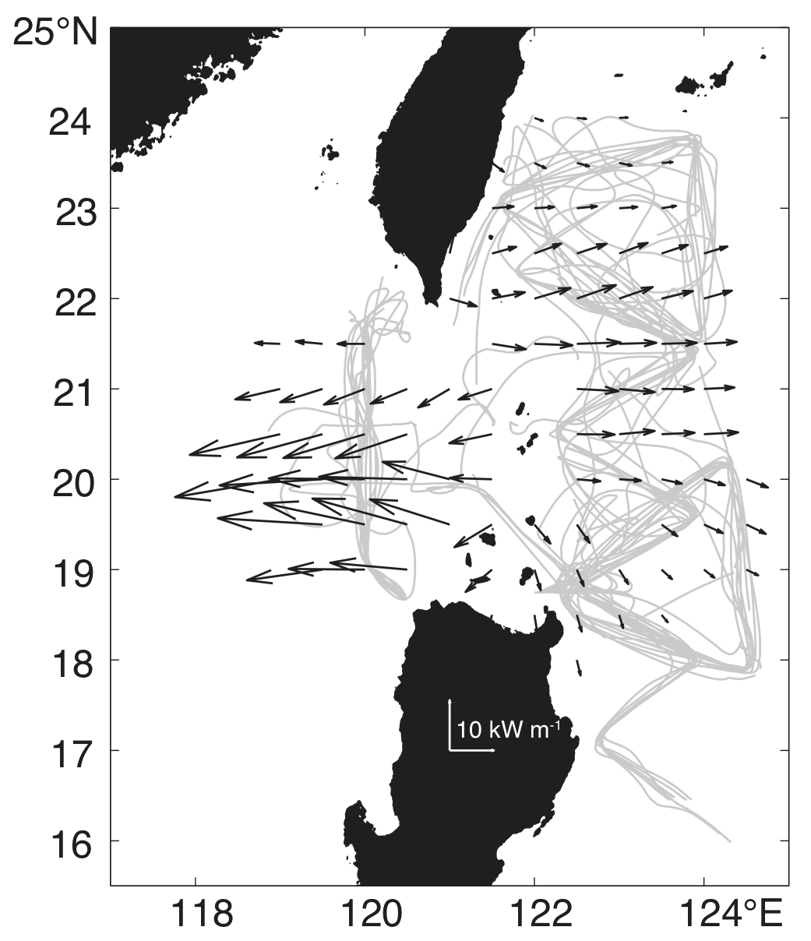
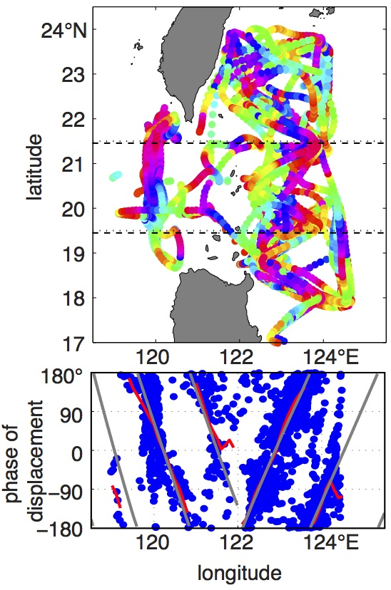
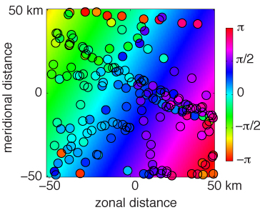
Internal Tides
IWISE
  Over 23,000 glider profiles are used to estimate isopycnal displacements consistent with diurnal and semidiurnal internal waves.
M₂ depth-integrated energy flux
Solely based on observations
800 x 600 km region
Isopycnal depth vs time
Diurnal fit (3-day window)
Semidiurnal fit (3-day window)
Glider depth vs time
The direction of propagation is inferred from spatial variations of the phase.
Propagation
direction
Data
(mode-1 phase)
Fitted plane
Rainville et al., 2013, JGR

Slide 22
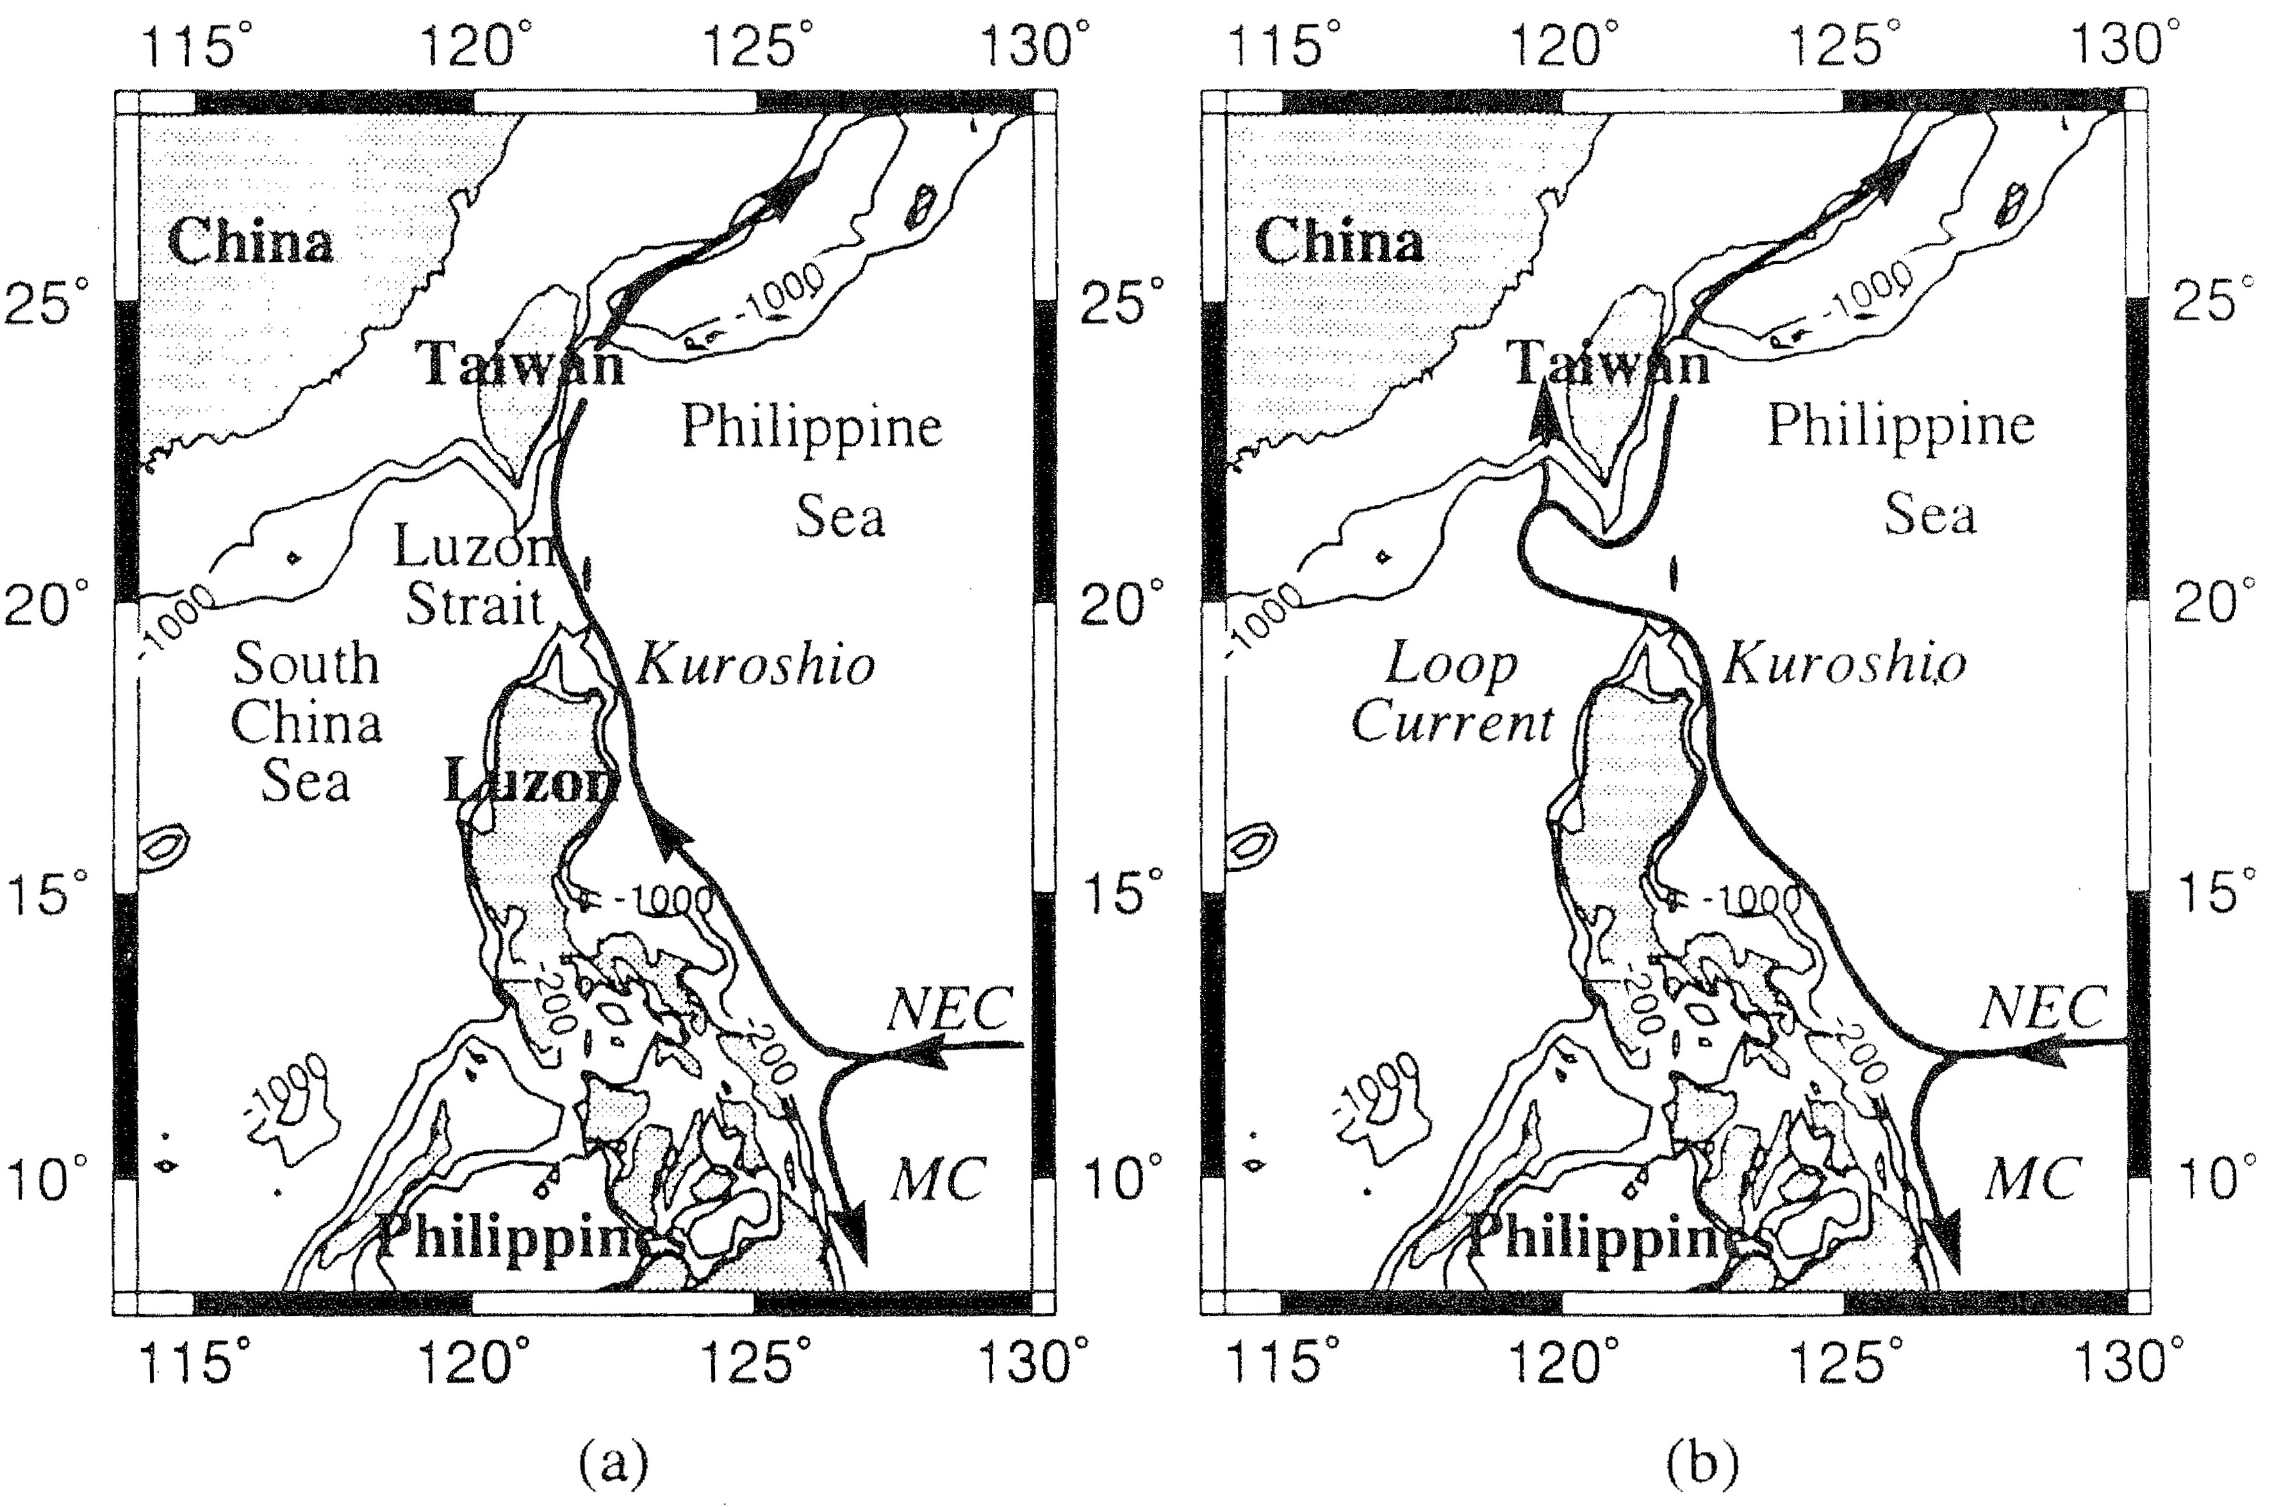
Kuroshio and Luzon Strait
QPEU
ITOP
Ekman Transport
ASIAEX
IWISE
Ekman Transport
Kuroshio 07/08
OKMC
PhilEx
Summer
Winter
(Farris & Wimbush, 1996)

Slide 23
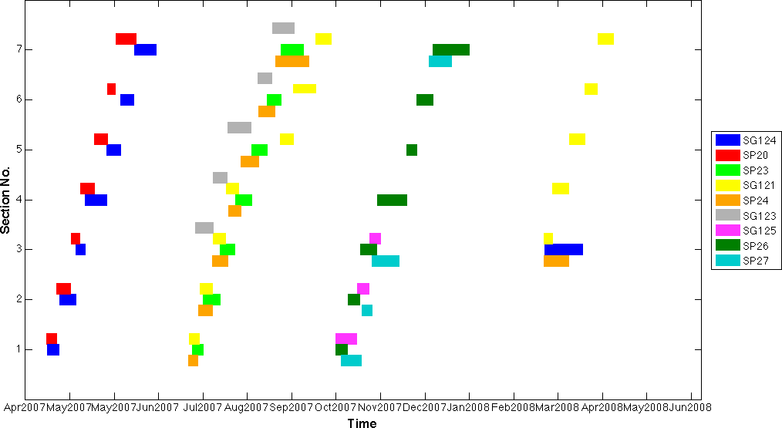
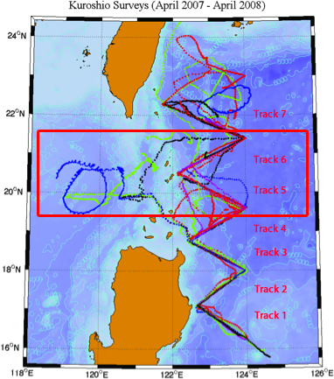
Glider-based Surveys of the Kuroshio 07/08
Craig Lee, Dan Rudnick, David Tang, Kai-Chieh Yang
Apr 2007 – Jun 2008
9 gliders, 13 missions
7-12 occupations per section
Gliders launched in cohorts at southern end, recover to north.
Surveyed across Kuroshio while moving downstream.
Good spatial coverage.
Learned to navigate within strong boundary current.

Slide 24
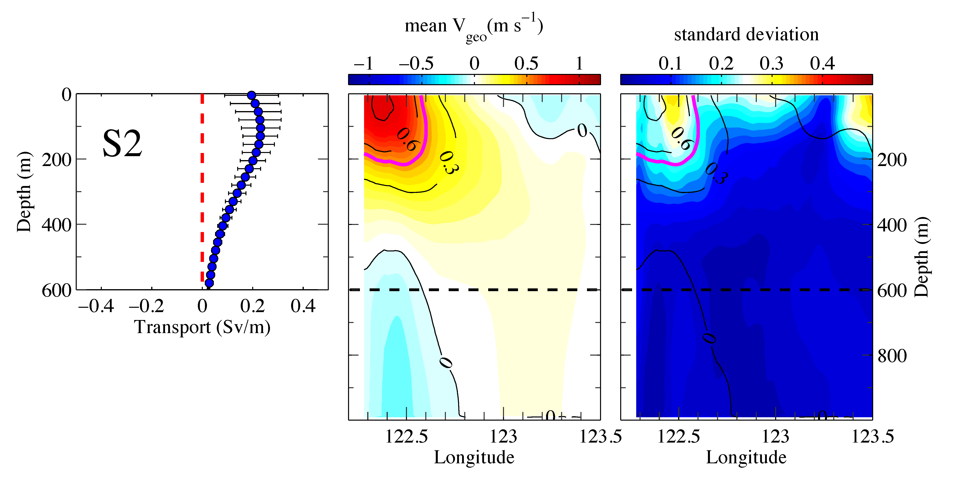
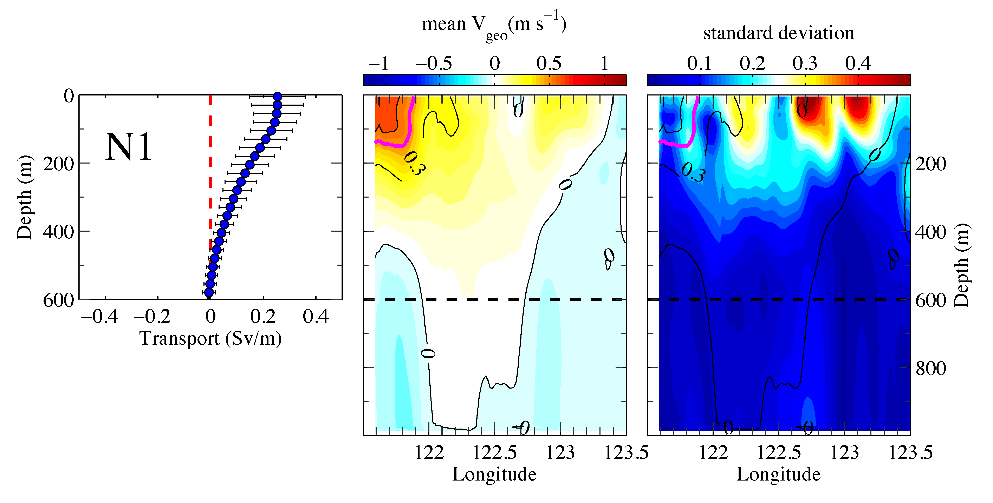
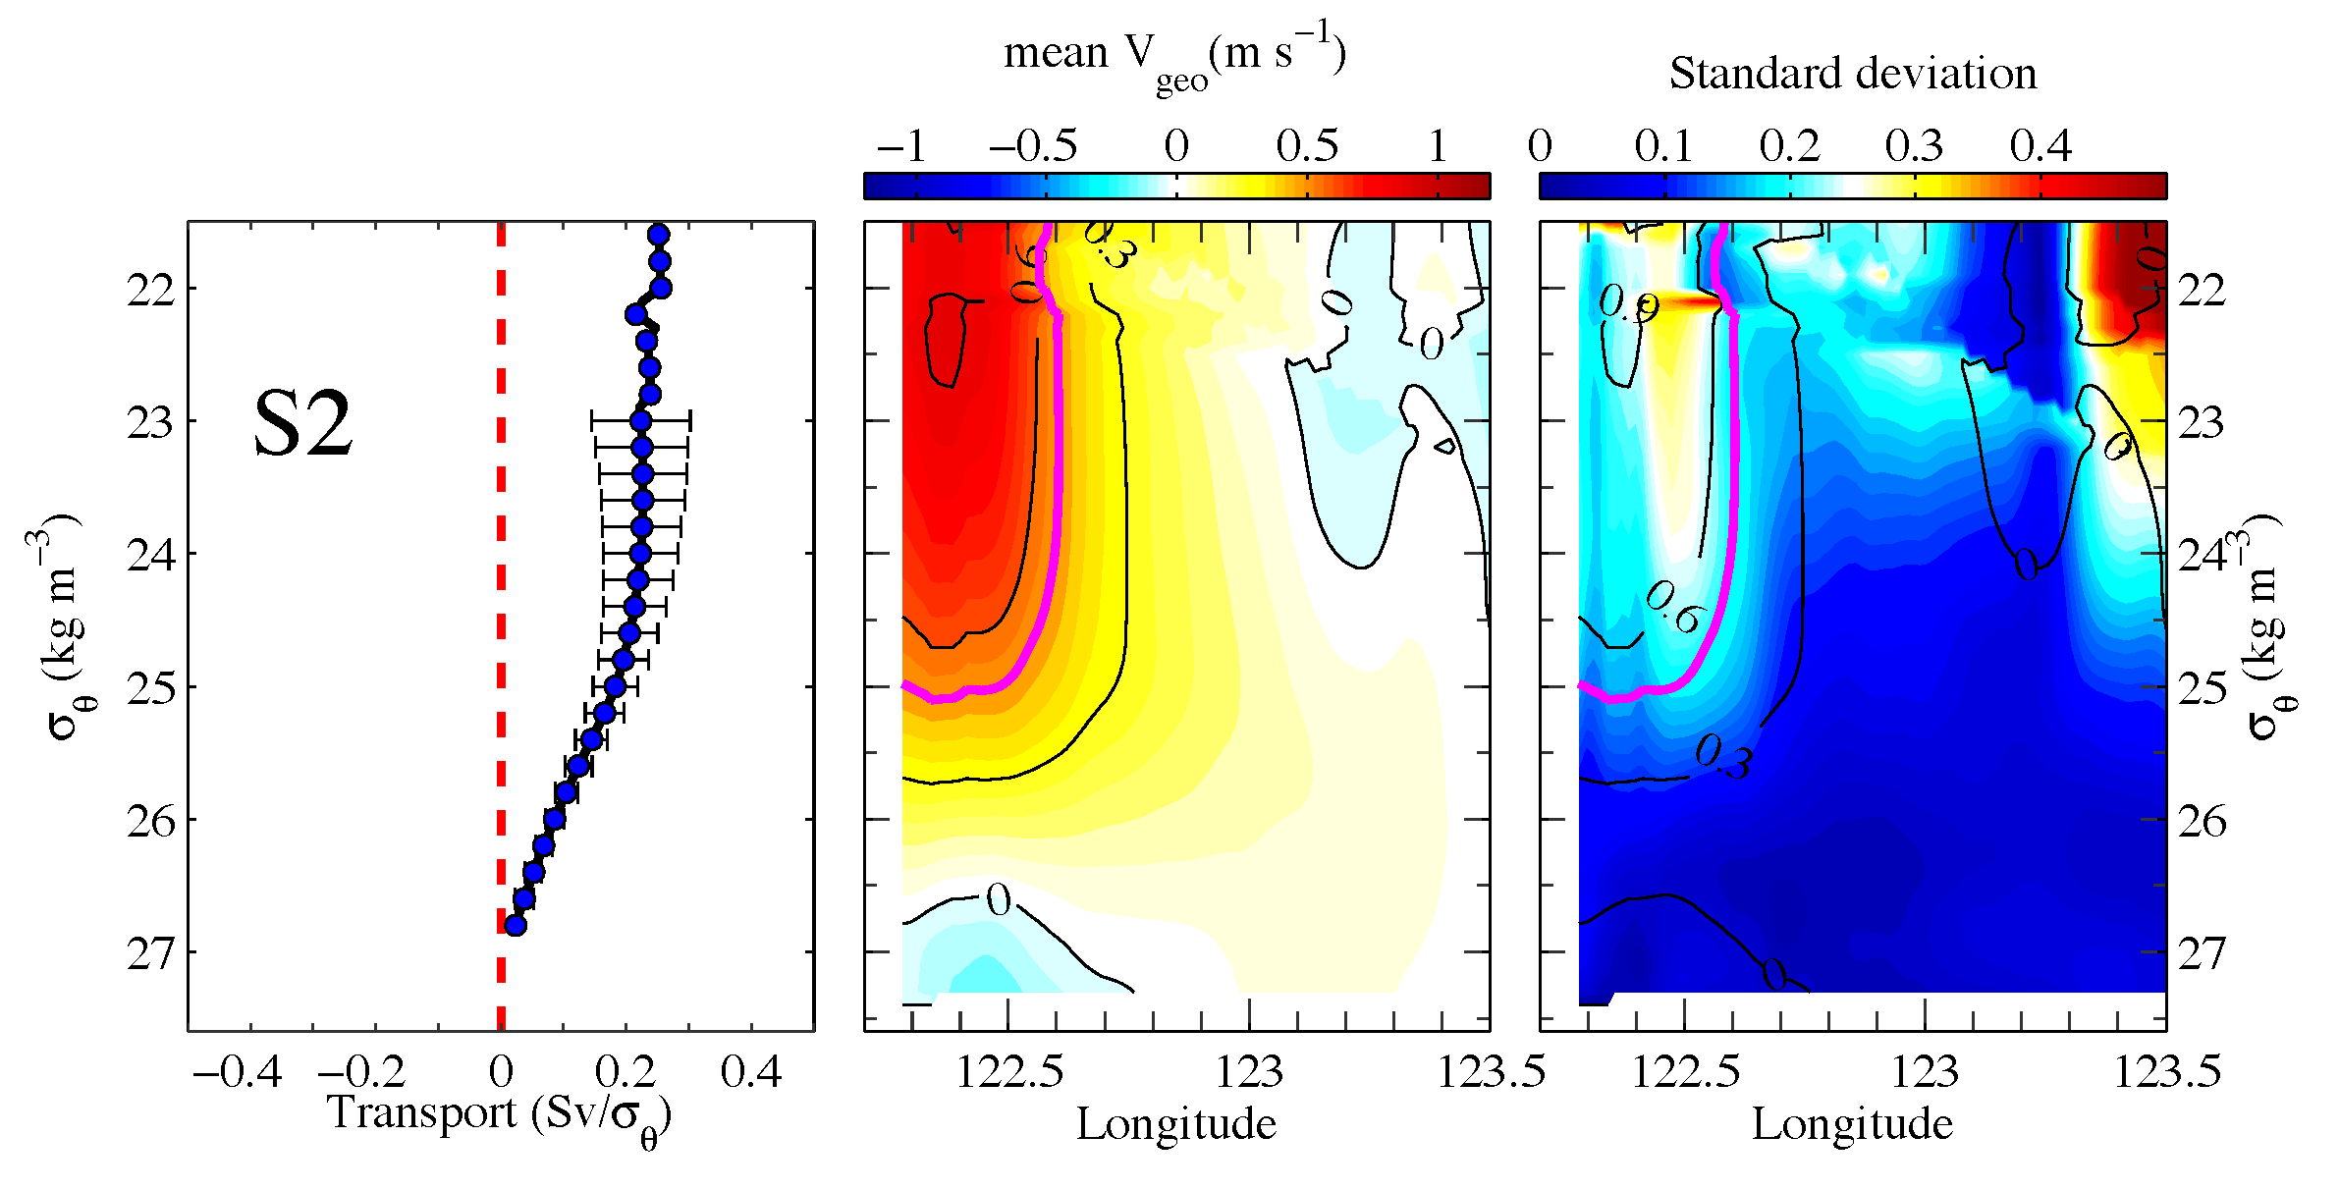
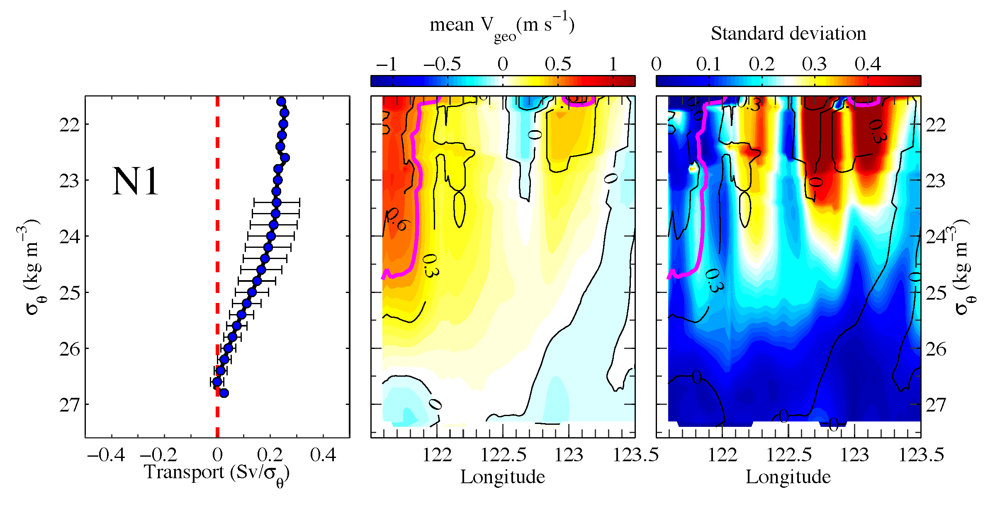
Mean Geostrophic Velocity
South
North
Dual core
High std at edges of outer core
Eddies?
Kuroshio to ~26.6
Observed density 48h (~40 km) low-pass filtered (internal wave heaving)
Referenced to observed depth-average (0 – 1000m) velocity

Slide 25
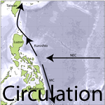
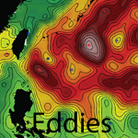
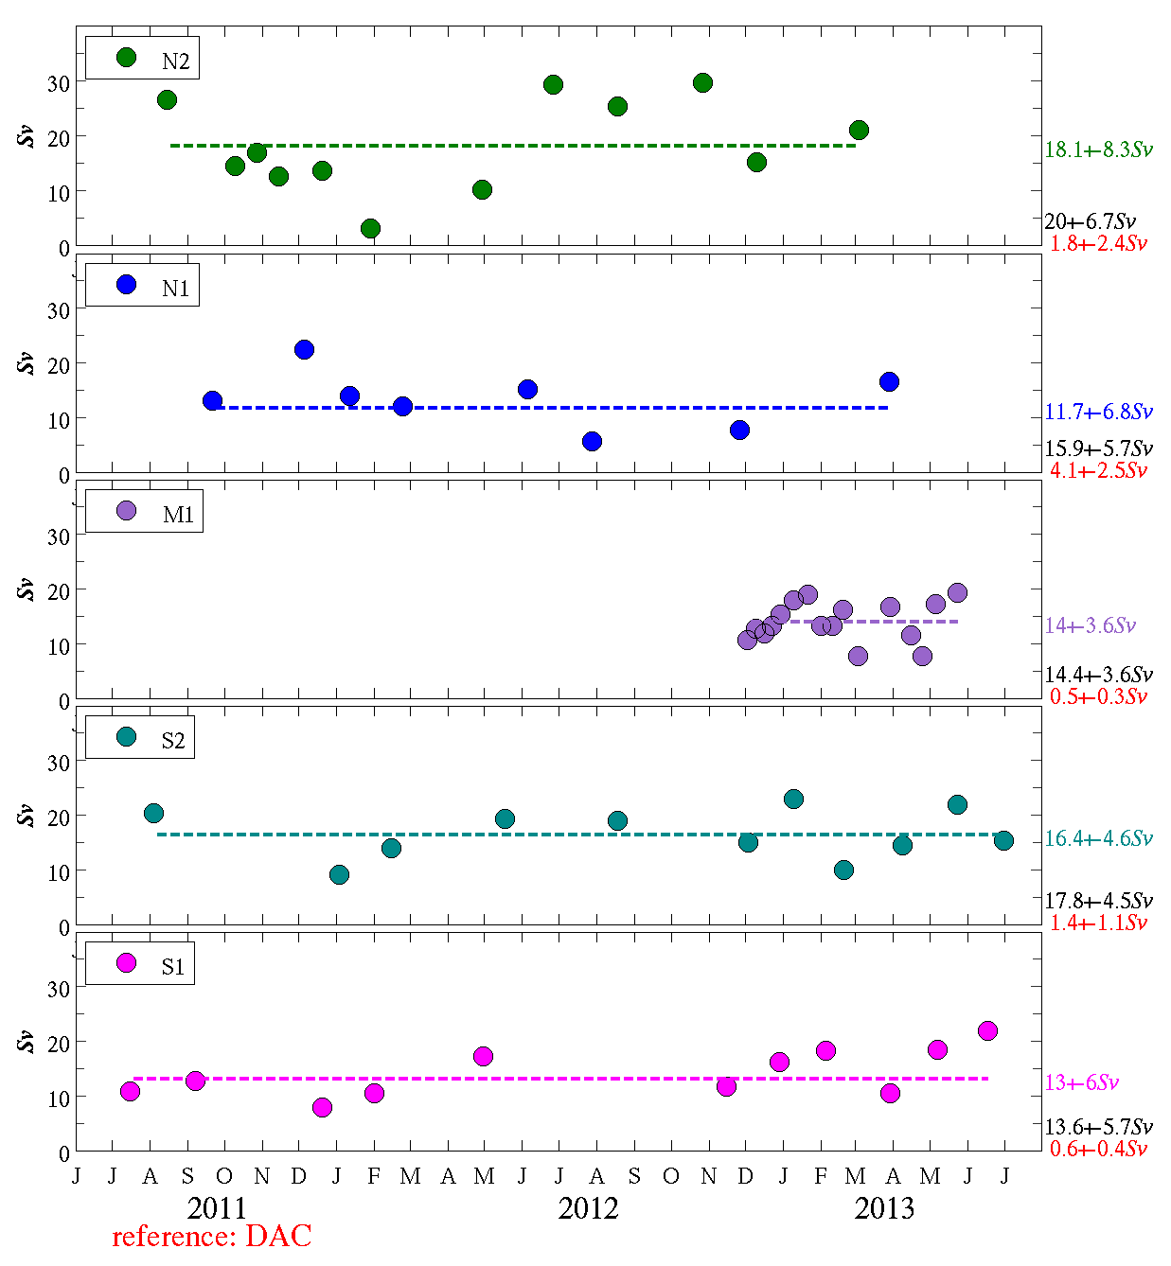
Kuroshio Transport
S1, S2, M1 consistent.
N1 transports seem low… correct for partial sections?
Largest (18 Sv) transport in northernmost section.
Eddy influence examined for mooring region (Lien et al)
Based on absolute geostrophic velocities.
Integrated to 123° 30' W
Integrated surface to 600m.
Partial Section
Cyclonic Eddy
Anticyclonic Eddy

Slide 26
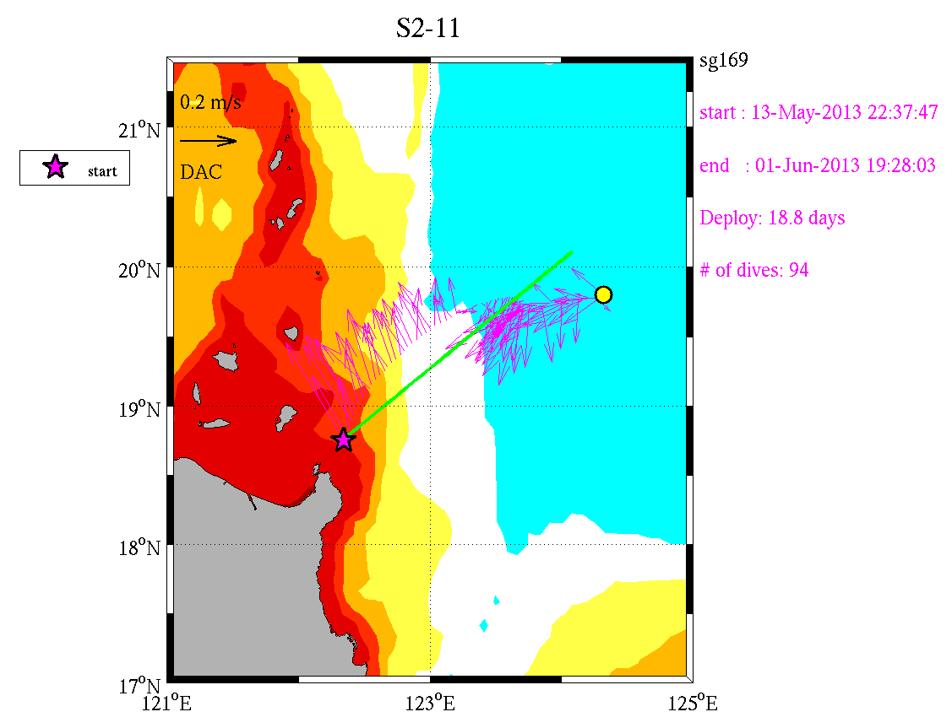



Example Section: S2 13 May – 1 June 2013
Depth-Average Velocity
AVISO SSH & Surface Velocity (24 May)
48-h low-pass to filter diurnal & semidiurnal.
North Pacific Tropical Water (NPTW): ~23.5 (~200m)
North Pacific Intermediate Water (NPIW): ~26.5–27 (~600m)
Kuroshio core tilts eastward with depth.
Velocities consistent with SSH.
Elevated transport - anticyclone amplifies Kuroshio?
projection exaggerates density gradient/shear
Anticyclonic eddy interacting with Kuroshio
Geostrophic Velocity
Salinity (color), σ_{θ} (contour)
NPTW
NPIW

Slide 27
AVISO Satellite SSH and Eddy Tracking
MSLA:
Maps of Sea Level Anomalies & geostrophic velocity anomalies
MADT:
Maps of Absolute Dynamic Topography & absolute geostrophic velocities
Notes:
Positions of six moorings at the entrance to the Luzon Strait (red dots), Aviso sea level anomaly (SLA) (color shading), and Aviso surface current anomaly (vectors) on 10 May 2013 (a) and 5 June 2013 (b). Velocity reference scale of 0.5 m s^{–1} is labeled in panel (a). Two eddies leading to Kuroshio transport anomaly events 7 and 8 are labeled in panel (b). Blue curves northeast of Luzon represent seaglider tracks. Panel (c) shows the map of absolute dynamic topography (MADT) and Aviso surface current.

