Slide 1
Examples of autonomous fleet optimisation John Allen VECTis Environmental Consultants Team Objective optimisation algorithms for tasking a fleet of vehicles in a predictive environmental model, taking account of vehicle capabilities and the job in hand special thanks to Marc Torner, David March, and SOCIB

Slide 2
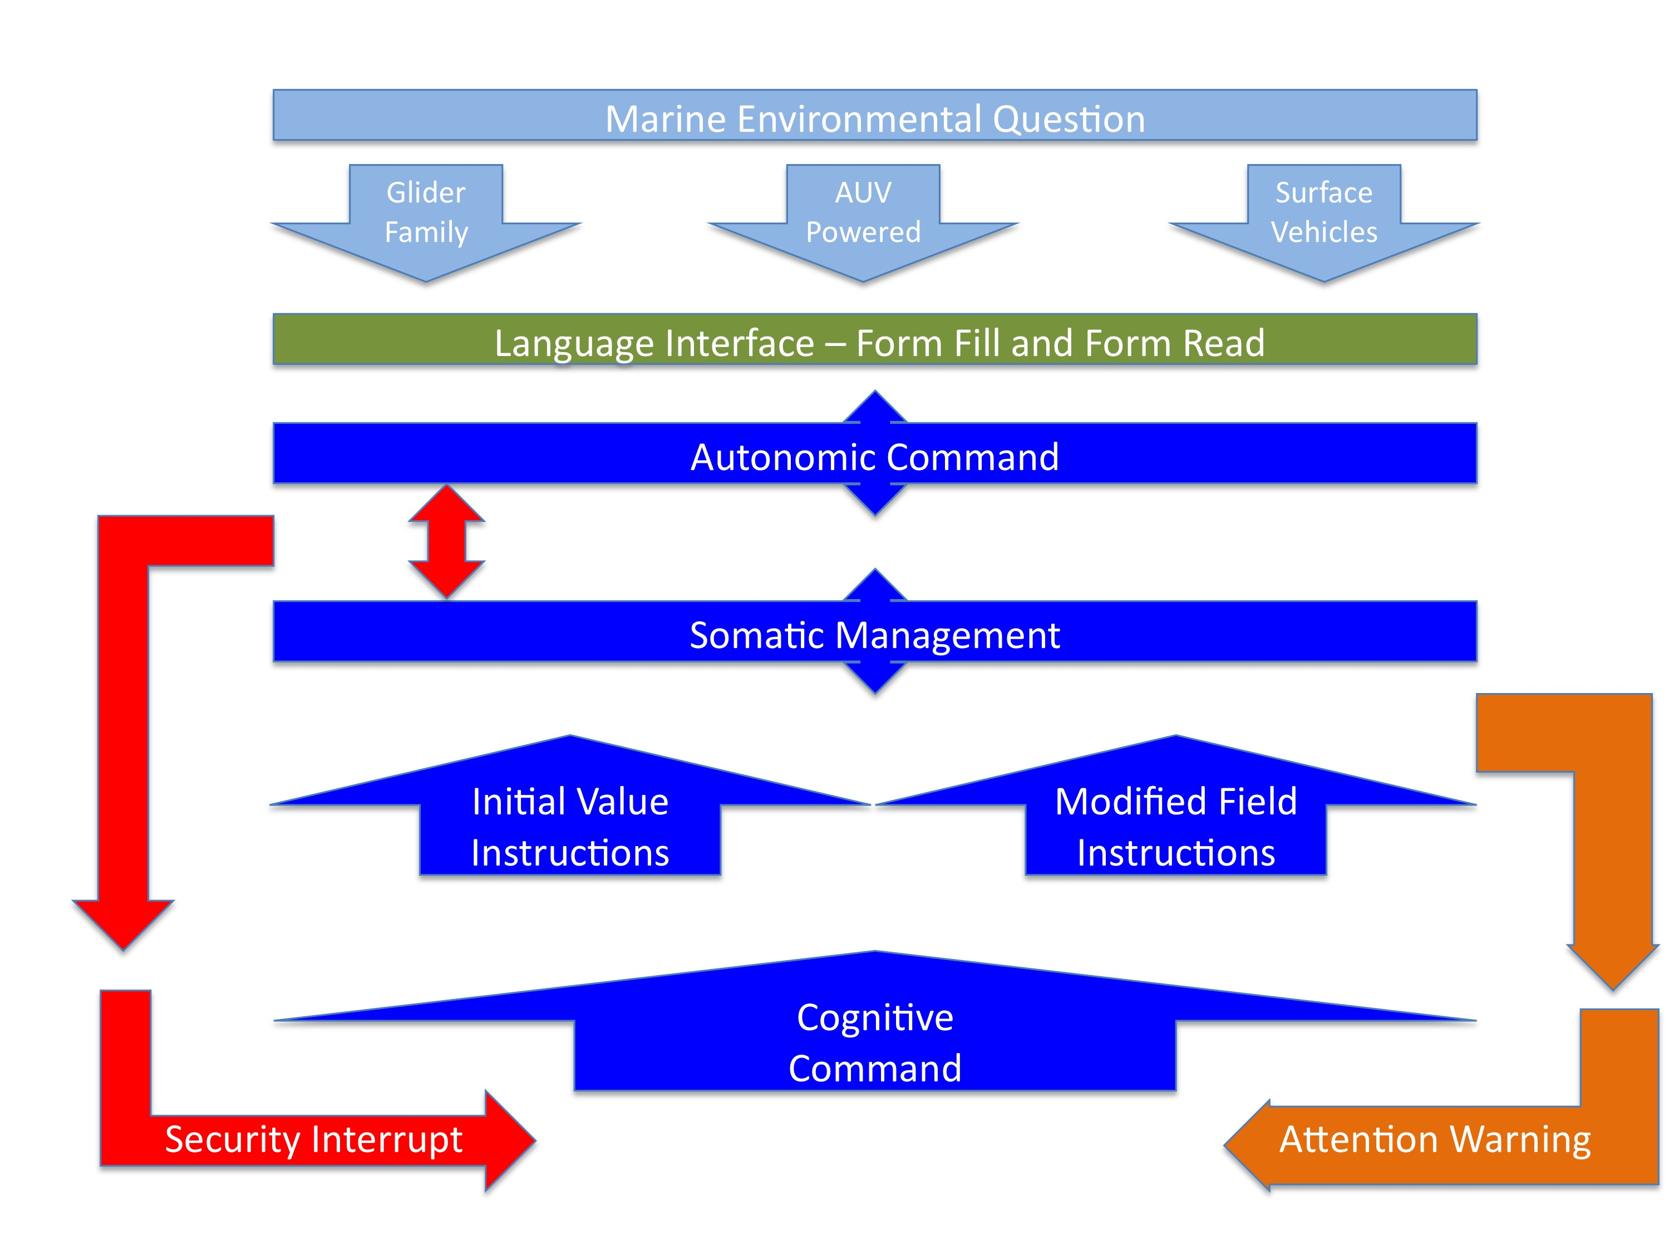
Structural concept

Slide 3
Optimisation
Environment forecasts
Latest vehicle positions
Simulate fleet vehicle track ensembles for sampling parameter space
Mission goal: target sampling priorities
Calculate cost function for each ensemble
Select optimal ensemble (minimise cost function)
Communication parameters
Extract vehicle way-points from optimal ensemble
Updated way-point data for all vehicles

Slide 4
Accelerated Autopilot
Heading focussed
Uses modelled environment
Monitors ‘past’ ability to predict/correct future outcome
Energy conscious
Attacks the current respectfully to its strength
Net heading progress implicitly prioritised
Waypoints are an output interface only
Feedback to environment

Slide 5
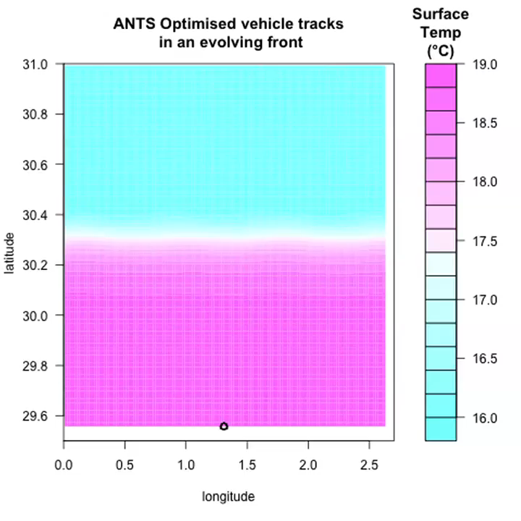
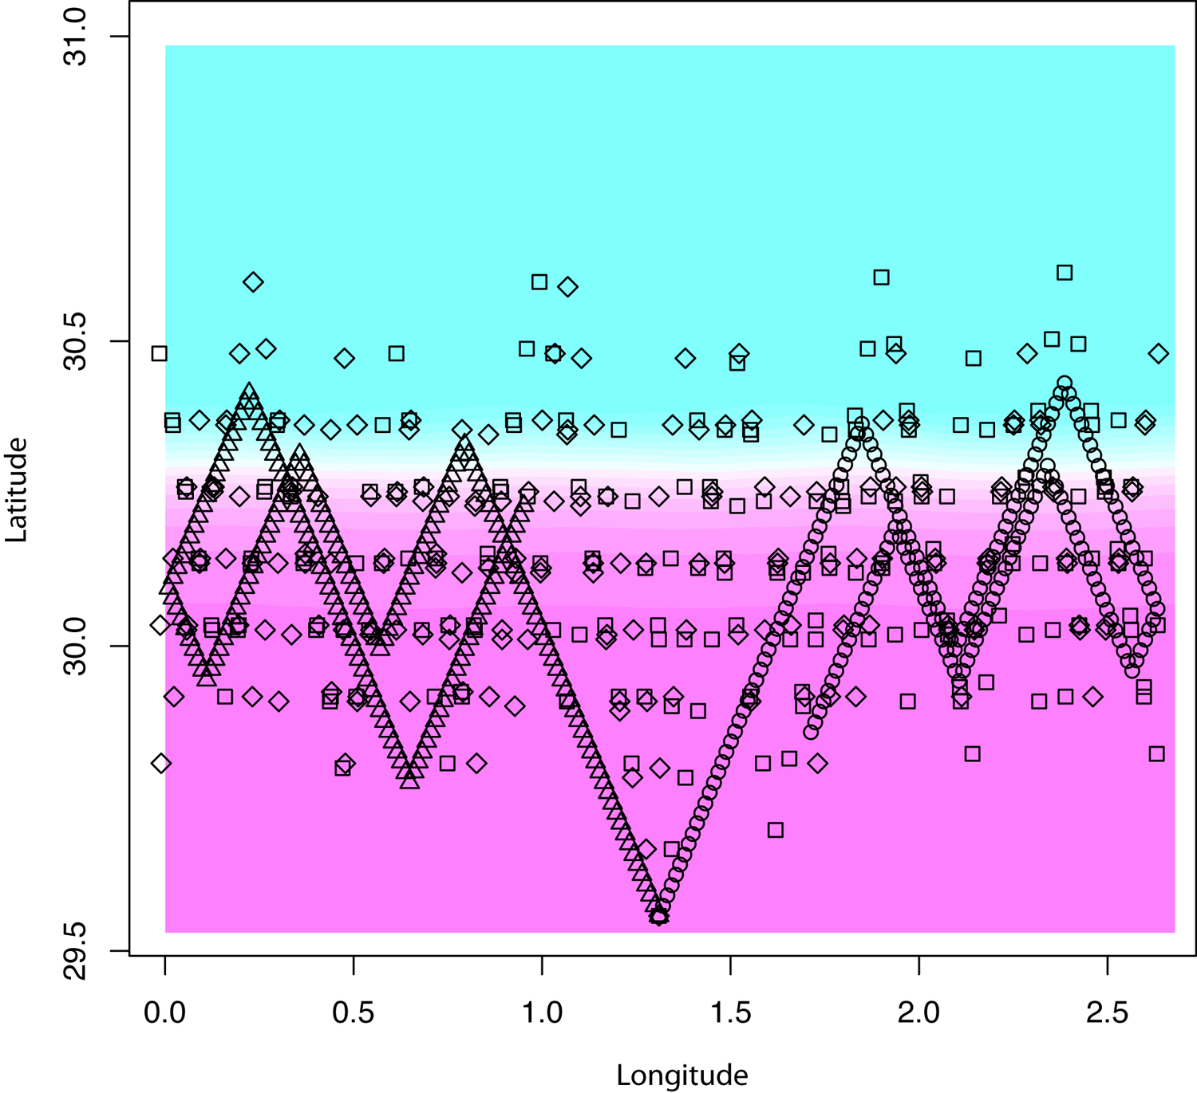
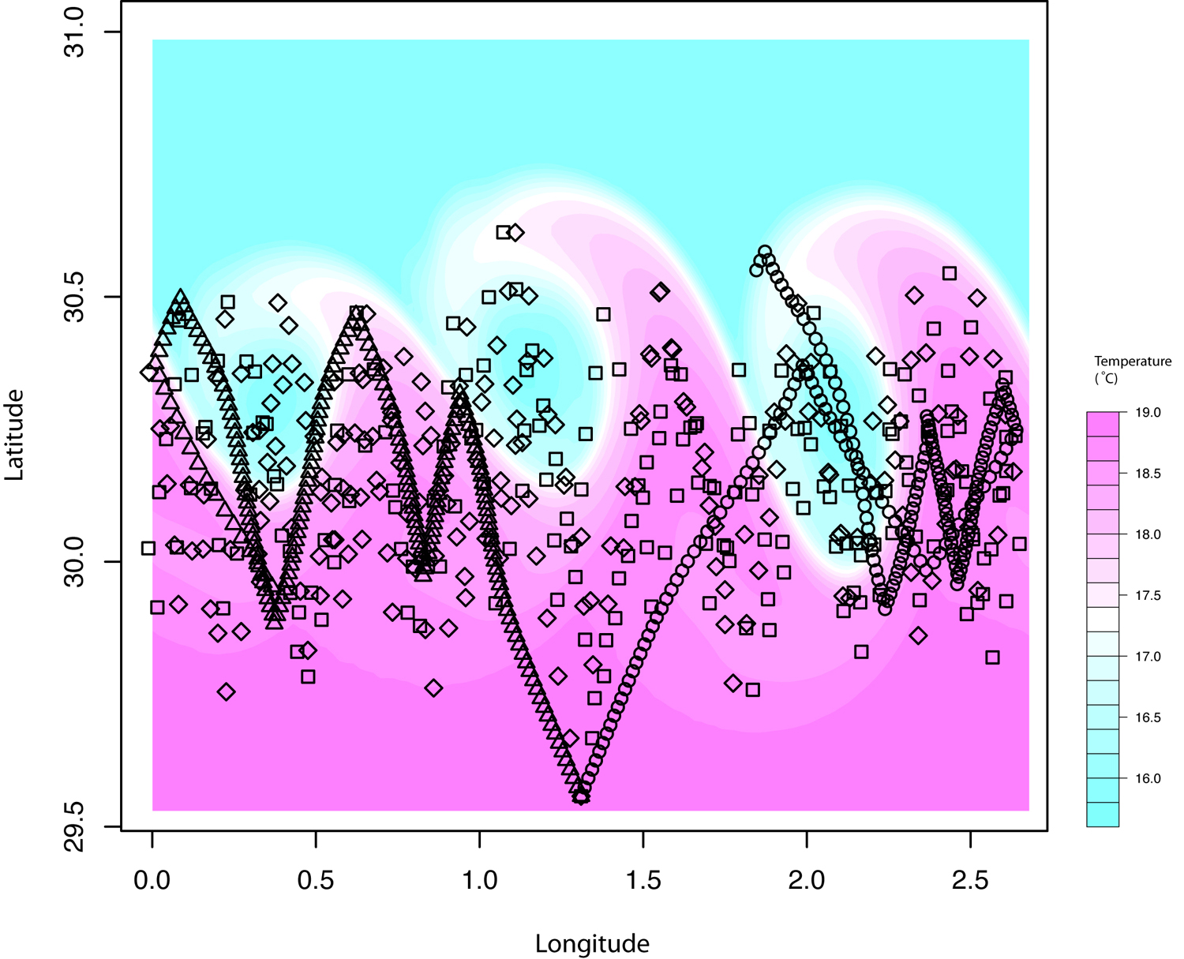
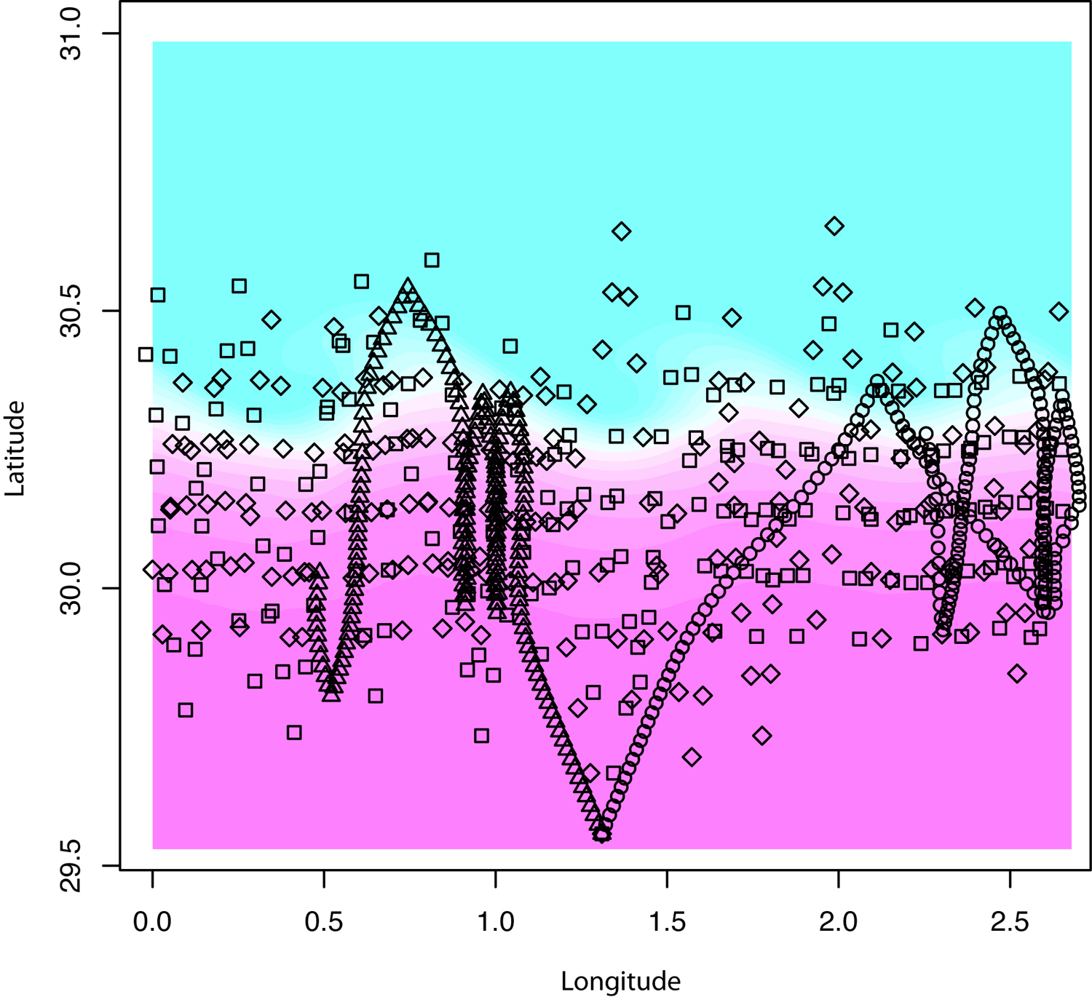
Job 1: Mapping

Slide 6
GA determined Optimal Solution
Means of doing the job: Survey space parameters
frontal limits
angle of direction of assets
surface reporting interval of assets
number of random ‘freaks’
incremental intervals in parameter space
How well can we do the job: Cost function
Mapping error on a parameter surface

Slide 7
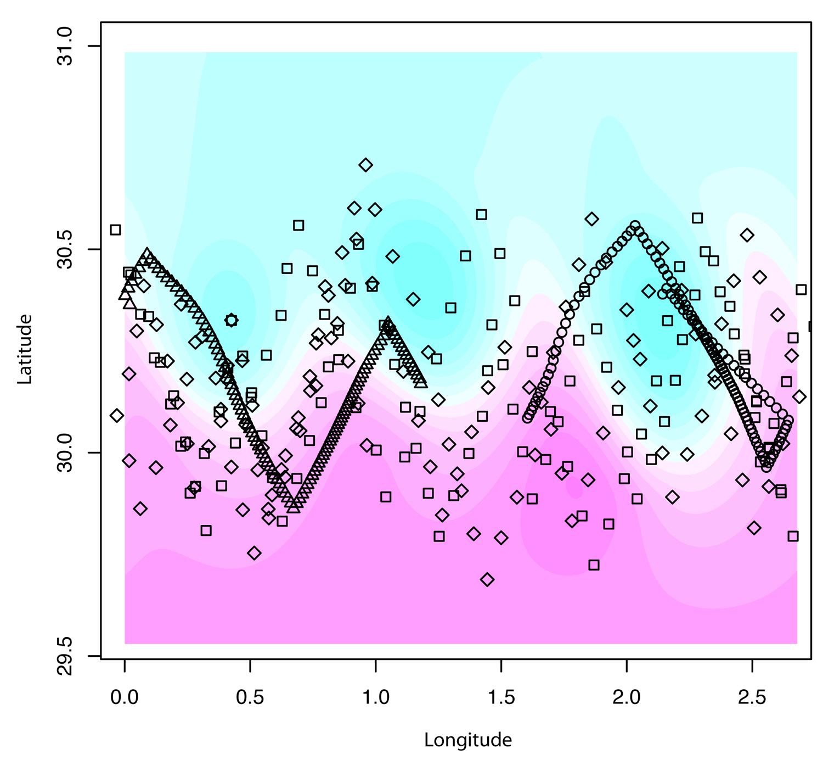
Adaptive Solution
“…. If I were you, I wouldn’t start from here”
Interruption
asset failure
changed job priorities
emerging risk
large errors in model environment

Slide 8
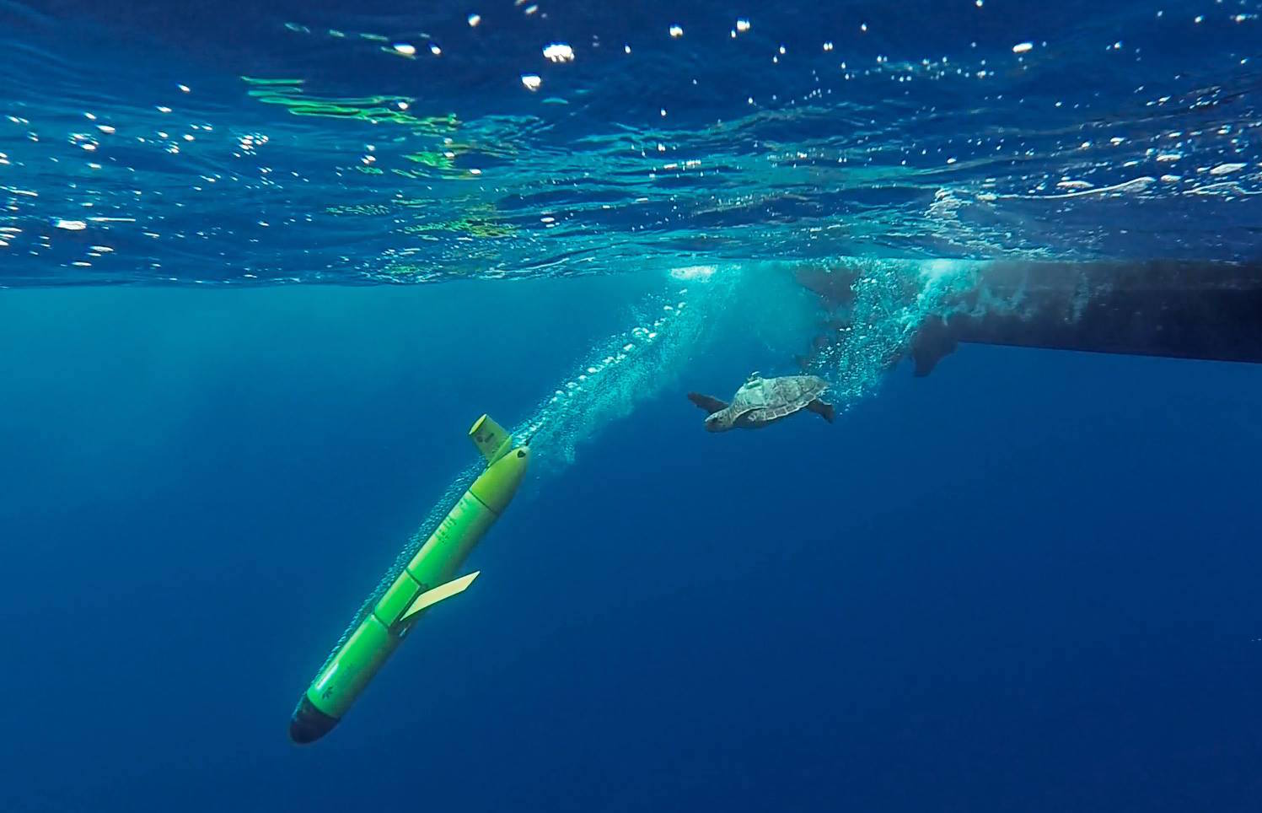

Job 2: “Oceanographic Turtles: ocean monitoring platforms for conservation and management”
© Salvador Sánchez
Dr. David March …. SOCIB

Slide 9
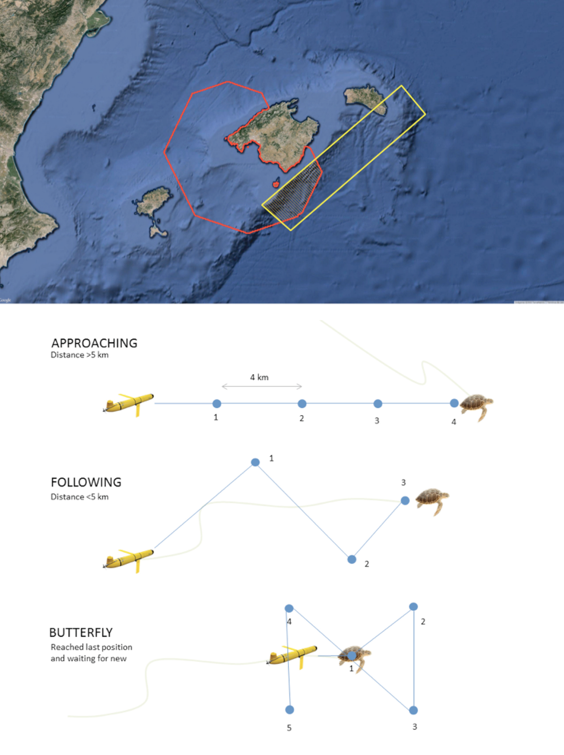
Gliding with Turtles

Slide 10
Gliding with Turtles
Means of doing the job: Survey space parameters
distance from turtle criteria
side length of approach polygon
surface reporting interval of assets
number of random ‘freaks’
incremental intervals in parameter space
How well can we do the job: Cost function
Mean proximity to turtle dives

Slide 11
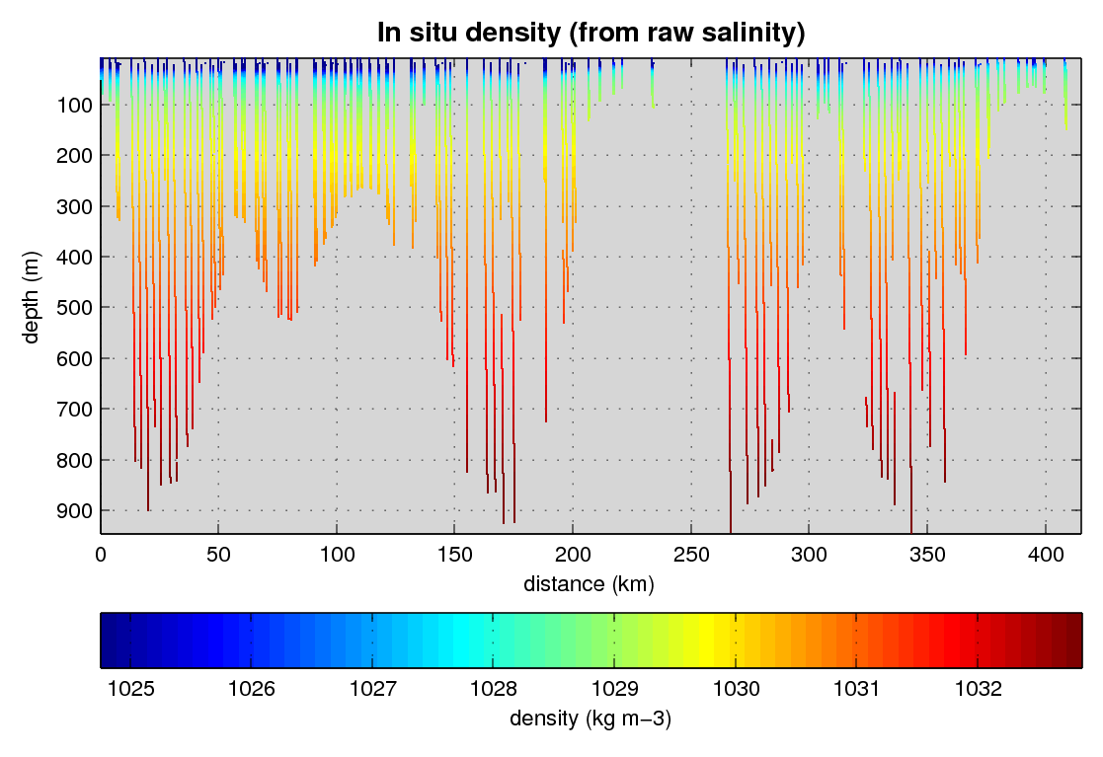
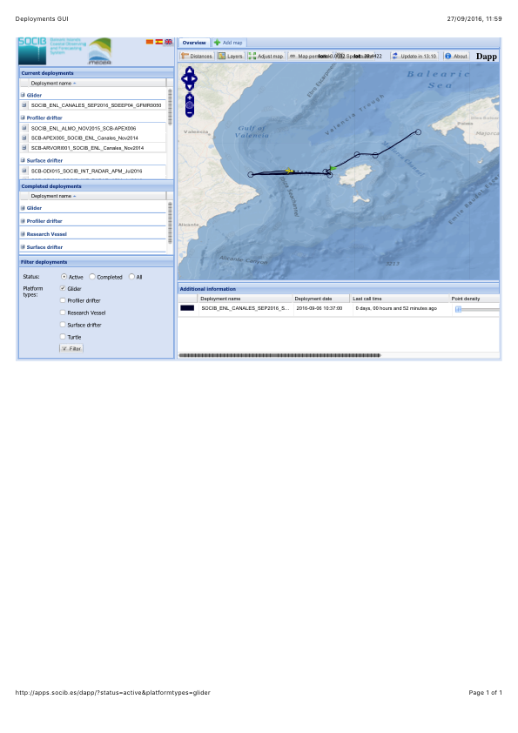
Job 3: Climate monitoring lines
www.socib.es

Slide 12
Ibiza Channel – W. Mediterranean return flow
Means of doing the job: Survey space parameters
‘fuzzy warm’ comfort zone distance
return to path ‘stiffness’ angle
surface reporting interval of assets
number of random ‘freaks’
incremental intervals in parameter space
How well can we do the job: Cost function
Integrated perpendicular distance to transect line

Slide 13
Ibiza Channel – monitoring line
behavior_name=goto_list
# LINES PRECEDED WITH # ARE NOT PROCESSED BY THE GLIDER
<start:b_arg>
b_arg: num_legs_to_run(nodim) -2 # 0 to N-1:this many wpts;-1: loop forever;-2:traverse list once (stop at last in list)
b_arg: start_when(enum) 0 # BAW_IMMEDIATELY
b_arg: num_waypoints(nodim) 14 # last_index + 1
b_arg: initial_wpt(enum) 0 # 0 to N-1:wp in list,-1:one after first one achieved,-2:closest
# Stopping condition applied to all of waypoints in the list
b_arg: list_stop_when(enum) 7 # BAW_WHEN_WPT_DIST(When sensor(m_dist_to_wpt) < behavior arg 'when_wpt_dist')
b_arg: list_when_wpt_dist(m) 1000 # used if list_stop_when == 7
b_arg: end_action(enum) 0 # what to do when list is done: 0-quit, 6-wait for ^F (re-read mafiles)
<end:b_arg>
<start:waypoints>
# longitude latitude index
# --------- -------- ------
0029.299 3859.319 # WAYPOINT_NAME, DATE, ETC...(AS COMMENT)
0032.357 3858.061 # WAYPOINT_NAME, DATE, ETC...(AS COMMENT)
0036.579 3858.354 # WAYPOINT_NAME, DATE, ETC...(AS COMMENT)
0040.676 3858.704 # WAYPOINT_NAME, DATE, ETC...(AS COMMENT)
0044.674 3858.927 # WAYPOINT_NAME, DATE, ETC...(AS COMMENT)
0047.670 3857.893 # WAYPOINT_NAME, DATE, ETC...(AS COMMENT)
0051.795 3858.180 # WAYPOINT_NAME, DATE, ETC...(AS COMMENT)
0055.751 3858.365 # WAYPOINT_NAME, DATE, ETC...(AS COMMENT)
0059.585 3858.540 # WAYPOINT_NAME, DATE, ETC...(AS COMMENT)
0103.488 3858.775 # WAYPOINT_NAME, DATE, ETC...(AS COMMENT)
0107.440 3858.957 # WAYPOINT_NAME, DATE, ETC...(AS COMMENT)
0103.821 3859.363 # WAYPOINT_NAME, DATE, ETC...(AS COMMENT)
0100.760 3858.073 # WAYPOINT_NAME, DATE, ETC...(AS COMMENT)
0057.078 3858.184 # WAYPOINT_NAME, DATE, ETC...(AS COMMENT)
<end:waypoints>

Slide 14
Conclusions
Open source software based control system
Different levels of feedback interface to vehicles
Form filling form reading interface
Define job
Define options for how the job could be done
select according to how well the job is done
Explicit costs low
But : testing/confidence
liability levels etc.

