Slide 1
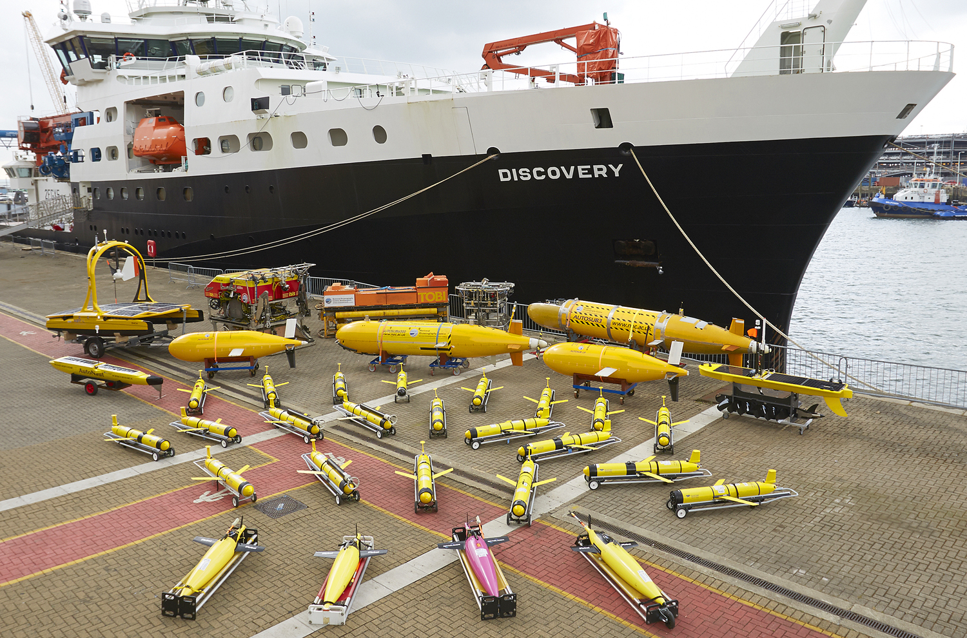
NERC Marine Autonomous and Robotic Systems (MARS)
Prof Russell B Wynn (Chief Scientist, MARS)

Slide 2
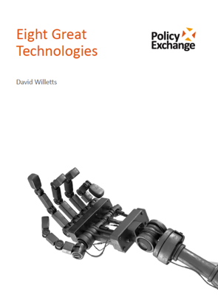
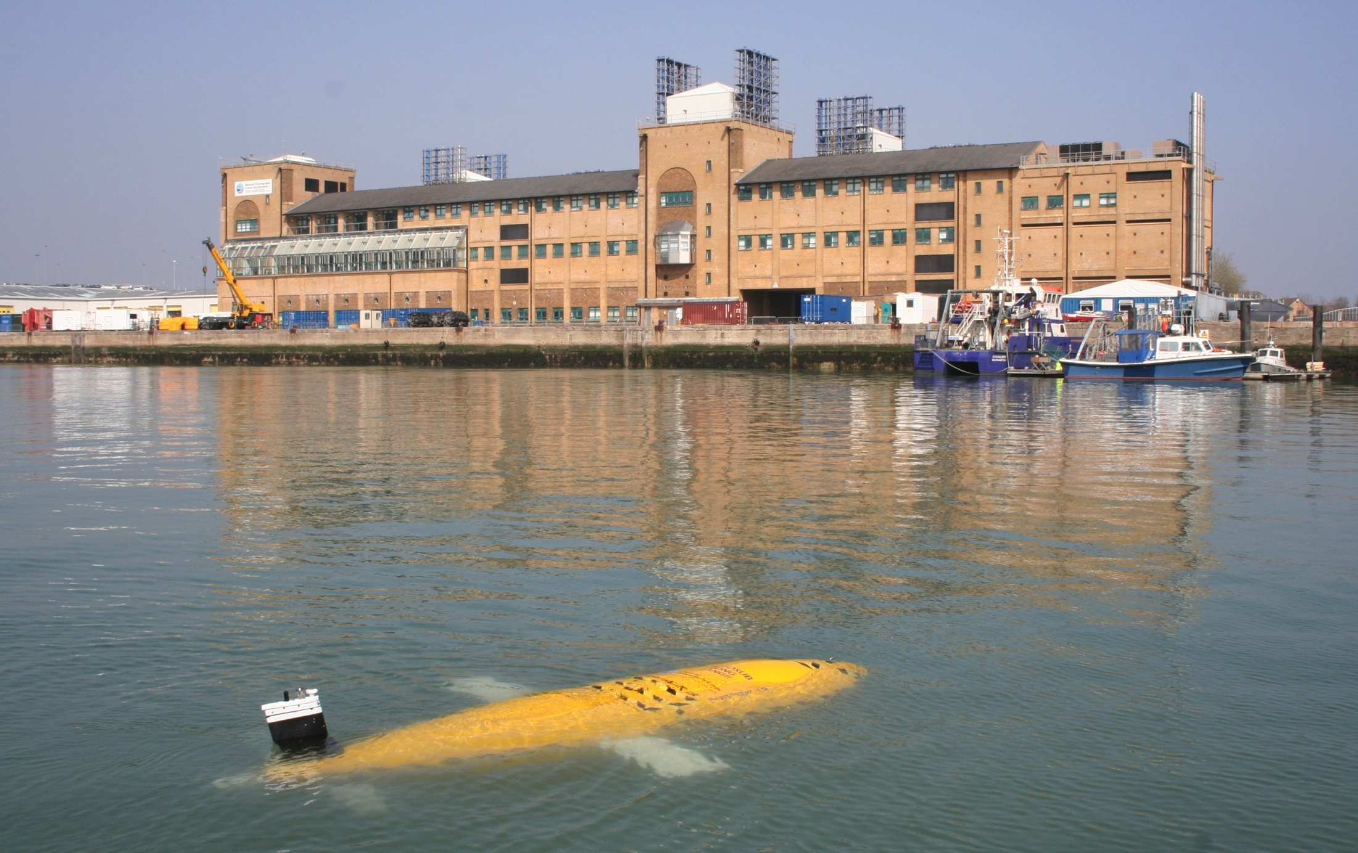
NERC Marine Autonomous and Robotic Systems (MARS)
2012-21: £25M of BIS capital investment into MARS
MARS now operates >40 vehicles for UK science
World-leading expertise in MAS sensor development
£3.5M MARS Innovation Centre recently completed
“Marine robotic systems will also be critical to cost effective routine mapping and monitoring of the oceans and seas, addressing the gross under sampling of the oceans…
Minister for Universities & Science
Rt. Hon. David Willetts MP
“Eight Great Technologies”

Slide 3
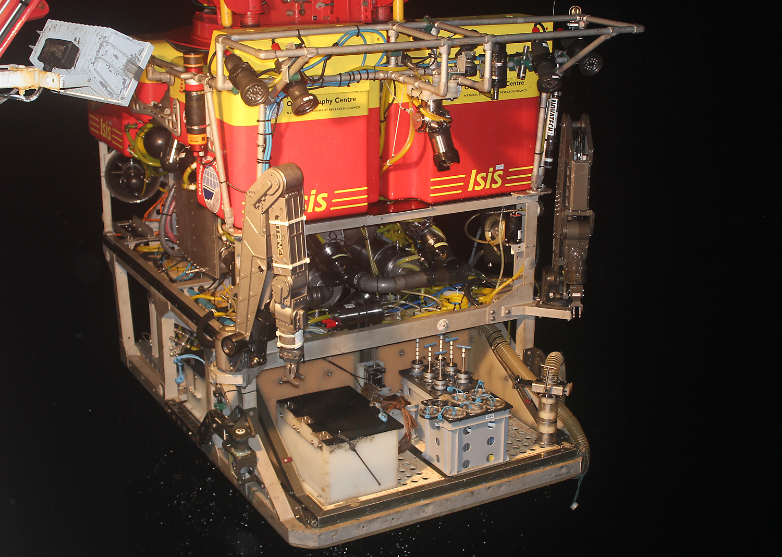
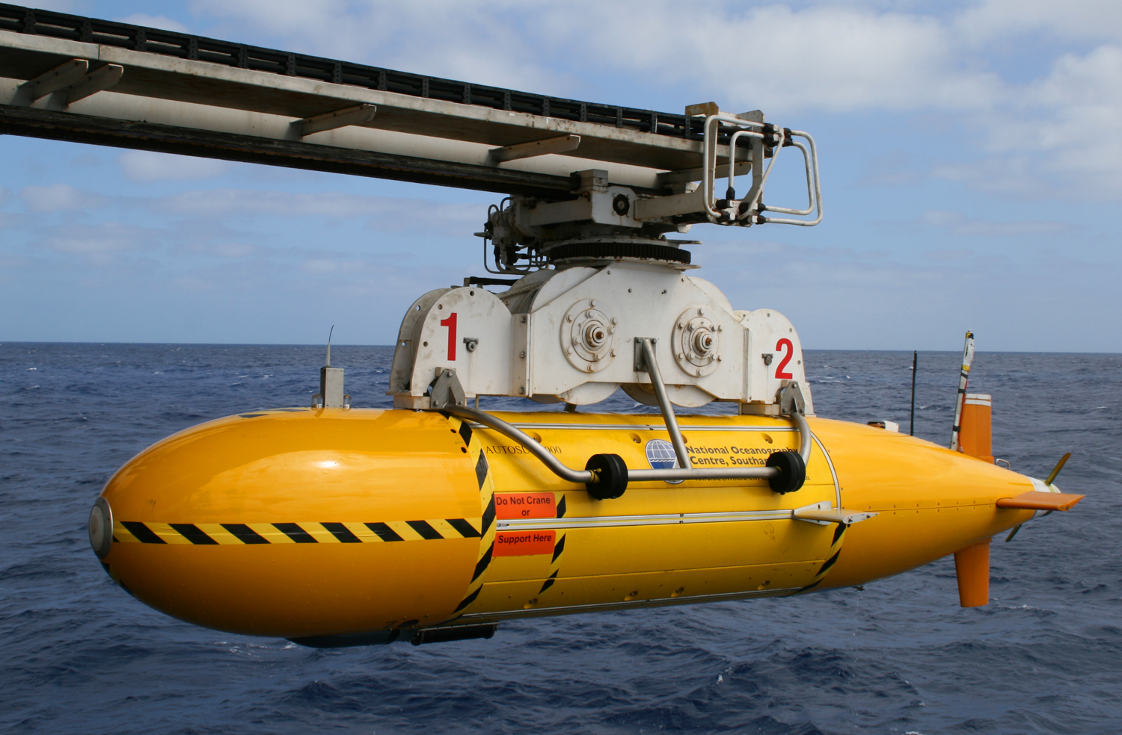
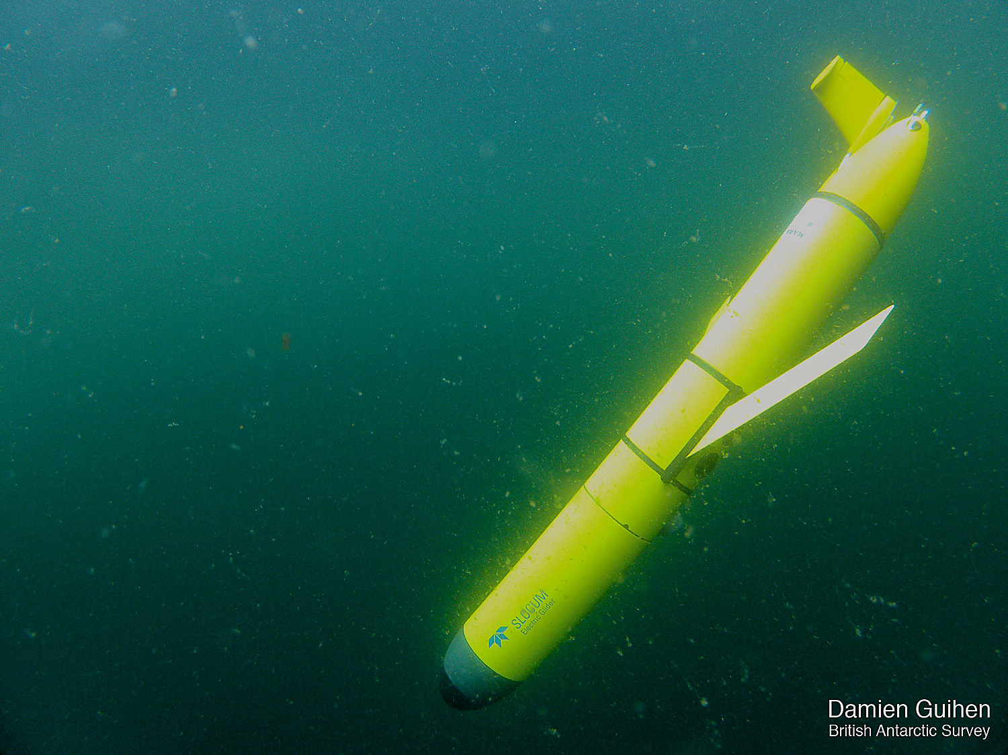
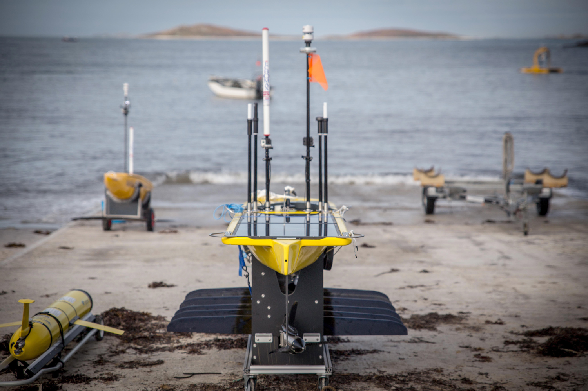
The MARS fleet at NOC (additional assets operated from SAMS/BAS)
Tethered Systems
AUVs
Underwater Gliders
Isis ROV
HyBIS
Autosub 3
Autosub6000
Autosub Long Range x 3
TW Slocum (1000m) x 12
TW Slocum (200m) x 10
Kongsberg Seagliders x 9
USVs
STAFF
~30 with a mix of:
Mechanical
Electronics
Software
Systems
Increasing endurance
Increasing flexibility
Increasing inter-operability
Increasing intelligence
Reducing cost
Reducing speed
LR Waveglider
C-Enduro and Autonaut

Slide 4
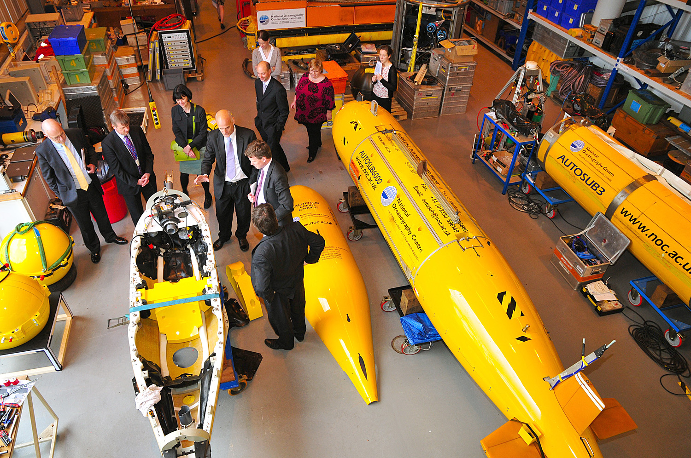
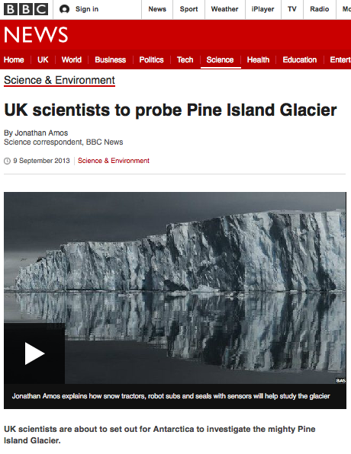
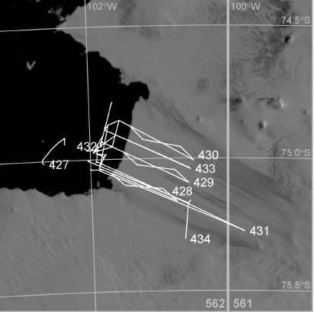
Autosub under-ice missions to Pine Island Glacier
100 km

Slide 5
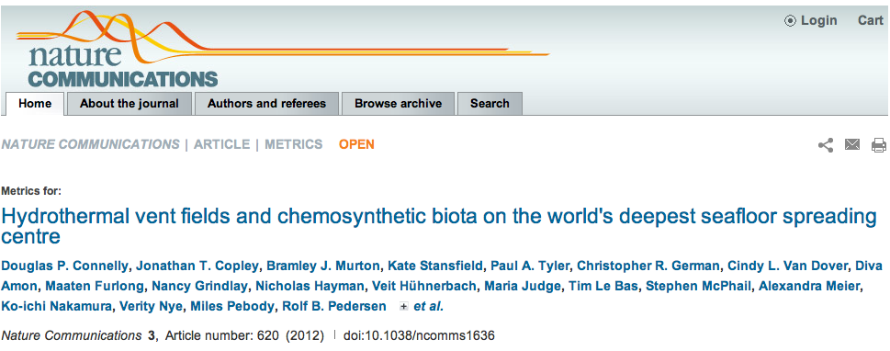
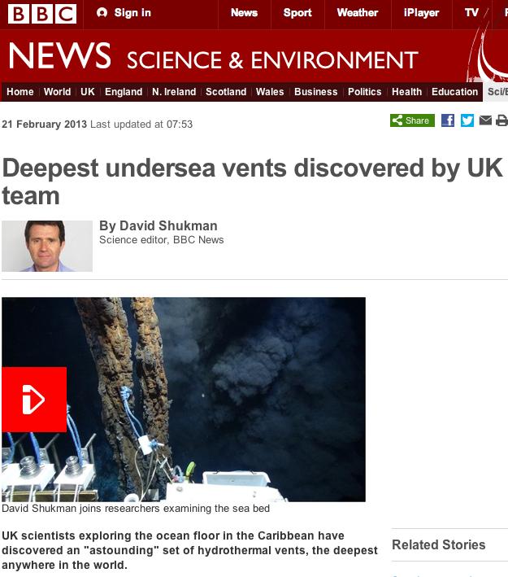
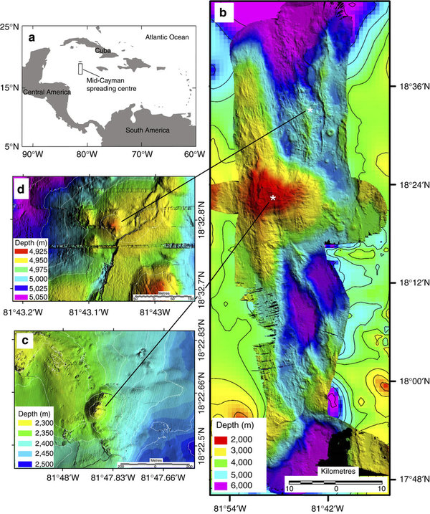
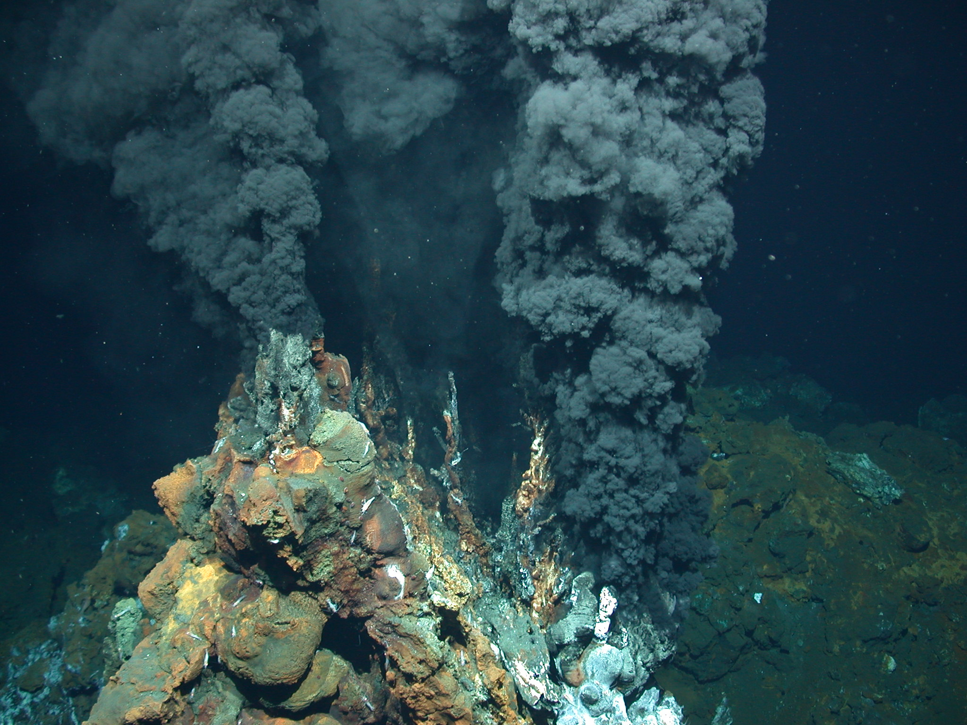
Mapping and sniffing World’s deepest and hottest hydrothermal vents (5 km WD)

Slide 6
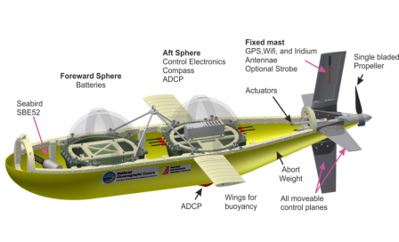
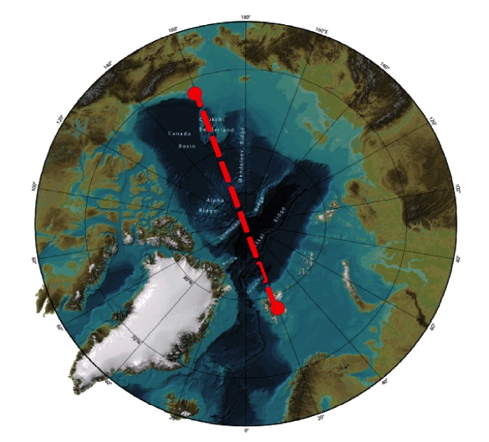
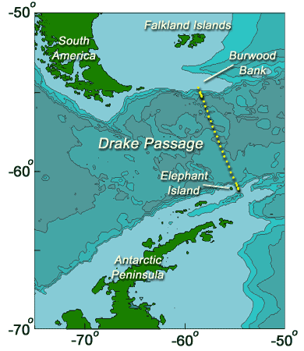
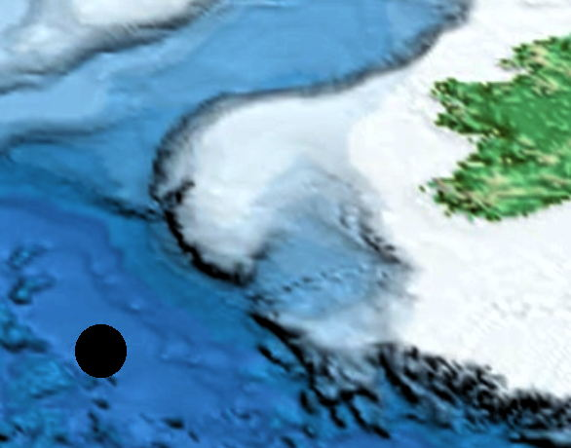
MARS Autosub Long Range (ALR)
Long-term observation of ocean choke points
Crossing the North Pole
Self deploying long-term moorings
PAP

Slide 7
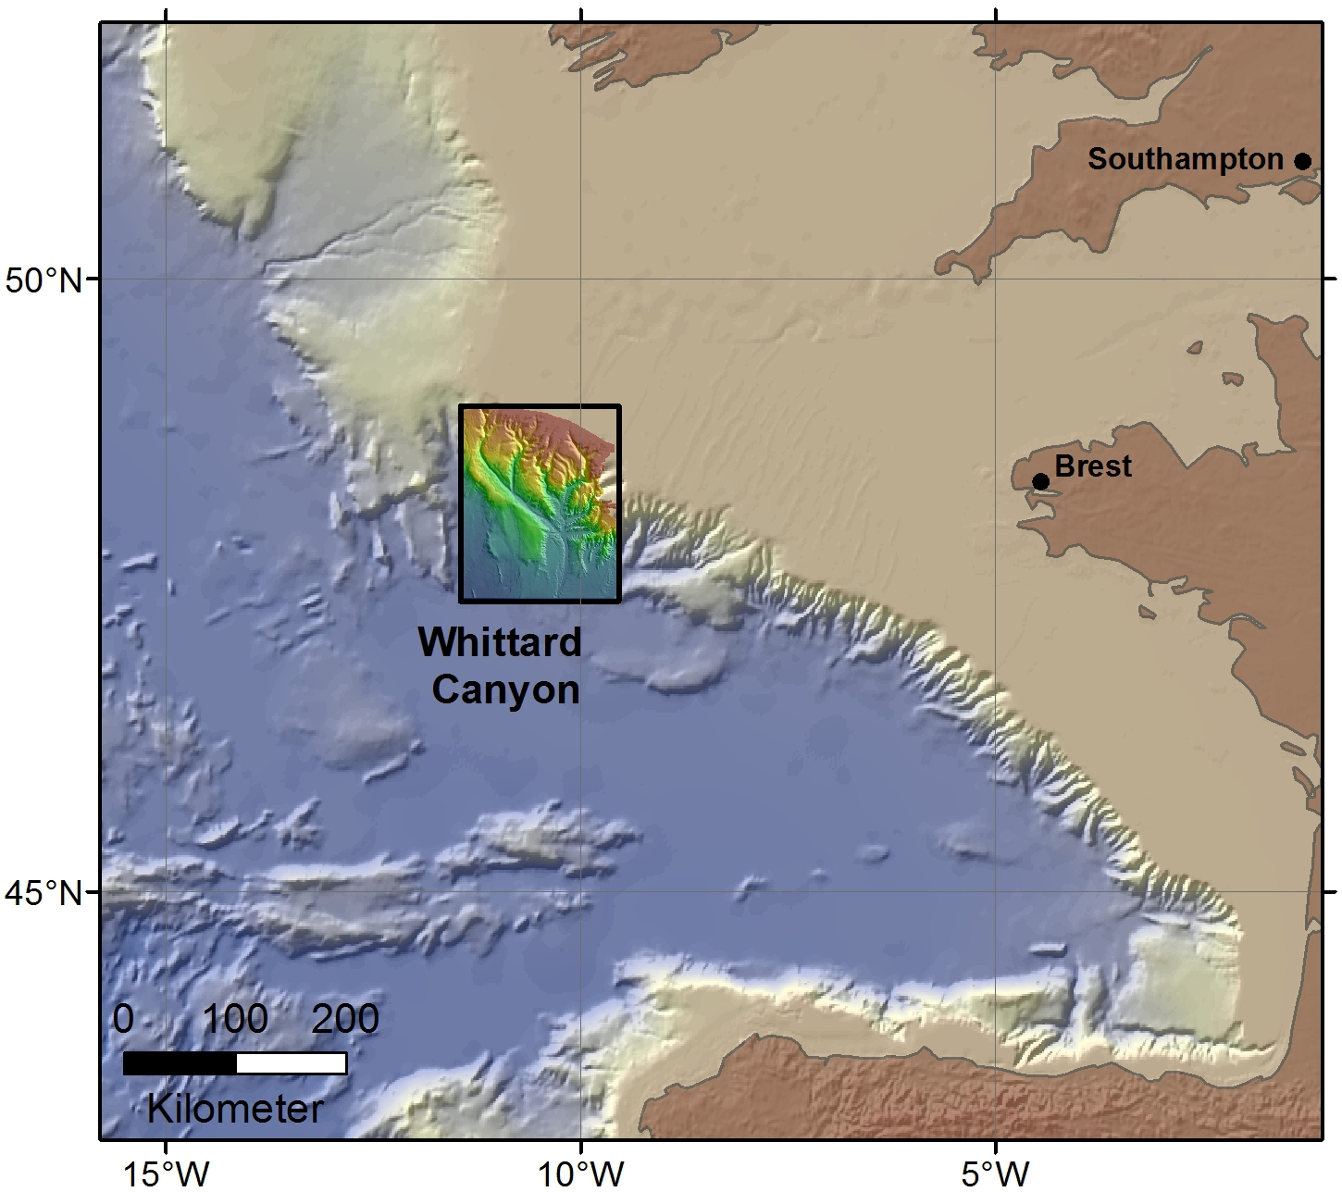
Multi-vehicle mapping and imaging of challenging environments

Slide 8
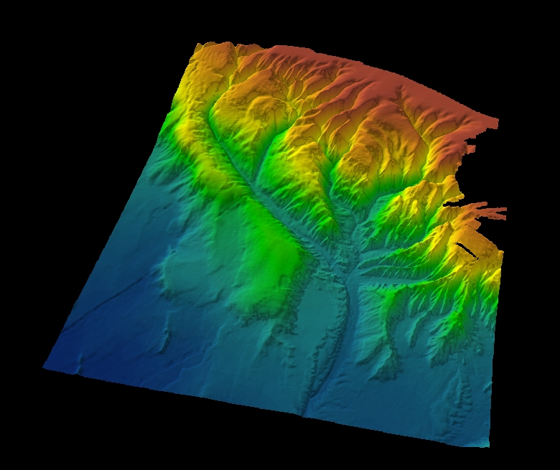
Vessel-based mapping of Whittard Canyon (resolution = >10-100m)
GSI

Slide 9
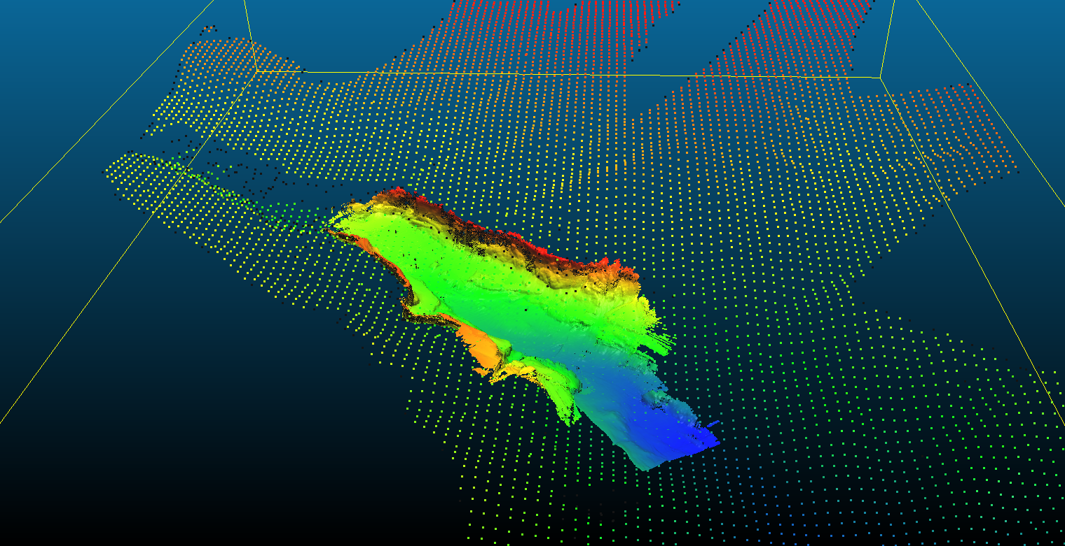
AUV mapping* of upper Whittard Canyon (resolution = 1-10m)
*includes sideways swath mapping

Slide 10
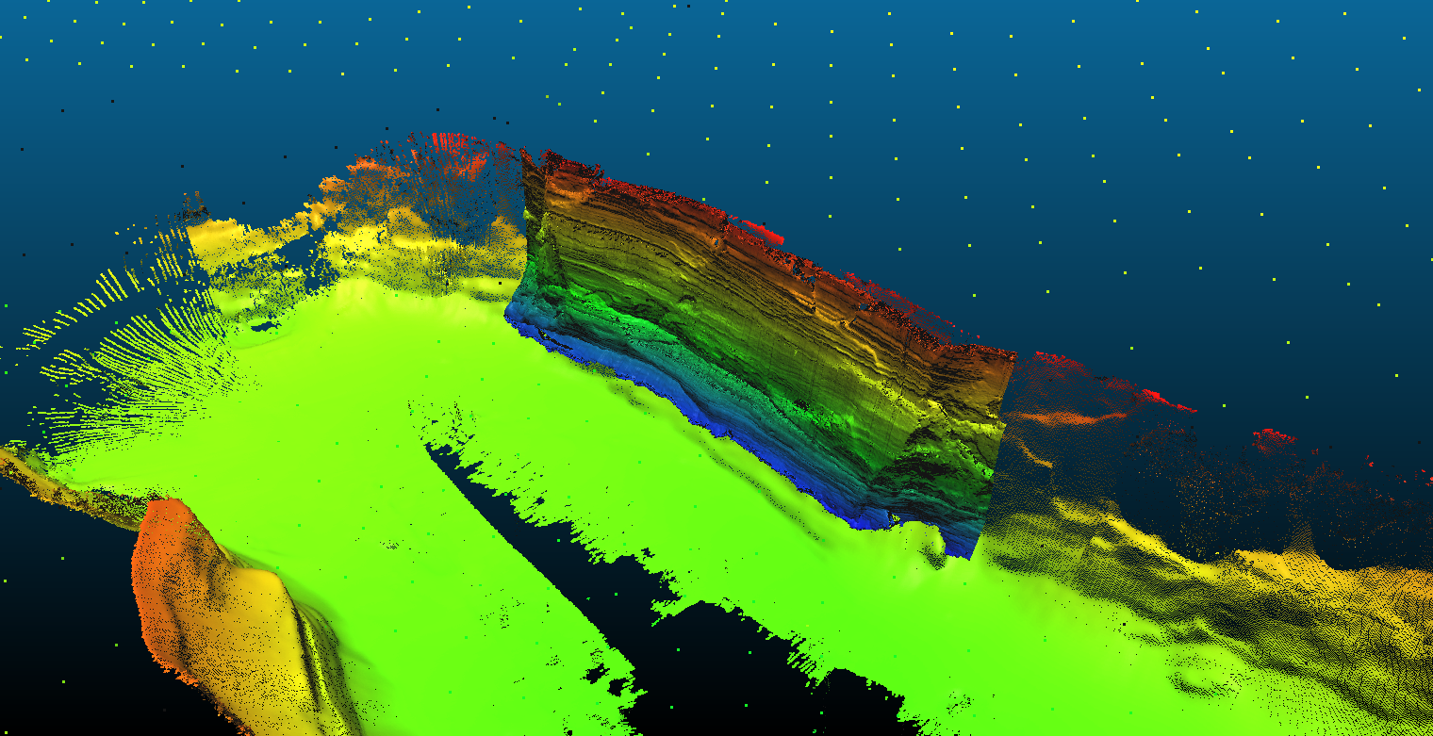
ROV mapping* of upper Whittard Canyon (resolution = 0.1-1m)
*includes sideways swath mapping

Slide 11
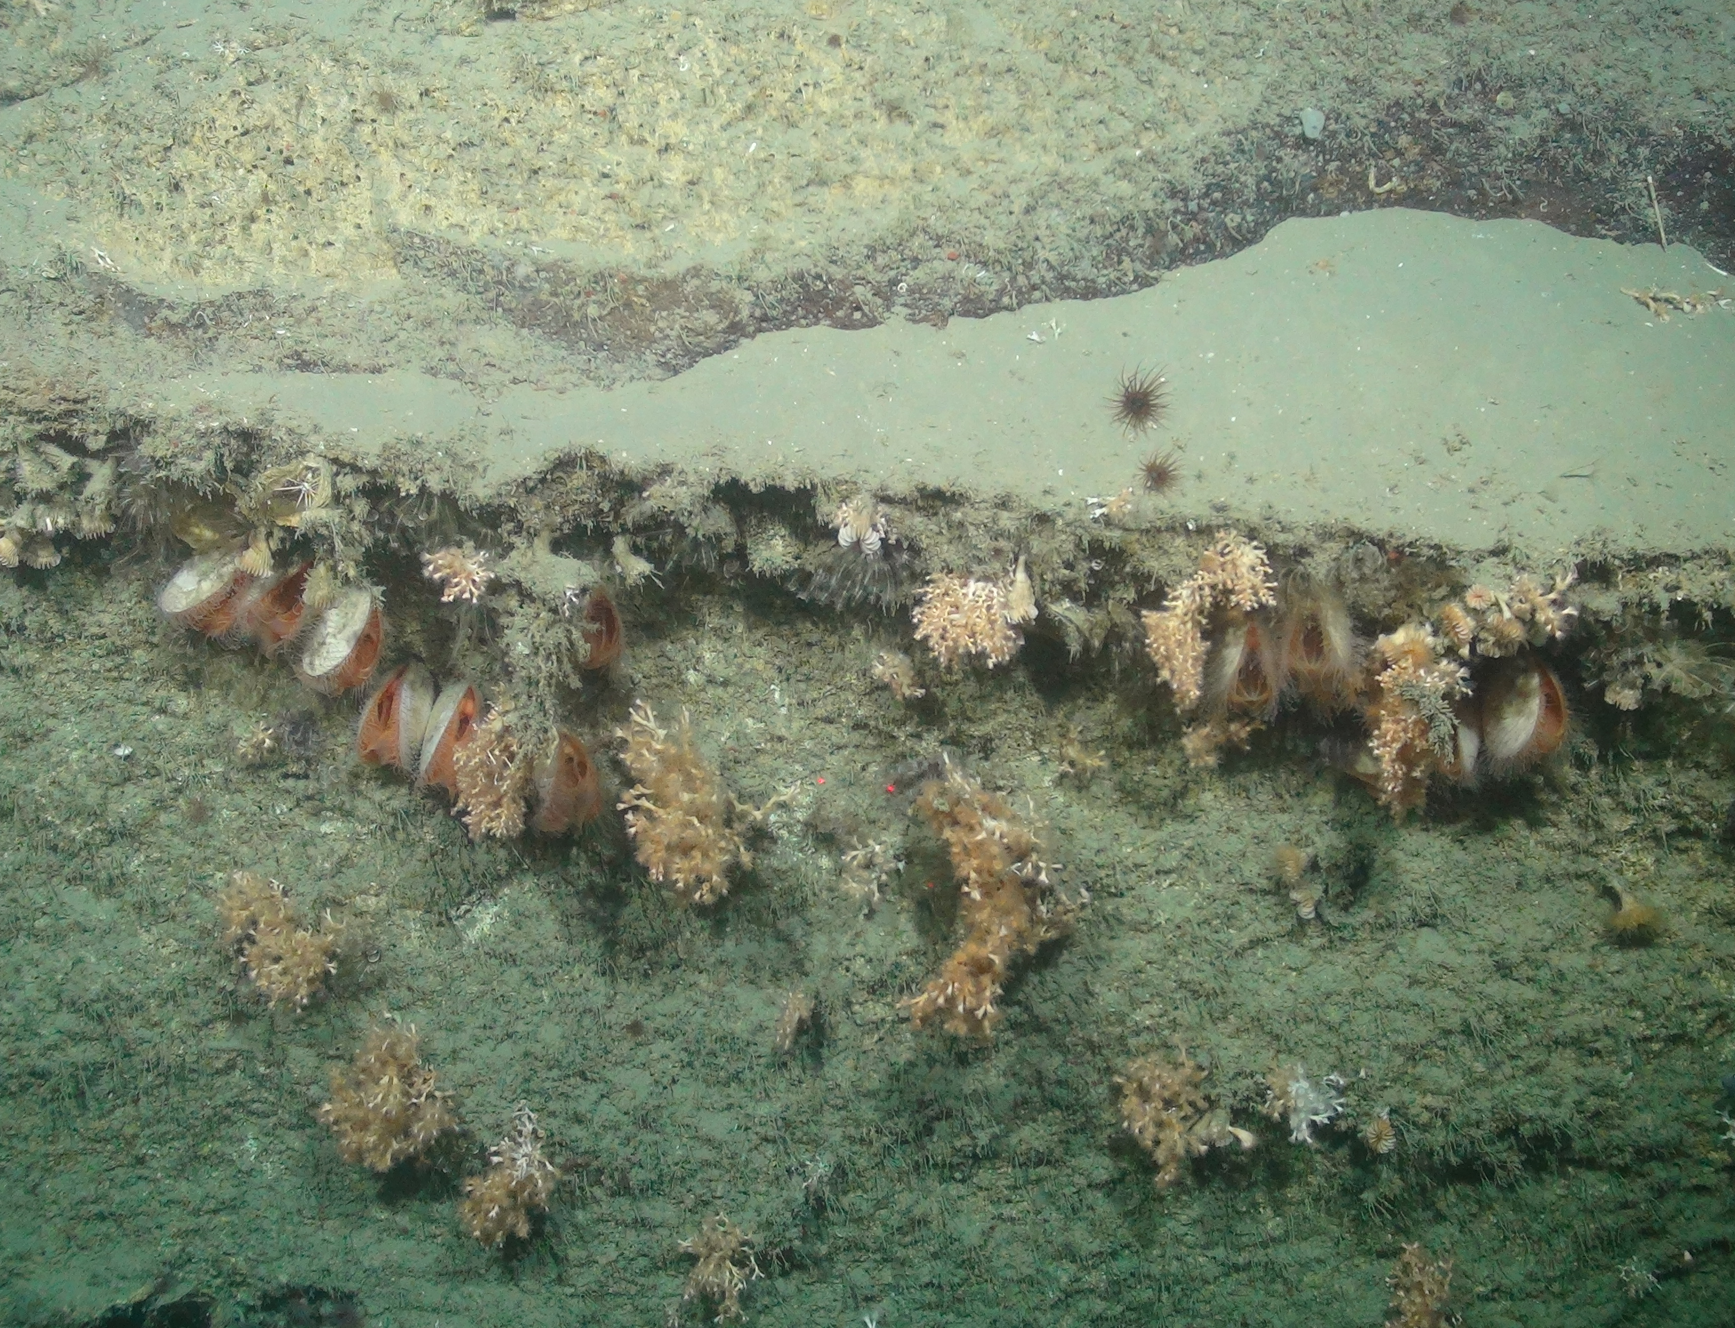
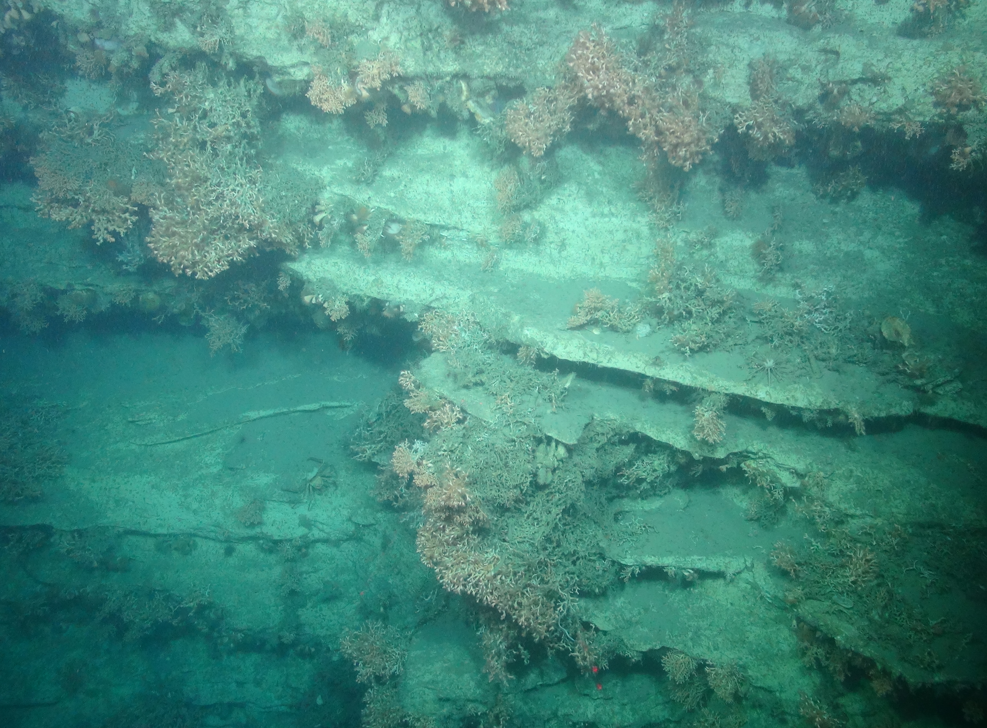
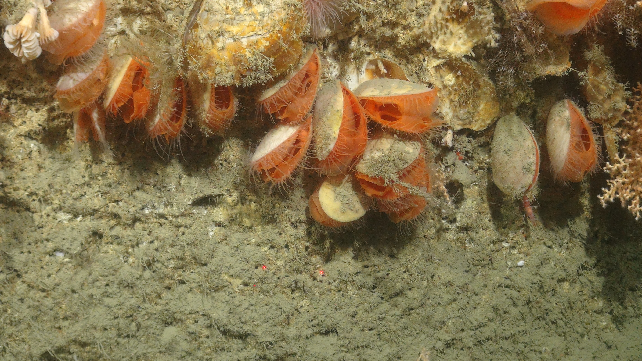
ROV imaging of upper Whittard Canyon (resolution = 0.1-1cm)

Slide 12
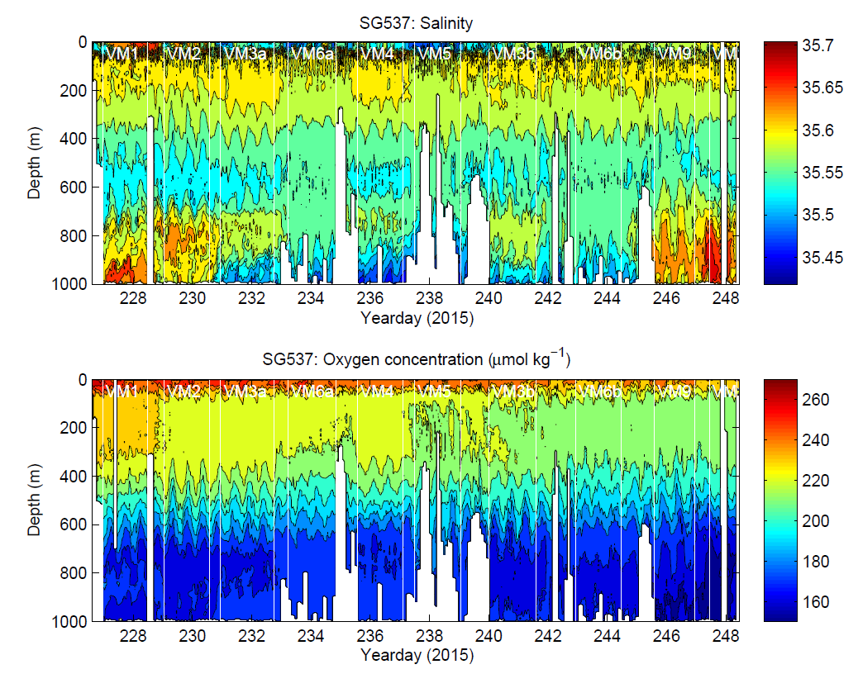

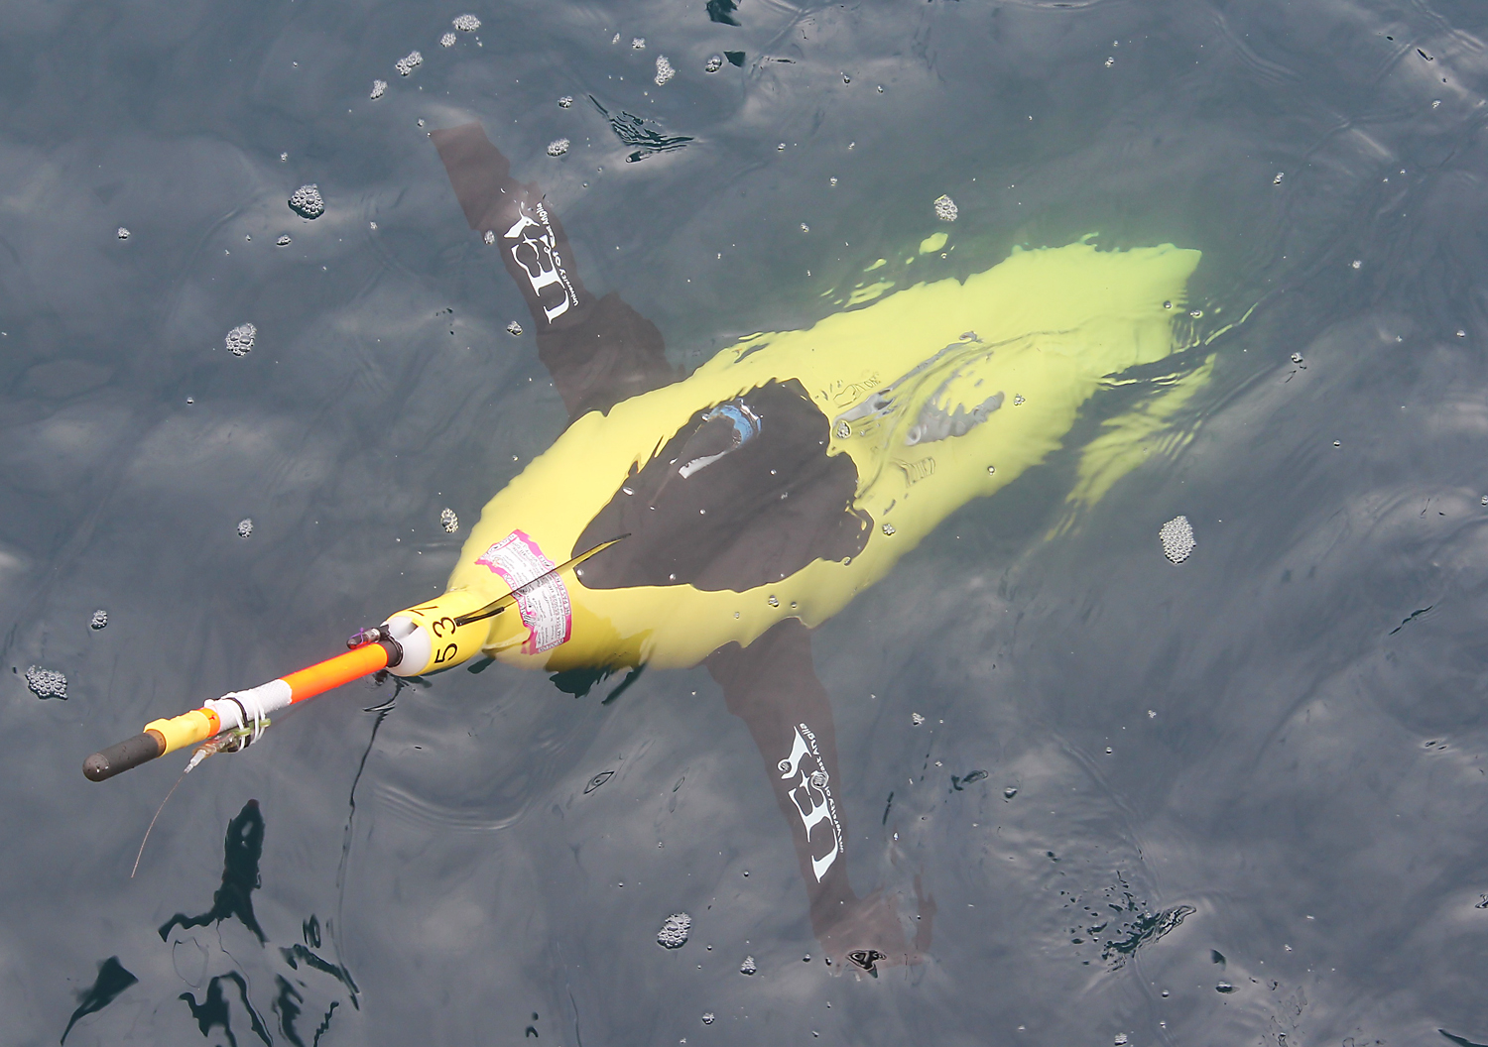
UEA Seaglider simultaneously collected 21 days of oceanographic data

Slide 13
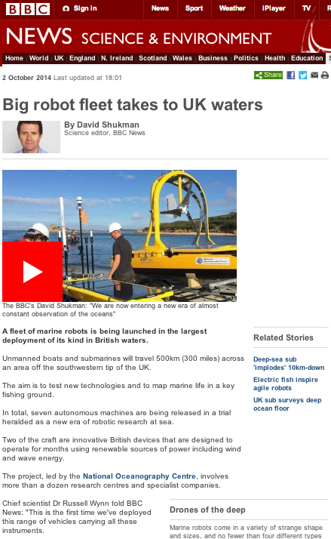
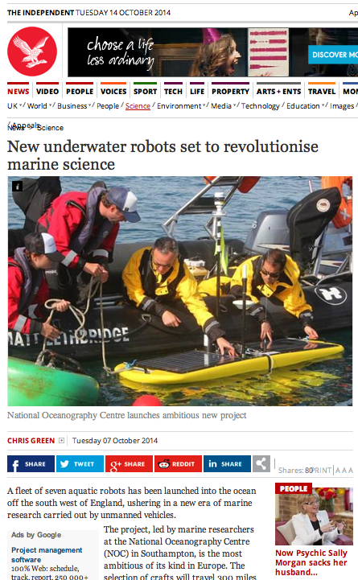
MASSMO missions provide positive media coverage of UK MAS capability

Slide 14
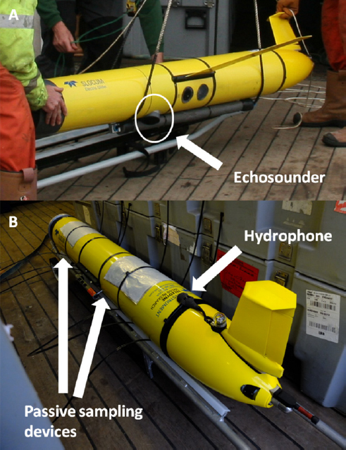

Submarine gliders for active and passive acoustic sensing of mobile species

Slide 15
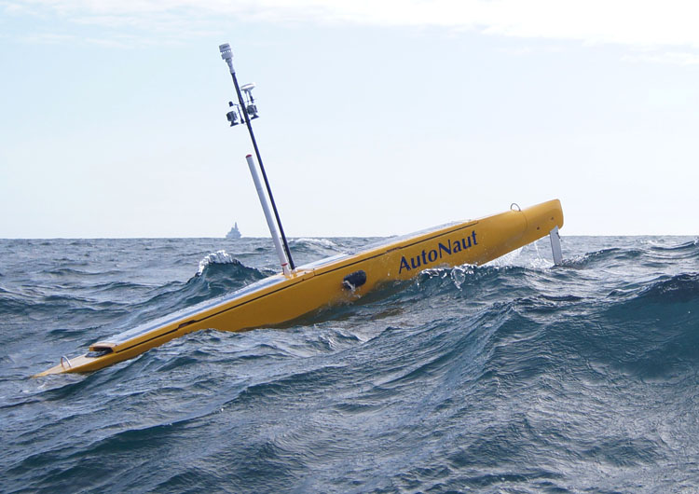
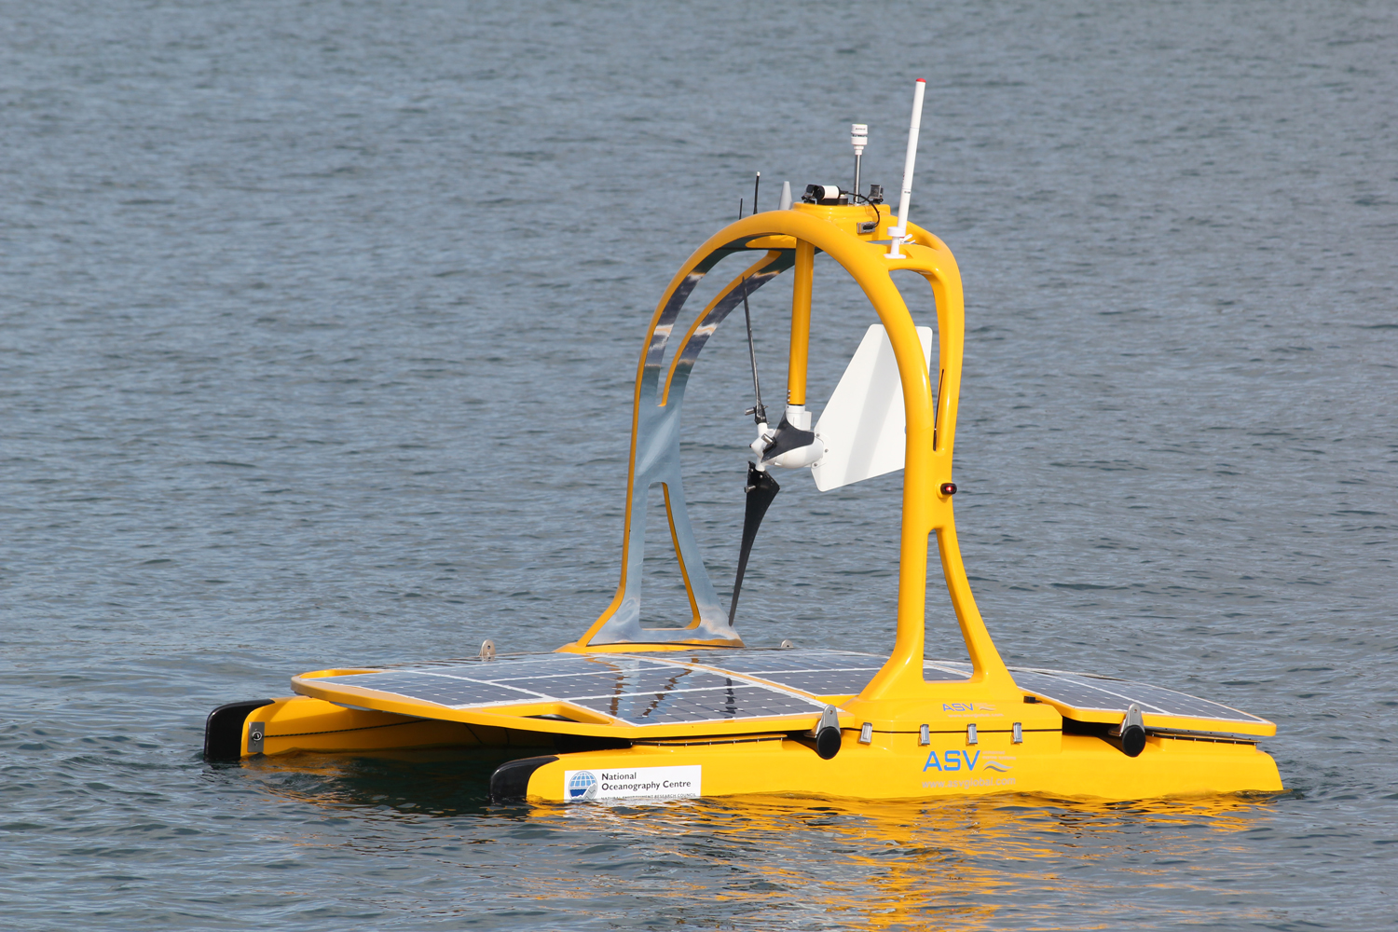
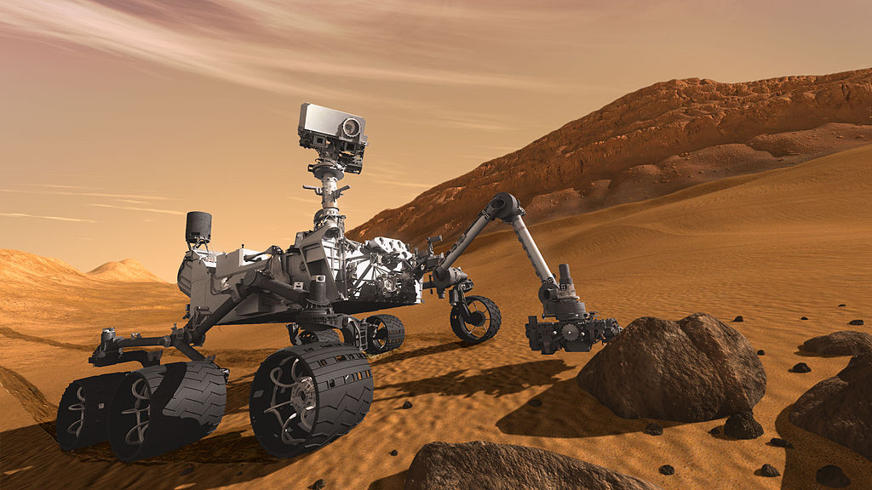
MARS Unmanned Surface Vehicles (USVs)
MOST AV ‘AutoNaut’
ASV ‘C-Enduro’

Slide 16
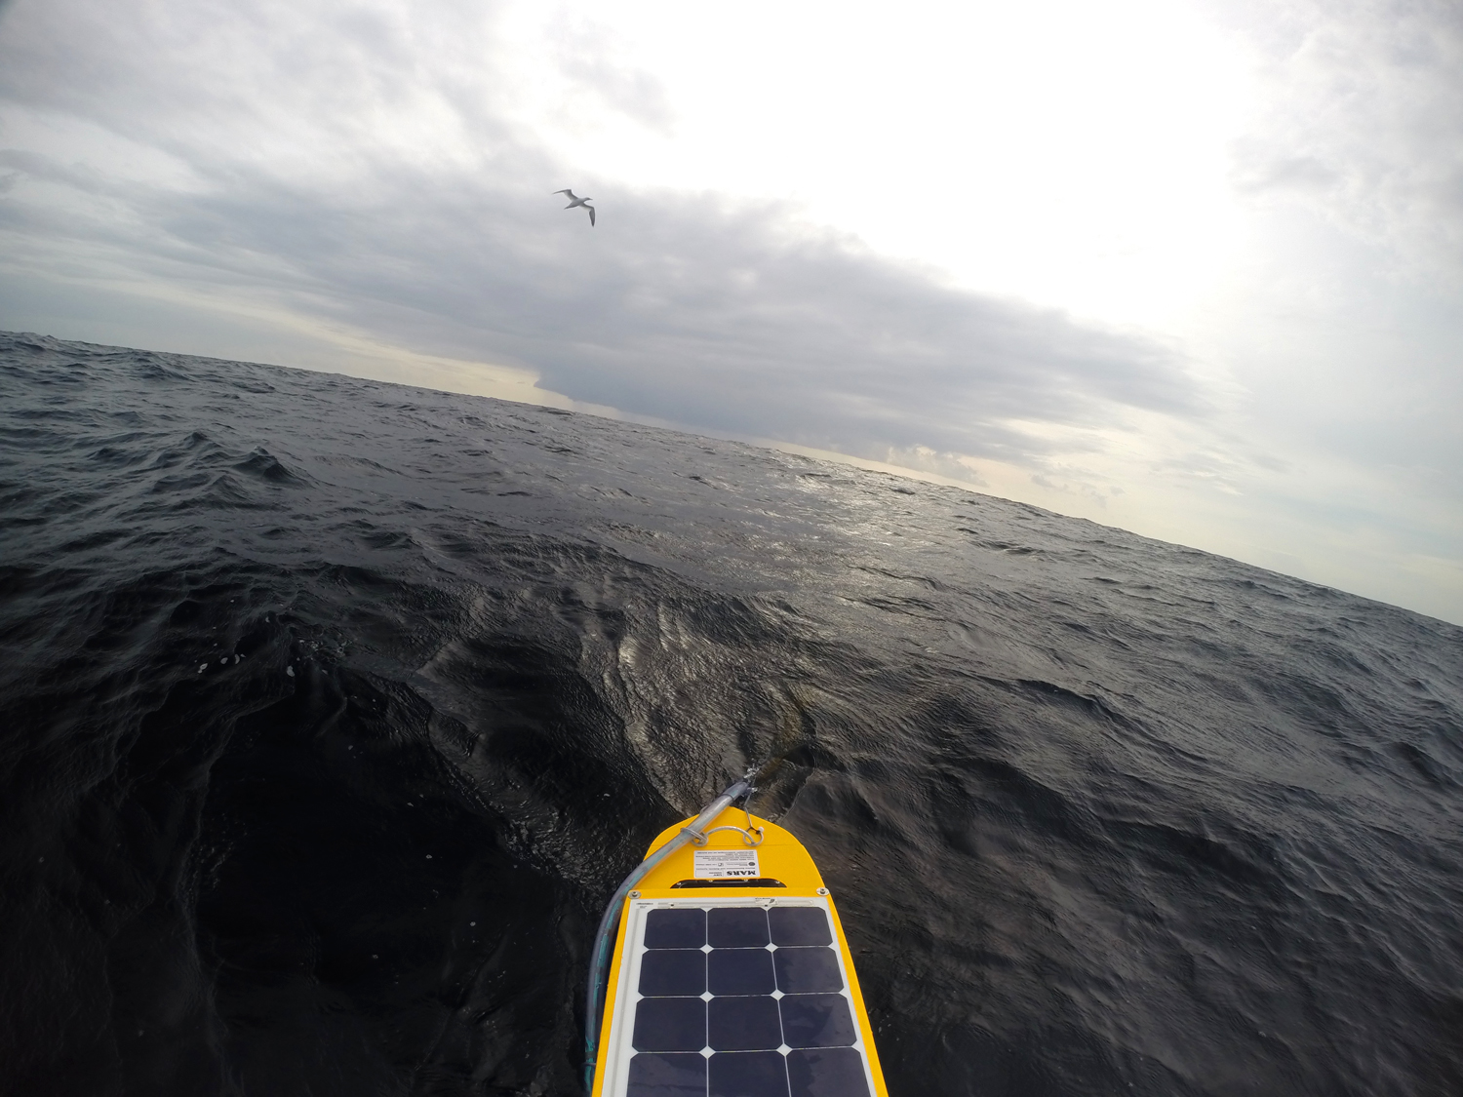
GoPro image from Autonaut USV showing Gannet and Narcine acoustic array

Slide 17
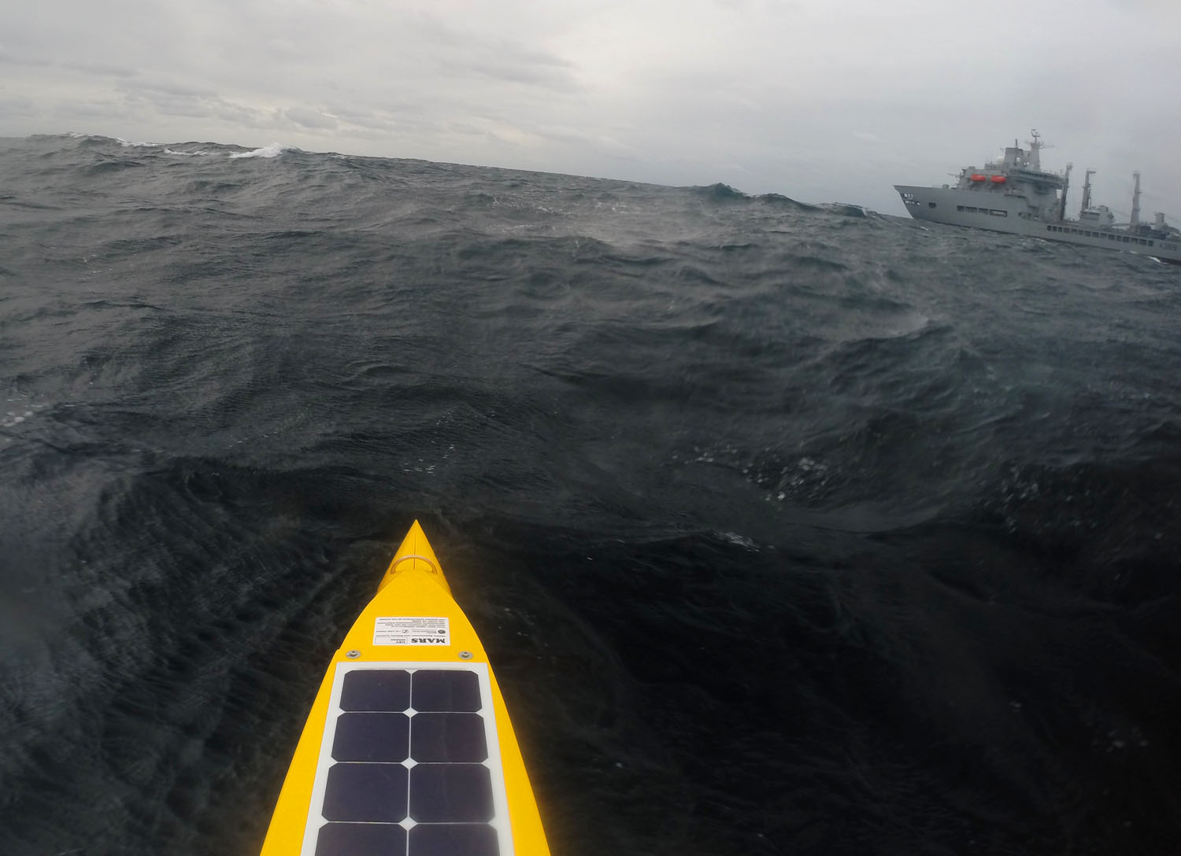
GoPro image from Autonaut showing Royal Navy vessel

Slide 18
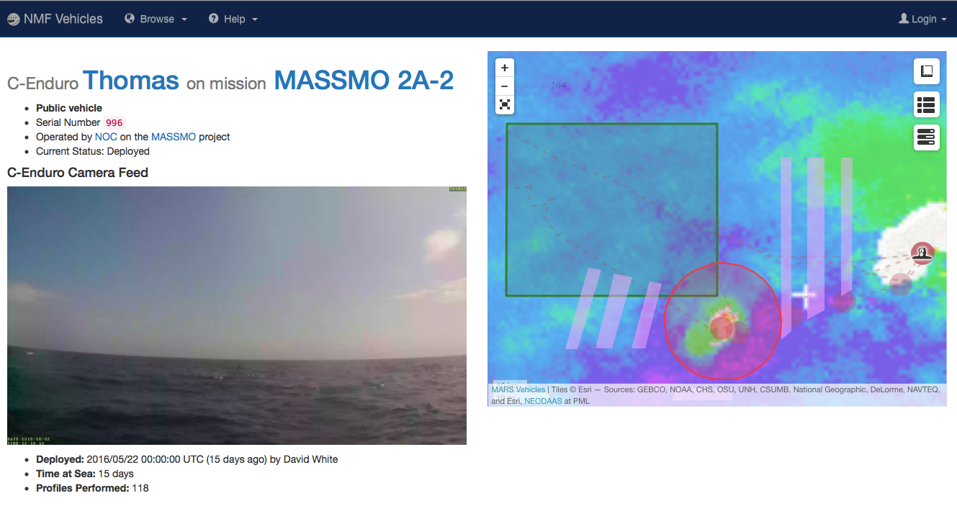
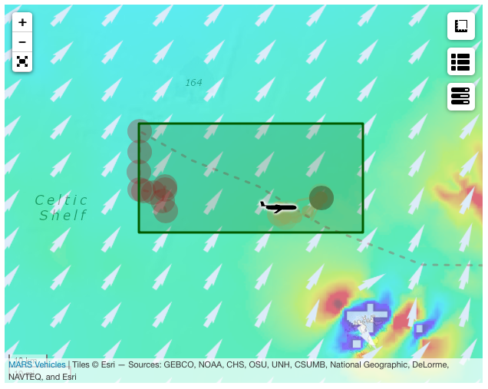
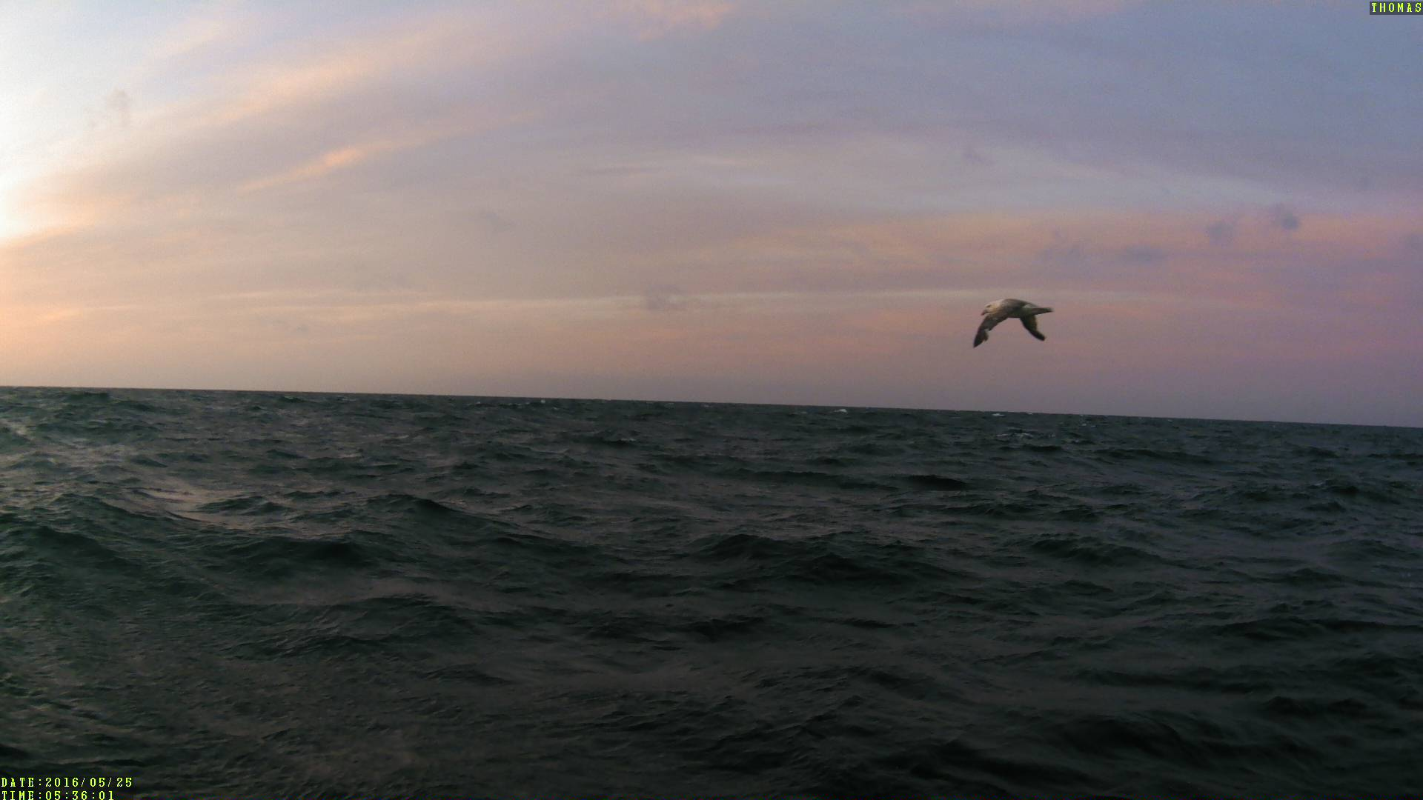
C2 developments during MASSMO2A in spring 2016

Slide 19
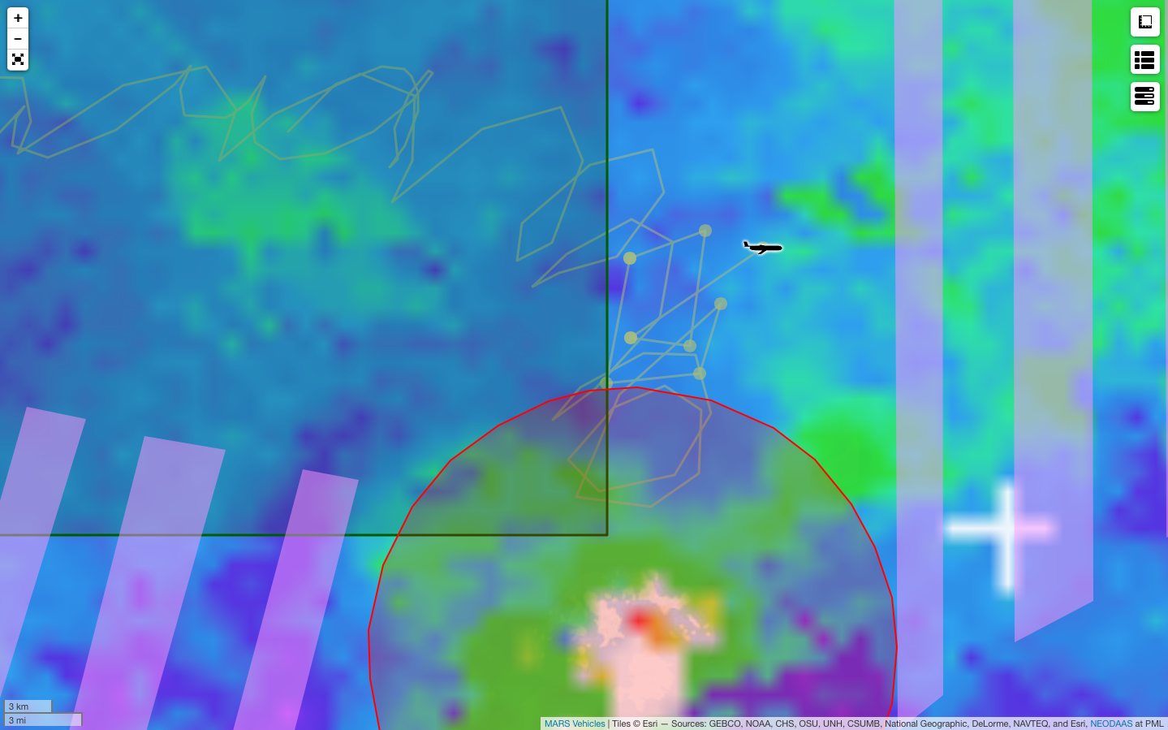
Survey box
Drake
Area where Drake twice entered mixed
waters with elevated surface productivity
Isles of Scilly

Slide 20
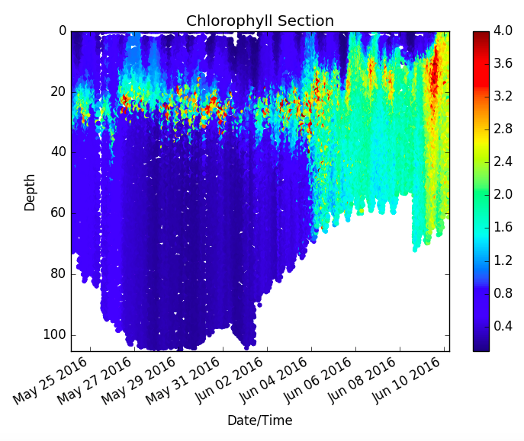
Subsurface chlorophyll maximum
Stratified waters
Tidal-mixing
fronts

Slide 21

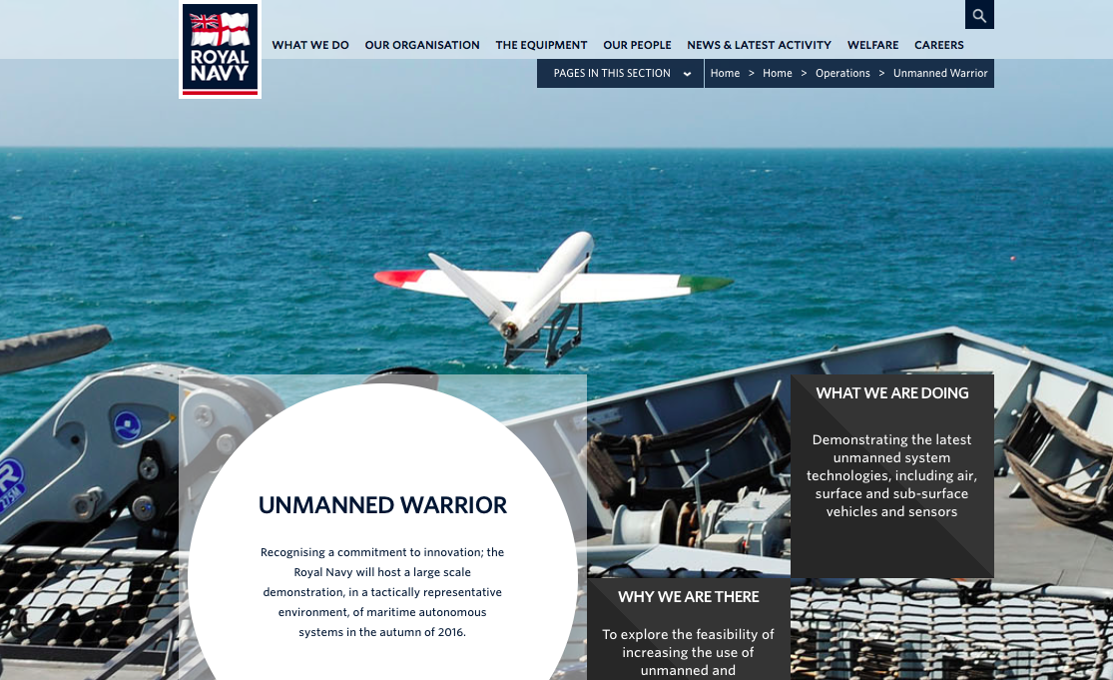

Slide 22


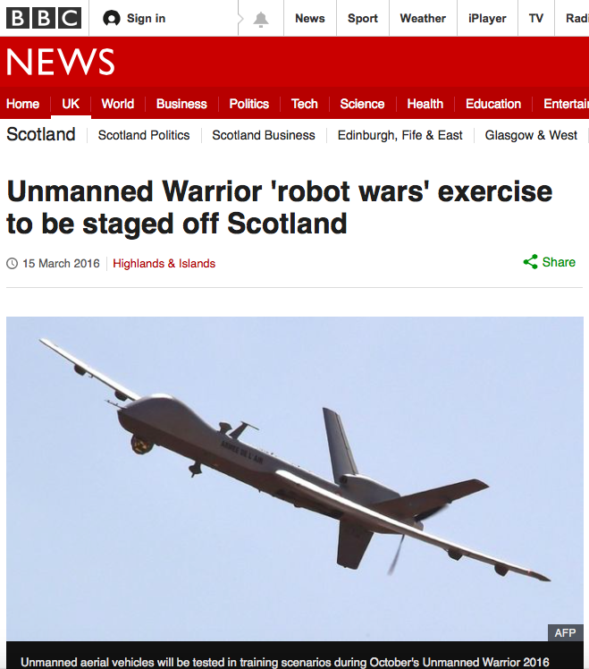


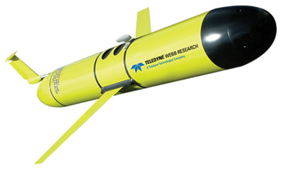








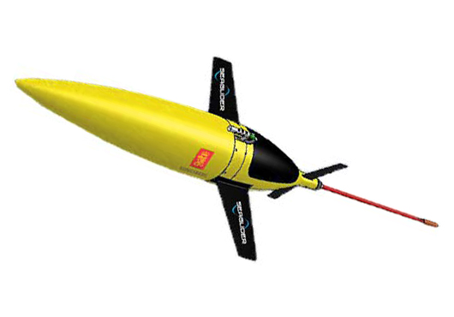
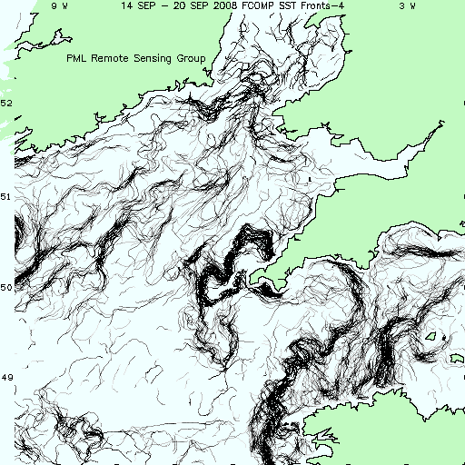


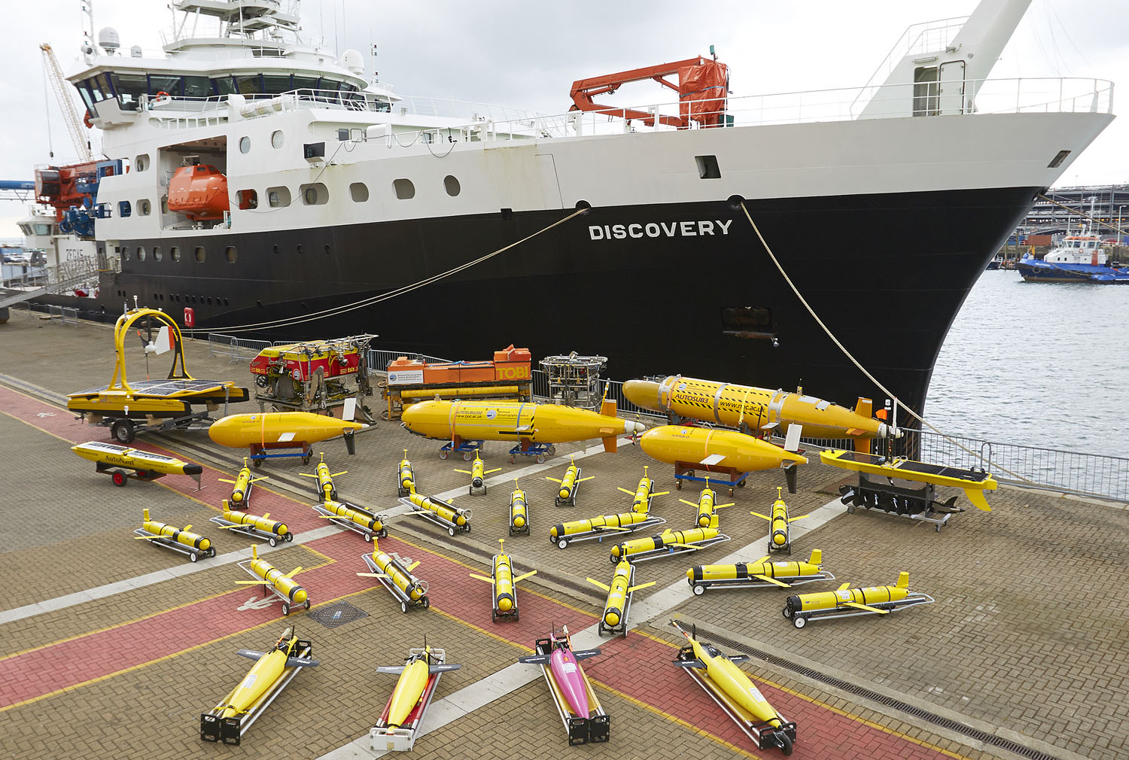

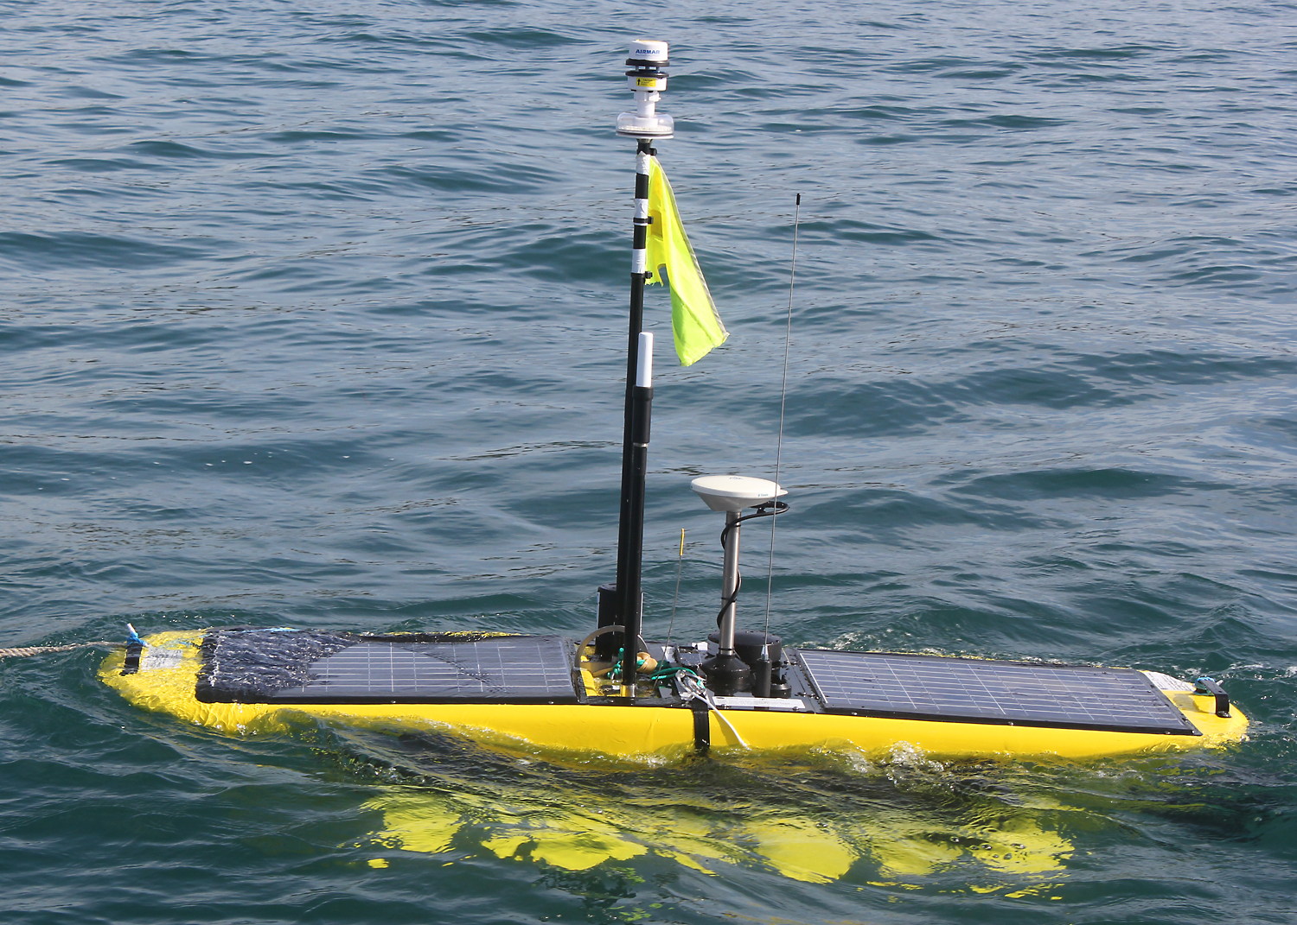






Project
funding
Promoting
innovation
Joint
operations
Public
engagement
Data
management
Operational
products
MASSMO3
Autumn 2016

Slide 23
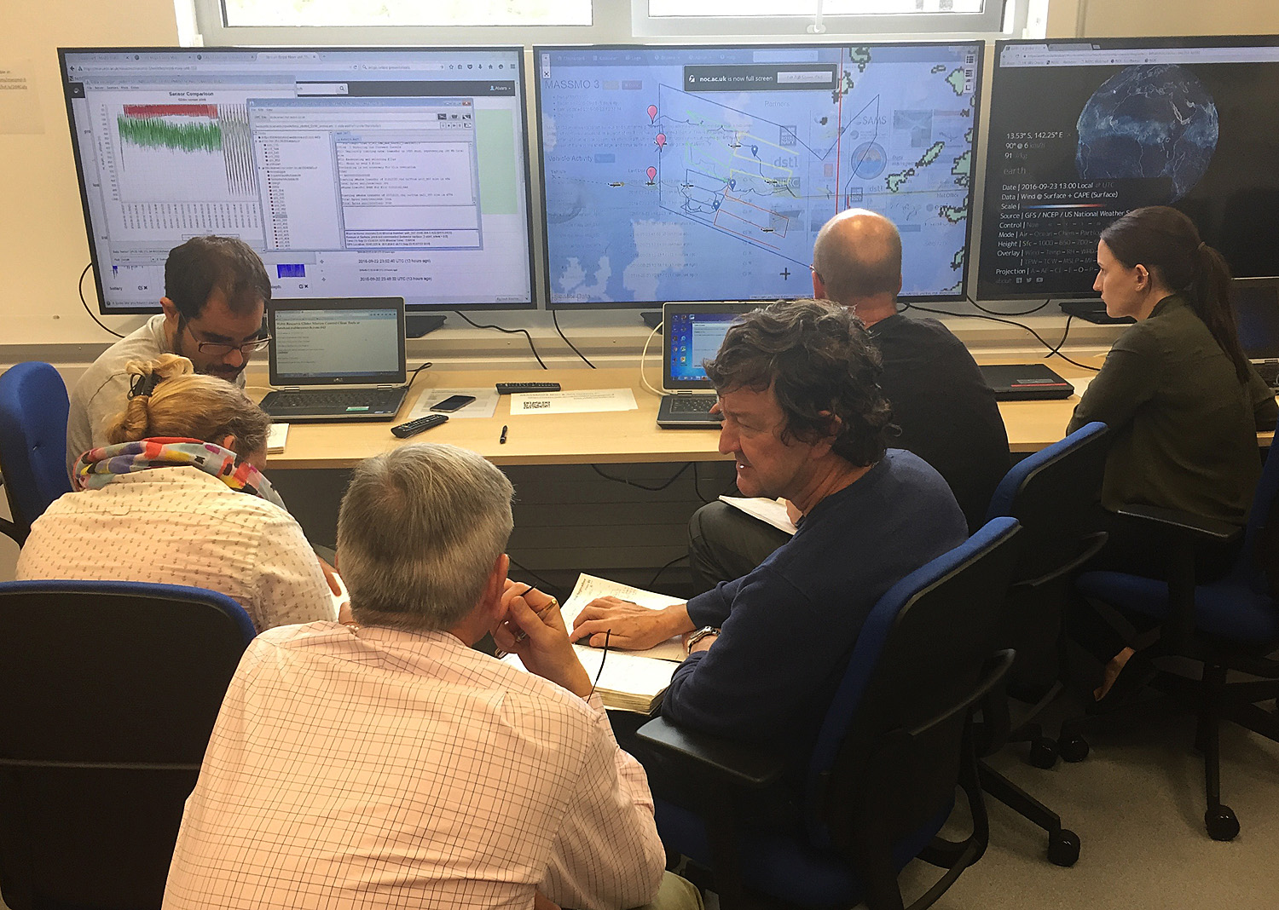
MARS glider pilots with Dstl and QinetiQ staff in the NOC Operations Room on 23 Sept 2016

Slide 24
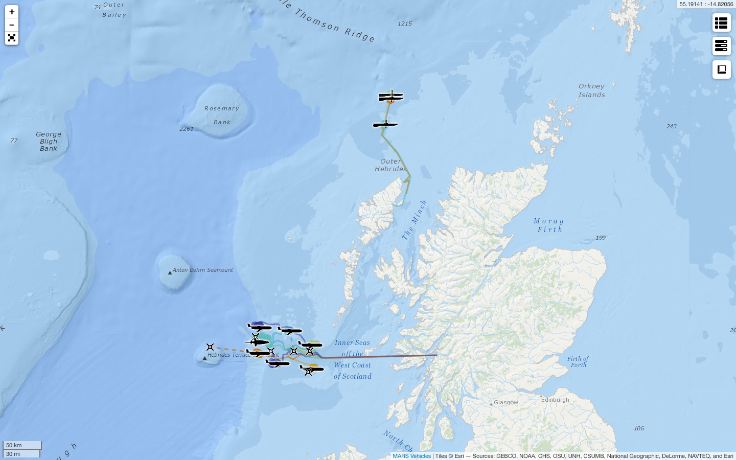
The MASSMO3 fleet at 2300 hrs on 21 Sept 2016
The largest simultaneous deployment of operational MAS in UK waters to date
Wave Glider x 3
Stornoway
Submarine Glider x 7
Oban

Slide 25
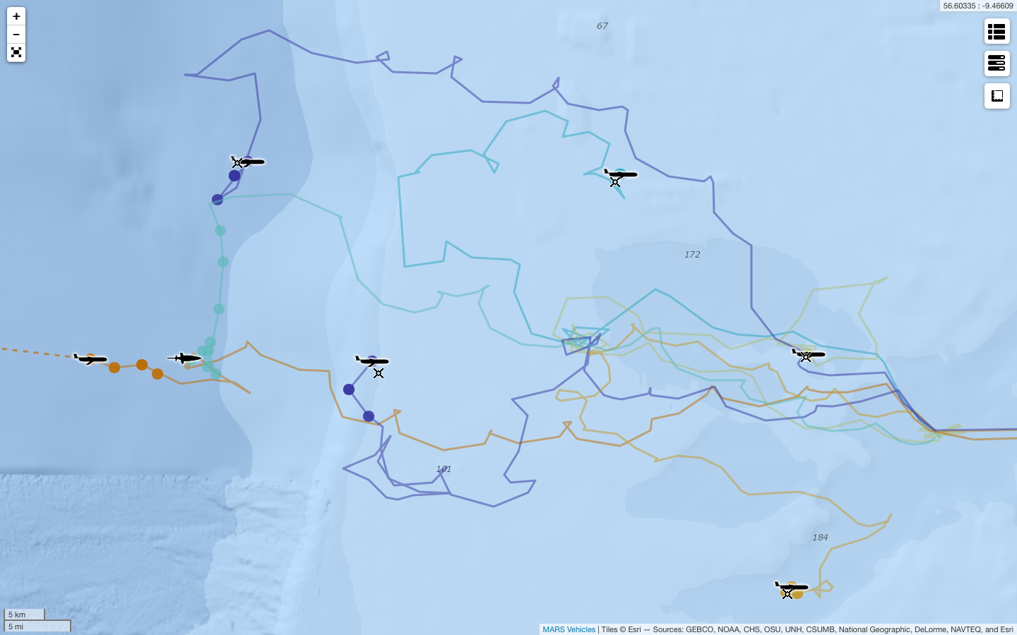
MASSMO3 submarine glider positions at 2200 hrs on 22 Sept 2016
Red arrows show likely propagation direction of internal waves towards ‘virtual mooring’ gliders
RN553
Nelson
Talisker
RN544
Drake
RN552
BOM491

Slide 26



Temperature data from three shallow gliders
16-22 Sept 2016
Note surface temperature decrease on 17 Sept (blue arrows)
Note consistent thermocline depth at ~50 m (black dashed line)
Note possible tidally-driven cyclicity in vertical displacement of thermocline
RN544
BOM491
Drake

Slide 27



Talisker Seaglider data
Thermocline
*
*
*
*
*
Thermocline
*
*
*
*
*
Thermocline
*
*
*
*
*

Slide 28

Wave Gliders underway up to 100 km north of Butt of Lewis at 2300 hrs on 21 Sept 2016
Boeing SHARCs reached the waypoint ~100 km north of Butt of Lewis in ~24 hrs (~2 kts)
Boeing SHARC 127
Boeing SHARC 117
NOC MARS Waimea

Slide 29

UK Met Office data showing wind gusts in the survey area at 2000 hrs on 23 Sept 2016

Slide 30






Wave Glider temperature and salinity data from 19-21 Sept 2016
Green arrows indicate when each vehicle commenced northwards transect
Red dashed line marks transition into colder and more saline offshore water
Black asterisks highlight fine-scale features sampled with all three vehicles
Boeing SHARC 127
Boeing SHARC 117
NOC MARS Waimea
*
*
*
*
*
*
*
*
*
*
*
*

Slide 31

Wave Glider locations at 0540 hrs on 26 Sept 2016
The Wave Gliders are due to undertake repeat crossings of the front marked F below
The SST map shows colder mixed surface waters south of this front
F
F
NOC MARS Waimea
Warmer stratified waters
F
Boeing SHARC 117
Boeing SHARC 127
F
F
Colder mixed waters

Slide 32



Boeing SHARC 117 SST data
SST map supplied by PML
Fronts marked as F (red = warmer side)
Green shading denotes SST <13ºC
Thin brown line = Boeing SHARC 117 track
WFIW
CSOW
WFIW
Holding
station
Holding
station
CSOW
12.6
CFMW
F
F
CSOW
13.3
13.3
CSOW
WFIW
F
WFIW
13.7
14
F
F
13
CFMW
WFIW
CSOW
WFIW
WFIW = Warmer, Fresher, Inshore Water
(14ºC reducing to 13.7ºC due to wind-driven mixing)
CSOW = Colder, Saltier, Offshore Water
(reducing offshore to a minimum of 12.6ºC)
CFMW = Colder, Fresher, Mixed Water
(variable but averaging ~13ºC)
CFMW

Slide 33

Future aim is to develop a truly integrated marine observing network for UK seas

