Slide 1
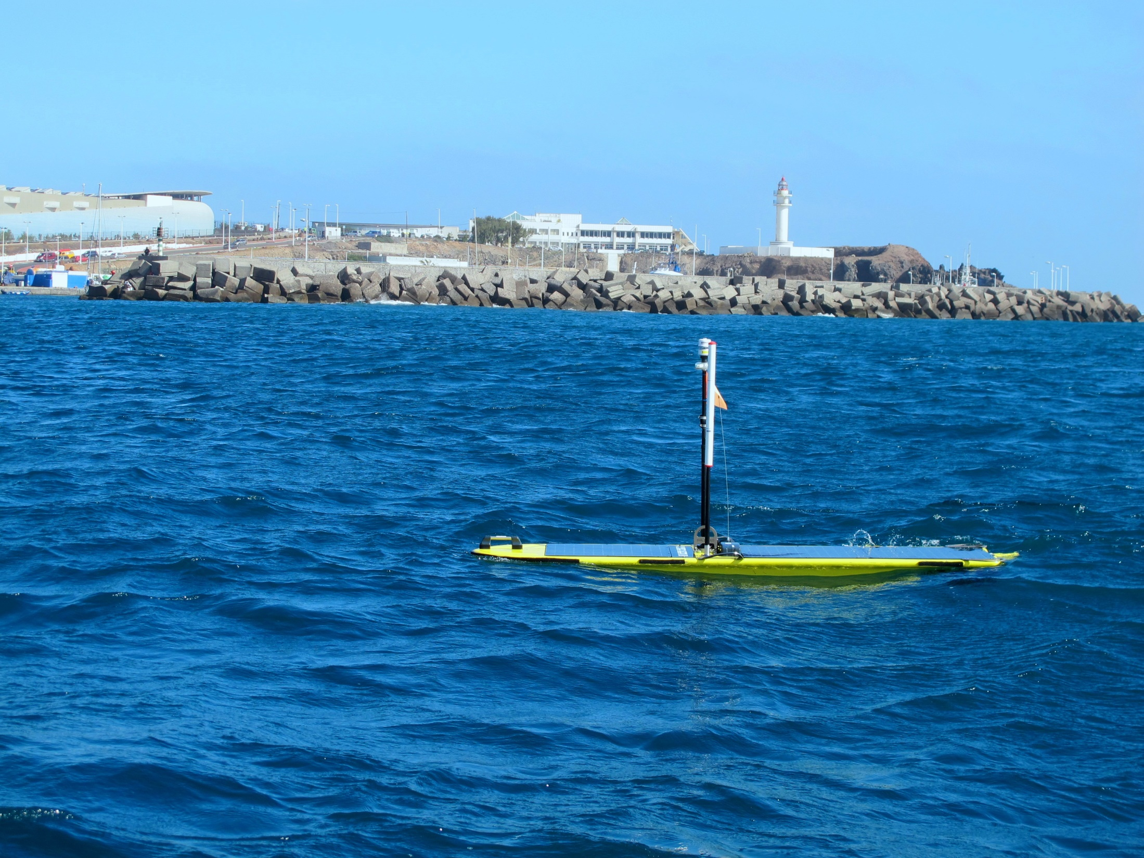
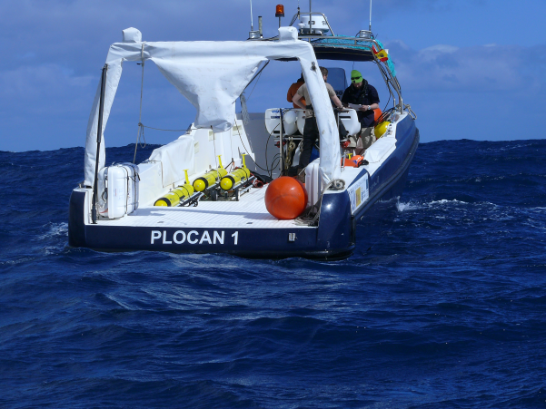

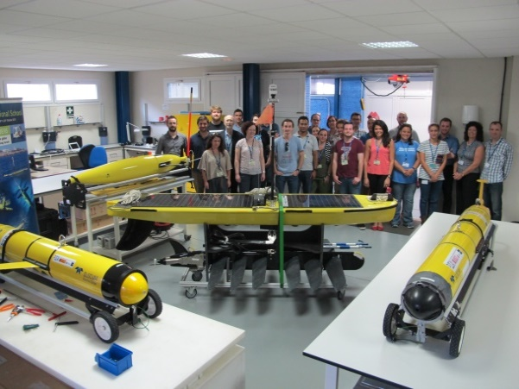
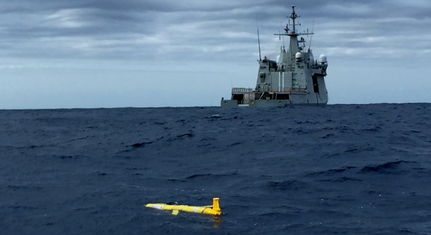
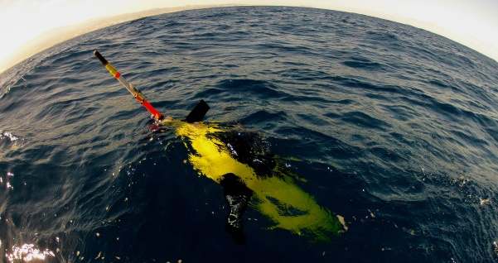
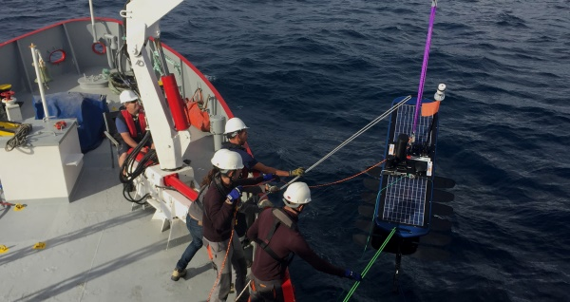
Improving in-situ ocean observations in the Macaronesia region with gliders
C. Barrera, R. Moran, T. Morales, A. Cianca, C. Almisas, MJ Rueda, J. Brito and O. Llinas.
7th EGO Conference. NOC. Southampton, UK. 26th-29th September 2016.

Slide 2

Outline
PLOCAN Gliderport facility
EU/National projects
Missions and endurance-lines
What’s next?

Slide 3
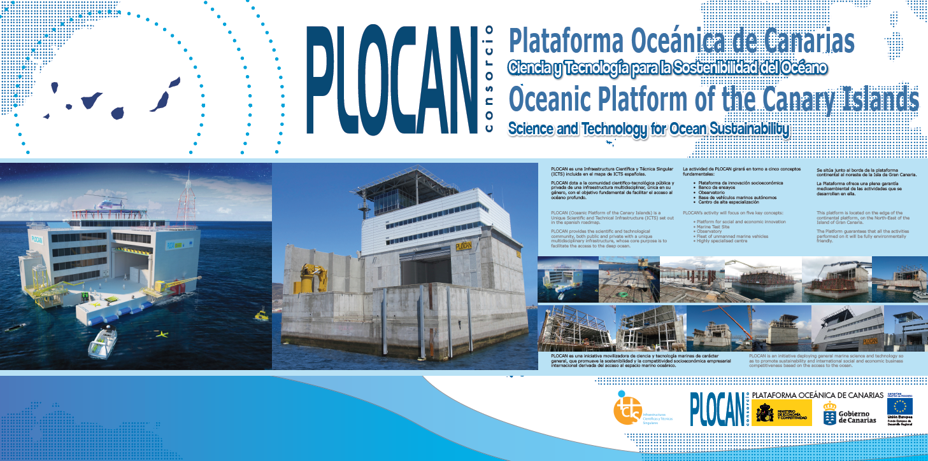
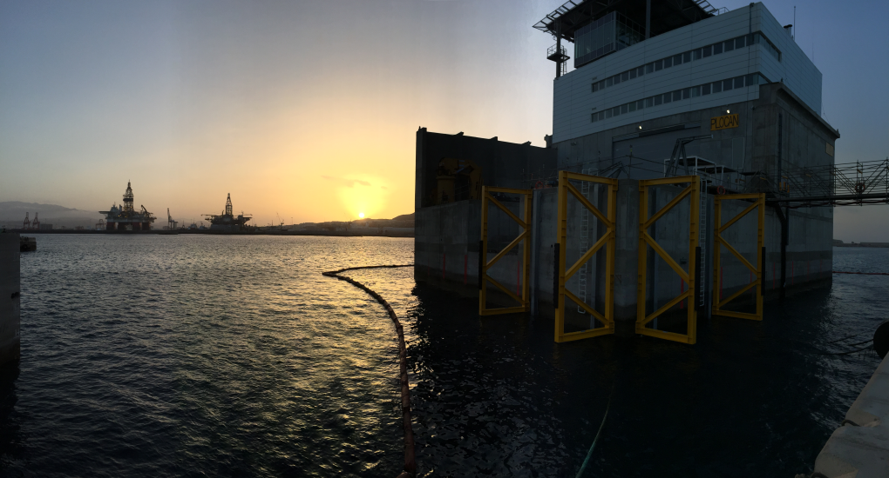
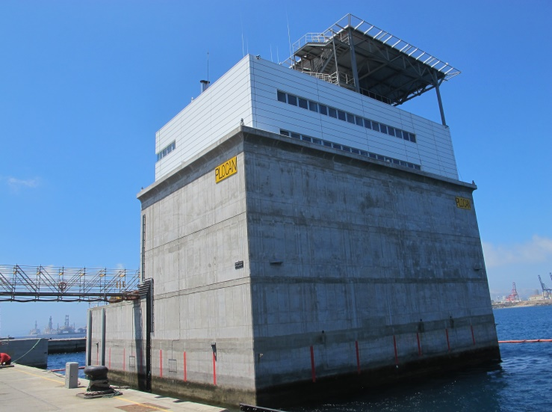

Slide 4
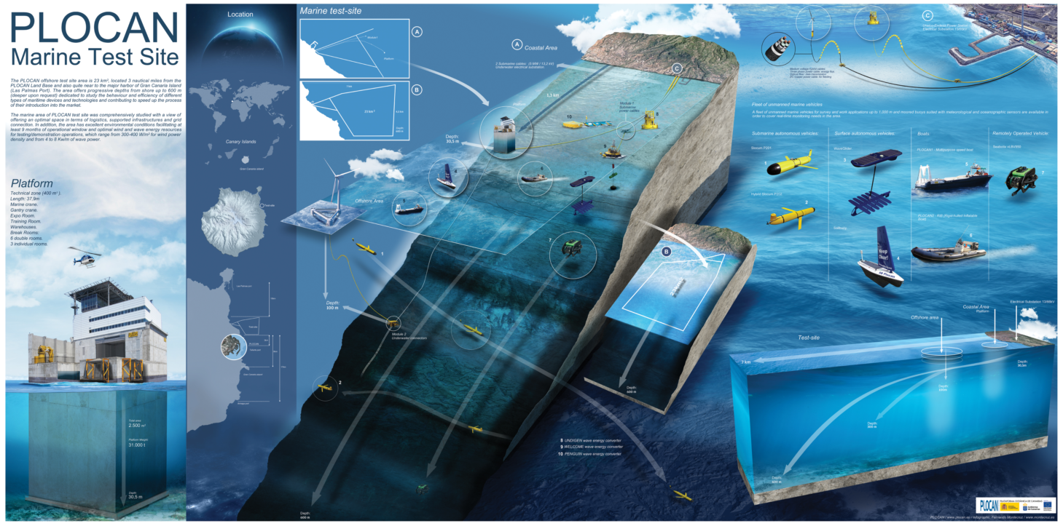
PLOCAN GLIDERPORT FACILITY

Slide 5
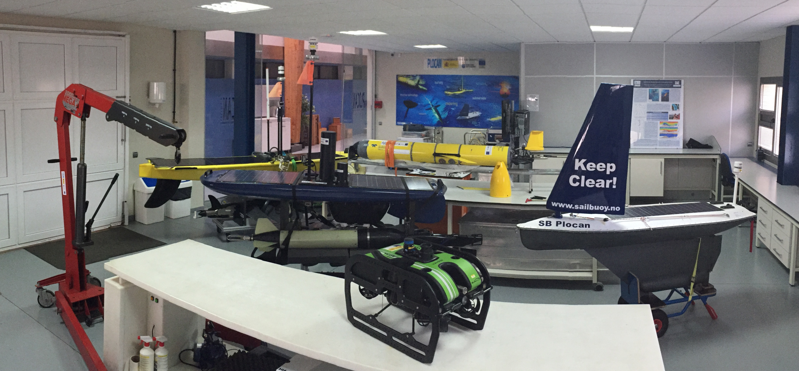
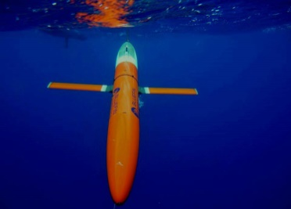
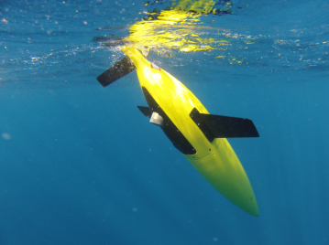
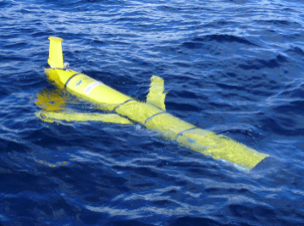
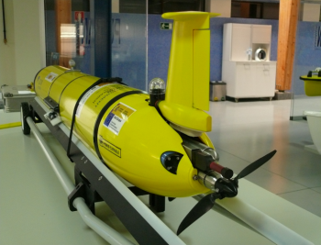
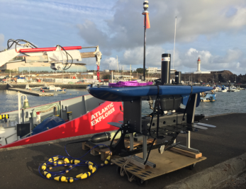
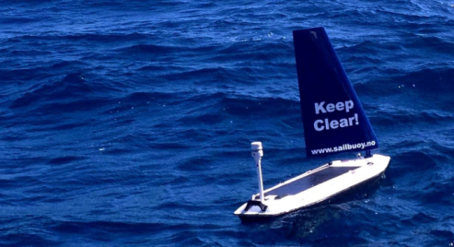
PLOCAN GLIDERPORT FACILITY
2010
2014
2015
2007
2010
2016

Slide 6
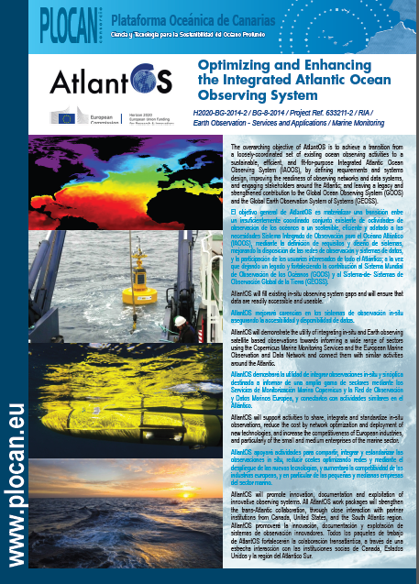
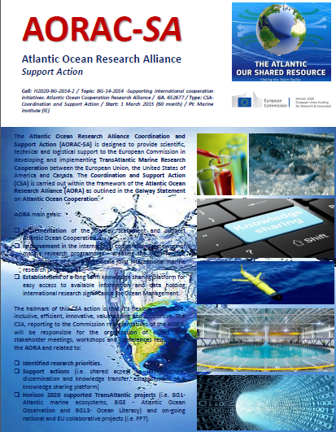
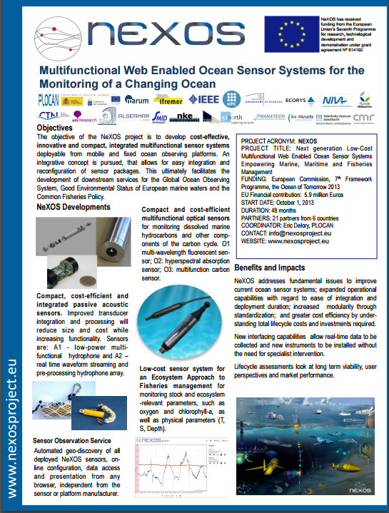
EU PROJECTS

Slide 7
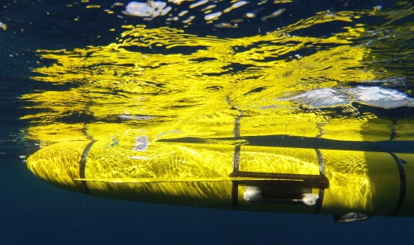
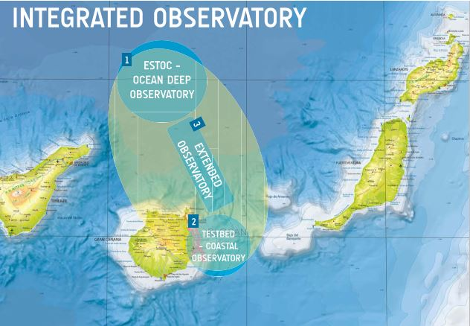
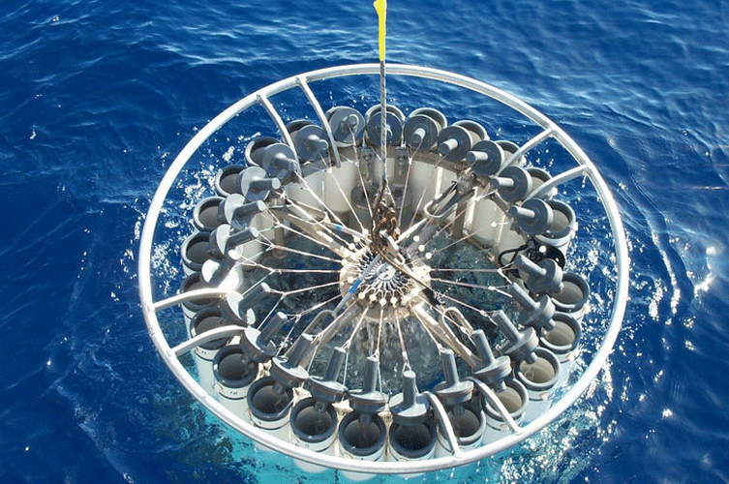
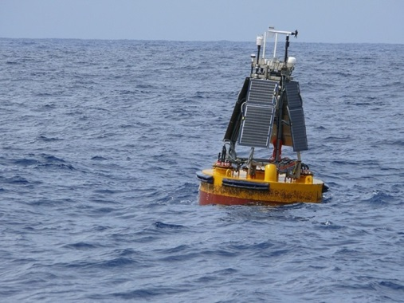
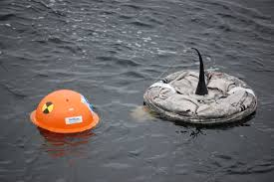
MISSIONS AND ENDURANCE LINE

Slide 8
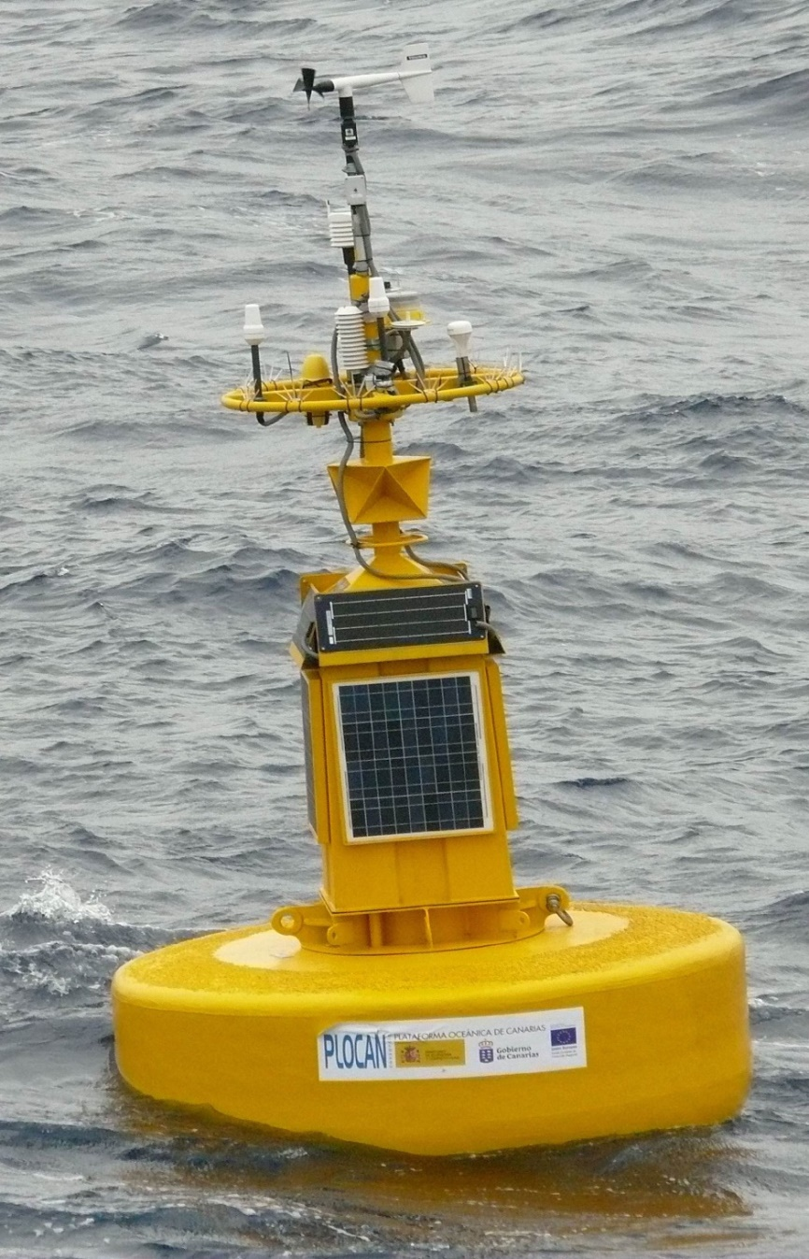
MISSIONS AND ENDURANCE LINE
PLOCAN/ESTOC Integrated Observatory
29º 10’ N – 15º 30’ W (65 Nm. Northwards PLOCAN facility)
3615 m. mooring depth
Meteorological and Oceanographic parameters monitoring
Selectable sampling and telemetry rate
Serviced every six months
Modular payload configuration
Versatile datalogger architecture
NRT data-visualization tool

Slide 9
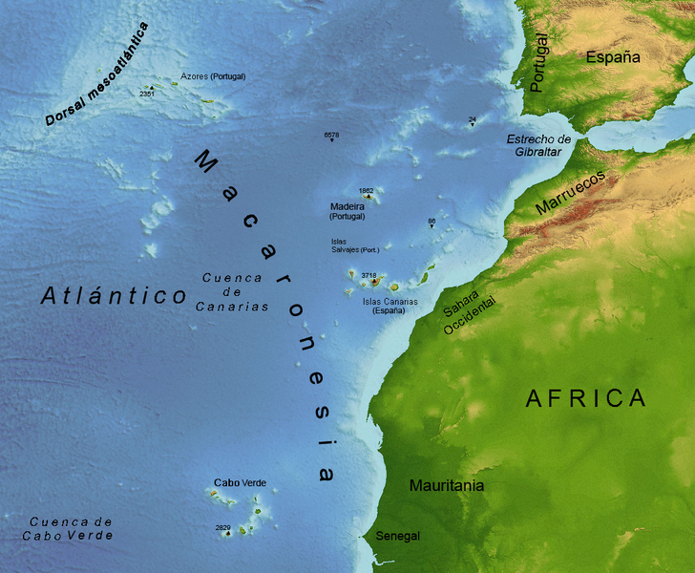














MISSIONS AND ENDURANCE LINE
Outermost region.
4 Ocean archipelagos.
Key socio-economic interest.
Atlantic Strategy.
H2020

Slide 10
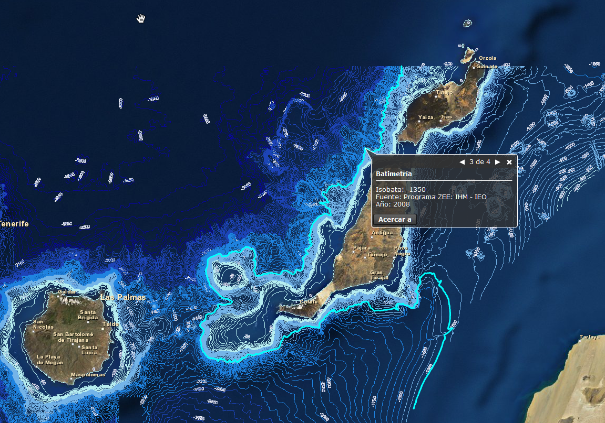
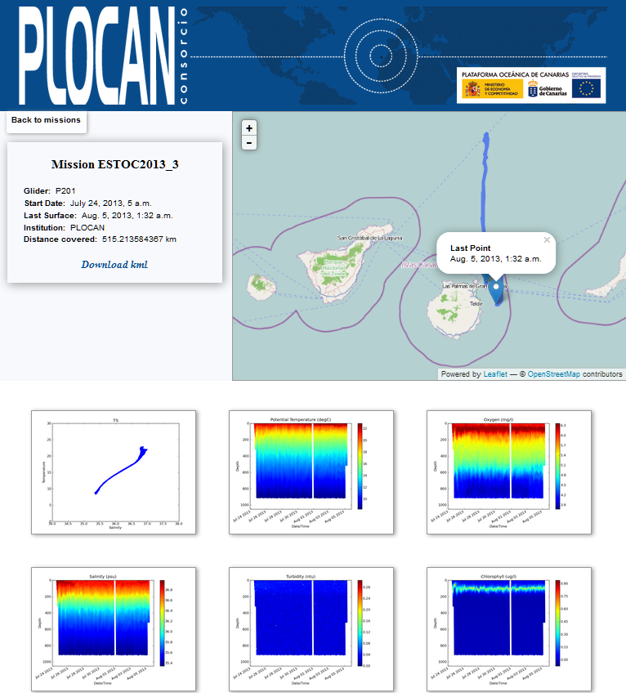
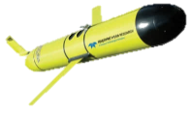
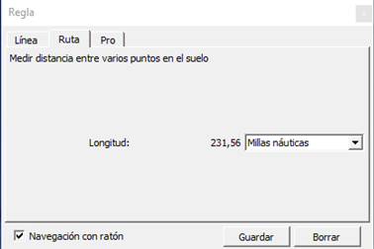

MISSIONS AND ENDURANCE LINE
WP1
WP2
#
ESTOC – Seasonal Glider Monitoring (2010-present)
3-weeks mission (Feb/May/Sept/Dec) / CTD, DO and CHL-A.

Slide 11


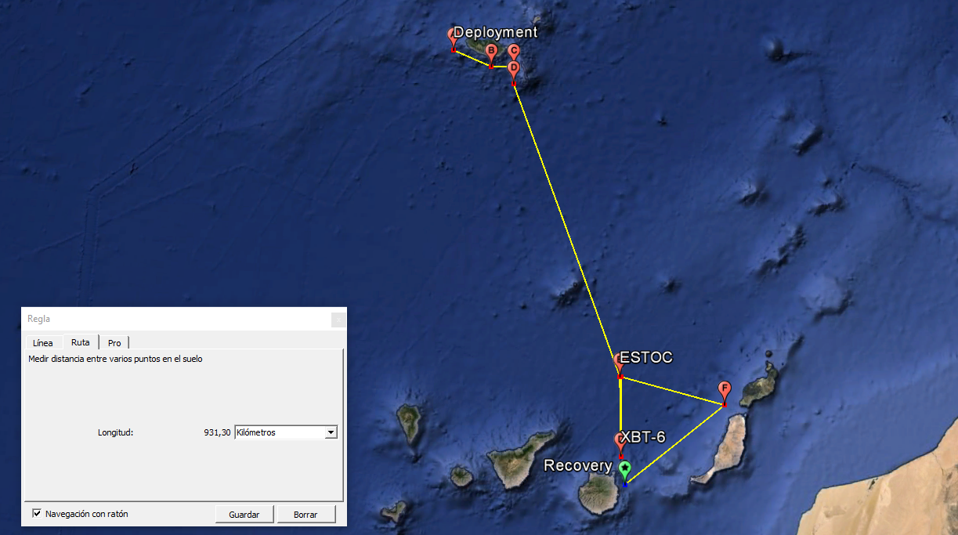
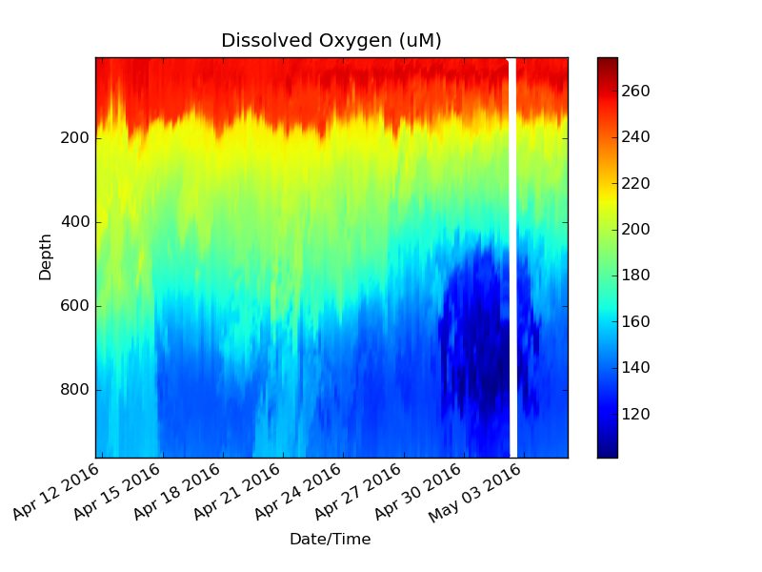
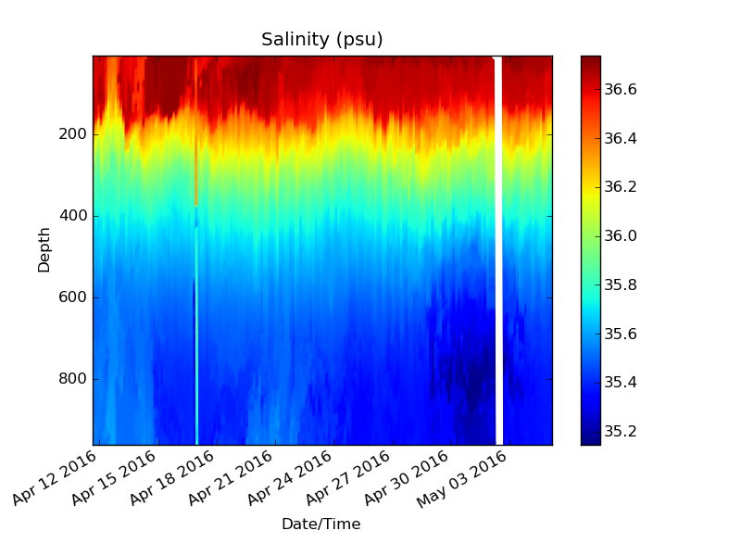
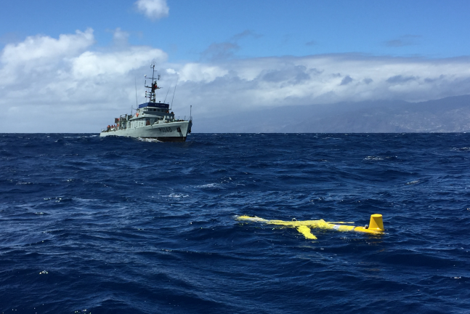
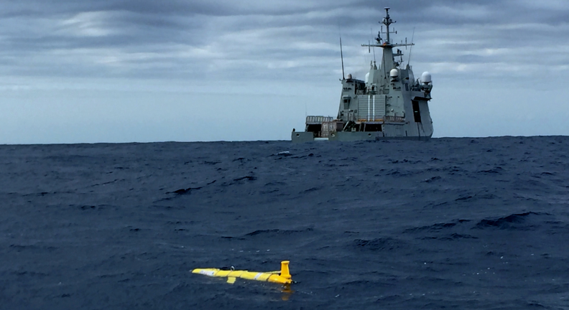


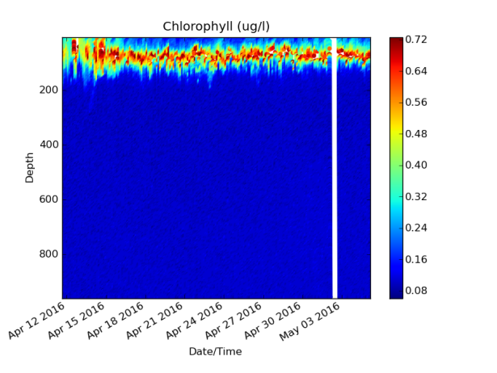
MISSIONS AND ENDURANCE LINE

Slide 12

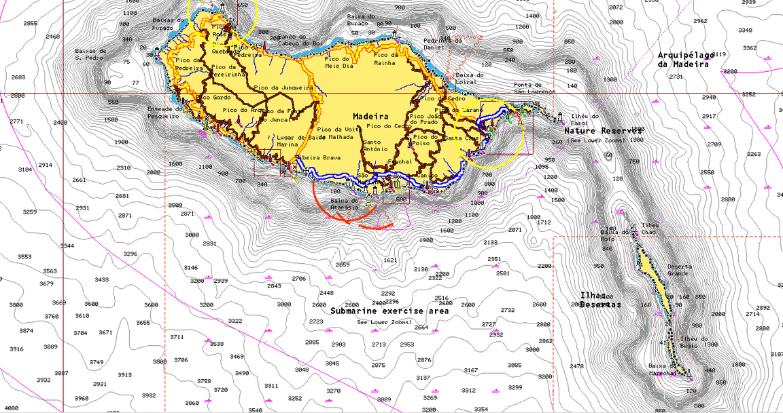



MISSIONS AND ENDURANCE LINE
A
B
C
D
A-D distance = 98 kms.
A= Deployment
To waypoint E (ESTOC)

Slide 13
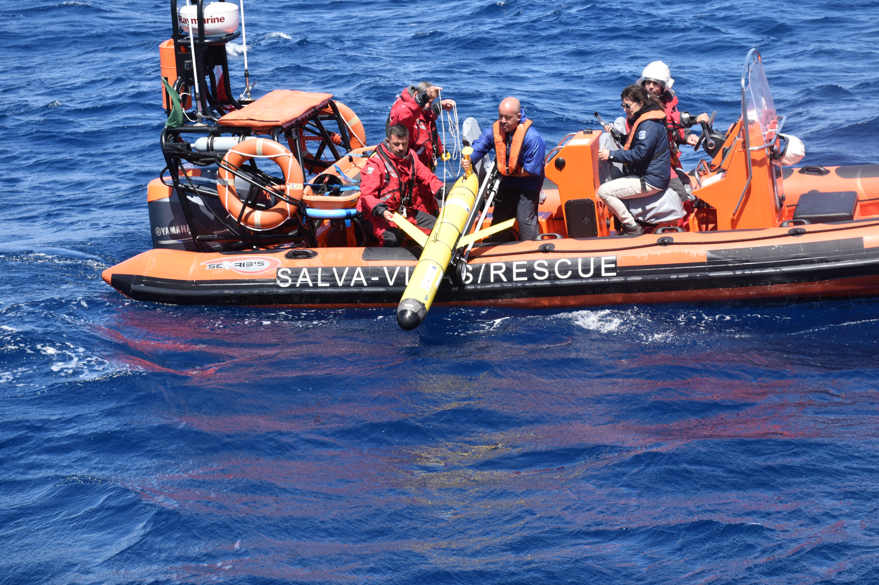
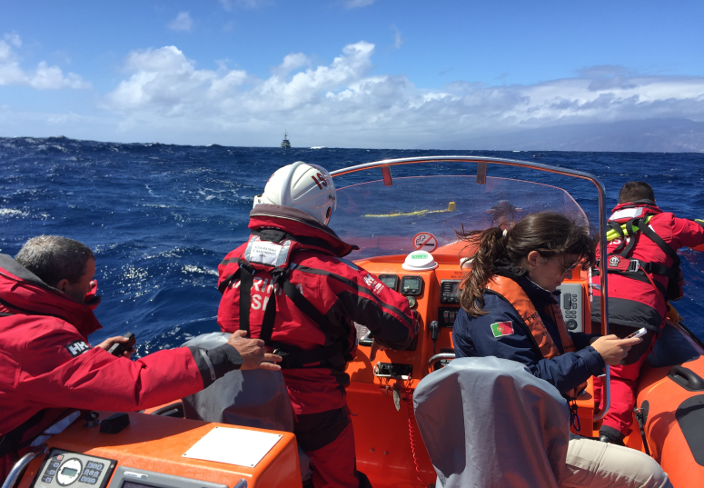
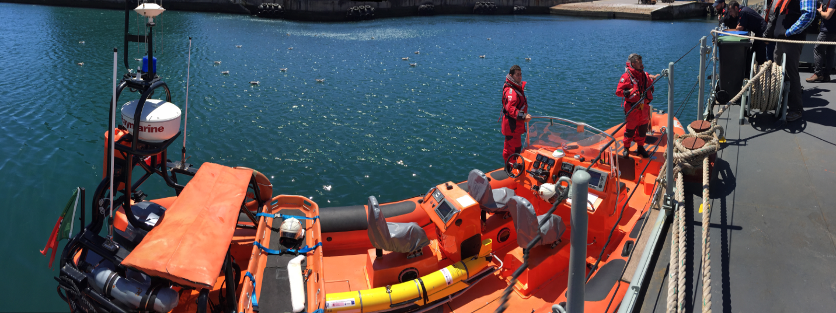

Slide 14
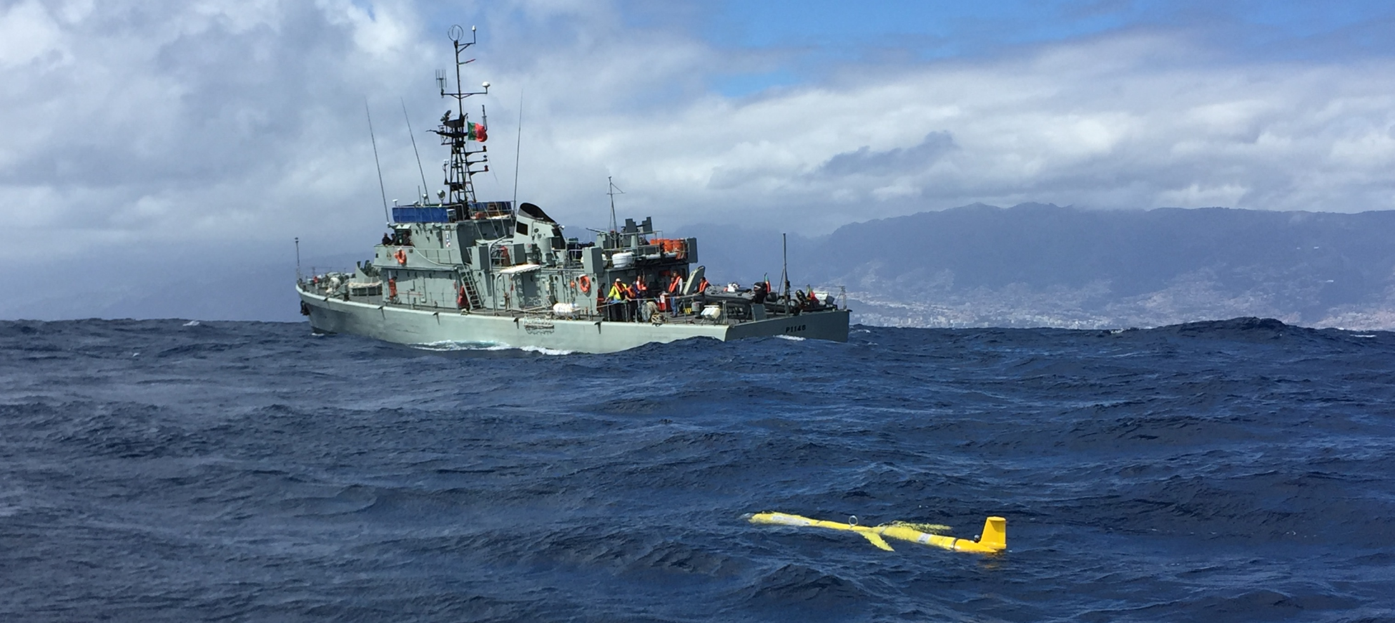
MISSIONS AND ENDURANCE LINE

Slide 15
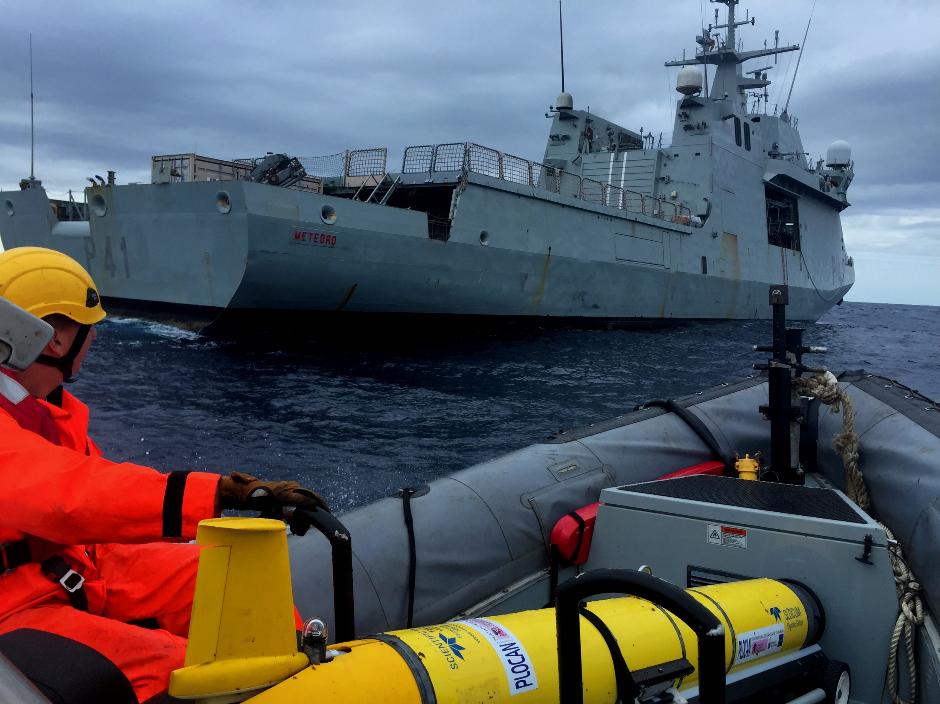
MISSIONS AND ENDURANCE LINE

Slide 16
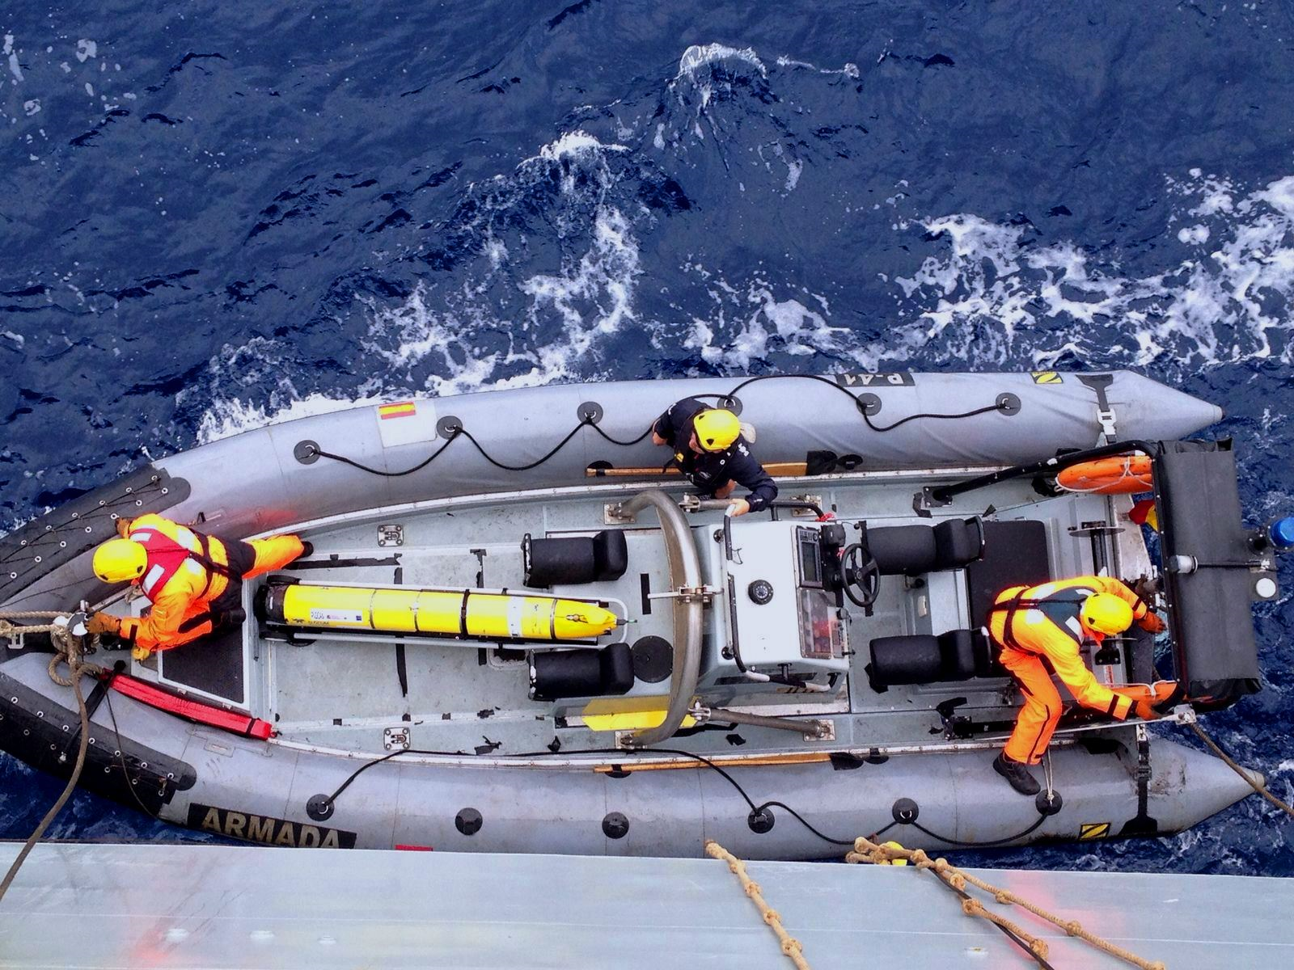
MISSIONS AND ENDURANCE LINE

Slide 17
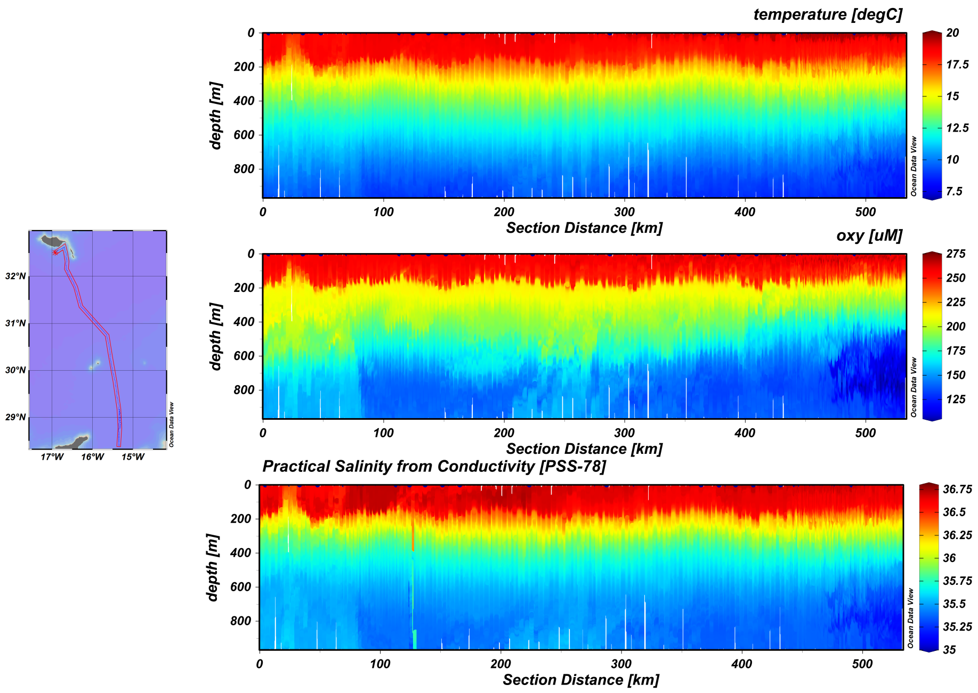
MISSIONS AND ENDURANCE LINE

Slide 18
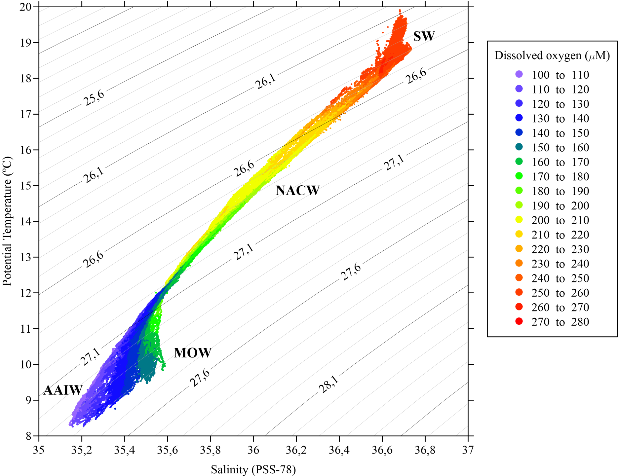
MISSIONS AND ENDURANCE LINE
DIAGRAM OF TEMPERATURE- SALINITY AND DISSOLVED OXYGEN
MAIN WATER MASSES

Slide 19
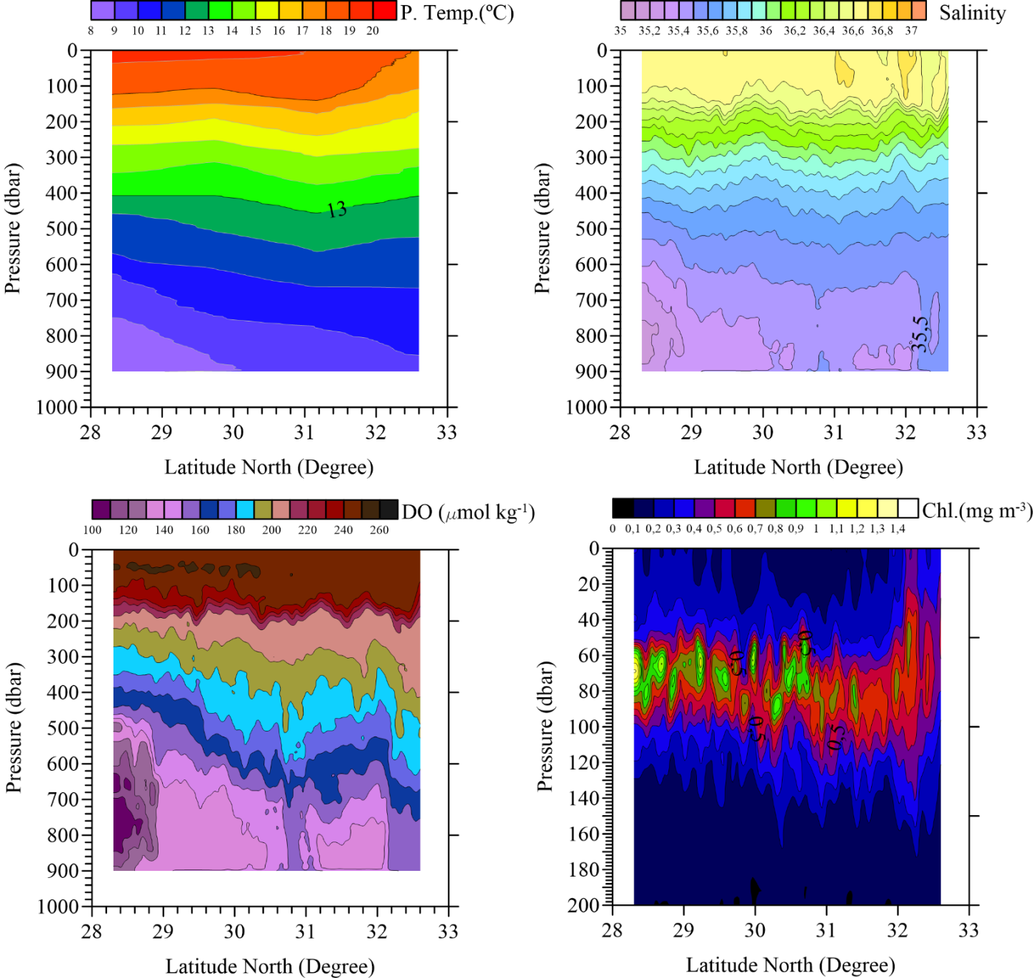
MISSIONS AND ENDURANCE LINE

Slide 20
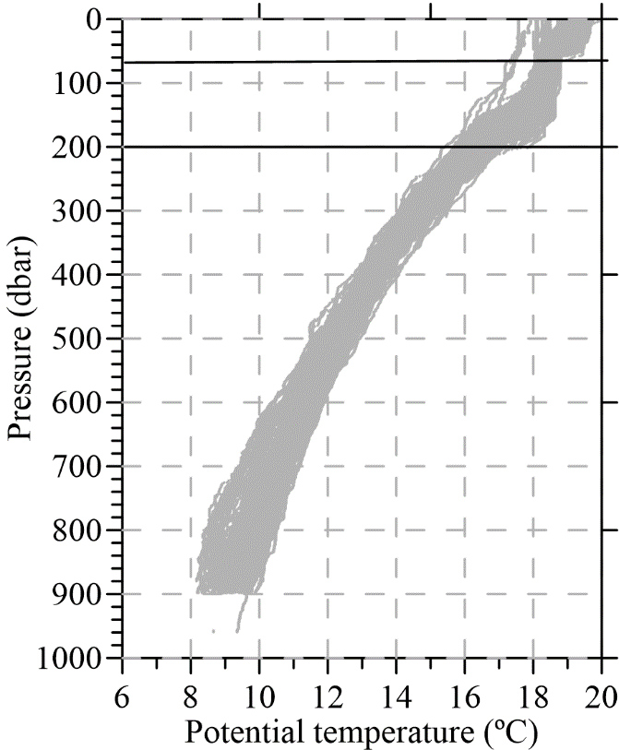
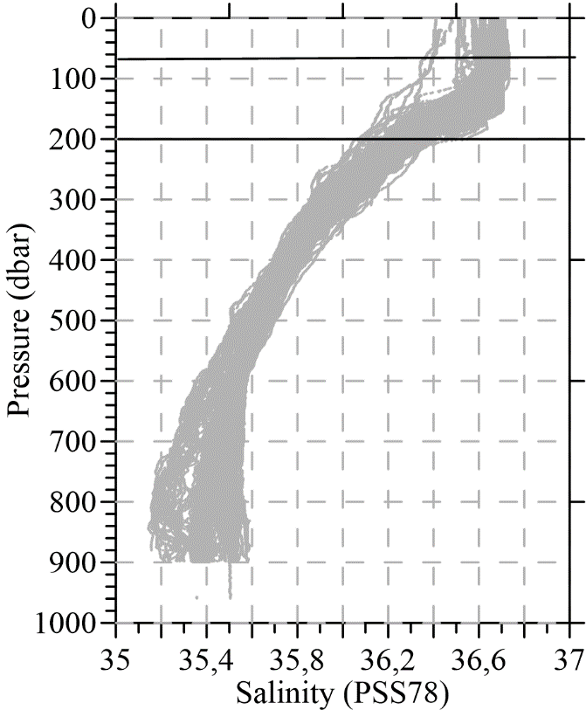
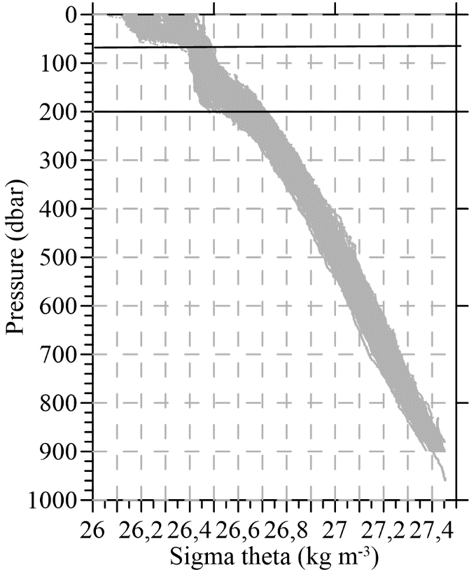

MISSIONS AND ENDURANCE LINE
DIAGRAMS OF TEMPERATURE, SALINITY, SIGMA-THETA AND TEMPERTURE GRADIENT
A PROBABLY PRESENCE OF MADEIRA MODE WATER

Slide 21

MISSIONS AND ENDURANCE LINE
SPATIAL DISTRIBUTION OF HIGHER PROPORTION OF AAIW
(27,3- 27,4) SIGMA THETA

Slide 22


WHAT’S NEXT?
Transect 1 - Gran Canaria/Dakhla/Gran Canaria - 870 kms (35 days)
Transect 2 - Gran Canaria/Laayoune/ Gran anaria - 360 kms (15 days)
Transect 3 - Gran Canaria/Agadir/Gran Canaria - 1560 kms (62 dias)

Slide 23


WHAT’S NEXT?
3X Oceanographic buoy for Meteo and Ocean parameters real-time measurements.

Slide 24




WHAT’S NEXT?
33 kms
8 kms
Dakhla

Slide 25
WHAT’S NEXT?
Outermost region.
4 Ocean archipelagos.
Key socio-economic interest.
Atlantic Strategy.
H2020

Slide 26






WHAT’S NEXT?

Slide 27






WHAT’S NEXT?

Slide 28






WHAT’S NEXT?

Slide 29

Thank you!!!
www.plocan.eu
carlos.barrera@plocan.eu

