Slide 1


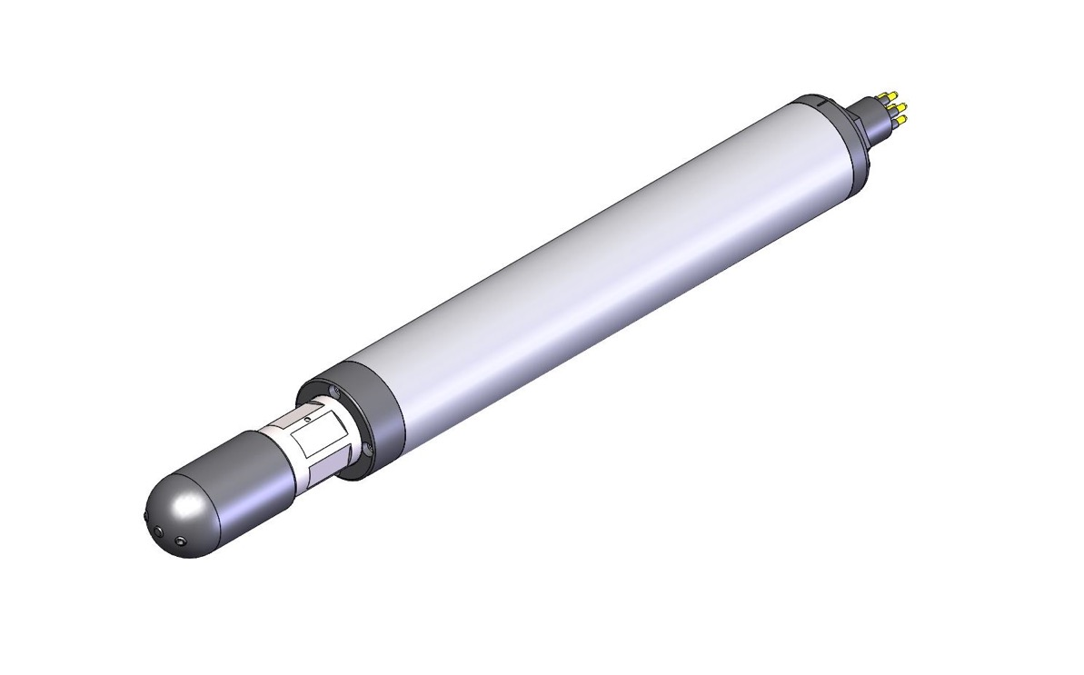
An electro-magnetic flow sensor for measuring the axial speed of gliders
Southampton, England
Date: September 29, 2016
Presenter: Fabian Wolk
fabian@rocklandscientific.com

Slide 2
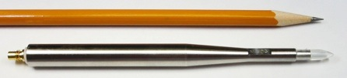

The Velocity Shear Probe
Notes:
How can we measure ocean turbulence?

Slide 3
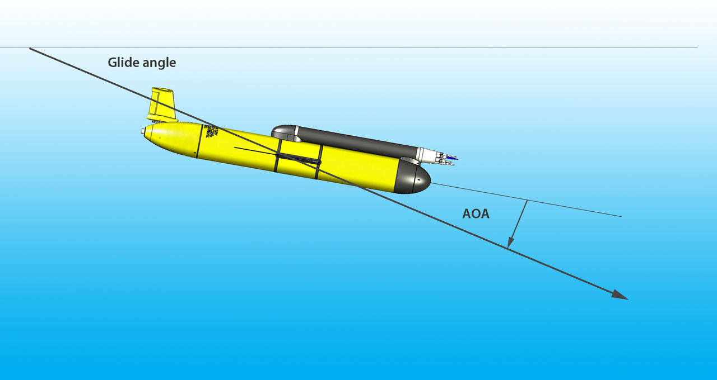





The Issue:
$$γ=θ+α$$
pitch
$$θ$$
$$α$$
$$w=\frac{dp}{dt}$$
$$U=w\sin{γ}$$

Slide 4

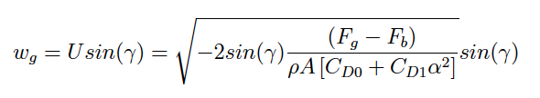


Accounting for the angle of attack, α
OMG: Flight model
(Merckelbach et al, 2010)
θ
Total glide angle,
We employ the hydrodynamic flight model of Merckelbach et al, 2010;
α
γ
θ
α
U
w
Where V_{g} = 56.075 ×10⁻³m³
m_{g} = 57.56 kg
A = 0.1m²
and ΔV_{bp} & θ from sensors
C_{D0} and C_{D1} are drag coefficients (due to parasitic and induced drag) dependent on α
Balancing buoyancy and gravitational forces
slide by Matthew Palmer, NOC Liverpool
Γ = mixing efficiency

Slide 5
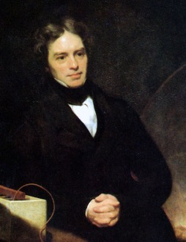
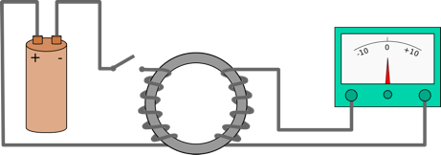
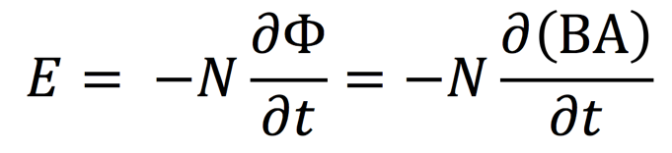
Electromagnetic Current Sensor: Operating Principle
1831, Michael Faraday
  electromagnetic induction
N number of windings
B magnetic field
A cross section of coil

Slide 6
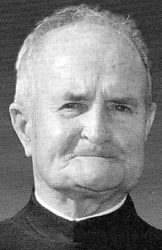
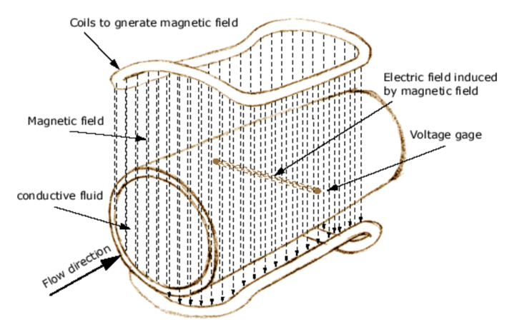
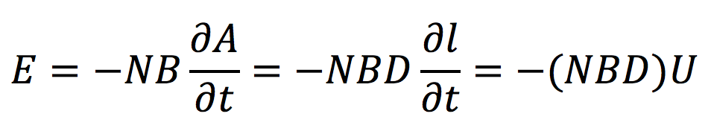
Electromagnetic Current Sensor: Operating Principle
1930, Father Bonaventura Thürlemann
  Inventor of the electro-magnetic current meter (”mag” meter)

Slide 7
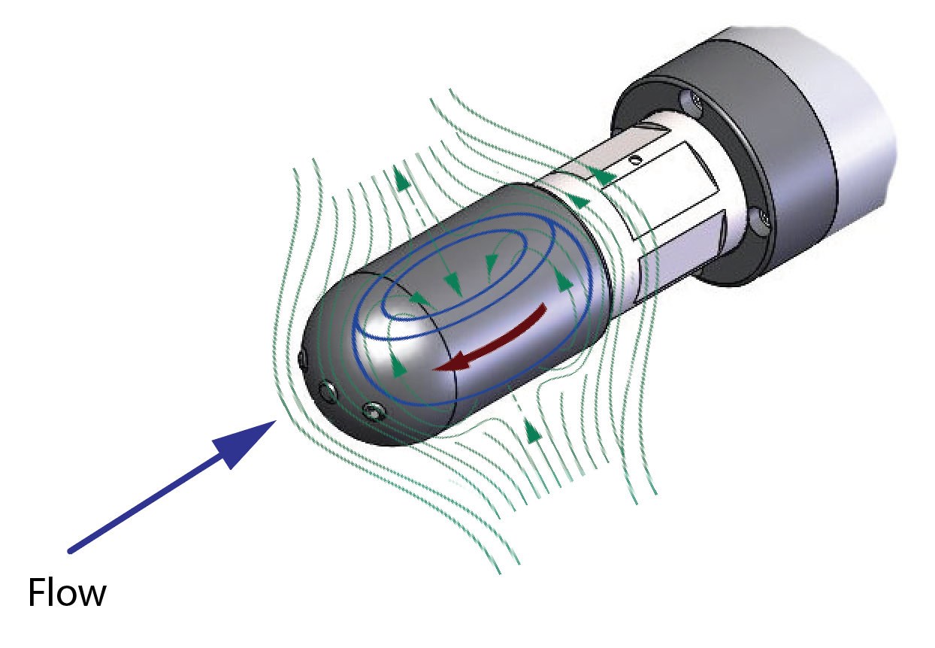
Electromagnetic Current Sensor: Operating Principle
U

Slide 8
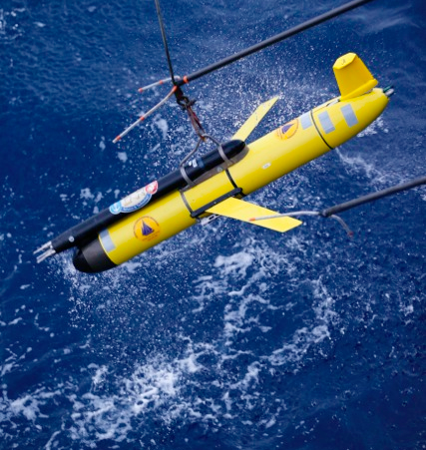
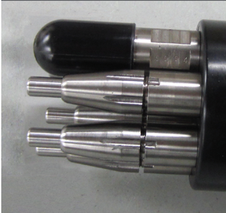
MicroRider configuration

Slide 9
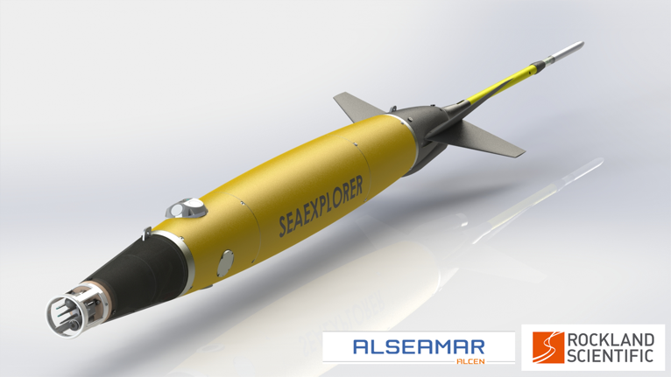
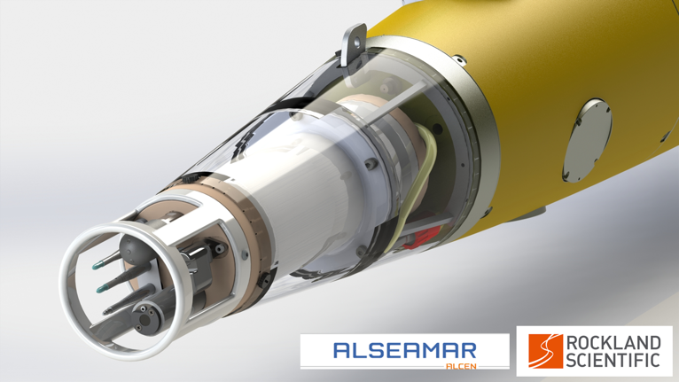
SeaExplorer configuration

Slide 10
MicroPod-EM configuration
Dimensions | Φ30mm, L 240 mm
Weight | 550 g (in air), 310 g Iin sea water)
Power Input (V) | 9 – 18 VDC
Power consumption | 85mA typical
Signal output | Choice of Analog (0-5V) or RS-232C
Depth rating | 1000m

Slide 11
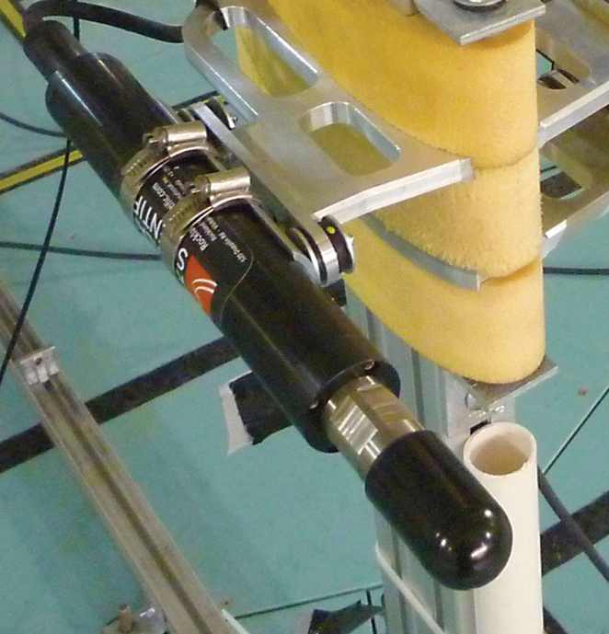
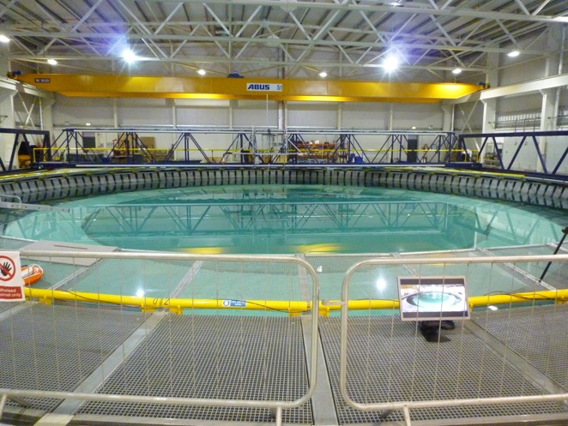
Laboratory and Flume
• Does not require any seeding of acoustic scatterers

Slide 12
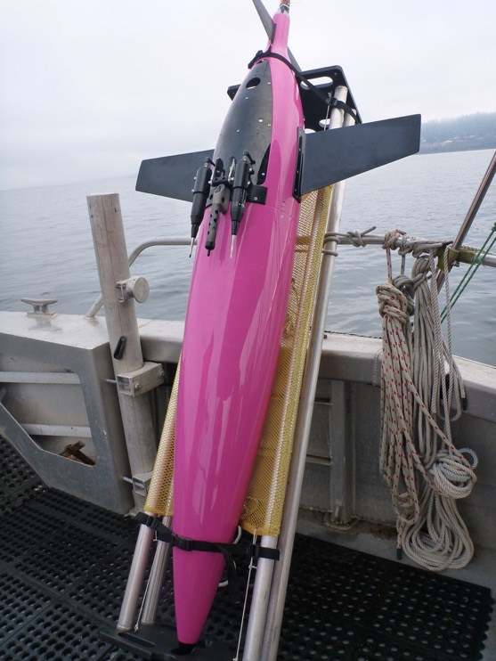
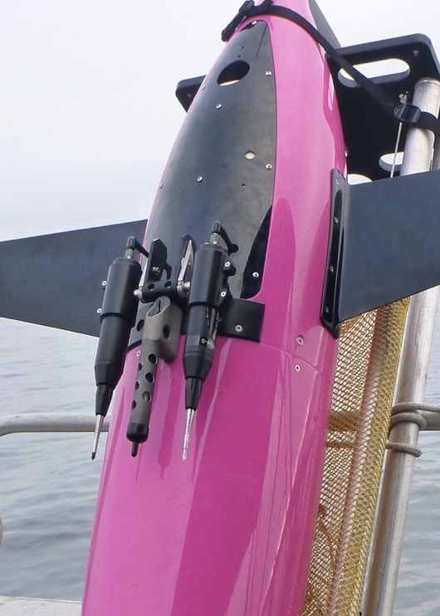
Seaglider configuration

Slide 13
General Sensor Specifications
Measurement principle | Electromagnetic induction
Measurement direction | 1-D axial
Measurement range | 0 to 5m/s
Data output | Analog (0-5V) or RS-232C (MicroPod-EM only)
Accuracy, analog output | larger value of ±0.025m/s or ±5%
Accuracy, digital output | larger value of ±0.005m/s or ±2%
Frequency resolution | TBD (estimated at 5Hz)
Measurement resolution (A/D) | 0.001m/s
Sensor head dimensions | Φ30mm, L 85.5 mm
Power Input (V) | 4.85V - 5.15V
Power consumption | 85mA typical (approximately 0.5 W)
Depth rating | 1000m

Slide 14
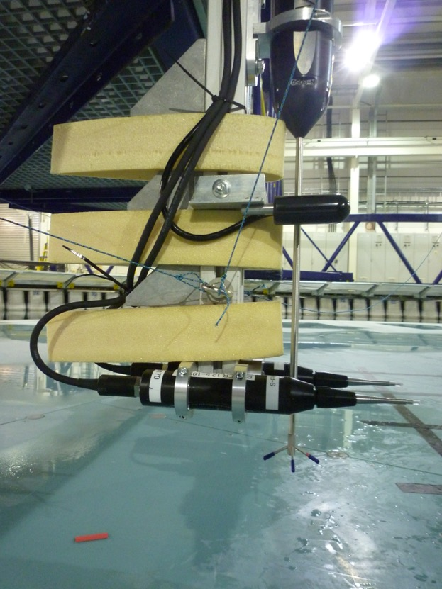
FloWave TT tests

Slide 15
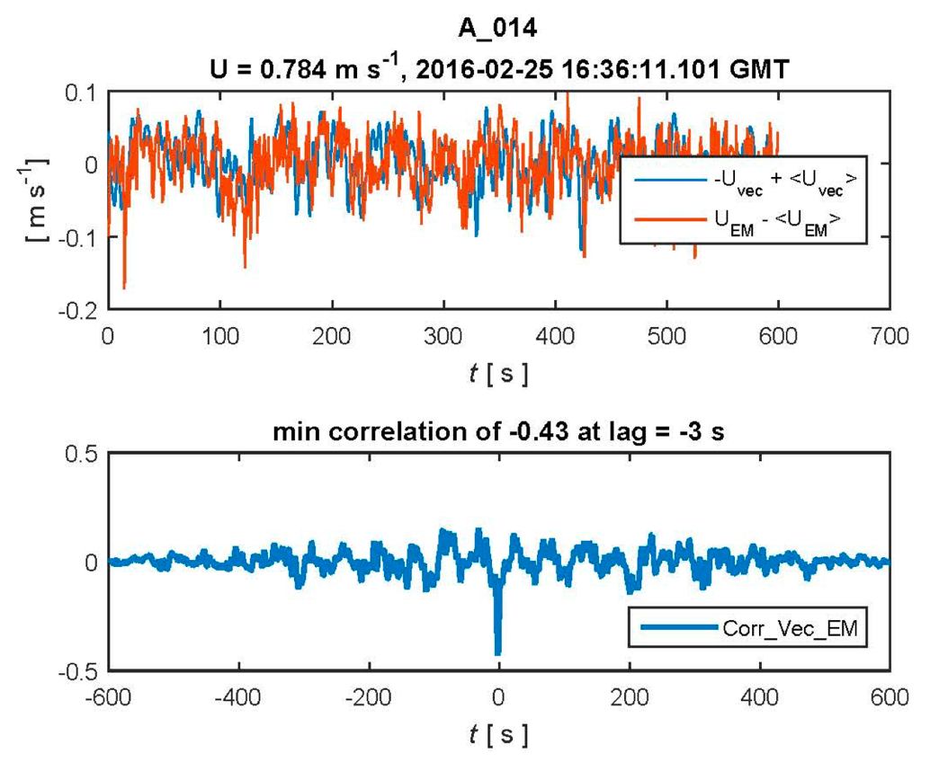
FloWave

Slide 16
Summary
Small EM flow meter provides a direct measurement of the axial speed U of gliders
This is useful for scaling signals of sensors, particularly shear probes
May be useful to inform/improve glider flight models
Integration in various glider platforms

