Slide 1
Surface Vehicle Assisted Navigation of an Underwater Glider
Mingxi Zhou
Brad deYoung
Ralf Bachmayer

Slide 2
Outline
Motivation
Evaluation of the USBL/modem
Improved vehicle model for navigation
Conclusions and future work

Slide 3
Modified Slocum glider in AOSL
Objective: To map and monitor icebergs use the Slocum glider
Notes:
Sonar configuration and the footprints on the iceberg
The underwater modem for navigation and communication
Customized thruster designed in AOSL

Slide 4
Navigation is critical in iceberg and seafloor mapping
Dead-reckoning is “OK” in gliding mode for the Slocum glider
Notes:
1. Introduce the process of dead-reckoning

Slide 5
UTM
Notes:
post-processing to correct the track of the glider.
Example red-online blue-post-process

Slide 6
Model based dead-reckoning is “not-so-good” in hovering mode with “the thruster”.
V =C₂ I² + C₁ I + C₀
Update: V =function (I)
V
Notes:
Because our thruster produce different force at different current readings.
Update the function

Slide 7
Improved local navigation with Ultra-Short Baseline – USBL Benthos DAT 900 Underwater modem
Ship / USV
Notes:
System setup.
submerged at 3 meters.

Slide 8
Initial evaluation
Resolved glider location including azimuth angle
Resolved location with unknown azimuth angle
Surface vessel position
100 m
Notes:
1. Landed on the seafloor
2. The scatters due the deflection on the seafloor and surface

Slide 9
Dynamic evaluation
May - 20 - 1
Speed =C₂ I² + C₁ I + C₀ + dV
Notes:
Left is the recorded current feedback and the corresponding speed calculated from the old molde.
Right shows the post-processed tracks of the glider using different additional speed assumed.

Slide 10
May - 20 - 2
Speed =C₂ I² + C₁ I + C₀ + dV

Slide 11
June – 8 -1
Speed =C₂ I² + C₁ I + C₀ +dV

Slide 12
Summary of the thruster performance in dynamic evaluation
Mission | Voltage | Current feedback | Original speed | Additional speed | Desired speed
5-20-1 | 8.5 [65%] | 218mA | 33.4 cm/s | 0 m/s | 33.4 cm/s
5-20-2 | 8.5 [65%] | 180 mA | 30.6 cm/s | 10 cm/s | 41.6 cm/s
6-8-1 | 8 [60%] | 126 mA | 26.0 cm/s | 35 cm/s | 61 cm/s
Current feedback
Voltage
Desired RPM
Load
Speed
Stalled
“Turbulent flow”
Current spikes
Spin & stop
Low speed

Slide 13
Remodel the vehicle speed vs. current
Old Model: V =C₂ I² + C₁ I + C₀
New Model: V = -0.23 I³ + 0.71 I² -0.27 I +0.61
Thruster stalled
Turbulence flow
Notes:
We increased the corresponding speed at low current feedback.
We fit the curve of the black square with 3rd order polynomial function

Slide 14
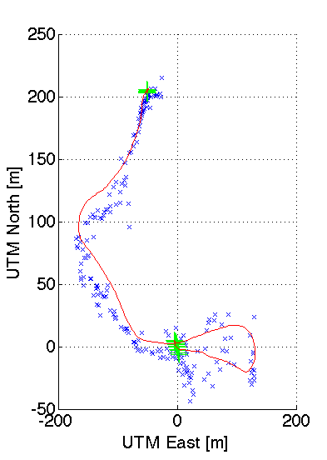
May -20-2
May -20-1
June - 8 -1
Over-estimating the speed in stalling in the new model.
The various flow through the thruster causing the change to the speed model
Works better when the thruster is not stalling

Slide 15
Vehicle path in 1st deployment
Vehicle path in 2nd deployment
Diving location
Surfacing location
Desired heading
June 15

Slide 16
Comparing detection of iceberg profiles in two separated deployments
The glider’s tracks are corrected using the new model

Slide 17
Conclusions and future work
Evaluated the performance of USBL for locating the underwater glider
Customized the navigation model in hovering
Improve the model by characterizing the thruster
Assist the dead-reckoned navigation online using acoustic localization (Automatically tuning).
Multi-vehicle operation with an Unmanned Surface Vessel, e.g. developing autonomous recovery

Slide 18







Acknowledgements
Terra Nova -Project

Slide 19
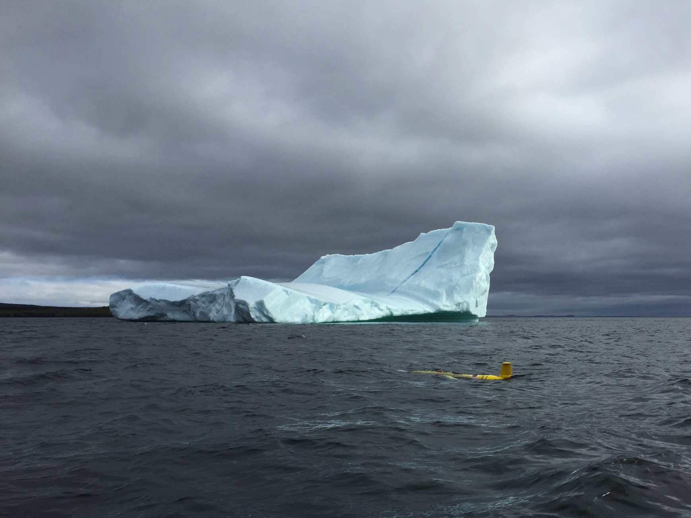
Thank you and Questions?

