Slide 1
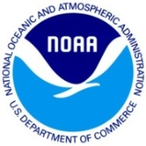

NOAA/AOML – CARICOOS Hurricane Underwater Glider Operations
Gustavo Jorge Goni¹
Francis Bringas¹
Ricardo Domingues^{2,1}
Jili Dong ^{2,1}
Grant Rawson^{2,1}
Ulises Rivero¹
Thomas Sevilla^{2,1}
Julio Morell³
George Halliwell¹
Sang-Ki Lee¹
Hyun-Sook Kim⁴
Luis Pomales³
Becky Baltes⁵
Richard Bouchard⁶
Yamil Rodriguez⁷
1 NOAA Atlantic Oceanographic and Meteorological Laboratory - AOML, Miami, Florida, USA
2 University of Miami, Cooperative Institute for Marine and Atmospheric Studies - CIMAS, Miami, Florida, USA
3 University of Puerto Rico, Mayagues, Puerto Rico, and Caribbean Coastal Ocean Observing System - CARICOOS
4 NOAA Environmental Modeling Center , College Park, Maryland, USA
5 NOAA Integrated Ocean Observing System – IOOS, Silver Spring, MD, USA
6 NOAA National Data Buoy Center, Stennis, Miss, USA
7 Autoridad Nacional de Asuntos Maritimos - ANAMAR, Dominican Republic

Slide 2
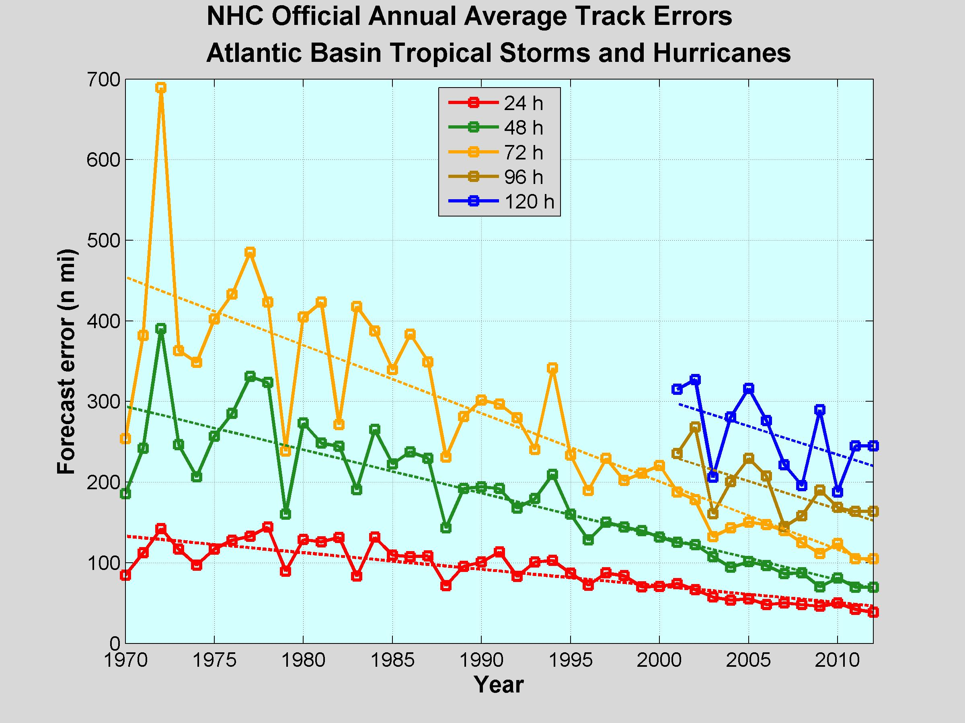
Tropical Cyclone Intensity and Track Forecasts Error
Major Hurricane History
NHC Official Track Error - Atlantic
North Atlantic Statistics
11 named Tropical Cyclones
6 Hurricanes (winds > 64 kt)
2-3 Major Hurricanes (winds > 96 kt, cat3)
Cat5: > 137 kt
Cat4: 113 – 136 kt
Cat3: 96 – 112 kt
Cat2: 83 – 95 kt
Cat1: 64 – 82 kt

Slide 3
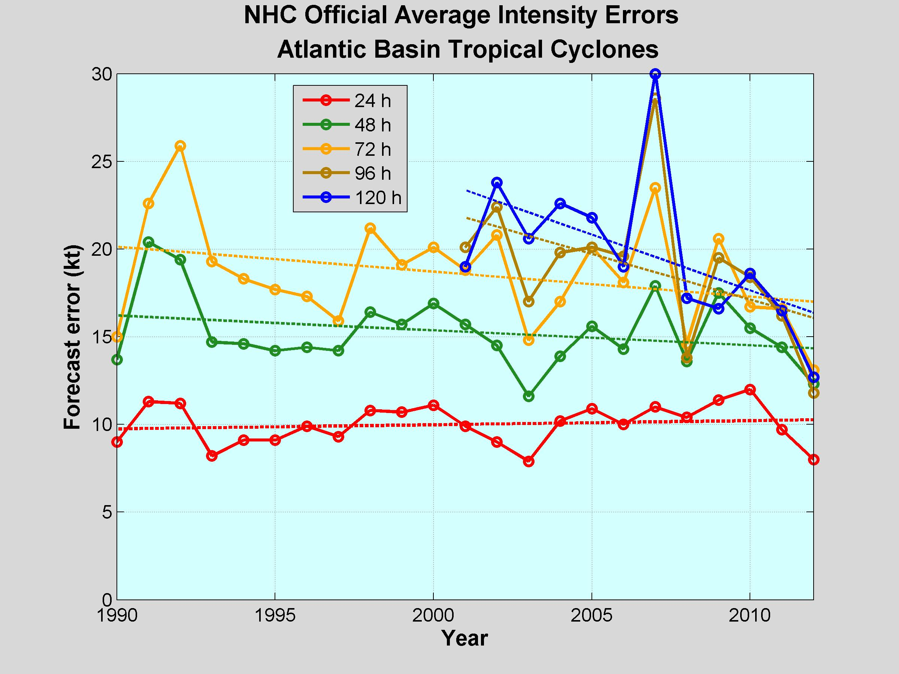
Tropical Cyclone Intensity and Track Forecasts Error
NHC Official Intensity Error - Atlantic
NHC Official Track Error - Atlantic

Slide 4
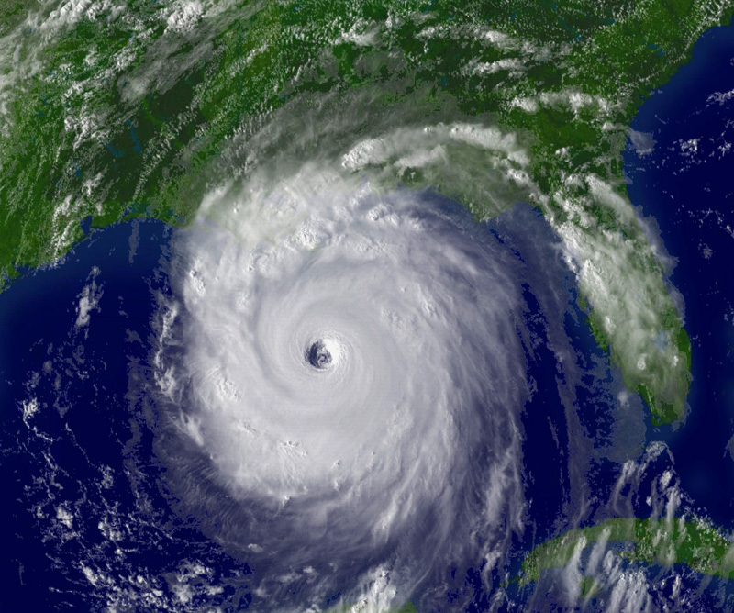
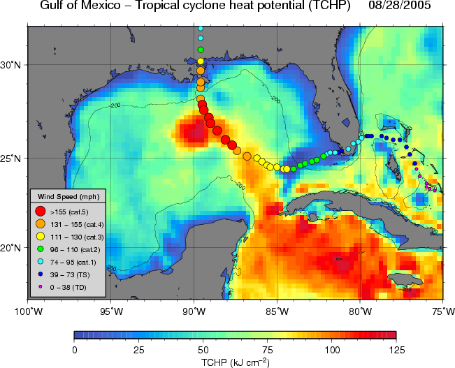
Role of the Ocean in Tropical Cyclone Intensification
Rapid Intensification of Hurricane Katrina (2005)
Katrina (2005) intensified rapidly from category 3 into a category 5 hurricane in less than 12 hours as it travelled over a warm ocean eddy
Other examples:
Opal (1995) [Shay et al., 2000]
Ivan(2004), Wilma (2005) [Mainelli et al., 2008]

Slide 5
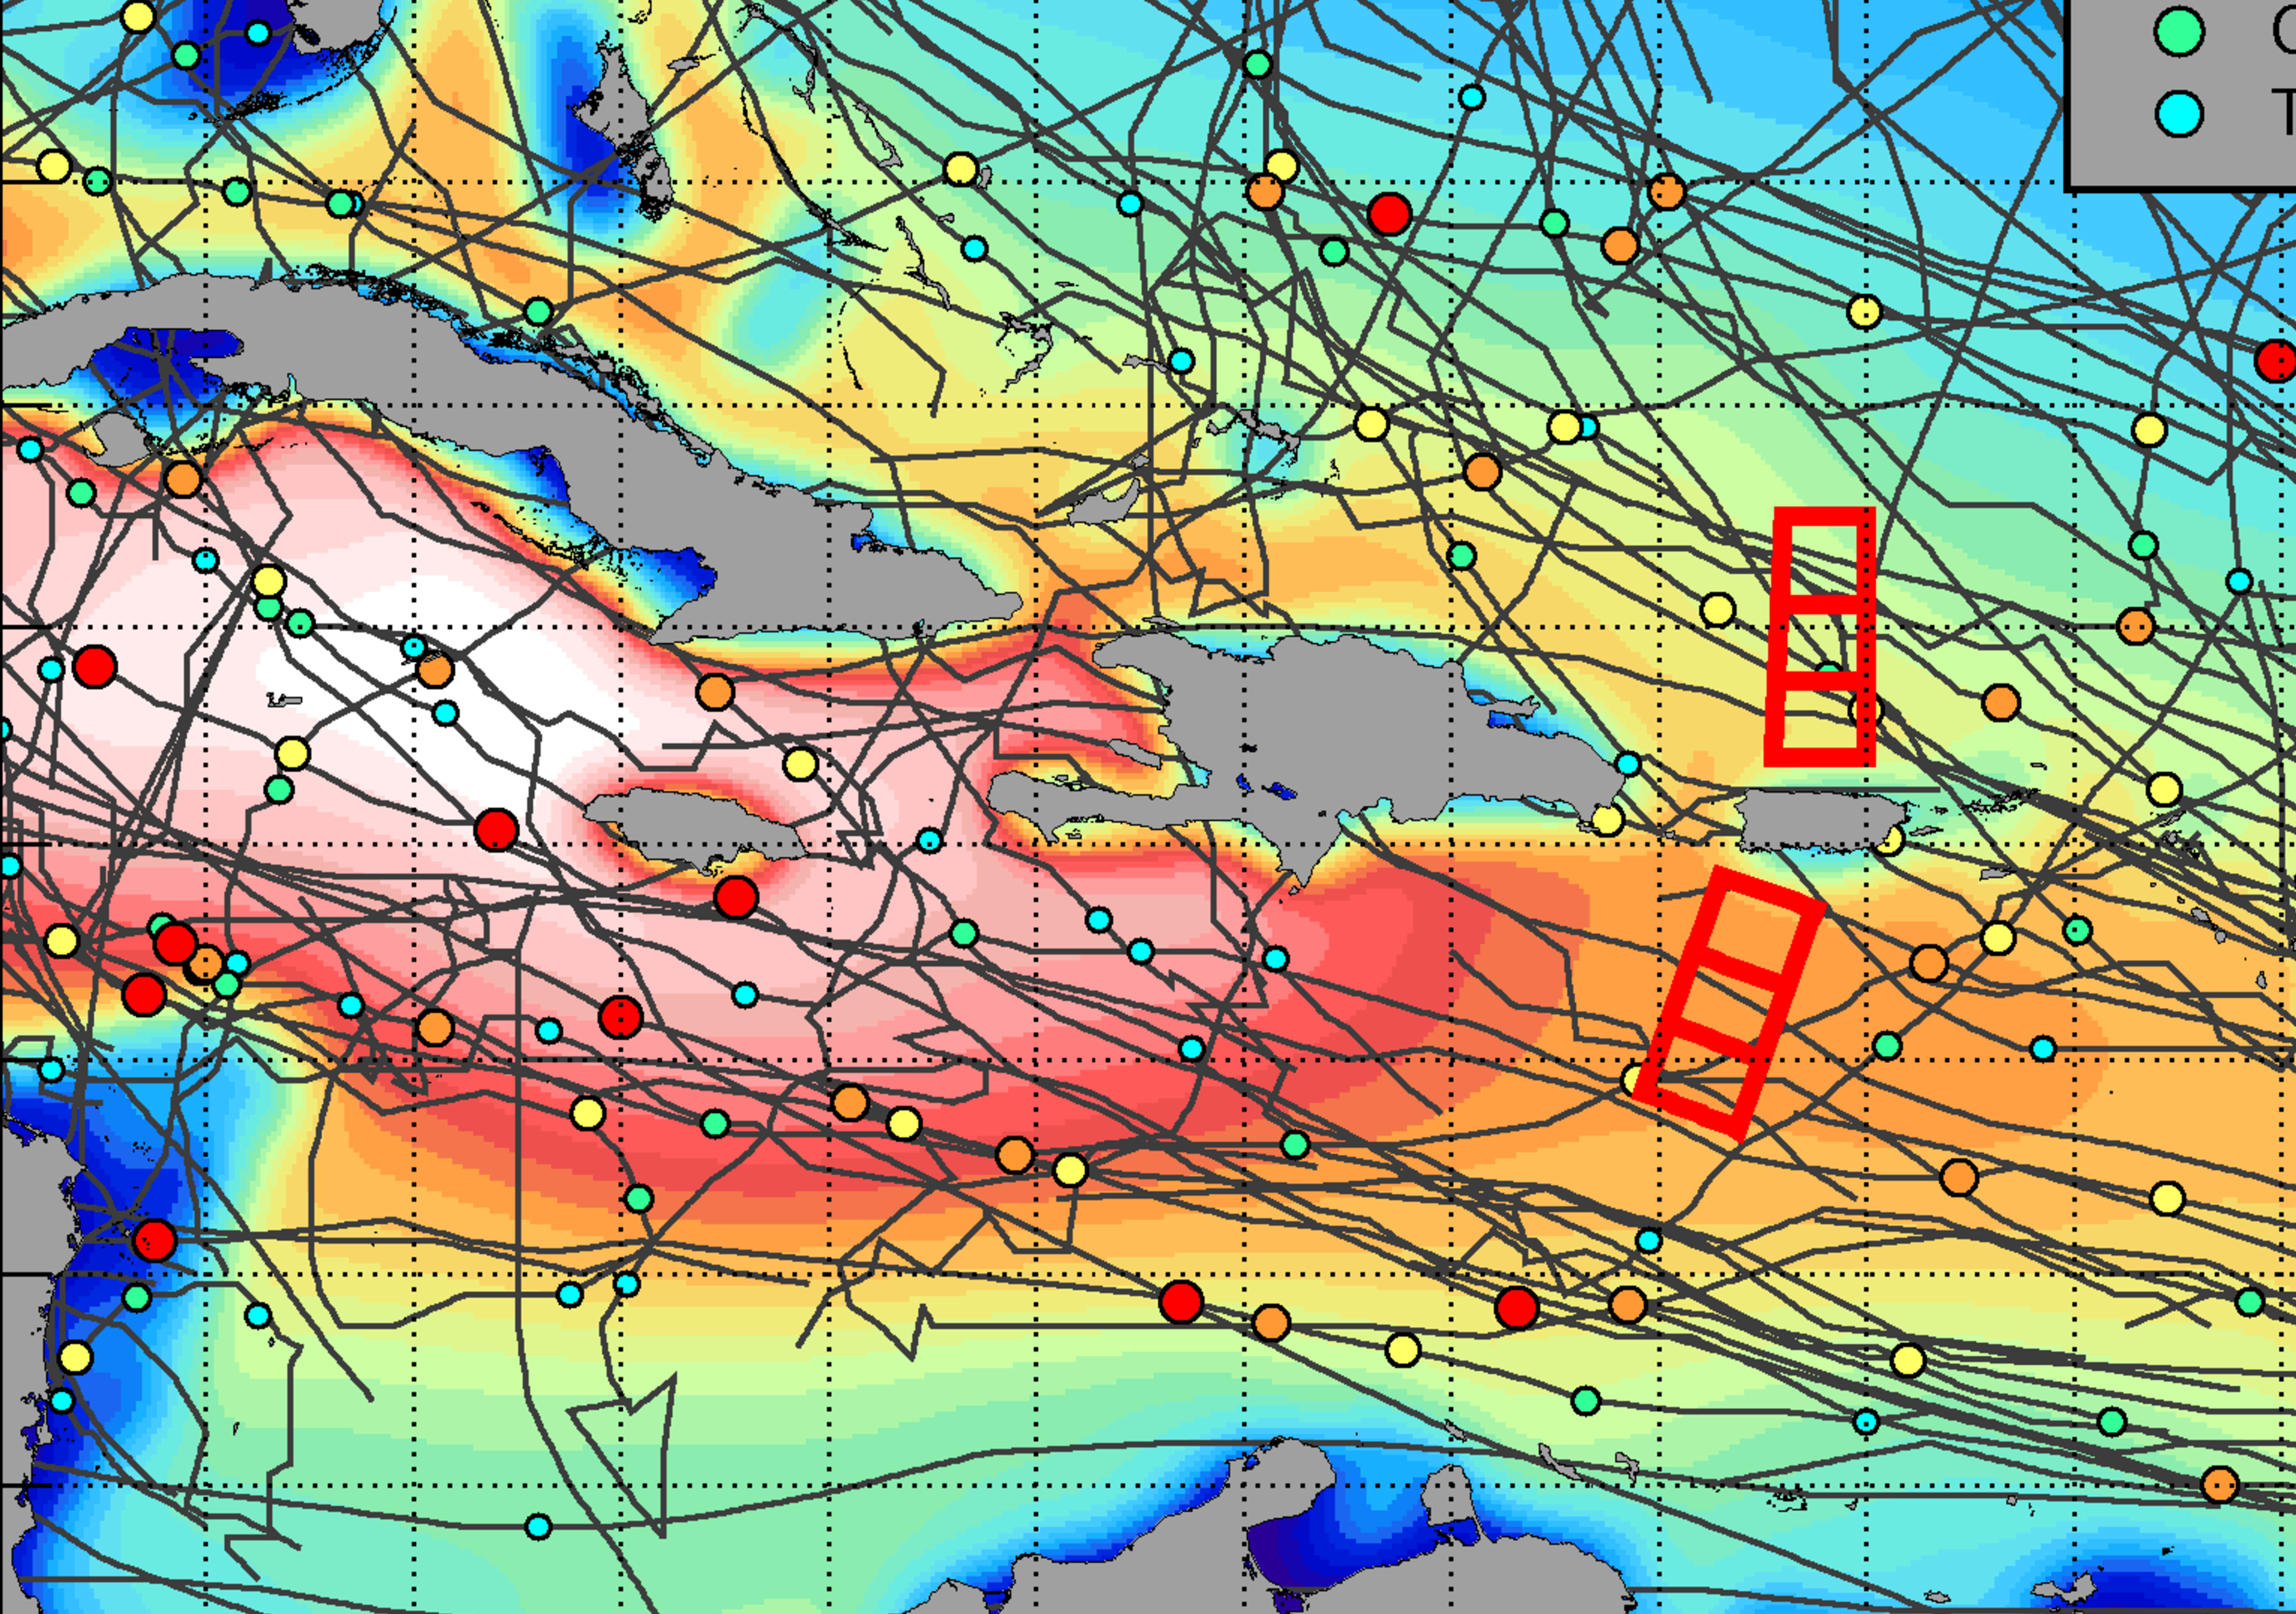
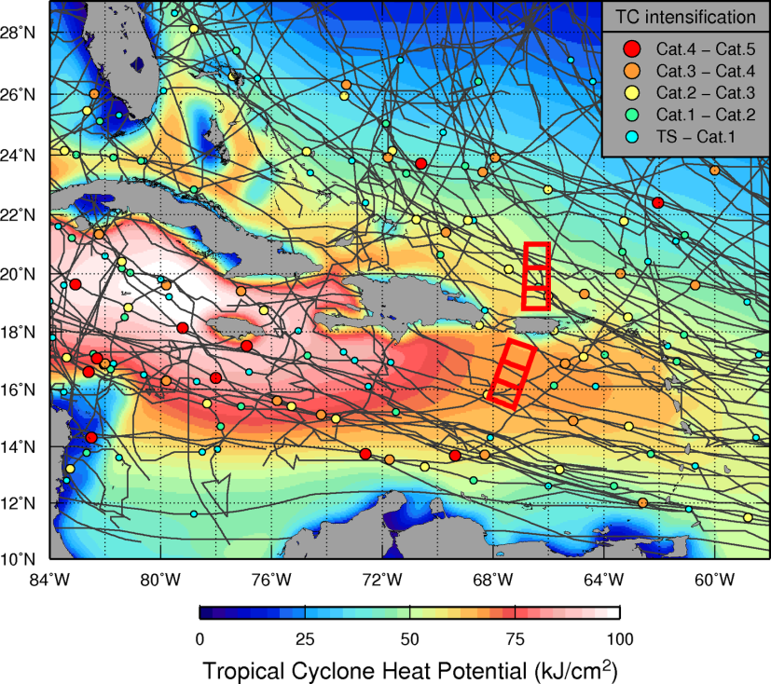
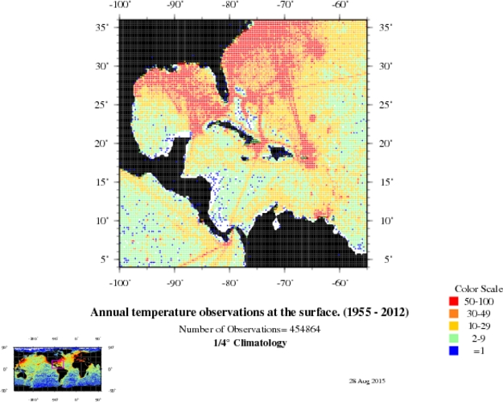
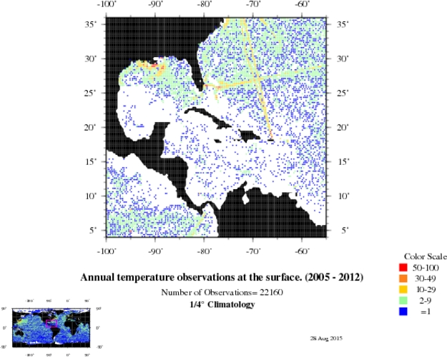
World Ocean Atlas 2013: # of Temperature profiles
1955-2012
Network of gliders to carry out sustained and targeted ocean observations in the Caribbean Sea and Tropical North Atlantic in support of hurricane studies and forecasts
DO
PR
2005-2012
Number of obs.
< 200
Need for UOHC obs.!

Slide 6
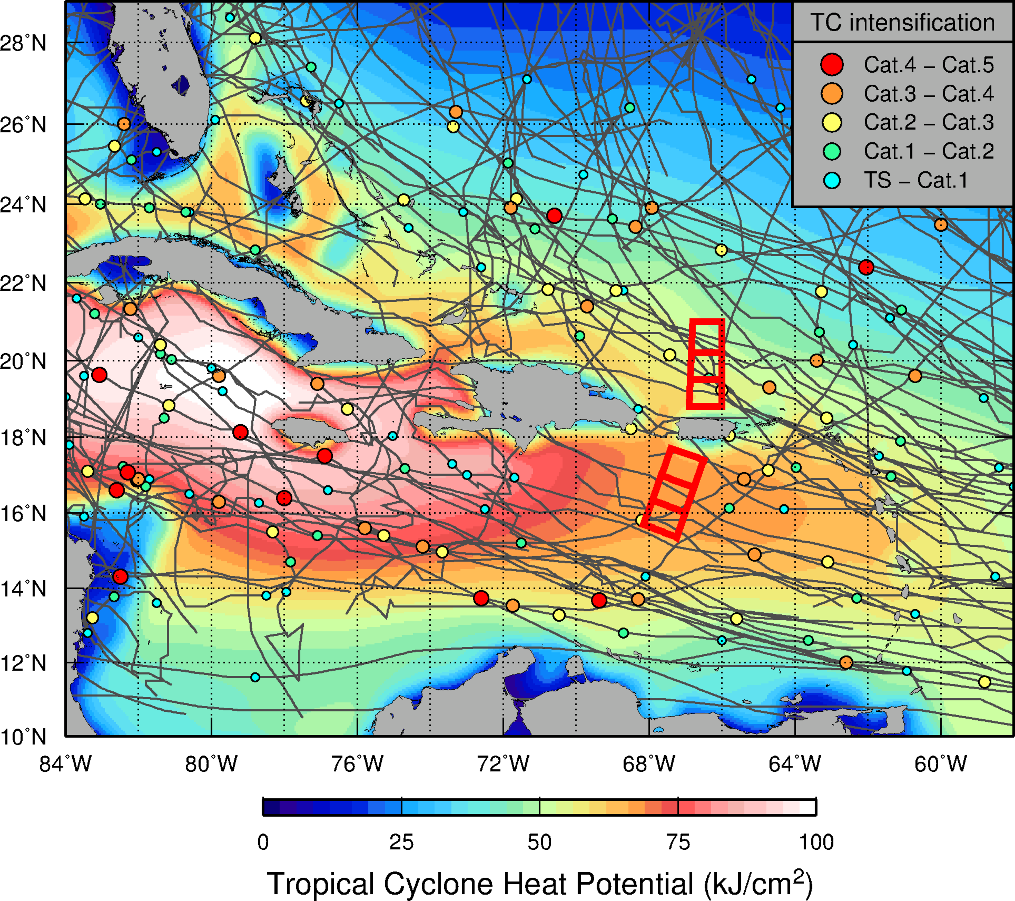
NOAA/AOML – CARICOOS Hurricane Underwater Glider Operations
Goal
Enhance our understanding of air-sea interaction processes during hurricane force wind events.
Objectives
Assess impact of hurricane force winds on upper ocean density structure, and
Assess impact of ocean profile data from underwater gliders in hurricane intensity forecasts.

Slide 7
NOAA/AOML – CARICOOS Hurricane Underwater Glider Operations
Supported by:
Disaster Relief Appropriations Act of 2013 (Sandy Supplemental funds, 2014-2015)
NOAA AOML (present)
NOAA IOOS and CARICOOS (present)
NOAA OAR AAA Reserve 2015 and 2016 (present)
NOAA NDBC (present)
  http://www.aoml.noaa.gov/phod/gliders

Slide 8
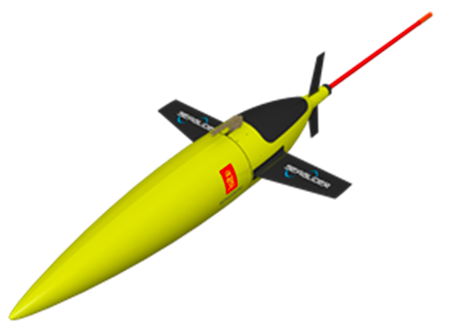
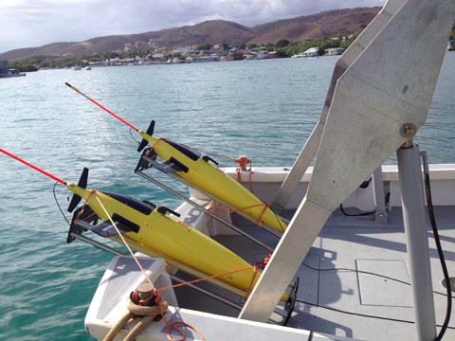
NOAA/AOML – CARICOOS Hurricane Underwater Glider Operations
Seaglider™
  4 vehicles
Sensors
  CT Sail or GPCTD
    Temperature & Salinity
  Aandera Oxygen Optode
    Dissolved Oxygen
  Wetlab - ECO Triplet
    Chlorophyll-a
    CDOM
    Backscatter (700 nm)

Slide 9
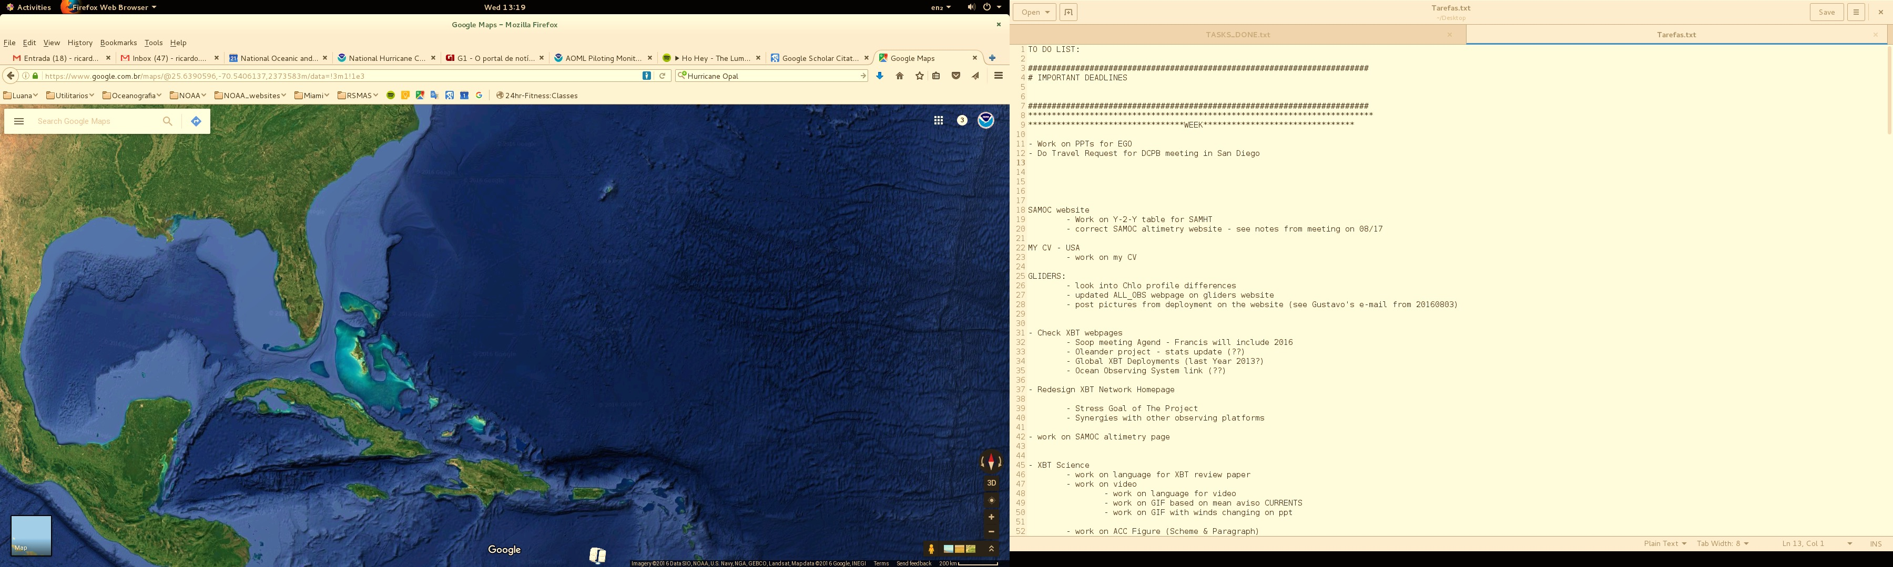
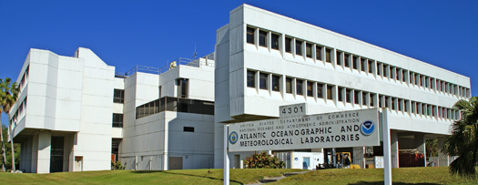
NOAA/AOML – CARICOOS Hurricane Underwater Glider Operations
NOAA-AOML
NOAA AOML
UPRM
Glider Port at UPRM, Puerto Rico

Slide 10
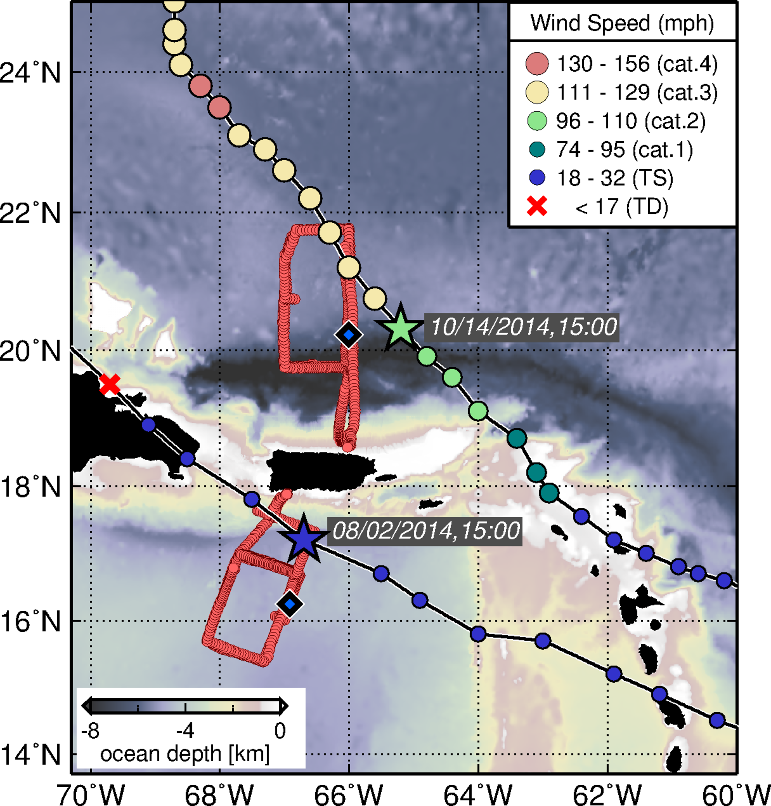
NOAA/AOML – CARICOOS Hurricane Underwater Glider Operations
Hurricane Season Deployments
July-November
Objective: carry out ocean observations in support of Hurricane studies and forecasts
Off-Hurricane Season Deployments
February-June
Objective: carry out ocean observations to improve understanding of the variability of the physical and chemical parameters in the Caribbean Sea
PR
PR

Slide 11
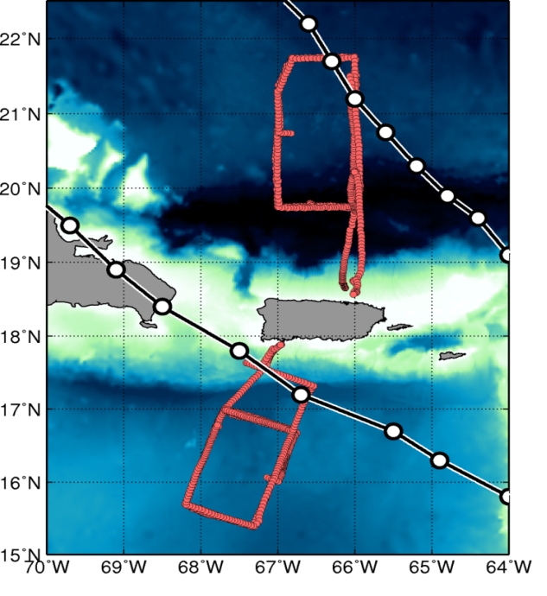
NOAA/AOML – CARICOOS Hurricane Underwater Glider Operations
5 missions, 20 months of observations, approximately 10,000 T, S profiles to date
First mission
Jul-Nov 2014
Second mission
Feb-Apr 2015
Third mission
Jul-Nov 2015
Fourth mission
March – June 2016
Hurricane Gonzalo
(October, 2014)
TS Bertha
(August, 2014)
Other remote and in-situ observations: targeted ocean observations (AXBTs, AXCTDs,..), Argo floats, surface drifters, satellite sea surface temperature and sea height.

Slide 12
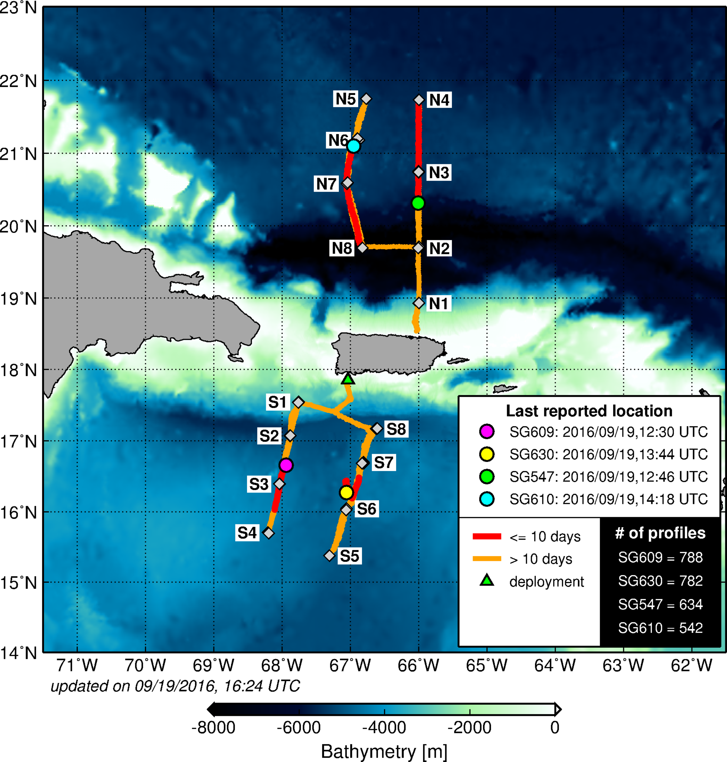
NOAA/AOML – CARICOOS Hurricane Underwater Glider Operations
5 missions, 20 months of observations, approximately 10,000 T, S profiles to date
Mission 5
(Underway)
July 2016 – present
Hurricane Season Deployment
4 Gliders Deployed
  2 in the Caribbean Sea
  2 in the Tropical North Atlantic
~3,000 profiles of each parameter:
  T & S
  Dissolved Oxygen
  Chlorophyll-a
  CDOM
Mission 5

Slide 13
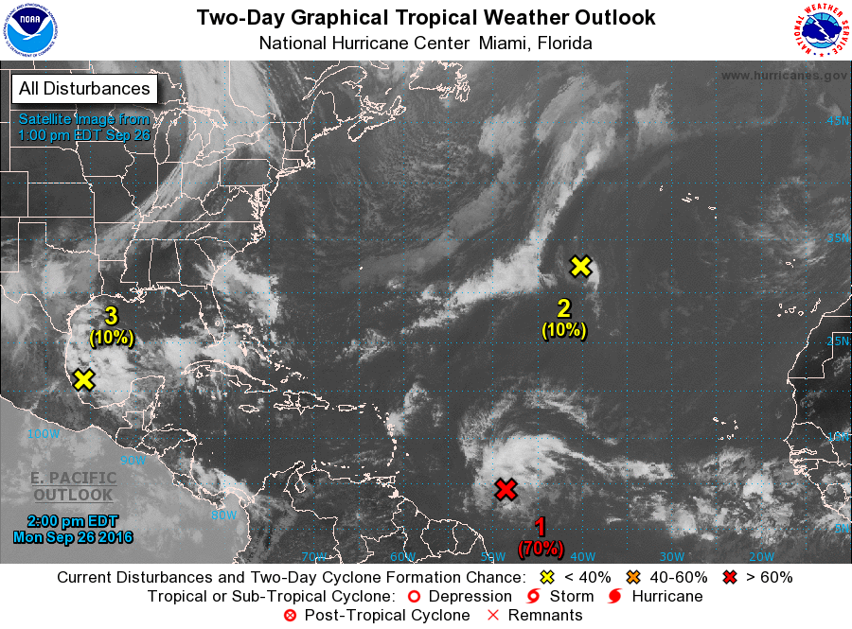
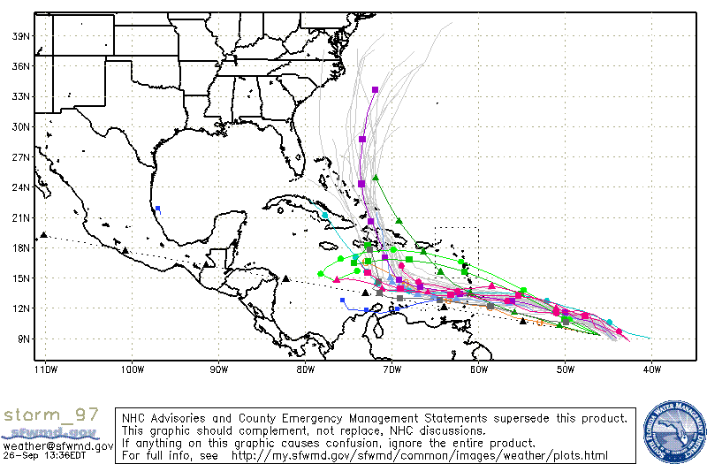
NOAA/AOML – CARICOOS Hurricane Underwater Glider Operations
Mission 5: Current Meteorological Conditions
Mission 5

Slide 14
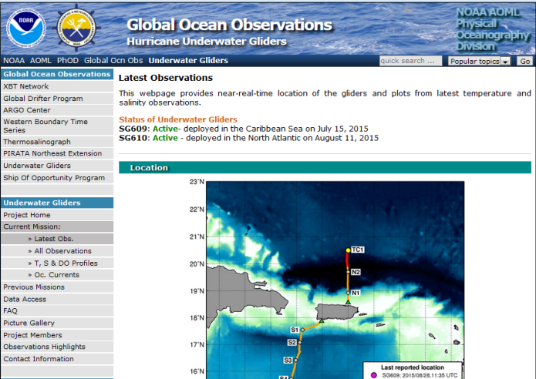
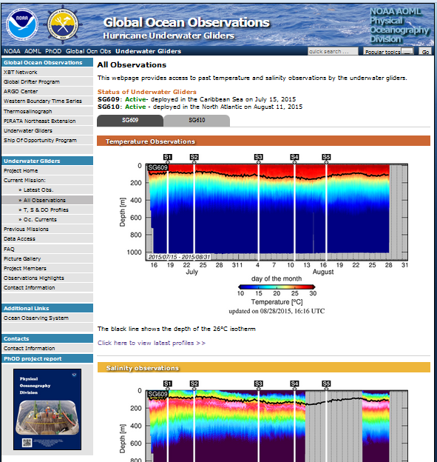
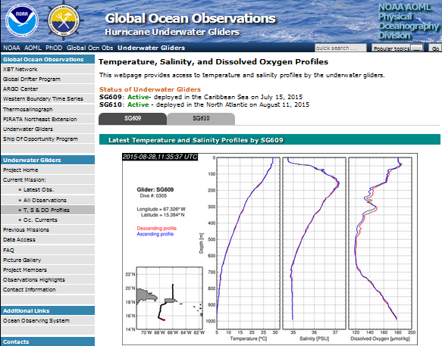
NOAA/AOML – CARICOOS Hurricane Underwater Glider Operations
Data Distribution
PHOD/AOML website
  http://www.aoml.noaa.gov/phod/gliders
  Real-time location
  Plot of glider observations
  Individual T, S & DO profiles
  Data Access
Global Telecommunication System – GTS
  Assimilated into forecasting systems
NOAA’s Integrated Ocean Observing System - IOOS
  http://www.ioos.noaa.gov/
NOAA NCEI
NOAA OSMC
NCEI – National Centers for Environmental Information
OSMC – Observing System Monitoring Center

Slide 15
Summary:
Underwater gliders can provide critical temperature and salinity profile data in real-time even during tropical cyclone wind conditions.
Over 10,000 profiles of each observed parameter, such as temperature, salinity, dissolved oxygen, and chlorophyll concentration have been collected during the first two years of the NOAA/AOML-CARICOOS Hurricane Underwater Glider Operations
One case study, with significant results during Hurricane Gonzalo (2014), indicates that glider data improves ocean initialization when assimilated within HYCOM-HWRF model.
Future work:
Continue collecting ocean profile data, with enhanced glider network.
Assess optimal observational strategy to improve TC intensity forecast using a suite of ocean observations.
Further collaboration with other institutions interested in monitoring the UOHC in support of Tropical Cyclone intensification studies and forecasts
Domingues, R., G. Goni, F. Bringas, S.-K. Lee, H.-S. Kim, G. Halliwell, J. Dong, J. Morell, and L. Pomales (2015), Upper ocean response to Hurricane Gonzalo (2014): Salinity effects revealed by targeted and sustained underwater glider observations, Geophys. Res. Lett., 42, doi:10.1002/2015GL065378.
Dong et al, Impact of underwater glider data on Hurricane Gonzalo (2014) forecast, 2016, to be submitted.

Slide 16
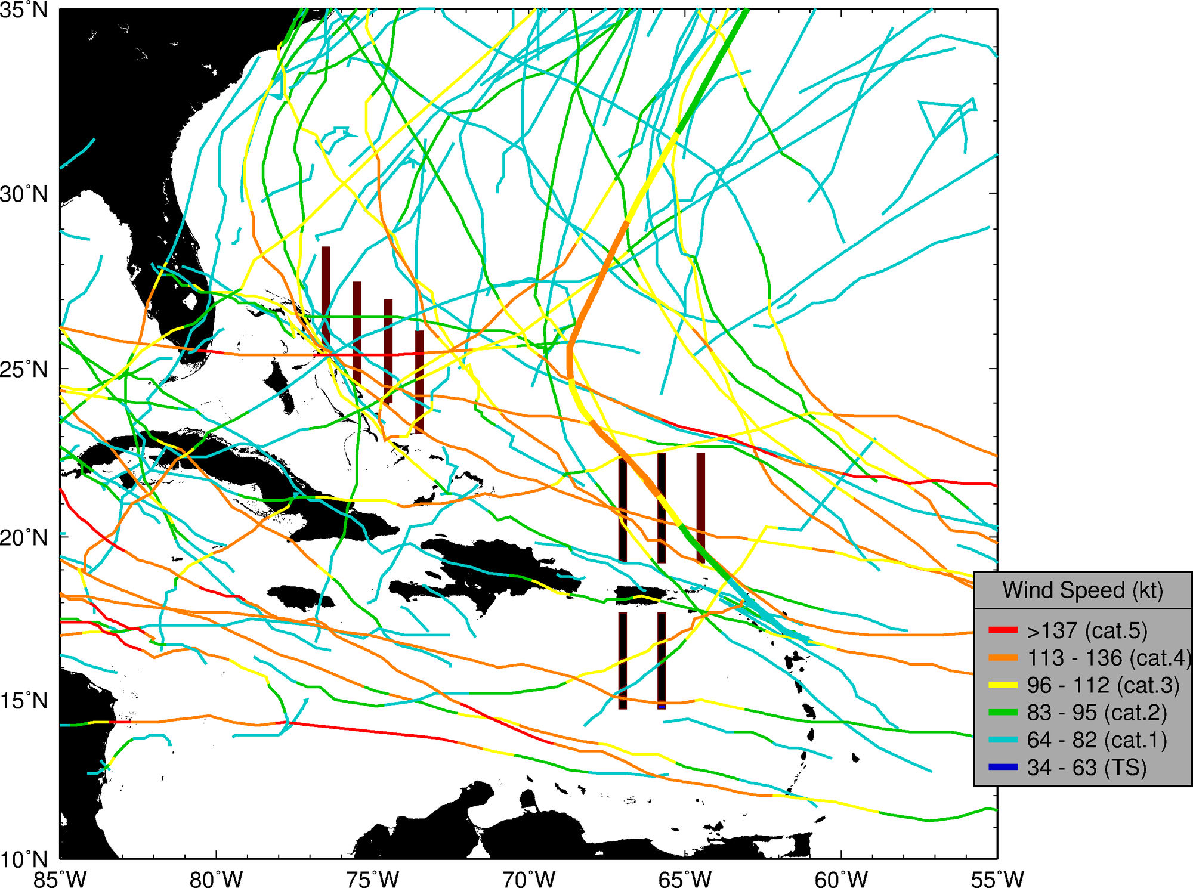
Future Work

Slide 17
NOAA/AOML – CARICOOS Hurricane Underwater Glider Operations
Gustavo Jorge Goni¹
Francis Bringas¹
Ricardo Domingues^{2,1}
Jili Dong ^{2,1}
Grant Rawson^{2,1}
Ulises Rivero¹
Thomas Sevilla^{2,1}
Julio Morell³
George Halliwell¹
Sang-Ki Lee¹
Hyun-Sook Kim⁴
Luis Pomales³
Becky Baltles⁵
Richard Bouchard⁶
Yamil Rodriguez⁷
1 NOAA Atlantic Oceanographic and Meteorological Laboratory - AOML, Miami, Florida, USA
2 University of Miami, Cooperative Institute for Marine and Atmospheric Studies - CIMAS, Miami, Florida, USA
3 University of Puerto Rico, Mayagues, Puerto Rico, and Caribbean Coastal Ocean Observing System - CARICOOS
4 NOAA Environmental Modeling Center , College Park, Maryland, USA
5 NOAA Integrated Ocean Observing System – IOOS, Silver Spring, MD, USA
6 NOAA National Data Buoy Center, Stennis, Miss, USA
7 Autoridad Nacional de Asuntos Maritimos - ANAMAR, Dominican Republic
Thank you
Gustavo.Goni@noaa.gov

