Slide 1




A glider observes chlorophyll dynamics during the transition from winter mixing to summer stratification across a sub-surface eddy in the Eastern Mediterranean
Angelos K. Hannides, Daniel R. Hayes,
Fabrizio d'Ortenzio, Pierre Testor, Laurent Mortier
EGO 7 | September 2016 | NOC, Southampton, UK
Funding

Slide 2
Goals and findings (so far)
Give a brief overview of Cyprus glider missions in the Levantine Sea
  Since 2008, >1100 d, >4000 dives, >18000 km
Demonstrate the potential of gliders as an observing platform applied to the case of the eastern Levantine
  Ideal: complex physical field hidden from satellites
Examine the utility of biogeochemical data a posteriori from standard sensor payloads
  Very promising: unprecedented synoptic view

Slide 3
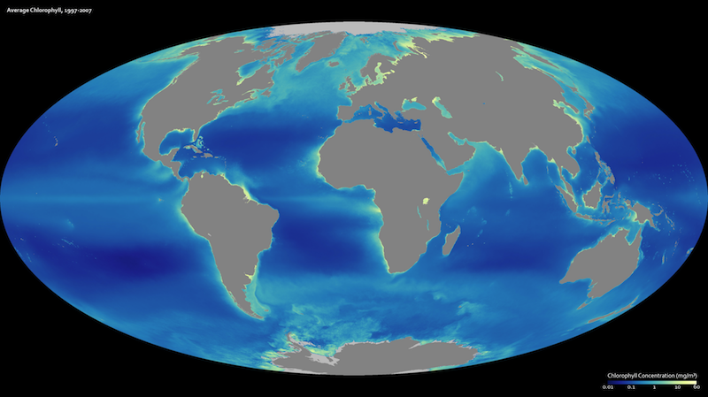
Challenges in studying the Levantine Sea
Oligotrophism
NASA Scientific Visualization Studio

Slide 4
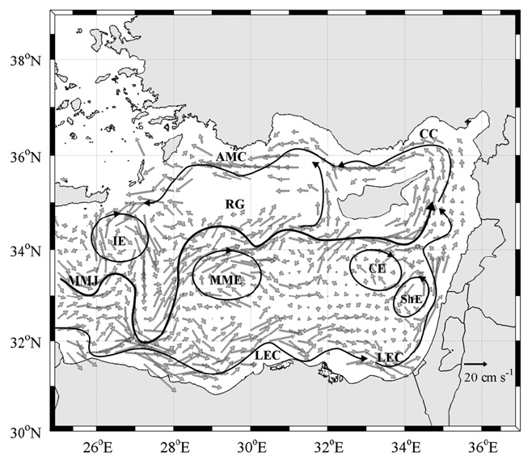
Challenges in studying the Levantine Sea
Complex circulation
Menna et al. 2012

Slide 5
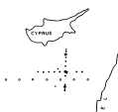
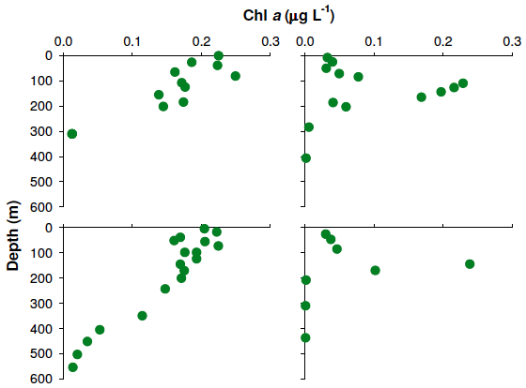
The Cyprus Eddy
February 1989
May 1989
Eddy
boundary
Eddy
core
Replotted from Krom et al. (1991)

Slide 6
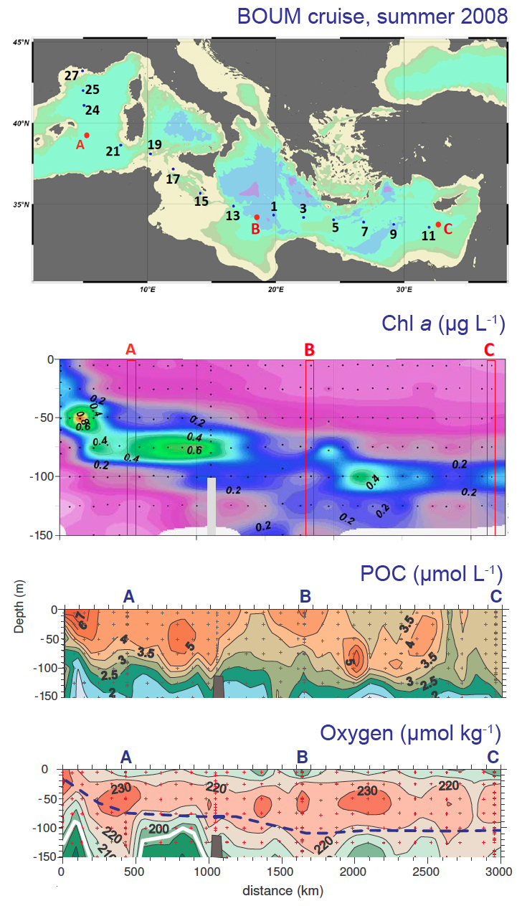
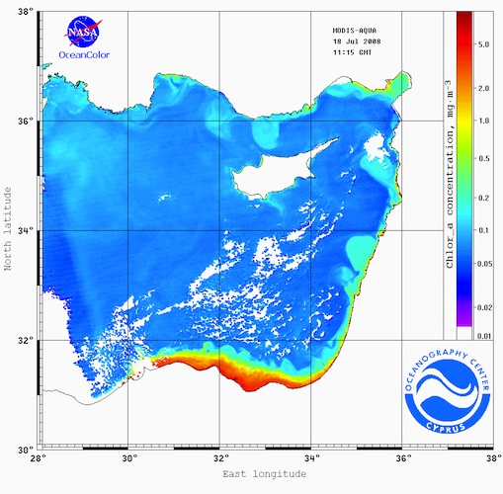
Remote sensing limitations
Oceanography Center, Univ. of Cyprus
Modified from:
Christaki et al. (2011),
Pujo-Pay et al. (2011)

Slide 7
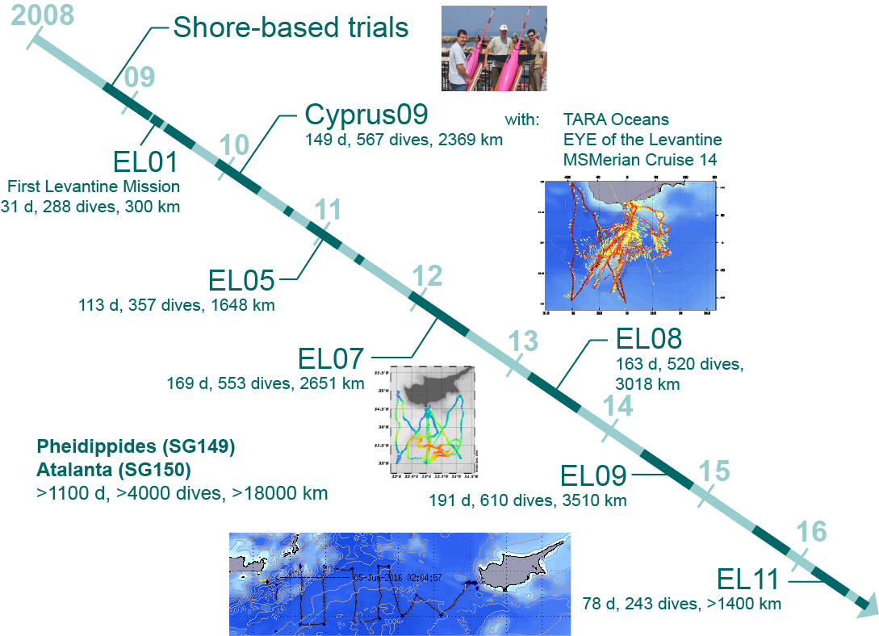
Glider missions – Eastern Levantine Sea

Slide 8
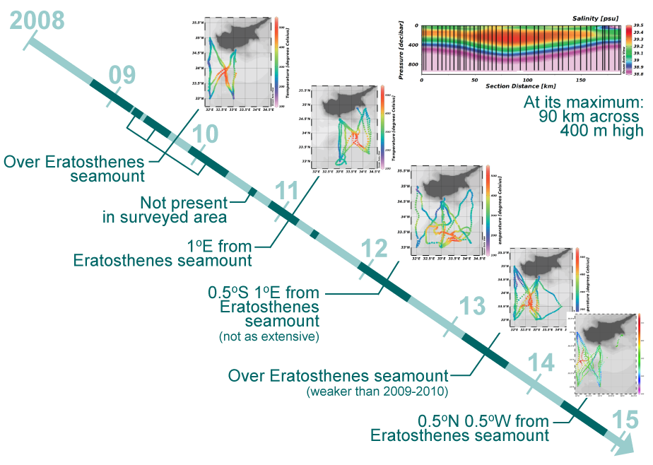
Charting the Cyprus Eddy

Slide 9
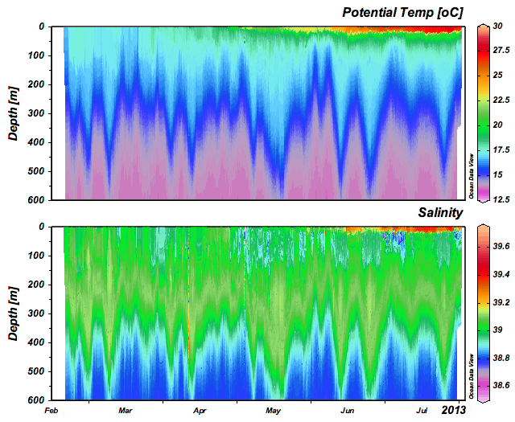
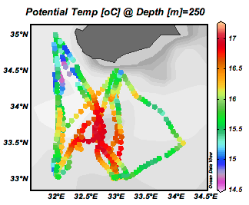
Winter to summer 2013 – T, S
EL09 Pheidippides-SG149 Days: 163 Dives: 520
Winter mixing to summer stratification
Eddy over
Eratosthenes seamount

Slide 10
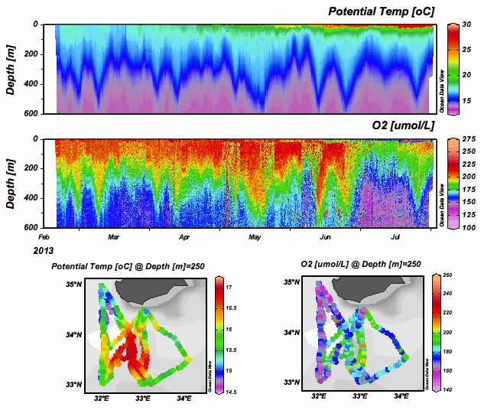
Winter to summer 2013 – O₂

Slide 11
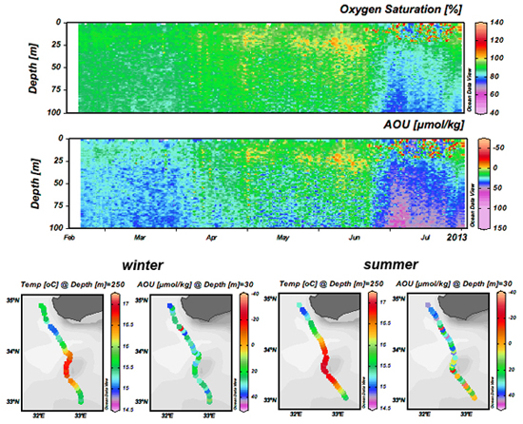
Winter to summer 2013 – O₂

Slide 12
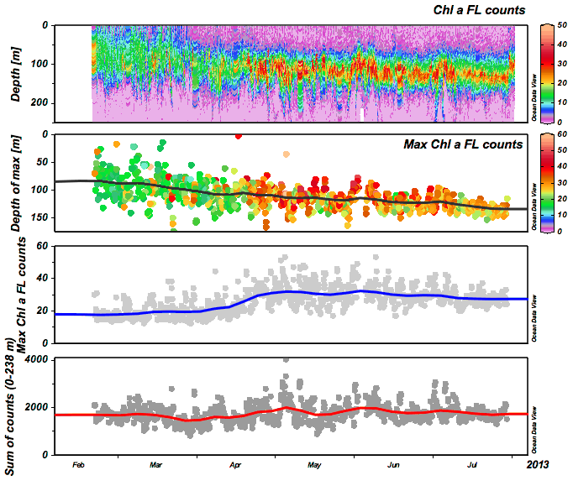
Winter to summer 2013 – Chl a FL

Slide 13
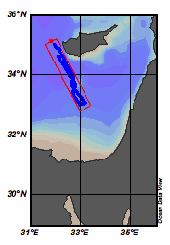
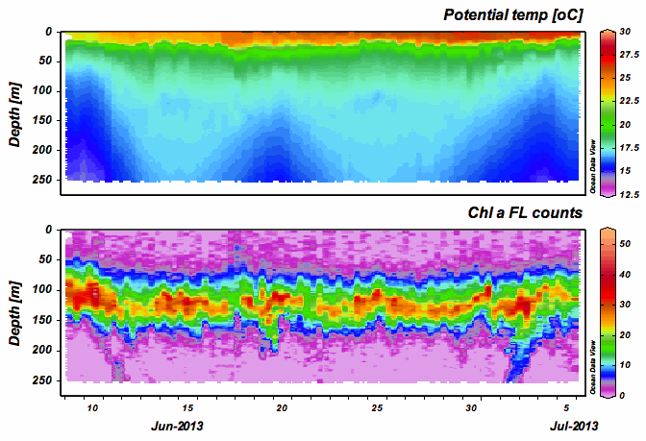
Winter to summer 2013 – Chl a FL

Slide 14
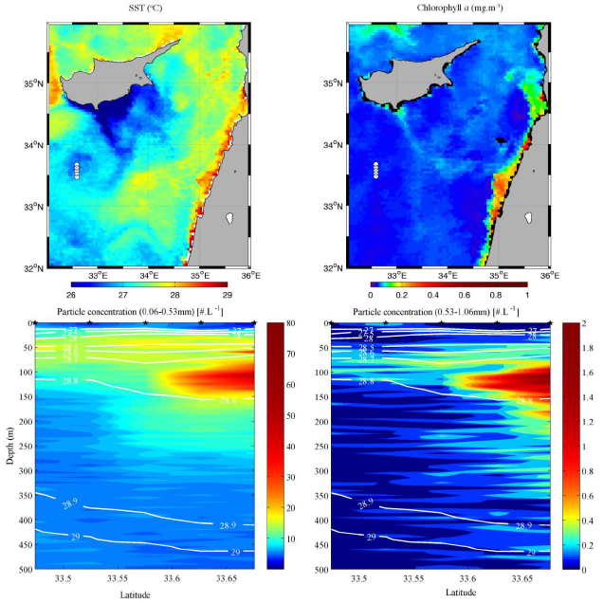
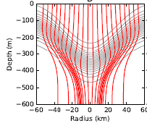
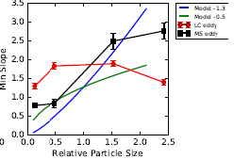
Particle export
Waite et al. (2016)

Slide 15
Next steps
Publication of glider biogeochemical data products(?)
(Inter)comparison / “calibration” of data using:
  Independent measurements from other contemporaneous missions, where available:
    Floats, gliders, ships:
    TARA Oceans, EYE of the Levantine

Slide 16
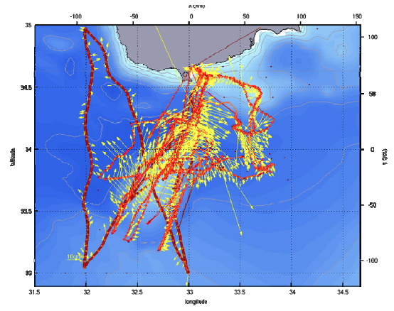
Next steps
The 11.2009-01.2010 experiment (Cyprus09)
Multiple platforms:
6 gliders
2 floats
4 surface drifters
Ship-board
measurements:
    CYBO (UCY)
    TARA-Oceans
    M.S. Merian
Partners:
Cyprus: UCY Italy: OGS
France: LOCEAN/UPMC, LOV Belgium: ULB
Hayes et al. (2011)

Slide 17
Next steps
Publication of glider biogeochemical data products(?)
(Inter)comparison / “calibration” of data using:
  Independent measurements from other contemporaneous missions, where available:
    Floats, gliders, ships:
    TARA Oceans, EYE of the Levantine
    Research cruises:
      Annual CYBO hydrography cruises
      Cross-basin (e.g., GoSHIP, GEOTRACES)
  Remote-sensing products: Chl a FL ➔ concentration
Guided multi-platform mission planning based on glider mission findings

