Slide 1
Drivers of variability in water mass exchange at a circulation choke’ point: observing-modelling approach
E.E. Heslop, B. Mourre, M. Juza, M. Torner, P. Testor, A. Bosse, F. Mirgirier,
E. Aguiar, R. Escudier, J. Tintoré
7th EGO Meeting, NOCS - Sept 2016

Slide 2
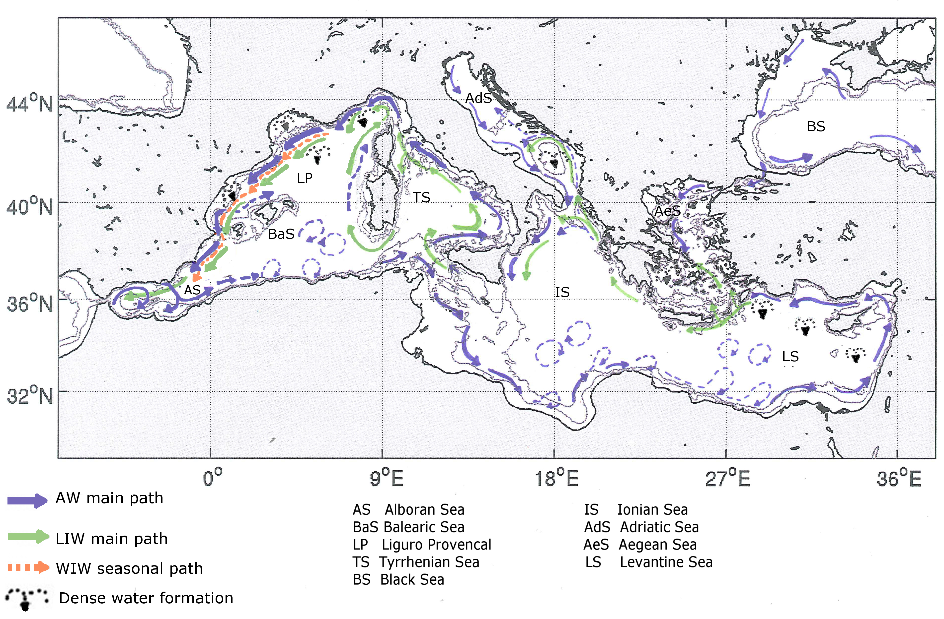
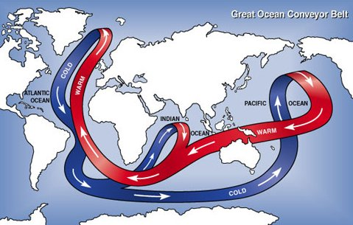
Mediterranean – small scale global ocean
Figure adapted from Millot and Taupier-Letage (2005) and Poulain et al. (2012), Heslop (2015)

Slide 3
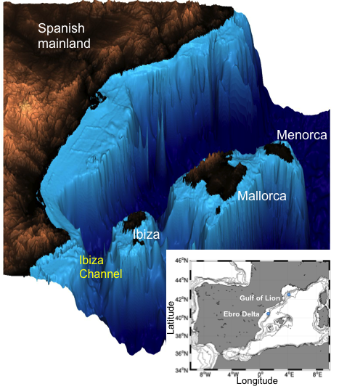
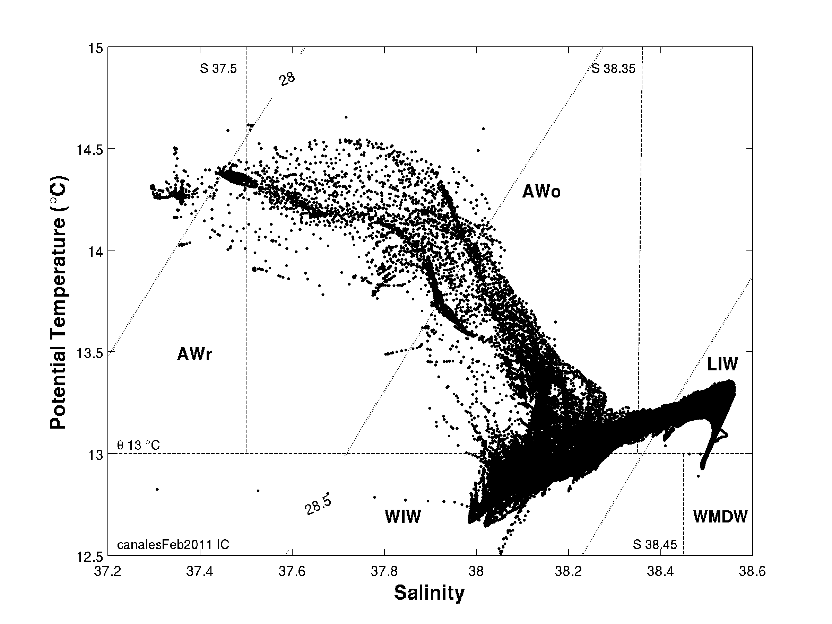
THE Ibiza ChanneL – circulation ‘Choke’ POINT
Narrow channel (80 km)
From north – more saline Northern Current
From south – fresher AW inflow
‘Blocking’ eddies – recirculation and association with WIW
Governs important N/S exchange different water masses
VARIABILITY affects ecosystem: Bluefin tuna, red shrimp (2016?)
Northern Current
Balearic Current
AW Inflow
A Complex INTERACTION, GLIDERS ENABLE HIGH RESOLUTION MONITORING TO RESOLVE PROCESSES AND SCALES
AW Inflow

Slide 4
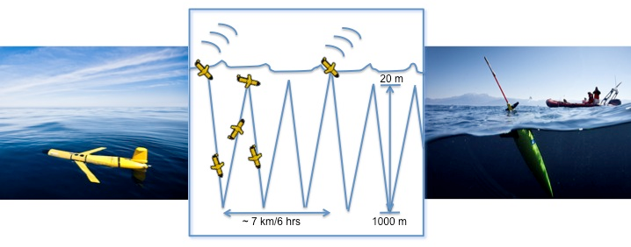
Motivation of the study
DETECT sub-seasonal to inter annual variability,
connect to drivers & Improve MODEL FORECAST
5.5 years, 36 missions, 162 transects Ibiza Channel
8 – 12 transects per mission
Working towards continuous coverage
Salinity calibrated to ship CTD/bottle samples
Correction onboard compass determined each mission

Slide 5
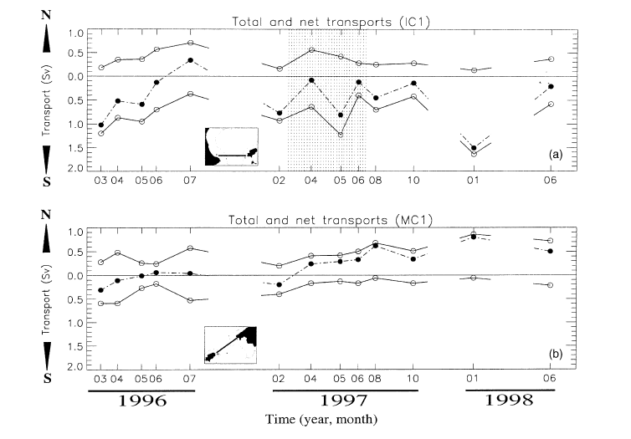
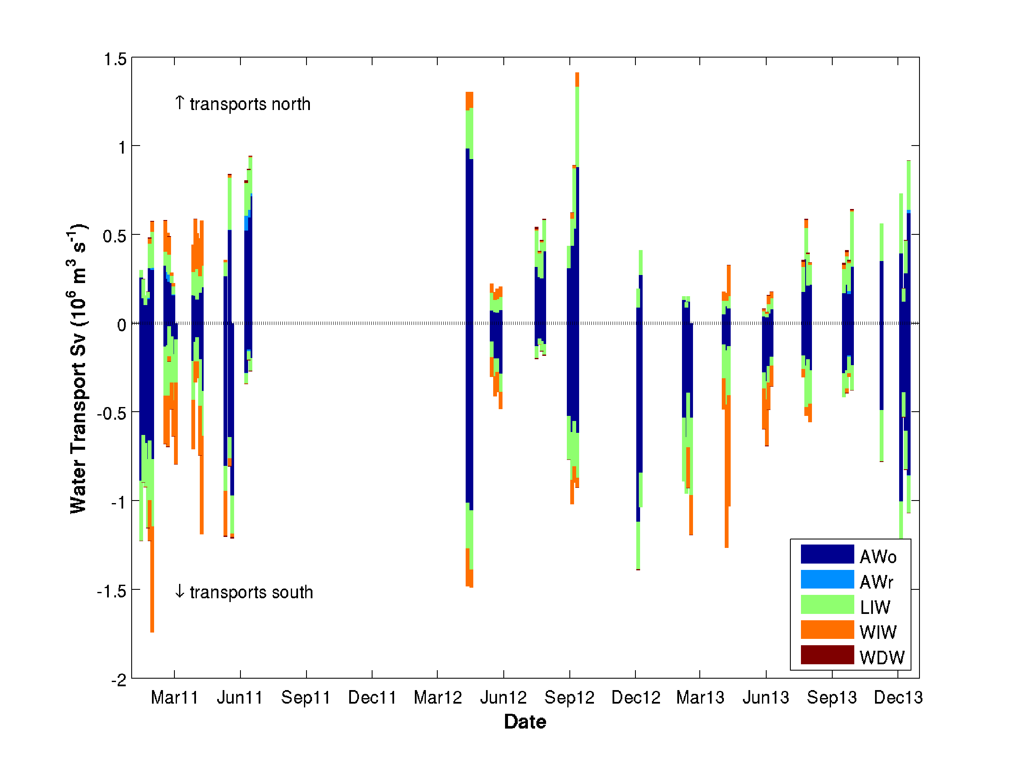
Motivation of the studY
Evolving understanding of the IBIZA CHANNEL exchange – through new technology and long term monitoring
Pinot et al (2002)
2.5 years , 12 ship surveys
>> Seasonal max. and min.
Heslop (2015)
3 years, 18 mission, 66 transects
>> High frequency variability, mean seasonal cycle

Slide 6
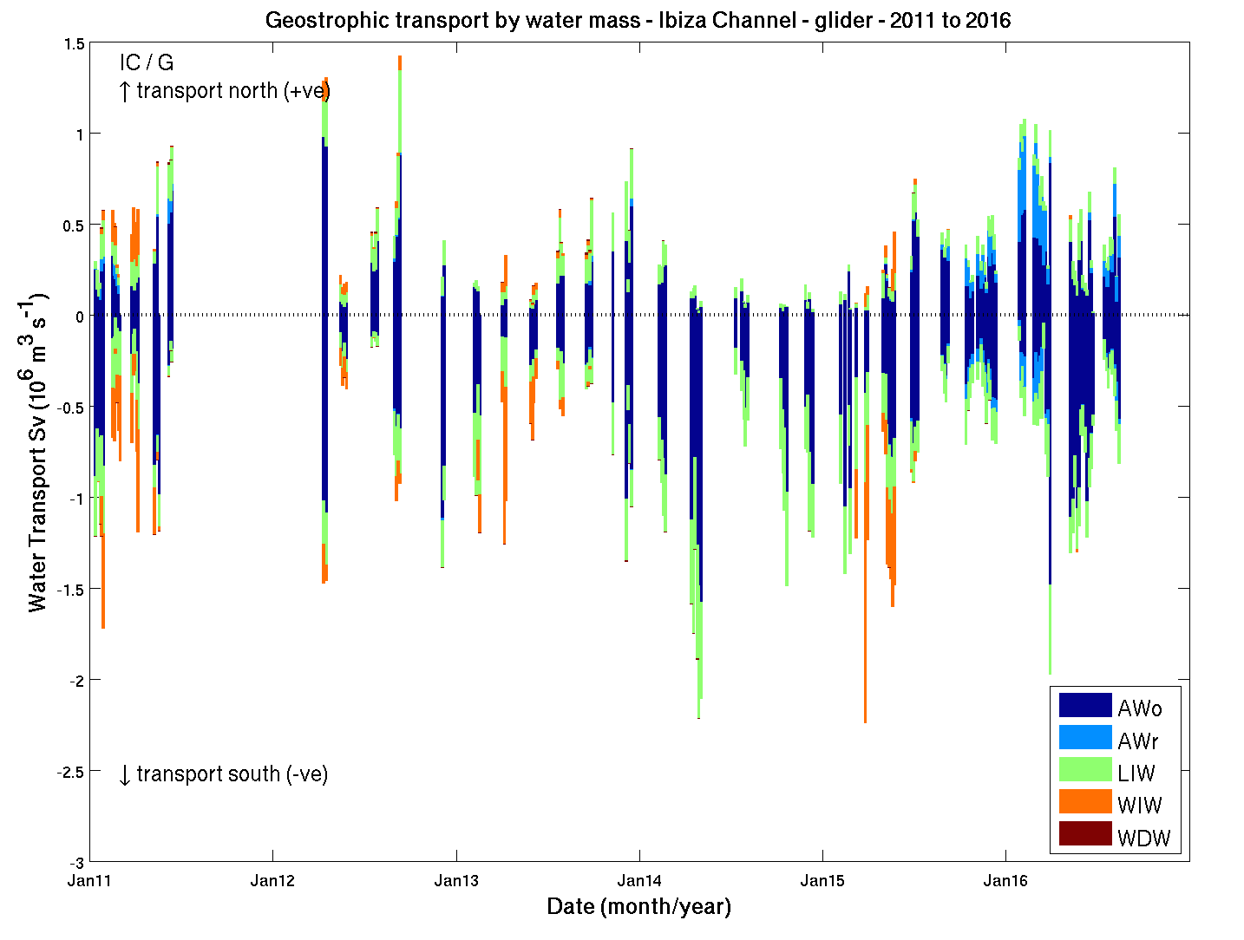
Stronger winter transport
Strong inflows fresh AW
2014 no WIW
Warmer LIW max.
High frequency variability in transport & interannual shifts in water mass properties

Slide 7
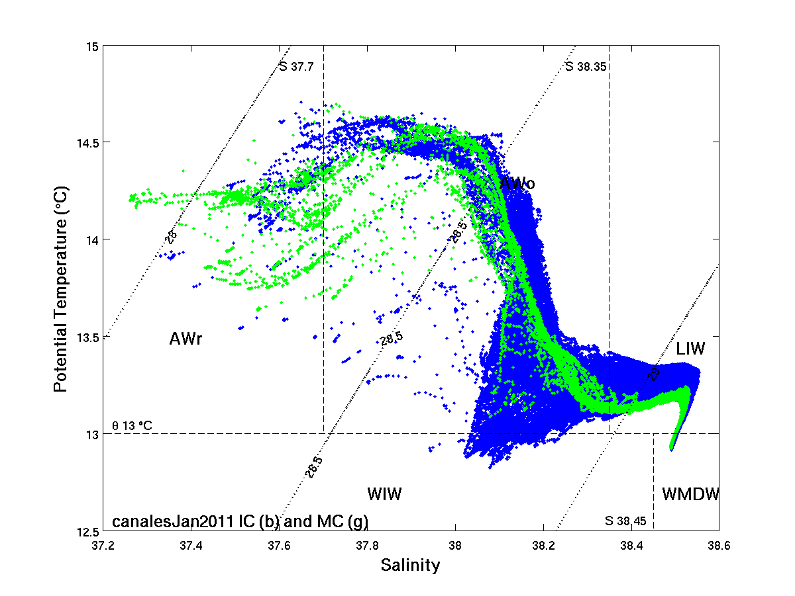
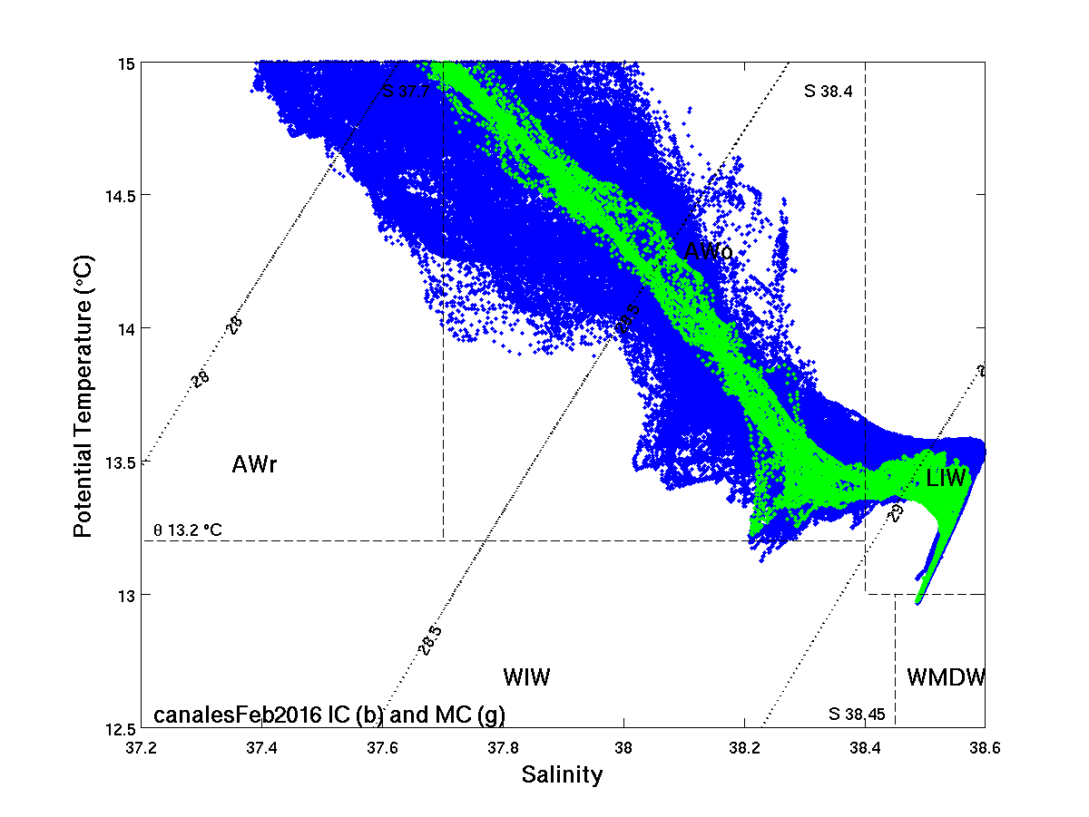
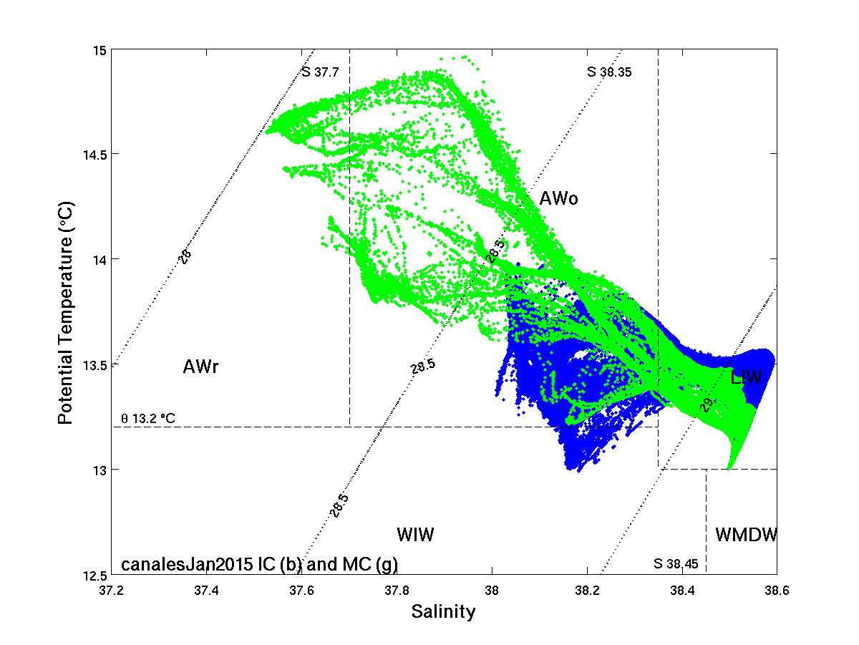
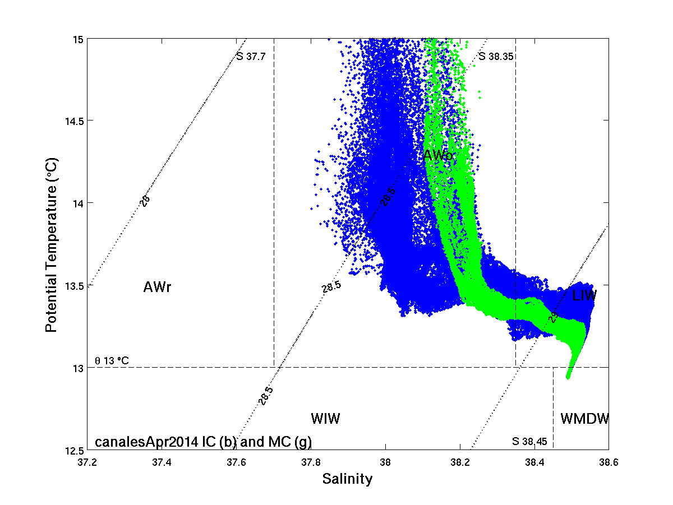
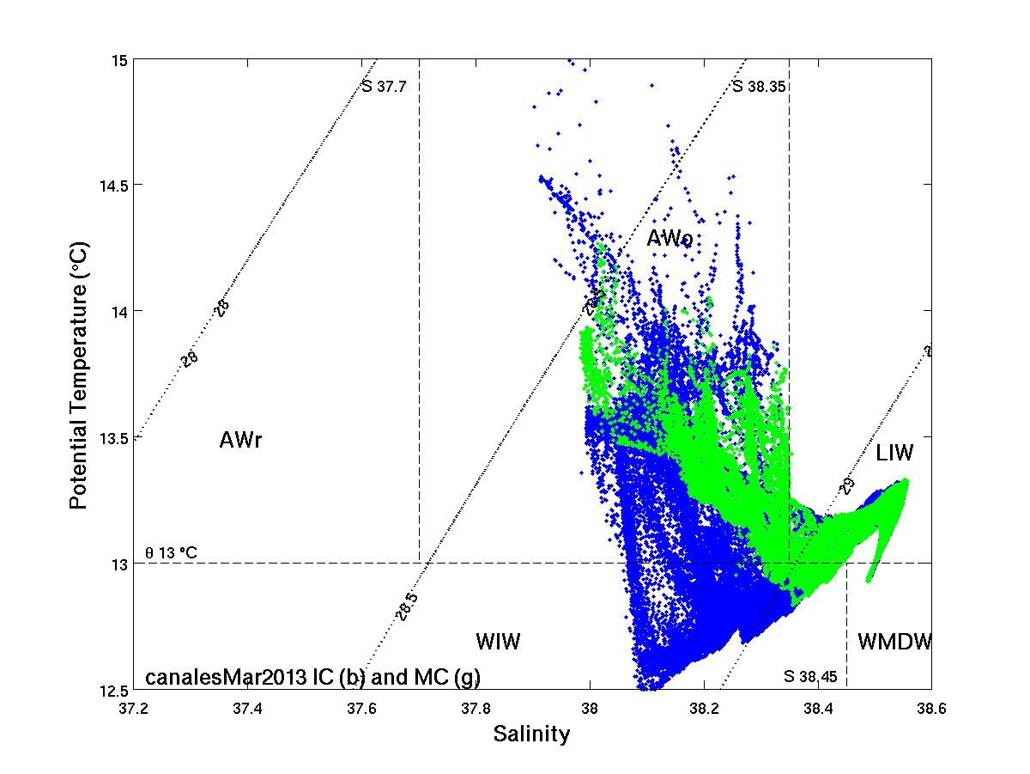
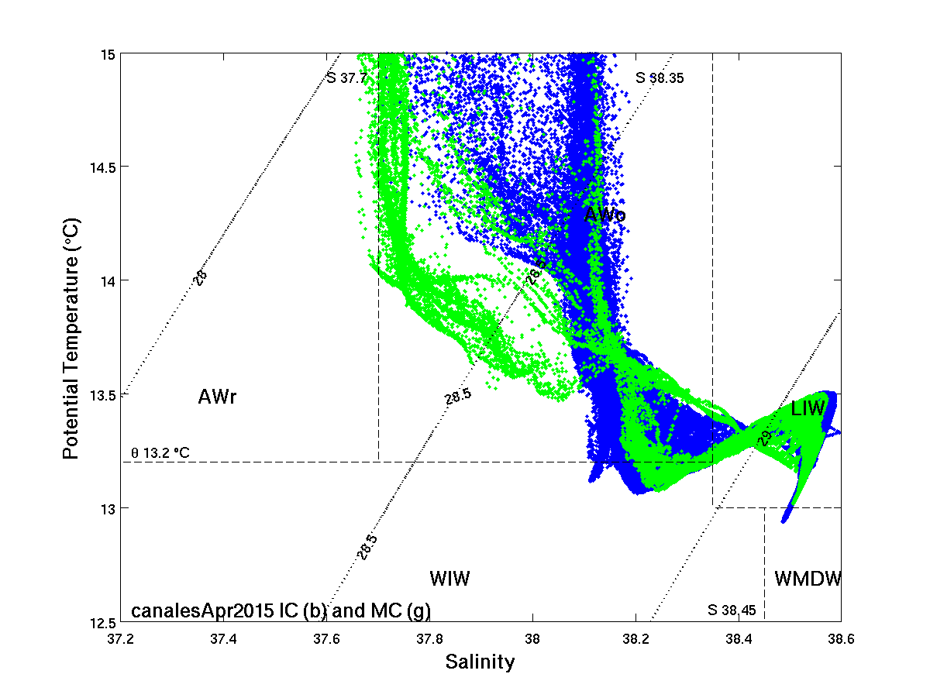
ibiza Channel Timeseries 2011 - 2016
Interannual shifts in water mass properties
Ibiza Channel (blue)
Mallorca Channel (green)

Slide 8
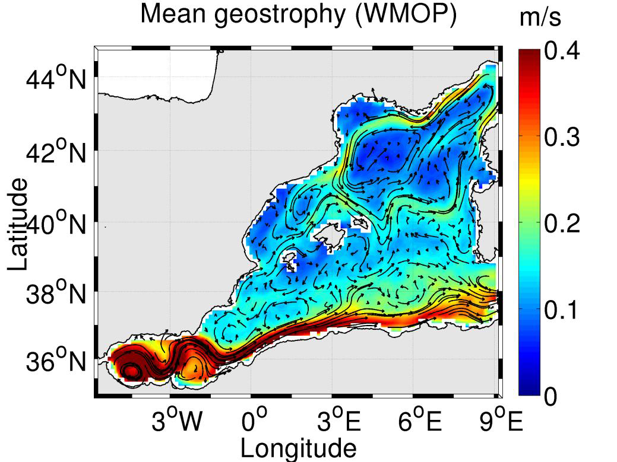
SOCIB WMOP Model configuration:
Model (WMOP):
Regional configuration of the ROMS
Spin up 2008, run 2009 – 2015
Gibraltar to Sardinia/Corsica
High resolution: 1.8 to 2.2km, vertical grid 32 sigma levels, bottom topography 30”
Forcing:
Initial & boundary conditions (1/16º, daily) from CMEMS MED-MFC
Atmospheric forcing Hirlam (3h 1/20º) from the Spanish Meteorological Agency (AEMET)
River runoff daily averaged for Var, Rhône, Aude, Hérault, Ebro and Júcar
Notes:
The model we use is the SOCIB operational model from Regional Ocean Modelling System, it si high resolution with spatial scale of similar order to the glider profiles in the Ibiza Channel – 2 km.

Slide 9
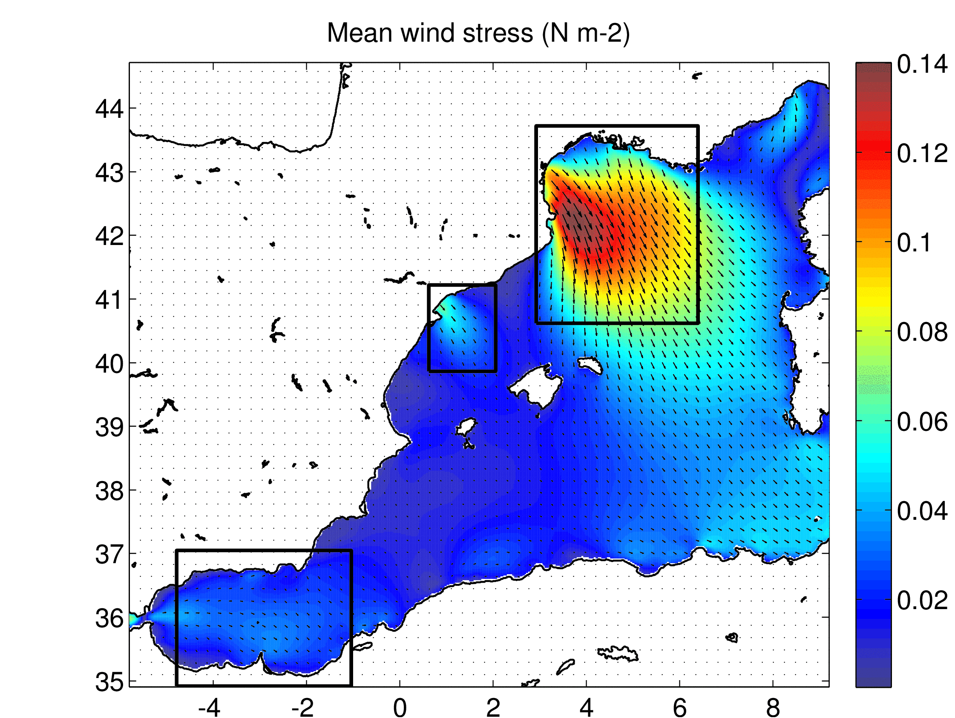
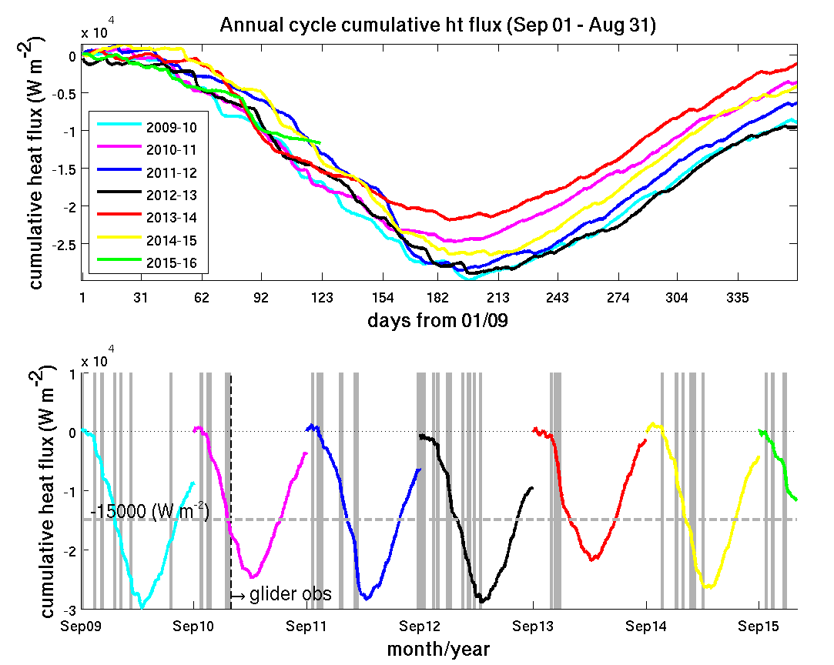
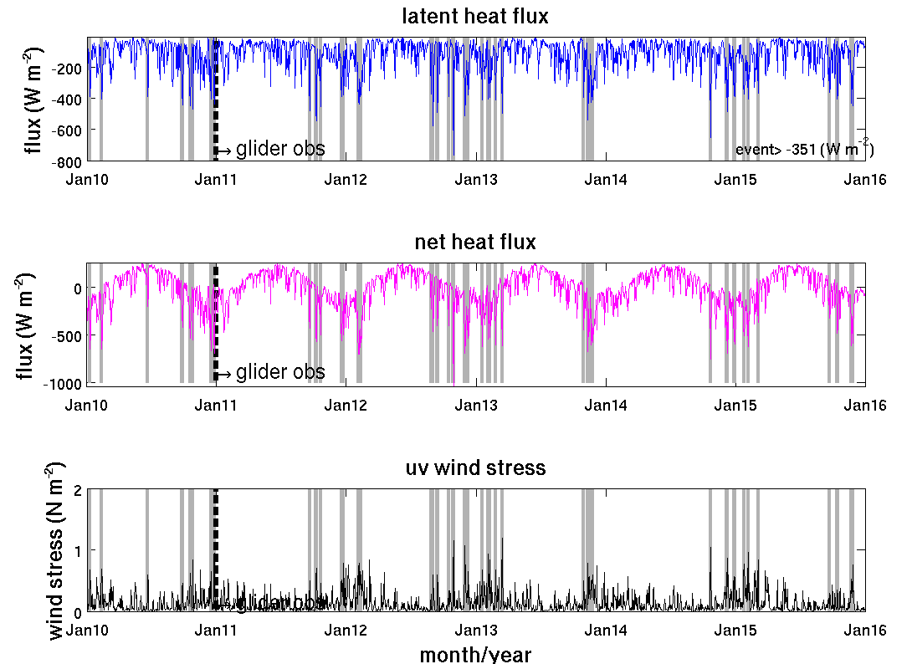
GULF OF LIONS FORCING
ATMOSPHERIC FLUXES FROM WMOP HINDCAST (HIRLAM FORCING):

Slide 10
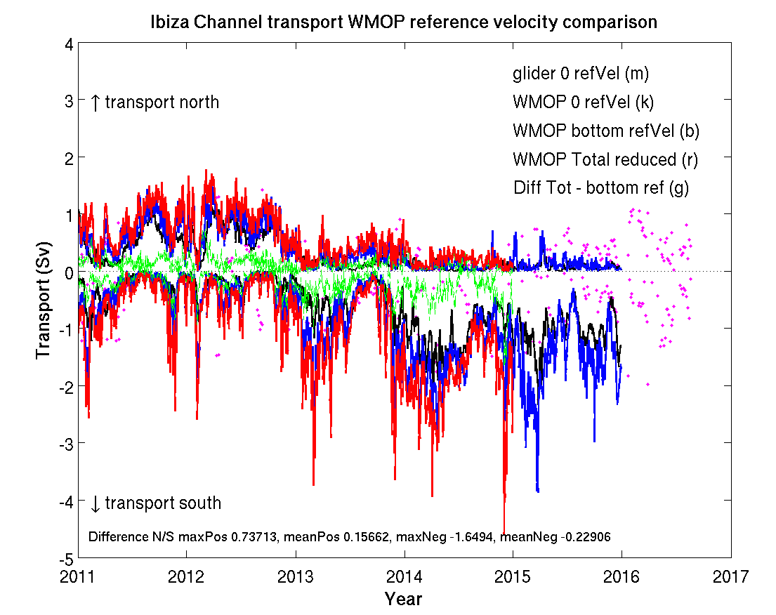
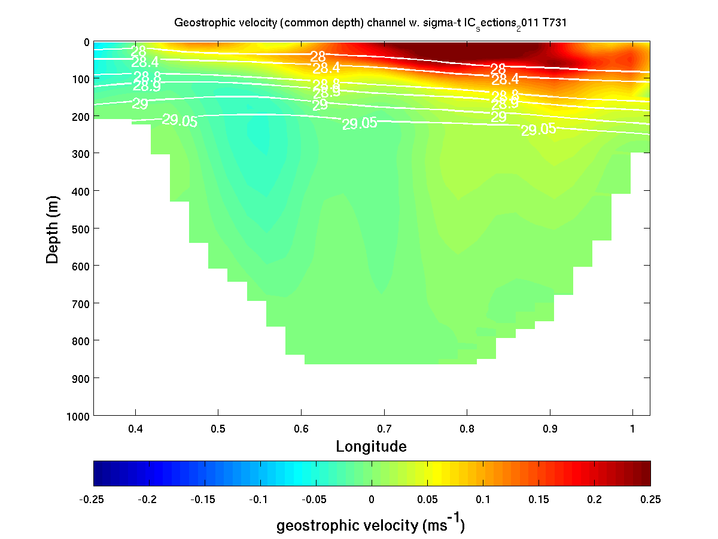
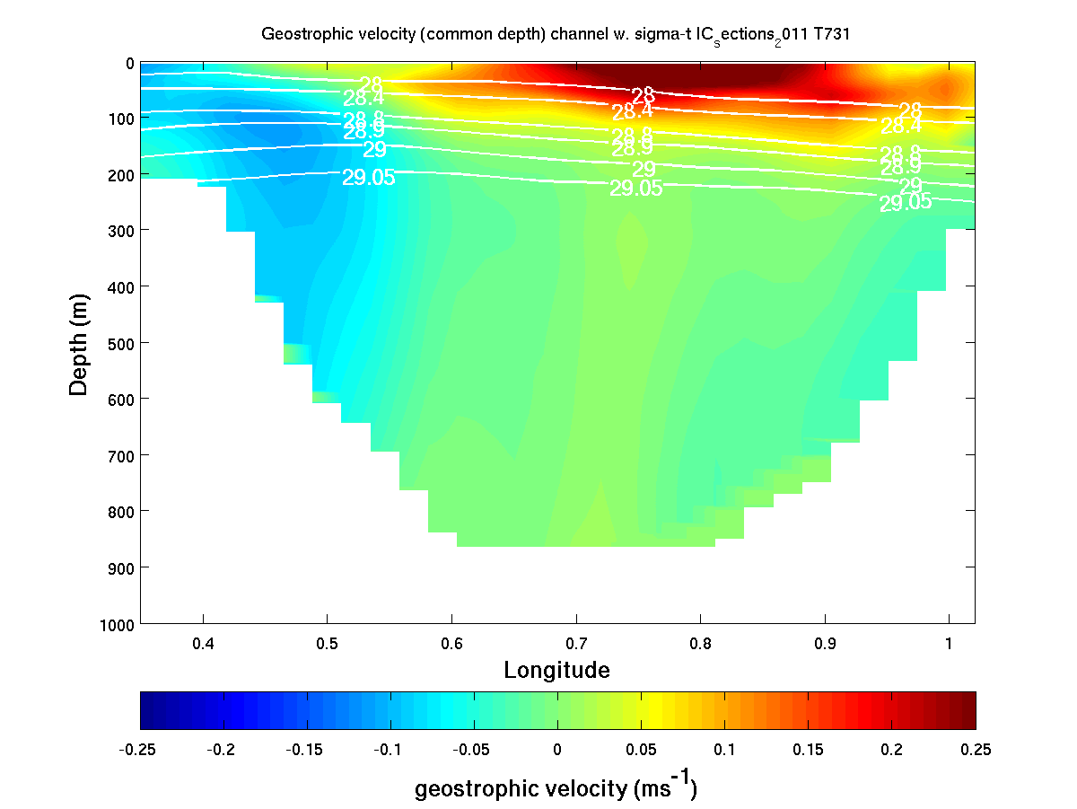
INSIGHT FROM COMPARISON GLIDER/WMOP:
Bottom velocity affect southward flow estimates, slope important, e.g. Jan 2011
GEOSTROPHIC TRANSPORT
Notes:
Zer ref 1.02 / -0.25
Ref 0.7 / -0.87

Slide 11
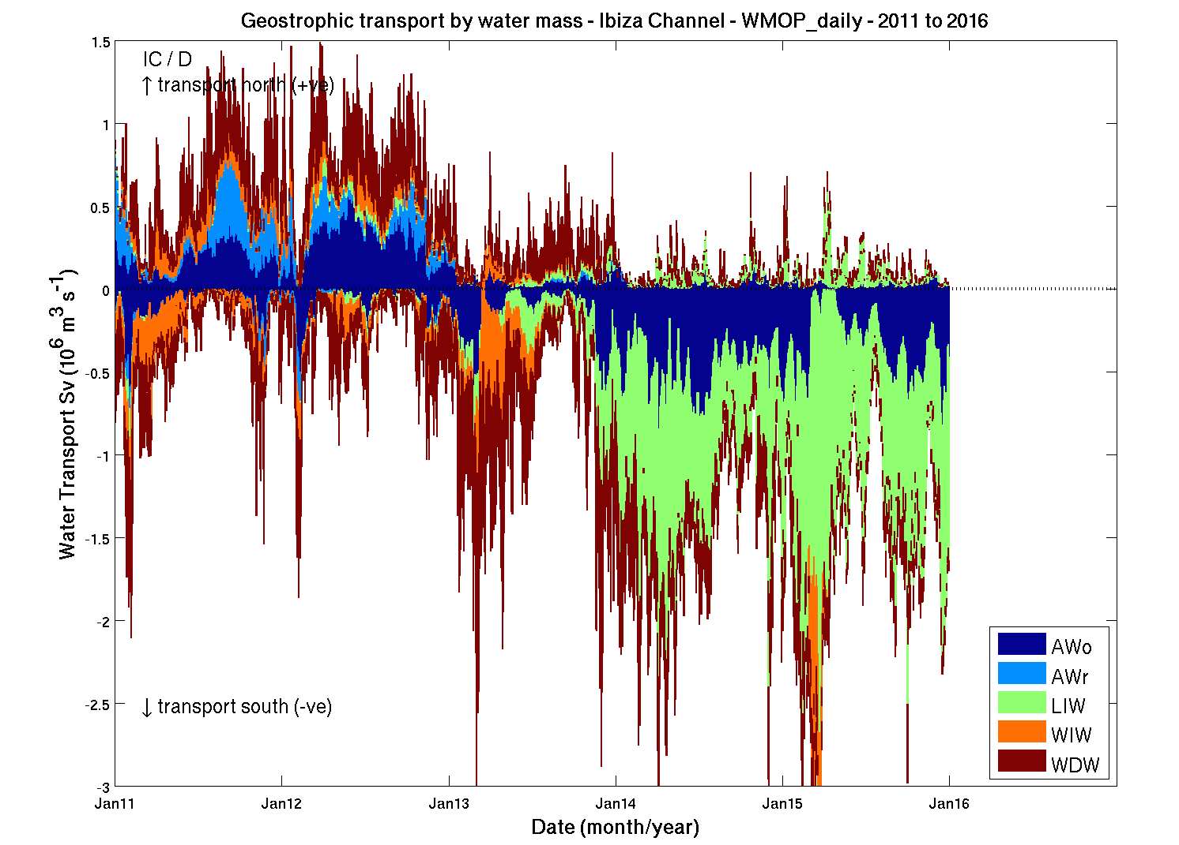
COMPARISON OF GLIDER TO WMOP:
WIW produced
LIW change detected
Overall problem with properties – WMDW/LIW/ WIW
Bias in initial state & boundaries (also MFS) >> work to correct now
Transport S OK
Transport N no

Slide 12
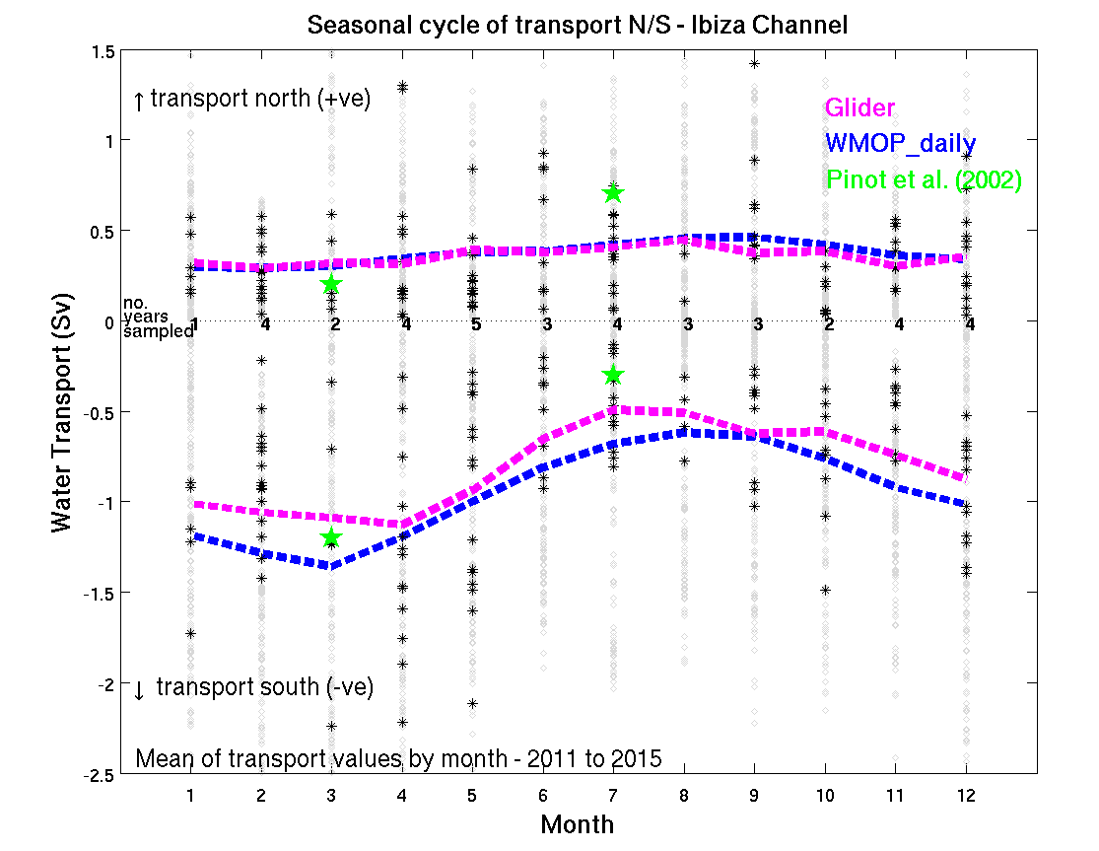
SEASONAL CYCLE IN TRANSPORT – GLIDER/WMOP:
MONTHLY MEAN TRANSPORT VALUES
Good match, long term means
Some confidence WMOP seasonal cycle in transport

Slide 13
CONCLUSIONS
Bottom velocities are important for southward flow, strong events – but not likely to fundamentally change the view
WIW production developing well – some prediction from forcing (2016)
Correction of model bias underway (also Argo)
On going:
Reference velocities from Depth Average Velocities work on going – usable information for slope currents
Drivers AW inflows – model and altimetry - prediction
Propagation and causes LIW warm anomaly (French and Spanish glider datasets)

