Slide 1





Eddy-mediated habitat compression through changes in the oxycline
Bastien Y. Queste
b.queste@uea.ac.uk
www.byqueste.com
EGO VII - Sept 2016
Notes:
Good morning everyone, thank you for giving me this opportunity today, I’m Bastien Queste and I’m going to tell you about GOGOGADGET

Slide 2
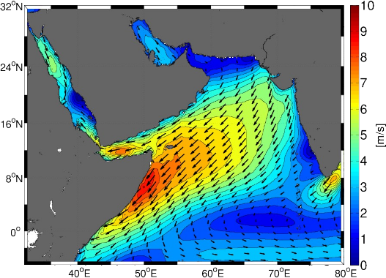
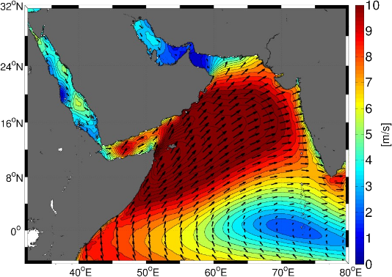
The monsoon reversal
Winter (NE) monsoon | Intermonsoon | Summer (SW) monsoon
December – February | March – May September – November | June – August
P. L’Hegaret (2015) Mesoscale variability in the Arabian Sea from HYCOM model results and observations: impact on the Persian Gulf Water path. Ocean Science
Notes:
Global deoxygenation trend
Increased worldwide effort, but Arabian Sea is ignored.
Keynote opening talk at OS was deoxygenation

Slide 3
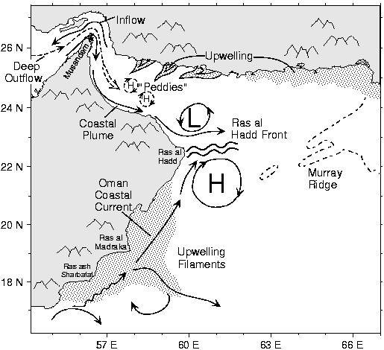
Schematic diagram of oceanic circulation in the Arabian Sea during the southwest monsoon. Source: Rosenstiel School of Marine and Atmospheric Science, University of Miami.
Notes:
Global deoxygenation trend
Increased worldwide effort, but Arabian Sea is ignored.
Keynote opening talk at OS was deoxygenation

Slide 4
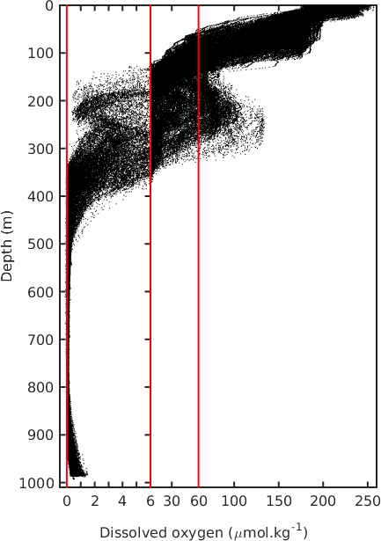
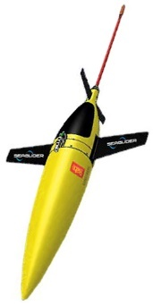
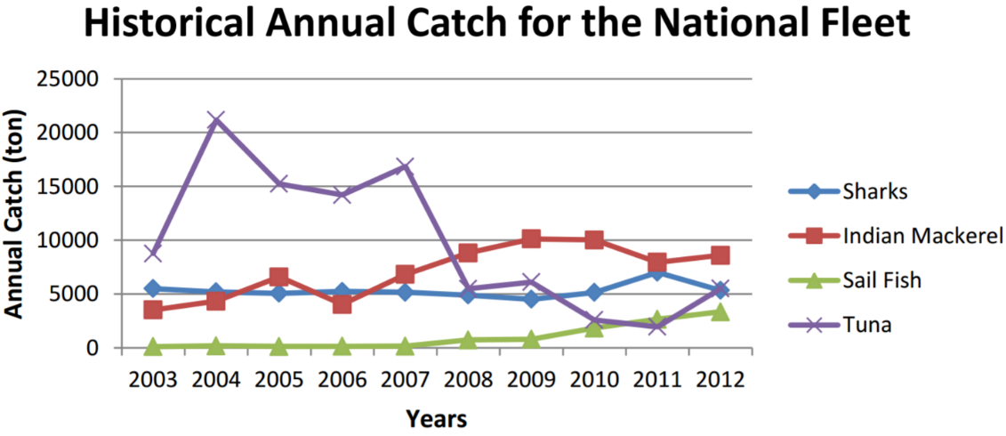
The oxygen minimum zone
3 Deployments:
March – June ’15
June – July ‘15
Dec – March ‘16
Queste et al. (in prep.) Eddy-mediated habitat compression through changes in the oxycline
Notes:
The overarching aim is to understand and quantify C, N and O cycling in the region in broad terms.
This sounds easier than it actually is because of the inherent difficulties in measuring these parameters over relevant time and spatial scale – otherwise it would’ve been done before. Such efforts are ongoing elsewhere: Pacific and Atlantic Gyres, Southern Ocean, Peruvian and African OMZ. This area remains neglected.
I will proceed by using what we already know – which is mostly models, T&S and some historical data to inform the field work.
The fieldworks goal will target specific regions showing a) hotspots of production/deoxygenation and b) high variability to maximise the processes that can be resolved and constrain what actually needs to be understood.
The use of cutting edge sensors will provide the in depth information that will shine a pretty powerful light on the biology and biogeochemistry of the region. This is in itself will be a great achievement.
The idea though is to then keep expanding, by both me (years 3-5, proposals, PhD students) and others (from disseminated data), by feeding this information back into models to improve NPZD models and better understand impacts of climate and on climate.

Slide 5
Dissolved oxygen (Aanderaa)
Estimate drift from atmospheric values (self test on Seagliders, bench tests and launch/recovery tests otherwise) as per Bushinsky et al. (2016) [For context see D’Asaro & McNeil (2013), Bushinsky & Emerson (2013), Johnson et al. (2015), Bittig & Kortzinger (2015)]
Calibrate against a 0% solution (using sodium dithionite or sulfite or other…) and atmospheric values (i.e. Johnson et al. 2015 and Bittig & Kortzinger 2016 technical note.) or a 100% saturation bubbled solution (ideally at multiple temperatures). These provide a linear gain factor to use to correct pO₂. (Accurate to 1%)
If using Winklers, calibrate according to Bittig et al. 2012 to account for temperature effect (Accuracy >> 1%)
Correct for sensor lag – best recommended practice is to use the Bittig et al. (2014) which accounts for double diffusion through the foil and through a boundary layer, and hydrostatic pressure (Uchida et al. 2008, Bittig et al. 2015).
The Bittig & Kortzinger (2016) Ocean Sciences technical note has a great overview in the Appendix.
Queste et al. (in prep.) Eddy-mediated habitat compression through changes in the oxycline
Notes:
Global deoxygenation trend
Increased worldwide effort, but Arabian Sea is ignored.
Keynote opening talk at OS was deoxygenation

Slide 6
The oxygen minimum zone
3 Deployments:
March – June ’15
June – July ‘15
Dec – March ‘16
Queste et al. (in prep.) Eddy-mediated habitat compression through changes in the oxycline
Notes:
The overarching aim is to understand and quantify C, N and O cycling in the region in broad terms.
This sounds easier than it actually is because of the inherent difficulties in measuring these parameters over relevant time and spatial scale – otherwise it would’ve been done before. Such efforts are ongoing elsewhere: Pacific and Atlantic Gyres, Southern Ocean, Peruvian and African OMZ. This area remains neglected.
I will proceed by using what we already know – which is mostly models, T&S and some historical data to inform the field work.
The fieldworks goal will target specific regions showing a) hotspots of production/deoxygenation and b) high variability to maximise the processes that can be resolved and constrain what actually needs to be understood.
The use of cutting edge sensors will provide the in depth information that will shine a pretty powerful light on the biology and biogeochemistry of the region. This is in itself will be a great achievement.
The idea though is to then keep expanding, by both me (years 3-5, proposals, PhD students) and others (from disseminated data), by feeding this information back into models to improve NPZD models and better understand impacts of climate and on climate.

Slide 7
The oxygen minimum zone
3 Deployments:
March – June ’15
June – July ‘15
Dec – March ‘16
Queste et al. (in prep.) Eddy-mediated habitat compression through changes in the oxycline
Notes:
The overarching aim is to understand and quantify C, N and O cycling in the region in broad terms.
This sounds easier than it actually is because of the inherent difficulties in measuring these parameters over relevant time and spatial scale – otherwise it would’ve been done before. Such efforts are ongoing elsewhere: Pacific and Atlantic Gyres, Southern Ocean, Peruvian and African OMZ. This area remains neglected.
I will proceed by using what we already know – which is mostly models, T&S and some historical data to inform the field work.
The fieldworks goal will target specific regions showing a) hotspots of production/deoxygenation and b) high variability to maximise the processes that can be resolved and constrain what actually needs to be understood.
The use of cutting edge sensors will provide the in depth information that will shine a pretty powerful light on the biology and biogeochemistry of the region. This is in itself will be a great achievement.
The idea though is to then keep expanding, by both me (years 3-5, proposals, PhD students) and others (from disseminated data), by feeding this information back into models to improve NPZD models and better understand impacts of climate and on climate.

Slide 8
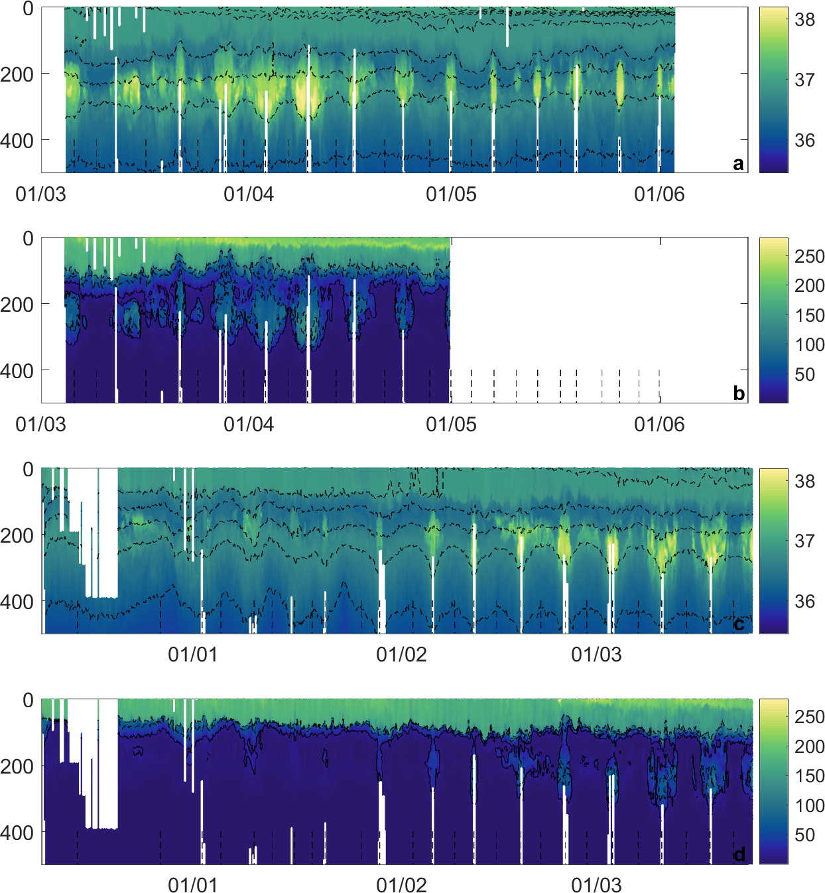
Persian Gulf Water
(PGW) Outflow
Absolute
Salinity
(g.kg⁻¹)
March – June 2015
Dissolved
oxygen
(µmol.kg⁻¹)
Absolute
Salinity
(g.kg⁻¹)
December – March 2016
Dissolved
oxygen
(µmol.kg⁻¹)
Queste et al. (in prep.) Eddy-mediated habitat compression through changes in the oxycline
Notes:
Global deoxygenation trend
Increased worldwide effort, but Arabian Sea is ignored.
Keynote opening talk at OS was deoxygenation

Slide 9
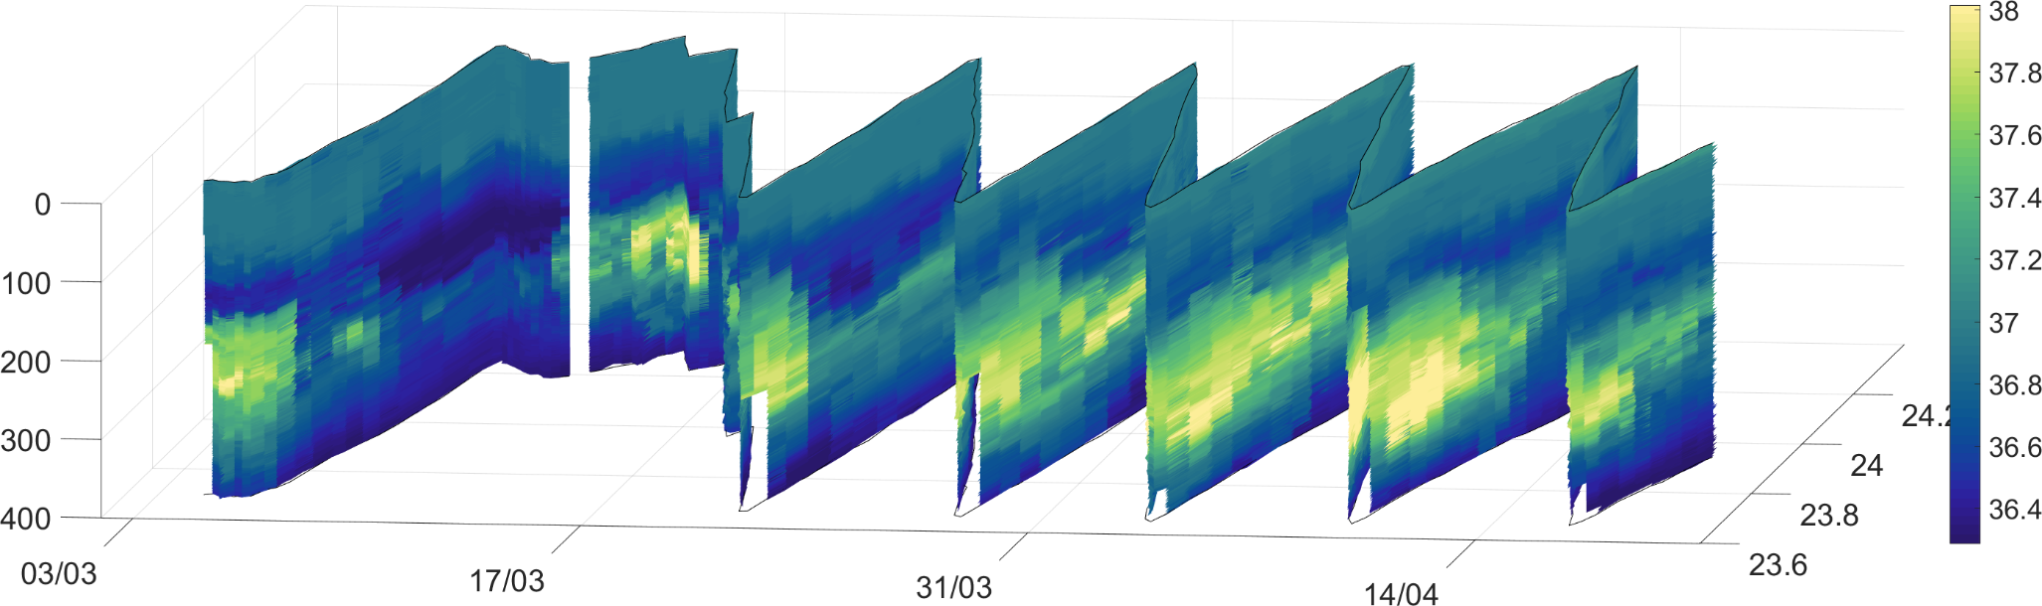
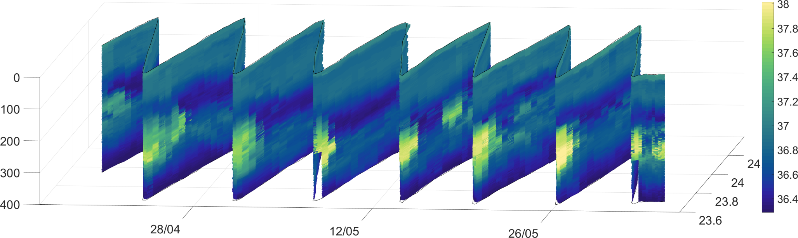
Persian Gulf Water
(PGW) Outflow
Above. Absolute salinity (g kg⁻¹) from the Seaglider (March – May ’15). The shelf is near you and the transects extend offshore “into the screen”.
Notes:
Global deoxygenation trend
Increased worldwide effort, but Arabian Sea is ignored.
Keynote opening talk at OS was deoxygenation

Slide 10
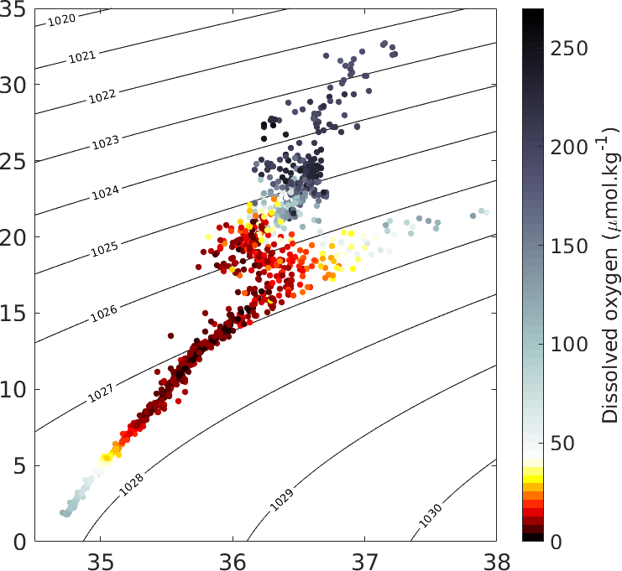
Rapid mixing of oxygen
Left. Downsampled TS curve coloured by dissolved oxygen. Notice the clear decrease in oxygen with decreasing spice.
Queste et al. (in prep.) Eddy-mediated habitat compression through changes in the oxycline
Notes:
Global deoxygenation trend
Increased worldwide effort, but Arabian Sea is ignored.
Keynote opening talk at OS was deoxygenation

Slide 11
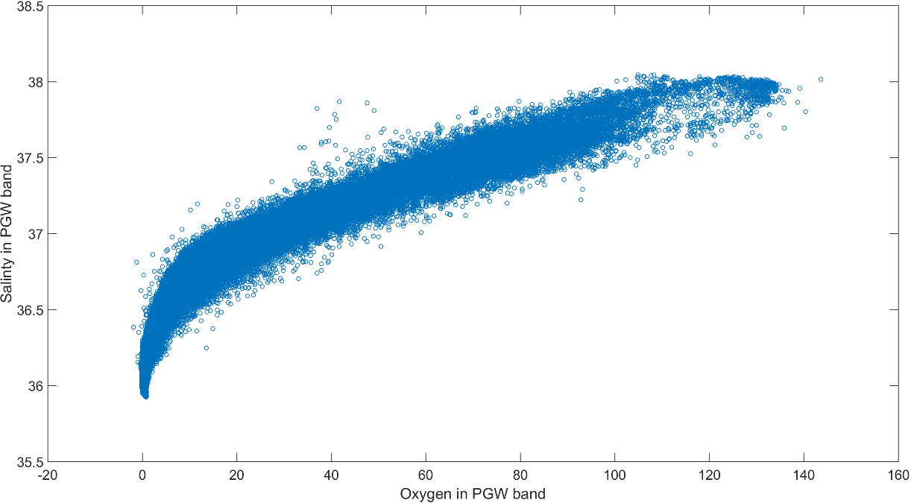
Rapid mixing of oxygen
Queste et al. (in prep.) Eddy-mediated habitat compression through changes in the oxycline
Notes:
Global deoxygenation trend
Increased worldwide effort, but Arabian Sea is ignored.
Keynote opening talk at OS was deoxygenation

Slide 12
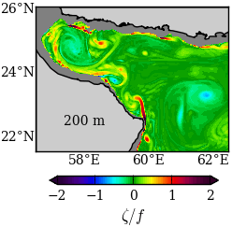
The oxygen minimum zone
Vorticity at 200m
(taken from C. Vic)
Notes:
The overarching aim is to understand and quantify C, N and O cycling in the region in broad terms.
This sounds easier than it actually is because of the inherent difficulties in measuring these parameters over relevant time and spatial scale – otherwise it would’ve been done before. Such efforts are ongoing elsewhere: Pacific and Atlantic Gyres, Southern Ocean, Peruvian and African OMZ. This area remains neglected.
I will proceed by using what we already know – which is mostly models, T&S and some historical data to inform the field work.
The fieldworks goal will target specific regions showing a) hotspots of production/deoxygenation and b) high variability to maximise the processes that can be resolved and constrain what actually needs to be understood.
The use of cutting edge sensors will provide the in depth information that will shine a pretty powerful light on the biology and biogeochemistry of the region. This is in itself will be a great achievement.
The idea though is to then keep expanding, by both me (years 3-5, proposals, PhD students) and others (from disseminated data), by feeding this information back into models to improve NPZD models and better understand impacts of climate and on climate.

Slide 13
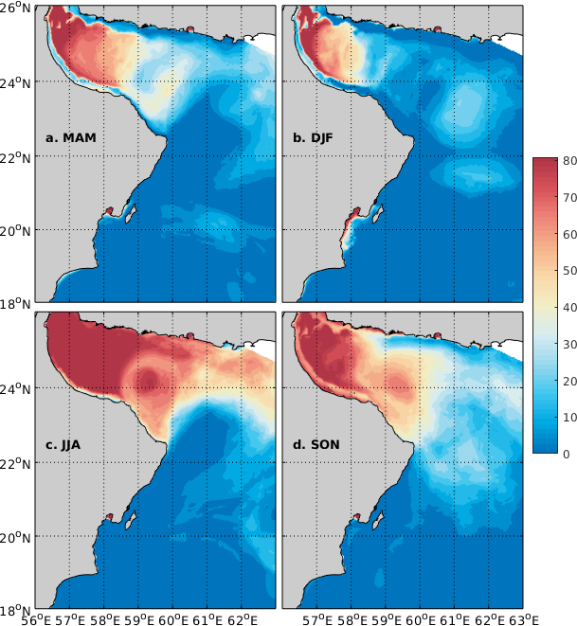
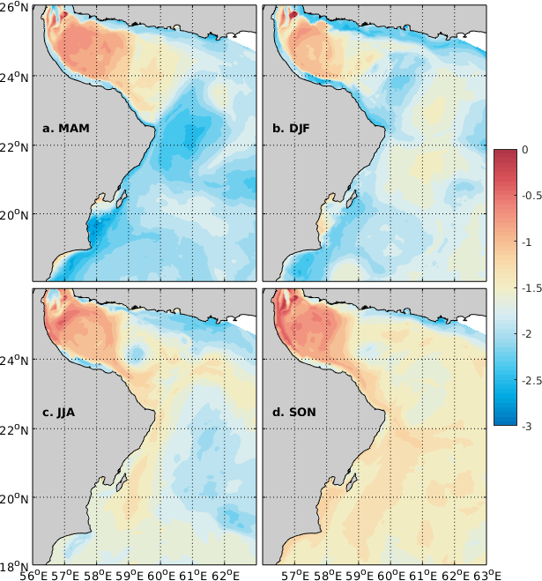
PGW spatial variability
Above left. Days per season with oxygen above 40 umol kg⁻¹ (PGW core)
Above right. Log10 of the salinity maximum variance at the PGW core
Queste et al. (in prep.) Eddy-mediated habitat compression through changes in the oxycline
Notes:
Global deoxygenation trend
Increased worldwide effort, but Arabian Sea is ignored.
Keynote opening talk at OS was deoxygenation

Slide 14
Any questions?
Thank you for your attention
Eddy dynamics and PGW outflow drive a system of intermittent refugia for smaller macrofauna.
Hugely dynamic and under-observed region with an “unreported” anoxic layer.
Maintained by a (very?) productive DCM driven by temporally + spatially varying upwelling.
Acknowledgements:
Clement Vic (U of Southampton) for the ROMS model output.
Sergey Piontkovski (SQU) for funding and fieldwork logistics in Oman.
5 Oceans Consultancy for rescuing our glider at the last minute.
Grants: ONR GLOBAL #N62909-14-1-N224; SQU EG/AGR/FISH/14/01; UK NERC NE/M005801/1 and NE/N012658/1.
Bastien Y. Queste :: b.queste@uea.ac.uk :: www.byqueste.com
Notes:
Global deoxygenation trend
Increased worldwide effort, but Arabian Sea is ignored.
Keynote opening talk at OS was deoxygenation

Slide 15
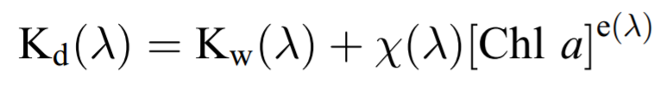
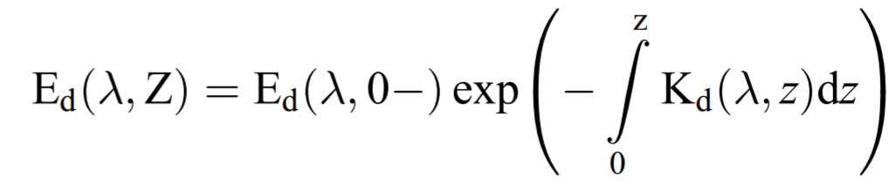
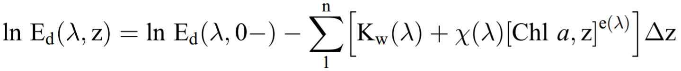
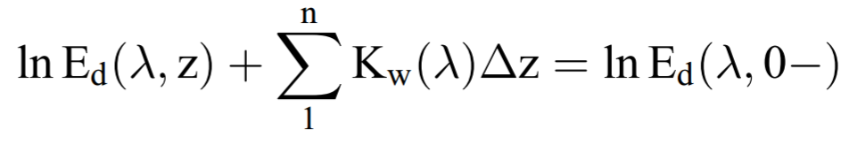
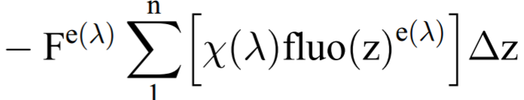
Chlorophyll a calibration
(On the topic of best practices and recommendations: don’t deploy a chlorophyll fluorometer without a PAR sensor. They’re cheap and low power.)
Xing et al. (2011) Combined processing and mutual interpretation of radiometry and fluorimetry from autonomous profiling Bio‐Argo floats…. JGR
Notes:
Global deoxygenation trend
Increased worldwide effort, but Arabian Sea is ignored.
Keynote opening talk at OS was deoxygenation

Slide 16
Chlorophyll a calibration
(On the topic of best practices and recommendations: don’t deploy a chlorophyll fluorometer without a PAR sensor. They’re cheap and low power.)
Xing et al. (2011) Combined processing and mutual interpretation of radiometry and fluorimetry from autonomous profiling Bio‐Argo floats…. JGR
Notes:
Global deoxygenation trend
Increased worldwide effort, but Arabian Sea is ignored.
Keynote opening talk at OS was deoxygenation

Slide 17
Chlorophyll a calibration
(On the topic of best practices and recommendations: don’t deploy a chlorophyll fluorometer without a PAR sensor. They’re cheap and low power.)
Xing et al. (2011) Combined processing and mutual interpretation of radiometry and fluorimetry from autonomous profiling Bio‐Argo floats…. JGR
Notes:
Global deoxygenation trend
Increased worldwide effort, but Arabian Sea is ignored.
Keynote opening talk at OS was deoxygenation

Slide 18
Chlorophyll a calibration
Chl a = F * fluo
(On the topic of best practices and recommendations: don’t deploy a chlorophyll fluorometer without a PAR sensor. They’re cheap and low power.)
Xing et al. (2011) Combined processing and mutual interpretation of radiometry and fluorimetry from autonomous profiling Bio‐Argo floats…. JGR
Notes:
Global deoxygenation trend
Increased worldwide effort, but Arabian Sea is ignored.
Keynote opening talk at OS was deoxygenation

Slide 19
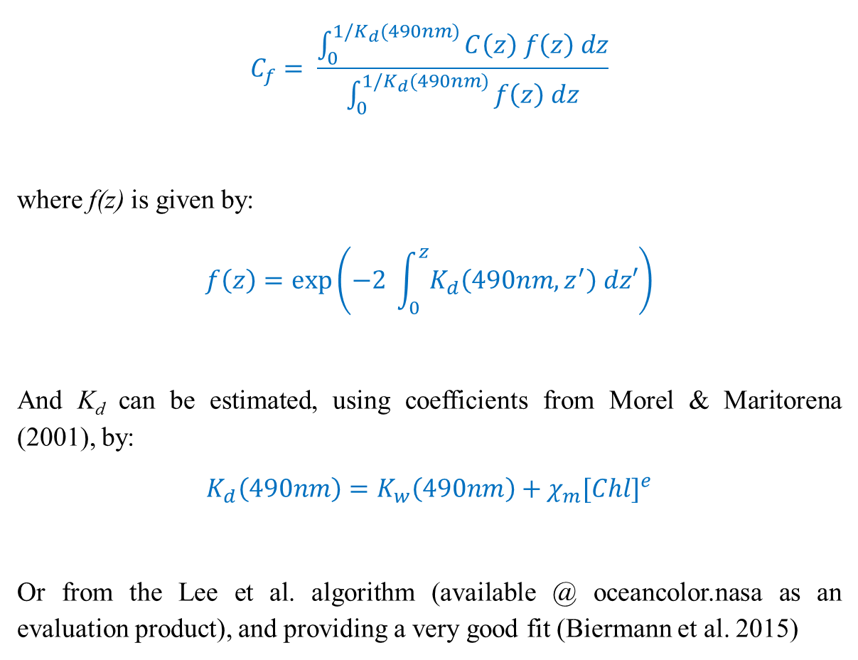
Chlorophyll a validation
$$C_{f}= \frac{\int_{0}^{1/K_{d}(490nm)}{C\left(z\right) f\left(z\right) dz}}{\int_{0}^{1/K_{d}(490nm)}{f\left(z\right) dz}}$$
where f(z) is given by:
$$f\left(z\right)=\exp\left(−2 \int_{0}^{z}{K_{d}\left(490nm,z^{′}\right) dz′}\right)$$
And K_{d} can be estimated, using coefficients from Morel & Maritorena (2001), by:
$$K_{d}\left(490nm\right)=K_{w}\left(490nm\right)+χ_{m}{[Chl]}^{e}$$
Or from the Lee et al. algorithm (available @ oceancolor.nasa as an evaluation product), and providing a very good fit (Biermann et al. 2015)
Queste et al. (in prep.) Multiplatform assessment of production in an intermittent upwelling region
Notes:
Global deoxygenation trend
Increased worldwide effort, but Arabian Sea is ignored.
Keynote opening talk at OS was deoxygenation

Slide 20
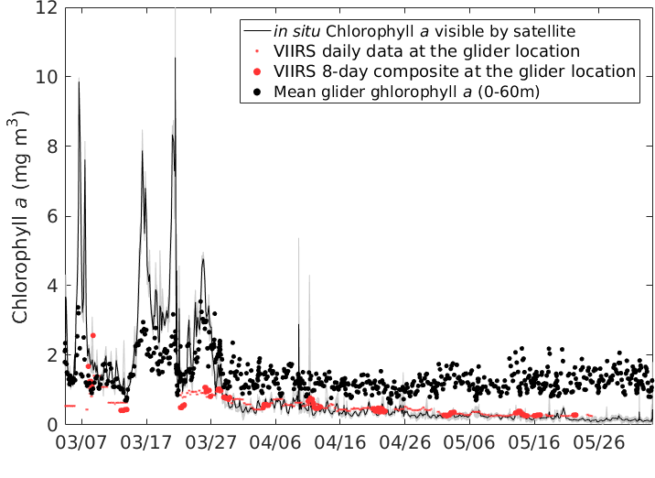
An underestimated DCM
Left. Glider calibration vs satellite showing what satellites can “see” (lines) and depth integrated chlorophyll a (black dots). Remote sensing cannot resolve the elevated biomass at the DCM
DCM (inter-monsoon)
Piontkovski, Queste et al. (in review) Subsurface algal blooms of the western Arabian Sea. MEPS
Notes:
Global deoxygenation trend
Increased worldwide effort, but Arabian Sea is ignored.
Keynote opening talk at OS was deoxygenation

Slide 21
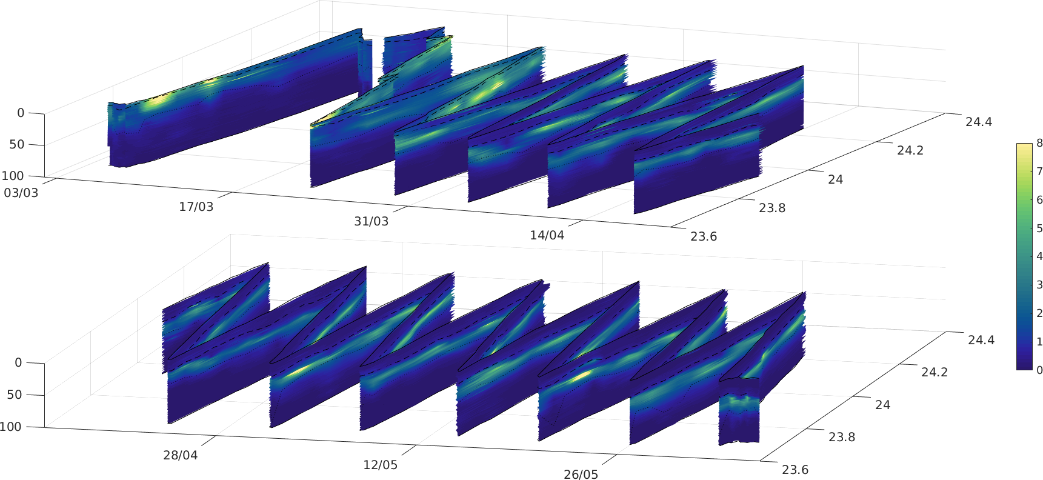
What drives the OMZ
Piontkovski, Queste et al. (in review) Subsurface algal blooms of the western Arabian Sea. MEPS
Notes:
Global deoxygenation trend
Increased worldwide effort, but Arabian Sea is ignored.
Keynote opening talk at OS was deoxygenation

Slide 22
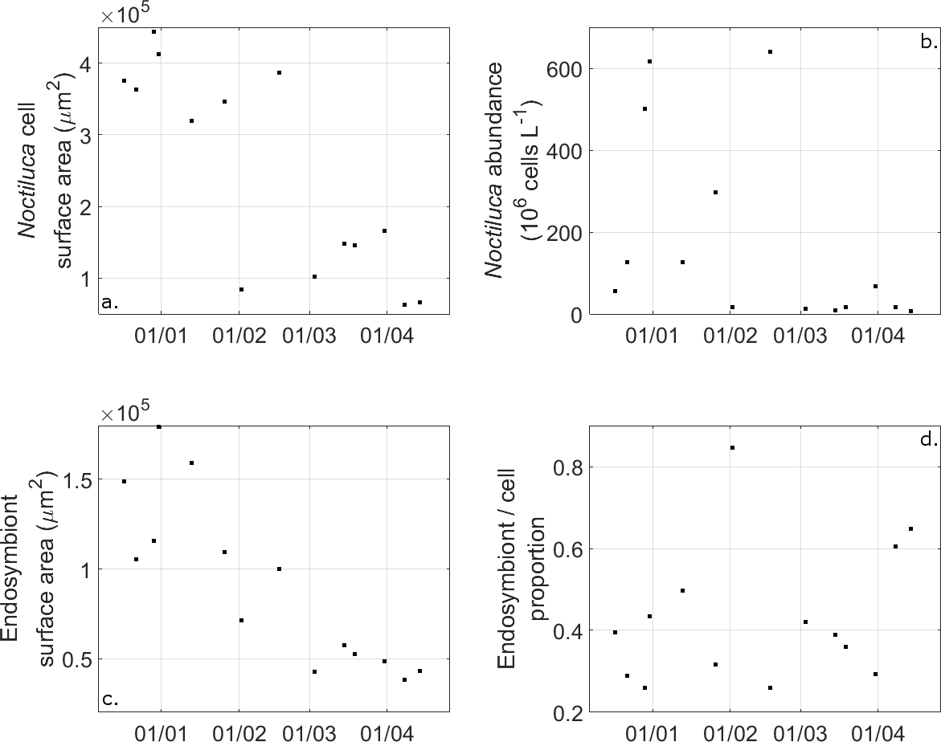
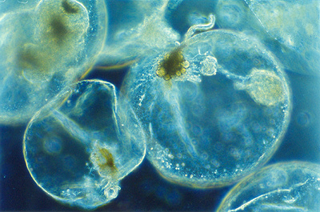
An underestimated DCM
Left. Temporal changes in Noctiluca cell size and abundance; endosymbiont size and relative proportion of endosymbiont to Noticluca cell.
Piontkovski, Queste et al. (in review) Subsurface algal blooms of the western Arabian Sea. MEPS
Notes:
Global deoxygenation trend
Increased worldwide effort, but Arabian Sea is ignored.
Keynote opening talk at OS was deoxygenation

Slide 23
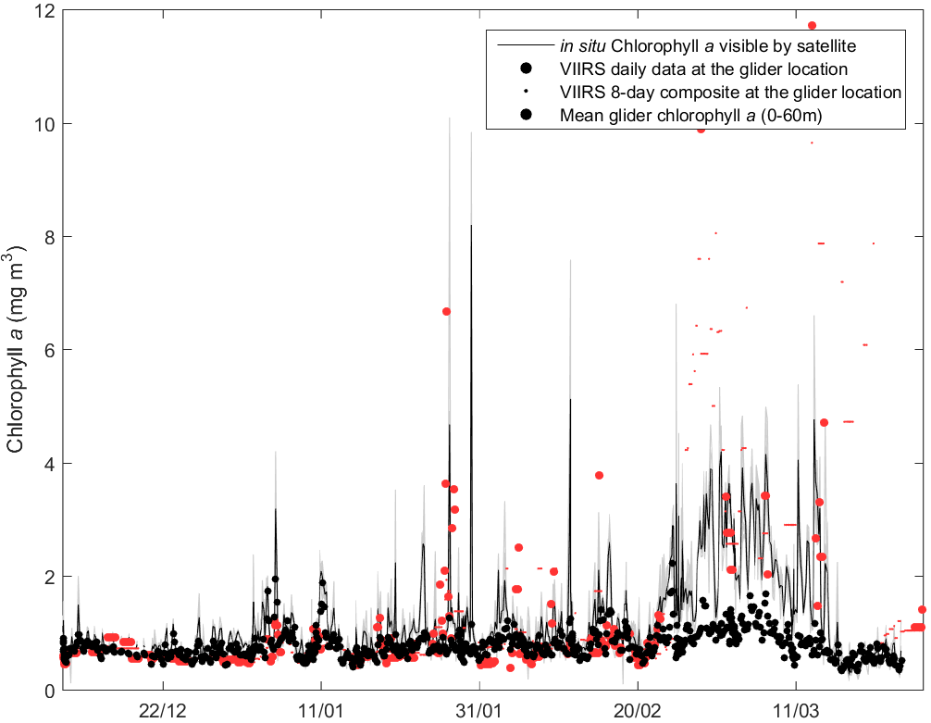
An overestimated bloom
Bloom event (monsoon)
Left. Glider calibration vs satellite showing what satellites can “see” (lines) and depth integrated chlorophyll a (black dots). Remote sensing cannot resolve the elevated biomass at the DCM
Queste et al. (in prep.) Multiplatform assessment of production in an intermittent upwelling region
Notes:
Global deoxygenation trend
Increased worldwide effort, but Arabian Sea is ignored.
Keynote opening talk at OS was deoxygenation

