Slide 1

The Norwegian Glider Observatory EGO September 2016
Legg inn «Avdeling / enhet» på hver side: 1 Gå til menyen «Sett inn» 2 Velg: Dato og klokkeslett 3 Skriv navn på avdeling eller
enhet i feltet «Bunntekst»
4 Velg «Bruk på alle"
Peter M Haugan^{1,2}
Peter.Haugan@uib.no
EM. Bruvik¹, I. Hessevik¹ H. Søiland², KA. Orvik¹,I. Fer¹, K. Våge¹, K. Kvalsund³
¹ Geophysical Institute, University of Bergen, Allégaten 70, 5007, Bergen, Norway,
² Institute of Marine Research, Nordnesgaten 50, 5005 Bergen, Norway
³ Runde Environmental Centre, Rundavegen 237, 6096 Runde, Norway

Slide 2
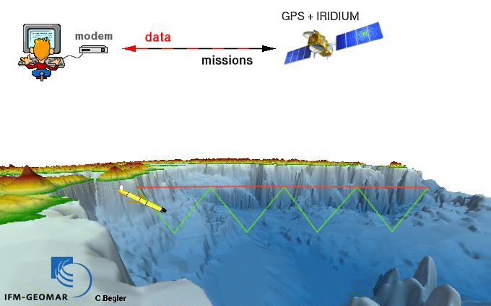
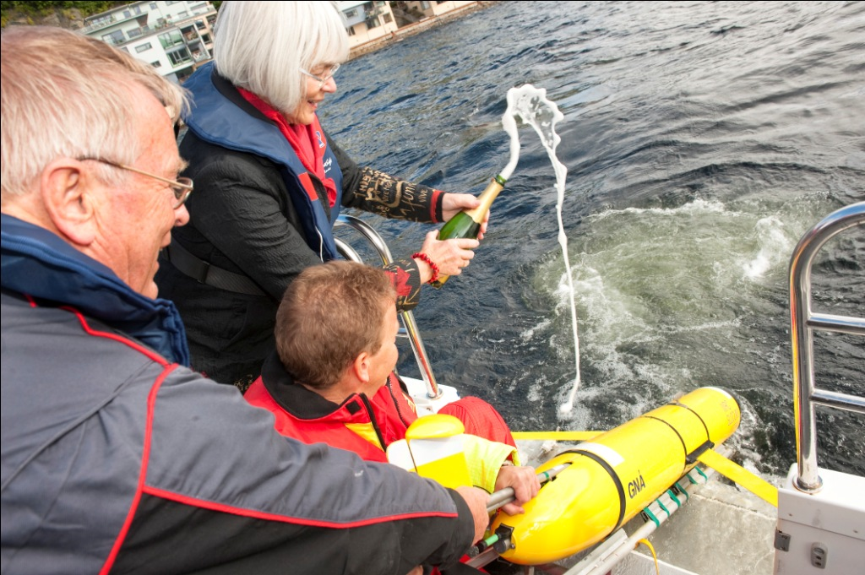
Norwegian Atlantic Current Observatory (NACO)
National research infrastructure facility since 2011
Operation central
ftp
Data centre
Models, ...
NACO launch, minister Tora Aasland
1000m
20-40 km/day horisontally
Notes:
3 manufacturers in the US. EGO COST

Slide 3

NACO proposal:
1. A real time mooring at Svinøy
2. A national facility for gliders to monitor the Norwegian Atlantic Current.
3. Buildup of competence and service to research projects.
Run by GFI/UiB with IMR and
Runde Environmental Centre as partners

Slide 4
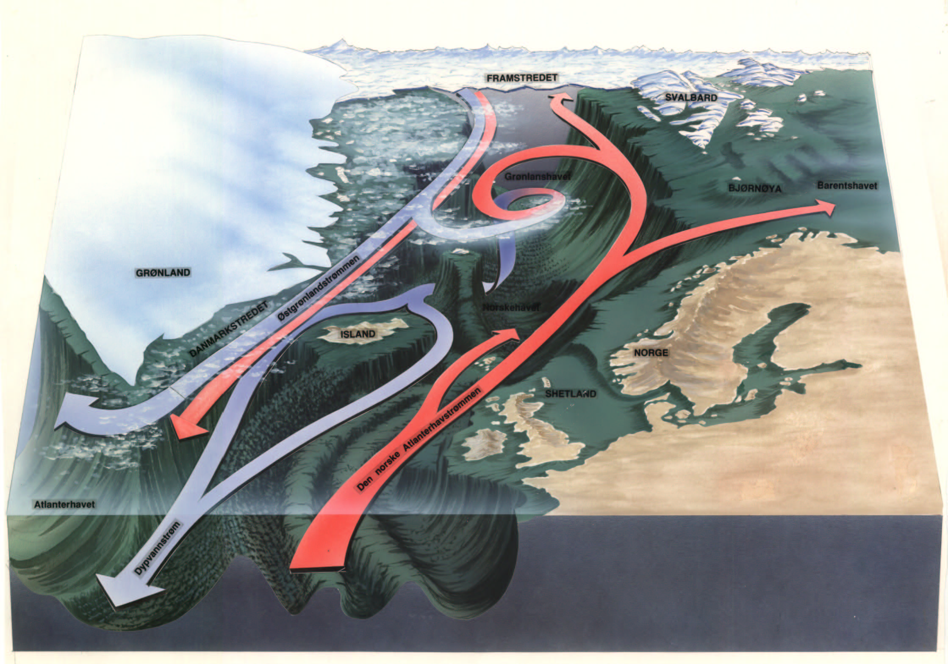
Historical time series/sections
Fram Strait
BSX
BSO
M
Greenland Scotland Ridge
“Nuka Arctica”
26.5 Rapid

Slide 5
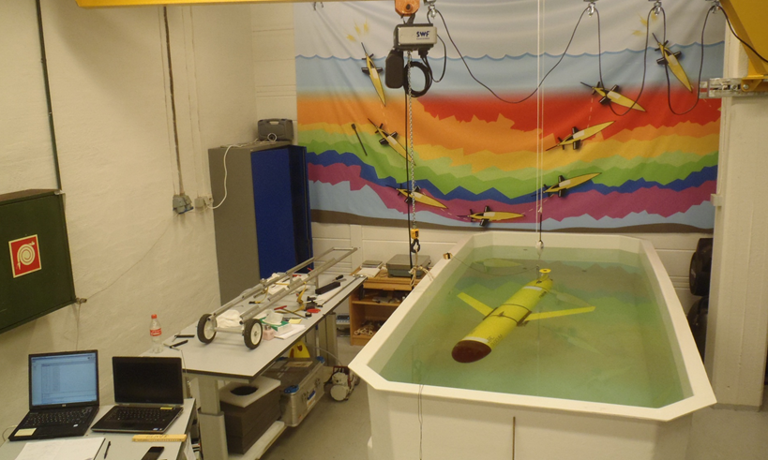
Facilities in Gliderlab in Bergen http://vimeo.com/96179776

Slide 6
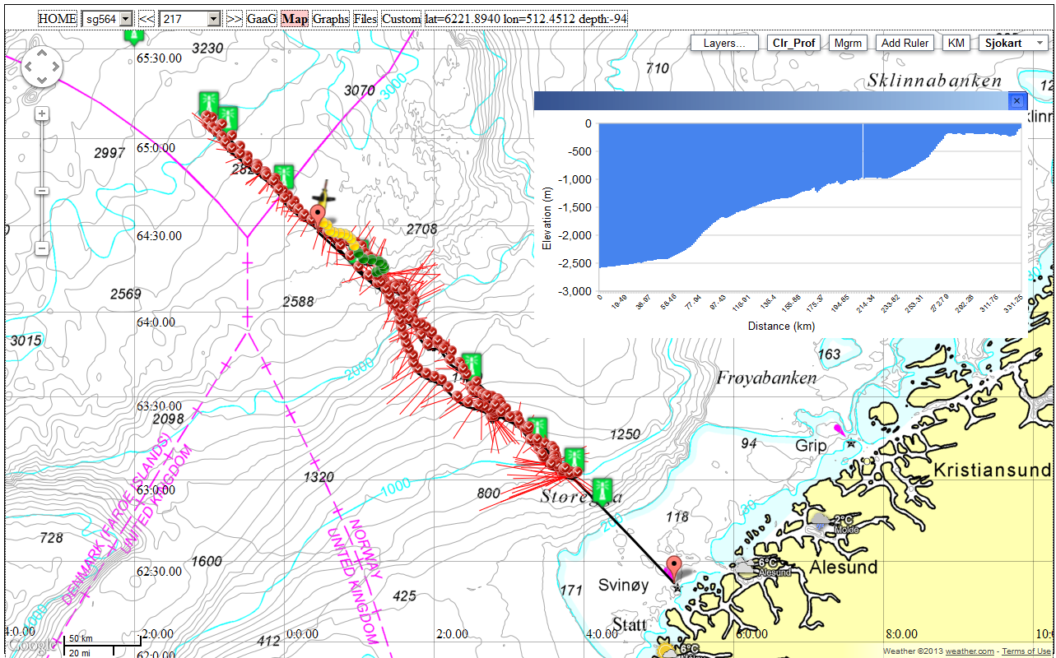
Gliderpage – Svinøy Seaglider repeat section
Fixed point observatory at shelf break @500m

Slide 7
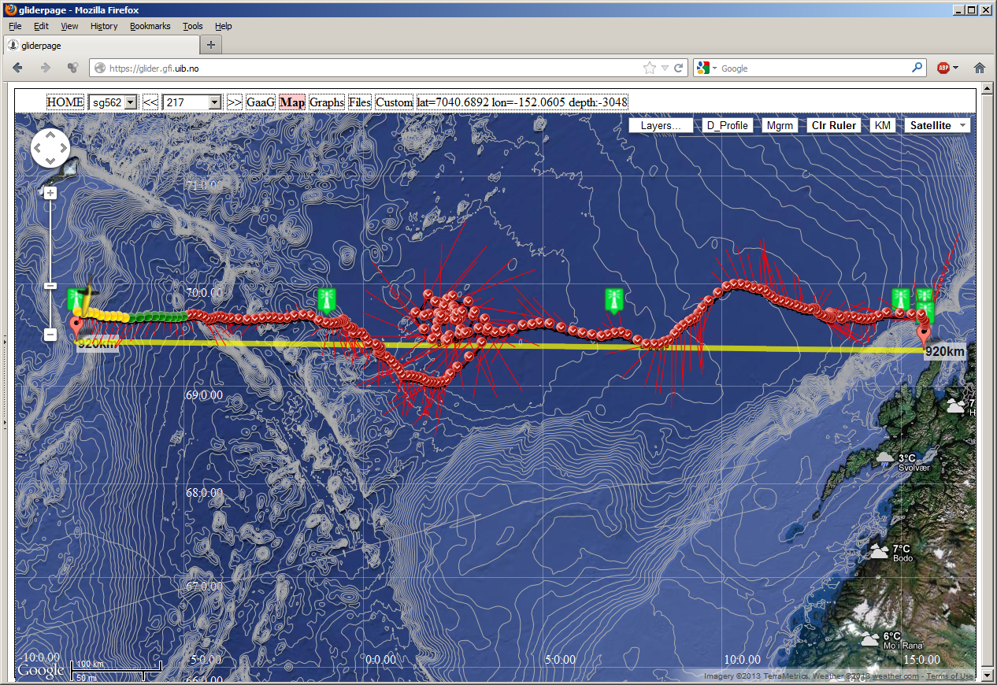
Lofoten basin section in Gliderpage
On Lofoten basin eddy see poster by Bosse and Fer –
Combination of 900km repeat section with process study

Slide 8
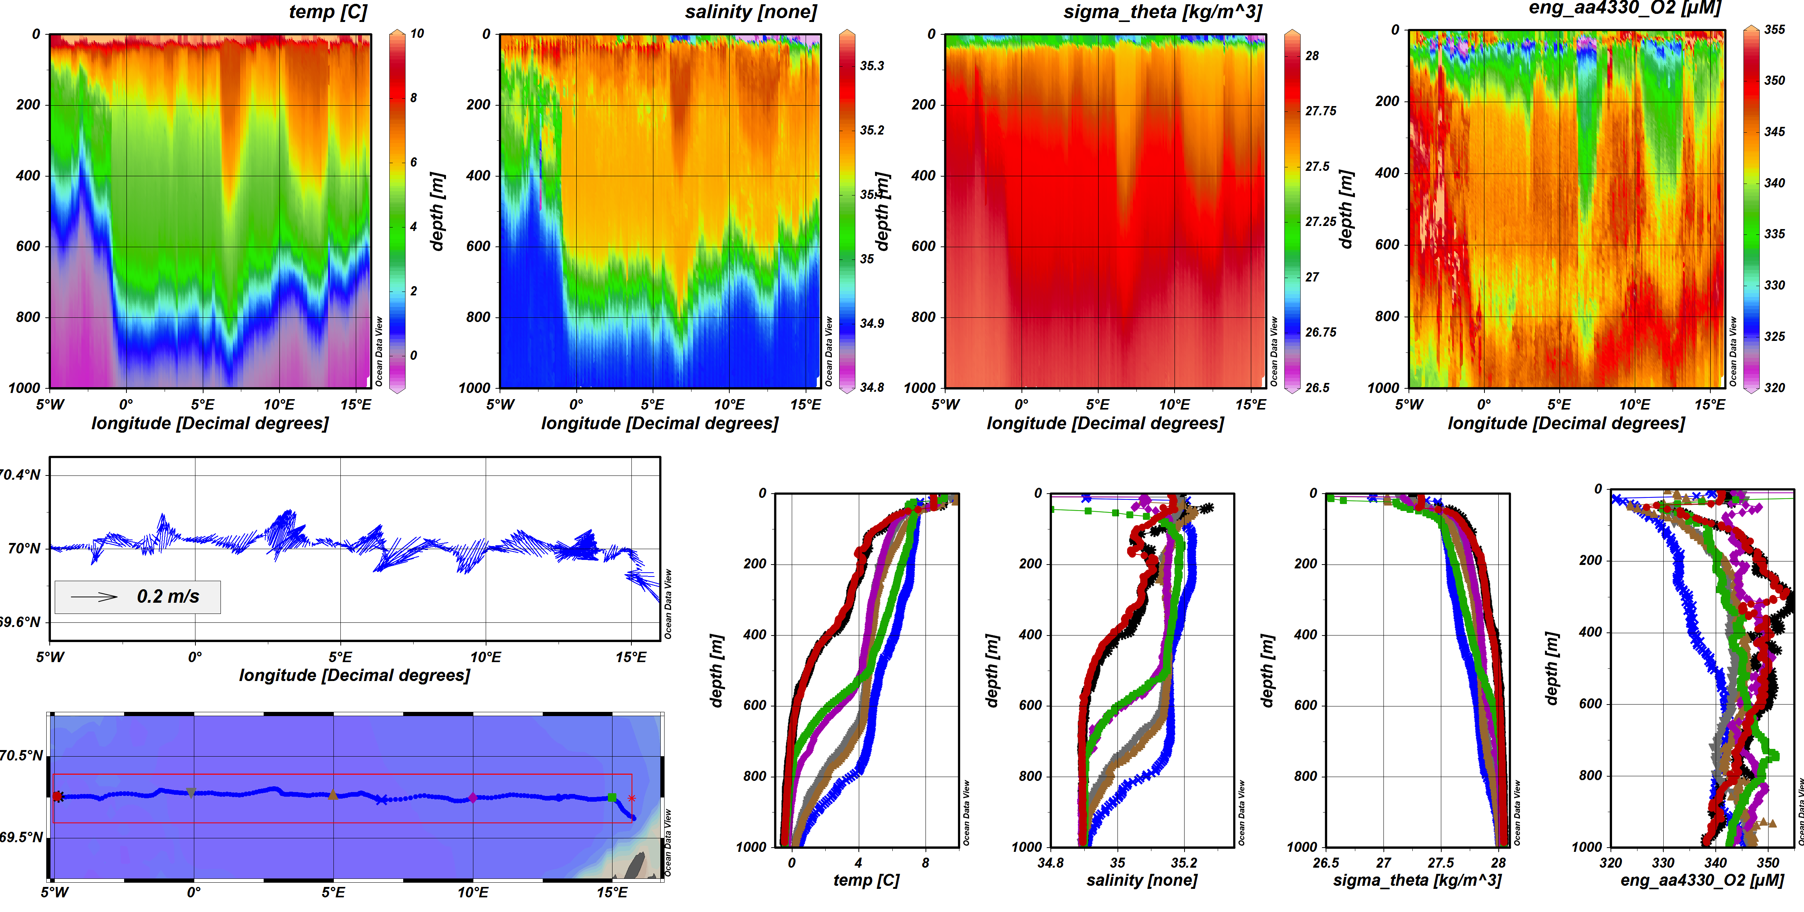
Typical standard section data

Slide 9
Piloting tool: Gliderpage developed at GFI
NACO: 6 Seagliders and 3 Slocums, > 40 000 km since 2012
No loss of equipment
Applied to projects in Norwegian Sea, Faroe-Shetland,
fresh water lake, coastal and fjord areas, Svalbard, Iceland
Web client based on Google Maps API v.3
Integration between Google Maps and open wms map data from statkart.no/geonorge.no, weather data from met.no/yr.no etc.
Integration between map application and technical matlab plots, communication with base station for editing of cmdfile/science/target, copy of data- and logfiles, monitoring of technical condition of glider.

Slide 10
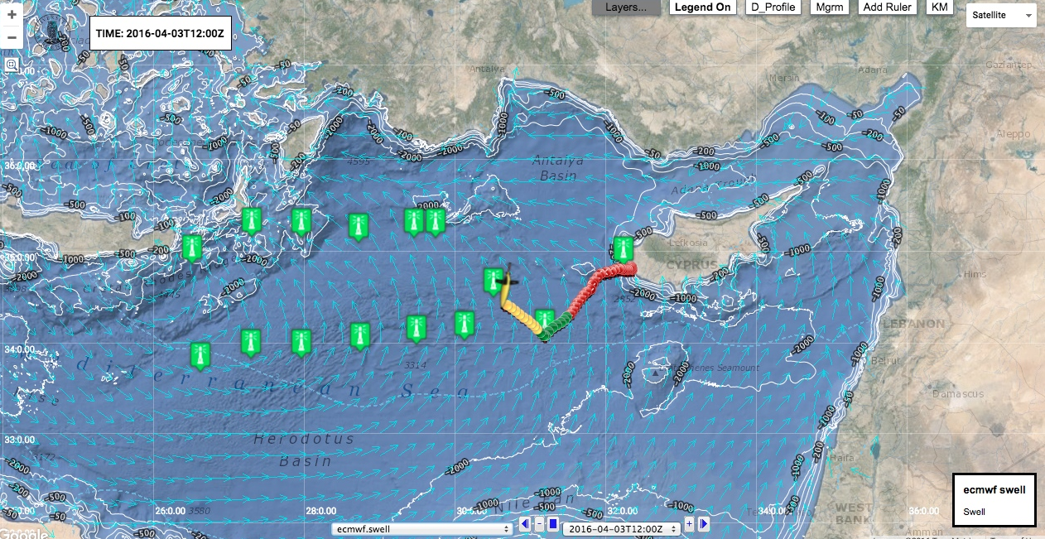
We appreciate international collaboration EGO, GROOM, AtlantOS, … Gliderpage also used by colleagues elsewhere.

Slide 11
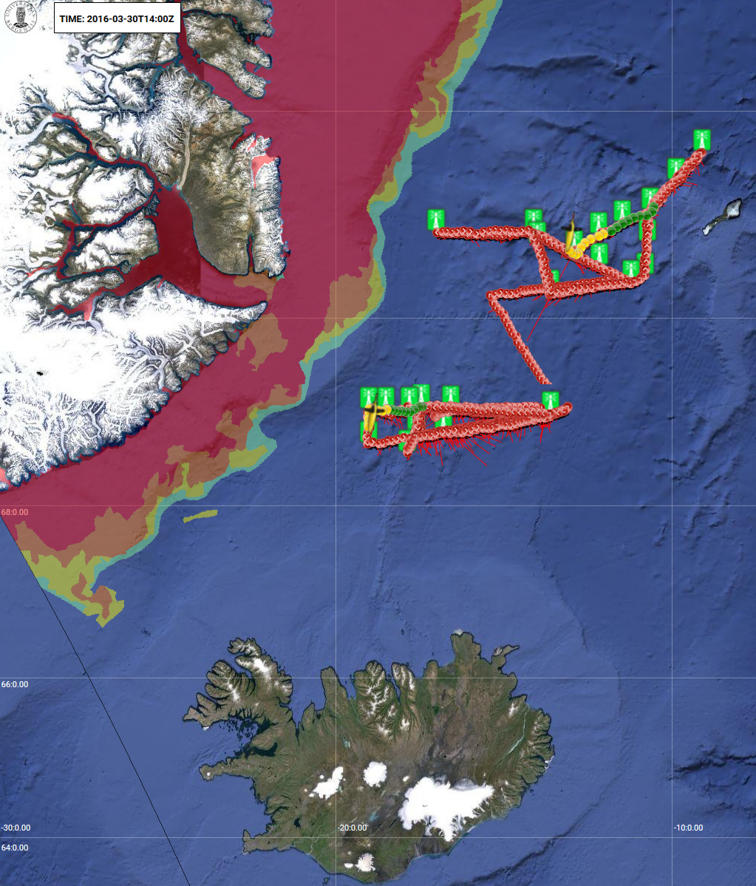
Recent operations Iceland – Jan Mayen – Greenland 3 Seagliders PI Kjetil Våge
Issues with sea ice
Navigation/Comm!
Low temp
Collisions
Entrapment

Slide 12
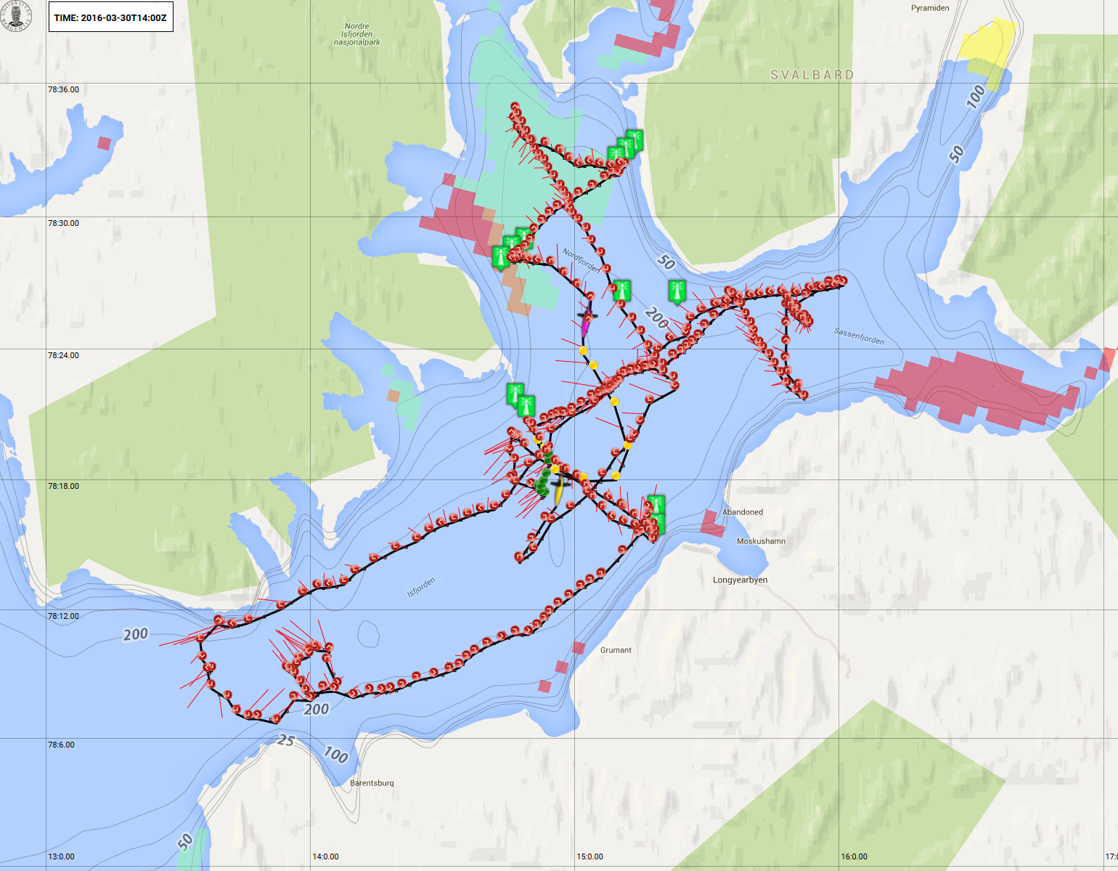
Example coastal/fjord project: Slocum operations in Isfjorden with the University Centre in Svalbard (UNIS) November 2014
Svalbard

Slide 13
Prospects
Extending area of operations to Svalbard and even south of Greenland-Scotland ridge as infrastructure serving new research projects
Gliders now considered in planning process for national sustained monitoring (Huse et al, IMR, 2015)
Consider move towards serving forecasting and biogeochemical applications

Slide 14
NACO project homepage, 2016, http://naco.gfi.uib.no
Realtime and historical data and tools http://naco2.gfi.uib.no

