Slide 1
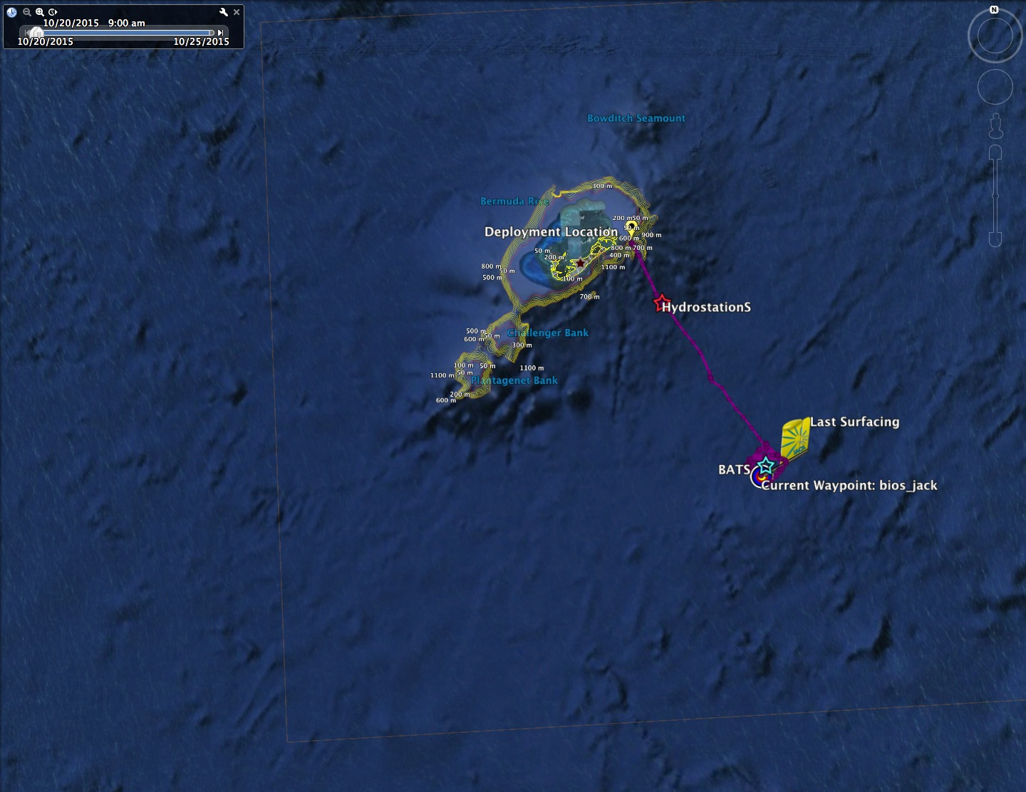


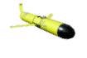
Radically Improved Observations of Physical and Biogeochemical Dynamics at Time Series Sites
Hydrostation “S”
BATS
Ruth Curry
Bermuda Institute of Ocean Sciences

Slide 2
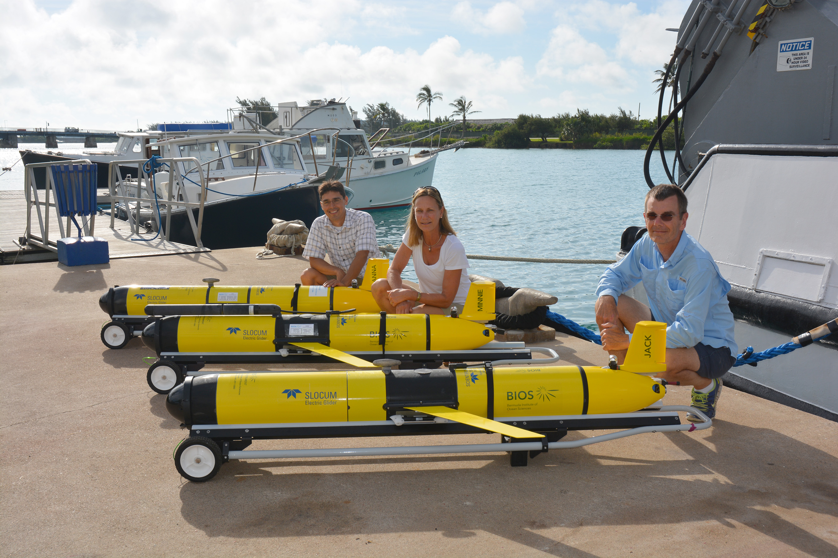
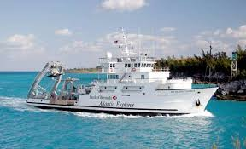
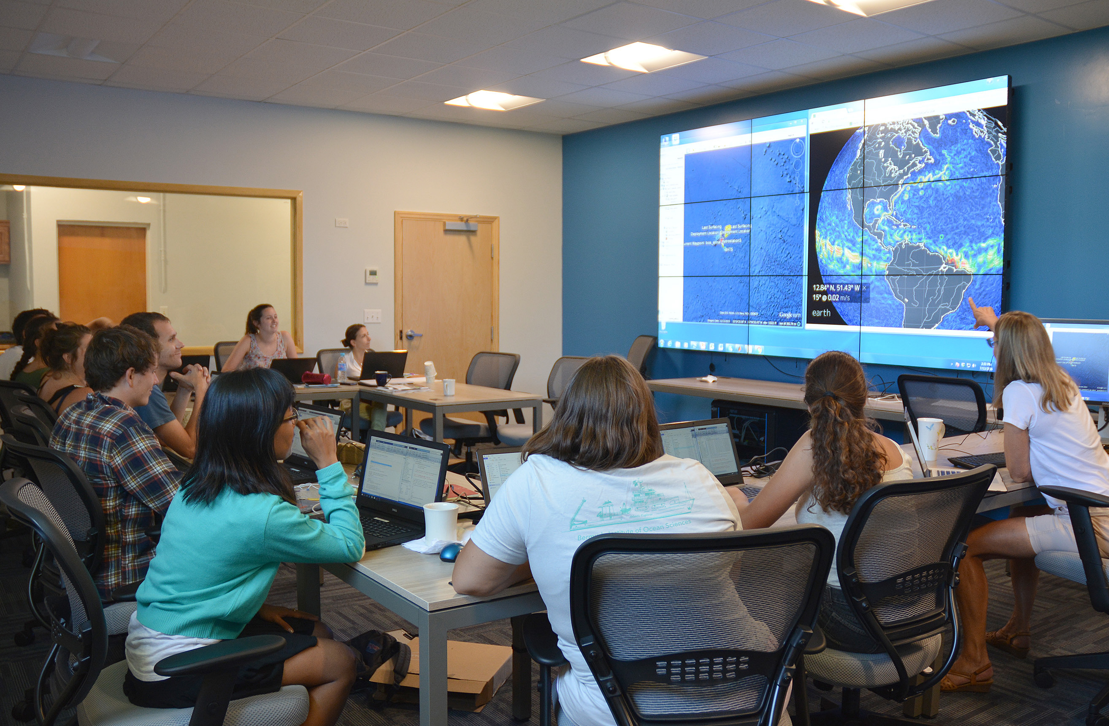

The MAGIC Team
R/V Atlantic Explorer
Bermuda: a great location for a glider lab….
The MAGIC Room

Slide 3
Scientific focus:
Dynamical response to hurricanes and winter storms
Carbon and nutrient cycling in the Sargasso Sea
Provide measurements of physical environment in support of other field programs
487 Days at Sea
Anna : 371
Minnie : 48
Jack : 68

Slide 4
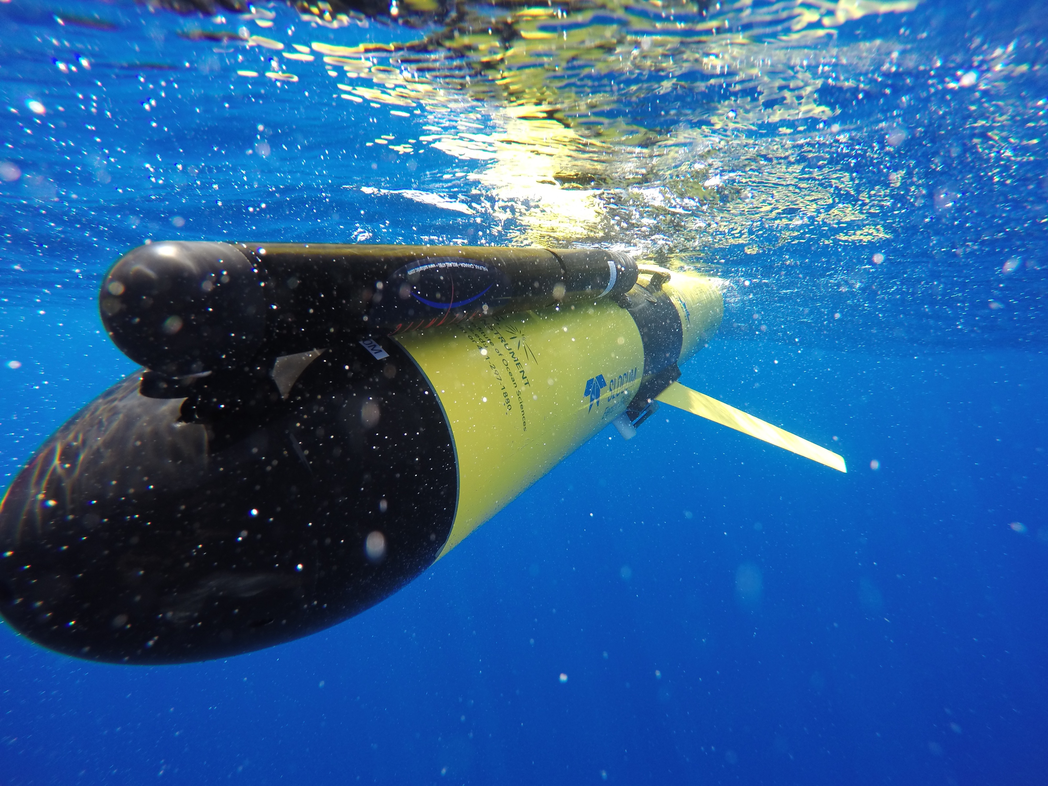
Gliders are providing detailed insights about the interplay between weather and ocean currents on short timescales (hours-days)…
…and how these affect the cycling of nutrients, oxygen and carbon -- processes at the core of the marine food web

Slide 5
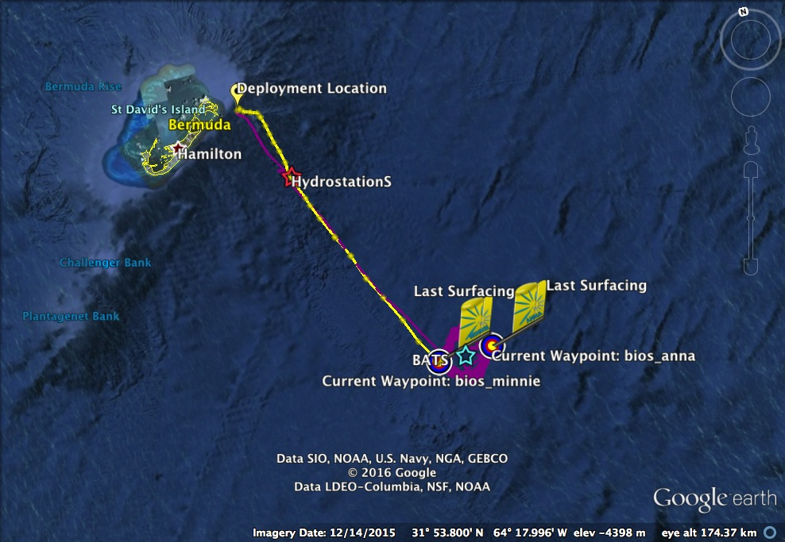
M
I
S
S
I
O
N
S
Spring Bloom
2016
Anna-5
15 Dec 2015 –
15 May 2016
Minnie-2
3 – 24 May 2016

Slide 6
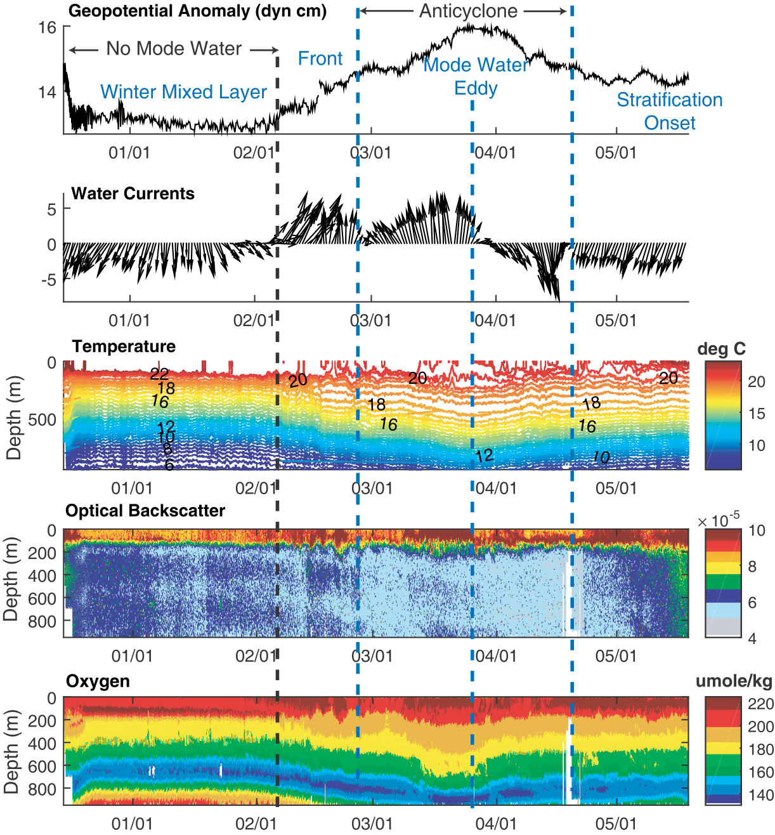
Anna-5
Spring Bloom 2016
Hydrographic Structures

Slide 7
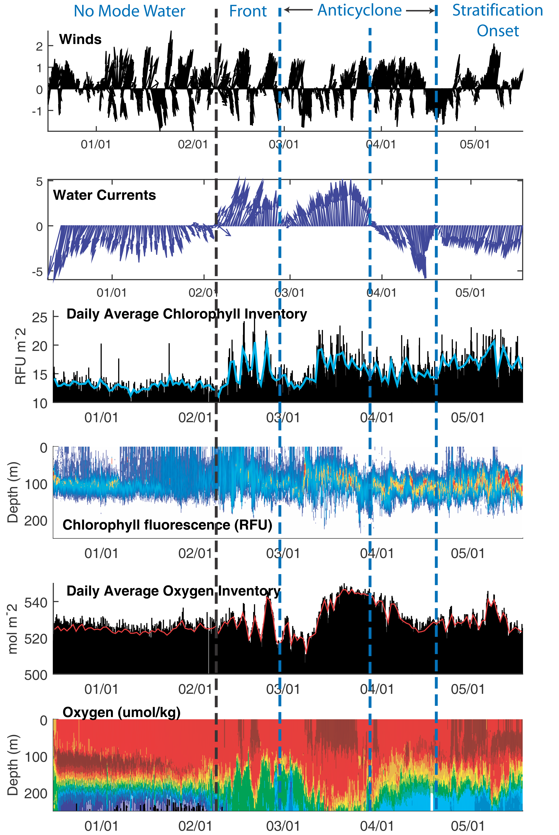
Anna-5
Spring Bloom 2016
New Production: Chlorophyll, O2 Inventories

Slide 8
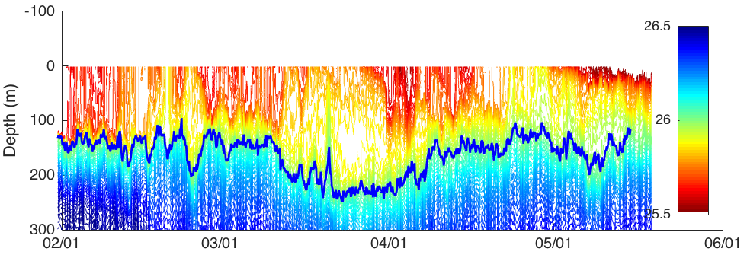
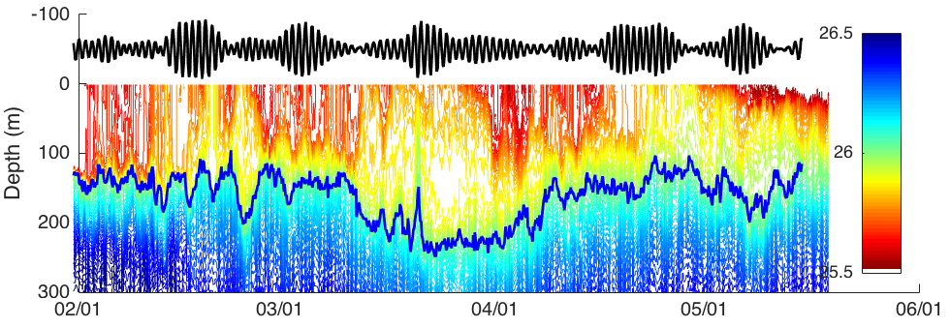
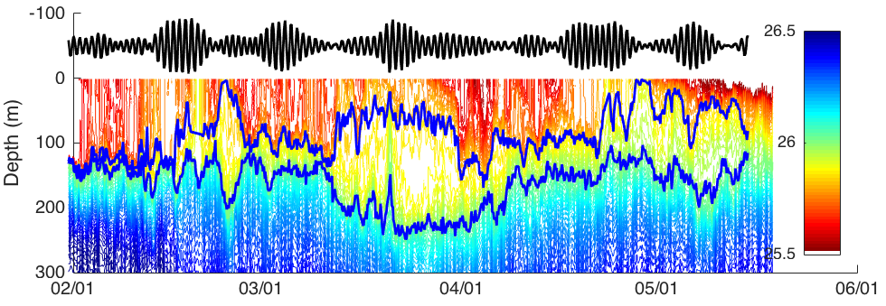
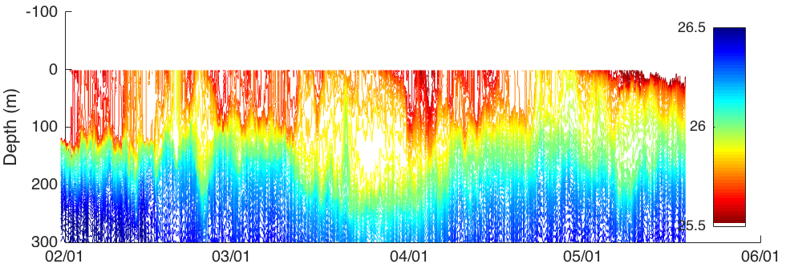
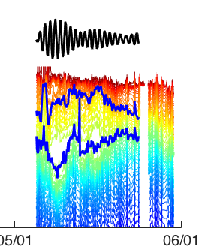
Anna-5
Depth of 20 deg isotherm, band-passed at the inertial frequency
Density
Sampling as virtual moorings, gliders measure range of frequencies (inertial - mesoscale) and episodic instabilities at the base of the mixed layer which bring deeper nutrient-rich waters up into the photic zone.
Minnie-2

Slide 9
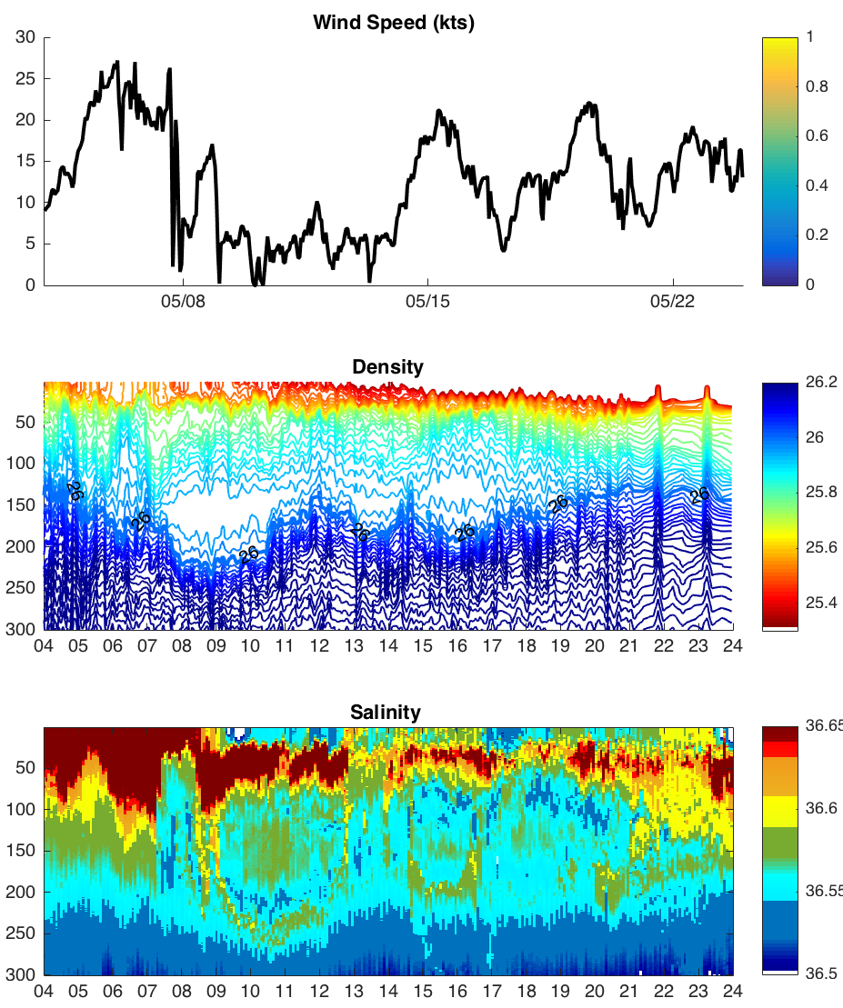
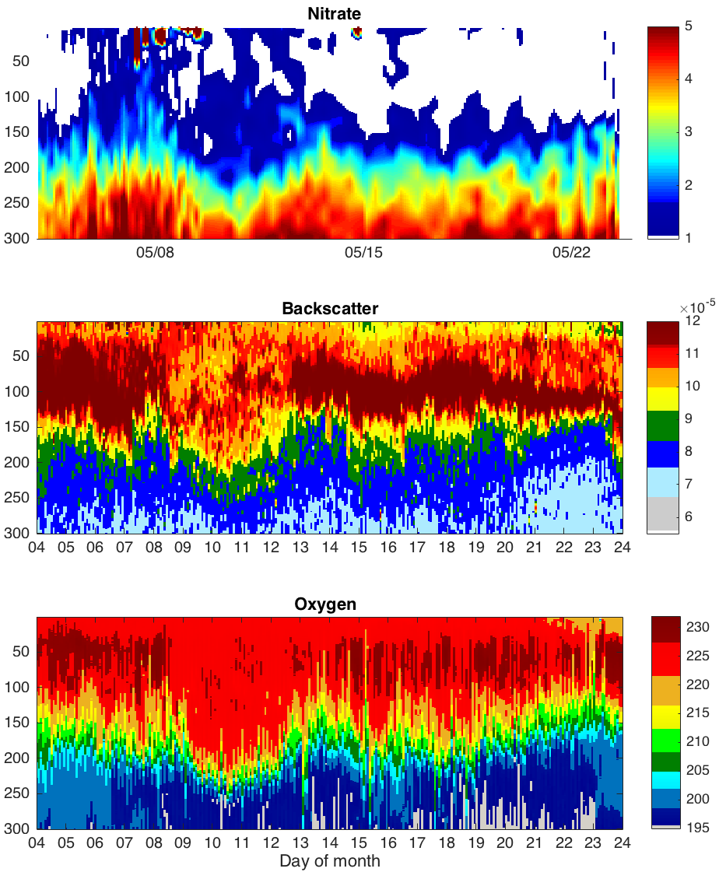
Minnie : Spring Bloom May 2016
May 5 - 9

Slide 10
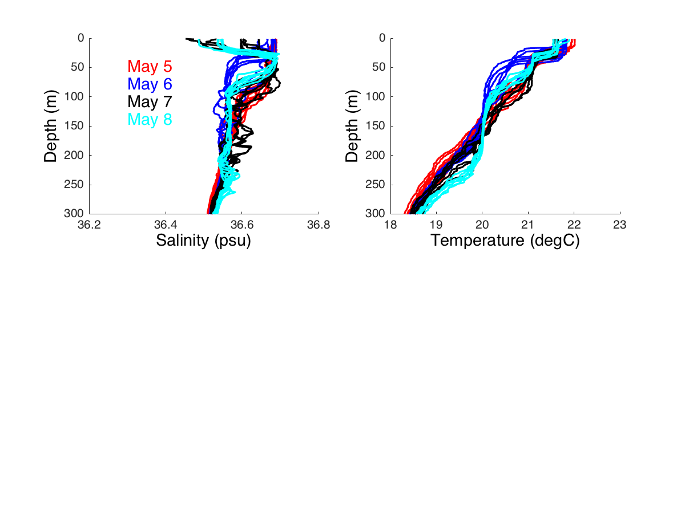
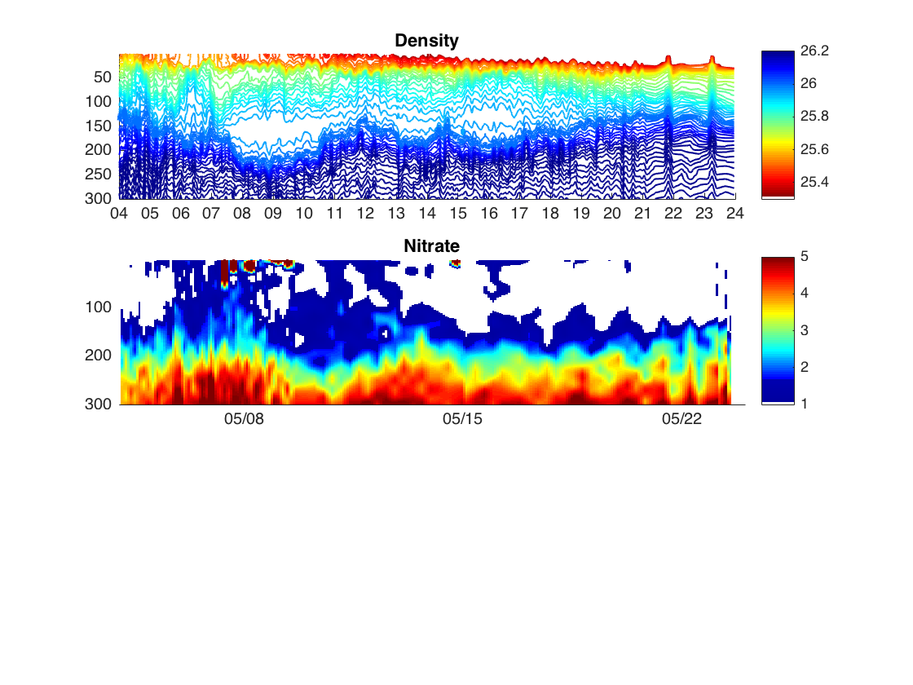
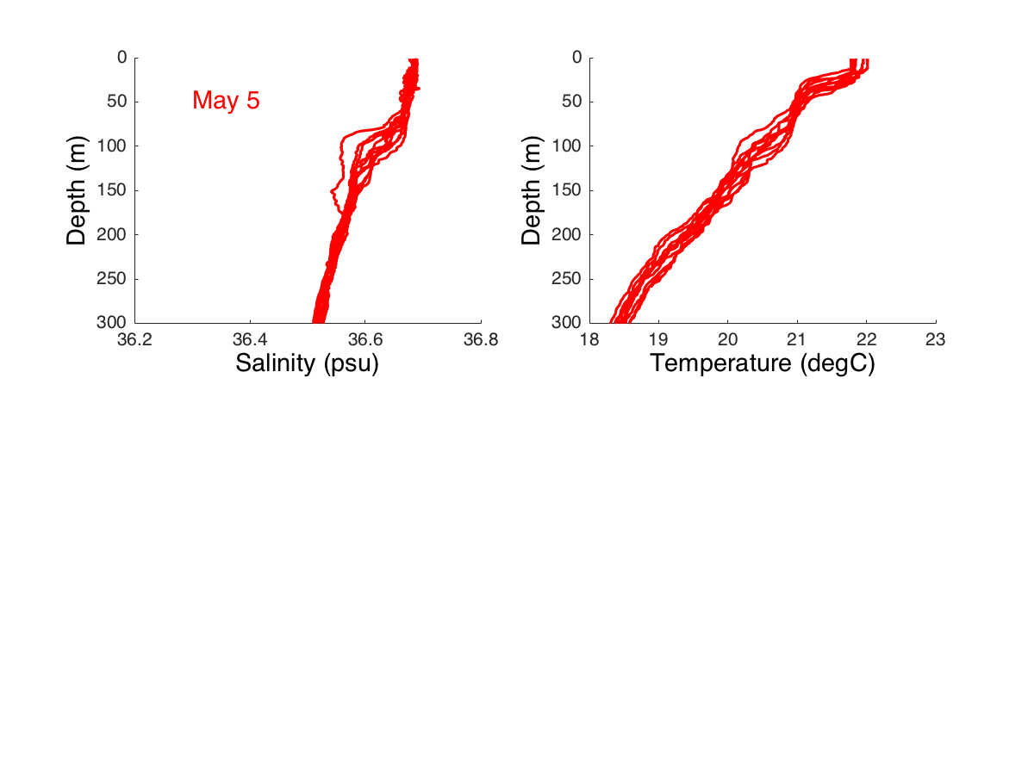
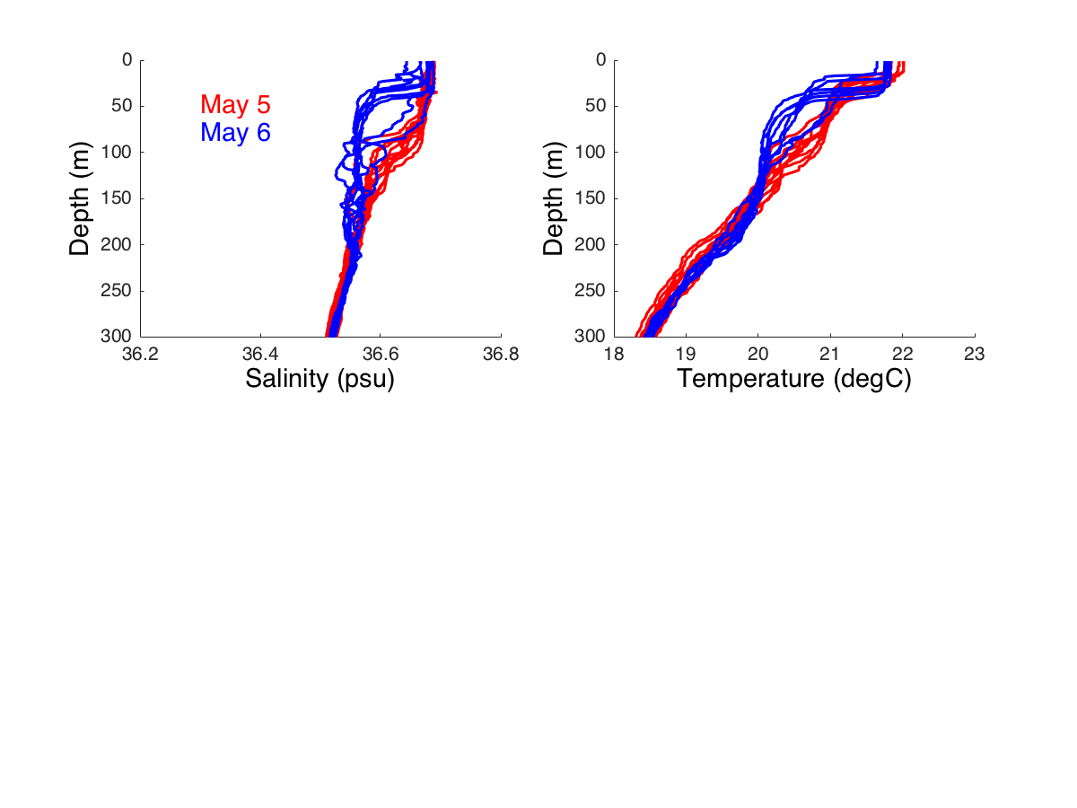
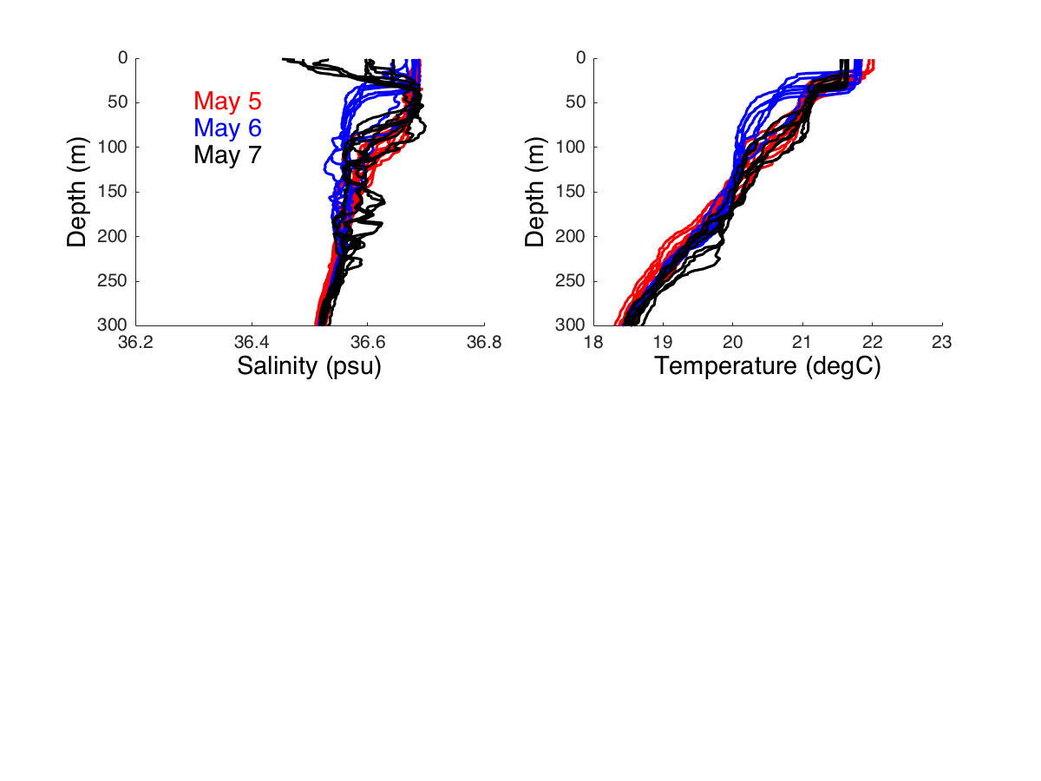
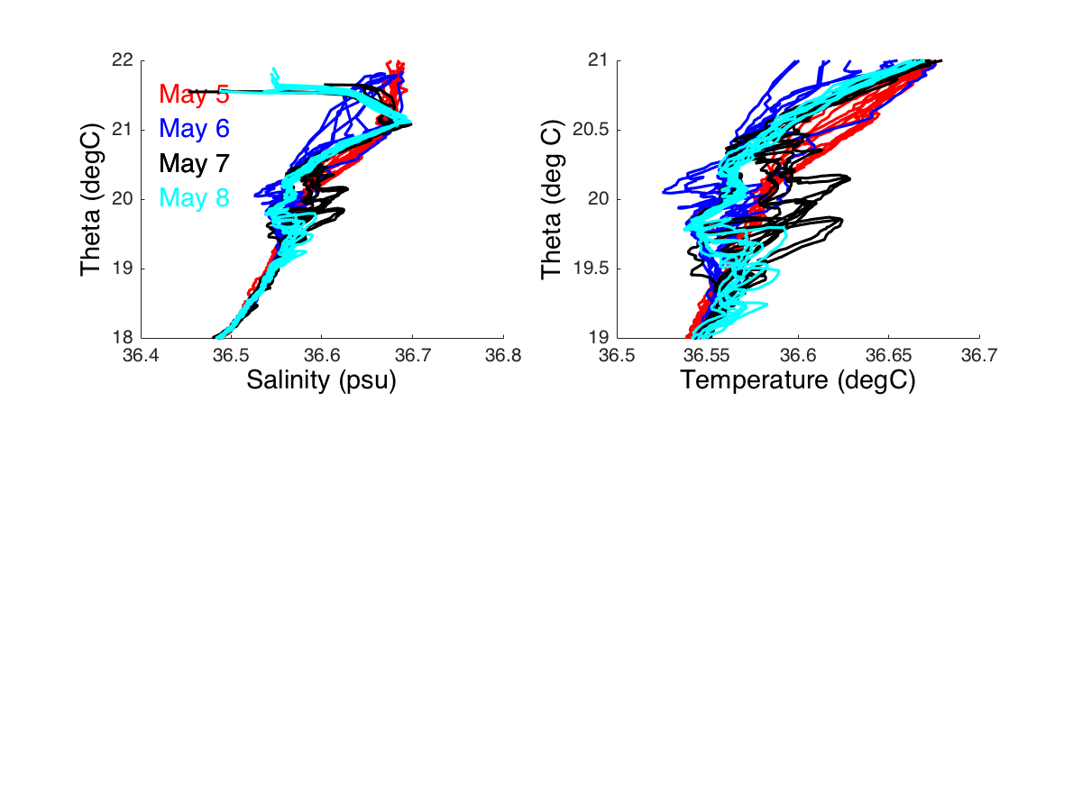
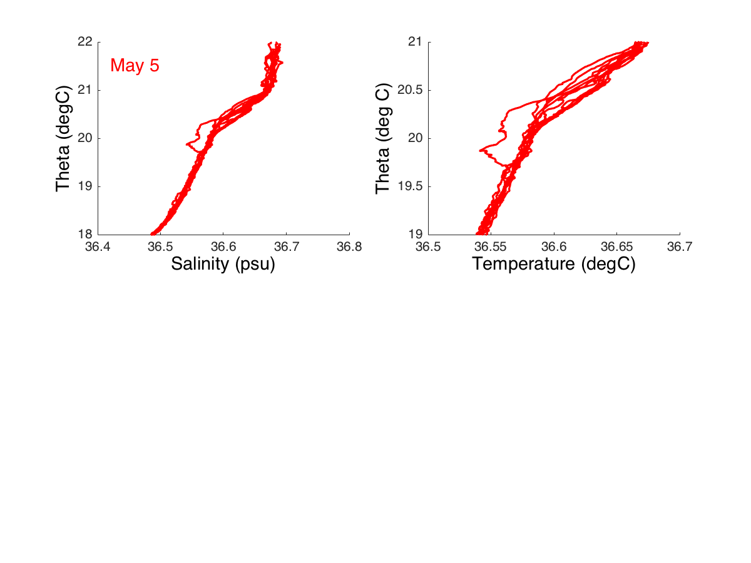
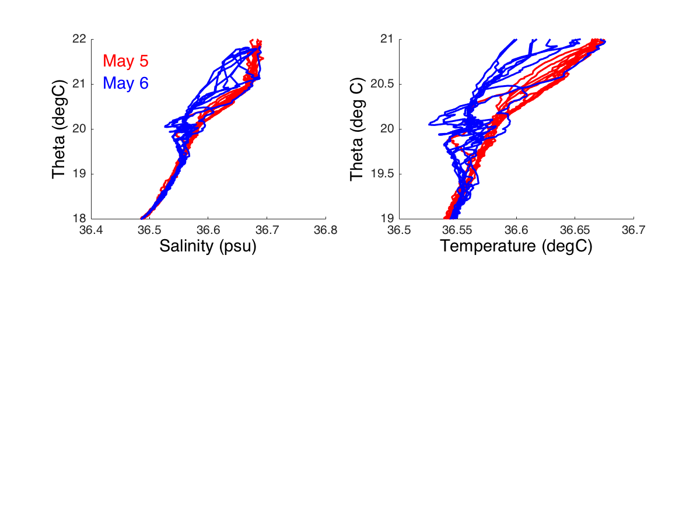
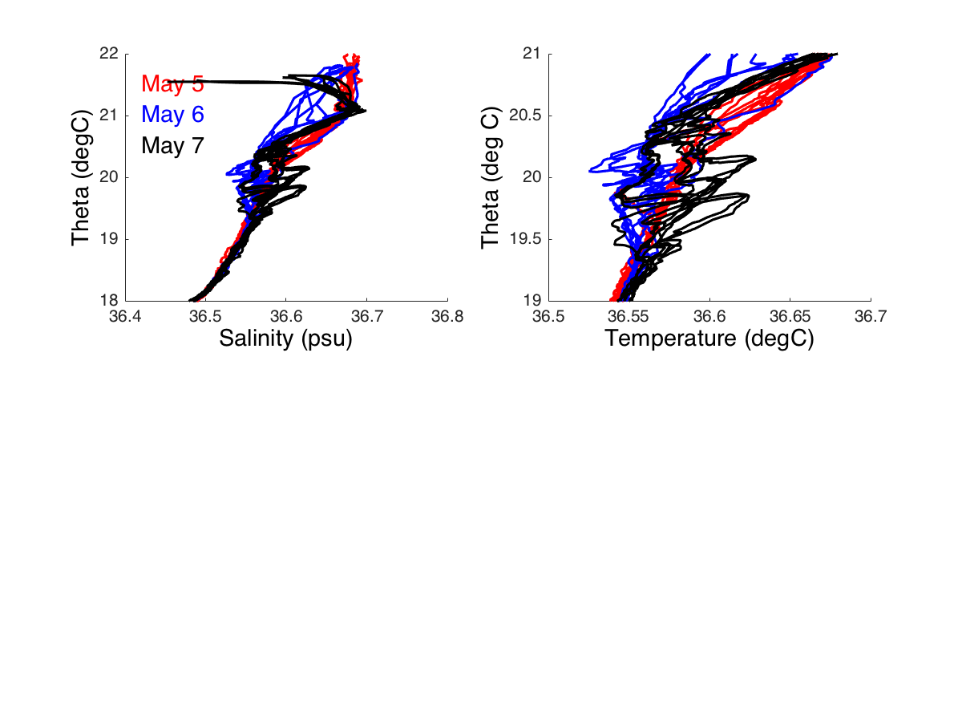
The event reset upper ocean properties in 4 days…
The boundary layer heaved up and down….
S
T
Mixing
Event
T-S
Created instabilities and turbulent mixing at base of ML which pumped nutrients and low salinity waters upward to the photic zone
5 – 9 May

Slide 11
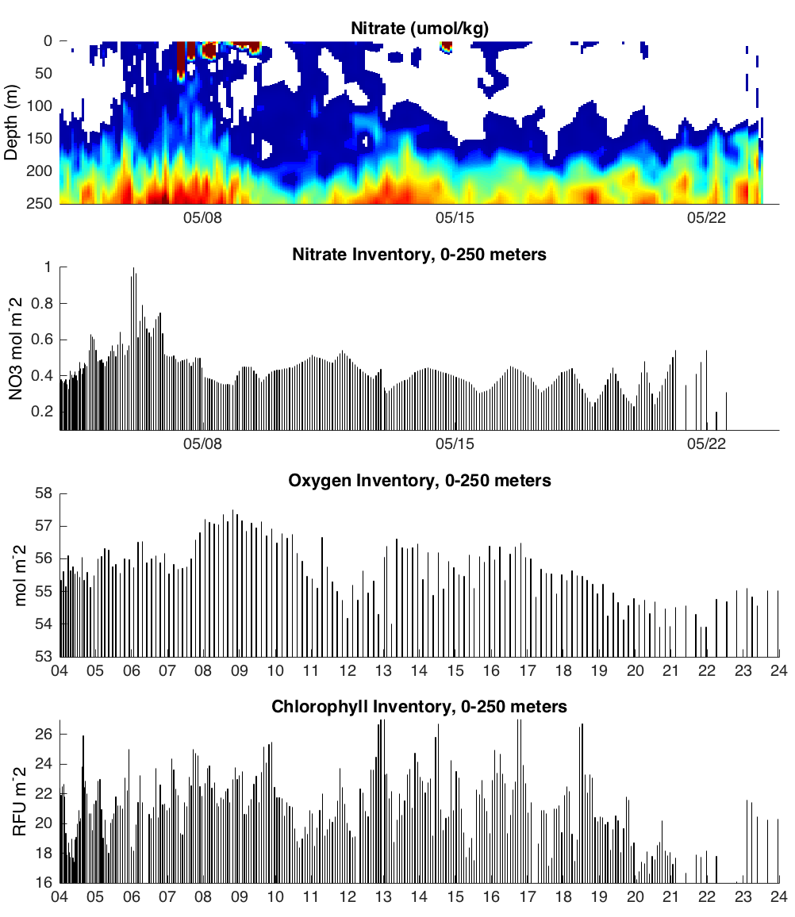
Inventories of nitrate, oxygen and chlorophyll…
reveal details of the biogeochemical response to the nitrate injection over the timeframe of 1-2 weeks.
NO3 and O2 inventories change in approximate Redfield proportions.
Photic Zone
Injection
Production
Remineralization
NO3
In
P
Respiration
O2
In
P
R
Chlor

Slide 12
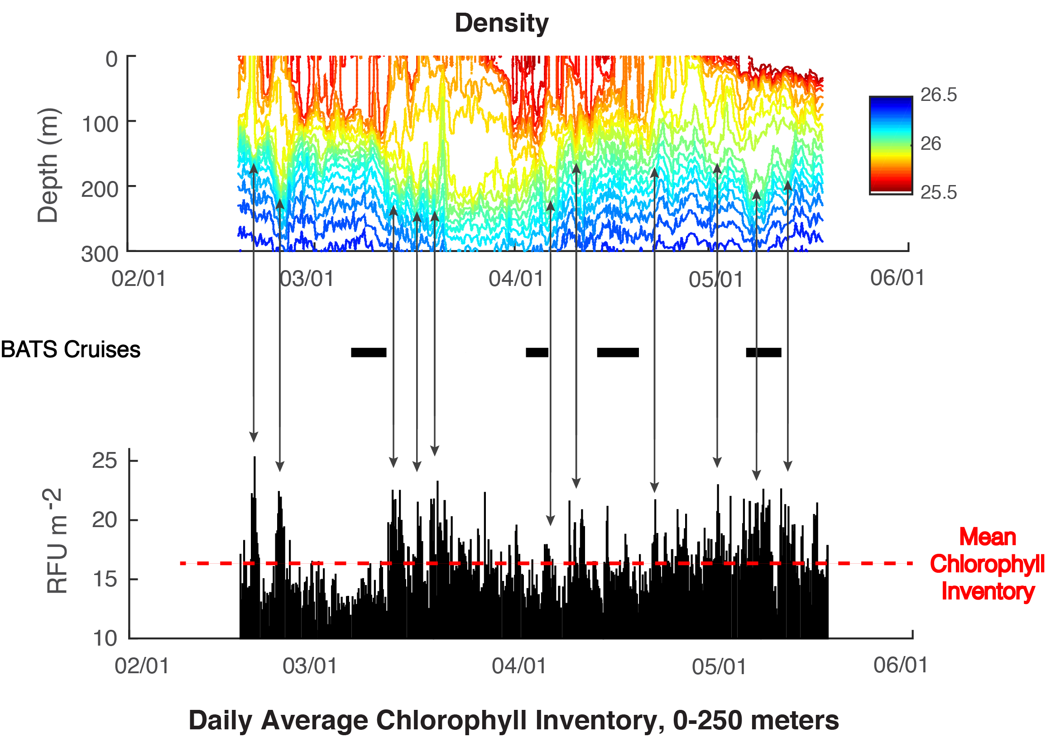
Short-term mixing events
Spring Bloom 2016
Anna-5

Slide 13
