Slide 1

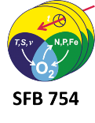

Occurrence and characteristics of mesoscale eddies in the tropical northeast Atlantic Ocean
Florian Schütte¹, Johannes Karstensen¹ and Peter Brandt^{1,2}
[1] GEOMAR Helmholtz Centre for Ocean Research Kiel, Germany
[2] Kiel University, Kiel, Germany
7th EGO conference on autonomous ocean gliders and their applications
Southampton, Great Britain
September 26-29, 2016

Slide 2

Sea surface temperature snapshot (May 4th, 2016)
Impact and role of eddies for ocean circulation, oceanic primary productivity and ocean biogeochemistry are still not fully understood
Notes:
Eddies are a prominent feature of the ocean circulation and exist over a wide range of scales
Impact on the large-scale circulation through the exchange of energy and dispersal of tracers
Effect on biogeochemical properties

Slide 3
Eastern boundary upwelling systems
25
22
19
16
°C
13
Equatorward winds result in offshore Ekman transport and subsequent coastal upwelling
s
On the continental shelf cold, fresh, nutrient-rich waters are upwelled

Slide 4
Eastern boundary upwelling systems
25
22
19
16
°C
13
Eddies have been identified as major agents for the exchange between coastal and the open ocean waters

Slide 5
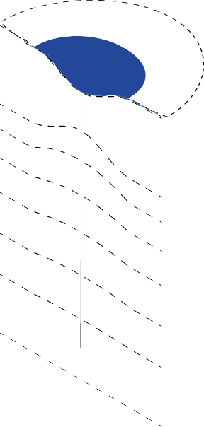
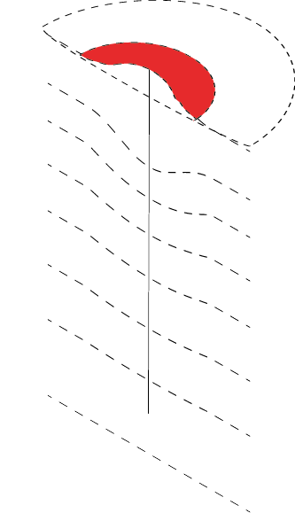
Mesoscale eddies (Northern Hemisphere)
Cyclone
Anticyclone
Sea level
depression
Sea level
elevation

Slide 6
Mesoscale eddies (Northern Hemisphere)
Cyclone
Anticyclone
Elevation
of isopycnals
Depression
of isopycnals
Notes:
It is need to be said that less is kwon about the vertical structure compared to the eddy surface signatures.

Slide 7
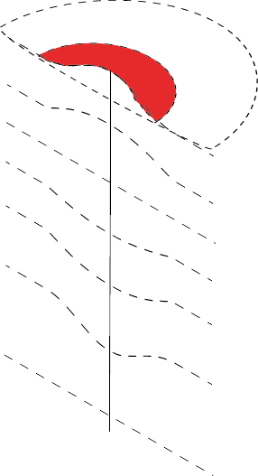
Mesoscale eddies (Northern Hemisphere)
Cyclone
Anticyclone
Anticyclonic Mode Water Eddy (ACME)
Sea level
elevation
Elevation
of isopycnals
Depression
of isopycnals
Recent model studies suggest that ACMEs represent a non-negligible part of the eddy field (Combes et al. 2015, Nagai et al. 2015)

Slide 8
Scientific key questions
1. What are the occurrence and characteristics of eddies generated in the eastern tropical North Atlantic?
2. What is the impact of the eddies on the large-scale heat, salt and oxygen distribution?
Notes:
3. How do oxygen concentrations in the eddy core evolve, and what is the eddies’ impact on the large-scale oxygen distribution?

Slide 9
Method: Sea level anomaly snapshot (May 4th, 2012)
cm
Sea level anomaly (SLA) and associated geostrophic velocity
Delayed-time reference data set “all-sat-merged” of SLA (Version 2014); daily temporal (1995 to 2013) and ¼° spatial resolution

Slide 10
Method: Eddy detection
cm

Slide 11
Method: Eddy detection
Algorithms are develop to detect and count eddies
Pre-requisites:
Eddy radius > 45 km
Eddy lifetime > 7 d
radius
> 45 km
cm

Slide 12
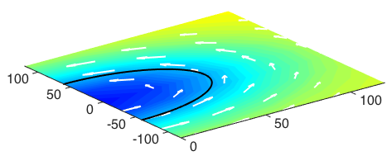
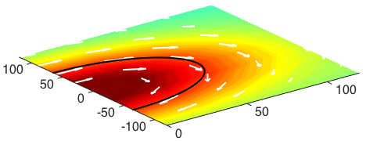
Mean eddy surface structure
Cyclone
Anticyclone
52%
48%
SLA
SLA
r
r
Distance from eddy center (km)
Distance from eddy center (km)
r
= average radius 51 ± 5 km
r
= average radius 53 ± 5 km

Slide 13
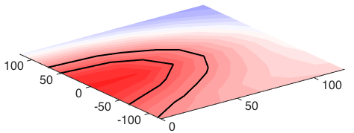

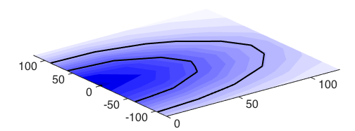
Mean eddy surface structure
Cyclone
Anticyclone
52%
48%
SLA
SLA
SST anomaly (SSTa)
0.2
SST anomaly (SSTa)
0.1
-0.05
0.05
-0.1
0.1
0
-0.1
-0.2
°C

Slide 14
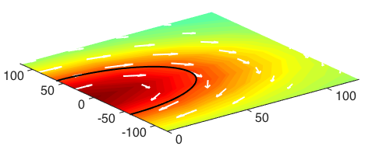
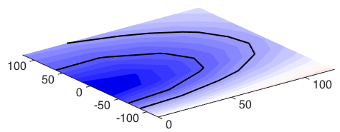
Mean eddy surface structure
Cyclone
Anticyclone
20% of all Anticyclones
52%
48%
39%
9%
SLA
SLA
SLA
SSTa
SSTa
SSTa
0.2
-0.05
0.05
-0.05
0.1
-0.1
0.1
-0.1
0
-0.1
-0.2
°C

Slide 15
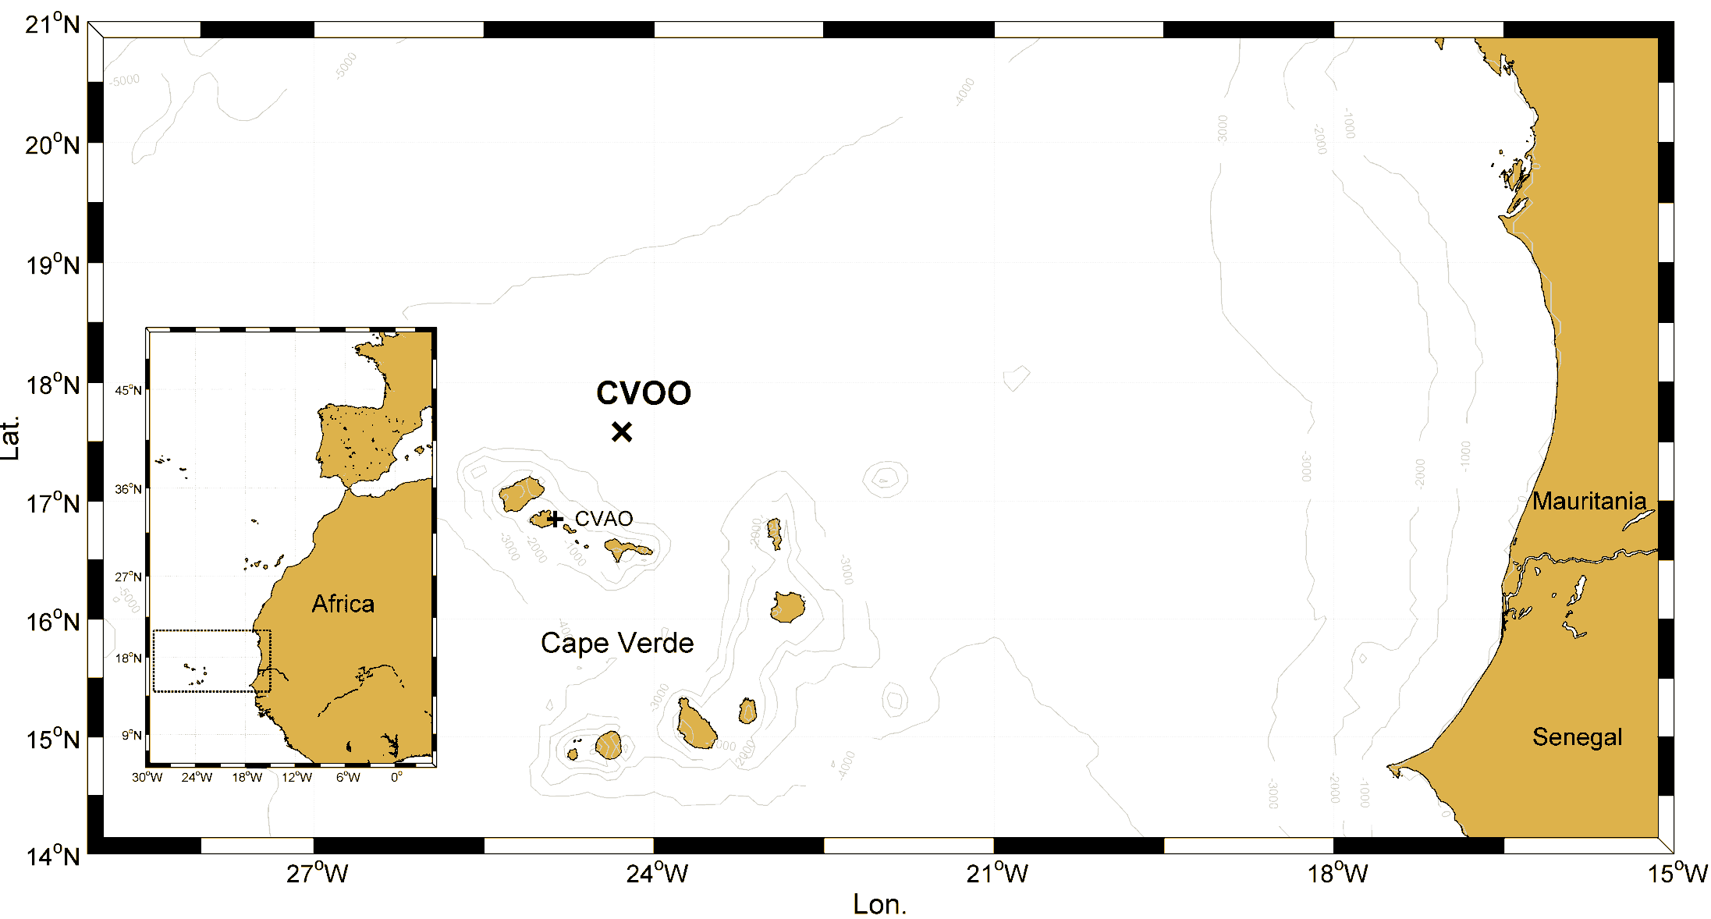
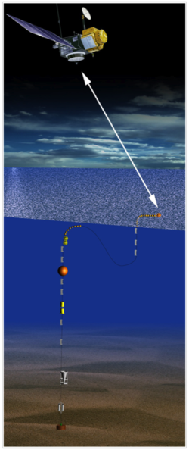
Monitoring System
Sea surface temperature (SST)
CVOO mooring and telemetry
Sea surface salinity (SSS)
Chlorophyll (Chl)
SLA

Slide 16
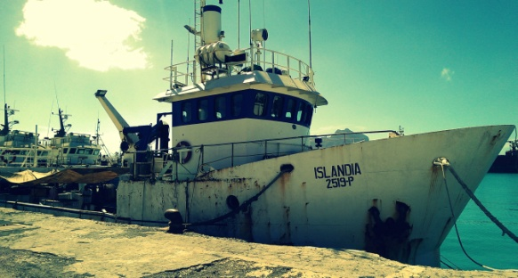
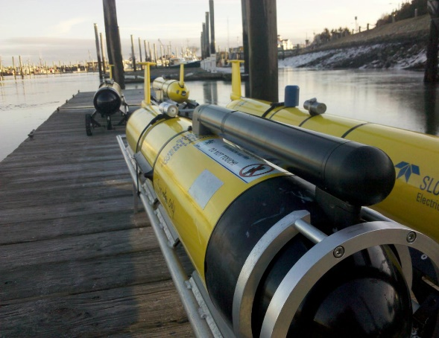
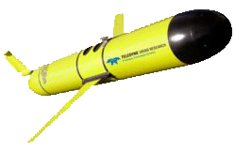
Eddy Hunt
Photo: Teledyne Webb Research

Slide 17
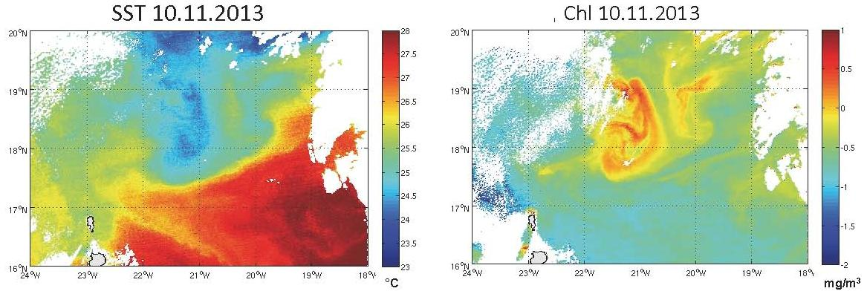
Monitoring System
open for everyone at http://cvoo.geomar.de/

Slide 18
Eddy Hunt

Slide 19
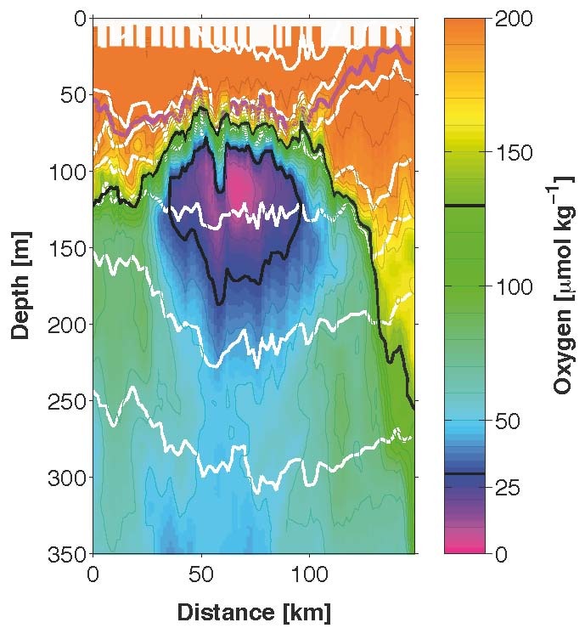
Glider data of an ACME
Temperature
Salinity
Oxygen

Slide 20
Mean eddy surface structure
Cyclone
Anticyclone
20% of all Anticyclones
52%
48%
39%
9%
SLA
SLA
SLA
SSTa
SSTa
SSTa
0.2
-0.05
0.05
-0.05
0.1
-0.1
0.1
-0.1
0
-0.1
-0.2
°C

Slide 21
Mean eddy surface structure
Cyclone
Anticyclone
ACME
52%
39%
9%
SLA
SLA
SLA
SSTa
SSTa
SSTa
0.2
-0.05
0.05
-0.05
0.1
-0.1
0.1
-0.1
0
-0.1
-0.2
°C

Slide 22


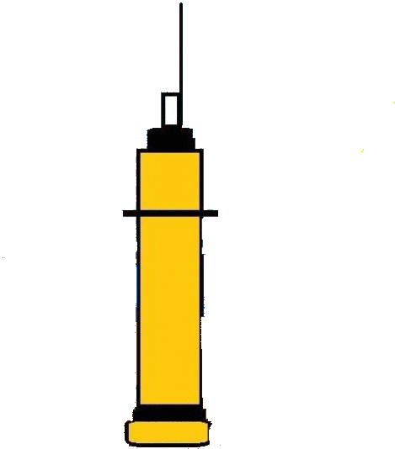
Data: In-situ data
In total 16.059 profiles:
Shipboard CTD stations (12%) 8 Glider deployments (6%)
Argo float profiles (60%) Cape Verde Ocean Observatory (22%)

Slide 23
Method: Combining vertical profiles with satellite data
vertical
profile
inside
cm
vertical profile outside

Slide 24
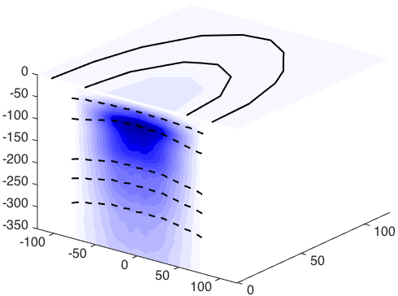
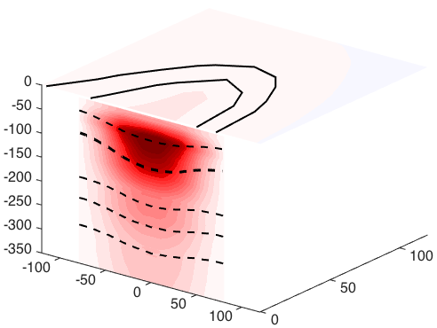
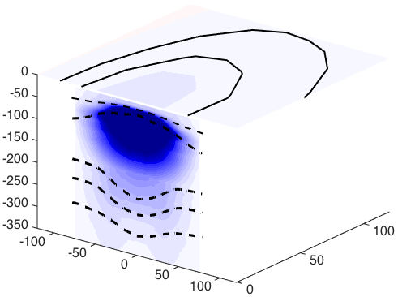
Mean eddy surface and vertical structure
Cyclone
Anticyclone
ACME
SSTa
SSTa
SSTa
2.5
1.5
0
-1.5
-2.5
°C
0

Slide 25
Mean eddy surface and vertical structure
Cyclone
Anticyclone
ACME
SSTa
SSTa
SSTa
2.5
1.5
0
-1.5
-2.5
°C
0
Eddy-induced cooling of Area II explains ~10% of the net surface heat flux
Eddy-based lateral transport of 2.07 Sv of SACW

Slide 26
Mean vertical eddy oxygen structure
Cyclone
ACME
Depth (m)
Oxygen anomaly (µmol kg⁻¹)
Distance from eddy center (km)
Highest oxygen anomaly right beneath the mixed layer
ACMEs feature much stronger oxygen anomalies

Slide 27
Impact of eddies on the oxygen distribution
shallow
OMZ
shallow
OMZ
Depth (m)
deep
OMZ
deep
OMZ
Oxygen (µmol kg⁻¹)

Slide 28
Impact of eddies on the oxygen distribution
Oxygen profile in the eastern tropical North Atlantic with oxygen depleted eddies
shallow
OMZ
shallow
OMZ
---- Oxygen profile in the eastern tropical North Atlantic without oxygen depleted eddies
Depth (m)
deep
OMZ
deep
OMZ
Oxygen (µmol kg⁻¹)
Oxygen depleted eddies are partly responsible for the formation of the shallow oxygen minimum zone

Slide 29
Summary
1. What are the occurrence and characteristics of eddies generated in the eastern tropical North Atlantic?
Three types of eddies exist: Anticyclones, Cyclones and ACMEs
The eddies feature strong T/S anomalies, most intense beneath the mixed layer
Cyclone
Anticyclone
ACME
SLA
SLA
SLA
SSTa
SSTa
SSTa

Slide 30
Summary
1. What are the occurrence and characteristics of eddies generated in the eastern tropical North Atlantic?
Three types of eddies exist: Anticyclones, Cyclones and ACMEs
The eddies feature strong T/S anomalies, most intense beneath the mixed layer
2. What is the impact of the eddies on the large-scale heat, salt and oxygen distribution?
Eddies induce a lateral transport and serve as transport agents, exporting the characteristics of the upwelling area from the coast, into the open ocean
The mesoscale eddy field directly impacts the regional heat/salt/oxygen budgets
Oxygen-depleted eddies are partly responsible for the formation of the shallow oxygen minimum zone

Slide 31
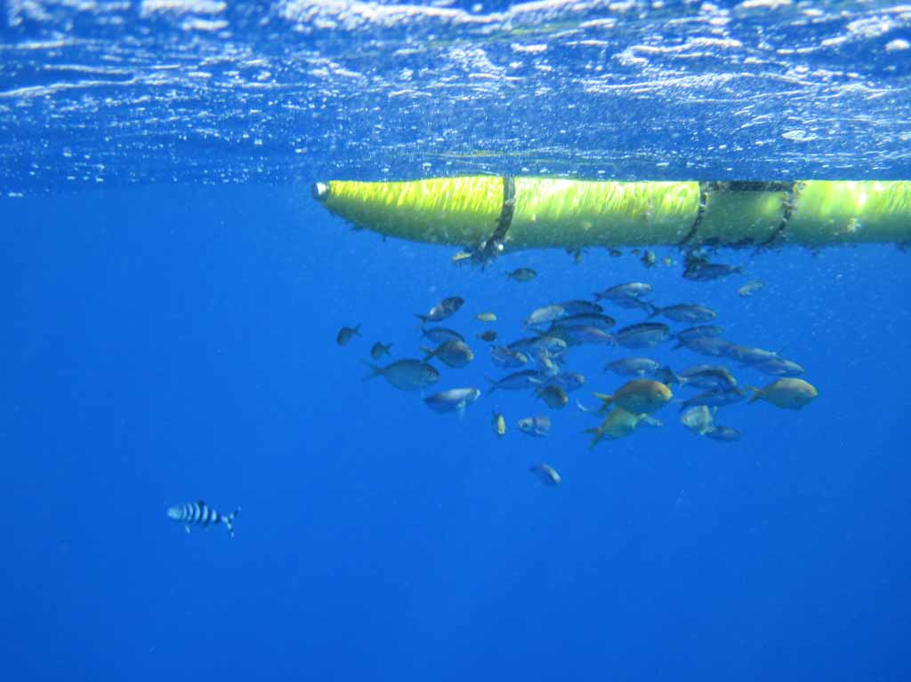
Extra Slides
Thank You

Slide 32
Reference
Schütte, F., Brandt, P., and Karstensen, J.: Occurrence and characteristics of mesoscale eddies in the tropical northeastern Atlantic Ocean, Ocean Science, 12, 663-685, doi: 10.5194/os-12-663-2016, 2016
Schütte, F., Karstensen, J., Krahmann, G., Hauss, H., Fiedler, B., Brandt, P., Visbeck, M., and Körtzinger, A.: Characterization of „dead-zone“ eddies in the tropical Northeast Atlantic Ocean, Biogeoscience Discuss., doi: 10.5194/bg-2016-33, 2016
Zindler, C., Marandino, C. A., Bange, H. W., Schütte, F., and Saltzman, E. S.: Nutrient availability determines dimethyl sulfide and isoprene distribution in the eastern Atlantic Ocean, Geophysical Research Letters, 41, doi:10.1002/2014GL059547, 2014
Karstensen, J., Fiedler, B., Schütte, F., Brandt, P., Körtzinger, A., Fischer, G., Zantopp, R., Hahn, J., Visbeck, M., and Wallace, D.: Open ocean dead zones in the tropical North Atlantic Ocean, Biogeoscience 12, 2597-2605, doi: 10.5194/bg-12-2597-2015, 2015
Löscher, C. R., Fischer, M. A., Neulinger, S. C., Fiedler, B., Philippi, M., Schütte, F., Singh, A., Hauss, H., Karstensen, J., Körtzinger, A., Künzel, S., and Schmitz, R. A.: Hidden biosphere in an oxygen-deficient Atlantic open-ocean eddy: future implications of ocean deoxygenation on primary production in the eastern tropical North Atlantic, Biogeosciences, 12, 7467-7482, doi: 10.5194/bg-12-7467-2015, 2015
Hauss, H., Christiansen, S., Schütte, F., Kiko, R., Edvam Lima, M., Rodrigues, E., Karstensen, J., Löscher, C. R., Körtzinger, A., and Fiedler, B.: Dead zone or oasis in the open ocean? Zooplankton distribution and migration in low-oxygen modewater eddies, Biogeosciences, 13, 1977-1989, doi: 10.5194/bg-13-1977-2016, 2016
Fielder, B., Grundle, D., Schütte, F., Karstensen, J., Löscher, C. R., Hauss, H., Wagner, H., Loginova, A., Kiko, R., Silva, P., and Körtzinger, A.: Oxygen Utilization and Downward Carbon Flux in an Oxygen-Depleted Eddy in the Eastern Tropical North Atlantic, Biogeoscience Discuss., doi: 10.5194/bg-2016-23, 2016
Karstensen, J., Schütte, F., Pietri, A., Krahmann, G., Fiedler, B., Grundle, D., Hauss, H., Körtzinger, A., Löscher, C.R., Testor, P., Vieira, N., and Visbeck, M.: Upwelling and isolation in oxygen-depleted anticyclonic modewater eddies and implications for nitrate cycling, Biogeoscience Discuss., doi: 10.5194/bg-2016-34, 2016

Slide 33
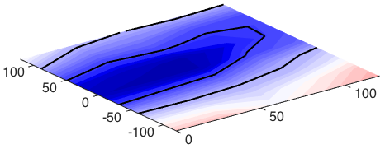
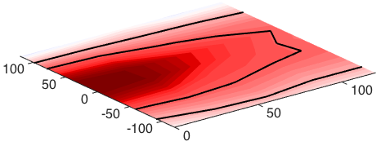
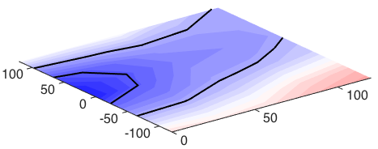
Mean eddy surface structure
Cyclone
Anticyclone
ACME
SLA
SLA
SLA
SSSa
SSSa
SSSa
0.2
-0.05
-0.05
0.1
-0.1
0.1
0.05
-0.1
0
-0.1
-0.2

Slide 34
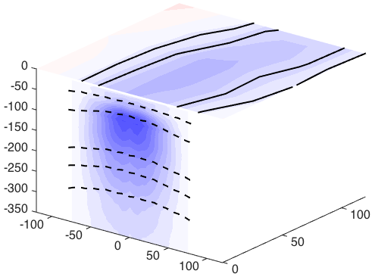
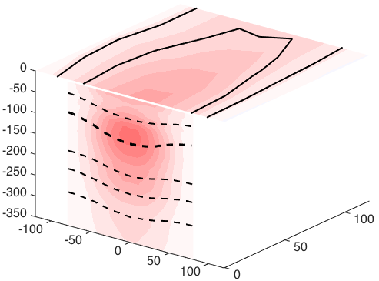
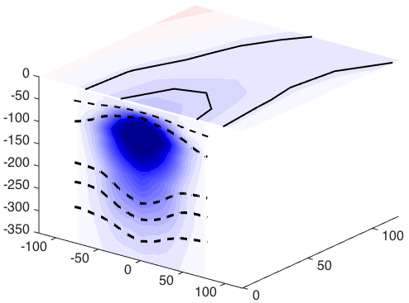
Mean eddy surface and vertical structure
Cyclone
Anticyclone
ACME
SLA
SLA
SLA
SSSa
SSSa
SSSa
0.8
-0.05
0.05
0.1
0.05
0.4
-0.1
-0.1
0
-0.4
-0.8

Slide 35
Method: Eddy detection
Okubo-Weiss based on the relationship between vorticity and strain tensors (Weiss et al., 1991)
Geometrical method based on closed streamlines of geostrophic velocity (Nencioli et al., 2010)
Pre-requisites:
Eddy radius > 45 km
Eddy lifetime > 7 d
2.
1.
radius
> 45 km
cm

Slide 36
Open-ocean low oxygen events
(blue trajectories – cyclones, green trajectories – ACMEs)
A high number of anomalous low oxygen concentrations is found
All anomalous profiles are associated with mesoscale eddies

Slide 37
Chlorophyll signatures of oxygen depleted eddies
Cyclones and ACMEs are associated with high productivity at the surface

Slide 38
The oxygen depleted eddy core
ACME
Favoring conditions for an oxygen depleted eddy:
Chl
High productivity
Oxygen
depleted
eddy
core
Enhanced respiration in the eddy core
High isolation of the eddy core
The oxygen content of these eddies in the eastern tropical North Atlantic decreases on average by about:
Cyclones 0.10 ± 0.12 μmol kg⁻¹ d⁻¹
ACMEs 0.19 ± 0.08 μmol kg⁻¹ d⁻¹

Slide 39
Results
Notes:
Temperature mit wind, dann pfeile rüber/ surface currents, dann die profile und t/S diagramm daneben, dann sauerstoff

Slide 40
Extra Slides

Slide 41
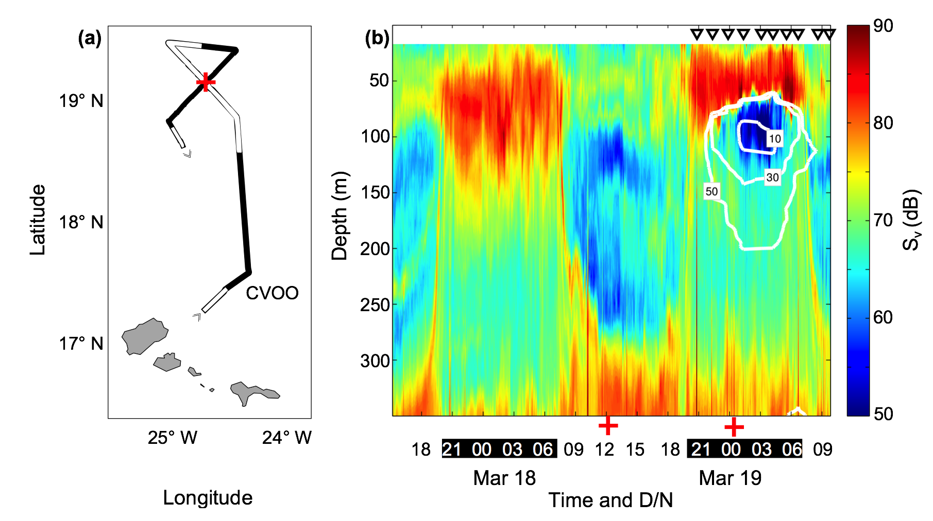
Extra Slides
Hauss et al. 2016

