Slide 1
Understanding Turbulent Controls On The Ocean Surface Boundary Layer With The Ocean Microstructure Glider
Matthew Palmer
Chris Balfour, MARS glider team
Mark Inall, Holly Pelling, Jeff Polton, Jo Hopkins, Juliane Wihsgott, Charlotte Williams, Holly Pelling etc.
See Hopkins et al, poster Thursday

Slide 2
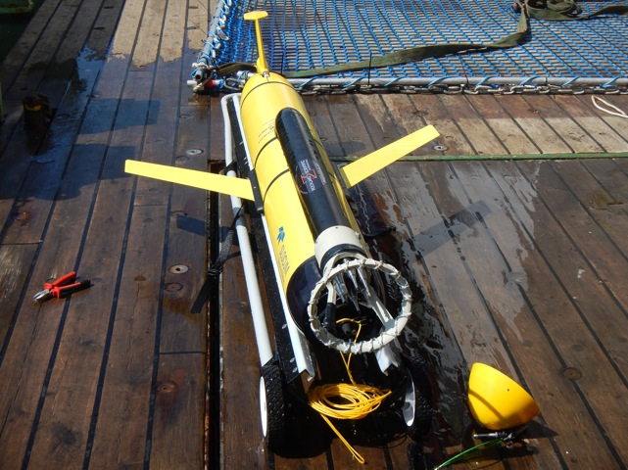
The Ocean Microstructure Glider OMG
U
u_{i}
but….
So accurately resolving flow past the sensor (U) is vital since ε scales with 1/U⁴

Slide 3

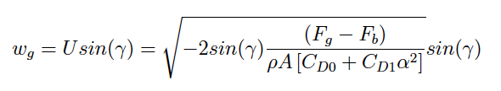


OMG: Flight model (Merckelbach et al, 2010)
Accounting for the angle of attack, α
θ
Total glide angle,
α
γ
θ
We employ the hydrodynamic flight model of Merckelbach et al, 2010;
α
U
w
Where V_{g} = 56.075 ×10⁻³m³
m_{g} = 57.56 kg
A = 0.1m²
and ΔV_{bp} & θ from sensors
C_{D0} and C_{D1} are drag coefficients (due to parasitic and induced drag) dependent on α
Balancing buoyancy and gravitational forces
Γ = mixing efficiency

Slide 4

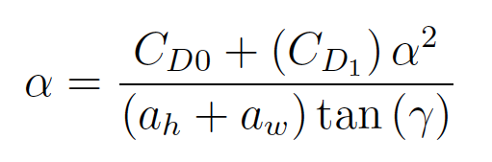
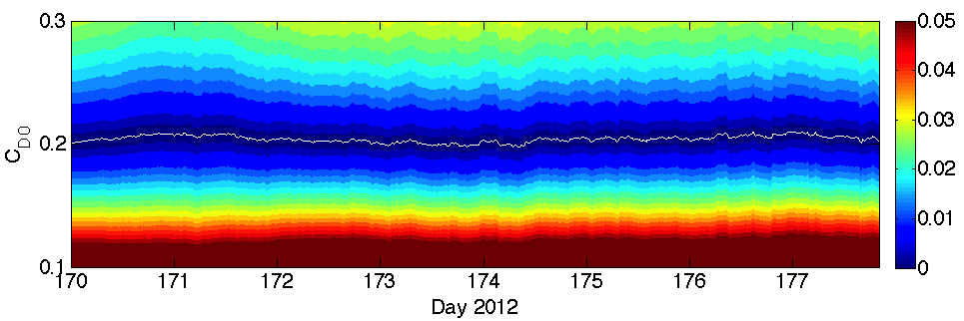
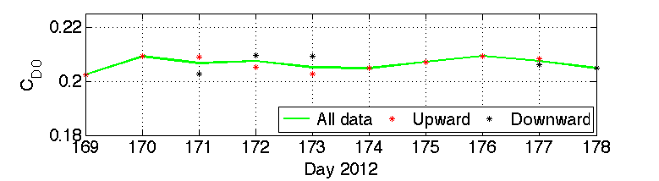
Using a flight model to constrain C_{D0} and α
Minimising difference between measured and modeled vertical velocity;
-
0
Estimate α iteratively using prescribed values for the lift-slope coefficients (a_{h} and a_{w}) and the induced drag C_{D1}
C_{D0,down} = 0.2070 (±2%)
C_{D0,up} = 0.2065 (±2%)
C_{D0} ~0.2066
For further information see Palmer et al,
J. Marine Systems (144)
available at noc.ac.uk/people/rolm/
Γ = mixing efficiency

Slide 5
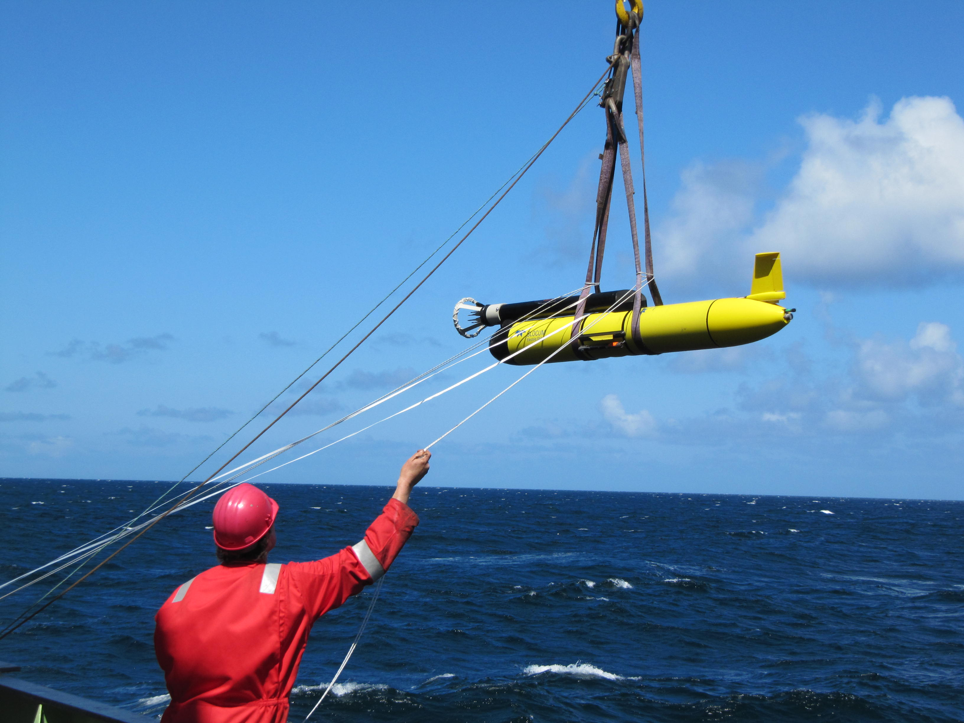
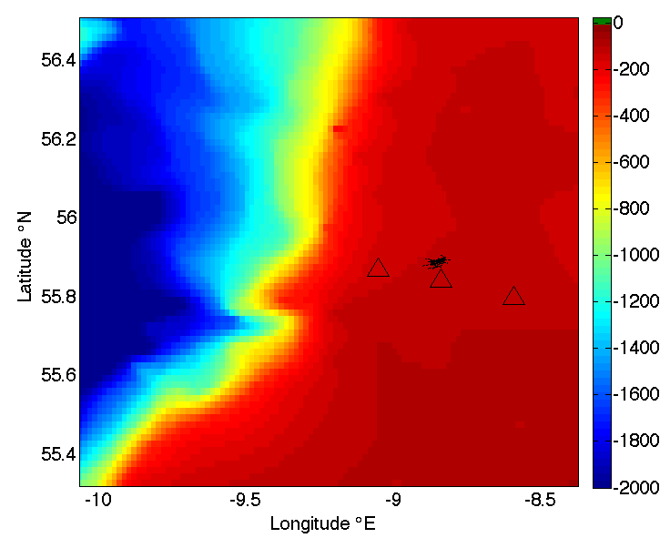
FASTNEt Ocean shelf exchange experiments:
2013: Malin Sea
OMG was deployed for 14.8 days alongside station SF which provides ADCP and ‘Wirewalker’ CTD.
OMG provides 1869 profiles of the TKE dissipation rate (ε), fast T and CTD, typically every 11 minutes.
Ocean Microstructure Glider

Slide 6
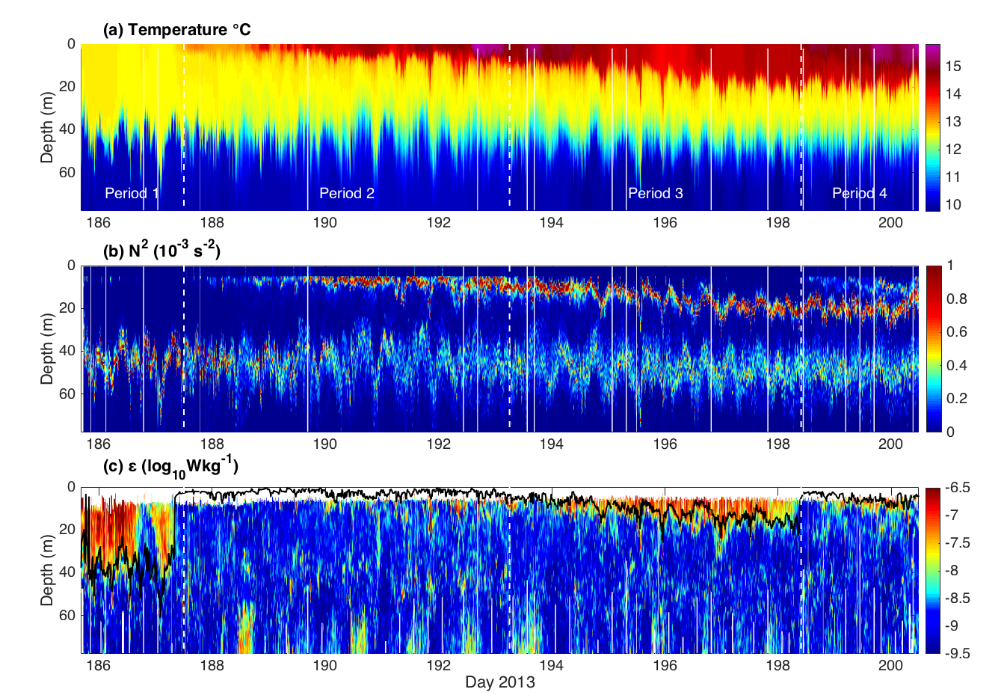
OMG Malin Sea: Measuring within the turbocline
130m
Steady deepening of the surface mixed layer
Storm mixing

Slide 7
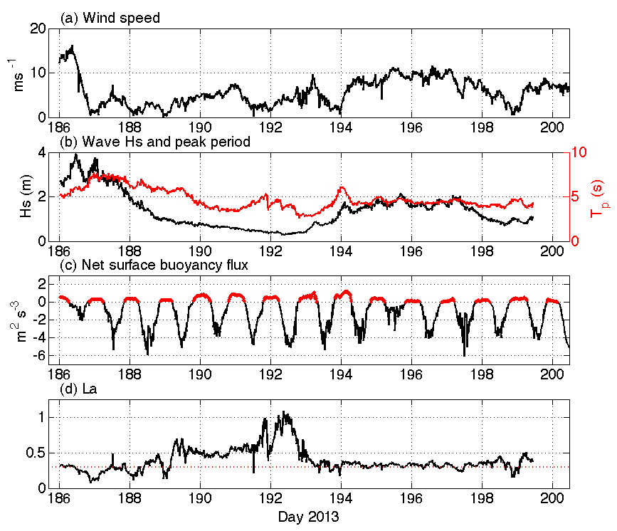
Surface forcing
Met forcing provided by nearby RRS James Cook.
Wave data from tri-axis wavebuoy.
Buoyancy flux +ve with heat loss from the ocean
Turbulent Langmuir number La_{t};
La_{t}² = u*/u_{S}

Slide 8
Working towards parameterisation of the Ocean Surface Boundary Layer (OSBL)
Belcher et al, GRL 2012
Wave
Regime diagram relates ε to h/L_{l} and La,
La = u* / u_{S} (u_{S} = Stokes drift)
L_{l} = -w³_{*L} / B_{s}
w³_{*L} = u*²u_{S}
La represents the balance between wind and waves,
h/L_{l} represents the balance between wave and buoyancy forcing

Slide 9
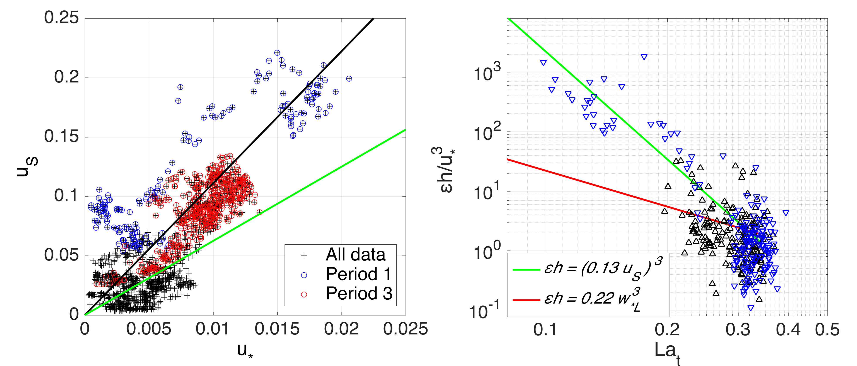
Relative contributions to surface forcing from wind, waves and convection
La_{t} = 0.3
v Bs > 0
^ Bs < 0
La_{t} = 0.4
Comparing non-dimensionalised εh/u*³ (z/h = 0.5) to La_{t}

Slide 10
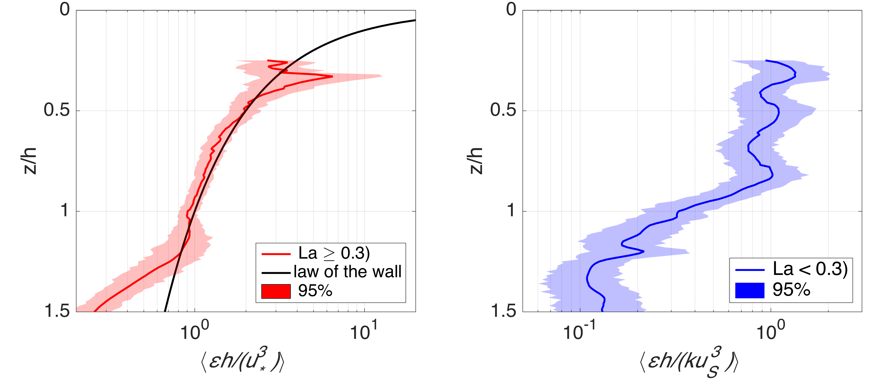
Depth dependency of turbulence during wind and wave dominated periods
Wind driven regime
Wave driven regime
OMG provides valuable validation of law-of-the-wall scaling.
During wave-convective case turbulence scales by (kU_{s})³ and shows no depth dependence

Slide 11
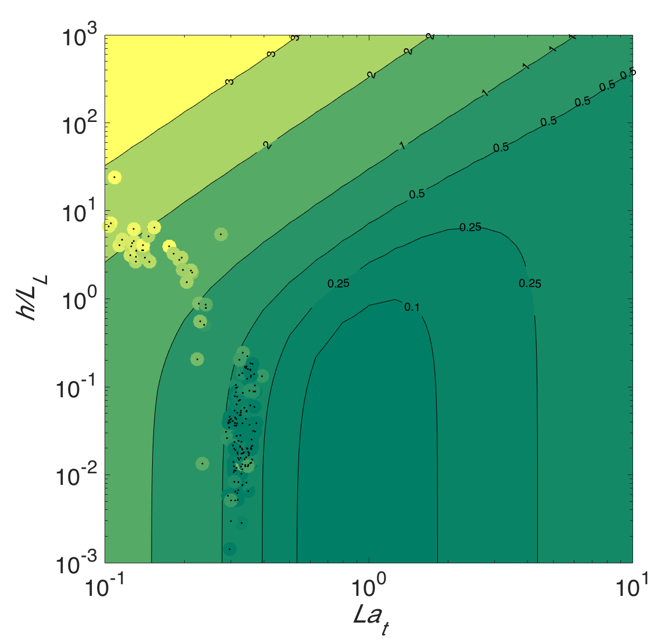
Working towards parameterisation of the Ocean Surface Boundary Layer (OSBL)
Convection
Wave
Waves
Wind
Data shows generally good agreement with Belcher et al, GRL 2012
Increased ε relative to h/L_{L} suggests the need for an additional wave dependent term in the convective regime.

Slide 12
Conclusions
A new 15 day time-series from an OMG provides unprecedented access to turbulent controls of the (very) shallow near surface layer.
The vast majority of data are confined to a narrow band of La_{t} ∼0.3, La_{t} <0.3 occurred only 25% of the time and La_{t} <0.20 occurred only 5% of the time.
During periods when La_{t} ≥ 0.3, turbulence is shown to be accurately predicted by u⋆³/h, decaying with depth following the law of the wall.
When waves dominate (i.e. La_{t} <0.3), turbulence is accurately scaled by k.u_{S}³/h, and follows a near constant distribution over h, where k is suggested to be a near constant O[0.1].
Our La_{t} <0.3 data however, coincides with a convective event. We therefore suggest that this relationship offers a potential for improved parameterisation for wave-convection interaction in the OSBL. Further validation is required.

Slide 13
Coming soon: Celtic Sea 2015

