Slide 1
Science enabled by gliders: penguin ecology, hurricane prediction, ocean dead zones and other highlights from the EGO conference
David Smeed National Oceanography Centre, UK
Acknowledgement
Thank you to all the presenters from the EGO conference ffor permission to use their material in this presentation
http://www.ego-network.org

Slide 2
Outline
The EGO network
7Th EGO conference on autonomous ocean gliders and their application
New developments in glider and sensor technology
Micro-scale to meso-scale physical processes observed with underwater gliders
Gliders in polar oceans: science and technological challenges
Observing biogeochemical processes with autonomous vehicles
Sampling strategies for single vehicles and networks
Glider operations: piloting, infrastructure, data management and legal issues
Gliders in the Global Ocean Observing System
The Ocean Gliders steering team

Slide 3
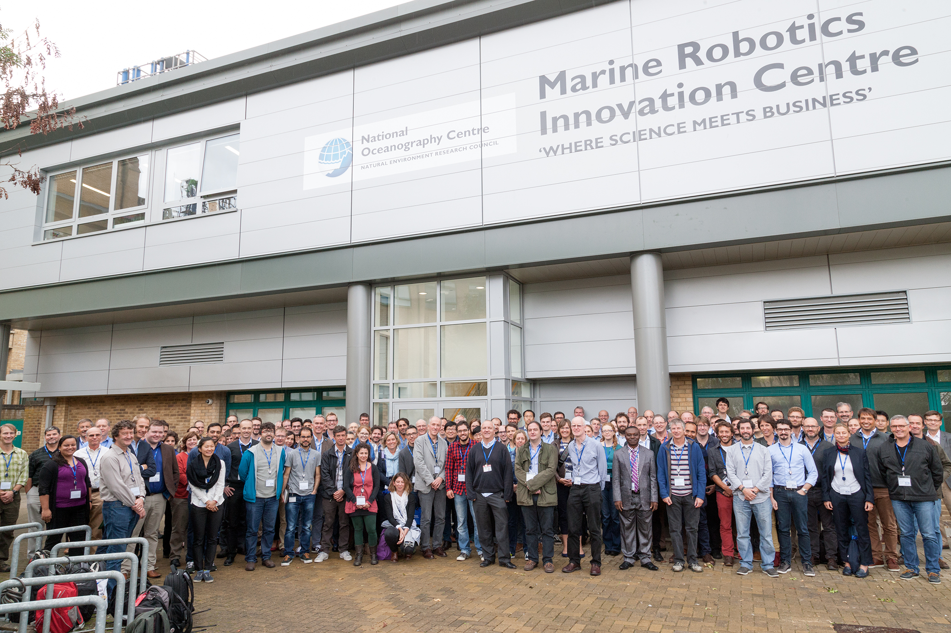
The EGO network
Started as informal collaboration between European glider users
Subsequently supported by two EU programs: EU-COST action and GROOM H2020 project
Now a global network of scientists and engineers
150 attendees at the conference

Slide 4
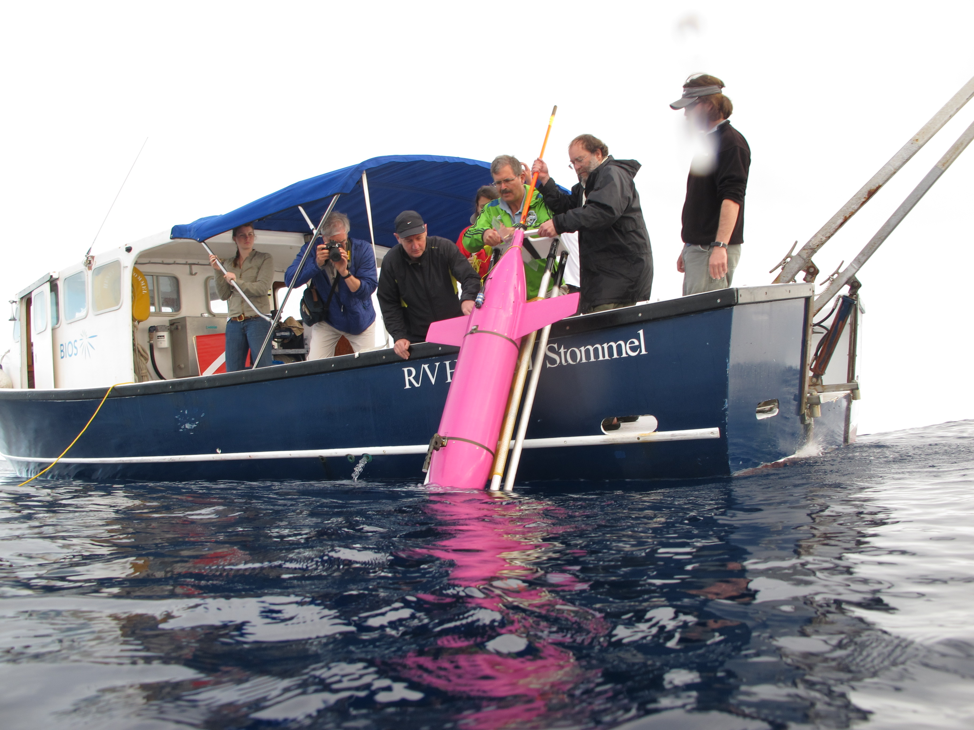
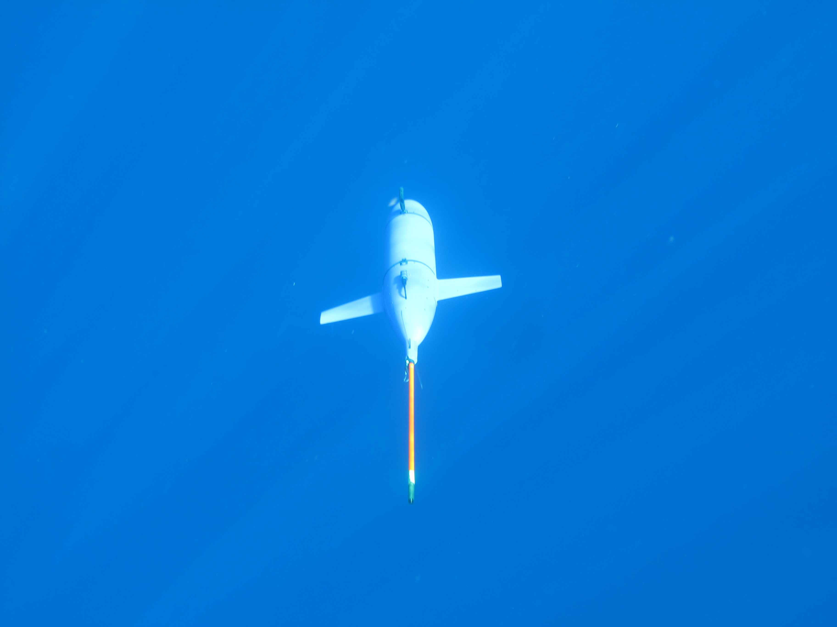
New developments in glider and sensor technology – DeepGlider
18 month / 10,000 km missions of continuous dives to 6 km depth @ 0.25 m/s
Charlie Eriksen, Univ Washington

Slide 5
New developments in glider and sensor technology - Surface Vehicle Assisted Navigation
Objective: To map and monitor icebergs
Ship / USV
Mingxi Zhou, Brad deYoung
Ralf Bachmayer
Memorial University, Canada

Slide 6
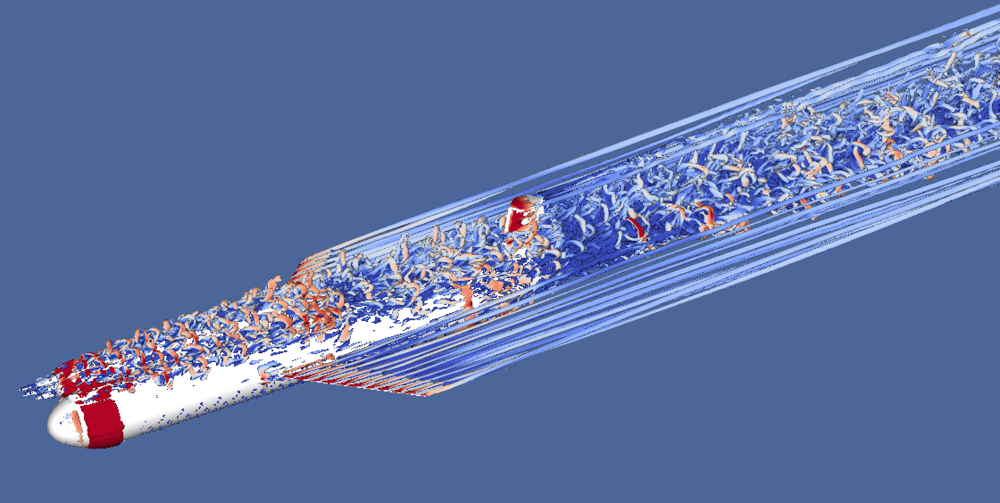
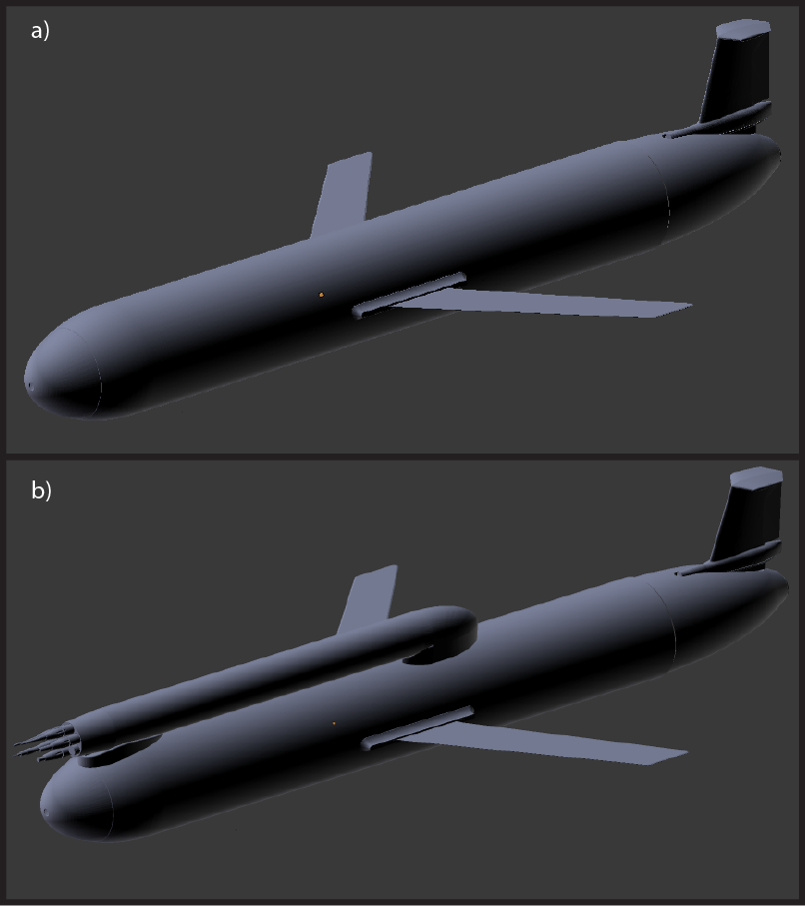
New developments in glider and sensor technology – modelling flow around gliders
Ben Moat, NOC
CFD simulations used to determine distortion of flow around glider and the impact upon sensor measurements

Slide 7
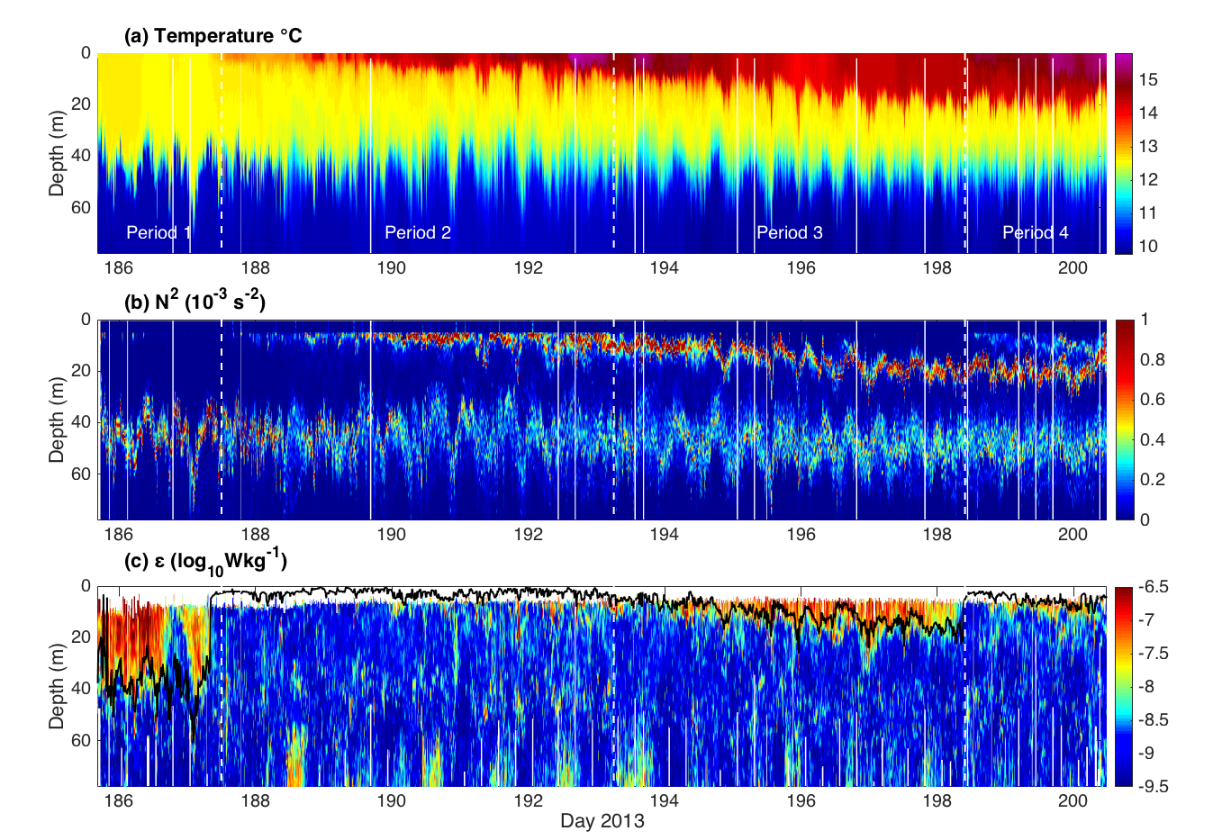
Micro-scale to meso-scale physical processes observed with underwater gliders - Ocean microstructure glider
Measuring turbulence down to scales of 1cm to understand mixing in the ocean
Matthew Palmer, NOC

Slide 8
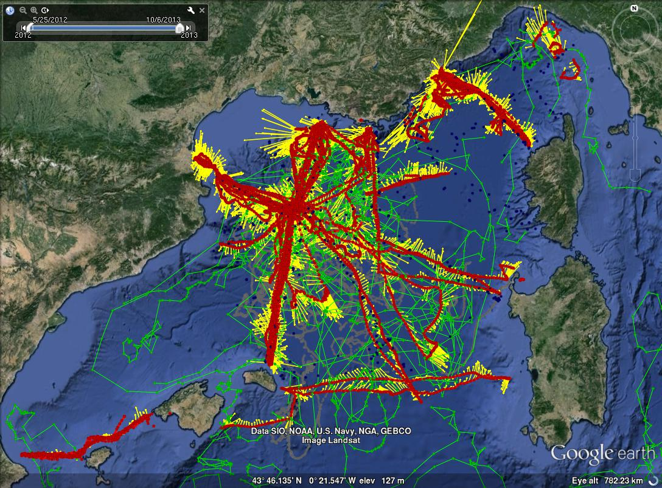
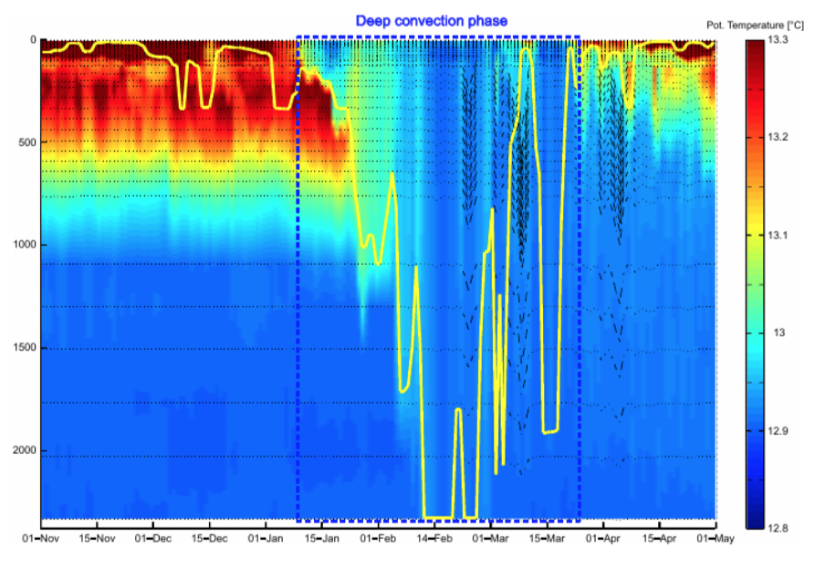
Micro-scale to meso-scale physical processes observed with underwater gliders - deep convection events
Sustained glider measurements in combination with other platforms reveals details and long term variability of intermittent but climatically important deep convection
01/07/2012 -> 07/10/2013
30 Glider deployments ~ 13,000 profiles (0-1000m)
6 CTD cruises ~ 400 profiles (0-bottom)
27 Argo ~ 1,500 profiles (0-1000m or 0-2000m)
10 Marisondes and surface drifters
Pierre Testor, Félix Margirier, UPMC, France

Slide 9
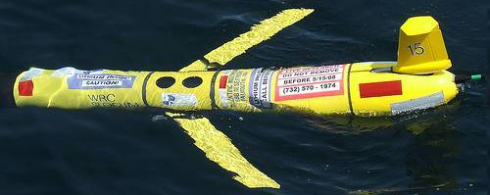
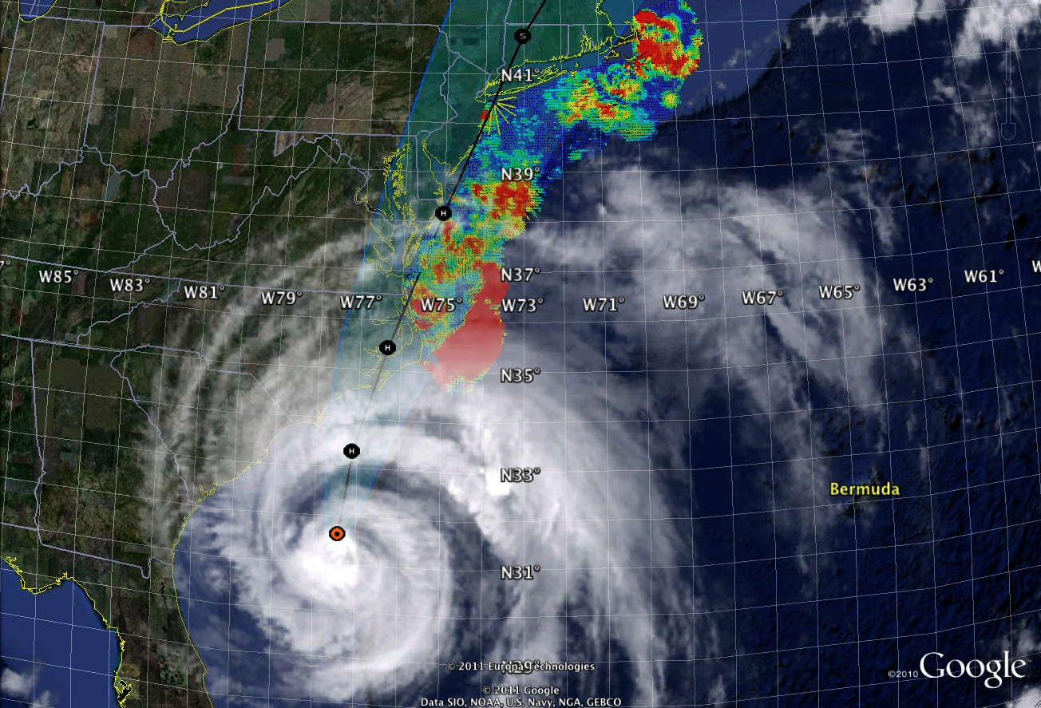
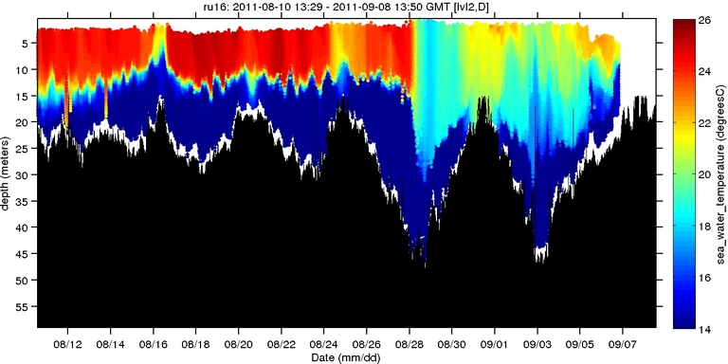
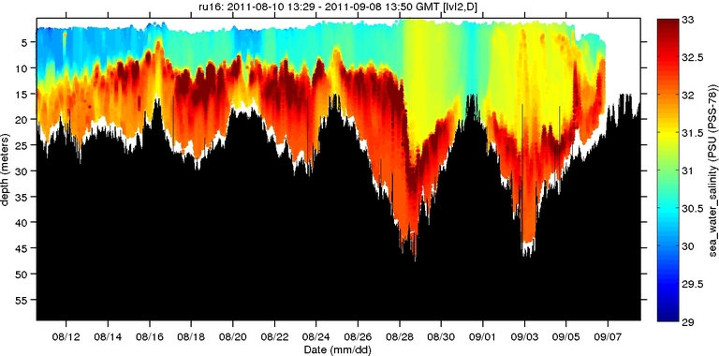
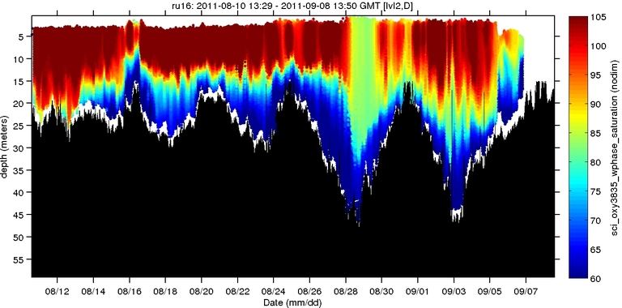
Micro-scale to meso-scale physical processes observed with underwater gliders -- hurricane prediction
Scott Glenn,
Rutgers University
Hurricane Irene
0
26
depth
temperature
55
14
0
33
depth
salinity
29
55
0
105
depth
Observing in hostile environments to improve the prediction of hurricanes intensity
% oxygen
55
60
8/12
date
9/07

Slide 10
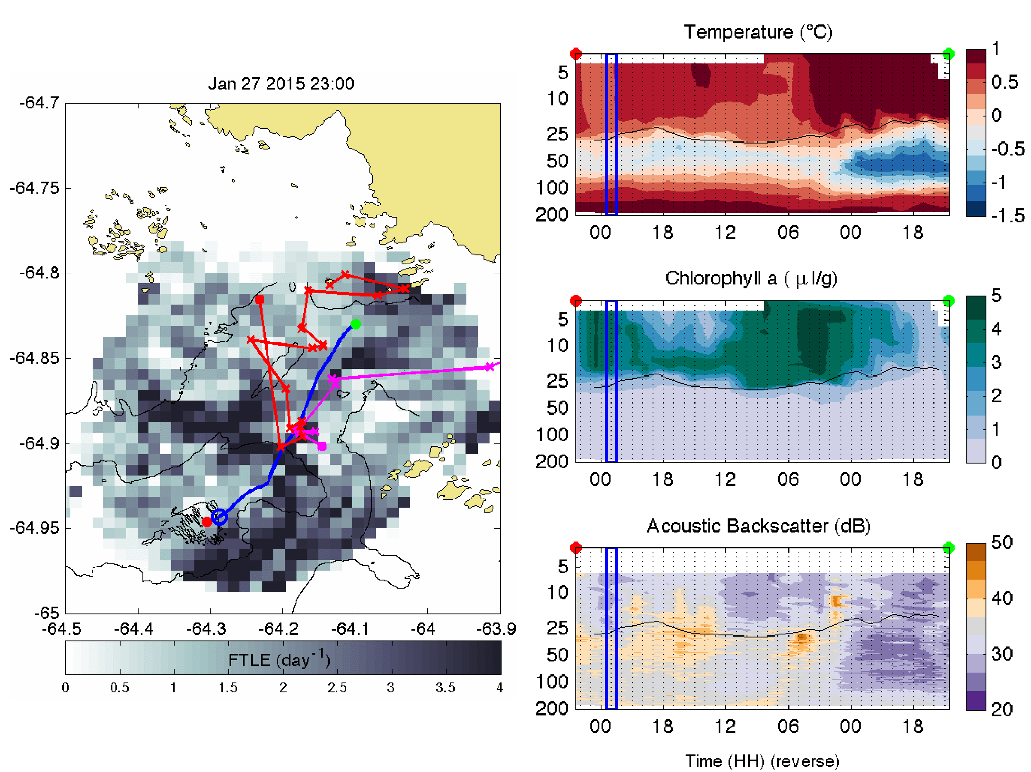
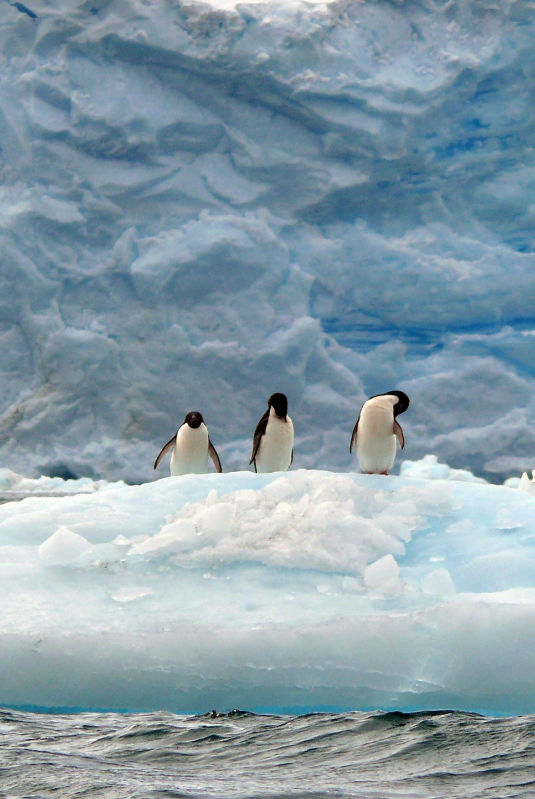
Gliders in polar oceans: science and technological challenges – penguin ecology
Tidal convergence zones concentrate phytoplankton, aggregate schools of krill and influence the behavior of penguins
Glider - 04:00 GMT
Adelie – 10:00 to 13:00 GMT
Gentoo – 21:30 to 22:30 GMT
Josh Kohut, Rutgers University

Slide 11
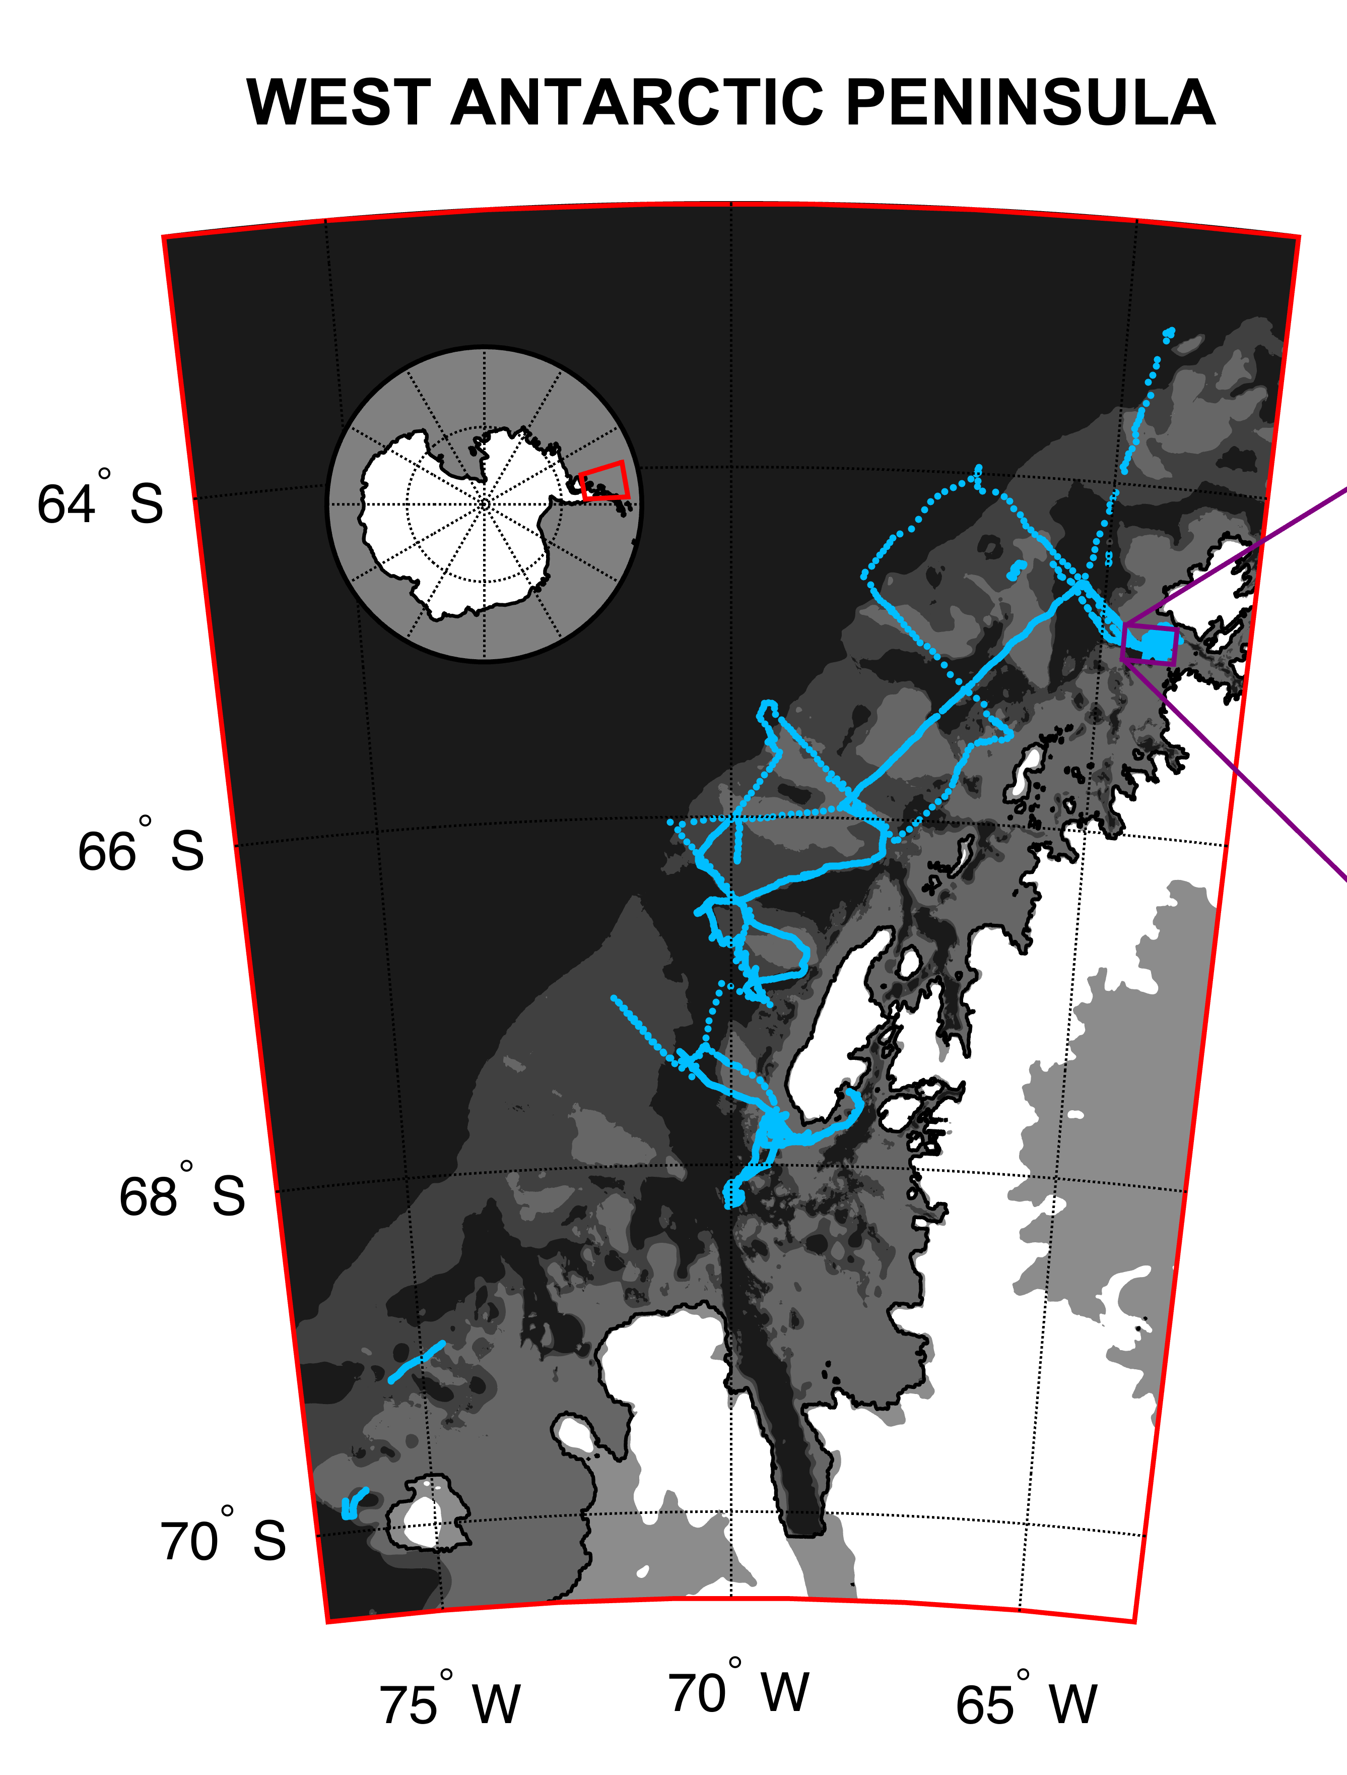
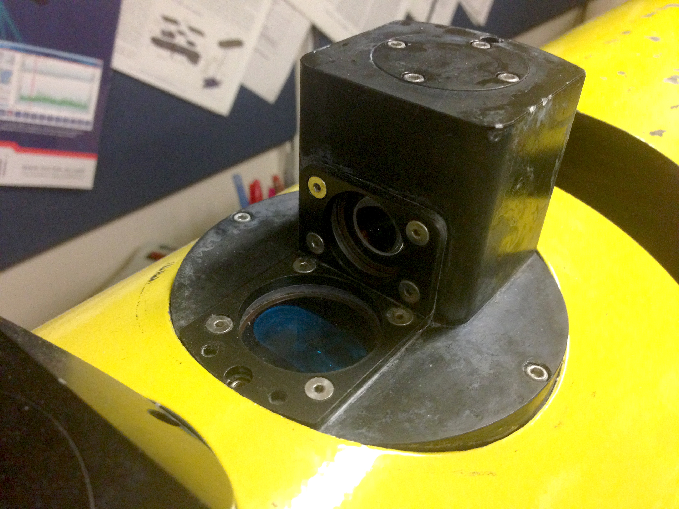
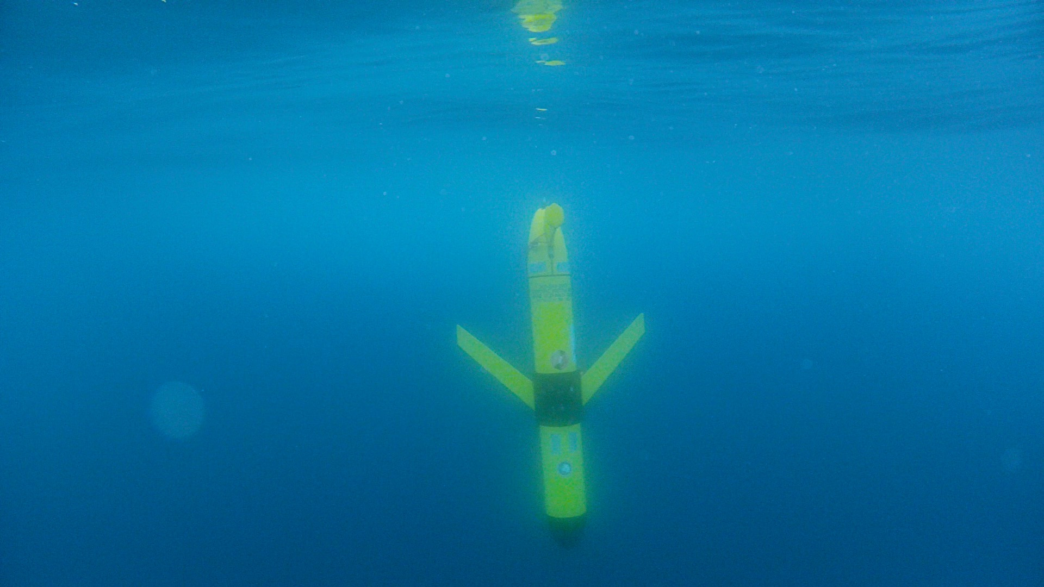
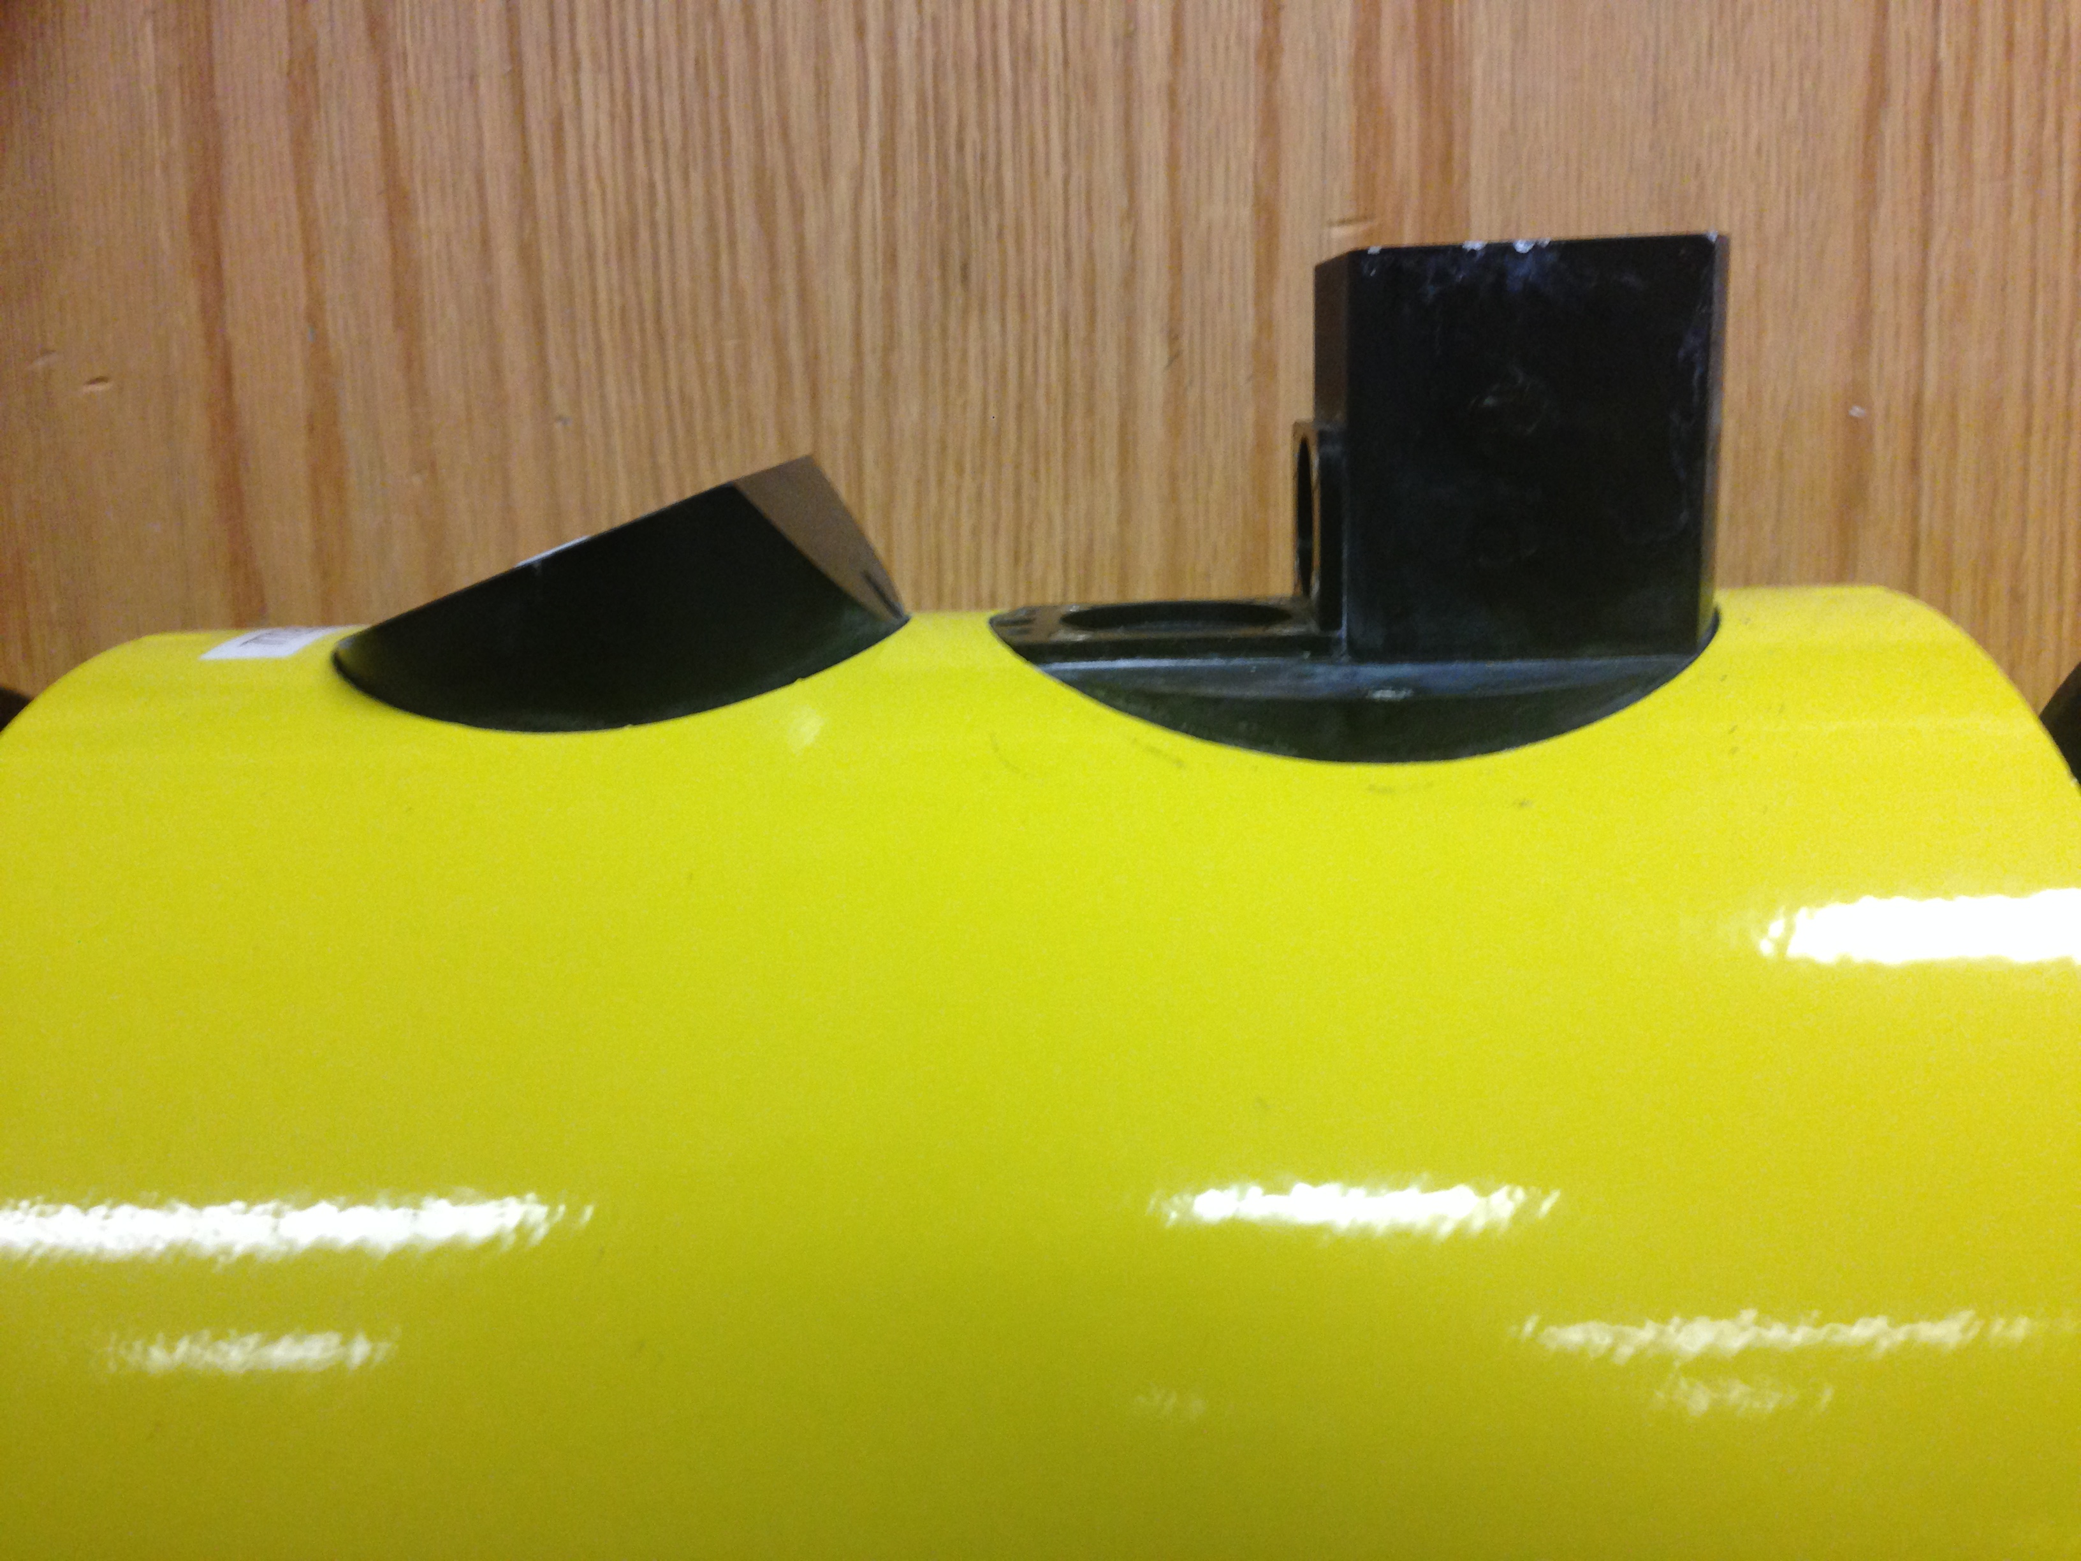
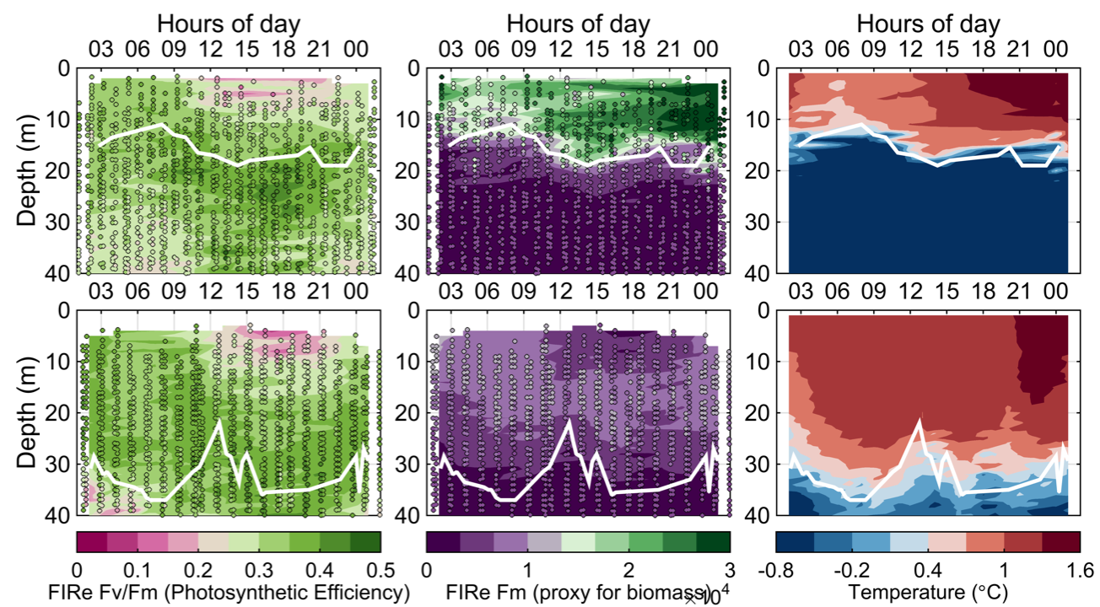
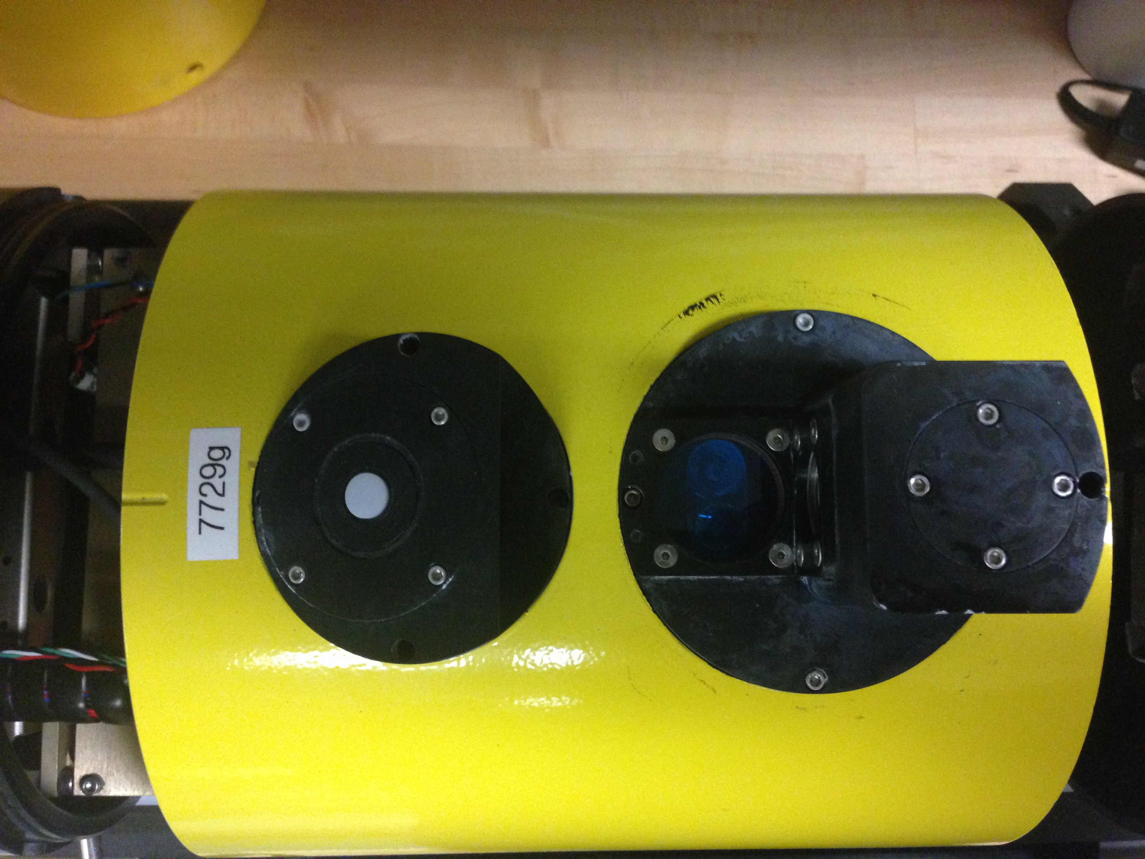
Observing biogeochemical processes with autonomous vehicles – Coupled physical and phytoplankton dynamics
A FIRe sensor on a glider allows mapping of phytoplankton physiological responses to physical forcing
PAR
FIRe
Filipa Carvalho,
Rutgers university

Slide 12
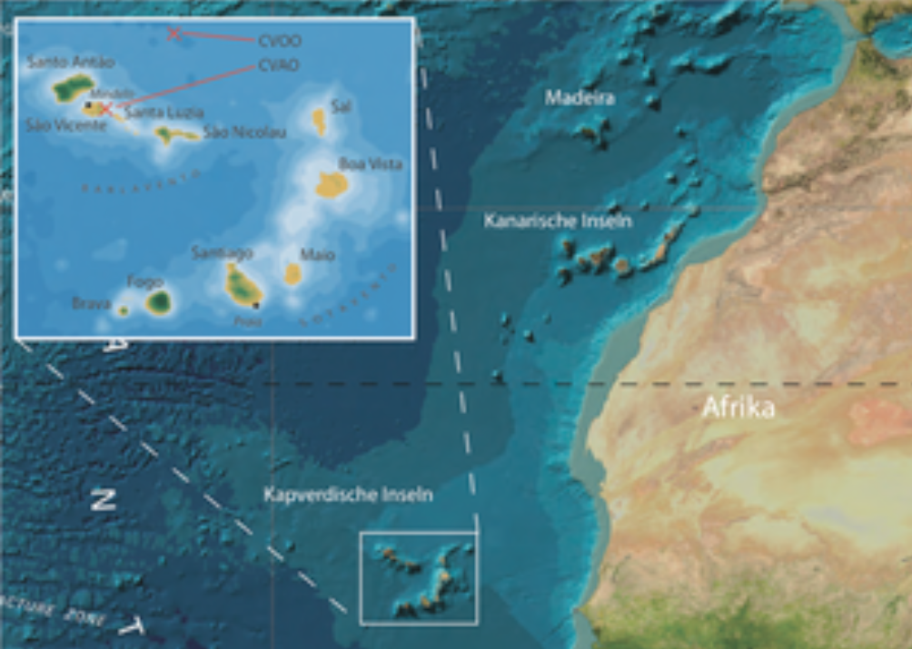
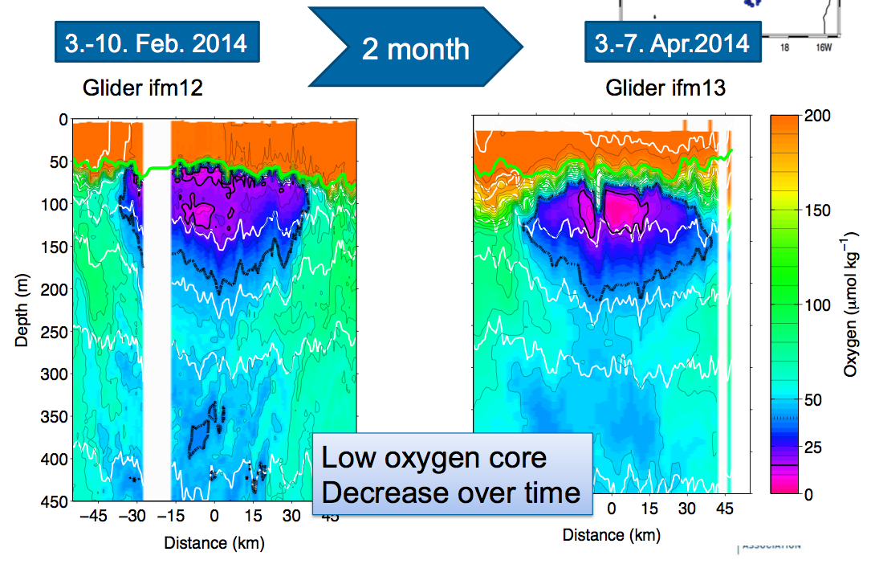
Observing biogeochemical processes with autonomous vehicles – ocean ‘dead zones’
Oxygen depleted eddies and nitrate cycling in the tropical Atlantic
Johannes Karstensen, GEOMAR

Slide 13
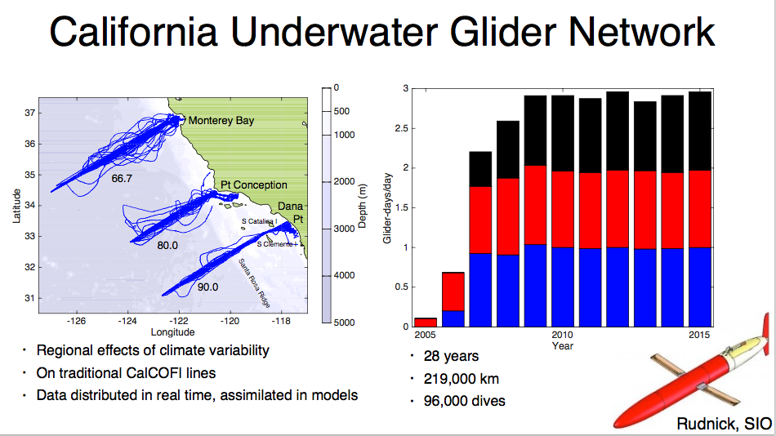
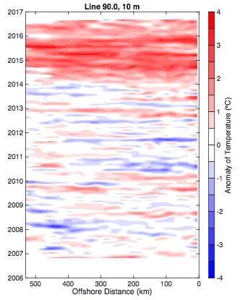
The role of gliders in the Global Ocean Observing System - The California Underwater Glider Network
Daniel Rudnick,
Scripps institute of Oceanography
10 years of continuous occupation allows identification of Climate anomalies, e.g. 2014-2015 warming, and 2015-2016 El Niño

Slide 14
Summary
Novel science often involves multiple platforms
Gliders enable:
New sampling strategies that compliment other platforms
Capability to monitor in hostile environments
Efficient platform for many sensors
International coordination and adoption of common standards will enable gliders to make important contribution to regional and global observing systems

