Slide 1





OSMOSIS Primary Production from Seagliders April-September 2013
Victoria Hemsley, Stuart Painter, Adrian Martin,
Tim Smyth, Eleanor Frajka-Williams

Slide 2
Outline
Background
Calibrating fluorescence sensors from PAR
Primary production calculations
Preliminary results

Slide 3
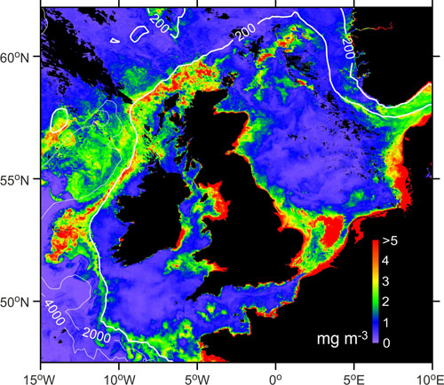
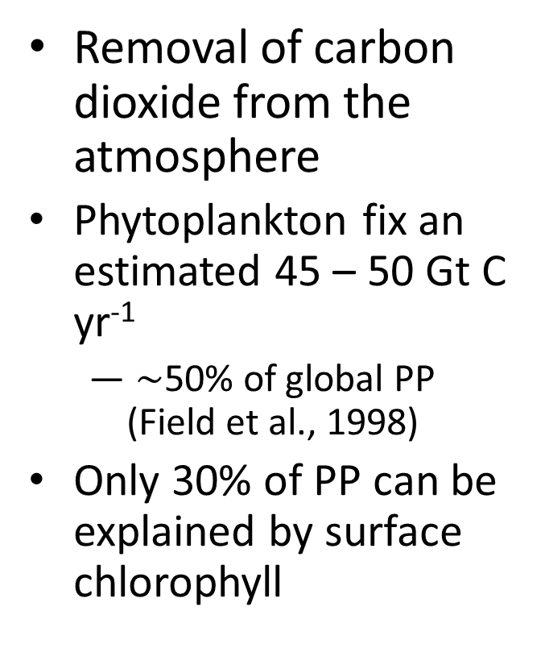
Background – Importance of Primary Production
Removal of carbon dioxide from the atmosphere
Phytoplankton fix an estimated 45 – 50 Gt C yr⁻¹
$\sim$50% of global PP (Field et al., 1998)
Only 30% of PP can be explained by surface chlorophyll
Chlorophyll concentration
NEODAAS, Plymouth Marine Laboratory, 30 May 2004

Slide 4
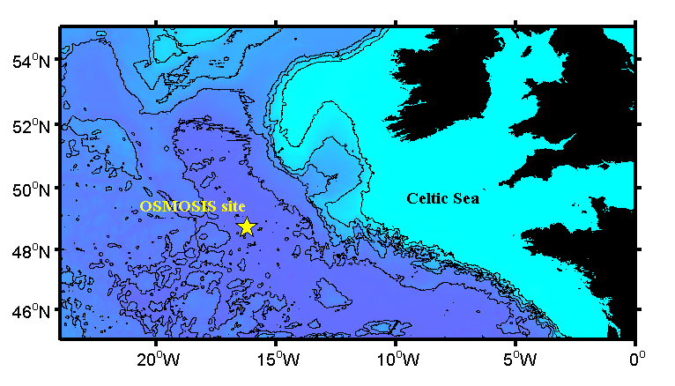
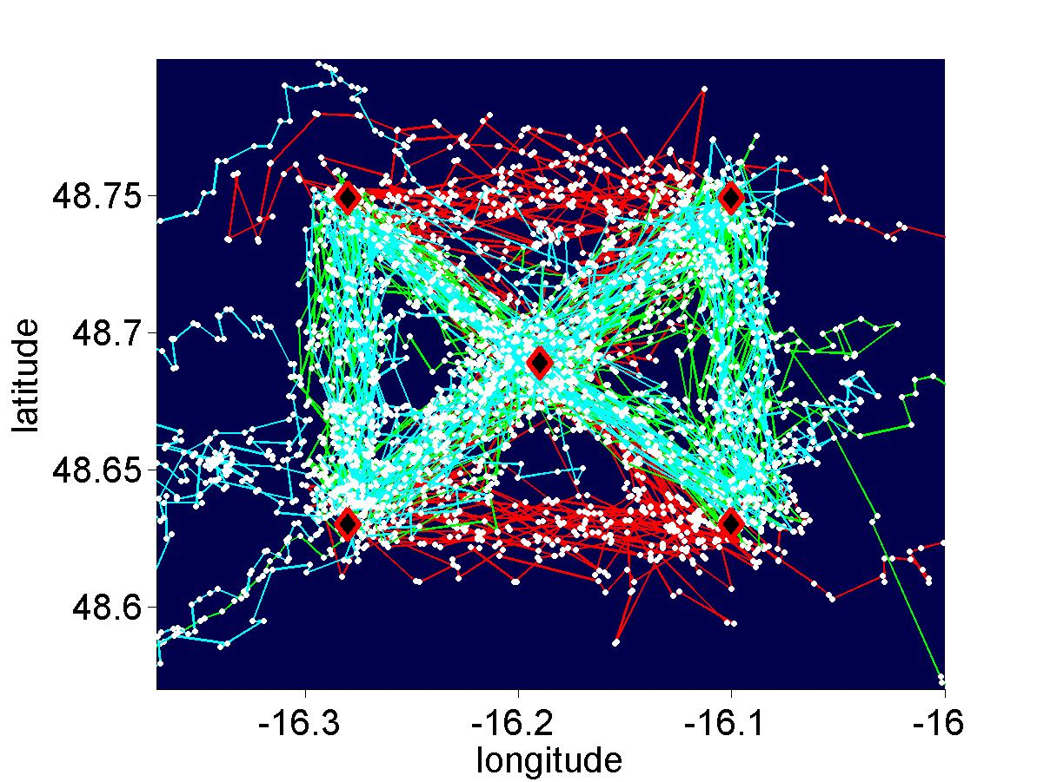
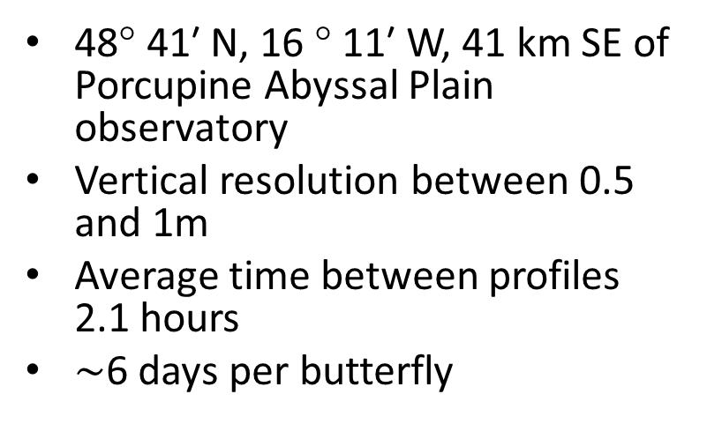
Background – Glider Mission
48° 41′ N, 16 ° 11′ W, 41 km SE of Porcupine Abyssal Plain observatory
Vertical resolution between 0.5 and 1m
Average time between profiles 2.1 hours
$\sim$6 days per butterfly
moorings
SG566 (Sep to Jan)
SG502
SG566 (Apr to Sep)
White dots are GPS positions at glider surfacing.

Slide 5
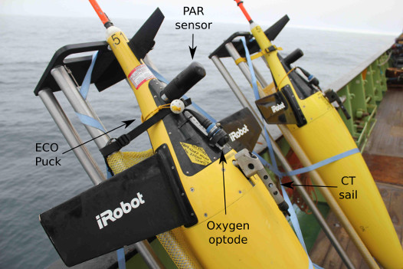
Background – Glider capabilities
Gliders sensors :
CTD
Chlorophyll a fluorescence
Particulate Optical Backscatter
Coloured Dissolved Organic Matter
Photosynthetic Active Radiation (PAR)
Dissolved oxygen

Slide 6
Motivation
Aims
Calibrate the fluorescence sensor from PAR profiles showing light attenuation
Use chlorophyll and PAR to calculate primary production (PP)
Fluorescence sensors are notoriously inaccurate, and have been shown to read higher than expected chlorophyll concentrations when using the manufacture’s calibration
Primary production is often underestimated from satellites

Slide 7
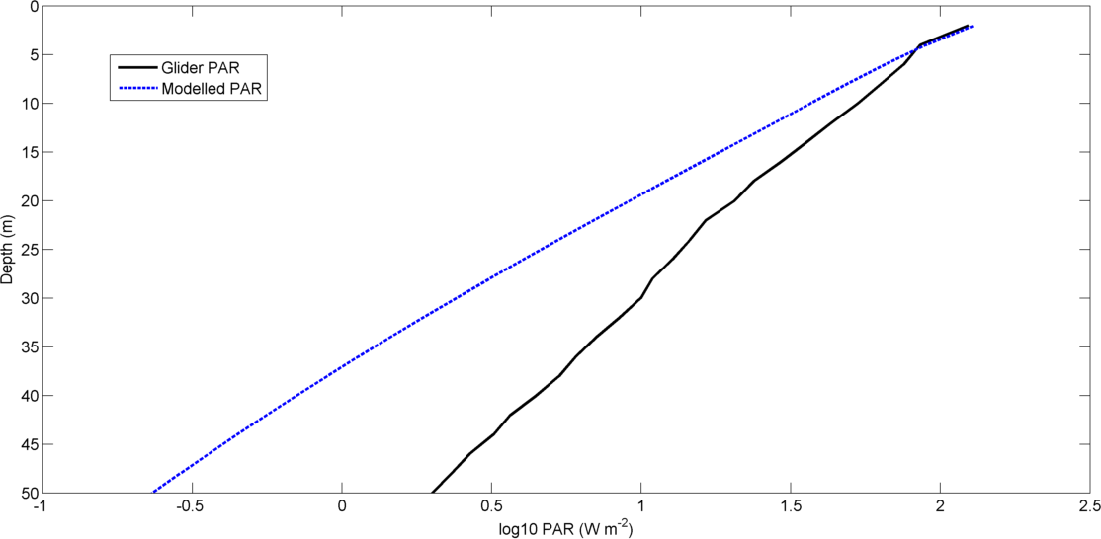
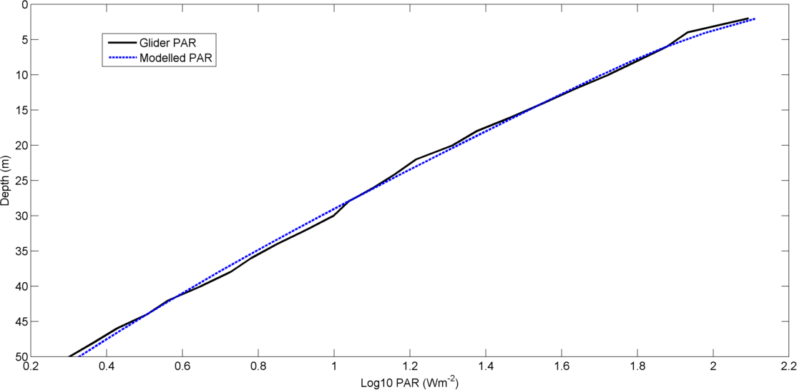
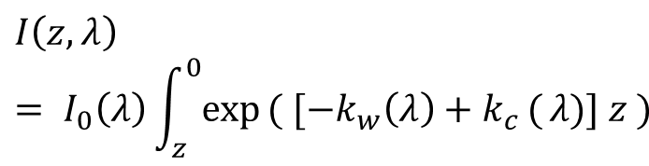

Scaling chlorophyll from PAR
$$I\left(z,λ\right)= I_{0}\left(λ\right)\int_{z}^{0}{exp}( [−k_{w}\left(λ\right)+k_{c }({λ)}] z )$$
$$k_{c}(λ)=χ_{c}\left(λ\right)C^{e(λ)}$$
Morel 2001
Light in the water column primarily attenuated by the water itself and chlorophyll
Attenuation observed by the glider is much lower than that assumed from the chlorophyll concentration
Notes:
Morel 2001 chlorophyll from glider is known to be measured too high, xc and exponent are functions of wavelength integrated over all wavelengths to match glider profile

Slide 8
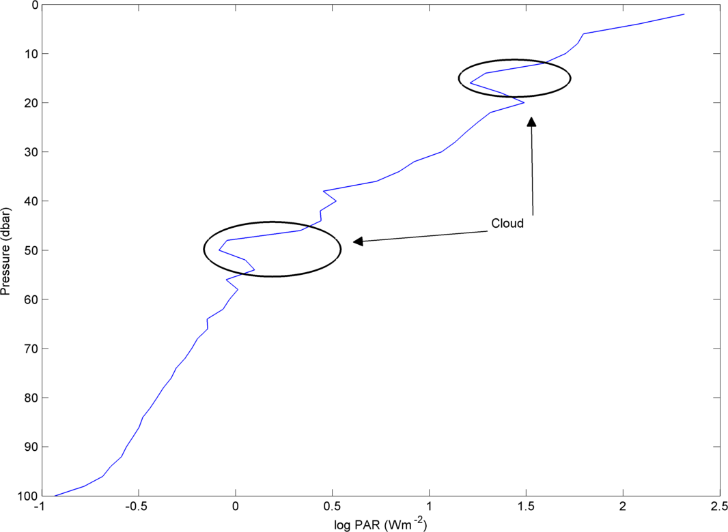
Processing of PAR profiles
Profiles removed from the analysis if the light increases with depth.
Assumed to be caused by clouds

Slide 9
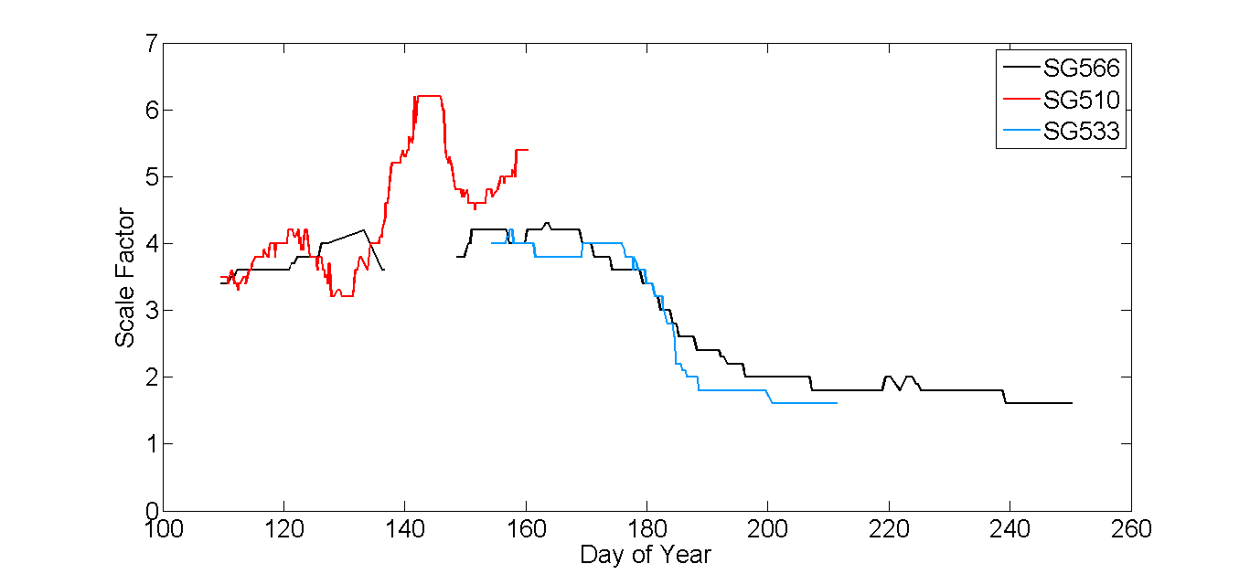
Scaling chlorophyll from PAR
Varying scale factor over the deployment
Fluorescence to chlorophyll ratio changes over the year.
Also seen from cruise bottle samples
Possible shift in community composition and formation of subsurface chlorophyll maximum

Slide 10
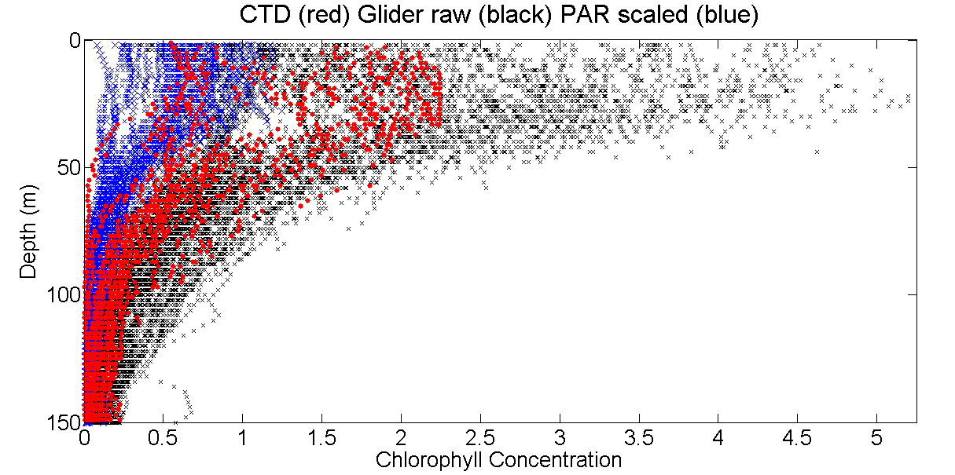
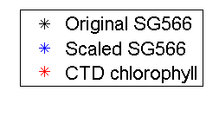
Scaling chlorophyll from PAR
Chlorophyll from seaglider manufacture’s calibration higher than expected
Chlorophyll from scaling with the PAR sensor now lower than expected

Slide 11
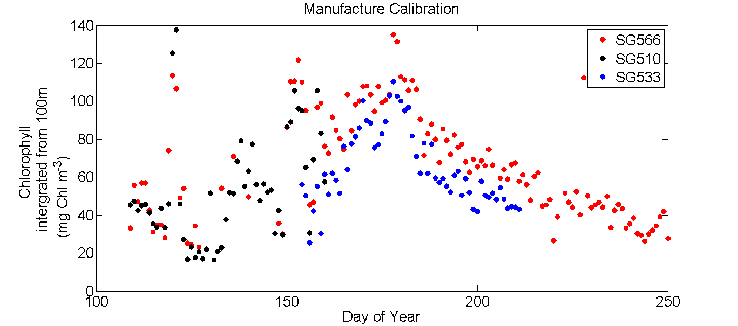
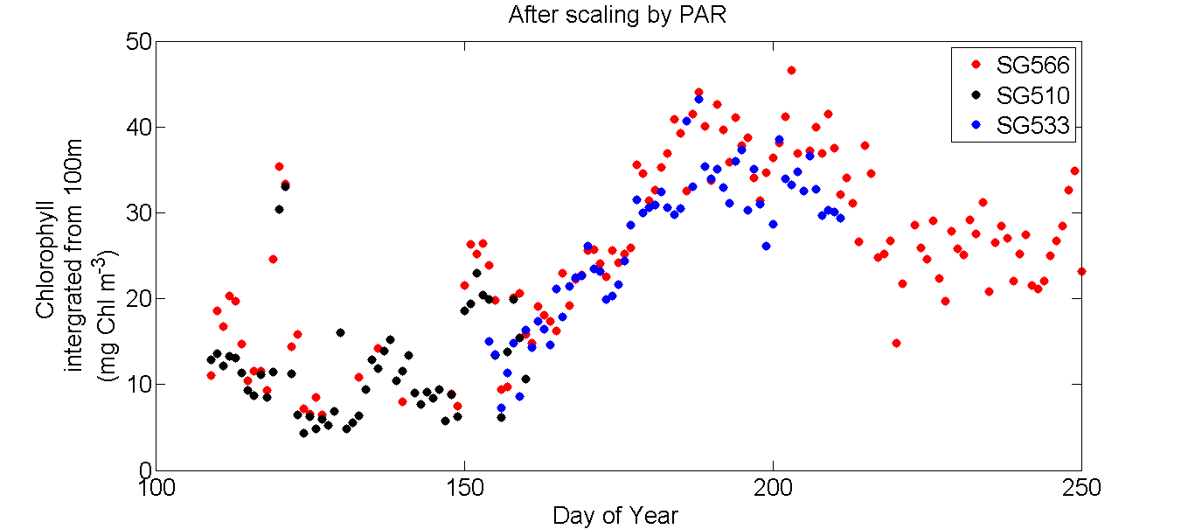
Scaling chlorophyll from PAR
Good match between gliders deployed at the same time
Less scatter than with manufacture’s calibration

Slide 12
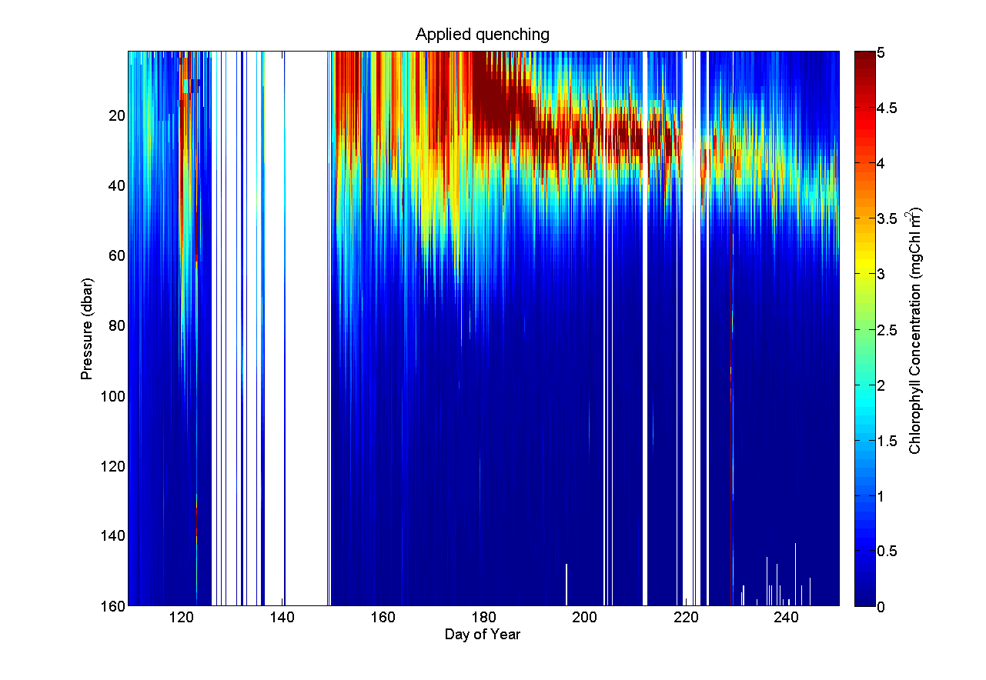
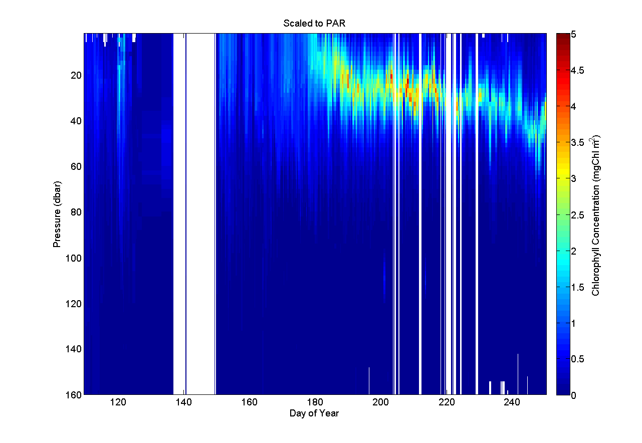
Scaling chlorophyll from PAR

Slide 13
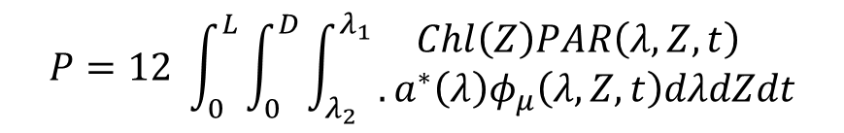
Primary Production
Spectral formulation of Morel 1991 couple with a radiative transfer model
The model uses inputs of:
Chlorophyll (fluorometer)
Spectral downwelling irradiance (PAR sensor 400-700nm split into 5nm intervals)
Date and location
Depth (m)
Each dive and climb are treated as a separate stations
Output: daily integrated values of PP (gC m⁻² d⁻¹)
$$P=12 \int_{0}^{L}{\int_{0}^{D}{\int_{λ_{2}}^{λ_{1}}{\begin{aligned}Chl\left(Z\right)PAR\left(λ,Z,t\right) \\ . a^{∗}\left(λ\right)φ_{μ}\left(λ,Z,t\right)dλdZdt\end{aligned}}}}$$
Smyth et al. 2005

Slide 14
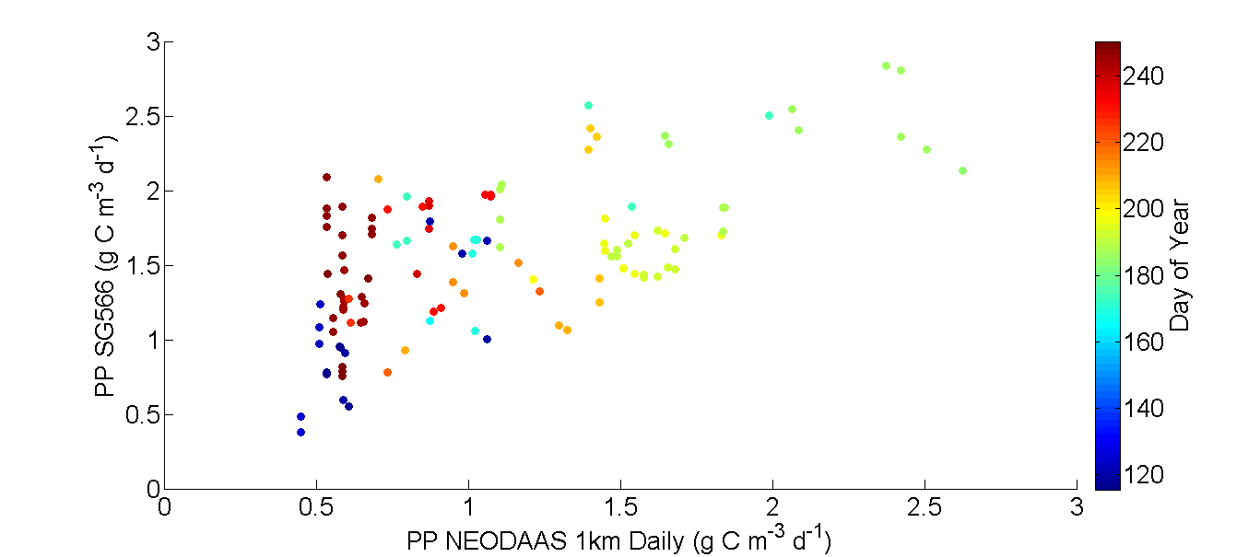
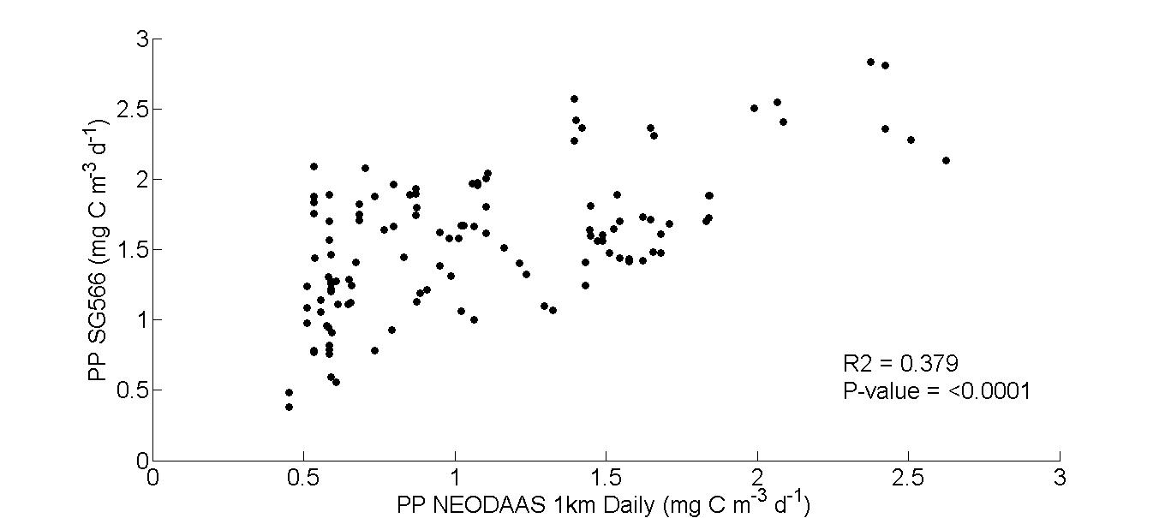
Preliminary Results
Comparison with 1km daily NEODAAS satellite product
Pixel taken at the surfacing of the glider on the same day.
Glider observes consistently higher primary production than the satellite

Slide 15
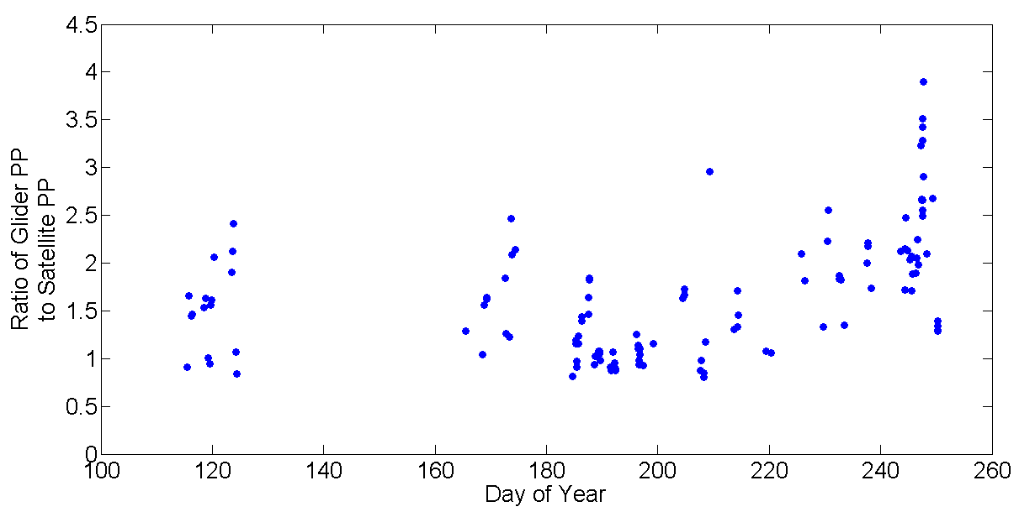
Preliminary Results
Comparison with 1km daily NEODAAS satellite product
Pixel taken at the surfacing of the glider on the same day.
Glider observes consistently higher primary production than the satellite

Slide 16
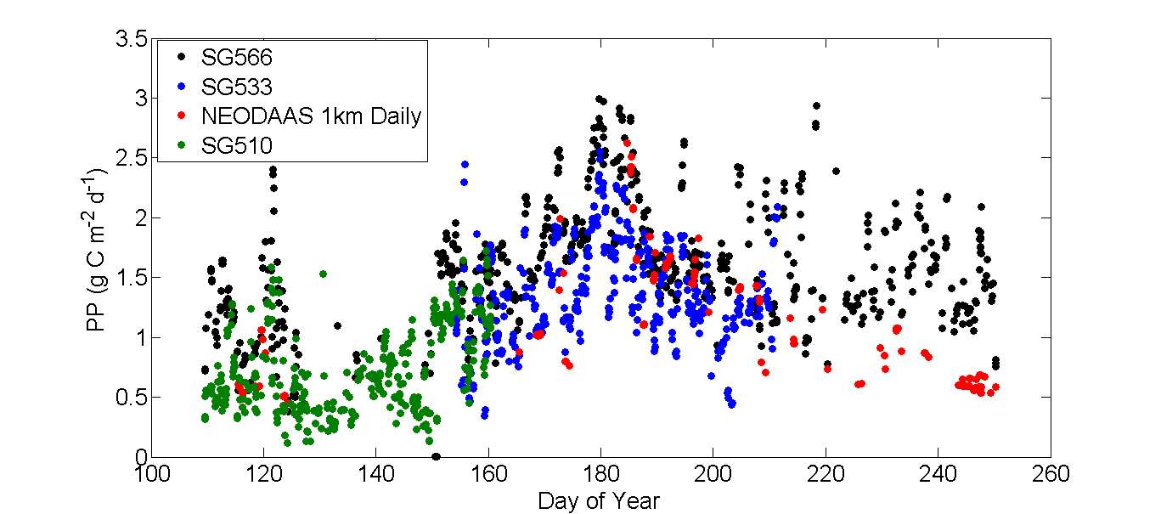
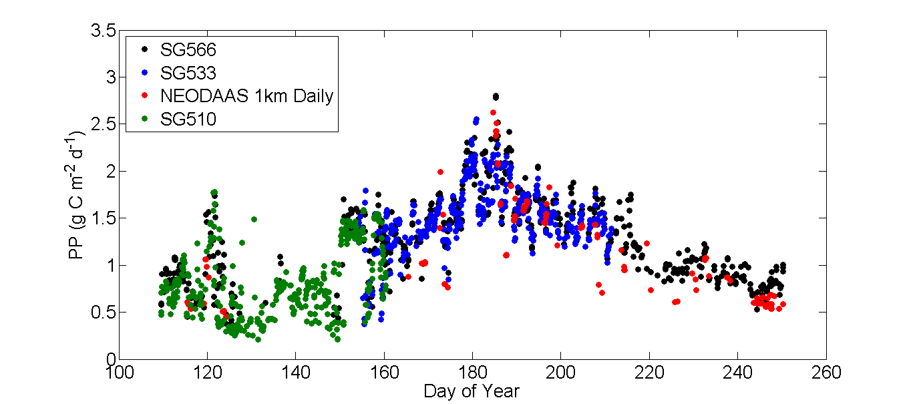
Preliminary Results

Slide 17
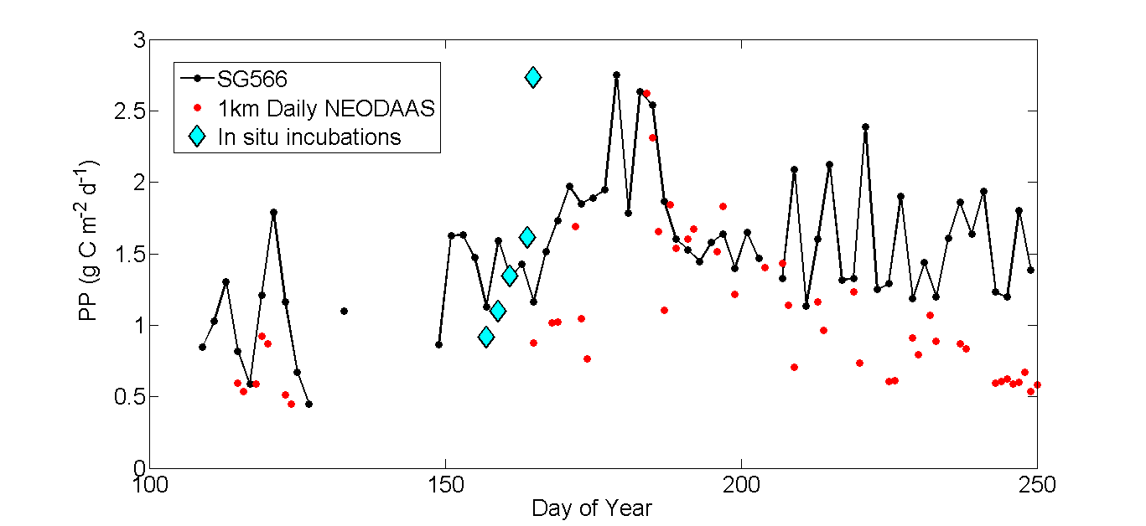
Preliminary Results
Daily averaged Seaglider PP estimates fit reasonably with in situ incubations and satellite PP
Deviation between Seaglider and Satellite towards the end

Slide 18
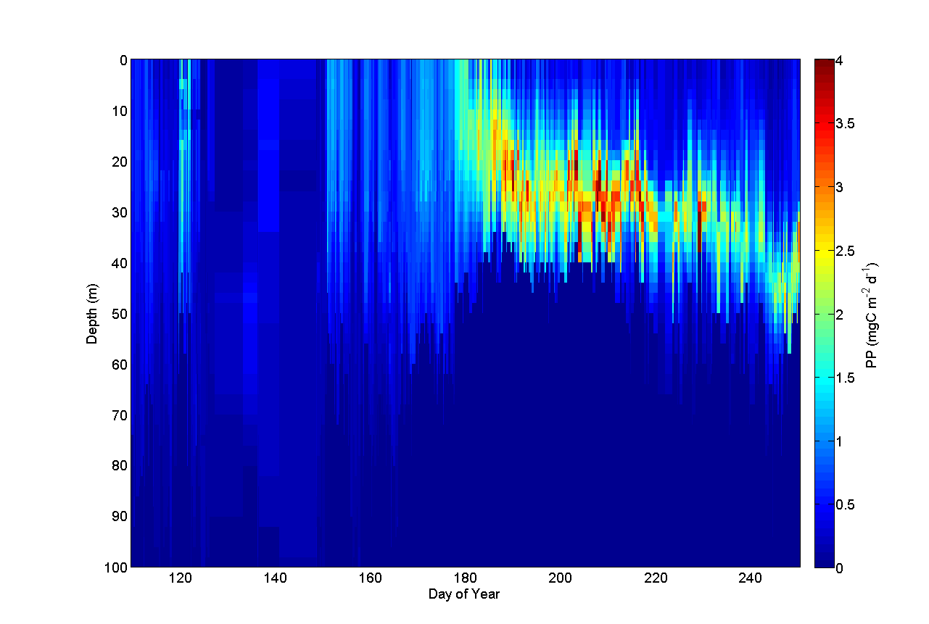
Preliminary Results - Primary Production with Depth

Slide 19
Future Development
Calibration of PAR sensors on gliders
Vertical velocities from Seaglider model to assess influence on PP
Temperature nitrate relationship to estimate nutrient field and influence on PP
Thank you for your attention

