Slide 1


Time variability of the ocean circulation around New Caledonia from altimetry, gliders and other in situ observations
Frédéric MARIN¹, Jean-Luc FUDA², Fabien DURAND³
¹ IRD - LEGOS, Nouméa, New Caledonia
² IRD – US IMAGO, Nouméa, New Caledonia
³ IRD – LEGOS, Toulouse, France
6th EGO Meeting and Final Symposium of the COST Action ES0904,Kiel, 16-17 June 2014

Slide 2
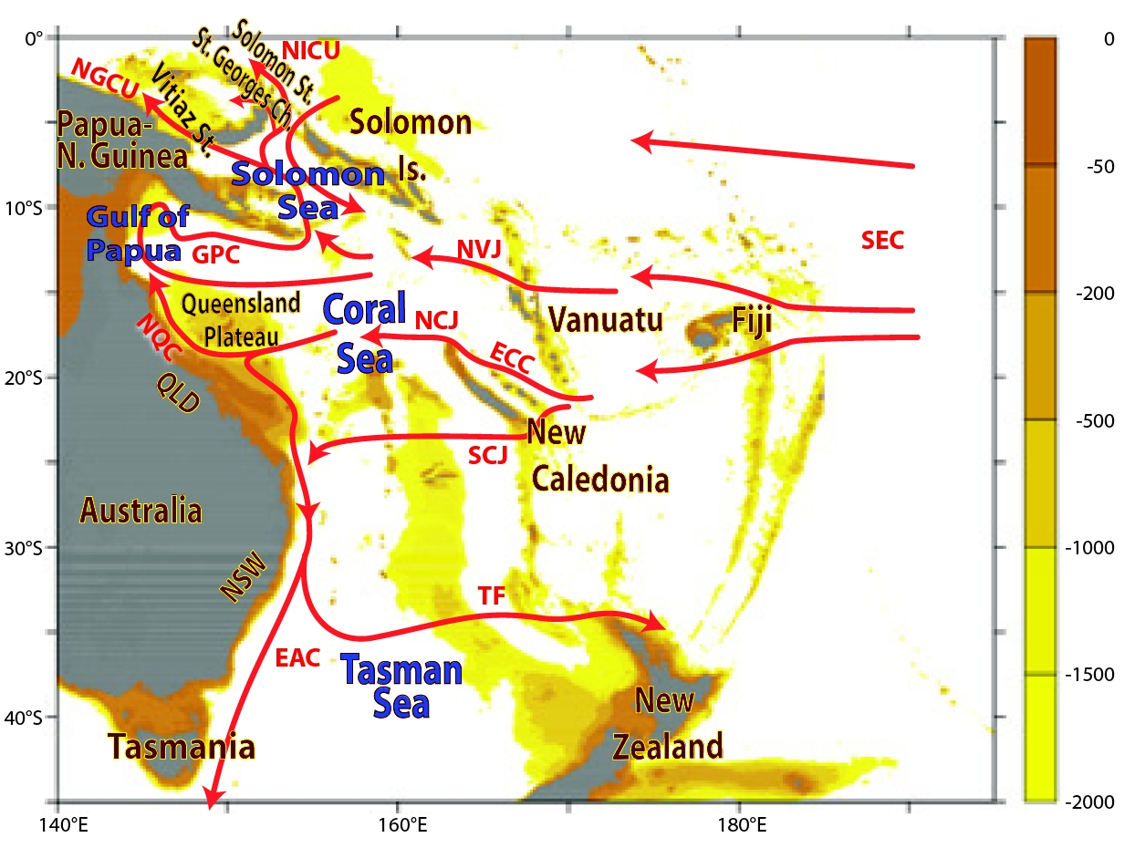
REGIONAL CIRCULATION IN THE SOUTHWEST PACIFIC
• complex bathymetry
• predominance of zonal jets
• low-frequency modulation of ENSO?
Ganachaud et al. (2012)
Kessler and Cravatte(2014)

Slide 3
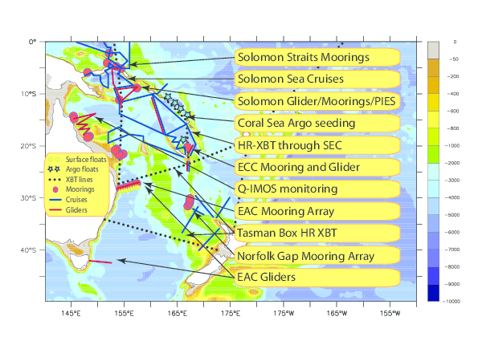
REGIONAL CIRCULATION IN THE SOUTHWEST PACIFIC
• complex bathymetry
• predominance of zonal jets
• low-frequency modulation of ENSO?
Ganachaud et al. (2012)
Kessler and Cravatte (2014)
SPICE program

Slide 4
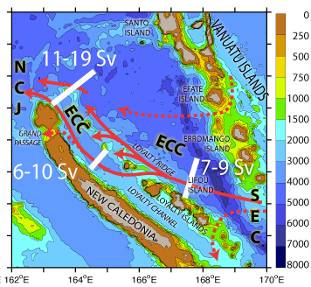
REGIONAL CIRCULATION IN THE SOUTHWEST PACIFIC
• South Caledonian Jet (SCJ)
• East Caledonian Current (ECC)
(Ganachaud et al., 2012; Kessler and Cravatte, 2014)
(Gasparin et al., 2011)

Slide 5
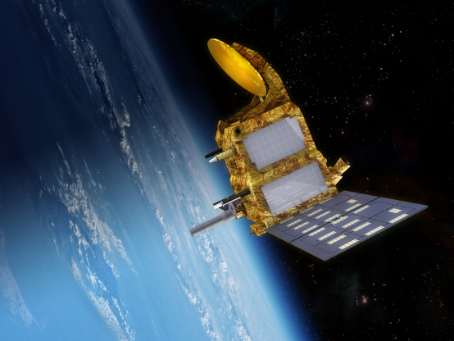
AltiGlidEx project:
to develop a synergy between altimetry and in situ observations to monitor the ECC (and SCJ)
Scientific questions:
• spatial structure of the ECC?
• time variability of the ECC transport and water masses and its causes?
• potential impact of this western boundary current on properties’ mixing?
Validation of the SARAL/AltiKa measurements :
• AltiKa: Ka-band altimeter onboard SARAL satellite,
dedicated to observations of near-coastal oceans
• case example to assess the performance of the Saral/AltiKa altimeter to monitor a coastal boundary current

Slide 6
Strategy of in situ observations
New insights on the ECC structure and variability from in situ observations, including gliders
Preliminary intercomparison between SARAL/Altika and in situ observations

Slide 7
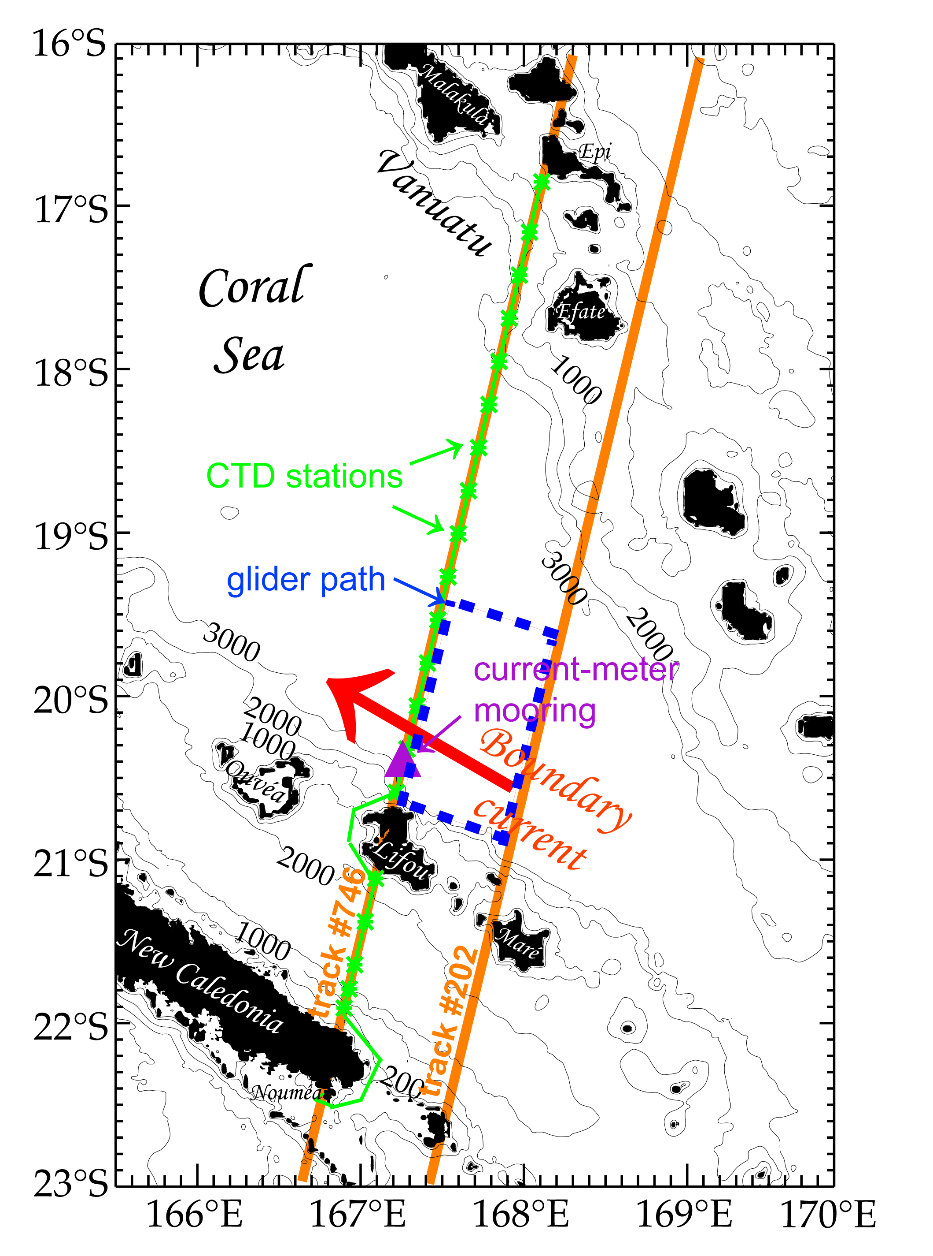
STRATEGY OF IN SITU / SATELLITE OBSERVATIONS
along two SARAL/AltiKa ground tracks
(#746 and #202)
• current-meter mooring in the ECC
(167°15’E – 20°26’S)
(0-1000m: nov. 2010 – oct. 2011)
(0-500m: oct. 2012 – nov. 2013)
• repeated SPRAY glider sections
0-1000m hydrographic sections
(5 missions since 2010)
• dedicated oceanographic cruise (LOSS)
0-2000m section + 0-600m SADCP currents
(oct.-nov. 2013)

Slide 8
STRATEGY OF IN SITU / SATELLITE OBSERVATIONS
2010
2011
2012
2013
SARAL / AltiKa
mooring
Track #746
cruise
glider
#202
glider
cruise
SCJ
glider

Slide 9
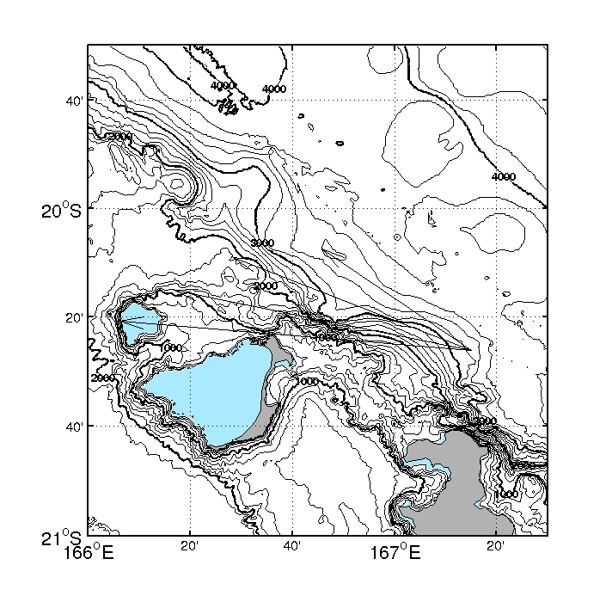

MOORING OBSERVATIONS (1) - MEAN CURRENTS
November 2010 – October 2011
October 2012 – November 2013
(0-1000m)
(0-500m)
8.7 cm/s
400m
6.1 cm/s
1000m
5.7 cm/s
400m
10.3 cm/s
200m
6.9 cm/s
60m
12.0 cm/s
40m
6.9 cm/s
200m
• velocities decrease with depth, but remain strong at 1000m
• velocities tend to align with local topography at great depths

Slide 10
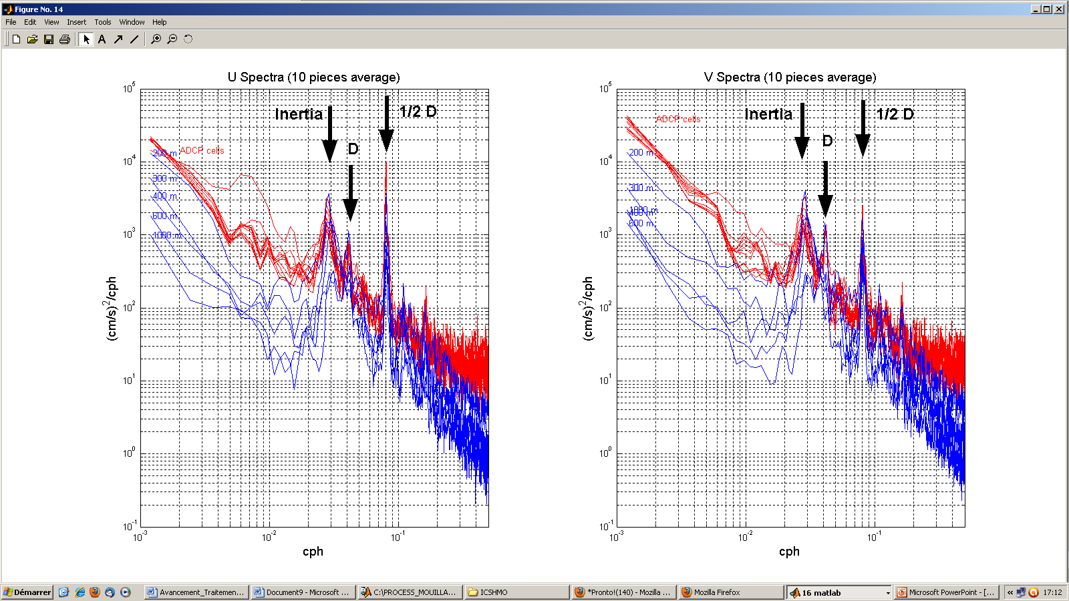
MOORING OBSERVATIONS (2) - HIGH-FREQUENCY VARIABILITY
Velocity spectra at the mooring (november 2010 – december 2011)
U
V
→ strong variability at inertial (~32h), semi-diurnal and diurnal frequencies
(at all depths)

Slide 11
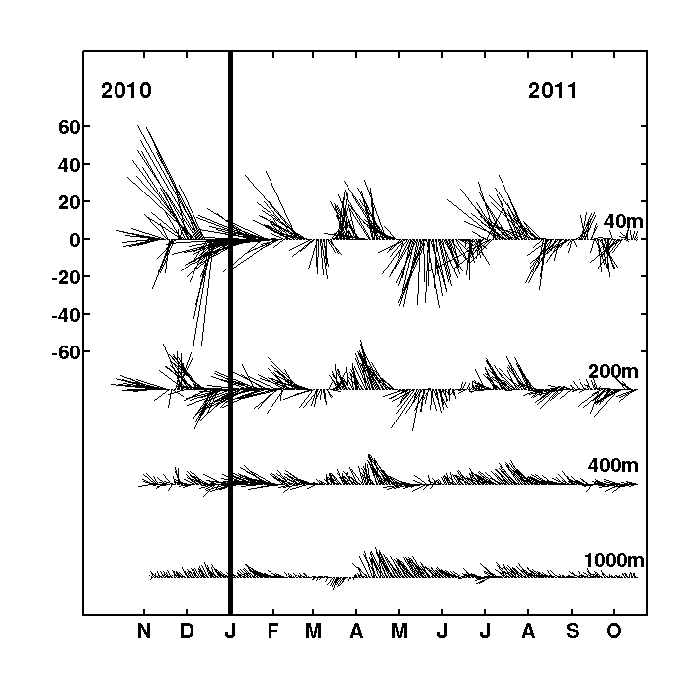
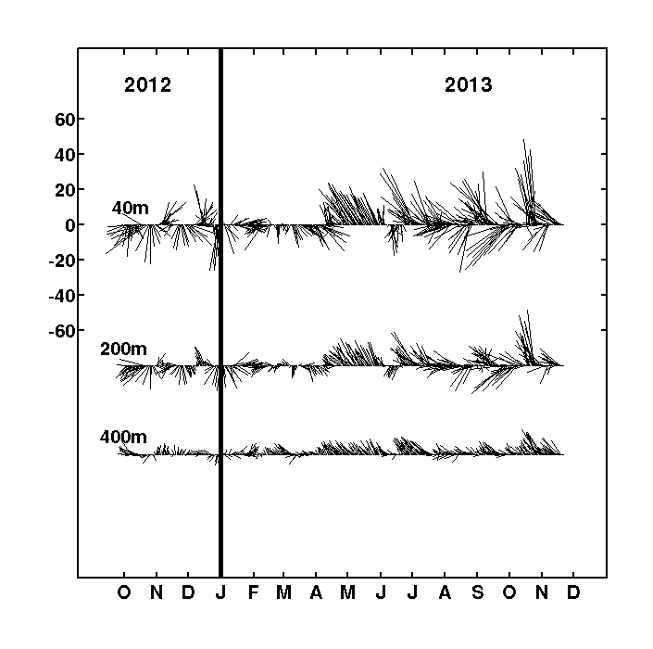
MOORING OBSERVATIONS (3) - INTRA-SEASONAL VARIABILITY
Daily-averaged currents observed at the mooring (167°15’E – 20°26’S)
cm/s
cm/s
November 2010 – October 2011
October 2012 – November 2013
• predominance of a surface-intensified intra-seasonal variability (above 300m)
• more stable jet-like velocities at greater depths

Slide 12
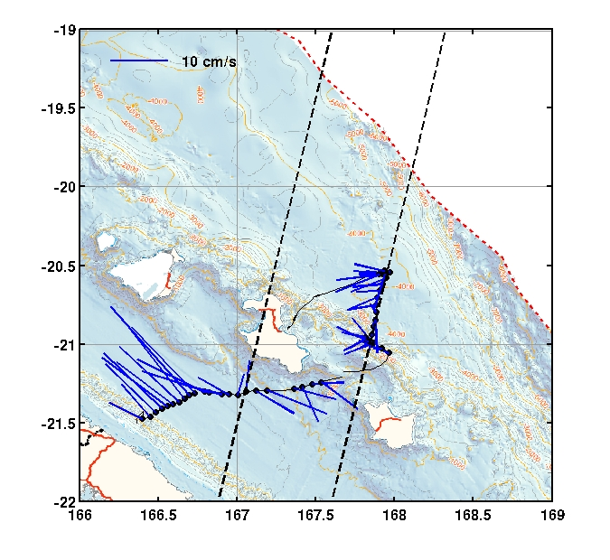
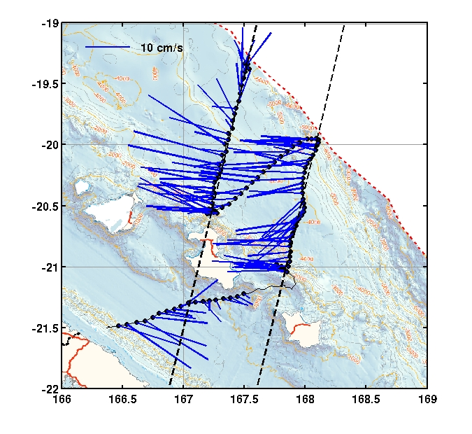
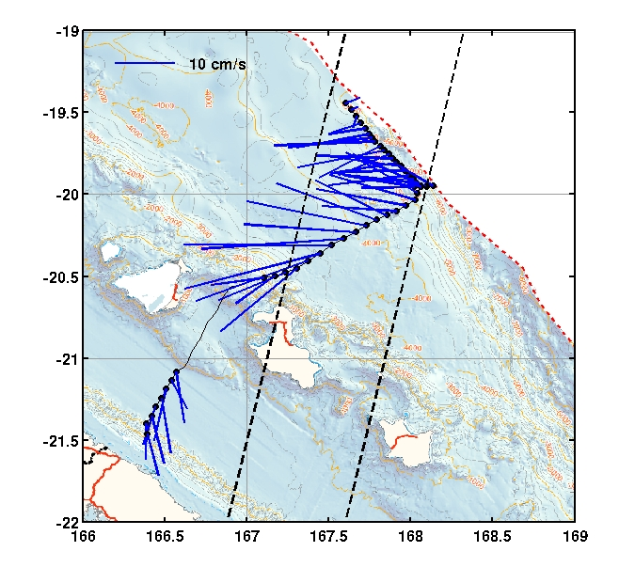
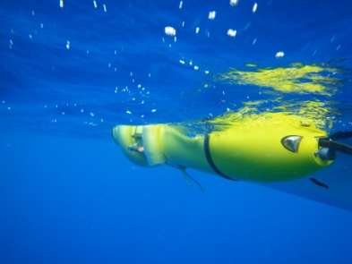
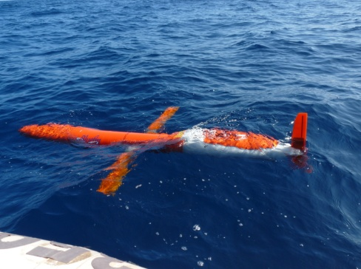
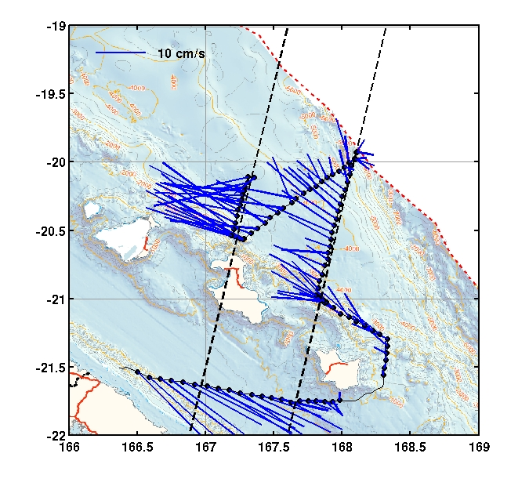
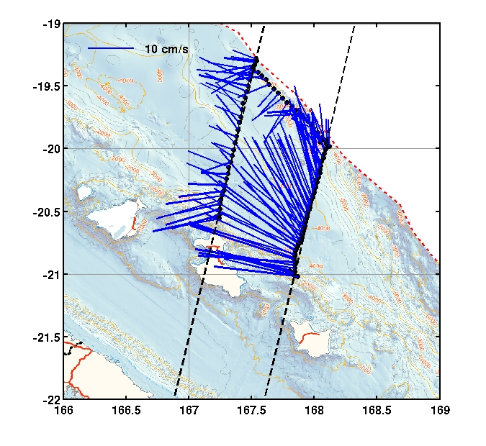
GLIDER OBSERVATIONS: (1) variability of 0-1000m mean currents
Aug. 2011
Jul. 2013
Aug. 2013
Sep. 2013
Oct. 2013
0-1000m mean current
estimated at each dive
from glider drift
• EEC is always present in glider observations, with significant time variability

Slide 13
GLIDER OBSERVATIONS: (1) variability of 0-1000m mean currents
Aug. 2011
Jul. 2013
Aug. 2013
Sep. 2013
Oct. 2013
0-1000m mean current
estimated at each dive
from glider drift
• EEC is always present in glider observations, with time variability
• out-of-phase variability of EEC and Vauban Current, related to eddies’ propagation

Slide 14
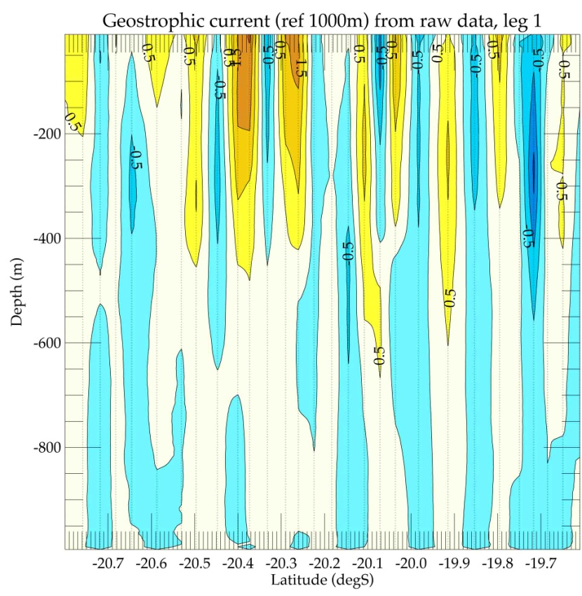
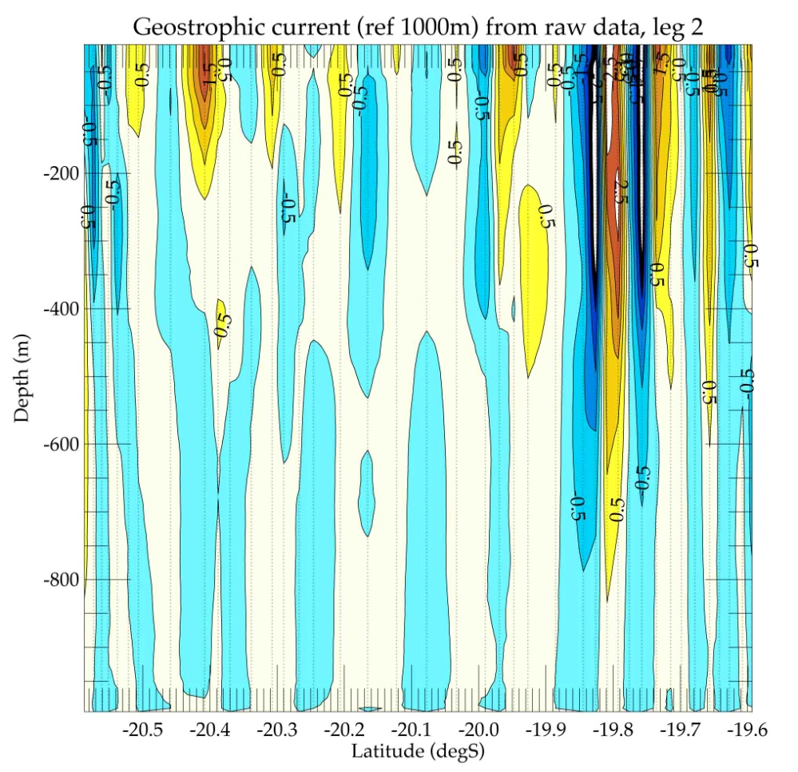
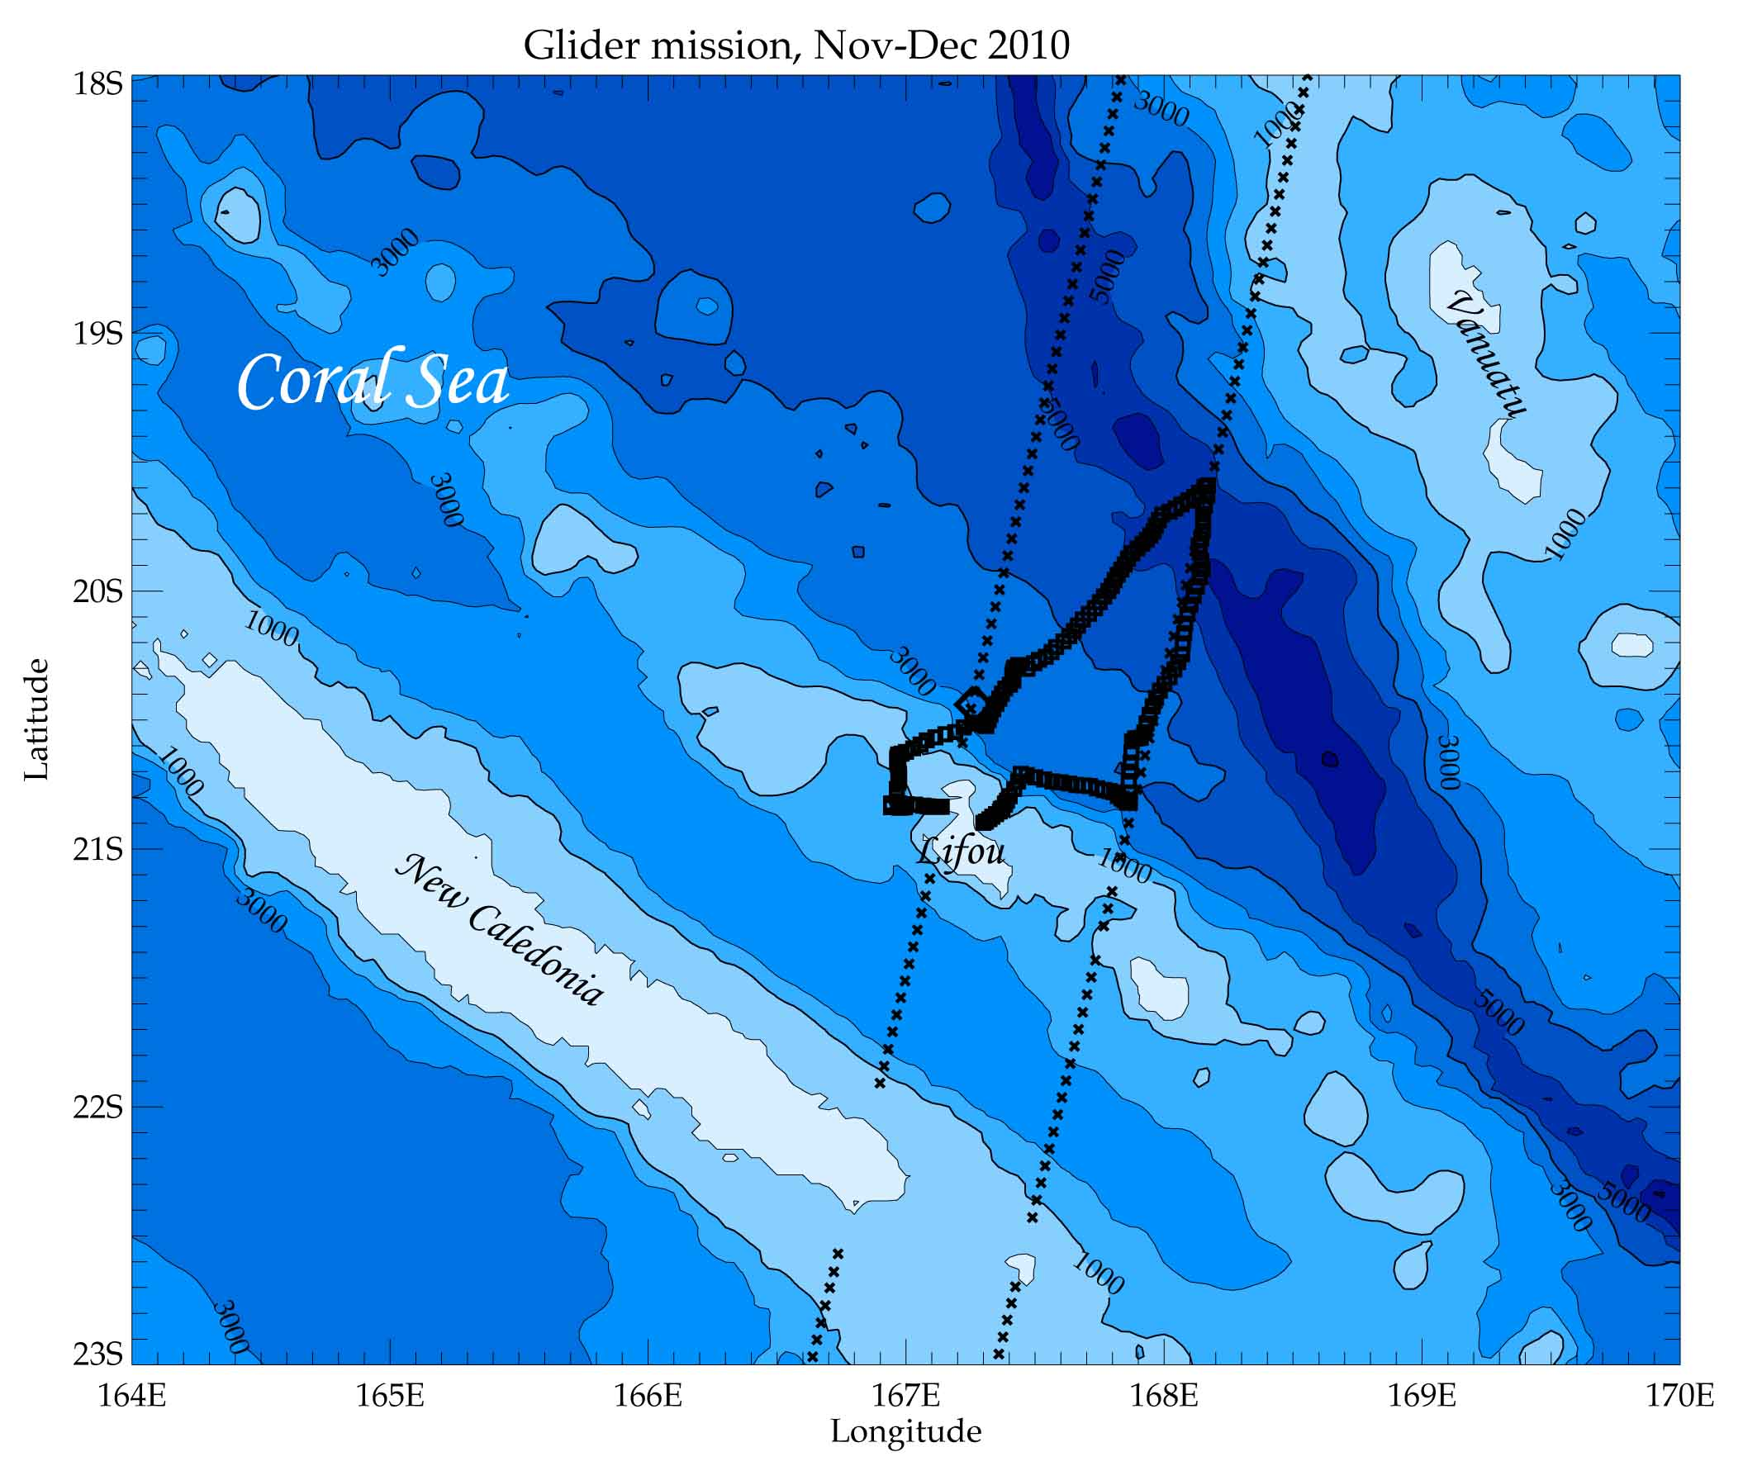

GLIDER OBSERVATIONS: (2) geostrophic velocities
Raw velocities
Leg 1 (mid-nov. 2010)
Leg 2 (early dec. 2010)

Slide 15
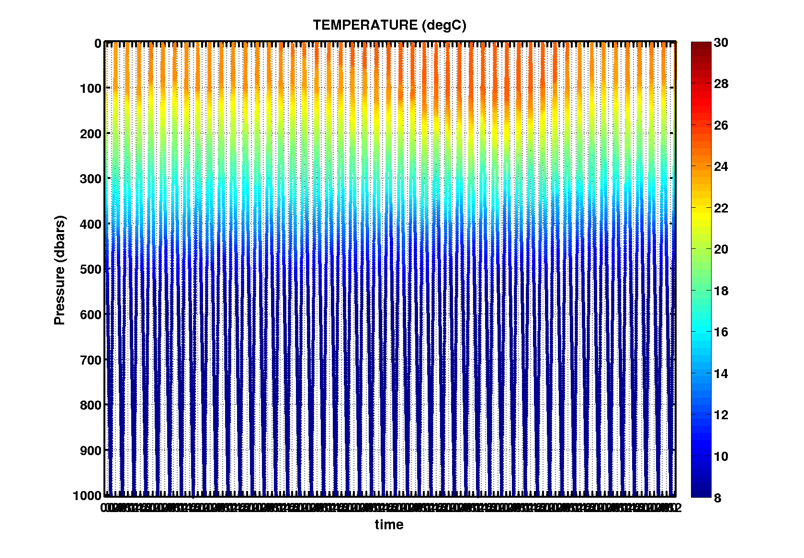
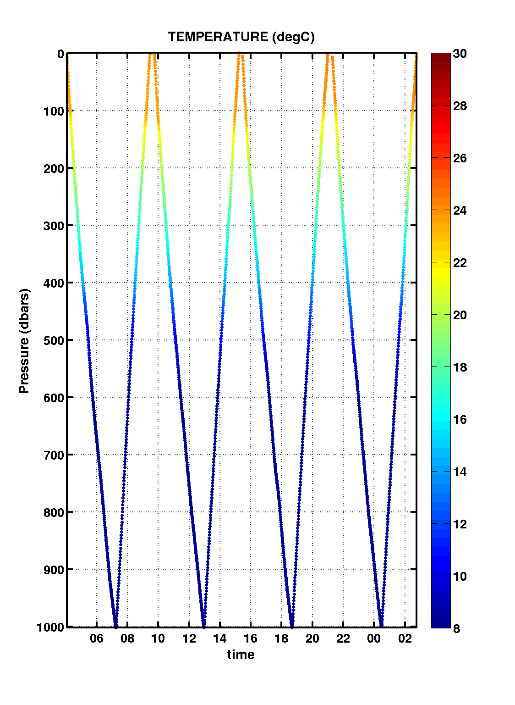
GLIDER OBSERVATIONS: (2) geostrophic velocities
Strategy to estimate geostrophic velocities (filtered out from tides)
Time filtering
(fit to tide harmonics)
32-hour-long
virtual mooring
Transect of interest
32-hour-long
virtual mooring
Mean cross-section geostrophic velocity and transport
mean density profile
(start of transect)
mean density profile
(end of transect)

Slide 16
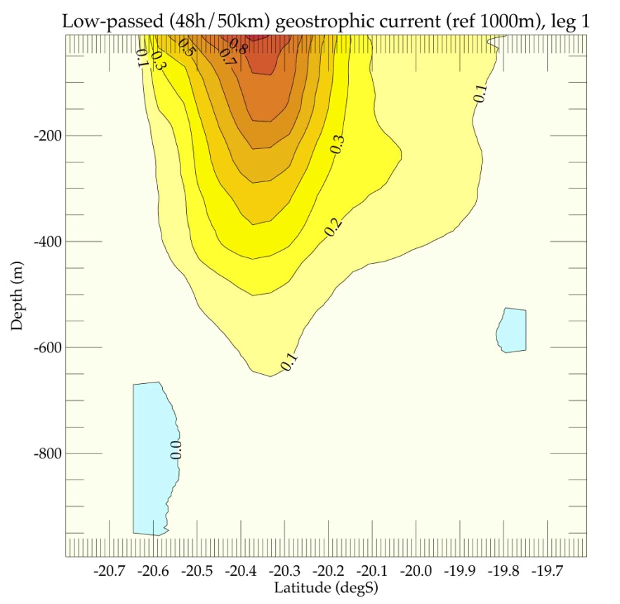
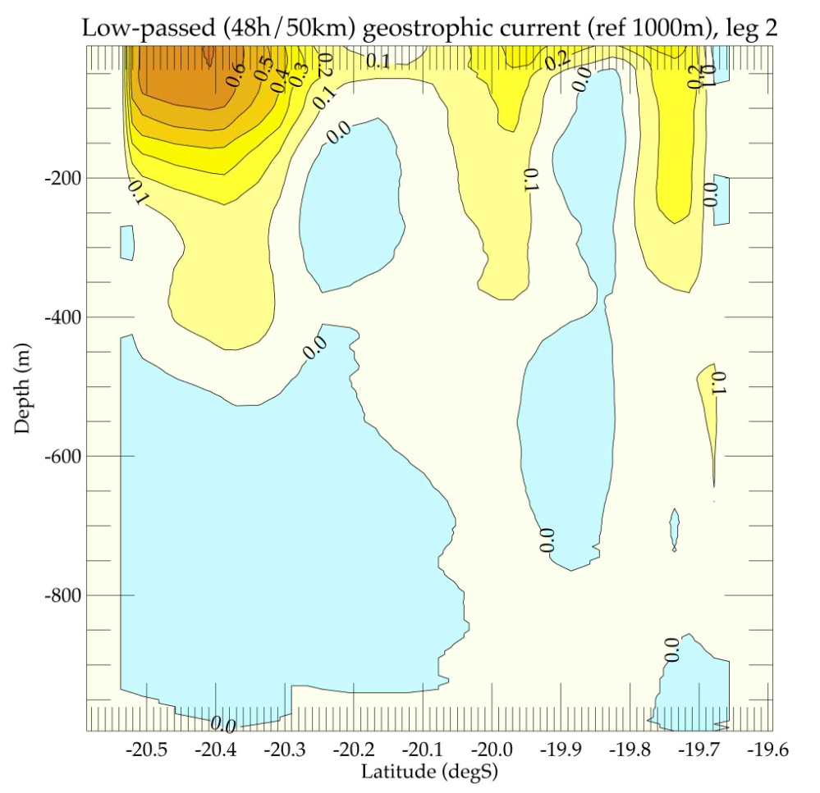
GLIDER OBSERVATIONS: (2) geostrophic velocities
Raw velocities
• importance of the filtering
• velocity at the reference level
Leg 1 (mid-nov. 2010)
Leg 2 (early dec. 2010)
Filtered velocities
15.0 Sv (W)
7.4 Sv (NW)

Slide 17
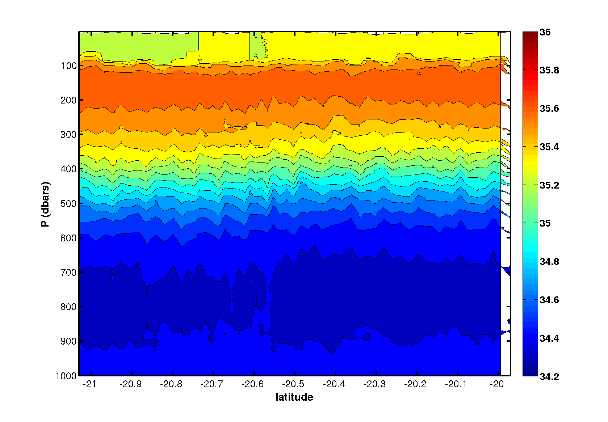
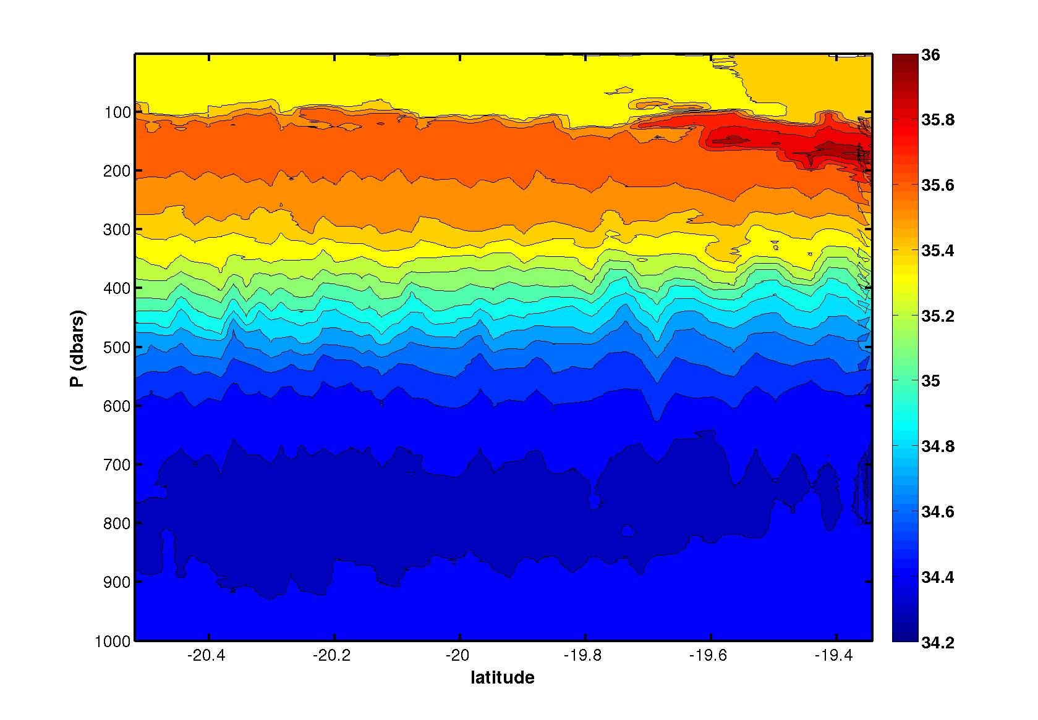
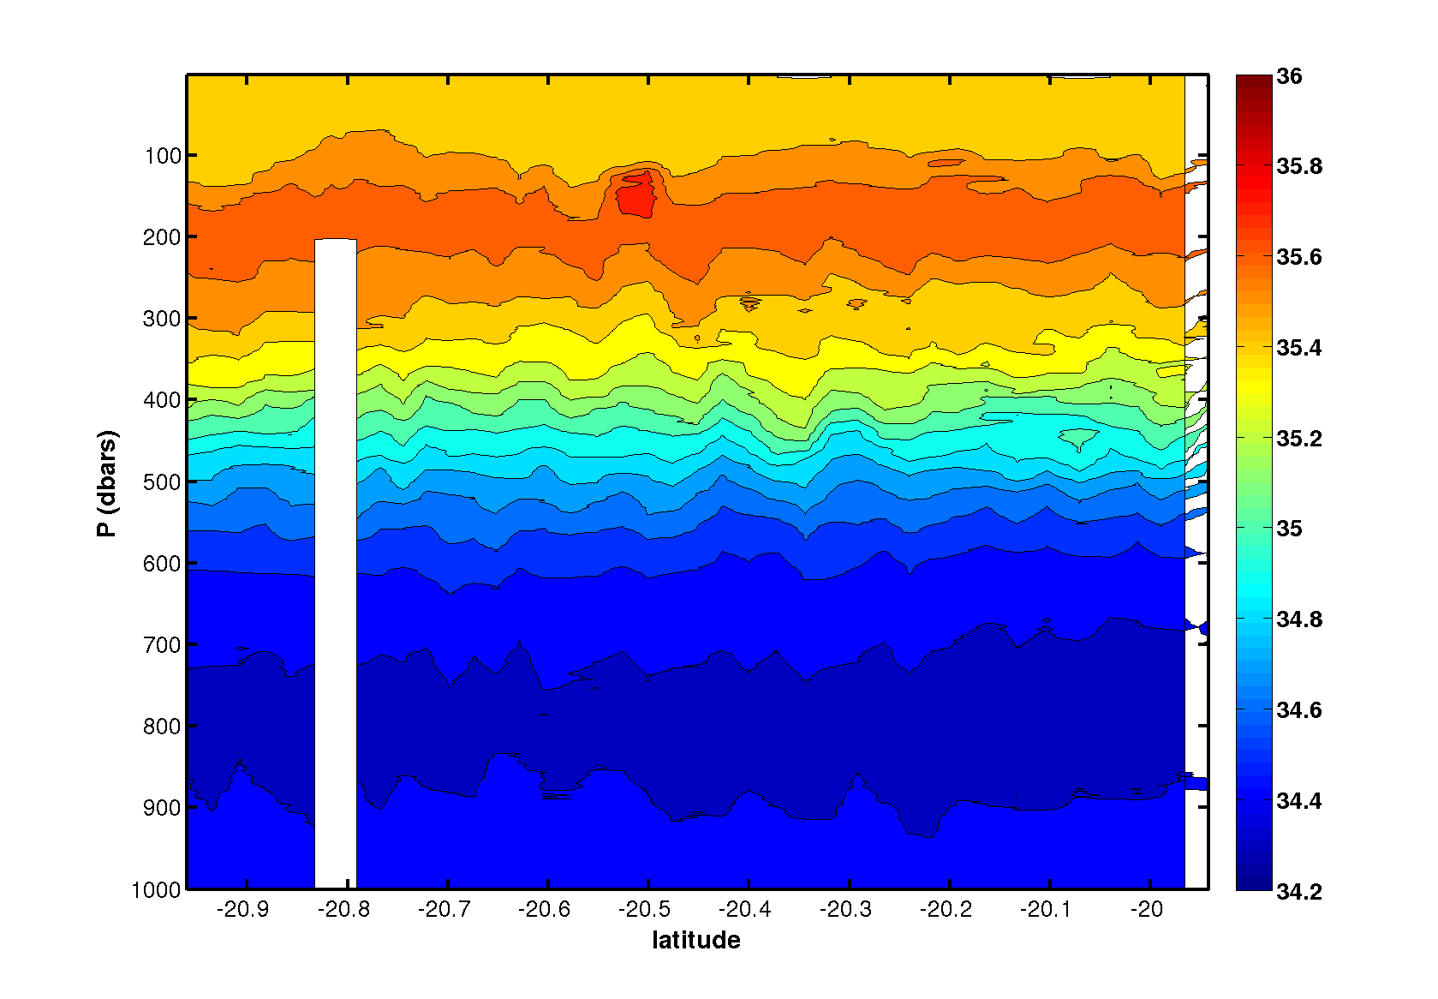
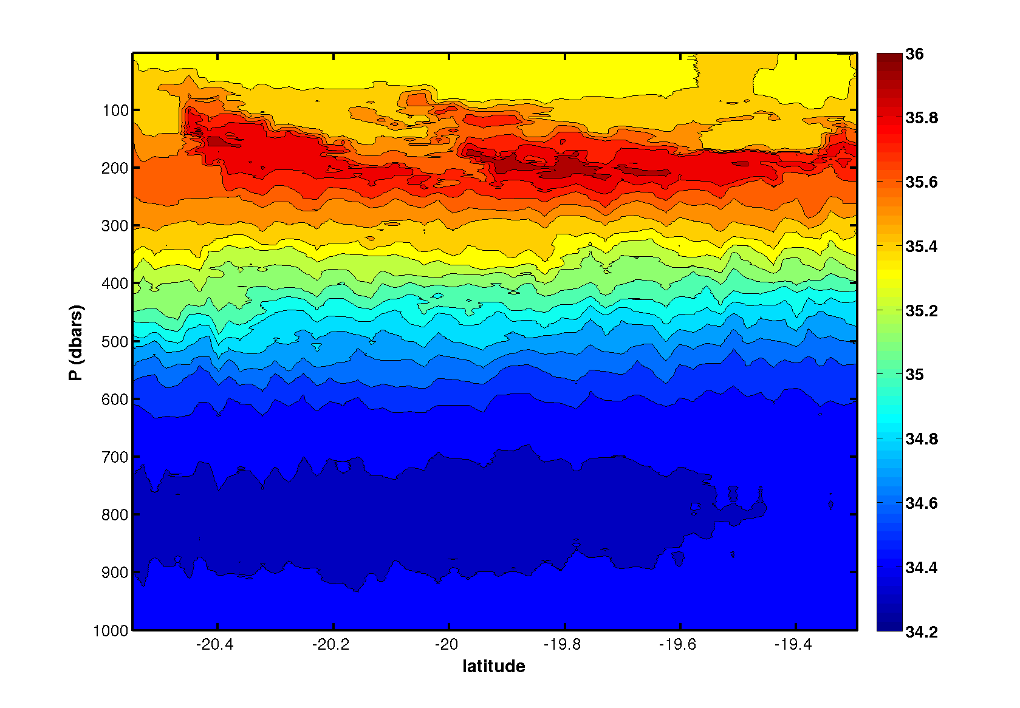
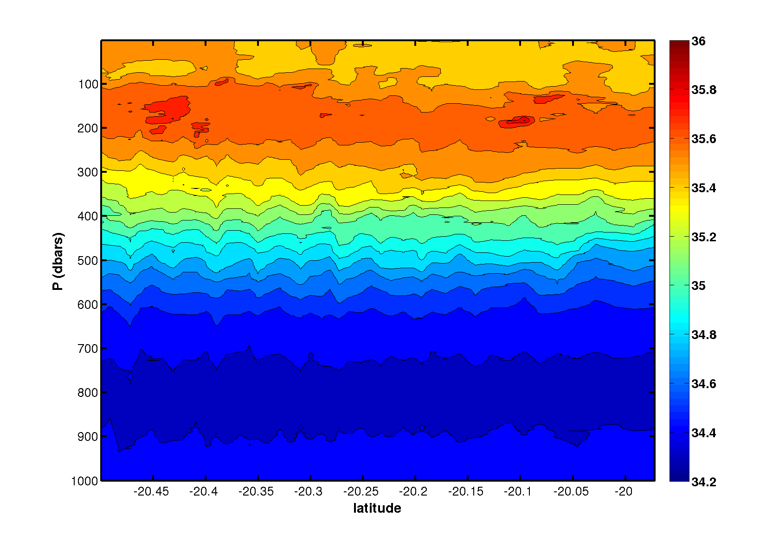
GLIDER OBSERVATIONS:
(3) Salinity sections
11 JULY 2013
Track #746
Track #202
23 JULY 2013
11 SEPTEMBER 2013
Track #202
2 OCTOBER 2013
19 OCTOBER 2013
• lateral high salinity instrusions

Slide 18
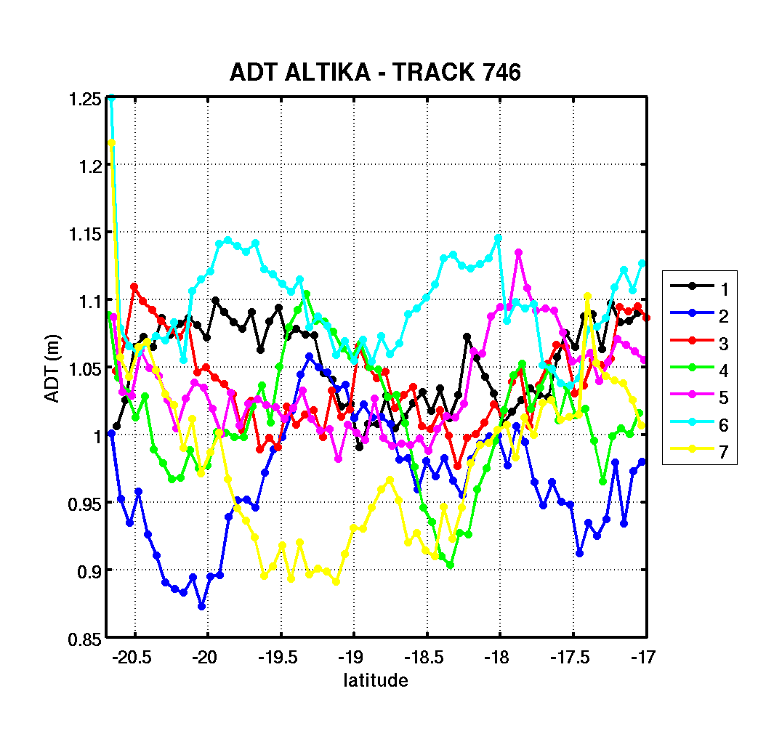
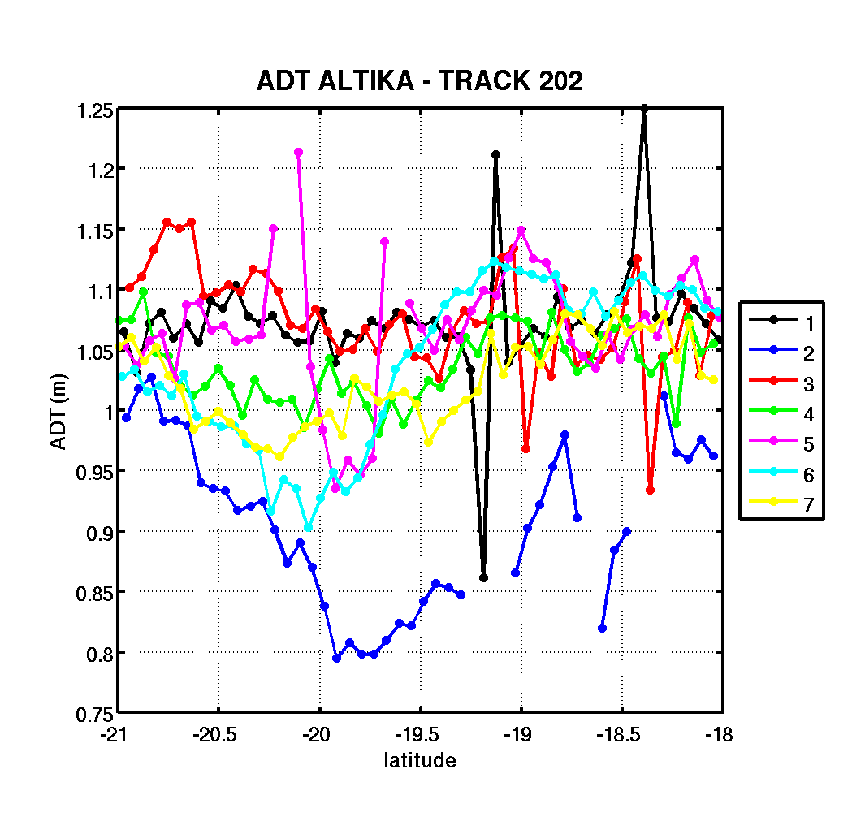
SARAL/ALTIKA OBSERVATIONS:
(1) variability of Absolute Dynamical in the ECC
Track 746
Track 202

Slide 19
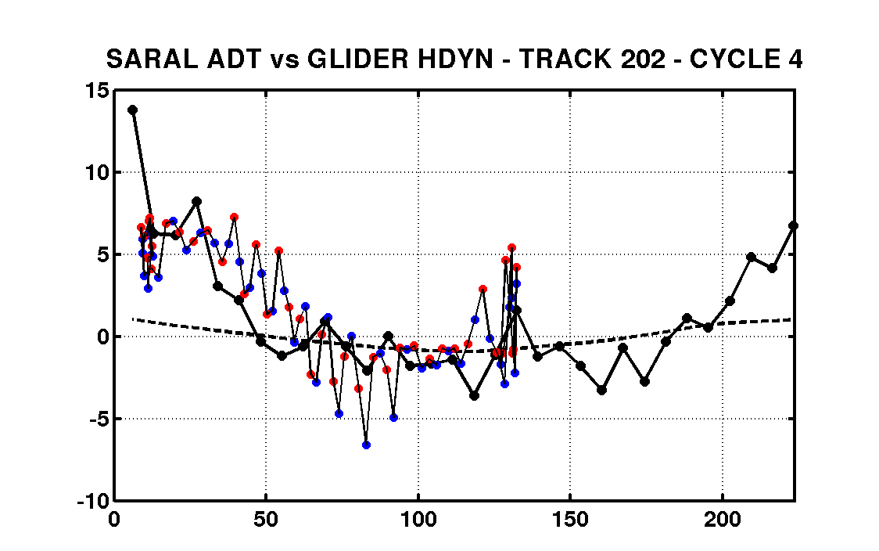
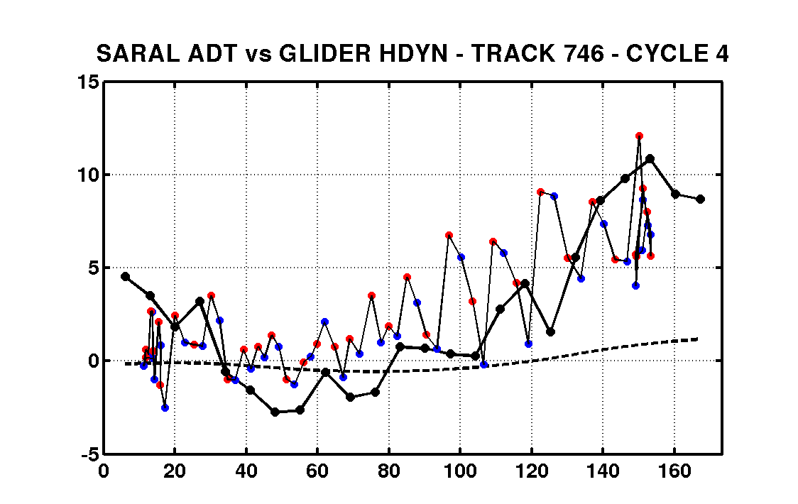
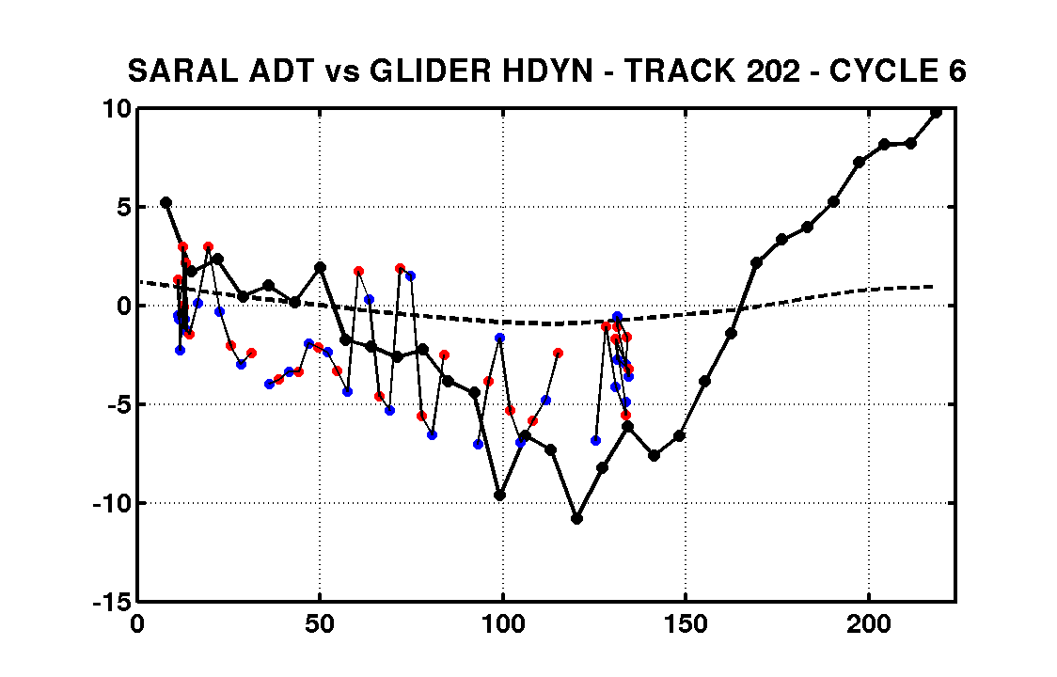
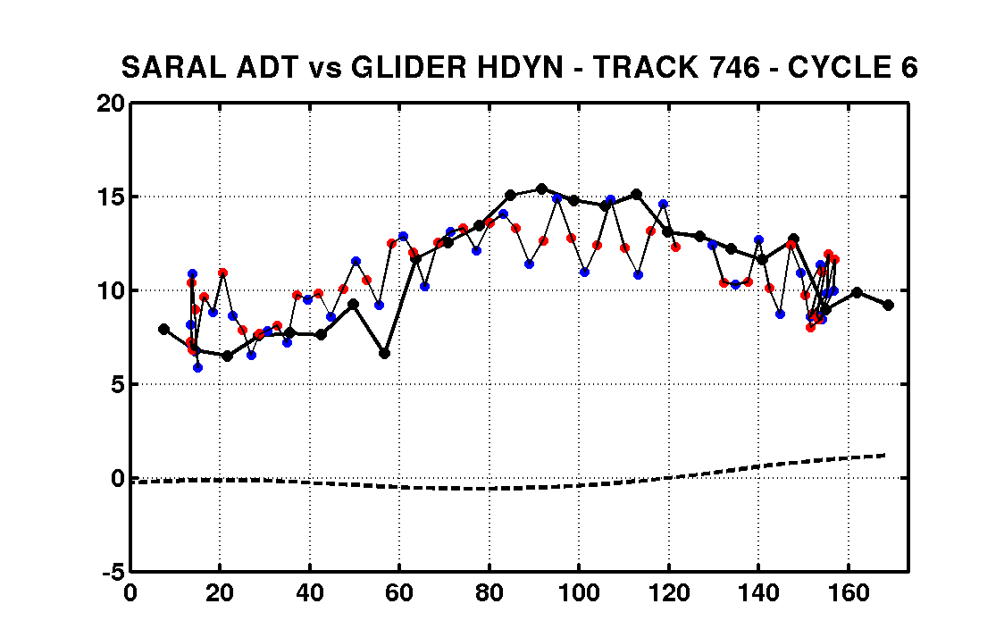
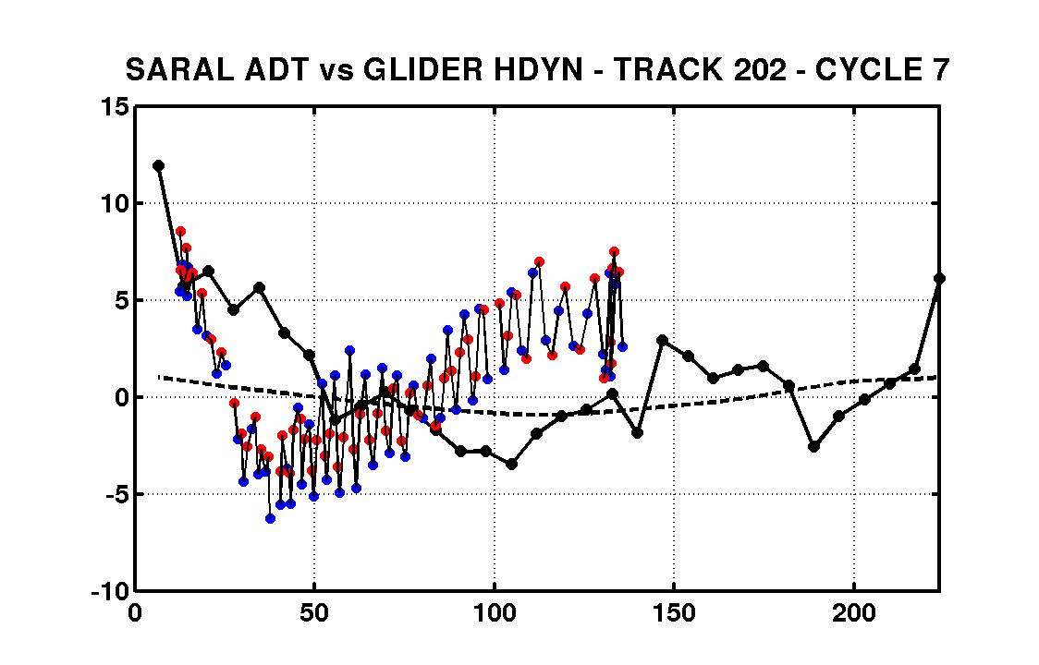
SARAL/ALTIKA OBSERVATIONS: (2) Comparison with in situ observations
Cycle 4
SARAL/AltiKa Absolute Dynamic Topography (cm)
Vs
Glider dynamic height (cm) w.r.t. 1000m
Cycle 4
Cycle 5
Track #202
Track #746
Cycle 5
Cycle 7
Distance from the coast (km)
Distance from the coast (km)

Slide 20
CONCLUSION
Glider observations in New Caledonia
• Nouméa: an additional glider port in the EU community
• needs of pre-filtering due to intense high-frequency variability
Time and space variability of the ECC
• strong variability of the circulation and mass transport associated with the ECC
• meso-scale / intra-seasonal variability in the ECC associated with eddies propagation
• evidence of water masses intrusion in the ECC
Intercomparison in situ / AltiKa observations
• case study for the intercomparison between AltiKa measurement and in situ obs.

