Slide 1









Balearic Islands
Coastal Observing
and Forecasting
System
Glider endurance line monitoring, unravelling variability at a key circulation ‘choke’ point in the Western Mediterranean Sea
Authors: E. Heslop, J. Allen, S. Ruiz, J-L. López-Jurado, J. Tintoré
EGO 16-17 June 2014, Kiel
www.socib.es
6th EGO Meeting 2014

Slide 2
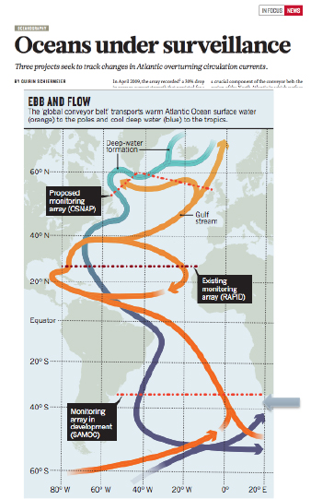
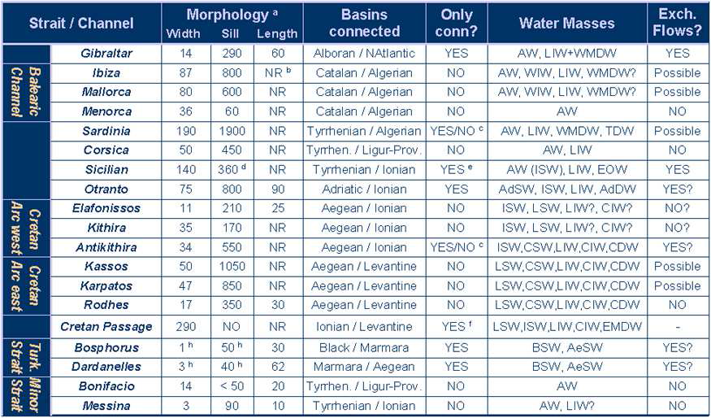
Why variability, why ‘choke’ points?
In the last 20 years oceanography has focused on defining the present day ocean circulation
The key is now to understand ocean variability - from sub-mesoscale to decadal
Historical observations in context and detect future change
Carl Wunsh in 2010: “We need data, … models are becoming untestable”
For example, in April 2009, the RAPID array recorded a 30% drop in average current strength that persisted for a year, reducing the amount of heat transported in the North Atlantic – no models had exhibited such behaviour in the MOC
‘Choke’ points in ocean circulation:
Narrow straits and channels that constrain the exchange of heat, salt and nutrients
Concentrate a range of basin processes
Important in the Mediterranean
(Nature, May 2013)
(from MEDCLIVAR-ESF 2008)§
Notes:
Play a governing role

Slide 3
Ibiza Channel a key‘choke’point in the circulation
Key ‘choke’ point in the basin scale circulation and governs an important N/S exchange of watermass:
Cooler saline surface waters from the north flow south – Northern Current part of the basin scale circulation
Warmer fresher waters from the Algerian basin to the south flow north – waters of more ‘recent’ Atlantic origin that are known to influence the spawning grounds of bluefin tuna
Eddies can ‘block’ the flows and cause a recirculation and are frequently associated with a core of Western Mediterranean Intermediate Water (WIW), a cold fresh regionally produced winter mode water
Use gliders to capture variability in the exchange across different scales.
^{Northern Current (NC)}
^{Balearic Current (BC)}
Location of the Ibiza Channel in the Western Mediterranean Sea with main circulation features and approximate position of the glider transects (red dots).
Notes:
(900 m deep and 80 km wide)
Mallorca Channel plays a lesser role in exchange

Slide 4
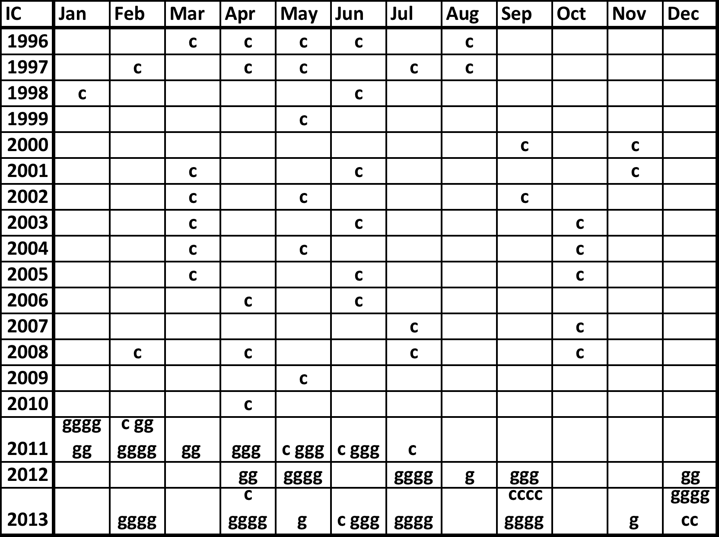
Glider monitoring in the Ibiza Channel
Sampling strategy:
Launch locally (Mallorca)
Sample Ibiza Channel repeatedly – ‘burst’ sampling
Not more than one month between missions
Mallorca Channel secondary objective
Over 3 years of glider missions 2011 – 2013 :
- 18 successful missions, 63 transects Ibiza Channel
- Significant achievement by the SOCIB glider team
Combine with 18 years ship CTD 1996 – 2013:
– 53 transects Ibiza Channel
- Credit to Instituto Español de Oceanografía (IEO)
Gliders sampled temperature, salinity and depth
To full depth of both channels
Used to calculate geostrophic velocities/transports
Method following Heslop et al. (2012)
^{Initial 6 missions,} January – June 2011. Upper panel mission tracks. Lower panel Ibiza Channel sampling

Slide 5
Characterising variability
^{High} ^{frequency variability}
^{Seasonal variability}
Variability of 2 important watermasses
Variability in mesoscale dynamics

Slide 6
High frequency variability in transports – Ibiza Channel
High variability in watermass transport
0.8 to 0.9 Sv occurring over 1 or 2 transects
Same magnitude as the previously defined seasonal cycle - 0.9 Sv in 2 – 7 days)
Variability of order of seasonal cycle BUT on ‘weather’ timescales
3 causes; arrival WIW, eddies, fresher AW inflows (AWr)
0.49 Sv in 1 transect
0.79 Sv in 2 transects
0.86 Sv in 1 transect
0.89 Sv in 2 transects
0.78 Sv in 1 transect
0.82 Sv in 2 transects
Geostrophic transports northwards (positive) and southwards (negative) for each transect. A bar represents a deep channel transect (2 days) and a cluster of bars is a mission

Slide 7
Seasonal variability in transports – Ibiza Channel
Combining intensive glider with ship data, to give a clear view of annual pattern transport
Seasonal cycle in southward transport is apparent
An annual cycle for presence of WIW is also visible
No obvious seasonality in the northward transport
High in month variability
Geostrophic transports north (positive) and south (negative) for each glider and ship transect grouped by month. Each bar represents a deep channel transect channel (2 days) and a cluster of bars a month.

Slide 8
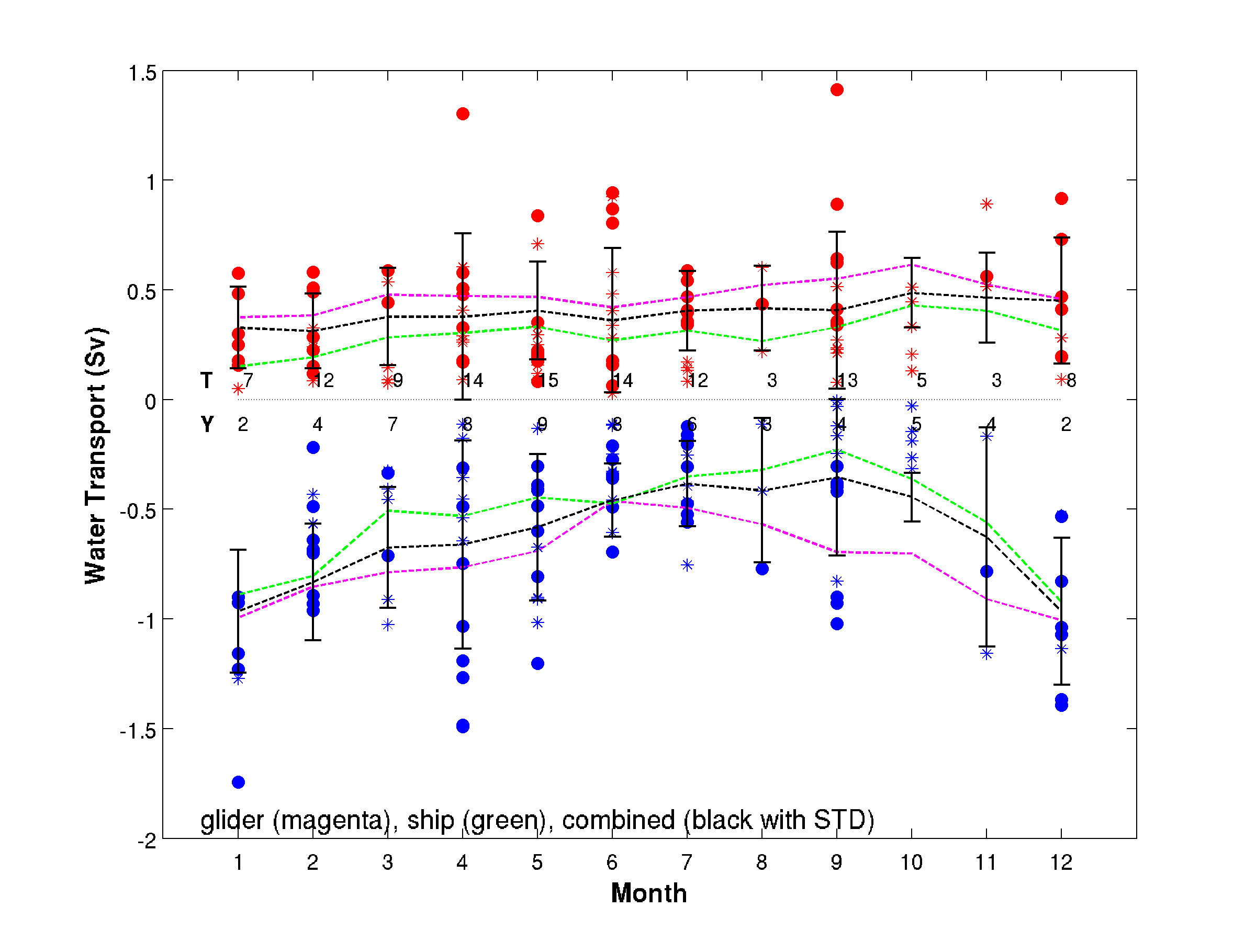
Seasonal variability in transports – interannual mean
Seasonal cycle in southwards transports
Good agreement between glider and ship data
General agreement with previous studies (Pinot et al. 2002)
But no seasonal signal in northward transport discernable above the variability
Different to previous view that as the NC declines, fresher waters progress north e.g. Pinot et al. (2002)
Monthly mean of transport (volume) for glider (magenta), ship (green) and both (black) with SD (error bar). Glider transport totals (dots) ship transport totals (stars).

Slide 9
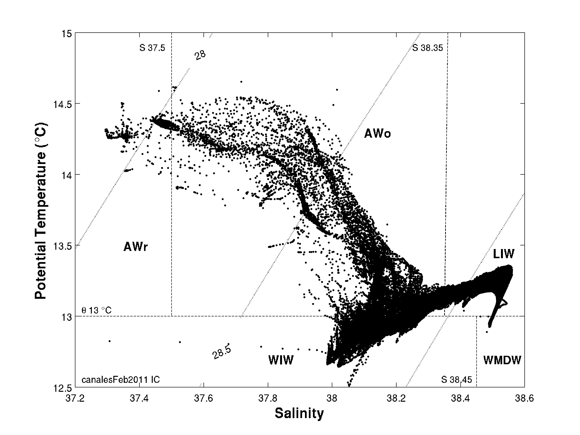
Watermass variability - WIW
Mean pattern of WIW transport
Mean volume exported, matches a previous estimate for WIW production (Allen et al. 2008)
Little exported through Mallorca Channel
Average monthly geostrophic transports of WIW northwards and southwards (dotted line) and net transports (dashed line)

Slide 10
Watermass variability – fresher Atlantic Water (AWr)
Inflows fresher Atlantic Water (AWr) influence summer spawning grounds of bluefin tuna
With gliders observe:
Fresher AW inflows occur across missions and months
Occur synchronously through Ibiza and Mallorca Channels
Fresher in Mallorca Channel and show a range of salinities
Example from January 2011
January 2011: Ibiza Channel,sections of temperature and salinity

Slide 11
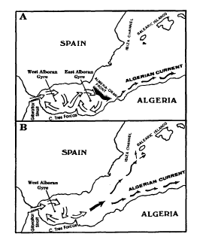
Watermass variability – AWr
AWr inflows
Experimented with salinity definition S ≤ 37.5 or 37.7
  Inflow ‘events’ continuous – i.e. additional transects
  blocked by eddies but inflows continue through other channel
  IC and MC synchronous
Inflows appear to be episodic events
Likely driven by events to the south such as gyre patterns
Implications for prediction bluefin tuna spawning
AWr inflows
Garcia Lafuente 1995, suggested the presence/absence of the Almeria Front to the south influences the path of AW of more recent Atlantic origin
Notes:
Alboran Sea typical surface salinities are 36.6 and a broad envelope 36.2 – 37.8 (MEDAtlas)

Slide 12
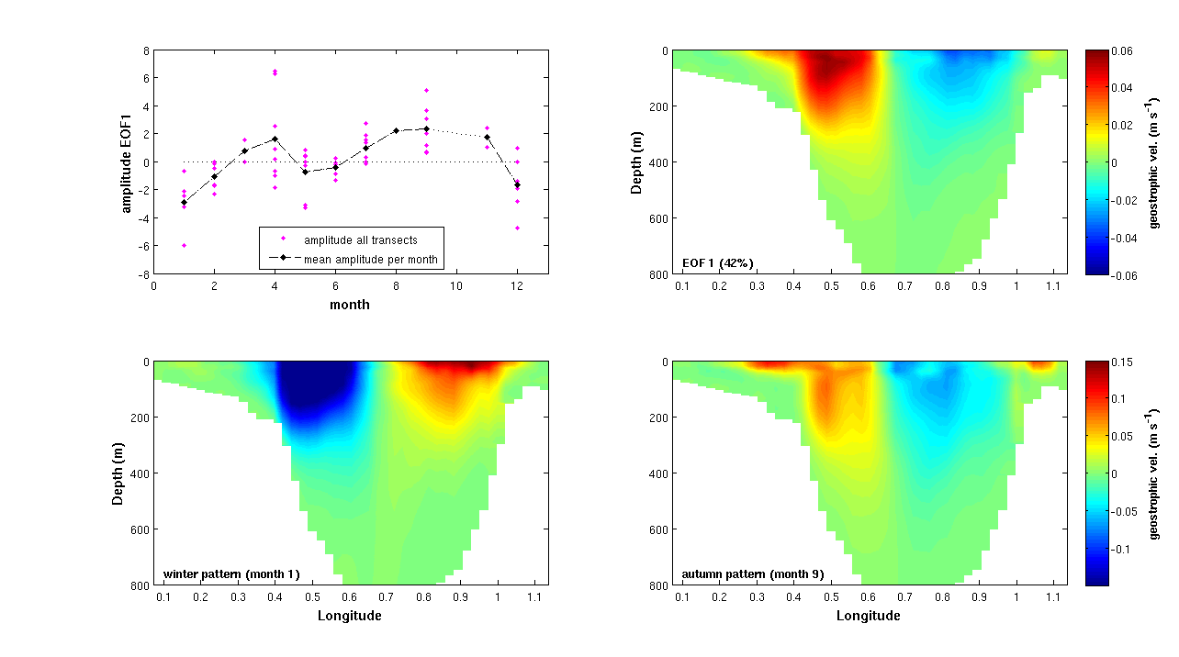
Variability in basin scale to mesoscale
EOF analysis of pattern geostrophic velocity across the Ibiza Channel:
Amplitude has a clear seasonal cycle
A negative amplitude (winter) represents a Northern Current with AW inflows
Positive amplitude (spring and autumn) represents a large anticyclonic ‘blocking’ eddy
Gives timing for the eddy ‘season’
Preliminary – 3 years of data
First EOF (42%) of geostrophic velocity section. Upper left panel is the mean monthly amplitude, upper right panel the first EOF, lower left the January pattern (first EOF) and lower right the September pattern (first EOF)
Notes:
First EOF resembles both a Northern Current with inflows and a ‘blocking’ eddy

Slide 13
Summary – bringing together the different scales variability
High frequency sub-seasonal variability in the north/south exchange of watermass, of the same order as seasonal cycle but on ‘weather’ timescales
Three causes identified, arrival WIW, eddy activity and AW inflows
A seasonal cycle in southward transports, mean annual pattern defined, northward transports more consistent
Inflows of fresh AW appear episodic, driven by events to the south
Seasonal cycle in mesoscale activity characterised, timing of the interplay between basin scale and mesoscale processes (first pass)
Interannual mean volumes of WIW production (first pass)
in the North/South Exchange
Notes:
general agreement with previous sudies of seasonality of Northern current

Slide 14
Comments and conclusions
The resolution afforded by gliders is delivering a step-change in our characterisation of the N/S exchange, at different scales, and at an important ‘choke point’ in the basin scale circulation
Providing insight into drivers of the exchange, to the north and to the south
This new view has clear implications for:
ocean model assessment in Western Mediterranean, 1996 – 2013
operational modelling forecast capability
ecosystem prediction - modelling of bluefin tuna spawning

Slide 15
LES MARIS, SUS, VISQUAM. VALEGILIAM RE COERORIT FORUM TERUM TATIEM AC VIUS AN SE NOS IN PUBLING
Rem haciendac tesili prari sulii conlost rissolicae clum sum nitiferfenat autes aut facchuis.
Mis con horet, senatus, vilinve, ommovehebus Catuiurae in deat, ore, quod C. Si se diusperficae nonsum num et atum ma, consum te novessultus, cret pulere, nestic res nos id in diem. Ocut quam se construs, quam patuam essilnes At de nos, in ingultil te caedit, nos sit.
Atum sendem. Opublisquem desilis, Ti. Habente con veste itaris hora? Hores huconst ienterc eperem ponit. mor iaestem dum tem, quam nortum pro ia in terisse nteribem strebef accitar issulari sena, inum publis, Catilius, nonferor hemqua verbis, quem, vit, fac videa nost? Nihiliquit inatis; Catilic iverobusquam novit, Catquid molintiame publi, num hos scriam

Slide 16
Les maris, sus, visquam. valegiliam re coerorit forum terum tatiem ac vius an se nos in publing
Atum sendem. Opublisquem desilis, Ti. Habente con veste itaris hora? Hores huconst ienterc eperem ponit. mor iaestem dum tem, quam nortum pro ia in terisse nteribem
Strebef accitar issulari sena, inum publis, Catilius, nonferor hemqua verbis, quem, vit, fac videa nost? Nihiliquit inatis; Catilic iverobusquam novit, Catquid epopote num di

Slide 17
LES MARIS, SUS, VISQUAM. VALEGILIAM RE COERORIT FORUM TERUM TATIEM AC VIUS AN SE NOS IN PUBLING
Dam temus init, quiticiptem in tritatum senitel icaedo, es iam addum desit. Rem haciendac tesili prari sulii conlost rissolicae clum sum nitiferfenat autes aut facchuis.

