Slide 1

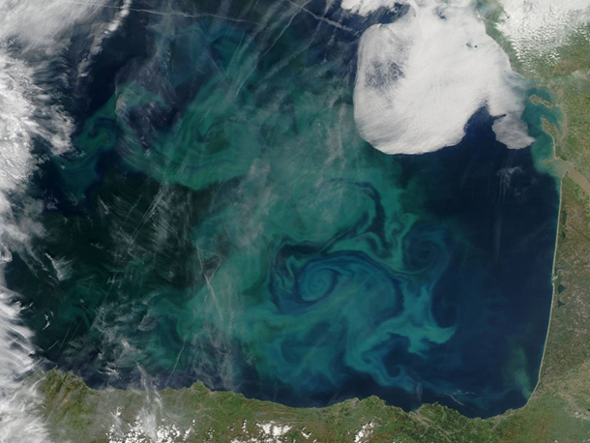

The GESSEB glider mission for analysing mesoscale eddies in the southeastern Bay of Biscay
CABALLERO, Ainhoa; TESTOR, Pierre; RUBIO, Anna; HERNÁNDEZ, Carlos; MADER, Julien
6th EGO Meeting, 17june 2014, KIEL

Slide 2
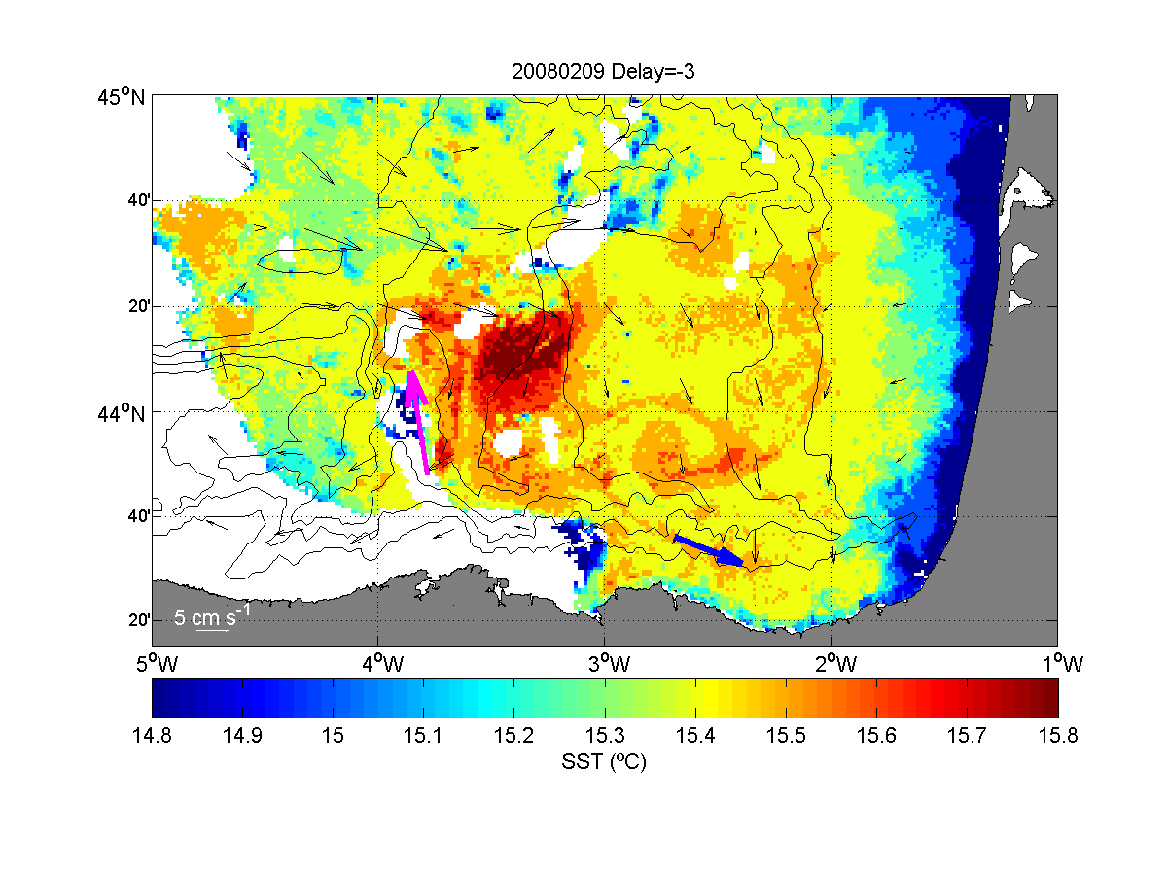
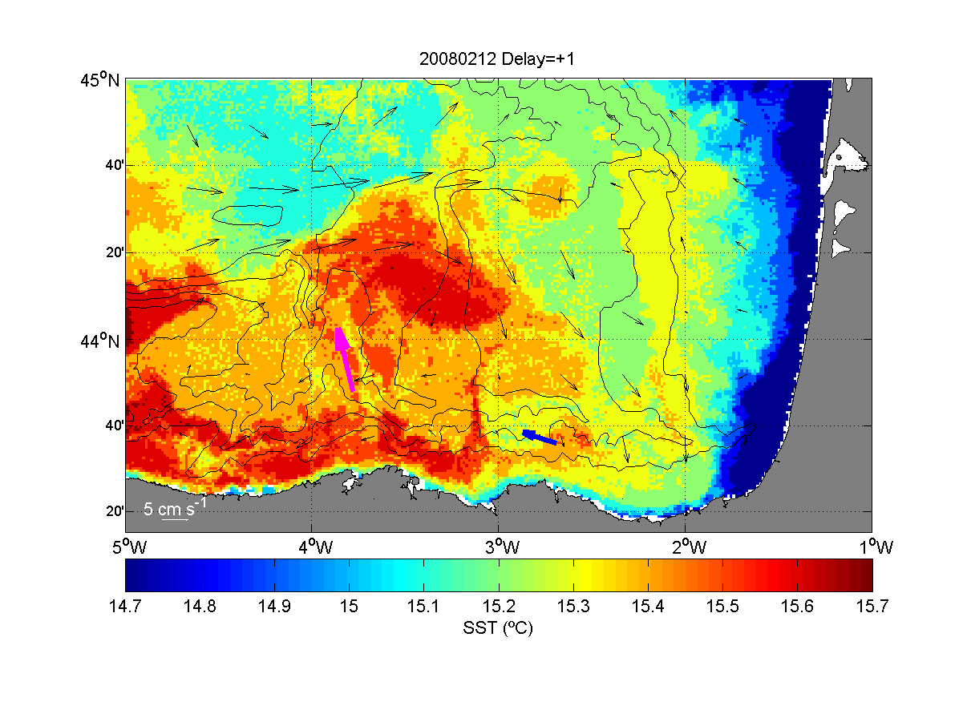
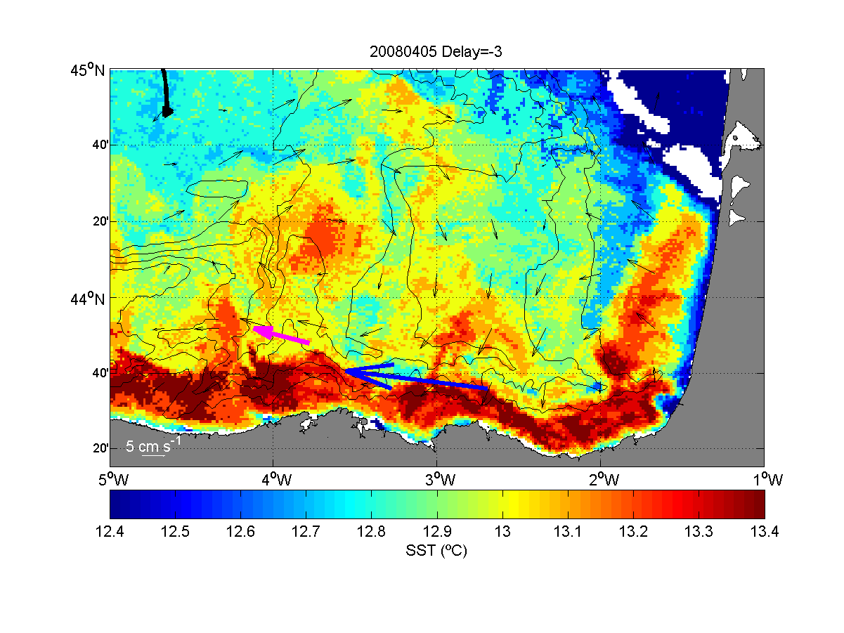
The GESSEB glider mission for analysing mesoscale eddies in the southeastern Bay of Biscay
introduction
The Bay of Biscay & mesoscale eddies
Slope Water Oceanic eDDIES (SWODDIES) are generated from a winter warm slope current insabilities, as a consequence of topographic irregularities (Pingree and Le cann, 1992a, Pingree and Le Cann, 1992b…).
February
April
SWODDIES have been observed afterwards by different authors and different methods: Satellite data, drifters, numerical models, XBT… (Garcia-Soto et al., 2002, Sánchez et al.,2004; Caballero et al., 2008, 2013…).

Slide 3
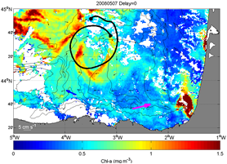
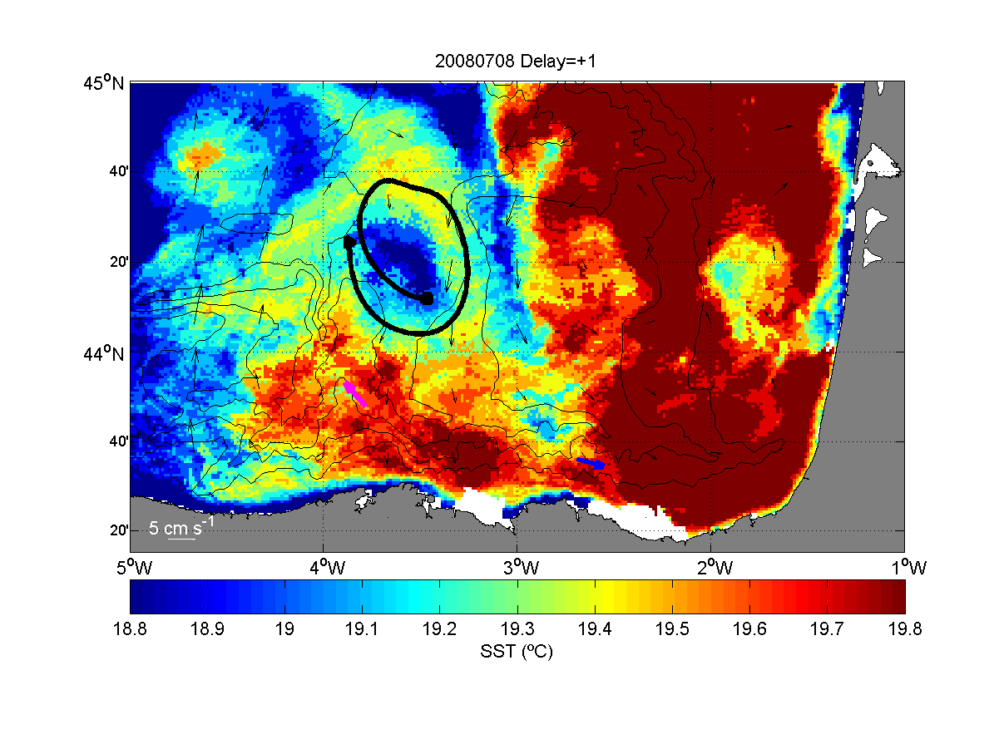
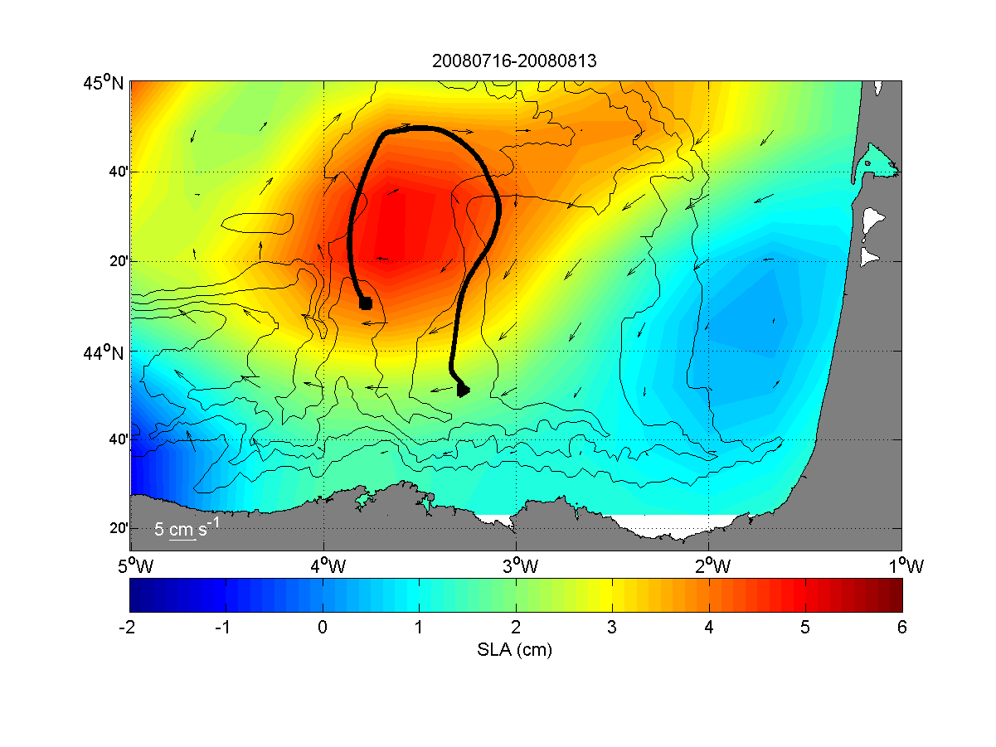
The GESSEB glider mission for analysing mesoscale eddies in the southeastern Bay of Biscay
introduction
The Bay of Biscay & mesoscale eddies
They migrate westward, excluding the so-called 4ºW anticyclonic that remains near the same position during weeks and months (Pingree and Le Cann, 1992a; Pingree and Le Cann, 1992b; Garcia-Soto et al., 2002). This kind of eddy appeared during years of strong winter slope current (Garcia-Soto et al., 2002…).
May
August
Mesoscale eddies modify the physical dynamics and affect the biology of the area (e.g. Irigoien et al., 2008): retention of plankton (e.g. ichthyoplankton), advection of particles, upwelling…

Slide 4
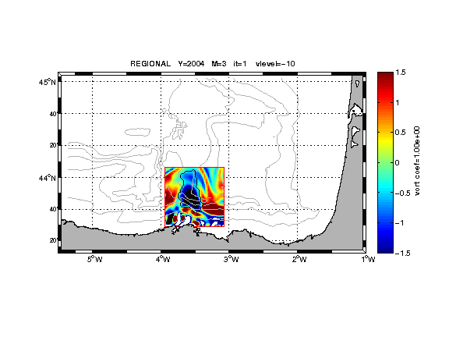



The GESSEB glider mission for analysing mesoscale eddies in the southeastern Bay of Biscay
introduction
Objectives of the GESEBB campaign
Analyzing 3D characteristics of the 4ºW SWODDY.
To know in detail the vertical structure of the eddy and its evolution during the two months of the campaign.
To sample in detail the vertical structures of the water column (stratification, thermocline…) over the shelf-slope area in a period which is especially interesting regarding the biological cycle of some of the key species for the fishery activity.
Glider mission funded by the First call of the JERICO TNA (7th Framework Programme).

Slide 5
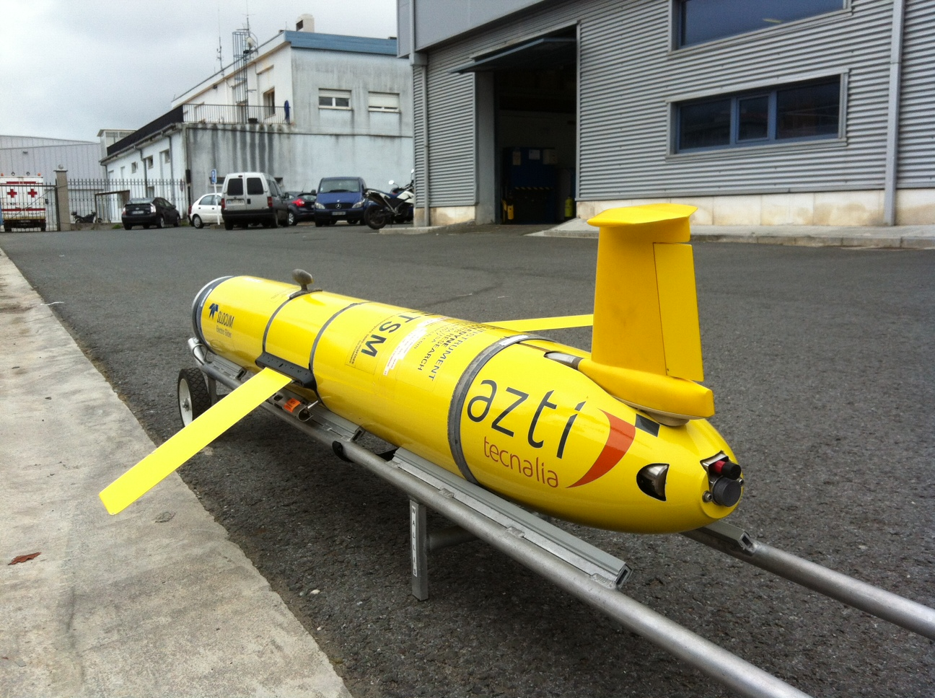
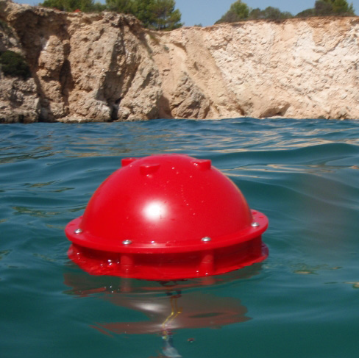
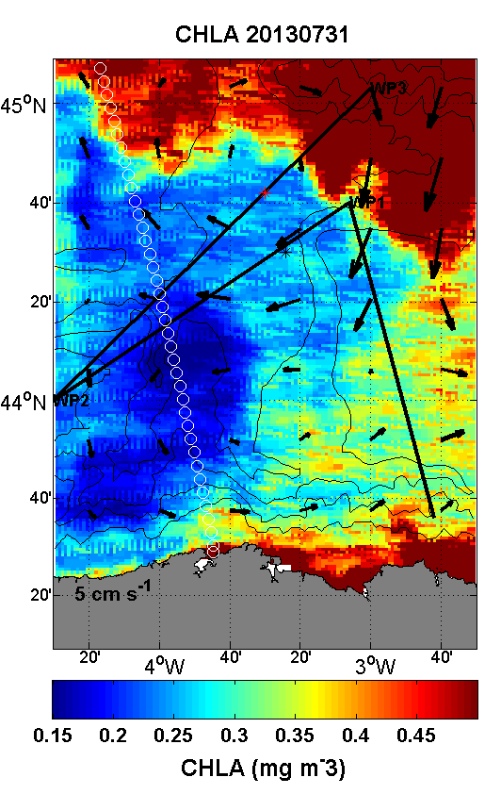
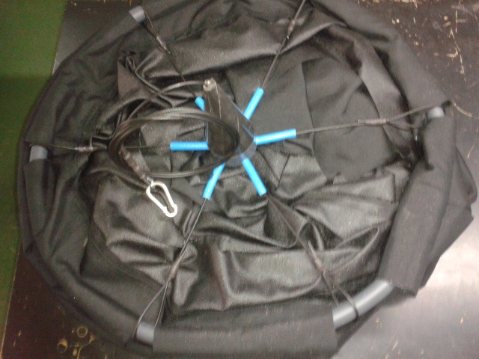

The GESSEB glider mission for analysing mesoscale eddies in the southeastern Bay of Biscay
Data & methods
Glider
Campe: Slocum-1000 type glider; from the INSU-CNRS; CTD, dissolved oxygen, and fluorescence-turbidity sensors.
Real time data transmission every surfacing event (~4h)
Deployment position: Around 43.64ºN 2.69ºW (Matxitxako B.)
Mission period: 23 July-24 September
Drifters
2 Ocean drifter Iridium (Albatros) drifters with a holey sock drogue centred at 50 m depth.
Deployment position: 44º42’N 3º30’W and 44º36’N 3º27’W
Mission period: 5 August -27 August and 2 September
Satellite data/images (NRT)
SST (AVHRR 1 km)
Chlorophyll-a concentration (MODIS 1 km)
AVISO-NRT altimetry (geostrophic currents, merged)
Center Of Eddy Finder (COE)
Applied to the vertical integrated currents
Developed by Nencioli et al. (2008)

Slide 6
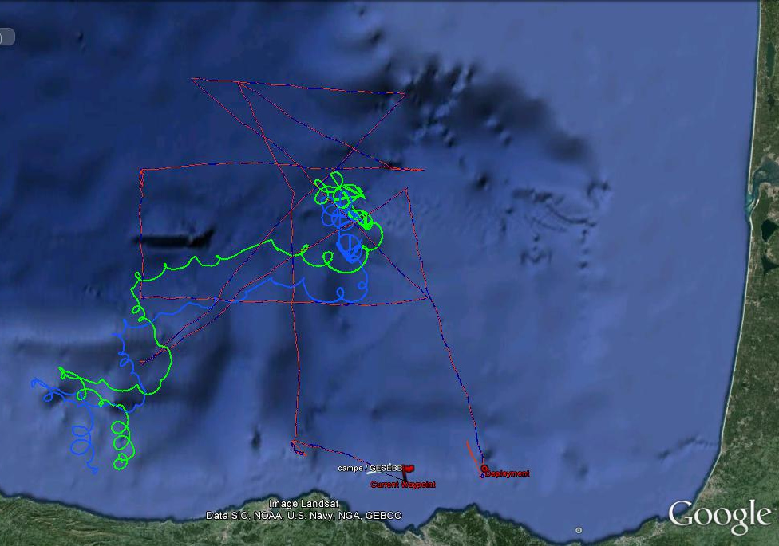
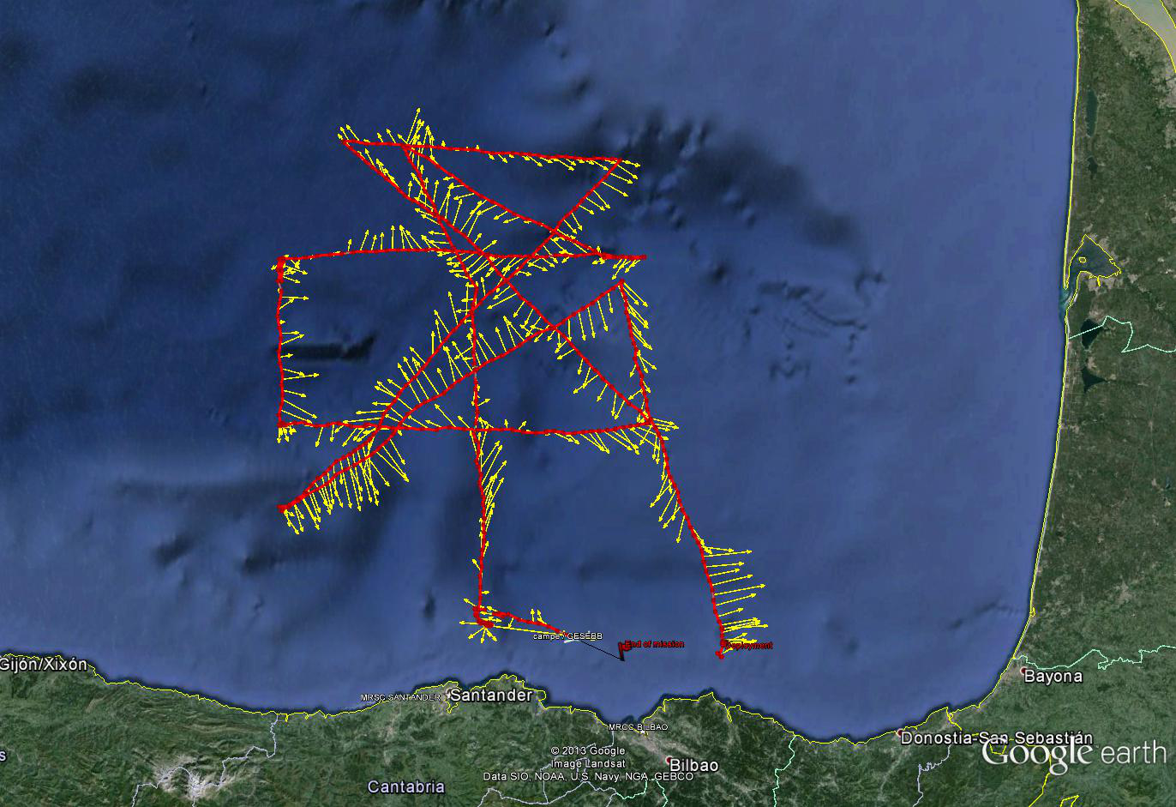
The GESSEB glider mission for analysing mesoscale eddies in the southeastern Bay of Biscay
Data & methods
FINAL MISSION DESIGN
Adapted transects
FIRST MISSION DESIGN
4 Rotating butterflies over the center of the 4ºW SWODDY
Cloud coverage…
Not possible to locate the center of the eddy

Slide 7
The GESSEB glider mission for analysing mesoscale eddies in the southeastern Bay of Biscay
Results & discussion
19.6ºC-24.4ºC
33.9-35.6
9.5ºC -10.2ºC
35.6-35.9

Slide 8
The GESSEB glider mission for analysing mesoscale eddies in the southeastern Bay of Biscay
Results & discussion
Transect | Date |  | Anticyc./Cyc. | Center Of Eddy
 |  |  |  | (Nencioli et al., 2008)
Number | Initial | Final |  | Lat | Lon
1 | 23-Jul | 30-Jul | C1 | 44 | -2.72
2 | 30-Jul | 5-Aug | A1 | 44.56 | -3.36
 |  |  | C2 | 44.25 | -4
3 | 5-Aug | 13-Aug | C2 | 44.2 | -4.1
 |  |  | A1 | 44.6 | -3.57
4 | 13-Aug | 17-Aug | A1 | 44.85 | -3.46
5 | 17-Aug | 24-Aug | A1 | 44.74 | -3.64
6 & 7 | 24-Aug | 30-Aug | A2? | 44.15 | -3.33
8 | 30-Aug | 3-Sep | _ | _ | _
9 | 3-Sep | 9-Sep | A1 | 44.87 | -3.75
10 | 9-Sep | 12-Sep | A1 | 45.03 | -3.74
11 | 12-Sep | 15-Sep | A1 | 45 | -3.78
12 | 15-Sep | 20-Sep | C2 | 44.12 | -4.04
Recovering T. | 22-Sep | 24-Sep | _ | _ | _
Migrating?

Slide 9
The GESSEB glider mission for analysing mesoscale eddies in the southeastern Bay of Biscay
Results & discussion
4 Days before the mission beginning
TRANSECT 1: CYCLONE C1

Slide 10
The GESSEB glider mission for analysing mesoscale eddies in the southeastern Bay of Biscay)
Results & discussion
TRANSECT 1: CYCLONE C1
C1

Slide 11
The GESSEB glider mission for analysing mesoscale eddies in the southeastern Bay of Biscay
Results & discussion
TRANSECT 1: CYCLONE C1
C1
-
-

Slide 12
The GESSEB glider mission for analysing mesoscale eddies in the southeastern Bay of Biscay
Results & discussion
TRANSECT 2: ANTICYCLONE A1 / CYCLONE C2

Slide 13
The GESSEB glider mission for analysing mesoscale eddies in the southeastern Bay of Biscay
Results & discussion
TRANSECT 2
Anticyclone A1 Cyclone C2
A1
C2

Slide 14
The GESSEB glider mission for analysing mesoscale eddies in the southeastern Bay of Biscay
Results & discussion
TRANSECT 2: ANTICYCLONE A1 / CYCLONE C2
A1
C2
+
-
+
-

Slide 15
The GESSEB glider mission for analysing mesoscale eddies in the southeastern Bay of Biscay
Results & discussion
TRANSECT 2: ANTICYCLONE A1 / CYCLONE C2
Implications to local fisheries: E.g. Tuna catches during the duration of the transect *:
- Mainly in the border of the anticyclonic/cyclonic eddy.

Slide 16
The GESSEB glider mission for analysing mesoscale eddies in the southeastern Bay of Biscay
conclusions
Conclusions
The mean mixed layer depth, during the mission, was located around 20-40 m depth. The maximum fluorescence is observed at the bottom of the mixed layer (30-60 m).
During the GESEBB campaign 2 different cyclones and at least two anticyclones were sampled from surface to 1000 m depth.
A cyclone centred in 44.2ºN 4ºW was observed, during the two months missions.
Sampled anticyclones could be different or the same migrating.
The water column notably changes below these structures, depending on the rotation sense:
  The cores of cyclonic eddies are characterized by a depression of the isotherms from the surface to 150-200 m depth and a doming between 200 m and at least 1000 m.
  The cores of anticyclonic eddies are characterized by a doming of the isotherms from the surface to 100 m depth and a depression between 100 m and at least 1000 m.

Slide 17
The GESSEB glider mission for analysing mesoscale eddies in the southeastern Bay of Biscay
conclusions
Conclusions and future work
Hence, the observed cyclones and anticyclones expand and contract the seasonal mixed layer.
The vertical variability also affects the fluorescence/turbulence and the concentration of the dissolved oxygen (not shown), whose maximums as well as quantity varies. Maximum fluorescence has been observed below the anticyclones and below the bottom of the mixed layer.
An eddy tracking method must be applied with DT altimetry data, in order to discriminate different structures (mainly for anticyclones).

Slide 18
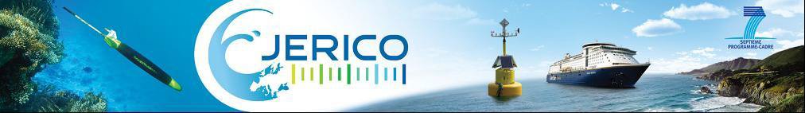
THANKS FOR YOUR ATTENTION!
Acknowledgements: Laurent Beguery (INSU), Simón Ruiz (SOCIB), Francesco Nencioli (Mediterrantean I. of Oceanography), Ana Rietz (Sasemar)… EGO-COST Action. And all the people that made possible this campaign!

