Slide 1
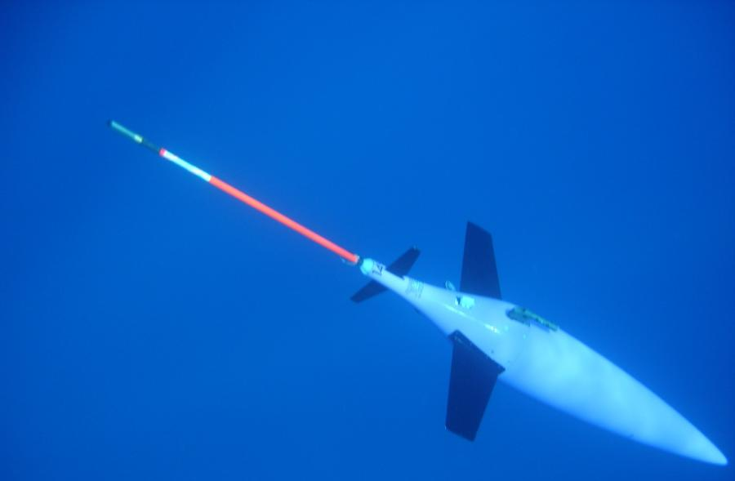
Description of the Long-lived Subsurface Mesoscale Eddy South of Cyprus
D. Hayes¹, Angelos Hannides¹, George Zodiatis¹, Georgios Georgiou¹
Hezi Gildor², Pierre Testor³
¹Oceanography Center, University of Cyprus, Nicosia, Cyprus
²Hebrew University of Jerusalem, ISRAEL
³Universite de Pierre et Marie Curie, Paris, FRANCE
Everyone’s Gliding Observatories: 16-17 June 2014, Kiel, Germany
Notes:
1

Slide 2
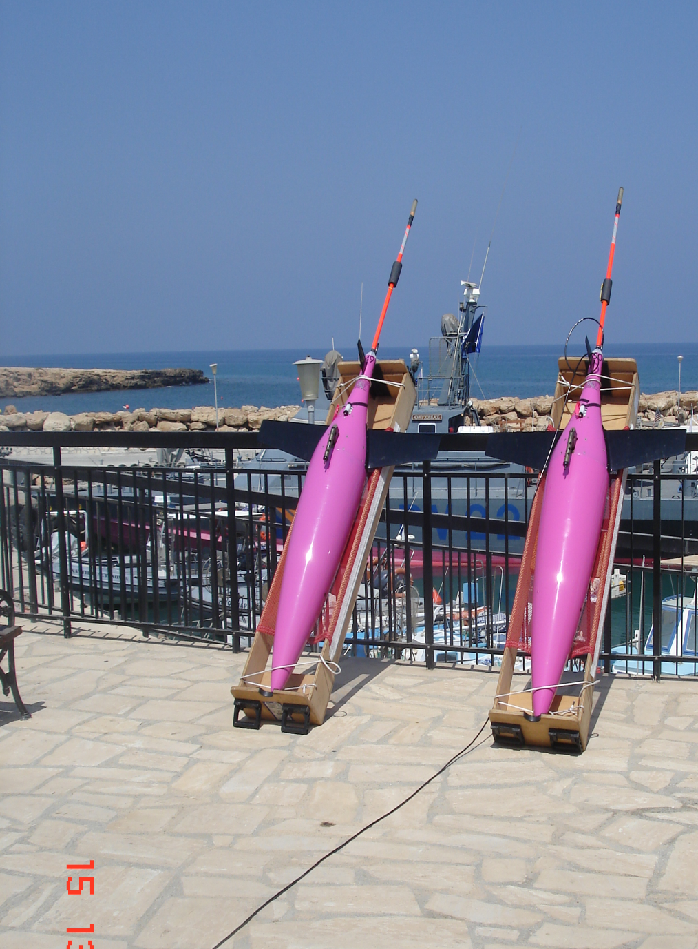
Outline
Introduction
Gliders
Observations to date
Results
Maps of eddy
Sections through eddy
Time series of water mass properties
Future Plans
Generation?
Evolution?
Ecosystems?

Slide 3
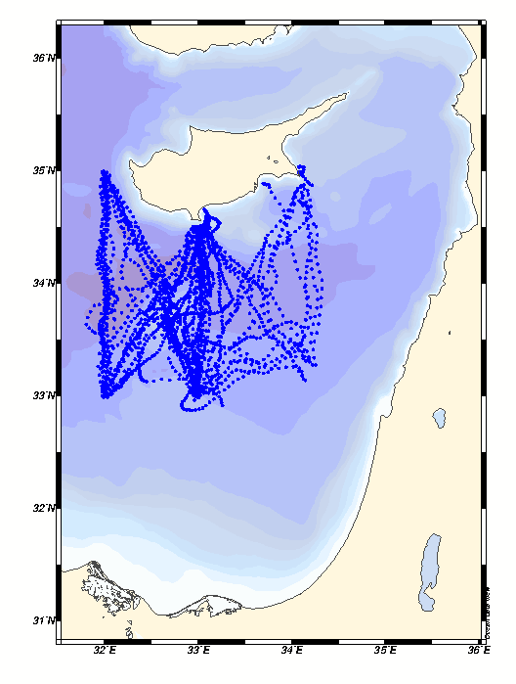
Observations: 2 gliders, 5 years
From March 2009-present, 7 missions longer than 1 month
>12,300 km over ground
>2800 dives, most to 1000 m
These allow tracking of water properties over time at a fine spatial and temporal detail
Temperature, Salinity, Oxygen, shallow Chl-a and Optical backscatter
Notes:
3

Slide 4
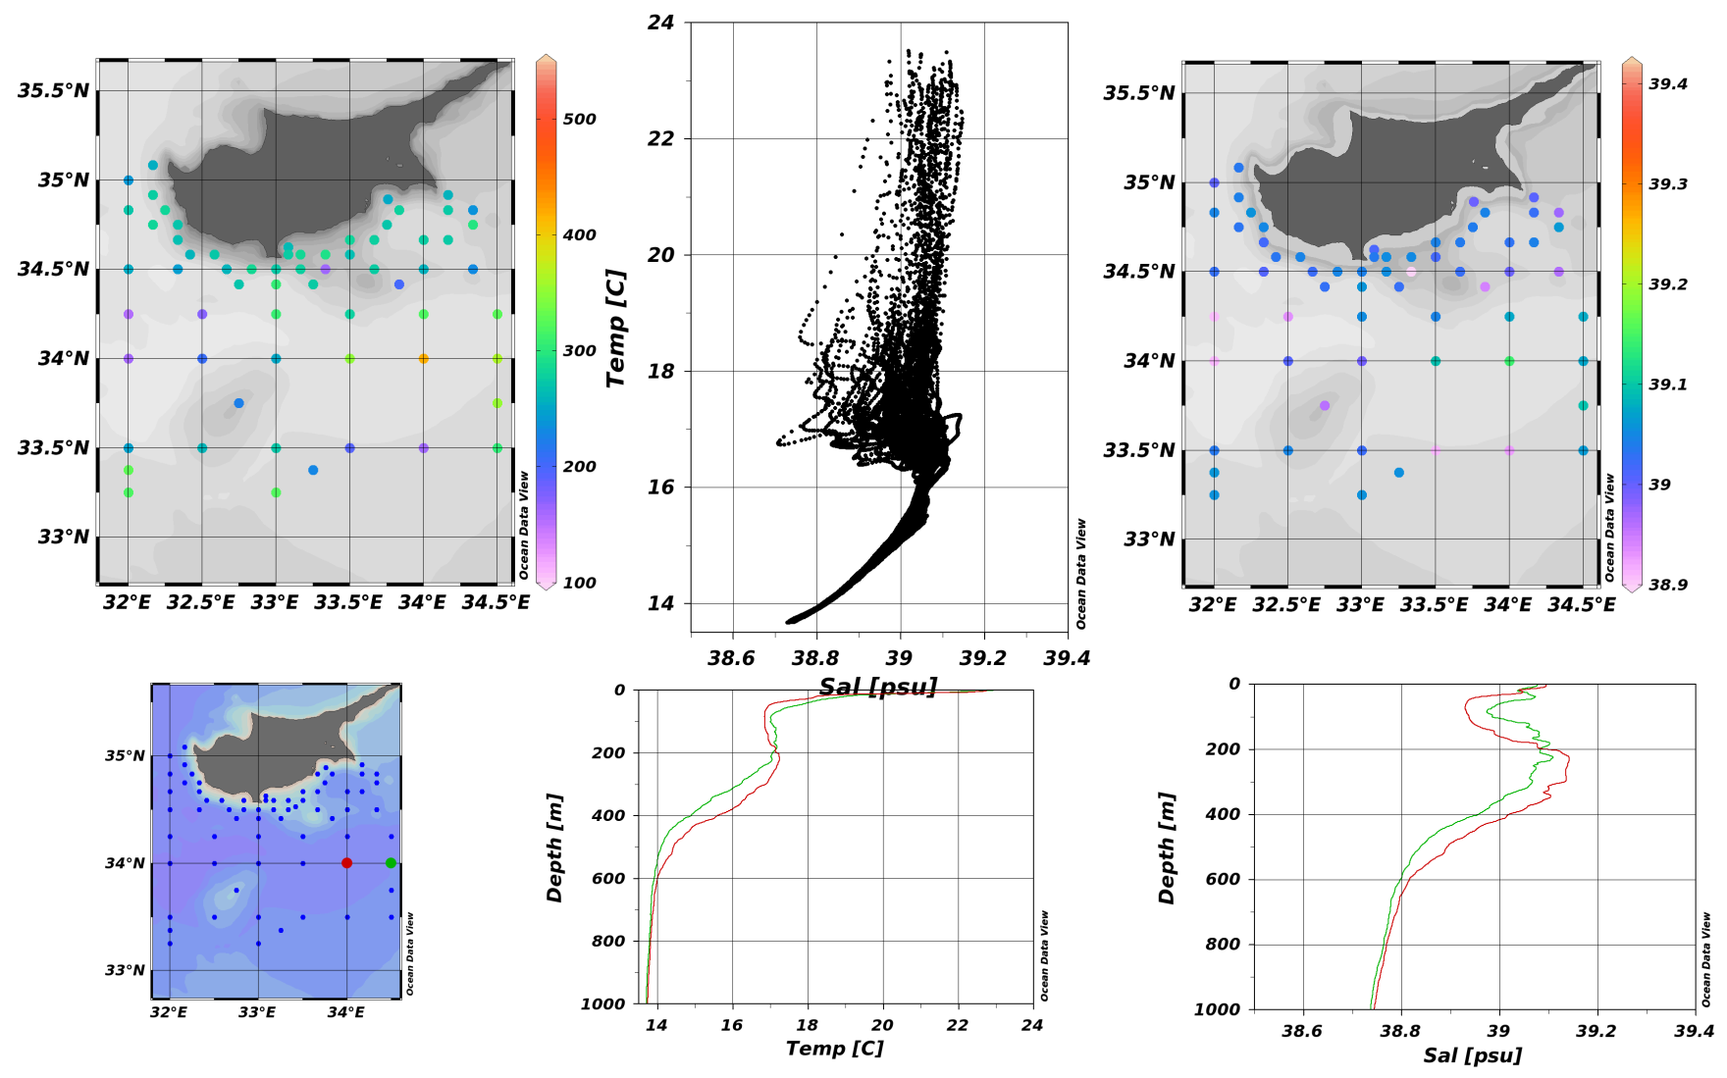
Observations: Hydrographic cruises
26 since 1995
Depth of 29.0 sigma (low boundary of LIW)
Salinity at 250 m (approximate depth f max salinity)
CYBO-15: 2003-05
Notes:
4

Slide 5
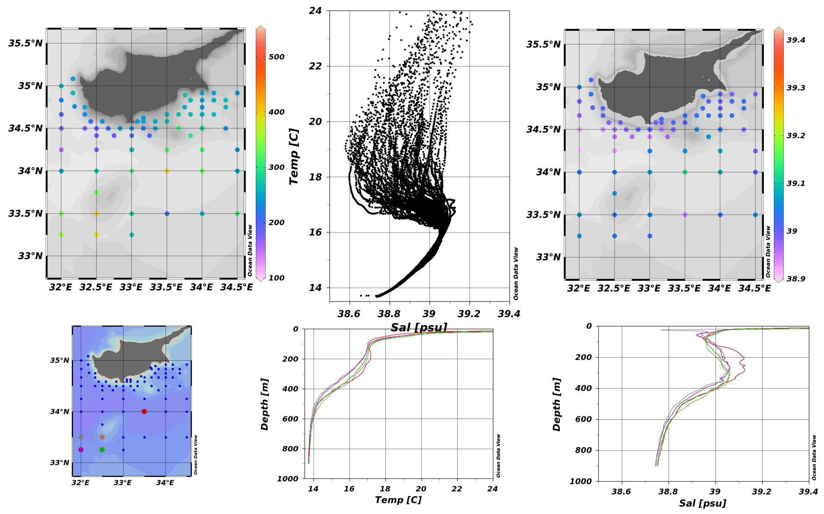
Observations: Hydrographic cruises
26 since 1995
CYBO-16: 2003-08
Notes:
5

Slide 6
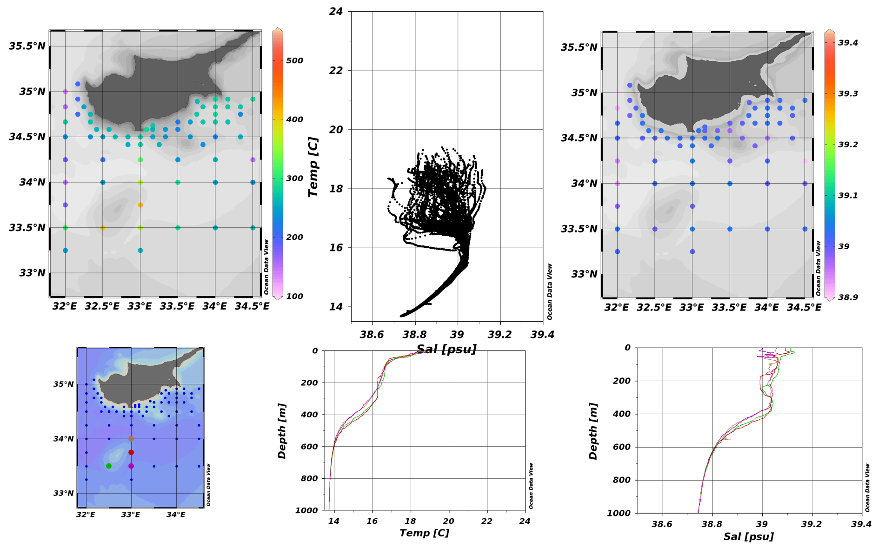
Observations: Hydrographic cruises
26 since 1995
CYBO-17: 2004-04
Notes:
6

Slide 7
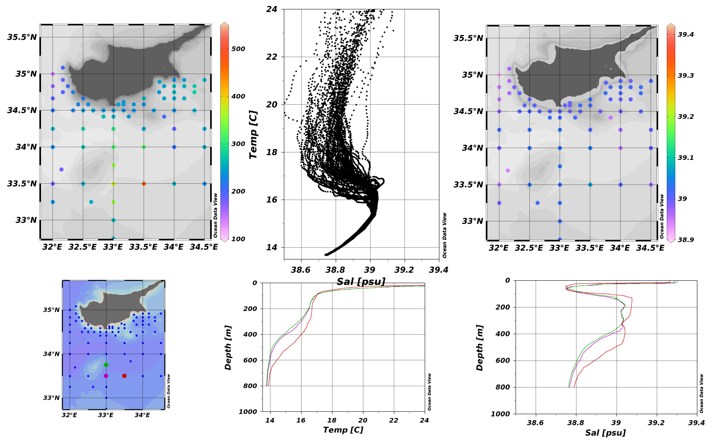
Observations: Hydrographic cruises
26 since 1995
CYBO-18: 2004-08
Notes:
7

Slide 8
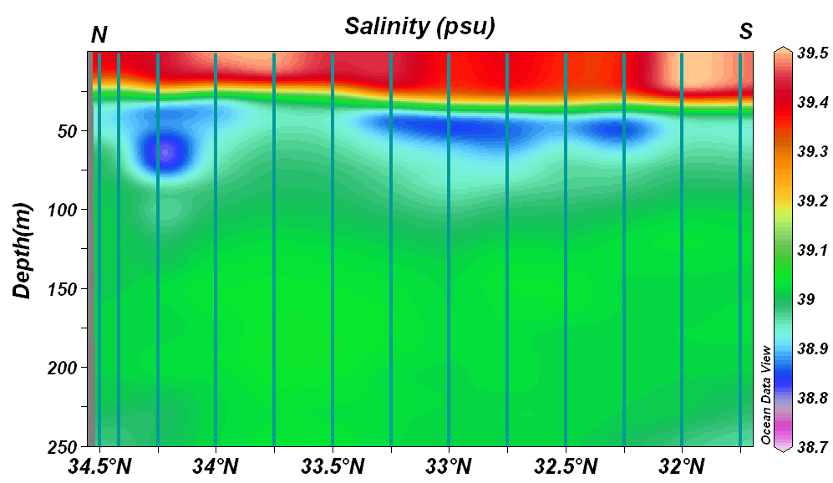
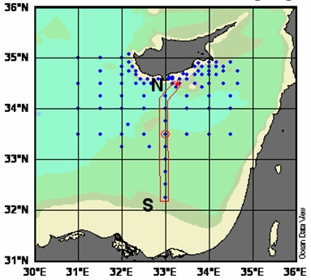
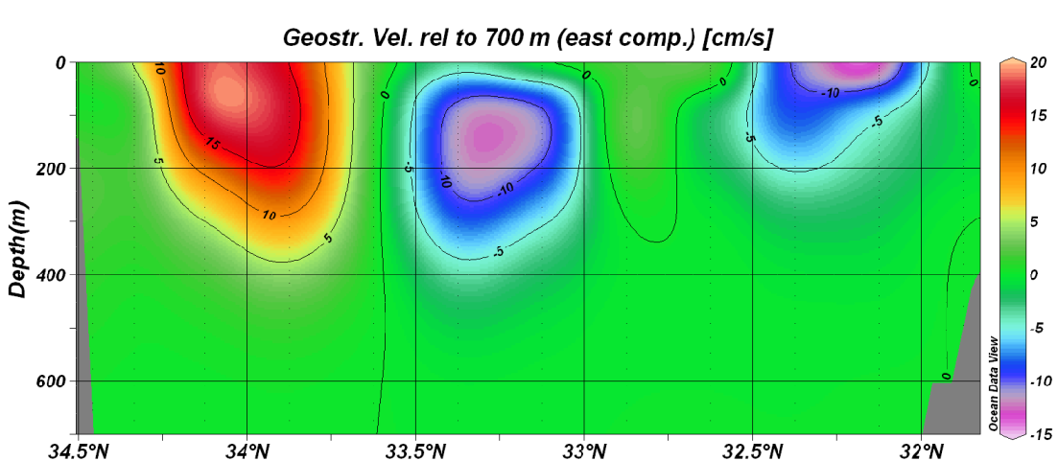
Observations: Hydrographic cruises
26 since 1995
CYBO-19: 2005-09

Slide 9
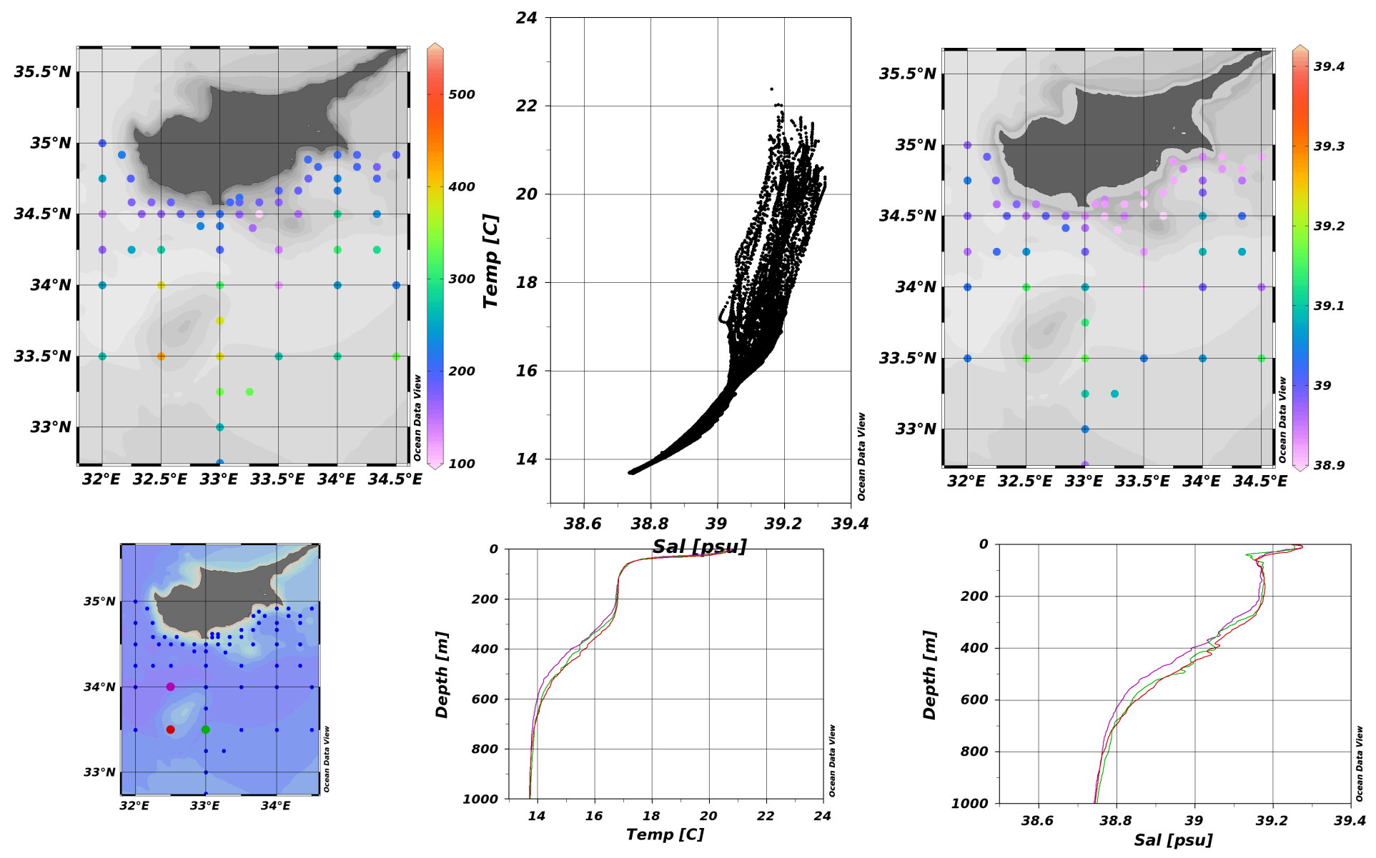
Observations: Hydrographic cruises
26 since 1995
CYBO-20: 2006-05
Notes:
9

Slide 10
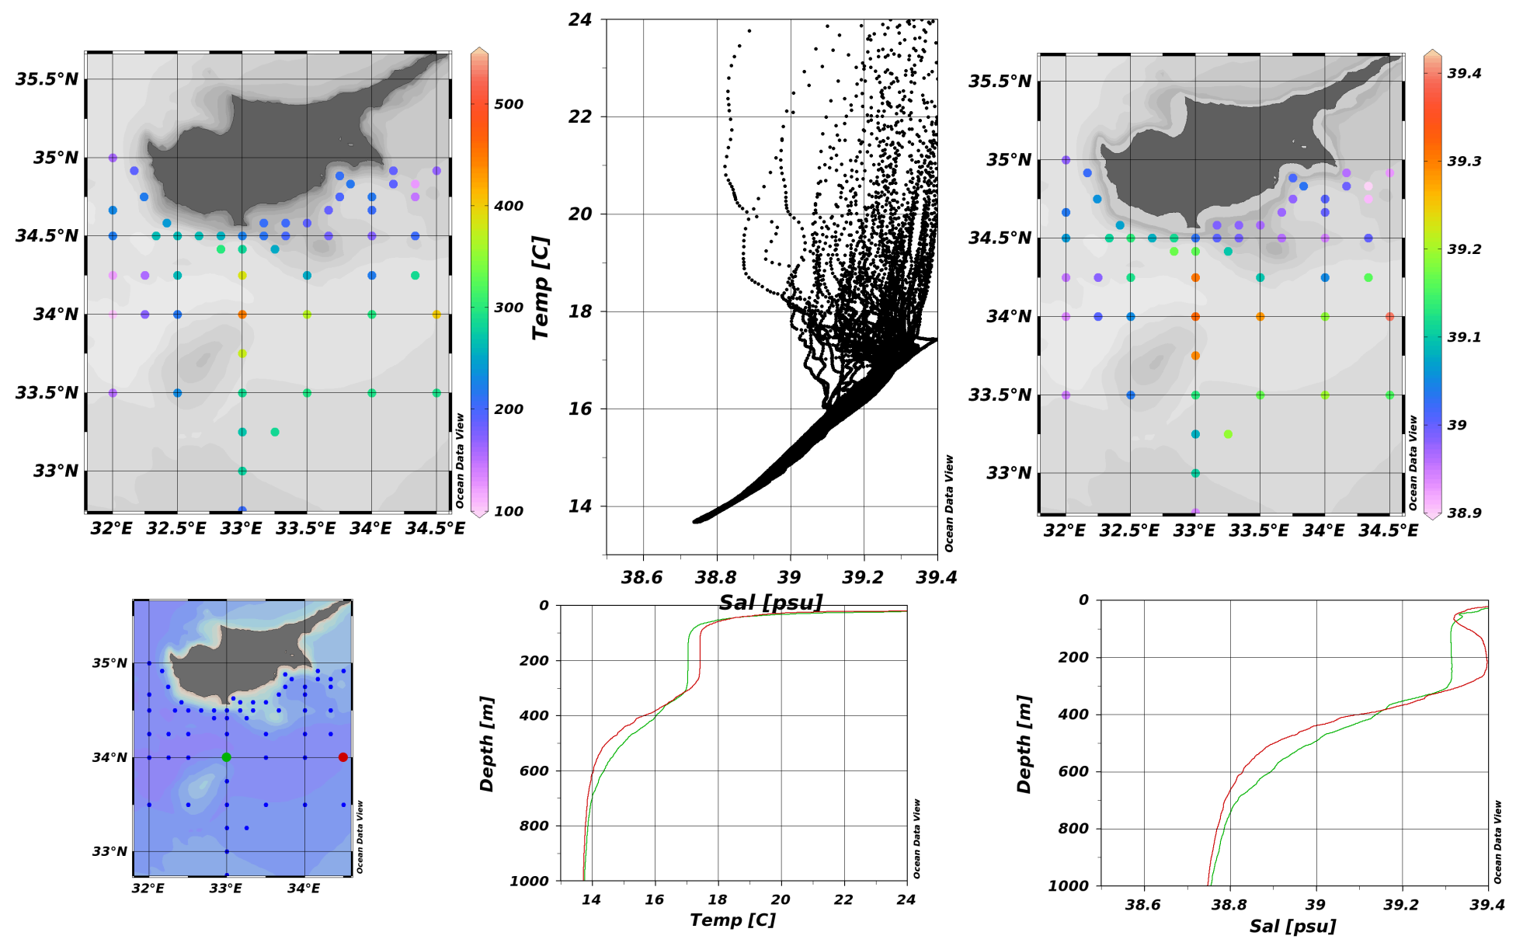
Observations: Hydrographic cruises
26 since 1995
CYBO-21:2007-07
Notes:
10

Slide 11
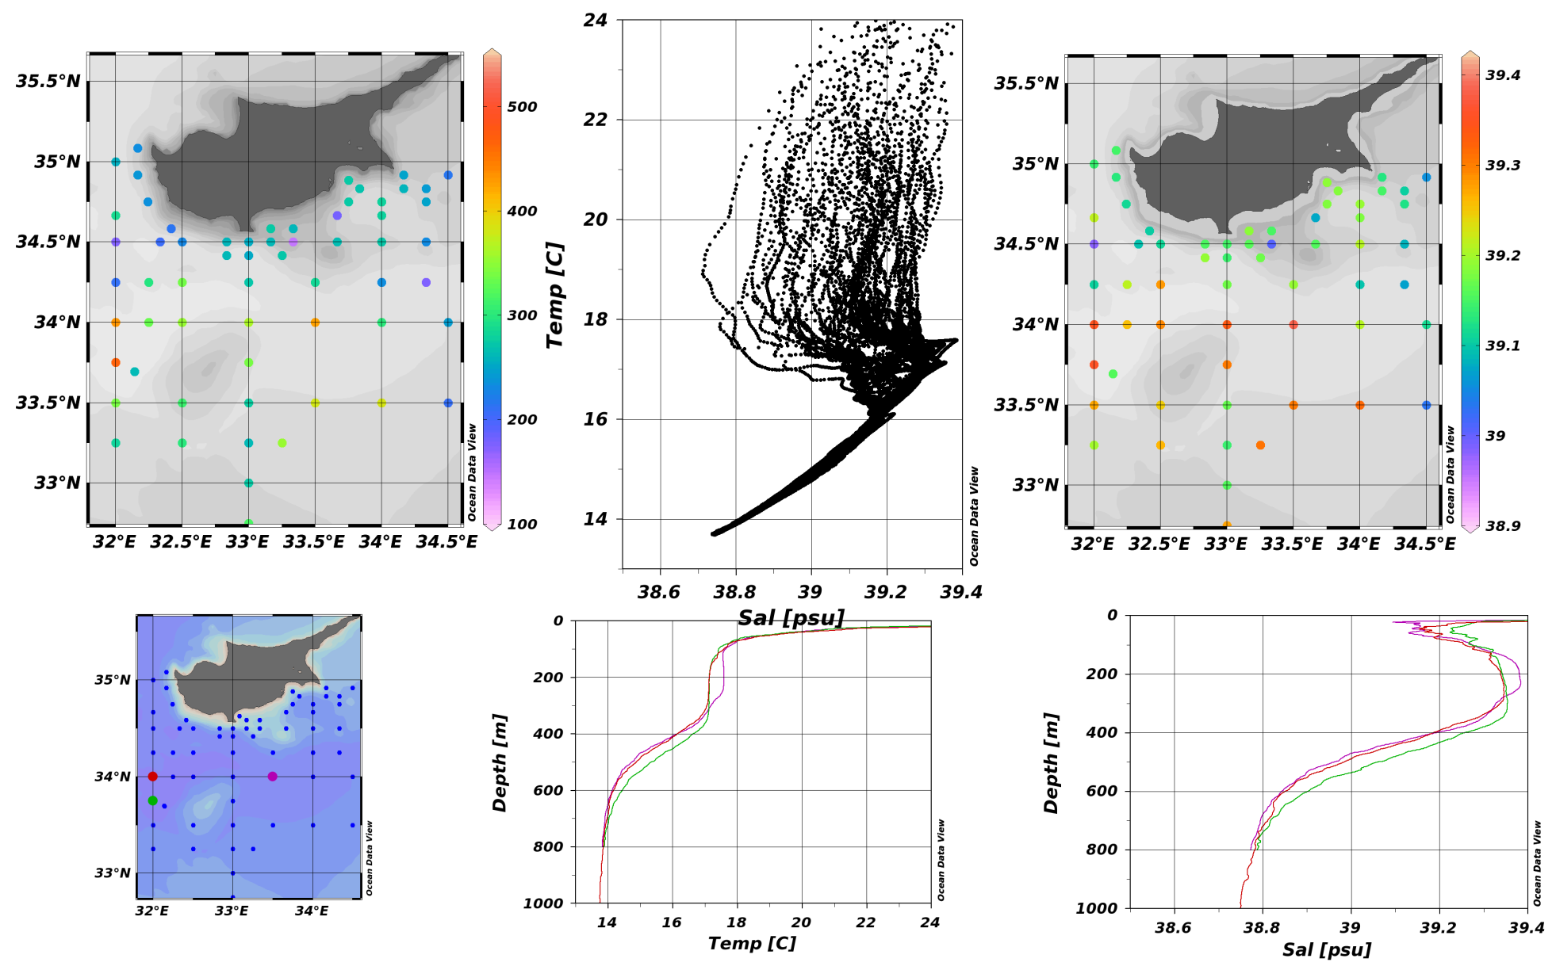
Observations: Hydrographic cruises
26 since 1995
CYBO-22:2009-08
Notes:
11

Slide 12
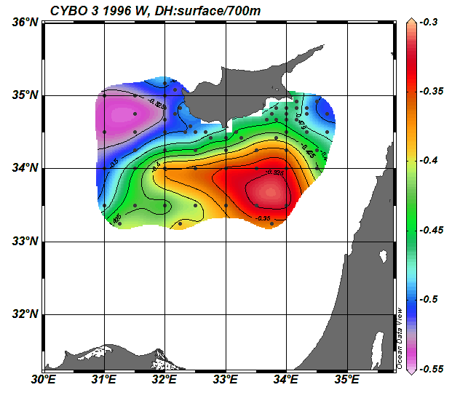
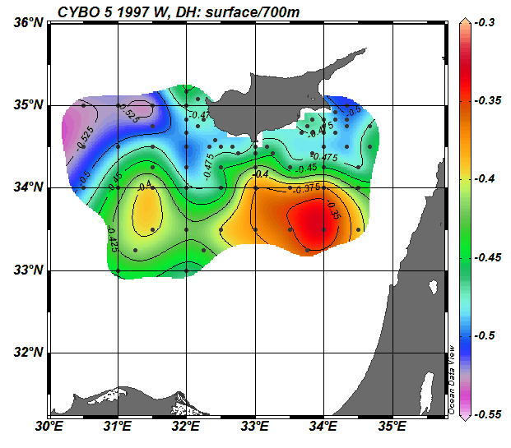
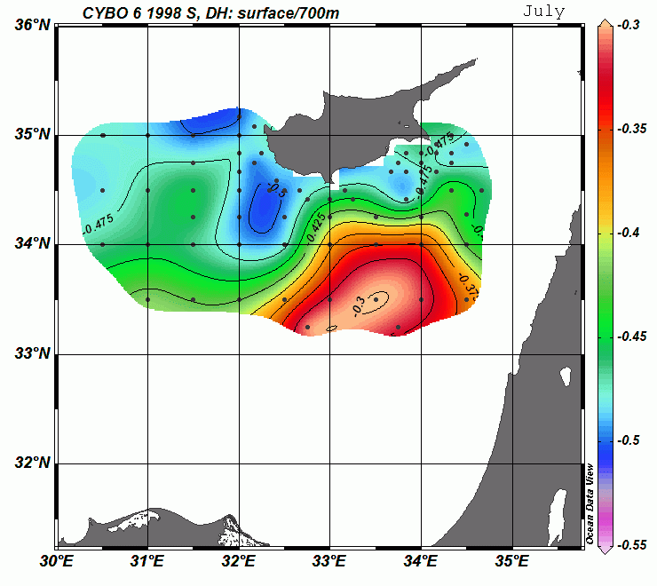
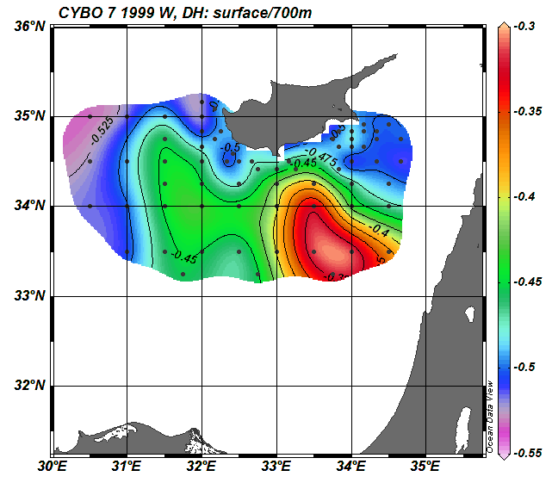
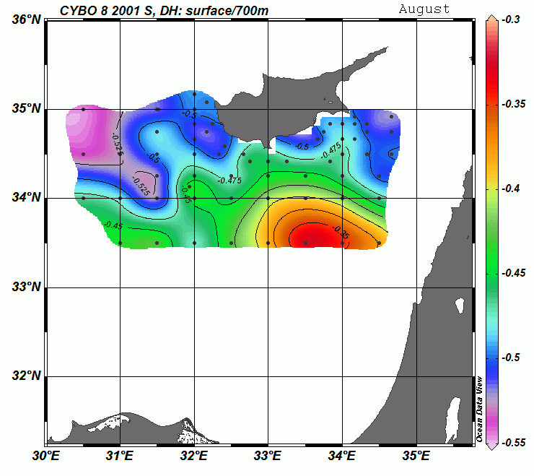
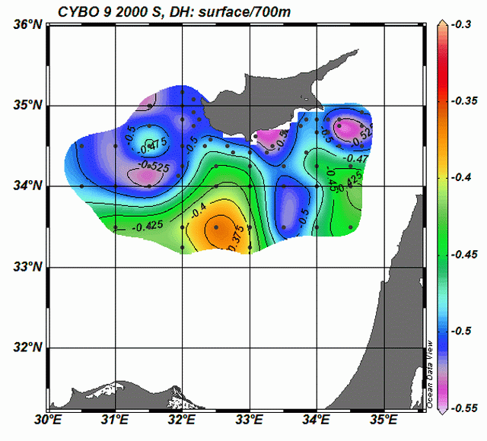
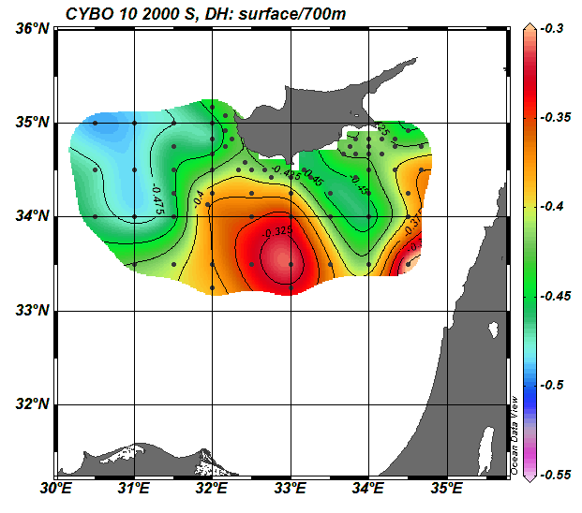
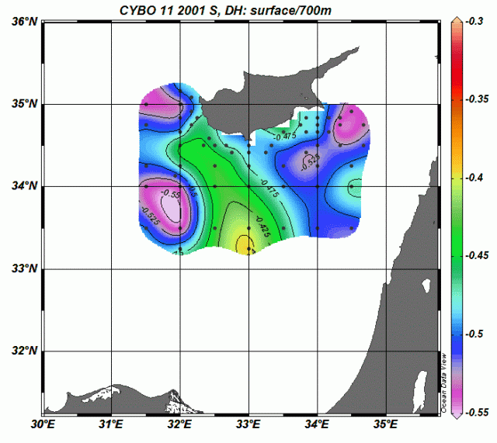
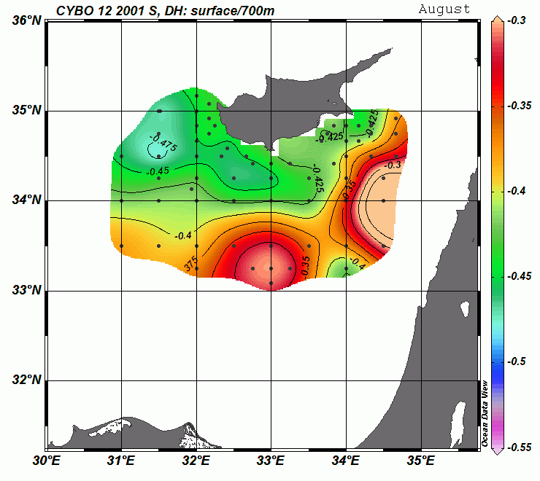
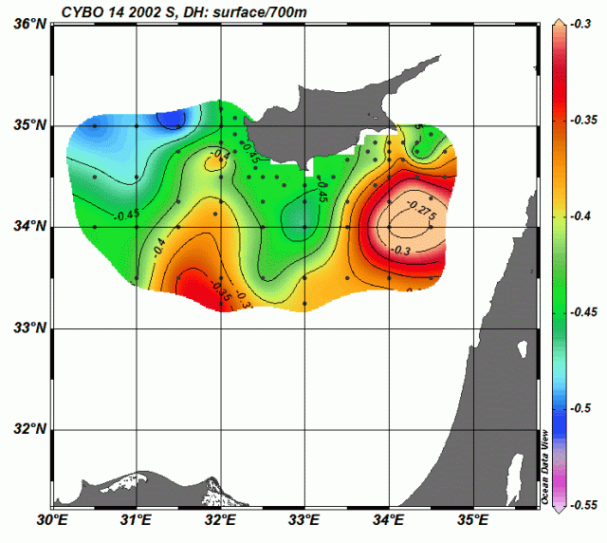
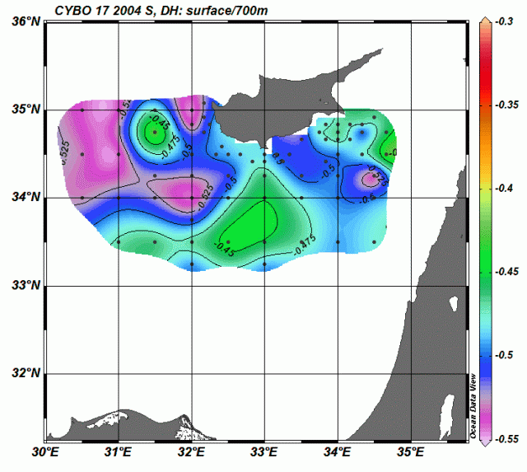
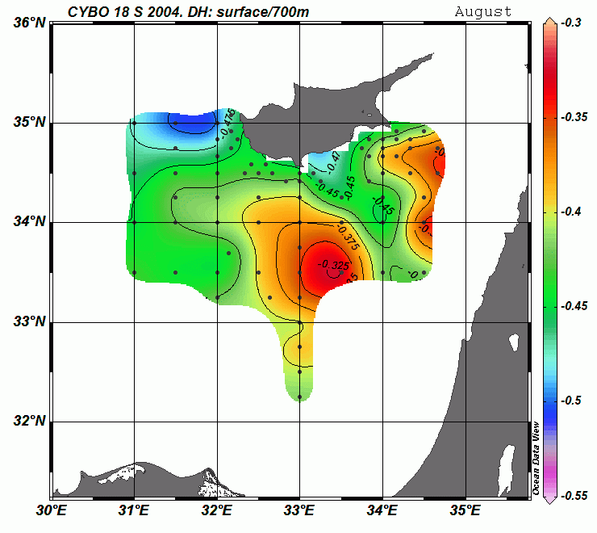
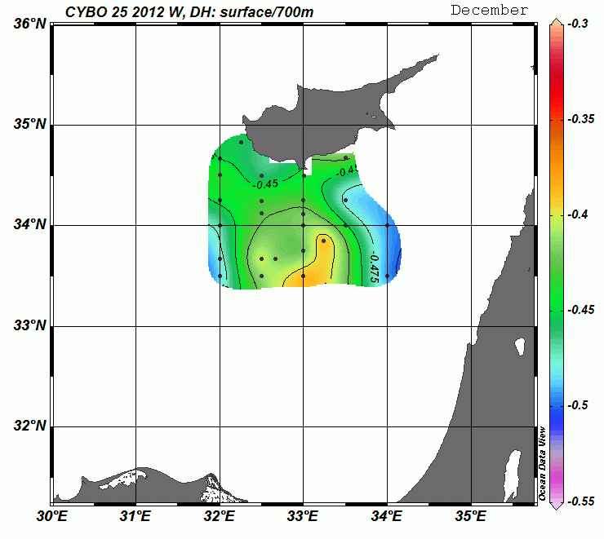
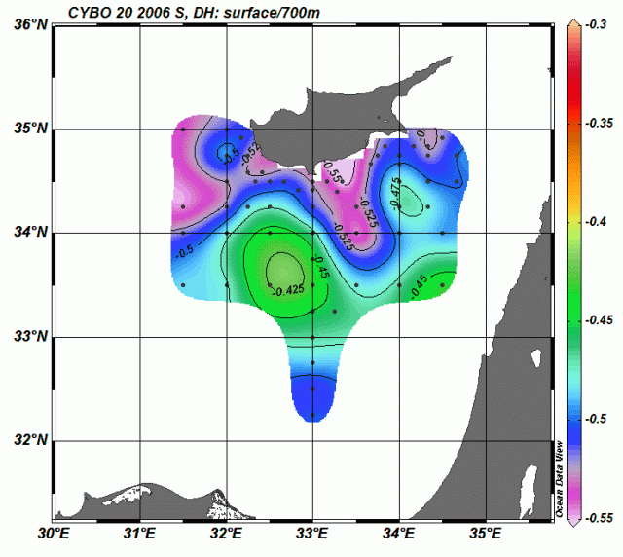
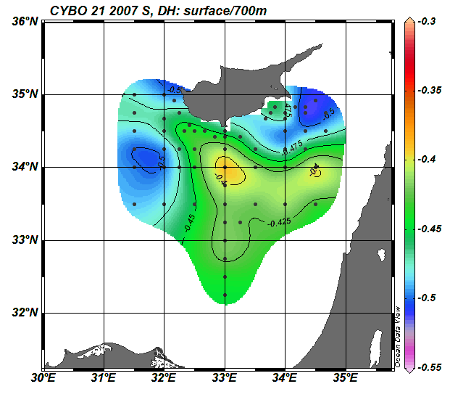
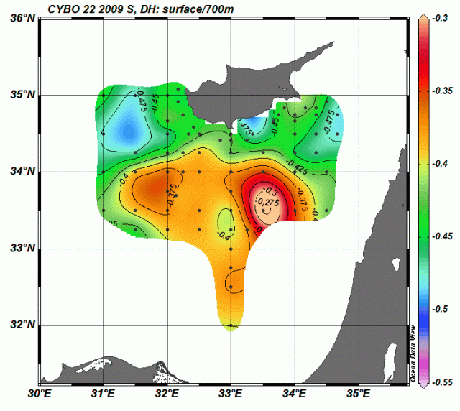
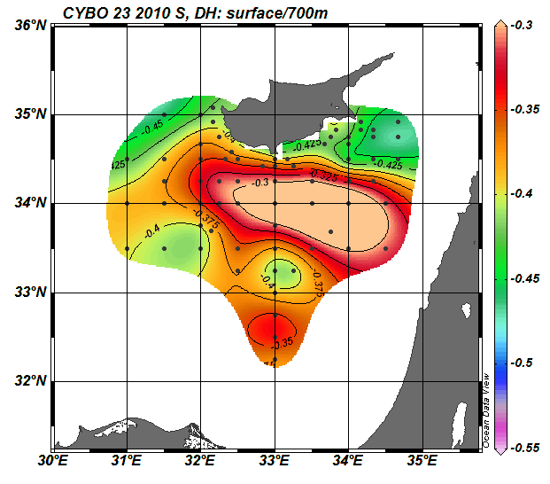
Geostrophic Surface Current

Slide 13
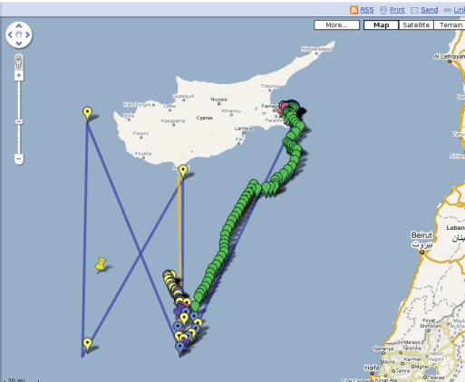
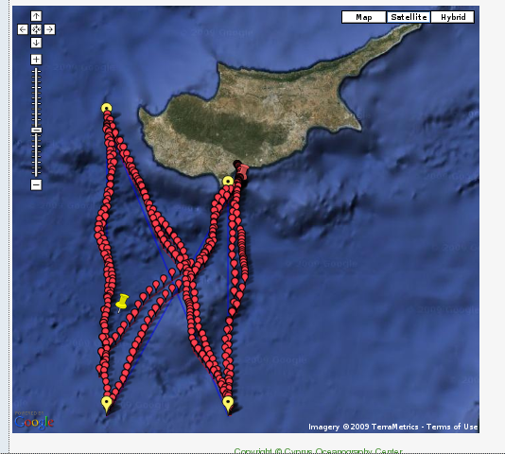
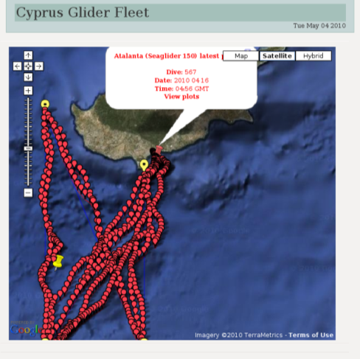
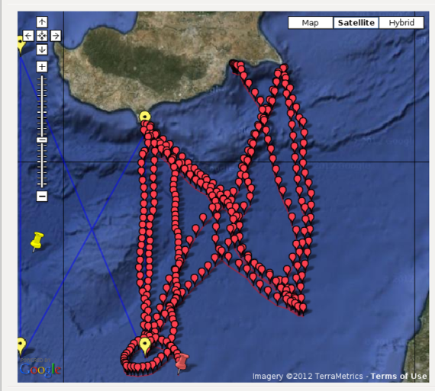
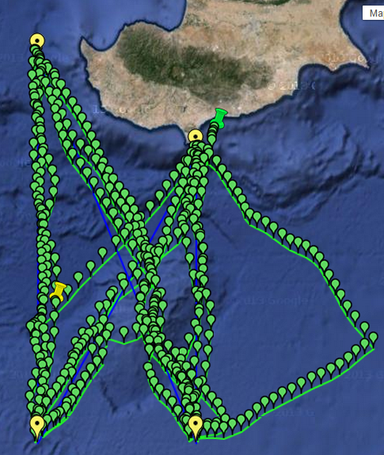
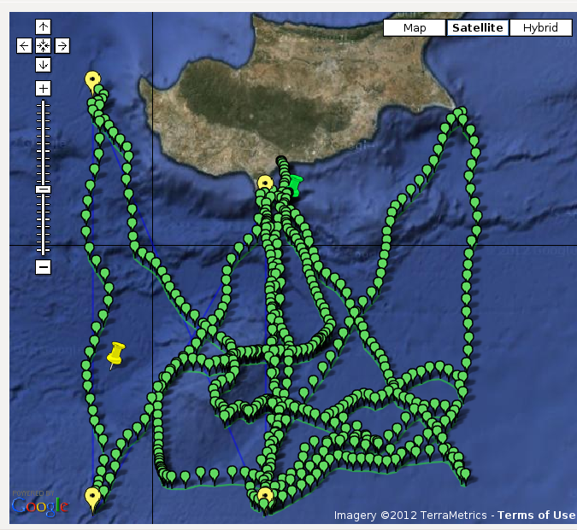
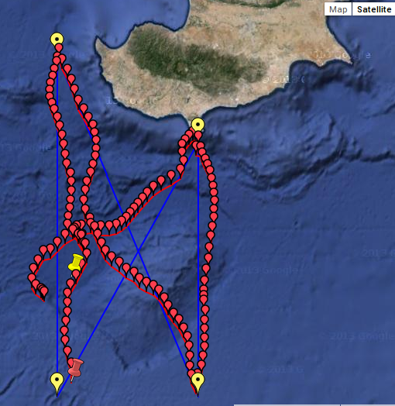
Observations to date: By Mission
March-April 2009
Oct 2010-Feb 2011
May-Aug 2009
Nov 2009-April 2010
Dec 2011-Jun 2012
Feb-Aug 2013
April 2014-present

Slide 14
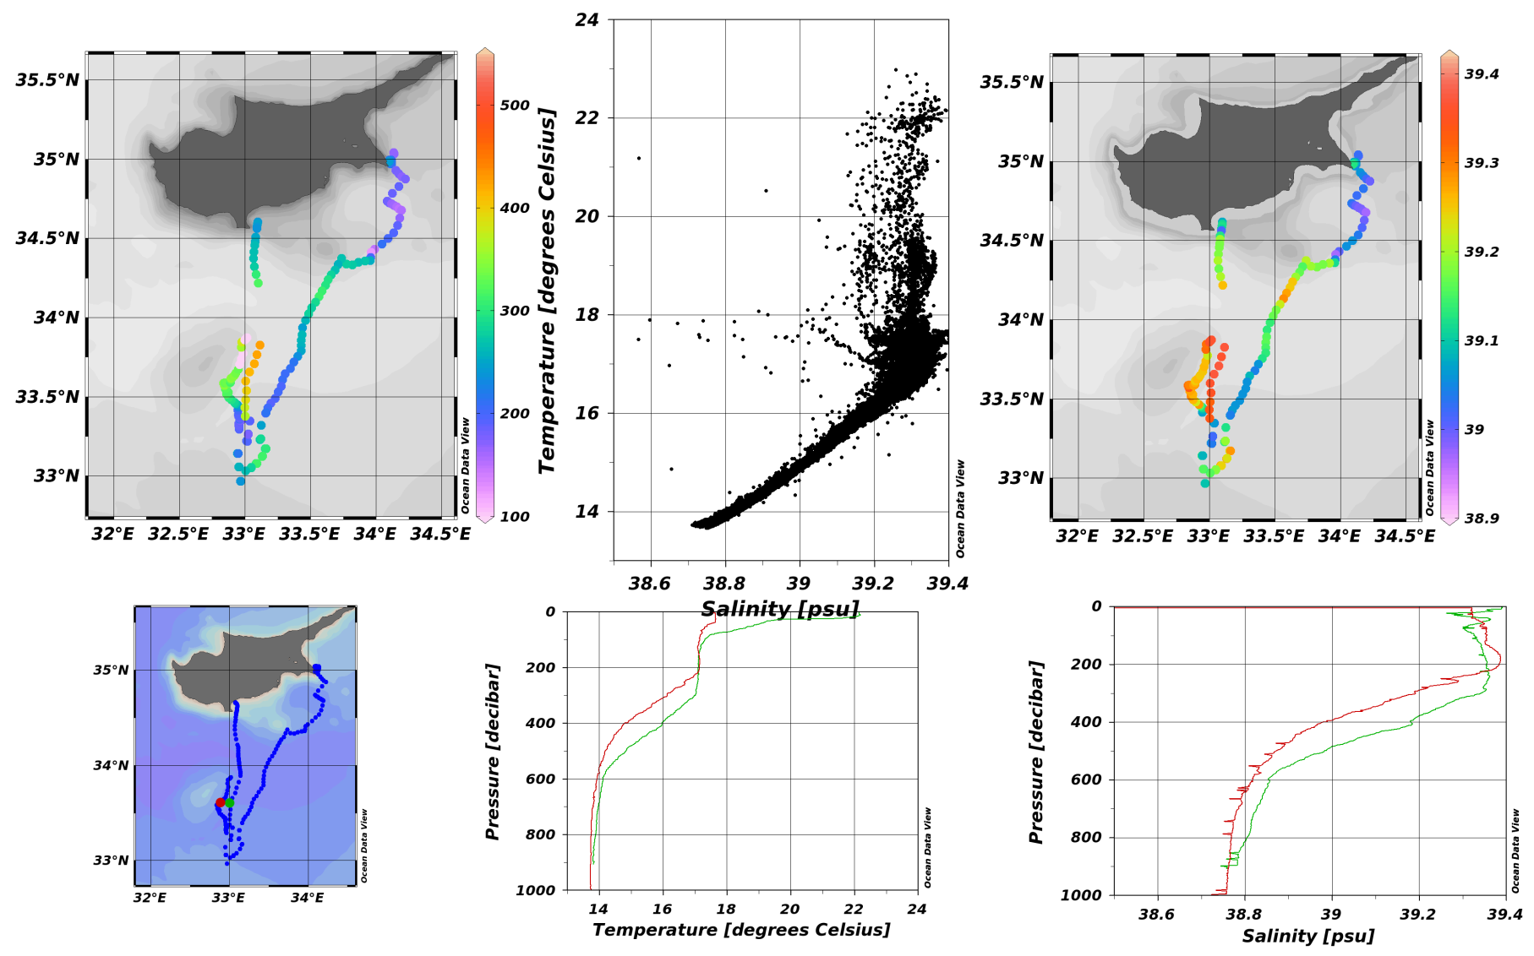
Results
First glider measurements spring 2009
Eddy located over the seamount, Anticyclonic, warm and salty core
March-May 2009

Slide 15
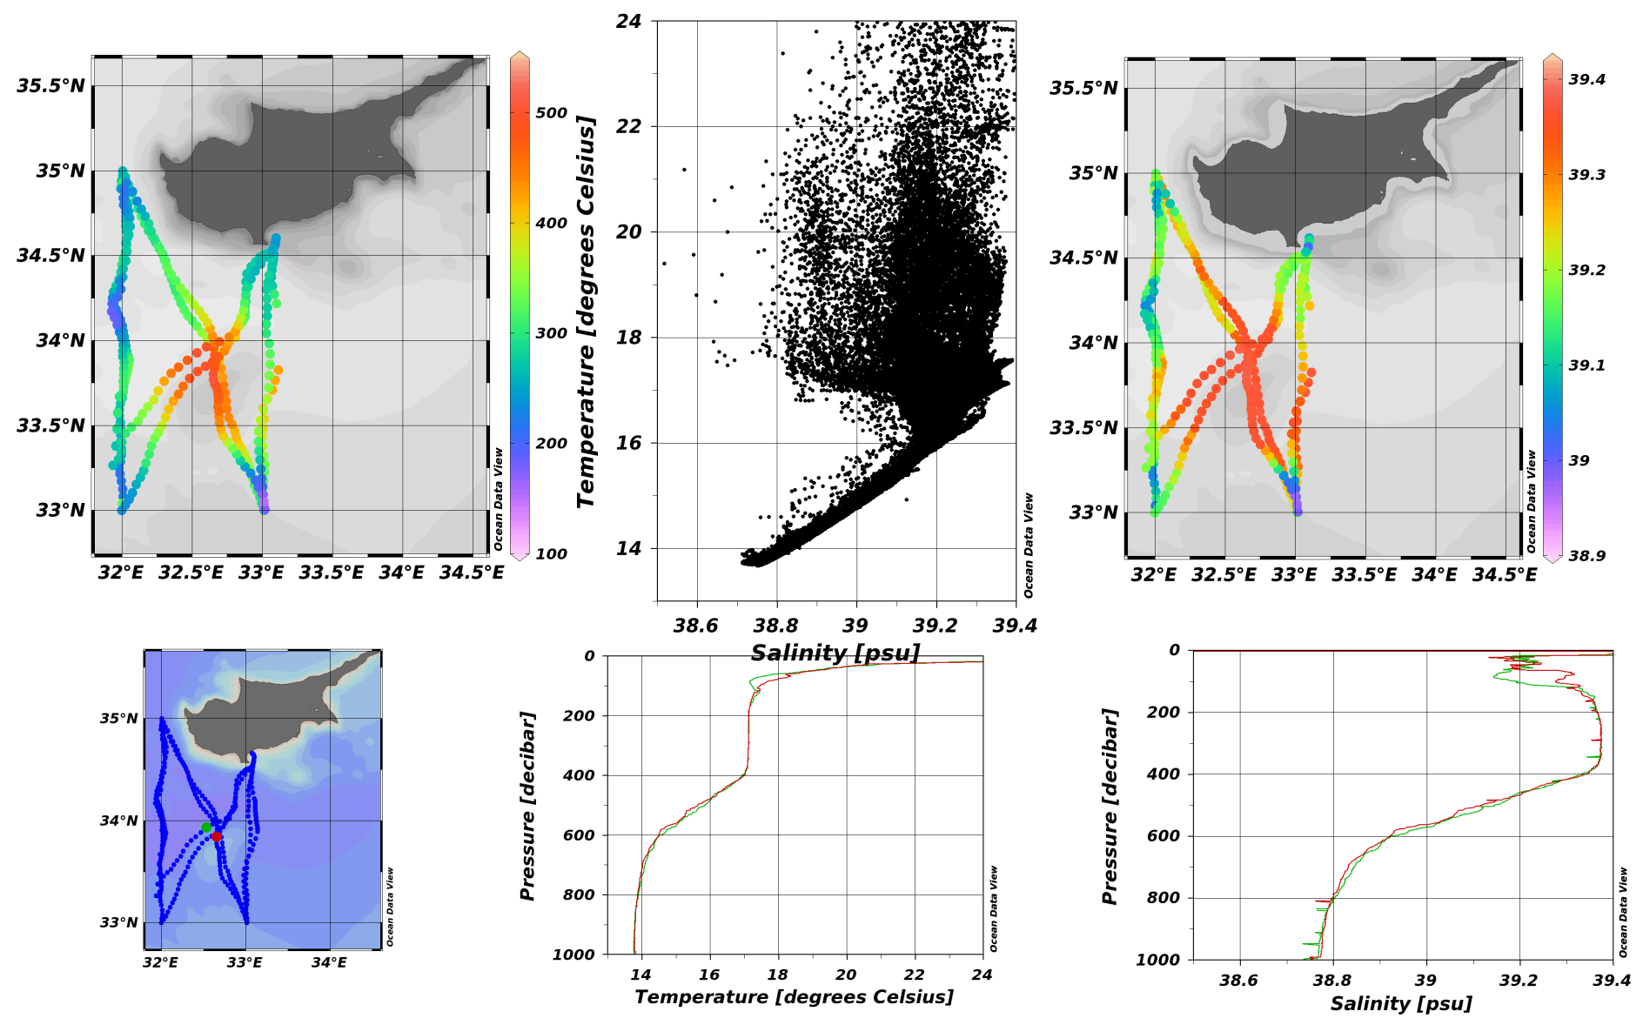
Results
First glider measurements in eddy summer 2009
Eddy located over the seamount, Anticyclonic, warm and salty core
May-August 2009

Slide 16
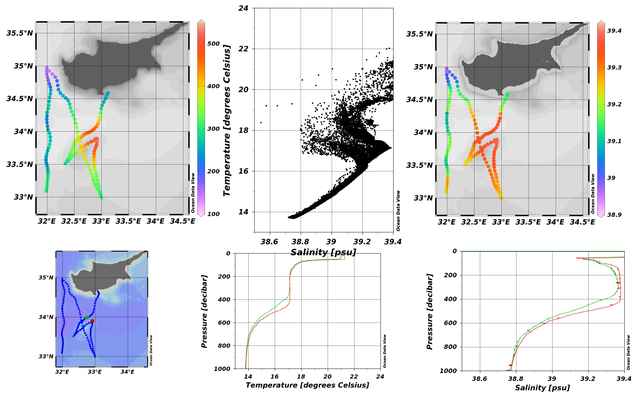
Results
EYE of the Levantine I
Eddy located over the seamount, Anticyclonic, warm and salty core
Nov- 2009 to Jan-2010

Slide 17
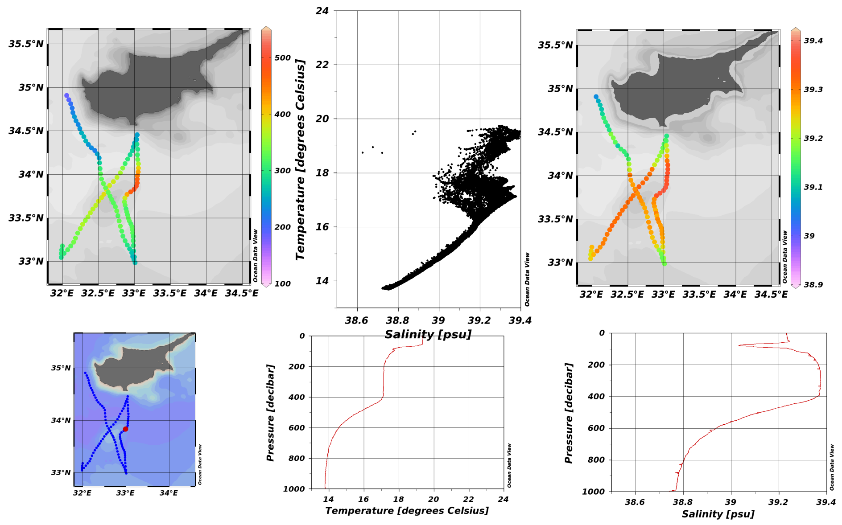
Results
EYE of Levantine period II
Eddy located over the seamount, Anticyclonic, warm and salty core
Jan-Feb-2010

Slide 18
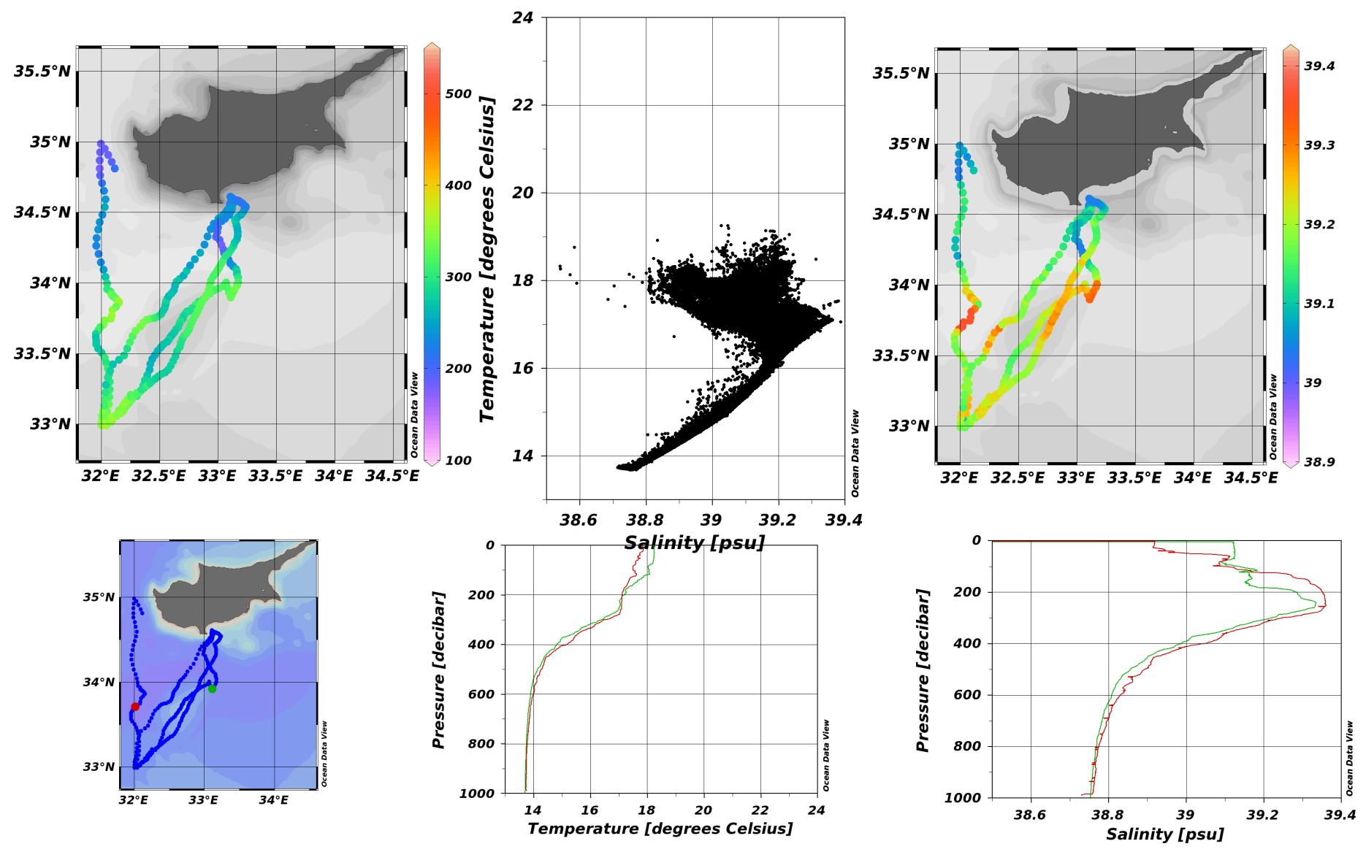
Results
EYE of Levantine period III
Eddy gone?
Feb-April-2010

Slide 19
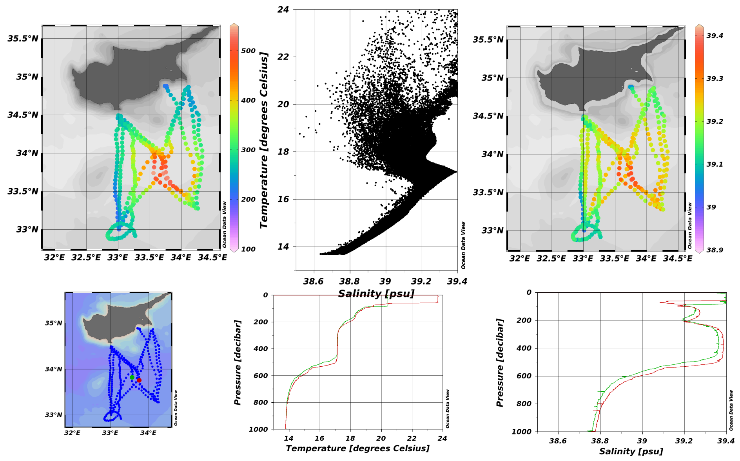
Results
New eddy
Oct 2010 to Feb 2011

Slide 20
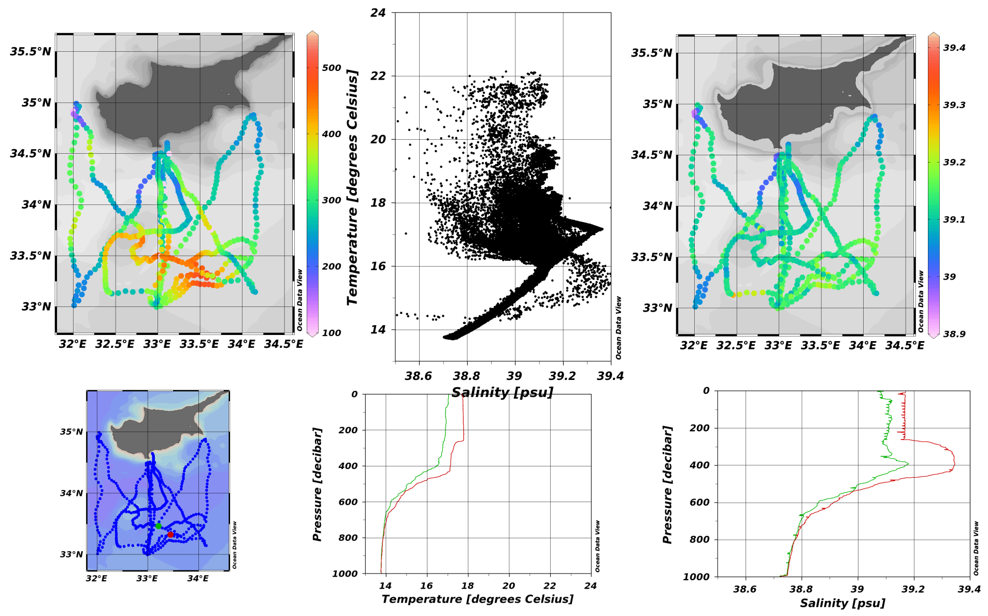
Results
Eddy shrunk, shifted south after 9 months
Dec 2011 to June 2012

Slide 21
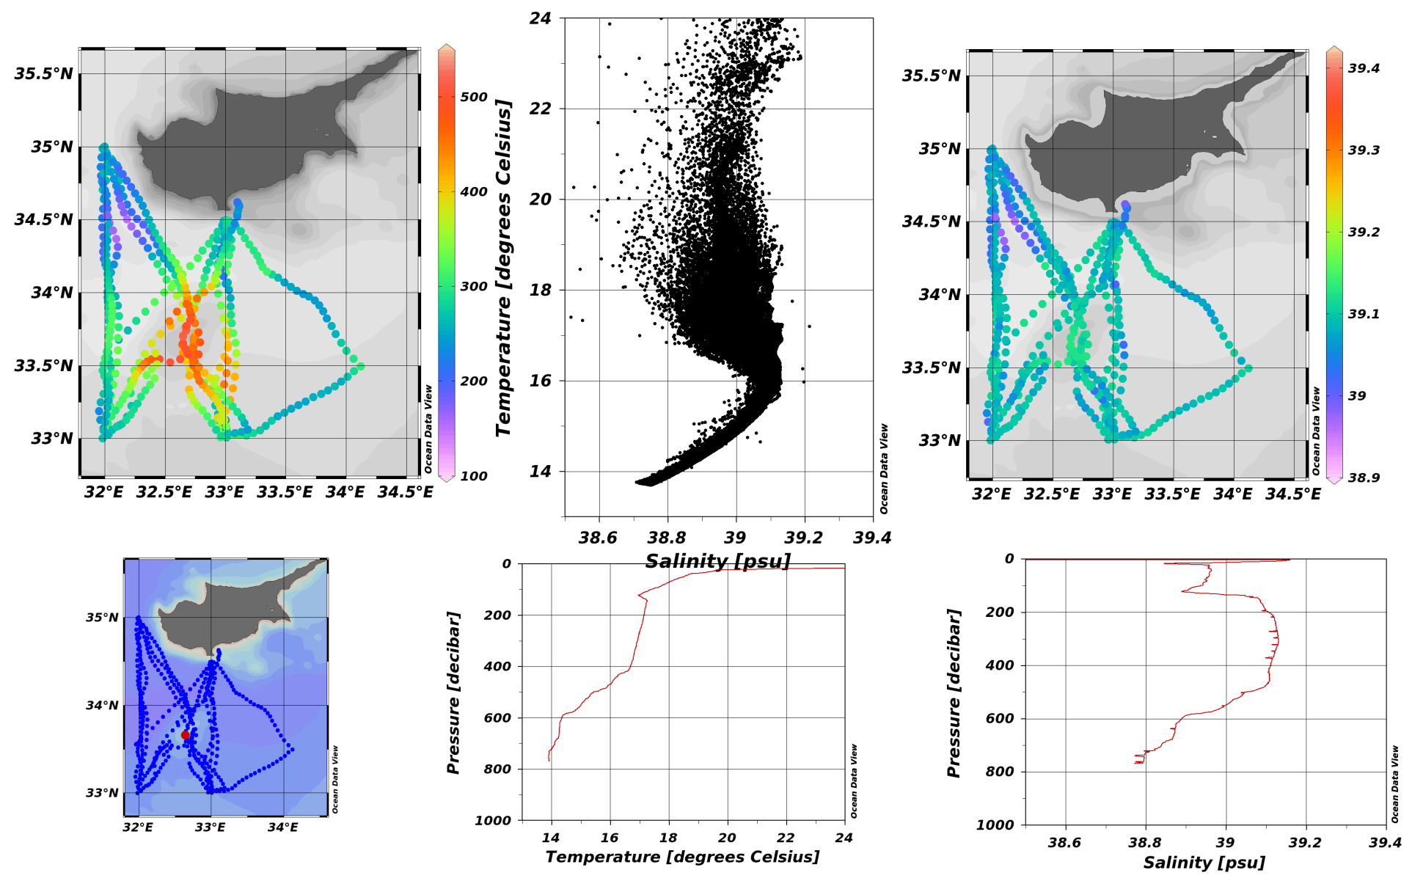
Results
Another new, weaker eddy
Feb-Aug 2013

Slide 22
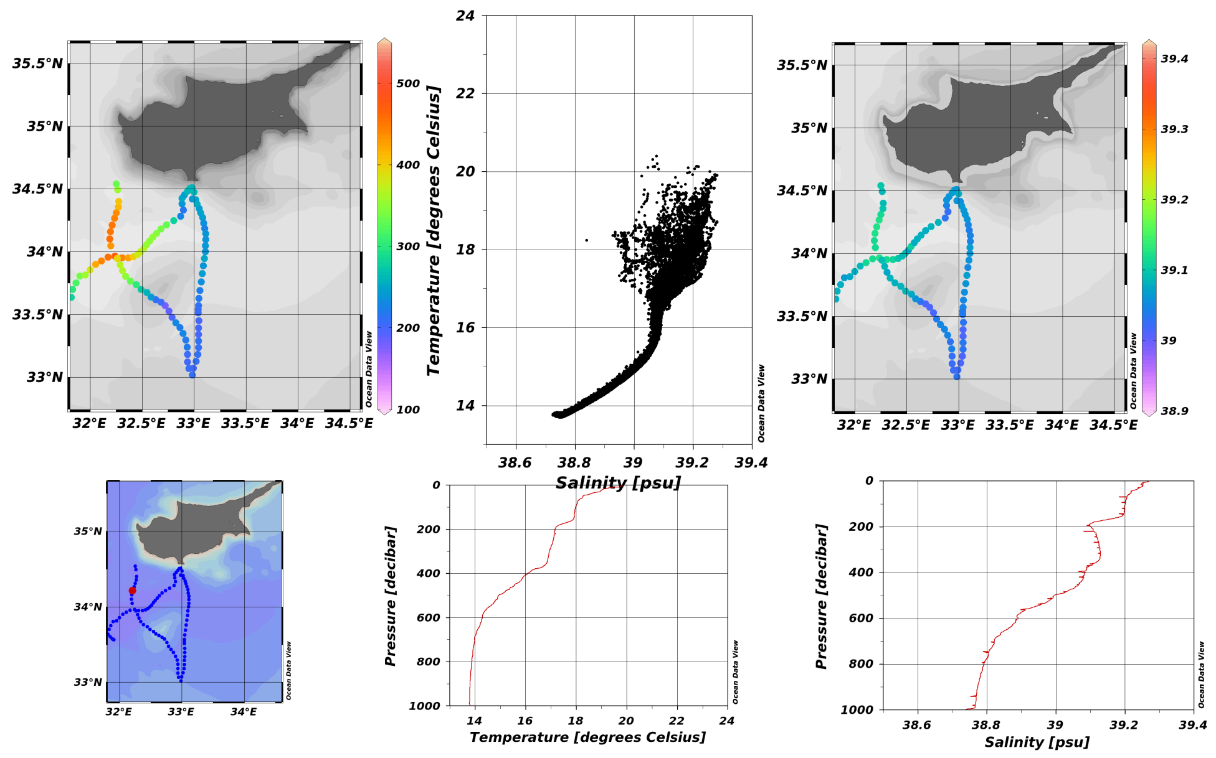
Results
Moved to NW?
April-May 2014

Slide 23
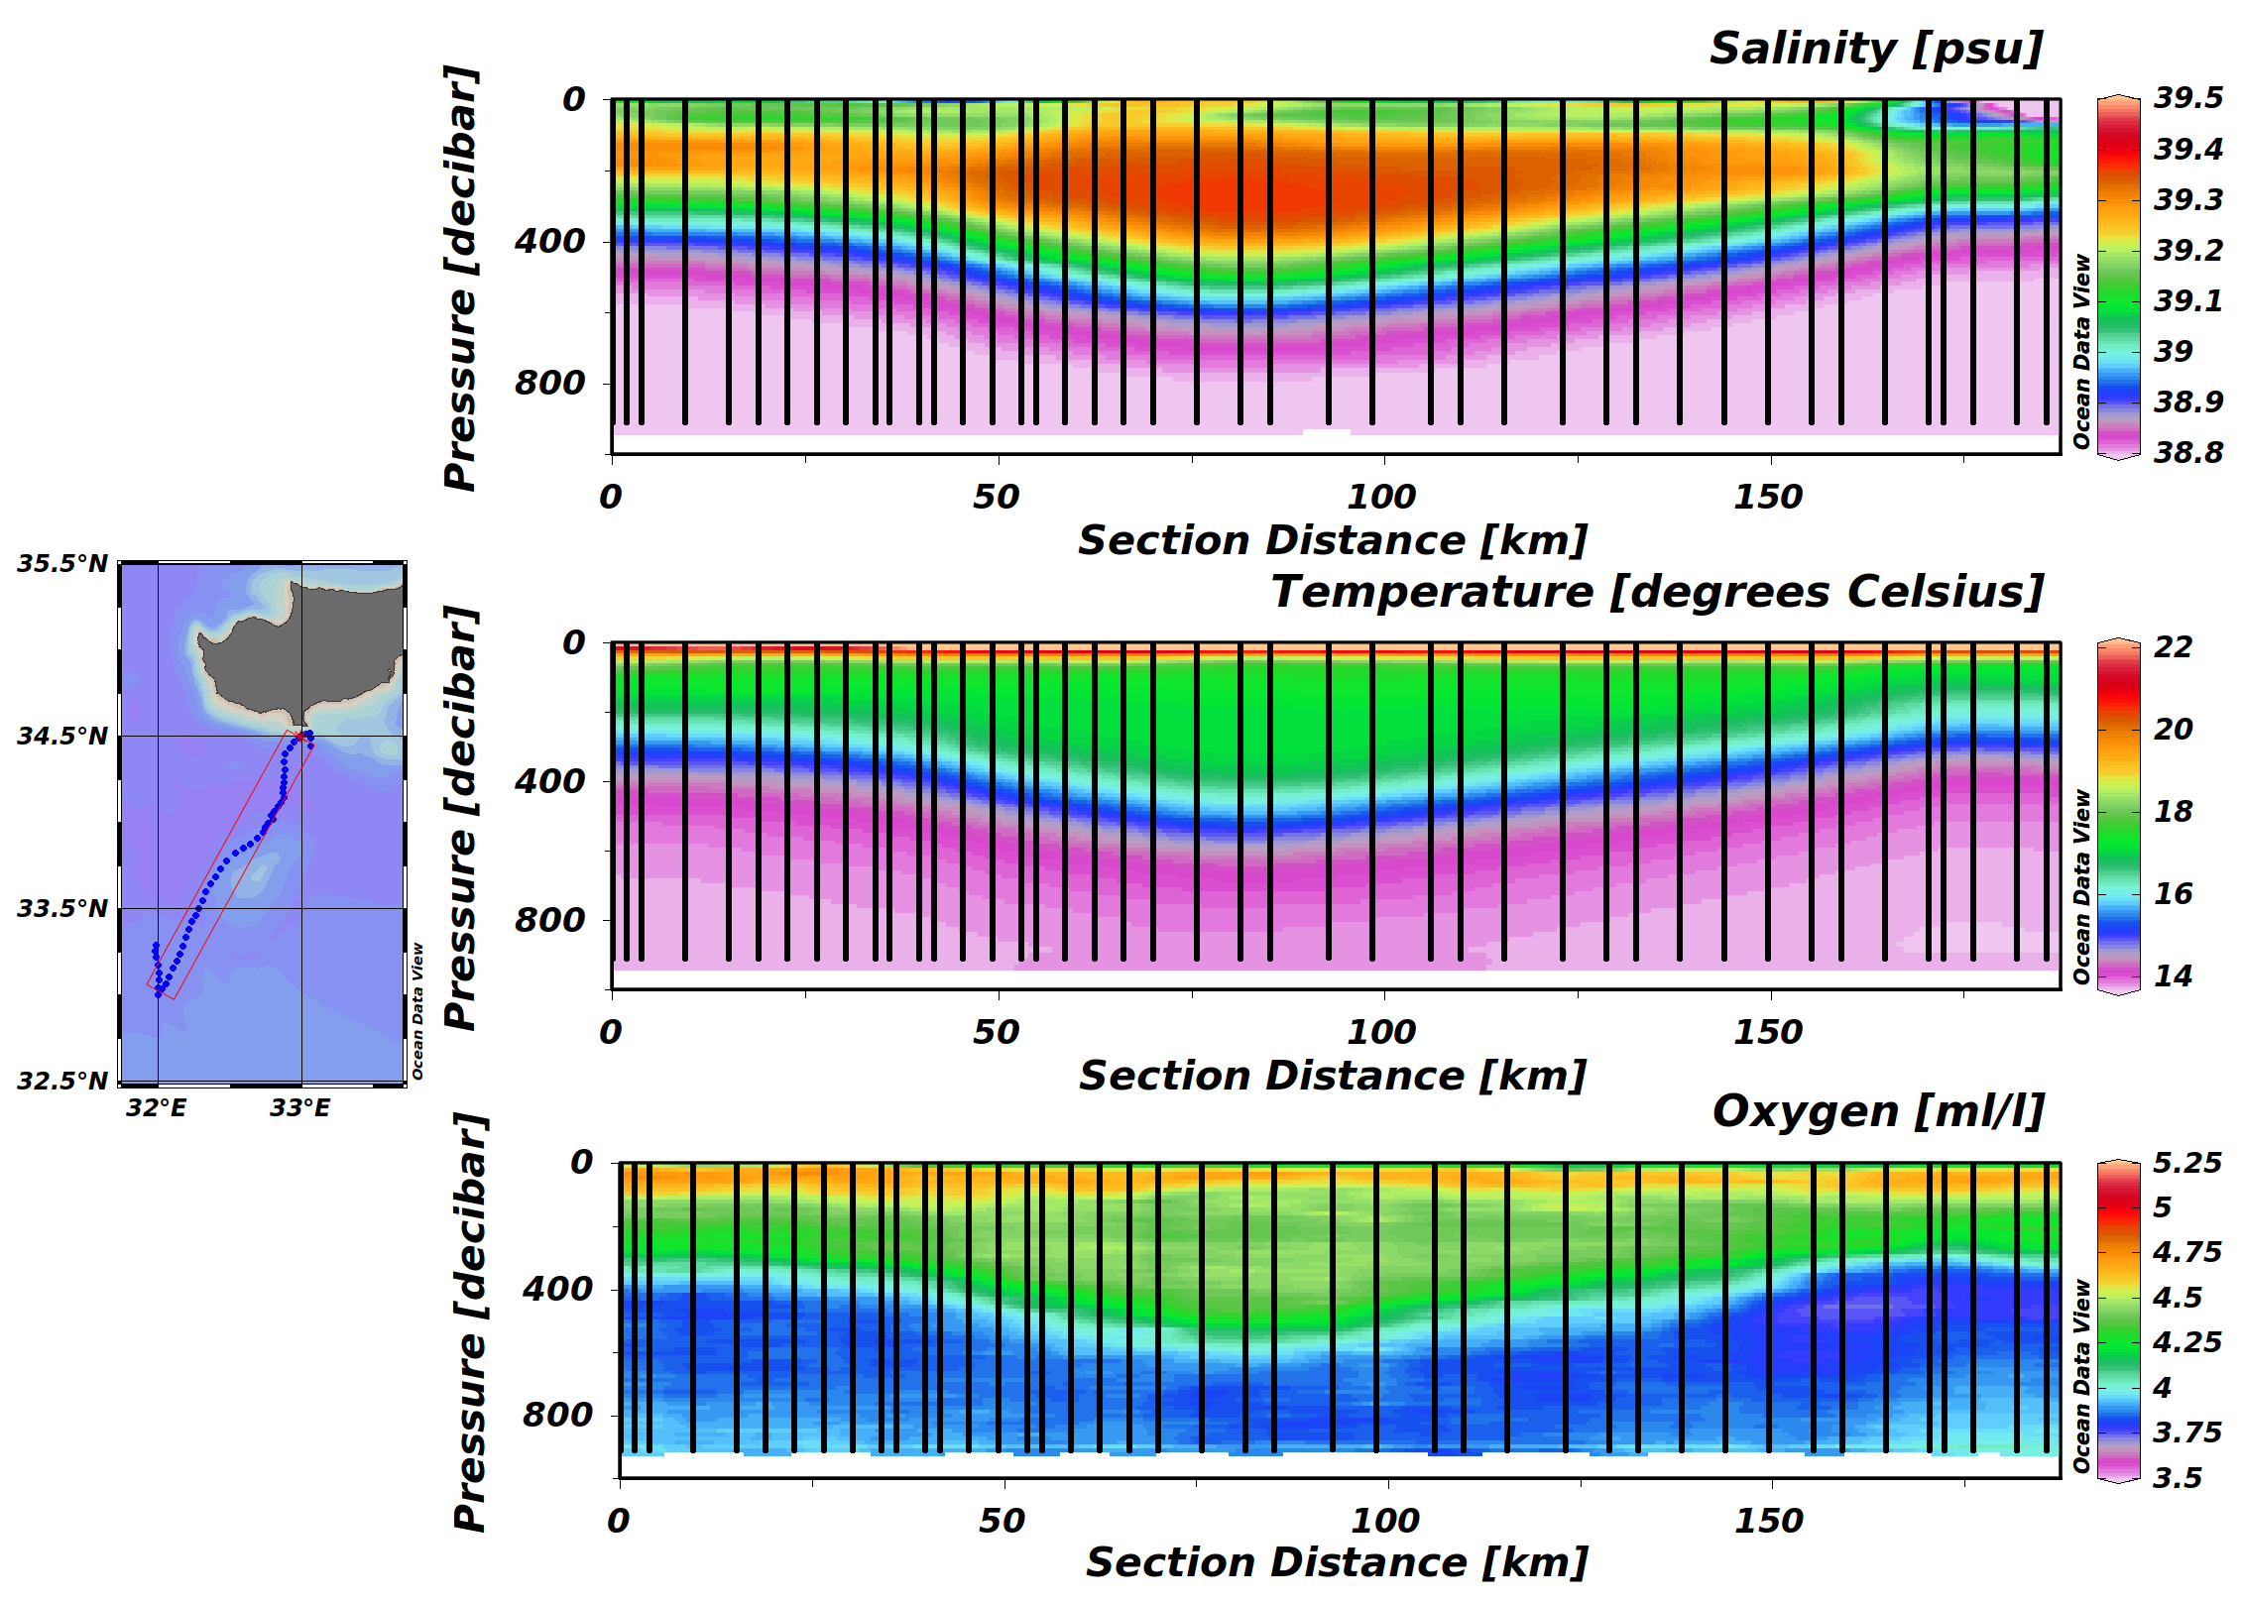
Results
2009 June 24-July 4 transect
NE edge of Eratosthenes
Depth-ave velocity, Max 30 cm/s
Anti-cyclonic
Radius ~40km
N-S Section ‏
LIW to 500 m.
Asymmetric
Low oxygen in eddy. High oxygen in Atlantic Water over the eddy (70-100m)‏
Notes:
23

Slide 24
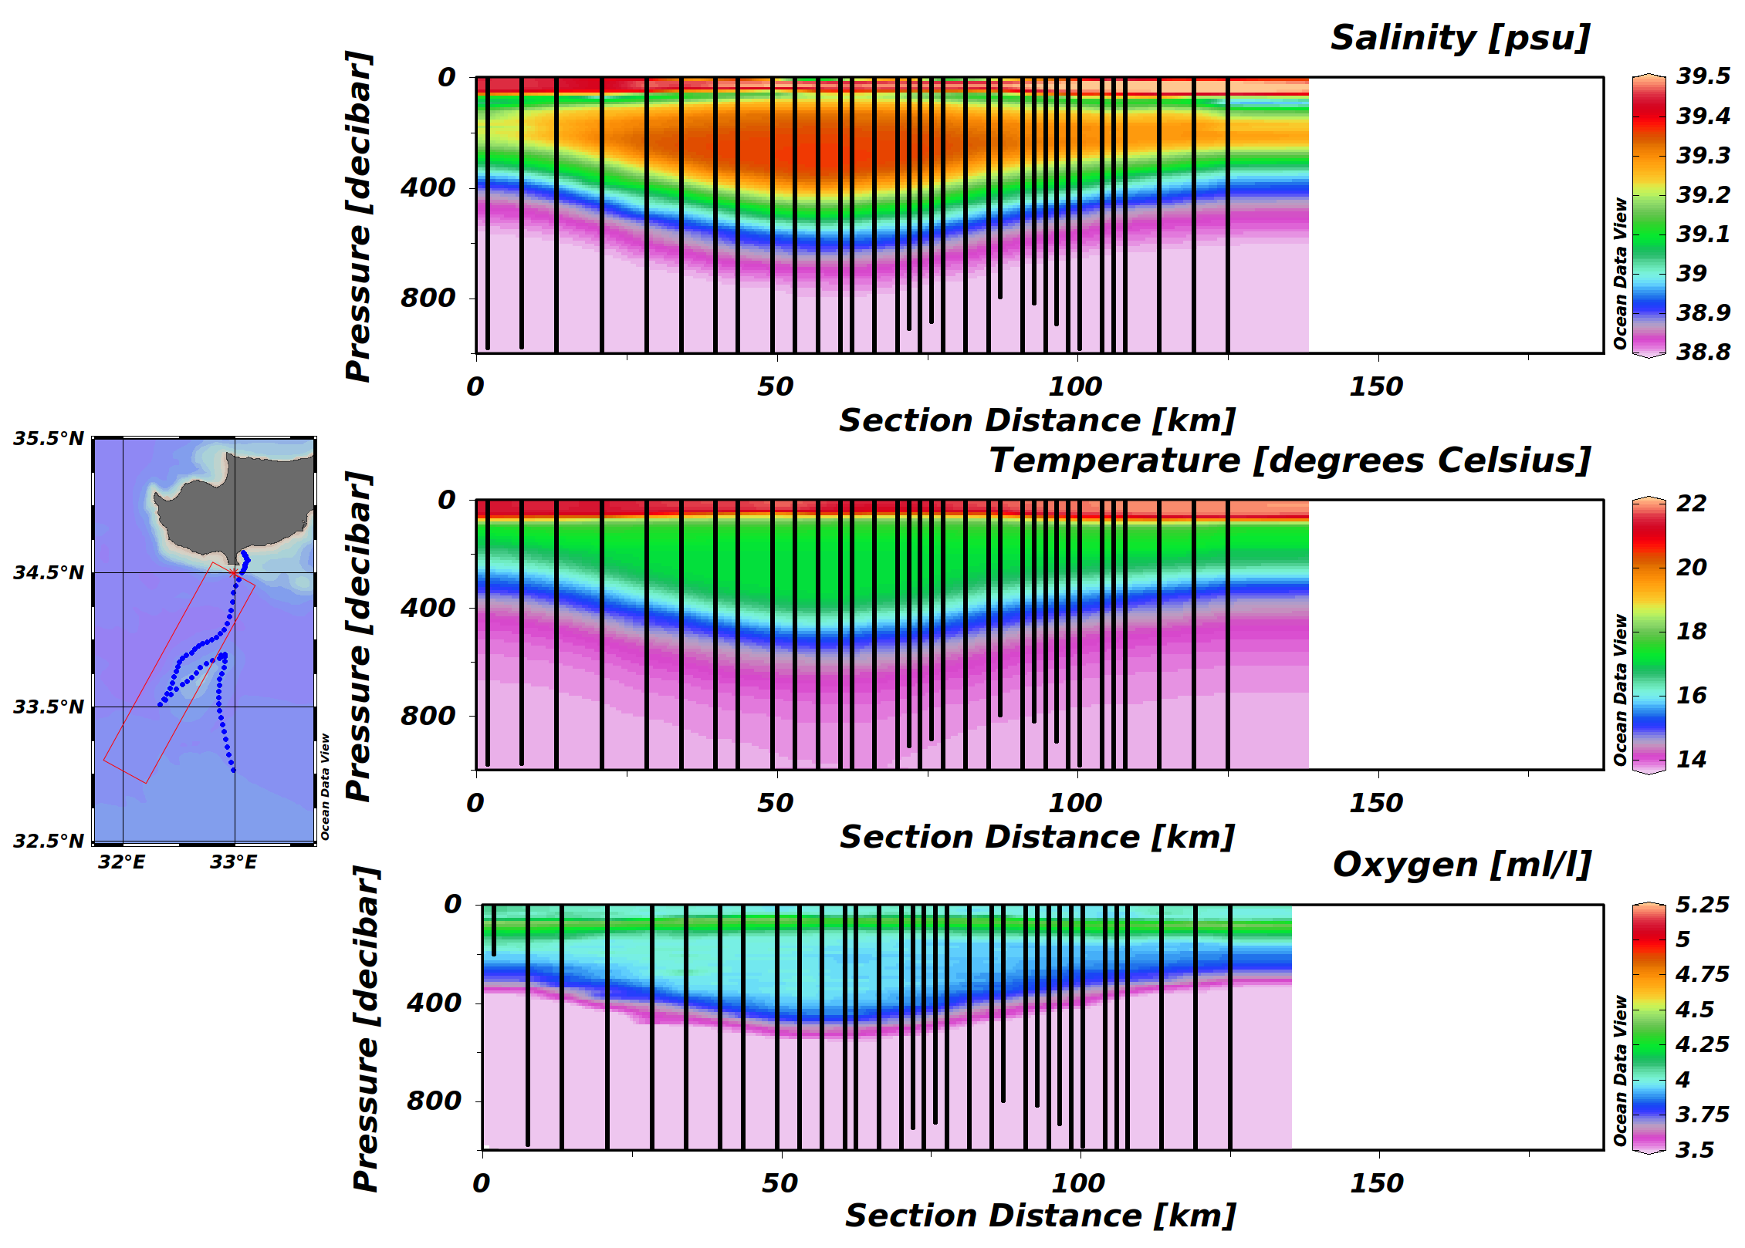
Results
2009 Nov 23-Dec 1 transect
N-S Section ‏
LIW to 500 m.
Asymmetric
Low oxygen in eddy. High oxygen in Atlantic Water over the eddy (70-100m)‏
Notes:
24

Slide 25
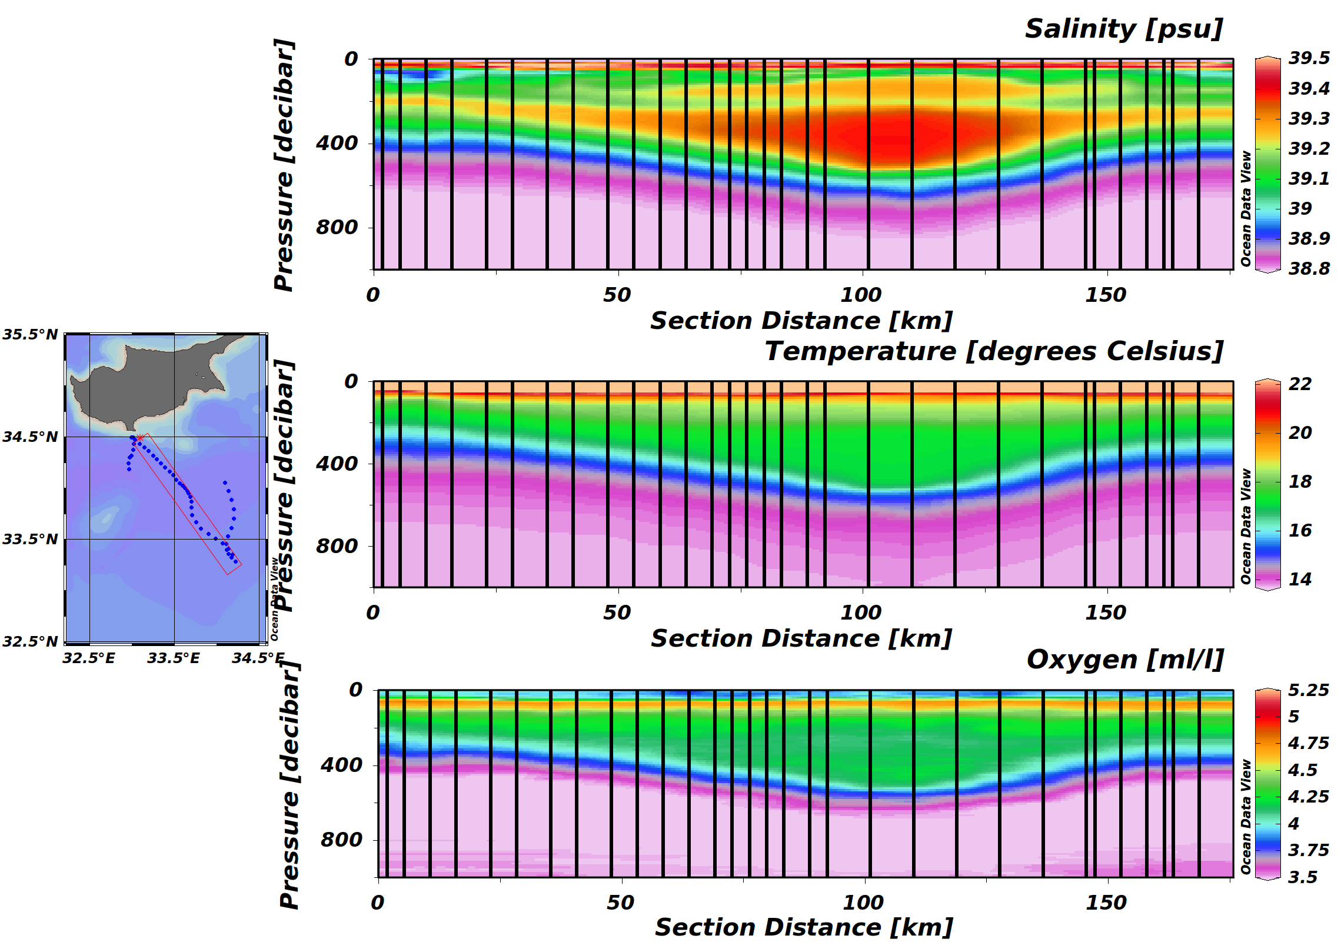
Results
2010 18-31 October
Section from NW to SE
Salinity intrusions
Must apply theory to calculate quasi-geostrophic currents
Notes:
25

Slide 26
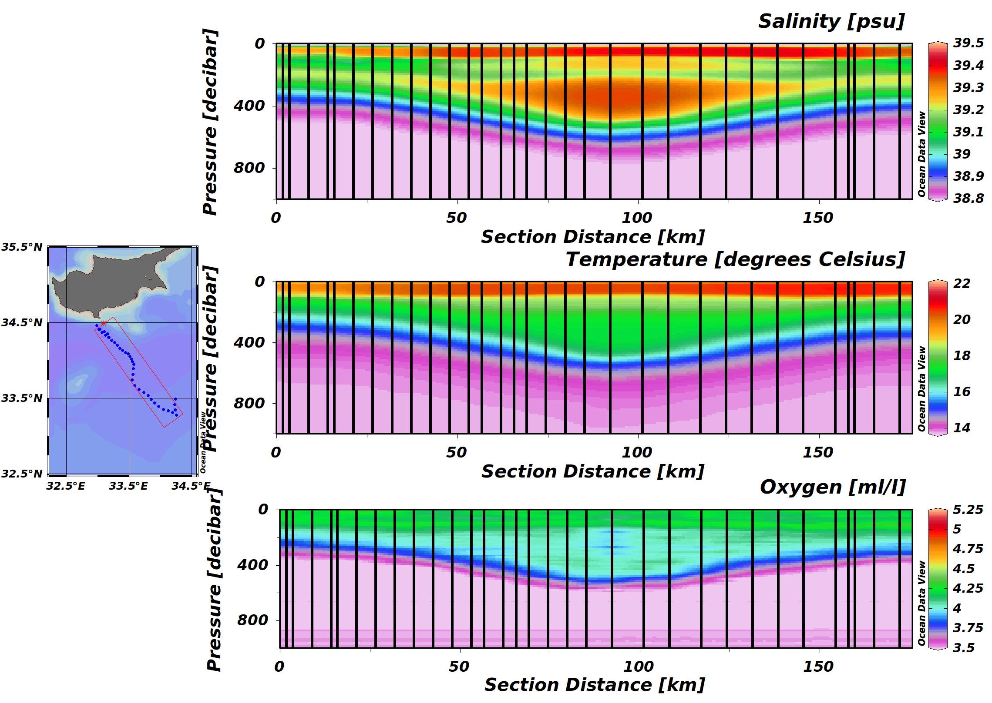
Results
January 2011, T, S, Oxygen

Slide 27

Results
2012 24 January-8 February
Section from W to E
Eddy much smaller, deeper
South of previous
Notes:
27

Slide 28

Sea Operations—intensive sampling, drifters
23 Nov ‘09 – 13 Jan ‘10
Surface drifters and MADT
General AC circulation in seamount region
Stagnation near eddy center
Second eddy to East (Shikmona Eddy)‏
EYE of the Levantine (12/2009)‏
Notes:
28

Slide 29

Future Plans
Continue lines, in cooperation with hydrographic cruises whenever possible (CYBO)
Validate oxygen, chlorophyll and suspended matter with traditional methods for our region
Extend lines or join with lines to neighboring countries
Supplement the gliders with new types of sensors.
Continue data assimilation in Cyprus regional operational model.
In-depth analysis of the Cyprus Eddy and interaction with topography and ecology
Notes:
29

Slide 30



Slide 31



SLA: velocity field

Slide 32


Slide 33



Results
Vertical profile in Cyprus eddy
October 2010-February 2011
29 January 2012

