Slide 1
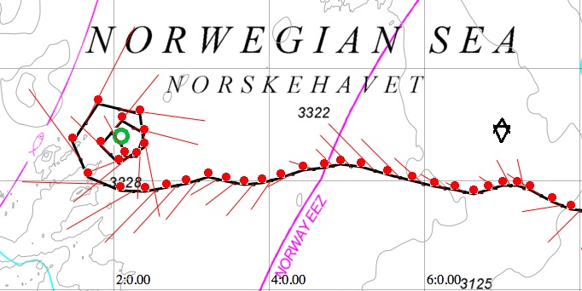


The Eddy field of the Lofoten Basin from Seaglider
K.A.Orvik
P. Haugan, K. Kvalsund, I. Hessevik, E.M. Bruvik
The Norwegian Atlantic Current Oservatory

Slide 2
Norwegian Atlantic Current Observatory (NACO)
Seagliders in the Norwegian Sea since 2012
)
Figure from Orvik and Niiler,2002

Slide 3
Seaglider 160 on an 8 month mission in 2009 iAOOS programme
Høydalsvik et al, 2013

Slide 4
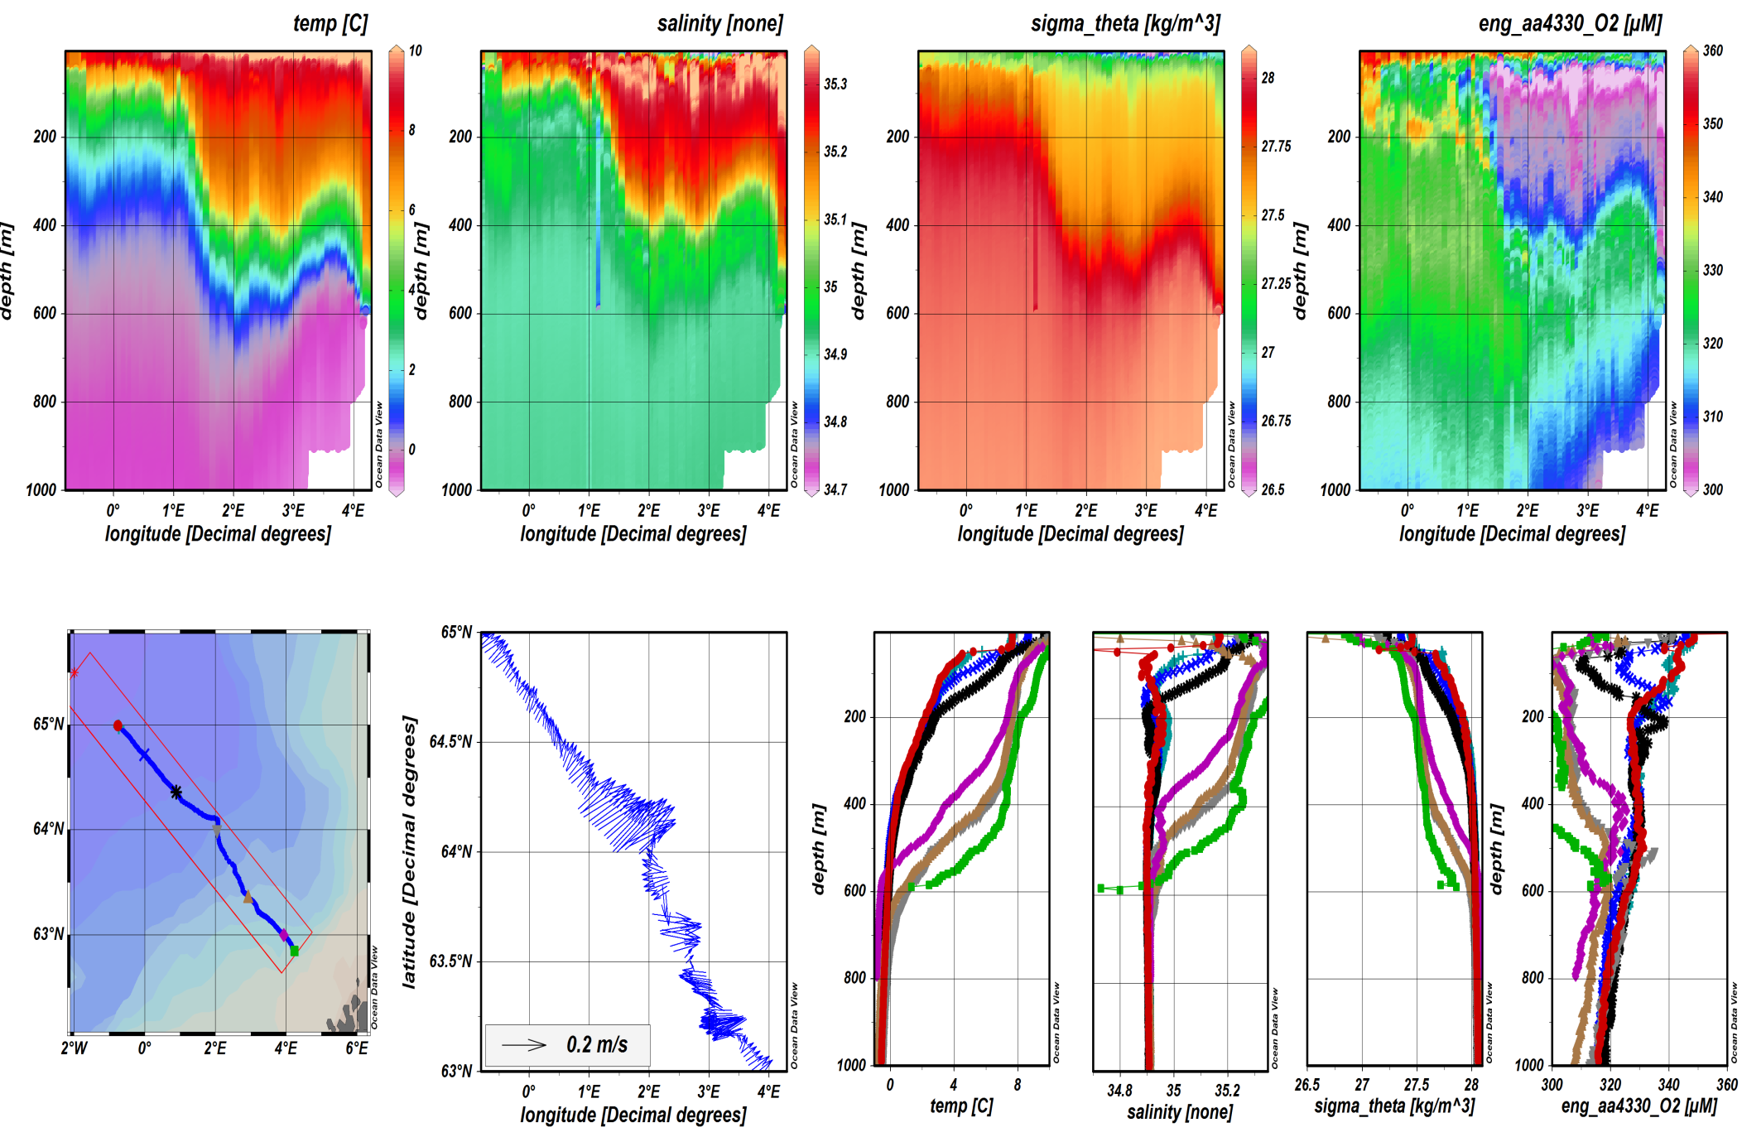
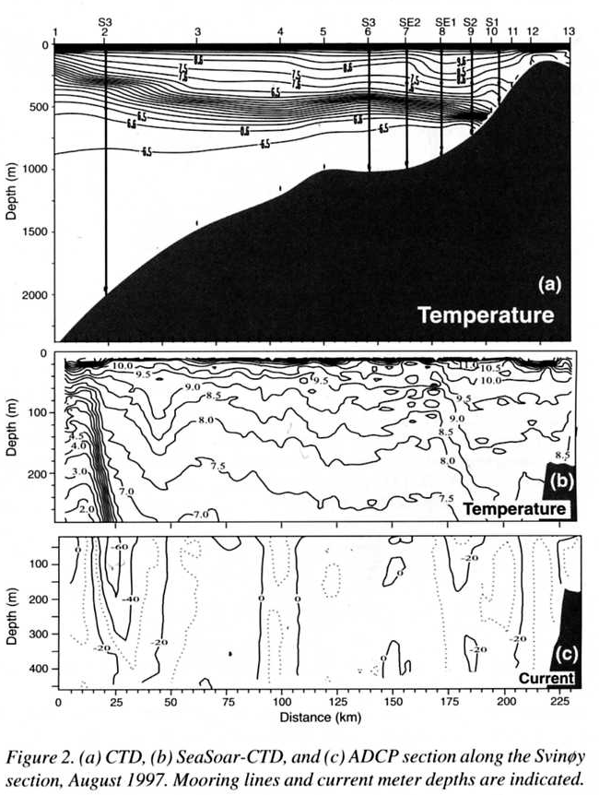
Svinøy Section
Seaglader 2012 Standard CTD; SeaSoar: Adcp 1997

Slide 5
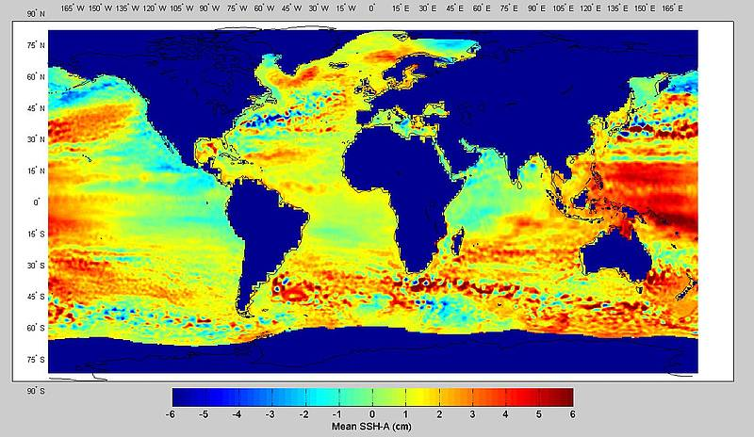
Sea Surface Height (SSH) from space
Why the Lofoten Basin?

Slide 6
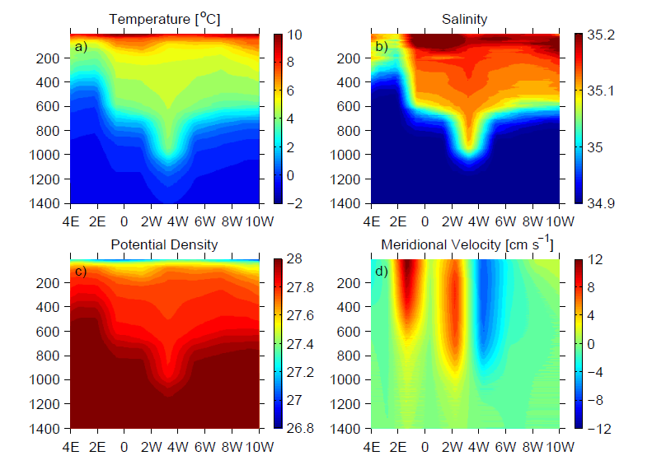
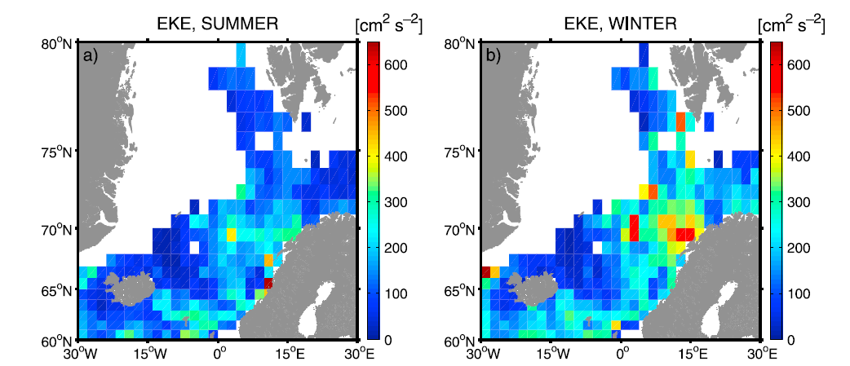
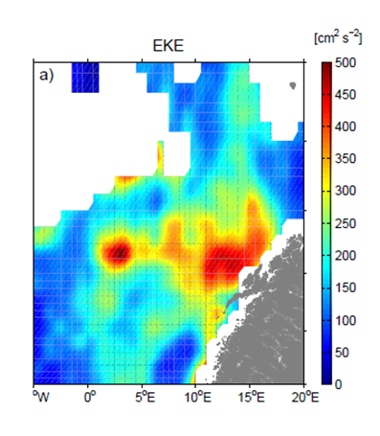
What do we know about the Lofoten Basin?
CTD transect along 70N July 2009 and Eddy Kinetic Energy from SVP drifters
From Anderson et al., 2009

Slide 7
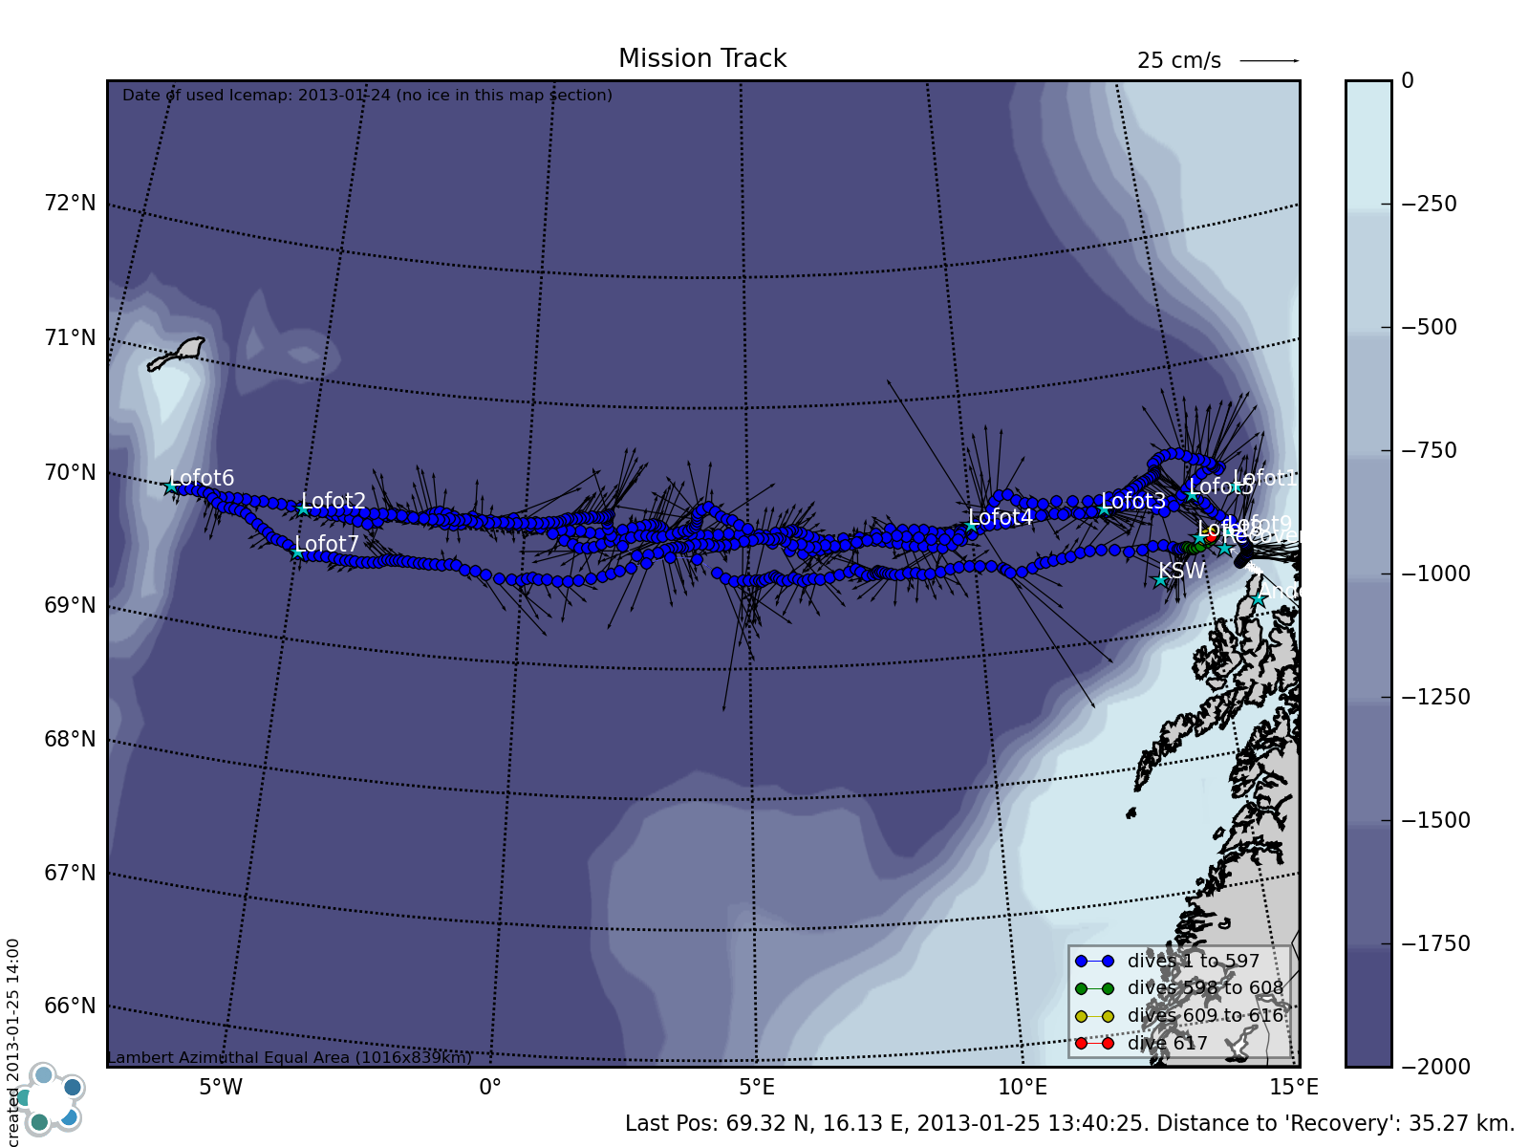
Lofoten Basin Seaglider misssion July 2012-February 2013

Slide 8
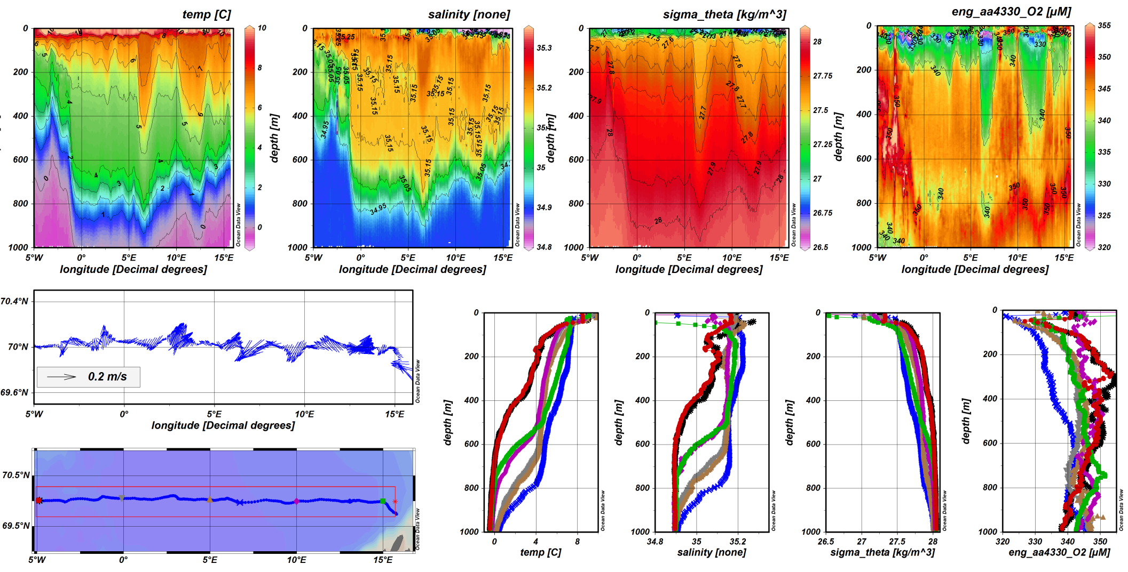
The first Lofoten transect, July-August 2012

Slide 9
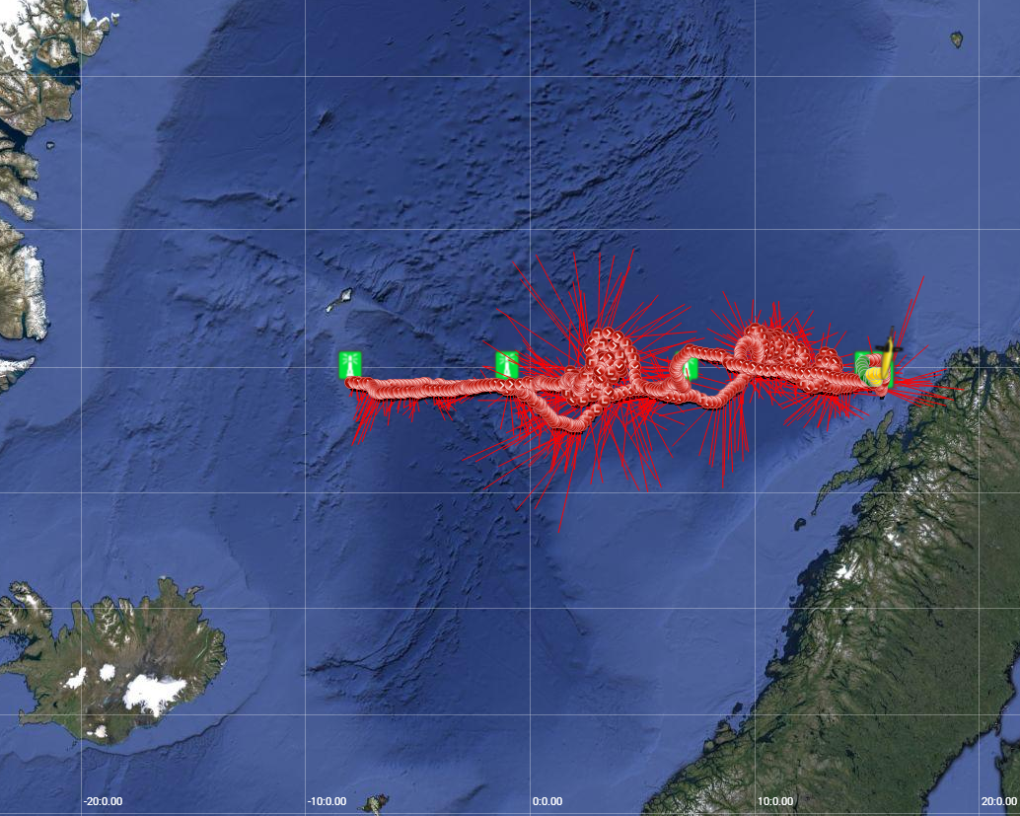
Seaglider 562: Crossings of the Lofoten Basin February-September 2013

Slide 10
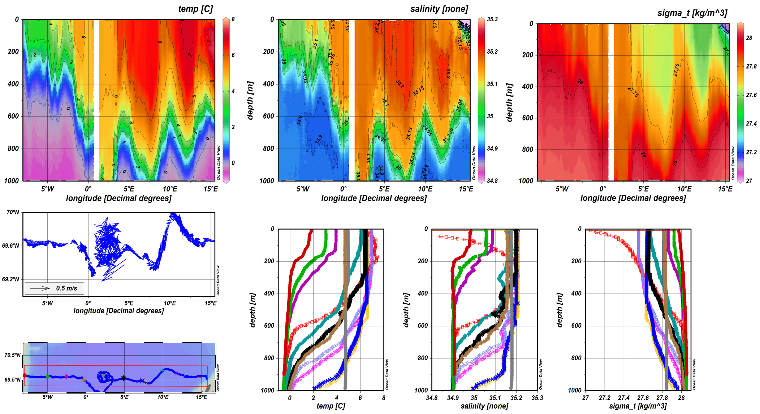
Seaglider transect Lofoten-Jan Mayen February-April 2013

Slide 11
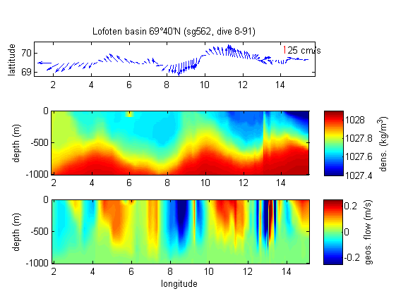
Geostrophic and average velocity Lofoten Basin 4

Slide 12
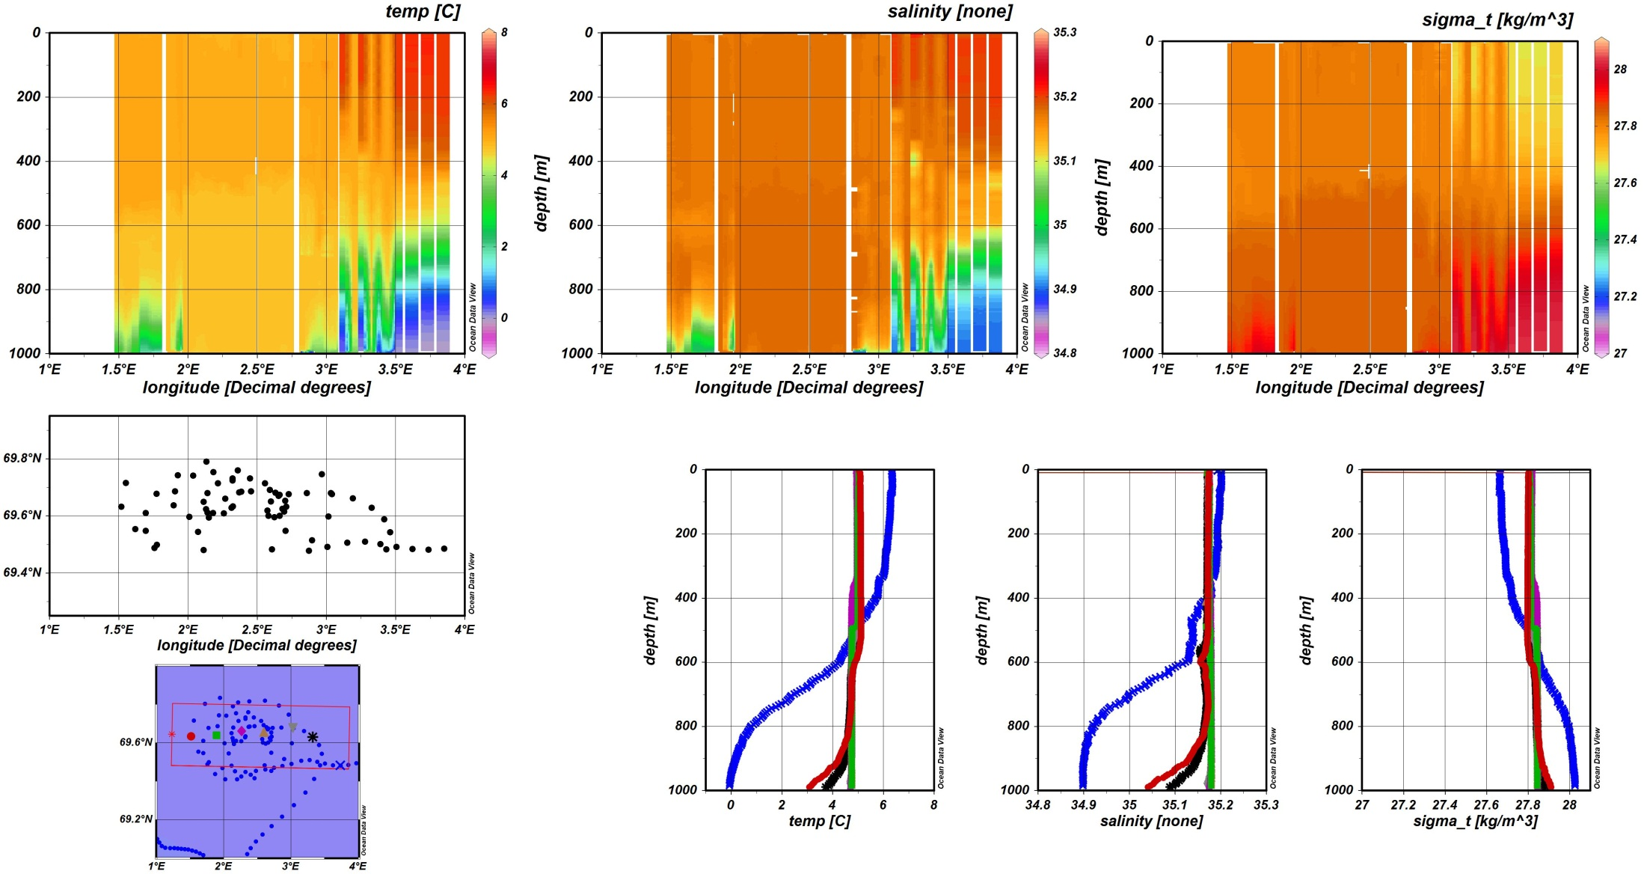
East-West profile of the LB-Eddy
Søiland and Rossby, 2013

Slide 13
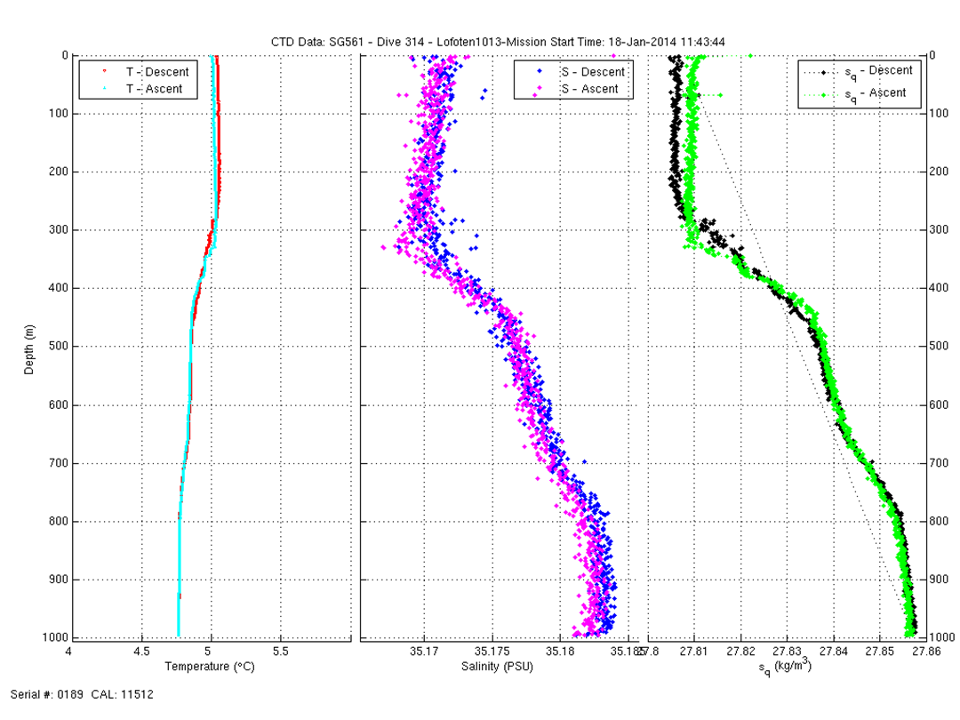
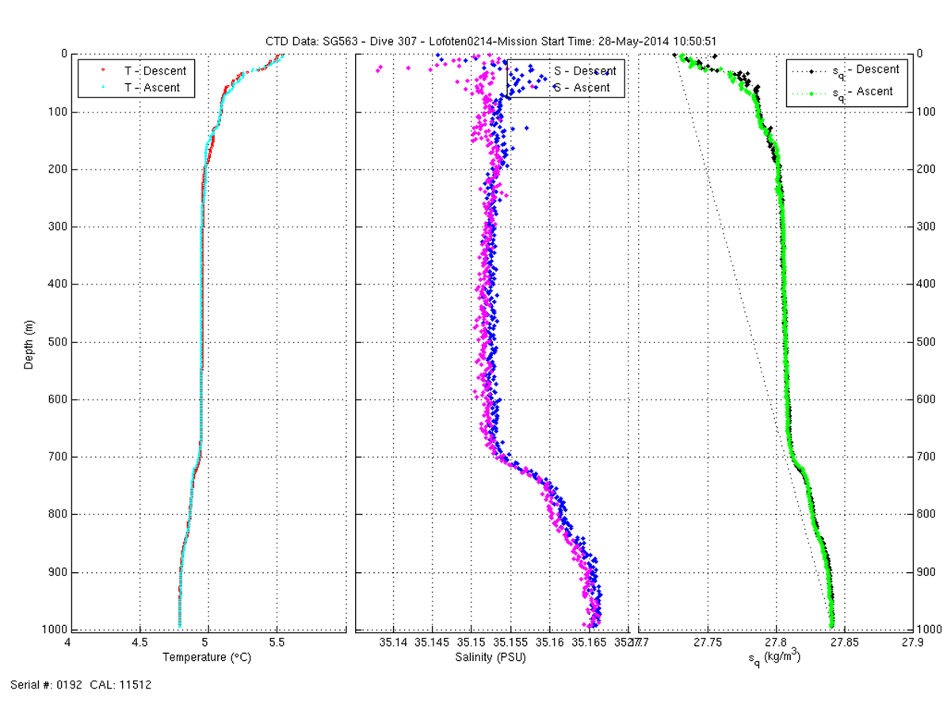
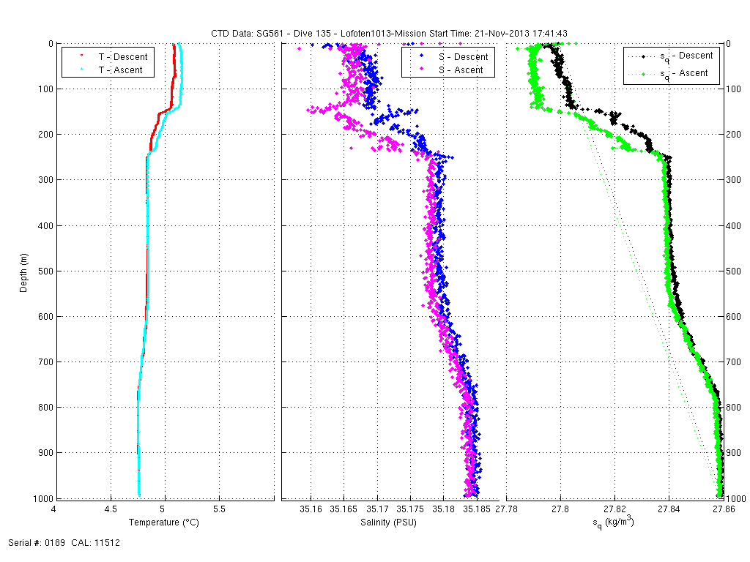
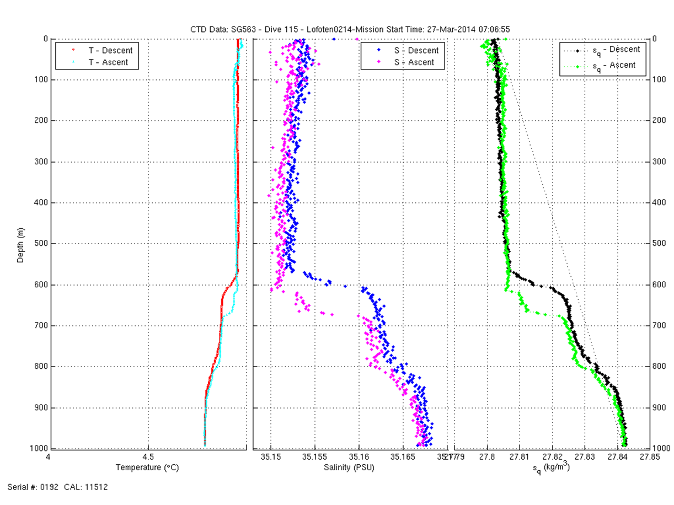
Development of the temperature profile in the LE-core during winter 2013-14
November 2013
January 2014
March 2014
May 2014

Slide 14



November 2013
January 2014
March 2014
May 2014

Slide 15
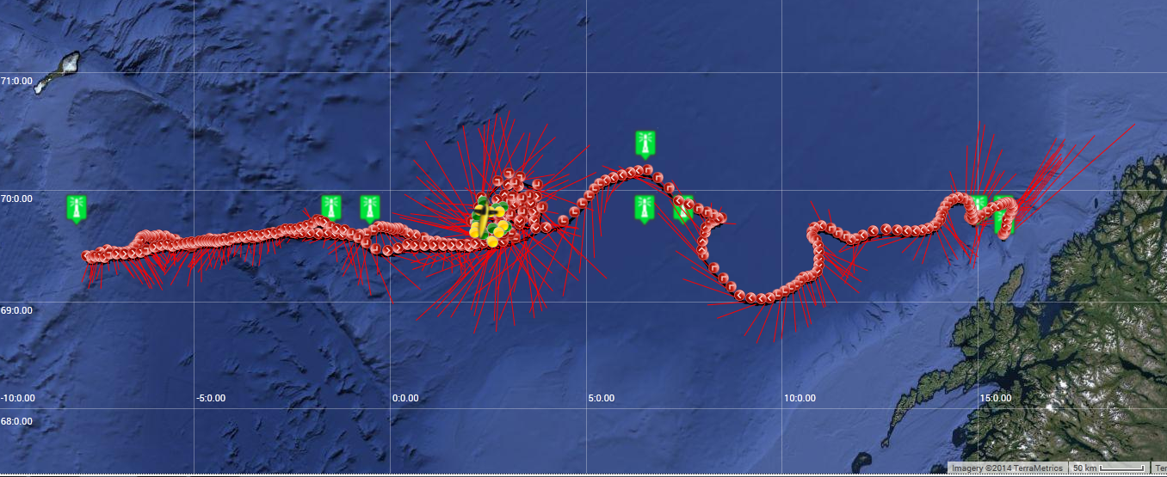
Ongoing Seaglider crossing of the Lofoten Basin since February 2014

Slide 16
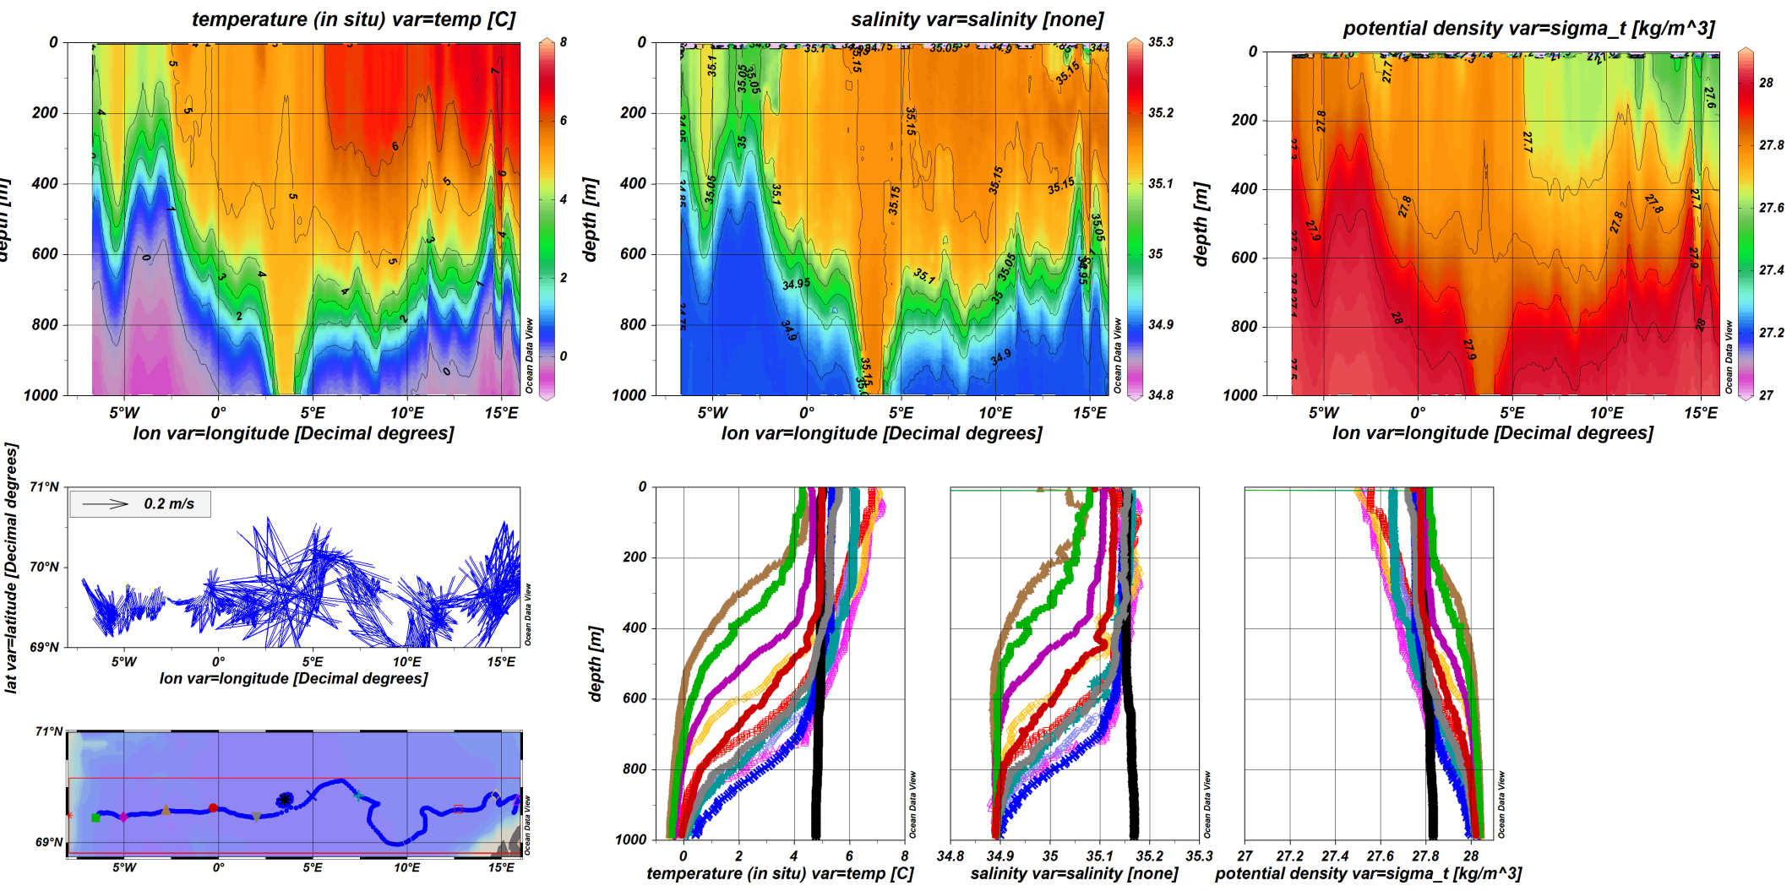
Lofoten Basin transect February-March 2014

Slide 17
Thank you!

