Slide 1
EGO-COST ACTION
Grant Holder Statement
D. Hayes¹, Gregory Konnaris¹, Tommy Eleftheriou¹
¹Oceanography Center, University of Cyprus, Nicosia, Cyprus
Everyone’s Gliding Observatories: 16-17 June 2014, Kiel, Germany
Notes:
1

Slide 2
Outline
Time frame
Members
Budget

Slide 3
Action Parties
Grant Holder:
OC-UCY(Oceanography Center - University of Cyprus)
Daniel Hayes, Gregory Konnaris, Tommy Eleftheriou

Slide 4
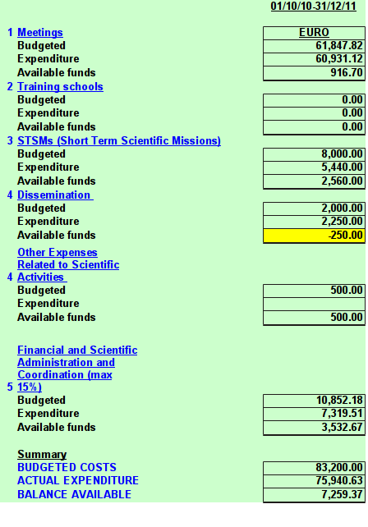
Budget and expenses
2010-10 to 2011-12-31
Notes:
4

Slide 5
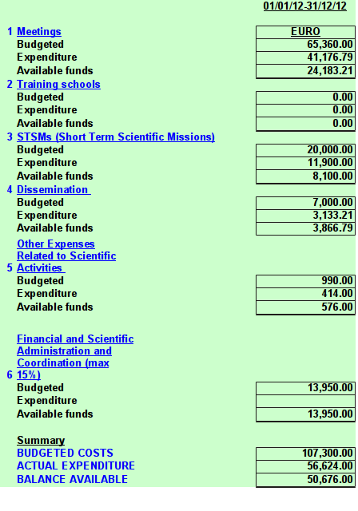
Budget and expenses
2012-01 to 2012-12-31
Notes:
5

Slide 6
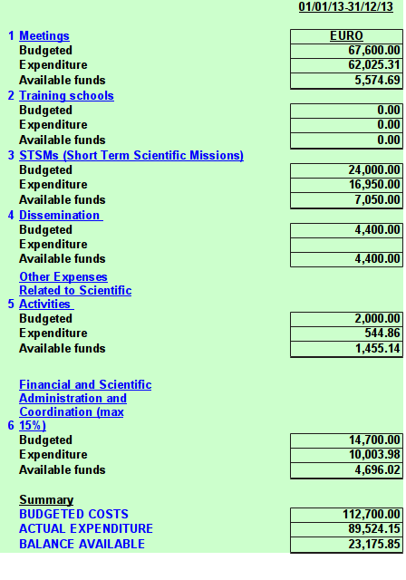
Budget and expenses
2013-01 to 2013-12-31
Notes:
6

Slide 7
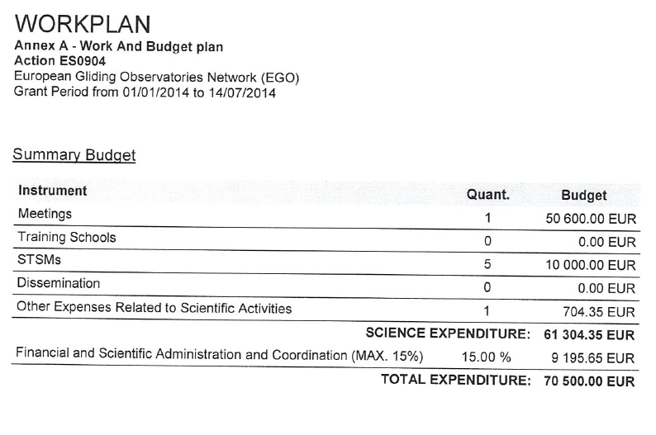
Budget and expenses
2014-01 to 2013-07-14
Only one STSM and this meeting so far (89 invited, 35 claim)
(57x800=45,600 Euro for the participants + 5,000 Euro for LOS)
Notes:
7

Slide 8
Summary
Budget use: some money went unused
Procedures: generally followed well
Contact with COST office: efficient and productive
Perhaps better information to participants about procedures and availability of funds could have helped?
THANK YOU ALL FOR YOUR COOPERATION!
Notes:
8

