Slide 1
WG 4:
Networks, links with the other observing systems and OSSEs
WG lead:
J. Karstensen (Germany)/J. Hernandez-Brito (Spain)

Slide 2
WG 4 relevant ES0904 science objectives
Overarching Objective of ES0904:
European coordination of on-going research using gliders,
and the conception of future research
ES0904 relevant subtopics:
Homogenization of national rules/regulations for glider operations from a legal and marine safety perspective
Link with international groups of experts such as IOC/UNESCO, JCOMM, International Maritime Organization (IMO)…
Improvement of glider data assimilation methods for models
(global/coastal)
Promote the use of glider-type sampling in Observing Systems design studies in order to optimize to mission planning and observing system network synergetic (e.g. application of Observing System Simulation Experiment (OSSE) methods)

Slide 3
WG 4 science questions
“How can gliders be combined with other observatories (floats, moorings, ships, etc.) in an optimal way ?”
“What are the requirements for a sustained glider component in an observing system? – legal, logistics, financial”
-> WG 4 has a tight link with
GROOM WP2 “A glider component in the GOOS”
Global Ocean Observing system (GOOS) characterization
  Legal aspects
  (Cost aspects) – not explicitly mentioned in the ES0904 work program

Slide 4
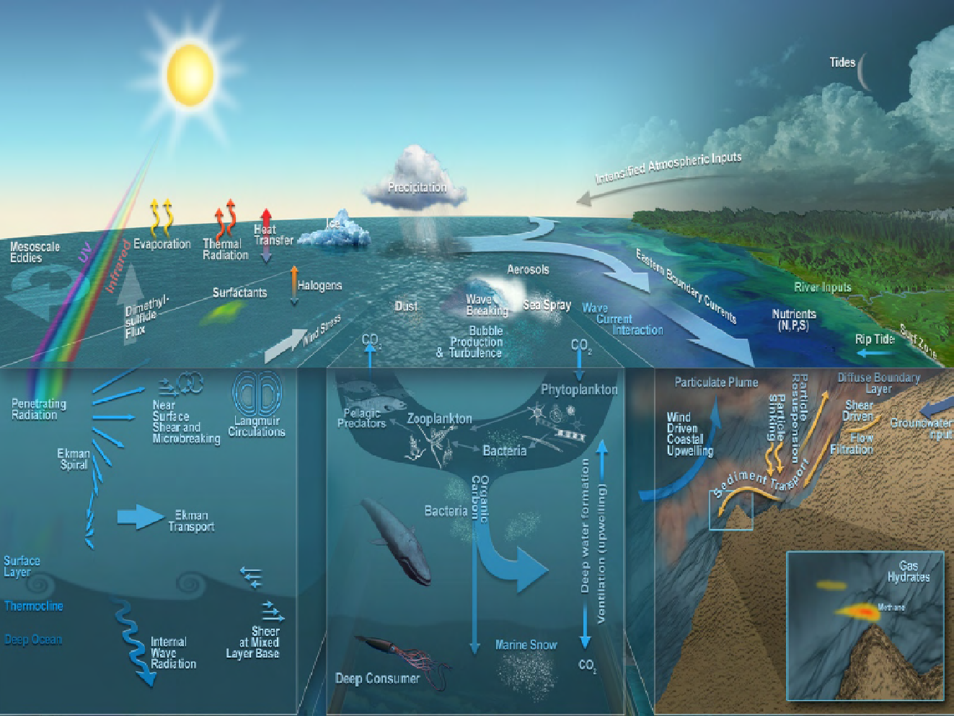
Ocean Observation: A multidisciplinary challenge
Courtesy Neptune, John Delaney, and Mark Stoermer
sampling issues (scales and parameters)
observations AND modeling, legal aspects, costs !

Slide 5
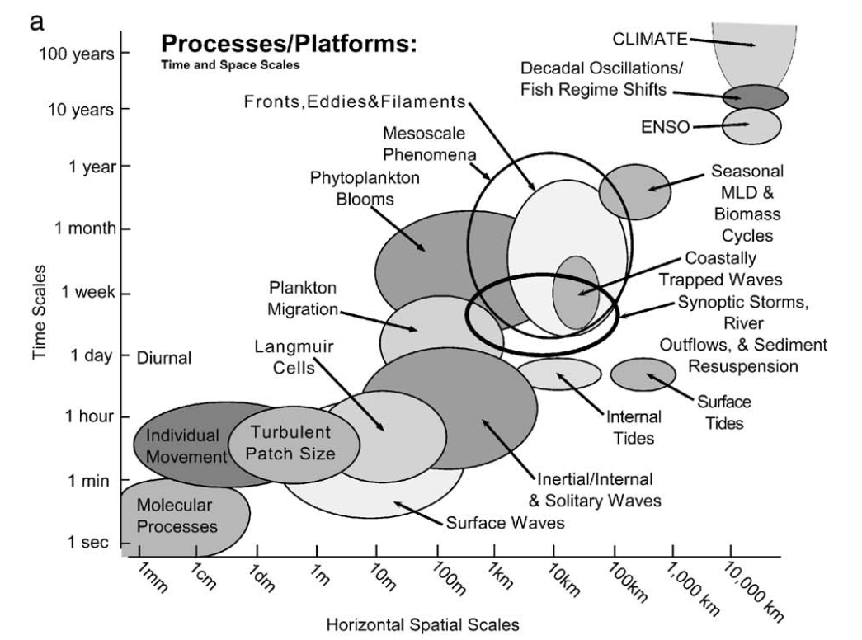
A different way in looking at the problem

Slide 6
Observing System Components
+ Satellites

Slide 7
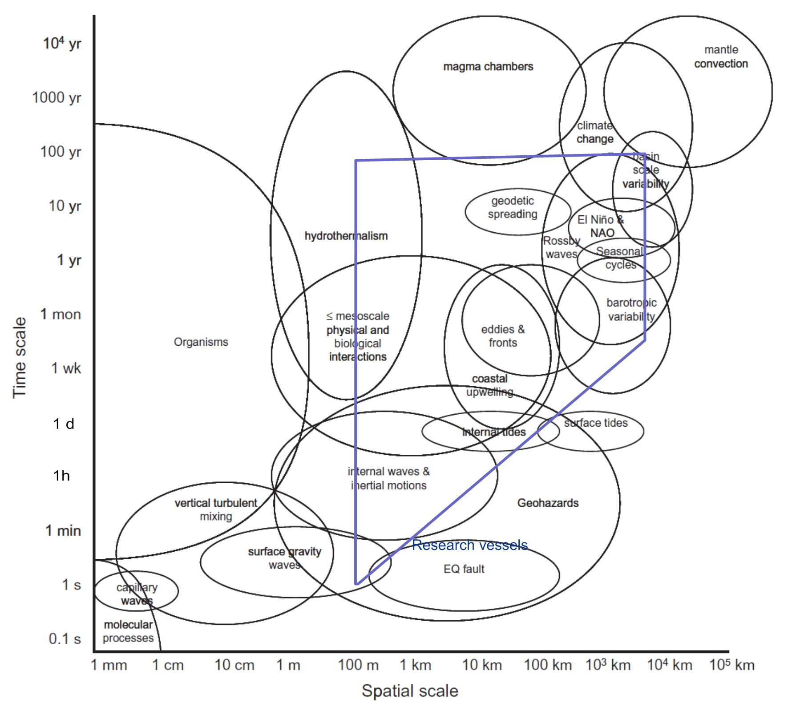
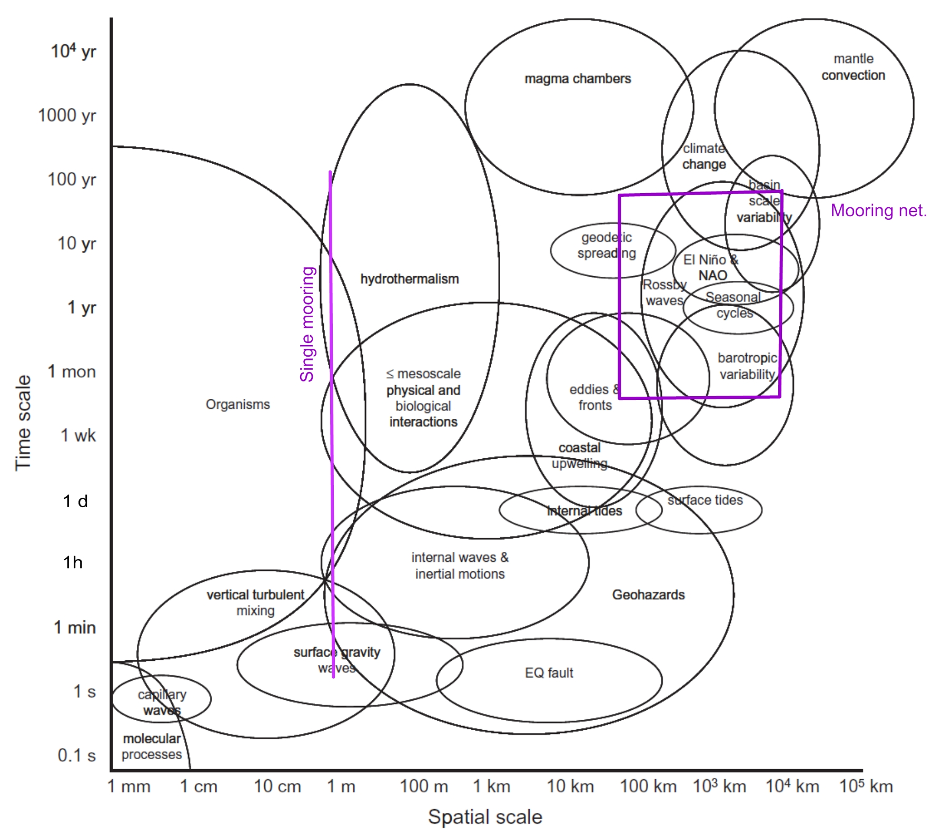
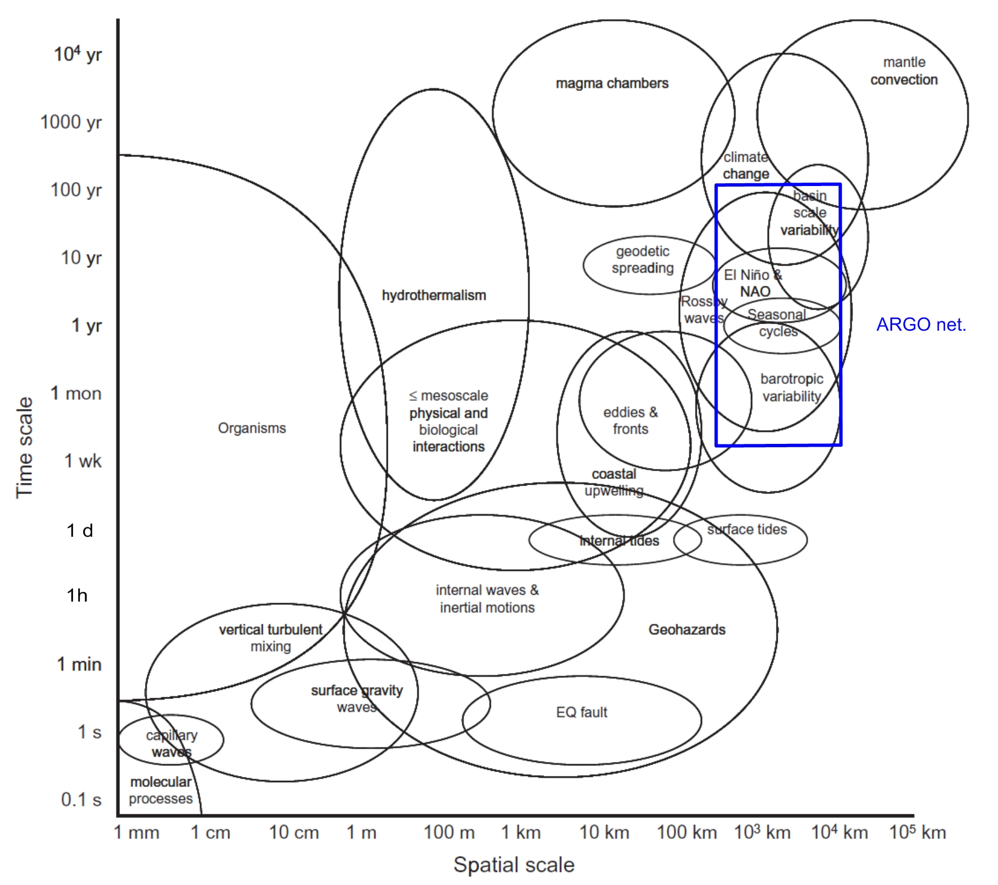
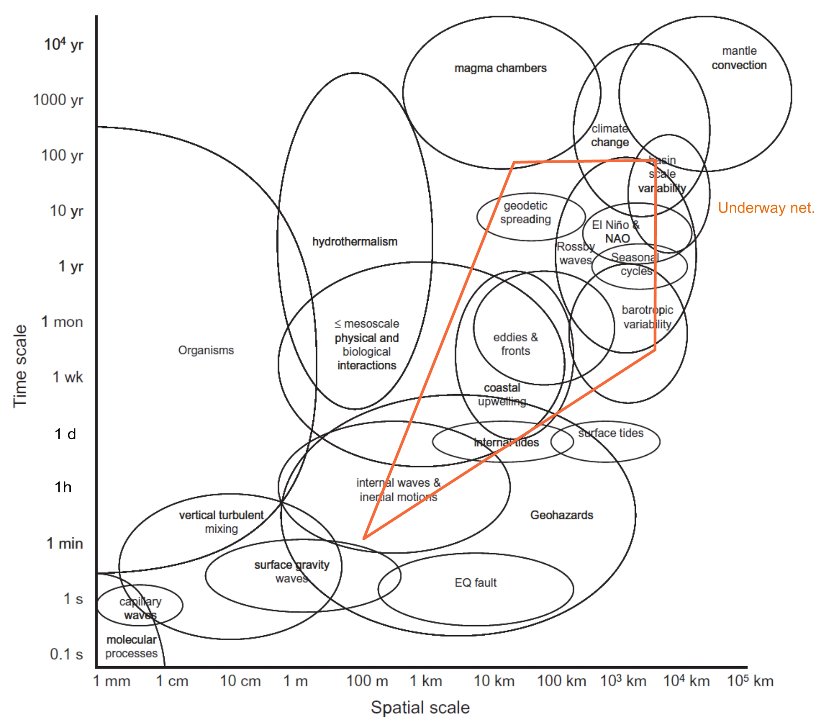
Capabilities of the Observing System components
Mooring
Argo
Research vessels
SOOP

Slide 8
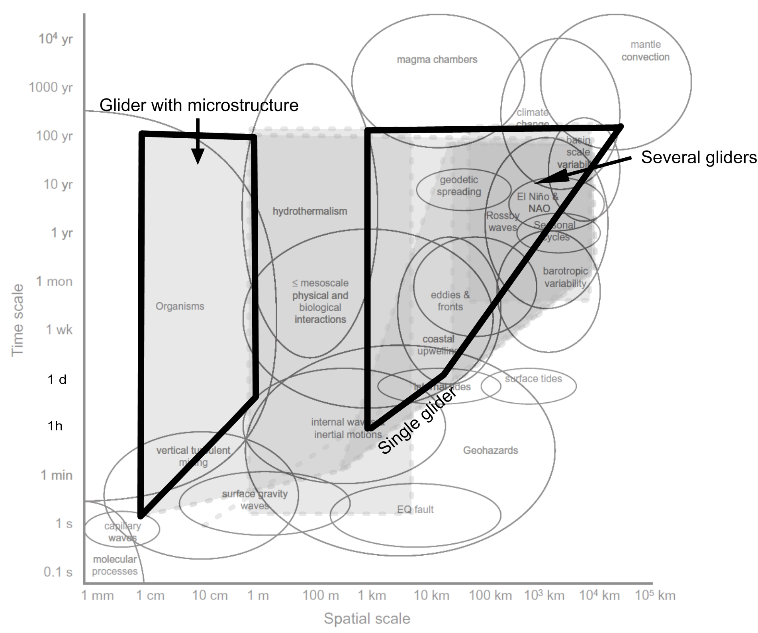
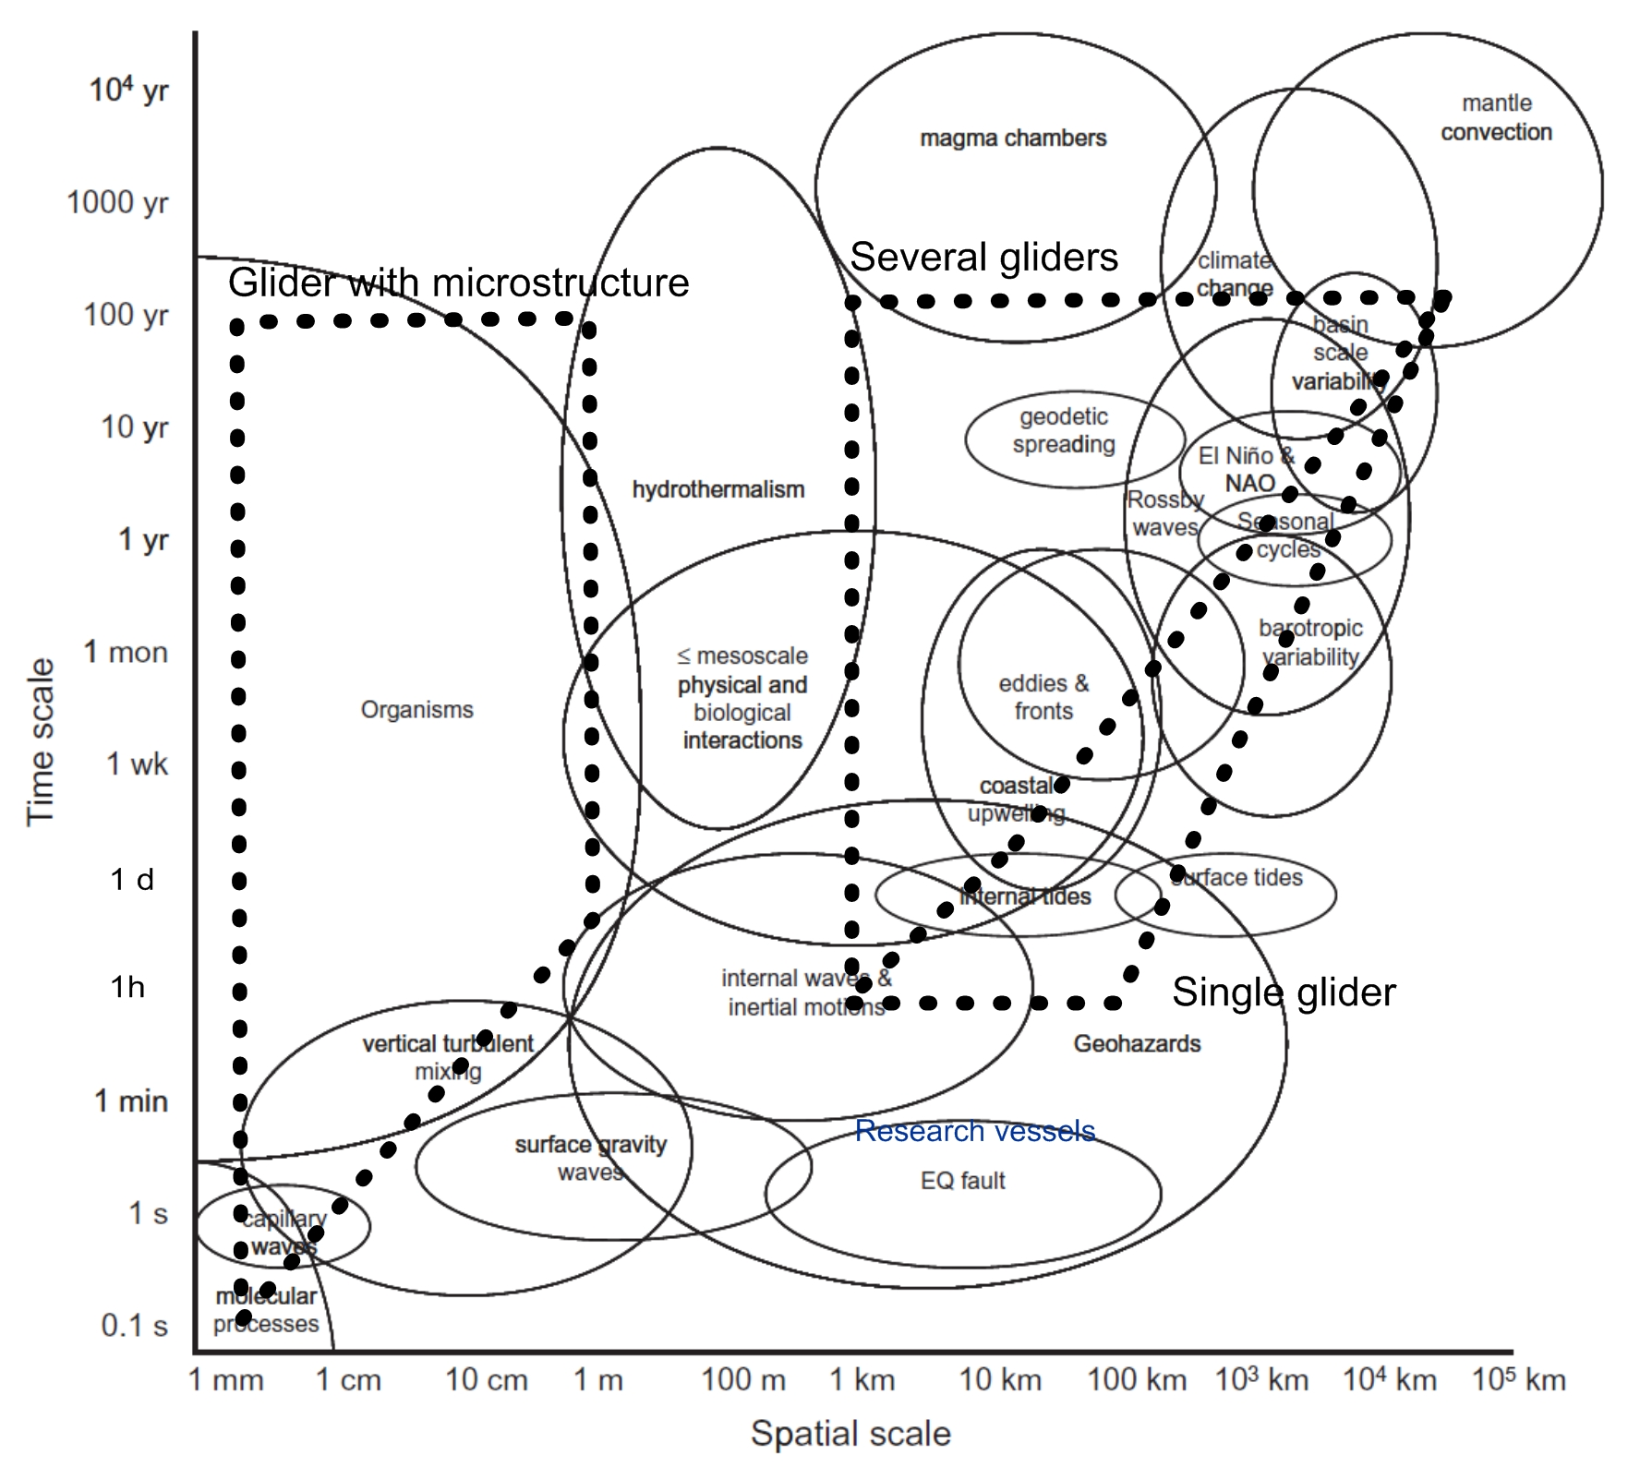
Capabilities of the Observing System components
Mooring
Research vessels
Argo
Glider
SOOP

Slide 9
WG4 Strategic goal:
Rising awareness of Gliders as an observing tool
Presentations of project at international conferences (e.g. regional observing system/operational oceanography meetings: FOO meeting Hamburg, BOOS meeting, GODAE meeting, …)
Public outreach (e.g. CNN report on glider survey, Oceanology, Public events, Movie/Flyer material)
Milestone
5th session of the WMO-IOC JCOMM-OCG
presentation of EGO activities to Chairs and National representative of JCOMM and coordinators of GOOS observing programmes
(Silver Spring, Maryland, USA September 2013)

Slide 10
WG4: OSSE activities
Public report

Slide 11
WG4: Assimilation & OSSE activities
The report summarizes three aspects of the synergy between numerical modelling and observational data (glider):
How can model solutions being evaluated by using glider observations (temperature, depth integrated flow)?
How can OSSEs being used to guide optimal glider platforms deployment?
“Real world” case studies of data assimilation (Mediterranean Sea & Nordic Seas)

Slide 12
WG4: Glider as part of the GOOS
Public Report

Slide 13
WG4: Glider as part of the GOOS
The report describes sampling (space, time) and sensor (observed variables) capabilities of the existing GOOS observatories (Argo, Ship, XBT, drifter, moorings).
Based on the evaluation of sampling versus observing requirements the potential contribution of gliders is assessed.
A literature review is presented.
An outcome of the assessment is that gliders are critical observing tools for applications in boundary currents, the transition zone between coastal ocean /open ocean, for targeted sampling of (sub)mesoscale features (fronts, eddies), as well as for cross-disciplinary surveys.
Special cases are Hazards (e.g. oil-spill) and use of gliders for “data-messenger” surveys.

Slide 14
WG4: Legal aspects of Glider Operations
Public reports

Slide 15
WG4: Legal aspects of Glider Operations
The classification issue for gliders (boat, debris, equipment, …?) was better resolved. As long as the deployment is in the framework of “marine scientific research” (MSR) gliders can be considered as research equipment – as such UNCLOS can be applied.
The adoption of a specific code of conduct should be drafted and, ultimately, submitted to the competent organizations such as the IOC.

Slide 16
WG4: Legal aspects of joint glider management in Europe
On a national level the member states developed national strategies for joint and/or individual glider infrastructure operations. Here, the national legal regulations apply.
On a European level the “European Research Infrastructure Consortium” (ERIC) is identified as the only relevant framework for joint funding and management of a European glider infrastructure.
Nevertheless, currently a joint European glider infrastructure is not explicitly included in the ERIC Roadmap process. Alternatively, concepts that may integrate a glider infrastructure with existing ERICs (e.g. EuroArgo ERIC) could be evaluated.

Slide 17
Overall summary of work in WG 4
WG 4, in close collaboration with GROOM WP2, has made important investigations on the glider specifics in ocean sampling.
Considering the sampling, the navigational capabilities and data accessibility glider provide crucial data for the Global Ocean Observing system, and its regional sub-systems.
From a legal perspective glider deployments can not be conducted on a “common base”, such as it has been formulated in the IOC Resolution XX-6 for the Argo floats and surface drifters.
Nevertheless, the awareness of the deployment of AUVs significantly increased over the last couple of years and currently new concepts are developed.
One critical achievement of the COST ES0904 was the invitation to the WMO-IOC JCOMM-OCG meeting in Sept. 2013.
Over the next couple of years it is required to implement the glider part of GOOS. The implementation will first of all require a coordinating body - a coordinator (linked to JCOMM) and an advisory committee

Slide 18
Thank you for your attention!

