Slide 1



Artificial intelligence: Autonomy, networking and autopiloting of gliders
Dr. Alberto Alvarez
(Presented by Dr. John Osler)

Slide 2
Outline
Introduction
Networking and optimum mission planning
Adaptive and optimum sampling of gliders
Adaptive and optimum sampling of gliders as part of heterogeneous networks
Automatic piloting
Increasing autonomy in gliders
COST short term scientific missions

Slide 3
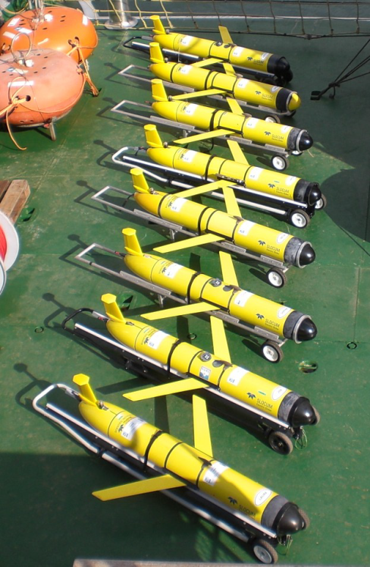
Introduction
Gliders can monitor vast areas of the ocean
Due to their limited purchase and operating costs, gliders are well suited to implement a networked concept of ocean observations.
Implementing networks of gliders requires support systems to automatically handle piloting issues
Presently, gliders cannot provide real time alerts about field anomalies. A reactive component needs to be included in the platform for exploration / surveillance tasks

Slide 4
Networking and Optimum Mission Planning Methodology (Alvarez & Mourre, J. Atmos. Ocean. Tech., 2012)
The advent of ocean observatories creates a demand for allocating and complementing observational resources, to maximize the information content of the collected data.
Compatibility between the observing capabilities of the different nodes must be found by designing optimum sampling strategies.
These sampling strategies could adapt to the evolution of the environment, considering the motion capabilities of some of the sensor nodes of the network.
Adaptation of the network topology requires a continuous feedback of information between the nodes and a data processing unit.
NUMERICAL MODEL
PROCESSING UNIT
Covariance from models
Velocity field from models
MISSION PLANNER UNIT
1. Reproduce glider navigation with surface points
2. Evaluate cost function + path planning
3. Optimization
PATTERN SEARCH
GENETIC ALG.
SIMULATED AN.
MISSION
Winner
Notes:
‘Winner’ has lowest value of cost function, given ten minutes each to compute an optimum sampling strategy. REP10 gliders remained 30 minutes at surface to allow process (and send new mission in real time). In practice, pattern search provided best performance in short time periods (10 minutes).

Slide 5
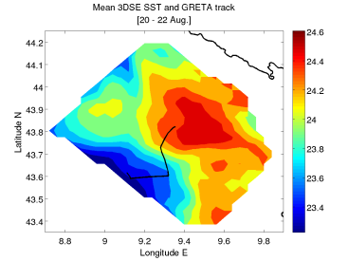
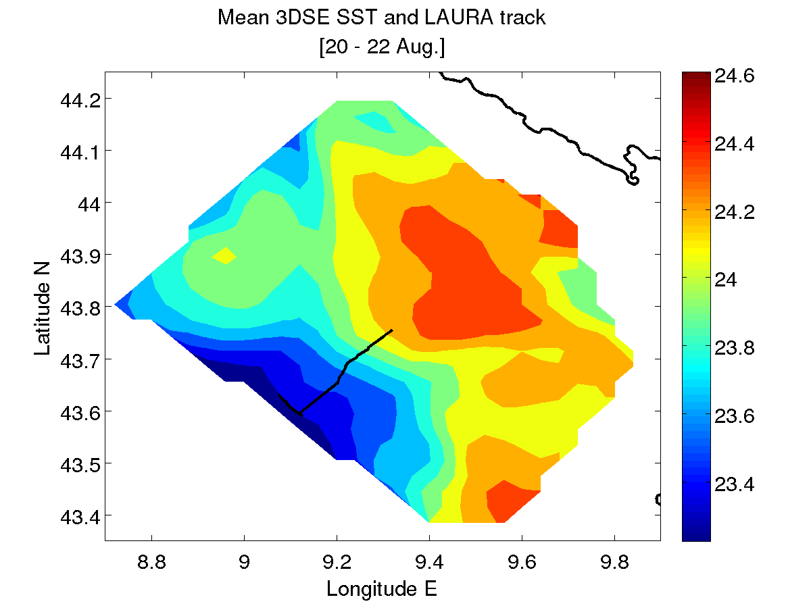
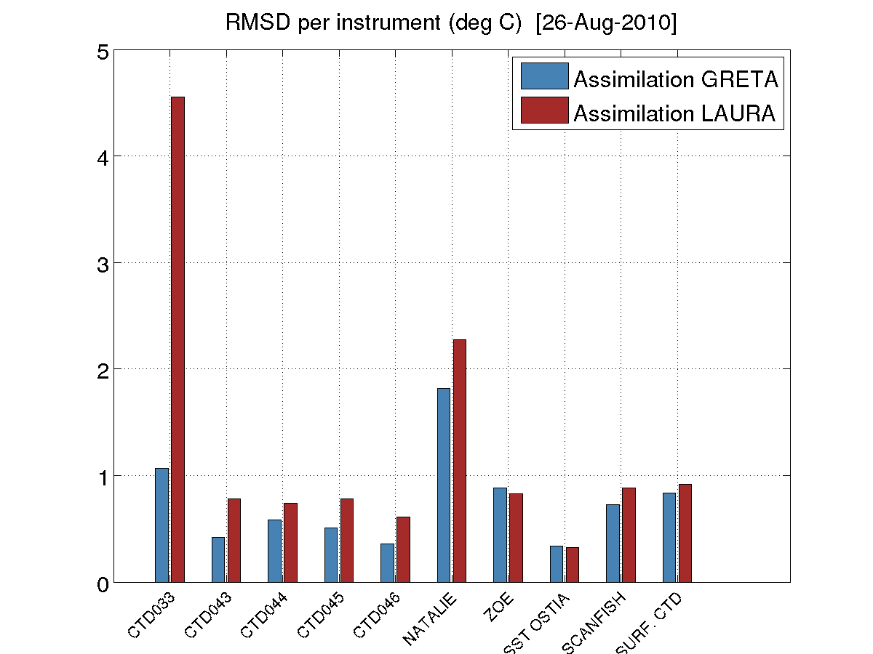
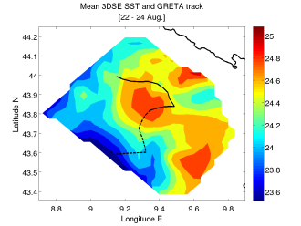
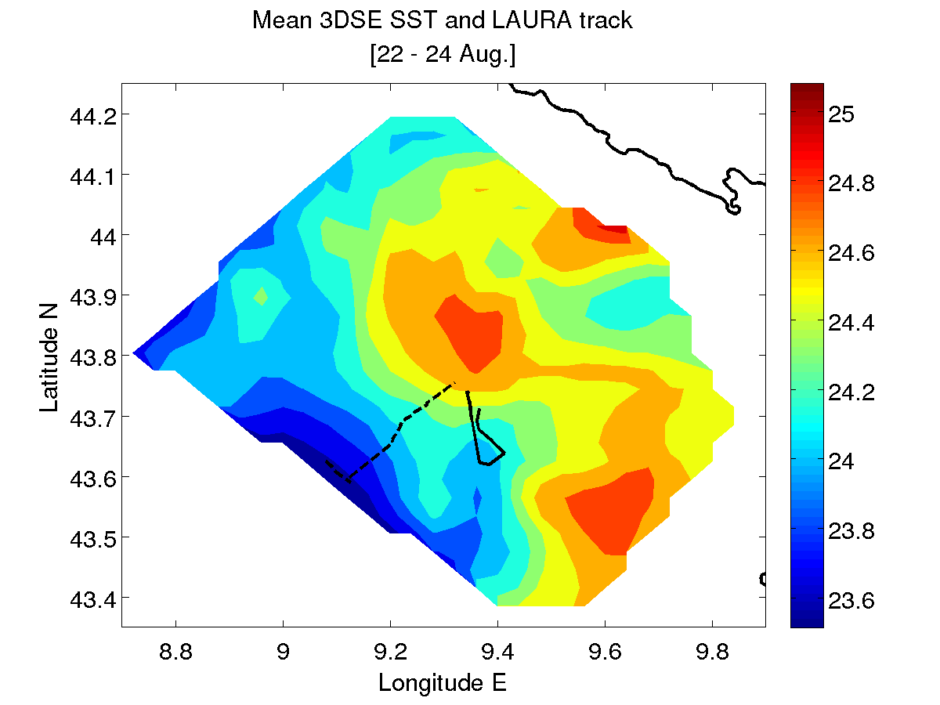
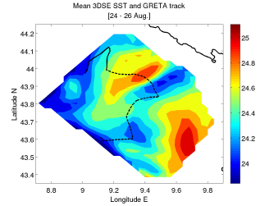
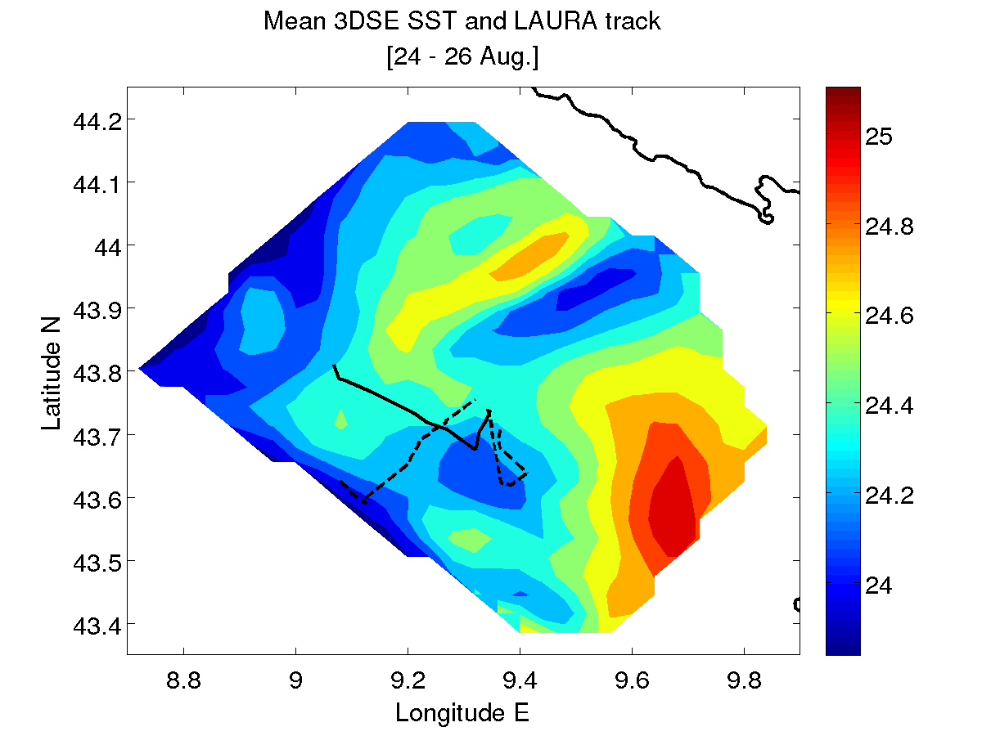
Networking and optimum mission planning: Gliders Mourre & Alvarez, Deep Sea Res., 2012
20 Aug
22 Aug
24 Aug
26 Aug
3DSE forecast
3DSE forecast
Notes:
One glider (L) following optimal sampling trajectory, and one glider (R) following arbitrary trajectory.
Repeated for three assimilation cycles
Colour is model SST
GRETA is optimal sampling, Laura is arbitrary (GRETA outperforming Laura)
Note optimization included current field

Slide 6
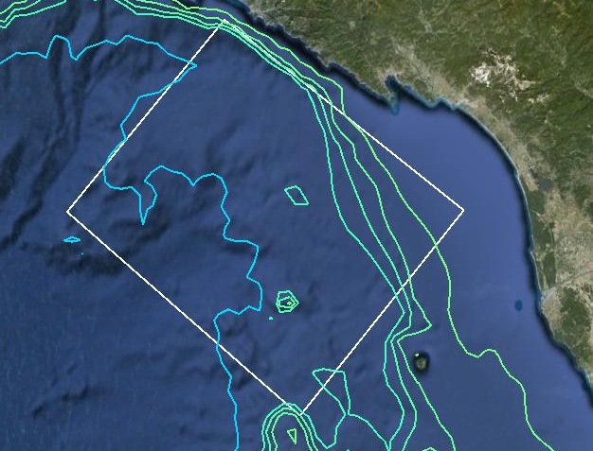
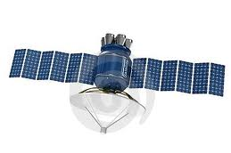
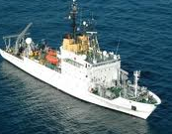
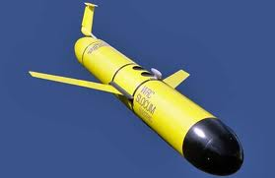

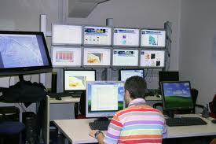

The performance of a heterogeneous network constituted by a glider and a drifting profiling float to characterize a “denied area” was investigated in the framework of the MED-REP13 sea-trial

Slide 7
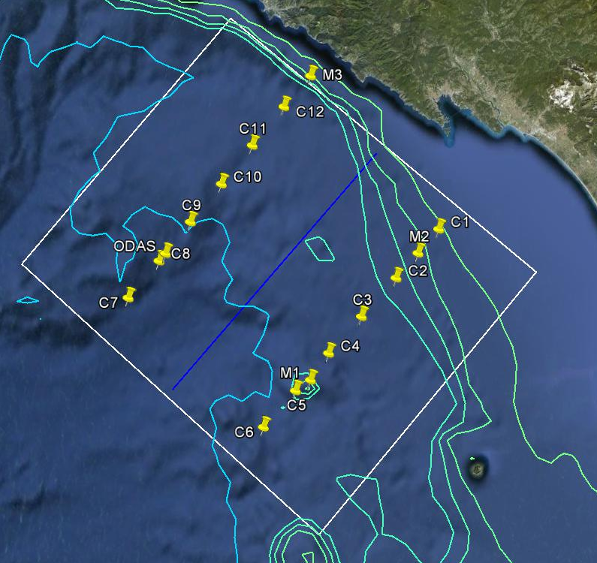
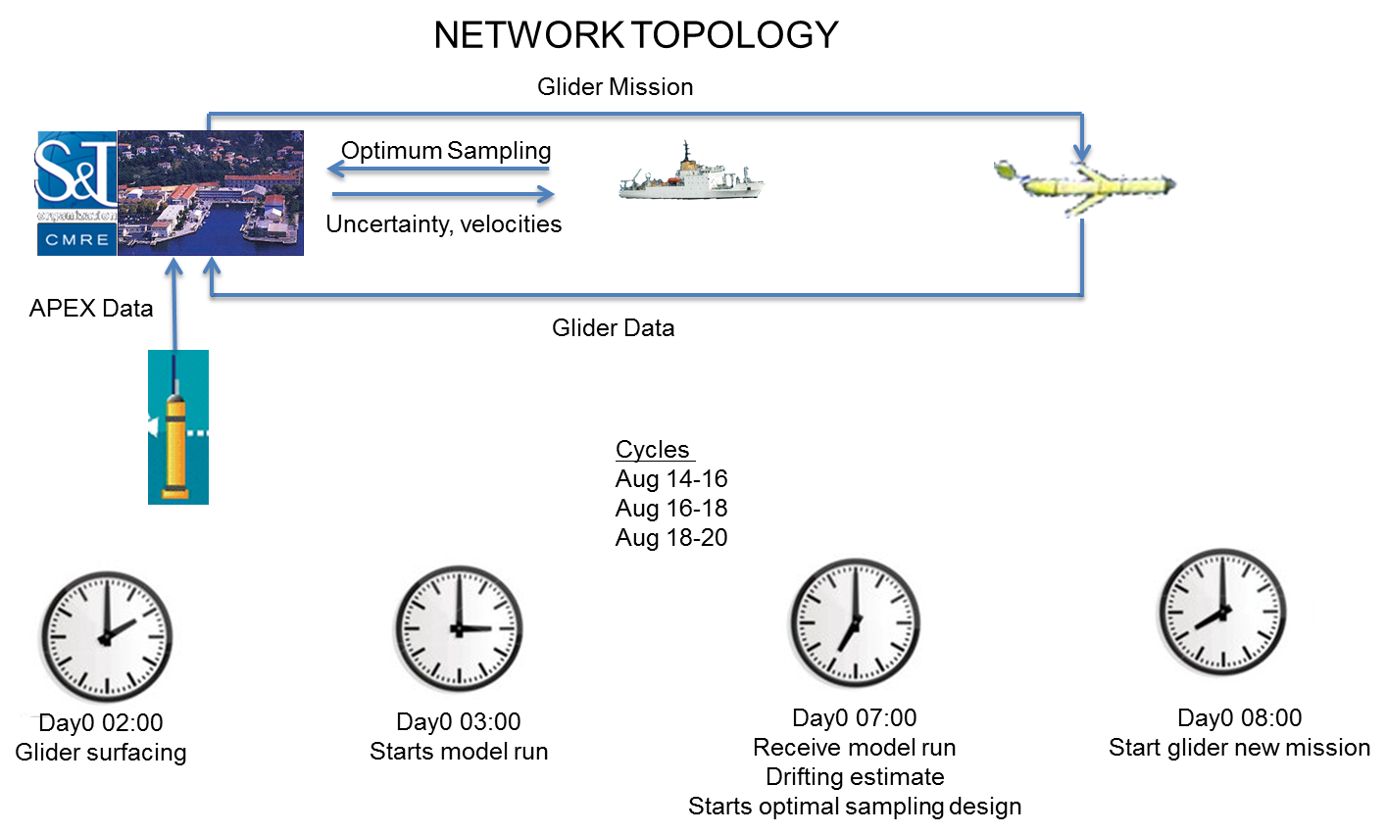
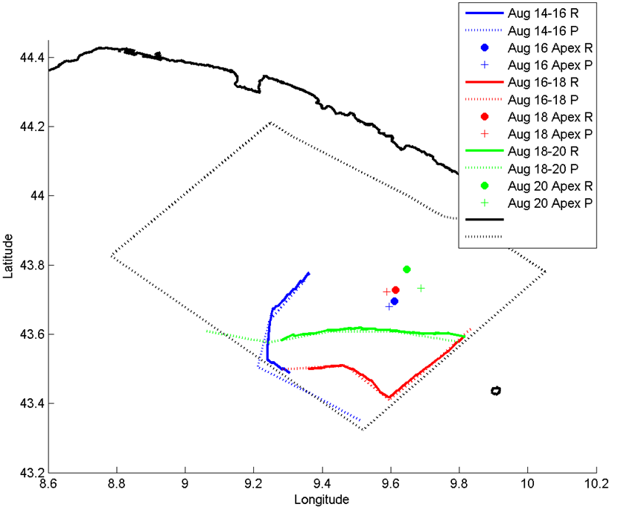
Networking and optimum mission planning: Gliders in heterogeneous networks
From 14 to 18 August 2013, the data gathered by a glider and a profiling float was assimilated into the Regional Ocean Modelling System (ROMS).
A 2-day assimilation cycle was considered
Optimum glider trajectories were adaptively generated based on expected float positions within each assimilation cycle.
White Line- Boundary of the denied area
Orange Line- Adaptive glider trajectory
Red Line- Drifting trajectory of APEX buoy
Yellow icons- Location of the ODAS buoy, moorings and CTDs
JADE+APEX
Notes:
Scope: Glider - ARGOS buoy network
Timescale: 2 day collection / assimilation cycle (psuedo-operational)
Top right: CTD validation lines
Bottom right: solid lines are actual paths, dashed are commanded, dots – actual buoy, + predicted buoy
NB: Glider avoids sampling area in which buoy can provide data

Slide 8
Automatic Piloting
An automated control, navigation and supervision system for glider fleets was tested and validated during GROOM-REP-13.
The system is constituted by two modules:
Determines the optimum sampling strategy of the glider network, generates the navigation files encoding the commanded waypoints for all platforms in the flee, transmits waypoints to gliders (via next module).
Performs the real time navigation of glider platforms by providing, in an automatic way, the commands needed when the platform surfaces. It also automatically detects anomalies in the mission execution producing the corresponding alerts.
Notes:
After optimum sampling missions computed (3 gliders network), waypoints send to CNRS, mission scripts send to CMRE, downloaded to gliders.
Automatic supervision from CNRS.
Repeated for 4 days
Solid – actual paths, dotted – commanded
Strong currents encountered in this experiment (not included in optimization because experiment was expected to be done with deep gliders but shallow were actually used)
Note: if you do not have a good current field, better not to use

Slide 9


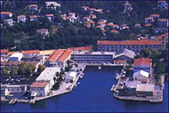
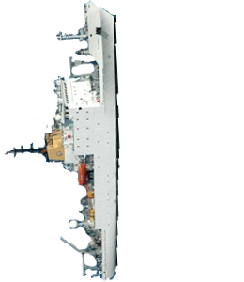
Automatic Piloting
Commanded
to go to recovery point
NETWORK TOPOLOGY
Glider Mission
Optimum
Sampling
Glider Mission
Optimum Sampling
Uncertainty
Commanded
to go to recovery point
Notes:
After optimum sampling missions computed (3 gliders network), waypoints send to CNRS, mission scripts send to CMRE, downloaded to gliders.
Automatic supervision from CNRS.
Repeated for 4 days
Solid – actual paths, dotted – commanded
Strong currents encountered in this experiment (not included in optimization because experiment was expected to be done with deep gliders but shallow were actually used)
Note: if you do not have a good current field, better not to use

Slide 10
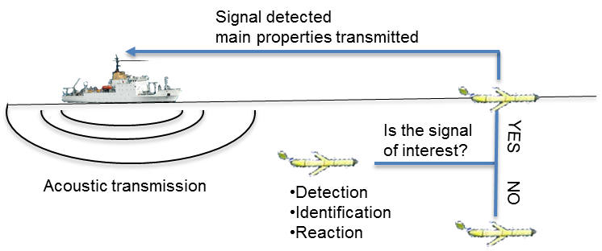
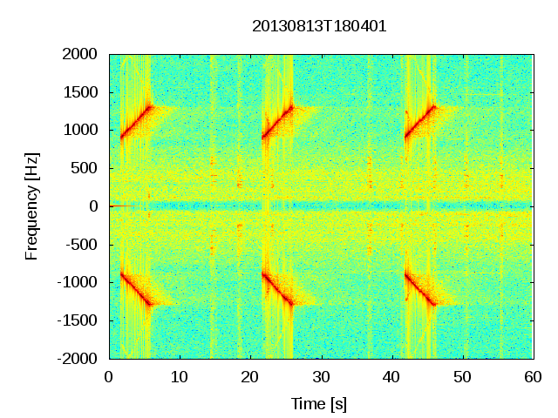
Increasing autonomy in gliders (Jiang and Osler, CMRE-PR-2014-012 )
#D,secTime,dbSnr,dbMfPeakLevel,dbRxLevel,numPoints
0,1.989,36.0986,152.162,-10.7331,75
1,21.986,37.0557,153.341,-10.2306,68
2,41.982,36.9155,152.369,-10.6938,58
Acoustic source:
Power 195 dB,
depth 60 m
Glider:
Missions of 20 minutes
dives up to 30 m depth
Range:
1.5, 2.5, 3.5 and 5 Km
LFM 900-1300 Hz, 4s long
Notes:
Glider surfaced at all four ranges tested with correct identification of signal (command surfacing), interface to flight controller and telemetry system

Slide 11
COST STSM Inbound
Visitor | Supervisor | Dates | Subject
Chris Hughes | A. Alvarez | 25 Mar-7 Apr 2012 | Optimum sampling
Marc Torner | A. Alvarez | 5 Aug-20 Aug 2013 | GROOM-REP13
Tania Morales | D. Cecchi B. Garau A. Alvarez | 30 Sep-11 Oct 2013 | Data processing
Pierre Cauchy | J. Yong-Min A. Alvarez | 24 Nov- 30 Nov 2013 | GROOM-REP13
Gareth Lee | R. Onken | 6-26 Jun 2014 | REP14-MED

Slide 12
COST STSM Outbound
Visitor | Supervisor | Dates | Subject
Daniele Cecchi | Thiery Caval (IFREMER) | Dec 2012 | File format conventions
Bartolome Garau | Lucas Merckelbach (HZG) | Jan 2013 | CTD processing (thermal lag)

