Slide 1
Data-management activity
Within Groom and with COST support, the glider data-management group is building a system for gliders to :
provide a single access point to European gliders data & metadata
improve data coherency and documentation in term of format, quality, processing chain
build a capability to serve both operational (within a few hours) and research (best quality after calibration and validation) users
This system is developed in coherency
with other glider systems developments (IMOS in Australia, IOOS in USA)
with other JCOMM networks (Argo, OceanSITES, …)
with IODE standards (SeaDataNet/EU, QUARTOD/USA, GOSUD, GTSPP…).

Slide 2
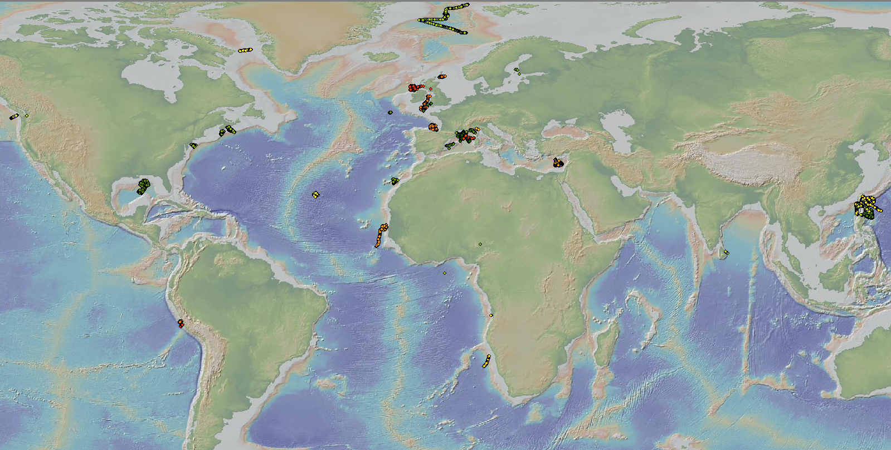
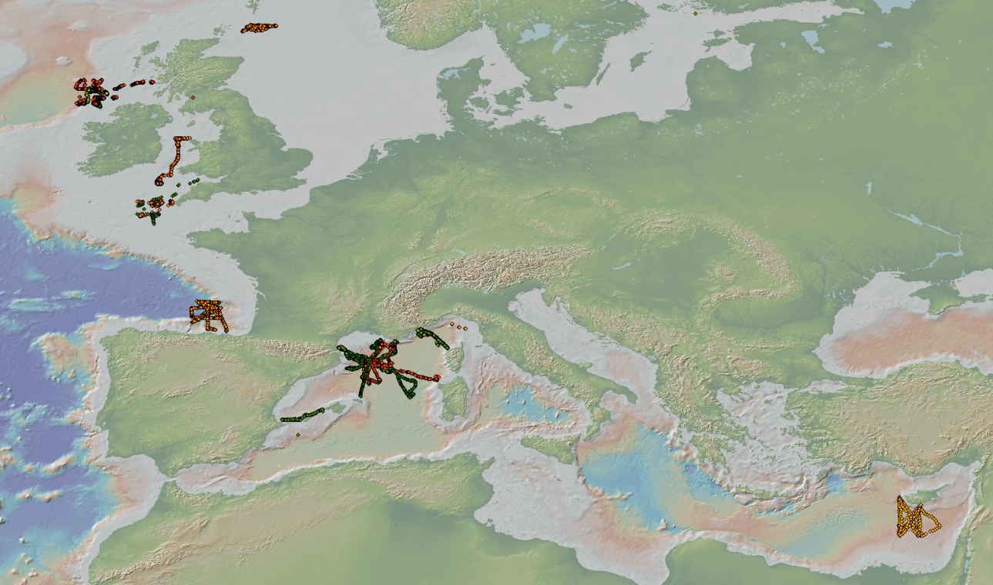
Data management activity
In 2013, more than 55 800 vertical profiles from 41 gliders were distributed to operational models

Slide 3
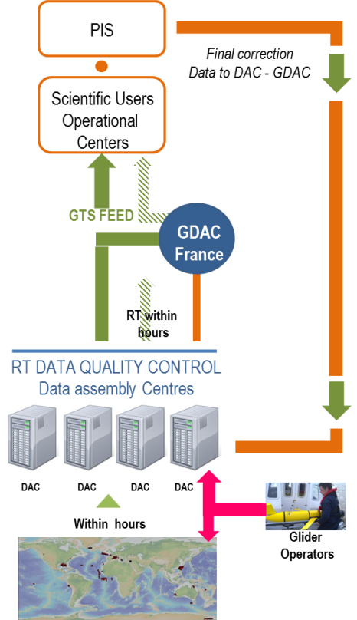
Data flow
The real-time and delayed mode data flow system was agreed in October 2012 in Paris

Slide 4
Data flow
The list of DAC/Glider Operators/PIs is summarized in the following table
Country | DAC | Glider Operator | Delayed Mode PI
UK | BODC | UEA , SAMS, NOC CEFAS, BAS | UEA , SAMS, NOC, CEFAS, BAS
France | CORIOLIS | LOCEAN, LOV, MIO, LEGOS, LPO, DT-INSU | LOCEAN, LOV,MIO, LEGOS, LPO
Italy | CMRE | CMRE | CMRE
 | OGS/CORIOLIS | OGS | OGS
Germany | HZG | HZG | HZG
 | CORIOLIS | GEOMAR,AWI | GEOMAR, AWI
SPAIN | CORIOLIS | PLOCAN | PLOCAN
 | SOCIB | SOCIB, CSIC | SOCIB, CSIC
Norway | UiB/IMR | UiB | UiB
Cyprus | OC-UCY | OC-UCY | OC-UCY
Greece | CORIOLIS | HCMR | To Be Defined
Finland | To Be Defined | To Be Defined | To Be Defined
Ireland | BODC? | MI | MI
Poland | CORIOLIS | IOPAS | IOPAS

Slide 5
Data format
The Glider data and metadata NetCDF format is now defined and described in the user‘s manual V1.1 This is a common data exchange format
http://www.coriolis.eu.org/Observing-the-ocean/Observing-system-networks/EGO-gliders/EGO-Glider-data-management/A-NetCDF-implementation-for-glider-observations
The matlab real-time processing chain to provide quality controlled metadata, time-series and vertical profiles is available for Slocum and Seaglider platforms

Slide 6
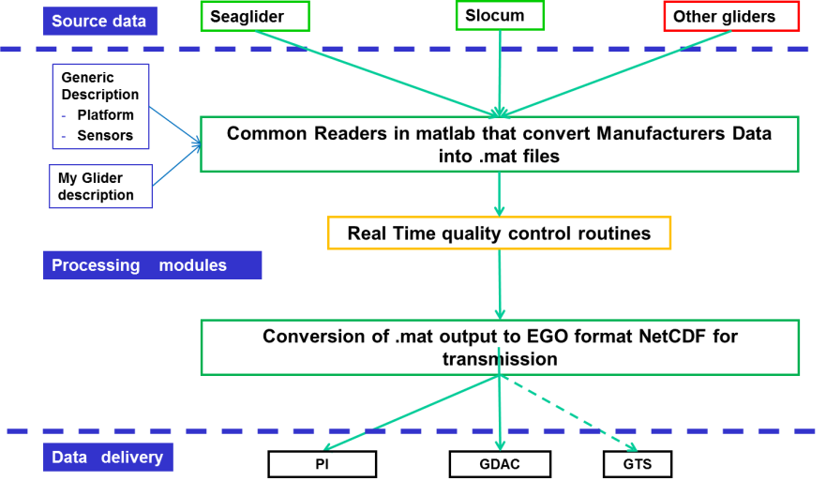
Data processing for a glider deployment

Slide 7
Data processing for a glider deployment
The deployment configuration and metadata are stored in a simple JSON file : an ASCII list of items, human and computer readable
Examples: ftp://ftp.ifremer.fr/ifremer/glider/v2

Slide 8
Data processing
The collaborative development of the matlab data processing is shared between BODC, CMRE and Ifremer
Version 1 delivered to GROOM in Spring 2014 on the SVN repository https://forge.ifremer.fr/svn/oo-ego-gliders/trunk
Issues are tracked on Mantis https://forge.ifremer.fr/mantis
The procedure to distribute Glider data on GTS in TESAC format is documented
BODC and Coriolis distribute glider data on GTS
BODC is working with WMO partners on a BUFR template for gliders and Argo floats.
Coriolis distributes glider data to MyOcean EU project

Slide 9
Deployment recommendations
For Slocum recommendation to keep the history of the mission changes was proposed by GEOMAR and agreed by partners.
The list of variables(sbdlist) that needs to be transmitted and their sampling periods. The sbdlist also advises on some technical parameters to be sent back to shore (navigation, battery info…). For the science sensor (TBDLIST) the recommendation for CTD recommend at list one measurement every 60s
Geomar also prepared recommendations on pressure correction on Slocum when the two pressure sensors (one for navigation and one for the CTD ) disagree for identified reason detailed in the papers.

Slide 10
Quality control
Recommendation for automatic real time QC for Temperature/Salinity/Oxygen/Chlorophyll have been discussed and the documentation will be available before summer 2014. This work is shared with EU Argo E-AIMS project.
For Delayed mode, QC working group have been set up per parameters. The activity started and will have to continue after the end of the GROOM project as the issues are complex.

Slide 11
Current derived from Glider navigation
The calculation of current derived from glider navigation is described in the document : « Recommendations for processing depth-averaged currents estimated from underwater gliders”, Lucas Merckelbach and Bartolome Garau
It is not yet implemented in the GROOM matlab code

Slide 12
Conclusion
The glider data and metadata user’s manual is available
http://www.coriolis.eu.org/Observing-the-ocean/Observing-system-networks/EGO-gliders/EGO-Glider-data-management/A-NetCDF-implementation-for-glider-observations
The matlab data processing is ready for use
Example : http://www.coriolis.eu.org/All-news/News/SG558-glider-deployed-in-Norwegian-sea-a-first-implementation-of-EGO-data-processing
The real-time QC code is developed but still tested
The delayed mode QC for oxygen and chlorophyll should be very close to Argo floats delayed mode
Argo delayed mode QC for oxygen is available and applicable to gliders
Delayed mode QC for chlorophyll : the first step of chlorophyll A concentration processing is now documented for Argo floats

