Slide 1



Ocean glider data management: Argo concepts, GROOM, OGC sensor observation services
6th EGO Meeting – 16th June 2014
Justin Buck (juck@bodc.ac.uk)
+ many collaborators
British Oceanographic Data Centre

Slide 2


The numerous collaborators
Sylvie Pouliquen
Thierry Carval
Jean-Philippe Rannou
Marine Autonomous
Robotic Systems (MARS) facility
Task 3.2 - Data management
Cost action ES0904
Data STSM partners
Mark Hebden
Lise Quesnel
Adam Leadbetter

Slide 3
Outline
Introduction
GROOM data flow
Common data tools
Sensor observation services

Slide 4
Introduction

Slide 5
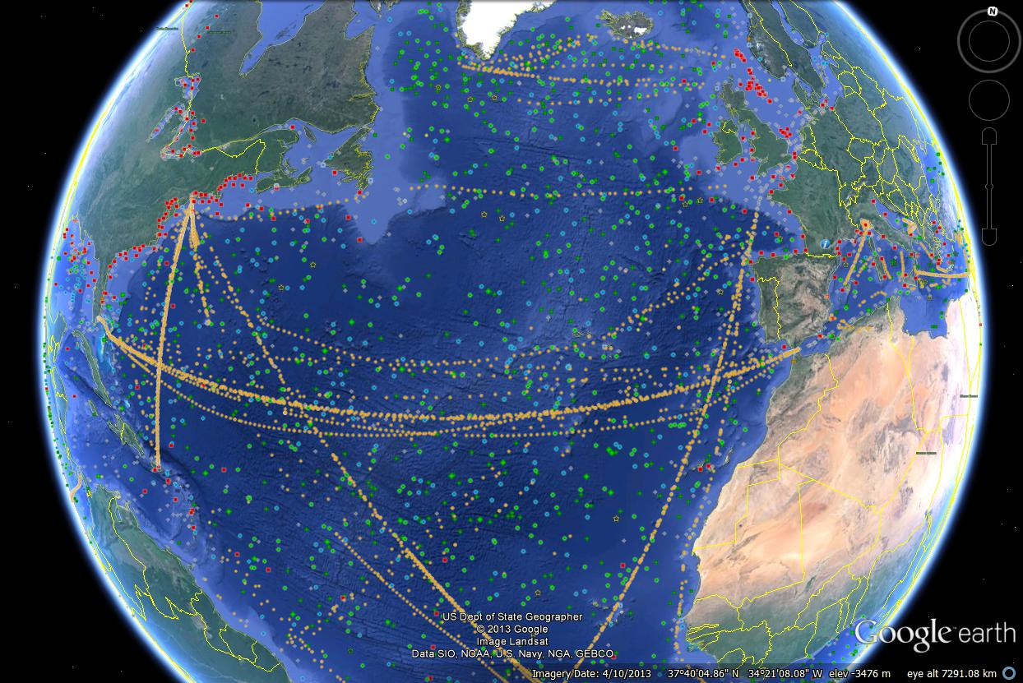
GOOS status (JCOMMOPS)

Slide 6
User expectations
Data easily accessible from a unique point/portal
Data coherent in terms of:
Data format
Data Quality
Processing chain (clearly documented)
Additional requirements for Monitoring and forecasting users:
Data are available in near real time (within 24 hours)
Data are available in delayed mode after calibration and /or validation (typically within 12 months)

Slide 7
Stakeholder expectations
Opportunity to use more observations than they could afford alone
Operate jointly part of the network
Benefit from the other partners' experience from design to implementation to data management and user uptake
A key phrase for funding bodies:
Acquire once, use multiple times

Slide 8
However ...
Broadly speaking, two distinct types of deployment:
‘Process’ type studies – short duration, spatially restricted, typically associated with a cruise. Designed to answer a specific question and can have data restrictions.
‘Sustained observation’ studies – longer duration, regional scale missions. Typically repeated sections. Of interest to the ocean modelling and forecasting community.
So there is potential for conflict between ‘project’ interests and ‘operational’ interests

Slide 9
Gliders/GROOM/EGO

Slide 10
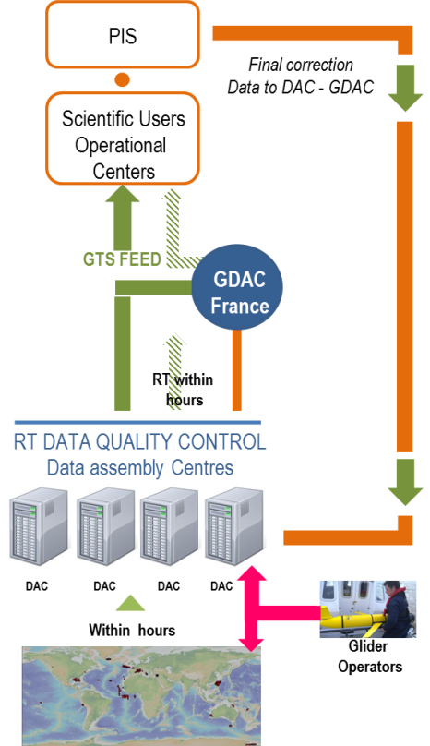
GROOM Task 3.2 Data system goals

Slide 11
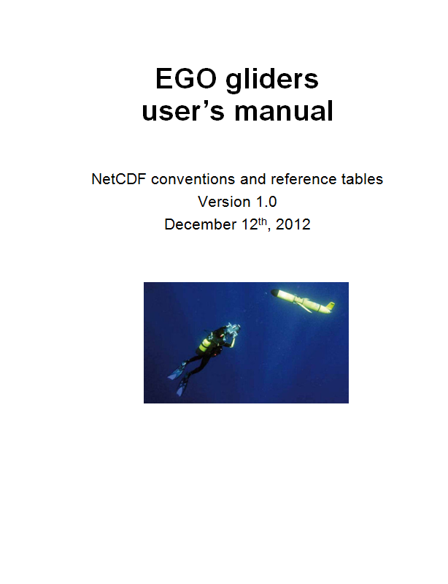
A common data exchange format
EGO glider data format established by the GROOM community (October 2012):
Climate and Forecast (CF) and SeaDataNet compliant NetCDF.
Interoperable with data standards being developed internationally (e.g. IMOS in Australia and IOOS in the U.S).
Standard quality control protocols for both near real-time and ‘delayed-mode’ glider datasets (utilising Argo).
Ensures that glider data, metadata and technical information are stored and distributed in a consistent manner.

Slide 12
Common data tools

Slide 13
BODC workflow
Automated (Provider)
upload
Data Provider
Unauthorised user
External Database
Authorised user
Source data
Delayed mode meta/data
Source meta
Discovery
Checkout
Automated (BODC) download
Prepare request
Register Arrival
Error Handling & Reporting
Authorise
Archive
Authenticate
Convert to standards [meta/data]
Data Scientist
QC/Calibration
Automated download/upload
Merge as relevant
Manual Processing
Store as relevant
Database meta
File System meta/data
Database data

Slide 14
BODC workflow & common tools
Automated (Provider)
upload
Data Provider
Unauthorised user
External Database
Authorised user
Data
collection and secure
archive
Source data
Delayed mode meta/data
Source meta
Discovery
Data
delivery
Checkout
Automated (BODC) download
Prepare request
Register Arrival
Error Handling & Reporting
Authorise
Archive
Reformatting & processing
(EGO code)
Authenticate
Convert to standards [meta/data]
Data Scientist
QC/Calibration
Automated download/upload
Merge as relevant
Manual Processing
Store as relevant
Internal
storage
Database meta
File System meta/data
Database data
Notes:
Red boxes are BODC internal systems or tailored to the needs of individual stakeholders.
Green box is common section of workflow.

Slide 15
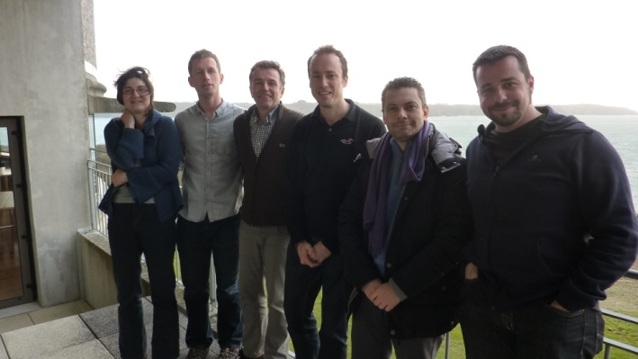
STSM to develop common tools
Brest, December 2012
Goal to develop first version of common tools
Tomeu Garau, Daniele Cecchi (NURC)
Thierry Carval, Jean-Philippe Rannou (Ifremer)
Justin Buck, Mark Hebden, Lise Quesnel (BODC)

Slide 16
Common tools requirements
Modular [for easy modifications and maintenance]
Consistent input/output interfaces between modules
Simple!
Flexible enough to handle varying use cases
Robust and handles any error with known rollback points
Reports every failure
Similar tasks such as reading from the database are done using similar approaches

Slide 17
Common tools workflow
Source data
Seaglider
Slocum
Other gliders
Collection of source data readers, multiple readers per platform type. Data from single transmission converted to a .mat
Conversion of .mat output to EGO format NetCDF for transmission
Single transmission quality control routines
Processing
modules
Merge single transmission files to produce EGO NetCDF containing trajectory for deployment
Time series quality control routines
Corrections/calibration routines
Data
delivery
Originator
GDAC
GTS

Slide 18
JSON files drive a generic system
Raw data files
JSON files
describing
variables to
transfer
JSON files describing
deployment, glider and sensor configurations
JSON files
describing
EGO format
EGO NetCDF writer
Merged EGO NetCDF file
*The flexibility means system is usable in other projects e.g. SMRU animal tags

Slide 19
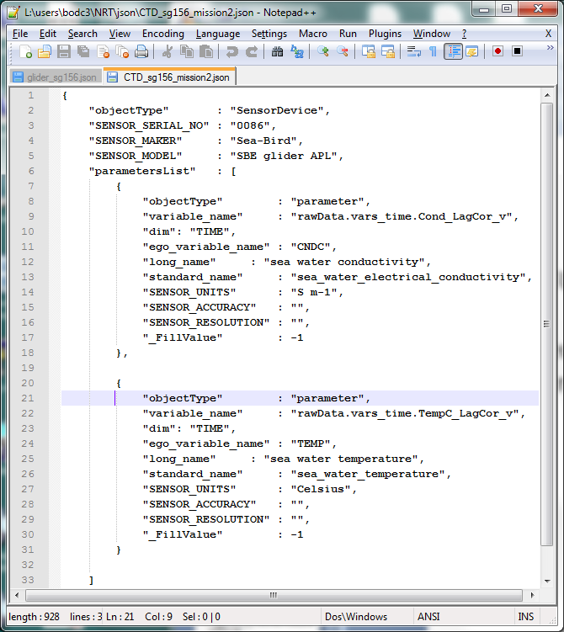
JSON files
EGO NETCDF writer controlled by JSON files.
Example on right describes CTD sensor metadata.

Slide 20
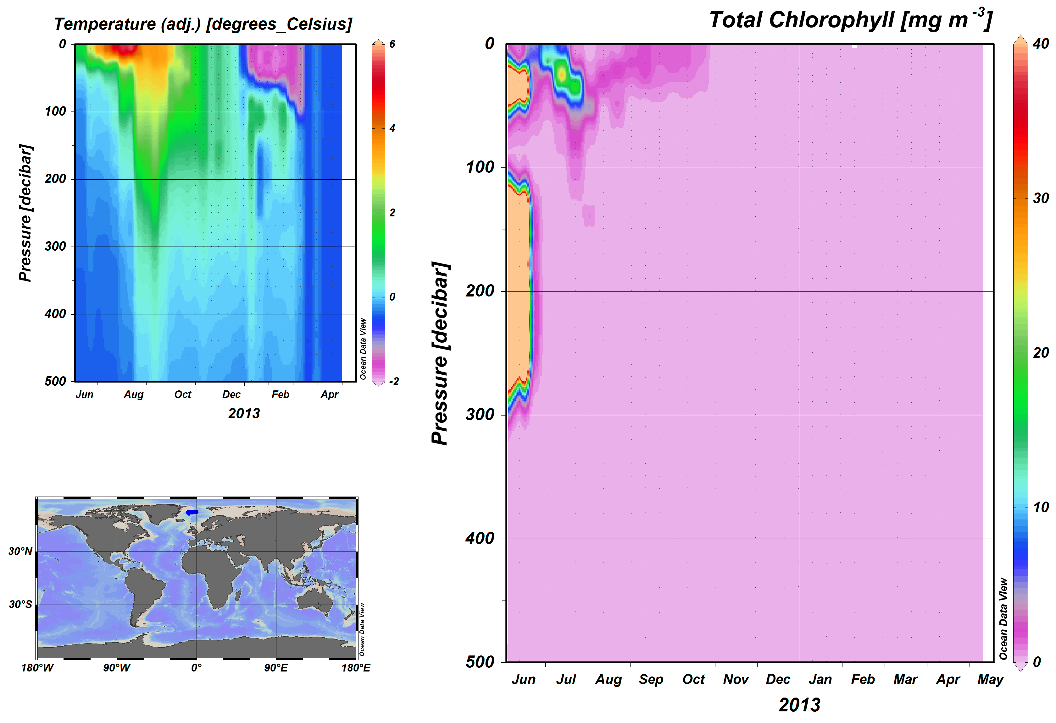
Real time quality control
Test are adaptations of established Argo QC
RTQC configured via JSON files
Presently implemented tests
Valid range (e.g. TEMP, PRES, speed etc)
Regional range
Gradient
Spike
Stationary
Position on land
Density inversion

Slide 21


Sharing of code
Code is available on the Ifremer SVN repository with Mantis used for bug tracking
Pooling of common code from multiple centres
Code has a reciprocal public license
A SeaDataNet login is required
Thierry Carval is administrator and can grant access

Slide 22
Sensor Observation Services

Slide 23
BODC workflow & common tools
Automated (Provider)
upload
Data Provider
Unauthorised user
External Database
Authorised user
Data
collection and secure
archive
Source data
Delayed mode meta/data
Source meta
Discovery
Data
delivery
Checkout
Automated (BODC) download
Prepare request
Register Arrival
Error Handling & Reporting
Authorise
Archive
Reformatting & processing
(EGO code)
Authenticate
Convert to standards [meta/data]
Data Scientist
QC/Calibration
Automated download/upload
Merge as relevant
Manual Processing
Store as relevant
Internal
storage
Database meta
File System meta/data
Database data
Notes:
Red boxes are BODC internal systems or tailored to the needs of individual stakeholders.
Green box is common section of workflow.

Slide 24
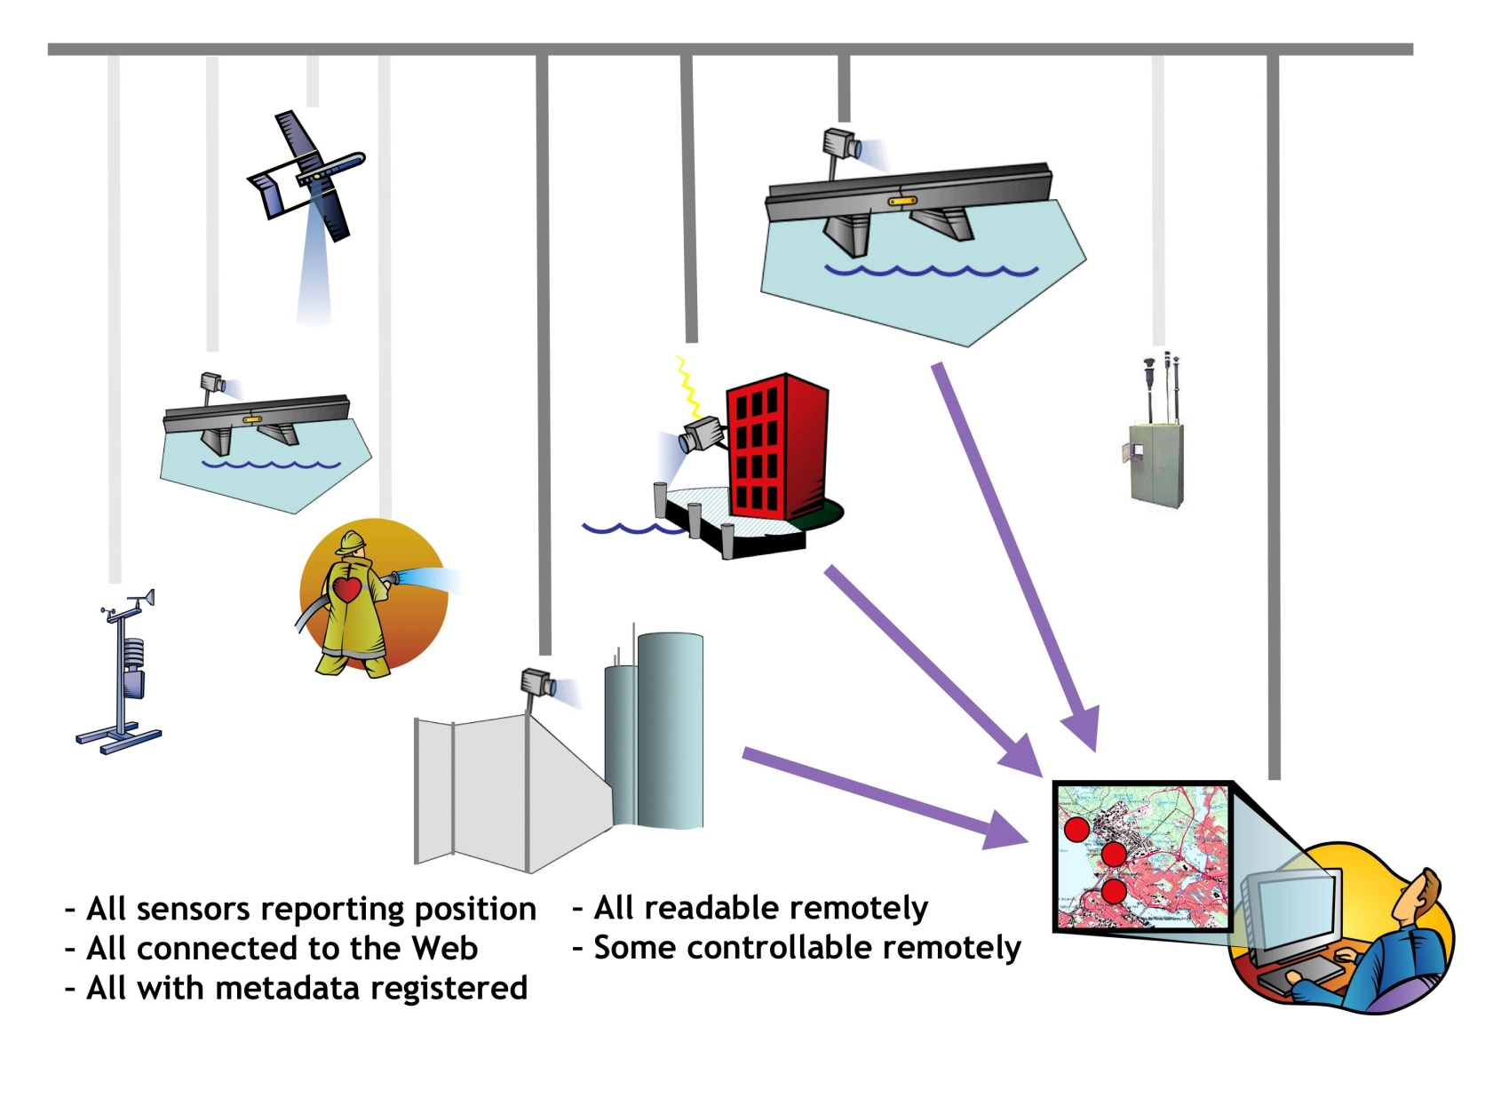
Sensor webs - connecting data
From http://www.sensorsmag.com/networking-communications/wireless-applications/the-big-picture-sensor-webs-disaster-response-demo-1338

Slide 25
OGC, SWE, O&M?
Sensor Web Enablement
OGC – Open Geospatial Consortium
SWE – Sensor Web Enablement initiative
OGC Defined prototyped and tested sensor web components:
Sensor Model Language (SensorML)
Observations & Measurements (O&M)
Sensor Observation Service (SOS)
Sensor Model Language
Observations & Measurements
...

Slide 26
Why SWE?
Standardized web services will exist for accessing sensor information and sensor observations
Sensor systems will be capable of real-time mining of observations to find phenomena of immediate interest
Sensors will be capable of issuing alerts based on observations, as well as be able to respond to alerts issued by other sensors
O&M required for EC INSPIRE directive

Slide 27
OGC Sensor Observation Service (SOS)
The SOS standard is applicable to use cases in which sensor data needs to be managed in an interoperable way.
Defines a Web service interface which allows querying observations, sensor metadata, as well as representations of observed features.
Defines means to register new sensors and to remove existing ones.
Defines operations to insert new sensor observations.

Slide 28
International Harmonisation
Meeting with IOOS and IMOS during December 2013 to harmonise data formats
Adjusted format includes metadata structure changes for OGC SOS compatibility

Slide 29
ncSOS – NetCDF implementation
SOS service run on a repository of NetCDF files via a THREDDS server
C.F1.6 and Attribute Convention for Dataset Discover (ACDD) attributes required
IOOS adapting THREDDS for 3D trajectory data
BODC investigating the addition of access control methods for restricted data

Slide 30
Potential BODC implementation
NRT Source data
Gliders
NRT Ship underway
Others e.g. Animal tags, Argo, sea level, etc ...
Accession of data
Conversion to CF NetCDF with ACDD compliant attributes
Met Office for push to GTS
Single transmission quality control routines
Processing
modules
Storage in repository of files
Application of calibrations
THREDDS server with ncSOS
Methods to interrogate & package data
Data
delivery
NODB (when delayed mode ready as per IDP project)
Originator via SFA
GDAC
web

Slide 31
Summary
First concepts for glider data management based on OceanSites, Argo, etc formed the basis of GROOM activity
Basic common tools available for conversion of glider data to an international exchange format
Todays technology permits more advanced data delivery methods than a decade ago and a prototype SOS services being developed
Several projects contributing ODIP & SenseOCEAN (active), AltantOS (proposed)

Slide 32
Questions?

