Slide 1

The Norwegian Atlantic Current Observatory
- a national facility for gliders
Peter M. Haugan
Geophysical Institute (GFI), University of Bergen, Norway
Kjell Arild Orvik, Idar Hessevik, Erik Magnus Bruvik, GFI,
Karsten Kvalsund, Runde Environmental Centre
Henrik Søiland, Institute of Marine Research
naco.gfi.uib.no
www.gfi.uib.no
www.rundecentre.no/forsking/glidarprosjektet/

Slide 2
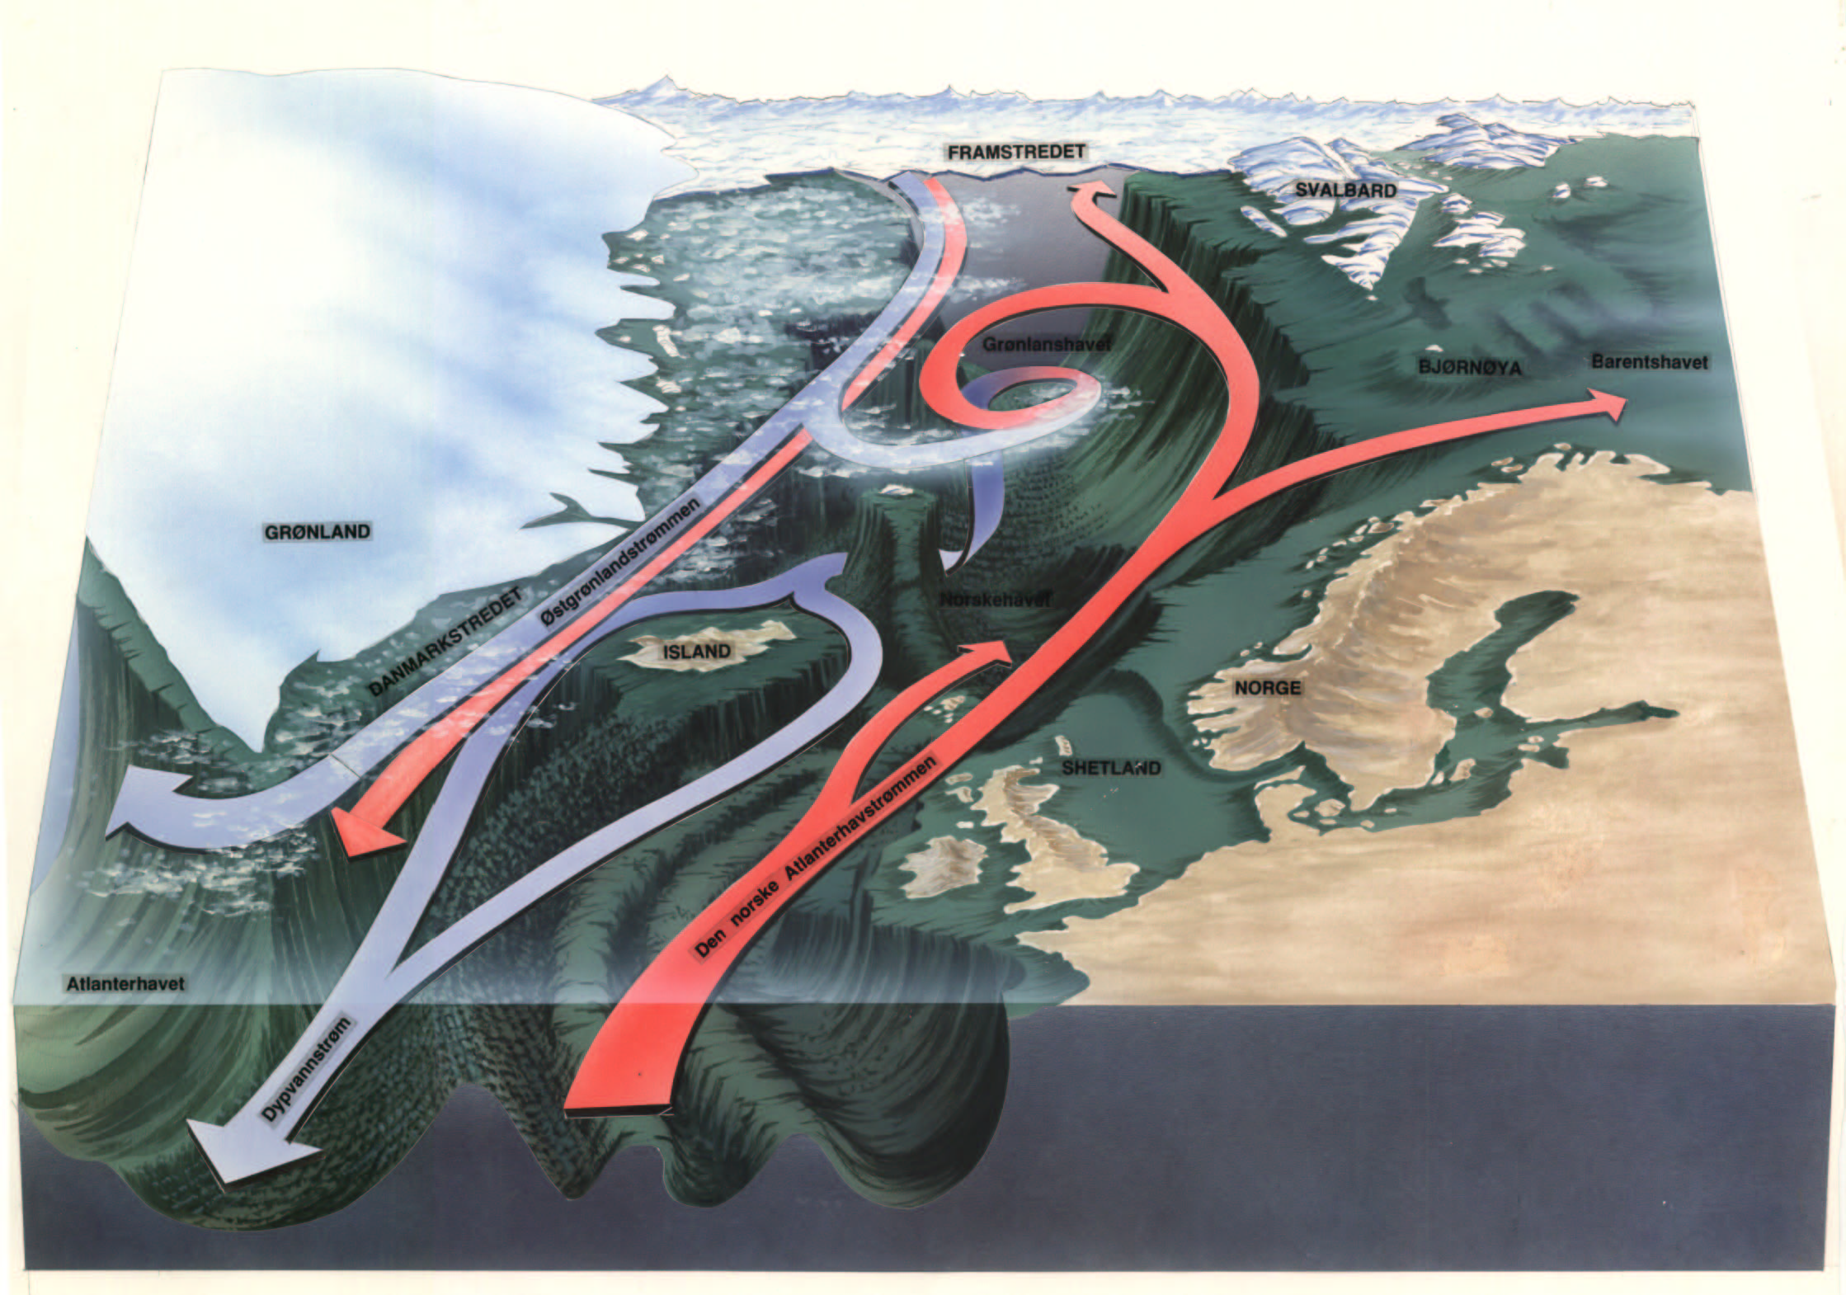
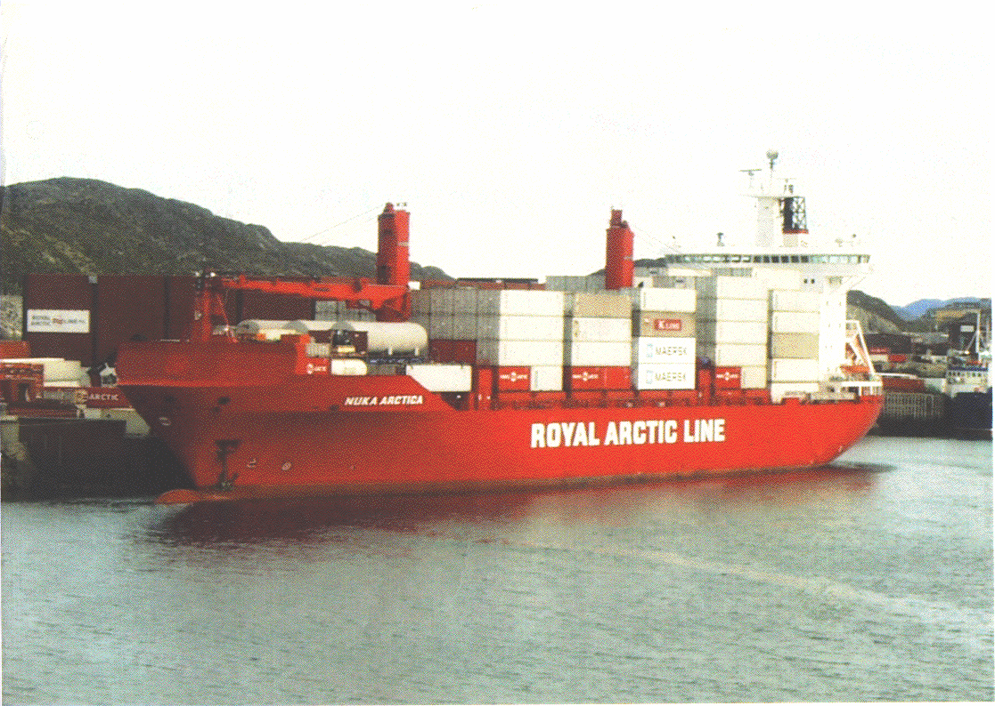
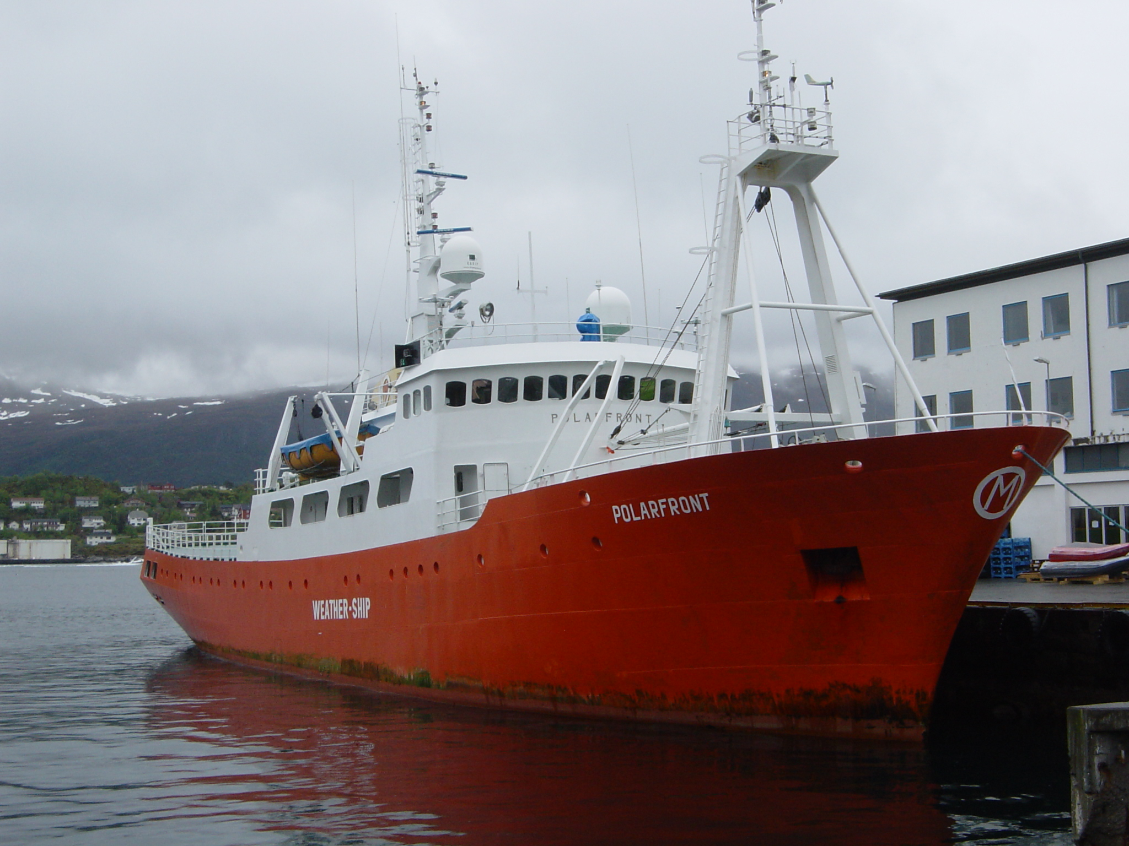
Past North Atlantic/Norwegian Sea sites/sections
Fram Strait
BSX
BSO
M
Greenland Scotland Ridge
“Nuka Arctica”
26.5 Rapid

Slide 3
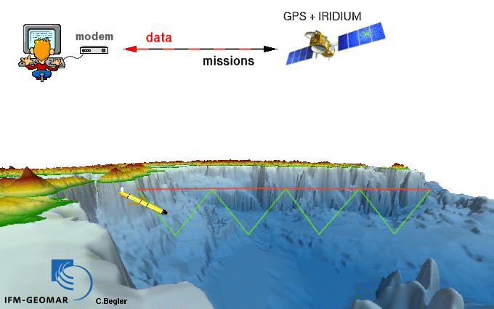
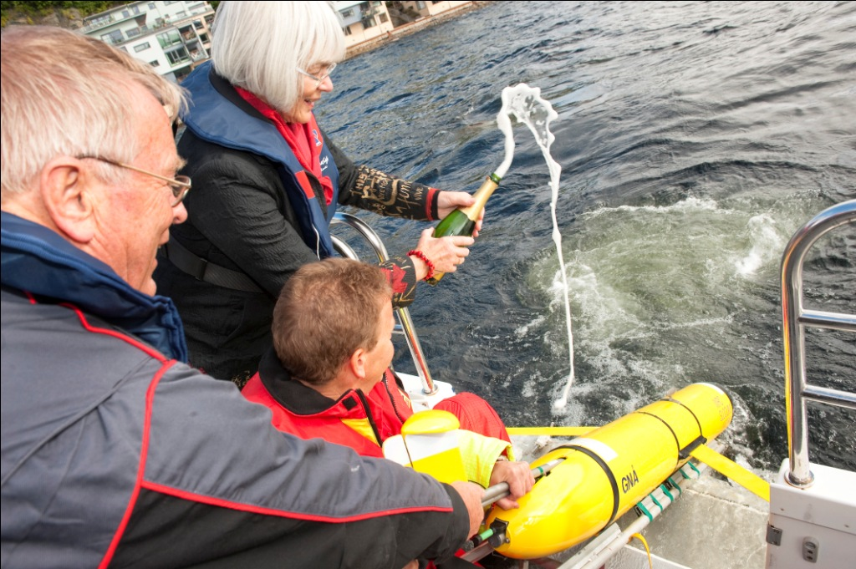
Norwegian Atlantic Current Observatory (NACO)
National glider facility and a fixed point mooring@Svinøy
Operation central
ftp
Data centre
Models, ...
NACO launch, minister Tora Aasland
1000m
20-40 km/day horisontally
Notes:
3 manufacturers in the US. EGO COST

Slide 4
The Norwegian Atlantic Current Observatory
National Norwegian research infrastructure application June 2009 - gliders as vehicles for AW monitoring
Revised application January 2010 including mooring
Project start 2011
Reference mooring at Svinøy section tested fall 2011 and winter 2012
Three Teledyne Webb Slocums owned by IMR refurbished and made available from spring 2012
Six iRobot Seagliders purchased winter/spring 2012
Training courses for our personnel at Webb and iRobot
Acceptance tests in Sognefjord 13-14 March 2012 iRobot and Bjørnefjord 15-16 March 2012 Webb
Start regular use of Seaglider April and Slocum May 2012

Slide 5
Structure of NACO project
Users who provided
letters of support
National infrastructure
- Only one glider facility
The European projects
EGO COST
FP7 GROOM
provide possibilities for
glider port coordination
in Europe
Ramp-up demo period,
but will need user fees for
sustained operations

Slide 6
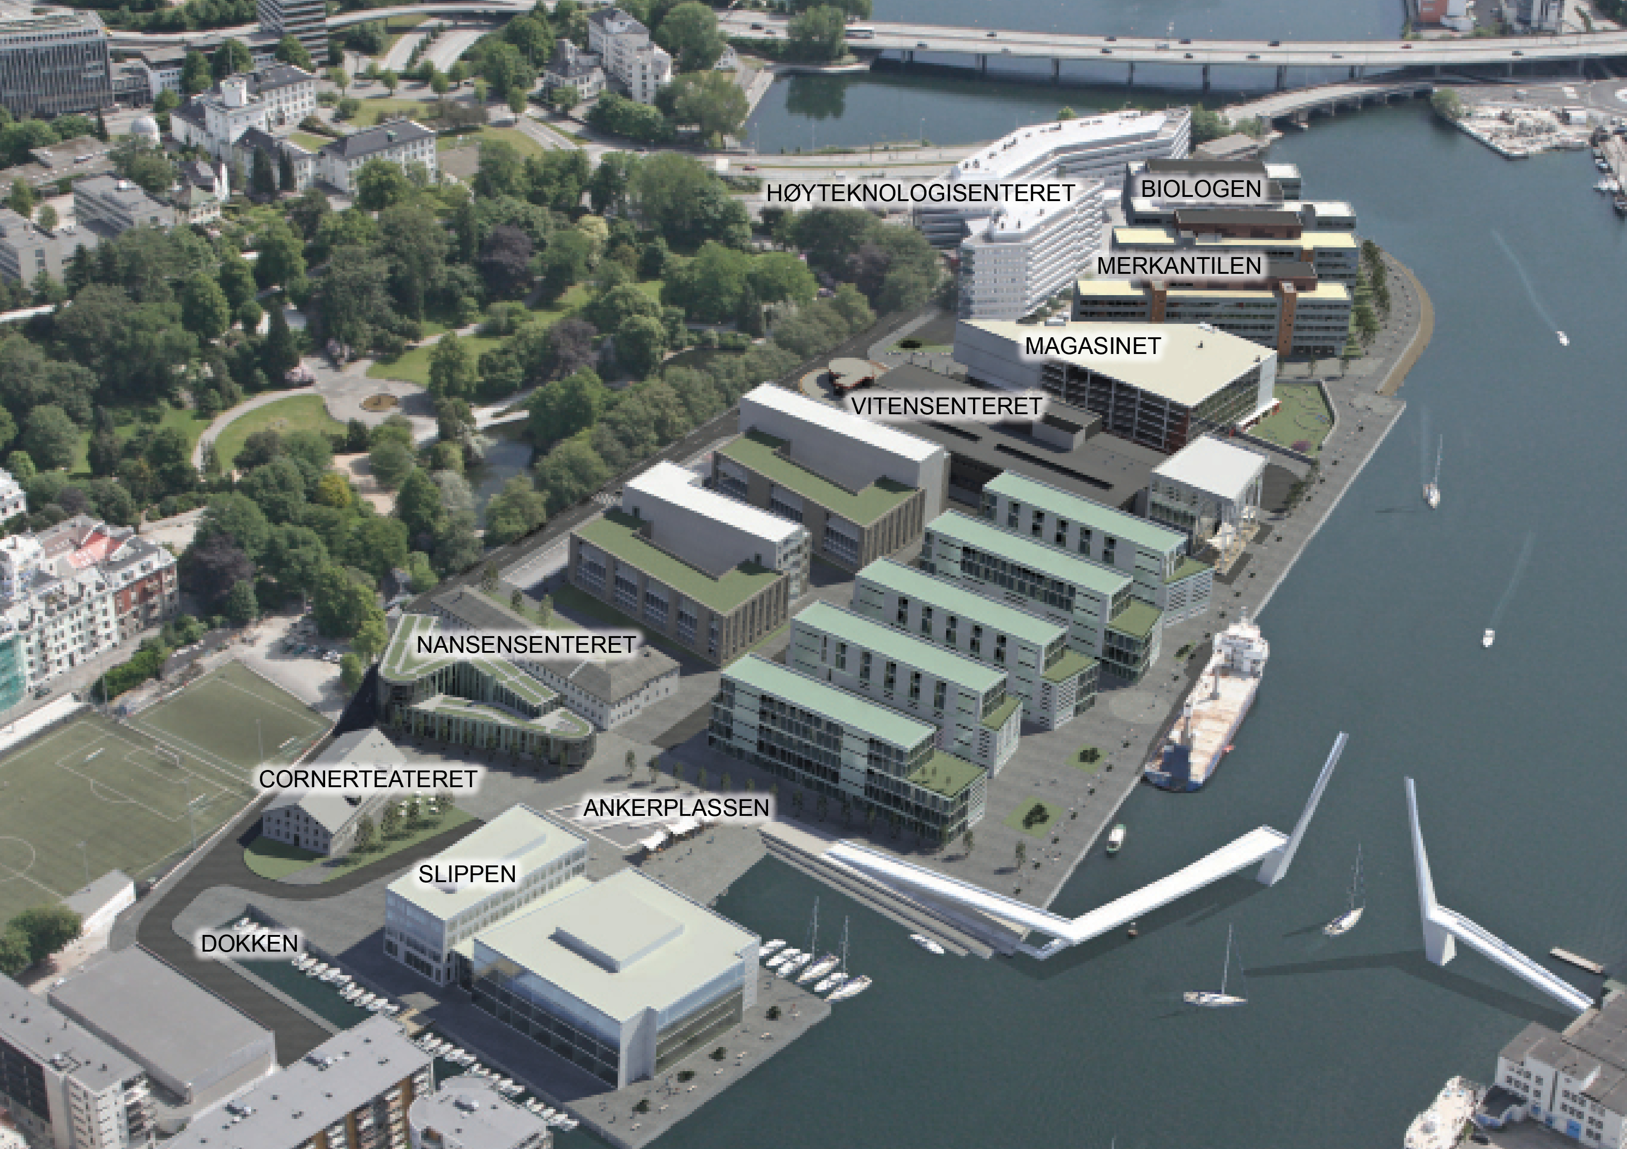
Local facilities in Bergen - Marineholmen
GFI workshop
Glider lab
Geophysical Institute (GFI)

Slide 7
NACO =
1. A real time mooring at Svinøy
2. A national facility for gliders to provide services also outside NACO area. Buildup funded by Research Council, use by projects.
From Orvik and Niiler, 2002
Run by GFI/UiB with IMR and Runde Environmental Centre as partners

Slide 8
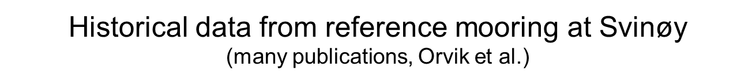
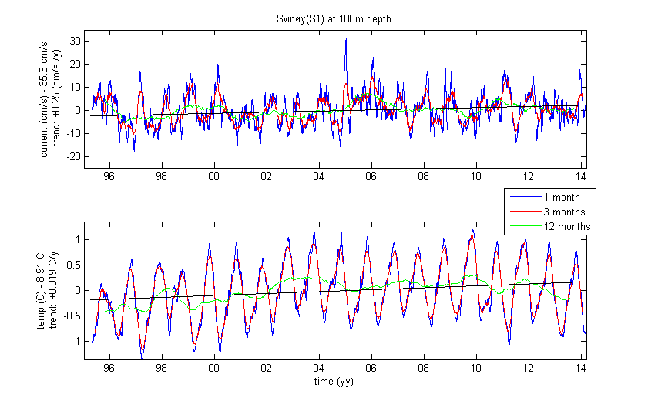
S1-100m Current and temp timeseries 1995-2014

Slide 9
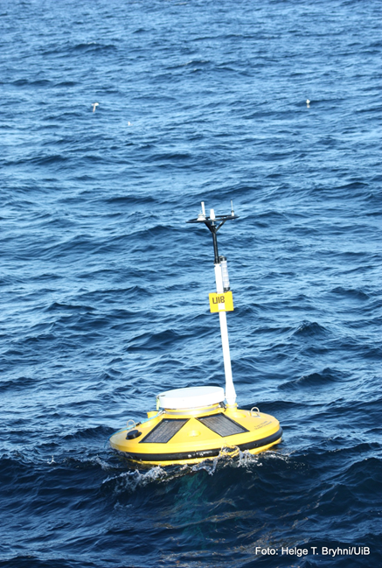
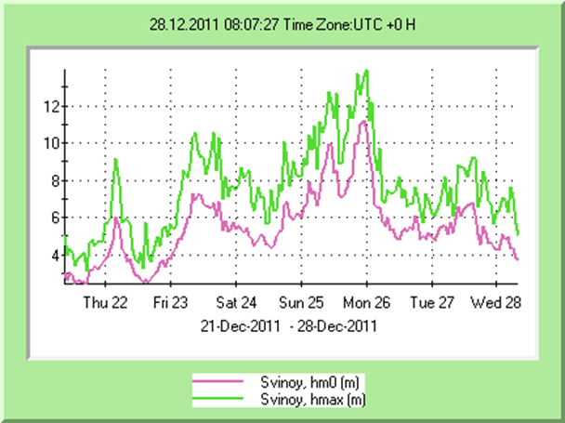
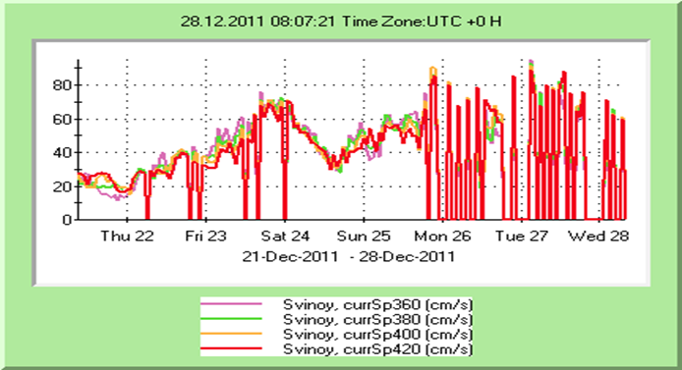
NACO-buoy: Real time monitoring of the Norwegian Atlantic Slope Current
Waves and Current (350-450m) during Dagmar

Slide 10
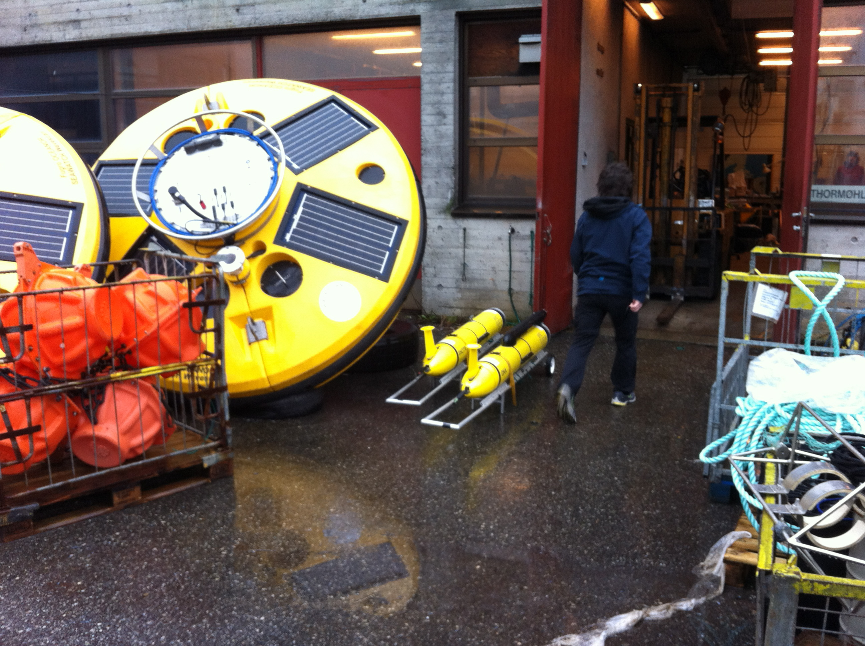
Glider preparation and tests GFI March 2012

Slide 11
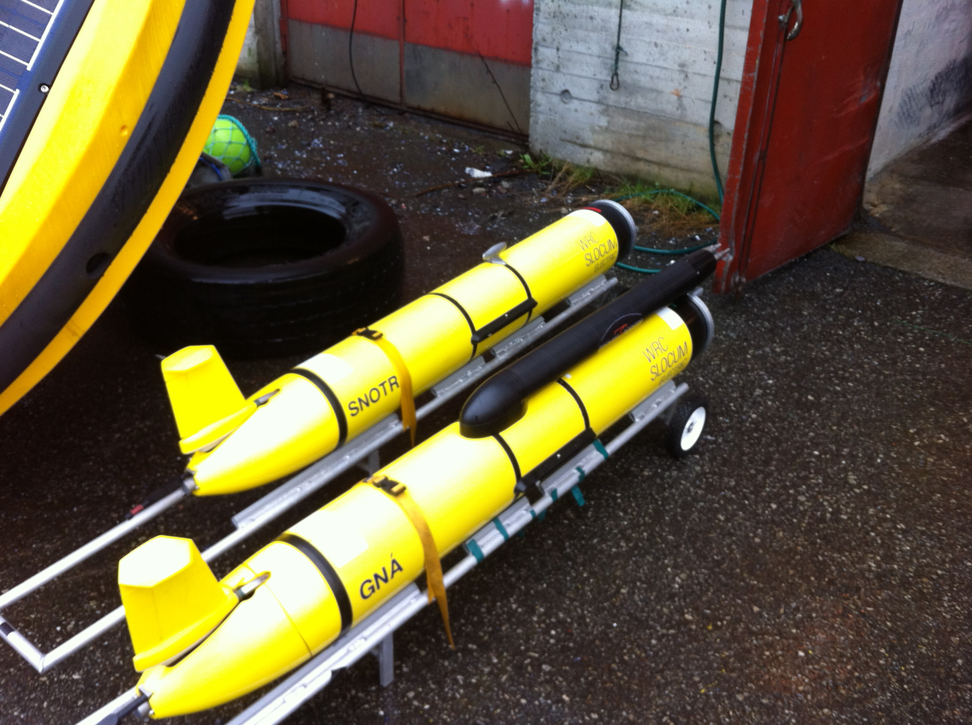
Slocums, one with turbulence sensors

Slide 12
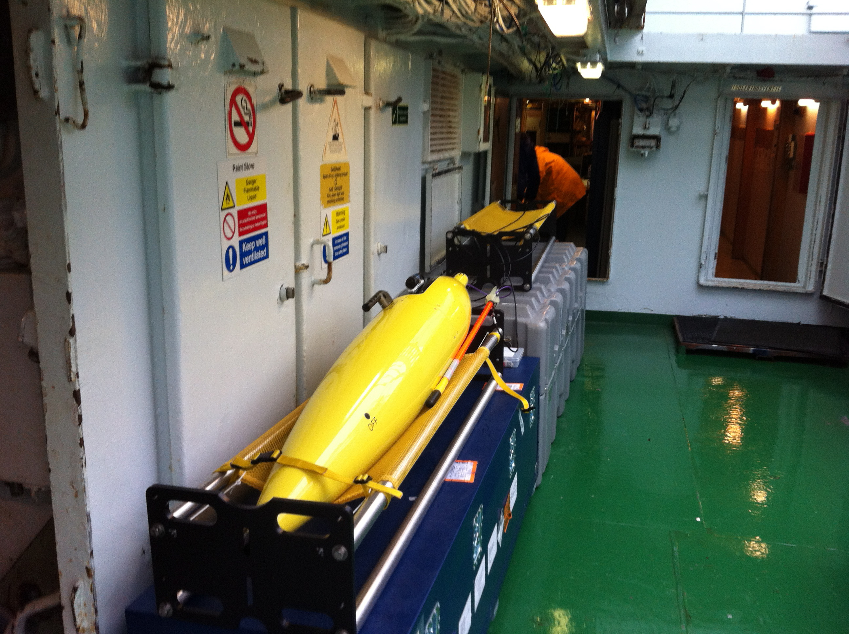
Seaglider onboard R/V Håkon Mosby before deployment

Slide 13
Glider use within NACO so far:
1. Sustained monitoring with two Seagliders total 4000 stations, Svinøy section 20 repeats since May 2012, Lofoten basin 10 since July 2012.
2. Short term research projects, e.g.
Two Slocums for turbulence process studies around the Faroes.
Inland lake studies
Fjord studies Northern Norway and Svalbard
Potential missions 2015-2016?
Scientific user committee will decide:
Iceland, Svalbard, Benguela are among proposals in addition to NwAC.

Slide 14
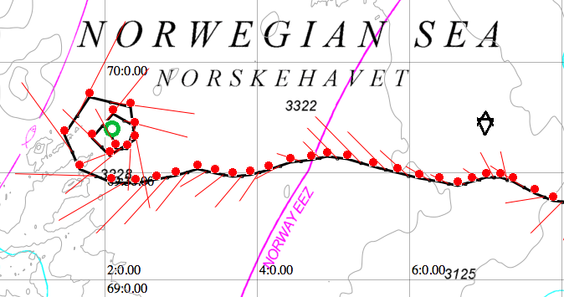
Piloting tool: Gliderpage – developed at GFI
Web client based on Google Maps API v.3
Integration between Google Maps and open wms map data from statkart.no/geonorge.no
Integration between Google Maps and weather data from met.no/yr.no
Integration between map application and technical matlab plots, communication with base station for editing of cmdfile/science/target, copy of data- and logfiles, monitoring of technical condition of glider
See separate presentation by Hessevik et al

Slide 15
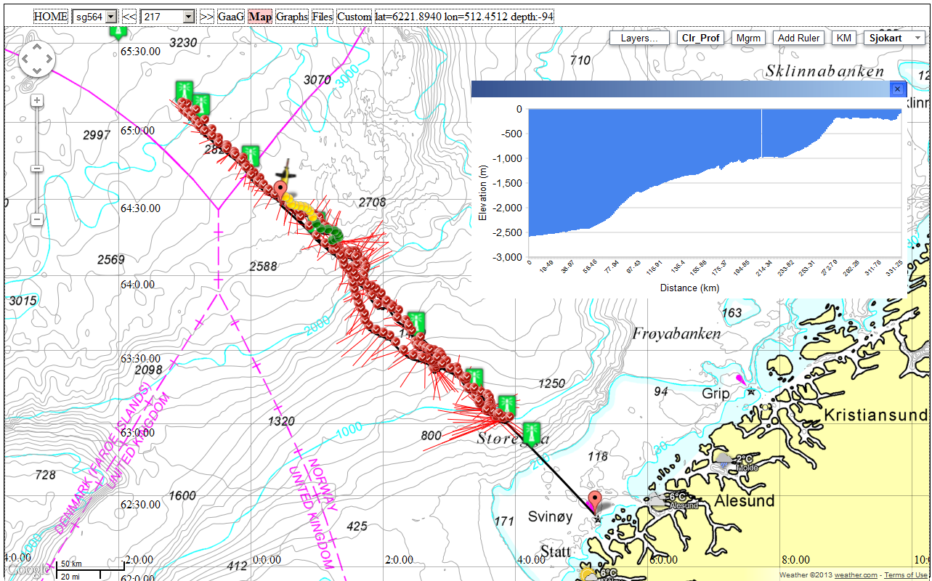
Svinøy section in Gliderpage

Slide 16
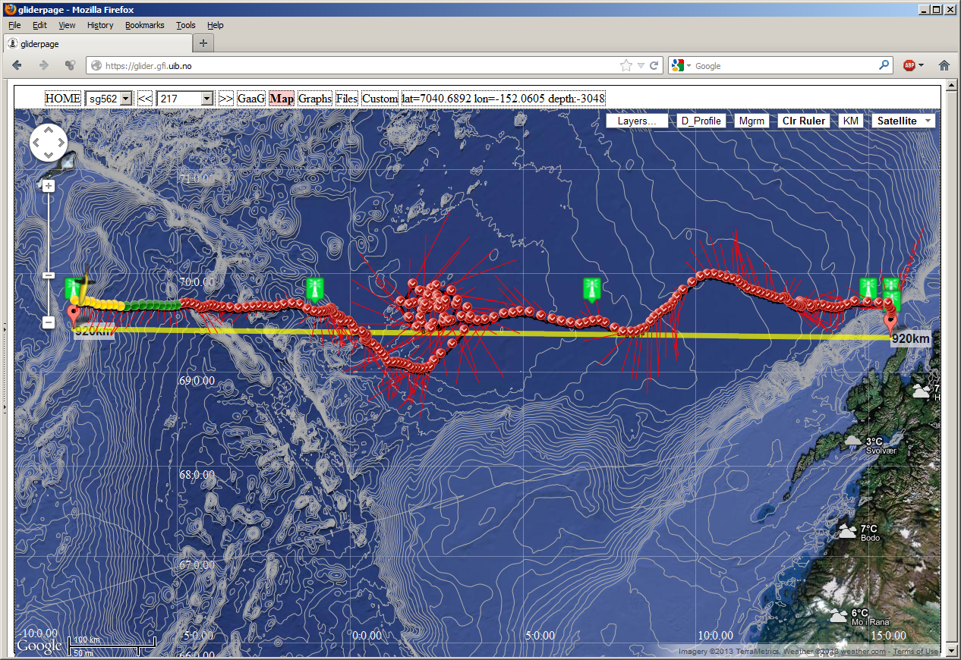
Lofoten basin section in Gliderpage

Slide 17
Exercises within the project 2013-2014
  Prepare for operational phase 2015-2020:
    Gain experience in mission planning, ballasting, deployment, piloting, recovery, refurbishment
    Piloting:
      Purchased 24/7 piloting services from third party OPTIMARE 2012- early 2013
      Developed inhouse capability 2013-2014
    Cost model for research and commercial users including freight, deployment/recovery, maintenance, piloting services per month, depreciation including risk of loss.
    Set up user committee for priorities from 2015

Slide 18
Experience, status and prospects
  Seagliders are very suitable for long section monitoring in areas with not too strong currents.
  Sections can be combined with fixed point observations with good results; also worthwhile and relatively easy to make room for eddy and other process studies.
  Initial investment cost in gliders and training of personnel is considerable; cost of glider lab / glider port is less.
  Own work on tailoring and embedding of manufacturer software turned out to be well worth the effort; in less than one year we could pilot ourselves with a small team at less than commercial cost.
  Slocums so far primarily used for shorter term integrated process studies.
  Outreach including exhibition and film: http://vimeo.com/96179776

Slide 19
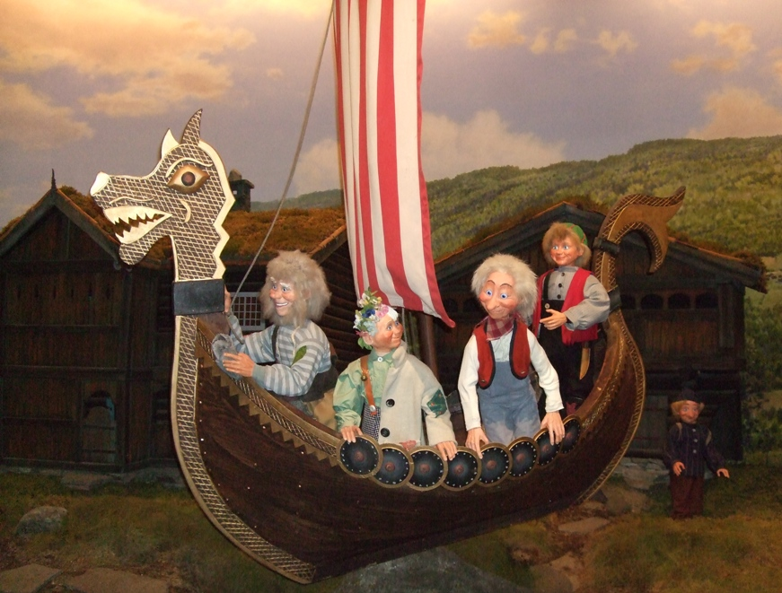
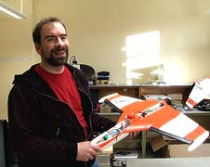

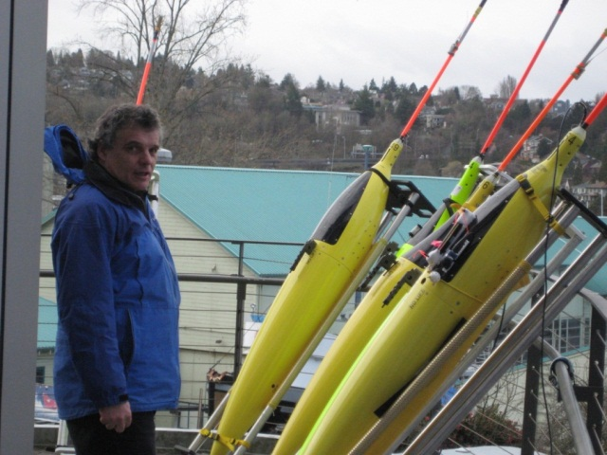
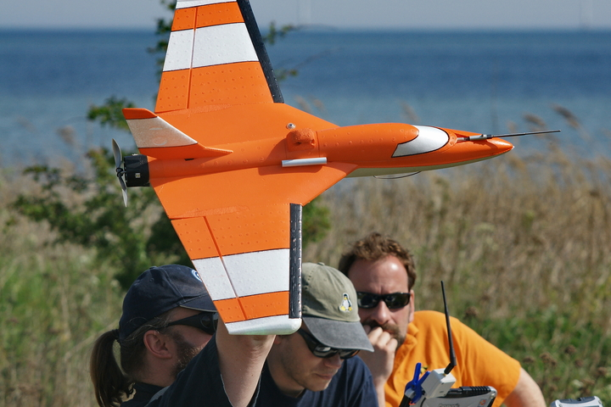
Future of ocean and atmosphere measurements
Notes:
Våre skip går til lands og til vanns – og i lufta med!

