Slide 1
Gliders in the Baltic Sea – a future perspective Alenius P.¹, Tikka K¹ and Barrera C² ¹Finnish Meteorological Institute, FMI ² Plataforma Oceánica de Canarias, PLOCAN

Slide 2
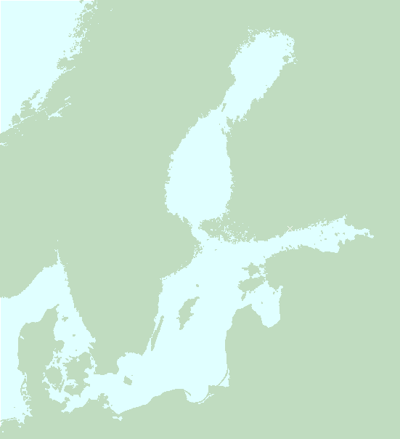
Baltic Sea natural and observational scales
The Baltic Sea is a complex system with several sub-basins
It is shallow and has a rather complex bottom topography
There are areas with lots (thousands) of islands
The geographic scales extent from meters to 1000 km
Traditionally observations have been done by research ships
Monitoring is usually done in sparse grids with horizontal spacing of 10 NM or more
Case studies has been done by RV’s with grids having spacing of ≈ 5 NM

Slide 3
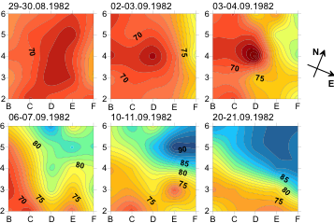
Some eddy scales in the Baltic Sea
Halocline horizontal correlation scales 20 -24 km
Layer thickness correlation scales 11 – 13 km
Internal Rossby-radius ≈ 10 km in BSP ≈ 1.5 -5 km in the gulfs
Elken et. al. 2005

Slide 4
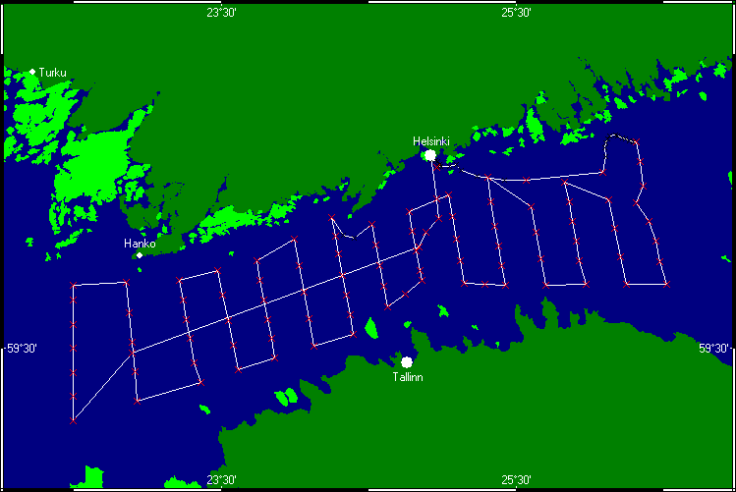
Traditional process study – a grid in the Gulf of Finland

Slide 5
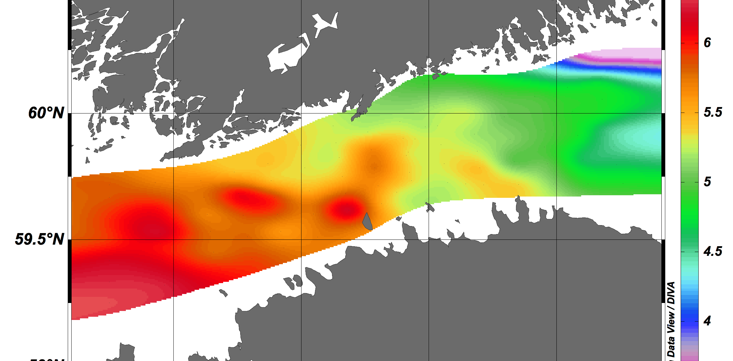
Surface salinity scales in the Gulf of Finland

Slide 6
Gliders in the Baltic Sea
Two unsuccessful missions, no data!
2010 July in Boknis Eck
Slocum glider
Virtual mooring for 1 week
2500 casts
2013 September in Bothnian Sea and Archipelago Sea
Slocum glider, deep sea version from PLOCAN
Section 2.5 days
Virtual mooring 24 h
2014 April in Gulf of Finland (MSI)
Slocum shallow sea model
Technical test

Slide 7
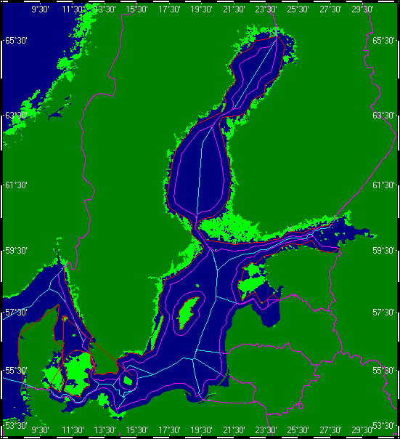
Baltic Sea political borders

Slide 8
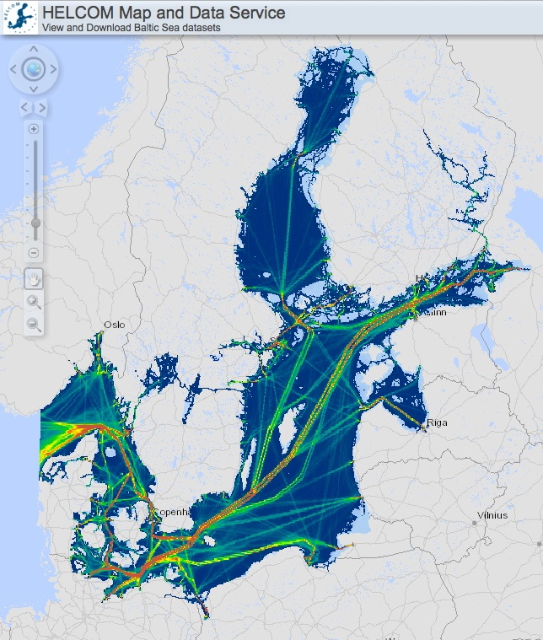
Baltic Sea traffic

Slide 9
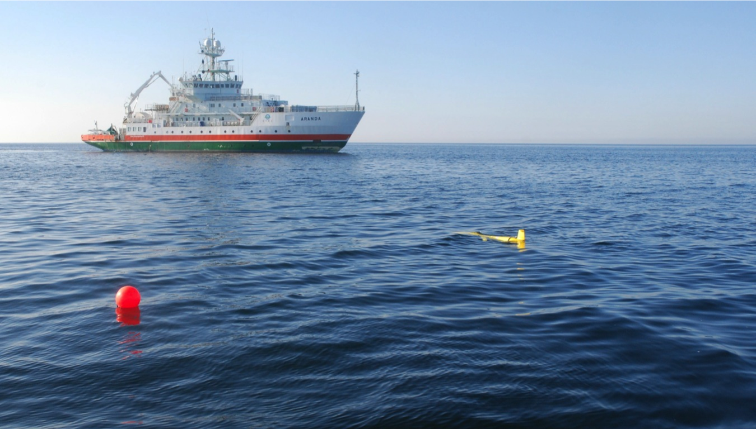
RV Aranda cruise GROOM2013, 11-18.9.2013
Photo K.Tikka

Slide 10
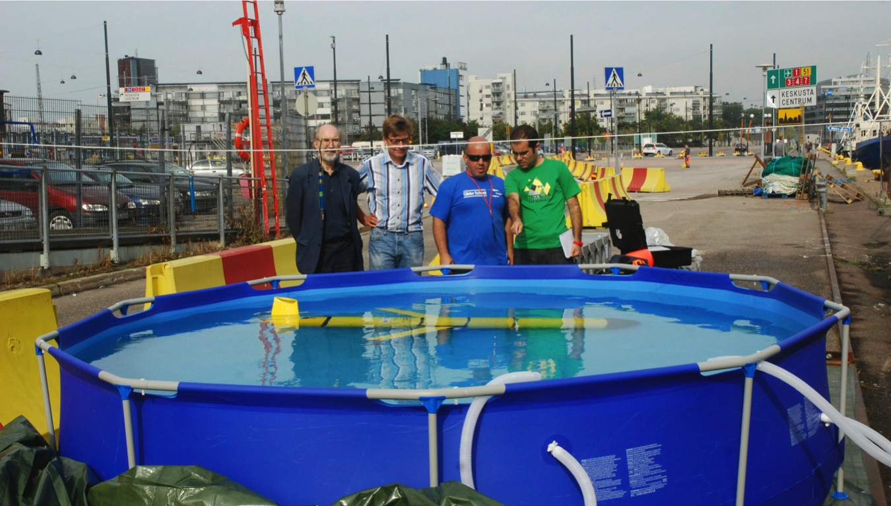
A ballasting tank is needed a temporary lab in Helsinki

Slide 11
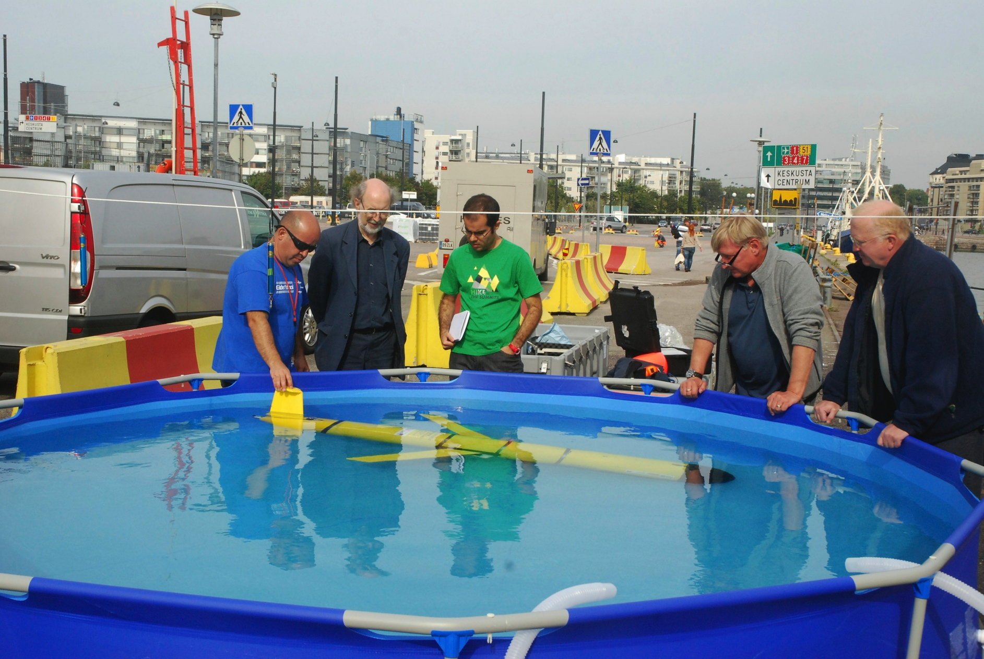
Essential persons: glider experts, cruise leader, captain, first officer
Photo K.Tikka

Slide 12
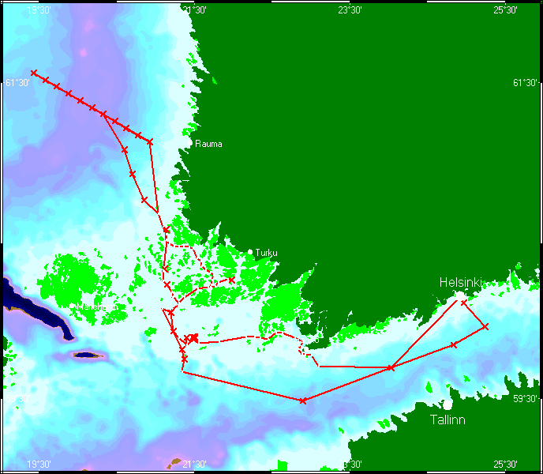
GROOM Baltic Sea Glider experiments
Section experiment
Virtual mooring

Slide 13
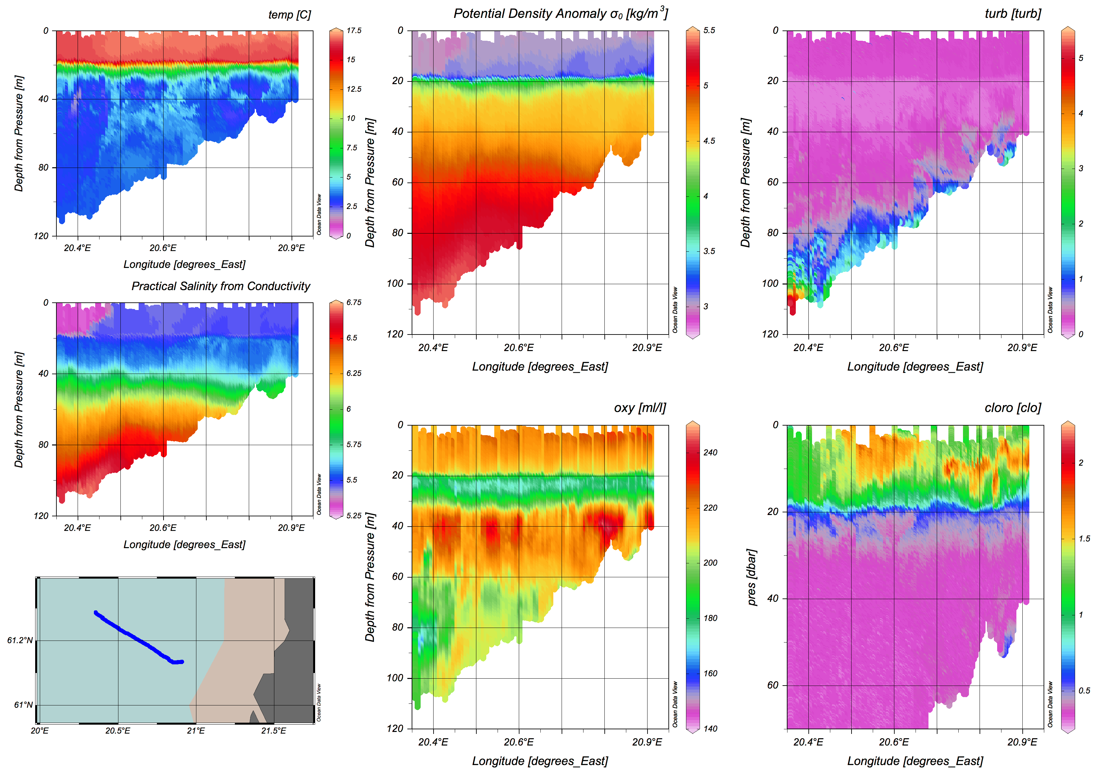
Glider data from the section (topography nicely followed)

Slide 14
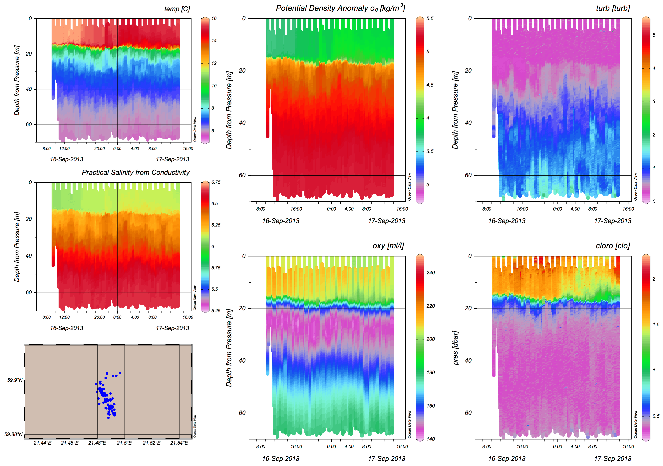
Glider virtual mooring data from a small archipelago basin

Slide 15
Some glider characteristics in the section mode
Goes to 100 m depth in 120 - 200 m distance in 12 – 16 minutes

Slide 16
How COST ES0904 benefitted FMI and the Baltic Sea
Excellent possibility to get into the community
GROOM partnership
PLOCAN glider school attended
Successful glider test in northern Baltic Sea
Co-operation with PLOCAN was the key to success
Raised much interest among institutions and great audience
Gave understanding on the possibilities
Legal framework clarified
Insight into resources needed
Great enthusiasm

Slide 17
Supporting data for glider usage in the Baltic Sea
Weather models
3D ocean models (HBM, Nemo) 2NM
Wave models
Ice models
AIS data from marine traffic directly received
Coastal radar data (ice movement, too)
Satellite images
Argo float data
Research cruises
Ship of opportunity data (Alg@Line)
Some semi-permanent moorings
Close co-operation between institutes and authorities like coast guard and navy

Slide 18
Conclusions
Gliders are useful in the Baltic Sea
Focus may be on meso-scale phenomena
They complement other research means
Slocum shallow sea model is an option
Endurance up to 2 months (?) in the Baltic Sea
Need piloting
Avoid collisions: keep away from ship tracks
Legal issues are important: keep in your waters
Invest on data processing
Get networked (EGO http://www.ego-network.org)
PLOCANs glider school suggested
COST ES0904 and GROOM have been very important to us

Slide 19
COST ES0904 and EU are acknowledged for funding this work
PLOCAN is acknowledged for coming to the Baltic Sea with a glider
Aranda crew is acknowledged for enthusiastic extra help

