Slide 1
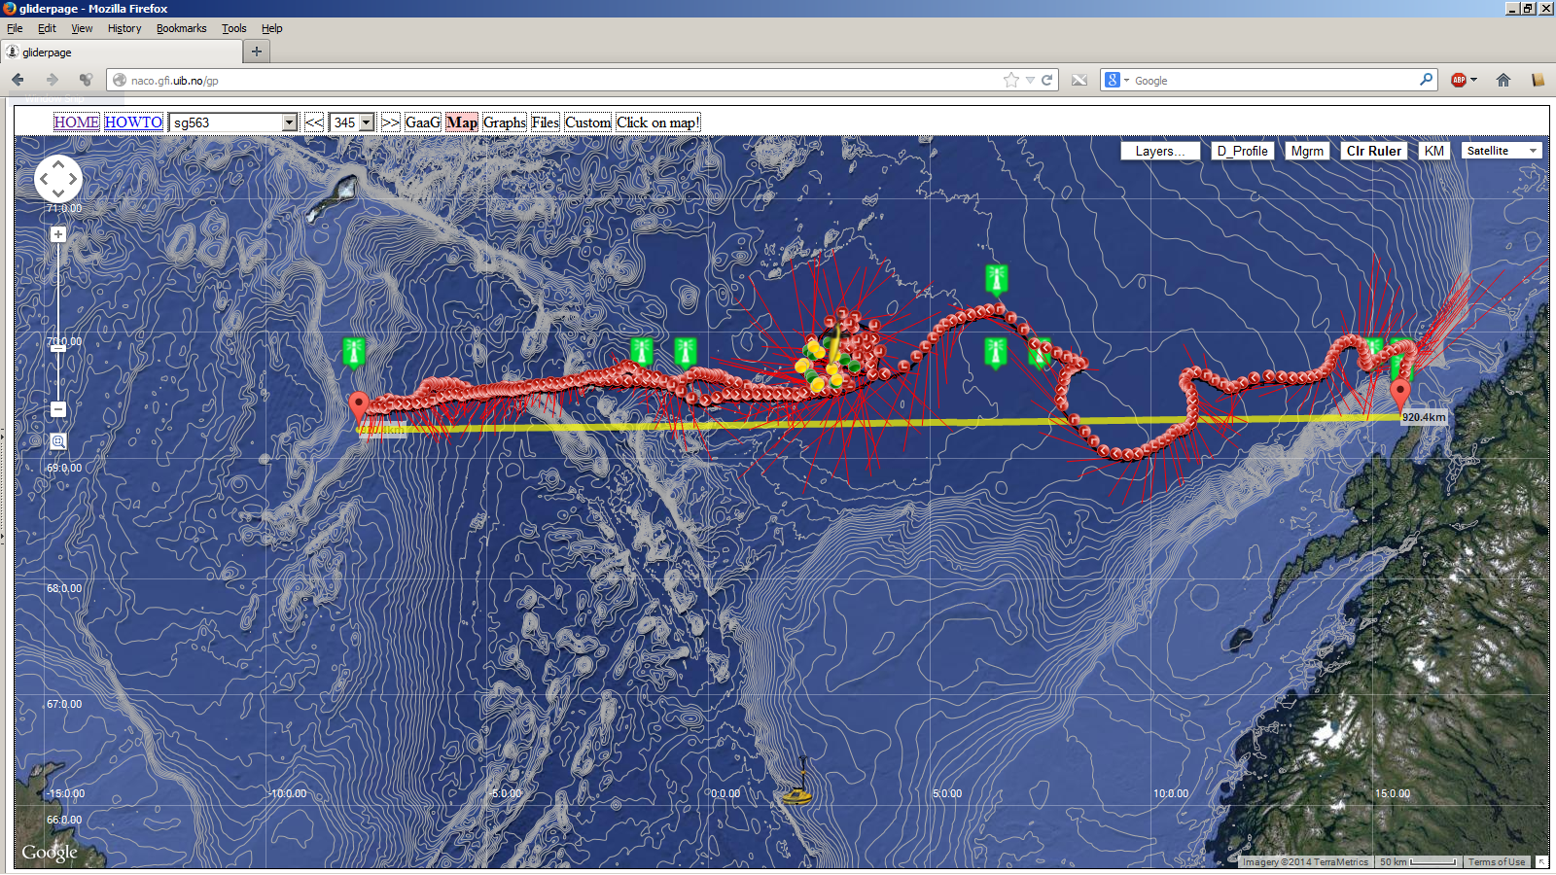
Naco Gliderpage – http://naco.gfi.uib.no/gp
A tool for piloting Seagliders from web-clients
or: HowTo avoid learning vi

Slide 2
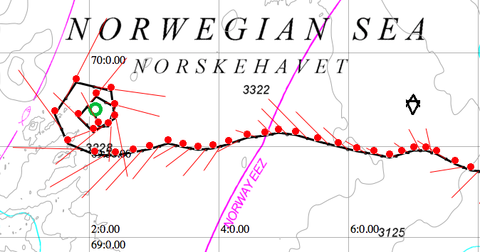
Naco Gliderpage - developed at Geophysical Institute, UoB Norway
Web-client tool based on Google Maps API v.3
Integration of Google Maps and free wms/gis map-layers from statkart.no/geonorge.no, ngdc.noaa.gov (gebco08) and arcgisonline.com
Integration of Google Maps and weather data from Norwegian met.office: met.no/yr.no
Integration between the map-application, tech. matlab plots, communication towards the basestation for editing cmdfile/science/target, download of data- and logfiles, update from recent dive and monitoring tech. health of gliders .
Developed in javascripts, html, python and matlab

Slide 3
Naco Gliderpage versions:
Gliderpage Pro pilot version
https - userid & password login required
Sync towards the seaglider basestation
Glider page public version (http://naco.gfi.uib.no/gp)
http – general public access
Pilot functions disabled (no editing of essential files)
Sync towards Pro pilot web-server
Gliderpage Pro pilot backup/dev server.
Near identical configurations.

Slide 4
Naco Gliderpage Web-client tool advantages:
All necessary applications integrated into one interface and one application
No «tech applications» like ssh/sftp/winscp/vi
allows «non-tech» seaglider pilots.
- No local matlab or python installations
(all run by scripts on web-server)
Entire group of pilots, scientists and the public
access data and figures from the same interface.
Reliable and stable. Free for the glider community.

Slide 5
Naco Gliderpage:
Google Maps Api v.3
High quality global & regional maps
Well known and flexible interface
Google maps elevation service
Easy access to WMS and GIS-layers
(WMS- web map server, GIS – Geogr. information services)
Drawback: Google Maps use a variant of the mercator projection (EPSG:3857). Operations deep into the polar ice require polarstereographic projections and probably OpenLayer maps

Slide 6
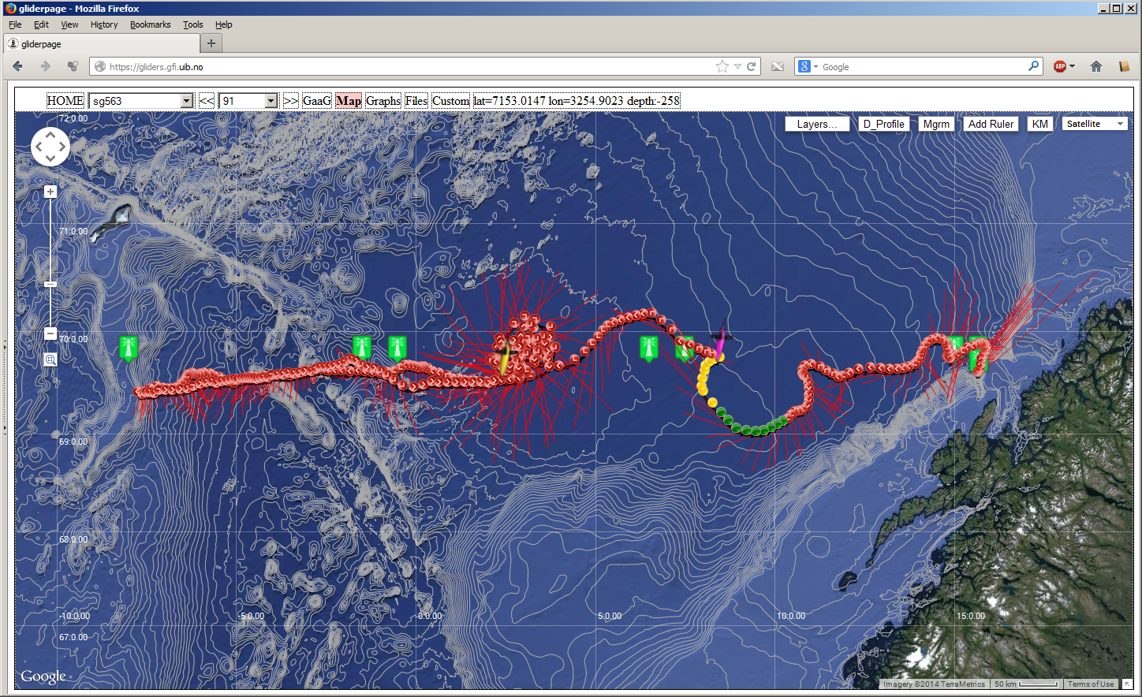
Gliderpage – maps

Slide 7
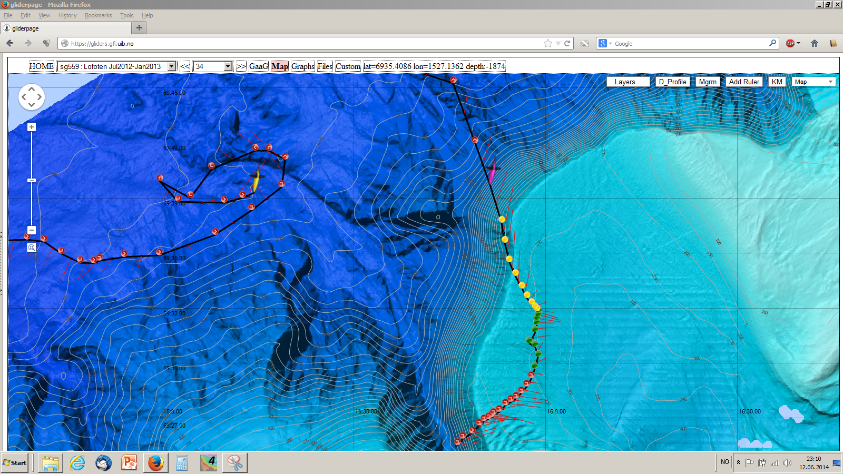
Gliderpage – Regional multibeam echosound + contour maps

Slide 8
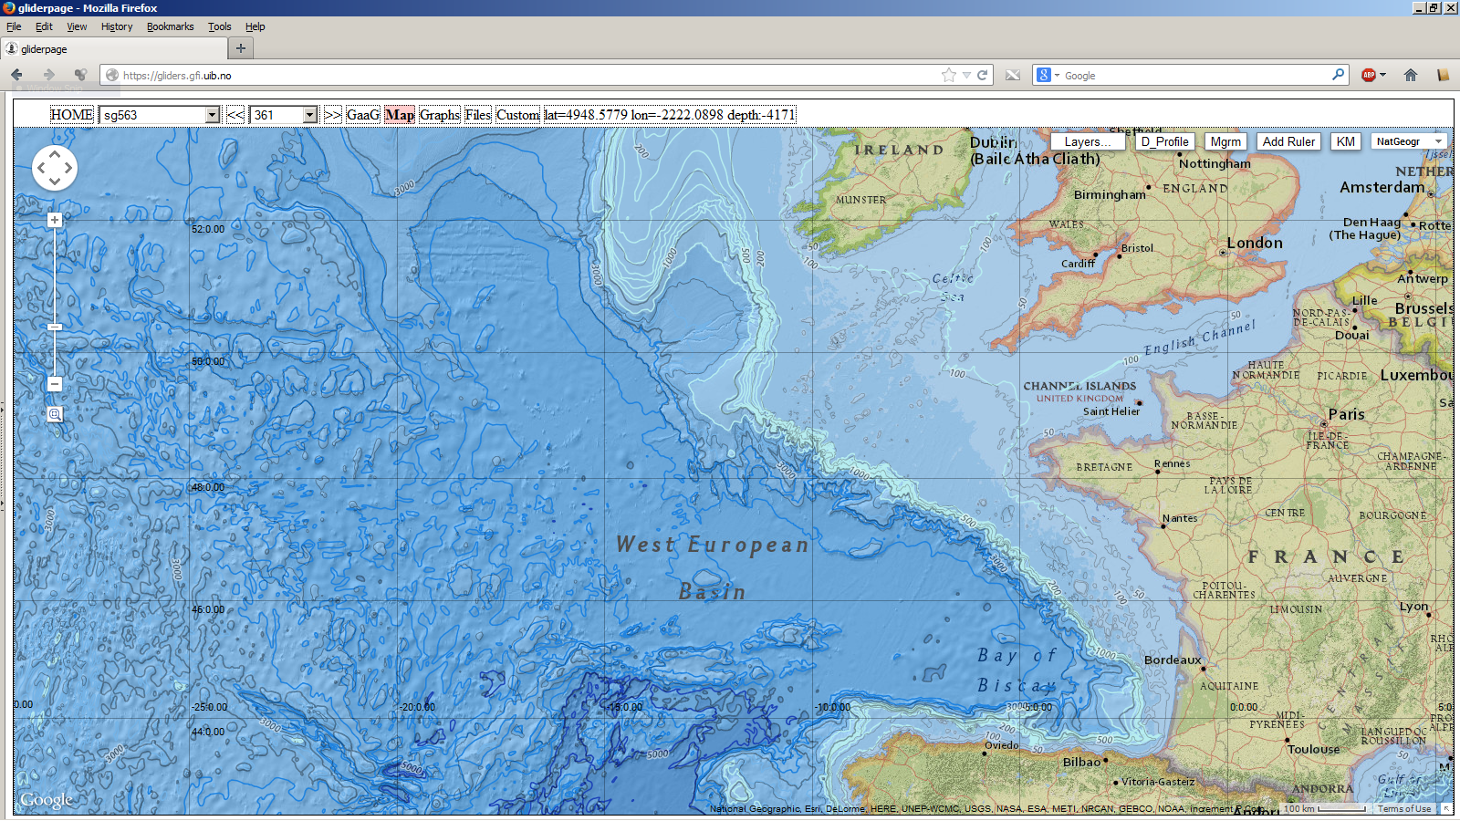
Gliderpage – National Geograph. maps

Slide 9
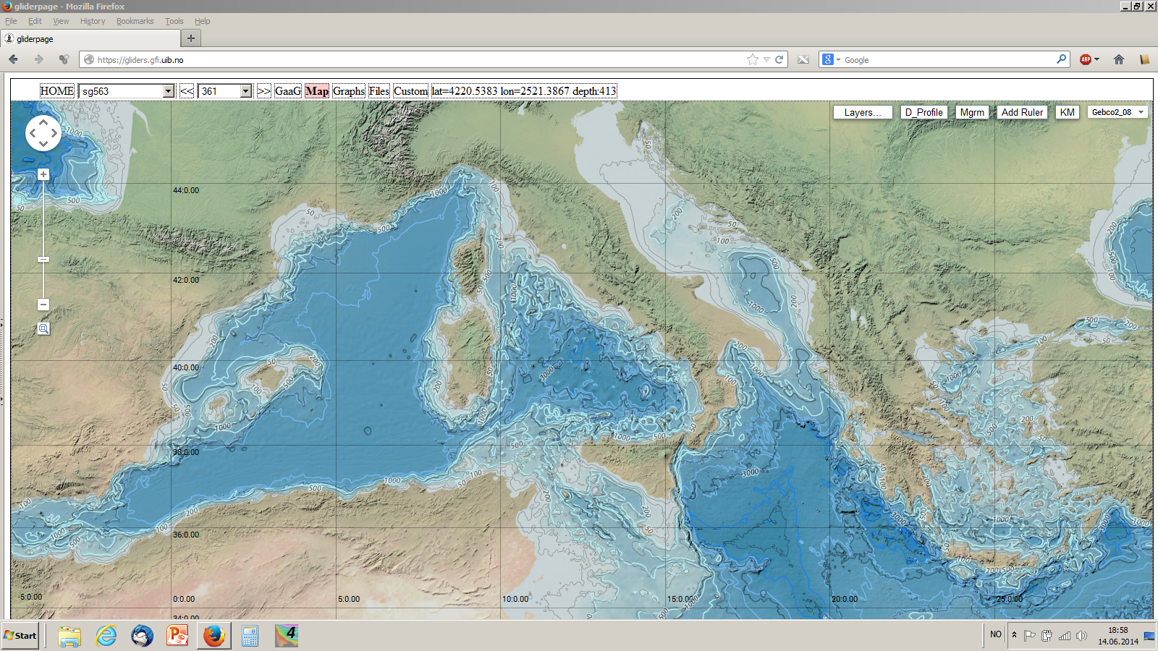
Gliderpage – Gebco08 maps

Slide 10
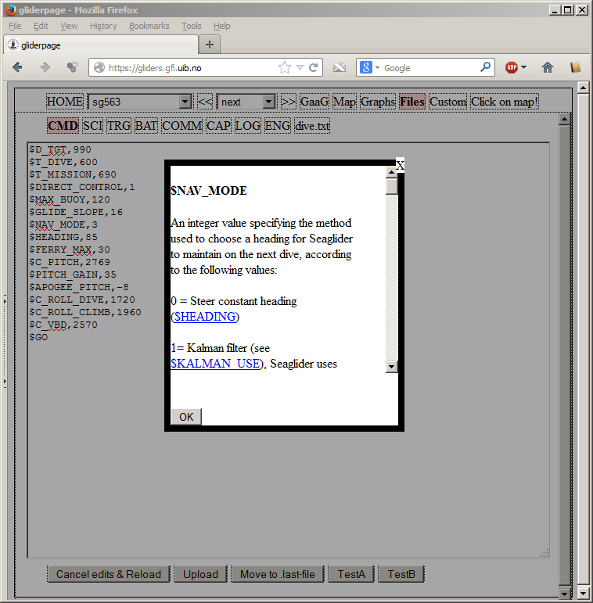
Gliderpage – pilot functions
Glider pilot functions
- Essential file editor
Next Dive - Edit:
CMDFILE, SCIENCE,
TARGET, BAT
Every Dive - Read:
Comm.log, Capture
*.LOG *.ENG
dive.txt

Slide 11
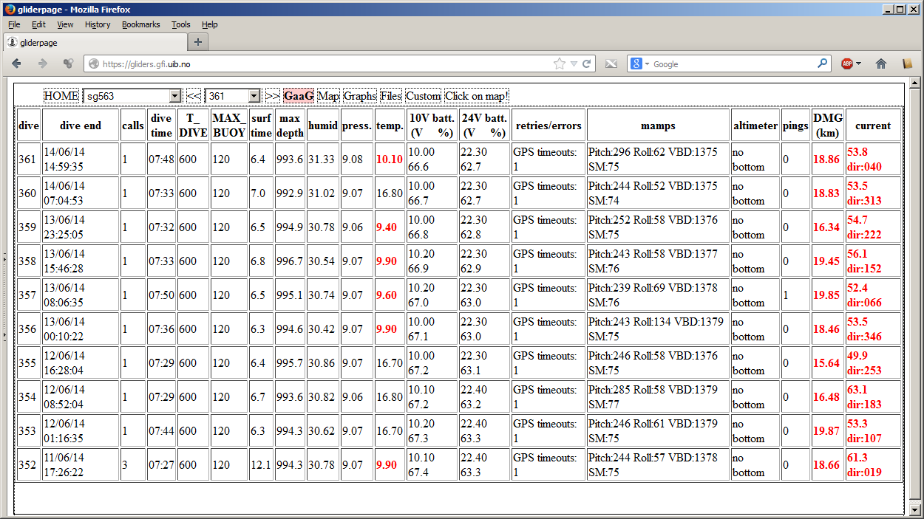
Gliderpage – pilot functions
GaaG – Glider at a Glance
Monitor Glider tech. health

Slide 12
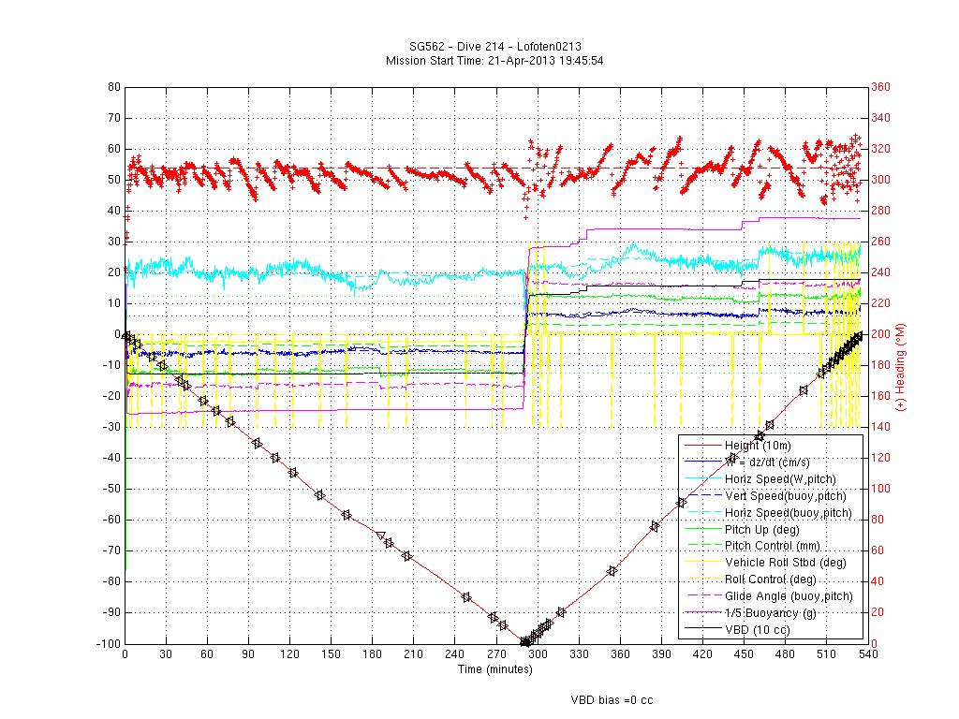
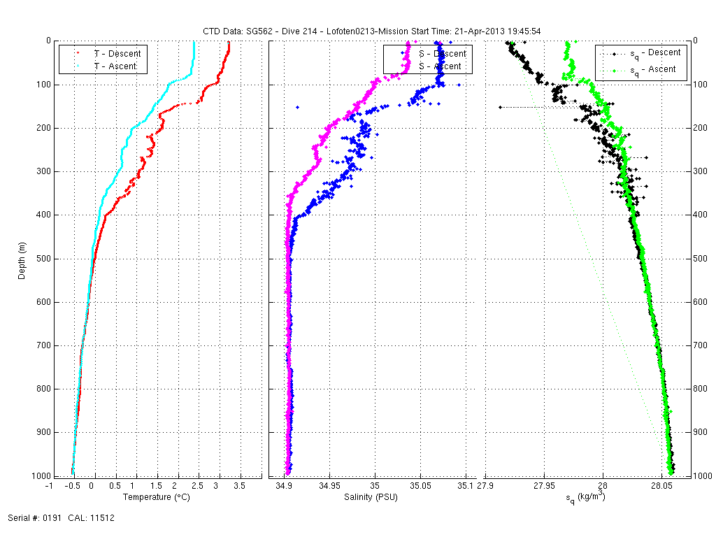
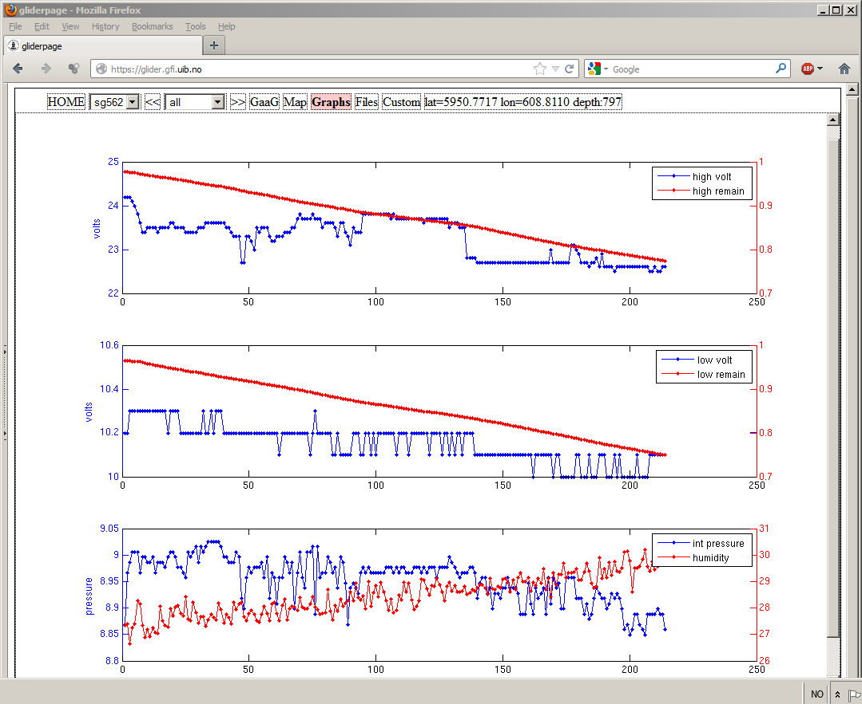
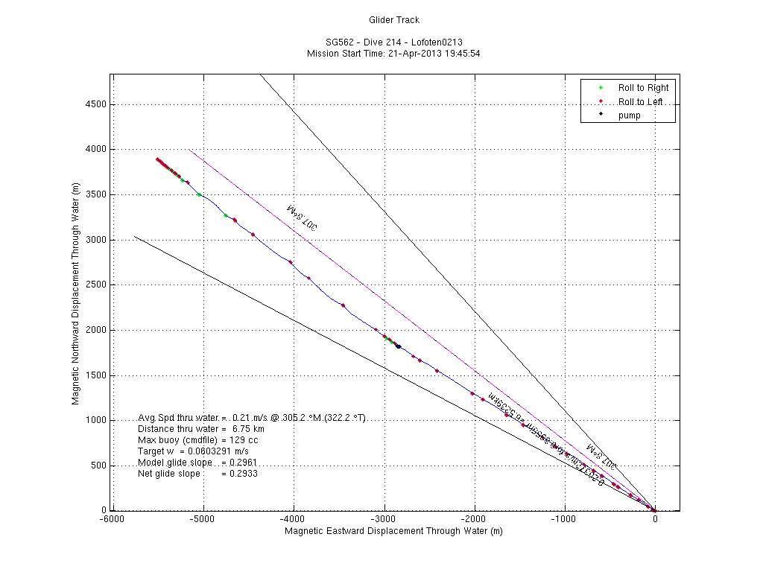

Gliderpage – tech. plots for pilot control

Slide 13
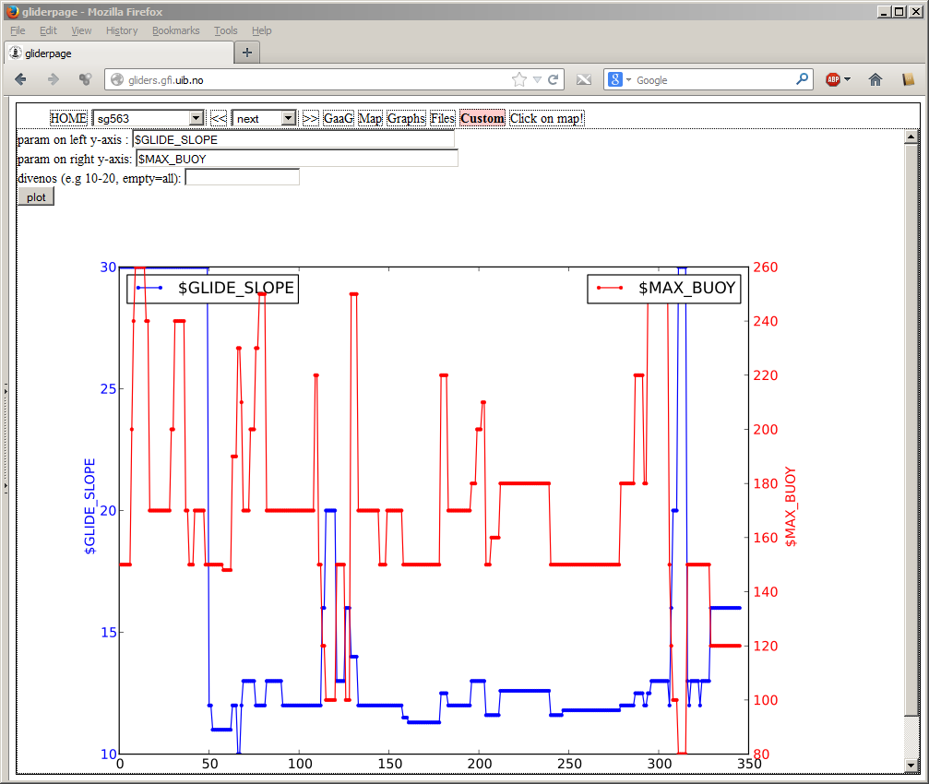
Gliderpage – Custom plots
Plots any pair of seaglider parameters for a series of dives

Slide 14
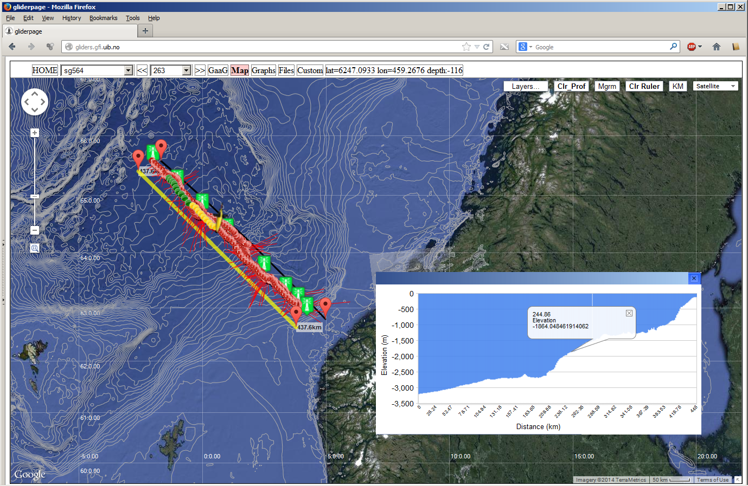
Google maps++: Ruler tool, Elevation services & depth contours

Slide 15
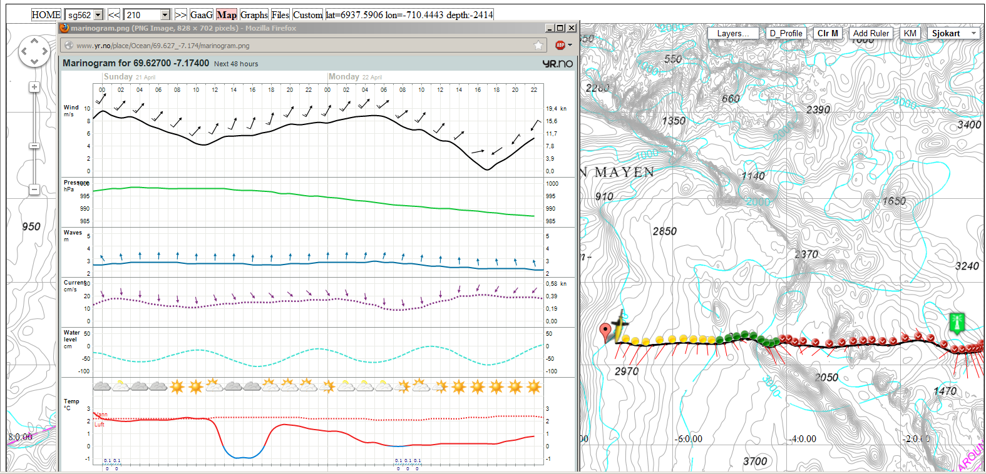
Gliderpage – weather data from met.no

Slide 16
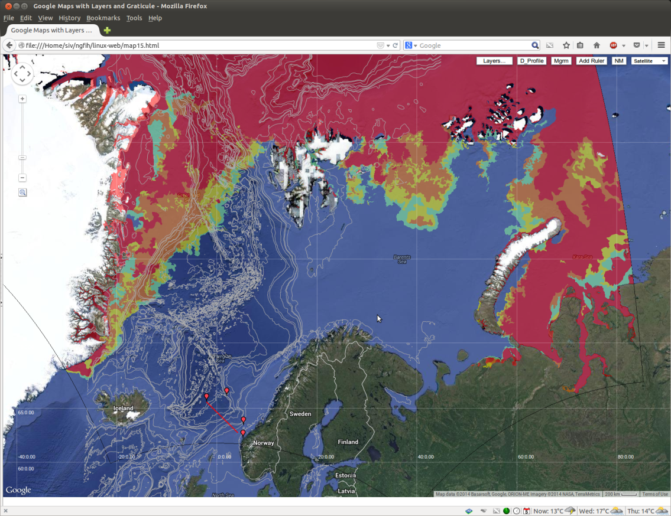
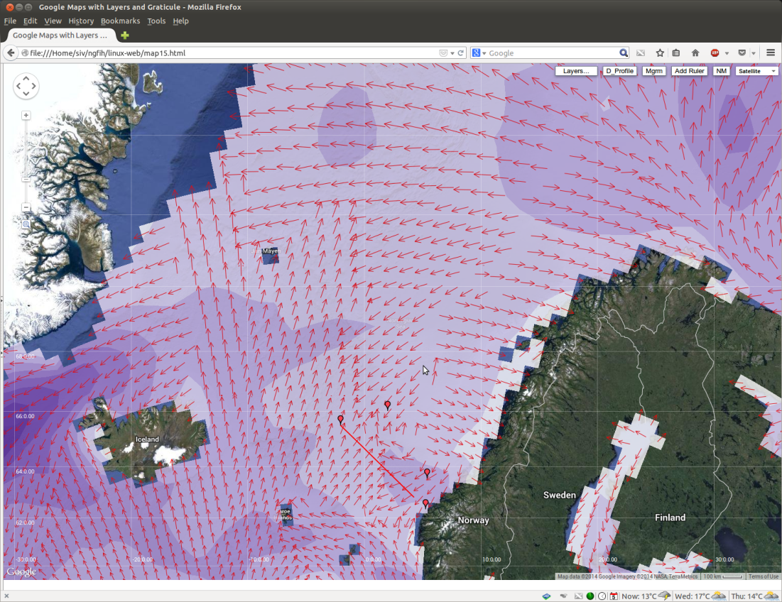
Gliderpage – Enhancements in progress
Ice charts
For ice edge operations
Wave & wind charts
Model forecasts from met.no

Slide 17
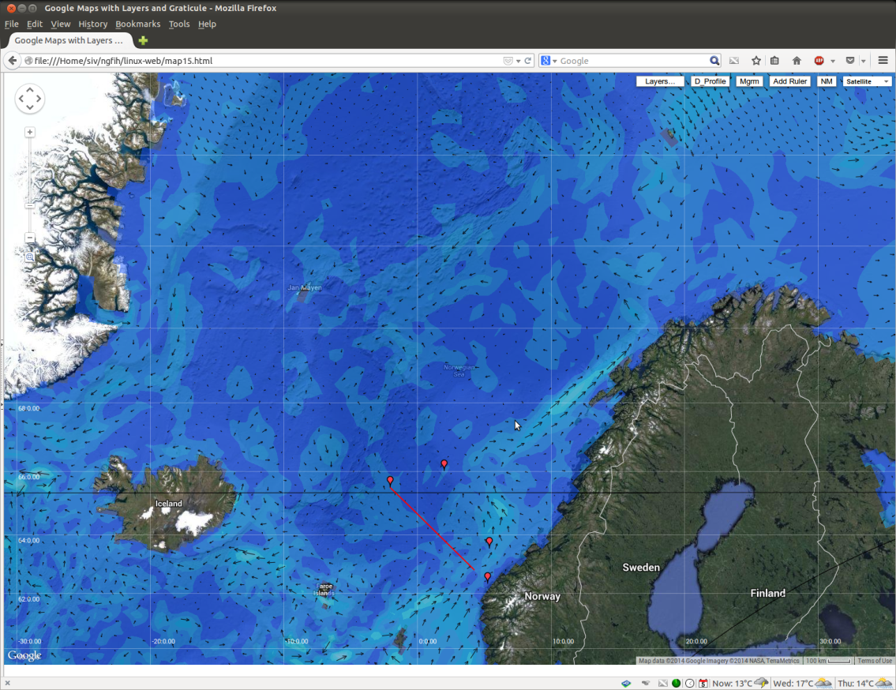
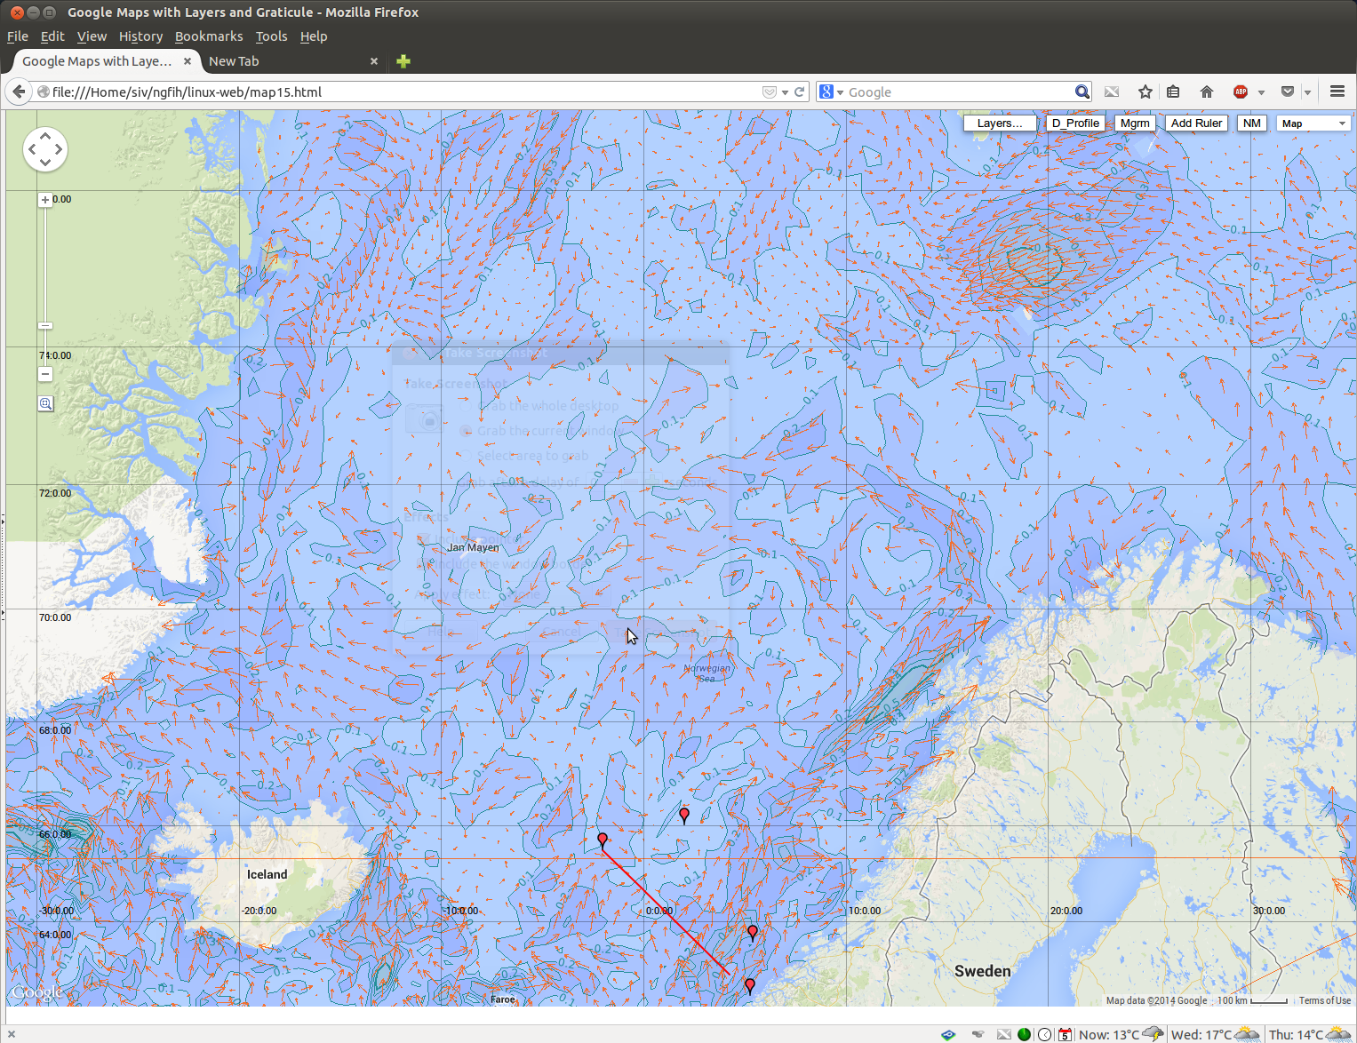
Gliderpage – Enhancements in progress
Regional current models
Model prognosis from met.no

Slide 18
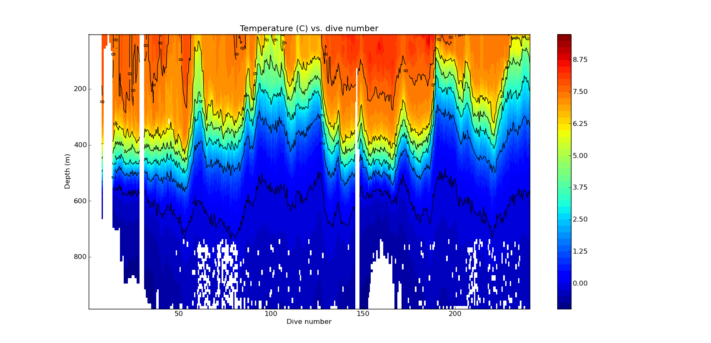

Gliderpage – Enhancements in progress
- Custom science plots
Based on Python
Future: Gliderpage Slocum module?
Other groups may have other solutions and preferences.
More alternatives/Better ideas - «Let the flowers bloom»
Collaborative ideas are welcome!

Slide 19


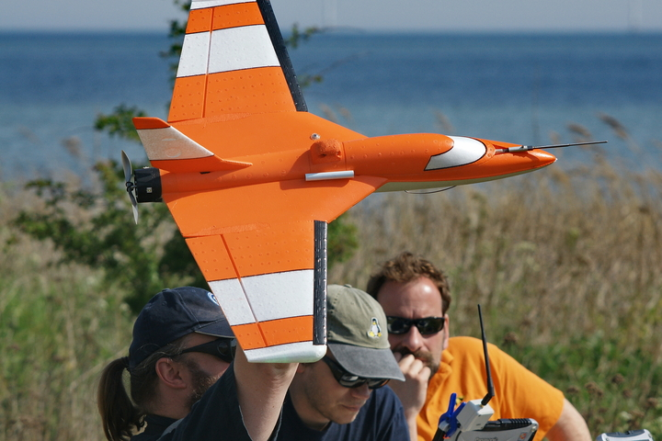

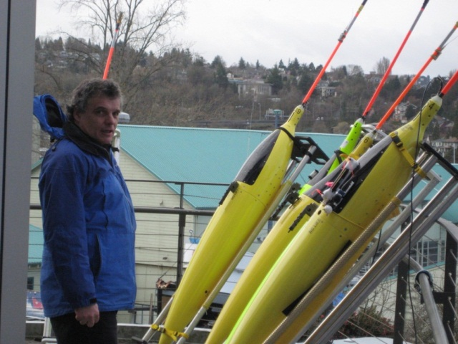
Notes:
Våre skip går til lands og til vanns – og i lufta med!

Slide 20

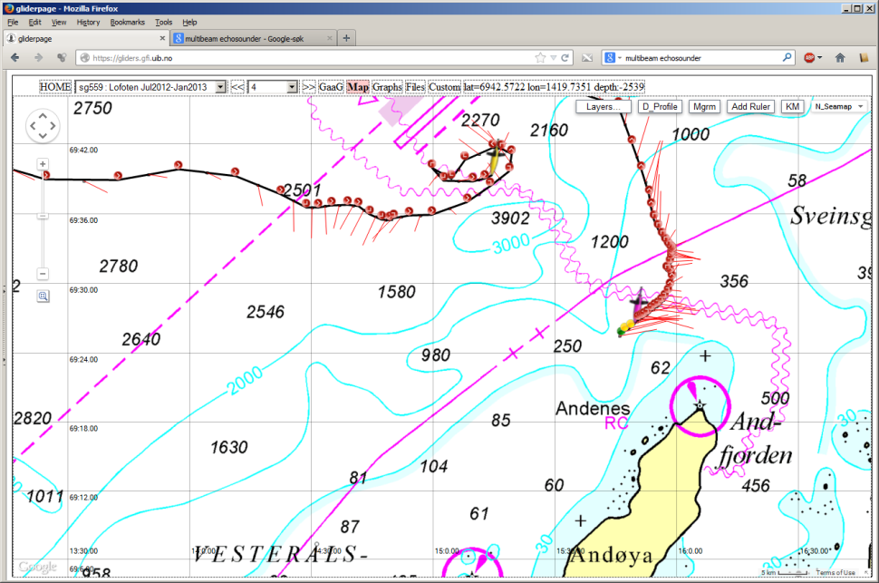
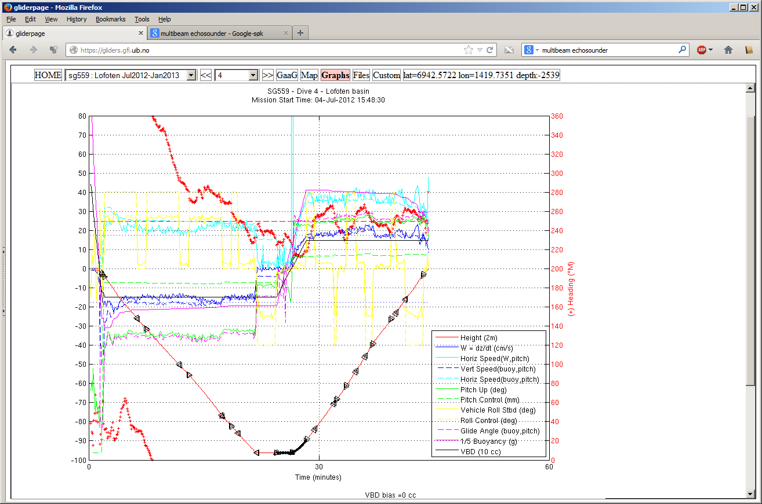
Gliderpage – New vs Old map

Slide 21
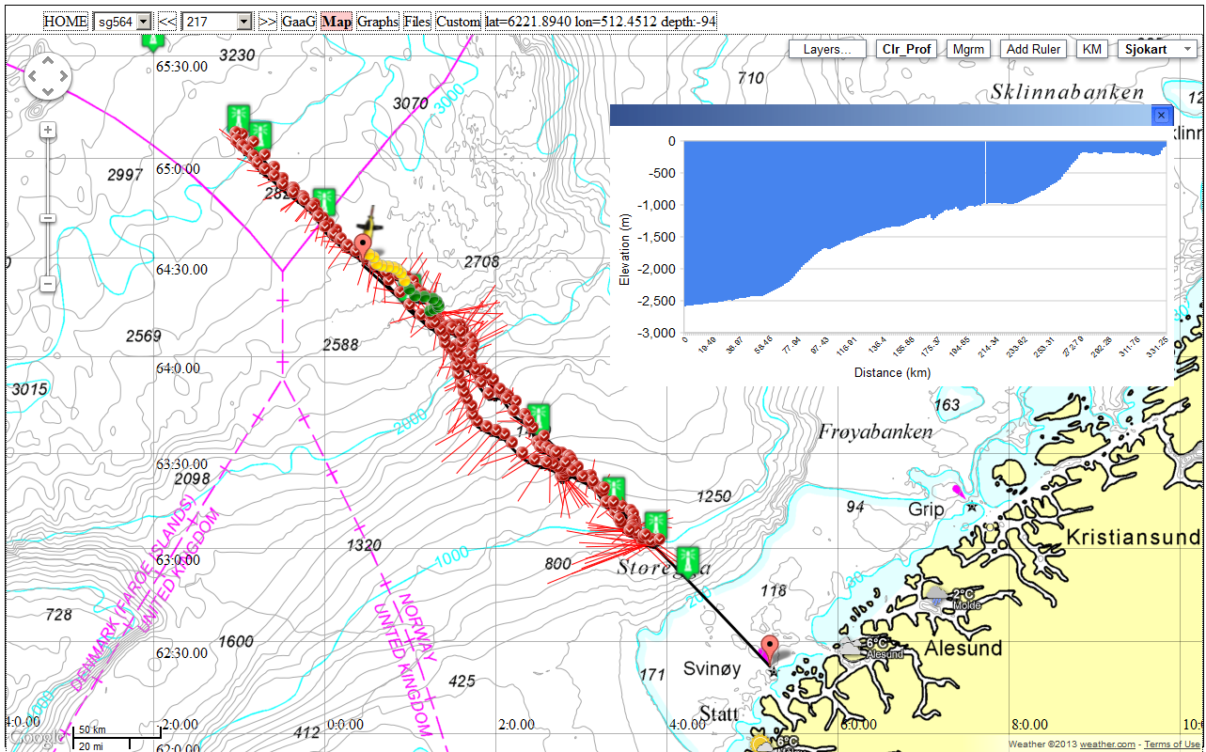
Gliderpage – depth average current vs depth profile

Slide 22
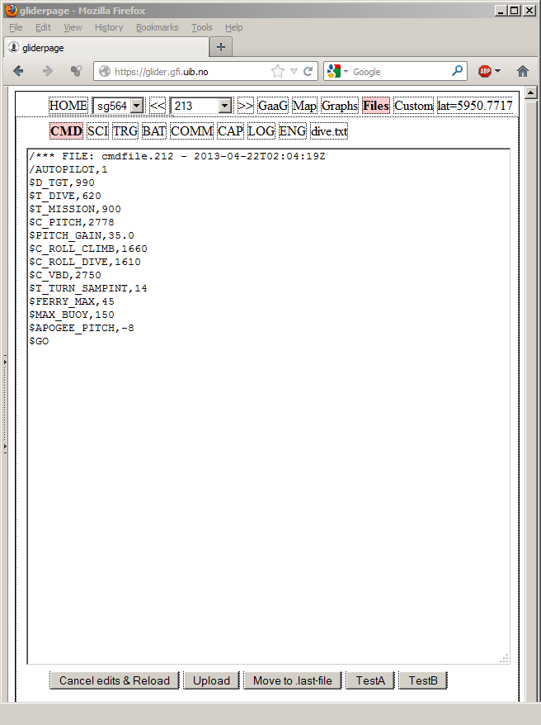
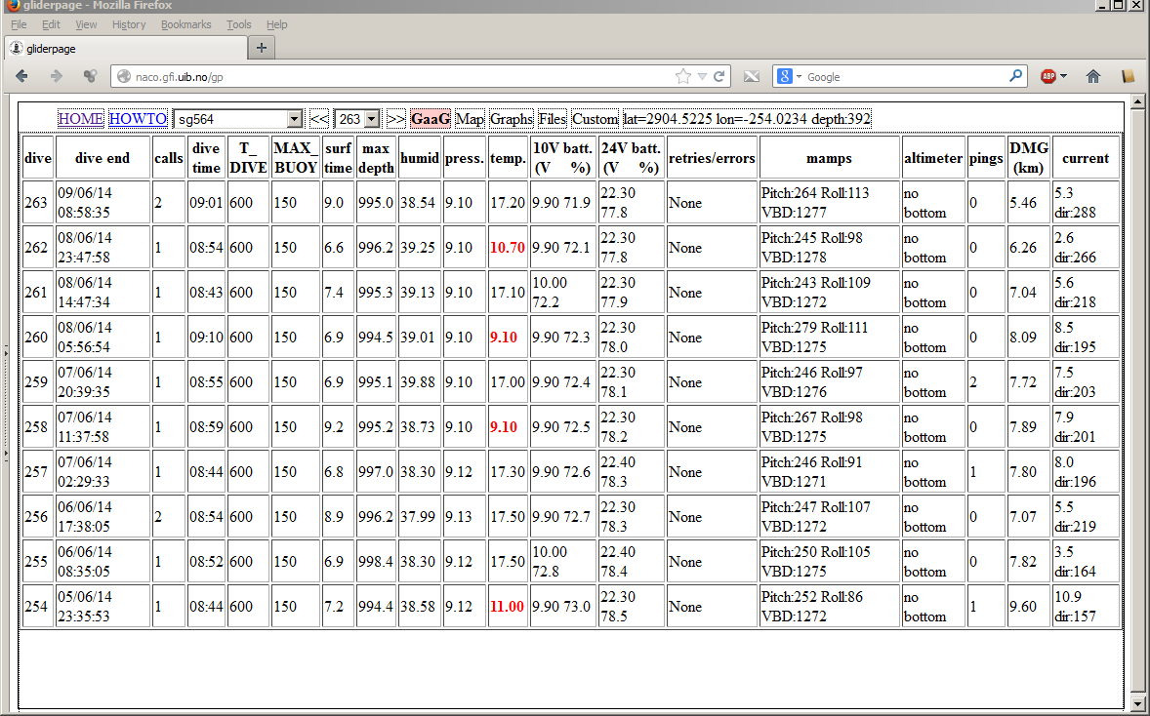
Gliderpage – editing cmdfile/targets, surveillance of tech health

