Slide 1
6th EGO conference & Final COST ES0904 symposium
Welcome in Kiel !
Kiel, Germany, 16 – 17 June 2014

Slide 2
EGO Meetings
1st Paris, Oct. 2006
2nd Palma de Mallorca, Oct. 2007
3rd La Specia, Oct. 2008
4th Larnaca, Nov. 2009
5th Gran Canaria, Mar 2011
EGO/GROOM/JERICO Mallorca, May 2012 EGO/GROOM Nicosia, Jan. 2013 EGO/GROOM Trieste, June 2013
6th EGO meeting Kiel, June 2014
What will be the future of EGO?
COST Period

Slide 3
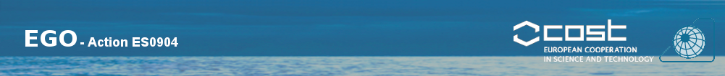
Logistics
6th EGO Meeting, Kiel, June 2014

Slide 4
General
Please sign the attendance list on both days!
Conference bag: badge, recipe, info material
Posters: please leave them at the registration desk (will be set up for you), will be on display for both days
Internet: W-LAN EDUROAM shall be available
Coffee breaks (sponsor: Kongsberg Maritime, J. Bornhöft GmbH)
Lunchbreak “on your own” (e.g. Campus suite, many restaurants etc. along the shore)
Questions? The Kiel team will help! (Nadira, Martina, Mario, Till, Susanne …)
Notes:
Thanks to all for

Slide 5
Today: Monday (16.6.)
Morning session:
Science & technology talks
Afternoon session session:
COST Action ES0904 final symposium & evaluation
Poster presentation:
Today 18:00 to 21:00 across the street in the GEOMAR building
Conference “Dinner”:
Light meals will be served along with the poster session
Champagne (sponsor: ACSA)
Glider vehicles on display:
Seaglider, ACSA glider, SLOCUM G1 glider in poster area
TV set (World Cup 6pm)

Slide 6
2nd day: Tuesday (17.6.)
Sign attendance list!!
Return badges
Airport transportation?
Group of 4 (open a list during coffee break): Airport Taxi Service (about 20€)
KielEXX (takes about 1 hours) – this is NOT the bus but a Minibus service, little less than 30€

Slide 7
Helmholtz Centre for Ocean Research Kiel
From the deep sea to the atmosphere

Slide 8
Kiel Marine Sciences over more than 300 years
Marine Research with tradition and innovation
From the Baltic to the world oceans
1697 – Samuel Reyher: first experiments
1870 – Victor Hensen and Karl Möbius: Royal Prussian Commission for Marine Research
1902 – Laboratory for international marine research in Kiel
1914 – Foundation of the Institute for Marine Transport (today Institute for the World Economy)
1937 – Foundation the Institute for Marine Research (IfM)
1987 – Foundation of Geomar
2004 – Merger of IfM and Geomar: IFM-GEOMAR
2012 – GEOMAR Helmholtz Centre for Ocean Research Kiel

Slide 9
Helmholtz Centre for Ocean Research Kiel
Marine Research with tradition and innovation
GEOMAR
Foundation by public law
Member of the Helmholtz Association of German Research Centres
Budget: 65 Mio. Euro, about 42 Mio. institutional funding, 23 Mio. project funding
Staff: 850, about 450 scientists
Close relationship to Kiel University: joint professorships (up to 40), curricula, large research projects: cluster of excellence „The future ocean“, collaborative research project 754

Slide 10
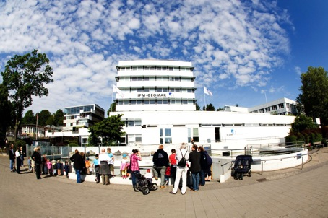
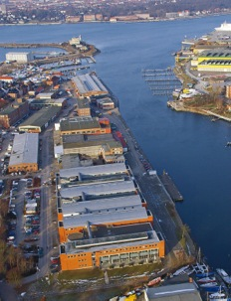
Helmholtz Centre for Ocean Research Kiel
Marine Research with tradition and innovation
West shore (former IfM) East shore (former Geomar)

Slide 11
Major Research Topics
The role of the ocean in climate change
Anthropogenic impact on marine ecosystems
Biological, mineral and energy resources
Plate tectonics and marine hazards

Slide 12
Major research topics
Helmholtz Centre for Ocean Research Kiel
From the deep-sea to the atmosphere
The role of the ocean in climate change: temperature and sea level rise, extreme events, CO₂ budget
Anthropogenic impact on marine ecosystems: food webs, ecosystem and climate change, ocean acidification, overfishing, aliens
Marine resources: natural substances from the sea, gas hydrates, mineral resources
Plate tectonics and natural hazards: subduction zones volcanism, and tsunamis

Slide 13
Infrastructure
Research vessels
Large-scale equipment
Isotope- and trace metal analytics
Modelling

Slide 14
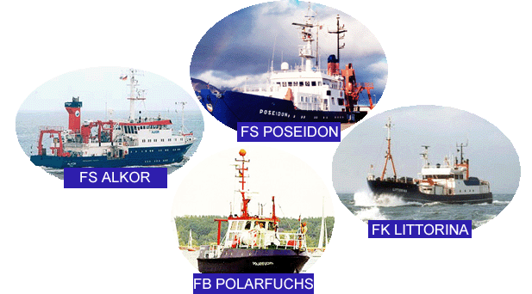
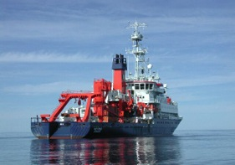
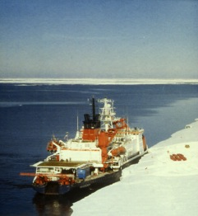
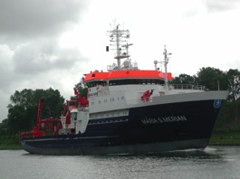
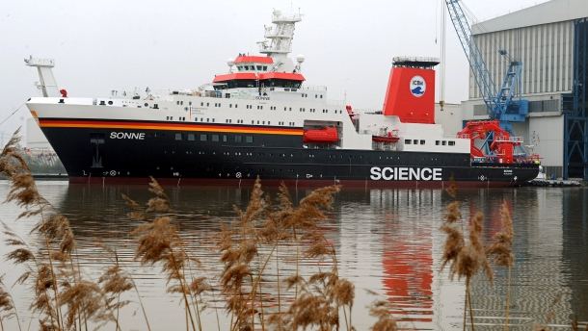
Infrastructure:
Research vessels
RV Meteor
RV Polarstern
RV Maria S. Merian
RV Sonne

Slide 15
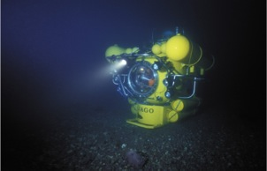
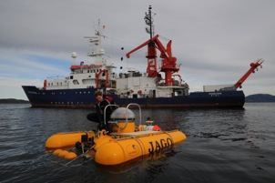
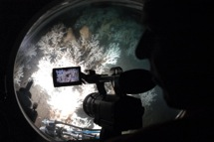
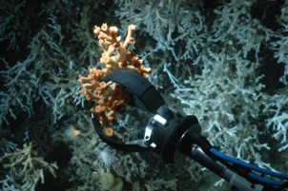
Research submersible „JAGO“
Infrastructure:
Large-scale equipment – submersible JAGO
1 pilot, 1 scientist (observer)
400 m max. diving depth
3 t system weight
transport in standard container

Slide 16
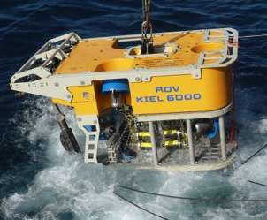
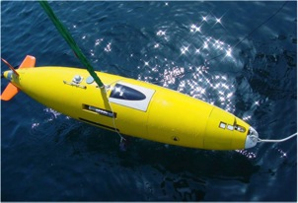
Infrastructure:
Large-scale equipment – deep-sea robots
ROV „Kiel 6000“
Deep-sea robot („Remotely Operated Vehicle“) up to 6.000 m depth funded by the State of Schleswig-Holstein
ROV „Phoca“
Deep-sea robot („Remotely Operated Vehicle“) up to 3.000 m depth
AUV „ABYSS“
Deep-sea robot („Autonomous Underwater Vehicle“) up to 6.000 m depth funded by DFG

Slide 17
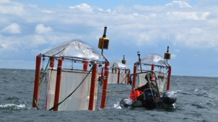
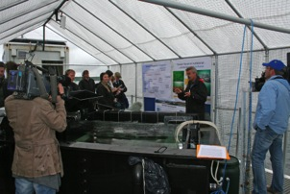
Infrastructure:
Large-scale equipment – mesocosm systems
Off-shore mesocosm systems
9 systems,
largest devices world-wide
investigation of ocean acidification
Benthocosm system
6 tanks (12 experimental options)
control on various parameters
investigation of different anthopogenic impacts on marine ecosystems

Slide 18
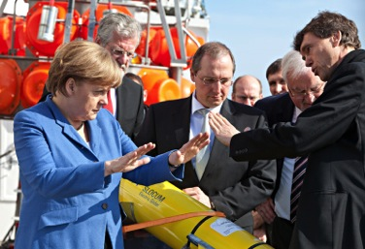
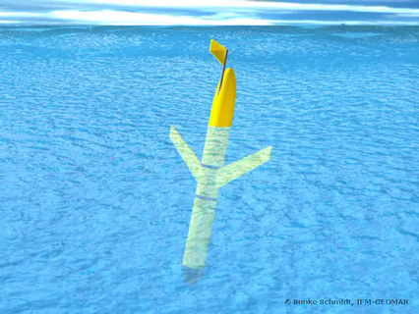
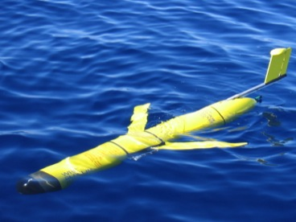
Infrastructure:
Autonomous Ocean Glider
Profiling the upper 1000m
Communication in real time
Endurance of up to 6 months
A wide range of electric sensors

Slide 19
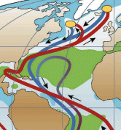
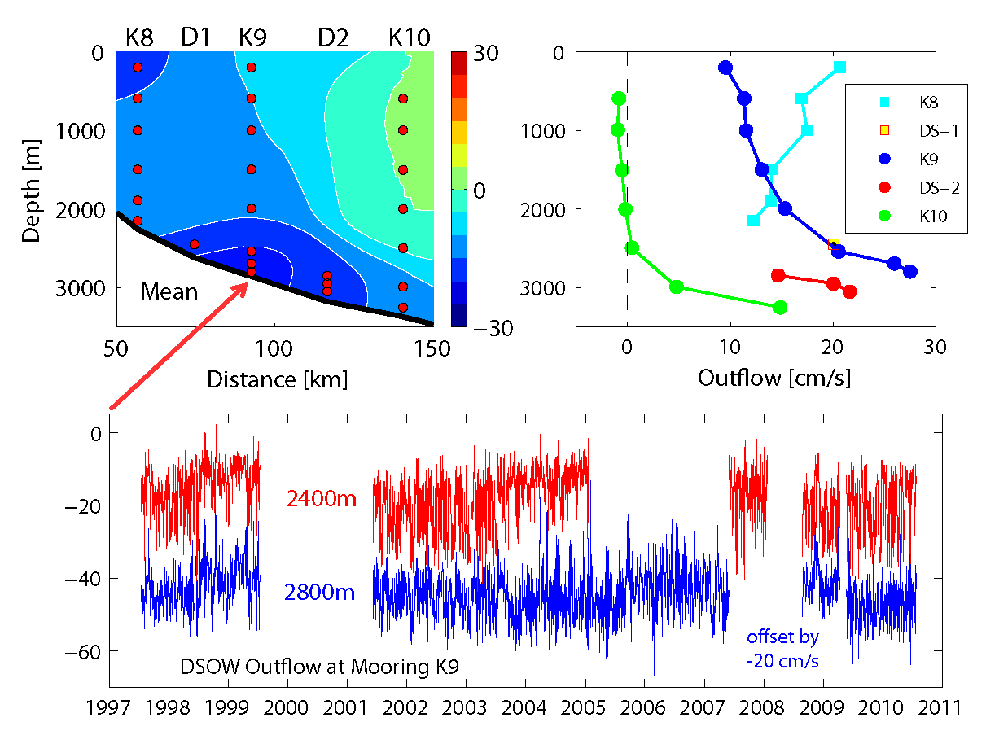
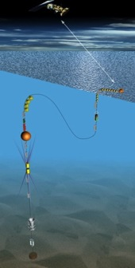
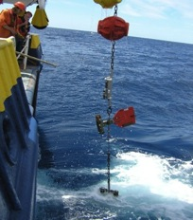
Infrastructure:
Ocean Observatories
Moored observatories are deployed to monitor many ocean paramter including the deep return flow of the Gulfstream system.

Slide 20
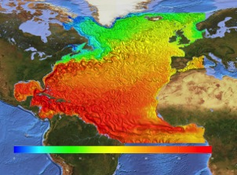
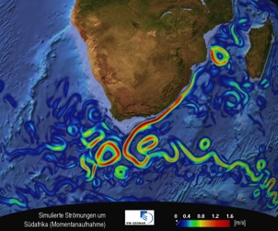
Modelling
Infrastructure
Ocean and climate modelling
Eddy-resolving models
Coupled models with chemical and biological feedback
Access to high-performance computing centres (Kiel, Hamburg, Stuttgart,..)

Slide 21
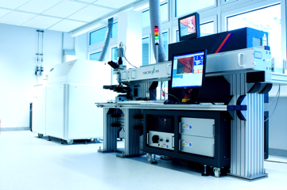
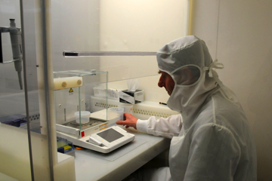
Mass spectrometry & clean-air labs
Infrastructure
Isotope and trace metal analytics
GEOMAR has more than 10 large mass spectrometry devices for high-resolution investigation of samples.

Slide 22
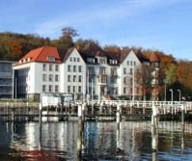
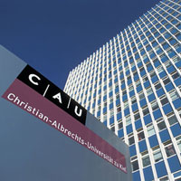
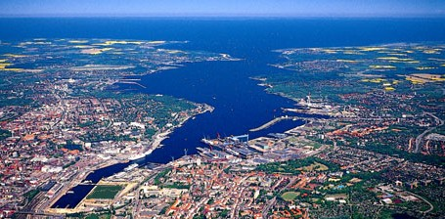
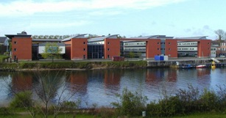
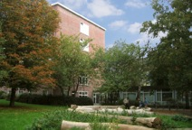
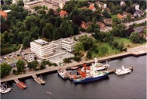
„Network of Kiel Marine Sciences”
Faculties of the
Christian Albrechts University
Kiel Institute
for the World Economy
GEOMAR
Helmholtz Centre for Ocean Research Kiel
MUTHESIUS
Academy of Fine Arts

Slide 23
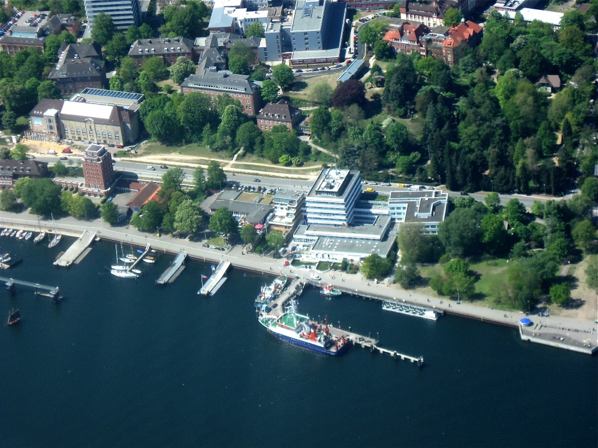
Welcome to Kiel!

