Slide 1
Introduction
Seaglider
EGO 2009
4th EGO Meeting and Glider School
16-20 November
Larnaca, Cyprus

Slide 2
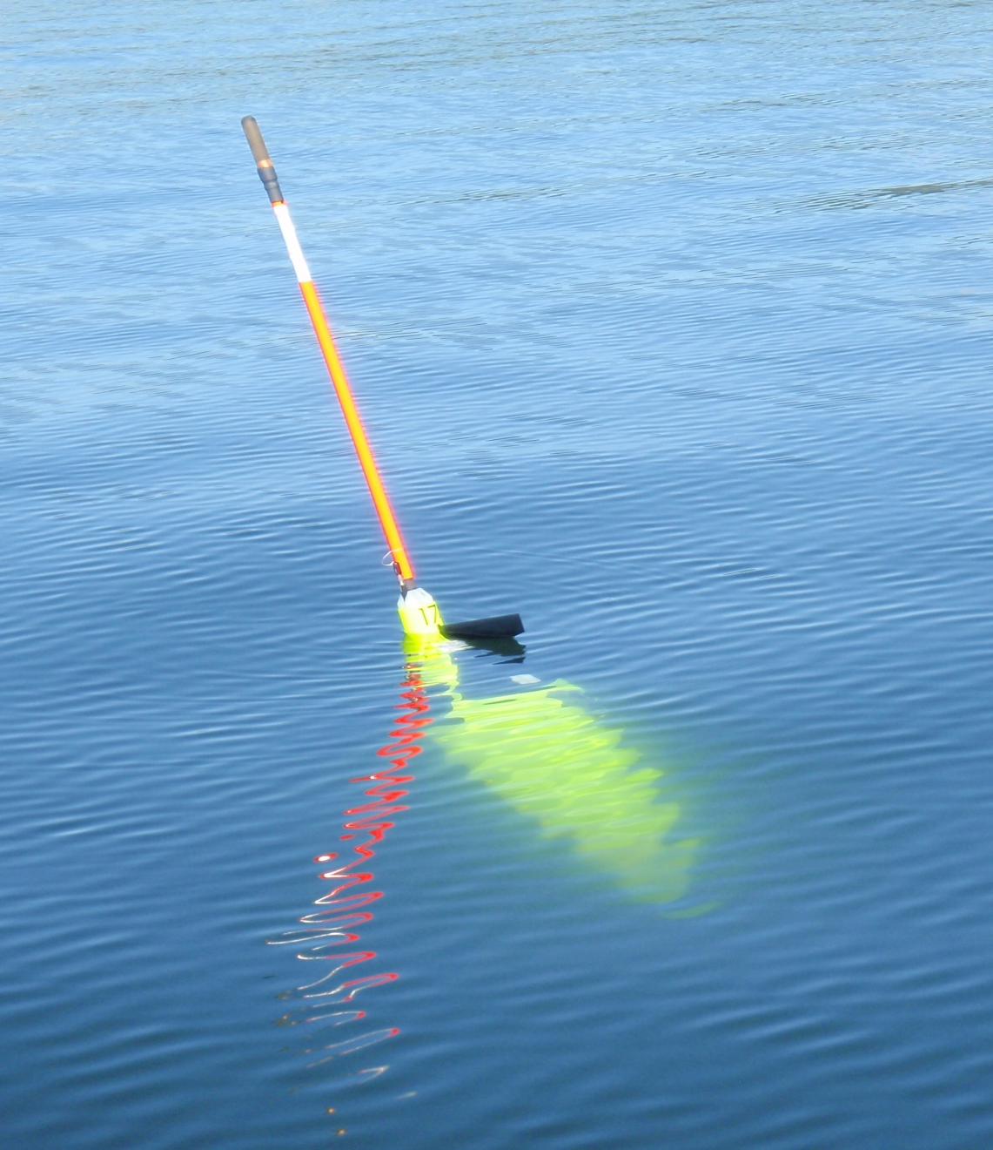
Unique Features of the Seaglider
Flooded fairing with low-drag shape
Iso-compressible pressure hull
Antenna on end of tail-boom - spar-buoy surface attitude
New version of lithium primary batteries for ~10 mo endurance
Two battery packs & voltages
No emergency drop weight - mass used for larger batteries - safeties covered by code

Slide 3
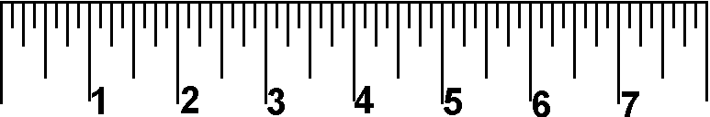

Specifications
Seaglider Specifications:
  Body Size: 1.8 m long, 30 cm maximum diameter
  Wing Span: 1 m
  Antenna Mast Length: 1 m
  Weight: 52 kg (dry)
  Maximum Depth: 1,000 m
  Maximum Travel Range / Duration: 6,000 km (650 dives to 1 km depth)
  Battery Endurance: Up to 10 months run time (mission dependent)
  Typical Speed: 25 cm per second (½ a knot)
  Glide Angle: 16° to 45° (1:3.5 to 1:1 slope)
  Size and weight allow launch and recovery by two people from a small boat. Ships can be used if desired; however, large oceanographic vessels with cranes and numerous handling capabilities are not necessary.

Slide 4
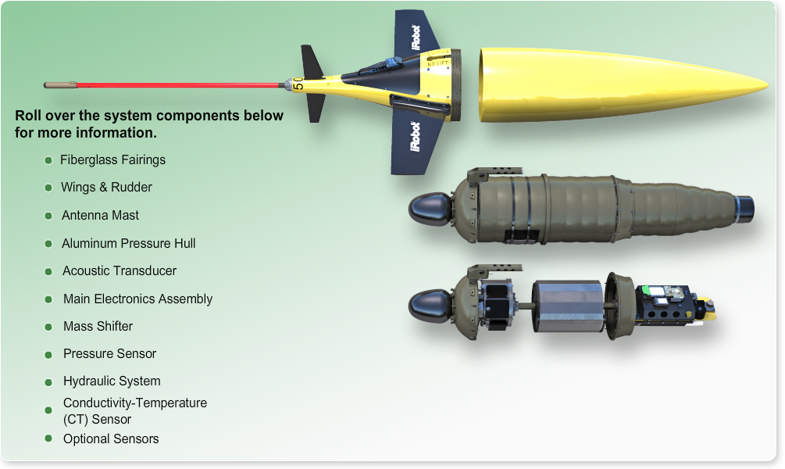
Seaglider Components

Slide 5
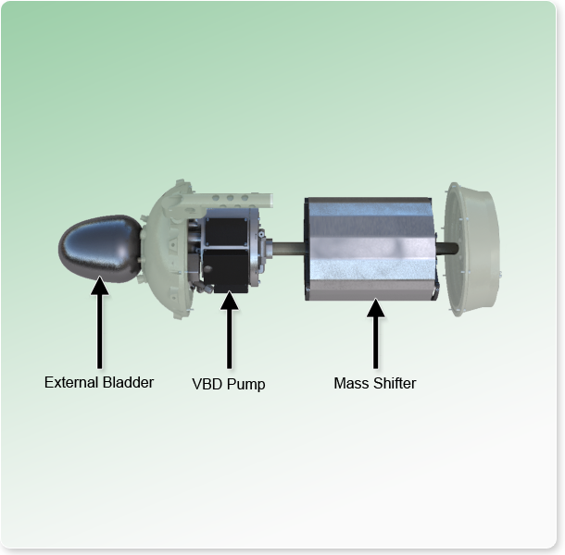
Control of Pitch, Roll and Buoyancy (VBD)
The Seaglider has electric motors that drives its sub-systems (the mass shifter and the hydraulic system). These sub-systems control pitch, roll, and buoyancy. Potentiometers are attached to these mechanical systems to identify their current positions at any given time.
Positions are measured in a range from 0 to 4095 analog-to-digital (A/D) counts, and are converted to engineering units such as cm for the mass shifter and cm³ for VBD.

Slide 6
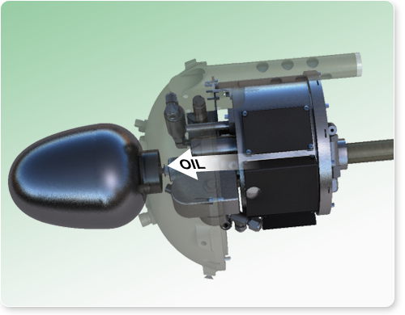
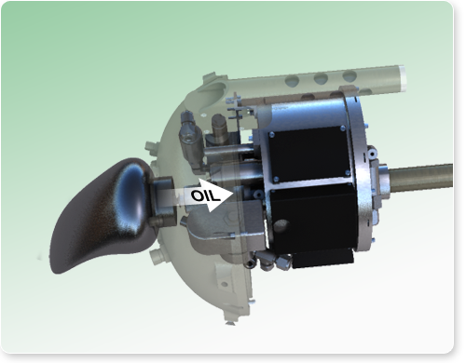
Variable Buoyancy Device (VBD)
The VBD is a mechanism used to control buoyancy. The main purpose of this hydraulic system is to maintain a specified total vehicle displacement by varying the size of an oil-filled bladder external to the pressure hull.
The system pumps oil from an internal reservoir to the external bladder to increase volume displacement, and allows oil to bleed from the external bladder to the internal reservoir to decrease volume displacement.

Slide 7
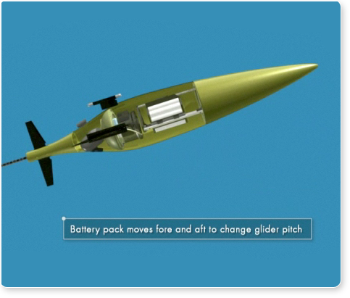
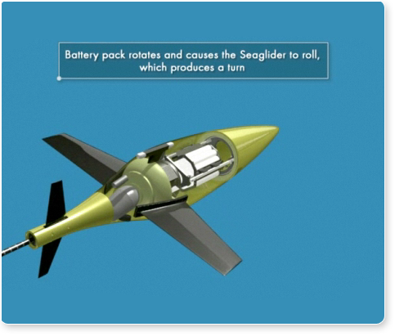
Pitch and Roll
Pitch
Roll

Slide 8
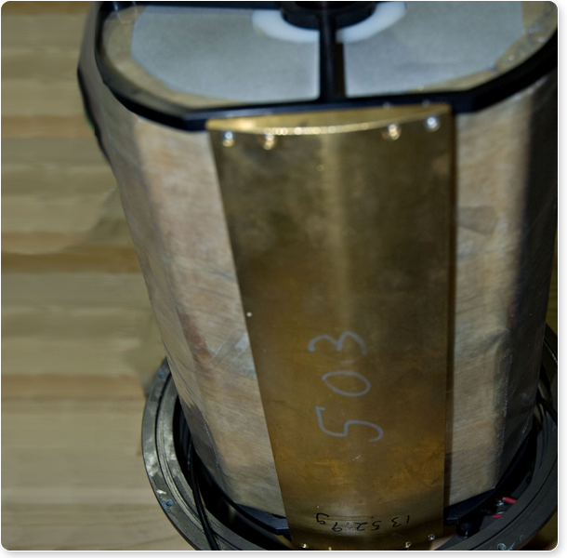
Mass Shifter
Shifting a large internal mass provides both pitch and roll control for maneuvering the Seaglider.
The high-voltage battery pack (~9.7 kg) and a brass weight below it (~1.3 kg) are moved fore and aft to change the pitch of the glider by moving the overall center of gravity fore and aft of the center of buoyancy.
The assembly is rotated about the center axis of the glider to change the center of gravity right and left (an effect of the brass weight) of the center of buoyancy to make the glider roll.
The Seaglider achieves static trim by the addition of ballast inside the fairings.
The position and amount of ballast is determined by mission and trim requirements.

Slide 9
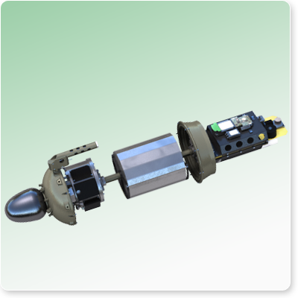
Conversion Factors and Gains
Conversion factors convert A/D counts to physical displacement of the mechanical design expressed in engineering units.
  The VBD conversion factor is often used to adjust trim.
  The VBD conversion factor is 4.077 A/D counts per cm³ of oil and is fixed by the mechanics of the pump system.
The gain of each system is the relationship between the control motion and the vehicle's response. Gains for pitch and roll are a function of the amount of mass and buoyancy and their location. Each glider is different.
  Roll gains vary around a 1:2 ratio, so to get 1° of vehicle roll, the mass shifter must be rolled 2°.
  Pitch gains vary from ~25°/cm to ~43°/cm, so to change vehicle pitch by 25°-43°, the battery must be moved 1 cm.
  The relationship between the movement of oil and the change in buoyancy is dependent upon the density of the surrounding water

Slide 10
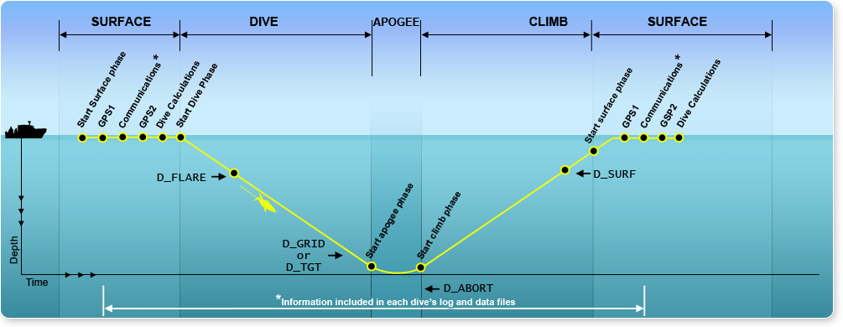
Dive and Run Phases

Slide 11
Operating Basics
Seaglider operating basics include:
Buoyancy change drives dive profiles.
  Buoyancy change provides a vertical velocity or vertical change in force.
Wings are propellers for forward motion.
  The wings provide hydrodynamic lift to propel the vehicle forward as it dives or climbs. The glider gets its lift from its body and wings, which convert the vertical velocity provided by the buoyancy engine (VBD) into horizontal (forward) velocity. The lift provided by the wings is responsible for horizontal movement. Changes in buoyancy only provide vertical movement.
Glide slopes vary from approximately 1:1 to approximately 1:5.
  The glide slope is represented as vertical distance covered to horizontal distance covered. The slope can be as steep as 45°, but ideally, it should be more shallow, such as 15° to 25°.
Horizontal speed is approximately 25 cm/s or 0.5 kts.
  The horizontal speed is equivalent to a slow walk or a very fast crawl. The Seaglider moves with the current when the current’s speed is greater than 0.5 kts. Currents are generally stronger in the upper 500 m range than they are below 500 m range. Therefore, in areas with strong surface currents, a glider is often able to make headway against the current by diving down underneath stronger currents.

Slide 12
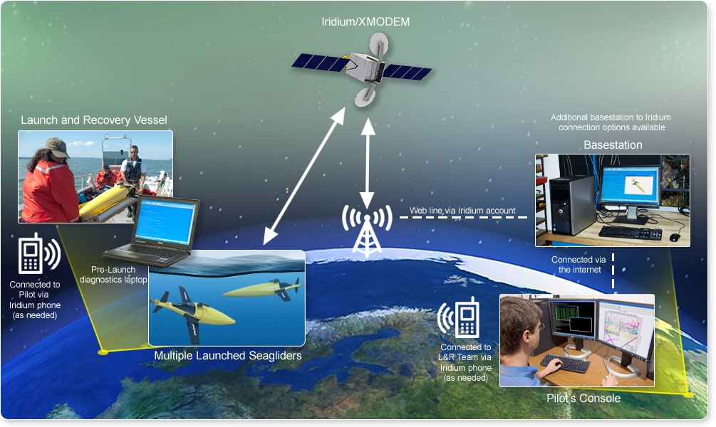
File Command/Transfer System

Slide 13
File Types – Control Files
Control files include:
  Command File (cmdfile) - Contains adjustable parameters to control the glider's operation.
  Science File (science) - Contains control for sensors in terms of depth ranges and sampling frequency, as well as how often the glider checks its guidance and control systems (i.e., heading, vertical velocity, and controls thereof)
  Targets File (targets) - Contains waypoint coordinates.
  PicoDOS Command File (pdoscmds.bat) - Contains picoDOS direct actions, such as resending dive files and changing targets out of sequence. The glider looks for this file on each call in to the basestation.
  For examples of control screens using this data and editors see:
    http://iop.apl.washington.edu/seaglider/

Slide 14
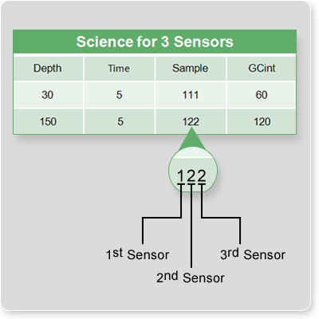
Science File
The pilot specifies science sampling intervals and guidance and control (G&C) intervals. S\he determines the bottom of the depth interval (in meters), base sampling interval (in seconds), sensor sampling multiplier (0-9), and G&C interval (in seconds).
Single-digit multipliers (0-9) are applied to the base science sampling interval for each sensor in the same order as given in the $SENSORS parameter. “0” disables the sensor in that depth interval. Here is how the sensor sampling multiplier works: For each row, the sample column contains three single-digit multipliers, with each applied to a different sensor. The first digit is the multiplier for the first sensor, the second digit for the second sensor, and so on. The glider multiplies the time by the digit that corresponds to the sensor’s order.
Here are the practical limits on sampling:
  No shorter than once every 4 seconds for CT.
  Bound on depth intervals is dependent on pressure sensor resolution - 2m minimum recommended.
  Choices here make a an impact on energy use as more samples and shorter G&C intervals use more processor and sensor power.
  The science file (science) is edited by the pilot, using a text editor of their choice, and kept in the Seaglider's home directory on the basestation.

Slide 15
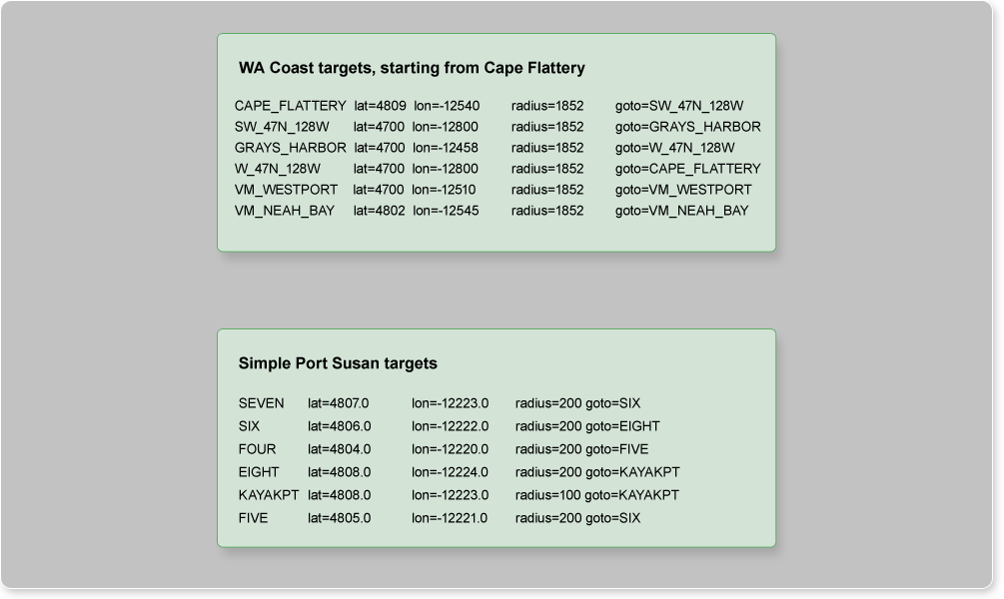
Target File
Waypoints are sometimes referred to as targets in the Seaglider flight path. Each waypoint is specified by name and contains latitude and longitude coordinates. The glider must surface within a certain radius of the waypoint to consider the target reached (+ or - x meters, set by the pilot). The pilot can change the active target via the Extended PicoDOS target command in the pdoscmds.bat file.

Slide 16
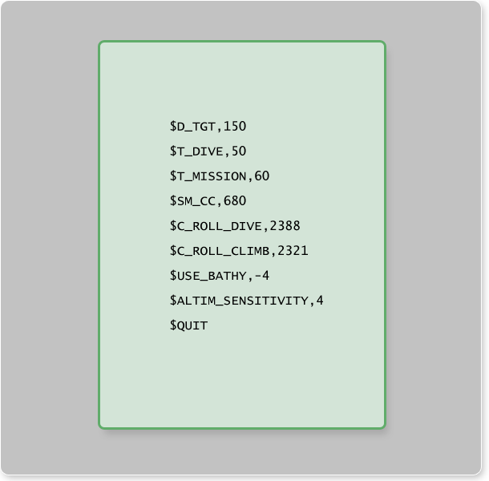
Command File
The Command file (cmdfile) is of considerable interest to the pilot, because it is used to control the Seaglider.
This file contains:
  One of three directives ($QUIT,$RESUME, $GO)
  Parameters

Slide 17
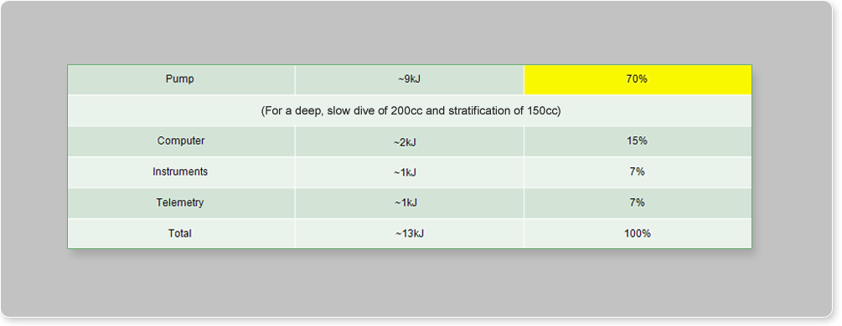
Energy Budget (for 1000-Meter Dive)
The VBD sub-system is the predominant energy consumer. Proper system tuning will allow for greatest energy efficiency.
The Seaglider flies half a knot on half a watt (½ knot ~ 25 cm/s ~ 1 km/hr).

Slide 18
Operating Basics (Continued)
Seaglider operating basics continued:
Forces acting on a glider are small.
  The variable volume is less than 2% of the full volume of the Seaglider (~51 liters) and the final trim ballast is typically less than 1% of the mass (~52 kg).
Pitch and roll trim are very sensitive.
  Pitch and roll systems are tuned during the first flights to find center points that will keep the glider performing at best efficiency. Small motions can have large effects, e.g., moving the pitch mass only 1 cm can change the Seaglider pitch by as much as 40° depending on ballasting and sensor configuration.
Halving the glider’s speed doubles its range.
  Drag is proportional to the square of speed, so halving the speed doubles the range (distance).
The main energy draw is the buoyancy pump.
  The buoyancy pump uses approximately 70% of the glider’s energy. So the depth of dives and the force developed from the VBD and stratification of the ocean are critical to mission length and duration. This affects how long the glider can stay out in the water before it must be recovered and its batteries changed.
  Seaglider batteries last the longest when dives are deep, slow, and occur in water that has little change in density.

Slide 19
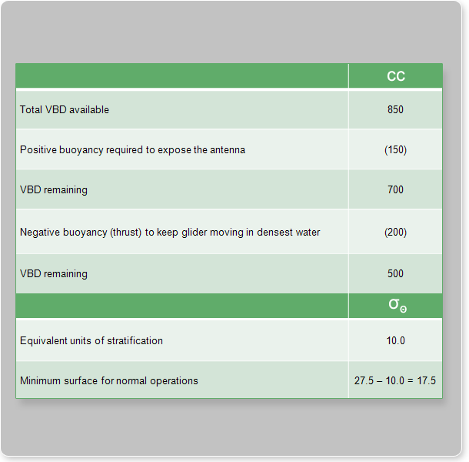
Allocation of Available Buoyancy
Here is a typical ocean example of allocation of available buoyancy. If you have a VBD system that has a grand total of 850 cm³ of potential range, which is the whole stroke of the VBD engine, you can find out how much stratification (or how much difference in the density between the deep water and the surface water) you can run a vehicle in. Here is how you find this out.
First, you want to take off some volume to get the antenna out of the water at the surface. (If you can’t get the antenna out of the water, you can’t communicate with the glider.) 150 cm³ is allotted to get the antenna out of the water. Subtracting 150 cm³ from 850 cm³ leaves 700 cm³.
An additional 200 cm³ is reserved for making the glider heavy at apogee to keep it moving (thrust). This number can vary from location to location. Subtracting 200 cm³ from 700 cm³ leaves 500 cm³. This is the total amount of buoyancy available for the mission. If you divide 500 by the rule of thumb of 50, you get the equivalent of about 10 σ_{τ} units.
If you have a bottom water density of 1023.0 kg/m³ and you subtract that 10 σ_{τ}, you could theoretically work in a surface water density of 1013.0 kg/m³.

Slide 20
Questions?

