Slide 1
NOC-MARS Update
Alvaro Lorenzo, Justin Buck

Slide 2
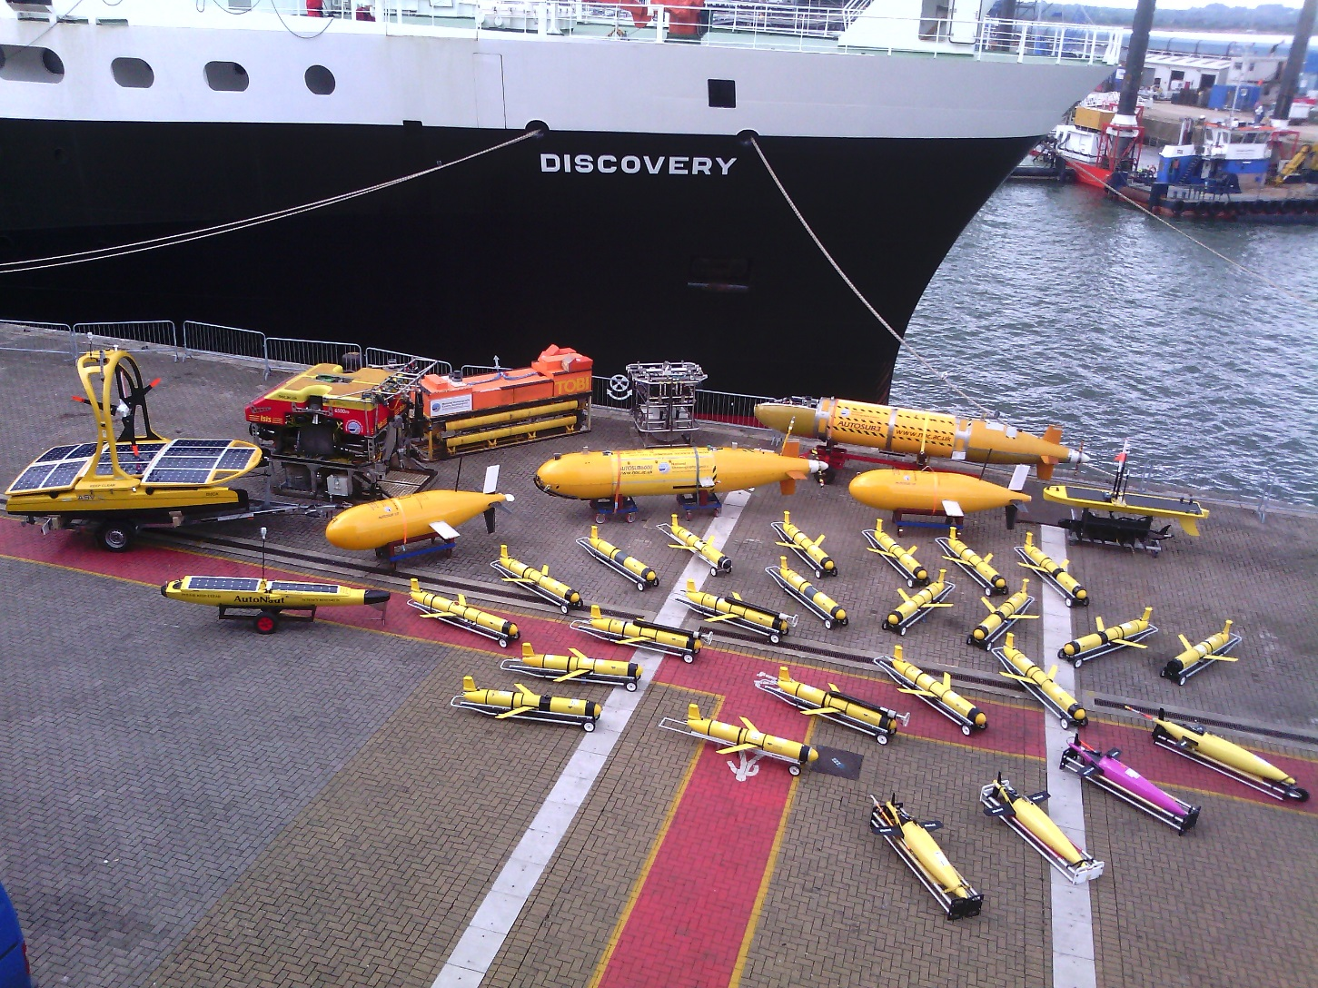
The MARS Fleet

Slide 3
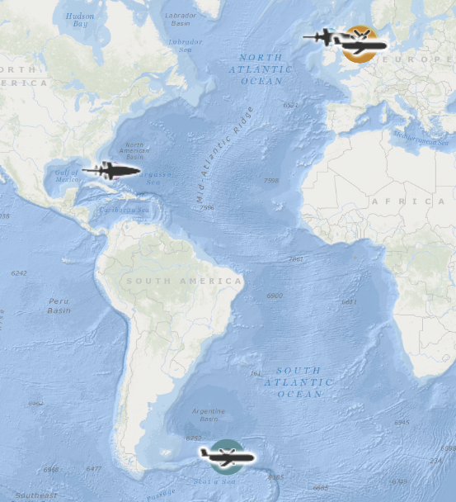
MARS Fleet - Deployments

Slide 4
MARS Fleet Deployments
 | NOC-MARS | SAMS | UEA | BAS | Total
2016-17 | 8 | 5 | 3 | 0 | 16
2017-18 | 18 + 5 | 9 | 0 | 3 | 33

Slide 5
Oceanids – Command and Control (C2)

Slide 6
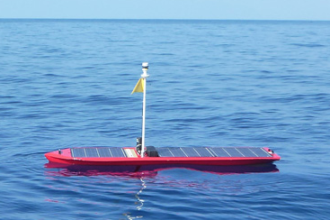
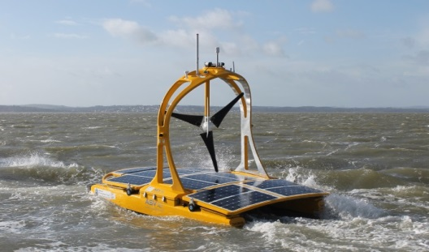
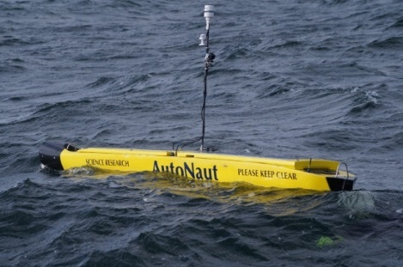
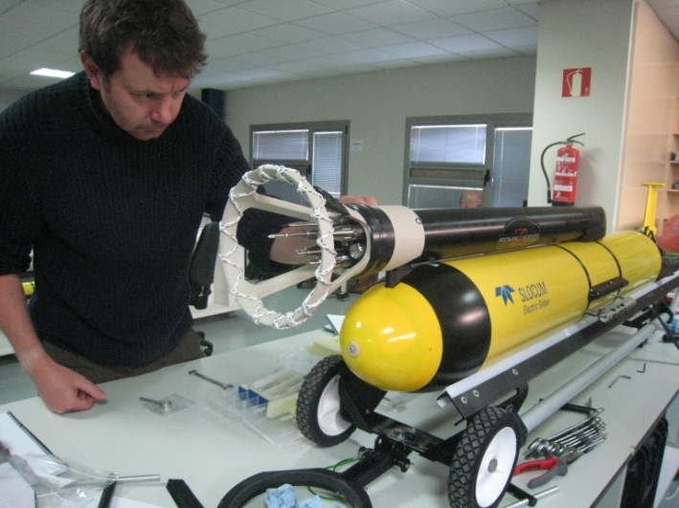
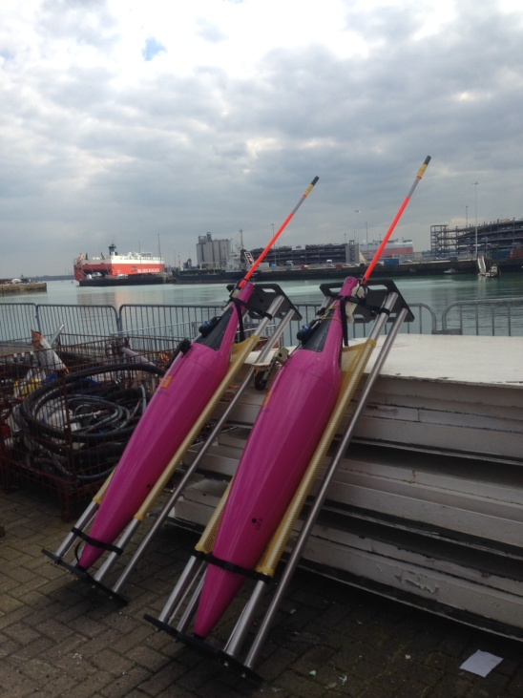
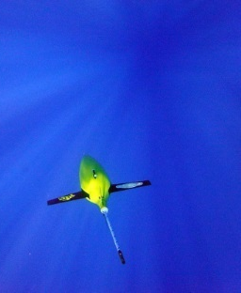
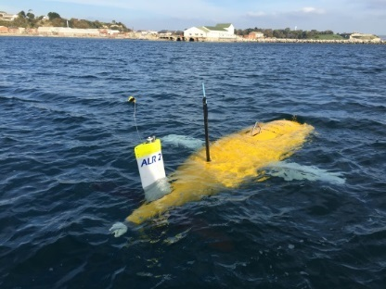
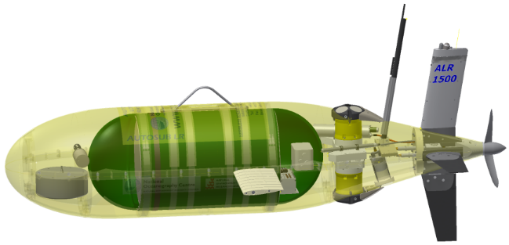
MARS Long Range Fleet
Unmanned Surface Vehicles
Underwater Gliders
Low Powered AUVs

Slide 7


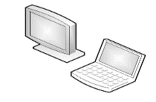
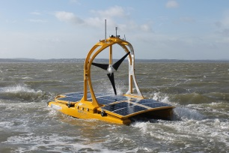
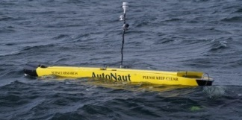
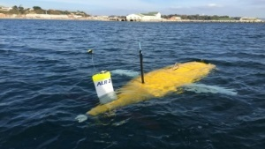

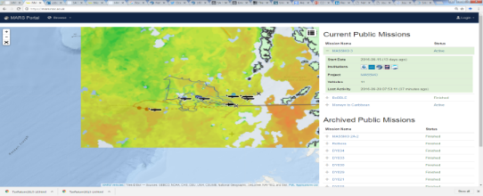
Fleet
Command and Control
Autosub
Long Range
Slocum
C-Enduro
Seaglider
Waveglider
Autonaut
Data Management
Data Visualisation
www.mars.noc.ac.uk
Science Data
Current Long Range Operations

Slide 8


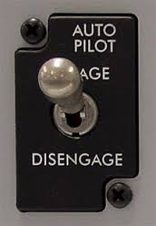




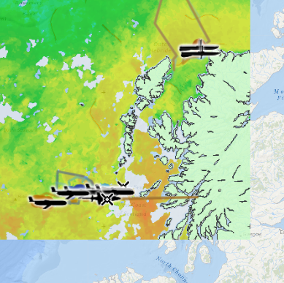




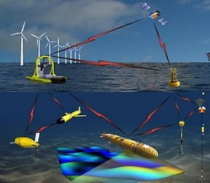
The New Loop
Unified Piloting Interface
www.mars.noc.ac.uk
Human pilots controlling a fleet of vehicles or autonomous control of the fleet with human oversight.
AIS,
Tides,
Weather,
Etc.
Science Data Products
Piloting Aids e.g.
Fleet Health Monitoring &
Mission Risk Assessment
Data Processing
Vehicle Missions
Oceanids - Integrated Command Control and Near Real Time Data
Consistent data formats e.g. NetCDF
Science Data
&
Engineering Data
Fleet Operations
Data Management
Science Data

Slide 9




Happy Scientist
Data Management
Unified Piloting & Visualization
www.mars.noc.ac.uk
Science Data

Slide 10
OCEANIDS C2 is an Engineering Project to develop a UK National System

Slide 11
BUT

Slide 12
It is also about the Data
BODC Is highly implicated in the project.
There is a dedicated WP to develop data infrastructure (WP3):
Glider Data Curation
Data delivery
There is a dedicated package to showcase the emerging data infrastructure (WP6).

Slide 13
Benefits for the UK Scientific Community
The project will give Scientists:
Quicker access to their data.
Better visibility of the state of the data.
A number of machine to machine tools to exploit the data.
Intuitive tools for mission planning and piloting, no matter what platform has been chosen.
Project Objectives
Project Objectives
Provide a unified infrastructure to pilot the NERC fleet.
Automate transfer and archiving of science data into the BODC
Implementing a straight forward access to the data.
Develop the infrastructure to allow piloting automation.
Provide the system as a National Infrastructure.
Provide a unified infrastructure to pilot the NERC fleet.
Automate transfer and archiving of science data into the BODC
Implementing a straight forward access to the data.
Develop the infrastructure to allow piloting automation.
Provide the system as a National Infrastructure.

Slide 14
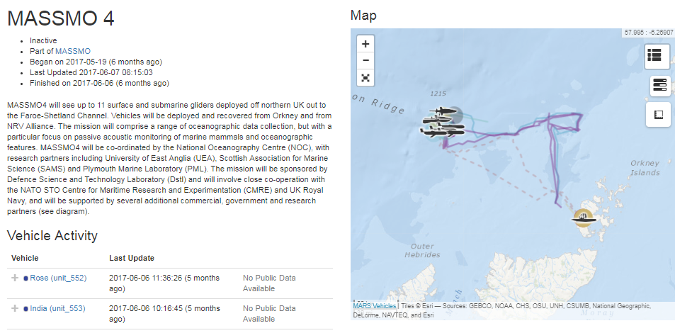
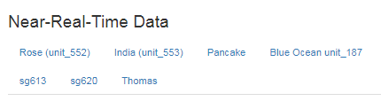
MASSMO04 – mock up of glider portal
https://mars.noc.ac.uk/missions/massmo-4
Data access to be included on portal

Slide 15
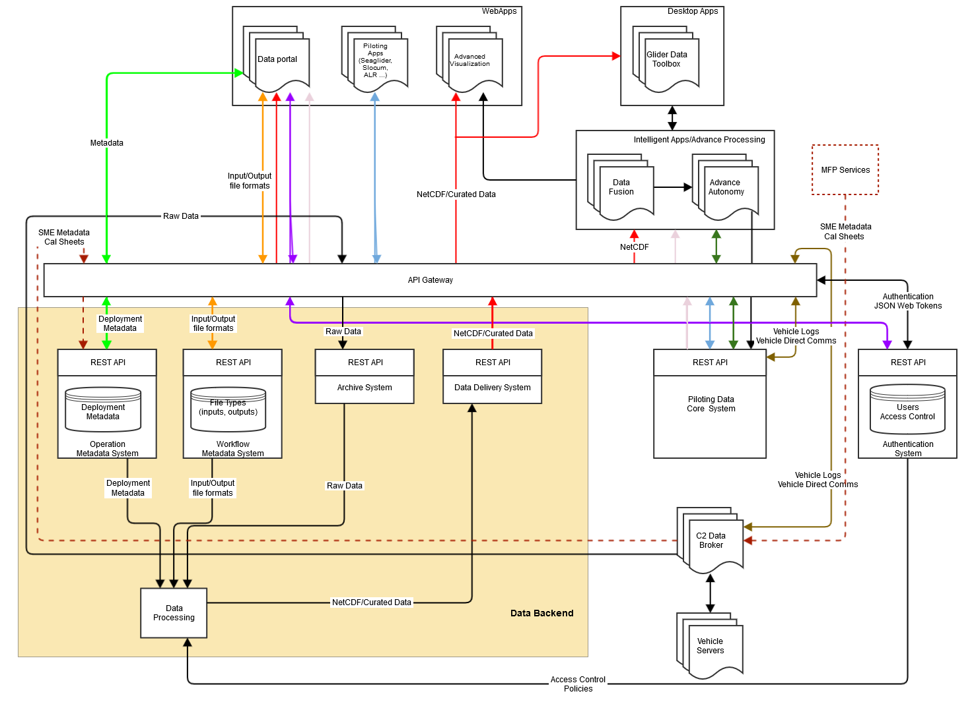
System Architecture
Pre – Release 2

Slide 16
Current status of C2 EGO data work
Done
Creation of the API gateway to access services
Basic glider metadata on API
Current development
Full deployment metadata
More robust archive system, enabling a push of data direct to archives
Automatic production of an basic EGO file (mandatory metadata/data only)
Future development
Creation of deployment metadata via MARS portal
Data dissemination (MARS portal, BODC, EGO, …)
Automatic production of an enhanced EGO file (non-mandatory metadata/data)
Automatic ingestion of recovery & delayed mode data

