Slide 1

WP3.4 SAMS Glider activity and plan
OUTLINE:
’Boundary Current’ missions since 2009
‘Boundary Current’ missions in 2017
AtlantOS mission 2017/18
Papers
Dissemination and Outreach activities

Slide 2
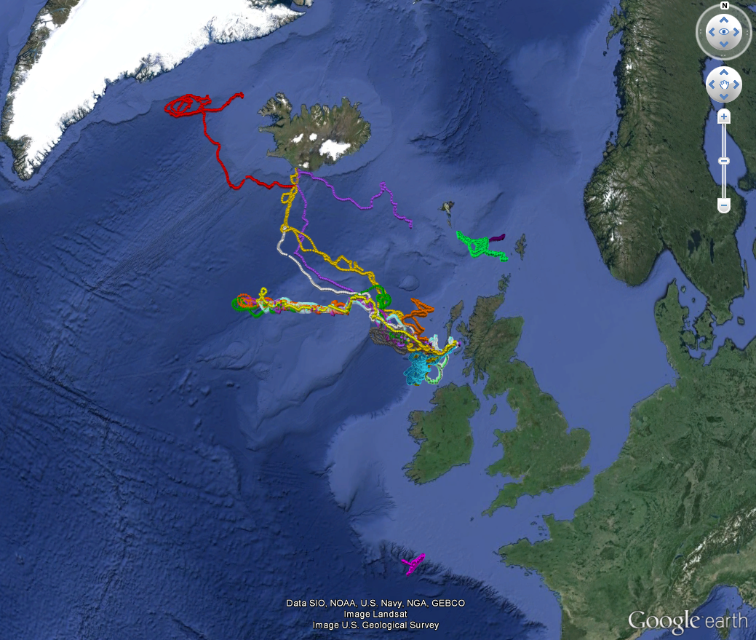
October 2009 until now:
27 missions
> 7 years at sea
> 27,000 dives
> 50,000 km
Notes:
2

Slide 3
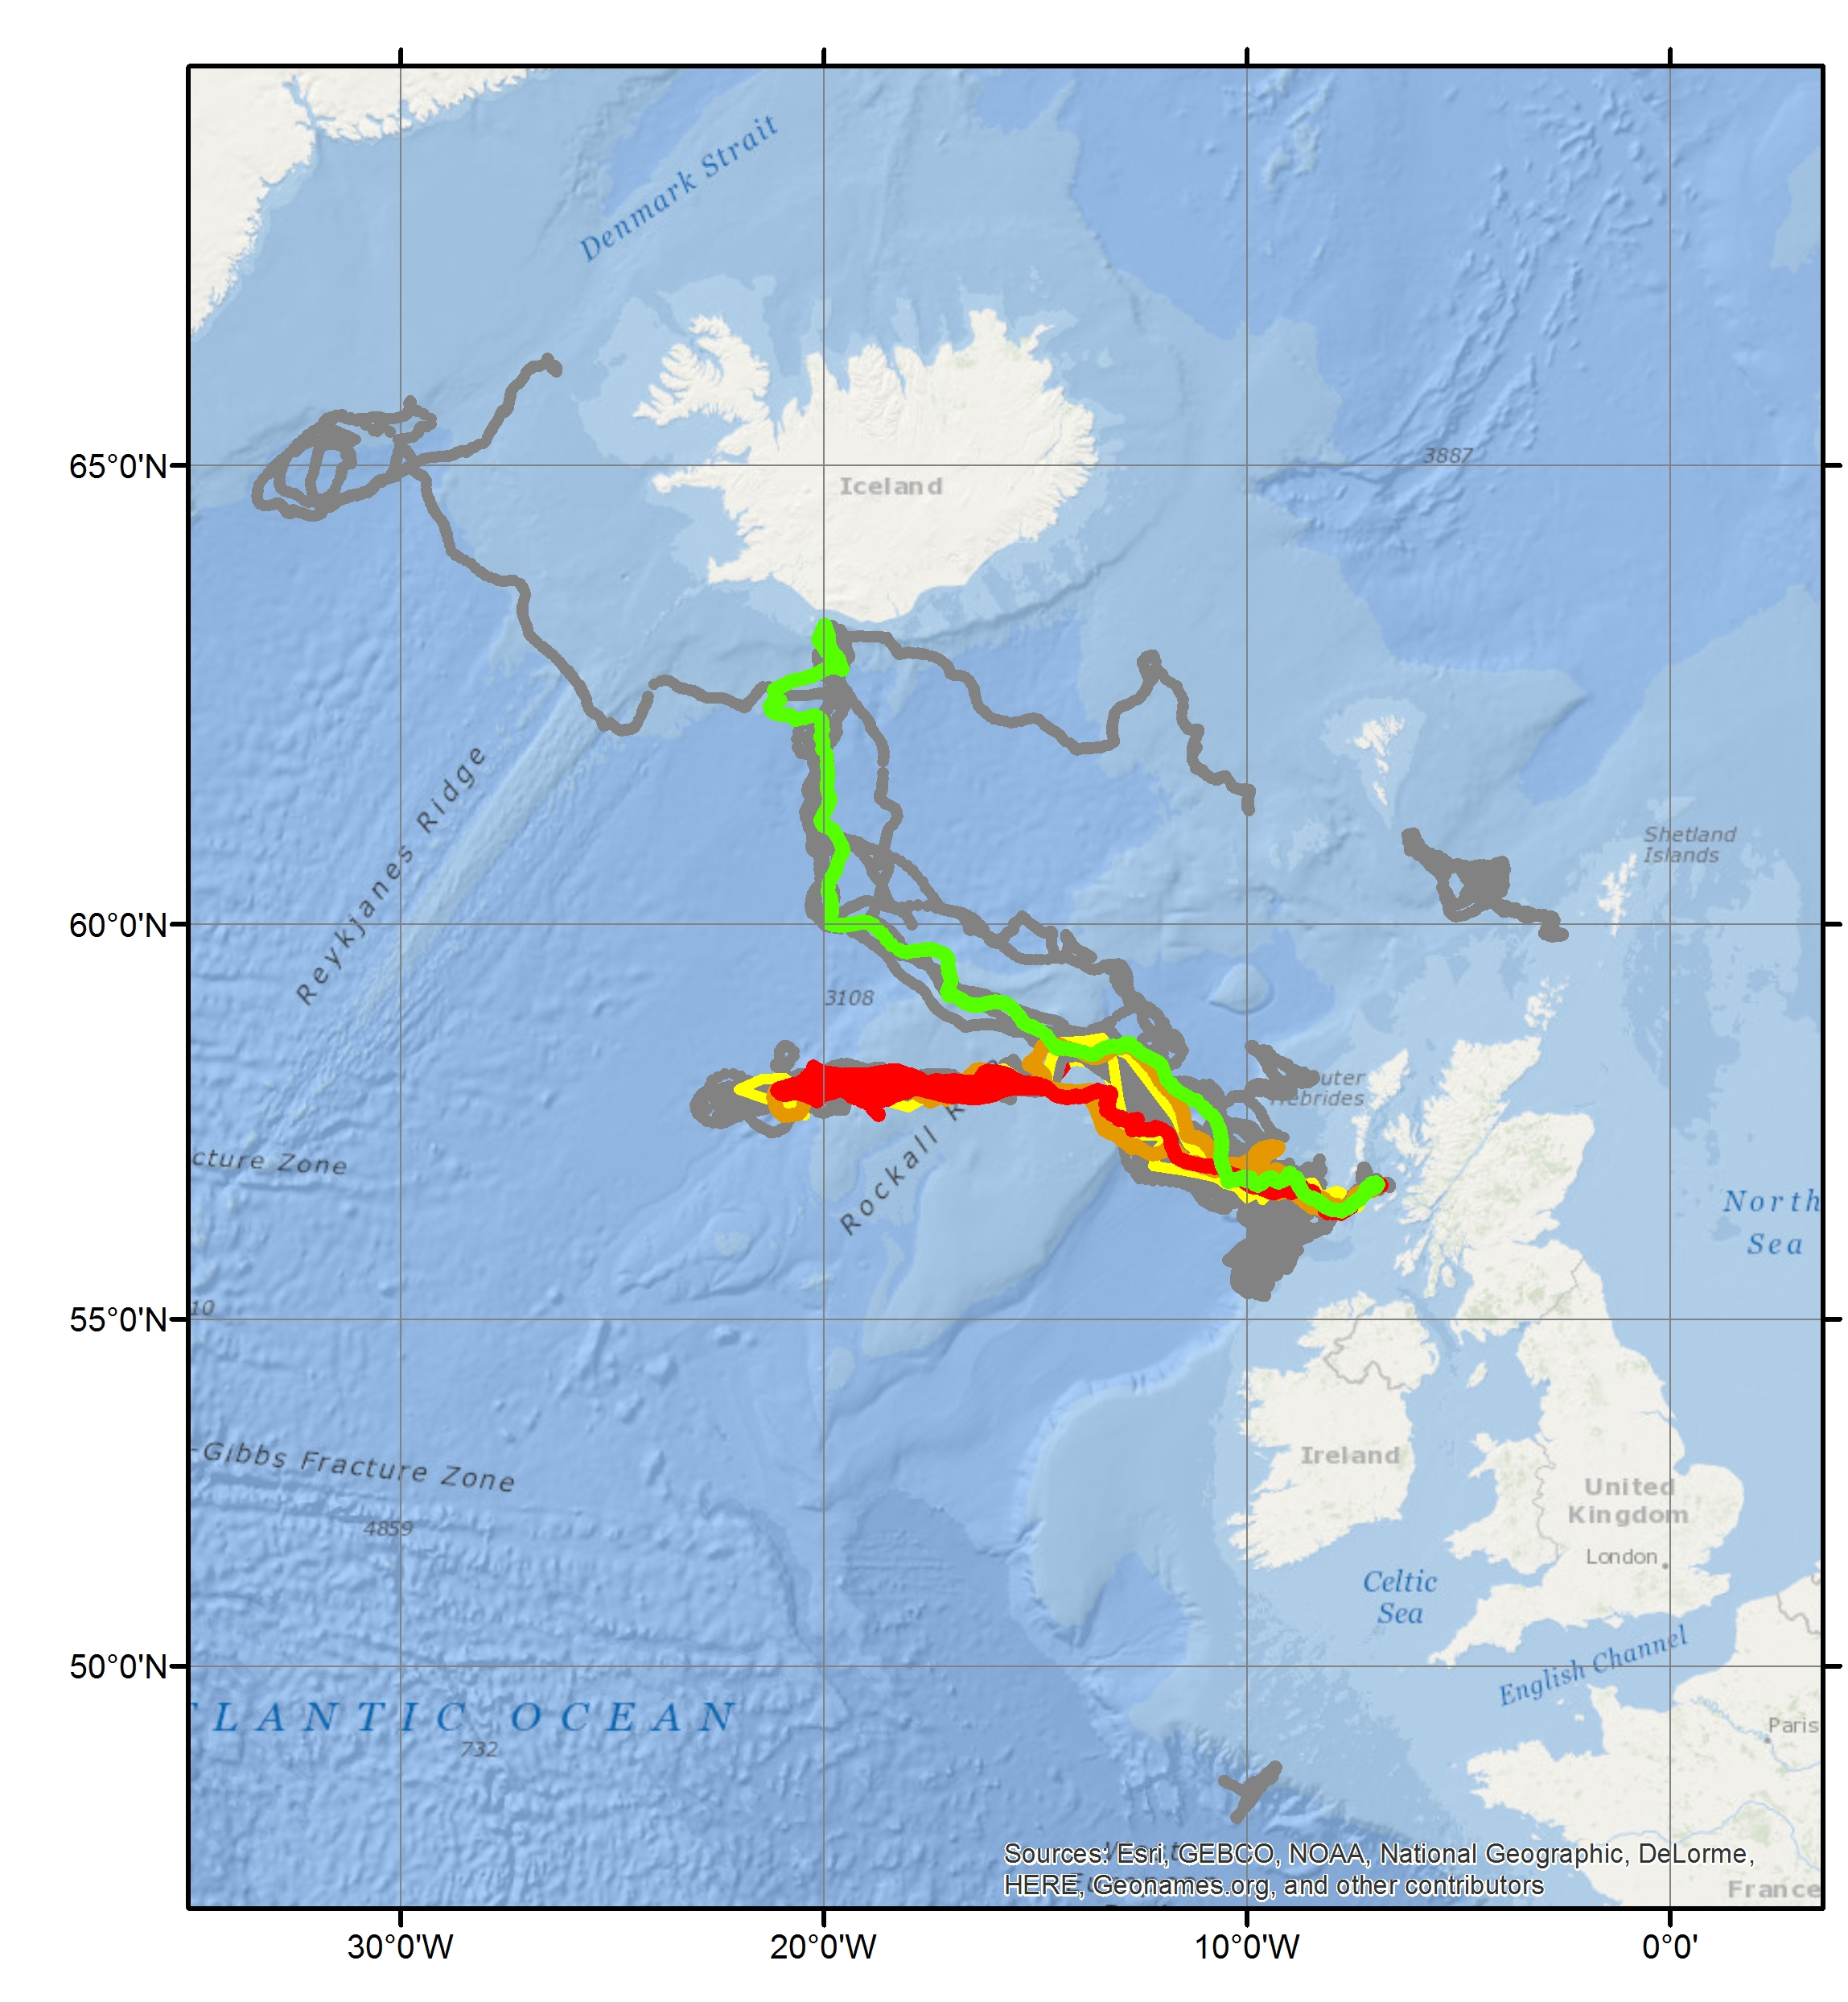
Since Jan. 2017:
- 5 missions
- 470 days at sea
- 4430 dive cycles
- 7670 kms travelled
- Growler, OSNAP7, Oct16 – Feb17
- Scapa, OSNAP8, Feb17 – May17
- Bowmore, EEL6, Feb17 – May17
- Bellatrix, OSNAP9, May17 – Nov17
- Jura, OSNAP10, Nov 17 – ongoing
Notes:
3

Slide 4
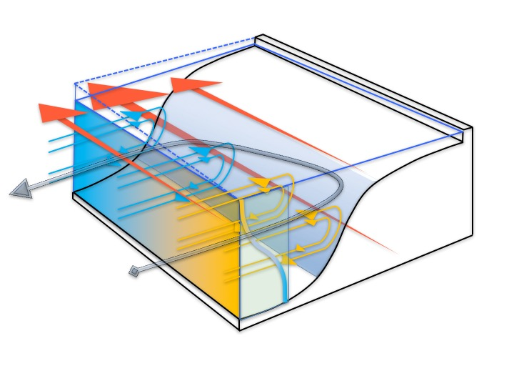
Oceanic density/pressure gradients and slope currents. Huthnance, Harle & Inall, JPO in prep “JEBAR” revisited.
AtlantOS mission 2018
New Seaglider with RSI turbulence package
10 repeat transects of European Slope current
Frictional controls on boundary currents

Slide 5
papers
Hall, R. A., B. Berx, and M. E. Inall (2017), Observing internal tides in high-risk regions using co-located ocean gliders and moored ADCPs, Oceanography, doi:10.5670/oceango.2017.220.
Houpert, L., M. E. Inall, E. Dumont, S. F. Gary, C. Johnson, M. Porter, W. E. Johns, and S. A. Cunningham (2017), Transport and energetic small structure of the Eastern North Atlantic gyre from observations, Journal of Geophysical Research, submitted.
Jones, S., F. Cottier, M. Inall, and C. Griffiths (2017), Decadal variability on the European continental shelf, Progress in Oceanography, under revision.
Marsh, R., I. D. Haigh, S. A. Cunningham, M. E. Inall, M. Porter, and B. I. Moat (2017), Large-scale forcing of the European Slope Current and associated inflows to the North Sea, Ocean Science, 13(2), doi:10.5194/os-13-315-2017.
Porter, M., M. E. Inall, A. C. Dale, J. Hopkins, J. A. Barth, M. Palmer, D. A. Smeed, D. Aleynik, and C. Mahaffey (2016), Glider observations of enhanced deep water upwelling at a shelf break canyon: a mechanism for cross-slope carbon and nutrient exchange, Journal of Geophysical Research, 121(10), 7575-7588, doi:10.1002/2016JC012087.

Slide 6

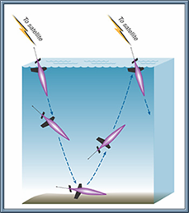
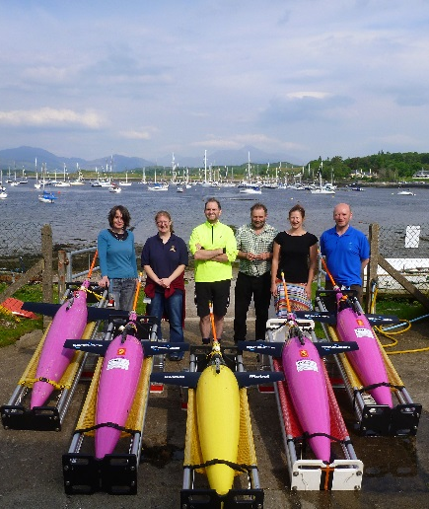
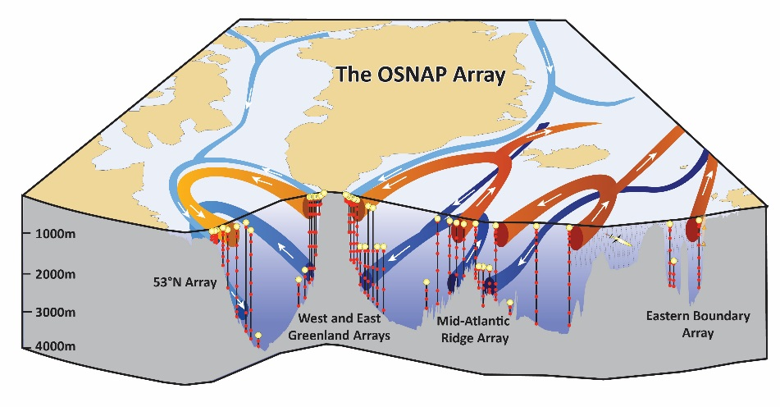



Overturning in the Subpolar North Atlantic Programme
Climatic impacts of warm Atlantic waters on northern European and Arctic systems
Houpert, L., M. E. Inall, E. Dumont, S. F. Gary, C. Johnson, M. Porter, W. E. Johns, and S. A. Cunningham (2017), Transport and energetic small structure of the Eastern North Atlantic gyre from observations, Journal of Geophysical Research, submitted.
Notes:
Challenge 1 – Ocean warming
$44M UK US Germany Canada
To what extent is warming in the sup-polar oceans imported into the Arctic and responsible for warming and ice loss.
Delivering Heat and declining nutrients and exporting fresh water.
For example – large loss of Barents sea ice strongly related to warming altantic inflow. Ditto for greenland ice sheets - but perturbations to atmospheric circulation it seems is equally important – we’ll come onto that in the next slide
Export of fresh water – slowing circulation – postentially cutting off the north sea from key oceanic nutrient source
--------

Slide 7
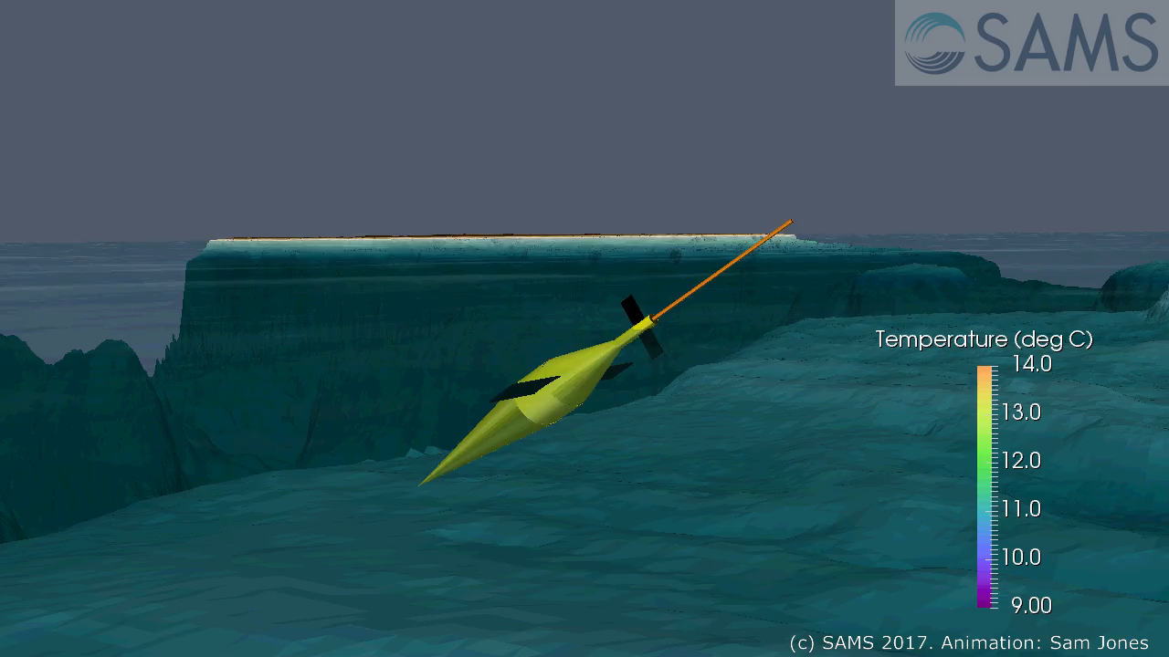
Outreach: paraview animations

Slide 8
Dissemination and communication activities
OceanGliders TaskTeams activities (Boundary Currents interests)
G7 Future of the seas and oceans initiative. Contributions to action plans (6-month, 2-years and 5-years) for Gliders in polar and boundary regions. Meeting in Paris, April 2017, and subsequent action plan preparation.
Inall, M. E., S. Jones, D. Aleynik, and E. Dumont (2017), MASSMO3: Comparison between glider data, WeStCOMS model and Hydrobase3 observational climatology. Report., SAMS, Oban.
Gliders as part of a multi-platform study (2016), M. Porter, M. E. Inall, J. Hopkins M. R. Palmer, A. C. Dale, D. Aleynik, J. A. Barth, C. Mahaffey, D. A. Smeed. Scottish Alliance for Geoscience Environment and Society annual general meeting.
Glider use in the seasonal ice zone (2017), Marie Porter, Finlo Cottier, Byongjun Hwang, Estelle Dumont, Emily Venables. UK Arctic Science Meeting September 2017.
Scottish Parliament engagement event: Gliders for environmental science. November 2017. Loic Houpert + Mark Inall + Stuart Cunningham.
Arctic Circle forum, Edinburgh 19-21 November 2017. Inall
Houpert L.et al., Transport Structure and Energetic of the North Atlantic Current in Subpolar Gyre from Observations. EGU General Assembly 2017, 23–28 April 2017, Vienna, Austria
Houpert L.,et al. Transport Structure and Energetic of the North Atlantic Current in the Eastern part of the Subpolar Gyre. 7th EGO Conference, 26–29 September 2016 Southampton, UK

