Slide 1
Ongoing and planned ocean glider activities at the University of Bergen
AtlantOS meeting, November 2017, Gran Canaria
Peter M Haugan and Ilker Fer with contributions from Anthony Bosse, Kjetil Våge and Benjamin Pfeil
Geophysical Institute, Bergen, Norway

Slide 2
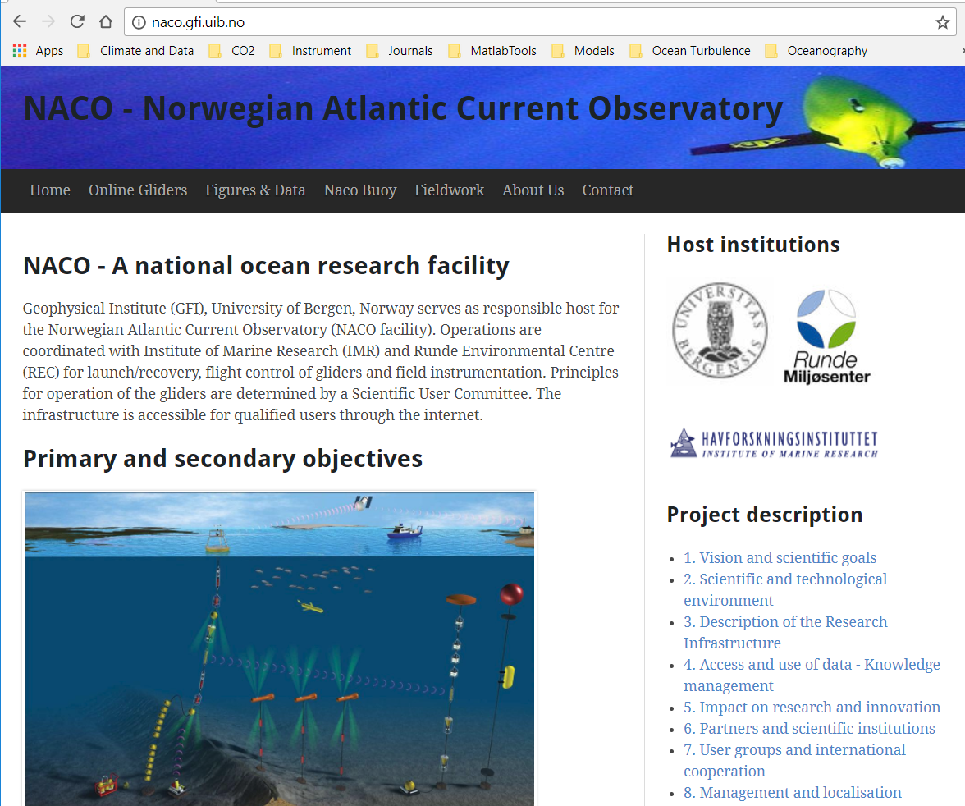
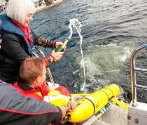
Norwegian Atlantic Current Observatory (NACO)
A national research infrastructure facility for ocean gliders since 2011
The first 5-y project goal was to monitor the Norwegian Atlantic Current
The infrastructure is available for other projects
6 Kongsberg Seagliders and 3 TDW Slocums
Web site: http://naco.gfi.uib.no
Realtime and historical data and tools: https://naco2.gfi.uib.no
NACO launch,
minister Tora Aasland
Notes:
Teledyne Webb Research Delivers Slocum Glider UC Davis

Slide 3
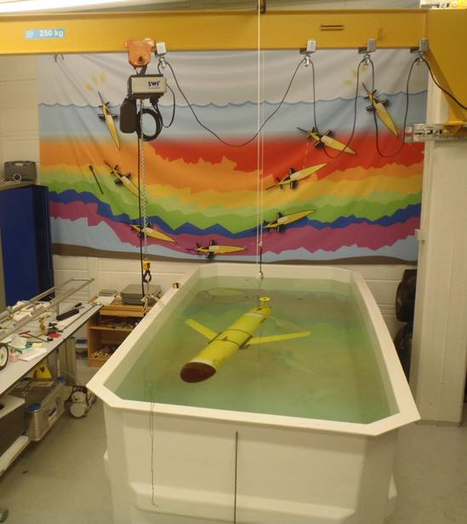
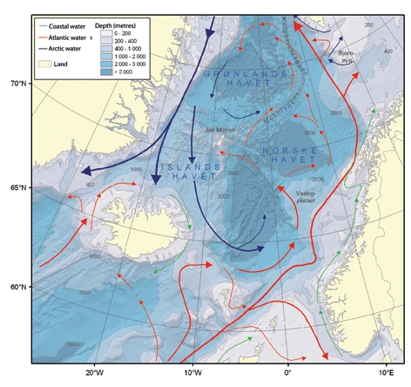
Svinøy and Gimsøy Sections; Station M
Ballasting tank in glider lab

Slide 4
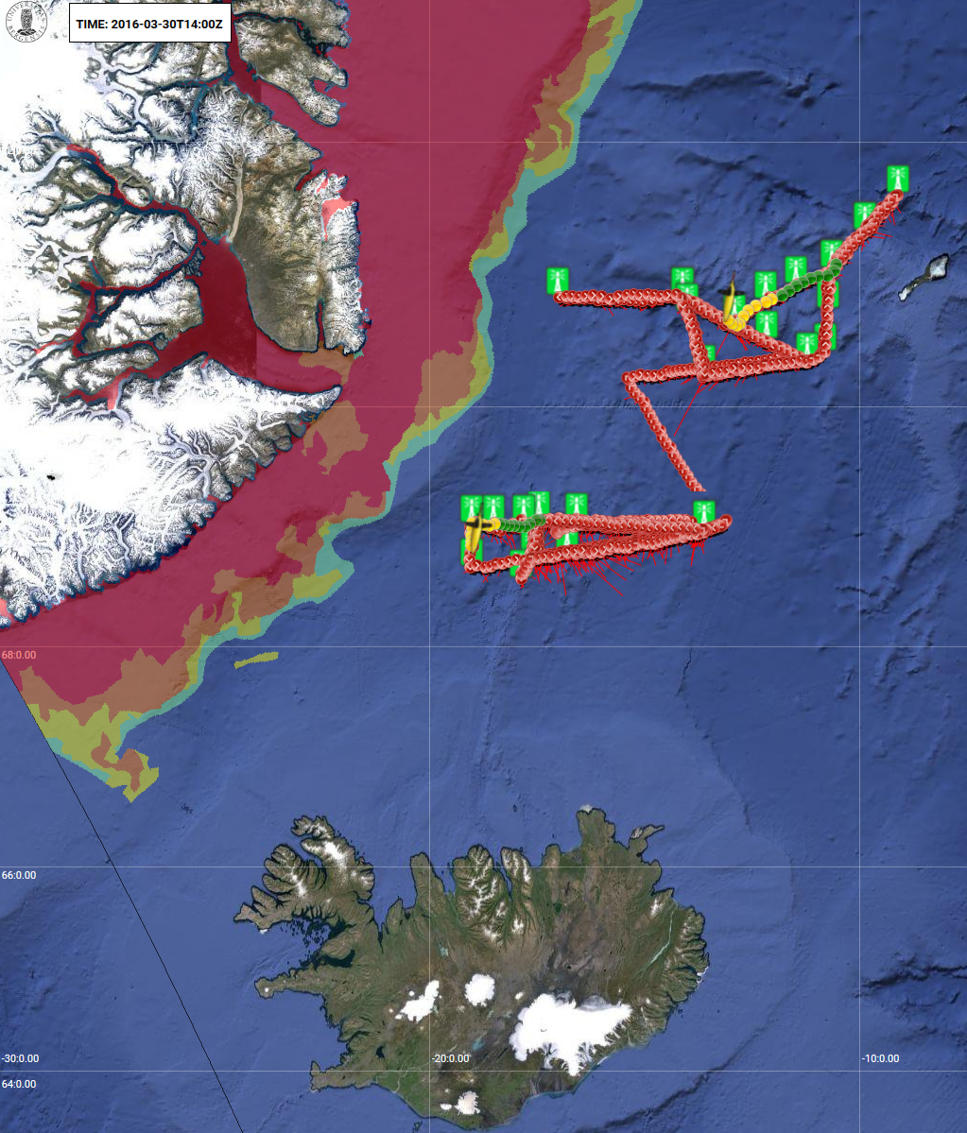
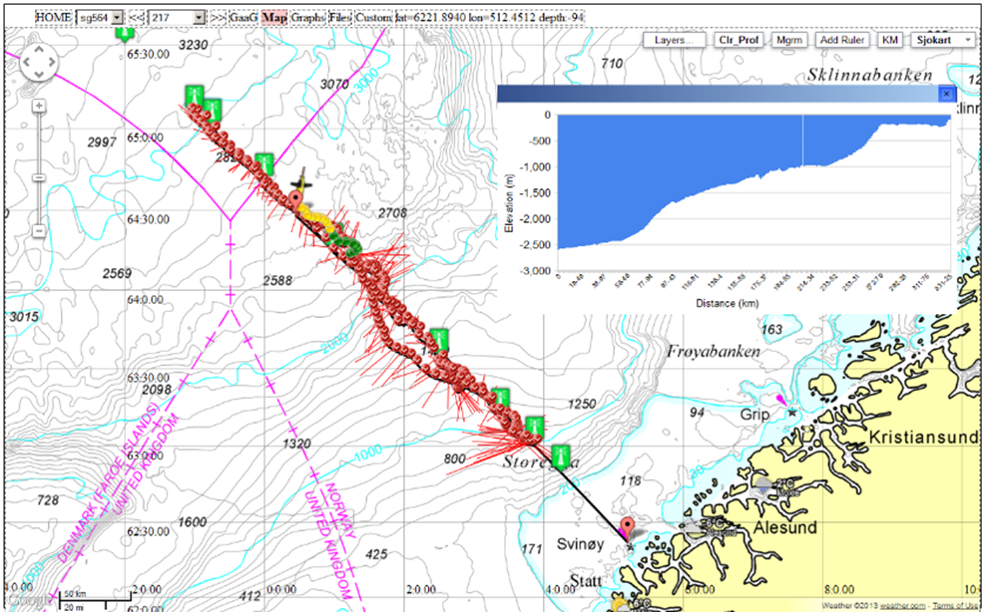
Piloting tool & Gliderpage developed at GFI
Missions in Norwegian Sea, Faroe-Shetland,
fresh water lake, coastal and fjord areas, Svalbard, Iceland and Greenland Seas

Slide 5
Web client based on Google Maps API v.3
Integration between Google Maps and
wms map data from statkart.no/geonorge.no,
weather data from met.no/yr.no,
CMEMS altimeter products; ice charts; etc.
Integration between map application and technical matlab plots
Profile and contour plots from science sensors
communication with base station for editing of cmdfile/science/target, copy of data- and logfiles, monitoring of technical condition of glider

Slide 6
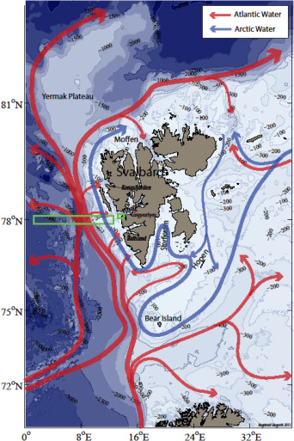
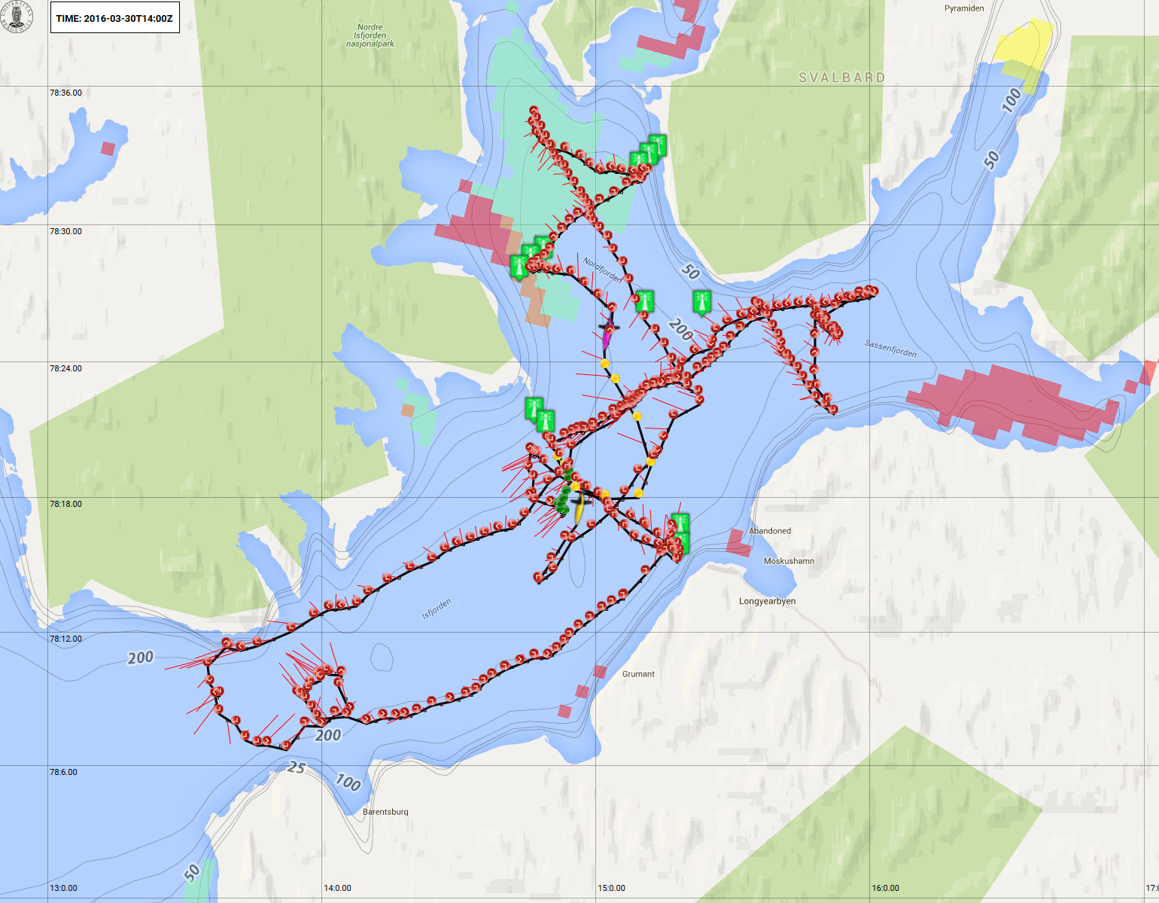
Slocum missions in Isfjorden, Nov 2014
Svalbard
Longyearbyen

Slide 7
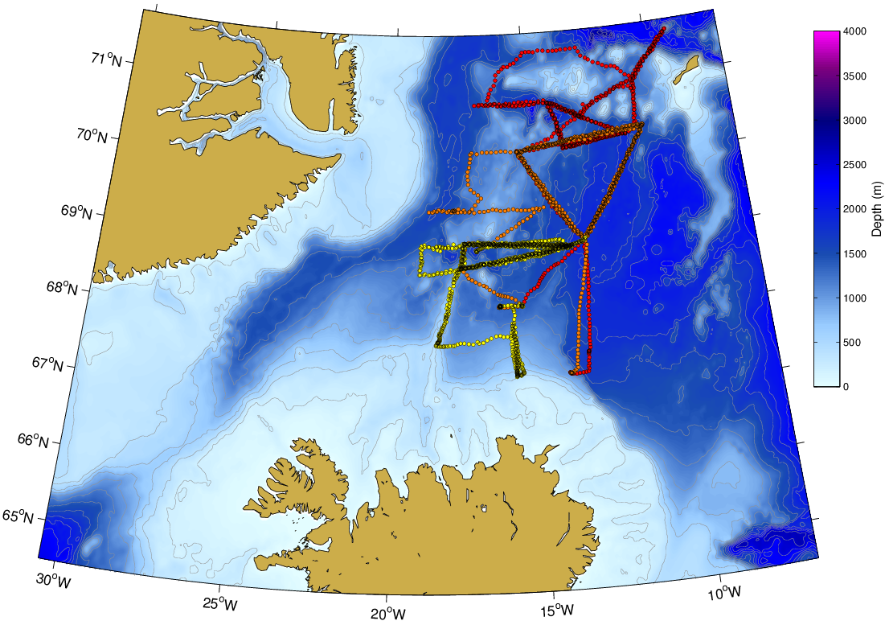
Water mass transformation in the Iceland and Greenland Seas
Purpose: Quantify evolution of seasonal mixed layer and map extent of convection
PI: Kjetil Våge
3 Seaglider missions
Aug 2015 - May 2016

Slide 8
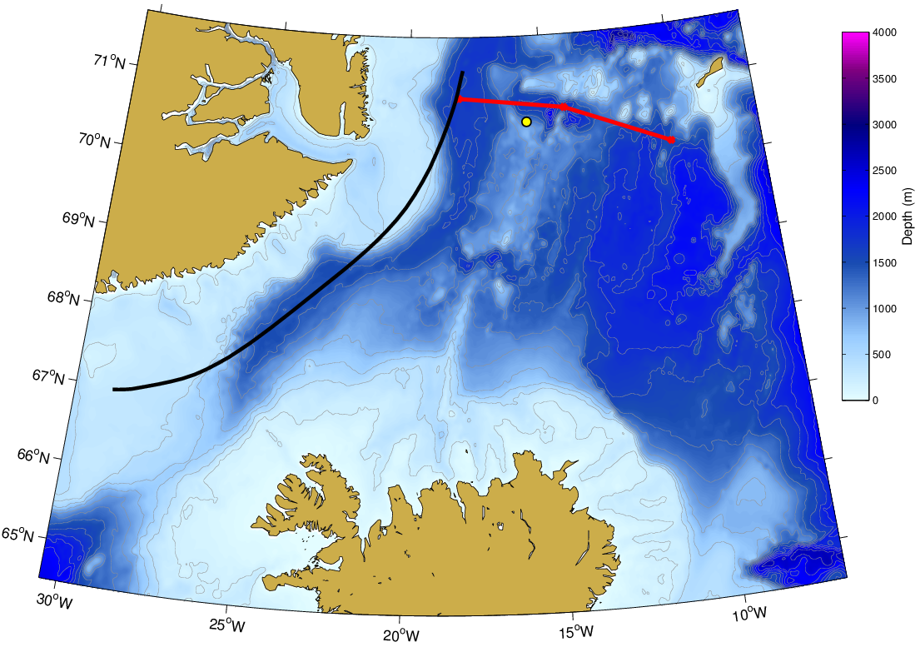
Glider track
Purpose:
Investigate water mass transformation in the vicinity of the ice edge
Mooring
PI: Kjetil Våge
1 Seaglider mission Oct-17 to Jun-18.
2 Seagliders with ice avoidance algorithm will be deployed in the Greenland Sea from Dec-17.
Ice edge (mean 50% sea ice concentration contour)
Notes:
Dec17 SG: explore the region between the ice edge and the center of the basin/gyre in the Greenland Sea, where we expect to see the deepest convection and the strongest air-sea fluxes. Those gliders will operate farther north, north of the West Jan Mayen Ridge and largely outside the domain of the map.
ice avoidance algorithm : the glider will be able to recognize conditions in which sea ice at the surface may be or is likely to be present (i.e. by registering sufficiently low temperatures and/or salinities). In that case, the glider will not surface. Depending on the instructions we've given the glider, it will either return toward a pre-defined safe location and surface when it determines that it is safe to do so or continue a pre-set number of dives in the same direction before turning around.

Slide 9
Water mass transformations in the Lofoten Basin
PI: Ilker Fer
Lofoten Basin eddy evolution from 3-years of NACO data from 6 Seaglider missions
Yu et al. (2017, JGR)

Slide 10
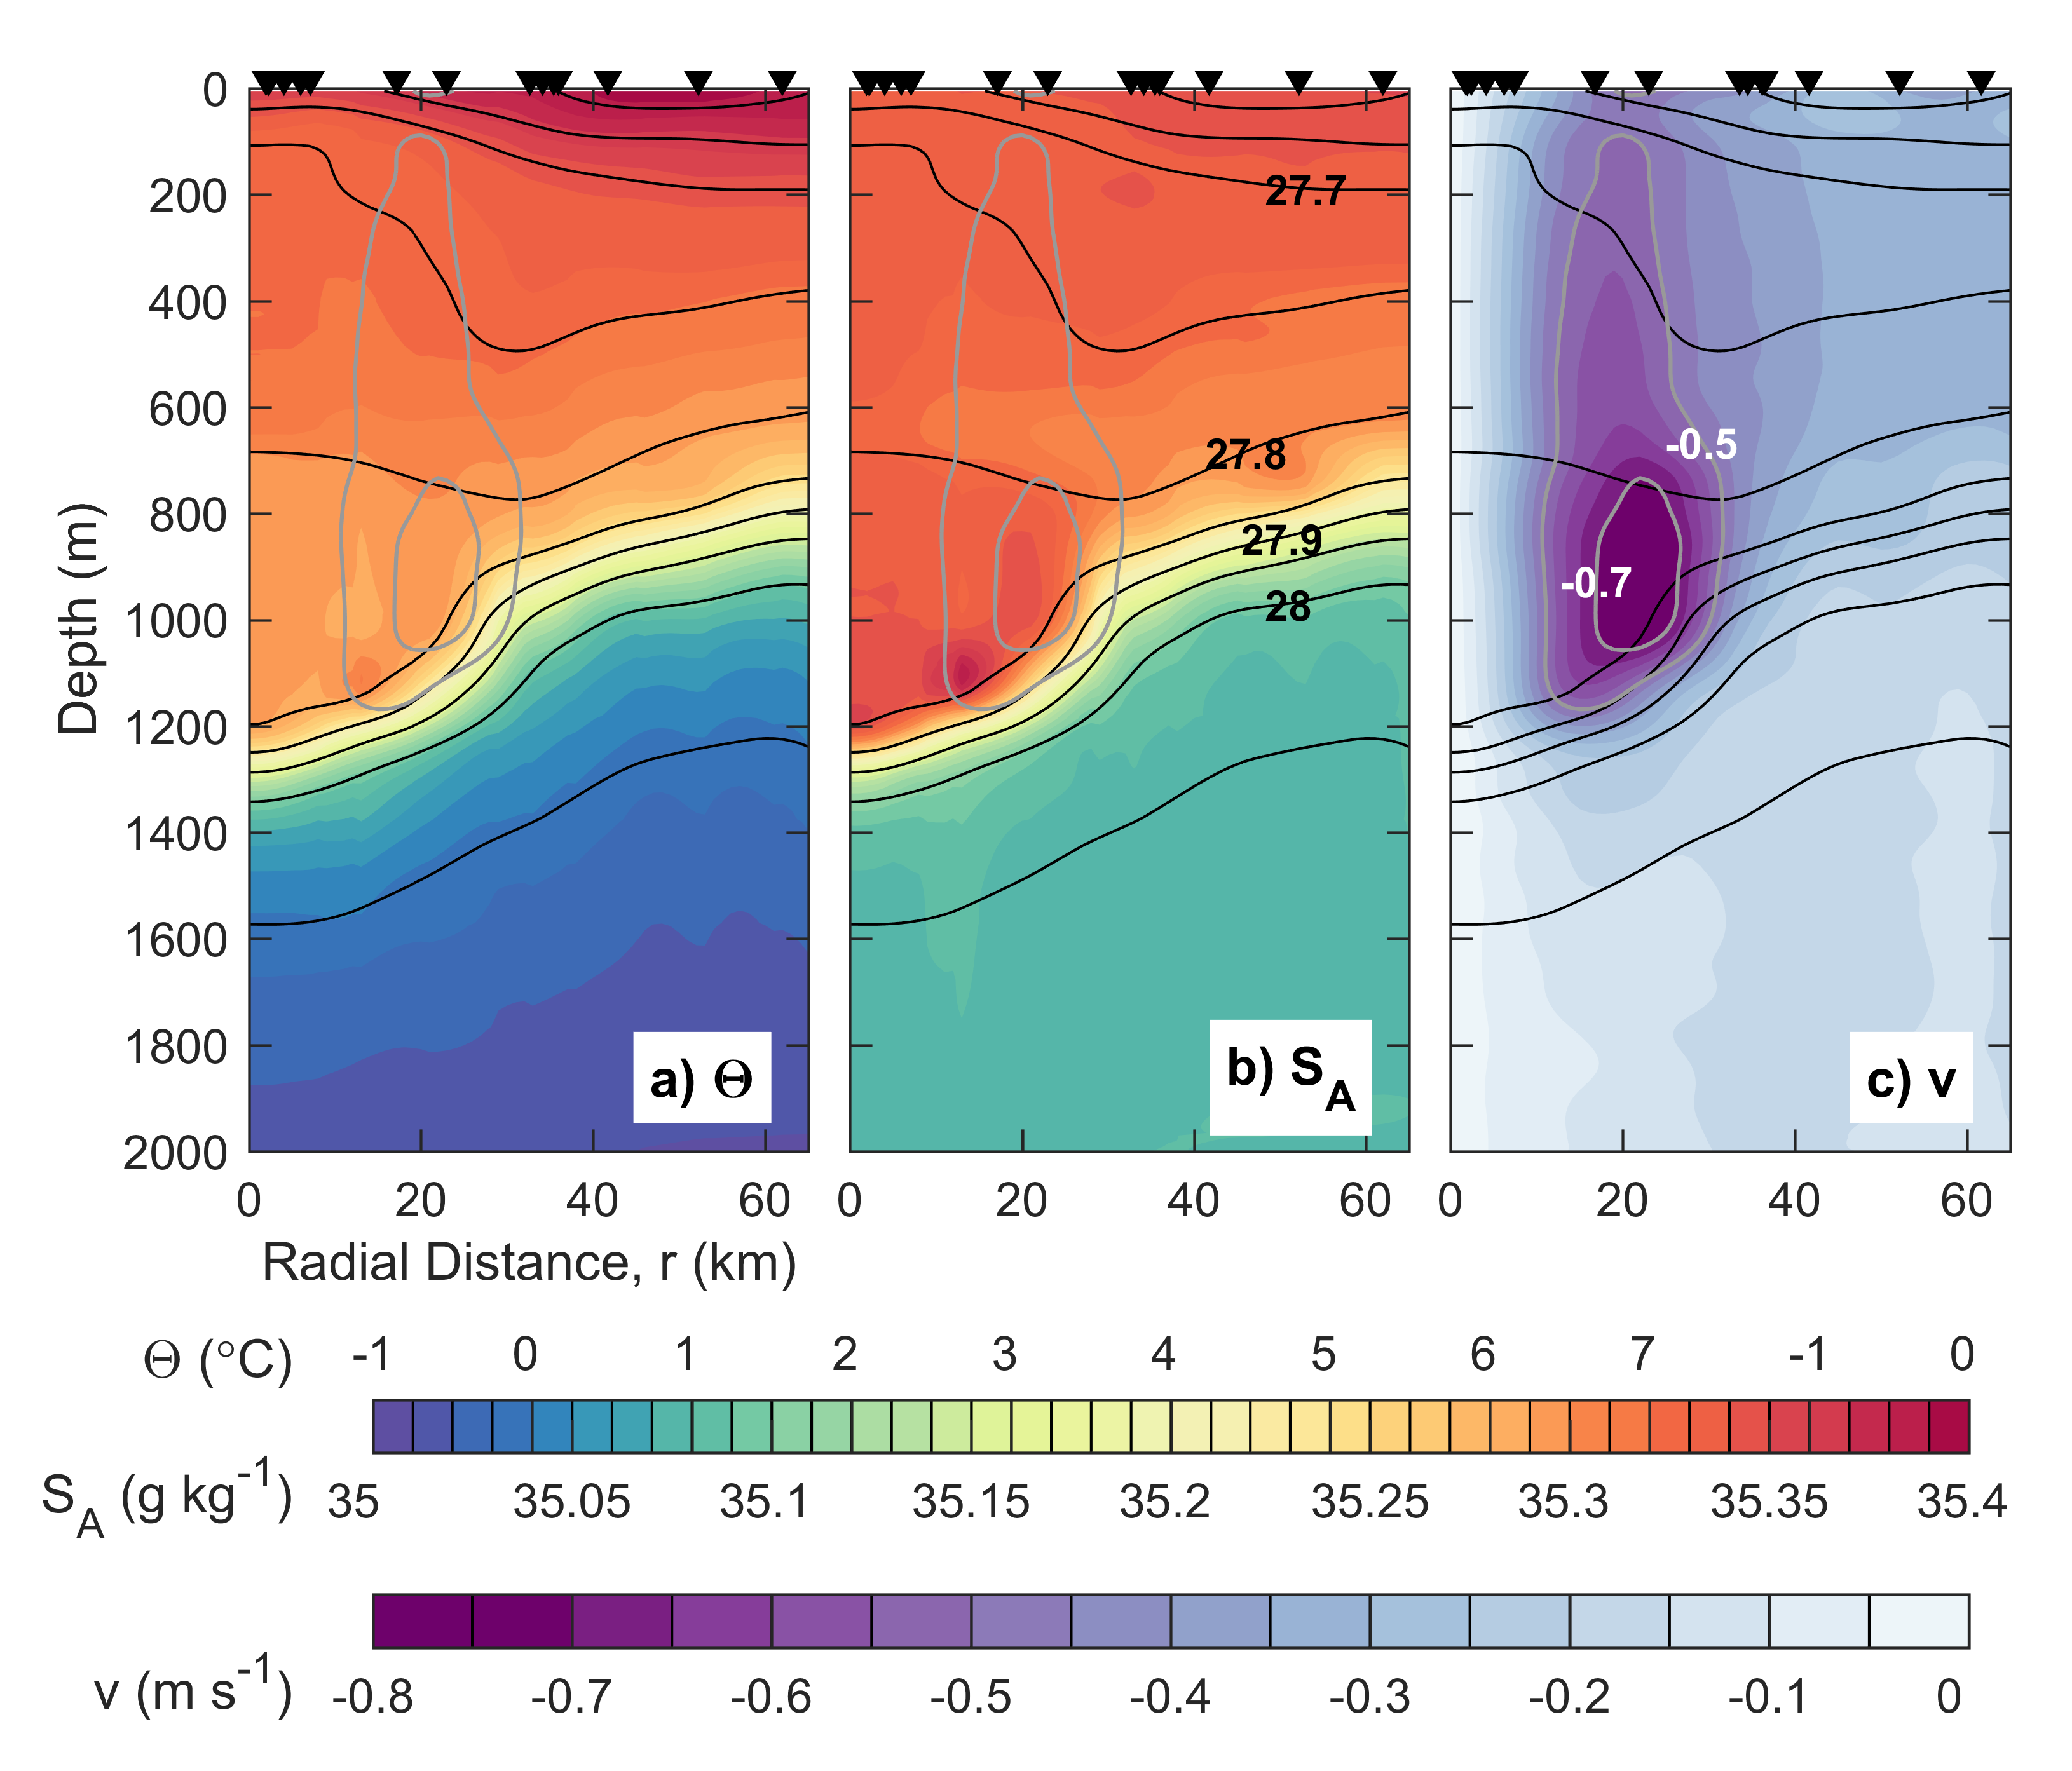
A snapshot radial section of the Lofoten Basin eddy:
Temperature, salinity, and azimuthal velocity

Slide 11
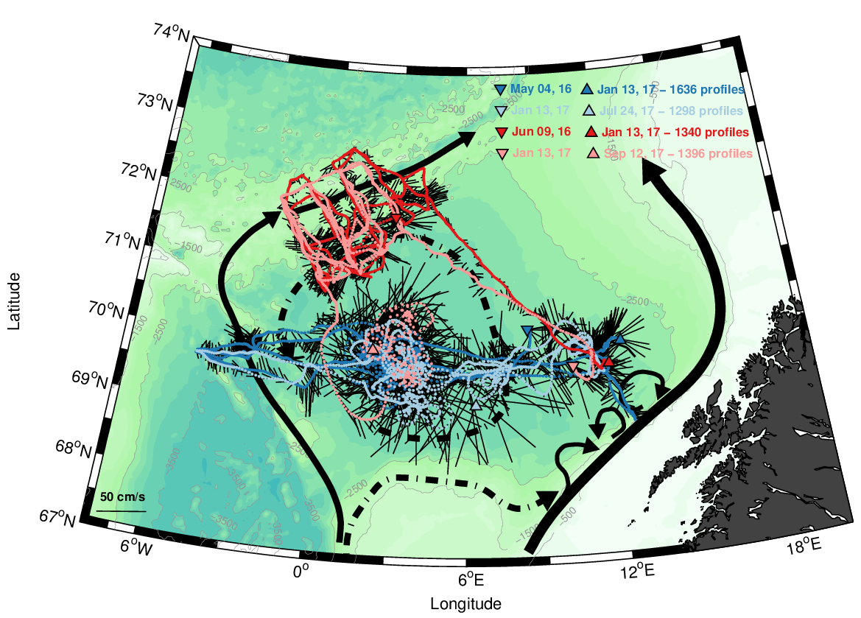
Water mass transformations in the Lofoten Basin
Recently completed:
2 SG missions in the Lofoten Basin
2 SG missions across the Mohn Ridge
PI: Ilker Fer

Slide 12
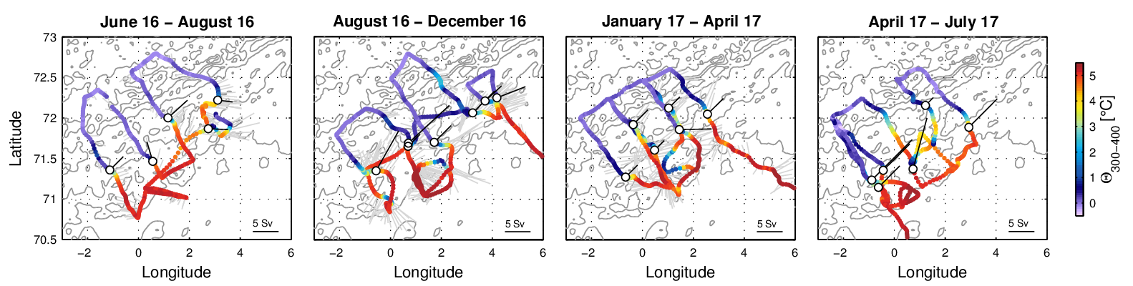
Mohn Ridge

Slide 13
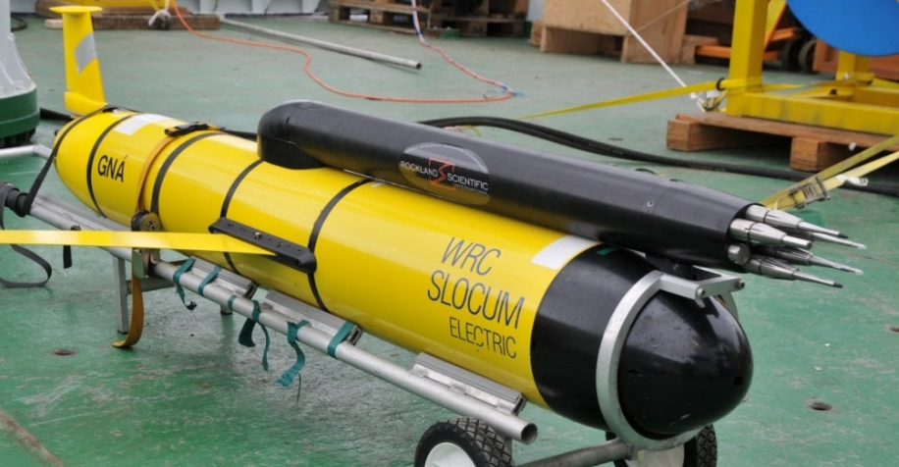
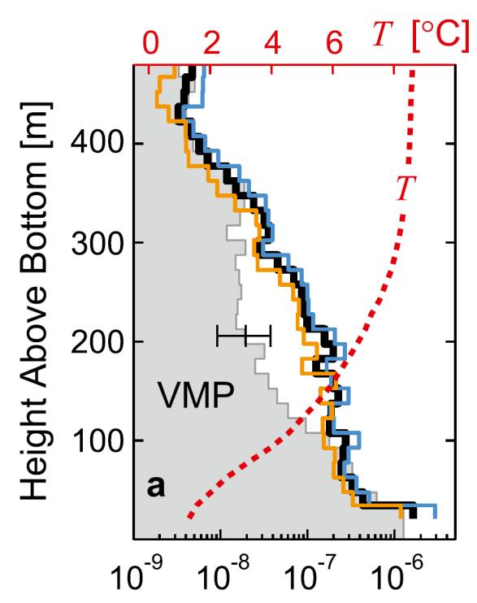
Microstructure sensors on ocean gliders
TDW Slocum
Seaglider
Fer et al.
(2014)
ε [W kg⁻¹]
Creed et al.
(2015)

Slide 14
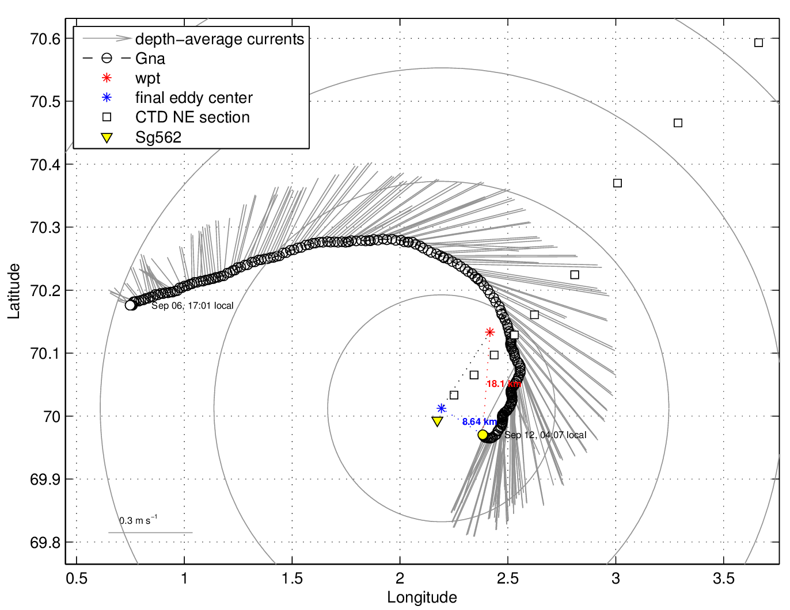
TDW Slocum
Microstructure glider deployed in the Lofoten Basin Eddy during a cruise in September 2017 to supplement shipboard measurements

Slide 15
West Spitsbergen Current
Ambitions to monitor the boundary current west of Spitsbergen
SIOS, Svalbard Integrated Arctic Earth Observing System
Process studies through The Nansen LEGACY
Carmack et al. (2015)

Slide 16
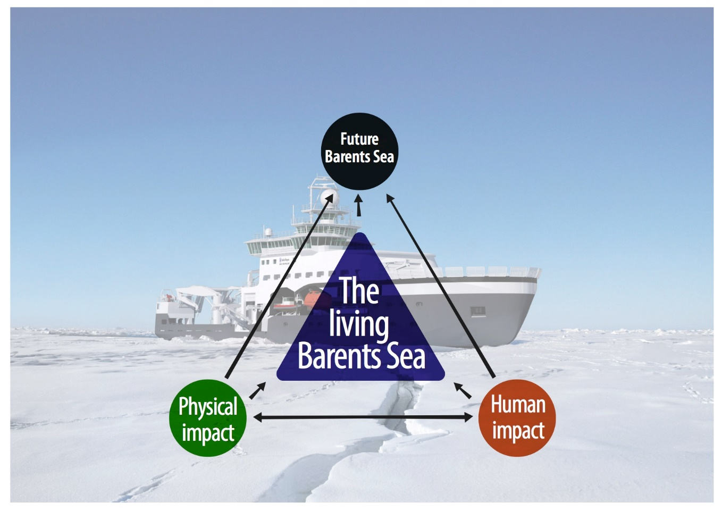

The Nansen LEGACY
assembles a national team of Arctic expertise to…
investigate how physics and humans impact the living present and future Barents Sea

Slide 17
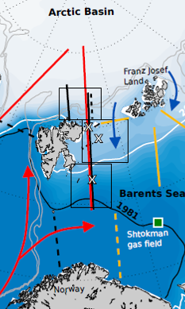
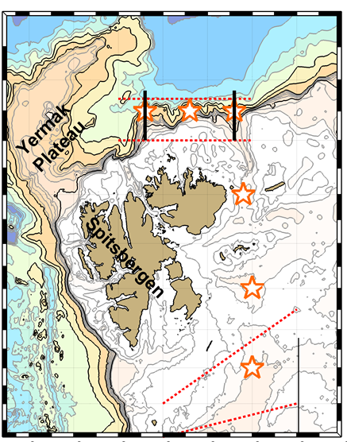
Extensive field work
2018-2022
Coming up cruises with gliders (Ilker Fer):
RV Kristine Bonnevie: 27 Jun - 10 Jul 2018
RV Kronprins Håkon: 11 - 23 Sep. 2018
Plans from summer 2018:
1 Seaglider (LEGACY),
1 microstructure glider (LEGACY cruises)
Long term, 1 Seaglider,
West Spitsbergen (SIOS)

