Slide 1
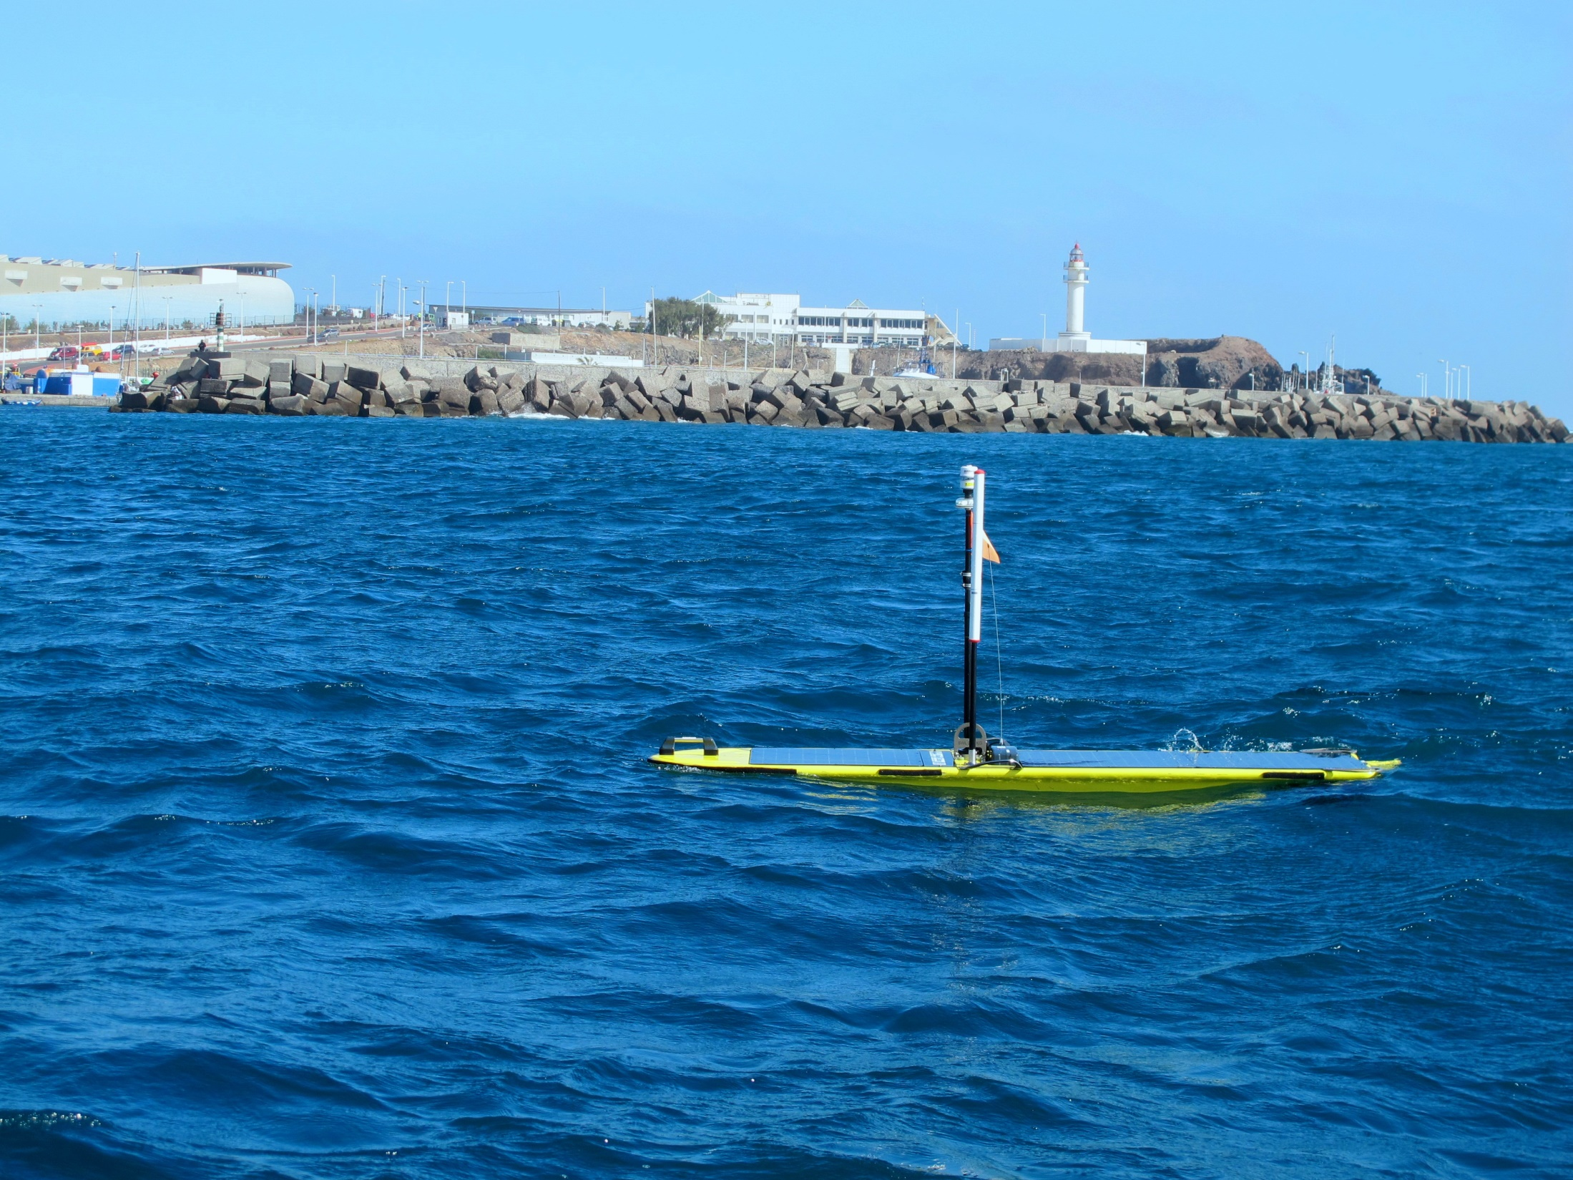
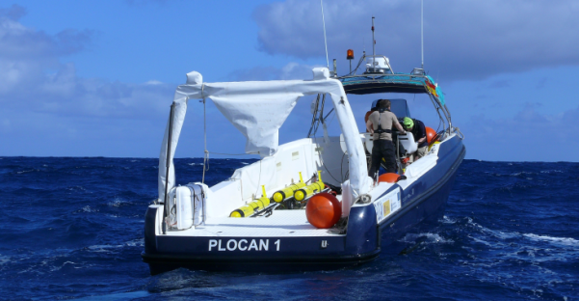


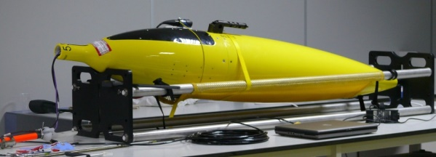
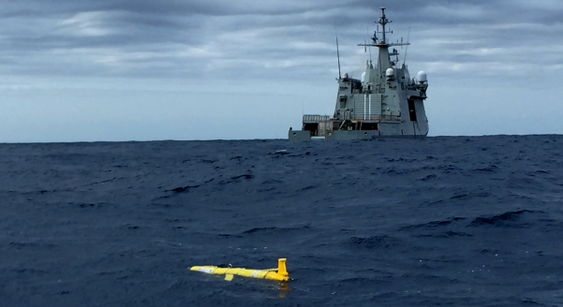
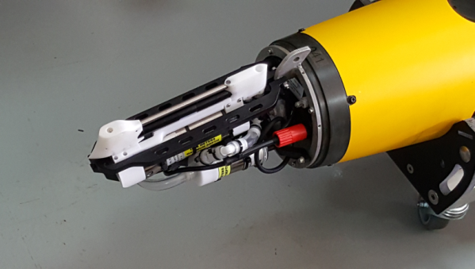
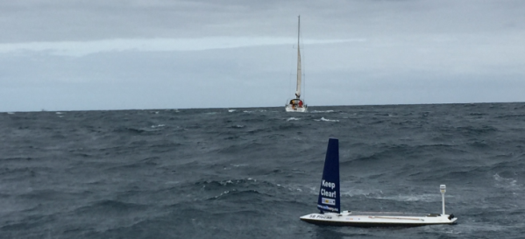
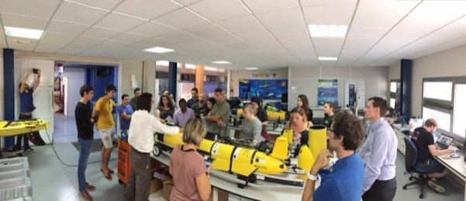
PLOCAN
GLIDERPORT FACILITY FOR THE EAST-CENTRAL NORTH ATLANTIC
3rd AtlantOS GA – Las Palmas, 20th Nov 2017
Oceanic Platform of the Canary Islands

Slide 2

Summary _WP3.4 Contribution
    Gliderport facility improvements
    Glider operations/missions
    Training
    Data
    Dissemination

Slide 3
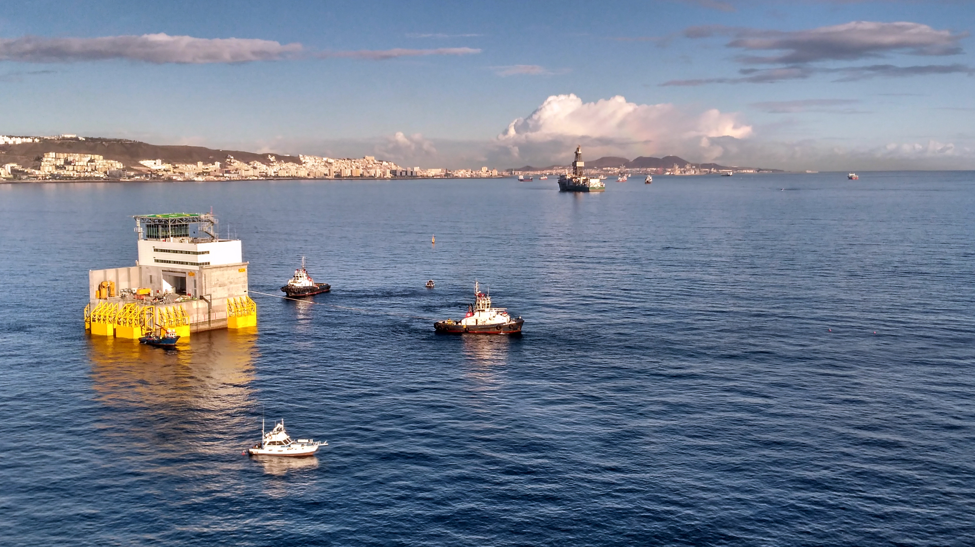
PLOCAN GLIDERPORT FACILITY-

Slide 4
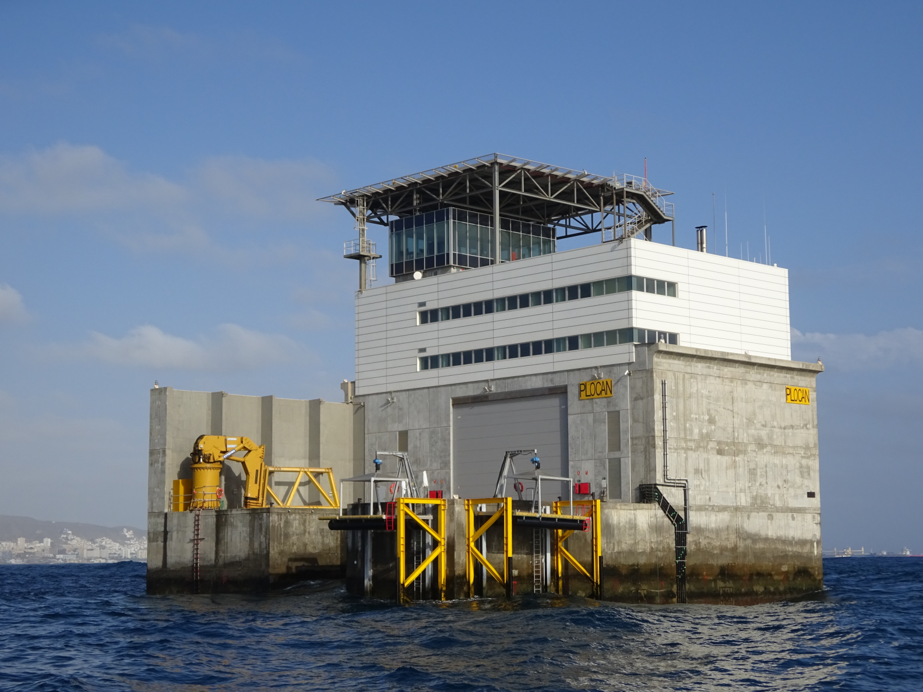
PLOCAN GLIDERPORT FACILITY-

Slide 5
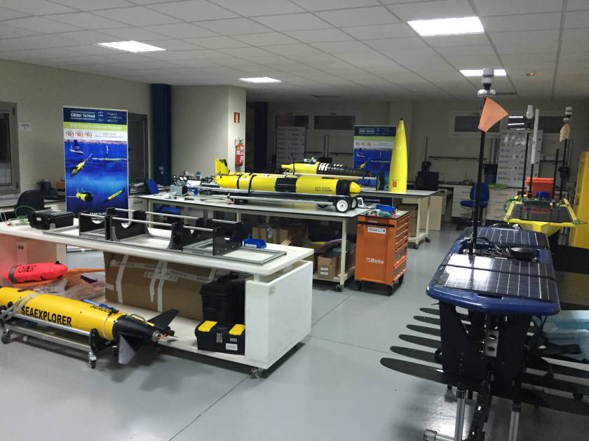
PLOCAN GLIDERPORT FACILITY-

Slide 6
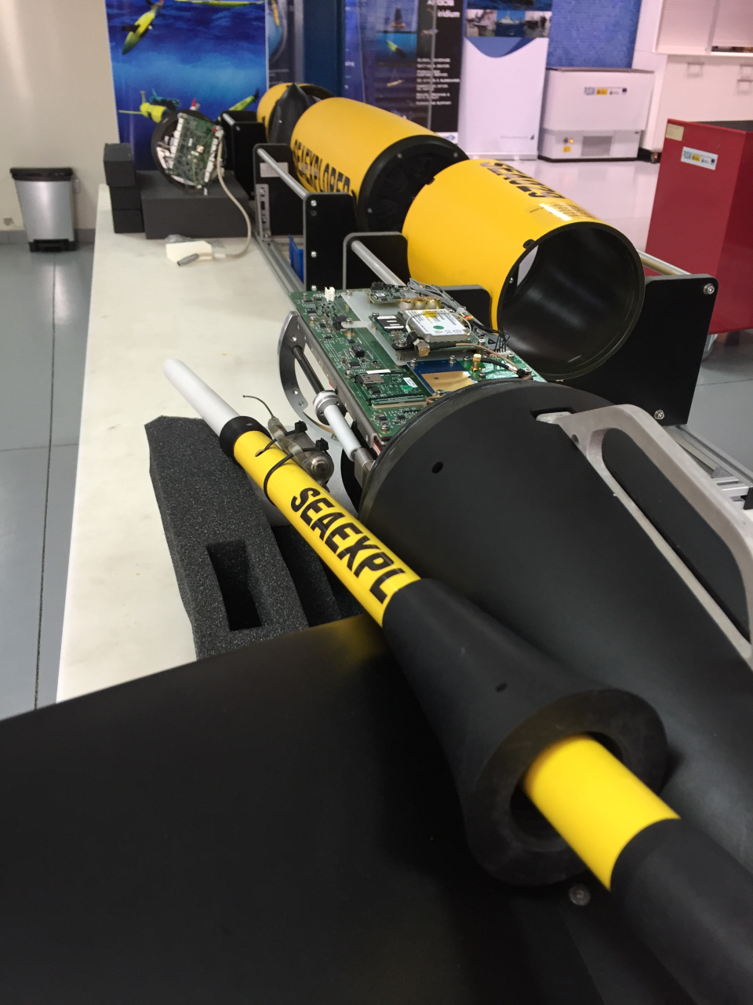

PLOCAN GLIDERPORT FACILITY-
SeaExplorer
GPCTD
Rinko DO
Wetlabs Puck Chl-A and Turbidity
MiniFlu - Hydrocarbons

Slide 7
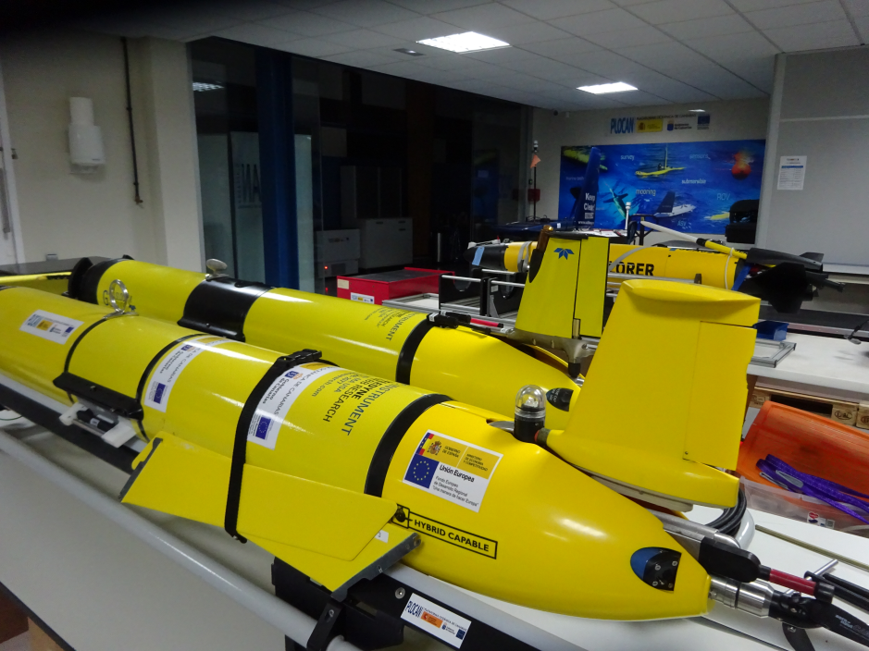
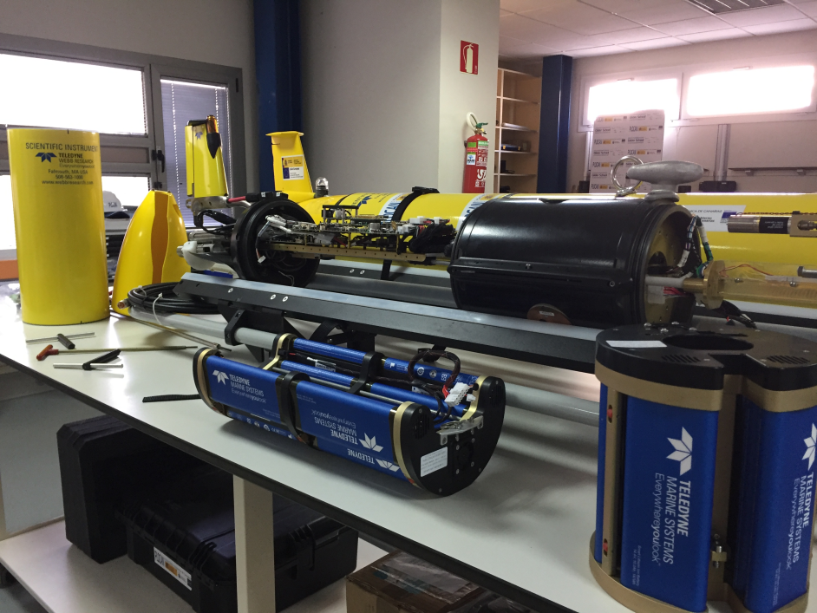
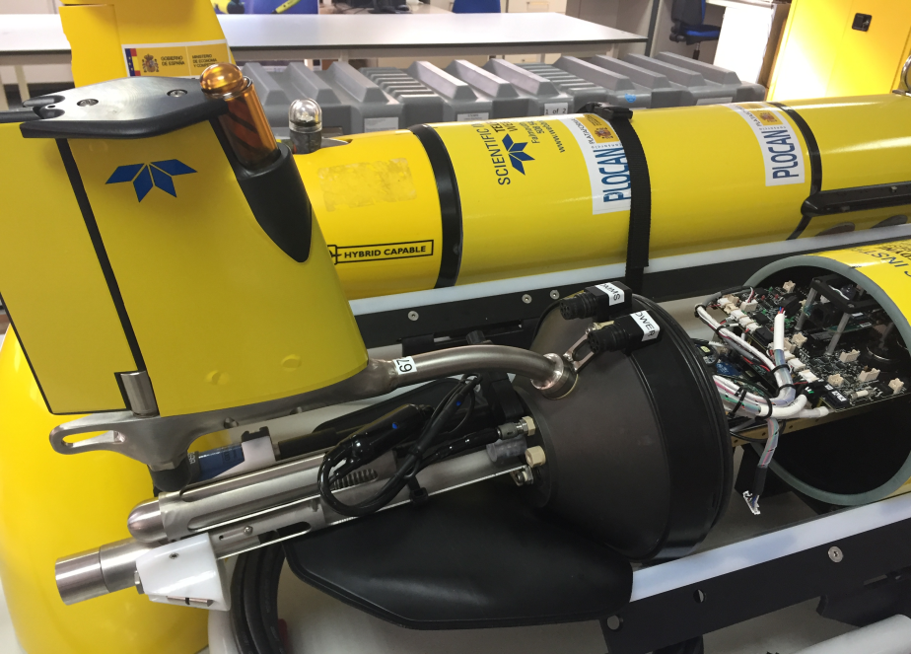
PLOCAN GLIDERPORT FACILITY-
Slocum G3
GPCTD
AADI Optode
Wetlabs Puck (Chl-A and Turbidity)

Slide 8
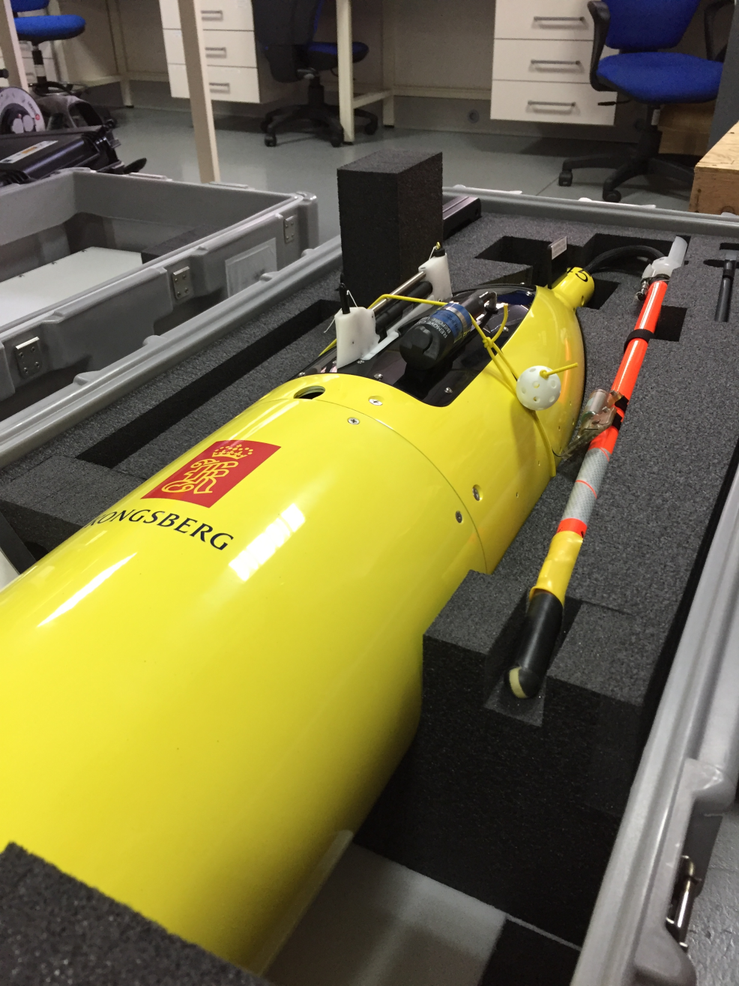
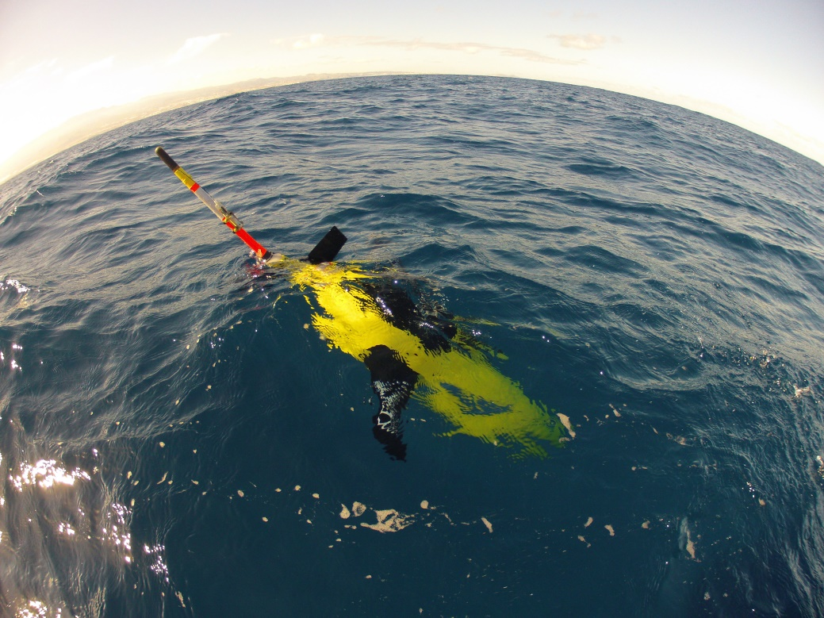
PLOCAN GLIDERPORT FACILITY-
Seaglider 1K
GPCTD
AADI Optode
Wetlabs Puck (Chl-A and Turbidity)

Slide 9
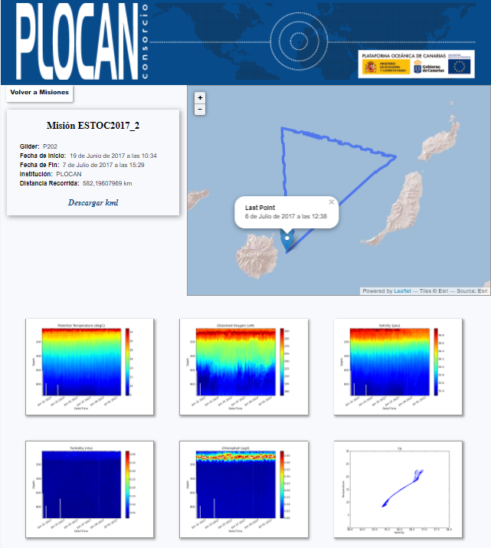
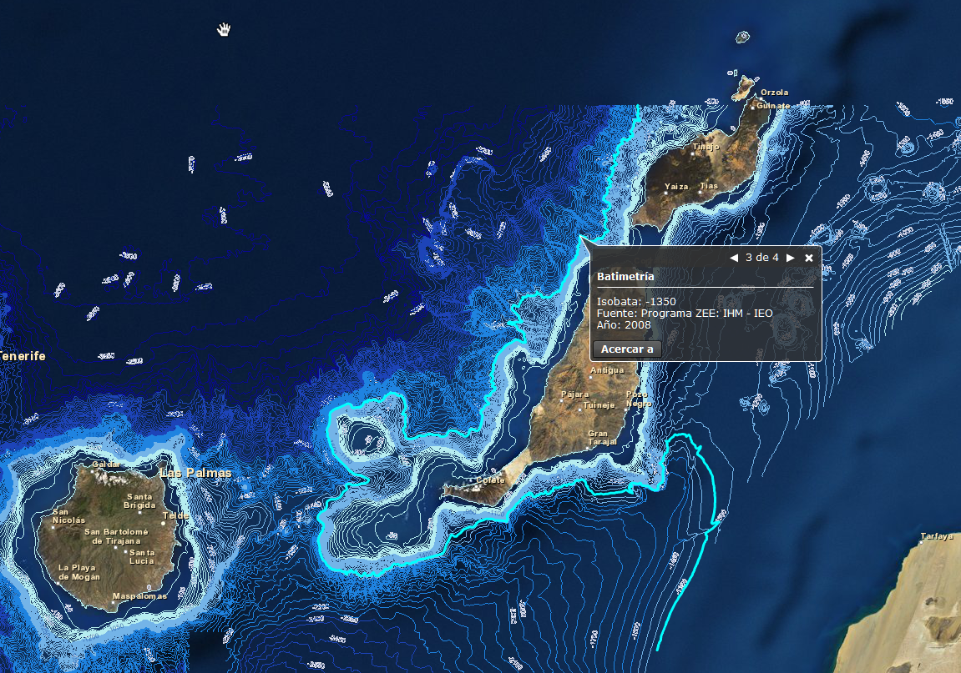


GLIDER OPERATIONS
ESTOC (WP1)
WP2
WP3
ESTOC (29º 10’N - 015º 30’ W)
3 weeks mission // Seasonal
170 dives down to 1000 m.
250 Nm.

Slide 10

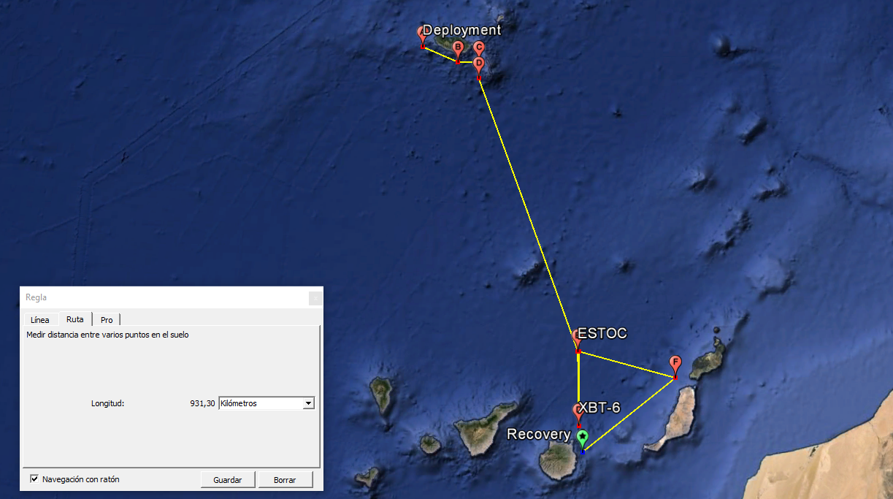
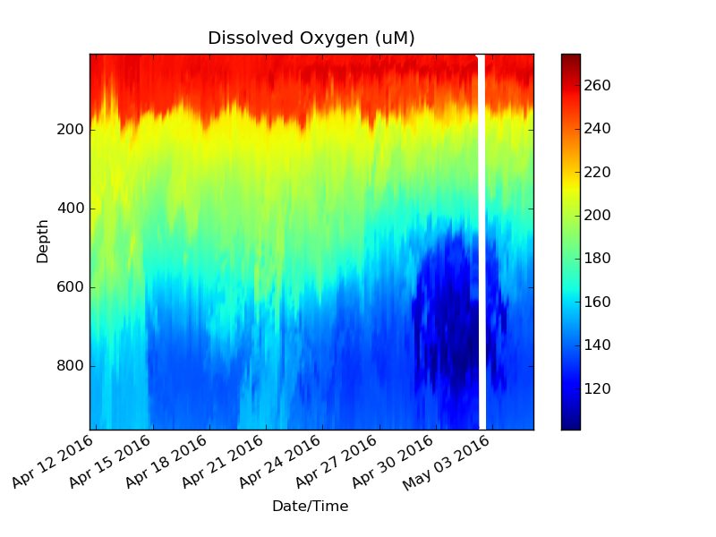
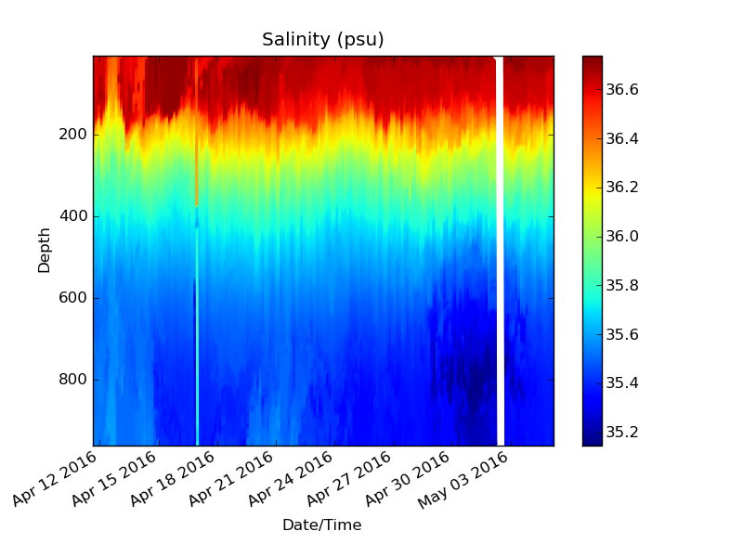
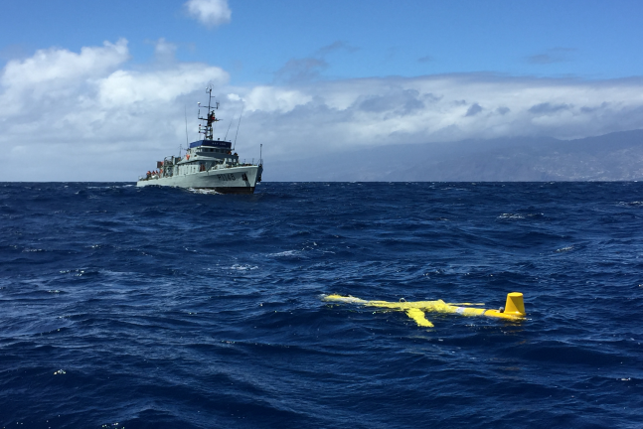
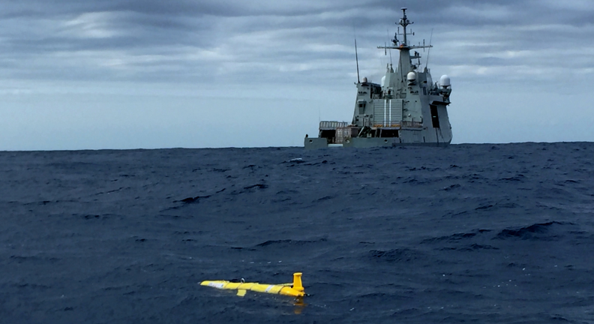


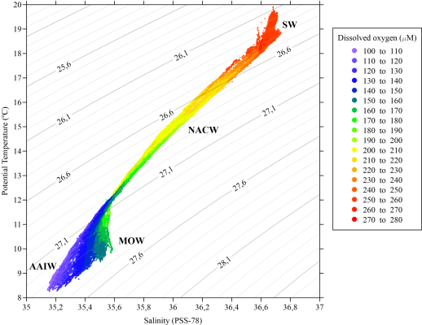
GLIDER OPERATIONS

Slide 11
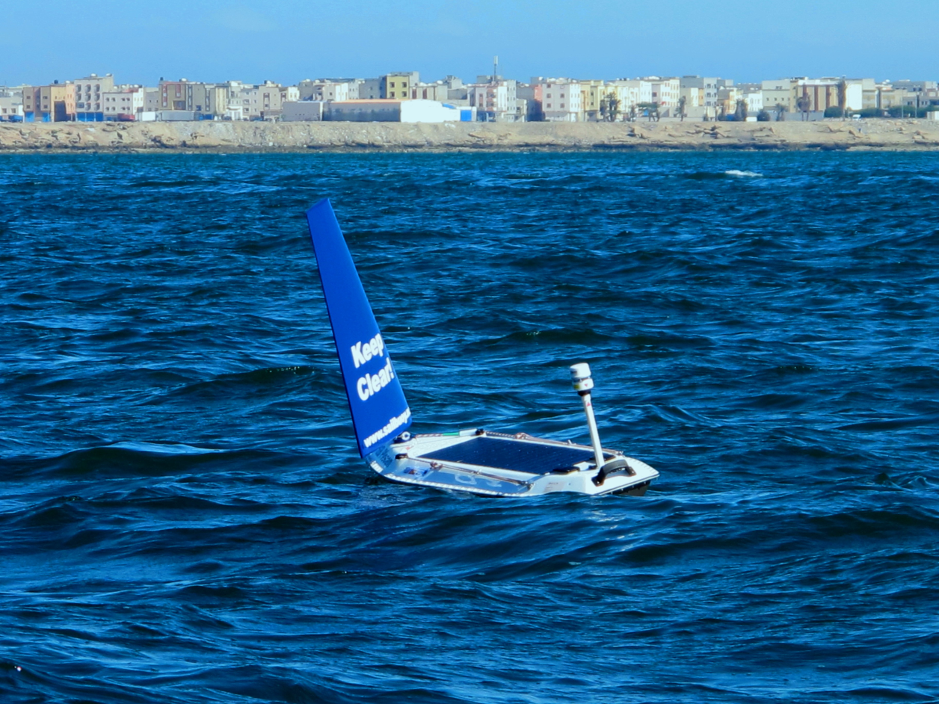

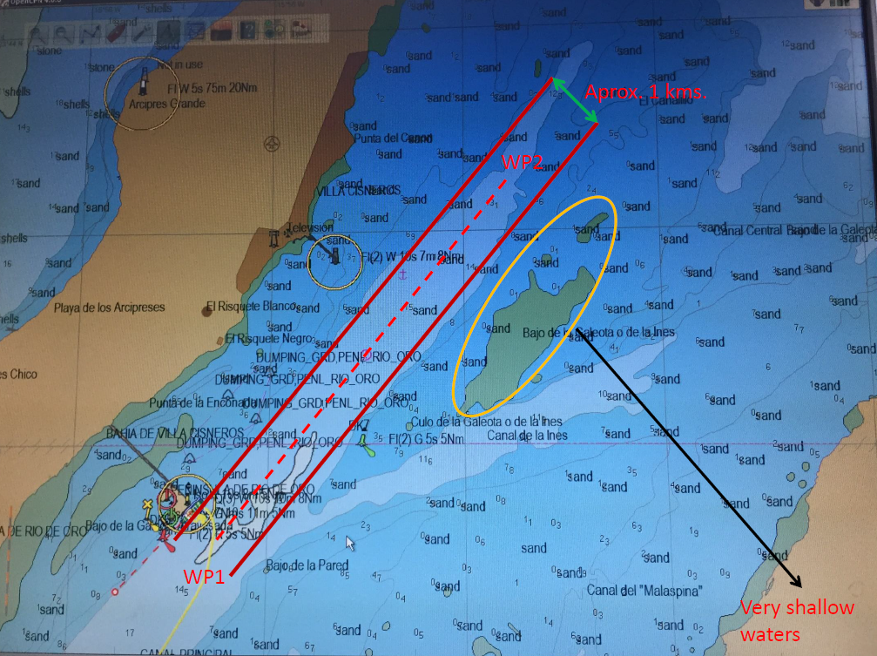
GLIDER OPERATIONS
Study Case
Dakhla Bay (Morocco)
3 days mission.
In partnership with INRH

Slide 12
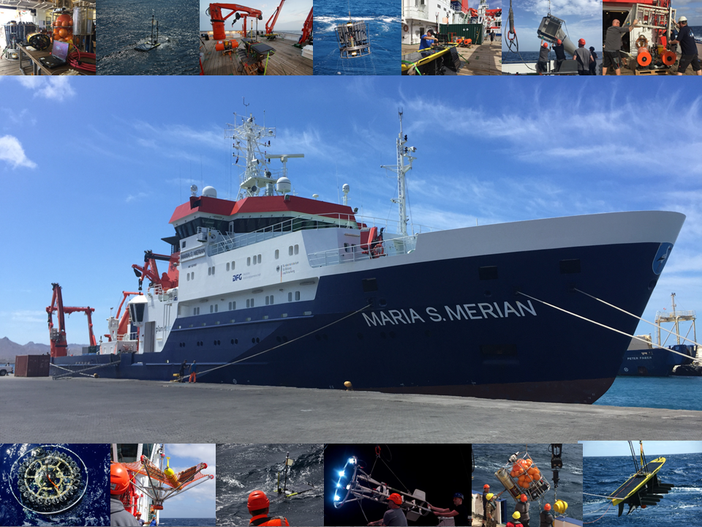



GLIDER OPERATIONS
Cruise MSM61
Senghor seamounth multidisciplinar monitoring with different devices and sensors.
Waveglider SV3 suited with ADCP, GPCTD, Dissoled Oxygen, Fluorometer and pH.

Slide 13
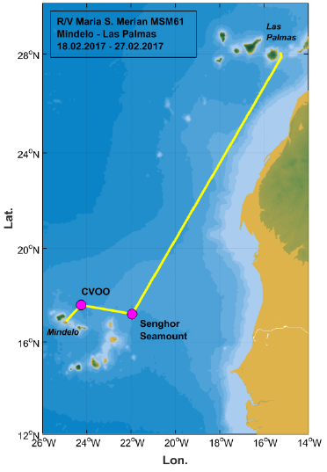
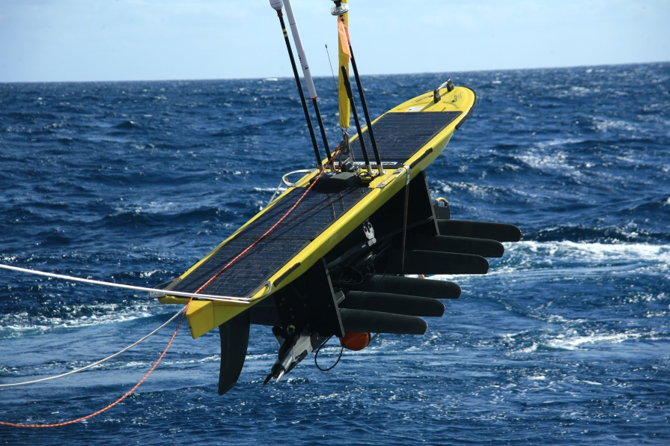
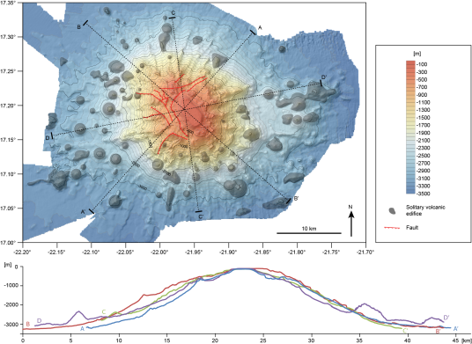
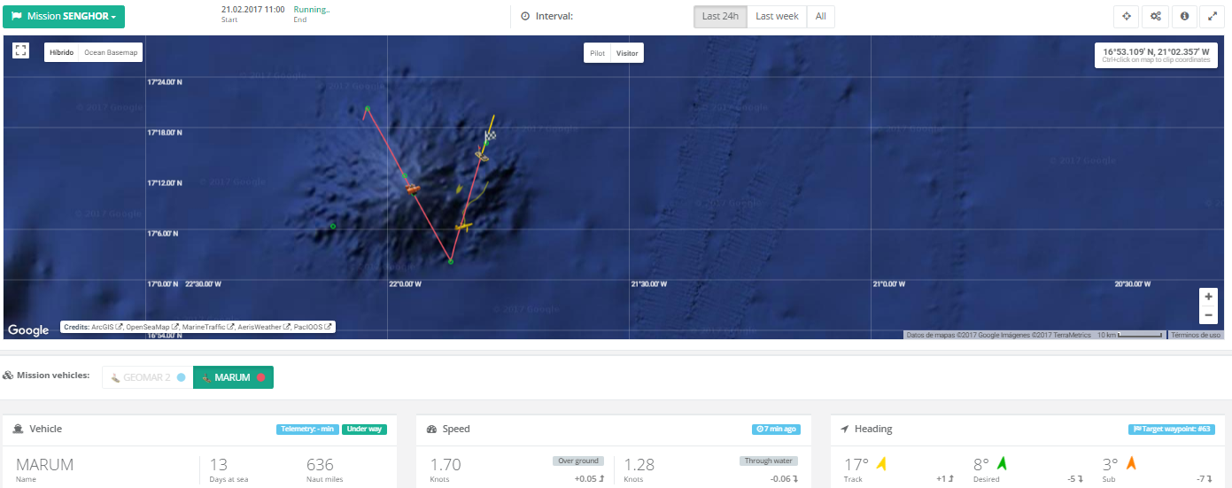
GLIDER OPERATIONS

Slide 14
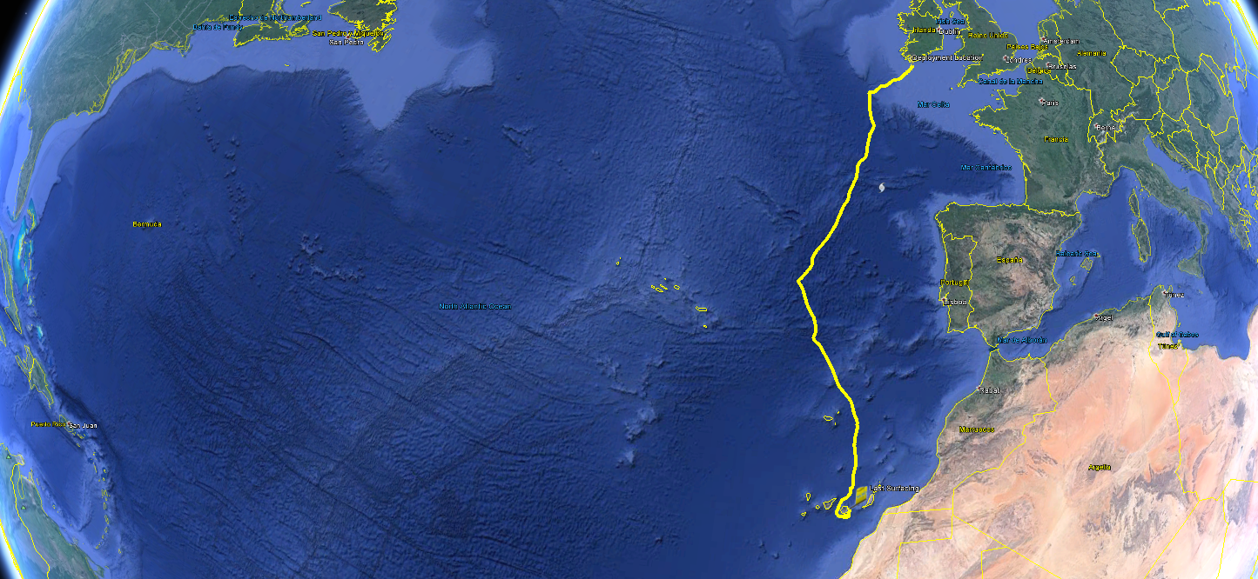
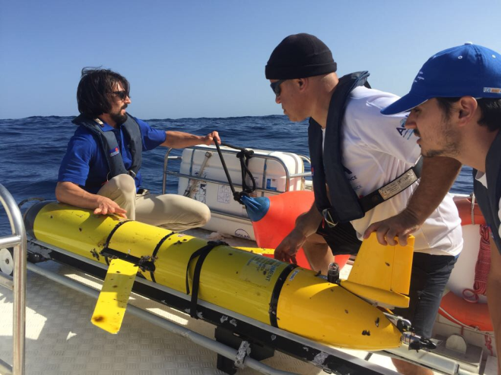
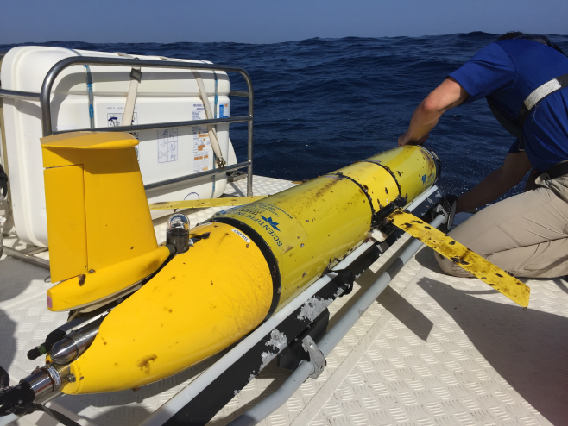




GLIDER OPERATIONS

Slide 15
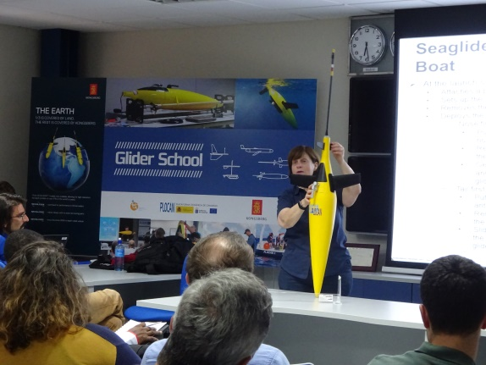
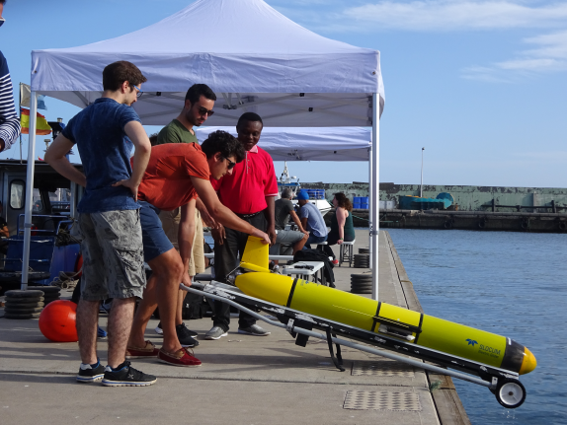


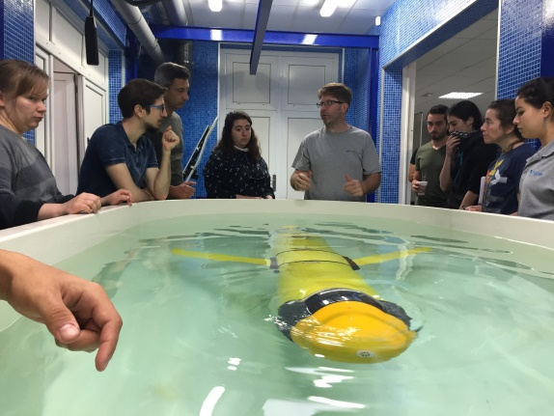
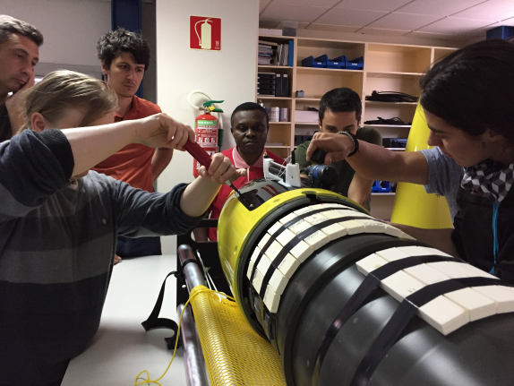
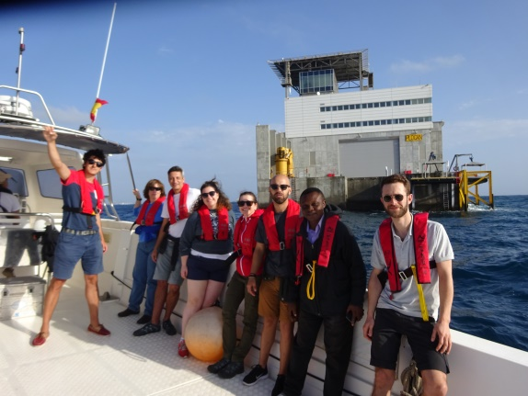
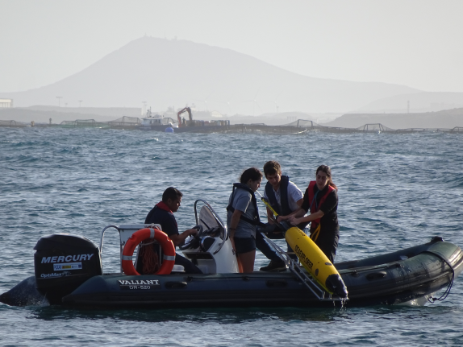
GLIDER TRAINING
www.gliderschool.eu
8th edition.
More than 120 students joined since 2011.
Attendees this year from Portugal, France, Canada, Israel, Nigeria, Chile, Ireland, Germany, Finland and Spain.
Companies supporting: Teledyne, Liquid Robotics, Alseamar, Kongsberg,CLS, Offshore Sensing and Exocetus.
Institutions supporting: MARUM, MBARI, Rutgers University, Memorial University and EGO-Network.

Slide 16
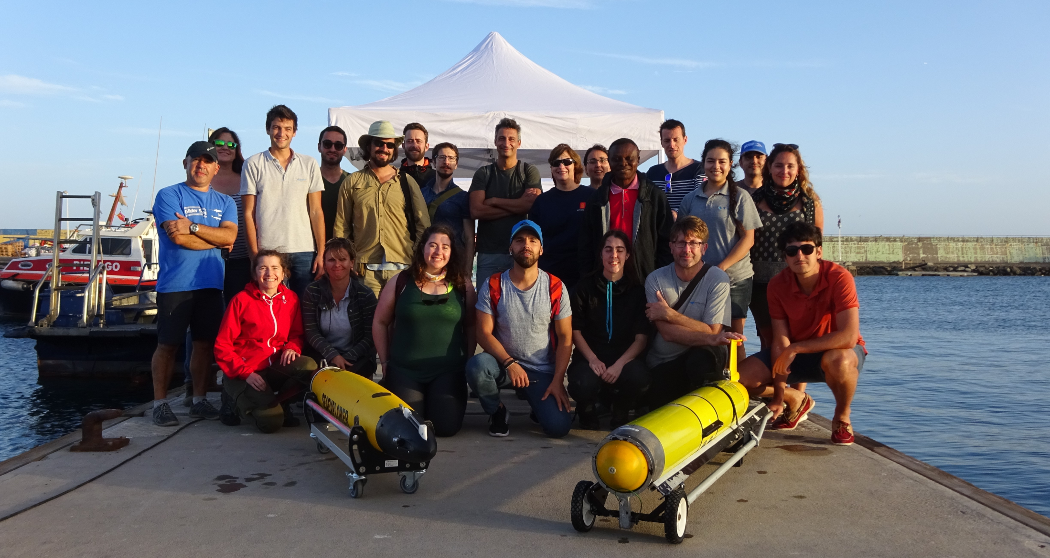
GLIDER TRAINING

Slide 17
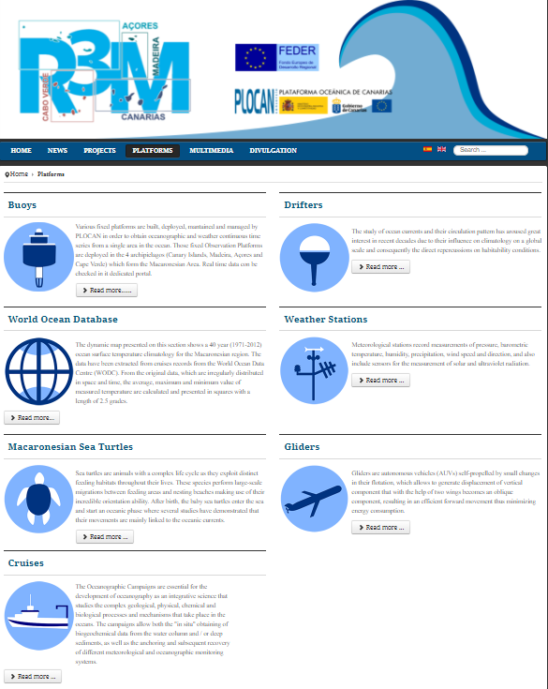
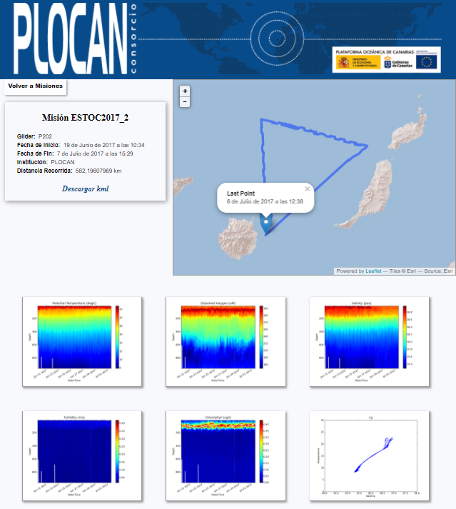
GLIDER DATA

Slide 18
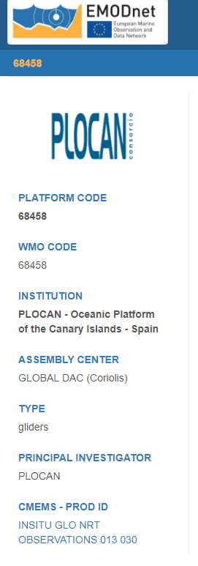
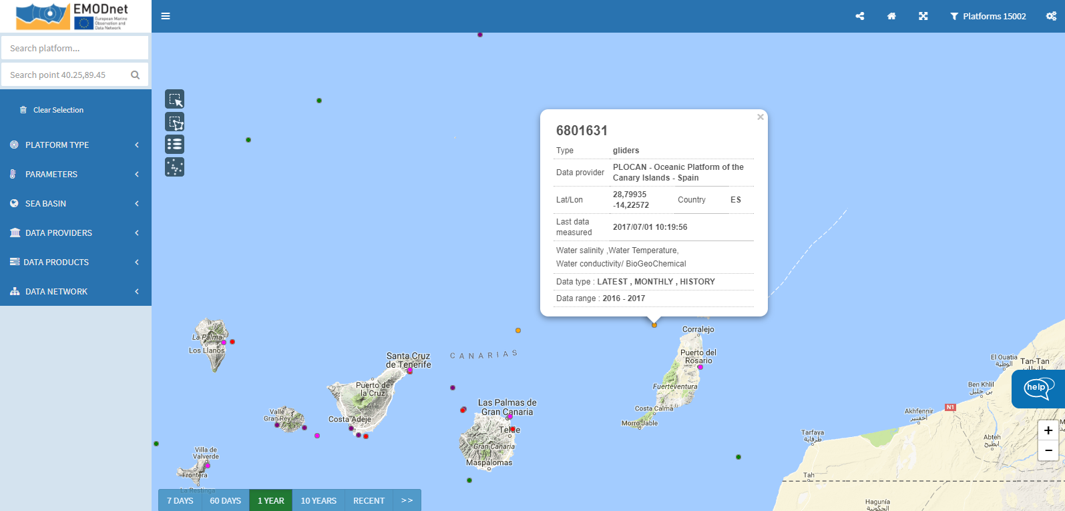
GLIDER DATA

Slide 19
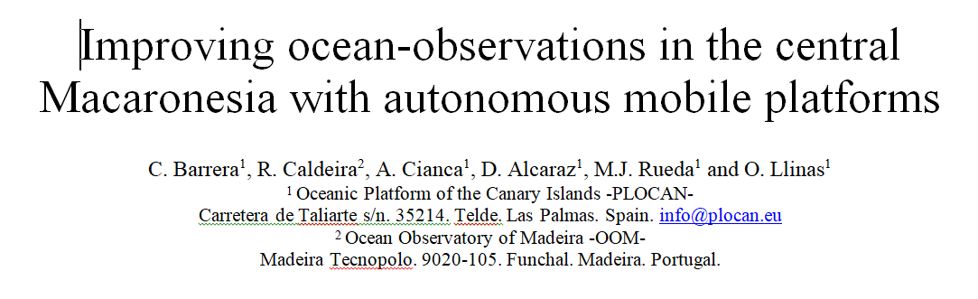



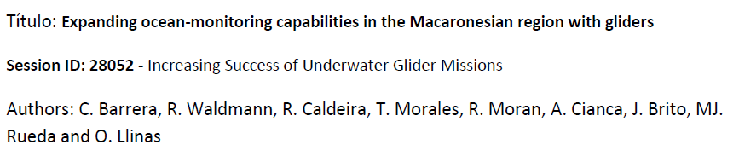

GLIDER DISSEMINATION

Slide 20
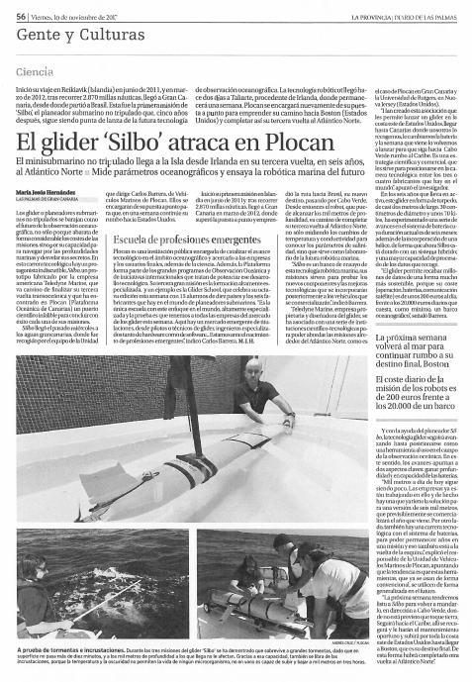
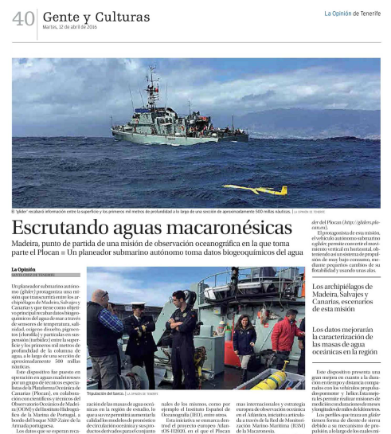
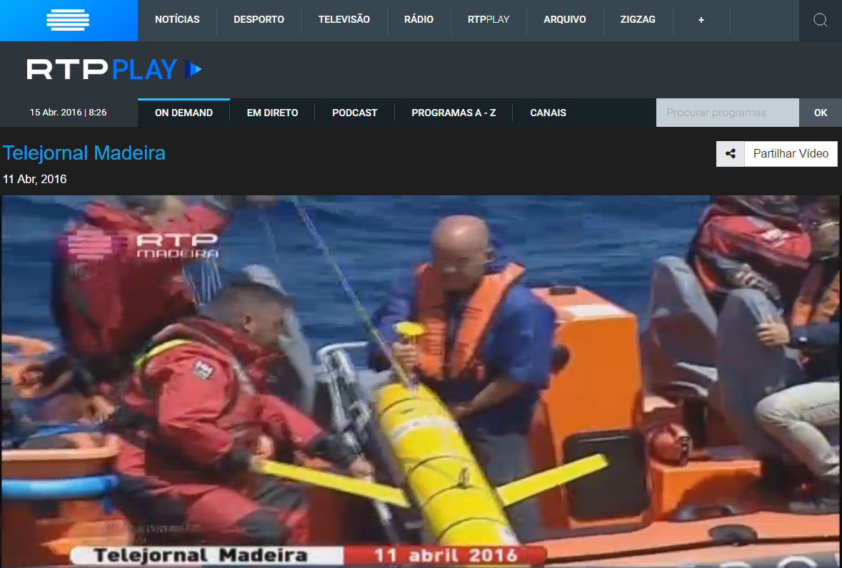
GLIDER DISSEMINATION
http://www.rtp.pt/play/p85/e231422/telejornal-madeira

