Slide 1
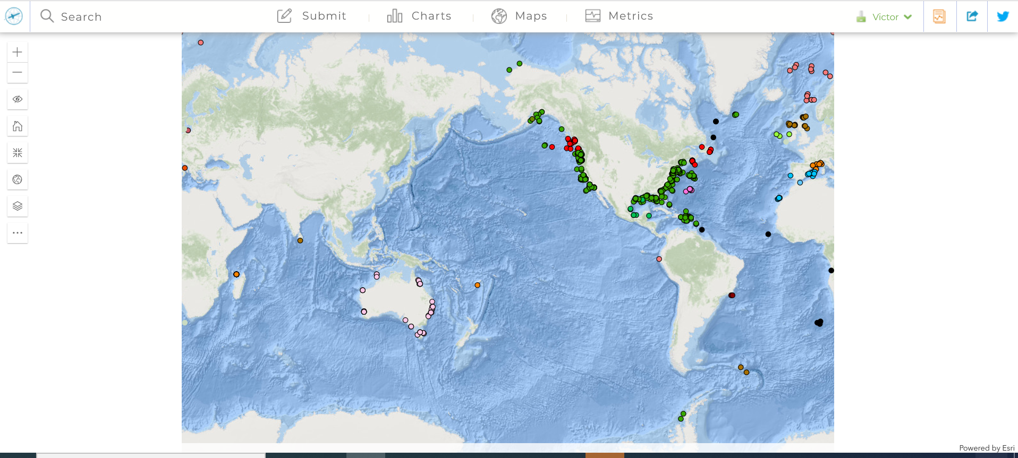
Tutorial to request WMO ID for OceanGliders
Users can only request id for national program they are members !
https://www.ocean-ops.org/board?t=oceangliders#
Log in !

Slide 2
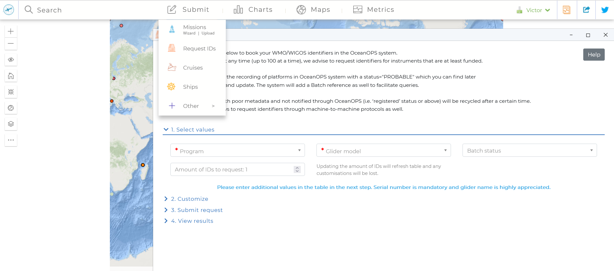
Step 1 : request id tool
1
2

Slide 3
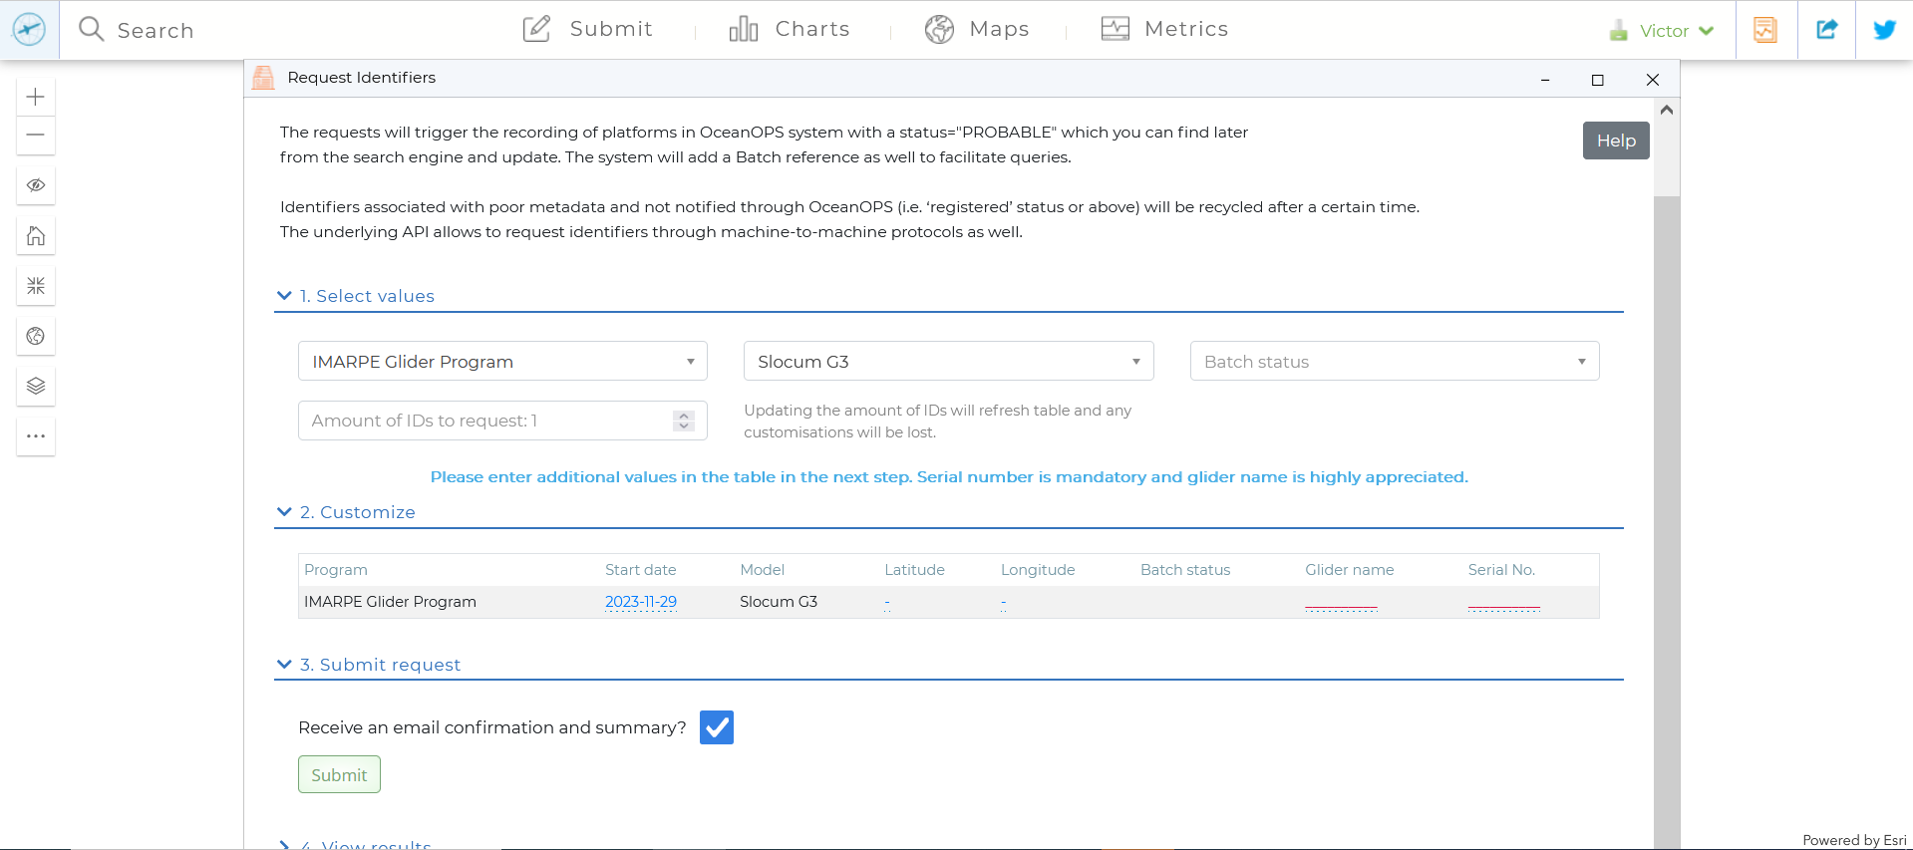
Step 2 : Register the glider mandatory information
2
1
3
5
4
5 : use Serial No as glider name if no glider name
6

Slide 4
Step 3 : Receive WMO ID online and through email and keep it safe
In addition to the summary on the website, you should have receive a WMO ID through email.
Keep it safely or find it back on www.OceanOPS.org
If you need support: support@ocean-ops.org

